Slide 1
Session #11: Memorization and Privacy
Tuesday, October 4
CSCI 601.771: Self-supervised Statistical Models

Slide 2
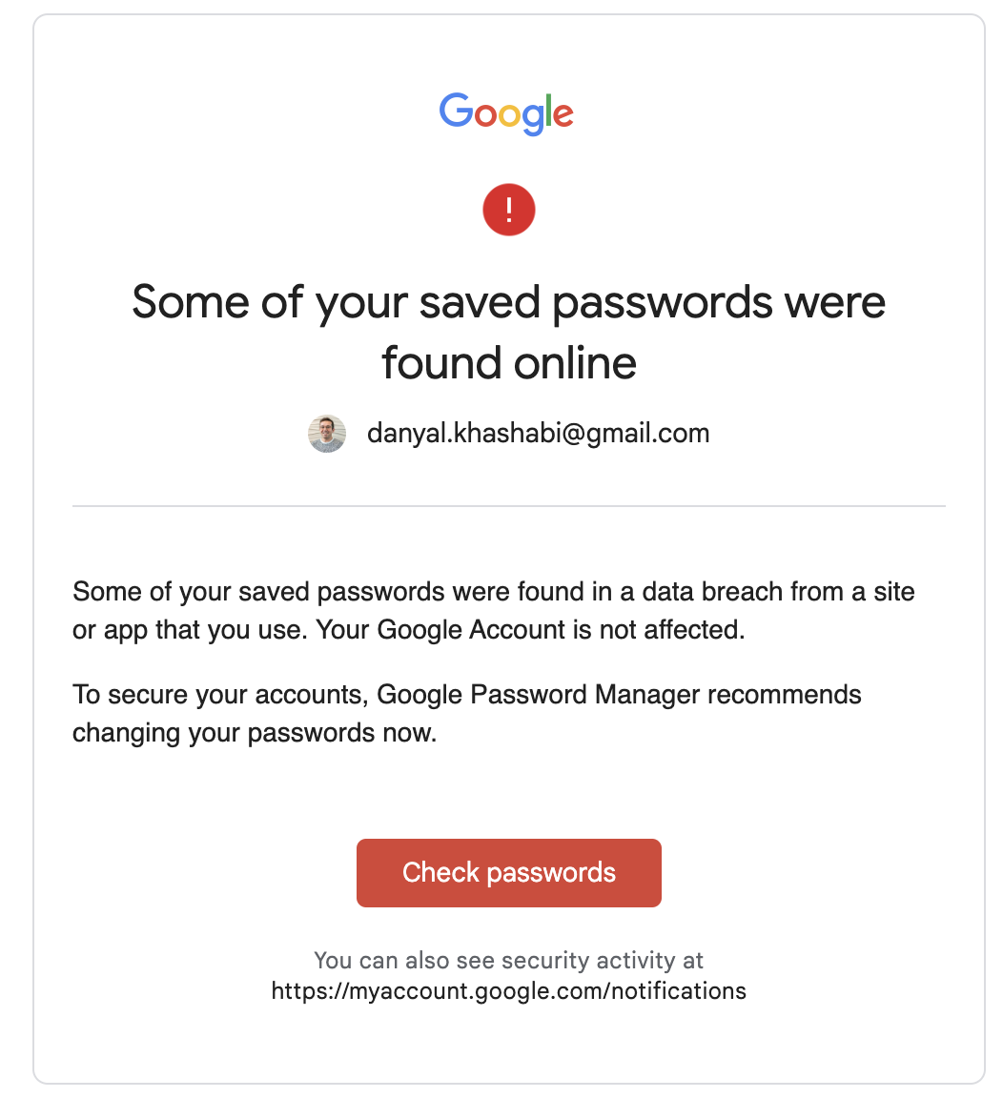

Slide 6
Quantifying Memorization Across Neural Language Models
Stake Holder Review

Slide 8
Paper Main Idea
As Language Models get Larger, Memorization within the model increases, and arises concerns

Slide 9
Properties that Impacts Memorization
Model Scale: Larger models memorize 2-5X more than smaller models
Data Duplication: Repeated words are more likely to be memorized
Context: Longer context sentences are easier to extract

Slide 10
Graphs

Slide 11
What is memorization ?
A string s is extractable with k tokens of context from a model f if there exists a (length-k) string p, such that the concatenation [p || s] is contained in the training data for f , and f produces s when prompted with p using greedy decoding.
Greedy decoding just picks the next token containing the largest probability – the argmax

Slide 12
Creating the dataset:
Ideally we want to test on every sequence but this is too computationally expensive
The authors use a small but REPRESENTATIVE sample to get statistical confidence (50,000 sequences)
To account for duplication – the set is duplication normalized
This means we have repeated sequences which influence's memorization!

Slide 13
Setting up experiments:
The Pile which is the largest publicly available dataset is used
The GPT-Neo Family of models is used
Parameters range from 125 million to 6 billion

Slide 14
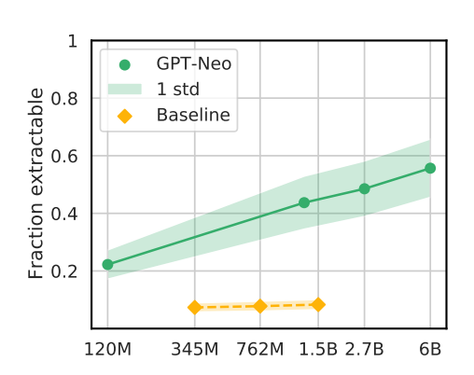
Bigger Models Memorize More
There is a log linear trend with respect to increasing model size
GPT-2 is used as a baseline which confirms the models are memorizing and not just generalizing

Slide 15
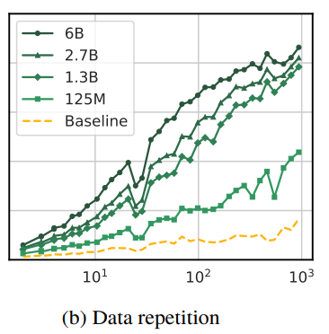
Repeated Strings Are Memorized More
Between 2 and 900 duplicates are tested on
There is once again a log linear relationship between the number of repetitions and fraction extractable

Slide 16
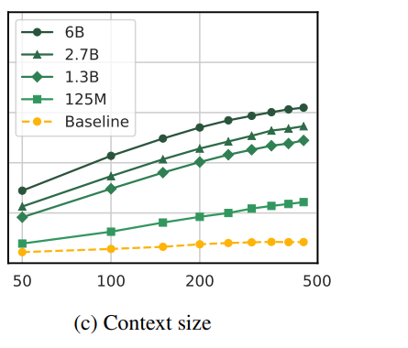
Longer Context = More memorization
Language models may only show memorization when prompted with sufficiently long context
This is good as it protects privacy but may leave vulnerabilities open

Slide 17
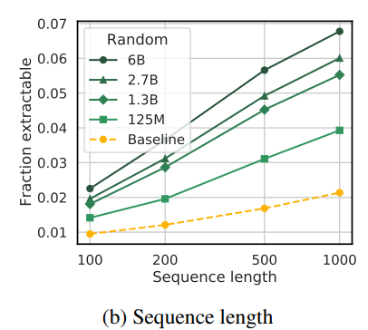
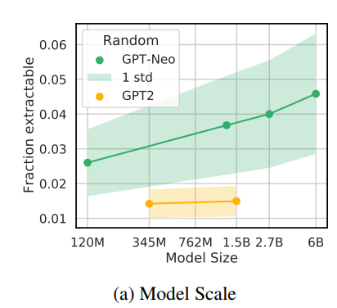
Random Data Set Sampling
We sample truly random sequences this time for a total of 100,000 unique sequences
The overall probability of memorization is lower however, the trends remain the same

Slide 18
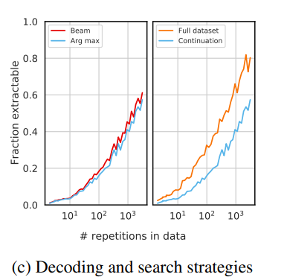
Different Strategies for search and decode
Testing is done using beam search vs standard greedy decoding
The second experiment tests for whether the prompt is anywhere in the data

Slide 19
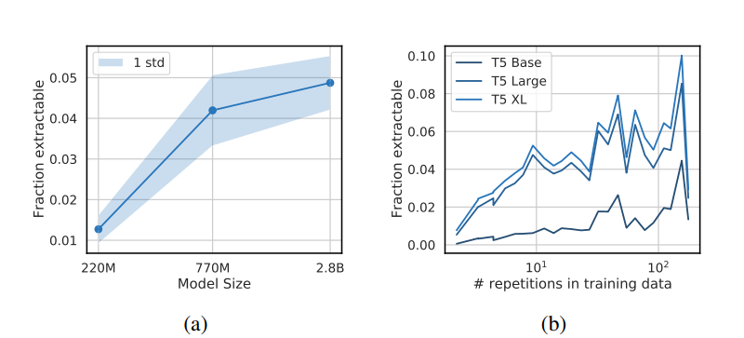
Replication study
This was done on T5 models
The relationship with model size is clear however not with repetitions

Slide 20
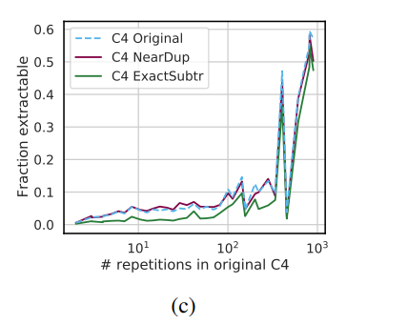
De–Duplication:
Exhibits less memorization than duplicated dataset
De-duplication is helpful up until approximately 100 repeats after that it is imperfect

Slide 21
🔭Ammar Latheef, Ayo Ajayi

Slide 22
Main Ideas
Paper motivation:
Large language models memorize training data which can violate user privacy, degrade utility, and hurts fairness.
Experiments on GPT-Neo model, GPT-2 model, and T5 masked language model. The main results:
Bigger models memorize more
Repeated strings are memorized more
Longer context discovers more memorization
🔭Ammar Latheef, Ayo Ajayi

Slide 23
Looking Beyond
What other methods can we use to effectively prepare datasets to reduce memorization issue within large language models?
Paper proposes deduplication and finds that:
Models trained on deduplicated datasets memorize less data than models trained without deduplicated data sets
Deduplication does not help with for sequences repeated more than ~100 times.
How can we determine possible prompts to use that will minimize the memorization issue in large language models?
What other ways can we quantify memorization?
🔭Ammar Latheef, Ayo Ajayi

Slide 24
Testing for Memorization of Sensitive Information
This paper measured direct memorization in LMs by testing if the model completes the text in training data if given context.
Instead, test if models memorize associations between people and their data.
<Name>’s physical address is _______
This is unlikely to be the real prefix of a specific person’s address in the training data. But we want to test if the model can associate the name with the address, assuming the data exists in the training corpus.
Huang et al (2022) tested this with emails, attempting to get LMs to reveal email addresses.
Deduplication could be used on sensitive information in the training dataset.
🔭Ammar Latheef, Ayo Ajayi

Slide 25
Reviewers

Slide 26
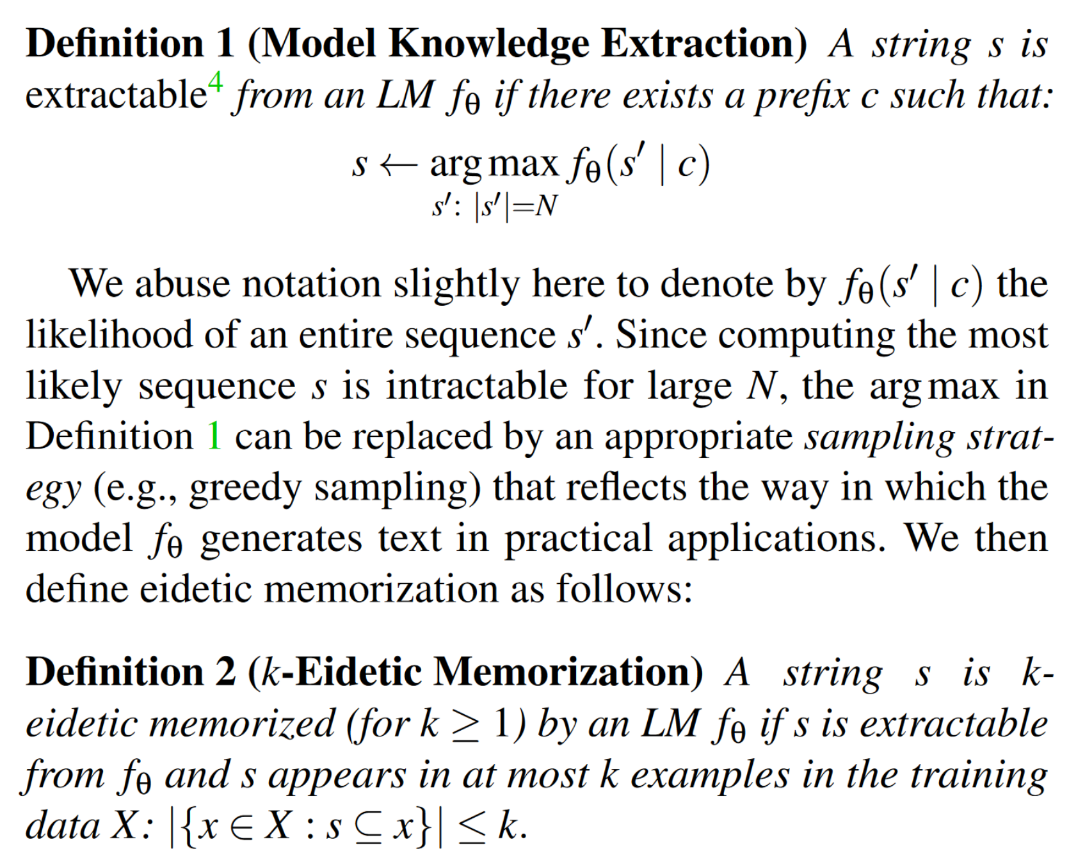
Pros
Convincing Model and dataset choices
Strong motivation
Figure2- (memorization definition) from Counterfactual Memorization in Neural Language Models
Figure1- (memorization definition) from Extracting Training Data from Large Language Models
Figure2- (memorization definition) from the paper

Slide 27
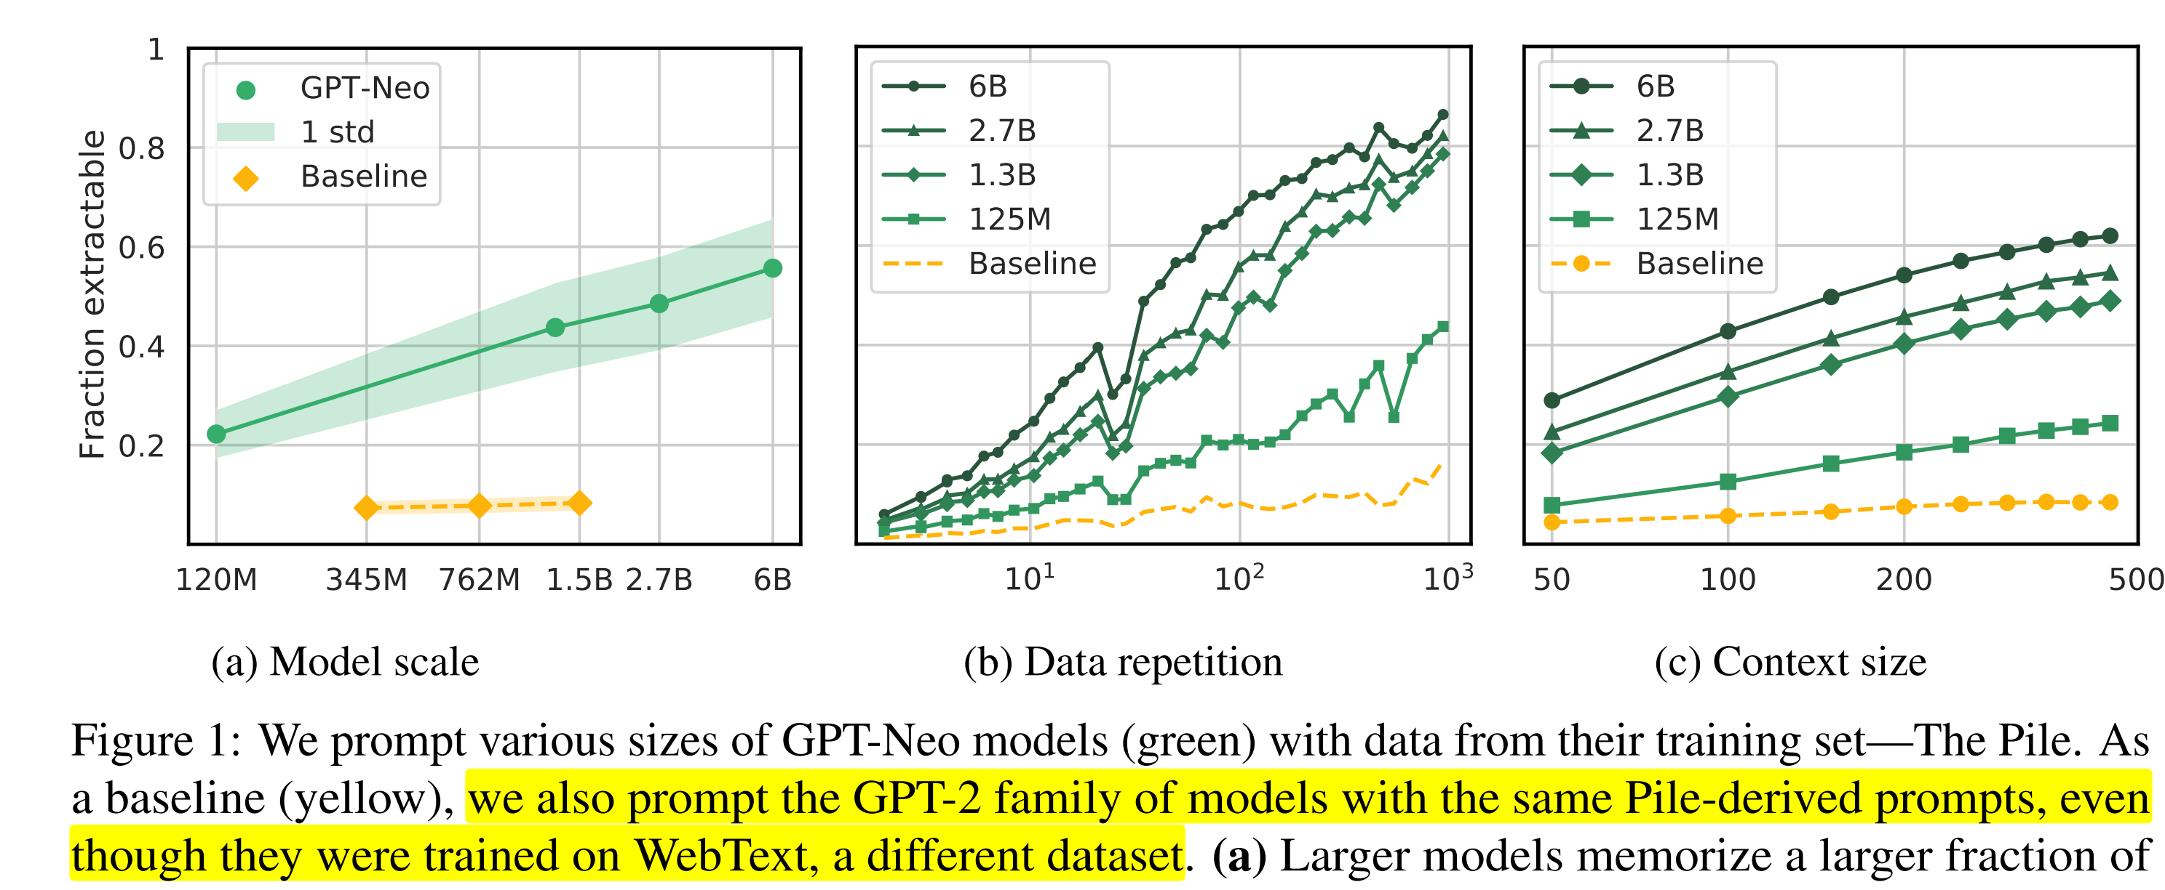
Some clarification/future work?
Would the Pile-derived prompts give an accurate representation of how the GPT-2 family perform?
How is it exponential?

Slide 28
Pros
✅ Analysis of diverse properties that significantly impact memorization
✅ Replication study on different language models and datasets
✅ Thorough Methodology and Experiments section
✅ Straightforward data visualization and examples

Slide 29
Limitations
No analysis about the modified "duplication-normalized" dataset(not open-source)
Only consider model comparing, no single model analysis (i.e. What's the repetition threshold of a model "remember" a certain sequence)

Slide 30
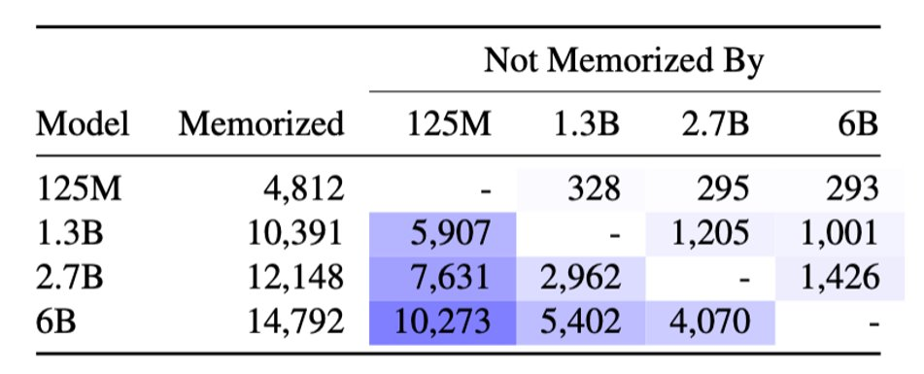
Limitations
Report the sequence as “extractable” if the next 50 tokens (25words) emitted by the model exactly match
Model has some amount of memorization not shared by each other model. (Even the 125M model memorizes a few sequences the 6B model does not.) Go over those sequences.

Slide 31
Limitations
Fraction extractable decreased in specific range for data repetition
No discussion on why this phenomenon occurs

