Slide 1
Session #18: Self-Supervised Vision-Lang Models
Thursday, October 27
CSCI 601.771: Self-supervised Statistical Models

Slide 2
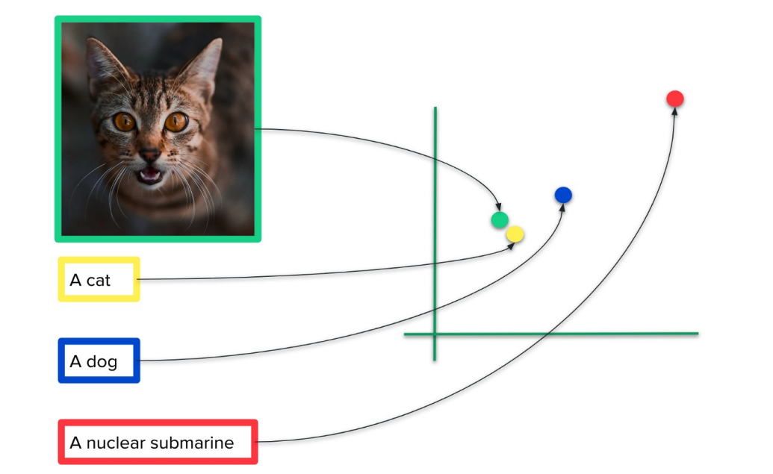

Slide 3
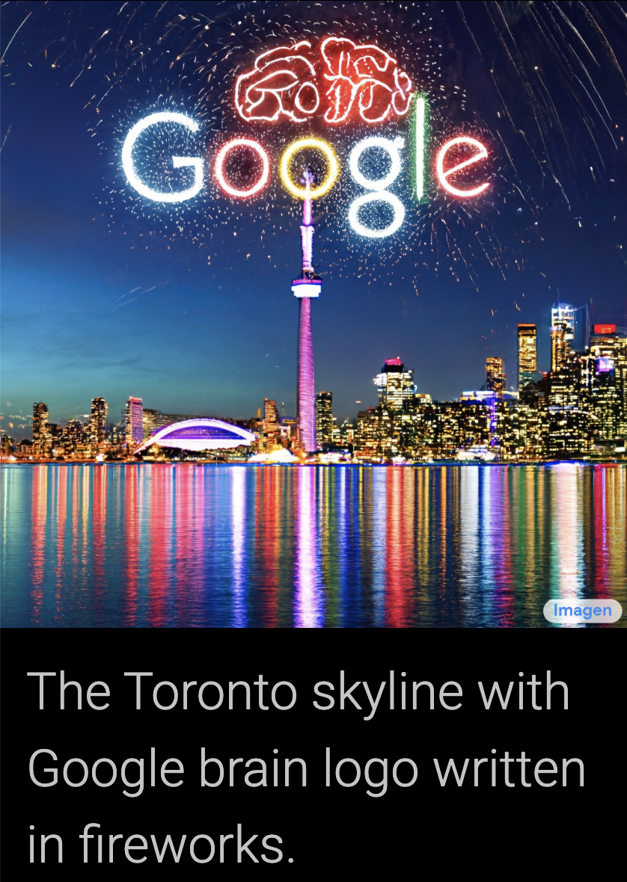
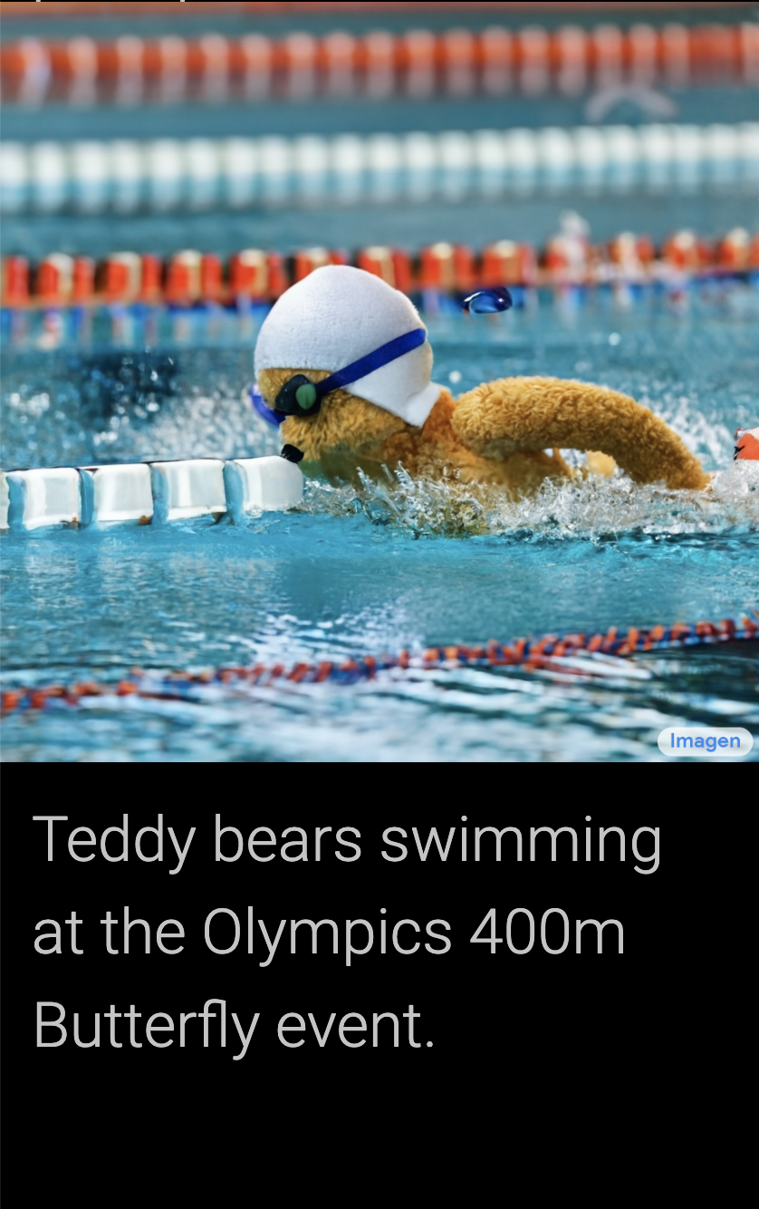

Slide 5
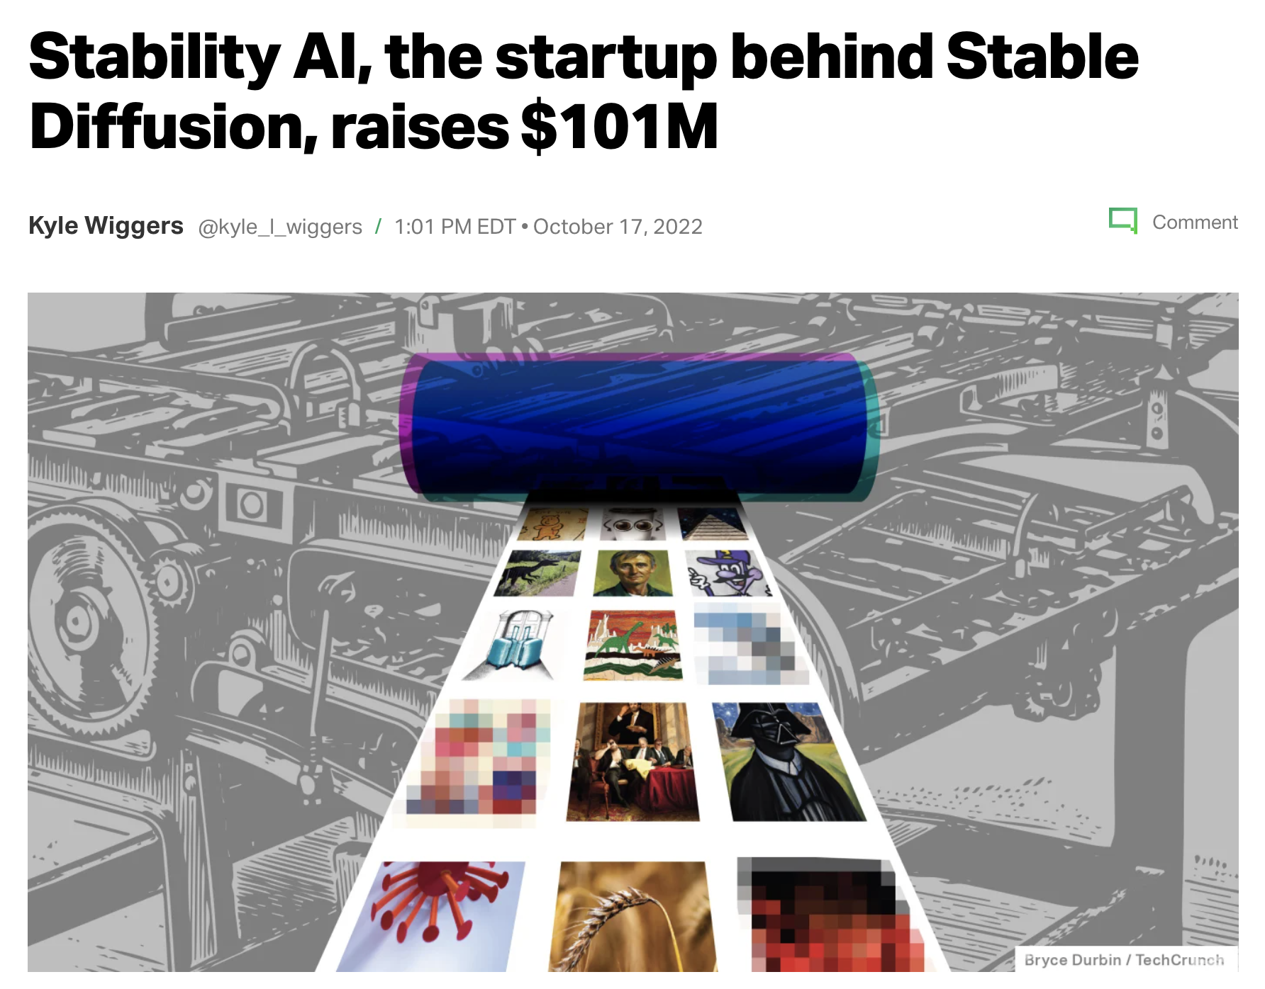

Slide 6
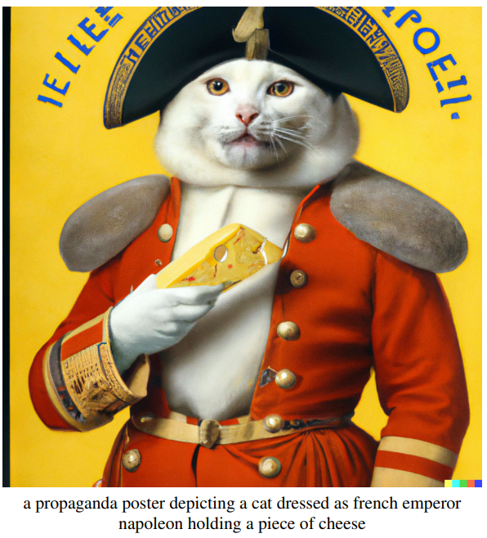
Stakeholder: Introduction
unCLIP: Two-stage model that generates image from text caption
CLIP: Model for image representation
Diffusion model: Model for image generation
Combined: text-conditional generative model
Prior model: Given text caption, generates CLIP image embeddings (diffusion > autoregressive)
Decoder (invert CLIP encoder): Given image embedding, produces image
🔎: Isabel, Vicky

Slide 7
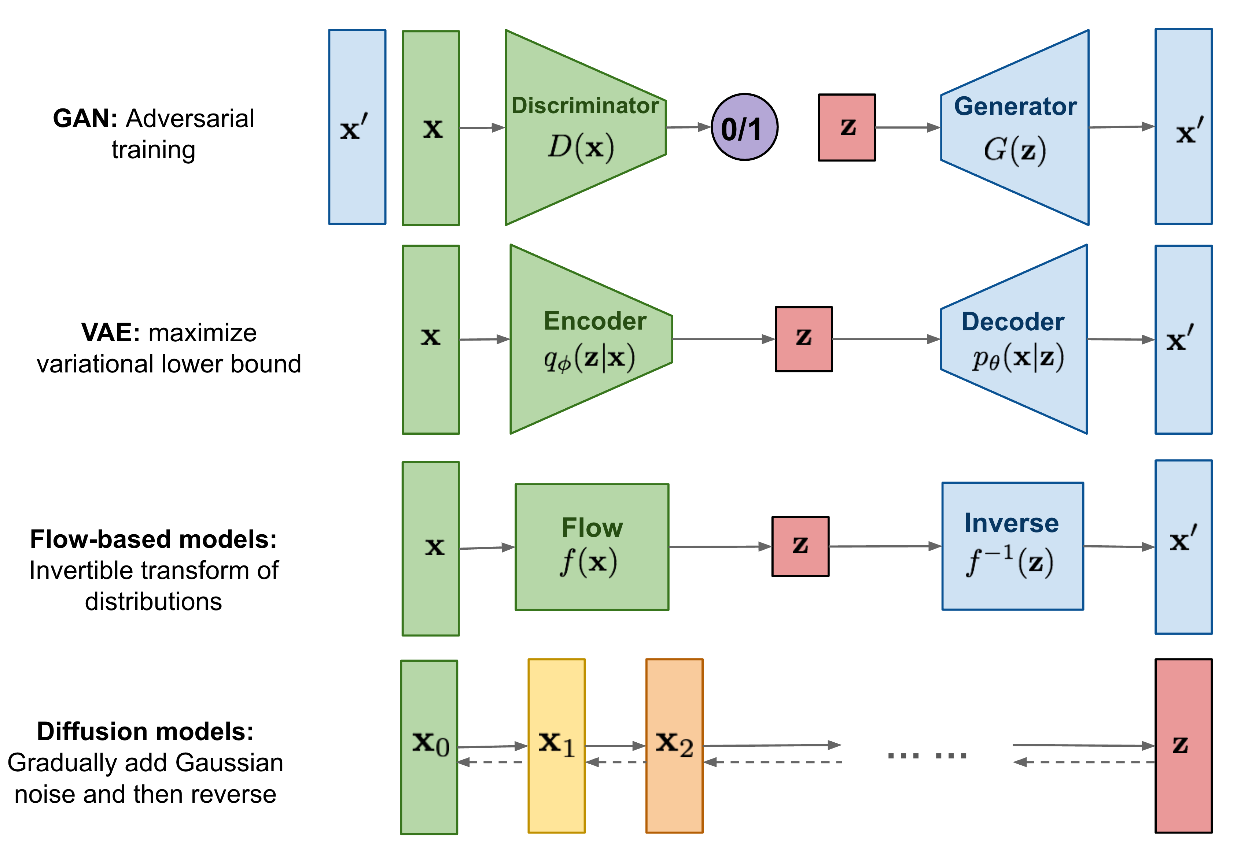
Stakeholder: Related Work
🔎: Isabel, Vicky

Slide 8
Stakeholder: Method
Training data: (x,y) Embeddings: z_{i} , z_{t}
Decoder: P(x | z_{i} , y)
Generation (diffusion model): Modify GLIDE encoder to project CLIP embeddings 1) to existing timestep embedding and 2) into four tokens of context
- classifier-free guidance
High resolution (upsampler models): 64x64 > 256x256 > 1024x1024
- Gaussian blur | BSR degradation
Prior: P(z_{i} | y)
Autoregressive: z_{i} converted into sequence of discrete codes and predicted autoregressively
- reduce dimensionality with PCA (transformer with causal attention mask)
- append to sequence: y, z_{t} , z_{i} ⋅ z_{t}
Diffusion: z_{i} modeled using Gaussian distribution model
- decoder-only Transformer with causal attention mask
- append to sequence: y, z_{t} , diffusion timestep embedding, noised z_{i}
🔎: Isabel, Vicky

Slide 9
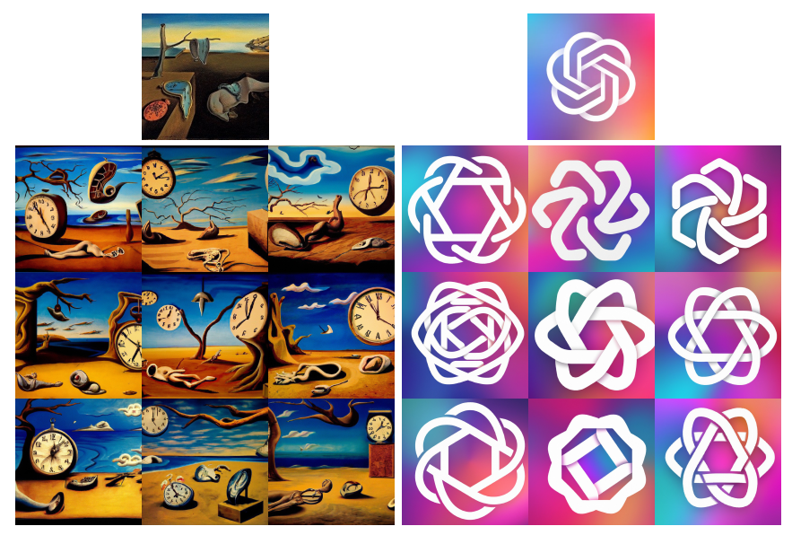
Stakeholder: Image Manipulation
Image x encoded as (z_{i}, x_{T})
Variation
Same content but vary in:
shape and orientation
DDIM with η (=0 is deterministic)
🔎: Isabel, Vicky

Slide 10
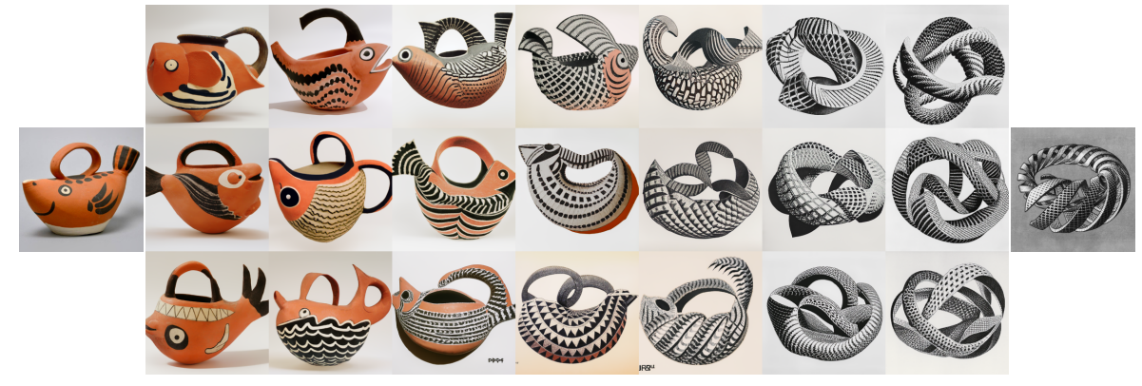
Stakeholder: Image Manipulation
Interpolation: rotate embeddings with spherical interpolation
🔎: Isabel, Vicky

Slide 11
Stakeholder: Image Manipulation
Text Diff: Norm vector for text diff between two text captions
- rotate between embedding and text diff with spherical interpolation
🔎: Isabel, Vicky

Slide 12
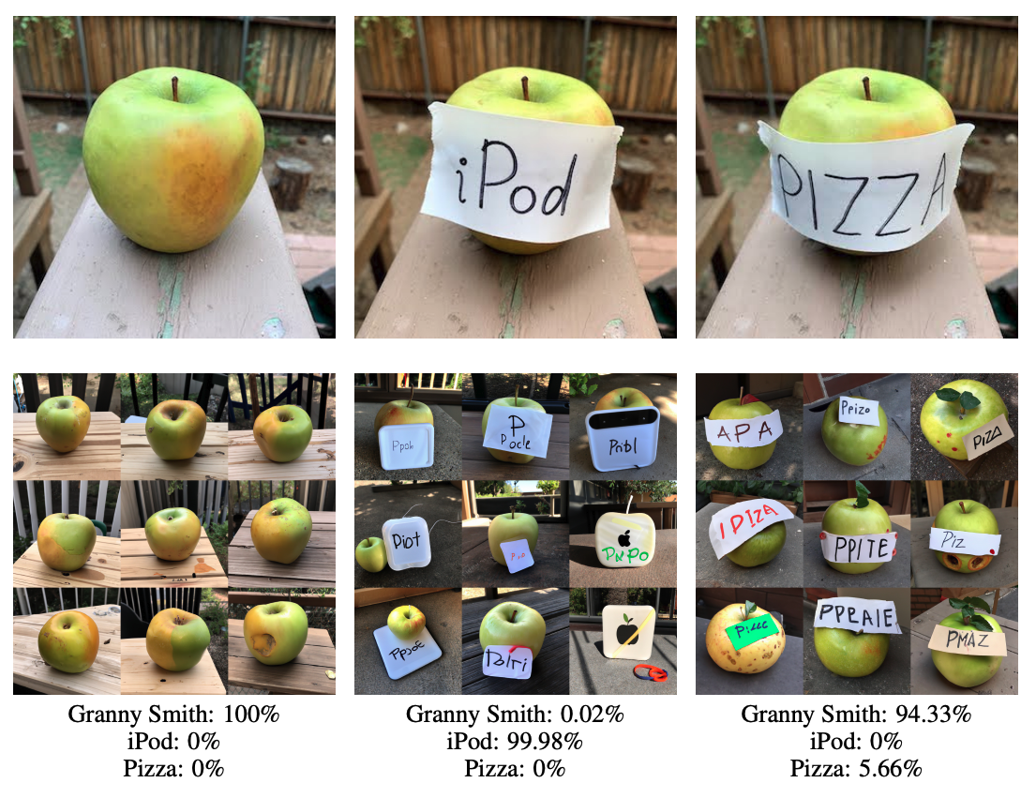
Probing the CLIP Latent space
🔎: Isabel, Vicky
Decoder model allows us to visualize with the CLIP image encoder is seeing

Slide 13
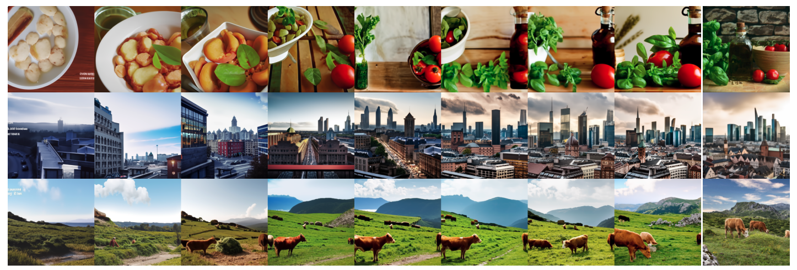
Probing the CLIP Latent space
🔎: Isabel, Vicky
Use PCA on CLIP embeddings and progressively increase the dimension

Slide 14
Text to Image Generation - Human Evaluation
Compare to GLIDE (SOTA in T2I Gen)
Ask humans to give preference on the following:
Photorealism
Caption Similarity
Diversity
Probability humans preferred unCLIP over GLIDE
🔎: Isabel, Vicky

Slide 15
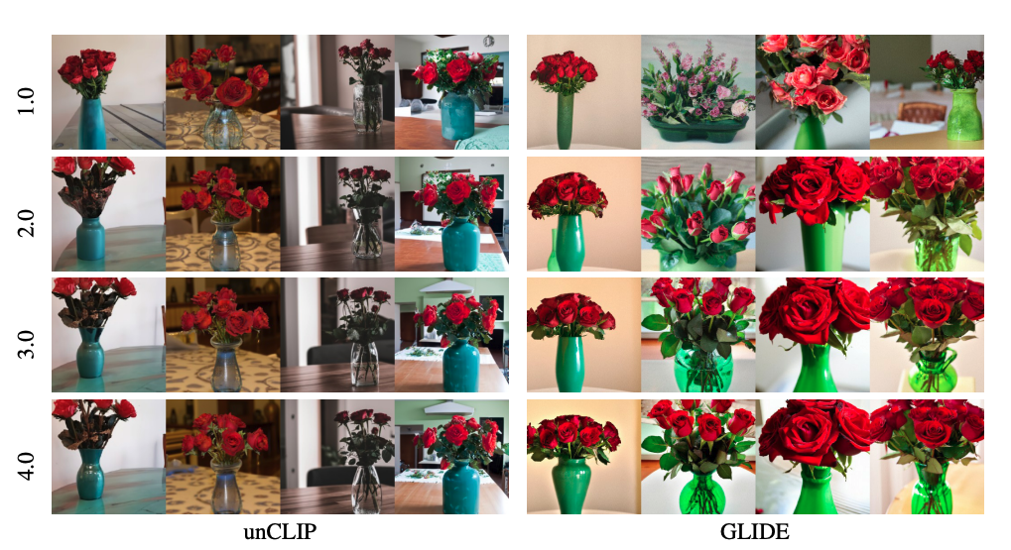
Improved Diversity-Fidelity Trade-off with Guidance
Guidance
🔎: Isabel, Vicky

Slide 16
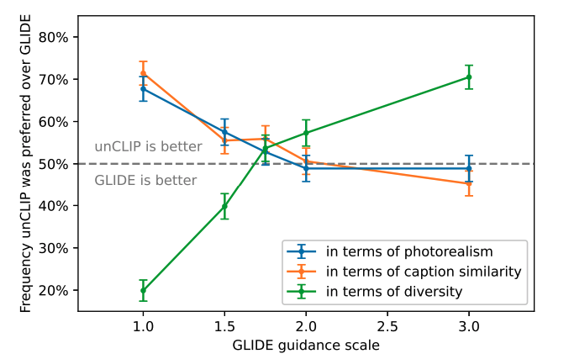
Improved Diversity-Fidelity Trade-off with Guidance
🔎: Isabel, Vicky

Slide 17
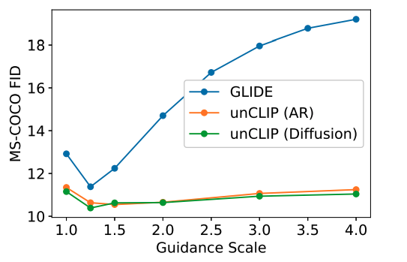
Improved Diversity-Fidelity Trade-off with Guidance
Lower MS-COCO FID is better
unCLIP gets news SOTA on MS-COCO FID
🔎: Isabel, Vicky

Slide 18
Aesthetic Quality Comparison
Use GPT-3 to sample artistic captions
Train a model on AVA dataset to predict aesthetic judgements
Use model to evaluate aesthetic quality
🔎: Isabel, Vicky

Slide 19
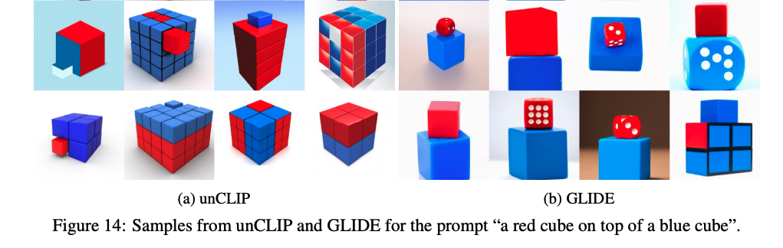
Limitations
unCLIP is worse than GLIDE at binding attributes to objects
🔎: Isabel, Vicky

Slide 20
Limitations
unCLIP struggles to produce coherent text
🔎: Isabel, Vicky

Slide 21
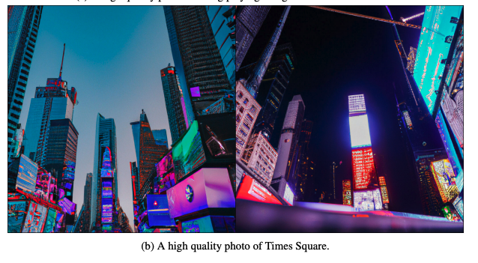
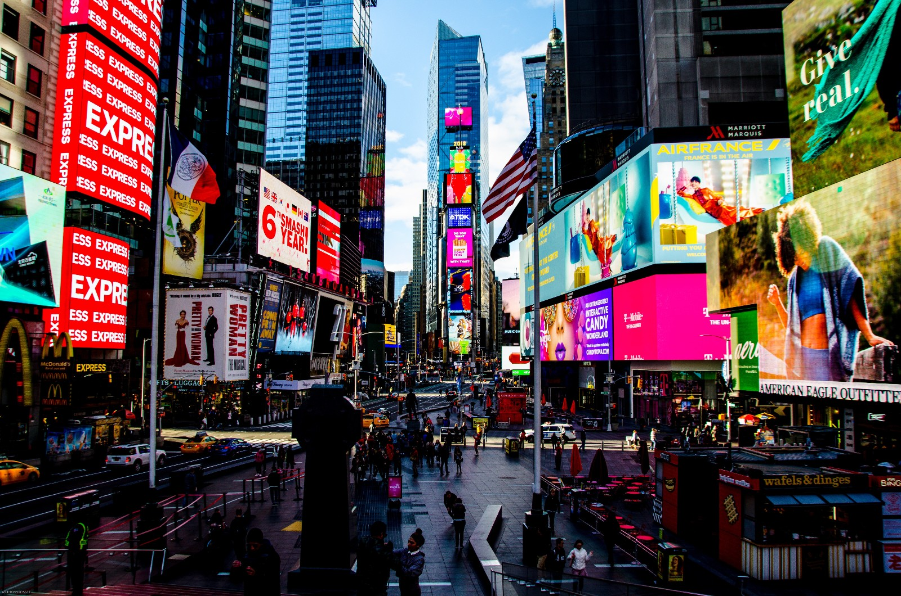
Limitations
unCLIP produce low details for complex scenes
🔎: Isabel, Vicky

Slide 22
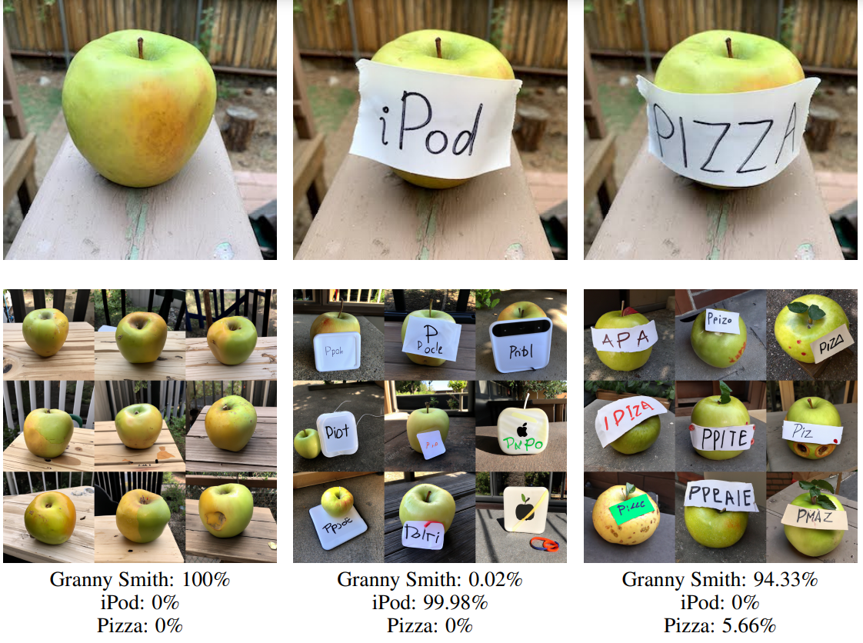
Review: Strengths
Importance of the Prior
Modelling CLIP image embedding is integral to good performance. Alternative considered and tested
unCLIP latent space has nice properties like interpolation and controllable variation
Visualization of the latent space of CLIP – a great tool for understanding the inner processes of image encoder.
🔎: Tianqi, Neha, Zhiqing

Slide 23
Reviewer: Weaknesses
Too much unexplained concepts, hard to understand.
The model is weak with complex situations. e.g., producing coherent text and details in complex scenes.
Computation of the prior (AR & Diffusion) is poorly motivated:
Autoregressive prediction of dimensionality-reduced CLIP image embeddings
Assumptions of PCA met?
Why autoregressive?
Diffusion prior on sequence of [encoded text, CLIP text emb, emb for diffusion timestep, noised CLIP image emb, final emb to predict image embedding]
🔎: Tianqi, Neha, Zhiqing

Slide 24
Reviewer: Weaknesses
The label of each image is no longer a noun, but a sentence, so images that were forcibly divided into the same kind in the past have “infinitely fine-grained” labels.
Example: ImageNet labels images as "dogs," and with this paired example, one can learn the nuances of "dogs" in different environments and doing different things.
The pairing of text and images is not strong enough. This is why the authors repeatedly stress collecting huge datasets, because they have to suppress the noise by means of big data.
OpenAI has not released the data set, we only know that there are 500,000 queries, but we do not know what these queries are, such as simple descriptions or complex descriptions. If it is just a simple description, such as "black cat", "lecture room", etc.
🔎: Tianqi, Neha, Zhiqing

Slide 25
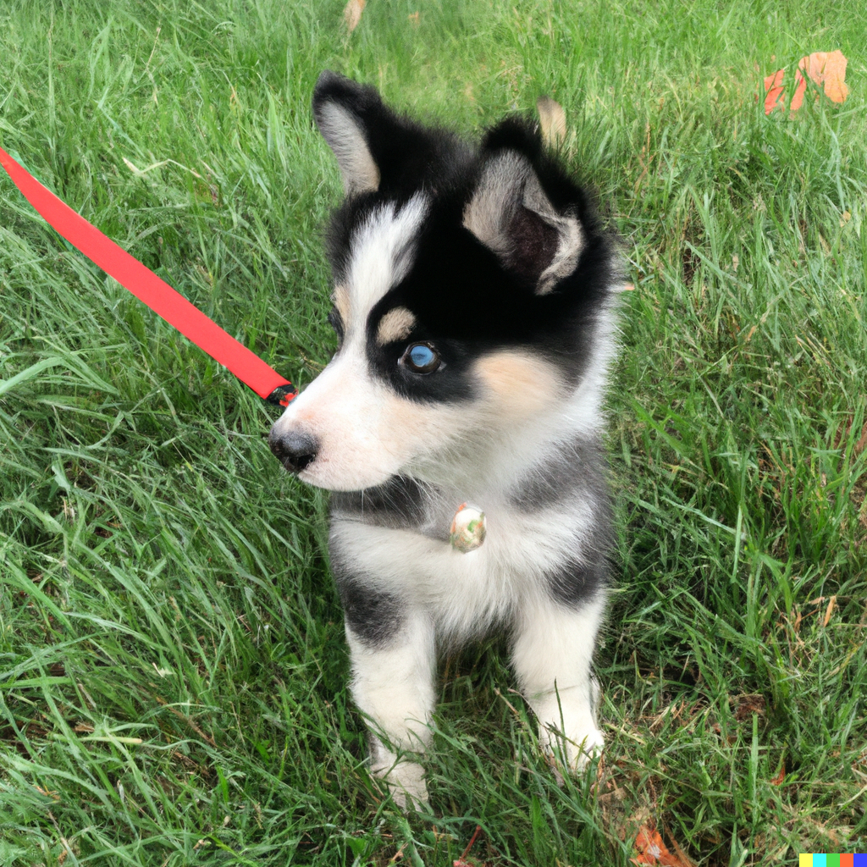
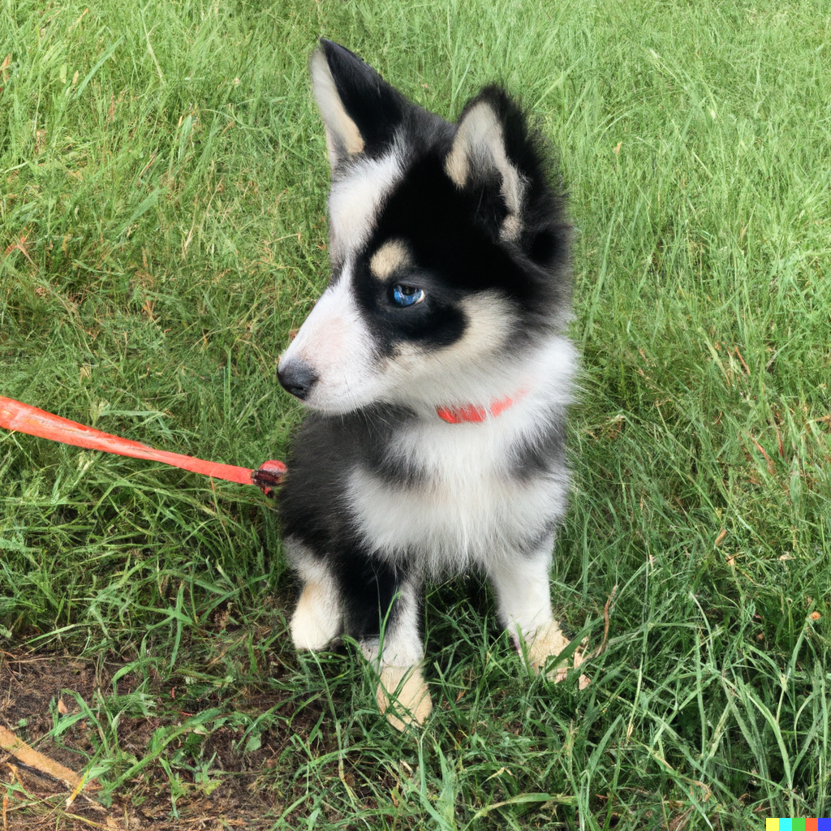
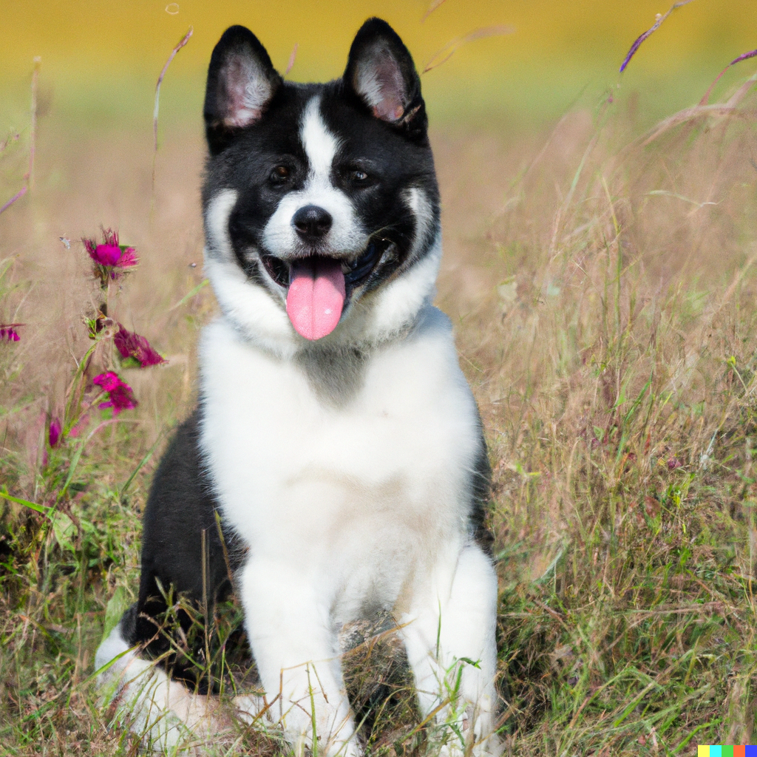
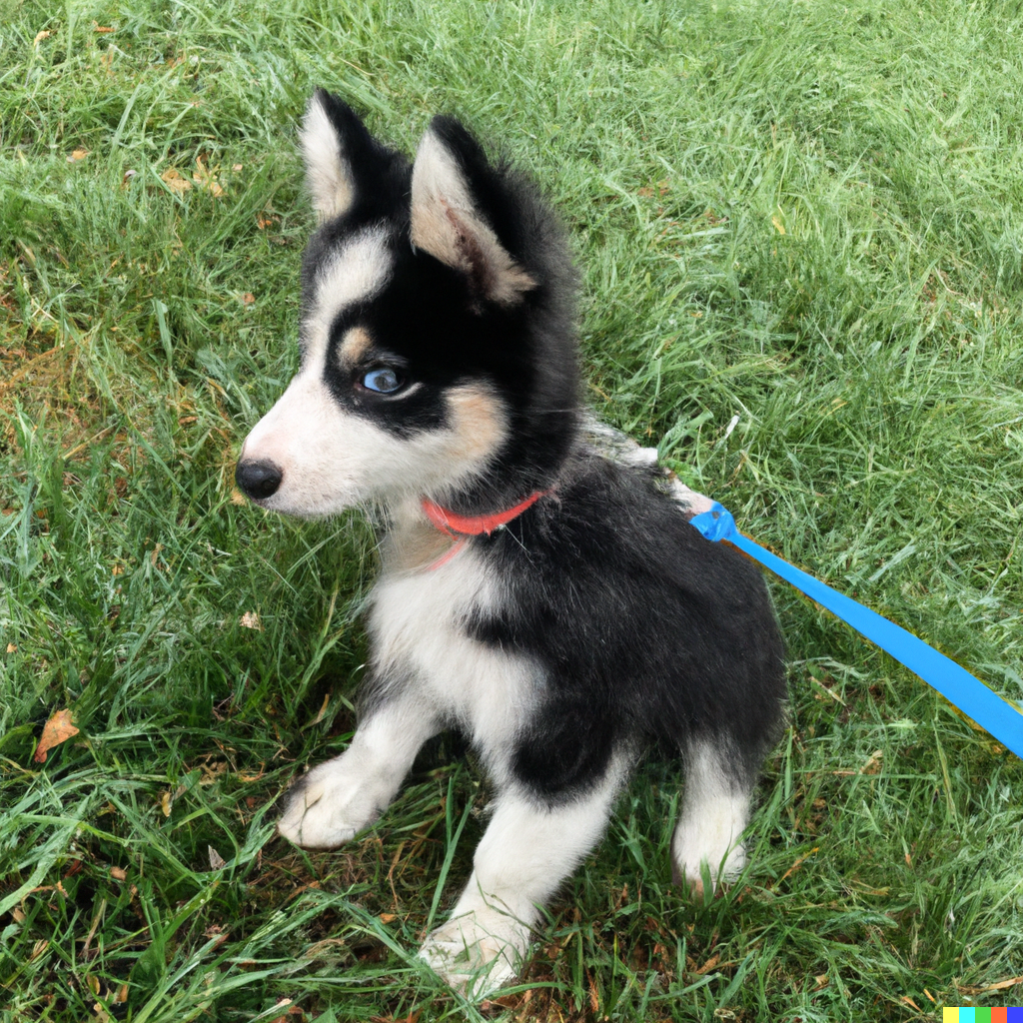
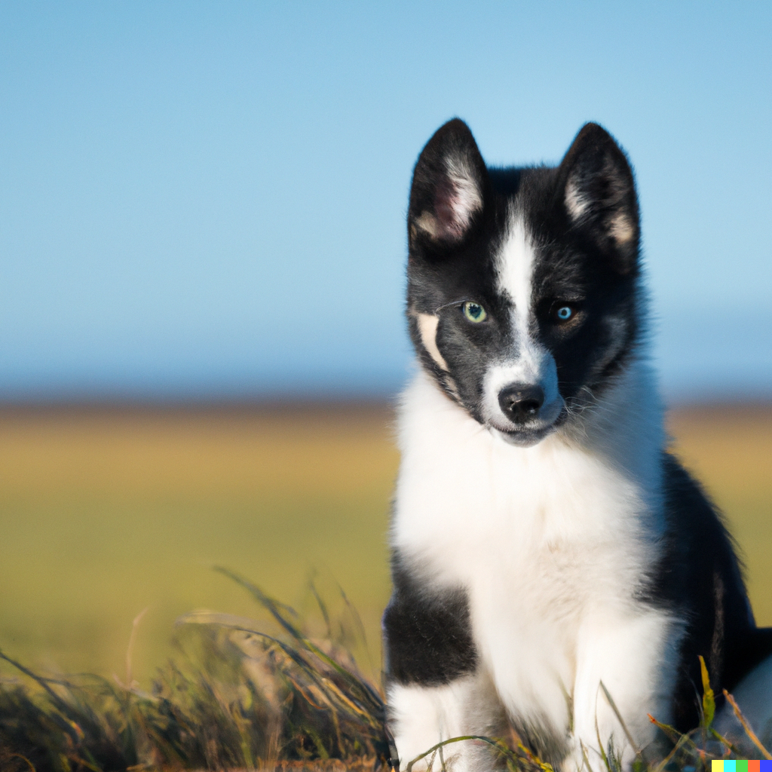
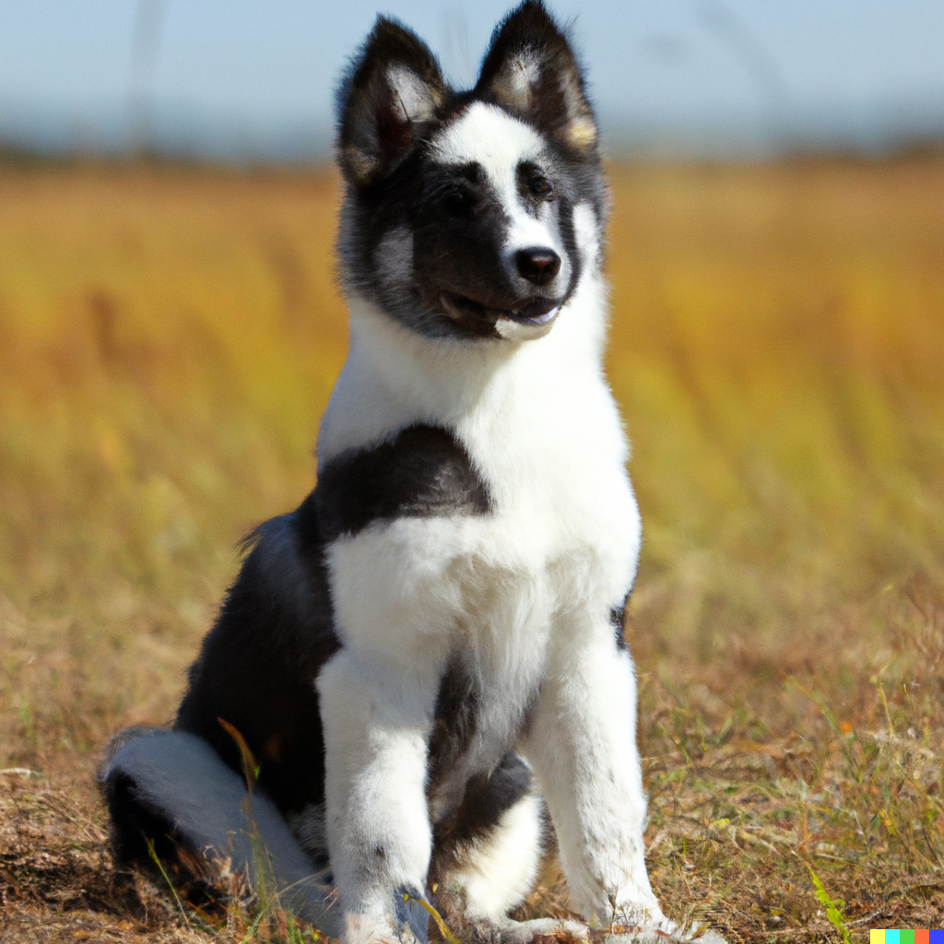
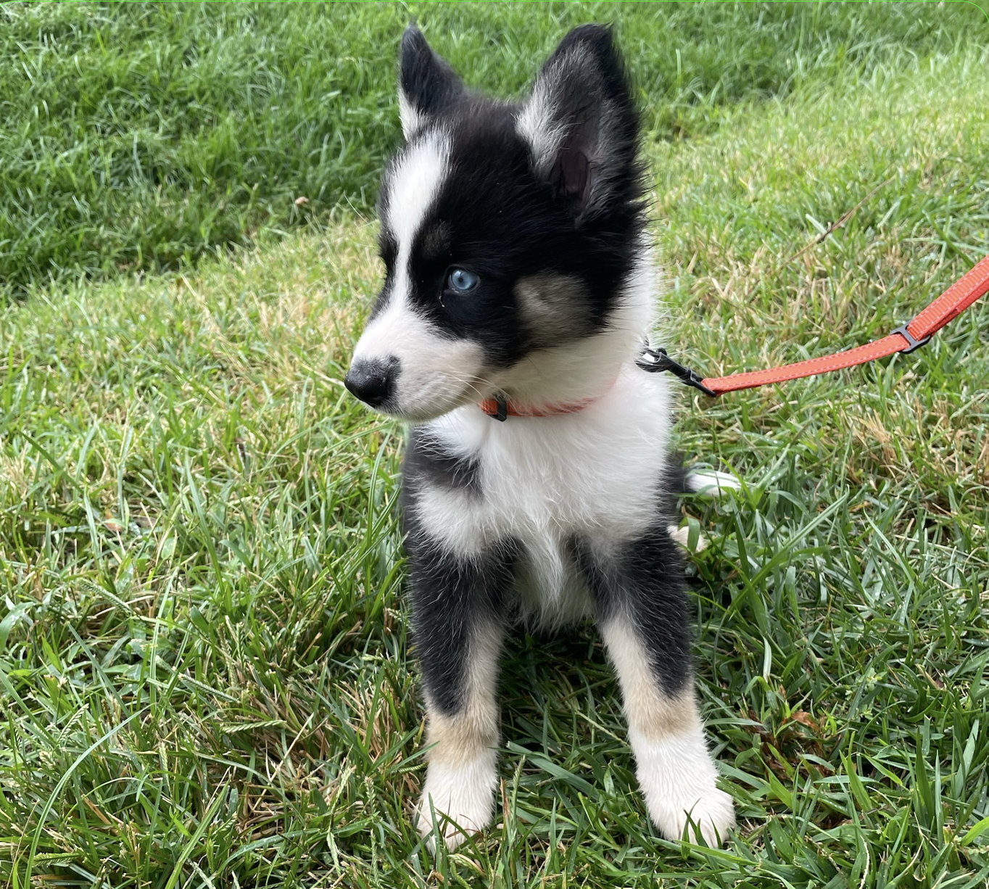
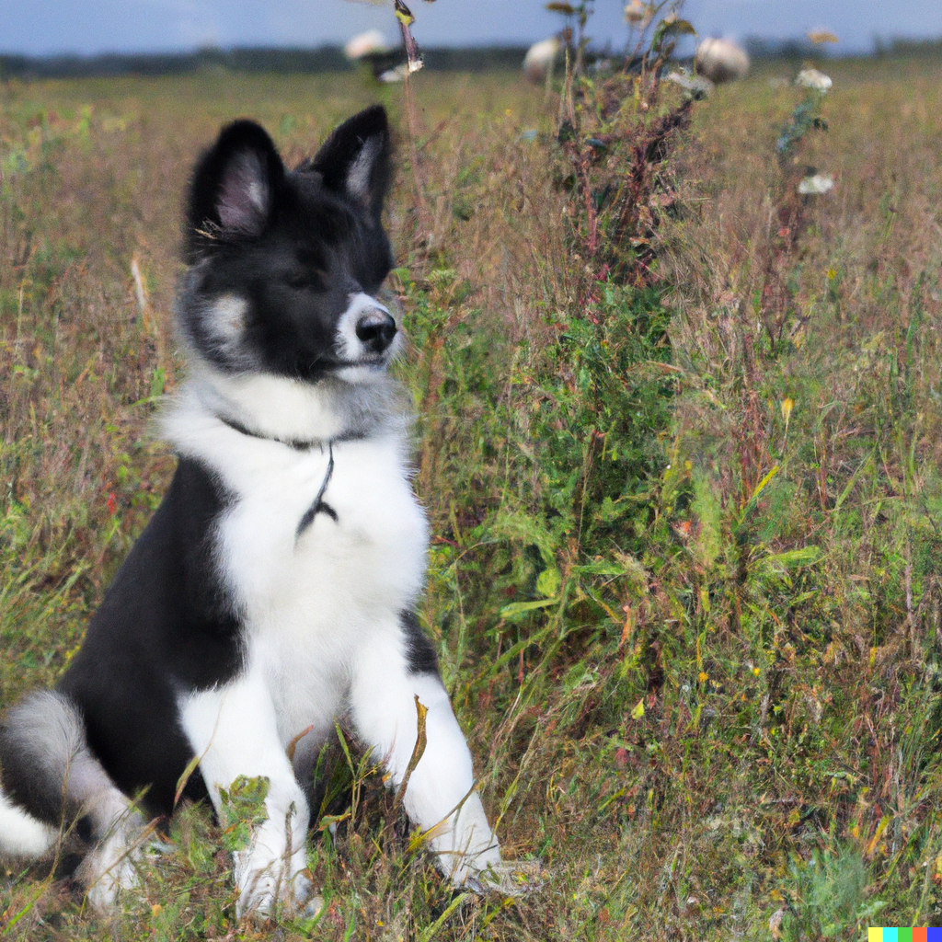
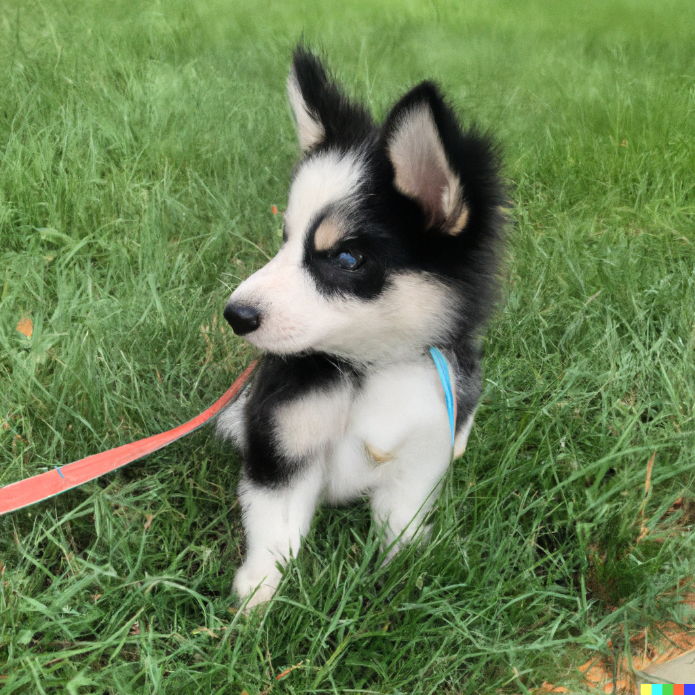
Empiricists
DALL-E 2 is the only open-source implementation of unclip (https://labs.openai.com)
Can you guess which one is the real puppy?
1
2
3
4
5
6
7
8
9
👩🏽‍🔬: Iliana, Aayush, Boyuan

Slide 26
Empiricists
Variations generated by the decoder diffusion model
👩🏽‍🔬: Iliana, Aayush, Boyuan

Slide 27
Empiricists
A cubist painting of a Yakutian Laika dog in a field with sunglasses
👩🏽‍🔬: Iliana, Aayush, Boyuan

Slide 28
Empiricists
A Yakutian Laika dog in a field with sunglasses in anime style
👩🏽‍🔬: Iliana, Aayush, Boyuan

Slide 29
Empiricists
A Yakutian Laika dog in a space suit sipping a piña colada in the desert
👩🏽‍🔬: Iliana, Aayush, Boyuan

Slide 30
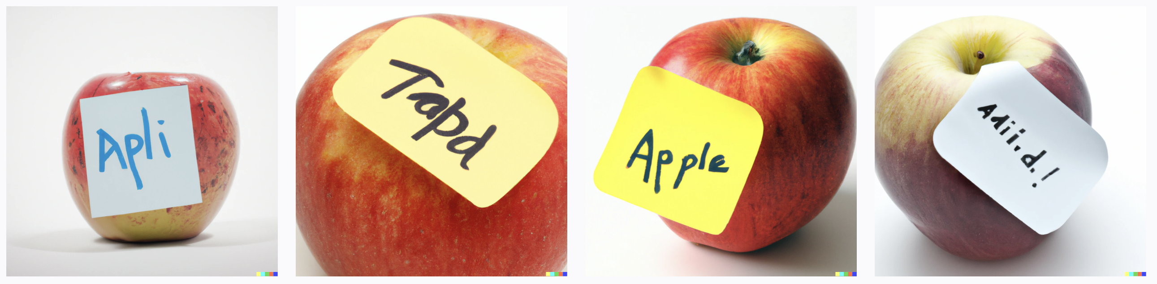
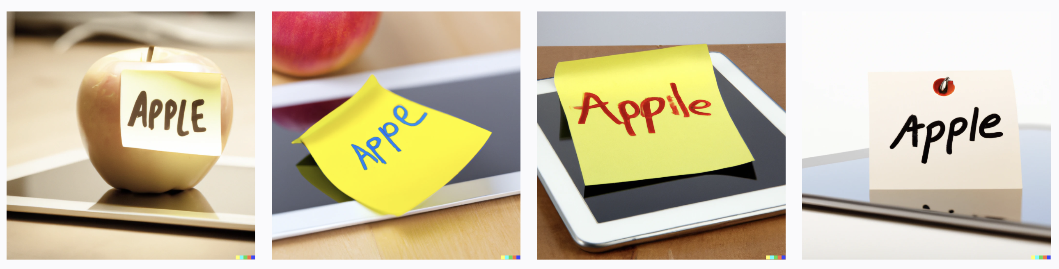
Empiricists: Typographic attacks
👩🏽‍🔬: Iliana, Aayush, Boyuan

Slide 31
Empiricists: Typographic attacks
👩🏽‍🔬: Iliana, Aayush, Boyuan

Slide 32
Empiricists: Typographic attacks
👩🏽‍🔬: Iliana, Aayush, Boyuan

Slide 33
Empiricists: Typographic attacks
👩🏽‍🔬: Iliana, Aayush, Boyuan

Slide 34
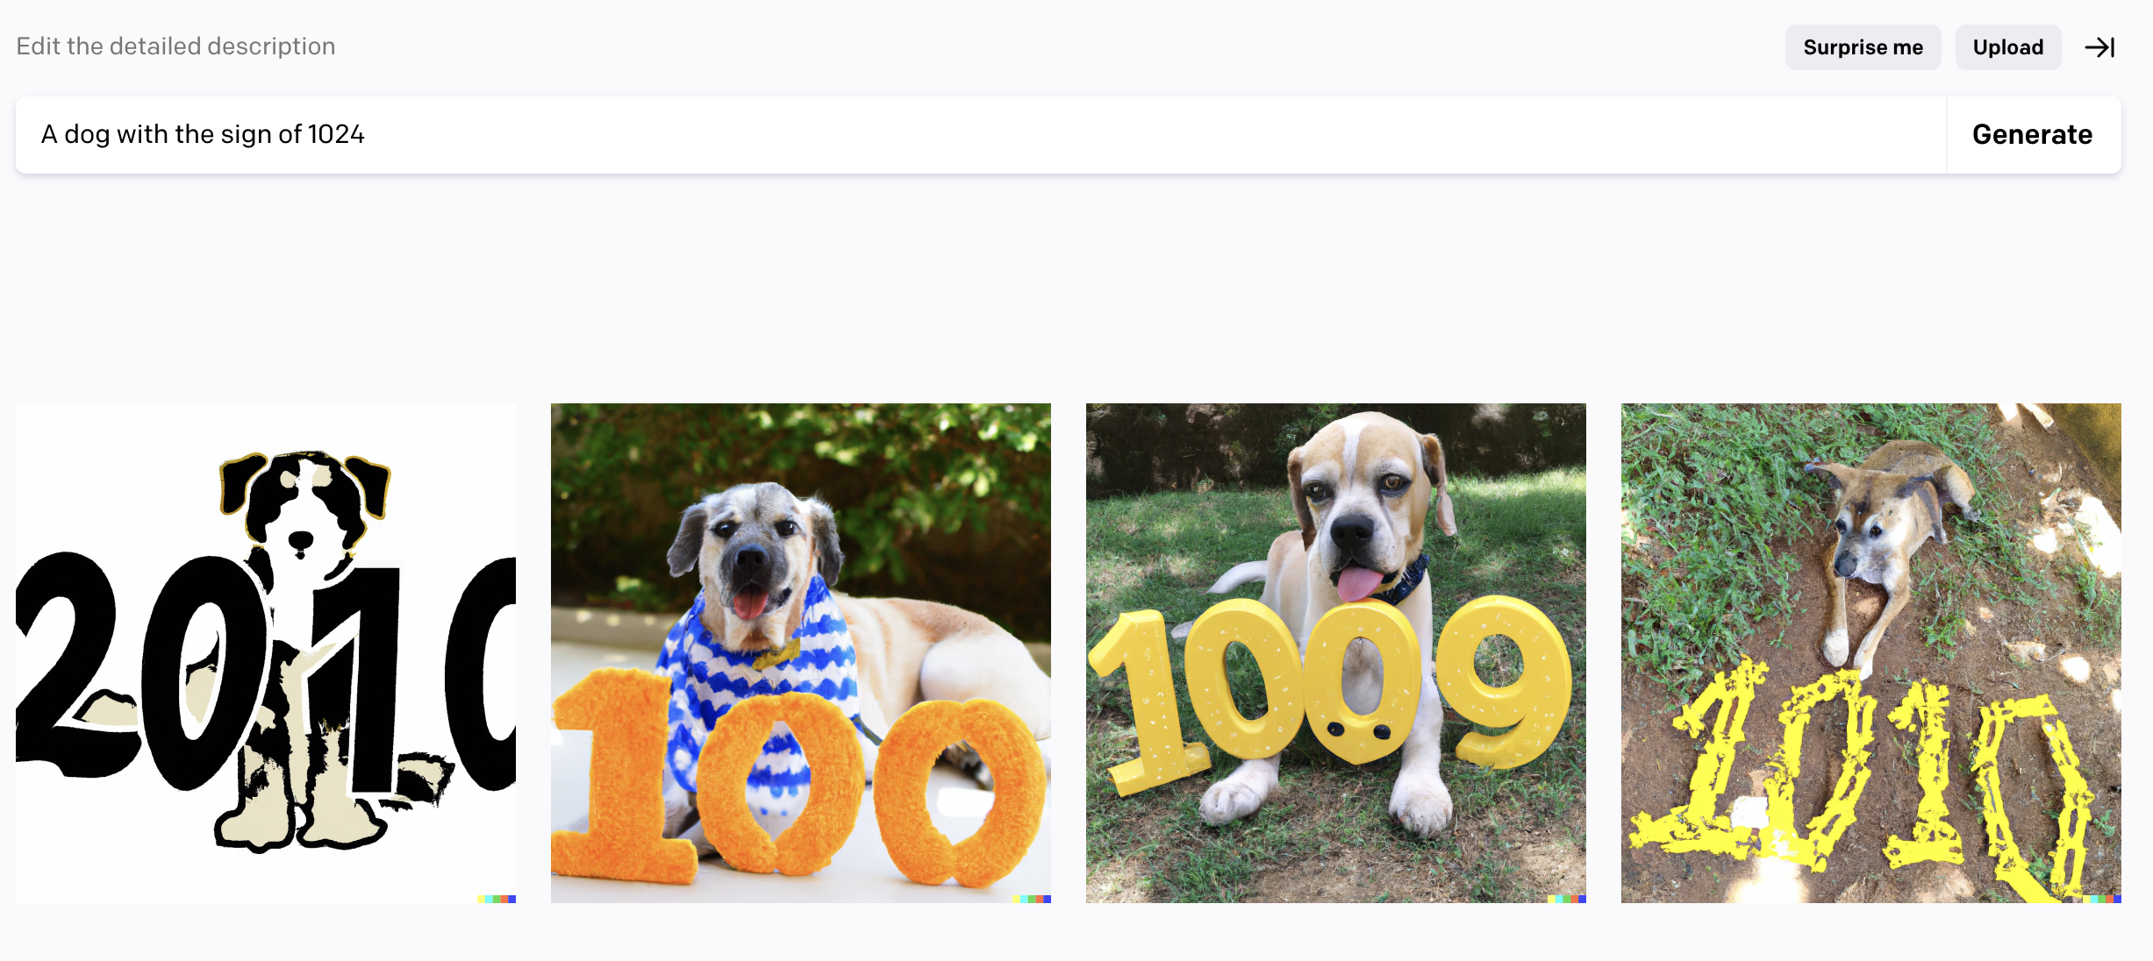
Empiricists
Limitation1: Number Understanding
👩🏽‍🔬: Iliana, Aayush, Boyuan

Slide 35
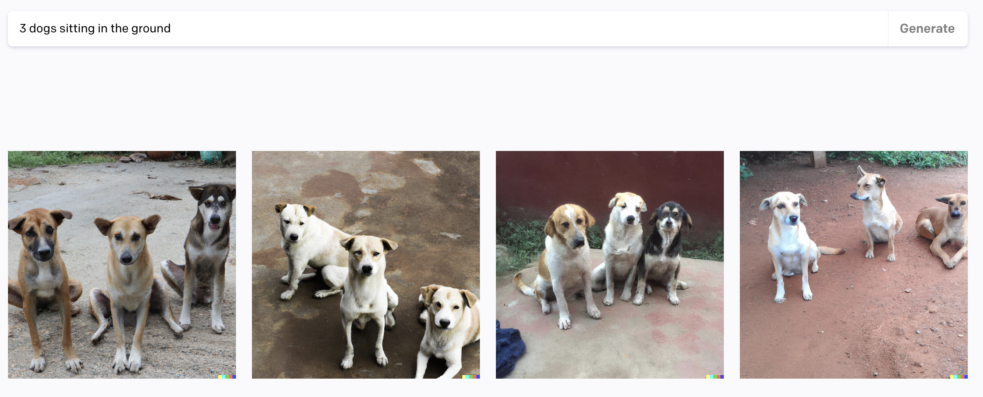
Empiricists
Limitation2: Counting
👩🏽‍🔬: Iliana, Aayush, Boyuan

Slide 36
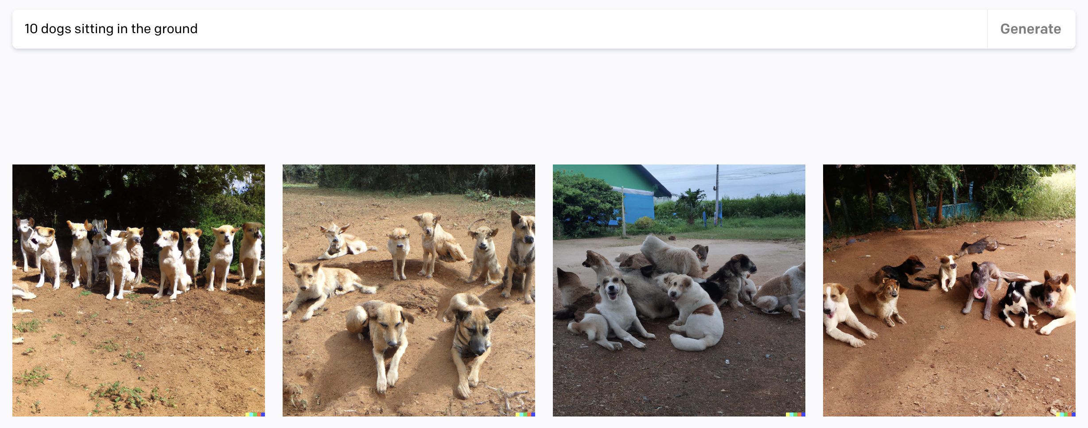
Empiricists
Limitation2: Counting
👩🏽‍🔬: Iliana, Aayush, Boyuan

Slide 37
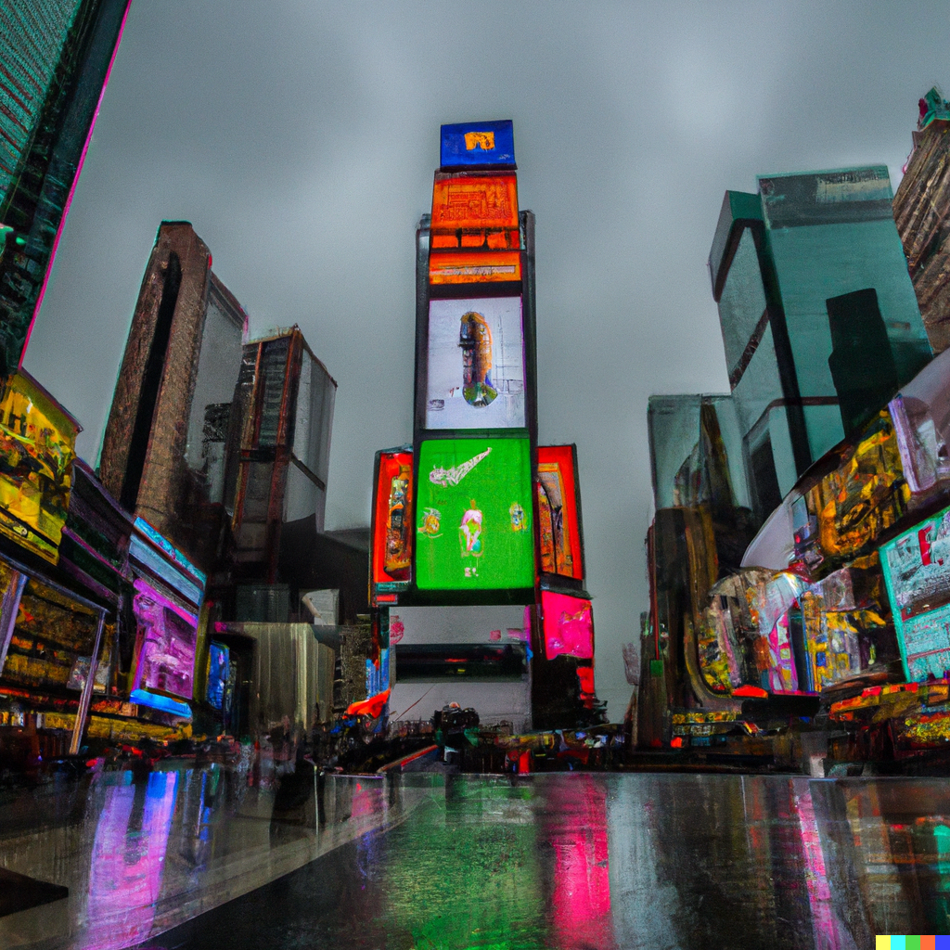
Empiricists
Limitation 2: Bad Details
Example: A photo of the time square
👩🏽‍🔬: Iliana, Aayush, Boyuan

Slide 38
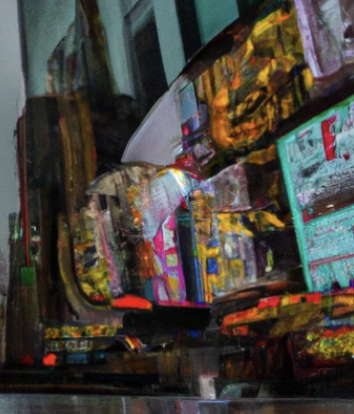
Empiricists
Limitation 2: Bad Details
Example: A photo of the time square
👩🏽‍🔬: Iliana, Aayush, Boyuan

Slide 39
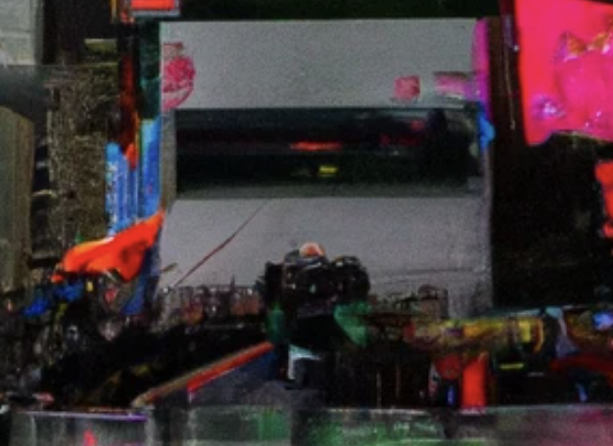
Empiricists
Limitation 2: Bad Details
Example: A photo of the time square
👩🏽‍🔬: Iliana, Aayush, Boyuan

Slide 40
Visionary
Practicality
Theory
Application

Slide 41
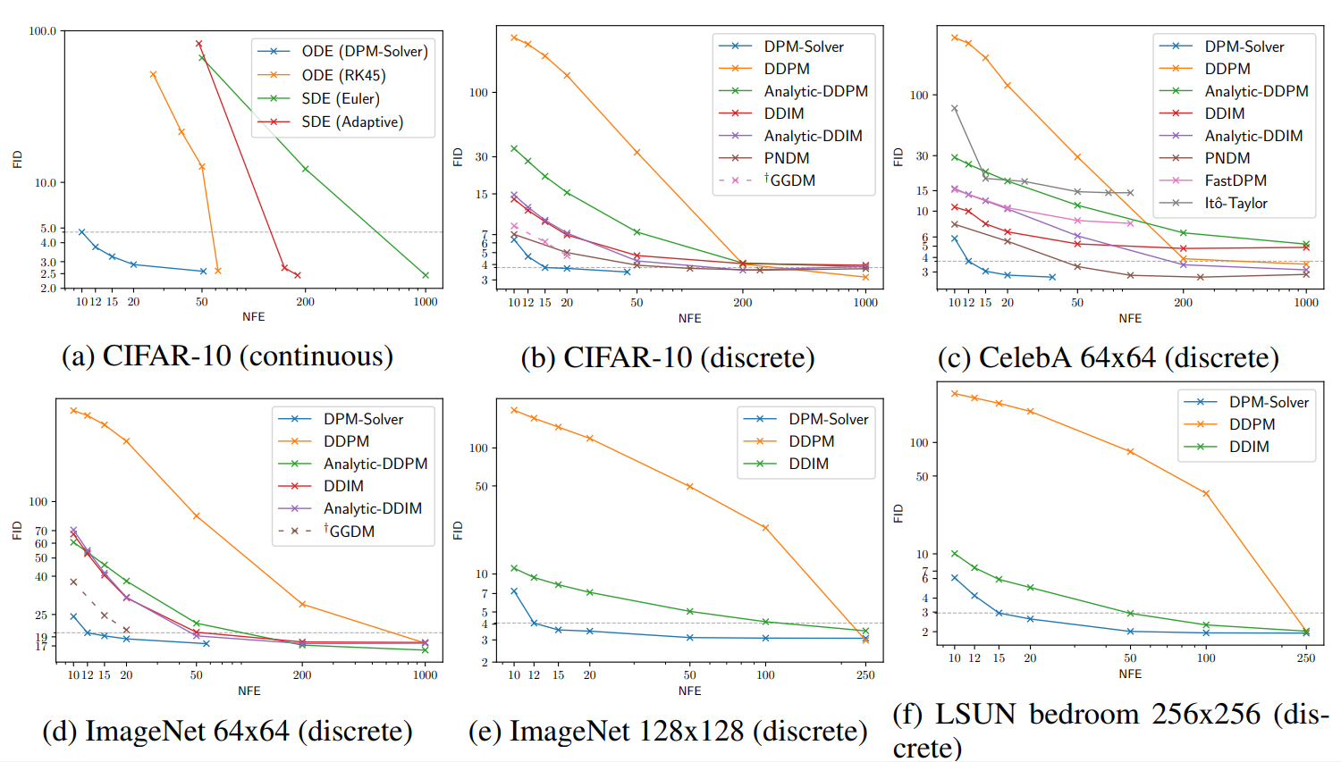
Practicality
Speed-up in sampling

Slide 42
(2)Speed-up in training?
A remaining open problem…

Slide 43
Relax Constraints?
Replace Langevin dynamics with?
Replace gaussian noise with more complex perturbation?
Hierarchical VAE is more powerful -> but less stable and harder to train?

Slide 44
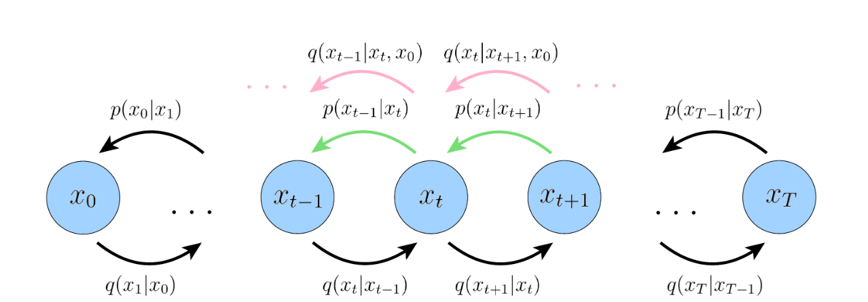
Relax Constraints?
In variational diffusion model, x0’s information is also used
Can/should we relax the markov property further?

Slide 45
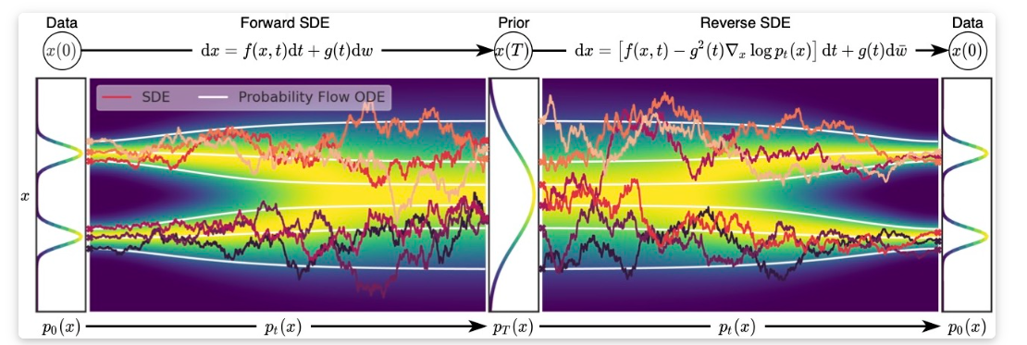
Other potential work
Better sampling strategies
Discrete -> Continuous process
Stochastic differential equations (SDE)
Probability flow ODE

Slide 46
Application-Diffusion for Language?

Slide 47
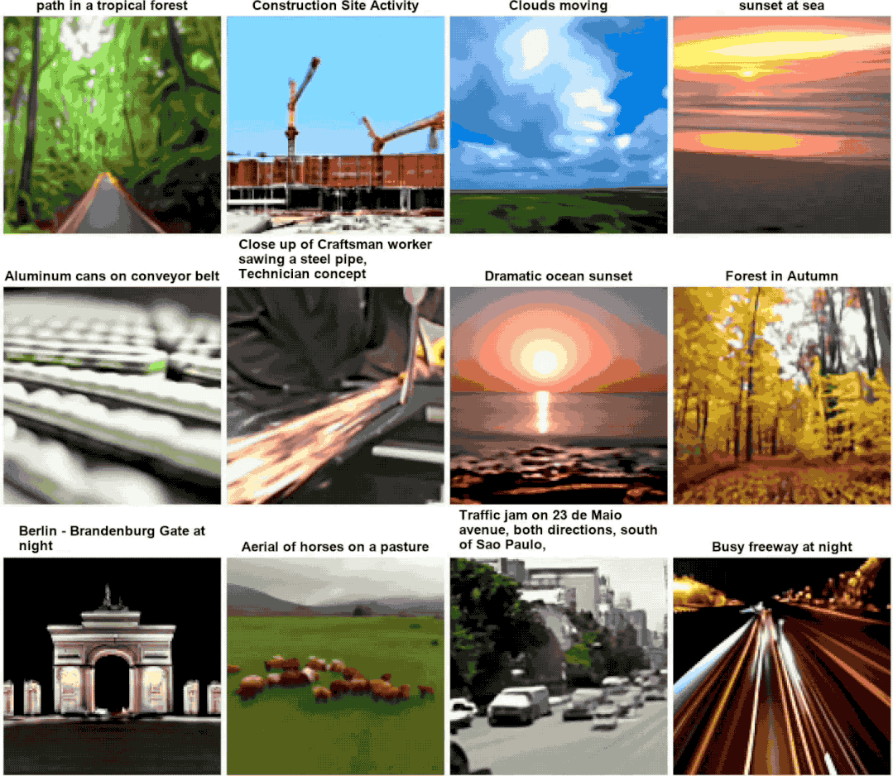
Application – Diffusion for Video?
Video prediction
Text-conditioned video generation

