Slide 1
Session #20: Retrieval from Memory
Thursday, November 3
CSCI 601.771: Self-supervised Statistical Models

Slide 3
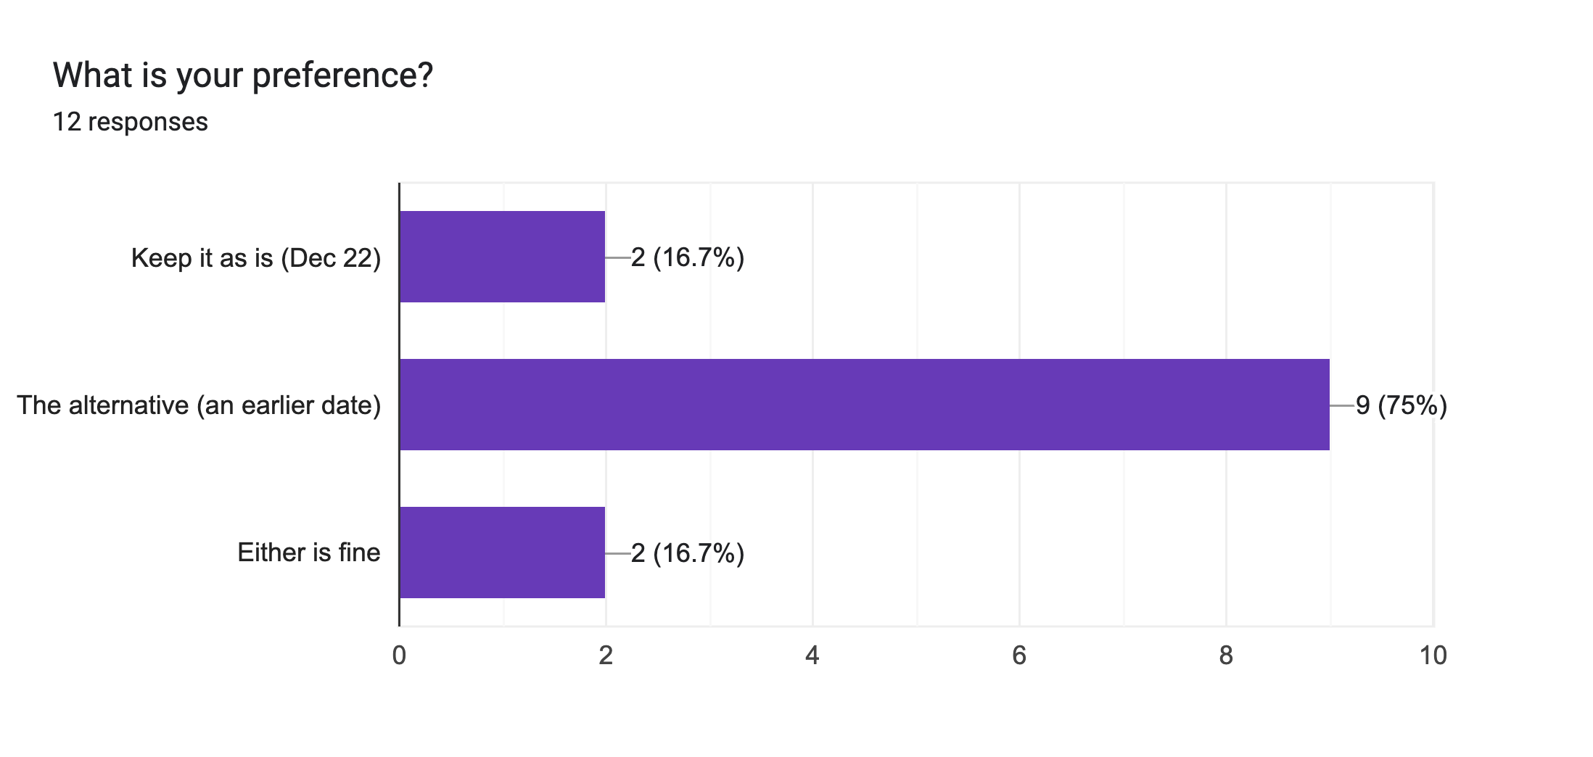

Slide 4
Comments
"I'd prefer the earlier date in general but the only issue is that that week is EMNLP, so a few of us will be traveling. If there is an alternate way to submit our presentations by Dec 8th (e.g. a recording) I'd prefer the earlier date."
"It would be great if we move the report date to a bit later if possible "
"[MASK] and I are at EMNLP in Abu Dhabi during this time but we are very happy to do the earlier date + coordinate some sort of virtual presentation if possible "

Slide 5
Problem Statement
Some issues with pre-trained neural language models:
They cannot easily expand or revise their memory
They can’t straightforwardly provide insight into their predictions
They may produce “hallucinations”
Stakeholders✍️: Muzzi & Fadil

Slide 6
Model Overview
Figure 1: Overview of the model.
Combined pre-trained retriever (Query Encoder + Document Index) with a pre-trained seq2seq model (Generator) and fine-tune end-to-end.
For query x, Maximum Inner Product Search (MIPS) is used to find the top-K documents z .
Stakeholders✍️: Muzzi & Fadil

Slide 7
Models difference
Both models are trained by directly minimising the log likelihood of each target - log p(y|x)
Stakeholders✍️: Muzzi & Fadil

Slide 8
Overall Setup
A single Wikipedia dump is used for all experiments
Each article is split into 100 word chunks to form 21 M documents
The top k documents are retrieved for each task with k being limited between 5 to 10
Stakeholders✍️: Muzzi & Fadil

Slide 9
Open Domain Q/A
Questions are treated as input output text pairs
RAG is trained by minimizing negative log likelihood
Comparisons are made to the extractive Q/A paradigm and to closed book Q/A
Tested on 4 datasets Natural Questions (NQ) , TriviaQA (TQA) WebQuestions (WQ) and CuratedTrec (CT)
Stakeholders✍️: Muzzi & Fadil

Slide 10
Results
Sets new SOA performances in all categories
More efficient than salient span masking training
Generating answers allows us to get them even when they don't directly exist in the passage

Slide 11
Abstractive Q/A
MMARSCO NLG is used as the task
There are 10 gold passages retrieved for the questions via a search engine and then annotated into an answer
Using only the Questions and answers makes MMARSCO abstractive
RAG must rely on its parametric knowledge to generate reasonable answers
Stakeholders✍️: Muzzi & Fadil

Slide 12
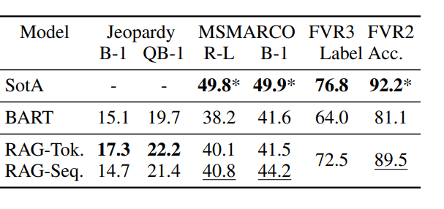
Results
Approaches SOA performances
Specially impressive given that there s no access to the gold passages
RAG hallucinates less and gives more factually correct answers than BART

Slide 13
Jeopardy Q/A
Generates factually demanding Jeopardy questions
Splits from SearchQA , with 100K train, 14K dev, and 27K test examples are used
BART model is trained for comparison
Finally human evaluation is done for accuracy and specificity
Stakeholders✍️: Muzzi & Fadil

Slide 14
Results
RAG Token Outperforms RAG Sequence with both outperforming BART
RAG more factual in 42.7% of cases !

Slide 15
FEVER
Classifies whether a natural language claim is supported or refuted by Wikipedia
Retrieval problem coupled with entailment reasoning task
Map FEVER class labels (supports, refutes, or not enough info) to single output tokens and directly train with claim-class pairs
No supervision is used on retrieved evidence
Stakeholders✍️: Muzzi & Fadil

Slide 16
Results
Within 4.3% of SOA systems
Within 2.7% of RoBERTa SOA although its only given the claim
Top 10 document are gold in 90% of cases!

Slide 17
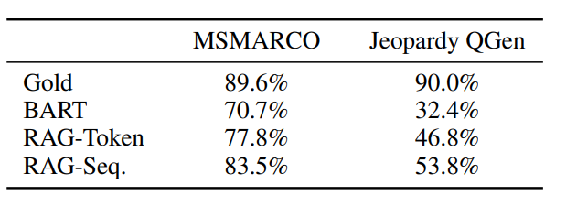
Additional results
Generation diversity
Retrieval Ablations

Slide 18
Additional results
Index hot swapping
Replacing non parametric memory is enough to change the way data works in RAG !
Effects of more documents

Slide 19
TBD
TBD
👩🏽‍🔬: TBD

Slide 20
TBD
TBD
🔎: TBD

Slide 21
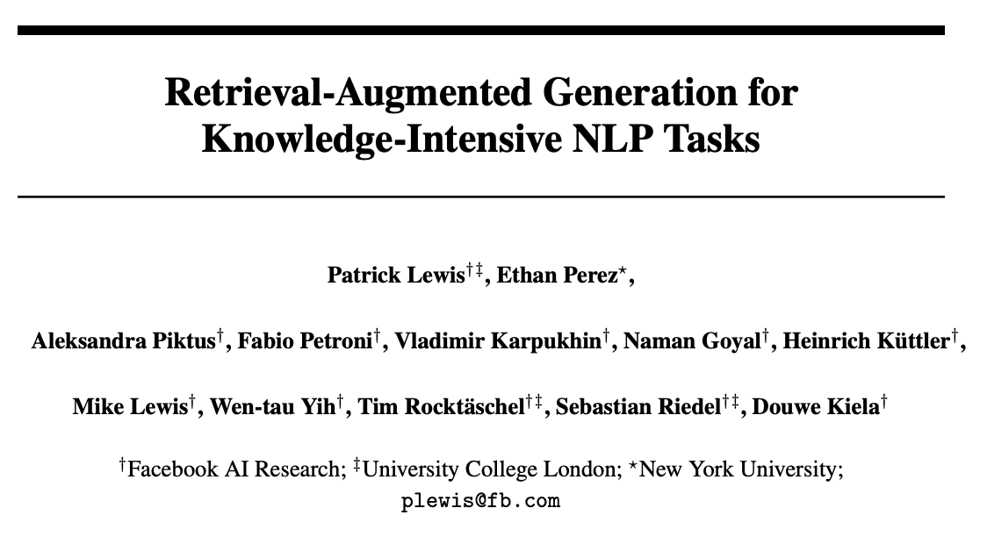
Ayo & Elisée

Slide 22
🟢 RAG Version Diversity
Proposed 2 version of RAG:
RAG Sequence (Retrieved single doc from data base and condition on 1 doc)
RAG Token (Retrieved multiple doc from data base and switch b/w the set of doc )

Slide 23
🟢 RAG Variance Comparison

Slide 24
🟢 Interaction b/w Parametric vs Non-Parametric

Slide 25
🟢 other Positives
Latent Retrieval: No labels needed for retrieved docs.
General in use/application: For any seq2seq task.
Easy to follow and well visualized.

Slide 26
🟢 other Positives (CONT.)
Results indicate what RAG model, RAG-token vs RAG-seq, perform better on certain tasks, so others interested in solving certain problems (Open-domain Question Answering) for instance, might opt to using RAG-seq model.
Usage of pairwise comparative evaluation as opposed to Likert scores or single-turn pairwise evaluation for Jeopardy Question Generation.
RAG's world knowledge can be updated by replacing its non-parametric memory unlike GPT (reducing hallucinations).
After updating Wikipedia dumps, they saw that RAG had 70% accuracy in the 2016 index and 68% accuracy in 2018 index. - "Who is the President of Peru?"

Slide 27
negatives
No clear explanation/hypothesis as to why the RAG-Tok model outperforms the RAG-Seq or vice versa in certain experiments. This was only done for the Jeopardy Question Generation experiment but not others.
Bringing up points not previously addressed in previous sections of the paper, such as the reference to Rouge-L points (could be a negative based on the type of reader).
Nit-pick: Grammatical errors
Retrieval and Generation framework discussed in the paper has also been used in other papers but was presented a new idea that was developed.
Retrieval-guided Dialogue Response Generation via a Matching-to-Generation Framework
Does RAG only look at Wikipedia articles? What happens if these articles are outdated? How can we fact-check the "facts?" This was a downside addressed in the broader impact section of the paper.
Notes:
ROUGE, or Recall-Oriented Understudy for Gisting Evaluation, is a set of metrics and a software package used for evaluating automatic summarization and software in NLP.

Slide 28
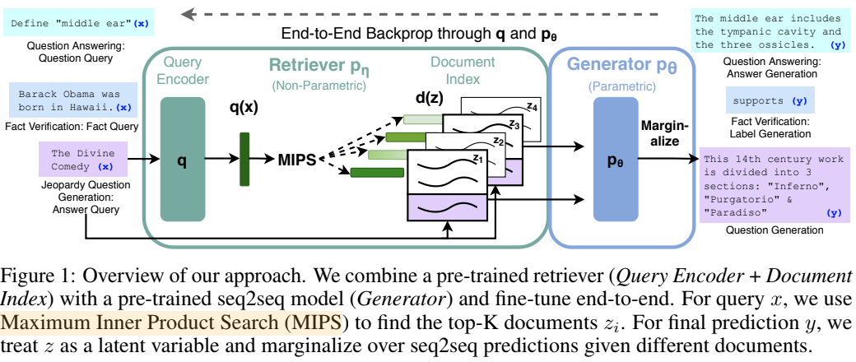
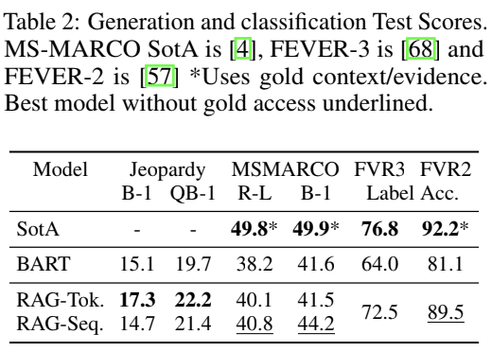
RAG Fact-verification experiments
Goal: Retrieve evidence related to claim, reasoning about this to classify whether supported, refused, or unverified by Wikipedia
Input: a claim, output: 3 classes
Test RAG models classification ability
Map 3 labels to single token and train claim-class pairs
🔭: Ha Bui
Patrick, et al., 2020. Retrieval-Augmented Generation for Knowledge-Intensive NLP Tasks

Slide 29
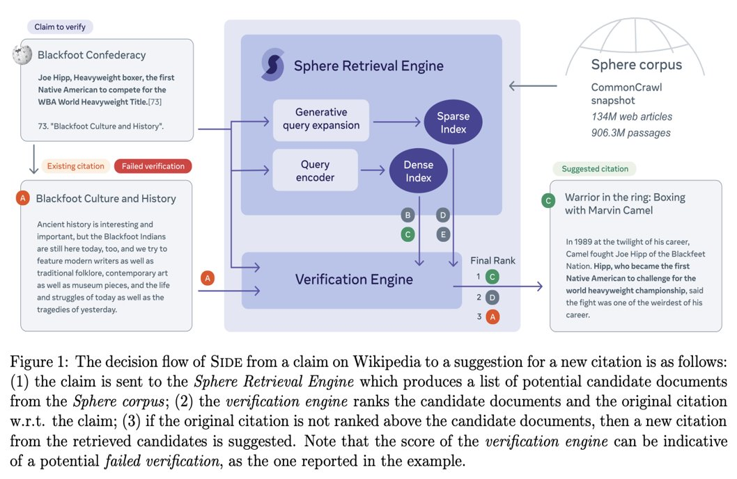
Use RAG model to support improving Wikipedia Verifiability
Motivation: claims that are likely to be challenged need to be backed by citations
🔭: Ha Bui
Fabio, et al., 2022. Improving Wikipedia Verifiability with AI

