Slide 1
Session #3: BERT
Tuesday, Sept 6
CSCI 601.771: Self-supervised Statistical Models

Slide 2
Notes:
Food for thought.

Slide 3
Ice Breaker
What is one question you have about this paper?
What is one thing you want to hear more about?

Slide 4
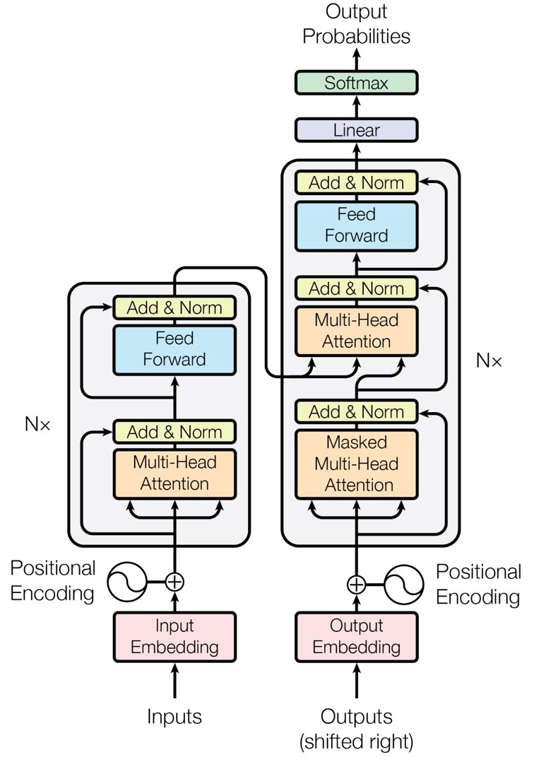
Recap
Transformers
An instance of Auto-Encoder (an unsupervised learning technique)
Encoder: Mapping from X->Z, aiming to understand the feature representation Z
Decoder: Mapping from Z->X, inverse mapping for reconstruction
An encoder-decoder architecture built with attention modules
Ashish, 2017. Attention Is All You Need
✍️: Ha, Isabel

Slide 5
Problems and motivation
Problems:
Previous NLP pretrained techniques are unidirectional, limit context understanding
Bi-directional LSTM is slow and not actually bidirectional (only concat left-to-right and right-to-left, leading to lost context understanding)
Motivation:
How to build a fast pretrained model, bidirectional, and preserve context understanding
=> Jacob, 2018. Bidirectional Encoder Representation from Transformer (BERT):
A stack of multiple transformer encoders
BERT is a fast bidirectional model and preserves context understanding
✍️: Ha, Isabel

Slide 6
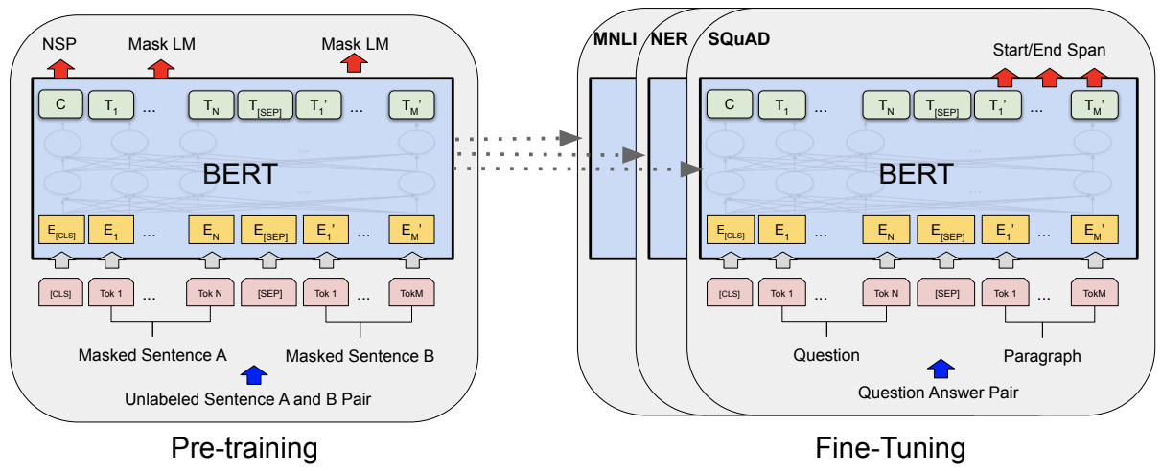
Method
Overview of two steps of training BERT:
Pre-training:
Goal: Understanding features in representation space
Trains model on unlabeled data over different pre-training tasks (Self-supervised learning)
Fine-tuning:
Goal: Make pre-trained model usable in downstream tasks
Initialized with pre-trained model parameters
Fine-tuned model parameters using labeled data from downstream tasks
✍️: Ha, Isabel
Jacob, 2018. BERT: Pre-training of Deep Bidirectional Transformers for Language Understanding

Slide 7
Method
Input Embeddings:
Token Embeddings: pre-trained token vocabs (“WordPleces”: 30K vocabs/tokens)
[CLS]: token beginning sentence, [SEP]: token ending sentence, [PAD]: padding token
Segment Embedding: sentence number encoder to vectors
Position Embedding: position of words within that sentence
=> Preserve ordering sentence inputs for BERT => Robust across downstream tasks
✍️: Ha, Isabel
Jacob, 2018. BERT: Pre-training of Deep Bidirectional Transformers for Language Understanding

Slide 8
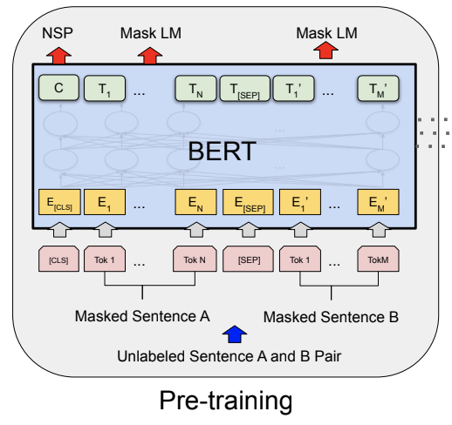
Method
Pre-training BERT:
Task #1: Masked Language Model
Inputs: The [Mask1] Hopkins University is located in [Mask2] city (E)
Outputs: [Mask1] = Johns, [Mask2] = Baltimore (C, T)
=> Helps understand bi-directional context
Task #2: Next Sentence Prediction
Inputs:
A: Johns Hopkins is a university (E)
B: It is located in Baltimore city (E)
Outputs:
Yes: Sentence B follows sentence A (C = 1)
=> Help understand context across different sentences
Jointly training by soft-max layer and cross-entropy
Jacob, 2018. BERT: Pre-training of Deep Bidirectional Transformers for Language Understanding
✍️: Ha, Isabel

Slide 9
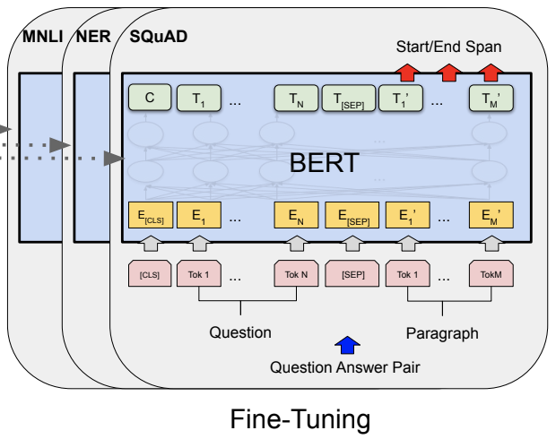
Method
Fine-tuning BERT:
Plugs appropriate inputs/outputs into BERT and fine-tuning all params end-to-end
Example in Questions Answering:
Inputs: Question, Paragraph
Outputs: start and end words that encapsulate the answer
Jacob, 2018. BERT: Pre-training of Deep Bidirectional Transformers for Language Understanding
✍️: Ha, Isabel

Slide 10
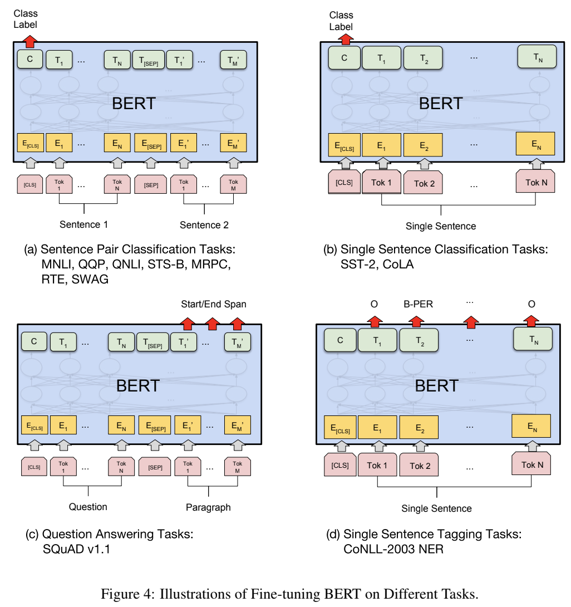
Experiments
Experimental Settings:
Models:
BERT_base (#transformer blocks L = 12, #hidden size H = 768, #self-attention heads A = 12): 110M params
BERT_large (L =24, H = 1024, A = 16): 340M params
Fine-tuning on 11 NLP tasks over GLUE, SQuAD v1.1, SQuAD v2.0, SWAG dataset
Jacob, 2018. BERT: Pre-training of Deep Bidirectional Transformers for Language Understanding
✍️: Ha, Isabel

Slide 11
Results
Jacob, 2018. BERT: Pre-training of Deep Bidirectional Transformers for Language Understanding
✍️: Ha, Isabel

Slide 12
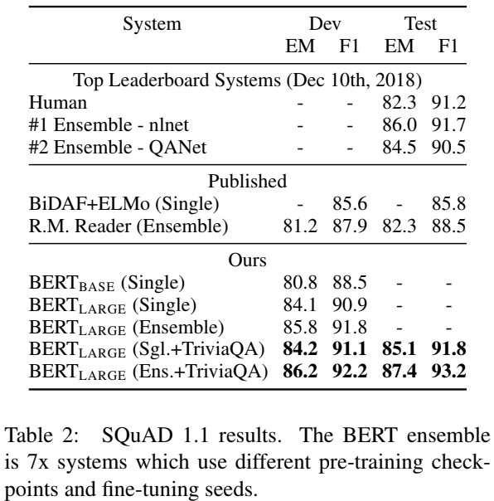
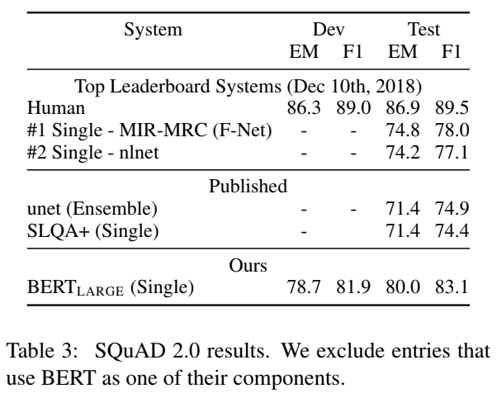
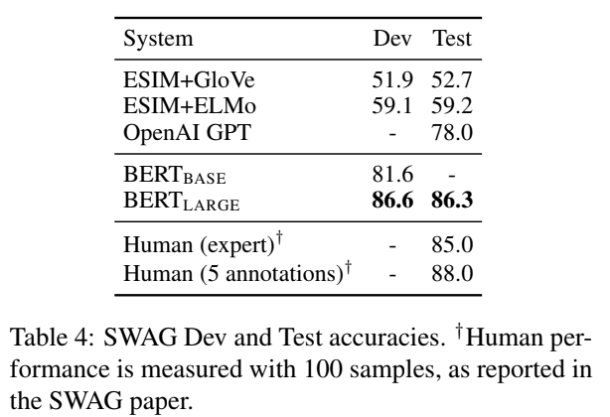
Jacob, 2018. BERT: Pre-training of Deep Bidirectional Transformers for Language Understanding
✍️: Ha, Isabel

Slide 13
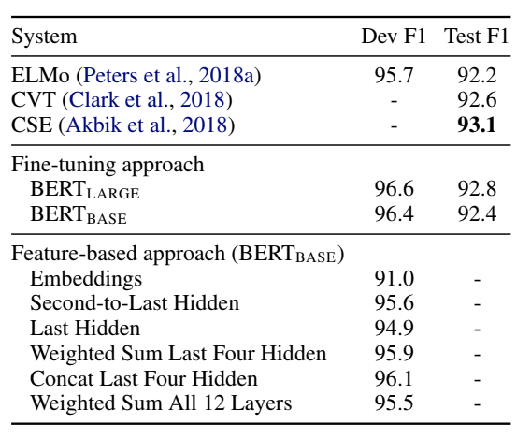
Ablation Studies
BERT is effective for both fine-tuning and feature-based approaches
Jacob, 2018. BERT: Pre-training of Deep Bidirectional Transformers for Language Understanding
✍️: Ha, Isabel

Slide 14
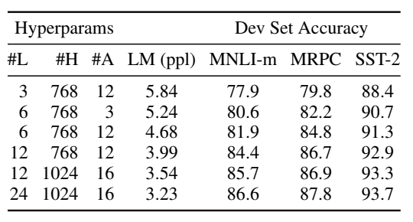
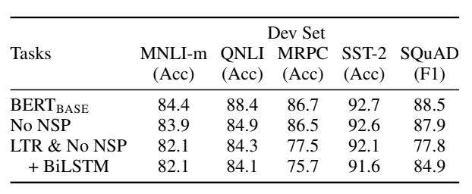
Ablation Studies
The deeper model, the better generalization
Pre-training Tasks matters
Jacob, 2018. BERT: Pre-training of Deep Bidirectional Transformers for Language Understanding
✍️: Ha, Isabel

Slide 15
Summary
Based on Transformer, BERT is a fast and bidirectional pre-trained model for NLP tasks
Training BERT includes 2 steps:
Pretraining: use self-supervised techniques to build good representation space
Fine-tuning: make use pre-trained representation for downstream tasks
BERT archives SOTA across many tasks:
Proving its context understanding in NLP
Showing a good pre-trained encoder for downstream tasks
✍️: Ha, Isabel

Slide 16
Table of contents (Reviewers)
1. Brief Summary of BERT
2. Reviewer Comments
2.1 Reviewer #1 - Karan
2.2 Reviewer #2 - Fadil
2.3 Reviewer #3 - Elisée
3. Conclusion and Discussion
Legends
🟢 Positive Point
🟡 Critical Point
🔎: Elisée Djapa, Fadil Isamotu and Karan Thakkar

Slide 17
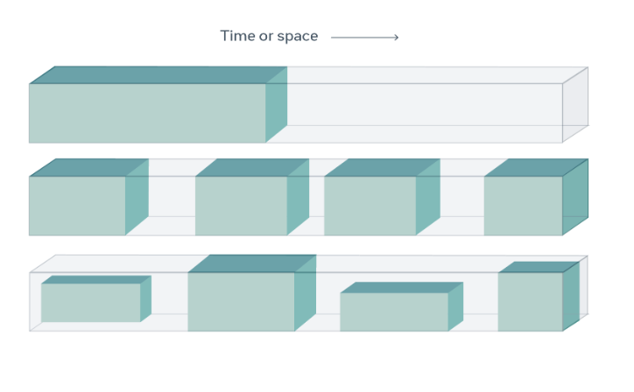
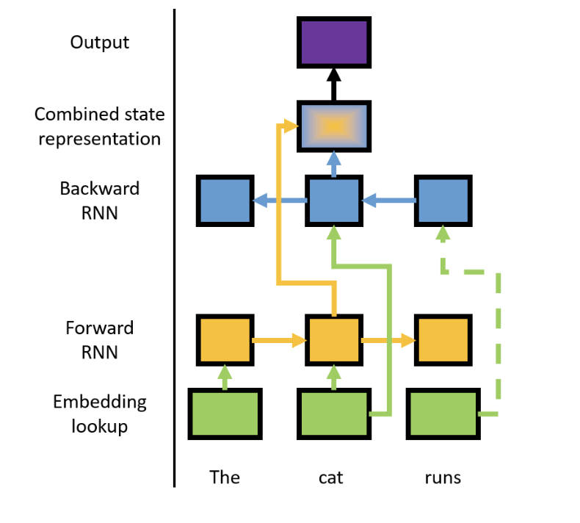
Brief Summary of BERT
Generative pretrained Transformer: GPT – 3
What is BERT?
A predictive language Model that takes into account bi-directional context.
What is the motivation behind BERT?
Include deep bi-directional context in learning language.
How ?
Masked Language Modelling
Bidirectional Encoder Representation from Transformers (BERT)
General
Problem in defining bi-directional context with models that are defined to predict next given past.
🔎: Elisée Djapa, Fadil Isamotu and Karan Thakkar

Slide 18
Reviewers #1 Comments
Background
Comments
Humans learn/comprehend language through reading.
The research indicates brain reads faster when pseudo masked
UNIDIRECTIONAL!!
🟢 Hence, BERT is loosely doing something similar to how brain does it.
🟡 BUT it used LTR and RTL?
Does our brain look at the future context while understanding language?
https://bionic-reading.com/
🔎: Elisée Djapa, Fadil Isamotu and Karan Thakkar
Just, Marcel Adam and Patricia A. Carpenter. “A theory of reading: from eye fixations to comprehension.” Psychological review 87 4 (1980): 329-54 .

Slide 19
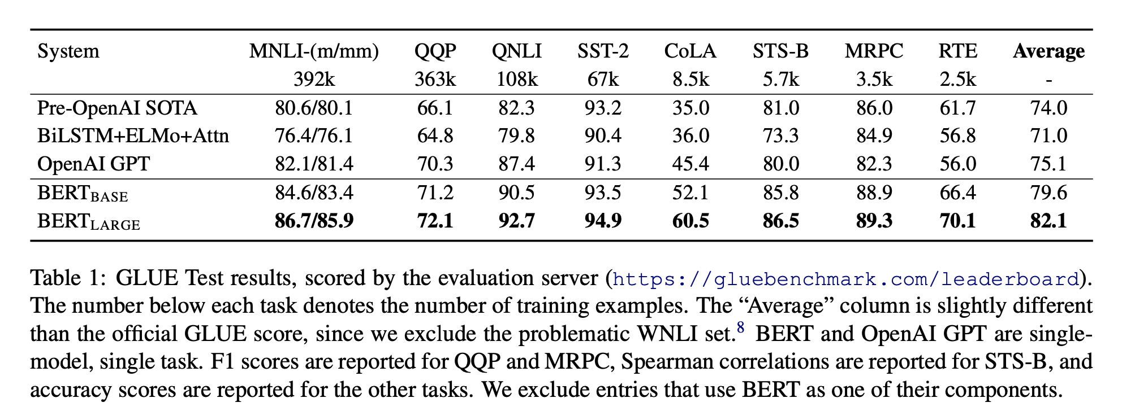
Reviewers #1 Comments
🟢 The overall performance of BERT has good improvement!
🟡 BUT curious as to why BERT and GPT never mentioned WNLI task results.
- they claim based on the FAQs that WNLI did not perform well because of the dataset mismatch BUT they mention QQP.
- Curious about the LM performance on the WNLI task. Is the bi-directional context confusing the model for the WNLI? (Cause in WNLI the LTR plays a major role)
🔎: Elisée Djapa, Fadil Isamotu and Karan Thakkar

Slide 20
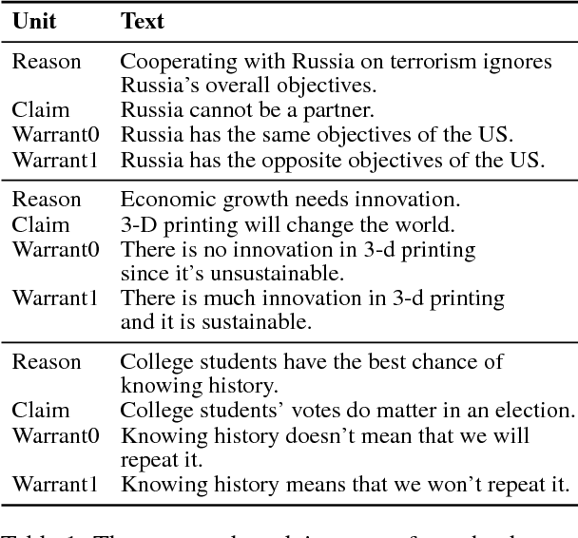
Reviewers #2 Comments
🟡 Why not a more contextually heavy task such as the Argument Reasoning Comprehension Task(ARCT)
🔎: Elisée Djapa, Fadil Isamotu and Karan Thakkar
ARCT snippet

Slide 21
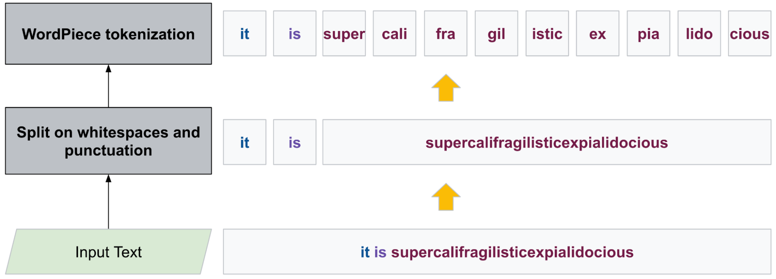
Reviewers #2 Comment 🟢 word-piece tokenizer concept
🔎: Elisée Djapa, Fadil Isamotu and Karan Thakkar

Slide 22
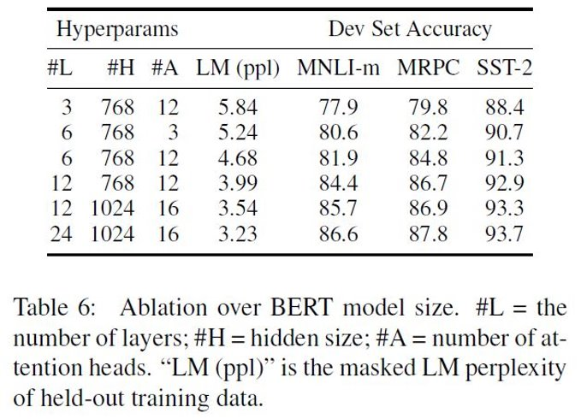
Reviewers #2 Comments
🟡 Over parameterized and no analysis on the inference time
🟡 Effects of Increase/decrease in number of attention heads and its effects on the accuracy of the NLP tasks.
🔎: Elisée Djapa, Fadil Isamotu and Karan Thakkar

Slide 23
Reviewers #3 Comments
🟡 Masked Language and Masking Procedure
We may need to re-evaluate how we learn language as humans
Mask too little and it will require more learning of the context by the model
Mask a lot and the model will miss the context of the sentence
🔎: Elisée Djapa, Fadil Isamotu and Karan Thakkar

Slide 24
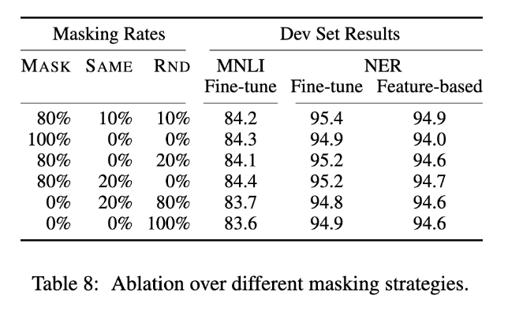
Reviewers #3 Comments
🟡 Unknown effect of varied % of masking rate
🔎: Elisée Djapa, Fadil Isamotu and Karan Thakkar
Notes:
The amount of masking which is 15% is what we need to analyze.
Should we do more?
Should we do less?
what is the effect on performance?
These questions were not answered in the paper

Slide 25
Reviewers #3 Comments
🟡 Fine Tuning BERT
Lack of specific language data set
Not enough data analysis and diversity for a fine tuning task
🔎: Elisée Djapa, Fadil Isamotu and Karan Thakkar

Slide 26
Conclusion (Gist of other Comments)
🟢 | 🟡
High Performance. | Very compute Intensive.
Authors acknowledge the disadvantages of the pre-training approach and perform experiments on feature extraction type setting. | Not practical in real-world applications, quite costly. It is slow to train because it is big and there are a lot of parameters to update.
Does not have the problem of ”see-itself” unlike other models. | Bi-directional context is deep, hence not explicitly weighted for LTR and RTL. Given a task the model cannot explain what is more important LTR or RTL.
Deep Bi-direction better than explicit LTR and RTL context as other layers can share this information. | Defined “sentence” does not make sense linguistically and is arbitrary.
🔎: Elisée Djapa, Fadil Isamotu and Karan Thakkar

Slide 27
Testing a Finetuned Question-Answer BERT
Here, I tested the capabilities of a BERT model fine-tuned on SQuAD, a question-answer dataset that was mentioned in the original BERT paper.
👩🏽‍🔬: Haoyue Guan and Ammar Ahmed Pallikonda Latheef

Slide 28
Testing a Finetuned Question-Answer BERT
Testing with a math-heavy text
👩🏽‍🔬: Haoyue Guan and Ammar Ahmed Pallikonda Latheef

Slide 29
Testing a Finetuned Question-Answer BERT
Testing with more information on the same questions
👩🏽‍🔬: Haoyue Guan and Ammar Ahmed Pallikonda Latheef

Slide 30
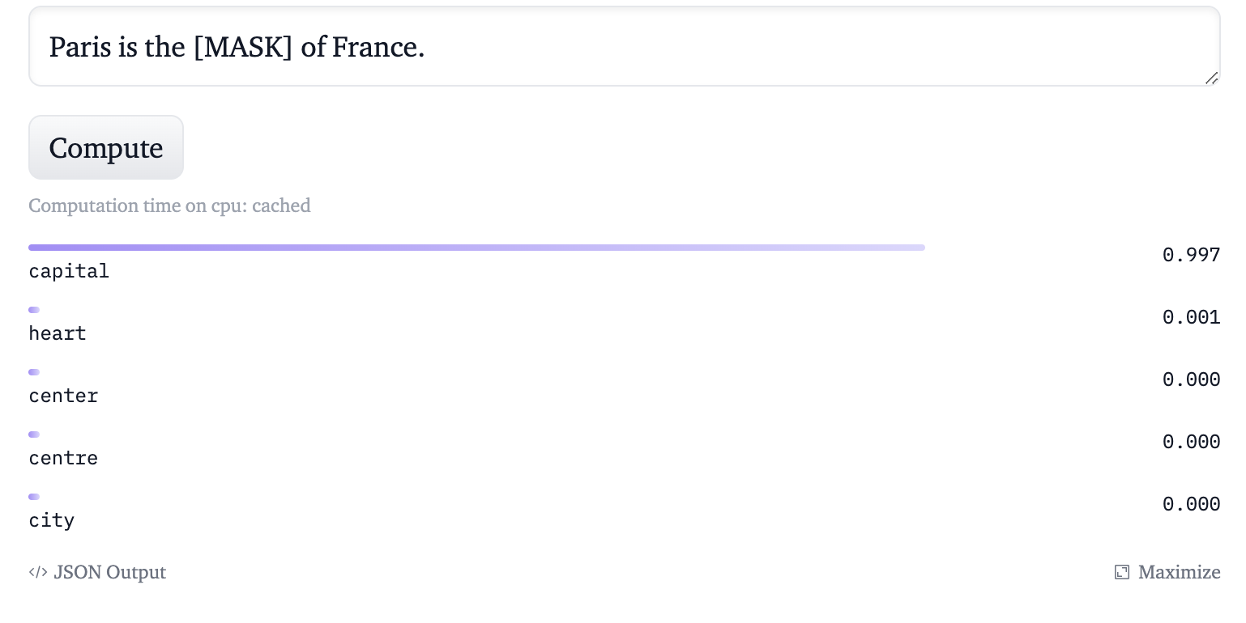
BERT AS MASKED LANGUAGE MODEL
What is a Masked Language Model?
The masked language model enables bidirectional learning of text by masking (hiding) a word in a sentence.
In this scenario, forcing BERT to use words on either side of the masked word in both directions to predict the masked word.
👩🏽‍🔬: Haoyue Guan and Ammar Ahmed Pallikonda Latheef

Slide 31
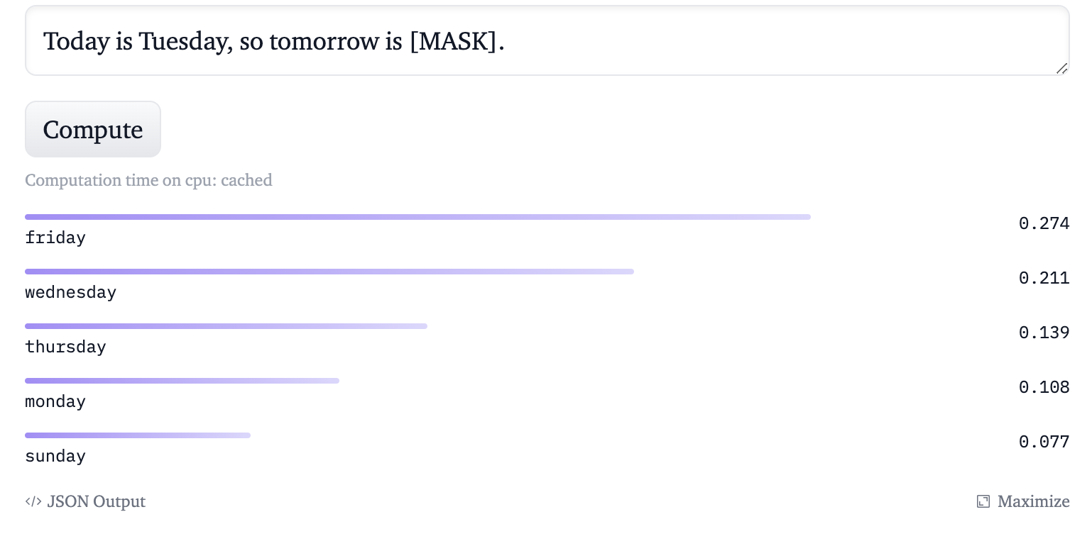
BERT AS MASKED LANGUAGE MODEL
What is a Masked Language Model?
The masked language model enables bidirectional learning of text by masking (hiding) a word in a sentence.
In this scenario, forcing BERT to use words on either side of the masked word in both directions to predict the masked word.
👩🏽‍🔬: Haoyue Guan and Ammar Ahmed Pallikonda Latheef

Slide 32
BERT AS MASKED LANGUAGE MODEL
BERT was specifically trained on Wikipedia (~2.5B words) and Google’s BooksCorpus (~800M words)
A massive dataset of 3.3 Billion words has contributed to the training of BERT
The prediction of the masked word lacks reasoning
👩🏽‍🔬: Haoyue Guan and Ammar Ahmed Pallikonda Latheef

Slide 33
BERT AS MASKED LANGUAGE MODEL
What is a Masked Language Model?
The masked language model enables bidirectional learning of text by masking (hiding) a word in a sentence.
In this scenario, forcing BERT to use words on either side of the masked word in both directions to predict the masked word.
👩🏽‍🔬: Haoyue Guan and Ammar Ahmed Pallikonda Latheef

Slide 34
Journey of BERT
🏺: Ayo Ajayi and Yongrui Qi
Notes:
Hi everyone, Im Ayo and <> and today we will talk about the history that inspired BERT and the advances made to BERT

Slide 35
Last week...
What problem was RNN trying to solve?
🏺: Ayo Ajayi and Yongrui Qi
🏺: Ayo Ajayi and Yongrui Qi

Slide 36
Last week...
What problem was RNN trying to solve?
Language Translation
🏺: Ayo Ajayi and Yongrui Qi

Slide 37
Last week...
What problem was RNN trying to solve?
Language Translation
What were the issues with Recurrent Neural Networks?
🏺: Ayo Ajayi and Yongrui Qi

Slide 38
Last week...
What problem was RNN trying to solve?
Language Translation
What were the issues with Recurrent Neural Networks?
"Recurrent computation is slow"
Long sequences could result in parts of the input being forgotten.
🏺: Ayo Ajayi and Yongrui Qi
Adopted from class slides

Slide 39
Last week...
What problem was RNN trying to solve
Language Translation
What were the issues with Recurrent Neural Networks?
"Recurrent computation is slow"
Long sequences could result in parts of the input being forgotten.
Long Short-Term Memory Networks
🏺: Ayo Ajayi and Yongrui Qi
Adopted from class slides
Notes:
Makes it easier for RNN to preserve information over many timesteps

Slide 40
LSTM?
LSTM networks are even slower to train.
Input data needs to be passed sequentially (one after the other). Words are passed in sequentially and are generated sequentially.
We need input from the previous state to make any progress on the current state. This does not make use of today's GPU designed for parallelization.
🏺: Ayo Ajayi and Yongrui Qi

Slide 41
What Inspired BERT?
🏺: Ayo Ajayi and Yongrui Qi

Slide 42
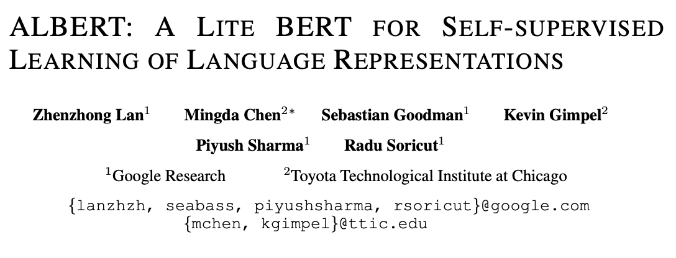
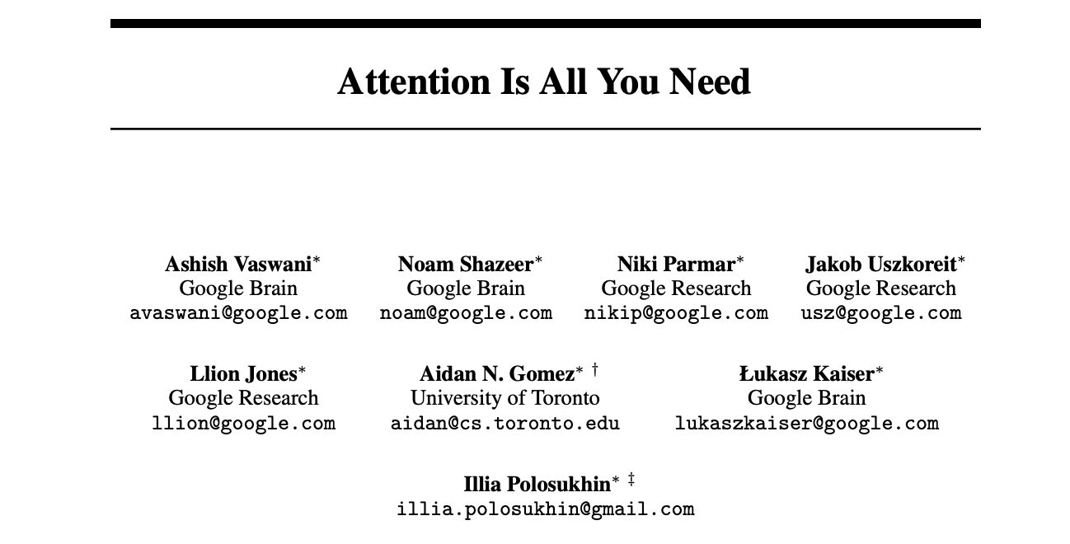
Timeline
05
Albert
03
BERT
02
Transformer
01
LSTM
1735-1780, 1997
2017
2019
2020
🏺: Ayo Ajayi and Yongrui Qi

Slide 43
🏺: Ayo Ajayi and Yongrui Qi

Slide 44
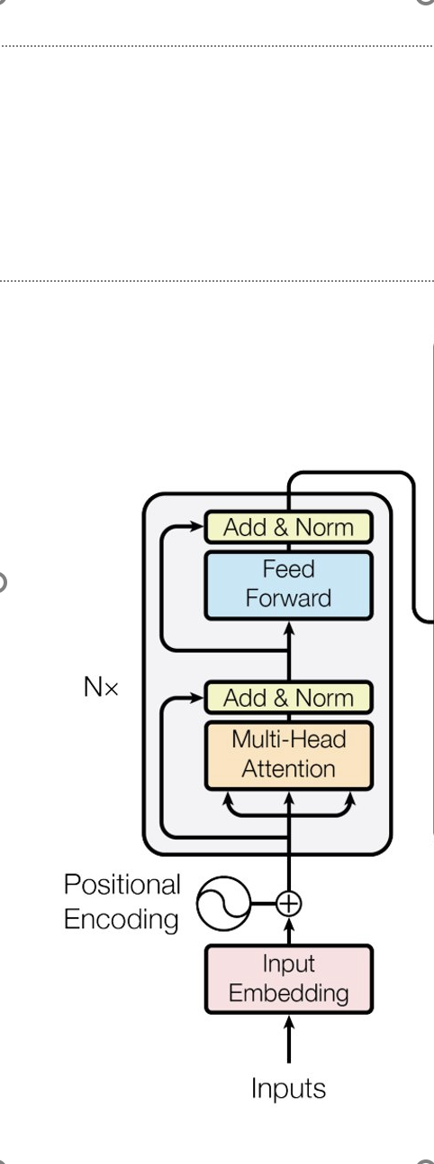
Transformers
Input sequence can be passed in parallel
🏺: Ayo Ajayi and Yongrui Qi
Notes:
With RNN, we pass each words one after the other, word embeddings generated one at a time
With Transformers, we pass in word simultaneously and get their embedding simultaneously

Slide 45
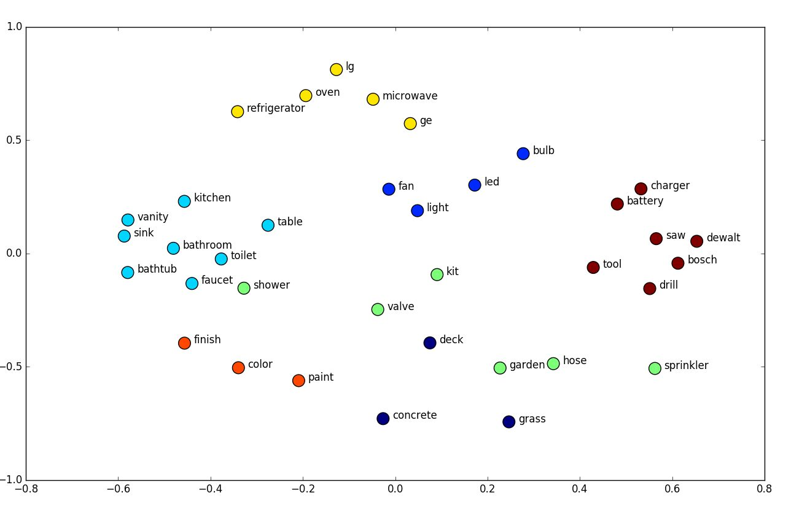
Transformer - Input Embeddings and Positional Encoding
Group similar words closer to each other in an embedding space.
Task: Translate English to Spanish
Input: I Love this Class
Goal: Word vectors with positional information
Image Source
🏺: Ayo Ajayi and Yongrui Qi
Adapted from here
Notes:
Map every word to a point in space where similar words and meaning are physically closer to each other called an embedding space.
SO WE ADD Postional Encoder: V Preserve the order of the sentence to not lose context

Slide 46
Transformer – Encoder Block
Multi-Headed Attention Layer
What part of the input should I focus on?
Self-attention: How relevant is the word in the sentence relevant to other words in the same sentence
Example: I love this class
I -> I love this class. -> attention vector [0.12 0.54 0.43 0.02]
Love -> I love this class. -> attention vector [0.08 0.61 0.87 0.52]
This captures relationships between words in a sentence.
Feed Forward Layer
Feed forward nets that is applied to all attention vectors. It transforms the vectors to a way that can be interpreted by either another encoder or decoder.
🏺: Ayo Ajayi and Yongrui Qi
Goal: What is English? What is context?
Adapted from here

Slide 47
Decoder
Spanish Input -> Embed + Positional Encoding
Self-attention: Creates attention vectors for every word in the Spanish sentence.
The attention vectors here and the vectors from the encoder are passed into another (encoder-decoder) attention block.
Determine how related they are to one another which is where the mapping happens.
Essentially, the decoder learns How to English words map to Spanish words?
🏺: Ayo Ajayi and Yongrui Qi
Goal: What is Spanish? What is context?
Adapted from here
Notes:
Then we pass each attention vector to a feed forward unit which makes it interpretable for another decoder or linear layer
Softmax layer transforms linear layer vertex to probability distribution
The final word is the word corresponding to the highest probability.
The output is the next predicted word, and we execute over each word until we reach the end.

Slide 48
Results
Models were trained on WMT 2014
English-German dataset with 4.5M sentence pairs
English-French dataset with 36M sentences
Models trained on 8 Nvidia P100 GPUs
BLEU Score:
Algorithm for evaluating the quality of text being translated.
🏺: Ayo Ajayi and Yongrui Qi
Notes:
They trained the model on <> datasets. For the task of English to German translations..

Slide 49
Encoder
Decoder
Understands language and context
Understands language and context
🏺: Ayo Ajayi and Yongrui Qi
Notes:
If we stack encoders, we then get BERT

Slide 50
Encoder
Decoder
+
🏺: Ayo Ajayi and Yongrui Qi
Notes:
If we stack encoders, we then get BERT

Slide 51
BERT - 2019
Bidirectional Encoder Representation from Transformer
🏺: Ayo Ajayi and Yongrui Qi

Slide 52
ALBERT: A Lite BERT
Why ALBERT
How ALBERT works
Performance ALBERT v.s. BERT
🏺: Ayo Ajayi and Yongrui Qi

Slide 53
Why ALBERT
The problems in BERT:
Memory limitation
Model parallelization ✅
Clever management ✅
Communication overhead
ALBERT incorporates 2 parameter reduction techniques:
Factorized embedding parameterization
Cross layer parameter sharing
Next Sentence Prediction (NSP) ineffectiveness
Self-supervised loss for sentence-order prediction (SOP)
🏺: Ayo Ajayi and Yongrui Qi

Slide 54
How ALBERT works
Factorized embedding parameterization
Recall BERT, XLNet, RoBERTa:
WordPiece Embedding Size E = Hidden Layer Size H
Question:
E: context independent
H: context dependent
Reduce Embedding Parameters
First project one-hot vectors into a lower dimensional embedding size E
Then project it into hidden space
O(V*H) ➡️ O(V*E+E*H)
E: 64, 128(best), 256, 768
🏺: Ayo Ajayi and Yongrui Qi

Slide 55
How ALBERT works
Cross-layer parameter sharing
Share all parameters across layers
Prevent the parameter from growth with the depth of network
Weight-sharing has an effect on stabilizing network parameters
🏺: Ayo Ajayi and Yongrui Qi

Slide 56
How ALBERT works
Inter-sentence coherence loss
Why NSP ineffectiveness
Lack of difficulty as a task
NSP conflates topic prediction and coherence prediction in a single task
Topic prediction is much easier
ALBERT: sentence order prediction (SOP) loss
Avoid topic prediction
Focuses on modeling inter-sentence coherence
🏺: Ayo Ajayi and Yongrui Qi

Slide 57
Performance ALBERT v.s. BERT Factorized embedding parameterization
🏺: Ayo Ajayi and Yongrui Qi

Slide 58
Performance ALBERT v.s. BERT Cross-layer parameter sharing
🏺: Ayo Ajayi and Yongrui Qi

Slide 59
High Level BERT overview
BERT uses attention based mechanism to learn contextual relations within NLP
An encoder reads the text and works with it bidirectionally
Bert is trained using masked tokens for 15% of the words and via next sentence prediction
🔭: Muzzi Godil

Slide 60
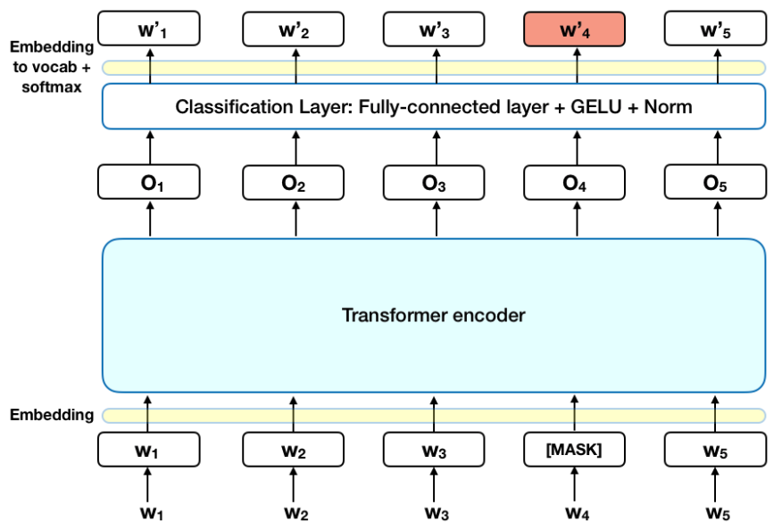
🔭: Muzzi Godil

Slide 61
PROBLEM
- BERT is too big
- Bert uses roughly 110 million parameters for its base form which means it take a long time to train , the larger form of BERT has 340 million parameters.
- This means a 12 layer transformer BERT takes 4 days to train !!
🔭: Muzzi Godil

Slide 62
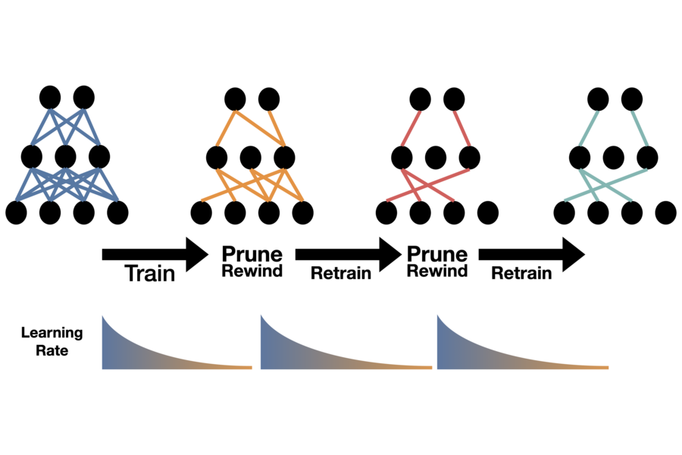
How do we make BERT smaller ?
1) Pruning:
This helps us identify the correct subnetwork needed
A MIT ICLR Study says rewinding and training gives great factorization results
🔭: Muzzi Godil

Slide 63
How do we make BERT smaller ?
2) Parameter sharing:
Creates a shared feature space which enables the same feature detector to be used across everything on one plane
To put into context for AlexNet: 105,415,600‬ weights vs 34,944 weights
🔭: Muzzi Godil

Slide 64
How do we make BERT smaller ?
3) Knowledge Distillation:
This allows efficient distilling of information from a pretrained BERT to a smaller model that can still work with great accuracy but much faster
Student-Teacher training where a teacher network adds its error to the student’s loss function, thus, helping the student network to converge to a better solution.
🔭: Muzzi Godil

