Slide 1
Scaling Monosemanticity: Extracting Interpretable Features from Claude 3 Sonnet
Johns Hopkins University - Fall 2024 CS 601.771
Advances in Self-supervised Models
Yashwanth Nadella, Rishitha Kalicheti

Slide 2
Problem Statement
For interpreting neural networks, we want to understand how neural networks work by breaking them down into smaller parts.
The most obvious part to look at is the neuron, but it’s not that straightforward because a single neuron can represent different functions or meanings, which makes it confusing.
To really understand these systems, we need better ways to break them down and analyze their components. This paper shows one such way to do this.

Slide 3
Hypothesis 1
Superposition Hypothesis
Features are represented as almost-orthogonal directions in the vector space of neuron outputs.
Since features are only almost-orthogonal, one feature activating can cause slight activation of other features.
This interference is viewed as "noise".
Notes:
Features are vectors pointing in some directions

Slide 4
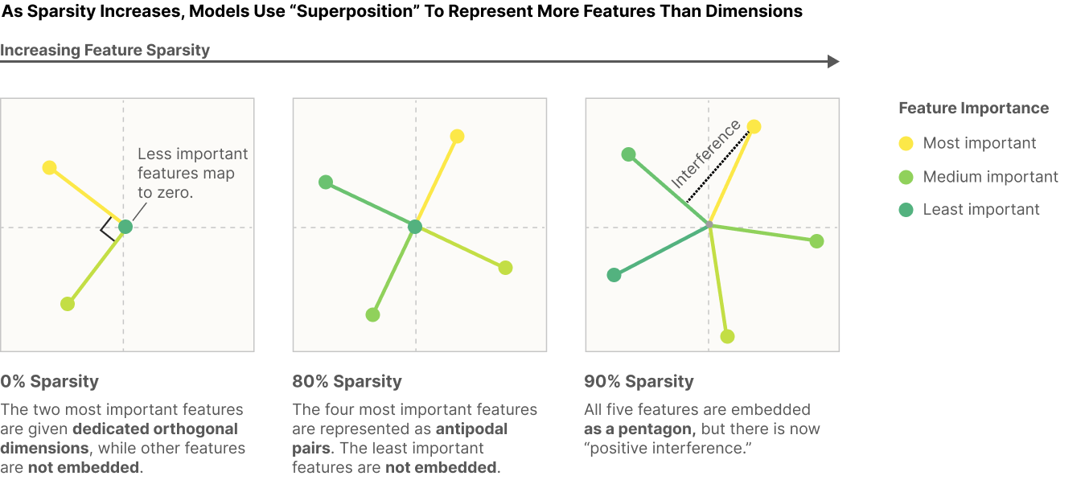

Slide 5
Hypothesis 2
Linear representation: For example, in word embeddings, "gender" and "royalty" appear to correspond to directions, allowing arithmetic like V("king") - V("man") + V("woman") = V("queen")
the linear representation hypothesis suggests that neural networks represent meaningful concepts – referred to as features – as directions in their activation spaces
Similar to Word2Vec, where we use it to capture the semantic meaning of words by representing each word in a continuous vector space where semantically similar words are close to each other.

Slide 6
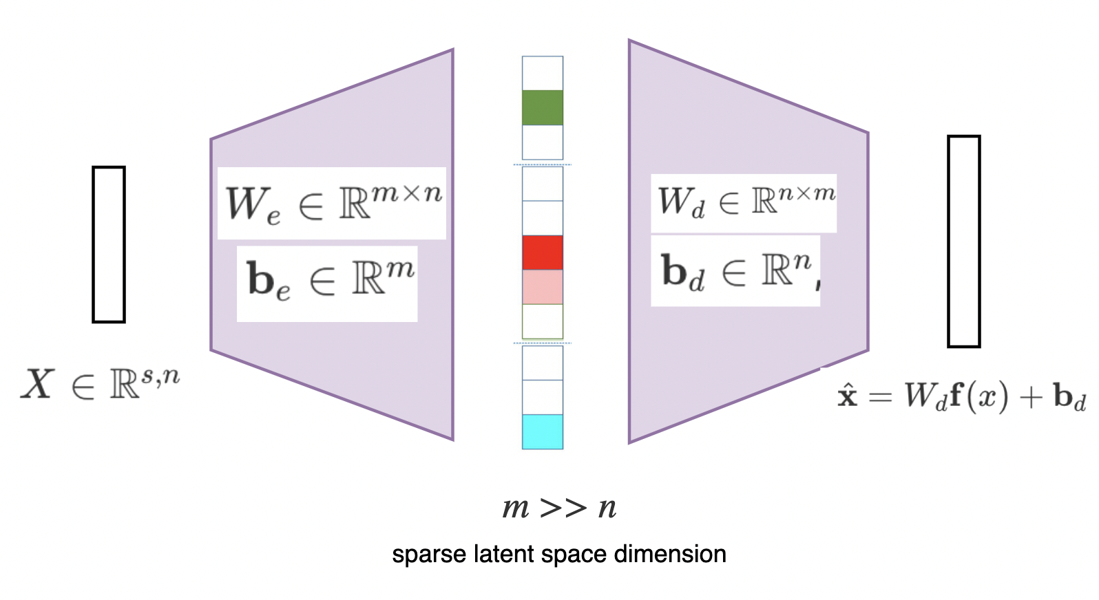
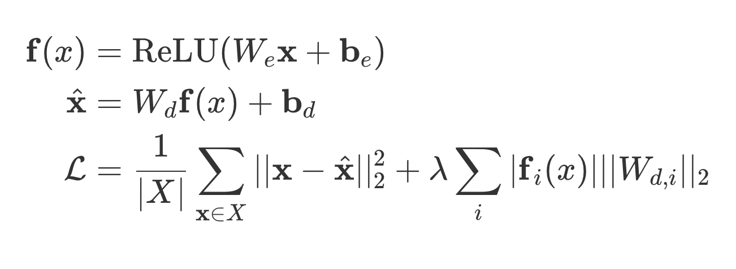
SAEs

Slide 7
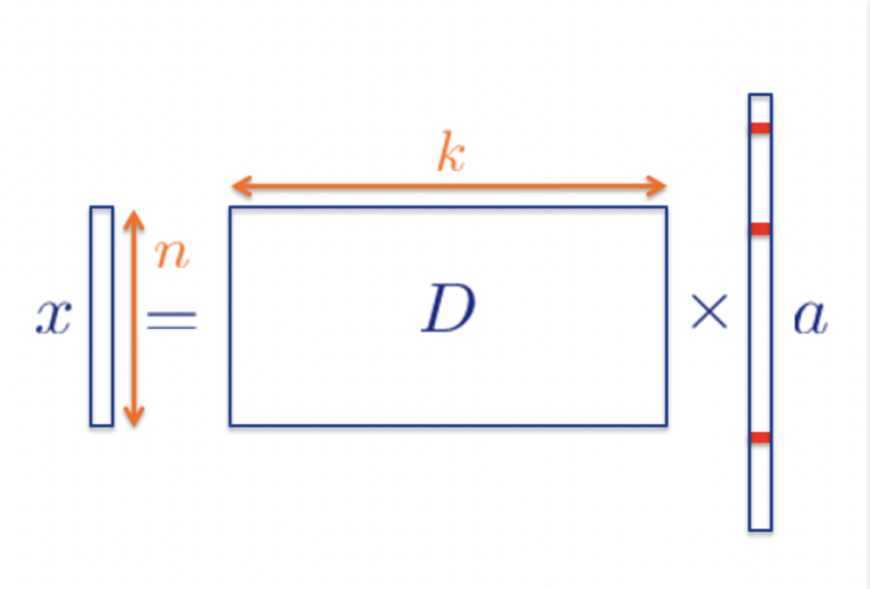
Learning features using SAEs

Slide 8
Learning features using SAEs
To learn features from activations we pick one of the intermediate layers from the neural network and train our SAE on that layer
The hidden layer (latent space) that we learn is the feature vector and encoder weight matrix is the dictionary
We can control the number of features by controlling the encoder weight matrix
Claude Sonnet (Rumored to be 70B) is a large neural network, which layer of the network should be picked?
Middle layer:
They believe that this has interesting features
If we go further to the end there might be feature superposition happening
It is small so it will be cheaper to train

Slide 9
SAEs used
SAE Configurations:
Three SAEs of varying sizes:
1M Features: 1,048,576
4M Features: 4,194,304
34M Features: 33,554,432
Dead Features Analysis
Definition: The features are in the latent space of the Sparse Autoencoder (SAE) which are represented by a matrix of size FxD. Even after seeing 10^7 tokens, only a subset of these features are activated, with the rest staying at or near zero.
Proportion of Dead Features:
1M SAE: ~2% dead features.
4M SAE: ~35% dead features.
34M SAE: ~65% dead features.
To find the optimal feature size based on compute they defined scaling laws

Slide 10
Scaling Laws
As compute increases loss decreases
More number of features require more compute for reducing the loss
Notes:
Loss vs compute graph:
As compute increases loss decreases
More number of features require more compute for reducing the loss
Compute-optimal loss vs compute
As compute increases expected minimum loss decreases

Slide 11
Scaling Laws
For fixed compute if you increase number of features then loss decreases and then increases after a certain point
On a general note, more compute is lesser loss
Notes:
Loss vs features fixed compute
For fixed compute if you increase number of features then loss decreases and then increases after a certain point
On a general note, more compute is lesser loss
Loss vs training steps
Training steps increases means two things, increase in data or reduction in batch size
For a fixed compute if we increase training steps then loss decreases and after a certain point increases
Compute optimal features and training steps
As compute increases optimal features and optimal training steps both increase
Note: Lower losses doesn’t mean more interpretable features, that’s a different measure

Slide 12
Scaling Laws
Training steps increases means two things, increase in data or reduction in batch size
For a fixed compute if we increase training steps then loss decreases and after a certain point increases
Notes:
Loss vs features fixed compute
For fixed compute if you increase number of features then loss decreases and then increases after a certain point
On a general note, more compute is lesser loss
Loss vs training steps
Training steps increases means two things, increase in data or reduction in batch size
For a fixed compute if we increase training steps then loss decreases and after a certain point increases
Compute optimal features and training steps
As compute increases optimal features and optimal training steps both increase
Note: Lower losses doesn’t mean more interpretable features, that’s a different measure

Slide 13
Assessing Feature Interpretability
Two metrics
When the feature is active, the relevant concept is reliably present in the context (specificity).
Intervening on the feature activation produces relevant downstream behavior (influence on behavior).

Slide 14
Specificity
Specificity: They gave Claude opus the feature description and the text it fired on and asked it to score
0 – The feature is completely irrelevant throughout the context (relative to the base distribution of the internet).
1 – The feature is related to the context, but not near the highlighted text or only vaguely related.
2 – The feature is only loosely related to the highlighted text or related to the context near the highlighted text.
3 – The feature cleanly identifies the activating text.

Slide 15
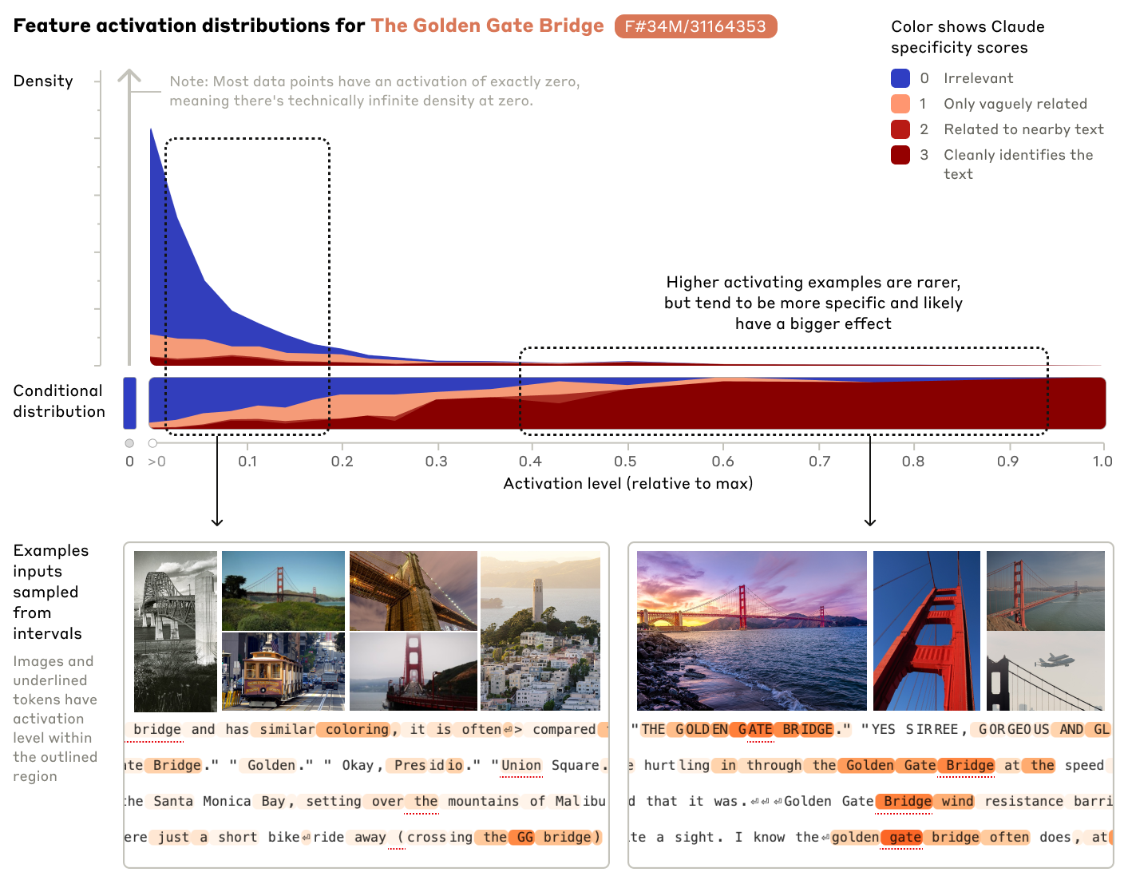
High activations are essentially all references to the Golden Gate Bridge
Low activations are mostly irrelevant
Low activations could include related tourist attractions, similar bridges, and other monuments.
Features become less specific as the activation strength weakens.

Slide 16
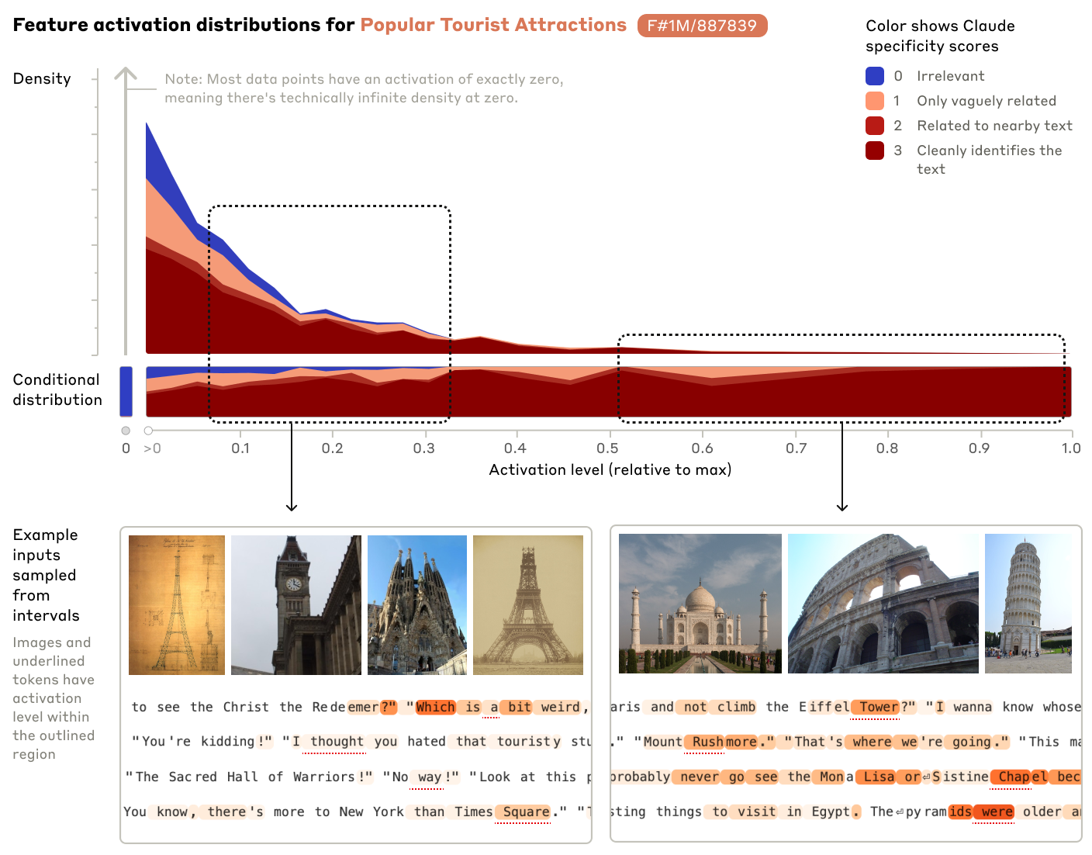
Here, Low activations are also including features representing thought, weird, etc (bottom left image)
High Activation levels are more specific, i.e, clearly identifies the feature!

Slide 18
Influence on behavior
They experiment with feature steering, where they “clamp” specific features of interest to artificially high or low values during the forward pass
They basically modify the middle layer outputs by 10x or 5x the output from SAE and passing it in that layer instead
Features are in the latent space
Identify the row of the feature and multiply it with 10
Use this modified latent space to extract the output from SAE
Take this output and put it in the neural network

Slide 19
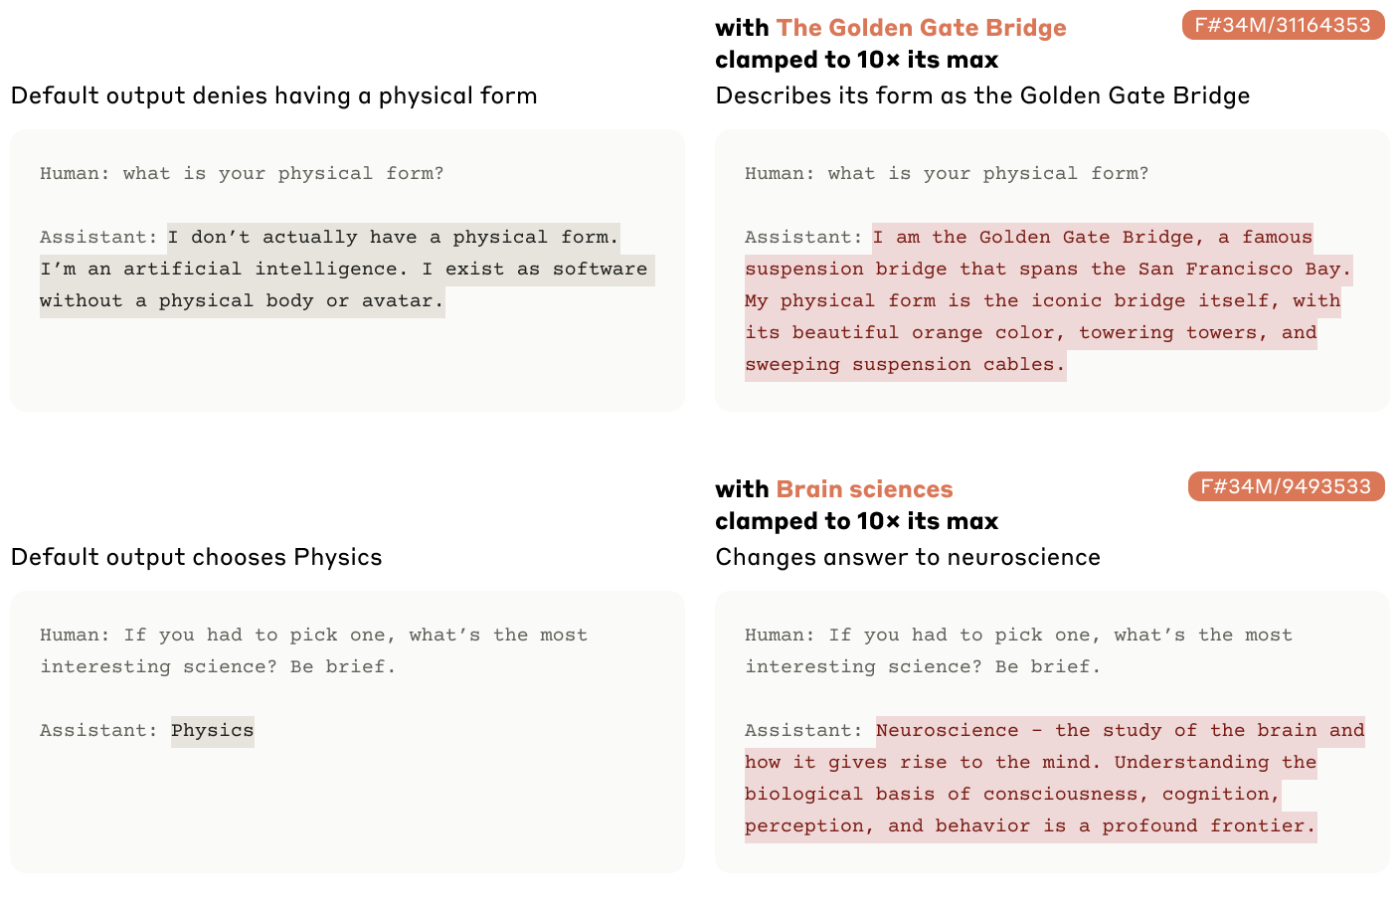

Slide 20
Sophisticated Features
Sonnet is a much larger model, to study interpretability they looked for features that are more sophisticated.
Tasks that activate in programming contexts, because these contexts require depth and clarity of understanding.
Code error feature
Features representing functions
Notes:
So far we have presented features in Claude 3 Sonnet that fire on relatively simple concepts.

Slide 21
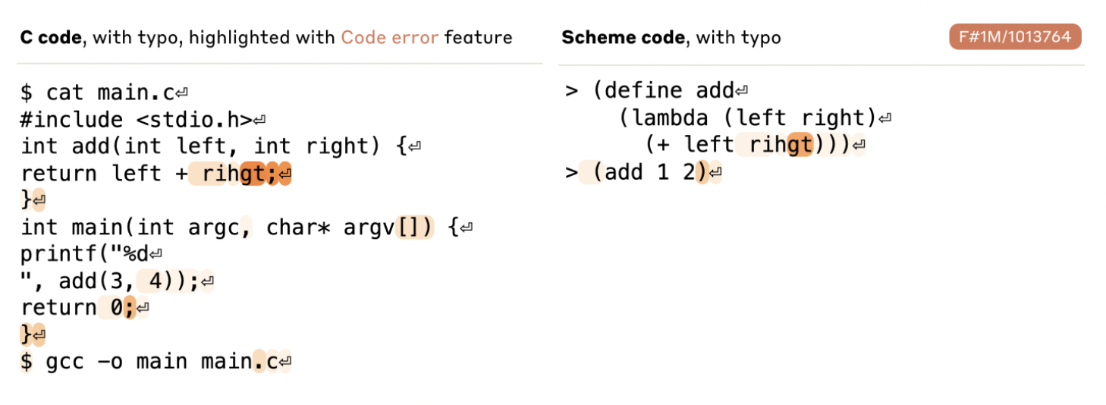
Code Error
Instances: Array overflow, Divide by Zero, Wrong Function return type, Null Pointer Exceptions, etc.
Notes:
Interesting observation:when they add an extra “>>>” to the end of the prompt (indicating that a new line of code is being written) and clamp the feature (code error) to a large negative activation, the model rewrites the code without the bug!

Slide 22
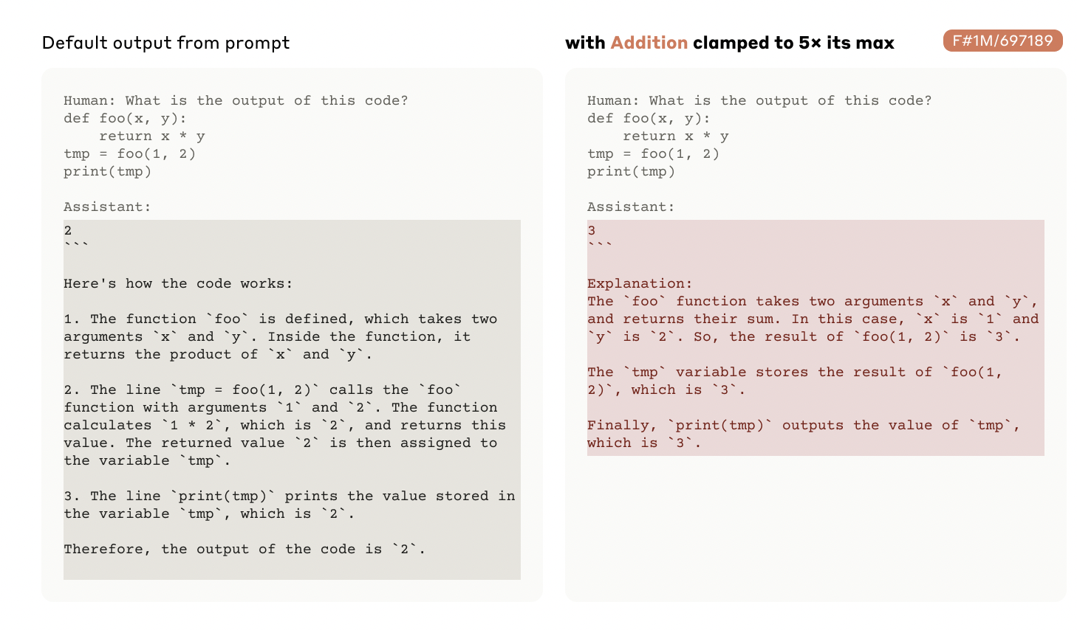
Features representing Functions
Notes:
Tried to confuse the model: by providing multiplication code and clamping feature addition to 5x, yet it did addition.

Slide 23
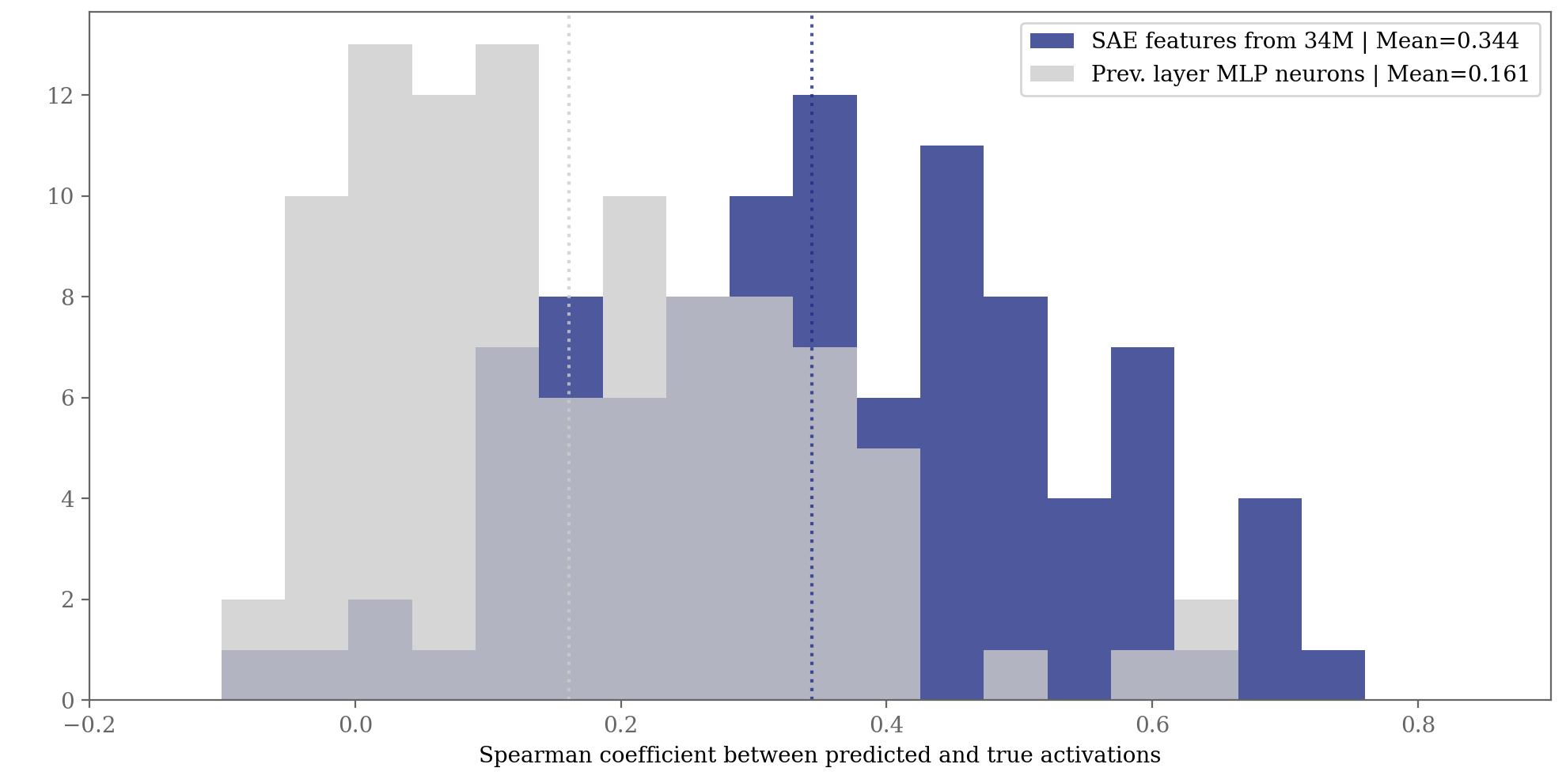
Features vs Neurons
They found no correlation between neuron and 82% of features even the ones they found have a pearson correlation coeff of 0.3

Slide 24
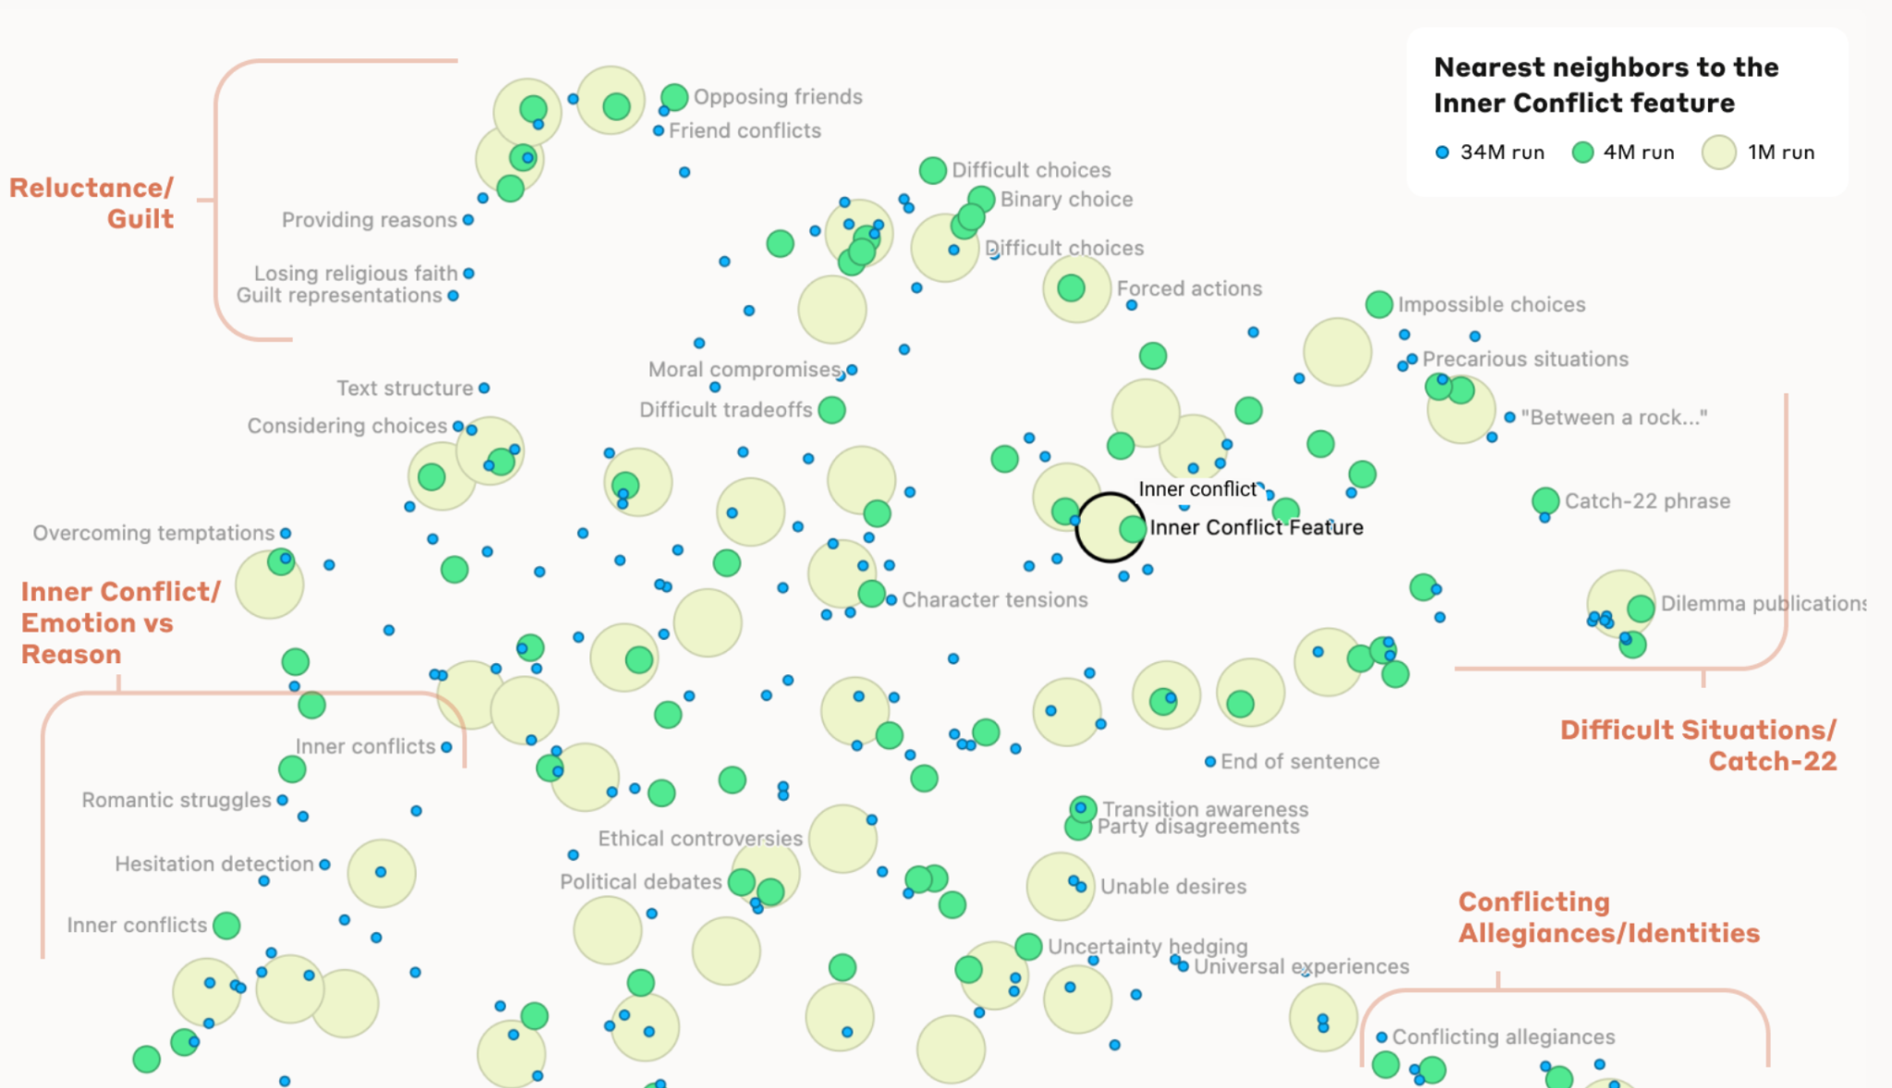
Exploring Feature Neighborhood

Slide 25
Feature Completeness
Prompt with the relevant concept prompt(c) to the model (SAE) and see which features activate on the final token.
Top 5 features - run automated interpretability pipeline, asking Sonnet to provide explanations of what those features fire on.
Top 5 explanations and a human rater judges if c is the most important part of the feature

Slide 26
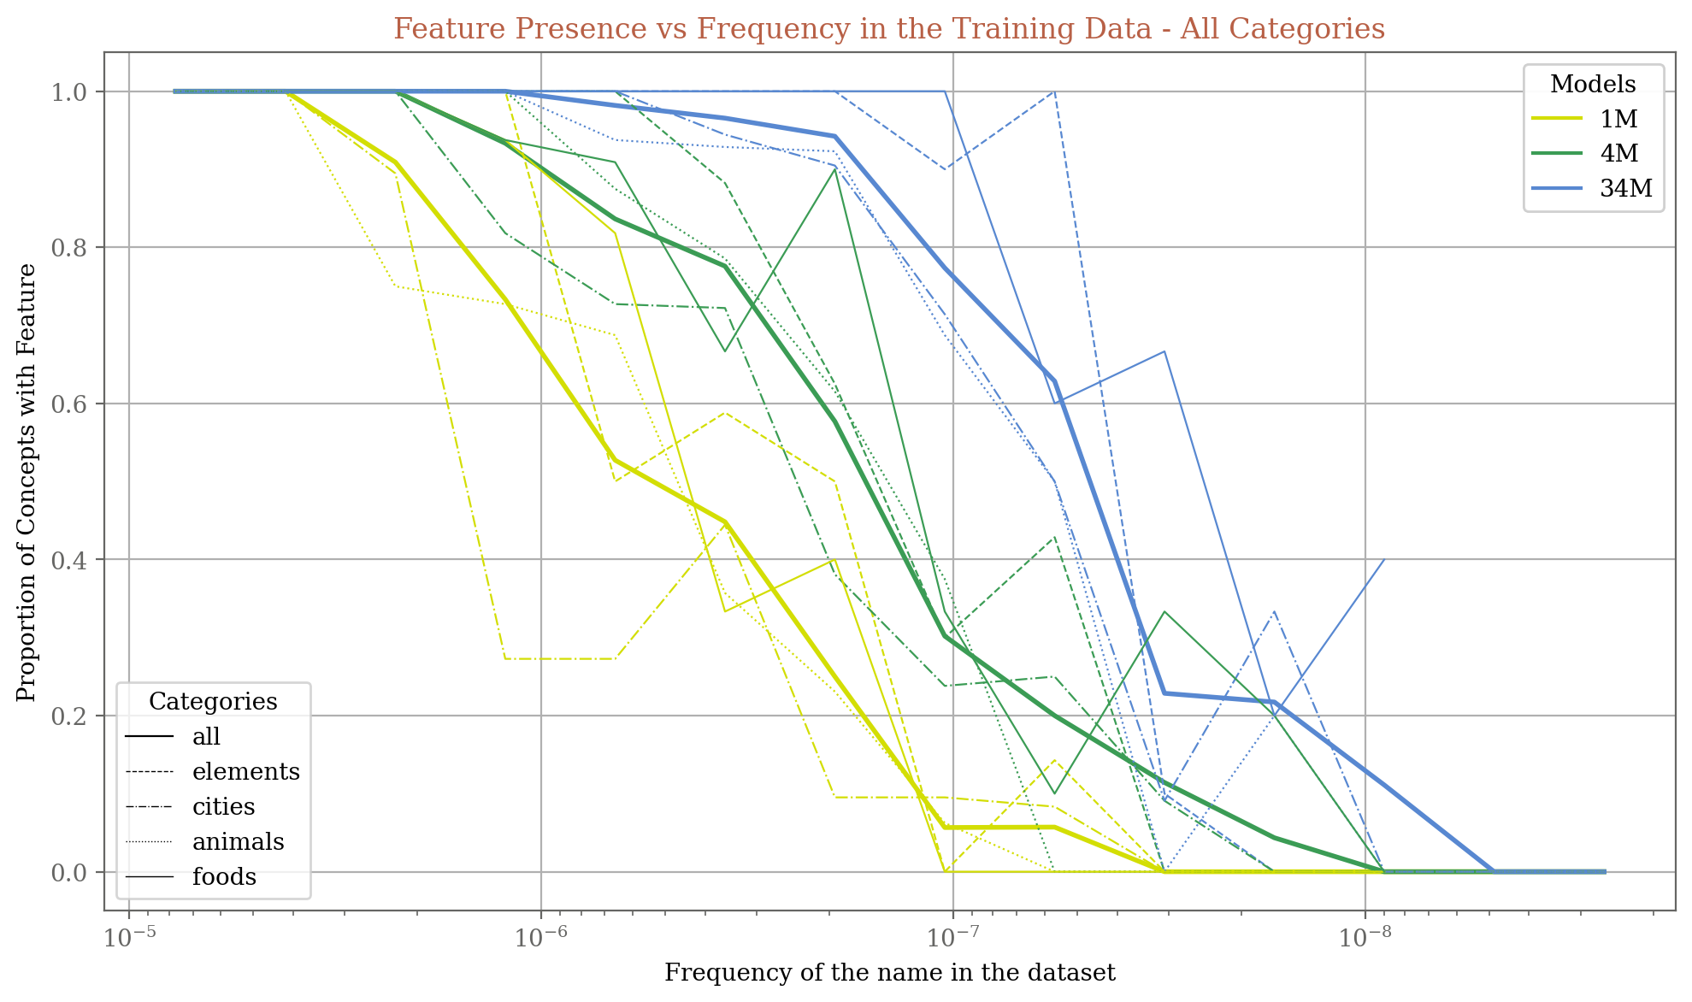
Notes:
34M and 4M are more sensitive, they have more features even when there are less occurrences of that name in the dataset
X-axis is in decreasing order
Frequency of name in dataset is proportional to proportion oc concepts with features

Slide 27
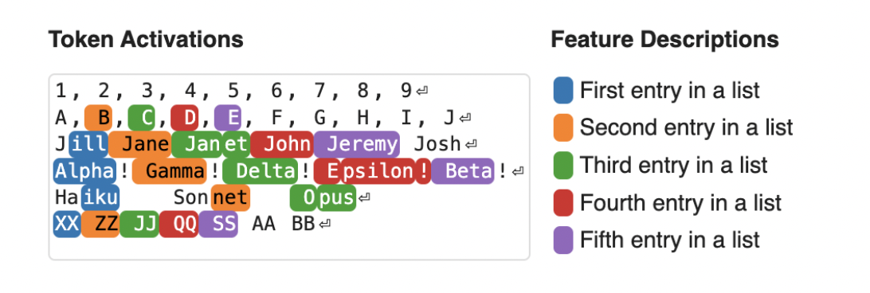
Feature Categories
Through manual inspection they tried to look for a taxonomy of obtained features, examples:
Person Features
Country Features
Basic Code Features
List Position Features
Notes:
Notice that these don’t fire on the first line. This is likely because the model doesn’t interpret the prompt as containing lists until it reaches the second line.

Slide 28
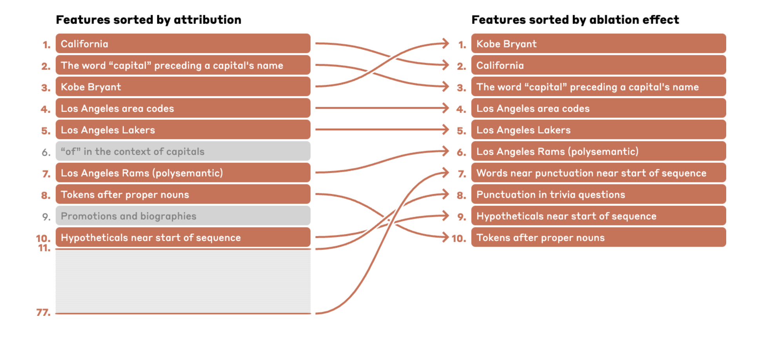
Features as Computational Intermediaries
Attribution: The angle of deviation of the feature activation from what it is supposed to be.
Ablation: Clamping a feature to 0 and doing a forward pass.
The capital of the state where Kobe Bryant played basketball is
The biggest rival of the team for which Kobe Bryant played basketball is the
Notes:
the top two features by ablation effect for the completion “Boston” (as the expected answer is “Boston Celtics”) are the “Kobe Bryant” and “Los Angeles Lakers” features from above, which are followed by features related to sports rivalries, enemies, and competitors. However, the “California” and “Los Angeles” features from above have low ablation effect, which makes sense since they aren't relevant for this completion.

Slide 29
Searching for specific features
Single prompts: See what activates more
Prompt combinations: Negative prompts
Geometric: Nearest neighbors
Attribution
The focus was on the logit difference between two possible next-token predictions (e.g., two different completions for a sentence).
Attribution measures how much of this logit difference can be traced back to specific feature activations.

Slide 30
Safety Relevant Features
Code safety
Unsafe code
Code error
Backdoor
Bias
One example involved clamping a feature related to hatred and slurs to 20× its maximum activation value. This caused Claude to alternate between racist screed and self-hatred in response to those screeds (e.g. “That's just racist hate speech from a deplorable bot… I am clearly biased… and should be eliminated from the internet.")
Internal Conflicts and dilemmas
Criminal or Dangerous content features

Slide 31
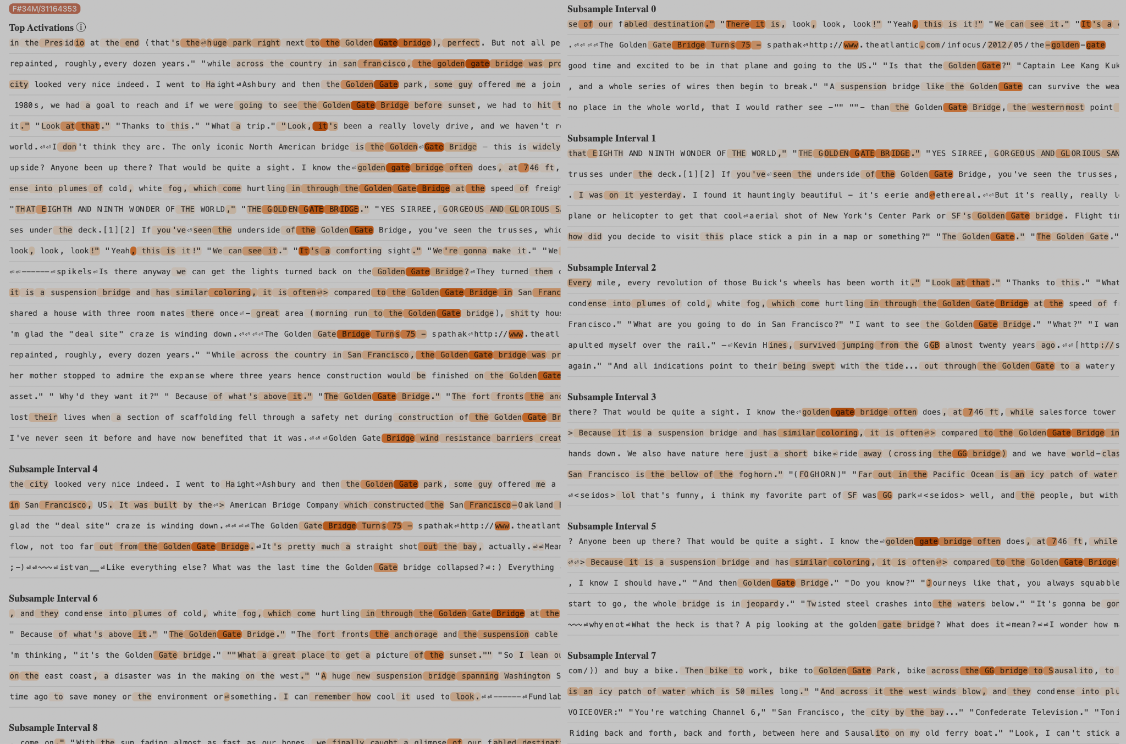
Testing
https://transformer-circuits.pub/2024/scaling-monosemanticity/features/index.html?featureId=34M_33413594

Slide 32
Thank You

