Slide 1
How to Train Long-Context Language Models
Pristina Wang, Mahler Revsine

Slide 2
Evaluation
Needle-in-a-hay-stack and RULER
HELMET benchmark

Slide 3
Why not current benchmark
Results are saturated

Slide 4
Why not current benchmark
HELMET has consistent ranking

Slide 5
HELMET
7 diverse application-centric categories
Recall
RAG
Re-ranking
ICL
QA
Summarization

Slide 6
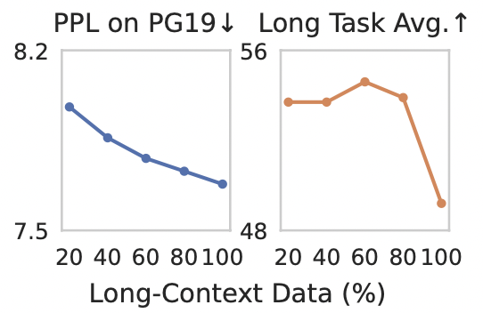
Why not perplexity?
Empirical results
While using more long data continues to improve PPL, using 100% long data hurts downstream long-context performance

Slide 7
Effects of Supervised Finetuning
SFT shows that the models continue to improve with more training tokens on RAG, re-ranking while unclear when evaluated before
SFT enables evaluation on QA and summarization

Slide 8
Short context performance
Previous techniques lower short-context performance
Position extrapolation(PE) and fine-tuning on long-context mixture SlimPajama

Slide 9
Long-context data curation
Mixture of long and short
60% long and 40% short

Slide 10
Long context source
Book/code 1:1 is the best

Slide 11
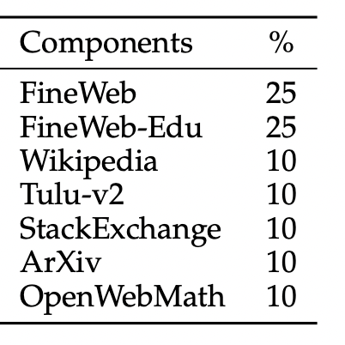
Short context source
More knowledge-intensive downstream-related data is the best
Retained llama-3-8b math ability the most

Slide 12
Train for more steps
Train 20B tokens of length 64K, then 20B tokens of length 512K
Improves performance on all long-context tasks

Slide 13
Train with a longer context than you evaluate on
Training on longer texts improves performance on shorter ones
Better results on all 64K inference tasks when trained on 512K

Slide 14
Should we fine-tune with synthetic data?
Previous work suggests synthetic data improves SFT
Instruction datasets have short prompts (1-4K tokens)
Could supplement them with synthetic long instruction data
40% QA (Question - Answer)
Llama-3-8B-Instruct generates QA pairs from chunks of long documents
30% RAG (Retrieval-Augmented Generation)
Reuse QA pairs, add random chunks from the document as faux retrievals
30% Synthetic summarization
Generate summaries of books via recursive summarization
Notes:
Summaries created via recursive summarization

Slide 15
Synthetic data harms model performance
Best performance with 0% synthetic data
Opposite trend found in previous work

Slide 16
Discrepancy with prior work
This study found that synthetic fine-tuning data was detrimental to task performance
Previous studies showed benefits to fine-tuning with synthetic data
The authors suggest two reasons for this difference:
Prior models had insufficient long-context training
Synthetic fine-tuning samples acted as additional training data
Prior approaches used much larger fine-tuning datasets
Synthetic samples helped prevent model degeneration

Slide 17
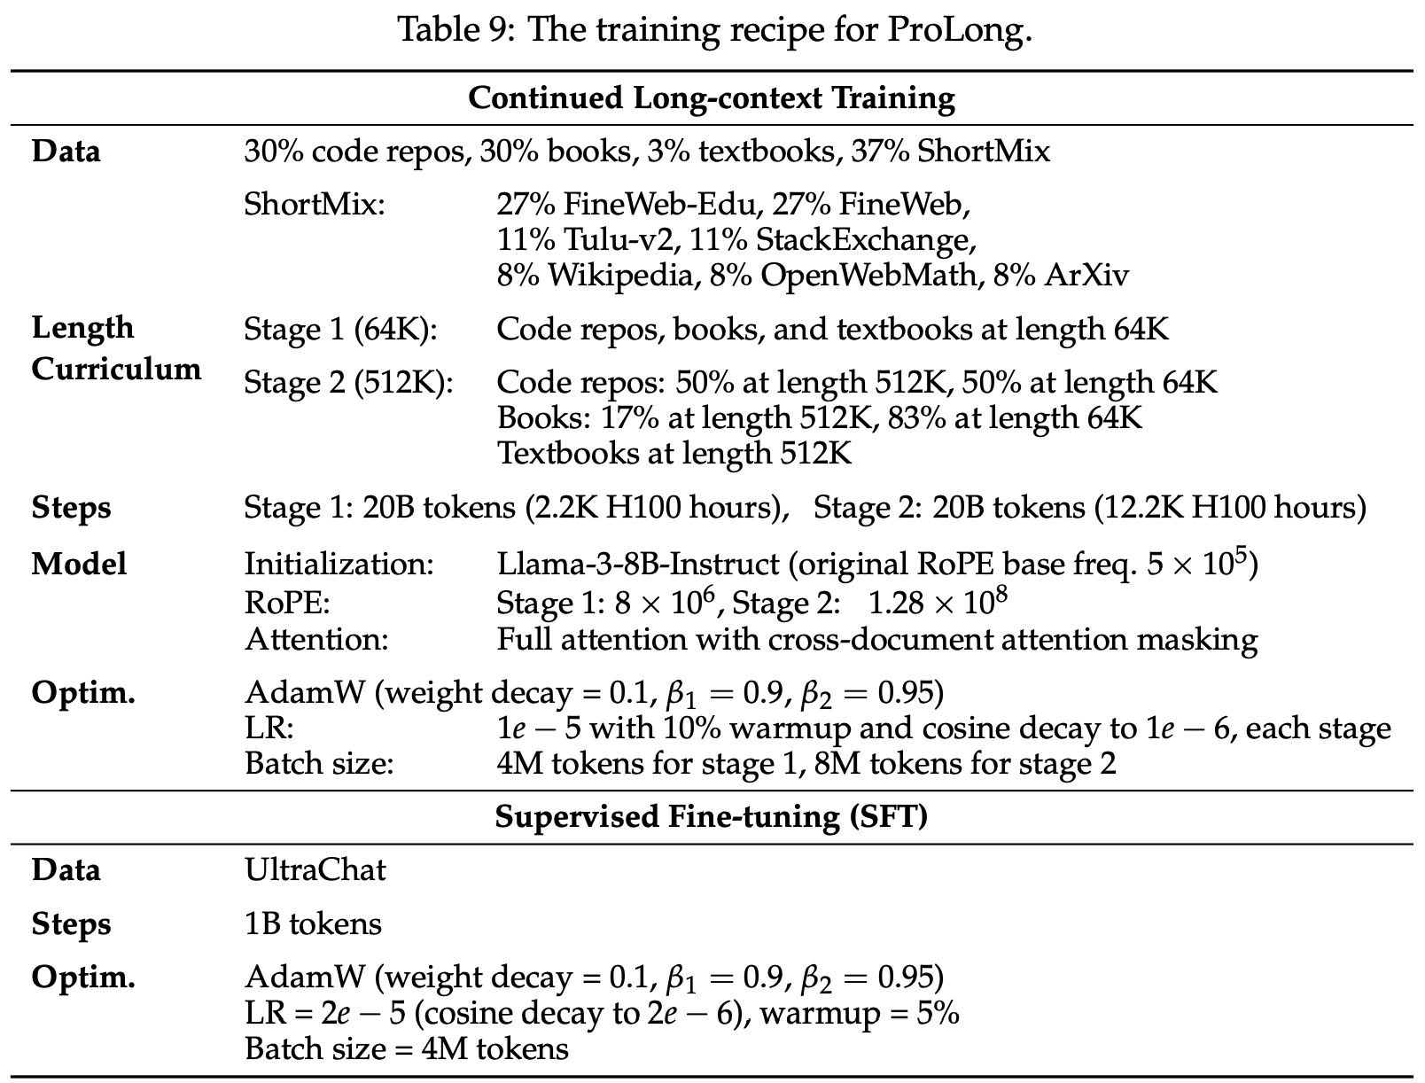
The final recipe for ProLong
Start with Llama-3-8B-Instruct model
20B 64K-length tokens, then 20B 64 / 512K tokens
Increase RoPE base from 10⁶ to 10⁸ for longer tokens
Include 3% textbooks
SFT via UltraChat dataset
Disable cross-document attention

Slide 18
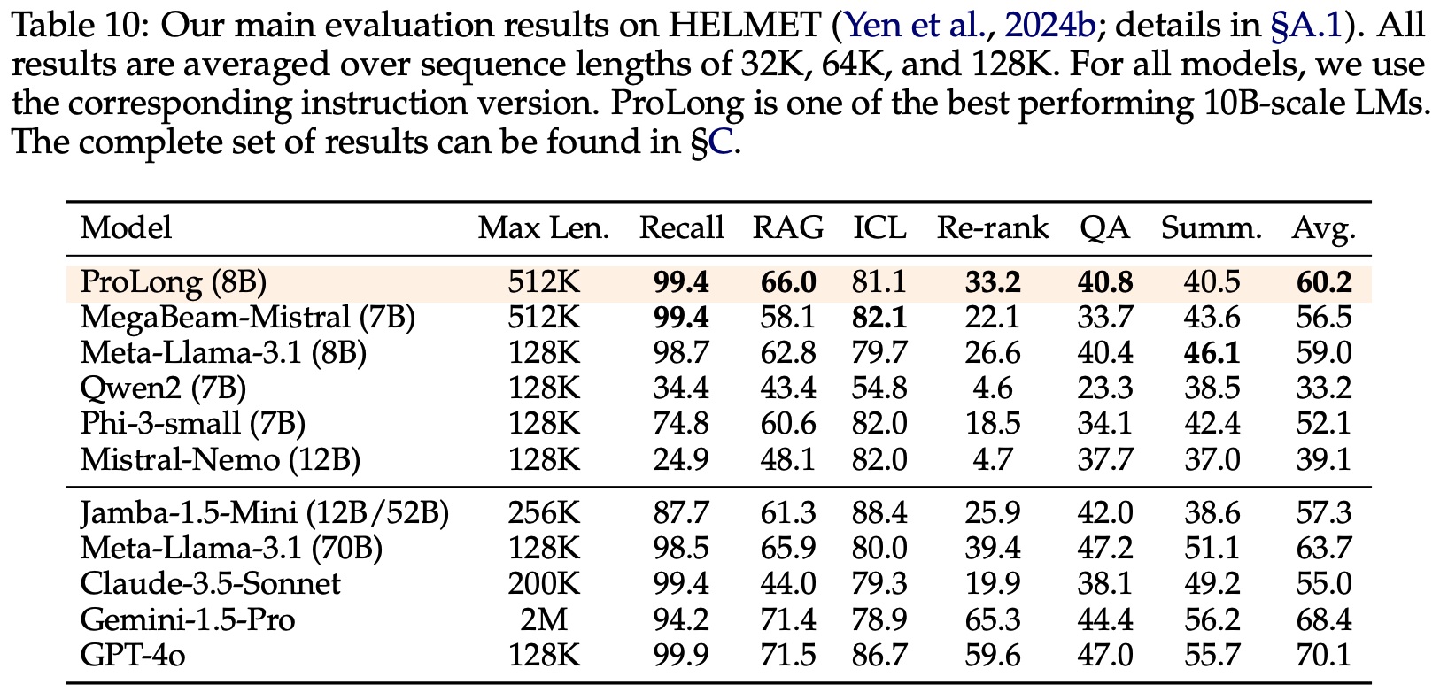
ProLong is the best model of its size
Outperforms Llama-3.1 with 5% as many training examples

Slide 19
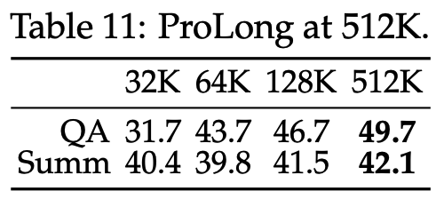
ProLong gets better at longer contexts
ProLong performs best at 512K
By contrast, many other models cannot run inference on more than 128K tokens

Slide 20
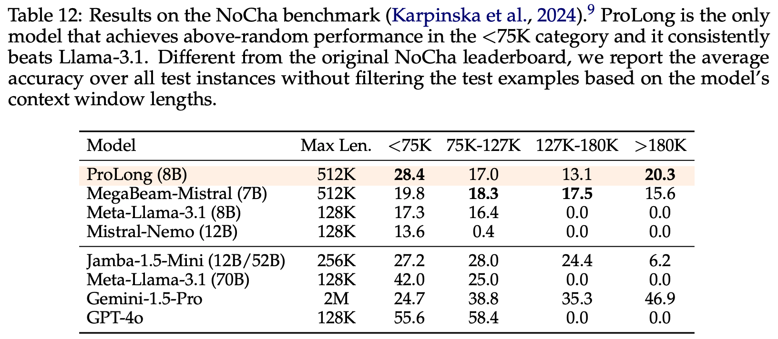
ProLong excels on the NoCha benchmark
Claim verification dataset
Human-curated, global reasoning tasks

Slide 21
Main takeaways
Much of the existing literature on long-context training is wrong
Sufficient to change the data composition, training regimen, and hyperparameters
Improvement in this domain is possible!

