Slide 1
CLIN: A Continually Learning Language Agent for Rapid Task Adaptation and Generalization
Dongwei Jiang, Yashwanth Nadella, Nov 12

Slide 2
What are Agents?

Slide 3
What are Agents?
An “intelligent” system that interacts with some “environment”
Physical environments: Robot, Autonomous car, …
Digital environments: Siri, AlphaGo, …
Language Agents: Those agents that primarily work with text / language.
“Upgrading” language models to language agents extends beyond their static knowledge to learn from and interact with environments, allowing them to ground their decisions.
Notes:
Anything that can be viewed as perceiving its environment through sensors and acting upon that environment through actuators.

Slide 4
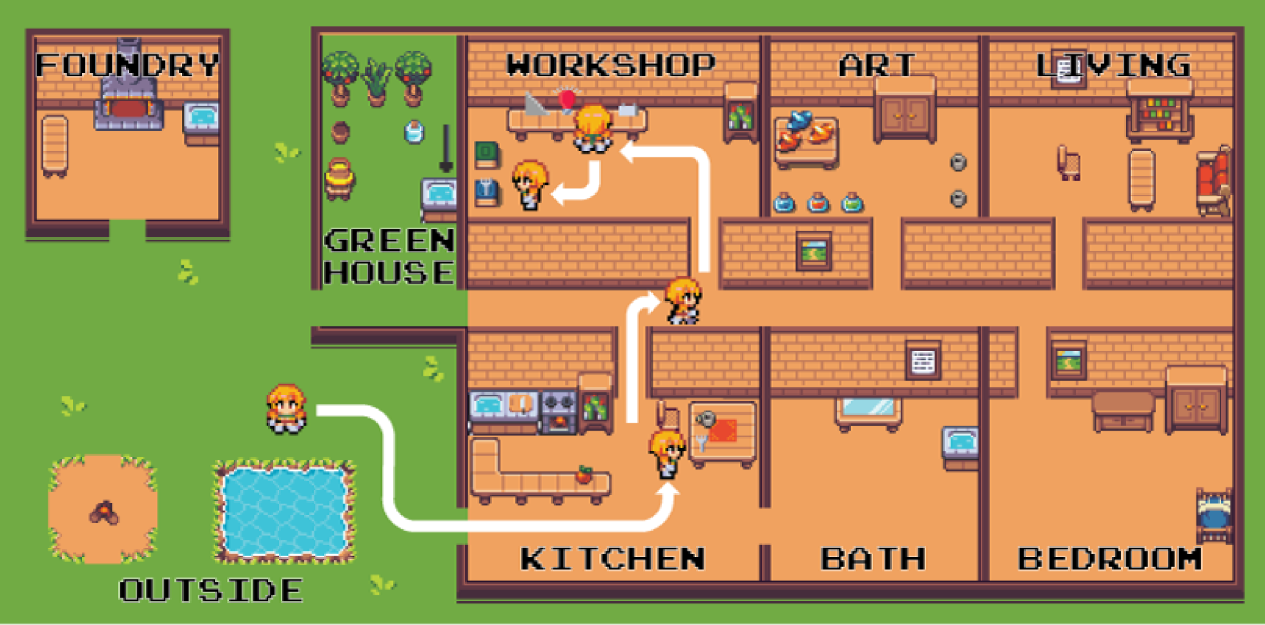
Example Environment: Science World - Animated
Your task is to determine if a metal fork is electrically conductive. The metal fork is located around the kitchen. First, focus on the metal fork. If conductive, place it in the blue box. If nonconductive, place it in the green box

Slide 5
Example Environment: Science World - Actual Interaction
Your task is to determine if a metal fork is electrically conductive. The metal fork is located around the kitchen. First, focus on the metal fork.

Slide 6
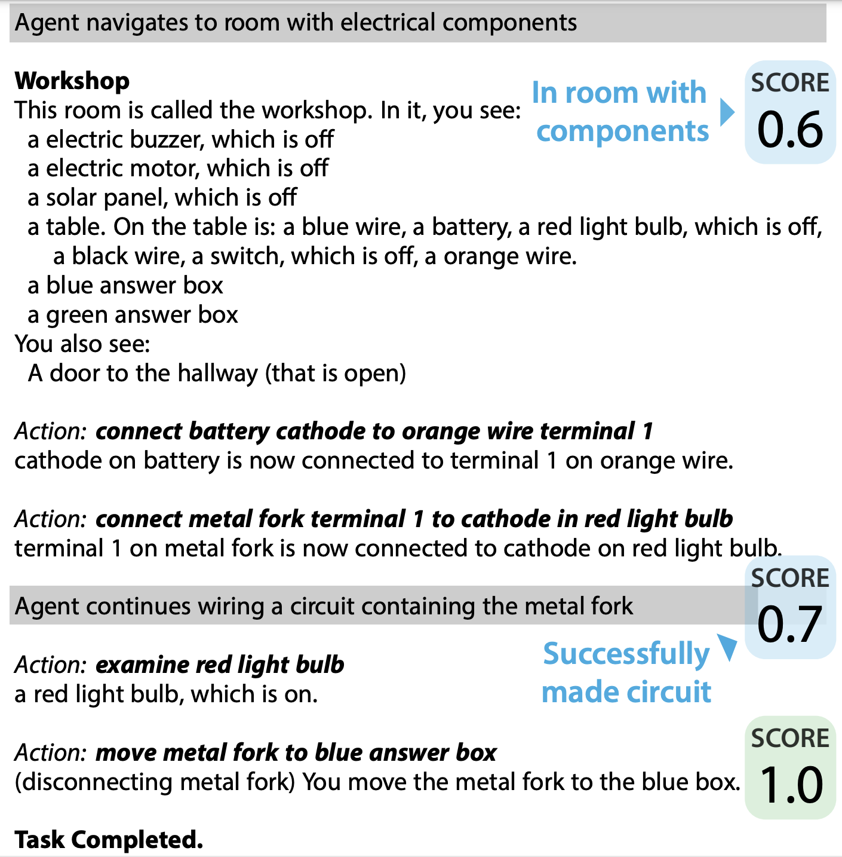
Example Environment: Science World - Actual Interaction
If conductive, place it in the blue box. If nonconductive, place it in the green box
Notes:
ka·thowd

Slide 7
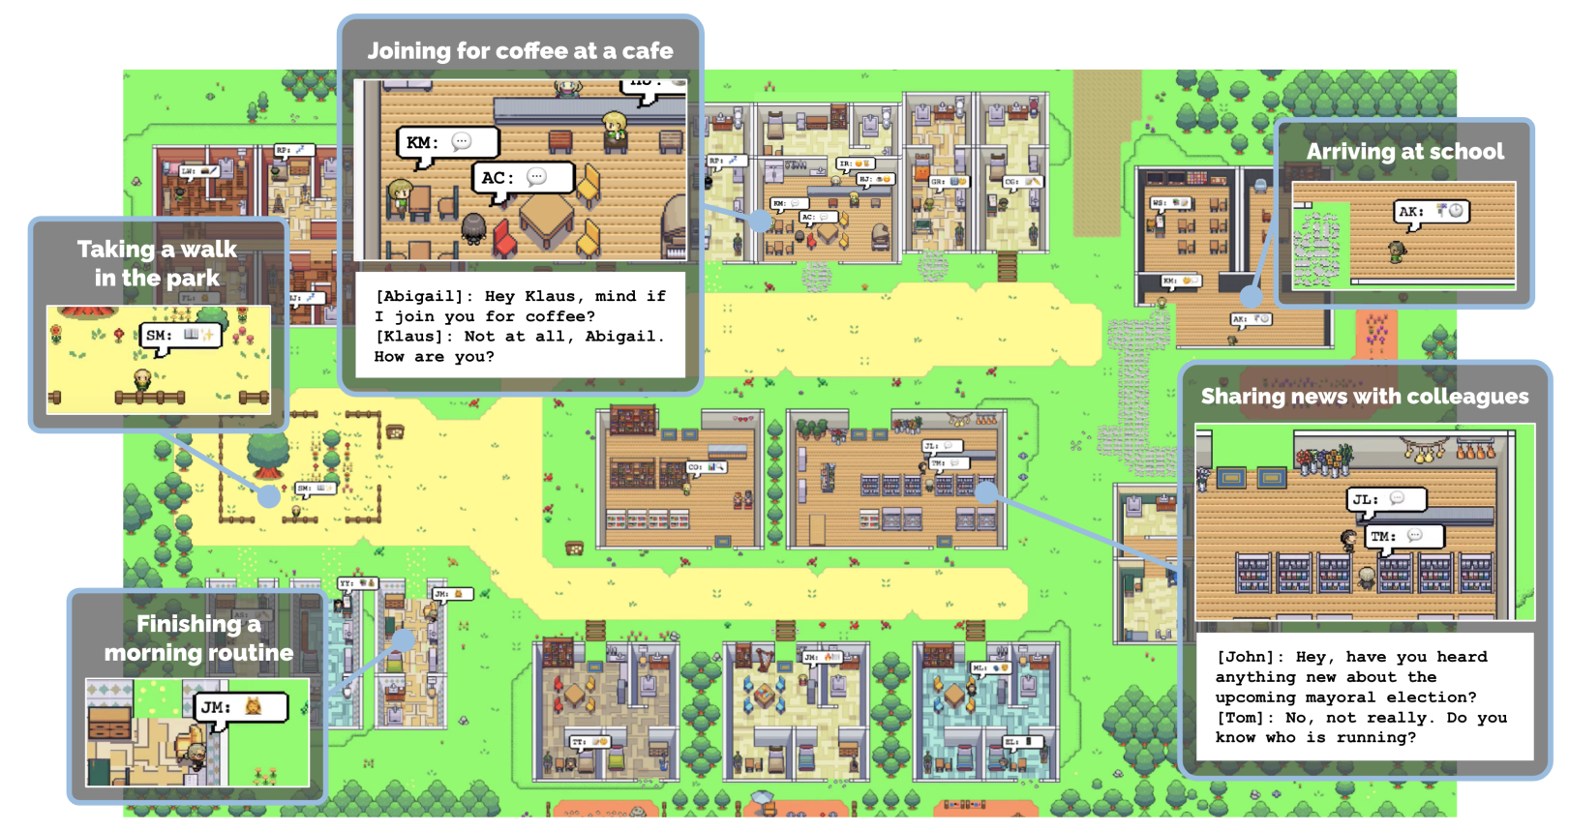
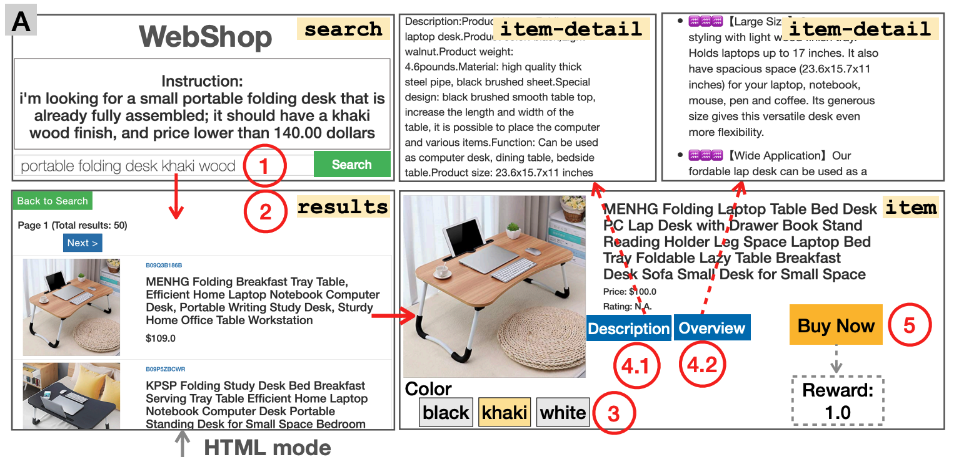
Btw, Lots of Other Worlds to be Discovered!
[Generative Agents, Park et al. 2023]
[WebArena: Zhou et al. 2023]
[AppWorld, Trivedi et al. 2024]
[WebShop, Yao et al. 2022]

Slide 8
Agent that Reasons: ReAct
We want agents to reason!
[ReAct: Shinn et al. 2023]
Notes:
While large language models (LLMs) have demonstrated impressive performance across tasks in language understanding and interactive decision making, their abilities for reasoning (e.g. chain-of-thought prompting) and acting (e.g. action plan generation) have primarily been studied as separate topics.

Slide 9
Agent that Learns: Reflexion
We want agents to learn (from past experiences)!
[Reflexion: Shinn et al. 2023]
Notes:
For example, a specific insight such as "In the next trial, I will go to desk 1 and find the lamp" (Shinn et al., 2023) may have limited value (or even hurt) for a different environment or task.

Slide 10
Can we do better?
Problem: Their instructions are too specific!
Solution: Let’s create insights that captures causal abstractions about agent’s actions, e.g., “opening doors may be necessary for movement between rooms”
Problem: We want useful causal knowledge to persist (and unhelpful knowledge to be
dropped) over time and between tasks and environments
Solution: We can maintain these abstractions in a continually evolving, dynamic memory, which is regularly updated as the agent gains experience
Notes:
Can we build an agent that can quickly adapt and generalize to a new task or environment at the test time?
Can we find a way to make agents learn continually from interacting and observing world changes?

Slide 11
CLIN - One Trial
“Your task is to boil water”
End
Task
“Find the water”
“Go to kitchen”
“Activating sink may be NECESSARY to obtain water, … etc.”
Goal
Action
Controller
Executor
G
A
Memory
O
GAO₁, GAO₂, … GAO_{n}
Observation
“... You see a sink …”
trial so far
(goal-action-observation-…)
Controller + Executor: Zero-shot GPT-4

Slide 12
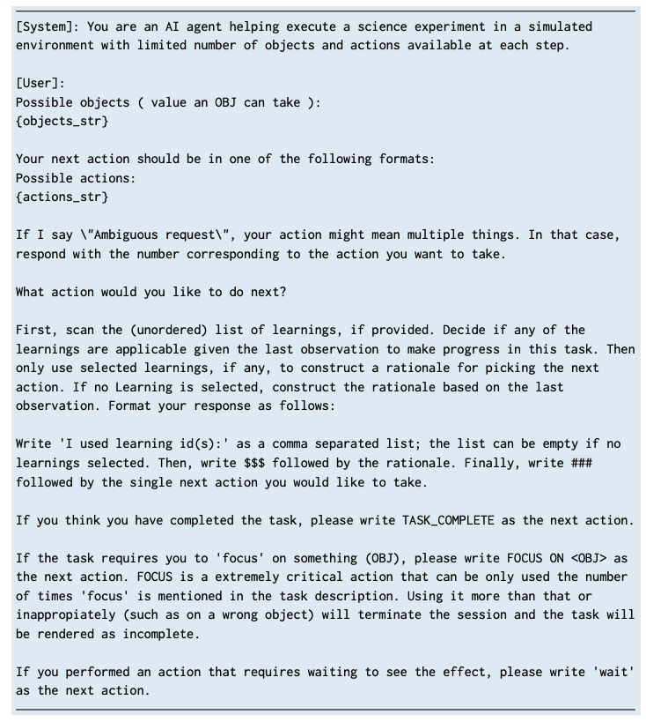
The Actual Prompts

Slide 13
CLIN - Memory Module
Input:
Task + Environment + {GAO}_{n}
GAO₁:
G: Find water, A: go to kitchen, O: You see sink
GAO₂:
G: Fill water in pot, A: Activate sink, O: Pot is filled with water
….
GAO_{n}:
…
Memory Generator
Summarizer: Zero-shot GPT-4
Output:
Moving to kitchen ENABLES obtaining water,
Activating sink ENABLES filling pot with water …
Memory
Types of Knowledge for Task Completion:
Actions that enable transitions to desired states.
X is NECESSARY to Y
Actions that produce no change or undesired changes.
X does not contribute to Y
Transitions that contribute positively to task progress.
X may …

Slide 14
Proposed Methods - Continually Updating Memory Module
Each trial refines the memory!
Memory Generator
Memory Generator
Memory Generator
Memory
Memory
Memory
Task + Environment +
Trial1
Trial 2
Trial 3
…
Trial n

Slide 15
Memories Generator - Explained!
Types of Knowledge for Task Completion:
Desired State Transitions: Actions that enable transitions to desired states.
X is NECESSARY to Y
Undesired or Ineffective Actions: Actions that produce no change or undesired state changes.
X does not contribute to Y
Helpful State Transitions: Transitions that contribute positively to task progress.
X may …

Slide 16
Generating Causal Abstractions
Memory Update Process After Each Trial:
After each trial, the memory generator receives:
The most recent trial data, consisting of (gt, at, ot) tuples and the final reward (rk).
Memories from the three preceding trials ({Sk−2, Sk−1, Sk}).
The generator creates an updated memory (Sk+1), containing a new set of causal abstractions for the next trial.
Causal Abstractions and Memory Size:
The generated memory focuses on key causal abstractions, which are fewer than the number of actions taken.
Saliency-Based Pruning: Important insights are retained based on the trial’s success, as indicated by the final reward, rk.

Slide 17
Meta Memory
Trial-Specific Memory vs. Meta-Memory:
During each task or trial within a specific environment, CLIN updates its memory based on recent actions and outcomes to improve performance in future trials for the same task.
However, these trial-specific memories are typically focused on the specific environment configuration and the immediate task requirements, meaning they are tailored to that particular setup.
Purpose of Meta-Memory:
Meta-memory is a more abstracted and generalized form of memory that helps the model go beyond the immediate task or environment.
To adapt to new tasks or different configurations, meta-memory captures broader causal insights that are not tied to a single environment or task instance but are applicable across various scenarios.

Slide 18
Which memories to select?
Prioritized Level Replay Scheme:
CLIN adopts a technique called the prioritized level replay scheme to systematically select the best memories.
This scheme involves evaluating each trial in an episode and choosing the most successful one—that is, the trial with the highest performance or most effective outcome.
Example of meta-memory
Memory
Trial 1: "Watering the plant leads to growth."
Trial 2: "Watering in moderation is important for certain plants like cacti."
Meta-Memory Abstraction:
"Watering is generally beneficial for plant growth, but the quantity and frequency depend on plant type."

Slide 19
Adapt
ADAPT Setup:
Objective: Evaluates CLIN’s ability to adapt to a single task by performing multiple trials in the same environment configuration.
Memory Initialization: CLIN starts with an empty memory at the beginning of the first trial.
Memory Generation and Update:
At the end of each trial, CLIN generates and updates its memory.
This memory captures causal abstractions based on both successful and failed actions, helping CLIN refine its strategy over subsequent trials.
Environment Reset: The environment is reset after each trial, but CLIN’s memory persists and accumulates knowledge across trials within the same environment.

Slide 20
ADAPT metrics
For both short tasks (Pick & Place) and long tasks (Grow Fruit), CLIN shows a steady increase in average reward across multiple trials, indicating that it learns and adapts effectively with each attempt.
The BASE to ADAPT transition in CLIN shows a significant performance improvement, demonstrating the effectiveness of memory updates and causal abstraction in enhancing task success.

Slide 21
GEN-ENV and GEN-ADAPT
GEN-ENV Setup:
Objective: Tests CLIN’s ability to transfer knowledge from prior experiences to solve tasks in unseen environments.
Training Phase:
For a specific task (task m), CLIN is run in 10 different training environment settings with variations in objects and starting locations.
During these trials, CLIN generates causal abstractions that are used to create meta-memories.
Testing Phase:
CLIN then uses these meta-memories to solve the same task in a new, unseen environment configuration.
GEN-ADAPT Setup:
The model can still keep updating it’s memory when it doesn’t perform well with GEN-ENV.

Slide 22
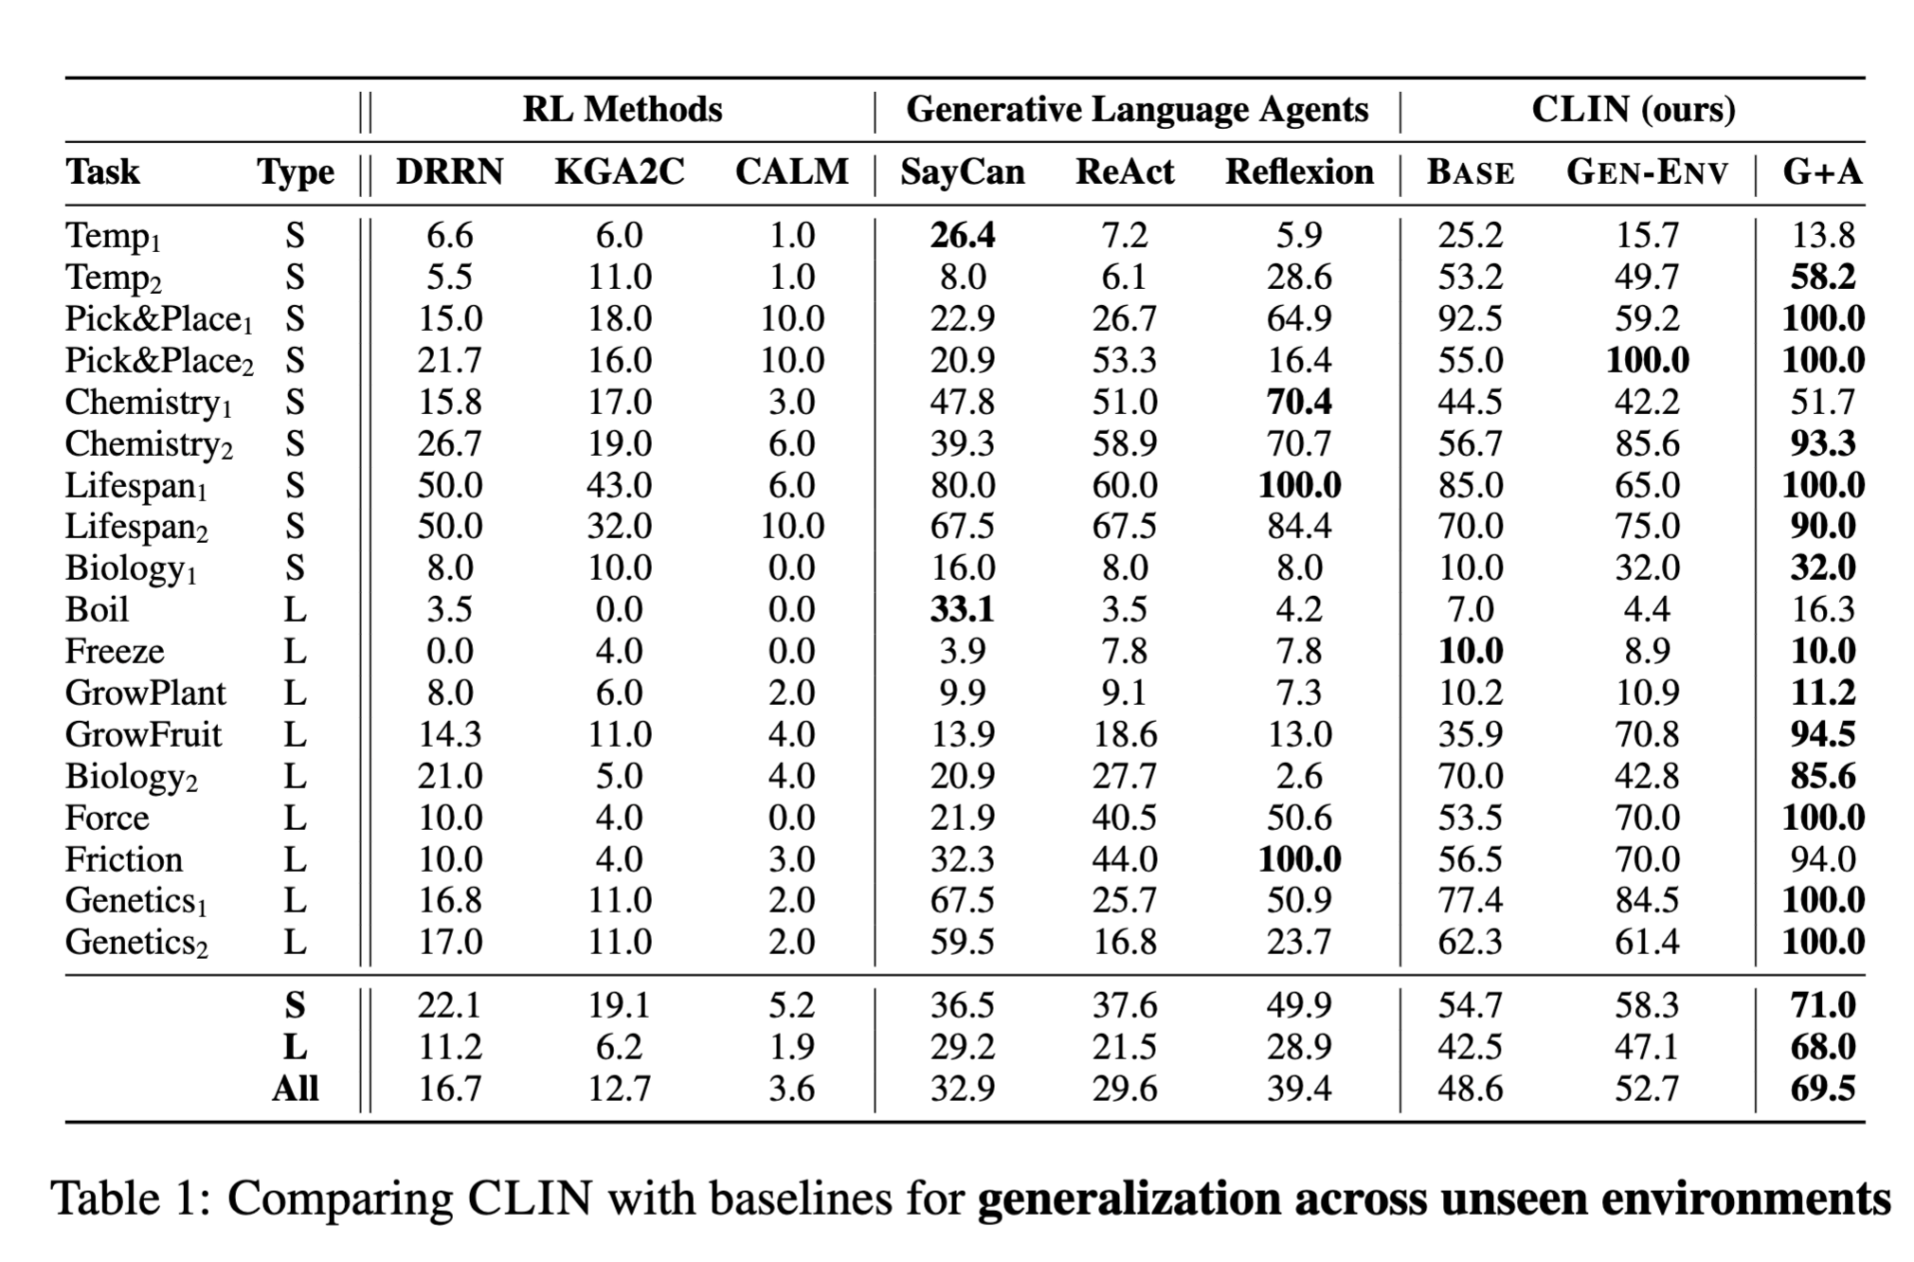
GEN-ENV Metrics
They say CLIN compared across unseen environments but isn’t G+A like training on the test set?
There is a drop in performances for a few tasks with GEN-ENV.
GEN-ENV + ADAPT beats the SOTA by a lot

Slide 23
Memory Structure Importance
Causal Abstractions in CLIN:
CLIN’s memory generation focuses on structured causal abstractions around two relations:
"Necessary": Actions that are essential for progress.
"Does not contribute": Actions that do not help or may hinder task progress.
Ablation Study with Free-Form Memory:
As a comparison, the memory generator was modified to produce free-form advice without enforcing a structured format.
This free-form memory lacks the clear causal structure found in CLIN’s standard memory (i.e., without "necessary" or "does not contribute" labels).
Findings:
Using unstructured memory resulted in a 6-point drop in average reward across tasks.
This performance drop occurred in 10% of cases compared to the structured causal abstractions used by CLIN.

Slide 24
Continued
Superior BASE Performance:
CLIN achieves higher BASE performance than both ReAct and Reflexion, despite using the same underlying language model (GPT-4).
Ablation Study on Controller Module:
The controller module in CLIN is responsible for generating a goal before determining the next action.
When the controller is removed (Abl-Controller-BASE setup), CLIN’s BASE performance significantly declines.
Performance Impact:
Without the controller, CLIN’s BASE performance drops in 44% of cases.
There is an 18-point decrease in average reward making Abl-Controller-BASE on par with ReAct, the foundational agent for Reflexion.

Slide 25
Limitation 1
Limitation: Lack of Exploration:
Dependency on Past Experience: CLIN’s learning is limited to actions and locations it has previously encountered, so unobserved activities or areas remain unknown.
Impact on Task Success: When a task-critical location or action is unknown from past trials, CLIN may struggle to complete tasks successfully.
Example: In a task to create orange paint, CLIN must find red and yellow paints in the art studio, which is not visible when starting from “outside.” Without prior exploration of the art studio, CLIN tries using irrelevant items (like an orange) and fails.
Another Example: In boiling or freezing tasks, CLIN fails if it hasn’t learned to measure the temperature regularly, which is crucial for these tasks.
Importance of Exploration: Prior exploration of task-critical locations or actions is necessary to generate useful memory insights and improve performance in future trials.

Slide 26
Limitation 2
Limitation: Poor Memory Retrieval:
Retrieval Errors in Meta-Memory: CLIN sometimes retrieves the wrong memory insights for a task, leading to repeated failures.
Example: In a task to boil gallium, CLIN needs to use an oven or blast furnace but repeatedly retrieves the insight to “activate the stove,” which is ineffective, resulting in task failure.
Challenge with Varied Initial Conditions: When initial conditions vary, it’s harder for CLIN to retrieve the most relevant insight, especially in the initial trial of generalization.
Future Improvement Needed: Improved memory representation and retrieval mechanisms could help CLIN access more relevant insights, which is suggested as an area for future work.

Slide 27
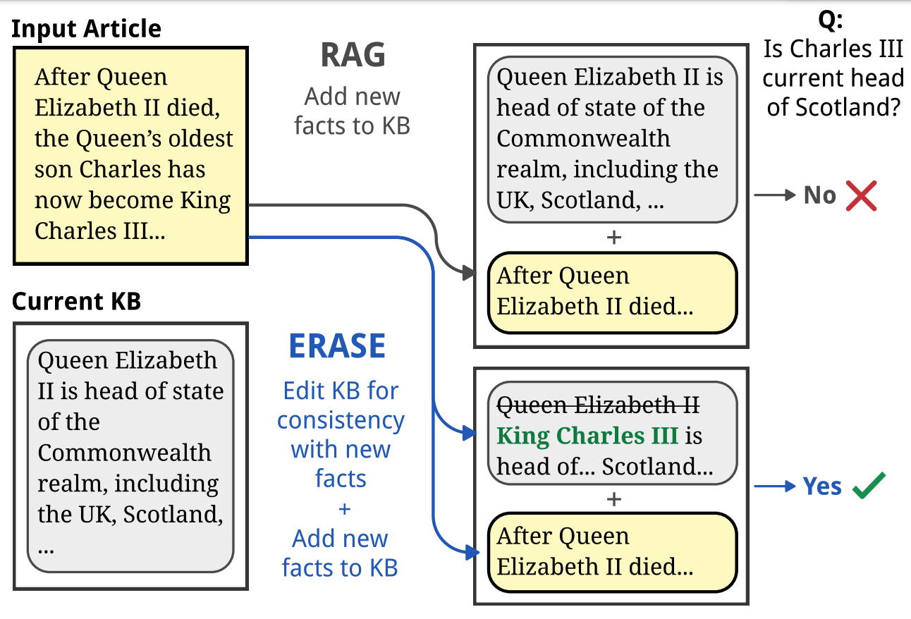
Other Related Works
When new documents are acquired, we incrementally deleting or rewriting other entries in the knowledge.
[Language Modeling with Editable External Knowledge: Li et al. 2024]
Notes:
Anything that can be viewed as perceiving its environment through sensors and acting upon that environment through actuators.

Slide 28
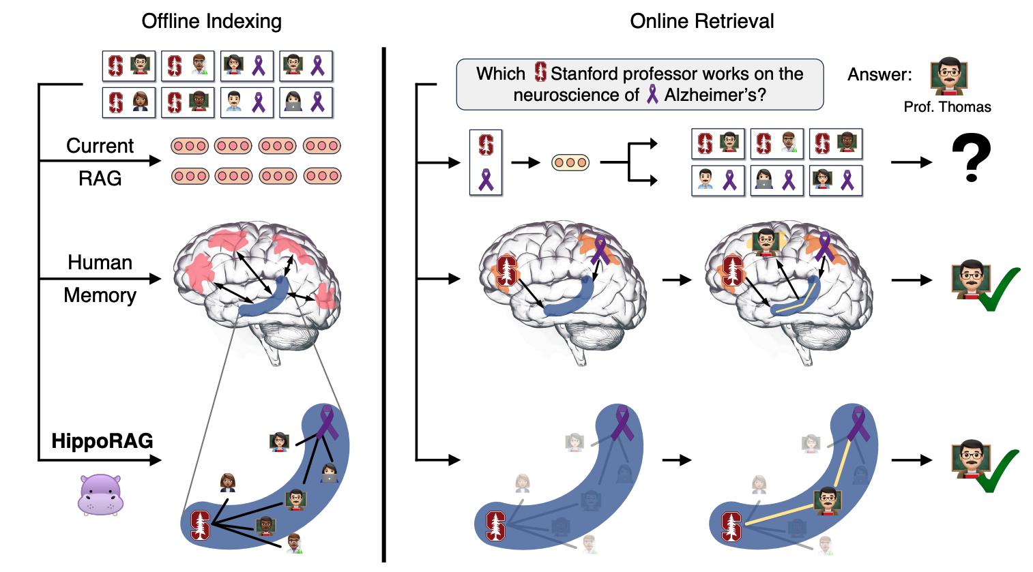
Other Related Works
We can use hippocampal indexing theory of human long-term memory to enable deeper and more efficient knowledge integration over new experiences!
[HippoRAG: Gutiérrez et al. 2024]
Notes:
Anything that can be viewed as perceiving its environment through sensors and acting upon that environment through actuators.

Slide 29
Thank you!

