Slide 1
Training LLMs over Neurally Compressed Text
Aydan Huang, Shaobo Liang

Slide 2
Intro
Goal: Improve training efficiency and handle longer contexts.
Why Compression?
Reduce token length.
Maximize compute efficiency.
Process longer sequences within model limits.
Notes:
Let’s start with the motivation behind using compression in language model training. As language models grow, so do their data and compute requirements. Compression offers several advantages:
It reduces the number of tokens, allowing the model to train faster and process more data within the same budget.
By compressing text, we can handle longer contexts, which is especially useful for tasks requiring deep contextual understanding.
With this in mind, we’ll explore how compression can make large-scale language model training more efficient.

Slide 3
What is compression?
Represent text with fewer bits while retaining information
Types of Compression:
Lossless: No information loss (e.g. Arithmetic Coding)
Lossy: Discards some information for higher compression rates (e.g. JPEG).
Information Theory Basics:
Entropy: Minimum average bit length needed to represent symbols.
Probabilistic Modeling: Assigns shorter codes to frequent symbols, longer codes to rare ones.
Notes:
To understand the techniques used in this paper, let’s start with an overview of compression. In information theory, compression is about reducing the number of bits needed to represent data. In our case, we want to compress text data in a way that retains as much information as possible, so we use lossless compression.
A key concept here is entropy, which represents the minimum average number of bits needed to encode symbols based on their probabilities. In general, more frequent symbols require fewer bits, while rarer symbols need more bits. This probabilistic modeling is the basis for methods like Arithmetic Coding. By encoding common patterns more efficiently, we reduce data length, making training faster. Next, we’ll look at the pipeline structure that integrates this compression.

Slide 4
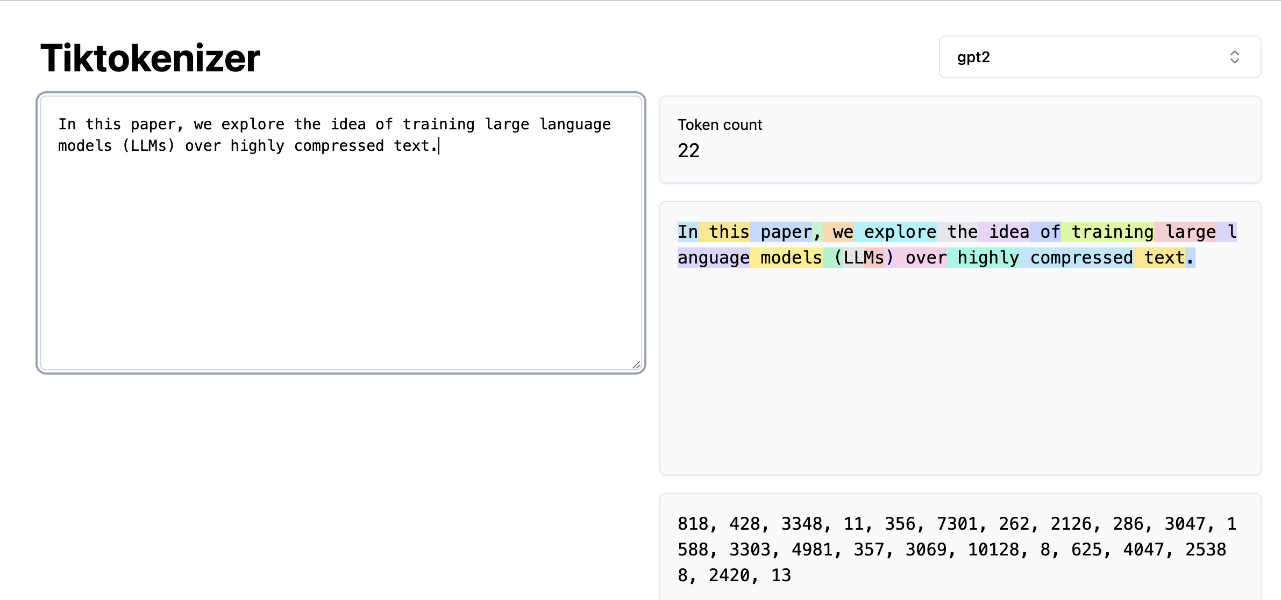
Background
Subword Tokens
Traditional LLMs process text by breaking it into subword tokens (e.g. BPE, SentencePiece).
Common tokenizers achieve around 4x compression.
Neurally Compressed Text
Train a model to compress text by assigning probabilities to sequences.
LLM can achieve 12x compression over English text
Question
Could we compress text even further to achieve greater compression rates and improve model efficiency?
(Delétang et al., 2024)
Notes:
Let’s start by setting some context around text compression in language models.
First, we have subword tokens, the standard approach used by most large language models. Subword tokenizers like BPE or SentencePiece break down text into manageable pieces—subwords—that the model can process. These tokenizers typically compress text to about 4 times its original length.
Neurally compressed text is a more advanced approach. Recent work shows that neural models can significantly compress text—up to around 12 times, as seen with models like Chinchilla 70B. This form of compression involves training a model to predict token probabilities, which are then used to reduce the sequence length even further.
This leads us to our main question: Could we compress text even further, and if so, what benefits might this bring? The idea is to investigate if even greater compression could improve model efficiency by allowing it to process longer contexts and more text within the same computational budget. This paper proposes a novel approach to answer this question and shows how it could transform model training.

Slide 5
Pipeline
Use Arithmetic Coding to reach near-optimal compression
Pipeline:
M1: Small language model trained on raw byte sequences.
AC: Compresses text to a bitstream.
M2: Trains on compressed tokens from AC bitstream.

Slide 6
Arithmetic Coding
Near-optimal coding method that encodes text into a bitstream.
Process:
Divides [0, 1) into intervals based on symbol probabilities.
Encodes sequences by refining intervals.

Slide 7
Example!
Let A = {X, Y}
P(X)=2/3, P(Y)=1/3
Encoding length 2 message

Slide 8
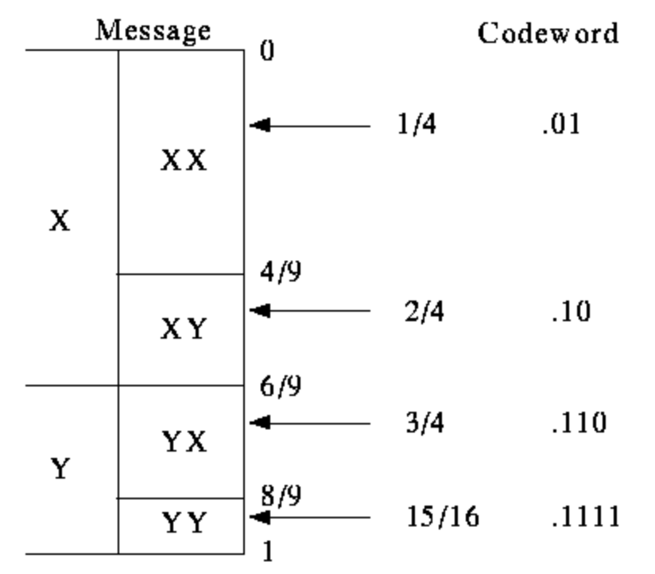
Example!
To encode message, just send enough bits of a binary fraction that uniquely specifies the interval

Slide 9
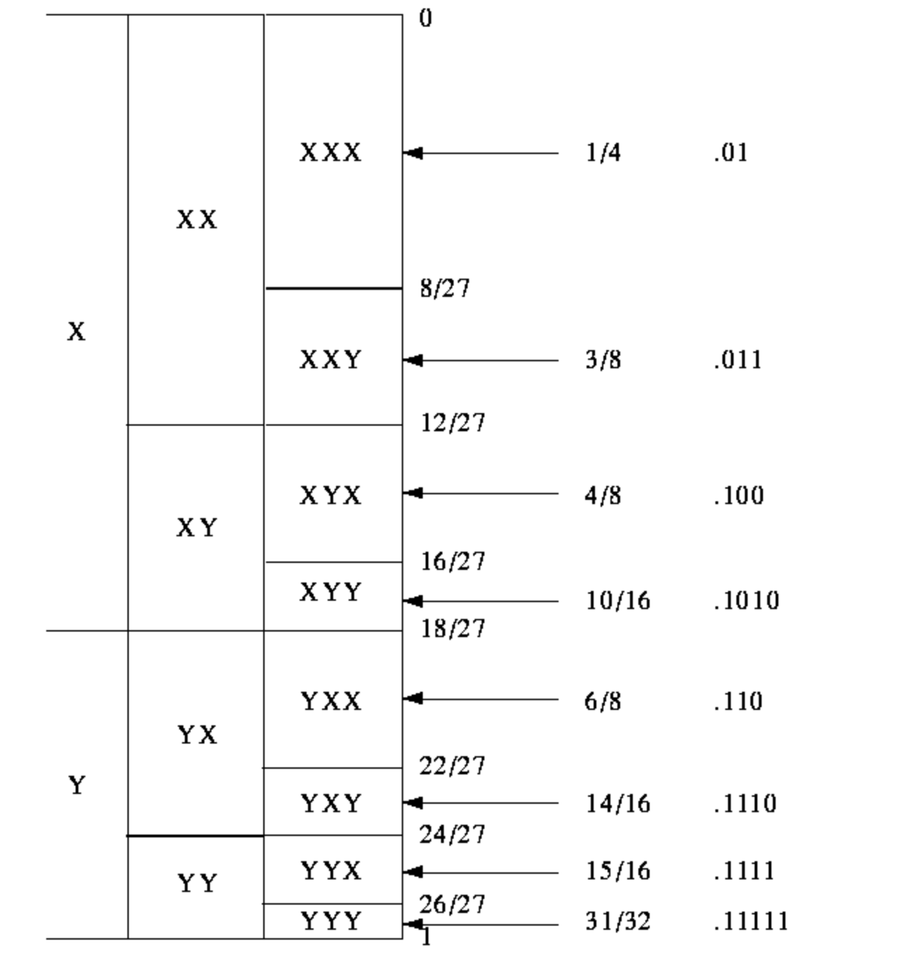
Example!
all possible length 3 messages to intervals
In general, number of bits is determined by the size of the interval
need –log2(p) bits to represent interval of size p
Approaches optimal encoding as message length got to infinity

Slide 10
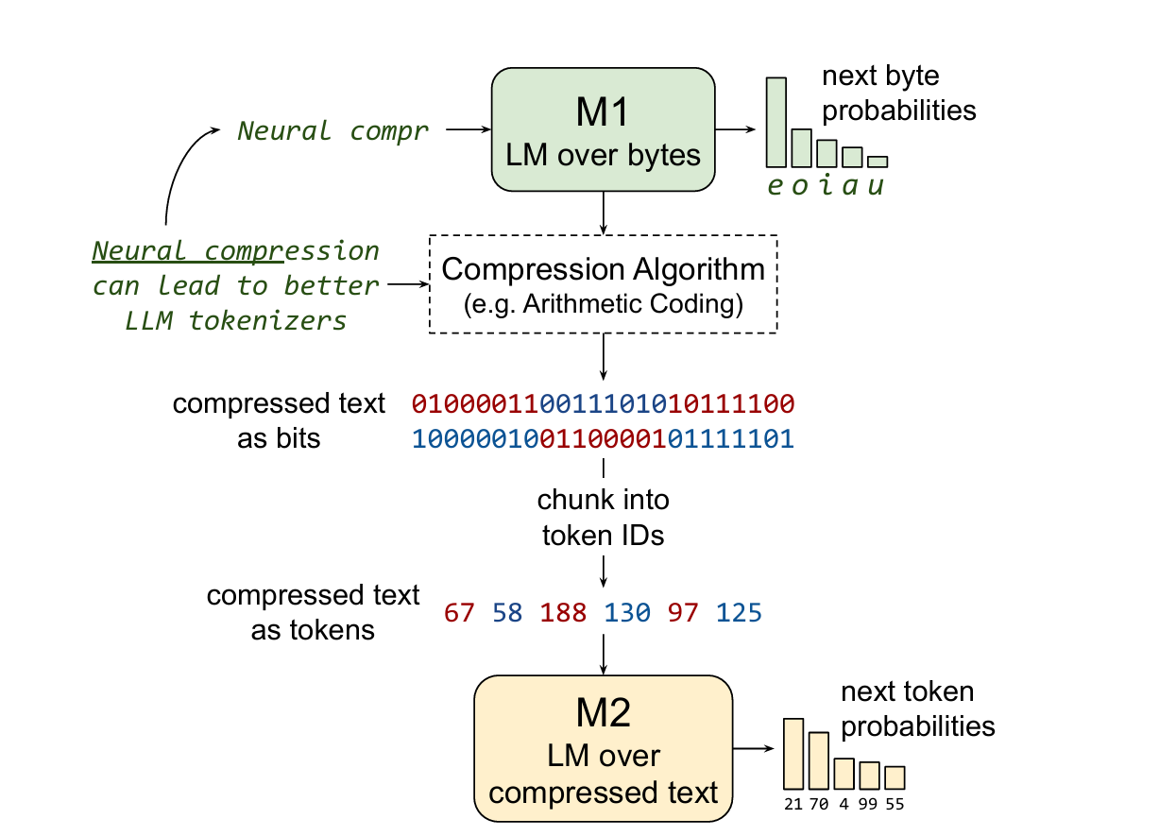
M1 Model​

Slide 11
M1 Model
Purpose of M1:
Predicts probabilities for each symbol
Simplifies low-level patterns for compression
Examples of Patterns:
Spelling, grammar, and word frequency
Result: Leaves high-level structure for M2 to learn.
compressed text
M1
M2
Notes:
M1 plays a foundational role in the compression process by predicting probabilities for each symbol in the text. Think of M1 as a filter—it captures and encodes low-level language patterns, such as common words, basic syntax, and grammar, that make the text predictable.
For example, M1 assigns higher probabilities to frequent words like ‘the’ or to basic structures like punctuation. By handling these low-level patterns, M1 simplifies the text, creating a bitstream where the low-level redundancy is reduced. This allows M2 to focus on learning the higher-level, more complex structures of the language. M1’s ability to model frequent and simple patterns makes it an essential part of the compression pipeline.

Slide 12
Problems with AC Compression
Challenges:
Random-looking output: Hard for M2 to learn from.
Dependence on M1’s accuracy: Imperfections leave learnable patterns.
No stable mappings: Context-dependent bit sequences.
Long-range dependencies: Expensive to process.
Impact: AC output can be difficult for M2 to interpret effectively.
Notes:
While Arithmetic Coding is efficient, applying it directly in LLM training introduces major challenges:
Random-looking output: The AC encoding creates a bitstream that appears as random noise, lacking the clear token boundaries typical in language processing. This randomness makes it difficult for M2 to interpret meaningful patterns.
Dependence on M1’s accuracy: Since M1 isn’t perfect, it leaves low-level patterns in the bitstream. These imperfections add noise, complicating M2’s task.
No stable mappings: Traditional tokenized text has consistent mappings (like ‘the’ always represented the same way). With AC, the encoding varies based on context, making it hard for M2 to learn stable representations.
Long-range dependencies: AC encoding is context-sensitive, meaning every part of the bitstream depends on prior context, creating long-range dependencies. This increases computational cost and makes it difficult for M2 to interpret patterns over long spans.
These limitations of vanilla AC motivated the authors to develop the Equal-Info Window approach, which helps M2 learn from the compressed text by stabilizing the encoding structure.

Slide 13
Equal Information Window AC
Equal-Info Windows:
Divides text into fixed-bit windows.
Compresses each window independently.
Compression stops once a threshold (e.g. 16 bits) is reached per window
Reset Mechanism:
Both AC algorithm and M1 model context are reset at each window
Ensures that each window can be independently decoded.
Notes:
To overcome these challenges, the authors propose Equal-Info Windows. Instead of compressing the entire sequence as one, they break it down into windows where each contains an equal amount of information, as measured by a set bit threshold (e.g., 32 bits). Once this threshold is reached, the window closes, and both the AC algorithm and M1’s context reset.
This resetting mechanism ensures that each window is independently compressible and decompressible. This separation allows M2 to interpret each window in isolation, significantly simplifying the learning process.

Slide 14
Benefits of Equal-Info Windows
Stable Mapping:
Each window consistently maps a fixed number of bits to tokens
Reduces the context sensitivity of each token
Improved Learnability:
M2 can learn patterns without needing to track AC state variables over long sequences
Efficiency Gains:
Enables effective compression while maintaining learnability
Achieves ~5.3x token-level compression, > standard tokenizers
Notes:
Equal-Info Windows provide several benefits:
They create a stable mapping between bits and tokens, allowing each window to consistently map a fixed bit length to tokens. This stability significantly reduces the dependency on previous context, making the bitstream more interpretable.
Learnability is improved because M2 can learn high-level patterns within each window without needing to track AC’s complex state across long sequences.
This approach achieves around 5.3x token-level compression, which is both efficient and learnable, marking a significant improvement over traditional subword tokenizers.

Slide 15
Tokenization of M2 Input
Training over bitstream isn’t ideal
Long sequence
Small vocabulary size (0 and 1)
Group N bits into a token
N ∈ {8, 16}
V ∈ {256, 65536}
Bigger N = higher compression ratio

Slide 16
Compression Ratio: Disambiguation
Token compression ratio
L_{iT} / L_{oT}
Sequence length reduction
Bit compression ratio
L_{ib} / L_{ob} = $\frac{\text{sequence} \text{length} \text{reduction}}{\text{bits}\text{ / }\text{token}}$
E.g., SentencePiece
4.28× length reduction
15 bits / token (larger vocab)
2.28× bit compression ratio
Tokenizing AC does not change bit compression ratio
Token compression ratio is the focus of this work
Reducing number of tokens fed into M2 would reduce computational overhead

Slide 17
M2: Experimental Setup

Slide 18
M2: Experimental Setup
5 model sizes
Each on 16 different M1s
M2
M1

Slide 19
M2: Experimental Setup
5 model sizes
Each on 16 different M1s
Compute-controlled
Each model sees 26.2 billion tokens
Total amount of text differ because of different compression ratios
M1

Slide 20
M2: Experimental Setup
5 model sizes
Each on 16 different M1s
Compute-controlled
Each model sees 26.2 billion tokens
Total amount of text differ because of different compression ratios
Baselines: Byte and Sentencepiece
Datasets: C4
M1

Slide 21
Evaluation Metrics
Models cannot be compared on per-token metrics
Shorter tokens will generally achieve higher likelihood and lower perplexity (because of smaller sample space)
[bits/byte] = (L_{oT}/L_{iT}) * ℓ / ln(2)
ℓ: negative log likelihood (Cross Entropy)
L_{oT}/L_{iT}: Inverse of compression ratio
Scaled cross-entropy
(Not perplexity)

Slide 22
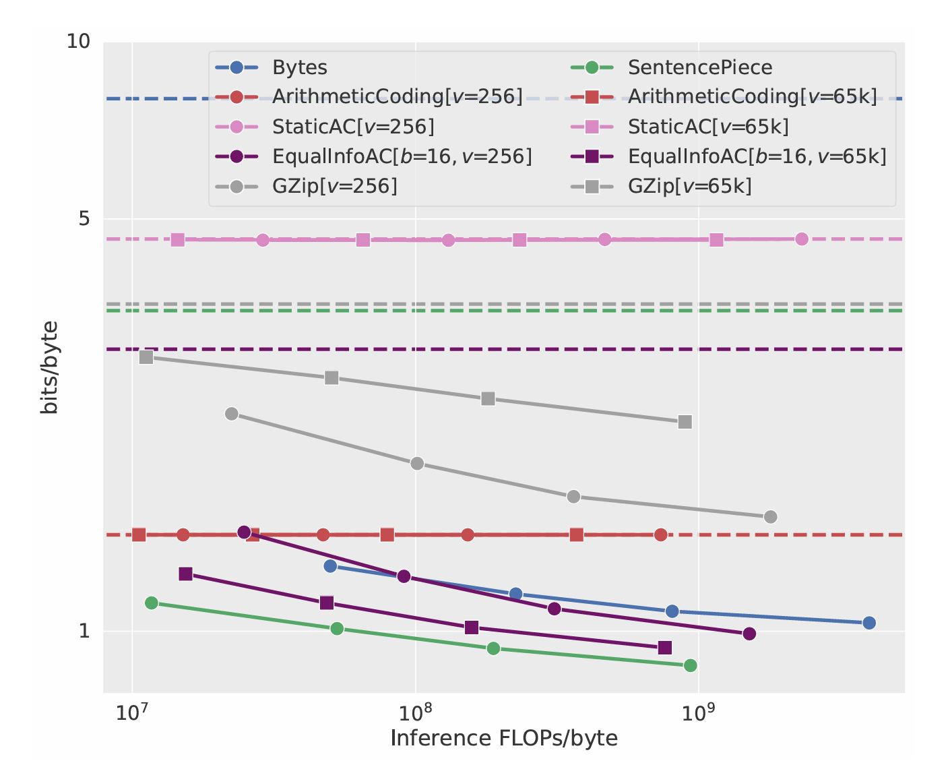
Grounding baselines in familiar context
Solid Lines: trained M2 models
Dashed Lines: equal probability to all tokens
SentencePiece 2b (best model):
bits/byte = 0.87
compression ratio = 4.28
Cross Entropy
= bits/byte * compression ratio * ln(2)
= 0.87 * 4.28 * 0.6932
= 2.5812
Perplexity = 5.9835
Other LMs on C4 validation:
Llama-2-7b-hf: ppl = 6.63
Mistral-7B: ppl = 6.94

Slide 23
Results: Performance
Solid Lines: trained M2 models
Dashed Lines: equal probability to all tokens
SentencePiece is the overall strongest

Slide 24
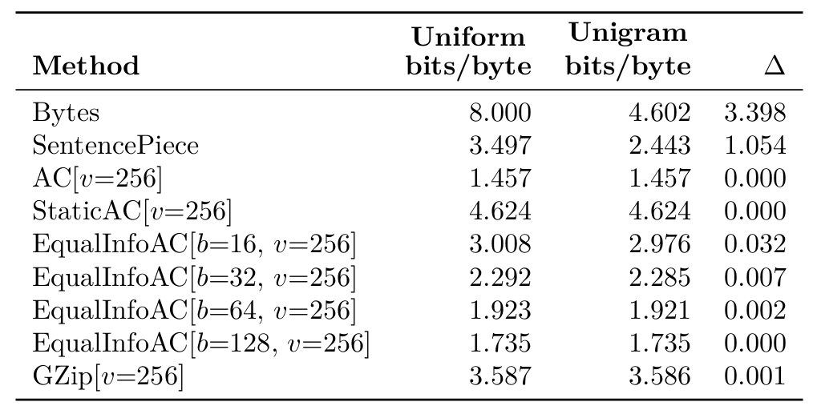
Compressors are Language Models
Trivial M2s shows non-trivial performance on some M1s
Almost 0 gain from unigram modeling compression output
Uniform distribution over tokenized vocabulary
M2 can only learn contextual information from these M1s

Slide 25
Results: Performance
Solid Lines: trained M2 models
Dashed Lines: equal probability to all tokens
SentencePiece is the overall strongest
M2 fails to learn on AC and StaticAC
M2 ends up with the same performance as M1

Slide 26
Results: Performance
Solid Lines: trained M2 models
Dashed Lines: equal probability to all tokens
SentencePiece is the overall strongest
M2 fails to learn on AC and StaticAC
M2 ends up with the same performance as M1
Equal-Info Window AC are learnable
Bigger tokens improves performance and cost
Can learn from uniform-unigram vocabulary—shows capacity to model longer contexts

Slide 27
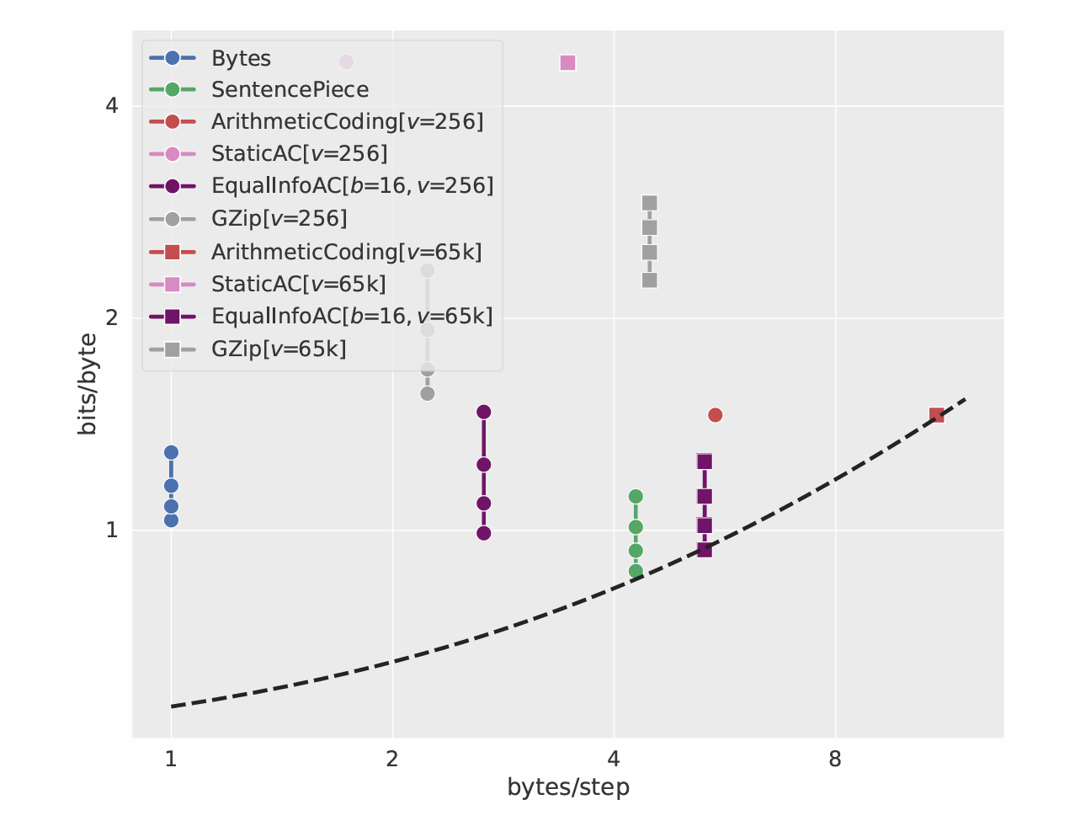
Advantage: Higher Bytes/Step
EqualInfoAC outperforms SentencePiece in terms of bytes/step
EqualInfoAC[b=16, v=65k]:
5.31 bytes/step
SentencePiece:
4.28 bytes/step
Takes fewer steps to generate the same amount of text
Potentially reduces generation latency
(Recall speculative decoding)
Dashed Line: Pareto frontier for tradeoff between bits/byte and bytes/step

Slide 28
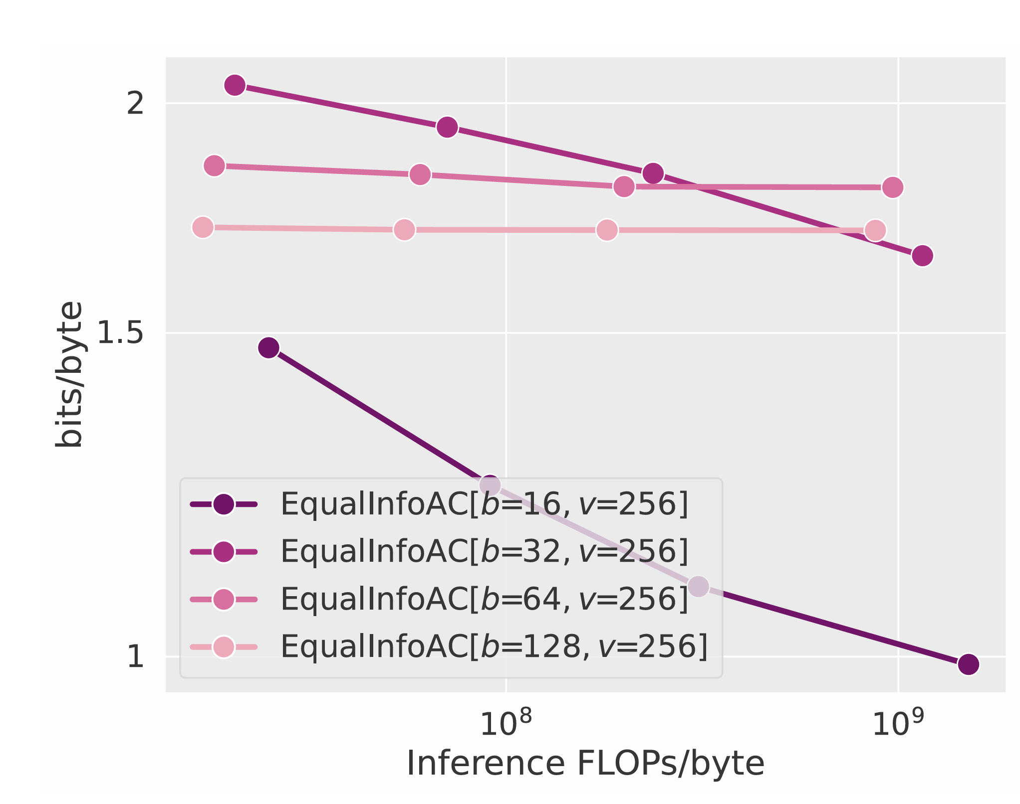
Shorter Windows are Better

Slide 29
Analysis: Qualitative Difference

Slide 30
EqualInfoAC is less stable
Stability: same text→token mapping

Slide 31
EqualInfoAC is less semantic
Semantic: tokens should align with meaningful linguistic units
SentencePiece tokens aligns with words morphemes

Slide 32
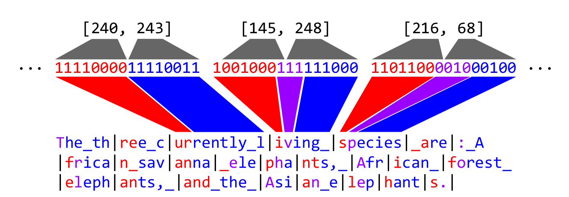
Token to text stability
token→text is stable when token size and window size match (b=16, v=65k)
Same token always map to the same output text

Slide 33
Token to text stability
token→text is stable when token size and window size match (b=16, v=65k)
Same token always map to the same output text
When there are multiple tokens per window, the text from the first token is more consistent

Slide 34
Token to text stability
token→text is stable when token size and window size match (b=16, v=65k)
Same token always map to the same output text
When there are multiple tokens per window, the text from the first token is more consistent
Window-initial characters are not well-compressed
Because M1 resets for every window

Slide 35
Takeaways
Nothing better than subword tokenization (yet)
Tokenizers with simple compression algorithms produces unlearnable sequences
EqualInfoAC works (sort of)
Advantage: higher compression rate, may reduce inference latency
Optimistic for future work
Even higher compression rates
Equal information per token may help with compute allocation
“Compression will give models a more direct view of the underlying raw text, thus helping with spelling and pronunciation tasks”
Expect somewhat less stability in text↔token mapping

Slide 36
Questions?
What is the best approach for designing a tokenizer?
Should we prioritize linguistic properties?
Is a purely mathematical approach enough?
Are there any other advantage of tokenization through data compression algorithms?
Do you think we need better tokenizers?
What are the problems of subword tokenizers?

