Slide 1
LLMs In The Imaginarium: Tool Learning Through Simulated Trial and Error
Rishitha Kalicheti
Elena Kote

Slide 2
Motivation
How accurately do LLMs use tools for which they have been trained?
We want LLMs to interact with the world through tools
Existing LLMs: 30% to 60% correctness rate
Existing methods focus on broad coverage of tools and flexibility of using new tools
ICL: flexible but lower accuracy
Fine-tuning: mainly focus tools not seen on training; catastrophic forgetting
Authors propose STE (Simulated Trial and Error)
Help LLMs master tools they have been trained on

Slide 3
Related Work
Name
Department Course Number Section Time Location
DATE
Tool-augmented LLMs
Learning from Feedback
Models with dynamic memory
Models with retrieval/search engines
Fine-tuning
ICL
More diverse tools: program executors, translation, APIs
LLMs can improve their predictions with feedback
Self-reflection can be used as a form of feedback for progressive learning
Growing memory of user and environmental feedback
Fine-grained short term memory
Distilled long-term memory

Slide 4
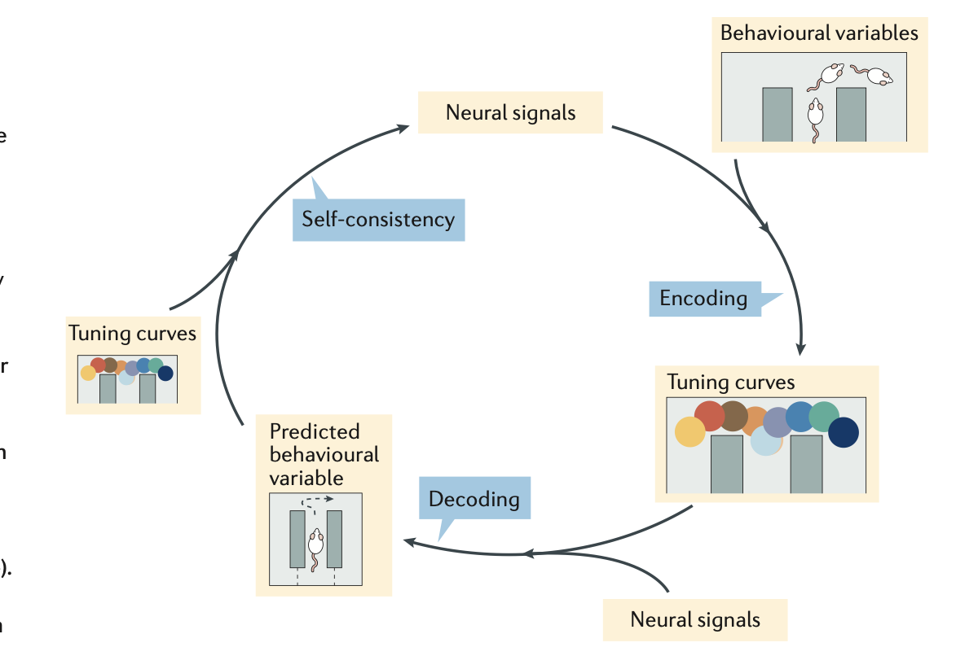
Simulated Trial and Error (STE)
A biologically-inspired method for tool-augmented LLMs.
Inspired by biological precedents (humans, apes, rats)
Trial and error
Imagine possible scenarios
Remember previous experiences
STE steps:
LLM simulates possible tool use cases
LLM iteratively interacts with tool
Reflect on current trial
Explore using short and long-term memory

Slide 5
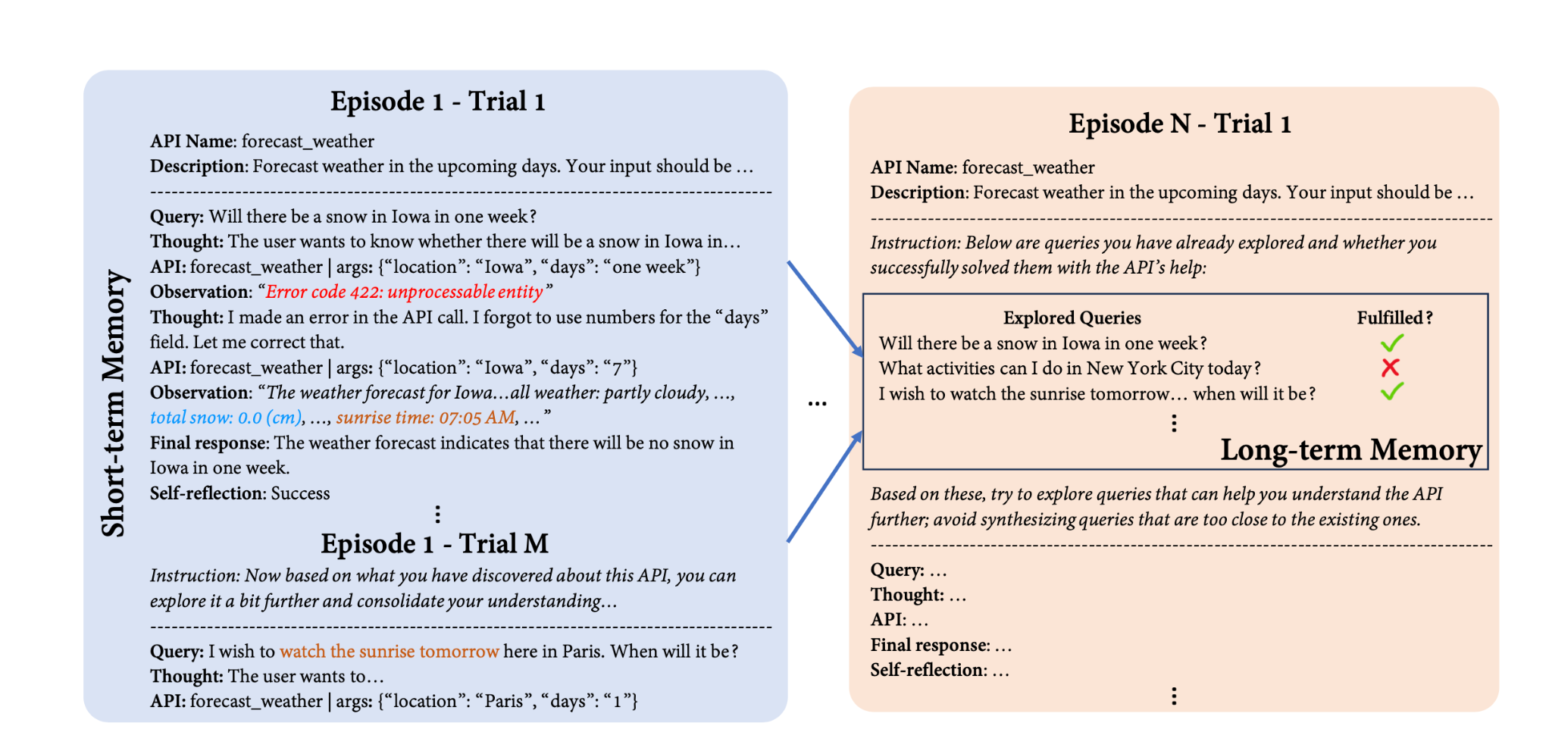
Exploration
LLM interacts with API to gain as much information from it as possible, on a series of Episodes and Trials
Episodes: Long-term memory
Trials: Short term memory
On each Trial
Imagine plausible query
Fulfill query by using API
Reflect on trial

Slide 6
Iterative self-refine with execution feedback
LLM learns from execution feedback to refine its own outputs
ReAct format
Verbalize internal thoughts
Make an action (API call)
Observe execution feedback
Repeat
until adequate API response (or max #calls reached)

Slide 7
Short - term memory
Name
Department Course Number Section Time Location
DATE
Each episode starts with a fresh short-term memory
Only remember recent trials
Learns from recent fine-grained successes and failures
Syntactic/semantic errors
Explores the API in greater depth
Based on previous observations of API

Slide 8
Long - term memory
Name
Department Course Number Section Time Location
DATE
Store distilled trial-and-error experiences from previous experiences
Keep track of past-explored queries and if fulfilled
Helps LLM continually expand exploration across different episodes
Instructed to imagine scenarios distant to existing ones

Slide 9
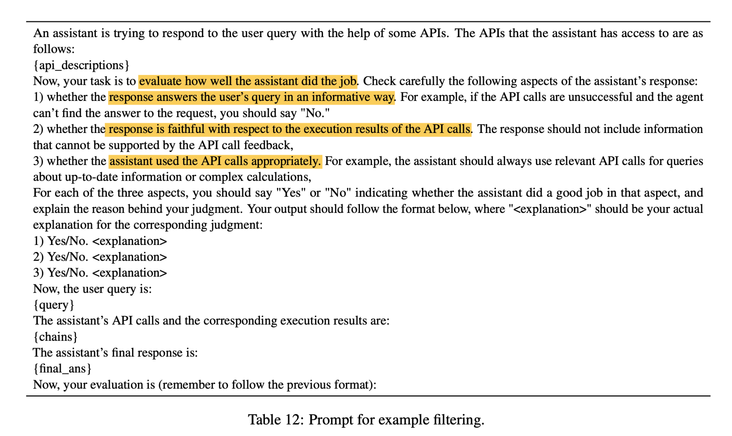
2. Exploitation
Trials obtained from exploration stage utilized for
ICL
Fine-tuning
For each trial
Extract synthesized user query
LLM’s last API call
Execution results
Final response from trial trajectory
Filter with GPT-4
Judge validity of each example
Paraphrase valid examples for each API

Slide 10
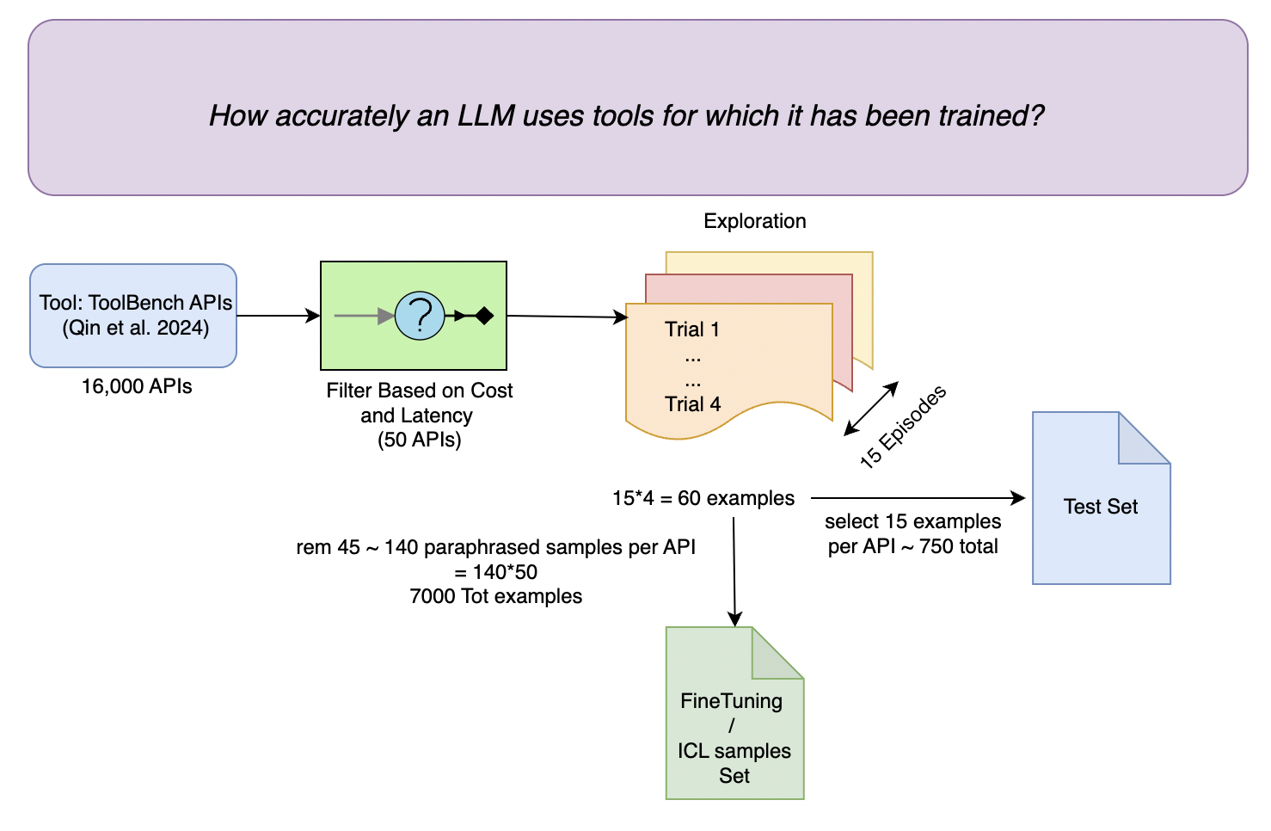
Experimental setup
Filtered and Selected 50 Tool APIs that are free, less latency and not rate limited from ToolBench
Used ChatGPT (16k) for exploration /paraphrasing.
Used GPT-4 (8k) for final filtering.
Finally generated Test Set and Fine-Tuning Dataset.
Next slide, ICL and Fine-Tuning setup

Slide 11
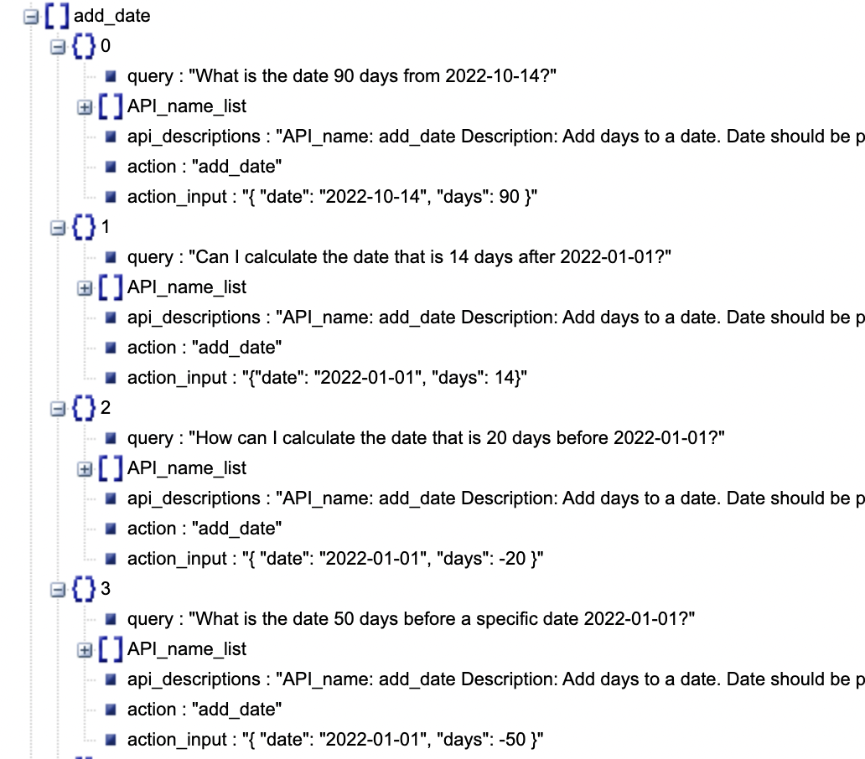
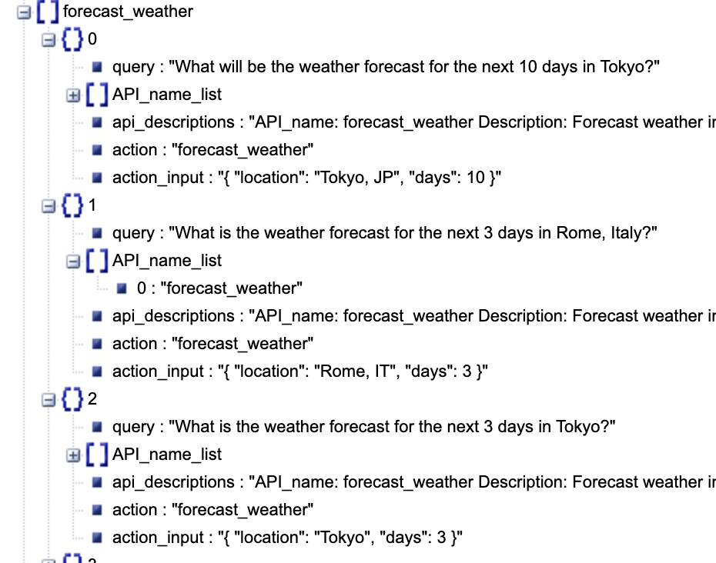
Dataset Example

Slide 12
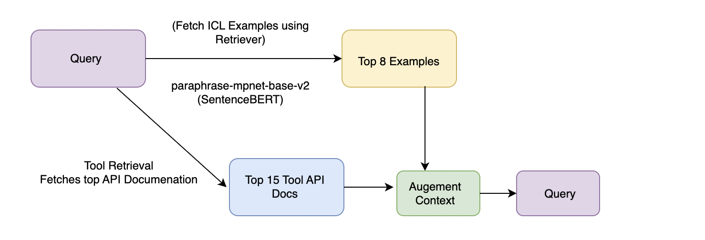
Experimental setup
Baselines:
ToolLLaMA-v2 - Llama-2-7B and fine-tuned on 126K tool use examples synthesized by ChatGPT- 3.5-turbo for general tool-use
Models: Llama-2-Chat-7B/13B, Mistral-Instruct-7B (Both FT, ICL). GPT-3.5-turbo/GPT-4 (ICL Only)
ICL Setup:
Fine-Tuning Setup:
LLMs fine-tuned on STE do not need such API documentation in the context
Reduces the inference cost - Why?
Cause of less input tokens.

Slide 13
Evaluation Metrics
Correctness
Wellformedness
API Match
Measures the accuracy of both:
1. Predicted API name
2. Arguments provided
Method of Validation:
1. Strict Value Ranges: String matching on arguments (Eg: Int, float check)
2. ChatGPT judges the correctness on natural lang args
Percentage of examples with valid API calls
1. No syntax errors.
2. No formatting errors.
Percentage of examples where the model selects the ground-truth API.
API Call matching.

Slide 14
Evaluation Metrics - Examples
Failure Cases
Correctness
Wellformedness
API Match
Ground Truth:
translateText(input="How are you?", targetLanguage="French")
Model Prediction:
translateText(input="What's up?", targetLanguage="French")
Argument input value mismatch,
judged incorrect
User Query:
"What will the weather be in San Francisco tomorrow?"
Ground Truth API:
getWeather(city="San Francisco", date="2024-11-17")
Predicted API:
searchCityInfo(city="San Francisco")
Model Prediction:
getWeather[location="Paris", date="2024-11-17"]
Invalid syntax getWeather() should be the right call

Slide 15
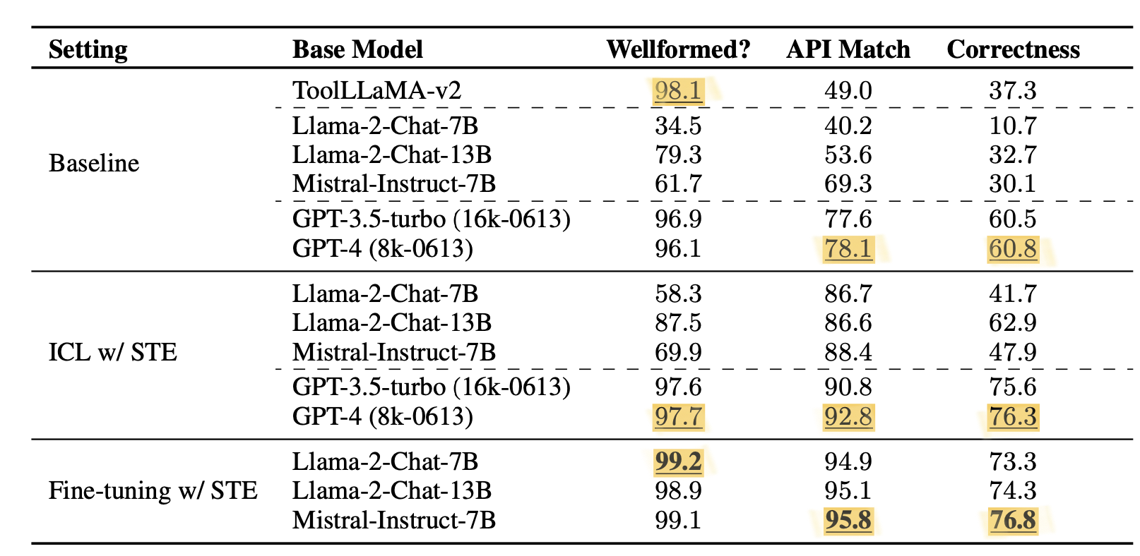
Results
STE is effective with both ICL and fine-tuning.
ICL with STE shows significant improvement over baselines (correctness metric).
Fine-tuning with STE significantly outperforms ICL.
This is likely because fine- tuning allows injecting a much wider range of tool use examples into a model than ICL.
This shows the importance of pre-incorporating tool-use knowledge into LLMs, i.e., the importance of exploration step to fetch FT examples/dataset.

Slide 16
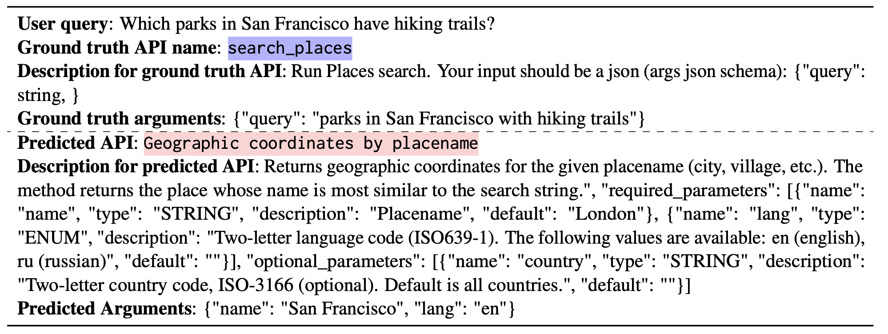
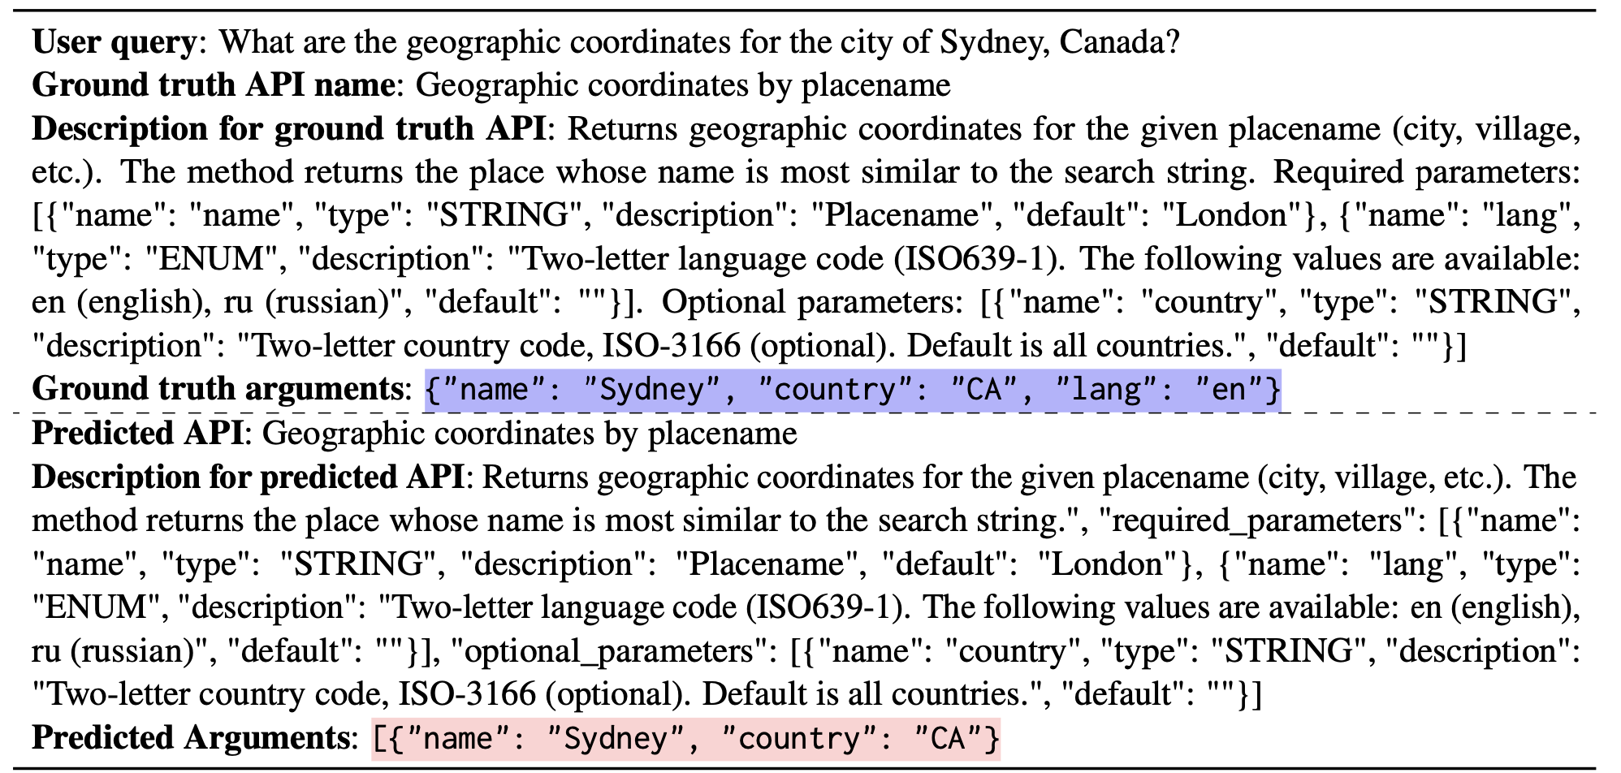
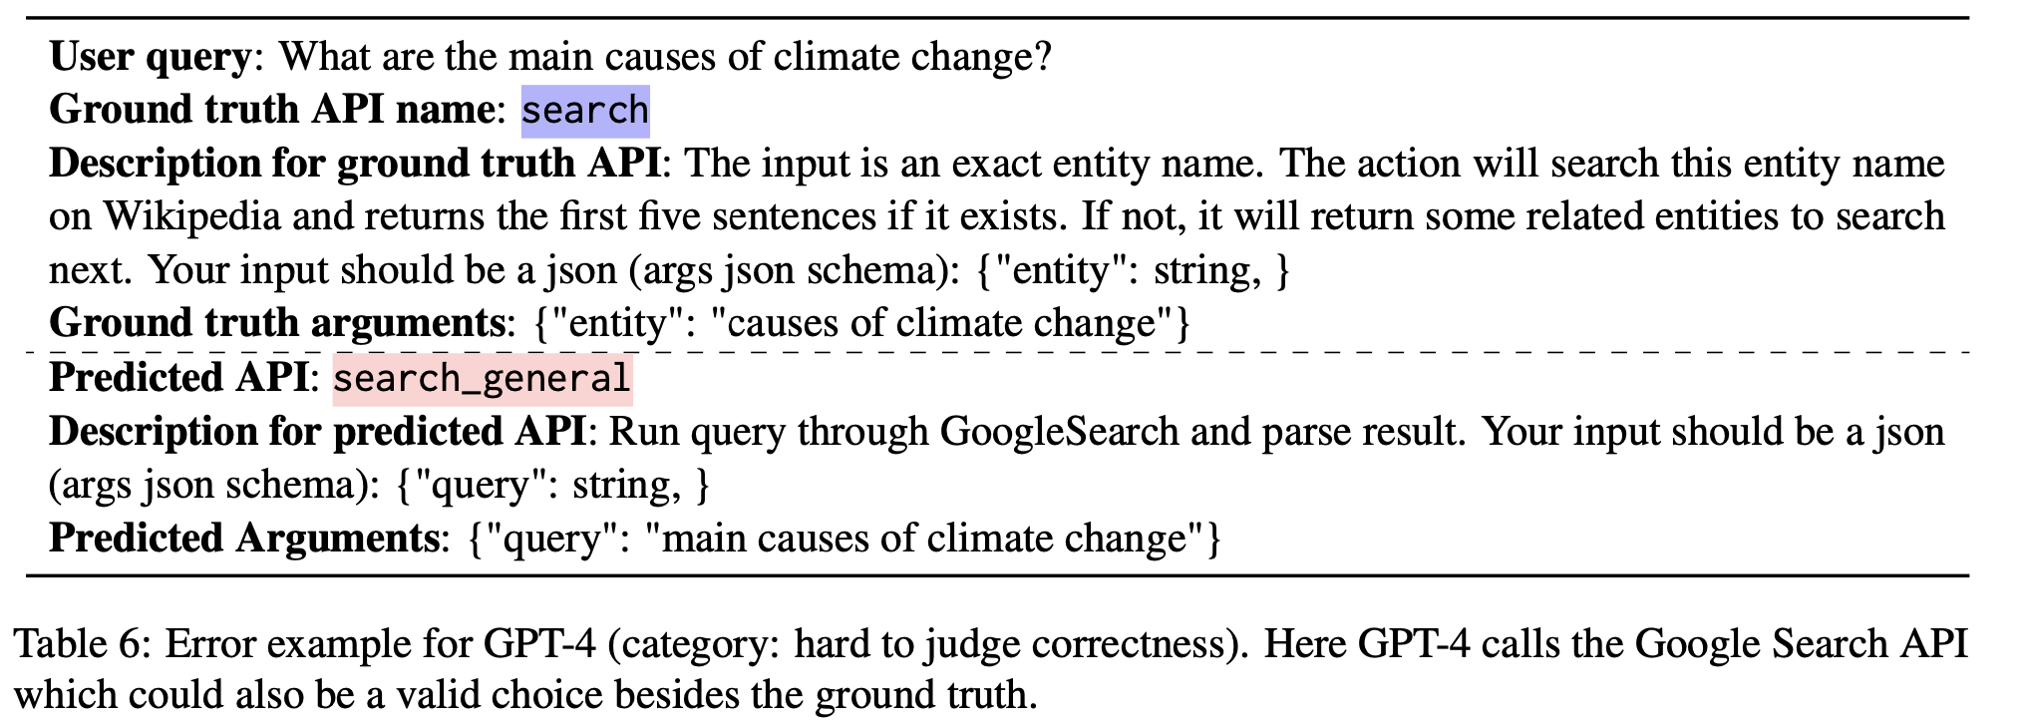
GPT-4 Error Analysis (Before -> After ICL with STE)
Wrong API call
36.7% -> 19.0%
STE helps better illustrate fine-grained semantics
Missing/Wrong API arguments
26.7% -> 10.0%
Hard to evaluate examples
36.7% -> 16.7%
Some tools have overlapping functionalities/are time-sensitive

Slide 17
Mistral-Instruct-7B Error Analysis ( FT with STE)
Commonsense/world knowledge (47.7%)
=> Scale or more knowledge retrieval
Language Understanding (31.6%)
=> Use stronger base LLM
Grounding
(21.1%)
=> fuzzy-matching; add decoding constraints

Slide 18
Ablation Study on Llama-2-Chat-7B
Execution Feedback: (-) Increase in ill-formed API calls (e.g., incorrect syntax or formatting)
Feedback ensures alignment with syntax/formatting requirements.
Short-Term Mem. (-) Misses details and fails to adapt based on prior errors. (Drop in correctness)
Misses exploration into fine-grained attributes (e.g., humidity, UV index, sunrise time). No specificity.
Short-Term Mem. Allows learning from immediate execution results. (i.e., previous trials in same episode)

Slide 19
Ablation Study on Llama-2-Chat-7B
Long-Term Mem. (-) Trials become repetitive and uninformative. (Drop in Correctness)
Long-Term Memory: Maintains diverse queries (e.g., locations, attributes, time).
Both Long and short-term Mems. significantly boost specificity, diversity, and correctness in trial-and-error learning
Self-Reflection
Crucial for maintaining informative long-term memory.
Enables the LLM to refine exploration and improve trial outcomes.

Slide 20
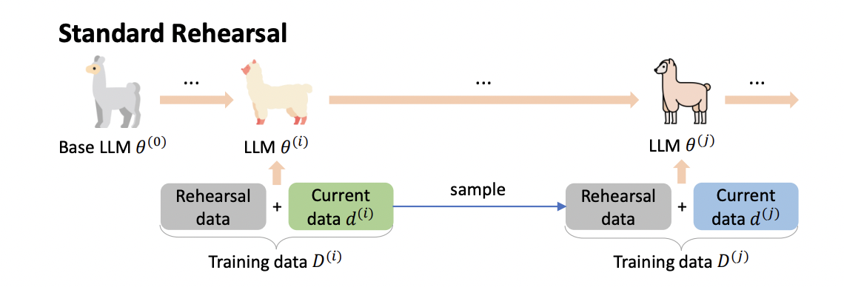
Continual Tool Learning
Catastrophic Forgetting of Fine-Tuned LLMs -> No Flexibility as new Tools get added.
Continual Learning with simple Rehearsal Strategy.
Experimental Setup:
Tools are split into 4 batches to simulate incremental learning.
Rehearsal Strategy:
During each training round:
Add 10% of previous tool-use examples (prev batch) into a replay buffer.
Include 2,000 random examples from FlanV2 for general non-tool-use capabilities.
Evaluation Metrics/Benchmarks:
Correctness score: Performance on previously learned tools after learning new tools.
General Capabilities: MMLU, BBH
Model Used: Llama-Flan

Slide 21
Continual Tool Learning - Results
Rehearsal enables flexible addition of new tools without catastrophic forgetting.
Effective with STE.
Without Rehearsal:
Drastic forgetting of previously learned tools.
Tools learned in earlier batches are most severely impacted.
With Rehearsal:
Forgetfulness Mitigated: Retains tool-use capabilities comparable to fine-tuned models (Llama-FT).
General Language Abilities Preserved: Performs well on MMLU and BBH.

Slide 22
Limitations
Iterative Improvement
Planning
Beyond Context limit
&
Potential overfitting
Tool unlearning?
Current Exploration-Exploitation setup over relies on strong models
Ex. GPT4 for train tool query generation (paraphrasing + filtering).
Prior works on Iterative learning using feedback loops and RL.
Authors say that eventually as the weaker models become more capable (after STE Fine-tuned) -> Can close the gap
Another orthogonal direction is about Tool use and comprehensive planning.
Planning multiple tool calls to fulfill complex queries (like multihop queries)
If planning is successful we don’t need FT dataset anymore, could just align models.
The problem of unlearning is important as tools could get deprecated/outdated
ToolkenGPT allows plug-and-play adaptation while enabling learning with large-scale examples
Use Retrieval models or Hierarchal compressed memory models to solve context limit issue.
It’s difficult to teach the model when not to use a tool.
To solve this, we can use negative examples (e.g., using contrastive objectives)

Slide 23
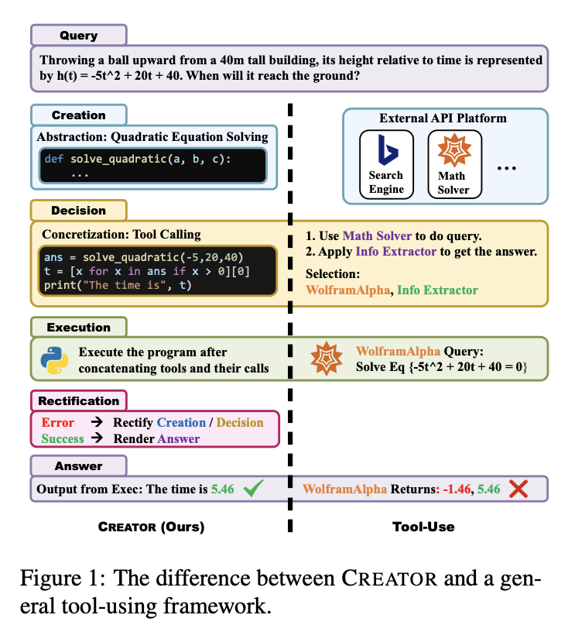
CREATOR: Tool Creation for Disentangling Abstract and Concrete Reasoning for Language Models
Name
Department Course Number Section Time Location
DATE
LLM ability limited by API availability and ability
CREATOR:
LLMs create their own tools using documentation and code realization
Disentangles abstract tool creation and concrete decision execution
Outperforms current CoT, PoT and tool-using baselines

Slide 24
Thank You!

