Slide 1
Llama 3 Herd of Models
9/10 Advances in Self-Supervised Models

Slide 2
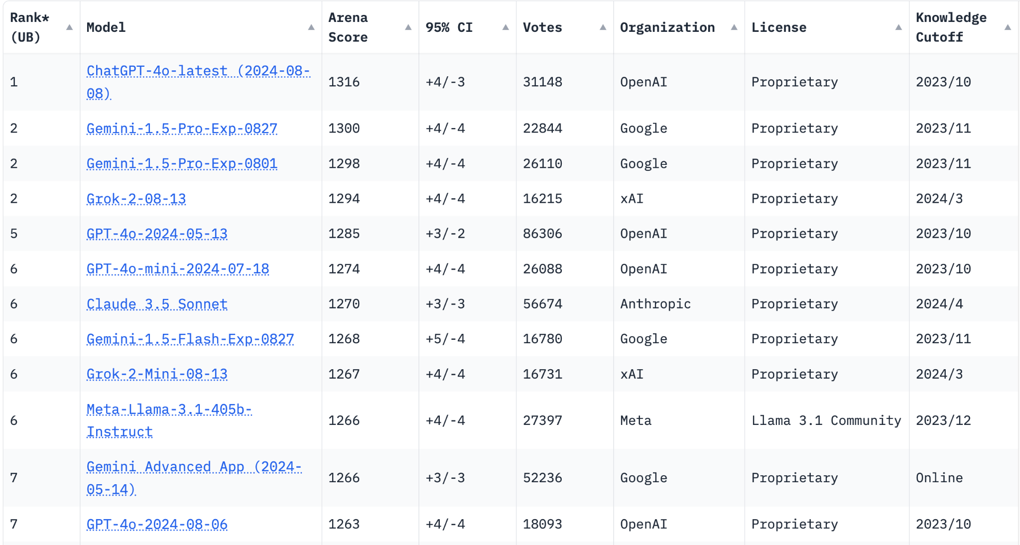
Llama 3.1-405b Instruct is Currently the Best Open Source AI

Slide 3
Overview
https://llama.meta.com/
On engineering Llama Models
Integrates image, video, speech capabilities, natively supports multilinguality, coding, reasoning, and tool usage.
Not MoEs or some amalgamation of Llamas! Use a standard dense Transformer.
Training Data: 15T / Scale: 8B - 405B
This presentation is on pre-training only
The paper is 92 pages long!
Notes:
Also Integrate image, video, speech capabilities
Pre-training & post-training 2 stages
Data: 15T / Scale: 8B - 405B / Arch: a standard dense Transformer

Slide 4
Pre-Training
Curation and Filtering of a large-scale training corpus
The development of a model architecture and corresponding scaling laws for determining model size
The development of techniques for efficient pre-training at a large scale
Development of a pre-training recipe

Slide 5
Data Acquirement

Slide 6
Part 1, Pre-training Data
Source
Much of data obtained from web
Maybe some Meta APP databases
Goal
To obtain a high-quality language model
Obtained multilingual data on general knowledge, code, and reasoning
Improved the data quality
Removed some inappropriate text
Determined the proportion of different data sources
Notes:
From 1.8T to 15T
Support key capability

Slide 7
Filtering, Cleaning and Deduplication
Removal of safety filtering
Removed sites that is likely to contain unsafe content, and personal identification info
Text extraction and cleaning
They created HTML parser to remove boilerplate and retrieve content only.
Got rid of markdown markers since it was harmful
Deduplication
Removal of duplicate, old versioned url
Global minhash document-level deduplication
Line level Remove lines that appeared more than 6 times in each bucket of 30M documents
expensive!!
Notes:
Minhash - hash substrings into multiple hashes, keep only the smallest one. Calculate jaccard similarity

Slide 8
Heuristic Filtering
Deduplication using n-gram coverage
Deduplicates items too long according to line-level deduplication
“Dirty Words” counting to remove adult websites
Kullback-Leibeler divergence to filter documents with excessive outlier tokens

Slide 9
Model-based Quality Filtering
Fasttext to recognize text referenced by Wikipedia
Trained a quality classifier DistilRoberta to generated quality scores for each documents
Quality classifier
Unlabeled training set of cleaned
Web documents
labeled training set of cleaned
Web documents
Llama 2

Slide 10
Code and Reasoning Data & Multilingua Data
Code
Trained a DistilRoberta model based on data annotation of Llama2 for extraction of web pages related to code and math.
Shares different token distribution from other sites.
Required domain specific HTML extraction, text features, and heuristics for filtering
Multi-language
Used fasttext based language identification to categorize 176 languages
Build custom document-level and line-level deduplication within data for each language
Used language-specific filters.

Slide 11
Limitations
No mention of the actual Data they used. (maybe issues on intellectual property)
Doesn’t specify webpage but the data extraction methods point towards majority web scraping.

Slide 12
Concoction
Developed a classifier to categorize the types of information and downsample the categories which is not important like entertainment
Performed scaling law experiments in small models to predict patterns on large models.
summary
50% - general knowledge
42% - code and reasoning !!!
8% - multilingual

Slide 13
Annealing
Upsampled high-quality data with a very low learning rate near the end of training, for example in reasoning and math area
Using in judging the value of specific domain datasets
assign 30% weight to new dataset and the remaining 70% weight to the default data mix
It can be evaluated whether the datasets has impacts on pre-training

Slide 14
Model

Slide 15
Model Architecture(Compared to Llama 2)
Grouped query attention(GQA) with 8 key-value heads
Used attention mask to prevents self-attention between differents documents
Notes:
Maybe we should give the interpretation for GQA and attention mask.

Slide 16
Grouped query attention(GQA)
Divide query heads into G=8 groups(each group has n=4/8/12 queries), each of which shares a single key head and value head.
Construct each group key and value head by mean-pooling all the original heads within that group.
Higher model quality than MPA
Faster than MHA
Reduces size of kv-cache
[ Ainslie, Lee-Thorp, Jong, Zemlyanskiy, Lebrón, Sangha’23 ]
Notes:
Grouped-query attention divides query heads into G groups, each of which shares a single key head and value head. GQA-G refers to grouped-query with G groups. GQA-1, with a single group and therefore single key and value head, is equivalent to MQA, while GQA-H, with groups equal to number of heads, is equivalent to MHA. Figure 2 shows a comparison of grouped-query attention and multi- head/multi-query attention. When converting a multi-head checkpoint to a GQA checkpoint, we construct each group key and value head by mean- pooling all the original heads within that group.
Gemma2 also uses GQA!

Slide 17
Attention mask
Significant for continued pre-training on very long sequences
Doc1: 3k
Doc2: 4k
Doc3: 1k
X
Notes:
Maybe remove this. This is standard in model training

Slide 18
Model Architecture
Used a vocabulary with 128K tokens. Combined 100K tokens from the tiktoken3 tokenizer with 28K additional tokens to better support non-English languages
tokenizer improves compression rates on a sample of English data from 3.17 to 3.94 characters per token
Increased the RoPE(position encoding method) base frequency hyperparameter to 500,000 to better support longer contexts.

Slide 19
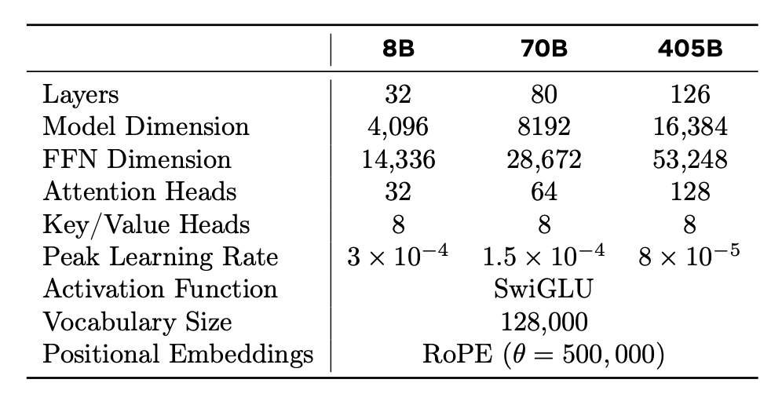
Model Architecture
Notes:
How about focusing on attention / key head

Slide 20
Scaling Laws
Prev scaling laws (Hoffmann et al., 2022; Kaplan et al., 2020):
predict only next-token prediction loss rather than benchmark
Scaling laws can be noisy and unreliable because they are developed based on pre-training runs conducted with small compute budgets

Slide 21
Scaling Laws
Established a correlation between the compute-optimal model’s negative log-likelihood on down-stream tasks and the training FLOPs.
Correlated the negative log-likelihood on downstream tasks with task accuracy, utilizing both the scaling law models and older models trained with higher compute FLOPs. (eg,Llama 2)

Slide 22
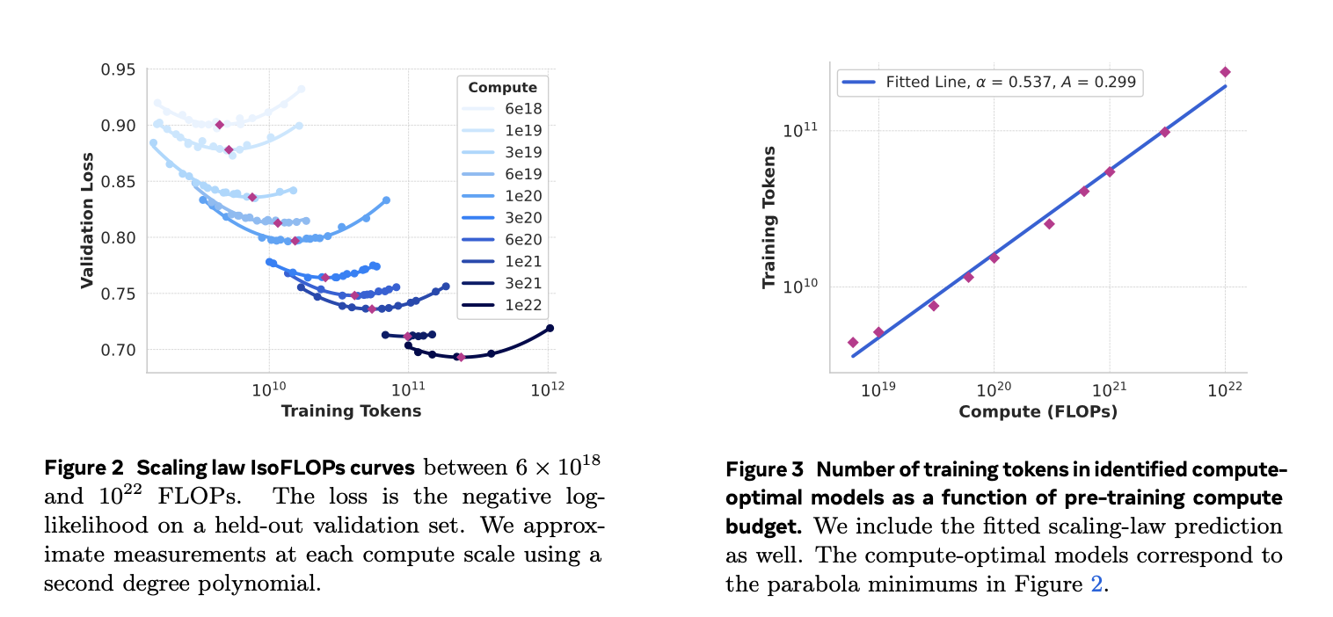
Scaling Laws
Optimization

Slide 23
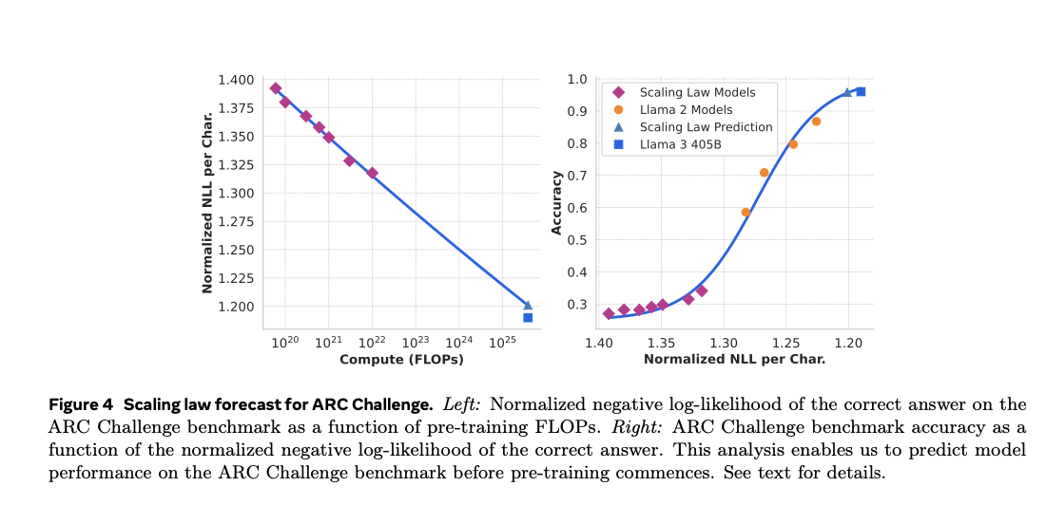
Scaling Laws
Experiments on various benchmark make sense
Training on small scaling law models
and Llama 2 models

Slide 24
Infrastructure, Scaling and Efficiency
Notes:
Stuff that cannot be made without large scale centers. Imaging having hundreds of millions of dollars to burn!
Probably the most novel part of this paper.

Slide 25
Engineering Challenges of Training a 405B Parameter Model
With 405 billion parameters storing the model weights in full precision (32-bit) results in 1,620 GB of vram just for the weights
Optimizers generally use three times the model size of memory. That results in 4,860 GB of vram
Training a model of this scale requires 80+ H100 GPUs to for a single instance
The model is trained in batches, meaning weight updates must be synchronized across batches, layers, tensors across GPUs.
Training such model requires massive infrastructure and smart parallelization schemes

Slide 26
Infrastructure

Slide 27
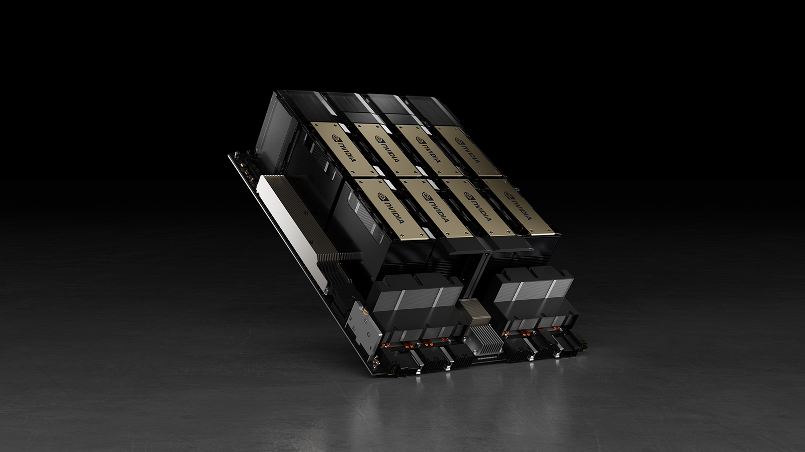
Compute
16k H100 80GB GPUs
400 million dollars on GPU alone
Server rack consists of eight GPUs and two CPUs
Training Jobs were scheduled via MAST, Meta’s global scale training scheduler

Slide 28
Storage and Network
Tectonic (Meta’s general purpose distributed file system)
240PB of storage, 7,500 servers
Each servers have throughput of 2TB/s and peak of 7TB/s
High burst occurs on checkpoint save
Important to keep frequent checkpoints due to recovery
Pan Et al., 2021 Battey and Gupta., 2024

Slide 29
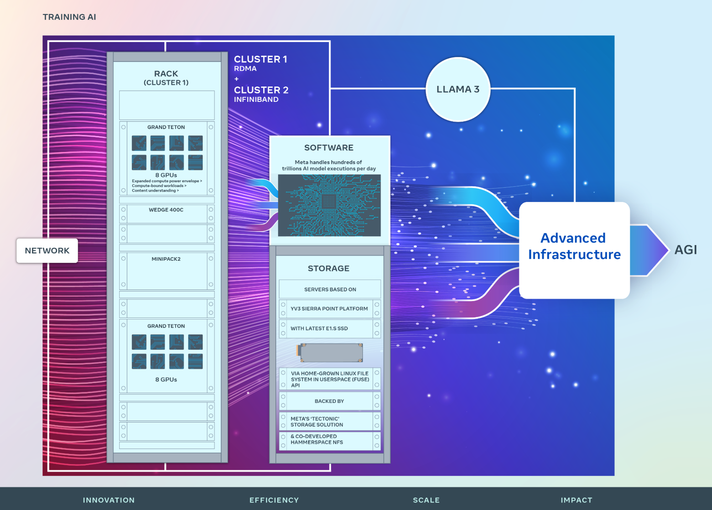
Network
Llama 405B used RDMA over Converged Ethernet fabric (RoCE)
Smaller models in the Llama 3 family were trained using Nvidia Quantum2 Infiniband fabric
Both clusters leverage 400Gbps interconnects between GPUs
Notes:
For 405B, they created their in house network
8 gpu with two server racks 16GPUs in rack host,, 192 racks, 8 pods.
The 8 pods have 1:7 oversubscription ratio
They have in

Slide 30
RoCE base structure
8 GPUs per rack
2 racks per rack host (16 GPUs)
192 rack hosts per pod(3072 GPUs)
8 pods (24K GPUs)
Oversubscription ratio of 1:7
Through load balancing, and congestion control, Llama team tackle the oversubscription ratio
Multiple channels between GPUs for granular flow and load balancing
Deep Buffer switches in the spine
Better load balancing (Check their paper!)
Notes:
For 405B, they created their in house network
8 gpu with two server racks 16GPUs in rack host,, 192 racks, 8 pods.
The 8 pods have 1:7 oversubscription ratio
They have in
These are all separate papers.

Slide 31
Parallelism

Slide 32
4D Parallelism
Tensor Parallelism
Chunks weight tensors into different devices
Context Parallelism
Divide input content into segments
Pipeline Parallelism
Partitions model vertically into stages by layers
Data Parallelism
Data parallelism shares the model, optimizer, and gradients
Notes:
Smallest to largest

Slide 33
4D Parallelism
Tensor Parallelism
Context Parallelism
Pipeline Parallelism
Data Parallelism
Notes:
Smallest to largest

Slide 34
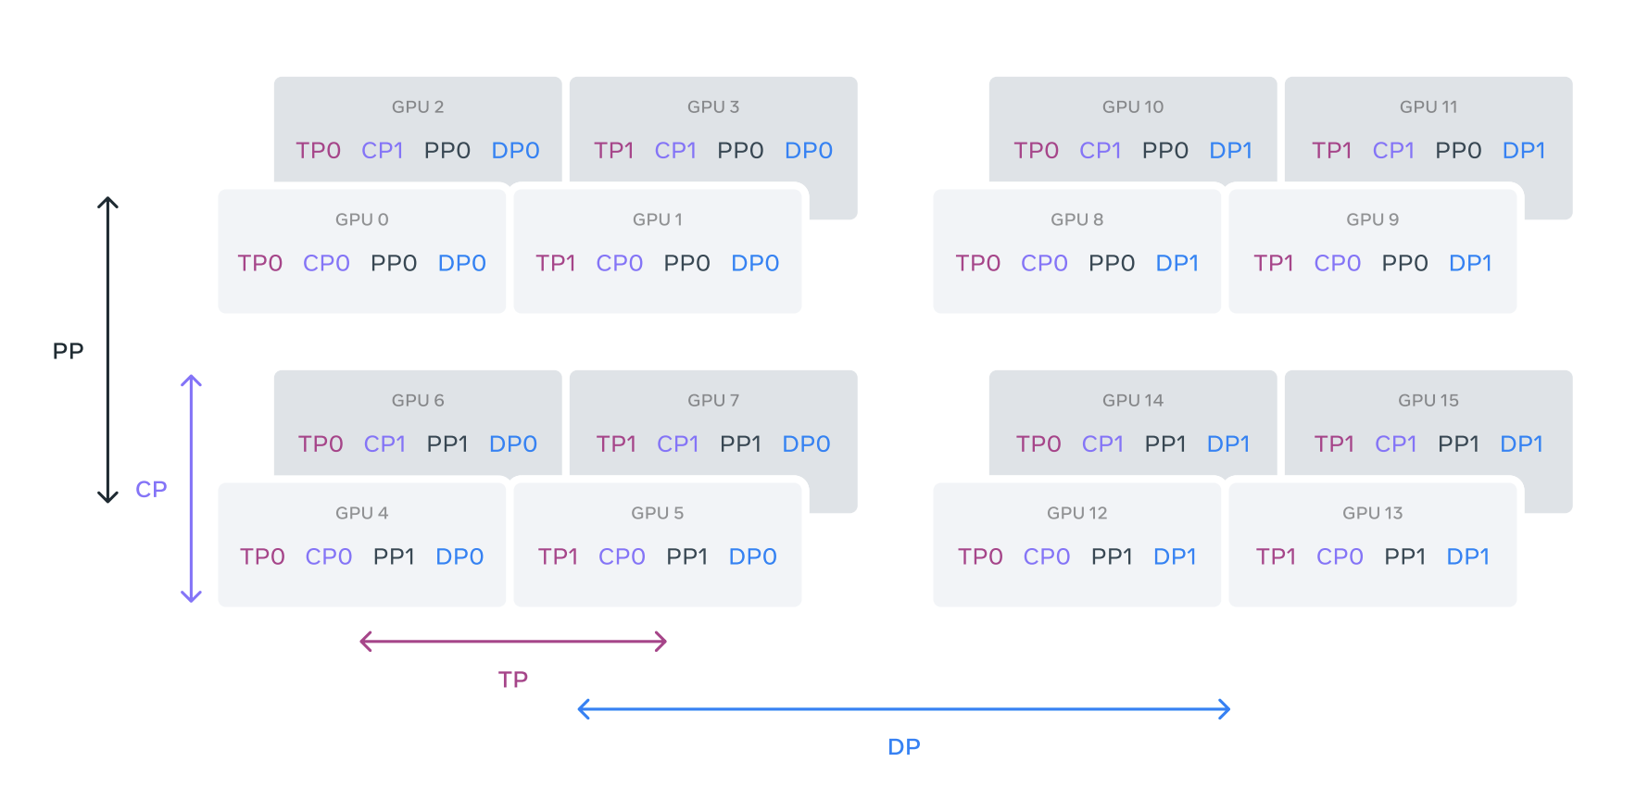

Slide 35
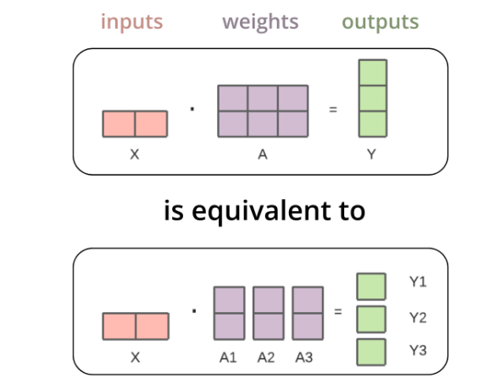
Tensor Parallelism
Splits large tensors to smaller tensors for modular computation

Slide 36
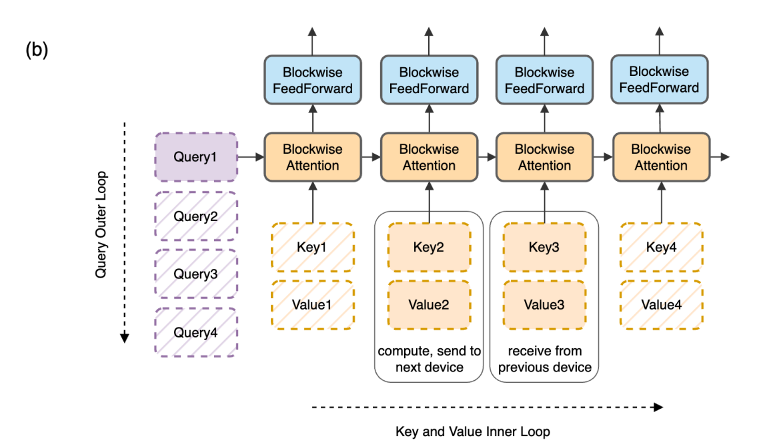
Context Parallelism
Splits context across multiple GPUs.
Utilizes ring-attention for compute
Utilized compute order flexibility of attention
Notes:
Softmax does not need to materialize before taking it.
https://arxiv.org/pdf/2310.01889

Slide 37
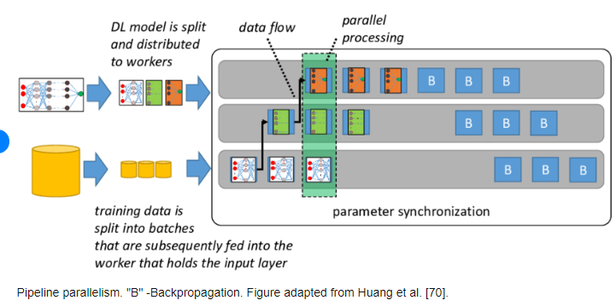
Pipeline Parallelism
Notes:
Previous version of pipeline parallelism requires number of gpus to divide number of pipeline stages. However, their change allows number of pipeline stages to be however they want

Slide 38
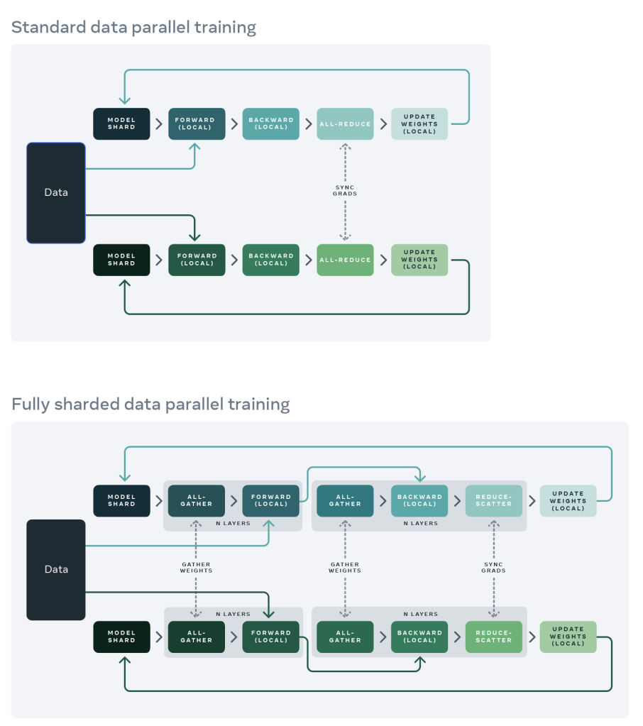
Data Parallelism
Trains models across different data
Uses Fully Sharded Data Parallelism (FSDP)
Synchronize updates using model, optimizer, and gradients shard.
Synchronized update happen every training step

Slide 39
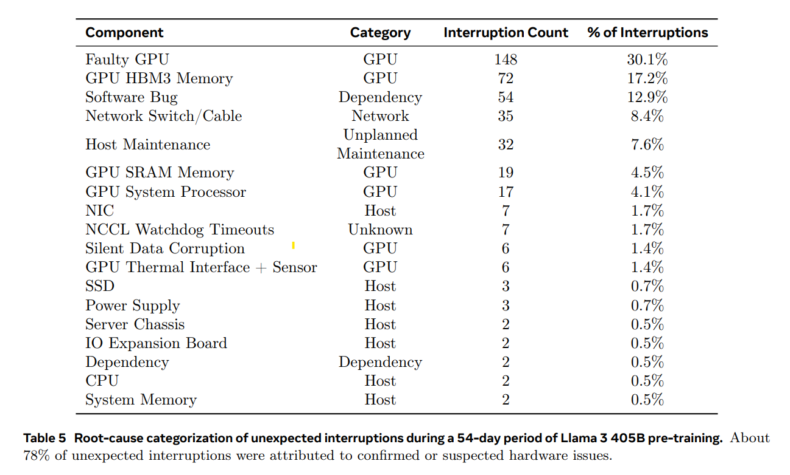
Training Stability
Achieved 90% effective training time
78% were due to hardware issues
Used PyTorch’s built in NCCL flight recorder to monitor
There was a 1-2% throughput variation based on time of day
Result of higher midday temperature

Slide 40
Training Recipe

Slide 41
Training Recipe
Initial pre-training
Long-context pre-training
Annealing

Slide 42
Initial Pre-training
Used linear warm up of 8,000 steps with peak learning rate of 8e-5.
Used cosine learning rate schedule decay to 8e-7 over 1,200,000 steps
Used lower batch size early in training to improve training stability
4M sequences of 4096 tokens up until 252M tokens
8M sequences of 8192 tokens until 2.87T tokens
Finally train on 16M batch size
Increased percentage of non-English data and mathematical data for initial pre-training.
Notes:
Started learning rate at 0 and linearly increment for 8000 steps until lr of 8e-5

Slide 43
Long Context Pre-Training
Trained on long sequences to support context windows of 128K tokens
Measured model performance on short-context evals and needle-in-a-haystack task
Gradually increased 8K context to 128K context window
800B training tokens used in long context pre-training

Slide 44
Annealing
During the final 40M tokens of training, the learning rate is linearly decreased to zero.
The final pretrained model weights are obtained by averaging over model checkpoints during this period.
During this period, data mix was enhanced by including text from upsampled data sources of high quality

Slide 45
Pretrained Model Evaluation

Slide 46
Pretrained Model Results
Standard Benchmarks
Robustness to changes in multiple-choice question setups
adversarial evaluations
the extent to which our evaluations are impacted by contamination of training data

Slide 47
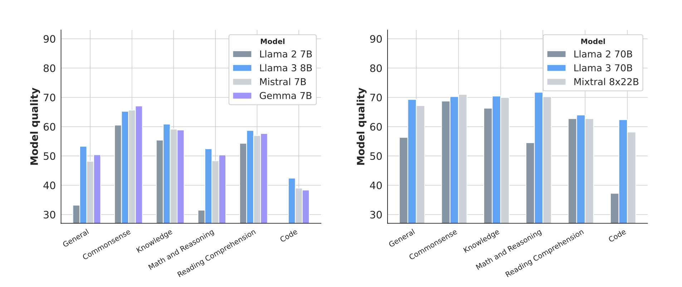
Standard Benchmarks
Win nearly all types of tasks!!

Slide 48
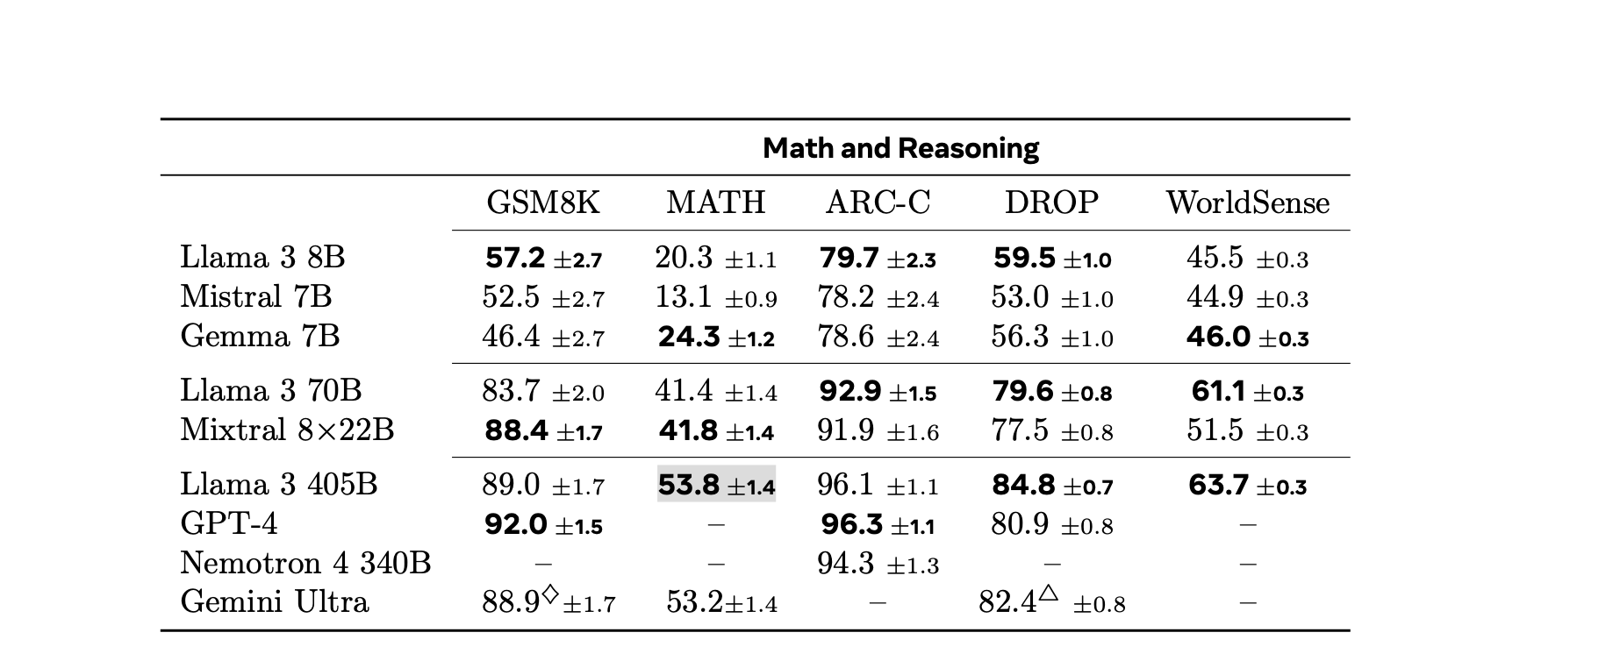
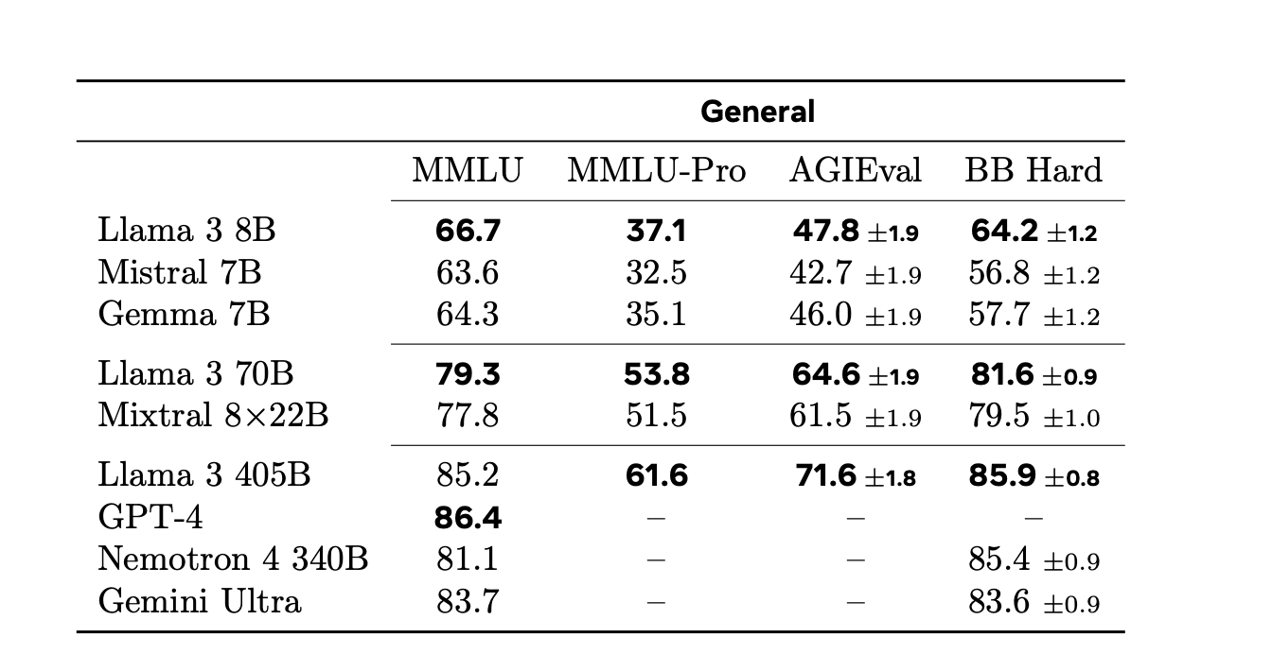
Standard Benchmarks
405B is very competitive among LM!!

Slide 49
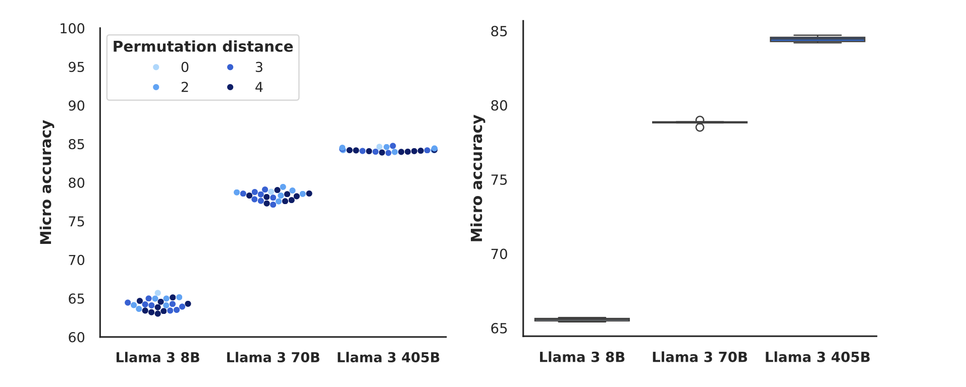
Robustness to changes in MCQ setups
Label variants
Few-shot label bias
Answer order
Prompt format
405B model shows high robustness in answer order changes
Notes:
Left: Performance for different label variants. Right: Performance for different labels present in few-shot examples.

Slide 50
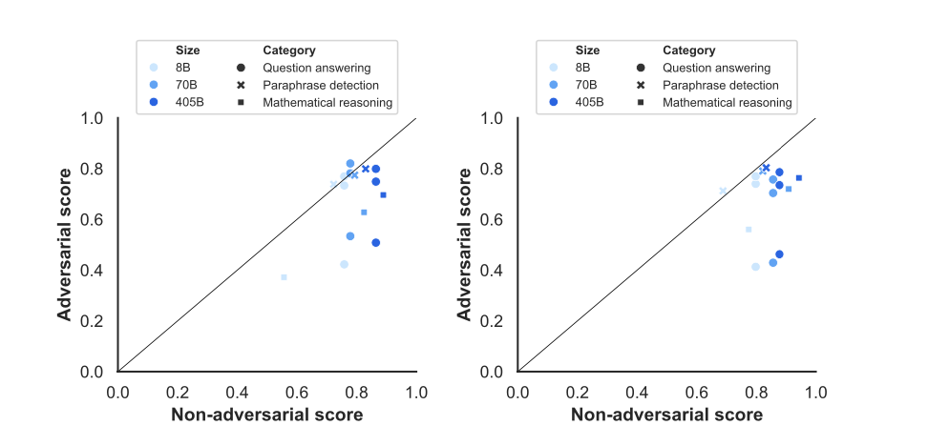
Adversarial evaluations
similar performance
the adversarial performances are substantially lower than the non-adversarial performances for math and question answering
Results for pre-trained models
Results for post-trained models

Slide 51
Contamination of training data impact
Method:
Consider an example of a dataset D to be contaminated if a ratio of its tokens are part of an 8-gram occurring at least once in the pre-training corpus.
Select separately for each dataset, based on which value shows the maximal significant estimated performance gain across the three model sizes.

Slide 52
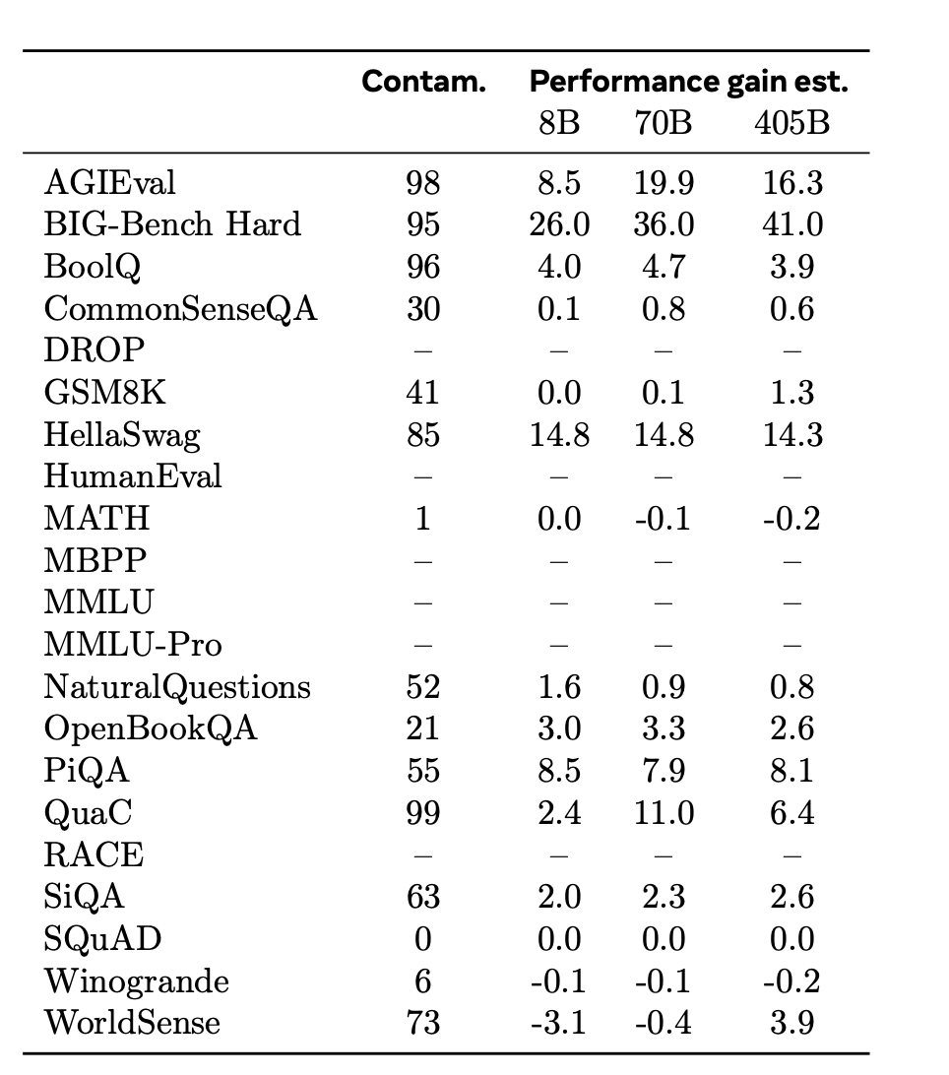
Contamination of training data impact
Both high
Other Detection methods needed
Seems no impact
Maybe larger n

Slide 53
Discussions

