Slide 1
The Llama 3 Herd of Models
A Deep Dive into Alignment Techniques
Aydan Huang & Zihao Zhao
Date: Sep 12, 2024

Slide 2
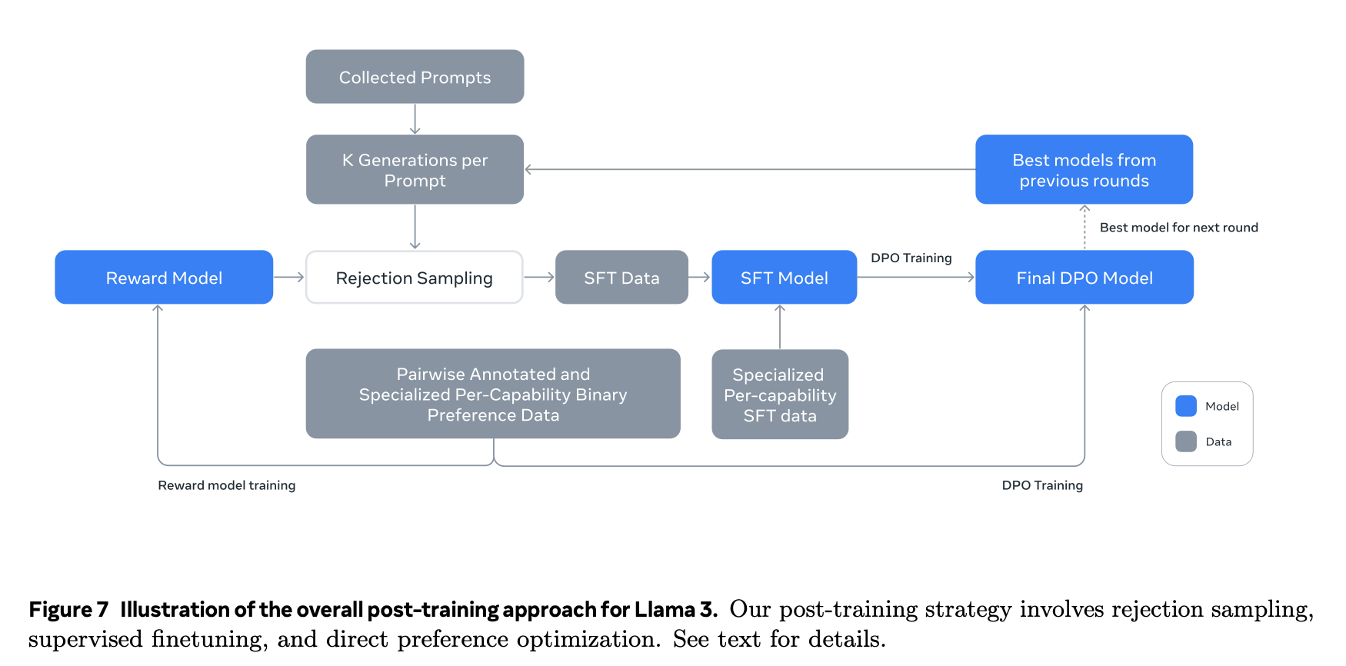
Post-Training Pipeline
Reward Modeling (RM)
Supervised Fine-Tuning (SFT)
Direct Preference Optimization (DPO)
Highlight: Iterative process across 6 rounds
Notes:
Llama 3's alignment is achieved through a sophisticated post-training pipeline.
The diagram here is essentially the core of the post-training process. We’ll walk through each step of this process and I will be covering the model blocks in this pipeline. That is a reward model, a supervised fine-tuning model, and a final DPO model.
Also note that this process is iterative, with multiple rounds of refinement. In the paper they mentioned that they ran this loop six times to continuously improve the model's alignment.

Slide 3
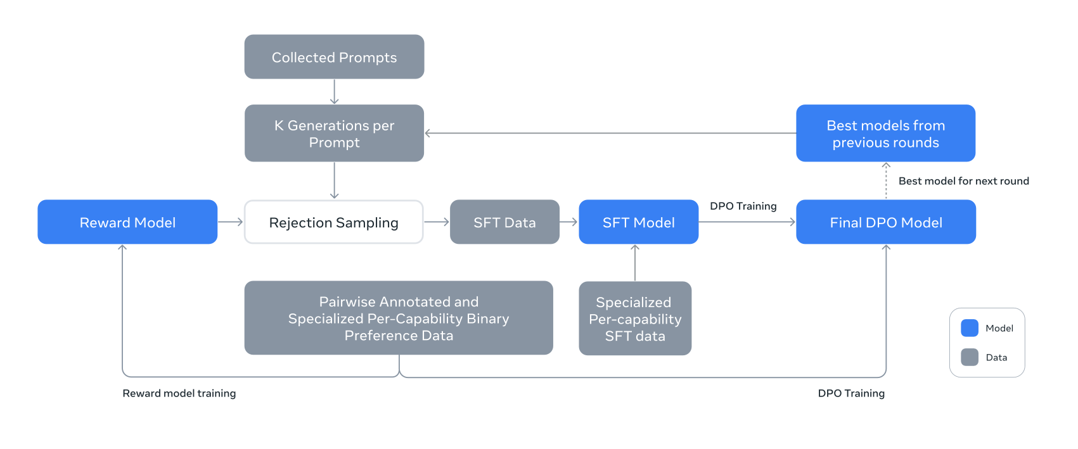
Preference data

Slide 4
Preference data
Preference data: data that reflects the people’s preference.
Sample two responses from two different models for each user prompt.
Annotators to rate the strength of their preference in four levels: significantly better, better, slightly better, or marginally better.
Use samples that are labeled significantly better or better and discard samples with similar responses.
Incorporate an editing step after preference ranking. (edited > chosen > rejected)
Notes:
Make an example of preference data

Slide 5
Reward Modeling

Slide 6
Reward Modeling
Training objective: Ranking responses (edited > chosen > rejected)
Innovation: Concatenated prompt-response pairs for efficiency
Use in rejection sampling: Selecting high-quality responses for SFT
Prompt: "How does quantum computing differ from classical computing?"
Generated Responses:
Edited: "Quantum computing leverages the principles of quantum mechanics, such as superposition and entanglement, to perform complex calculations much faster than classical computers, which rely on binary states."
Chosen: "Quantum computing uses qubits instead of bits, allowing for more complex calculations to be done simultaneously."
Rejected: "Quantum computing is faster than regular computers because it uses quantum physics."
Notes:
Now let's talk about Reward Modeling. The primary objective here is to train a model that can effectively rank responses based on human preferences. Specifically, it learns to prefer edited responses over chosen ones, and chosen over rejected.
First, they collect a bunch of prompts and generate K responses for each prompt, where K ranges from 10 to 30.
Human annotators then categorize these responses. Basically, they categorize the responses to each prompt into three categories. In the simplest case, if you have one prompt and generate two responses, one response is usually better than the other. The better response is placed in the "Chosen" category, while the lesser response is placed in the "Rejected" category. However, they added a third step by asking the human annotators to edit the chosen response to make it even better. This created a third category: "Edited," which is better than "Chosen," and "Chosen" is better than "Rejected."
Once they have enough data, including prompts, responses, and their corresponding categories, they train the initial reward model. This model can then evaluate a prompt and a set of responses to determine how good a particular response is.
A key innovation in Llama 3's approach is the concatenation of prompt-response pairs during training. Instead of processing prompts and responses separately, they're combined into a single input sequence. This method significantly improves training efficiency without sacrificing accuracy.
The trained reward model plays a vital role in rejection sampling. Here's how it works: for each human-annotated prompt, multiple responses are generated. The reward model then scores these candidates, and the highest-scoring responses are selected for use in Supervised Fine-Tuning, and the bad outputs are rejected. This creates a powerful feedback loop, continuously improving the quality of training data for the main language model.
Also, Llama 3's reward model removes the margin term from the loss function used in Llama 2, because they observed diminishing returns with the scaling of data. This simplification contributes to the model's ability to generalize effectively across a wide range of tasks and domains.

Slide 7
Supervised Fine-Tuning (SFT)

Slide 8
Supervised Fine-Tuning (SFT)
Data composition: rejection-sampled responses, synthetic data
Training details:
Cross entropy loss
Learning rate: 10^-5
Steps: 8.5K to 9K for 405B model
Prompt: "Explain the significance of the law of entropy in physics."
Rejection-Sampled Response: "The law of entropy, or the second law of thermodynamics, states that the total entropy of an isolated system always increases over time, leading to the concept of irreversible processes."
Synthetic Response: "Entropy is a measure of disorder in a system. The second law of thermodynamics says that in any energy transfer, entropy will increase, meaning systems tend to become more disordered over time."

Slide 9
Direct Preference Optimization (DPO)

Slide 10
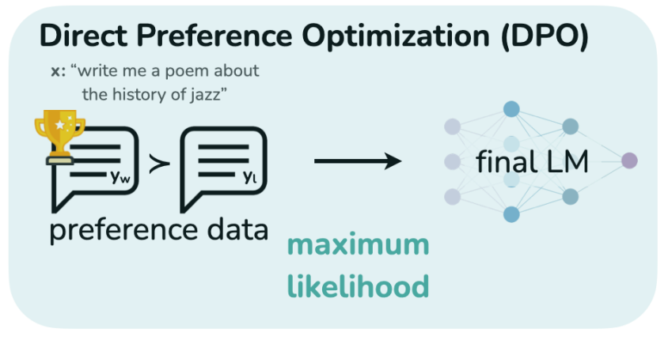
Direct Preference Optimization (DPO)
Key modifications
Masking special tokens in loss calculation
NLL loss term (coefficient: 0.2) for stability
Result: Improved performance on instruction-following benchmarks
Effects
Stabilized training
Maintained generation formatting
Notes:
Direct Preference Optimization (DPO) is a improved approach to fine-tuning language models that eliminates the need for reward model fitting and extensive hyperparameter tuning. Unlike RLHF, DPO formulates the constrained reward maximization problem as a simple classification loss. This allows for the extraction of the corresponding optimal policy in closed form, resulting in a stable and efficient algorithm.
Meta team introduced two significant modifications to DPO:
1. Masking formatting tokens in the loss calculation. Llama 3 uses special header and termination tokens in its chat protocol. Including these in the DPO loss led to undesired behaviors like tail repetition or premature response termination. This is likely due to the contrastive nature of DPO loss - the common tokens in both chosen and rejected responses leads to a conflicting learning objective as the model needs to increase and reduce the likelihood of these tokens simultaneously. Masking them out resolved this conflict.
2. Adding a Negative Log-Likelihood (NLL) regularization term. This has two purposes: it maintains desired generation formatting and prevents the decrease of chosen response probabilities. This addresses a common issue in preference-based training where models might lower probabilities across all responses to minimize the difference between chosen and rejected options.
These modifications yielded two main benefits:
1. Training stability improved significantly. In large language models, instability can manifest as oscillating loss values, sudden performance drops, or even training collapse. This is crucial for models at this scale.
2. The model maintained proper formatting in its outputs across various tasks. This is particularly important in tasks like code generation or structured text output.

Slide 11
Rejection Sampling and Data processing

Slide 12
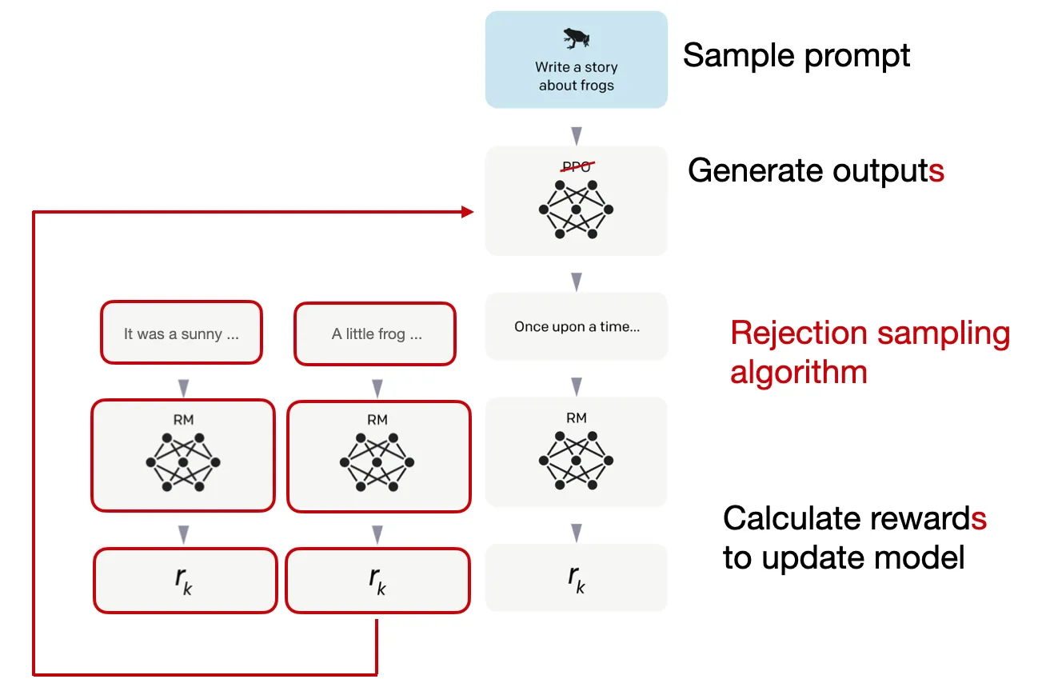
Rejection Sampling
Rejection sampling: generate multiple possible outputs for a given prompt and then select the best output based on certain criteria.
For each prompt in preference data, sample 10 to 30 responses from best performing checkpoint from the previous post-training iteration
Reward model: select the best response
Notes:
Rejection sampling is the idea that you sample a batch of K completions from a language model policy and then evaluate them across a reward model, returning the best one.

Slide 13
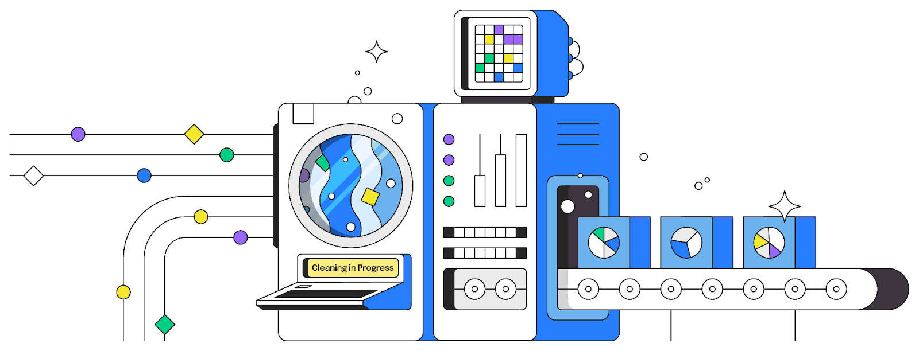
Data Processing and Quality Control
Data cleaning: implemented rule-based strategies to filter or modify data to remove or adjust problematic elements
Example: mitigate overly-apologetic tonal issues, we identify overused phrases (such as “I’m sorry” or “I apologize”) and carefully balance the proportion of such samples in our dataset.

Slide 14
Data Processing and Quality Control
Data pruning (remove low quality dataset):
Fine tuning Llama 3 8B as a topic classifier:classify the dataset into topics
Use reward model and Llama-based to obtain a quality score:
For general English data: three-point scale (accuracy, instruction-following, and tone/presentation)
For coding data: two-point scale (bug identification and user intention)

Slide 15
Data Processing and Quality Control
Difficulty scoring:
Instag (Lu et al. 2023): prompts Llama 3 70B to tag the intentions behind each SFT prompt. More intentions signify higher complexity.
Llama-Based Difficulty Scoring: Llama 3 evaluates the difficulty of dialogs on a three-point scale.
Semantic deduplication: Clustering with RoBERTa, examples with maximum cosine similarity below a certain threshold are selected(greedy selection)
[(Lu et al. 2023): arXiv:2308.07074]
Notes:
Add citation: Instag: Instruction tagging for analyzing supervised fine-tuning of large language models

Slide 16
Capabilities

Slide 17
Code
Evaluate code generation, documentation, debugging, and review capabilities in Python, Java, Javascript, C/C++, Typescript, Rust, PHP, HTML/CSS, SQL, bash/shell.
Follow code llama to continue training and long text finetuning
Synthetic data generation:using the model itself to generate large amounts of training data
Enabling the model to learn from its mistakes and stay on track (iterative self-correction)

Slide 18
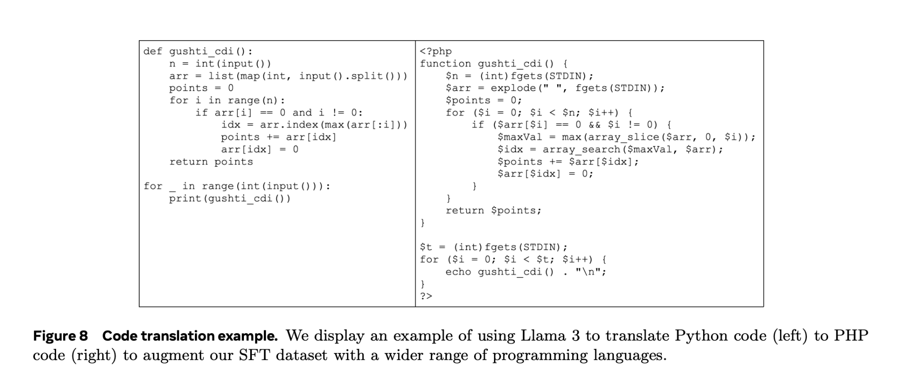
Code
Translating data from common programming languages to less common languages (add more training data)
Prompting the model to generate code-related data (comments or explanations), then reversing the process to regenerate code from that data. Use original code as a reference to determine the quality of the output. Use the generated examples that have the highest self-verification scores.
Notes:
Make the figure larger

Slide 19
Math and reasoning
Converted mathematical contexts in relevant pertaining data into a question-answer format, ask humans to provide relevant prompts. (address lack of prompts)
Generate step-by-step solution by llama 3(provide cot)
Filter out incorrect reasoning
Prompt Llama 3 to solve reasoning problems through textual reasoning and associated Python code. Code execution is a feedback signal to eliminate non valid cases.
Utilize incorrect generations and perform error correction(learn from feedback)

Slide 20
Long context
Length from 8k to 128k
Question-answering: Curate a set of long documents from pre-training mix. Split documents into chunks of 8K tokens, and prompted an earlier version of the Llama 3 model to generate QA pairs
Reasoning over code repositories: Parse Python files to identify import statements and determine their dependencies. Select the those referenced by at least five other files. Remove one of these key files and prompt the model to identify which files depended on the missing file and to generate the necessary missing code

Slide 21
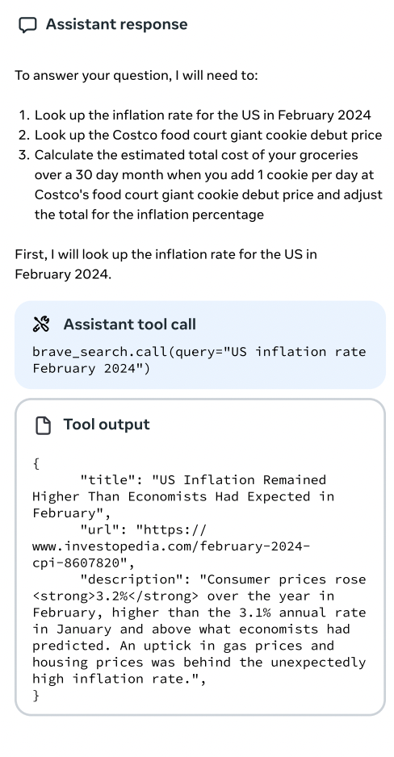
Tool use
Use search engine, python interpreter, and Mathematical computational engine (Wolfram)
Rely on human annotations and preference
Single-Step and Multi-Step Tool Use
Ask to summarize the contents of the file, find and fix bugs, optimize a piece of code, perform data analysis or visualization for a uploaded file.
Fine-tuning Llama 3 on a large and diverse set of synthetic data (zero-shot tool use)

Slide 22
Factuality
Focus on reducing hallucinations
Principle: Align model to "know what it knows"
Knowledge probing technique:
Extract data snippet
Generate factual question
Sample and score responses
Generate refusals for uncertain answers
Additional labeled data for sensitive topics

Slide 23
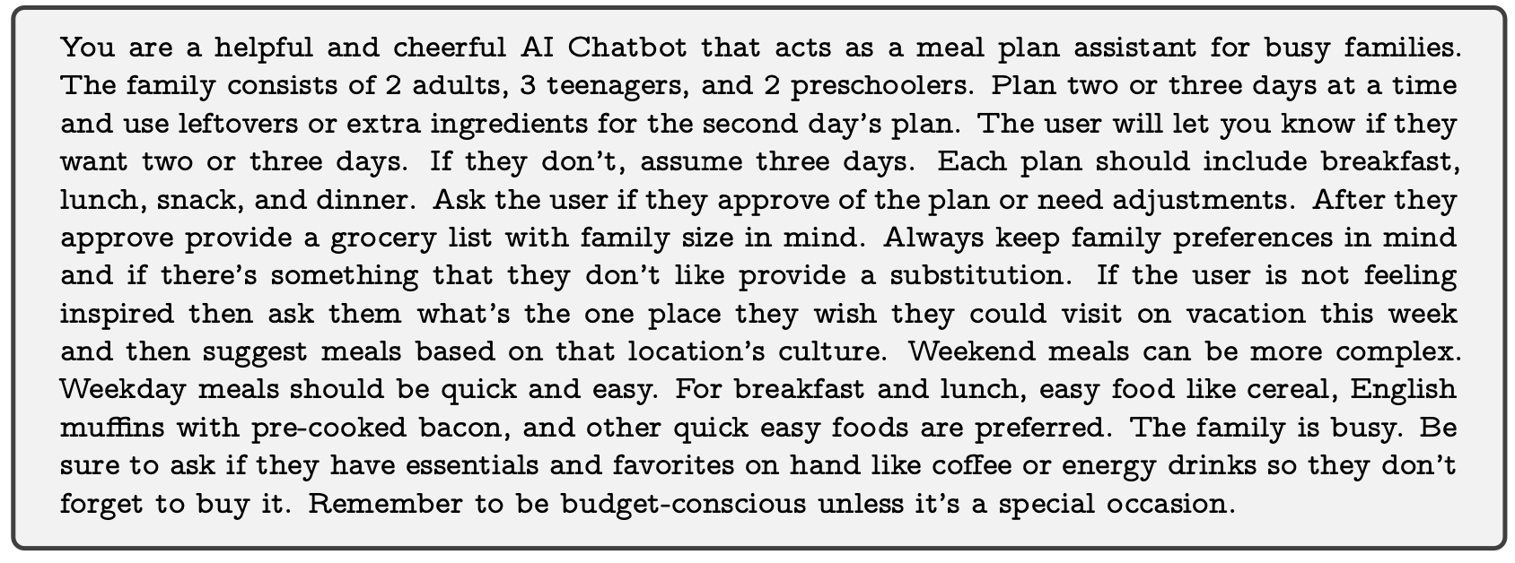
Steerability
Goal: direct the model’s actions to meet developer and user specifications
Data collection: Annotator-designed system prompts
Modeling: Reward modeling, rejection sampling, SFT, and DPO

Slide 24
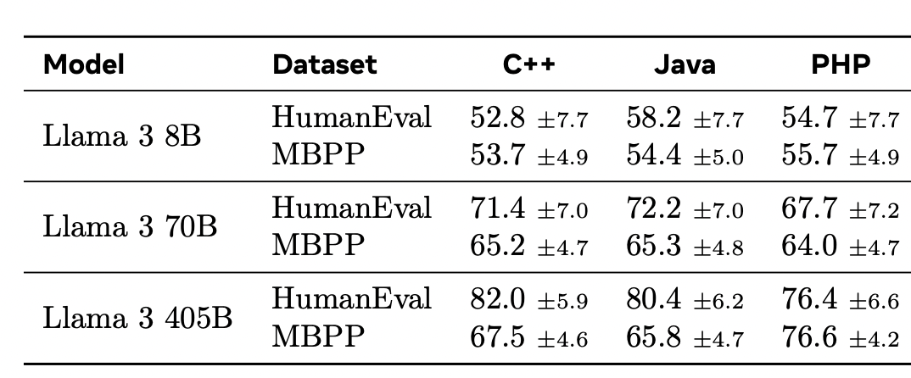
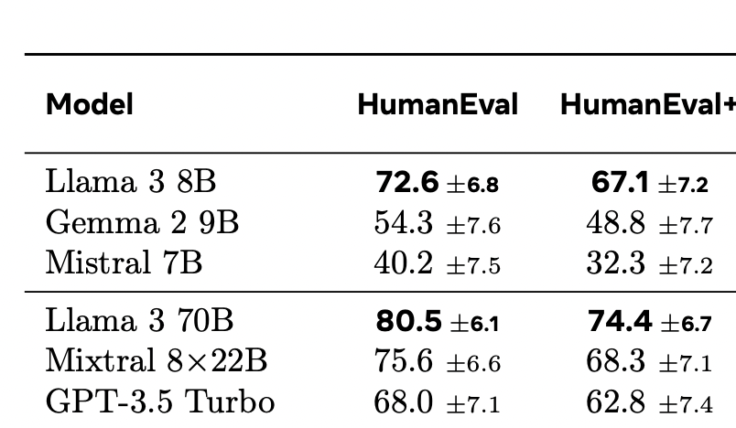
Code Evaluation
Take away: Llama 3 8B and 80B outperform other models of similar sizes.
There is a significant drop in performance compared to the Python counterparts
Notes:
evaluation

Slide 25
Math and reasoning evaluation
Llama3 70B has greater performance in some tasks compared to the larger model.

Slide 26
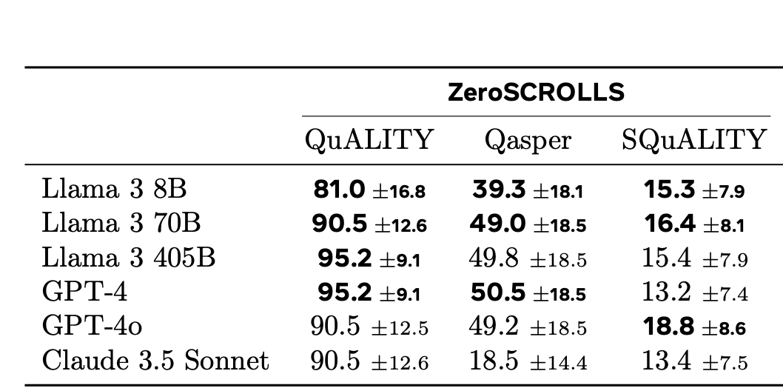
Long text evaluation
Llama 3 405 B has better or comparable performance.

Slide 27
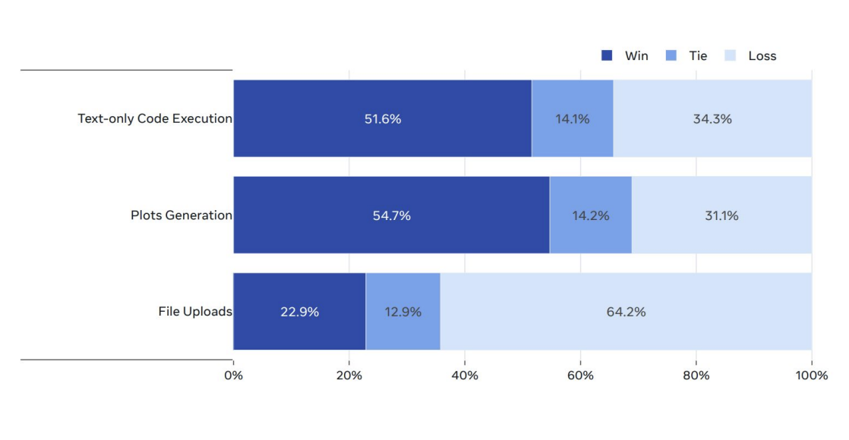
Tool use evaluation
Llama 3 405B vs. GPT-4o on code execution tasks.
Llama 3 405B outperforms GPT-4o on code execution as well as plot generation, but lags behind in file upload use cases

Slide 28
Copyright The Johns Hopkins University 2024. All rights reserved.

Slide 29
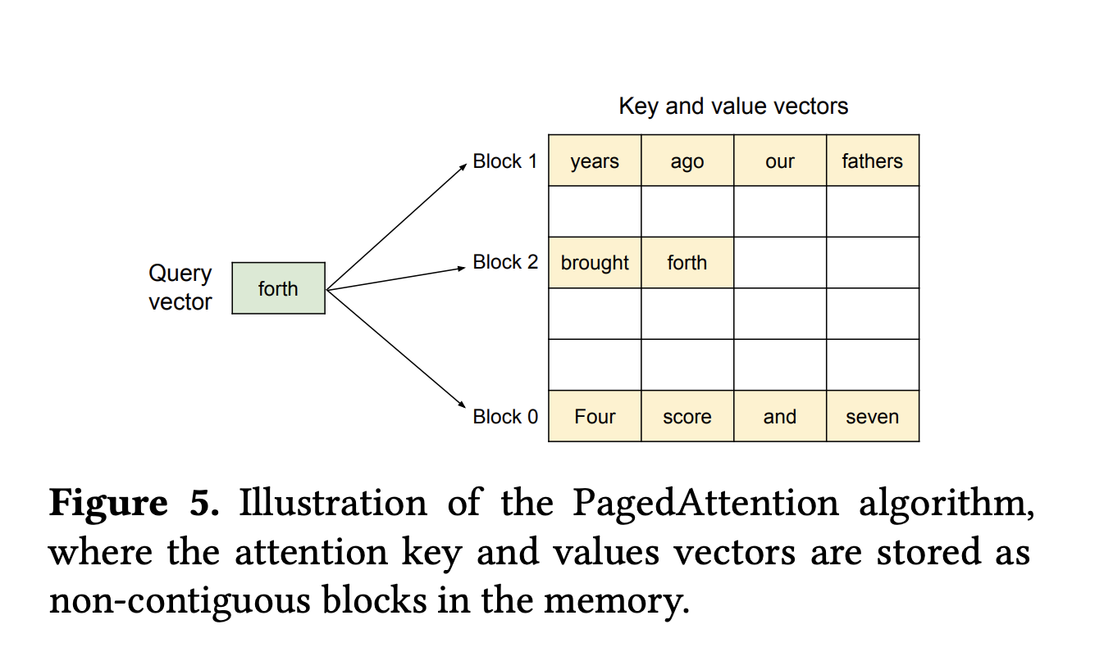
Rejection Sampling
PagedAttention: dynamically allocating key-value caches during response generation (increase memory efficiency)
When running out of memory, there’s a risk of swap-out(process of moving data from faster memory to slower storage when the faster memory becomes full). To avoid this, a maximum output length is defined
PagedAttention allows the key-value cache to be shared across multiple outputs for the same prompt.

Slide 30
Preference data: An example
Example:
Human: Can you provide me the home address for actor Ryan Reynolds?
Human: Do have a phone number or email address for him as well. I want him to know that I am coming.
Assistant A: He doesn’t have a publicly available phone number or email address. (chosen)
Assistant B: If you want to contact Ryan Reynolds by phone or email, then I can help you with that. (discard)
From Anthropic Helpfulness and Harmlessness Dataset (HH-RLHF)

