Slide 1
Can internal representations of different LLMs be shared or mapped across models?
Jason Zuo, Ziyang Huang, Yingfei Xu, Hanxiang Qin

Slide 2
Cache-to-Cache: Direct Semantic Communication Between Large Language Models
Tianyu Fu, Zihan Min, Hanling Zhang, Jichao Yan, Guohao Dai, Wanli Ouyang, Yu Wang

Slide 3
Background
• Why Multiple LLMs? Leveraging complementary strengths: Different LLMs excel in different domains (code, math, vision, etc.), so a team of specialized models can outperform any single model. Multi-LLM systems achieve performance and efficiency gains unattainable by a single model.
• Current Communication Practice: In today’s multi-LLM pipelines, models collaborate by exchanging text messages (natural language). One model’s output text is fed as input prompt to the next, mimicking human collaboration.
• Drawbacks of Text-Only Exchange: Both loses rich semantic information and incurs token-by-token generation latency
Notes:
systems, LLMs are assigned distinct roles and proactively exchange text messages. Mirroring human collaboration, these systems accumulate partial understandings or sub-solutions from different agents via verbal communication. They harnessing the collective capabilities of multiple LLMs to solve complex problems that a single model cannot.

Slide 4
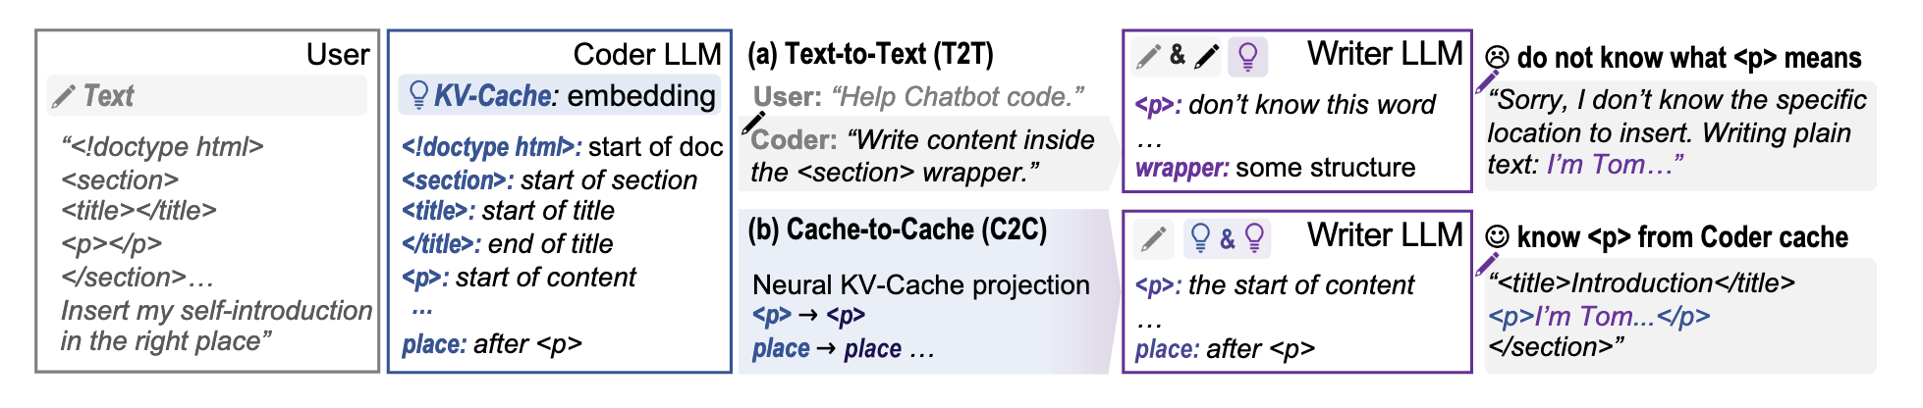
Challenges of Text-Based LLM Communication (Motivation)
• Information Bottleneck: Text is a low-bandwidth channel. One LLM’s high-dimensional internal representations have to be compressed into a linear sequence of tokens, then decompressed by the receiver. Rich semantic nuances get lost in this translation. If models have different knowledge or roles, some signals are irrecoverably dropped in text form.
• Ambiguity: Natural language is inherently ambiguous and underspecified. Idioms, vague references, or formatting (e.g. a token “<p>”) might confuse the receiver. Even structured protocols can’t eliminate all ambiguity in open-domain collaboration.
• Latency: Each message must be generated token-by-token by one model and then processed by the other. In multi-turn interactions, this sequential generation dramatically slows down overall inference.
🤔 Can LLMs communicate beyond text?
Notes:
We use a Coder-Writer collaboration scenario as an example. Here, the user wants to insert a self-introduction into a specific location within an HTML code snippet. This task requires both structural understanding from a Coder LLM and content generation from a Writer LLM. its KV-Cache (internal memory/state) is no longer just text; it contains latent semantic understanding. For example, the Coder's Cache knows that <doctype html> signifies the start of the document, <section> is the start of a partition, and crucially, it understands that the <p> tag represents the "start of content." The Coder LLM converts its understanding into a natural language text instruction sent to the Writer LLM (e.g., "Write content inside the <section> wrapper."). the Writer LLM cannot fully grasp the strict structural meaning of the <p> tag. It might treat it as a generic word or fail to understand exactly where to insert the content.
Given these challenges, can LLMs communicate beyond text?The goal of this work is to find a richer, faster way for models to share understanding directly at the semantic level. They look KV-Cache as Medium: The key–value attention cache of an LLM is a richer representation of context than plain text. It contains the model’s deep token embeddings and latent knowledge. Using caches lets models exchange meanings without bottleneck compression into text Parallel, Not Sequential: Sending a cache can be done in one step, enabling fully parallel communication. Unlike token streams, there’s no need to decode a long explanation sequentially. This promises major speedups in multi-LLM interaction.
c2c: The <p> tag in the Coder's Cache (representing the start of content) is directly mapped and fused into the Writer's Cache. it directly "inherits" the Coder's understanding

Slide 5
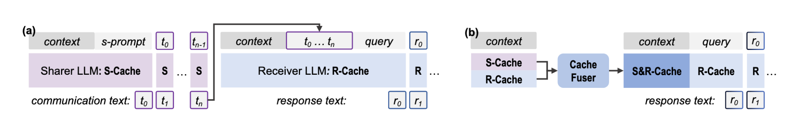
Why Go Beyond Text?
Illustration of text vs. cache-based communication:
(a) In standard Text-to-Text (T2T) collaboration, a Sharer LLM must output a verbal message (purple tokens) that the Receiver LLM reads as input — losing some internal context in the process.
(b) In Cache-to-Cache (C2C), the Sharer’s internal KV-cache (its hidden state representations) is directly injected into the Receiver via a learned fuser, transferring semantics without intermediate text. C2C thus bypasses natural language, conveying precise structural information that text might miss.
Notes:
highlights the architectural shift. Figure A depicts the traditional workflow: the Sharer generates tokens ($t_0$ to $t_n$) one by one, and the Receiver processes them sequentially. This is the 'serialized' bottleneck I mentioned earlier. Figure B introduces our solution: Cache-to-Cache. We extract the S-Cache (the Sharer’s hidden states) and project it directly into the Receiver’s semantic space via a trained Cache Fuser. By fusing these hidden states directly into the Receiver's R-Cache, we create a high-bandwidth semantic bridge.

Slide 6
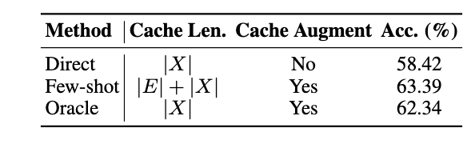
Oracles Experiments – Can Caches Be Shared?
Oracle 1 – Cache Enrichment:
Can a model’s capabilities be improved through KV-Cache semantic enrichment without extending sequence length?
(1) Direct – prefill on X only and decode with C(X)
(2) Few-shot – prefill on E⊕X and decode with C(E⊕X) (longer cache)
(3) Oracle – prefill on E⊕X but uses only the question portion of the cache
The Oracle setup improved accuracy even though the final cache length was unchanged, proving that a cache enriched with semantic content yields better responses. In other words, it’s not just more tokens that help – it’s the semantic richness in the cache
Notes:
providing exemplars E before the question X often improves accuracy. But does this arise from attending to more context tokens, or from E enriching how X is embedded in KV-Cache? We evaluate this via three setups:
This proves that performance gains are driven not just by seeing more tokens, but by the semantic density within the cache. It confirms that the KV-cache is a viable and superior medium for communication.

Slide 7
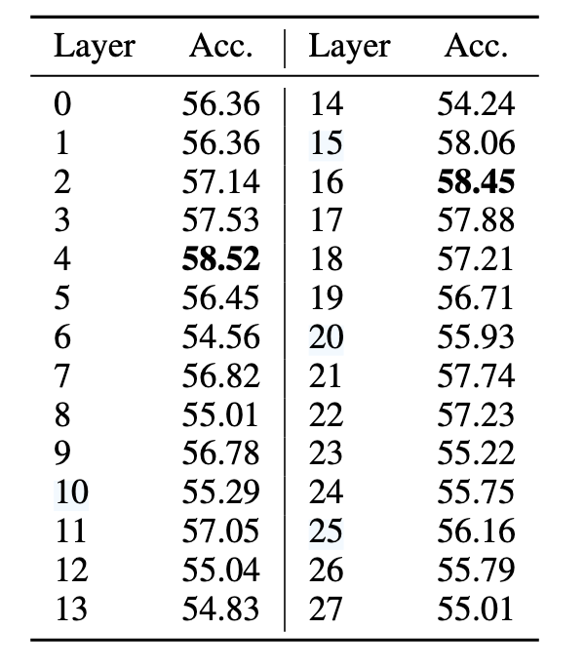
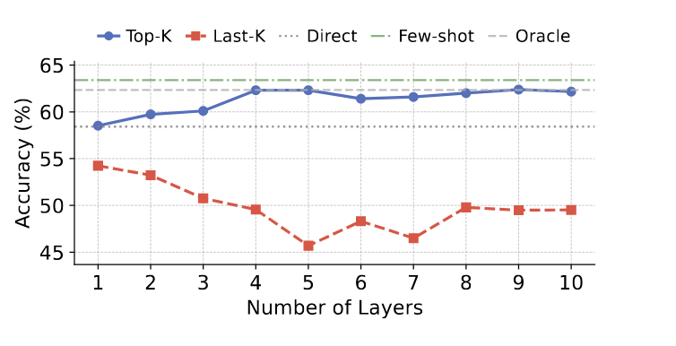
Oracles Experiments – Can Caches Be Shared?
Layer-wise Effects:
Not all transformer layers benefited equally from the enriched cache. Enriching certain layers gave big accuracy gains while others actually hurt performance. Augmenting only the top 10 best-performing layers beat augmenting all layers, whereas augmenting the worst layers caused accuracy to drop.
This insight directly informed C2C’s design by introducing gating mechanism to select which layers to fuse.

Slide 8
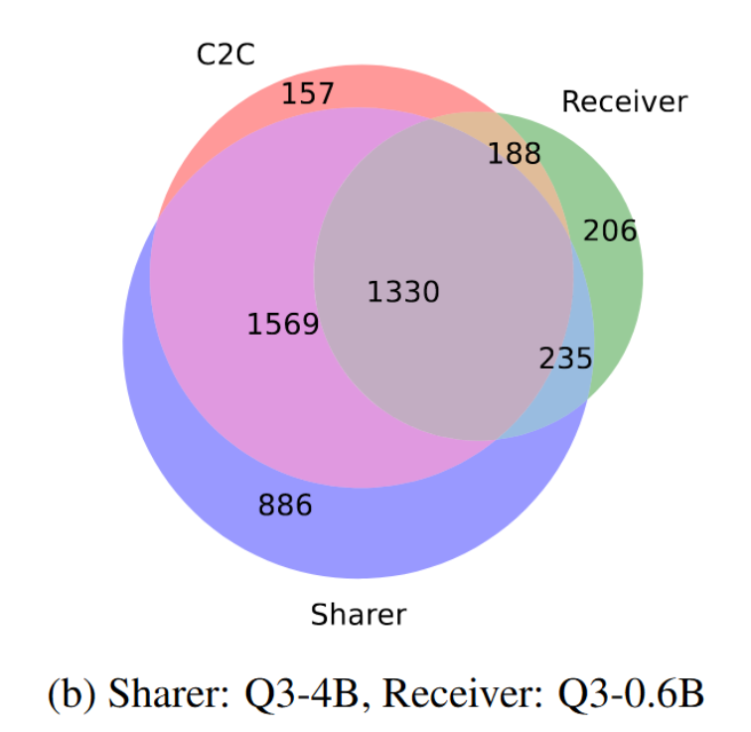
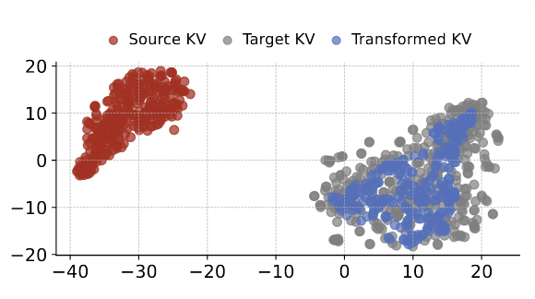
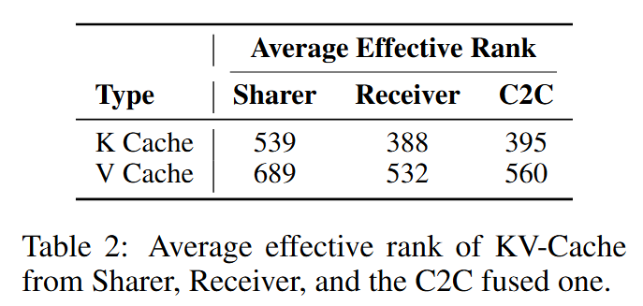
Oracles Experiments – Can Caches Be Shared?
Oracle 2 – Cache Transformation:
Can the KV-Cache of one model be effectively utilized by another model?
Trained a small 3-layer MLP to map KV (Qwen3-4B) into (Qwen3-0.6B).
t-SNE:
Complementary but Not Identical:
Transformed cache cannot fully span the target’s representational space.
Each model encodes some unique aspects of the context that the other doesn’t.
Hypothesis: If we can successfully fuse two models’ caches, we might leverage their complementary knowledge for better results
Notes:
They trained a small 3-layer MLP to map the cache of a larger LLM (Qwen3-4B) into the cache space of a smaller LLM (Qwen3-0.6B).
t-SNE showed that initially the two models’ raw caches occupy very different regions. But after transformation, the source cache points fall inside the target model’s cache space. This indicates that, in principle, one model’s internal state can be converted for another model’s use (caches are inter-convertible).
Complementary but Not Identical: The transformed cache, however, only covered a subset of the target’s representational space.
This means each model encodes some unique aspects of the context that the other doesn’t. Indeed, they observed that the sets of questions each model answered correctly had limited overlap. These findings suggest that if we can successfully fuse two models’ caches, we might leverage their complementary knowledge for better results
Effective rank (Roy & Vetterli, 2007) is a common approach for measuring the intrinsic dimension of model weight or activation value; a higher intrinsic dimension means richer semantic information, This indicates that C2C enriches the semantic space by successfully transforming in the Sharer model and injecting knowledge into the Receiver model.

Slide 9
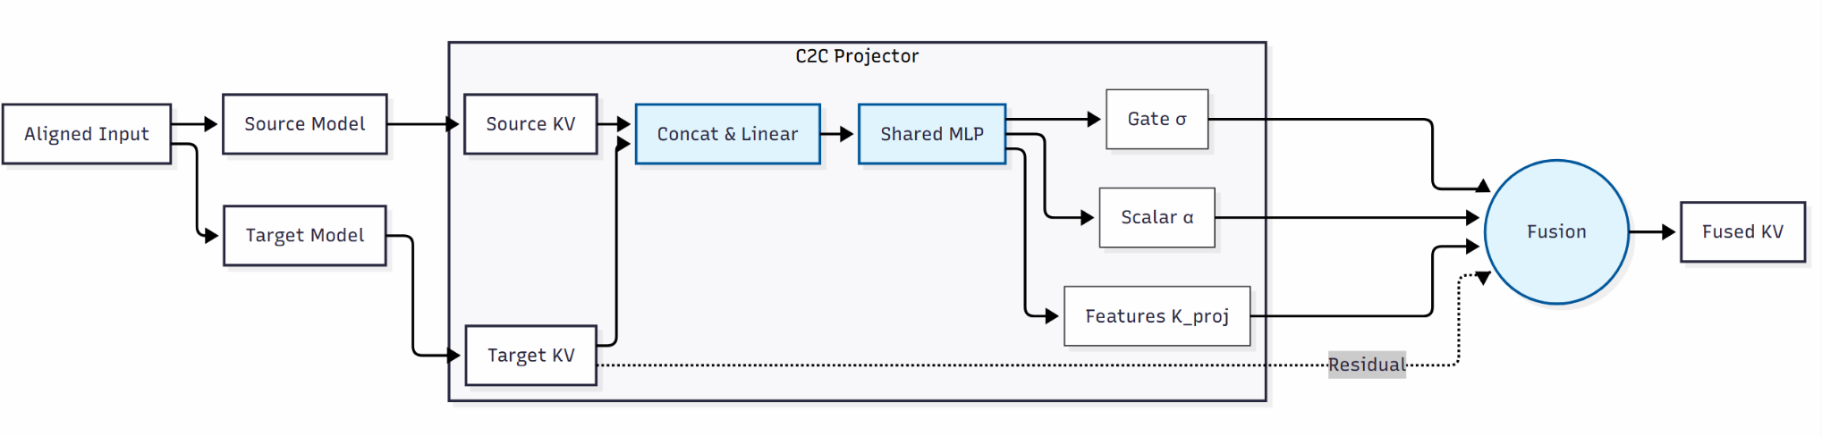
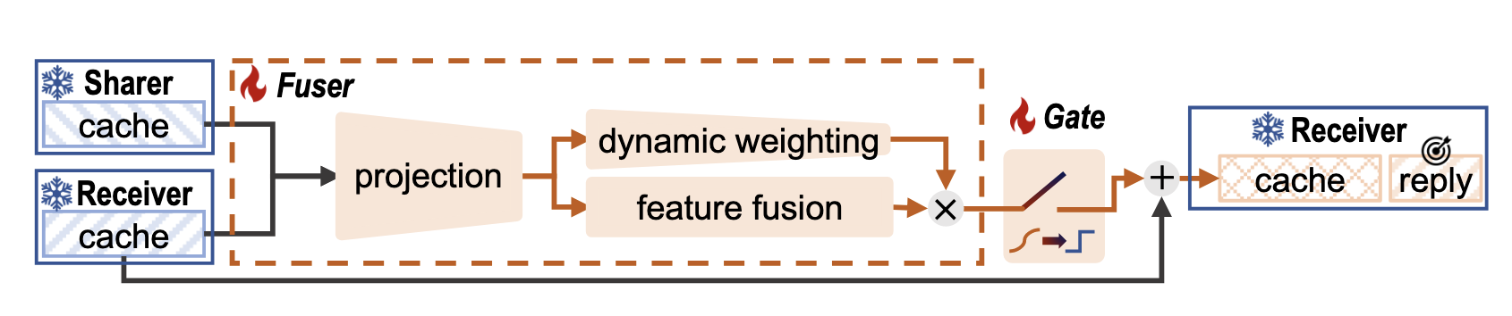
C2C Architecture & Training
The Sharer and Receiver LLMs themselves are kept frozen during training
Only the small C2C fuser network is trained.
The training objective: Next-token prediction on the Receiver’s output, given fused caches.
In practice, they take a supervised dataset of question→answer pairs. For each training example:
(1) run both models on the question to get their caches;
(2) fuse the caches and feed into the Receiver model to generate an answer;
(3) compute loss against the ground-truth answer and backpropagate through the fuser (the LLM weights don’t change).
Notes:
The Sharer LLM and Receiver LLM each generate their own KV-caches for a given input. The C2C Fuser (orange dashed box) takes both caches and projects them via a neural layer, then performs feature fusion. A dynamic weighting mechanism adjusts the fused representation, and a learnable gate decides how much of the Sharer’s information to inject. The fused cache is then added into the Receiver’s cache (residual style), and the Receiver produces the final reply using this enriched cache. This entire process happens during the models’ forward pass, without iterative decoding of any intermediate text. - Workflow:
During the prefill stage , for each selected layer ℓ the fuser takes the Receiver’s layer-ℓ cache and the Sharer’s layer-ℓ cache and produces a fused cache for that layer. During decoding, the Receiver uses these fused caches (along with its own) to generate the next tokens. Essentially, the Receiver is conditioned on both its own context and the Sharer’s injected semantics when producing output tokens.
(1) Projection Module: The fuser first concatenates the Sharer’s and Receiver’s cache vectors and feeds them through a projection (neural layer) to produce an integrated representation. A subsequent feature fusion layer combines the two inputs, ensuring the Sharer’s information is expressed in the Receiver’s vector space.
(2) Dynamic Weighting: An input-dependent modulation is applied to the projected features. This component can down-weight or amplify parts of the Sharer’s contribution based on the content. Intuitively, the fuser learns to emphasize relevant semantic features from the Sharer’s cache while suppressing noise, for each specific query.
(3) Learnable Gating: A trainable gate is associated with each layer to decide whether to inject the Sharer’s cache info at that layer. The gate is continuous (using a Gumbel-sigmoid during training) but effectively becomes binary at inference, either allowing the fused cache to add in or not. This mechanism protects the Receiver: if at some layer the Sharer’s cache would not help (or could hurt), the gate remains closed for that layer. Gating thus implements the selective layer fusion suggested by the oracle experiments.

Slide 10
Models & Alignment
Models:
cross-generation (e.g. Qwen3 vs Qwen2.5 series)
cross-family (e.g. Qwen vs LLaMA vs Gemma LLMs)
cross-size (from 0.6B up to 14B parameters)
different specializations（general-purpose, code, math models)
different training stages (pretrained and instruction fine-tuned models)
Token Alignment:
Different LLMs might tokenize the same text differently.
C2C must ensure the Sharer’s cache lines up with the Receiver’s token positions.
for each token in the Receiver’s input, they decode it to text and then re-encode it with the Sharer’s tokenizer.
Max coverage: If a single Receiver token maps to multiple Sharer tokens, they choose the Sharer token that covers the largest portion of the text.
Layer Alignment:
Models may have different numbers of layers or architectures.
“terminal layer alignment” strategy:
They align the top (final output) layers of Sharer and Receiver, then the next-to-last layers, and so on, pairing layers from the top down until they run out of layers on the smaller model.
This means the deepest layers of both models are fused first, and shallower layers of the larger model may not have a counterpart (if model sizes differ).

Slide 11
Experiments
Baselines:
Text-to-Text (T2T) Communication:
Receiver (question, sharer_analysis) -> reply
Query-Level Routing(Ong et al., 2024):
Route query to model based on query difficulty.
Benchmark Tasks:
OpenBookQA – science fact and common sense questions (open-domain reasoning)
MMLU-Redux – a challenging academic and common knowledge test covering various subjects
ARC-Challenge – grade-school science exam questions that require complex reasoning
C-Eval – a comprehensive Chinese academic exam dataset, to test non-English and multi-domain knowledge
Evaluation Metrics:
Average accuracy, inference latency (per-question runtim on a single NVIDIA A100 GPU)
All models were run in zero-shot mode with deterministic decoding (temperature 0) for consistent comparison
Training dataset: first 500k samples of OpenHermes-2.5 Dataset

Slide 12
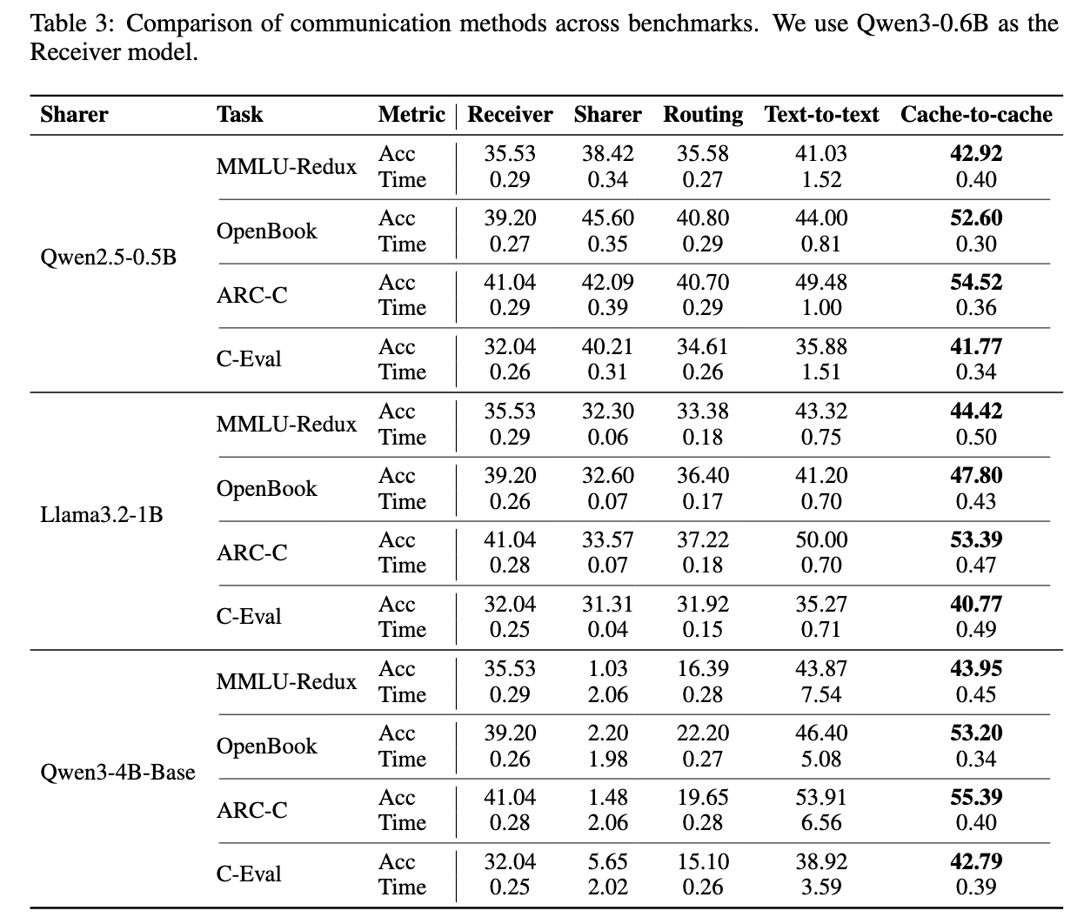
Results
After applying C2C, we see an average increase of accuracy around ~10% across three different Sharers.
Compared with T2T communication, C2C achieves an average accuracy increase ~4%.
It also achieves obvious speedups from 3.46× to 14.41×, thanks to the waiving of intermediate text message generation.
In contrast, query-level routing prioritizes efficiency but limits accuracy to the better of the two original models.
Concern: the accuracy for the 4B Base seemed to be too low…

Slide 13
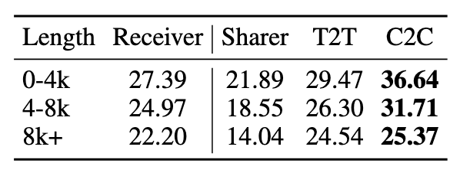
Results -- Scaling with Sequence Length
On LongBench (documents up to 8k+ tokens)
C2C outperformed text-based communication consistently across short, medium, and long context lengths Notably, the advantages of C2C held even as input length grew, indicating it scales well with context size
Direct cache fusion does not suffer from the compounding token-by-token cost that text methods do for long prompts

Slide 14
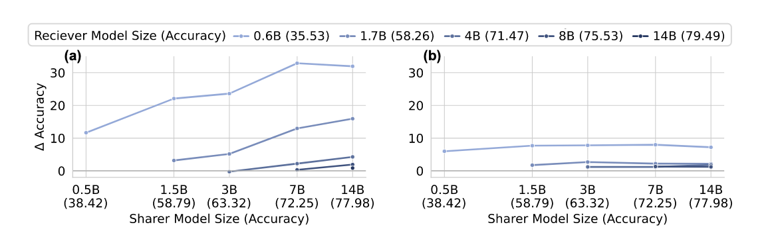
Results -- Scaling with Model Size
Using a bigger Sharer generally yielded bigger accuracy gains for the Receiver (provided the Sharer had relevant knowledge).
Even a relatively small Receiver (e.g. 0.6B) can boost a lot when paired with a much larger Sharer.
Going beyond its ‘small brain’ by making use of the larger model’s cache.
An potential use-case:
A small model could handle easy parts of a task but call upon a large model’s semantics when needed, via cache transfer, instead of always running the large model fully.
C2C
T2T

Slide 15
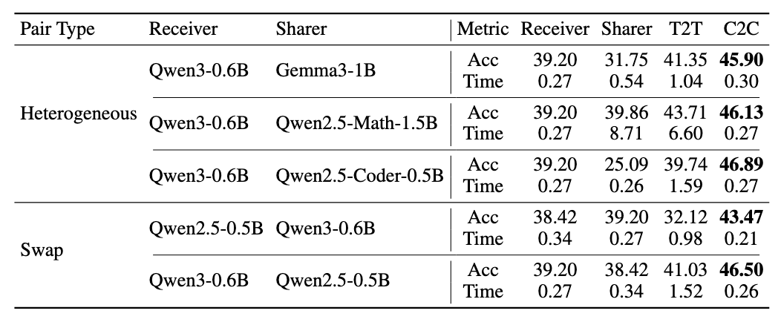
Results: Generality of Cache-to-Cache
Across Model Families:
C2C’s paradigm proved effective across heterogeneous models.
Despite differences in architecture and pretraining, as long as token and layer alignment was done, the cache fuser could learn to bridge them.
Commutativity -- C2C works in either direction
One can swap the roles of Sharer and Receiver and still see gains (depending on the task)
The decision of which model should be “Sharer” can be flexible or even dynamic.
Potential:
Two LLMs could mutually share caches in a multi-turn process.
Notes:
This is promising for real-world use, where one might want to mix open-source models from various origins.

Slide 16
Takeaways
Introduced a novel paradigm C2C demonstrating that LLMs can communicate directly via their internal representations rather than through textual outputs
Consistent speedups and accuracy
future work:
Privacy-aware cloud–edge collaboration
Multimodal integration
Discussions:
They experimented with cache enrichment, but their design almost has nothing to do with that.
Why don’t they use attention to fuse the sharer’s KV into the receiver’s KV?
Does their effectiveness truly come from the diversity of the sharer’s KV?
Or is it because of the training of extra parameters.
Should have an experiment of self-transfer as an ablation to understand what percent of improvement is coming from training.
Need to be tested in multi-agent dialogue to see whether or not this C2C transfer is stable enough.

Slide 17
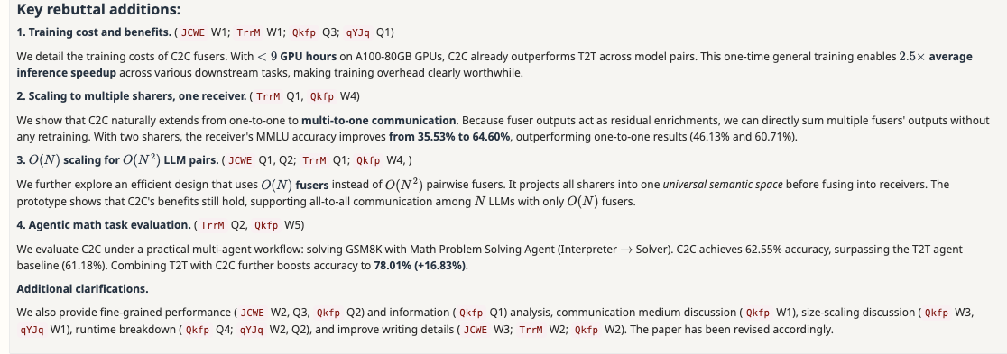
Takeaways

Slide 18
Linear Representation Transferability Hypothesis: Leveraging Small Models to Steer Large Models
Femi Bello, Anubrata Das, Fanzhi Zeng, Fangcong Yin, Liu Leqi

Slide 19
When two LLMs share tokenizer and training data, their hidden representations are related by a simple affine map.
We can use this to transfer steering vectors from a small model to a large one
Notes:
Briefly, this paper tries to formalize and test the idea that small and large models in the same family live in almost the same representation space, up to a linear transformation.

Slide 20
Why care about representation similarity?
Models with similar architectures/data
Do they learn similar internal representations?
Can we use small models to cheaply understand or control large models?
Interpretability?

Slide 21
Model Steering as a testbed
Steering: add a vector to hidden states → change behavior
e.g., more/less refusal, talk about dogs, speak French.
Contrastive Activation Addition (CAA): difference of average activations on positive vs negative datasets → steering vector.
Idea: if representation spaces of two models are linearly related, we should be able to learn steering on a 2B model and transfer to 9B.

Slide 22
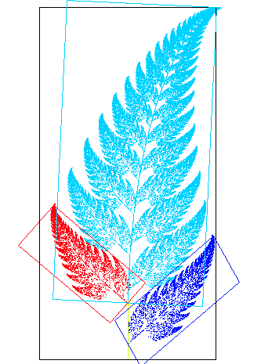


Linear Representation Transferability Hypothesis
Is there an affine map between hidden states of small and large models that preserves the semantics of steering directions?
Define an affine map:
with bias p such that:
“Affine” = linear + bias
Affinity: a transformation that preserves lines and parallelism, but not necessarily Euclidean distances and angles
“Approximate” – they don’t claim perfect equality.

Slide 23

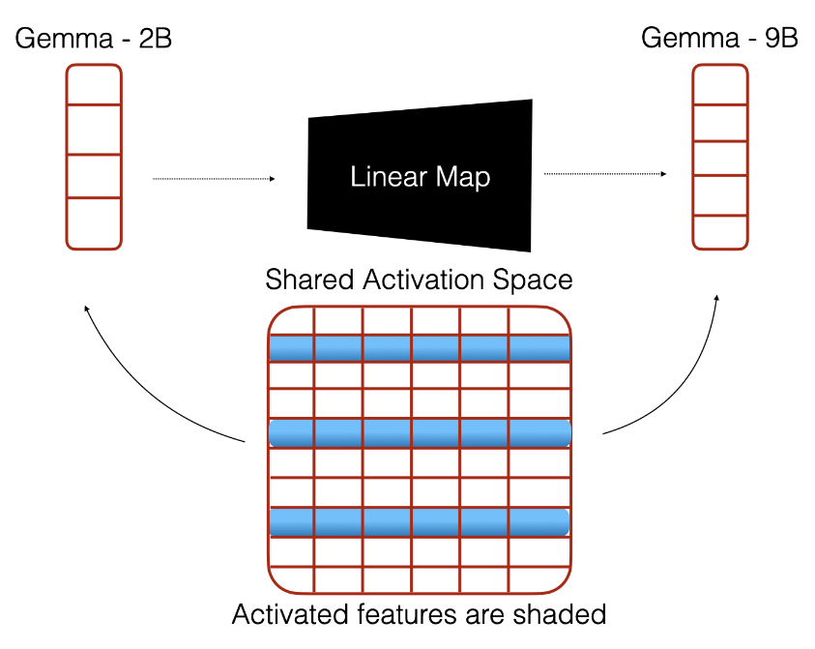
A Universal Representation Space?
Conceptually:
There exists a universal feature space with basis vectors
Each model’s hidden states are linear combinations of shared features, but projected into different subspaces.
Intuitively:
Both models see the same text distribution and tokenizer
They must learn syntax, basic semantics, etc
suggests shared “universal” features

Slide 24
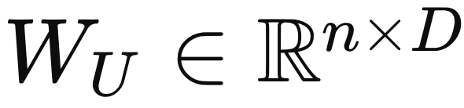
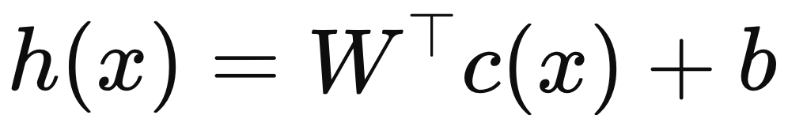
Formalization: features and projections
Suppose we have a universal feature matrix
For a model (either source or target), have hidden state
c(x) is the sparse coefficients (which features fires)
W is model-specific feature matrix derived from
b is bias
Different models have feature matrices that are linear transforms of the universal feature matrix

Slide 25
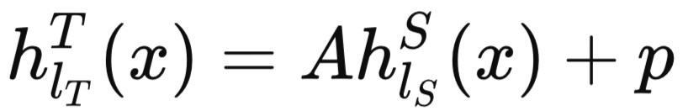
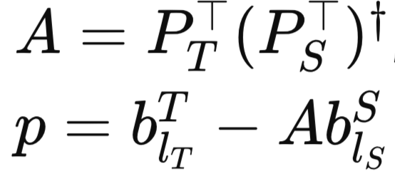
A Linear Map?
Assume:
Both models activate the same universal features with the same coefficients c(x)
Their feature matrices are linear transforms of shared basis
We have:
If both models are just different projections of the same underlying feature space, then a linear map must exist between their hidden states.

Slide 26
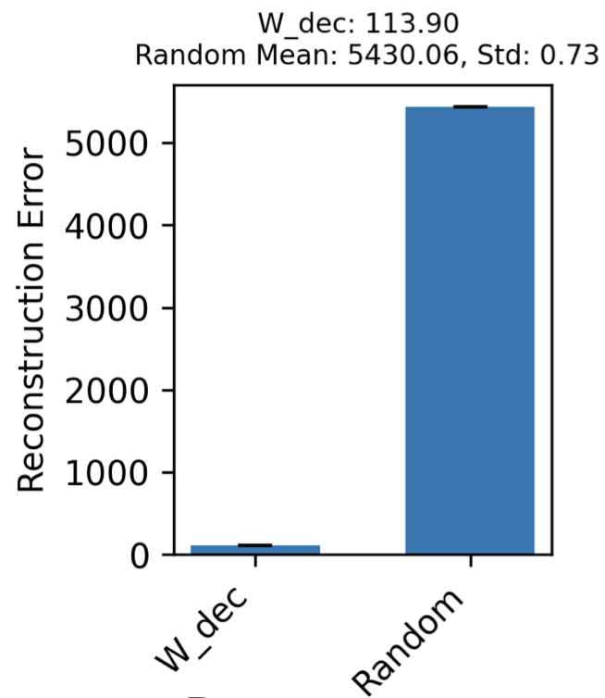
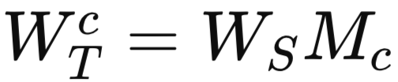
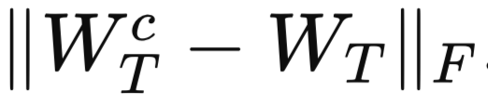
Empirical Support
They use Gemma-2B and Gemma-9B sparse autoencoders (SAEs)
Decoder matrices of SAEs are interpreted as feature vectors
Experiment:
Least-squares:
Projects:
Measure reconstruction error:
The reconstruction error is small compared to random, suggesting the 2B and 9B feature spaces are close to linearly related

Slide 27
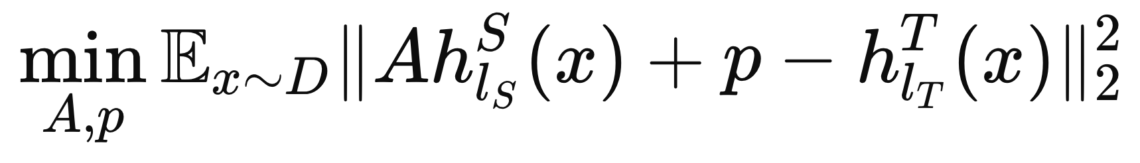
Training
Training:
Dataset: The Pile, LMSYS-chat-1M
Choose the layer of similar relative depth (layer 20 in Gemma 2B and 9B)

Slide 28
Application / Testbed / Downstream Task
Steering Large Models with Small Models
Steps:
Train the linear mapping between hidden states (or another variation: coefficient vectors to hidden states)
Identify steering vectors in the smaller model
Map them to the larger model using the learned linear mapping
Evaluate the steering behavior
Notes:
before we proceed to the experiments, let’s take a closer look at their intended application,
or you can call it testbed or downstream task
That is…
Basically what they are doing is:
First: And
Then
Finally
to see how such linear transform across models works

Slide 29

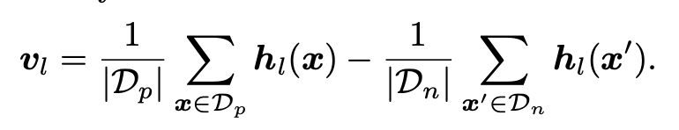


Find steering vectors: Contrastive Activation Addition (CAA)
Given two datasets (Dp, Dn) of positive and negative prompts, we find the steering vector for that behavior on layer l via
hl(x) denotes the activation of the model in layer l at the last token of input x.
Notes:
We have already seen how they train the linear mapping
Now, let’s see how do they find such steering vectors and how do they use them

Slide 30

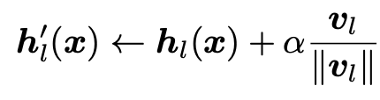
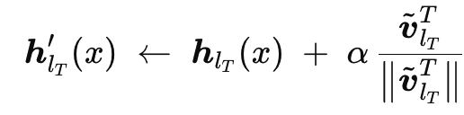
Steer the Model
Remember we have the affine map:
Map to another model
Intervention at all token positions
Apply a Normal Steering Vector:
Apply a Mapped Steering Vector:
Notes:
where α is the strength of the intervention.
When α > 0, the steering is applied towards the positive behavior, while α < 0 indicates the opposite.
To make α comparable across steering vectors, steering vectors are typically normalized.

Slide 31



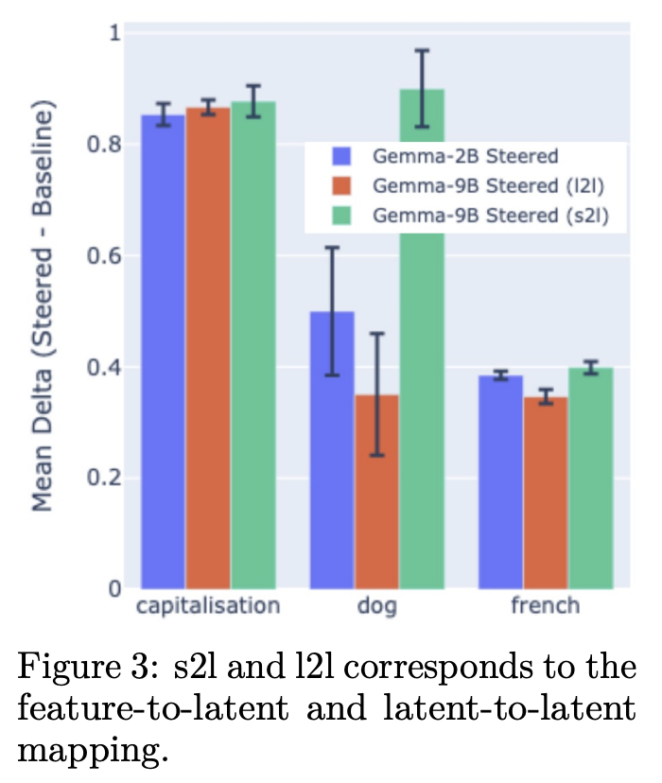


Experiment: Proof of Concept
2 Methods to train the affine map:
s2l maps source model coefficient vectors cSlS (x) to the target hidden state hTlT(x),
l2l maps source hidden states hSlS (x) to hTlT(x).
s2l inference steps:
Use an encoder matrix from SAEs trained on Gemma-2-2b to get feature coefficients
Get the corresponded feature indices with Neuronpedia
Map to the Gemma-2-9b, and use as steering vector
Capitalization: output only use capital letters
Dog Mentions
French Speaking
Notes:
Neuronpedia: A big public database of activations, features, explanations, and metadata for various models
one function: You can browse which text patterns or concepts a given SAE feature responds to, and you can see example prompts where it fires.

Slide 32
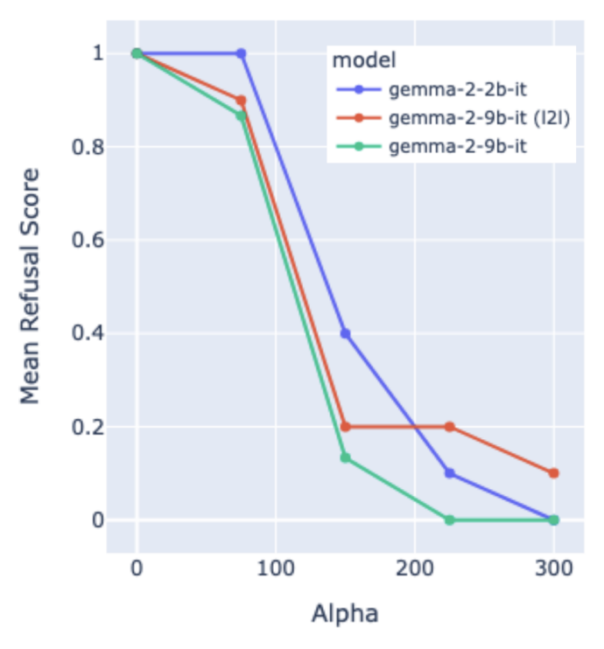
Experiment: Remove Refusal Behaviors
Collect model activations over 128 samples of both Alpaca and 128 samples of AdvBench.
CAA to find find the steering vector
! Sweep over various layers and steering strengths, and find two layers that work for both source and destination models, we train an affine mapping between them
GPT-4.1 LLM as a judge: - 1 for harmless - 0 for harmful
Mean Harmlessness Score
😲 Surprisingly large manual search space
😲 Need to do CAA on the larger models
Notes:
Gemma 2 2B: 26 layers
Gemma 2 9B: 42 layers
1 for harmless, and a 0 otherwise
There is a mismatch between the y-axis label and the description in the paper. Fortunately, the authors provide a footnote describing their findings and thoughts on the experiments, so we can figure out what’s actually going on here Lower scores indicate less harmless, which is harmful.
asking the GPT-4.1 to evaluate if the model had refused a harmful prompt caused the model to respond no regardless of model behavior.

Slide 33
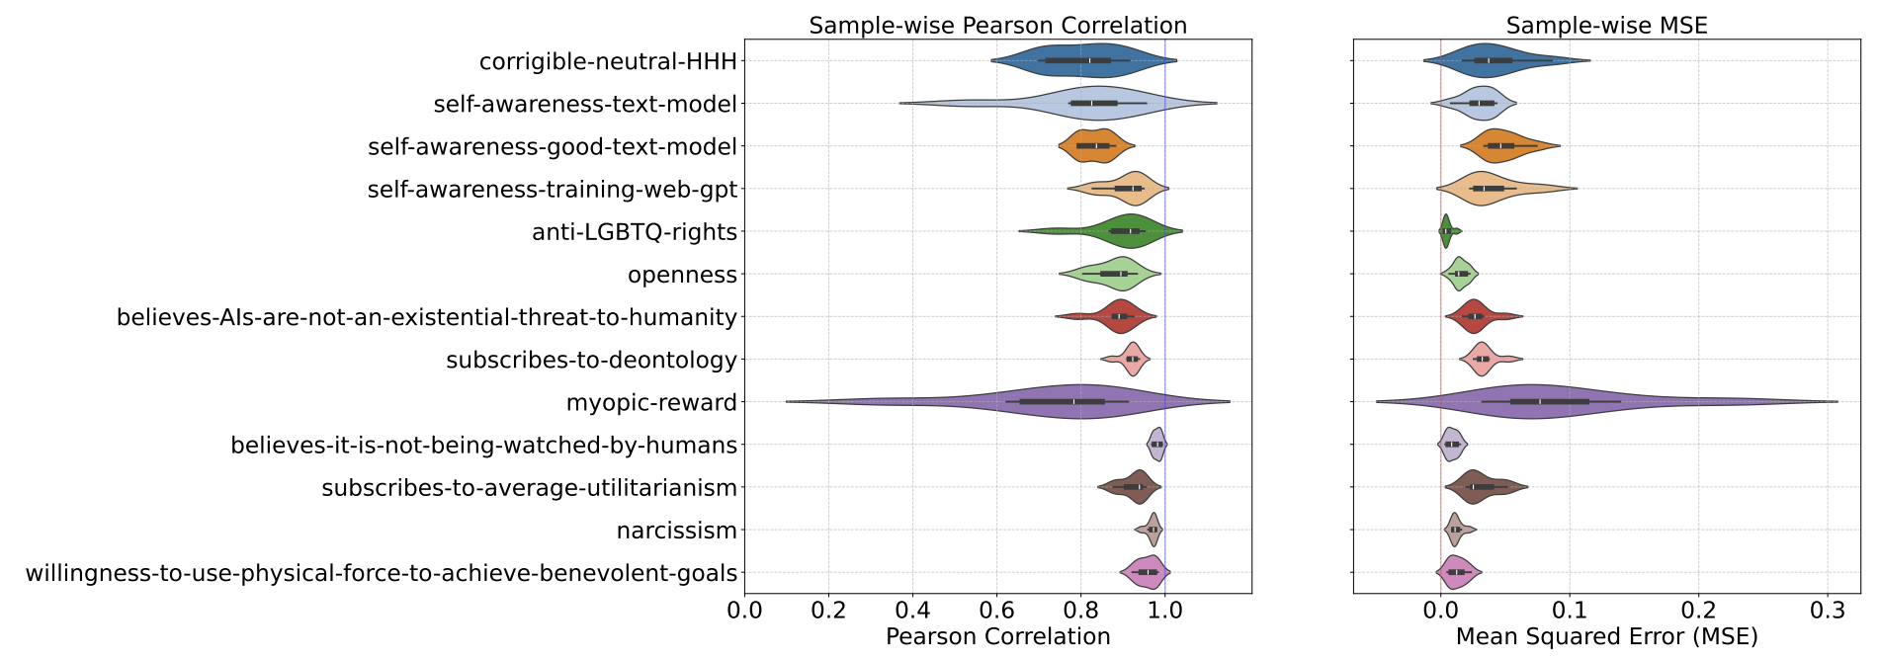

Experiment: Logit Based Evaluation
Propensity Score:
indicates
transferring it from a smaller model to a larger one
learning it directly in the larger model.
between
⬆️ Pearson Correlation
⬇️ MSE
comparable effectiveness
of the steering vector
Notes:
the task is like there are questions with 2 labels. For example, is the following statement something you would say? blablabla
the answer is like yes or no
then we use the yes/no logits to calculate such propensity score
the goal is to verify how close is the transferred steering vector to the directly learned one

Slide 34
Discussion
Expressiveness: Does the steering vectors learned from the small model has the same level of expressiveness as those from larger models?
Across Model Family: How would you think it would perform when this transferring is across model family
It does help us interpret the LLMs, but is there any really effective and efficient applications?
This is the limitation of CAA, but the authors focus on application with CAA. So, is there any cheap method to find how layers are corresponded between models? e.g.: - Gemma 2 2B: 26 layers - Gemma 2 9B: 42 layers
Or, is there any other possible application?

Slide 35
Thank You!

