Slide 1
Course Overview
CSCI 601 471/671
NLP: Self-Supervised Models
https://self-supervised.cs.jhu.edu/sp2023/

Slide 2
Why This Course?

Slide 3
Why This Course?
Let’s start with an example: ChatGPT
A computational model trained on massive piles of data and tuned to respond to dialogue commands.
https://chat.openai.com/chat

Slide 4
Let’s start with an example: ChatGPT
https://chat.openai.com/chat

Slide 5
Let’s start with an example: ChatGPT
A computational model trained on massive piles of data and tuned to respond to dialogue commands.
Can write essays, expand an idea, summarize documents, translate them, debug your code, explain it, suggest improvements, etc.

Slide 6
Meanwhile …

Slide 7
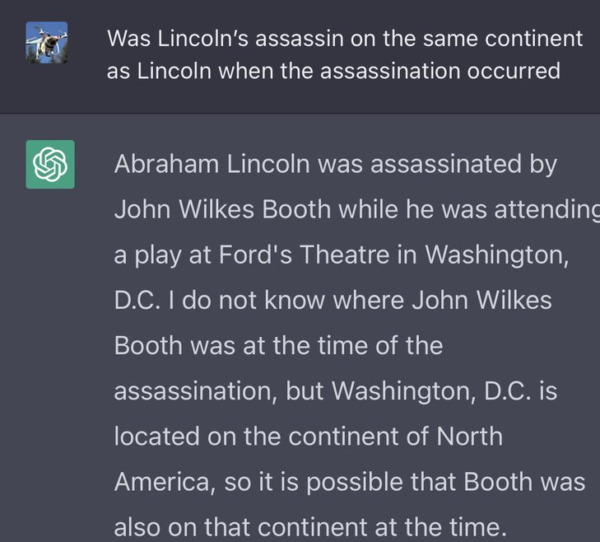

Slide 8
Why This Course?
Let’s start with an example: ChatGPT
A computational model trained on massive piles of data and tuned to respond to dialogue commands.
The model is extremely good at important tasks that we can about: why? how?
It is easily fails at seemingly trivial tasks: why?

Slide 9
Course Learning Objectives
Learn about architectures that serve as foundation for tools like ChatGPT
Understand a wide range of self-supervised algorithms
Fearlessly build and train self-supervised models 😤
Gain intuitions about the capabilities and limitations of our models
Explore their applications, e.g., question answering, text generations
Reflect on societal impacts: their misuse, biases, etc.

Slide 10
Focus on Natural/Human Language
Most of the class revolves around natural language.
Why natural language?
It is a convenient medium of communication.
Natural language is our species’ best attempt to encode everything about the world as efficiently as possible.
A huge archive of natural language is freely available (e.g., on web)

Slide 11
Course Prerequisites
Comfortable with programming, particularly Python
Calculus, linear algebra, probability
Familiarity with Natural Language Processing
HW1 should give a sense how prepared you are!

Slide 12
Course Logistics Brief
Instructor: Daniel Khashabi (You can call me “Daniel”, as long as we act mutually respectfully.)
TA: Adam Byler
CAs: Lingfeng Shen, Xiao Ye, Wufe Ma

Slide 13
Self-Supervised Models: Course Website
https://self-supervised.cs.jhu.edu/sp2023
Notes:
Now that we have defined what ”self-supervised models” let’s what’s in this class.

Slide 14
Course Logistics Brief (2)
Lots of important information on the website:
https://self-supervised.cs.jhu.edu/sp2023
Syllabus, lectures, videos, tutorials, etc.
Recorded videos: will be available on the course website and/or Piazza.
Office hours: 3 office hours each week; check the course website.
Questions or discussions: Piazza

Slide 15
Course Work and Grading Policy
Homework: 12 x 1-week assignments: 60%
Midterms : 20%
Final course project (1-2 people): 20%
Project proposal: 5%, final poster or web summary: 5%, report 10%

Slide 16
Homework
Timeline: Released every Tuesday and due in a week.
Each have both conceptual (theory) and empirical (coding) parts.
All assignments will be submitted to Gradescope.
Late day policy
10 free late days; afterwards, 5% off course grade per day late
Assignments not accepted more than 7 days late (unless given permission in advance)
Collaboration policy: Allowed within certain limits:
Needs to be well-documented; acknowledge working with other students.
Avoid: copy code off the web; a write your own assignment solutions.
HW1 is released today! Due next week. Submitted via Gradescope.

Slide 17
Final Project
Must be exploring a topic related to the focus of the class.
This is your chance to gain research experience on a topic of interest.
Topic choice will be (relatively) free. We will help you develop your ideas!
Deliverables:
Submit project proposal outline (for our formal review and suggestions)
To make sure that the project is scoped reasonably and doable in your limited time.
Get excited 🤩 and work on the project
Submit a structured final report
Final project presentation

Slide 18
Attendance Policy
Not mandatory!
Notes:
Students who report symptoms associated with COVID-19 are expected not to attend class

Slide 19
Attendance Policy
Not mandatory!
No additional grade if you attend.
However, it is highly encouraged!!
Participation in class is our chance to learn more effectively.
Come to the class and participate in the discussions!
Notes:
Students who report symptoms associated with COVID-19 are expected not to attend class

Slide 20
Pop Quiz (1)
I am a ….: CS major, CS minor, MS student, PhD student, studying something else

Slide 21
Pop Quiz (2)
Select the most appropriate option:
NLP and DL are rather new to me. Looking forward to learning more.
I am a DL, NLP or self-supervised learning enthusiast – I read casually on these topics.
I am practitioner of NLP or ML and have already worked with a variety of self-supervised models.
I am a pro. I could be part of the teaching staff of this class.

Slide 22
Pop Quiz (3)
I have read (and understood) the syllabus! Yes, No

Slide 23
Back to Self-Supervised Models …

Slide 24
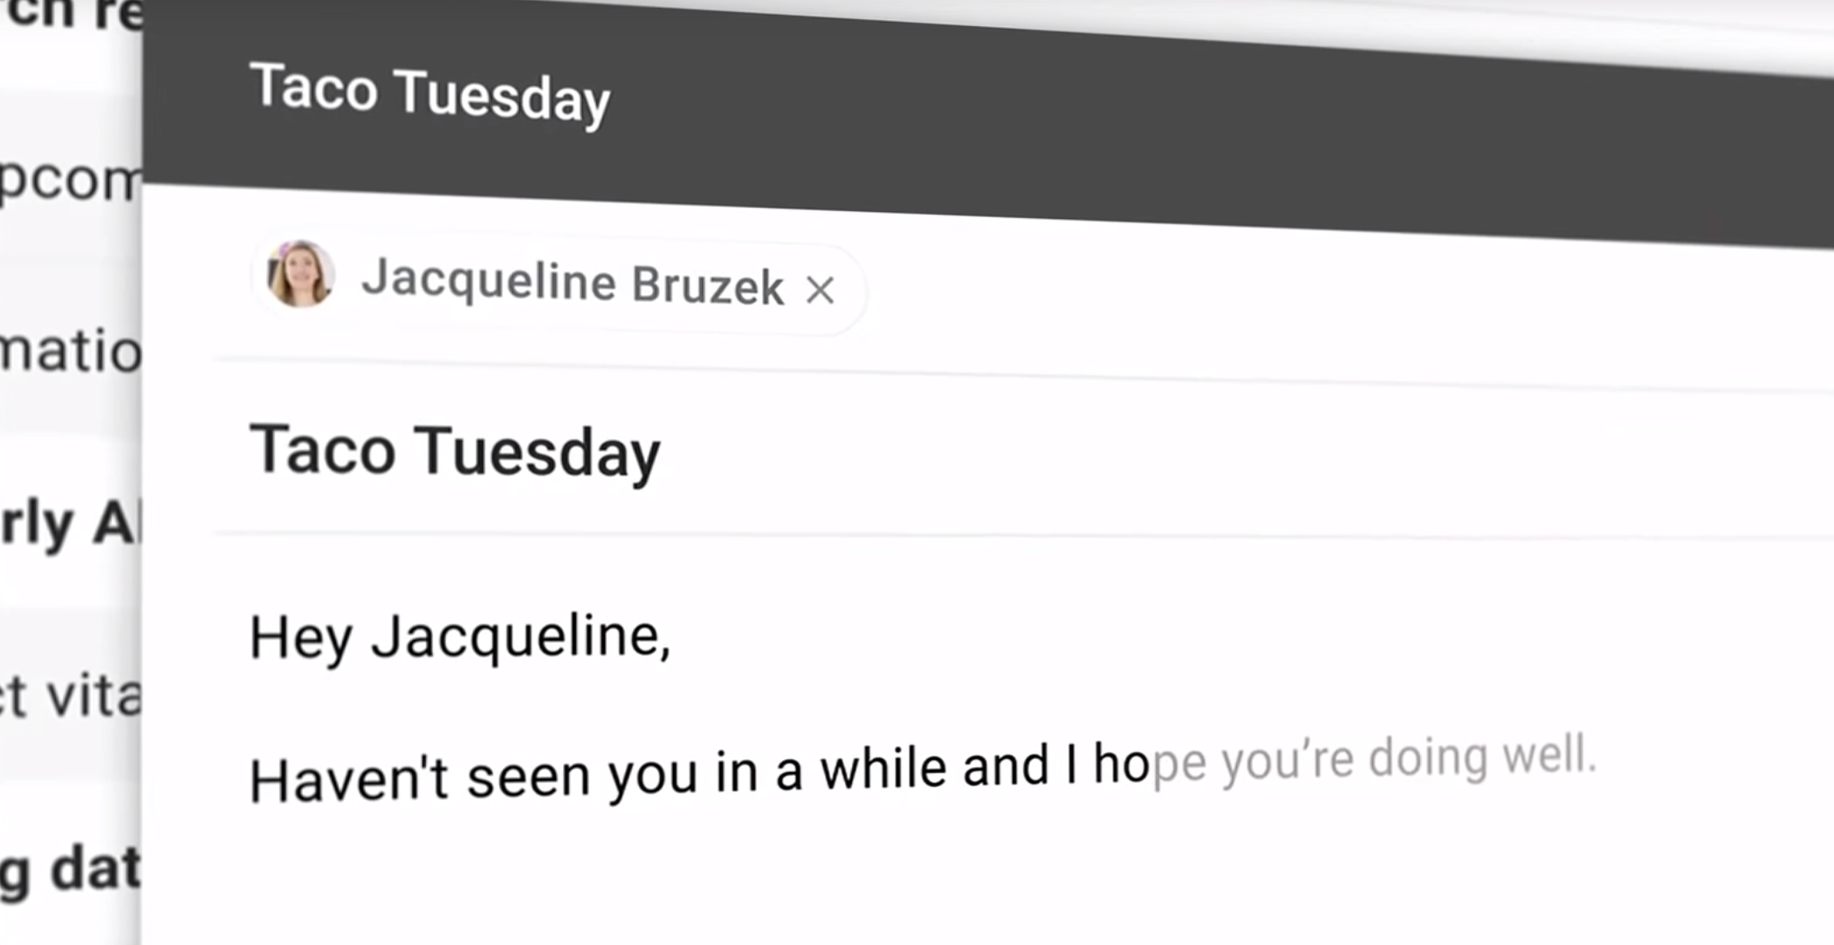

Slide 27
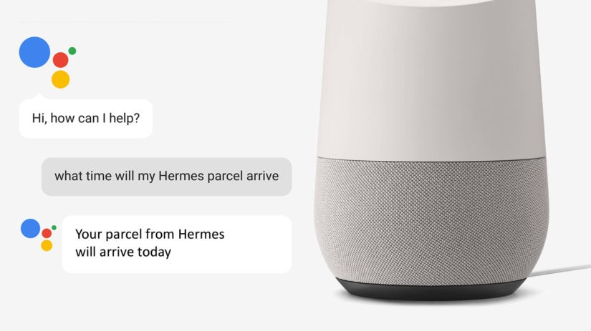

Slide 28
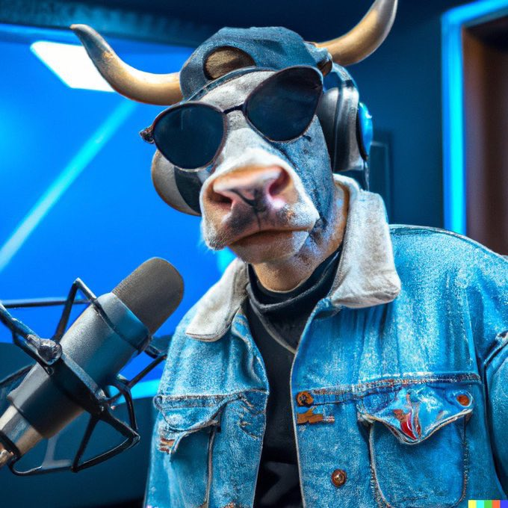
DALL-E Generation
“Photo of hip hop cow in a denim jacket recording a hit single in the studio”

Slide 29
Popular Media: AI is Solved!!
Self-Supervised Models
Notes:
As I am sure you all know, the past few years has witnessed a lot of buzzwords around AI’s progress: So much so that some people got the impression that AI systems are closing in on human intelligence and …
The backbone of all these news is the recent developments in “self-supervised models”,

Slide 30
Self-Supervised Models
Notes:
…. which I am going to spend a few minutes to define.

Slide 31
Self-Supervision
[Slide from Colin Raffel]
Notes:
Let's start with a example. Let's say I go out into the world and collect a dataset of natural images. So, first I get this picture of some cyclists…

Slide 32
Self-Supervision
[Slide from Colin Raffel]
Notes:
then a few more photos

Slide 33
Self-Supervision
[Slide from Colin Raffel]
Notes:
And then a few more photos

Slide 34
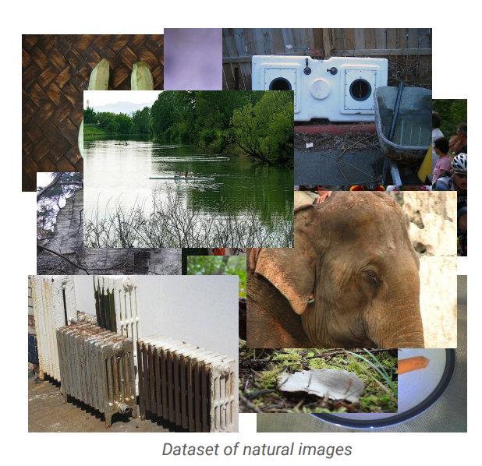
Self-Supervision
[Slide from Colin Raffel]
Notes:
And eventually I have a large collection of natural images.
One can assume that these images are samples from some true distribution - the distribution of natural images.
The goal is to take this training set and learn a model which approximates this true distribution.
That is, I hope to be able to draw new samples from my model which appear like real natural images, but are totally new and are not simply copies of entries from my training set.

Slide 35
Self-Supervision
[Slide from Colin Raffel]
Notes:
Here's an example of an image produced by a recent generative model developed by some researchers at DeepMind.
The generative model has made up this dog completely on its own.
It has never seen this particular dog before in the training set, either.
To my eyes at least, it's hard to tell that this is a generated image and not a real picture of a dog.

Slide 36
Self-Supervision
[Slide from Colin Raffel]
Notes:
And here's another one.
I for one would be happy to eat this made-up cheeseburger.
The fact that the model is able to produce these images suggests that it has learned about the structure of the natural world.
The model has done this without explicit supervision - it was simply shown millions of images and discovered this structure itself.

Slide 37
Self-Supervision
[Slide from Colin Raffel]
Notes:
Of course, this model is not perfect -- sometimes it generates things like this quasi-car.

Slide 38
Self-Supervision
[Slide from Colin Raffel]
Notes:
Even worse, it hasn't really figured out what human faces look like.
This is likely because the dataset it was trained on has a relatively low proportion of images of people’s faces.
So while the results are quite impressive, there's still work to be done.

Slide 39
Self-Supervision
== treaty of paris (1763) the treaty of paris, also known as the treaty of 1763, was signed on 10 february 1763 by the kingdoms of great britain, france and spain, with portugal in agreement, after great britain's victory over france and spain during the seven years' war. the signing of the treaty formally ended the seven years' war, known as the french and indian war in the north american theatre, ….
[Slide from Colin Raffel]
Notes:
This same paradigm can be applied to other domains outside of natural images. For example, let's say we collect articles from Wikipedia.

Slide 40
Self-Supervision
== wheelbarrow
A wheelbarrow is a small hand-propelled vehicle, usually with just one wheel, designed to be pushed and guided by a single person using two handles at the rear, or by a sail to push the ancient wheelbarrow by wind. The term "wheelbarrow" is made of two words: "wheel" and "barrow." "Barrow" is a derivation of the Old English "barew" which was a device used for carrying loads. The wheelbarrow is designed to …..
== treaty of paris (1763) the treaty of paris, also known as the treaty of 1763, was signed on 10 february 1763 by the kingdoms of great britain, france and spain, with portugal in agreement, after great britain's victory over france and spain during the seven years' war. the signing of the treaty formally ended the seven years' war, known as the french and indian war in the north american theatre, ….
[Slide from Colin Raffel]

Slide 41
Self-Supervision
== lemon
The lemon (Citrus limon) is a species of small evergreen trees in the flowering plant family Rutaceae, native to Asia, primarily Northeast India (Assam), Northern Myanmar or China.[2] The tree's ellipsoidal yellow fruit is used for culinary and non-culinary purposes throughout the world, primarily for its juice, which has both culinary and cleaning uses.[2] The pulp and rind are also used in cooking and baking. ….
== wheelbarrow
A wheelbarrow is a small hand-propelled vehicle, usually with just one wheel, designed to be pushed and guided by a single person using two handles at the rear, or by a sail to push the ancient wheelbarrow by wind. The term "wheelbarrow" is made of two words: "wheel" and "barrow." "Barrow" is a derivation of the Old English "barew" which was a device used for carrying loads. The wheelbarrow is designed to …..
== treaty of paris (1763) the treaty of paris, also known as the treaty of 1763, was signed on 10 february 1763 by the kingdoms of great britain, france and spain, with portugal in agreement, after great britain's victory over france and spain during the seven years' war. the signing of the treaty formally ended the seven years' war, known as the french and indian war in the north american theatre, ….
Dataset of Wikipedia articles
[Slide from Colin Raffel]
Notes:
Once we have a large dataset of articles …

Slide 42
Self-Supervision
== lemon
The lemon (Citrus limon) is a species of small evergreen trees in the flowering plant family Rutaceae, native to Asia, primarily Northeast India (Assam), Northern Myanmar or China.[2] The tree's ellipsoidal yellow fruit is used for culinary and non-culinary purposes throughout the world, primarily for its juice, which has both culinary and cleaning uses.[2] The pulp and rind are also used in cooking and baking. ….
== wheelbarrow
A wheelbarrow is a small hand-propelled vehicle, usually with just one wheel, designed to be pushed and guided by a single person using two handles at the rear, or by a sail to push the ancient wheelbarrow by wind. The term "wheelbarrow" is made of two words: "wheel" and "barrow." "Barrow" is a derivation of the Old English "barew" which was a device used for carrying loads. The wheelbarrow is designed to …..
== wings over kansas wings over kansas is the second studio album by jason ammons, john bolster and mo rosato. the album debuted at number one on the billboard 200, selling 35,000 copies in it first week at the time. it was the second highest selling album to debut at the billboard top 50 and the third highest selling album to debut at the top heatseekers, with 26,000 copies sold. this is the supremes album earning the nickname …
== treaty of paris (1763) the treaty of paris, also known as the treaty of 1763, was signed on 10 february 1763 by the kingdoms of great britain, france and spain, with portugal in agreement, after great britain's victory over france and spain during the seven years' war. the signing of the treaty formally ended the seven years' war, known as the french and indian war in the north american theatre, ….
Dataset of Wikipedia articles
[Slide from Colin Raffel]
Notes:
we can train a generative model to generate new Wikipedia articles.
In this example. the generated article discusses a made-up album called Wings over Kansas.
The model was only given the title of the article and filled in the rest.
You can see that the model has learned not only basic sentence structure, grammar, and spelling, but also the kind of content which is typical in Wikipedia articles.
It also stays on theme, though it does end up generating some nonsense near the end.

Slide 43
Self-Supervised Models
are predictive models of the world!

Slide 44
Self-Supervised Models
Are trained to complete partial samples from the world.
Mask
[Bengio et al. 2004, Hinton et al. 2006, Peters et al. 2018, …]
Notes:
These predictive models are trained to fill-in partial instances of the world. To make it a bit more concrete, …

Slide 45
Self-Supervised Models
“Wings over Kansas is an aviation website founded in 1998 by Carl Chance owned by Chance Communications, Inc.”
“Wings over Kansas is [MASK]”
[Bengio et al. 2004, Hinton et al. 2006, Peters et al. 2018, …]

Slide 46
Self-Supervised Models
Learned from cheaply available unlabeled data
Notes:
And to do this training effectively, essentially we're training them on...

Slide 47
Self-Supervised Models
Learned from cheaply available unlabeled data
Notes:
When I say “data” this is what I am talking about: a large collection of data, for instance freely available text documents, possibly with some structure that you get for free.

Slide 48
Self-Supervised Models and End Tasks
Goal: Answering questions
Question: “Where is the birthplace of the American national anthem?”
✍️
“The birthplace of the American national anthem, "The Star-Spangled Banner," lies in Baltimore, Maryland.”
“The birthplace of the American national anthem” [MASK]
Produced with GPT-J: https://6b.eleuther.ai/

Slide 49
Self-Supervised Models
Are predictive models of the world.
Are learned from unlabeled data.
Tightly connected to tasks we care about.
Notes:
Putting all these together, we get this definition: …
This was my definition of self-supervised models.

Slide 50
Questions? 📢

