Slide 1
Self-Supervised Learning Word Representations
CSCI 601 471/671
NLP: Self-Supervised Models
https://self-supervised.cs.jhu.edu/sp2023/
[Slide credit: Chris Manning, John Canny, Reda Bouadjenek, and many others ]

Slide 2
HW1 is released!
Due Tuesday.
Has both theory (background on algebra, etc.) and programming (word similarity).
A baseline for self-assessment.
Future homework may be more demanding.

Slide 3
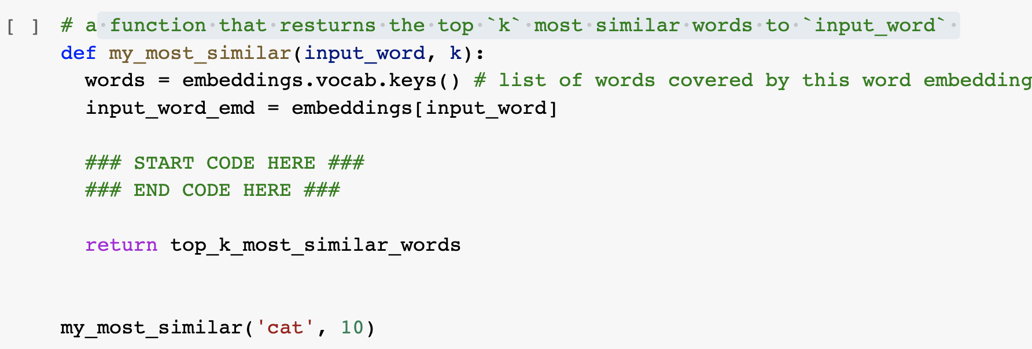
“Can I use external libraries?” No, unless specified!
Use the basic Python functions (no external libraries), unless explicitly specified.
In almost all places, you’re not expected to write more than 3-4 lines of code.

Slide 4
“I can’t install Gensim 3.x.y”
Current code is based on 3.6.0.
If you use other version, you might need to make minor changes to Gensim functions. Feel free to consult with Gensim documentation.
This is part of any programming experience. It's part of the job! Don't hate it, embrace it! 🤗

Slide 5
“My Colab Is Running Out of Memory”
Option 1: get a more high-performing Colab: $10 for a month
~ 2 x $ of Starbucks chocolate mochas
~ $ of Twitter verification
Option 2: use smaller word embeddings:
The output will be a bit different but that’s okay!
Note, the smaller vectors have smaller dimensionality.
# download the pre-computed embeddings
# embeddings = gensim.downloader.load('glove-twitter-50')
embeddings = gensim.downloader.load('word2vec-google-news-300')

Slide 6
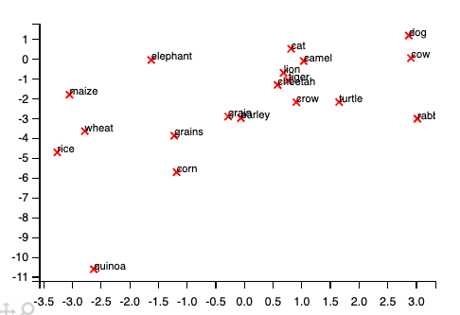
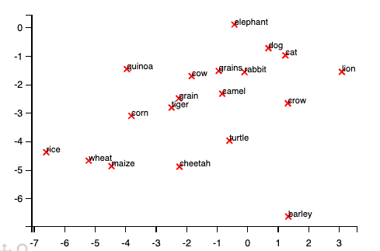
“My Visualization Looks a Bit Different!"
It’s possible that you visualization will be different.
In a reasonable output, semantically similar words should be closer.

Slide 7
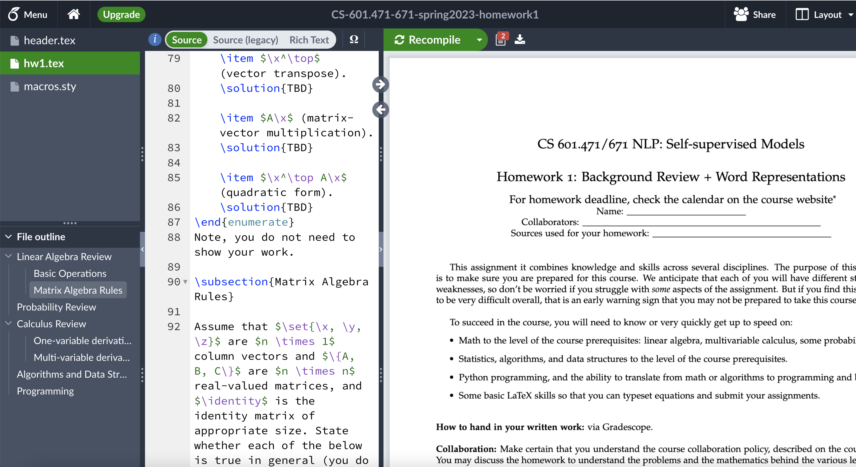
“Is Typesetting Mandatory?” No, but …
But 10x strongly recommended.
It is a must-have skill if you’re considering going to any research field.

Slide 8
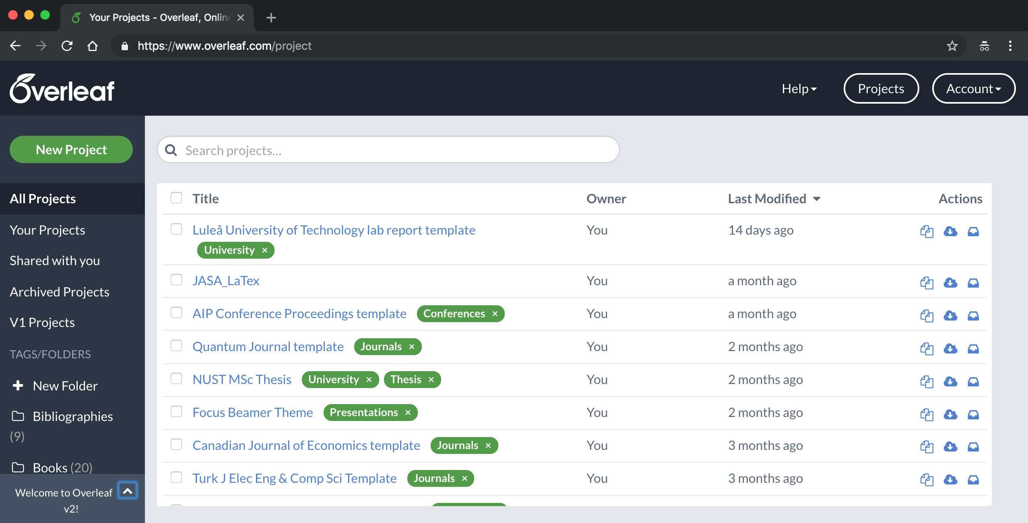
“Is Typesetting Mandatory?"
Go back to Overleaf home and ”copy” the homework template.

Slide 9
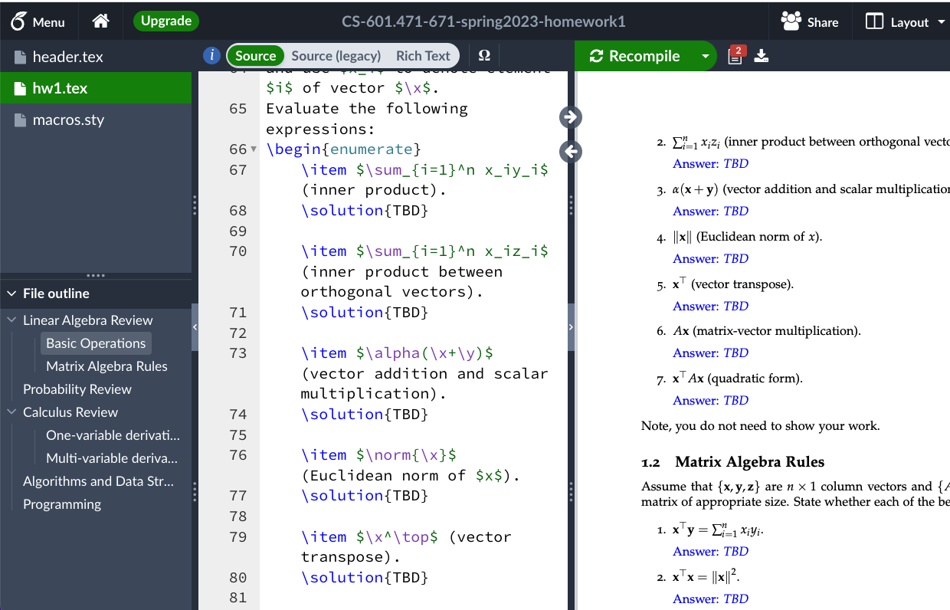
“Is Typesetting Mandatory?"
Go back to Overleaf home and ”copy” the homework template.

Slide 10
Chapter: Self-Supervised Meaning of “Words”
Human language and word meaning
Word2vec overview
Word2vec objective function gradients
Inspecting the resulting word vectors
Evaluating word vectors
Key learning today: extracting self-supervised meanings representation for word and the (really surprising!) result that word meaning can be represented rather well by a (high-dimensional) vector of real numbers.

Slide 11
“Meaning” in Inside Computer’s Brain
From perspective of your computer 🤖, which of the followings is sweeter?
(1) ”apple”
(2) 0110000101110000011100000110110001100101
(3) None
>> import bitarray
>> ba = bitarray.bitarray()
>> ba.frombytes('apple'.encode('utf-8'))
bitarray('0110000101110000011100000110110001100101')

Slide 12
Representing “Meaning”
There is inherent meaning attached to symbols in computers.
We need to design computational frameworks for representing “meaning”.
“apple” ← → 🍎
Notes:
Meaning and everything implied from it:
Apples are fruit
They’re edible
…

Slide 13
Representing “Meaning”
There is inherent meaning attached to symbols in computers.
We need to design computational frameworks for representing “meaning”.
But what is “meaning”?
“Meaning” according to Webster dictionary:
“apple” ← → 🍎
There are intentions behind these symbols
The idea that a person wants to express by using words, signs, etc.
Symbols are the vehicle of expression`
Notes:
Meaning and everything implied from it:
Apples are fruit
They’re edible
…

Slide 14
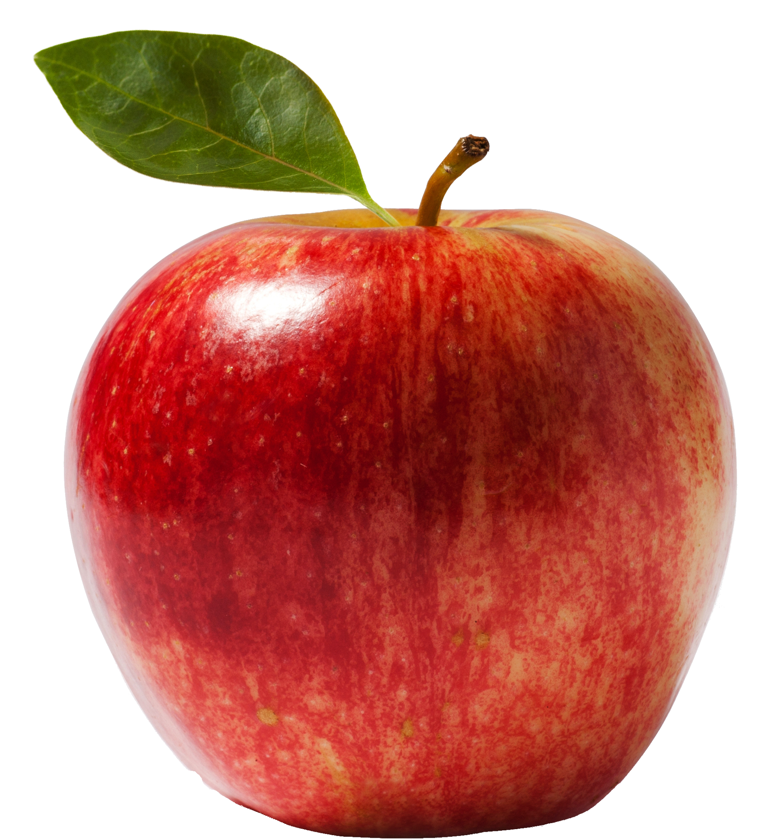
Difficulty of Representing “Meaning”
One symbol can have different meanings — often inferred from its context.
What is “apple”?
A company?
A fruit?
New York City?
….

Slide 15
Two Schools of “Semantics”
Semantics is concerned with the meanings of texts.
There are two main approaches:
1. Propositional or formal semantics: A block of text is to converted into a formula in a logical language (i.e., symbols to representing meaning).
“man bites apples” ➔ bites(man, apple)
bites(*,*) is a binary relation among its objects.

Slide 16
Two Schools of “Semantics”
Semantics is concerned with the meanings of texts.
There are two main approaches:
1. Propositional or formal semantics: A block of text is to converted into a formula in a logical language (i.e., symbols to representing meaning).
2. Vector representation: Texts are embedded into a high-dimensional space
Sentences similar in meaning should be close to this embedding (e.g. use human judgments)
“man bites apples” ➔ bites(man, apple)
bites(*,*) is a binary relation among its objects.
“man bites apples” ➔ (0.2, -0.3, 1.5,…) ∈ ℝ^{n}
Poll: which one is your favorite and why?

Slide 17
Two Schools of “Semantics”: Pros and Cons
Propositional or formal semantics:
Pro: easy to understand
Con: Need to hand-written; difficult to scale up
Vector representation:
Con: not easy to make sense of.
Pro: might be able to infer it algorithmically
In this class, we will mainly focus on the latter.
“man bites apples” ➔ bites(man, apple)
bites(*,*) is a binary relation among its objects.
“man bites apples” ➔ (0.2, -0.3, 1.5,…) ∈ ℝ^{n}
Self-supervised learning!!

Slide 18
Representing Words via Vectors: Approach 1
Question: What is the simplest way to represent a word (from a list of N words) with a vector?

Slide 19
Representing Words via Vectors: Approach 1
Question: What is the simplest way to represent a word (from a list of N words) with a vector?
Here is an idea:
Create N-dimensional vectors for each words
Except the corresponding element to 1, and zero the rest
These are called “one-hot” vectors
What are the limitations of one-hot vectors?
motel = [0 0 0 0 0 0 0 0 0 0 1 0 0 0 0]
hotel = [0 0 0 0 0 0 0 1 0 0 0 0 0 0 0]

Slide 20
Limitations of One-hot Meaning Vectors
Extremely long vectors:
# of words in vocabulary (e.g., 500,000+)
Word vectors are not comparable: No meaningful comparison we can make between word vectors other than equality testing.
Example: in web search, if a user searches for “motel”, we would like to match documents containing “hotel”.
There is no natural notion of similarity for one-hot vectors!
motel = [0 0 0 0 0 0 0 0 0 0 1 0 0 0 0]
hotel = [0 0 0 0 0 0 0 1 0 0 0 0 0 0 0]

Slide 21
Representing Words via Vectors: Approach 2
Learn vector representation such that words similar in meaning are closer.
Note about terminology: word vectors are also called (word) embeddings or (neural) word representations They are a distributed representation.
Question: what kind of algorithm can learn such representations?
0.286
0.792
−0.177
−0.107
0.109
−0.542
0.349
0.271
0.413
0.582
−0.007
0.247
0.216
−0.718
0.147
0.051
“motel” →
“hotel” →

Slide 22
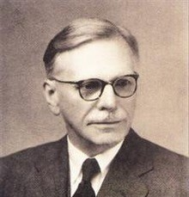
Similar Meaning ~ Similar Contexts
Similar words occur in similar contexts
Distributional semantics: foundation of many modern NLP models.
Note, here we use a narrow definition for “context”:
Context is the set of words that appear nearby (within a fixed-size window) a given word w.
“You shall know a word by the company it keeps” (John Rupert Firth 1957)
As an establishment providing accommodations provide a variety of amenities ...
A motel, an abbreviation for "motor ", is a small-sized low-rise lodging ...
One of the first was opened in Exeter in 1768 ...
hotel
hotel
hotel
These context words will represent "hotel”

Slide 23
Toward an Algorithms for Distributional Semantics
Similar words occur in similar contexts
Use this principle to build algorithms for self-learning
Specifically, embed words such that their embeddings are predictive of their contexts → Word2vec algorithm
…
problems
turning
into
banking
crises
as
…
outside context words center word outside context words in window of size 2 at position t in window of size 2
[Distributed Representations of Words and Phrases and their Compositionality. Mikolov et al. 2013]

Slide 24
Word2Vec: Overview
Word2vec [Mikolov et al. 2013] is a framework for learning word vectors
Collect a large corpus of sentences (e.g., Wikipedia)
Every word in a fixed vocabulary is represented by a vector
…
problems
turning
into
banking
crises
as
…
outside context words center word outside context words in window of size 2 at position t in window of size 2
[Distributed Representations of Words and Phrases and their Compositionality. Mikolov et al. 2013]

Slide 25
Word2Vec: Overview
Word2vec [Mikolov et al. 2013] is a framework for learning word vectors
Collect a large corpus of sentences (e.g., Wikipedia)
Every word in a fixed vocabulary is represented by a vector
For each position in the text, consider the “center” word c and context (“outside”) words o
The pairs of center word/context word are called “skip-grams.”
Typical distances are 3-5 word positions.
…
problems
turning
into
banking
crises
as
…
outside context words center word outside context words in window of size 2 at position t in window of size 2
[Distributed Representations of Words and Phrases and their Compositionality. Mikolov et al. 2013]

Slide 26
Word2Vec: Overview
Word2vec [Mikolov et al. 2013] is a framework for learning word vectors
Collect a large corpus of sentences (e.g., Wikipedia)
Every word in a fixed vocabulary is represented by a vector
For each position in the text, consider the “center” word c and context (“outside”) words o
Define a context predictability measure; i.e., the probability of o given c (or vice versa)
$$P\left(w_{t−2} \right|w_{t})$$
$$P\left(w_{t+2} \right|w_{t})$$
$$P\left(w_{t−1} \right|w_{t})$$
$$P\left(w_{t+1} \right|w_{t})$$
…
problems
turning
into
banking
crises
as
…
outside context words center word outside context words in window of size 2 at position t in window of size 2
[Distributed Representations of Words and Phrases and their Compositionality. Mikolov et al. 2013]

Slide 27
Word2Vec: Overview
Word2vec [Mikolov et al. 2013] is a framework for learning word vectors
Collect a large corpus of sentences (e.g., Wikipedia)
Every word in a fixed vocabulary is represented by a vector
For each position in the text, consider the “center” word c and context (“outside”) words o
Define a context predictability measure; i.e., the probability of o given c (or vice versa)
$$P\left(w_{t−2} \right|w_{t})$$
$$P\left(w_{t+2} \right|w_{t})$$
$$P\left(w_{t−1} \right|w_{t})$$
$$P\left(w_{t+1} \right|w_{t})$$
…
problems
turning
into
banking
crises
as
…
outside context words center word outside context words in window of size 2 at position t in window of size 2
[Distributed Representations of Words and Phrases and their Compositionality. Mikolov et al. 2013]

Slide 28
Word2Vec Representation via Maximum-Likelihood
Word2vec [Mikolov et al. 2013] is a framework for learning word vectors
Collect a large corpus of sentences (e.g., Wikipedia)
Every word in a fixed vocabulary is represented by a vector
For each position in the text, consider the “center” word c and “outside” context words o
Define a context predictability measure; i.e., the probability of o given c (or vice versa)
Keep adjusting the word vectors to maximize this probably
$$P\left(w_{t−2} \right|w_{t})$$
$$P\left(w_{t+2} \right|w_{t})$$
$$P\left(w_{t−1} \right|w_{t})$$
$$P\left(w_{t+1} \right|w_{t})$$
…
problems
turning
into
banking
crises
as
…
outside context words center word outside context words in window of size 2 at position t in window of size 2
[Distributed Representations of Words and Phrases and their Compositionality. Mikolov et al. 2013]

Slide 29
Word2Vec Probabilities: Pop Quiz
What is the right expression for $P\left(w_{t+2} \right|w_{t})$?
(A)$P\left(problems | into\right)$
(B) $P\left(cries | into\right)$
(C)$P\left(problems | cries\right)$
(D)$P\left(into | cries\right)$
$$P\left(w_{t−2} \right|w_{t})$$
$$P\left(w_{t+2} \right|w_{t})$$
$$P\left(w_{t−1} \right|w_{t})$$
$$P\left(w_{t+1} \right|w_{t})$$
…
problems
turning
into
banking
crises
as
…
outside context words center word outside context words in window of size 2 at position t in window of size 2

Slide 30
Word2Vec Probabilities
Question: what is a simple way to define $P\left(w_{t+j}|w_{t};θ\right)$?

Slide 31
Word2Vec Probabilities
Question: what is a simple way to define $P\left(w_{t+j}|w_{t};θ\right)$?
Answer: We will use two vectors per word w:
$v_{w}$when w is a center word
$u_{w}$ when w is a outside (context) word
This creates a bit redundancy, but it will simplify the exposition/derivations.
We will average these after the optimization is done.
$$P\left(o \right| c)$$
into
banking
$v_{c}$ $u_{o}$

Slide 32
Word2Vec Probabilities
Question: what is a simple way to define $P\left(w_{t+j}|w_{t};θ\right)$?
Answer: We will use two vectors per word w:
$v_{w}$when w is a center word
$u_{w}$ when w is a outside (context) word
This creates a bit redundancy, but it will simplify the exposition/derivations.
We will average these after the optimization is done.
Then for a center word c and a context word o:
The parameters of the optimization $θ$ are $\{u_{w}, v_{w},∀x∈V\}$
$$P\left(o \right| c)$$
into
banking
$v_{c}$ $u_{o}$
Notice the dot product!
$$P\left(o \right| c)=\frac{\exp\left(u_{o}^{T}v_{c}\right)}{\sum_{x∈V}{\exp\left(u_{x}^{T}v_{c}\right)}}$$

Slide 33
Word2Vec Probabilities
Question: what is a simple way to define $P\left(w_{t+j}|w_{t};θ\right)$?
Answer: We will use two vectors per word w:
$v_{w}$when w is a center word
$u_{w}$ when w is a outside (context) word
Choose a measure of similarity, for example, dot product:
Then for a center word c and a context word o, dot product of their representation $u_{o}^{}$ and $v_{c}$ be higher if tend to co-occur.
$$P\left(o \right| c)$$
into
banking
$v_{c}$ $u_{o}$

Slide 34
Word2Vec Probabilities
Question: what is a simple way to define $P\left(w_{t+j}|w_{t};θ\right)$?
Then for a center word c and a context word o define a similarity metric between their embeddings.
The learnable parameters of this model are $θ=\{u_{w}, v_{w},∀x∈V\}$
Notice the dot product!
$$P\left(o \right| c)=\frac{\exp\left(u_{o}^{T}v_{c}\right)}{\sum_{x∈V}{\exp\left(u_{x}^{T}v_{c}\right)}}$$

Slide 35
Word2Vec Probabilities: An Example
$$P\left(o\right|c)=\frac{\exp\left(u_{o}^{T}v_{c}\right)}{\sum_{x∈V}{\exp\left(u_{x}^{T}v_{c}\right)}}$$
If the representation of $o$ and $c$ are similar, they tend to co-occur.
$$P\left(w_{t−2} \right|w_{t})=p\left(problems|into\right)=\frac{\exp\left(u_{problems}^{T}v_{into}\right)}{\sum_{x∈V}{\exp\left(u_{x}^{T}v_{into}\right)}}$$
$$P\left(w_{t−2} \right|w_{t})$$
$$P\left(w_{t+2} \right|w_{t})$$
$$P\left(w_{t−1} \right|w_{t})$$
$$P\left(w_{t+1} \right|w_{t})$$
…
problems
turning
into
banking
crises
as
…
outside context words center word outside context words in window of size 2 at position t in window of size 2

Slide 36
Word2Vec Probabilities: Pop Quiz
What is the right expression for $P\left(w_{t+2} \right|w_{t})=P\left(cries|into\right)$?
(A) $\frac{\exp\left(u_{cries}^{T}v_{into}\right)}{\sum_{x∈V}{\exp\left(u_{x}^{T}v_{into}\right)}}$
(B) $\frac{\exp\left(u_{into}^{T}v_{cries}\right)}{\sum_{x∈V}{\exp\left(u_{x}^{T}v_{cries}\right)}}$
$$P\left(o\right|c)=\frac{\exp\left(u_{o}^{T}v_{c}\right)}{\sum_{x∈V}{\exp\left(u_{x}^{T}v_{c}\right)}}$$
(C) $\frac{\exp\left(u_{cries}^{T}v_{into}\right)}{\sum_{x∈V}{\exp\left(u_{x}^{T}v_{into}\right)}}$
(D) $\frac{\exp\left(u_{problems}^{T}v_{into}\right)}{\sum_{x∈V}{\exp\left(u_{x}^{T}v_{cries}\right)}}$
$$P\left(w_{t−2} \right|w_{t})$$
$$P\left(w_{t+2} \right|w_{t})$$
$$P\left(w_{t−1} \right|w_{t})$$
$$P\left(w_{t+1} \right|w_{t})$$
…
problems
turning
into
banking
crises
as
…
outside context words center word outside context words in window of size 2 at position t in window of size 2

Slide 37
Word2Vec Probabilities: SoftMax Function
This is an example use of the softmax function ℝ^{𝑛} → (0,1)^{𝑛}
The SoftMax function maps arbitrary values 𝑥_{i} to a probability distribution 𝑝_{i}
“max” because amplifies probability of largest 𝑥i
“soft” because still assigns some probability to smaller 𝑥i
Frequently used in Deep Learning
② Exponentiation makes anything positive
① Dot product compares similarity of o and c.
exp(𝑢^{𝑇}𝑣 )
𝑢^{𝑇}𝑣 = 𝑢. 𝑣 = ∑^{𝑛} 𝑢_{i}𝑣_{i}
₌ 𝑜 𝑐
i=1
𝑃 𝑜 𝑐
Larger dot product = larger probability
∑
exp(𝑢^{𝑇} 𝑣 )
/∈𝑉
/ 𝑐
③ Normalize over entire vocabulary to give probability distribution

Slide 38
Word2Vec Probabilities: Pop Quiz
What is the computational cost of computing $P\left(o\right|c)$?
$$P\left(o\right|c)=\frac{\exp\left(u_{o}^{T}v_{c}\right)}{\sum_{x∈V}{\exp\left(u_{x}^{T}v_{c}\right)}}$$
(A) constant (B) O(|V|) (C) O(|V|+d) (D) O(|V|xd)
$$P\left(w_{t−2} \right|w_{t})$$
$$P\left(w_{t+2} \right|w_{t})$$
$$P\left(w_{t−1} \right|w_{t})$$
$$P\left(w_{t+1} \right|w_{t})$$
…
problems
turning
into
banking
crises
as
…
outside context words center word outside context words in window of size 2 at position t in window of size 2

Slide 39
Word2Vec Representation via Maximum-Likelihood
For each position $t=1, …, T$ predict context words within a window
of fixed size m, given center word 𝑤_{𝑡}.
Data likelihood:
Goal: maximizing likelihood with respect to its parameters $θ$

Slide 40
Pop Quiz
Define $f\left(x\right)=−g\left(x\right)$. In order to maximize $f\left(x\right)$, we can:
maximize $g\left(x\right)$
minimize $g\left(x\right)$
minimize $g\left(−x\right)$
None of the above

Slide 41
Word2Vec Representation via Maximum-Likelihood
For each position $t=1, …, T$ predict context words within a window of fixed size m, given center word 𝑤_{𝑡}. Data likelihood:
The objective function $J\left(θ\right)$ is the (average) negative log likelihood:
maximizing likelihood ⟺ maximizing predictive accuracy ⟺ minimizing objective function

Slide 42
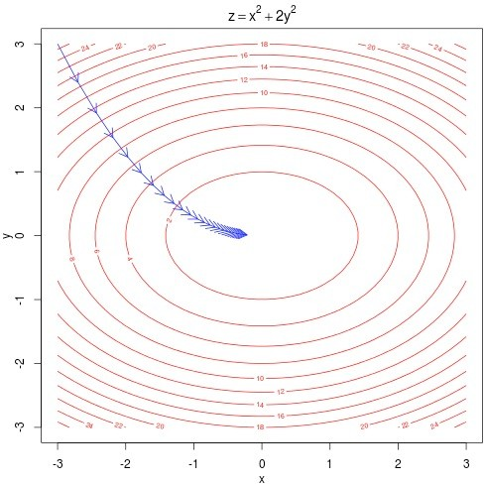
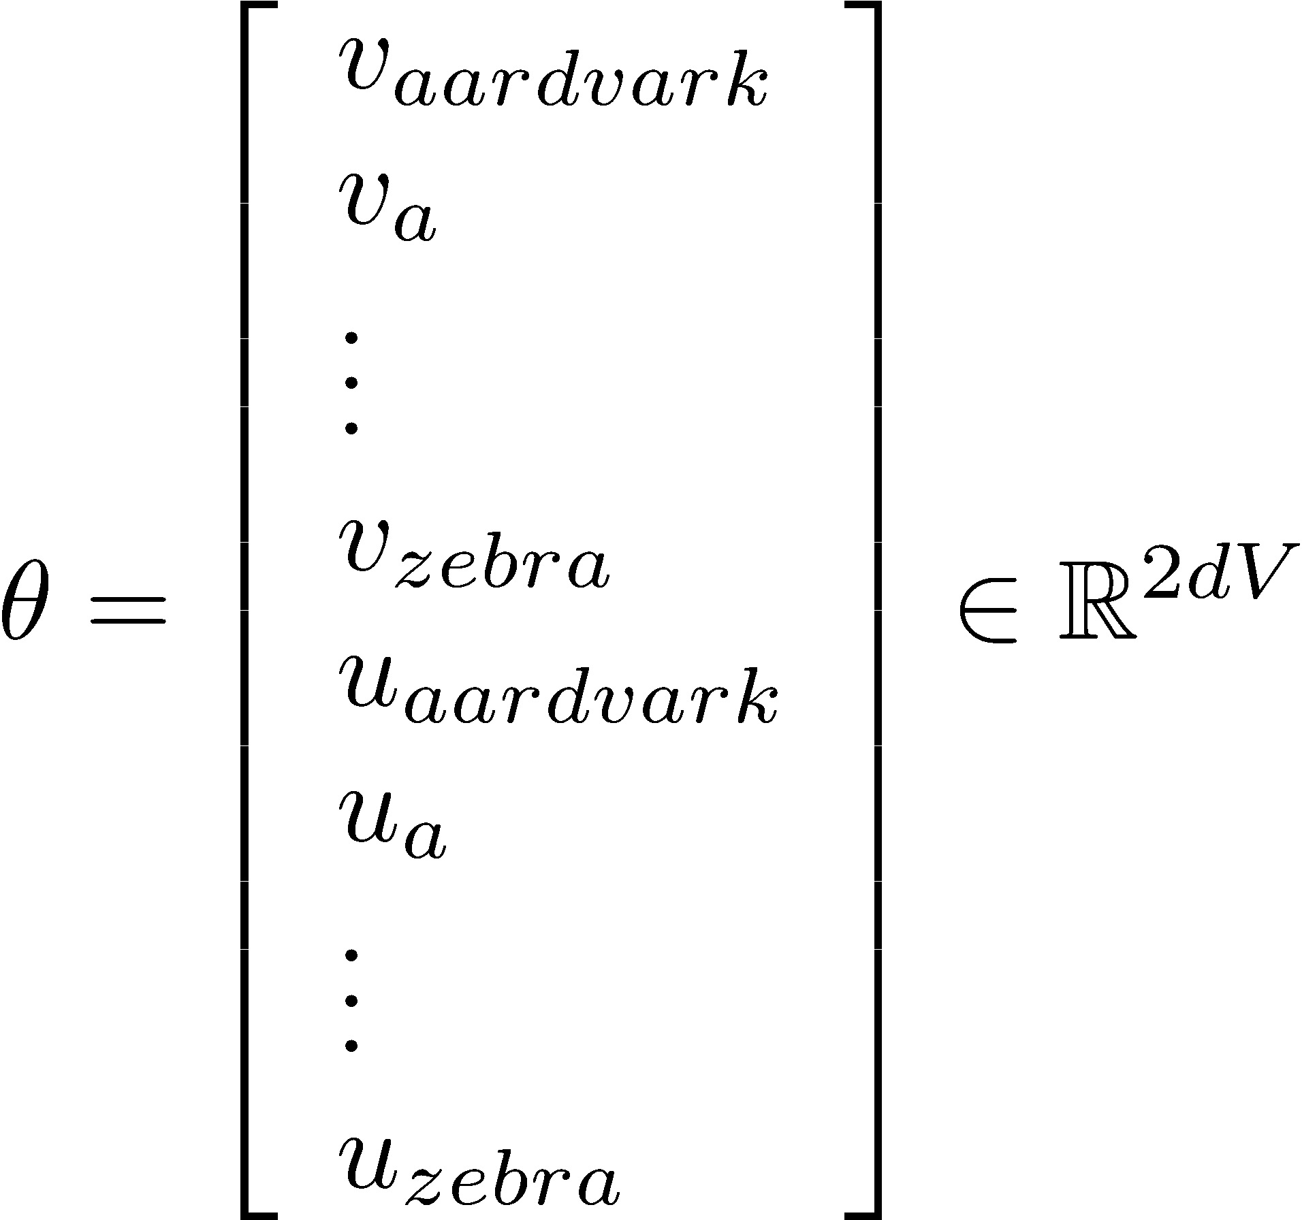
Training the Model via Minimizing the Loss
To train a model, we gradually adjust parameters $θ$ to minimize a loss $J\left(θ\right)$
Recall:
$θ$ represents all the model parameters, in one long vector
With d-dimensional vectors and V-many words, we have →
every word has two vectors
We optimize these parameters by walking down the gradient computed with respect to the word vectors (see the right figure).

Slide 43
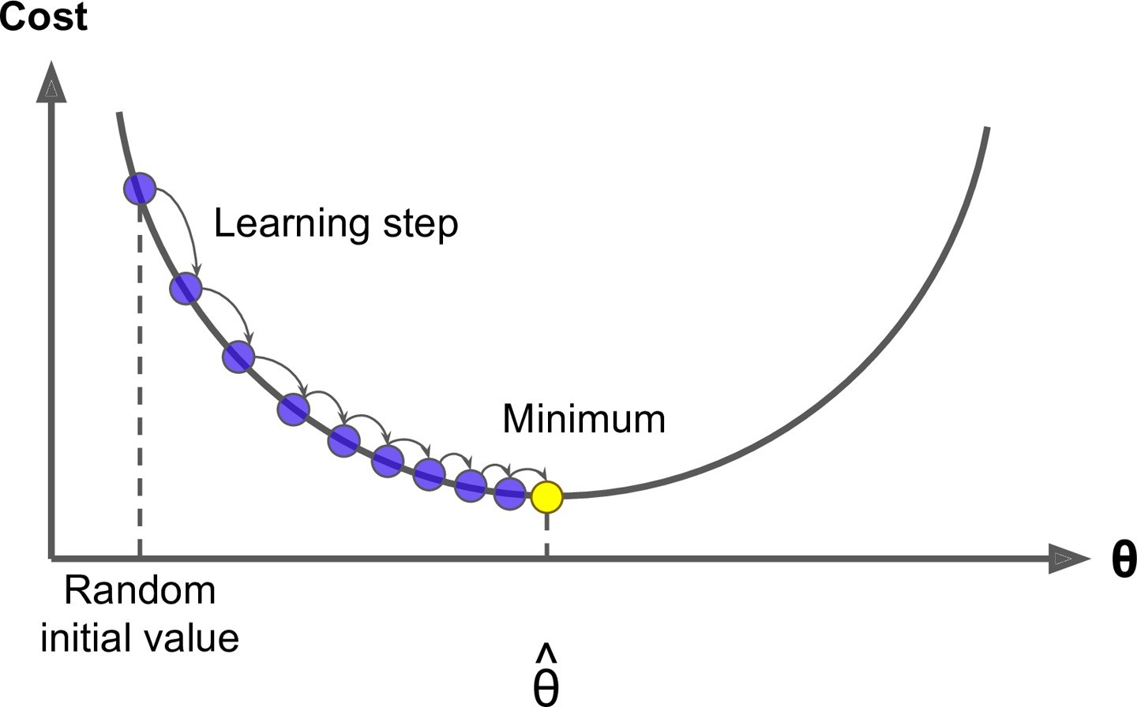
Optimization Recap: Gradient Descent
We have a cost function $J\left(θ\right)$we want to minimize
We can use Gradient Descent algorithm!
Idea: for current value of $θ$, calculate gradient of $J\left(θ\right)$, then take small step in direction of negative gradient. Repeat.
Note: Our objectives may not be convex like this. But life turns out to be okay!

Slide 44
Optimization Recap: Gradient Descent (1): Intuition
Imagine you’re blindfolded
Need to walk down a hill
You can use your hands to find the directions that may be downhill
[slide: Andrej Karpathy]

Slide 45
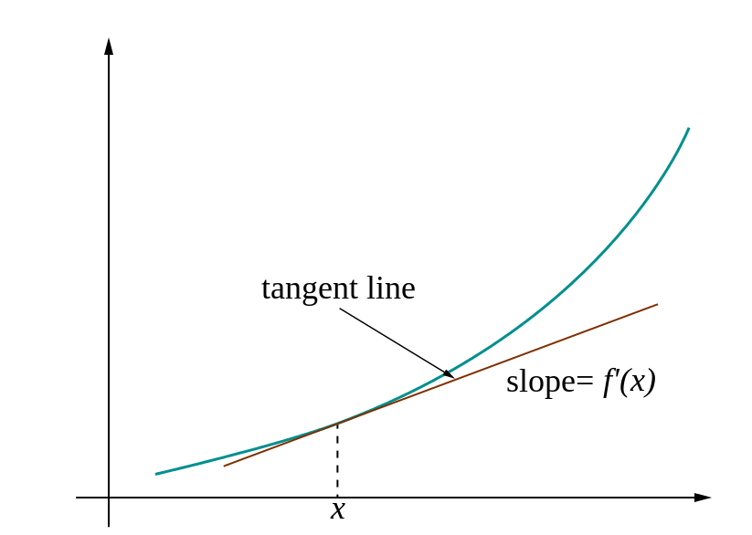
Optimization Recap: Gradient Descent (2): Intuition
In 1-dimension, the derivative of a function:
Why step in direction of negative gradient?
Gradient quantifies how rapidly the function $L(θ)$ varies when we change the argument $θ_{j}$ by a tiny amount.
$$\frac{∂L}{∂θ_{j}}=\lim_{h→0}{\frac{L\left(θ_{j}+h\right)−L(θ_{j})}{h}}$$

Slide 46
Optimization Recap: Gradient Descent (3)
𝛼 = step size or learning rate
Update equation (in matrix notation):
Update equation (for single parameter):
Algorithm:
Iteratively subtract the gradient with respect to the model parameters ($θ$)
i.e., we’re moving in a direction opposite to the gradient of the loss $L(θ)$
I.e., we’re moving towards smaller loss $L(θ)$

Slide 47
Optimization Recap: Gradient Descent (4)
Update equation (in matrix notation):
[demo credit: ICMS YouTube channel]

Slide 48
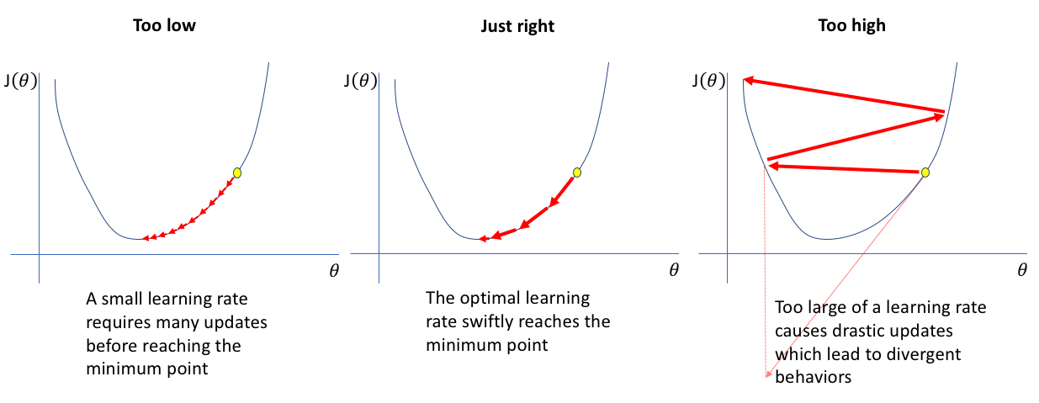
Optimization Recap: Gradient Descent (5): Setting the Step Size
What is a good value for step size $α$?
If $α=$ too small, it may be too slow
If $α=$ too large, it may oscillate
It may take trial-and-errors to find the sweet spot.
Another trick is to define a “schedule” for gradually reducing the learning rate starting from a large number.
More on this in the homework! ☺
[figure from: https://www.jeremyjordan.me/nn-learning-rate/]

Slide 49
Computing the Gradients for Word2Vec
Minimize the objective function (log-likelihood):
Derivatives of “center” vectors:
Derivatives of “outside” vectors:
$$J\left(θ\right)=−\frac{1}{T}\sum_{t=1}^{T}{\sum_{\begin{aligned}−m≤j≤m \\ j≠0\end{aligned}}{log P\left(w_{t+j} \right|w_{t};θ)}}$$
text length
window size
$$\frac{∂}{∂v_{c}}J\left(θ\right)= ?$$
We will derive the gradients with respect to the ”center” vectors. Similar calculations for “outside” vectors (homework!!)
$$\frac{∂}{∂u_{c}}J\left(θ\right)= ?$$

Slide 50
Today’s Recap
The fundamental question: how to represent and learn “meaning” of symbols.
Semantics: formal/propositional semantics vs. distributional semantics.
We learned about the core of Word2Vev (SkipGram algorithm).
HW1 is basically using the resulting vectors from Word2Vec.
Learning word embeddings via Gradient Descent: next time!

Slide 51
Linear Algebra Pop Quiz
Let $f\left(x\right)= \sum_{i}{g_{i}(h(x))}$. Assuming that $x∈ℝ^{d}$ and $x_{j}$ is the $j$-th $x$, answer the followings:
Q1: what is $\frac{∂}{∂x_{j}}f\left(x\right)$ based on $\frac{∂}{∂x_{j}}\left(g_{i}\left(h(x)\right)\right)$?
Q2: what is $\frac{∂}{∂x_{j}}\left(g_{i}\left(h(x)\right)\right)$ based on $\frac{∂}{∂x_{j}}h(x)$?
Q3: If $x, y∈ℝ^{d×1}$ what is $\frac{∂}{∂x}\left[x^{T}y\right]?$
Easier to see if you drive it for each element: $\frac{∂}{∂x_{j}}\left[x^{T}y\right]=\frac{∂}{∂x_{j}}\sum_{i}{x_{i} . y_{i}}=y_{j}$
$$\frac{∂}{∂x_{j}}f\left(x\right)= \sum_{i}{\frac{∂}{∂x_{j}}\left(g_{i}\left(h(x)\right)\right)}$$
(distributive property)
$$\frac{∂}{∂x_{j}}\left(g_{i}\left(h(x)\right)\right)=g_{i}^{′}\left(h(x)\right) ×h^{′}(x)$$
(chain rule)
$$\frac{∂}{∂x}\left[x^{T}y\right]=y$$

Slide 52
Computing the Gradients for Word2Vec
Minimize the objective function (log-likelihood):
$$J\left(θ\right)=−\frac{1}{T}\sum_{t=1}^{T}{\sum_{\begin{aligned}−m≤j≤m \\ j≠0\end{aligned}}{log P\left(w_{t+j} \right|w_{t};θ)}}$$
text length
window size
$$\frac{∂}{∂v_{c}}J\left(θ\right)=−\frac{1}{T}\sum_{t=1}^{T}{\sum_{\begin{aligned}−m≤j≤m \\ j≠0\end{aligned}}{\frac{∂}{∂v_{c}}log P\left(w_{t+j} \right| w_{t};θ)}}$$
(distributive property)
$$\frac{∂}{∂v_{c}}log P\left(w_{t+j} \right| w_{t};θ)=?$$

Slide 53
Computing the Gradients for Word2Vec (2)
$$P\left(o \right| c)$$
into
banking
$v_{c}$ $u_{o}$
$$\frac{∂}{∂v_{c}}log P\left(c \right|o;θ)=\frac{∂}{∂v_{c}}\left[log\frac{\exp\left(u_{o}^{T}v_{c}\right)}{\sum_{x∈V}{\exp\left(u_{x}^{T}v_{c}\right)}}\right]$$
$$=\frac{∂}{∂v_{c}}\left[\log{\exp\left(u_{o}^{T}v_{c}\right)− }\log{\sum_{x∈V}{\exp\left(u_{x}^{T}v_{c}\right)}}\right]$$
$$=\frac{∂}{∂v_{c}}\left[\log{\exp\left(u_{o}^{T}v_{c}\right)}\right]−\frac{∂}{∂v_{c}}\left[\log{\sum_{x∈V}{\exp\left(u_{x}^{T}v_{c}\right)}} \right]$$
(distributive property)
$$\frac{∂}{∂v_{c}}\left[\log{\exp\left(u_{o}^{T}v_{c}\right)}\right]=\frac{∂}{∂v_{c}}\left[u_{o}^{T}v_{c}\right]=u_{o}$$

Slide 54
Computing the Gradients for Word2Vec (3)
$$P\left(o \right| c)$$
into
banking
$v_{c}$ $u_{o}$
$$\frac{∂}{∂v_{c}}log P\left(c \right|o;θ)=\frac{∂}{∂v_{c}}\left[log\frac{\exp\left(u_{o}^{T}v_{c}\right)}{\sum_{x∈V}{\exp\left(u_{x}^{T}v_{c}\right)}}\right]$$
$$=\frac{∂}{∂v_{c}}\left[\log{\exp\left(u_{o}^{T}v_{c}\right)− }\log{\sum_{x∈V}{\exp\left(u_{x}^{T}v_{c}\right)}}\right]$$
$$=\frac{∂}{∂v_{c}}\left[\log{\exp\left(u_{o}^{T}v_{c}\right)}\right]−\frac{∂}{∂v_{c}}\left[\log{\sum_{x∈V}{\exp\left(u_{x}^{T}v_{c}\right)}} \right]$$
(distributive property)
$$?$$

Slide 55
Computing the Gradients for Word2Vec (4)
$$P\left(o \right| c)$$
into
banking
$v_{c}$ $u_{o}$
$$\frac{∂}{∂v_{c}}\left[\log{\sum_{x∈V}{\exp\left(u_{x}^{T}v_{c}\right)}} \right]=\frac{1}{\sum_{x∈V}{\exp\left(u_{x}^{T}v_{c}\right)}}×\frac{∂}{∂v_{c}}\sum_{x∈V}{\exp\left(u_{x}^{T}v_{c}\right)}$$
note: $\frac{∂}{∂x}\log\left(x\right)=\frac{1}{x}$
$$=\frac{1}{\sum_{x∈V}{\exp\left(u_{x}^{T}v_{c}\right)}}×\sum_{x∈V}{u_{x} \exp\left(u_{x}^{T}v_{c}\right)}$$
note: $\frac{∂}{∂x}\exp\left(f(x)\right)$
$=\frac{∂f}{∂x} × exp\left(f(x)\right)$
$$=\sum_{x∈V}{u_{x} × P\left(x \right|c;θ) }$$

Slide 56
Computing the Gradients for Word2Vec (5)
$$P\left(o \right| c)$$
into
banking
$v_{c}$ $u_{o}$
Putting things together:
The gradient $\frac{∂}{∂v_{c}}log P\left(c \right|o)$ quantifies the vector connecting these two quantities
TBD: is there better intuition?
$\frac{∂}{∂v_{c}}log P\left(c \right|o)=$ $u_{o} − \sum_{x∈V}{u_{x} × P\left(x \right|c) }$
the current representation of $o$
The expected (weighted avg) representation of the words that tend to co-occur with $c$.
$$\frac{∂}{∂v_{c}}J\left(θ\right)=−\frac{1}{T}\sum_{t=1}^{T}{\sum_{\begin{aligned}−m≤j≤m \\ j≠0\end{aligned}}{\left[u_{o} − \sum_{x∈V}{u_{x} × P\left(x \right|c) }\right]}}$$

Slide 57
Pop Quiz
What is the computational complexity of the followings? (assume that $P\left(o\right|c)$ is pre-computed we just need to look it up)
$$\frac{∂}{∂v_{c}}J\left(θ\right)=−\frac{1}{T}\sum_{t=1}^{T}{\sum_{\begin{aligned}−m≤j≤m \\ j≠0\end{aligned}}{\frac{∂}{∂v_{c}}log P\left(c \right|o)}}$$
$\frac{∂}{∂v_{c}}log P\left(c \right|o)=$ $u_{o} − \sum_{x∈V}{u_{x} × P\left(x \right|c) }$
O(d)
O(|V|)
O(|V|+d)
O(|V|.d)
O(T)
O(T.m)
O(T.m.|V|)
O(T.m.|V|.d)

Slide 58
Stochastic Gradient Descent
Challenge: $J\left(θ\right)$is a function of all windows in the corpus (potentially billions!)
So computing $∇_{θ}J\left(θ\right)$ is very expensive to compute
You would wait a very long time before making a single update!
Very bad idea for pretty much all neural nets!
Solution: Stochastic gradient descent (SGD)
Repeatedly sample windows and instances, and update after each one
Algorithm:
$$\frac{∂}{∂v_{c}}J\left(θ\right)=−\frac{1}{T}\sum_{t=1}^{T}{\sum_{\begin{aligned}−m≤j≤m \\ j≠0\end{aligned}}{\frac{∂}{∂v_{c}}log P\left(c \right|o)}}$$

Slide 59
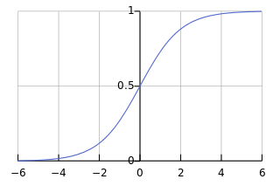
Skip-gram with Negative Sampling (HW)
The expensive computation: O(|V|.d)
Remember this gradient computation:
Idea: rather than enumerating over all vocabulary, let’s sample!
Maximize the probability that outside word co-occurs w/ the center
Minimize the probability of noise/random words around the center word
TODO: why did “exp” change to “sigma”
$$J′\left(θ\right)=\log{P\left(o\right|c)}=\log{\frac{\exp\left(u_{o}^{T}v_{c}\right)}{\sum_{x∈V}{\exp\left(u_{x}^{T}v_{c}\right)}}}=log\exp\left(u_{o}^{T}v_{c}\right){−\log{\sum_{x∈V}{\exp\left(u_{x}^{T}v_{c}\right)}} }$$
$$J_{NS}\left(θ\right)=−logσ\left(u_{o}^{T}v_{c}\right){−\sum_{k∈\{K samples\}}{\log{σ\left({−u}_{x}^{T}v_{c}\right)}}}$$

Slide 60
Aside about Negative Sampling
Have to be careful with sampling negative examples
Can sample using frequency.
Problem: will sample a lot of stop-words.
Mikolov et al. proposed to sample using:
$$p\left(w_{i}\right)=\frac{{f(w_{i})}^{3/4}}{\sum_{j}{{f(w_{j})}^{3/4}}}$$
Not theoretically justified but works well in practice!

Slide 61
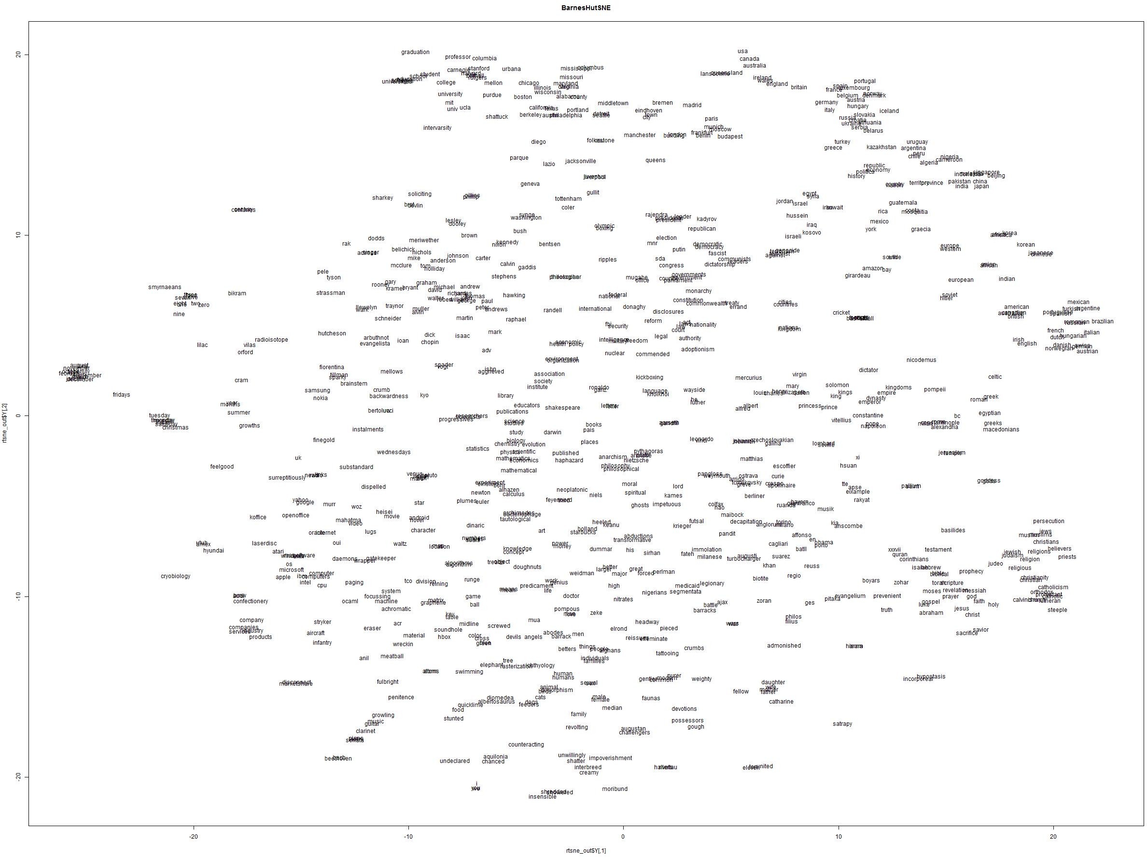
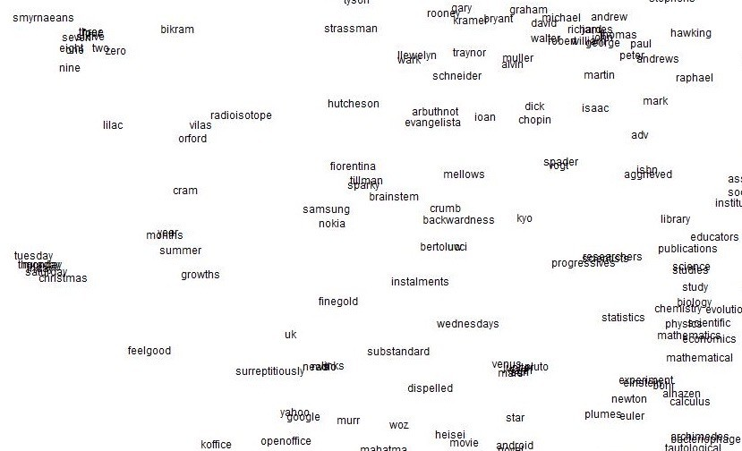
Word2vec maximizes objective function by putting similar words nearby in space
61

Slide 62
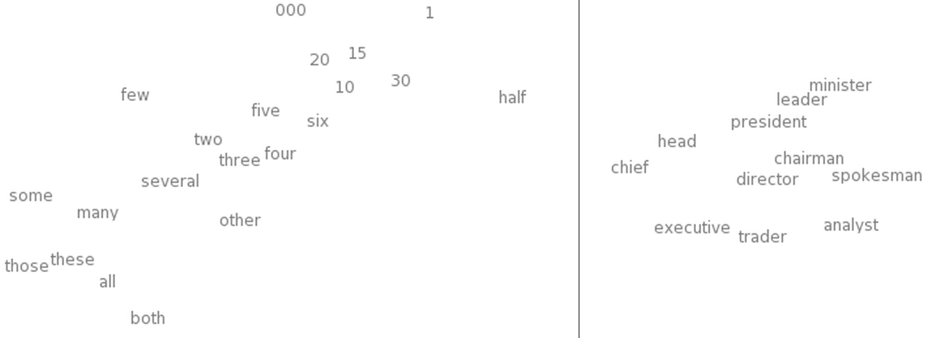
Word2vec maximizes objective function by putting similar words nearby in space
t-SNE of Word Embeddings
Left: Number Region Right: Jobs Region
[“Deep Learning, NLP, and Representations” by Chris Olah]

Slide 63
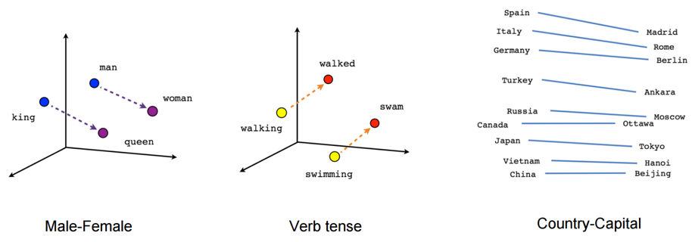
Composition
vec(“woman”)−vec(“man”) ≃ vec(“aunt”)−vec(“uncle”)
vec(“woman”)−vec(“man”) ≃ vec(“queen”)−vec(“king”)
This can be interpreted as “France is to Paris as Italy is to Rome”.
[Linguistic Regularities in Continuous Space Word Representations. Mikolov et al. 2013]

Slide 64
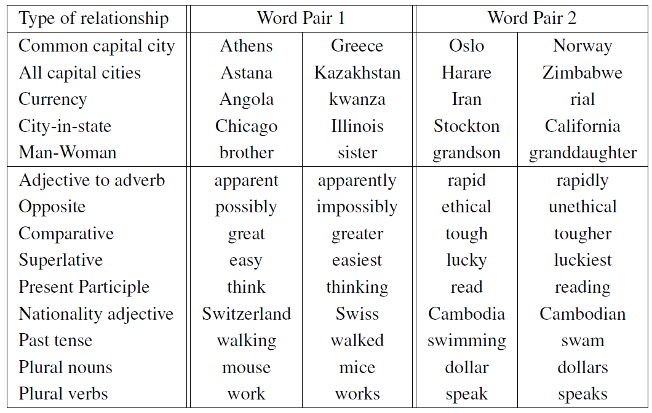
Relations Learned by Word2vec
Word2vec model computed from 6 billion word corpus of news articles
[Efficient Estimation of Word Representations in Vector Space. Mikolov et al. 2013]

Slide 65
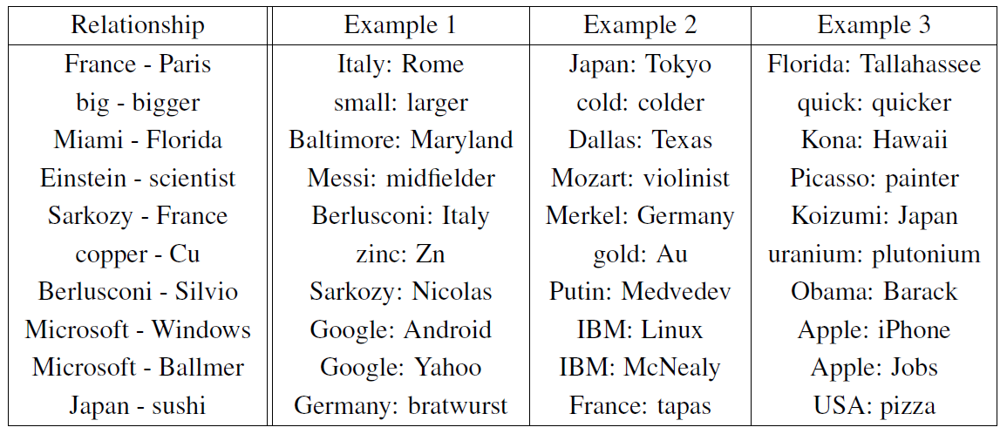
Relations Learned by Word2vec
A relation is defined by the vector displacement in the first column. For each start word in the other column, the closest displaced word is shown.
[Efficient Estimation of Word Representations in Vector Space. Mikolov et al. 2013]

Slide 66
Relations Learned by Word2vec
A relation is defined by the vector displacement in the first column. For each start word in the other column, the closest displaced word is shown.
[Efficient Estimation of Word Representations in Vector Space. Mikolov et al. 2013]

Slide 67
Relations Learned by Word2vec
A relation is defined by the vector displacement in the first column. For each start word in the other column, the closest displaced word is shown.
[Efficient Estimation of Word Representations in Vector Space. Mikolov et al. 2013]

Slide 68
Relations Learned by Word2vec
A relation is defined by the vector displacement in the first column. For each start word in the other column, the closest displaced word is shown.
[Efficient Estimation of Word Representations in Vector Space. Mikolov et al. 2013]

Slide 69
A relation is defined by the vector displacement in the first column. For each start word in the other column, the closest displaced word is shown.
[Efficient Estimation of Word Representations in Vector Space. Mikolov et al. 2013]

Slide 70
A relation is defined by the vector displacement in the first column. For each start word in the other column, the closest displaced word is shown.
[Efficient Estimation of Word Representations in Vector Space. Mikolov et al. 2013]

Slide 71
A relation is defined by the vector displacement in the first column. For each start word in the other column, the closest displaced word is shown.
[Efficient Estimation of Word Representations in Vector Space. Mikolov et al. 2013]

Slide 72
Word2Vec: Variants s
Output
Skip-Gram
W₋₂
What we just saw is the Skip-Gram model.
Predict context (“outside”) words (position independent) given center
There is also a CBOW (continuous-bag-of-words) variant.
Predict center word from (bag of) context words
Additional efficiency:
The current gradient computation w/ softmax function is expensive.
Alternative: Negative Sampling (Homework!!)
Input
W₋₁
Projection
w₀
w₁
w₂
Input
W₋₂
W₋₁
Output
Sum and projection
w₀
w₁
w₂
Continuous Bag of Words
(CBOW)

Slide 73
Word Embeddings: Big Picture
There are a variety of approaches:
Gradient-based algorithms:
Skip-gram/CBOW (Mikolov et al.), GloVe (Pennington et al.)
NNLM, HLBL, RNN (Bengio et al; Collobert & Weston; Huang et al; Minh & Hinton)
Count-based:
LSA, HAL, COALS, Hellinger-PCA (Lund & Burges; Rohde et al; Lebret & Collobert; Deerwester et al)
Brown clustering (Brown et al.)
Scales with corpus size
Better representations Captures complex patterns
Fast-ish training
Sub-par representations

Slide 74
Evaluating Word Vectors
How do we evaluate semantic regularities of distributed representations?

Slide 75
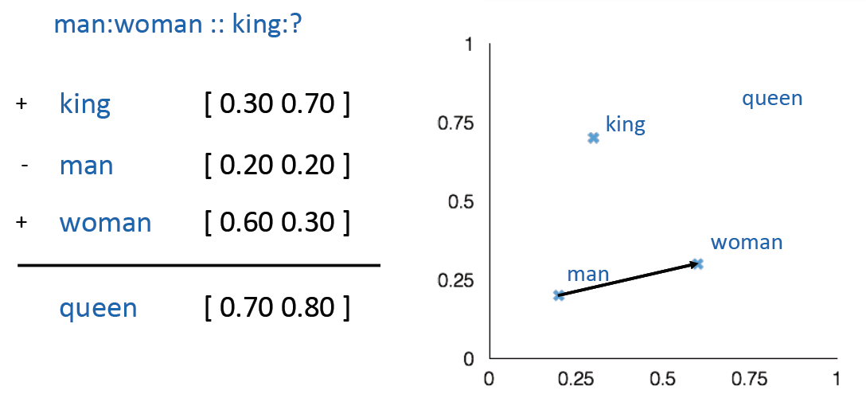
Evaluating Word Vectors: Word Analogies
Evaluate word vectors by how well their cosine distance after addition captures intuitive analogical relations.
Discarding the input words from the search (!)
Problem: What if the information is there but not linear?
a:b :: c:?

Slide 76
Evaluating Word Vectors: Word Sense Disambiguation
Most words have lots of meanings!
Especially common words
Especially words that have existed for a long time
Example: “pike”
Do word vectors capture word senses?
Can be framed as a classification problem! (Homework!!)
A sharp point or staff
A type of elongated fish
A railroad line or system
A type of road
The future (coming down the pike)
A type of body position (as in diving)
To kill or pierce with a pike
To make one’s way (pike along)
Notes:
TODO: add example sentences for each sense; or some of them

Slide 77
Classification Recap
Supervised learning: we have a training dataset consisting of samples
{x_{i},y_{i}}^{N}_{i=1}
x_{i} are inputs, e.g., words, sentences, documents, etc.
y_{i} are labels (one of C classes) we try to predict, for example:
Sentiment labels (+/–), named entity types, buy/sell decisions, word senses, etc.
Notes:
TODO: convert to math

Slide 78
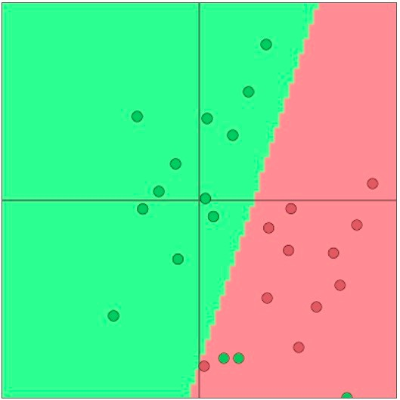
Classification Intuition
Training data: {x_{i},y_{i}}^{N}_{i=1}
In the example:
Input vectors in 2D space
Linear decision boundary
Traditional ML/Stats approach:
assume x_{i} are fixed,
train (i.e., set) softmax/logistic regression weights 𝑊 ∈ ℝ^{𝐶×𝑑} to determine a decision boundary (hyperplane) as in the picture
Model: For each fixed x, predict:
[Visualizations with ConvNetJS by Andrej Karpathy]
Notes:
TODO: convert to math

Slide 79
Classification with Softmax Classifier (Logistic Regression)
Each linear product $W_{y}.x$ indicates the score assigned to class $y$.
Here is the inference procedure:
Compute the score assigned to each class: ${f_{y}= W}_{y}.x ∀c∈C$
Pick the class with the highest score $\hat{y}= {argmax}_{c∈C}f_{c}$
To convert the scores into probabilities, pass them through the softmax function
$$p\left(y | x\right)=\frac{exp(f_{y})}{\sum_{c∈C}{exp(f_{c})}}$$
Notes:
I think W -> w (a vector)

Slide 80
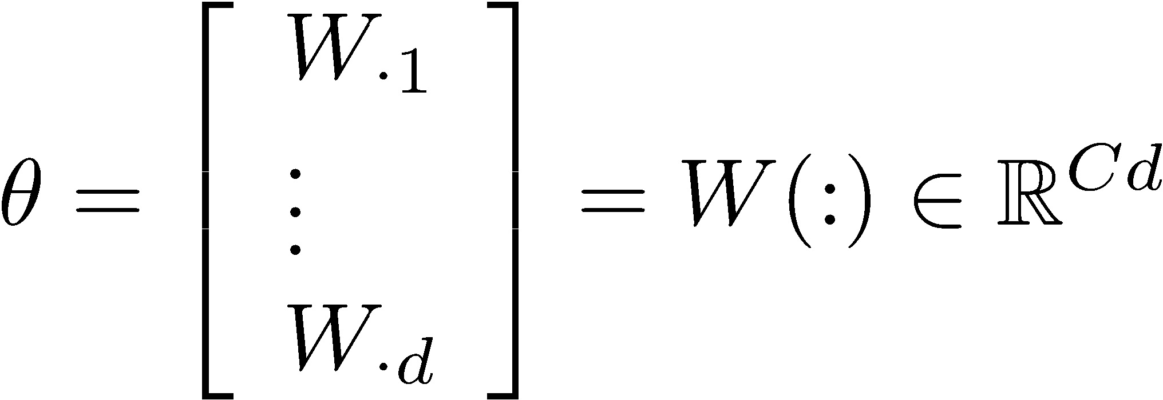
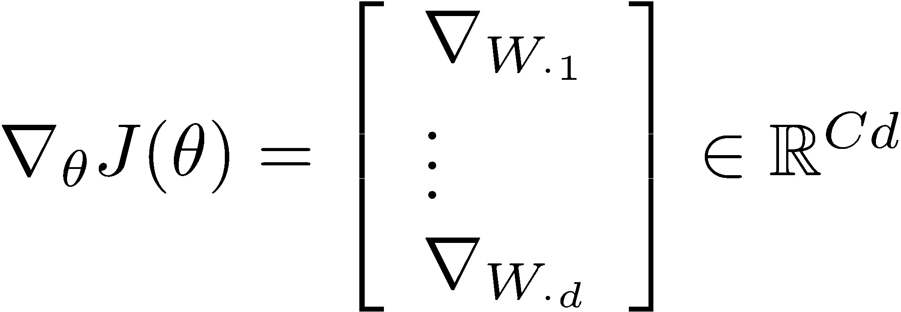
Classification with Softmax Classifier (Logistic Regression)
Training: for each training example (x,y) optimize the parameters $θ$ to maximize the probability of the correct class y, or.
or we can minimize the negative log probability of that class.
Objective for full dataset ${\left\{x, y\right\}}_{i=1}^{N}:$
Minimization via gradient descent:
Notes:
I think W -> w (a vector)

Slide 81
Lexical and Compositional Semantics
Lexical Semantics: focuses on the meaning of individual words.
Compositional Semantics: meaning depends on the words, and on how they are combined.

