Slide 1
Fixed-Window/Feedforward Language Models
CSCI 601 471/671
NLP: Self-Supervised Models
https://self-supervised.cs.jhu.edu/sp2023/
[Slide credit: Mohit Iyyer, Chris Manning, and many others ]

Slide 2
Logistics
HW2 grades are up!
Min: 50
Max 115
Median: 104
HW4 is released!
Please continue to give us feedback if you see any potential typos, odd phrasings, etc.
Office hour update: Starting from today I will have two office hours
Both Tuesday and Thursday immediately after the class.

Slide 3
Recap: LMs
Directly we train models on “conditionals”:
next word
context
P($X_{t}$| $X_{1}$, $…$, $X_{t−1}$)
Prob
mat
table
bed
desk
chair
Some model
“The cat sat on the [MASK]”

Slide 4
Recap: LMs as Implicit Joint Distribution of Language
Though implicitly we are learning the full distribution over the language:
Remember the chain rule: P($X_{1}, …, X_{t}$) = ${P(X}_{1})\prod_{i=1}^{t}{P(X_{i}}|X_{1}, X_{2}…,X_{i})$
Language Modeling ≜ learning prob distribution over language sequence.

Slide 5
P($X_{t}$| $X_{1},…$, $X_{t−1}$)
How do we estimate these probabilities?
Let’s just count!
P(mat | the cat sat on the) $=$ $\frac{count(“the cat sat on the mat”)}{count(“the cat sat on the”)}$
Challenge: Increasing $n$ makes sparsity problems worse.
Typically, we can’t have $n$ bigger than 5.
Some partial solutions (e.g., smoothing and backoffs) though still an open problem.
Notes:
This is, in fact, fundamentally what autoregressive models do. Given a sequence, which here we are calling y_1, y_2, ... and so on, an autoregressive model tries to predict y_t from all of the sequence entries before y_t.

Slide 6
Recap: N-gram Language Models
Terminology: n-gram is a chunk of n consecutive words:
unigrams: “cat”, “mat”, “sat”, …
bigrams: “the cat”, “cat sat”, “sat on”, …
trigrams: “the cat sat”, “cat sat on”, “sat on the”, …
four-grams: “the cat sat on”, “cat sat on the”, “sat on the mat”, …
n-gram language model:
$n−1$ elements
P($X_{t}$| $X_{1},…$, $X_{t−1}$) $≈$ P($X_{t}$| $X_{t−n+1},…$, $X_{t−1}$)
Notes:
This is, in fact, fundamentally what autoregressive models do. Given a sequence, which here we are calling y_1, y_2, ... and so on, an autoregressive model tries to predict y_t from all of the sequence entries before y_t.

Slide 7
Chapter Plan
Language modeling: definitions and history
Language modeling with counting
Measuring language modeling quality
Language Modeling with feed-forward networks

Slide 8
Generation from N-Gram Models
You can build a simple trigram Language Model over a 1.7 million words corpus in a few seconds on your laptop*
today the
Sparsity problem: not much granularity in the probability distribution
company 0.153
bank 0.153
price 0.077
italian 0.039
emirate 0.039
...
get probability distribution
Otherwise, seems reasonable!
* Try for yourself: https://nlpforhackers.io/language-models/
[adopted from Chris Manning]

Slide 9
Generation from N-Gram Models
Now we can sample from this mode:
today the
Sparsity problem: not much granularity in the probability distribution
company 0.153
bank 0.153
price 0.077
italian 0.039
emirate 0.039
...
get probability distribution
Otherwise, seems reasonable!
* Try for yourself: https://nlpforhackers.io/language-models/
[adopted from Chris Manning]

Slide 10
Generation from N-Gram Models
Now we can sample from this mode:
condition on this
today the price
Sparsity problem: not much granularity in the probability distribution
of 0.308
for 0.050
it 0.046
to 0.046
is 0.031
...
get probability distribution
Otherwise, seems reasonable!
* Try for yourself: https://nlpforhackers.io/language-models/
[adopted from Chris Manning]

Slide 11
Generation from N-Gram Models
Now we can sample from this mode:
condition on this
today the price of
Sparsity problem: not much granularity in the probability distribution
the 0.072
18 0.043
oil 0.043
its 0.036
gold 0.018
...
get probability distribution
Otherwise, seems reasonable!
* Try for yourself: https://nlpforhackers.io/language-models/
[adopted from Chris Manning]

Slide 12
N-Gram Models in Practice
Now we can sample from this mode:
today the price of gold per ton , while production of shoe lasts and shoe industry , the bank intervened just after it considered and rejected an imf demand to rebuild depleted european stocks , sept 30 end primary 76 cts a share .
Surprisingly grammatical!
But quite incoherent! To improve coherence, one may consider increasing larger than 3-grams, but that would worsen the sparsity problem!
* Try for yourself: https://nlpforhackers.io/language-models/
[adopted from Chris Manning]
Notes:
stuck between a rock and a hard place.

Slide 13
Scaling N-Grams
We can extend to trigrams, 4-grams, 5-grams, but soon we will hit the sparsity limitations.
In general, this is an insufficient model of language because language has long-distance dependencies:
“The computer which I had just put into the machine room on the fifth floor crashed.”

Slide 14
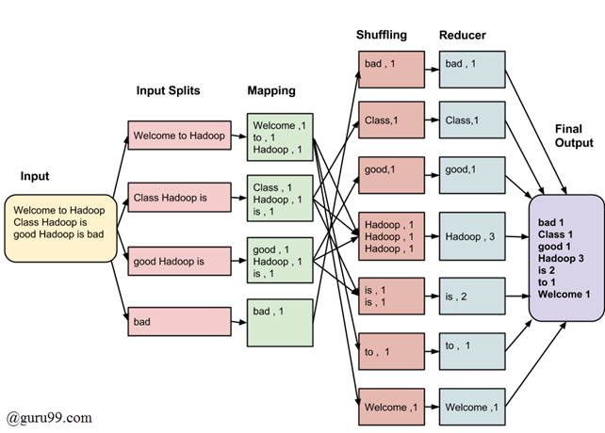
Aside: Computing N-Grams at Scale
TODO
https://learn.microsoft.com/en-us/samples/azure-samples/durablefunctions-mapreduce-dotnet/big-data-processing-serverless-mapreduce-on-azure/

Slide 15
Chapter Plan
Language modeling: definitions and history
Language modeling with counting
Measuring language modeling quality
Language Modeling with feed-forward networks

Slide 16
How Good is Our Language Model?

Slide 17
Evaluating Language Models
Does our language model prefer good sentences to bad ones?
Assign higher probability to “real” or “frequently observed” sentences
Than “ungrammatical” or “rarely observed” sentences?
We test the model’s performance on data we haven’t seen.

Slide 18
Evaluating Language Models
Setup:
Train it on a suitable training documents.
Evaluate their predictions on different, unseen documents.
An evaluation metric tells us how well our model does on the test set.

Slide 19
Evaluating Language Models: Example
Setup:
Train it on a suitable training documents.
Evaluate their predictions on different, unseen documents.
An evaluation metric tells us how well our model does on the test set.
Example: I use a bunch of New York Times articles to build a bigram probability table
A good language model should assign a high probability to held-out text!
Now I’m going to evaluate the probability of some heldout
data using our bigram table
train
eval
$$count(“on the mat”)$$

Slide 20
Be Careful About Data Leakage!
Advice from a grandpa👴:
- Don’t allow test sentences leak into training set.
- Otherwise, you will assign it an artificially high probability (=cheating).
Example: I use a bunch of New York Times articles to build a bigram probability table
A good language model should assign a high probability to held-out text!
Now I’m going to evaluate the probability of some heldout
data using our bigram table
train
eval
$$count(“on the mat”)$$

Slide 21
Evaluating Language Models: Intrinsic vs Extrinsic
Intrinsic: measure how good we are at modeling language
Extrinsic: build a new language model, use it for some task (MT, ASR, etc.)
Example: I use a bunch of New York Times articles to build a bigram probability table
Now I’m going to evaluate the probability of some heldout
data using our bigram table
extrinsic eval
train
eval
$$count(“on the mat”)$$

Slide 22
A Typical Machine Learning and Evaluation Protocol
Each choice of parameters in neural networks correspond to another function.
Model Hypothesis Class
$$ℱ=\left\{f_{1},f_{2},f_{3},…\right\}$$
Training data
$$D_{train}=\left\{\left(x_{1},y_{1}\right), …\right\}$$
Overall training: picking the best function:$f^{∗}$
Training is to pick the function given the observed data.
Held-out validation data
$$D_{val}=\left\{\left(x_{1},y_{1}\right), …\right\}$$
Testing is t predict the quality of the best selected function
Testing data
$$D_{test}=\left\{\left(x_{1},y_{1}\right), …\right\}$$
Evaluation on test set:
$${E_{\left(x, y\right) \sim D_{test}}\left[\left(ℓ(f\left(x\right),y\right)\right]}^{}$$

Slide 23
Evaluation Metric for Language Modeling: Perplexity
Perplexity is the inverse probability of the test set, normalized by the number of words:
A measure of predictive quality of a language model.
Minimizing perplexity is the same as maximizing probability
$$ppl\left(w_{1},…, w_{n}\right)=P{\left(w_{1}, w_{2}, …, w_{n}\right)}^{−\frac{1}{n}}$$

Slide 24
Evaluation Metric for Language Modeling: Perplexity
Perplexity is the inverse probability of the test set, normalized by the number of words:
Quiz: let’s suppose we have a sentence $w_{1},…, w_{n}$ and it’s fixed. Our model will correctly guess each word with probability 1/5. What is perplexity of our model?
$$ppl\left(w_{1},…, w_{n}\right)=P{\left(w_{1}, w_{2}, …, w_{n}\right)}^{−\frac{1}{n}}$$
$ppl\left(w_{1},…, w_{n}\right)={\left({\left(1/5\right)}^{n}\right)}^{−\frac{1}{n}}=5$
Intuition: the model is indecisive among 5 choices.

Slide 25
Evaluation Metric for Language Modeling: Perplexity
Perplexity is the inverse probability of the test set, normalized by the number of words:
$$ppl\left(w_{1},…, w_{n}\right)=P{\left(w_{1}, w_{2}, …, w_{n}\right)}^{−\frac{1}{n}}$$
$$=\sqrt[n]{\frac{1}{P\left(w_{1}, w_{2}, …, w_{n}\right)}}$$
$$=\sqrt[n]{\prod_{i=1}^{n}{\frac{1}{P\left(w_{i}|w_{<i}\right)}}}$$
(the chain rule)

Slide 26
Evaluation Metric for Language Modeling: Perplexity
$$ppl\left(w_{1},…, w_{n}\right)=\sqrt[n]{\prod_{i=1}^{n}{\frac{1}{P\left(w_{i}|w_{<i}\right)}}}$$
Perplexity for n-grams:
Bi-grams (2nd order Markov assumption):
Tri-grams (3rd order Markov assumption):
$$ppl\left(w_{1},…, w_{n}\right)=\sqrt[n]{\prod_{i=1}^{n}{\frac{1}{P\left(w_{i}|w_{i−1}\right)}}}$$
$$ppl\left(w_{1},…, w_{n}\right)=\sqrt[n]{\prod_{i=1}^{n}{\frac{1}{P\left(w_{i}|w_{i−1},w_{i−2}\right)}}}$$

Slide 27
Evaluation Metric for Language Modeling: Perplexity
In practice, we prefer to use log-probabilities
We can rewrite perplexity formula in terms of log-probs:
$$ppl\left(w_{1},…, w_{n}\right)=\sqrt[n]{\prod_{i=1}^{n}{\frac{1}{P\left(w_{i}|w_{<i}\right)}}}$$
$$=2^{\log{\sqrt[n]{\prod_{i=1}^{n}{\frac{1}{P\left(w_{i}|w_{<i}\right)}}}}}$$
$ppl\left(w_{1},…, w_{n}\right)=2^{H},$ where $H=−\frac{1}{n}\sum_{i=1}^{n}{\log_{2}{P\left(w_{i}\right|w_{1}, …, w_{i−1})}}$

Slide 28
Evaluation Metric for Language Modeling: Perplexity
In practice, we prefer to use log-probabilities
We can rewrite perplexity formula in terms of log-probs:
$ppl\left(w_{1},…, w_{n}\right)=2^{H},$ where $H=−\frac{1}{n}\sum_{i=1}^{n}{\log_{2}{P\left(w_{i}\right|w_{1}, …, w_{i−1})}}$
# getting loss using cross entropy
loss = F.cross_entropy(output, target)
# calculating perplexity
perplexity = torch.exp(loss)
print('Loss:', loss, 'PP:', perplexity)
Can be interpreted as cross-entropy between LM prob and language prob

Slide 29
Evaluation Metric for Language Modeling: Perplexity
In practice, we prefer to use log-probabilities
We can rewrite perplexity formula in terms of log-probs:
Quiz: let’s suppose we have a sentence $w_{1},…, w_{n}$ and it’s fixed. Our model will correctly guess each word with probability 1/5. What is perplexity of our model?
$ppl\left(w_{1},…, w_{n}\right)=2^{H},$ where $H=−\frac{1}{n}\sum_{i=1}^{n}{\log_{2}{P\left(w_{i}\right|w_{1}, …, w_{i−1})}}$
$$H=−\frac{1}{n}\left[\log_{2}\left(\frac{1}{5}\right)+…+\log_{2}\left(\frac{1}{5}\right)\right]=−log\left(\frac{1}{5}\right)⇒ppl\left(D\right)=5$$

Slide 30
Evaluation Metric for Language Modeling: Edge Cases
$ppl\left(w_{1},…, w_{n}\right)=2^{H},$ where $H=−\frac{1}{n}\sum_{i=1}^{n}{\log_{2}{P\left(w_{i}\right|w_{1}, …, w_{i−1})}}$
If $P\left(.\right)$ uninformative:
If $P\left(.\right)$ is exact:
$∀w∈V: P\left(w\right|w_{1:i−1})=\frac{1}{|V|} ⇒ ppl\left(D\right)=2^{−\frac{1}{n} n\log_{2}{\frac{1}{\left|V\right|}} }=|V|$
$∃w∈V:P\left(w\right|w_{1:i−1})=1 ⇒ ppl\left(D\right)=2^{−\frac{1}{n} n\log_{2}{1} }=1$
Perplexity is a measure of model’s uncertainty about next word (aka ”average branching factor”)
Perplexity ranges between 1 and |V|.

Slide 31
Lower perplexity == Better Model
Training 38 million words, test 1.5 million words, Wall Street Journal
N-gram Order | Unigram | Bigram | Trigram
Perplexity | 962 | 170 | 109
[Jurafsky & Martin: https://web.stanford.edu/~jurafsky/slp3/3.pdf]

Slide 32
How Should One Deal With Zeros?
$$ppl\left(w_{1},…, w_{n}\right)=\sqrt[n]{\prod_{i=1}^{n}{\frac{1}{P\left(w_{i}|w_{<i}\right)}}}$$
If $P\left(w_{i}|w_{<i}\right)=0$, ppl would go 🤯 !! (division by zero)

Slide 33
How Should One Deal With Zeros?
Training set: Test set:
… denied the allegations
… denied the reports
… denied the claims
… denied the request
… denied the offer
… denied the load
P(offer| denied the) = 0
[Dan Jurafsky]

Slide 34
How Should One Deal With Zeros?
Actually, how common are zero-probabilities? 🤔
Example: Shakespeare as text corpus
n=884,647 tokens (the length of Shakespeare writing),
|V|=29,066 (the size vocab used by Shakespear)
Shakespeare produced ~300,000 bigrams
Out of |V|^2= 844 million possible bigrams (some of them don’t make sense, but ok!)
So, 99.96% of the possible bigrams are never seen (have zero entries in the table)
[Mohit Iyyer]

Slide 35
How Should One Deal With Zeros? Smoothing
When we have sparse statistics:
3 allegations, 2 reports, 1 claims, 1 request = 7 total
Steal probability mass to generalize better
2.5 allegations, 1.5 reports, 0.5 claims, 0.5 request, 2 other = 7 total
$$count(“denied the”+ w)$$
$$w$$
$$w$$
[Dan Klein]

Slide 36
Summary Thus Far
Language Models (LM): distributions over language
N-gram: language modeling via counting
Models size O(exp(n)) — not good 😔
Challenge with large N’s: sparsity problem — many zero counts/probs.
Challenge with small N’s: not very informative and lack of long-range dependencies.

Slide 37
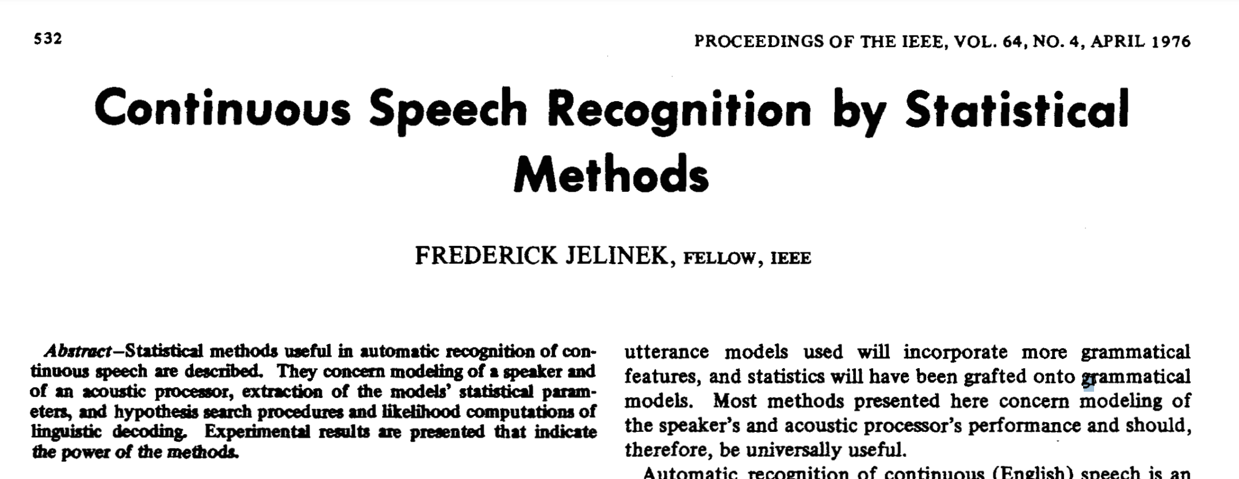
N-Gram Language Models, A Historical Highlight
Probabilistic n-gram models of text generation [Jelinek+ 1980’s, …]
Applications: Speech Recognition, Machine Translation

Slide 38
Chapter Plan
Language modeling: definitions and history
Language modeling with counting
Measuring language modeling quality
Language Modeling with feed-forward networks

Slide 39
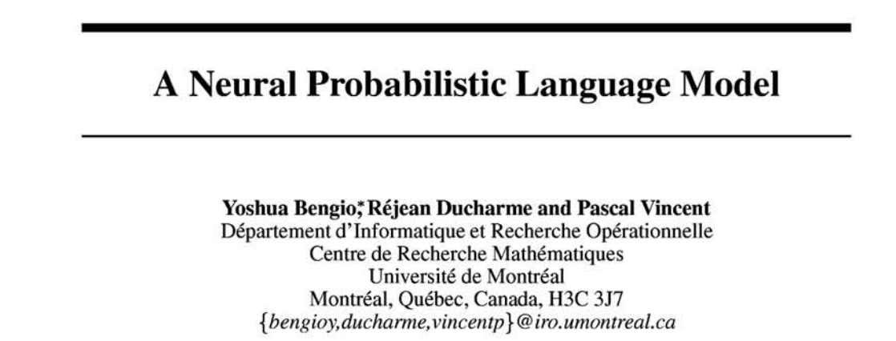
From Counting (N-Gram) to Neural Models
Probabilistic n-gram models of text generation [Jelinek+ 1980’s, …]
Applications: Speech Recognition, Machine Translation
“Shallow” statistical/neural language models (2000’s) [Bengio+ 1999 & 2001, …]
NeurIPS 2000

Slide 40
A Fixed-Window Neural LM
Given the embeddings of the context, predict the word on the right side.
Dropping the right context for simplicity -- not a fundamental limitation.
and
our
problems
turning
into
context words in window of size 4 target word

Slide 41
A Fixed-Window Neural LM
Given the embeddings of the context, predict the word on the right side.
Dropping the right context for simplicity -- not a fundamental limitation.
Discard anything beyond its context window
blah blah blah blah
and
our
problems
turning
into
discard
context words in window of size 4 target word

Slide 42
A Fixed-Window Neural LM
Given the embeddings of the context, predict a target word on the right side.
Dropping the right context for simplicity -- not a fundamental limitation.
Training this model is basically optimizing its parameters $Θ$ such that it assigns high probability to the target word.
Probs over vocabulary
Trainable parameters of neural network
mat
table
into
ant
chair
$$FFN ($$
$$, Θ)$$
O O O
O O O
O O O
O O O
lookup embeddings
and
our
problems
turning
into
context words in window of size 4 target word
[Bengio et al. 2003]

Slide 43
A Fixed-Window Neural LM
This is actually a pretty good model!
It will also lay the foundation for the future models (e.g., transformers, ...)
But first we need to figure out how to train neural networks!
Probs over vocabulary
Trainable parameters of neural network
mat
table
into
ant
chair
$$FFN ($$
$$, Θ)$$
O O O
O O O
O O O
O O O
lookup embeddings
and
our
problems
turning
into
context words in window of size 4 target word
[Bengio et al. 2003]

Slide 44
A Fixed-Window Neural LM
Prob
output distribution
$$y=softmax(W_{2}h)$$
mat
table
bed
desk
chair
Softmax
$$W_{2}$$
hidden layer
$$h=f(W_{1}x)$$
O O O O O O O O O O O O O O O
$$W_{1}$$
concatenate
concatenated word embeddings
$$x=[v_{1}, v_{2}, v_{3}, v_{4}]$$
O O O
O O O
O O O
O O O
lookup embeddings
and
our
problems
turning
into
context words in window of size 4 target word
[Bengio et al. 2003]

Slide 45
A Fixed-Window Neural LM: Compared to N-Grams
Prob
mat
table
bed
desk
chair
Softmax
Improvements over n-gram LM:
Tackles the sparsity problem
Model size is O(n) not O(exp(n)) — n being the window size.
$$W_{2}$$
O O O O O O O O O O O O O O O
$$W_{1}$$
concatenate
O O O
O O O
O O O
O O O
lookup embeddings
and
our
problems
turning
into
context words in window of size 4 target word
[Bengio et al. 2003, notes from Richard Socher]

Slide 46
A Fixed-Window Neural LM: Compared to N-Grams
Prob
mat
table
bed
desk
chair
Softmax
Improvements over n-gram LM:
Tackles the sparsity problem
Model size is O(n) not O(exp(n)) — n being the window size.
Remaining problems:
Fixed window is too small
Enlarging window enlarges $W$ — Window can never be large enough!
It’s not deep enough to capture nuanced contextual meanings
$$W_{2}$$
O O O O O O O O O O O O O O O
$$W_{1}$$
concatenate
O O O
O O O
O O O
O O O
lookup embeddings
and
our
problems
turning
into
context words in window of size 4 target word
[Bengio et al. 2003, notes from Richard Socher]

Slide 47
A Fixed-Window Neural LM: Going Deeper

Slide 48
Prob
Softmax
mat
table
bed
desk
chair
Add & Norm
Linear
Feed-Forward layer
xN
Add & Norm
Feed-Forward layer
Add & Norm
concatenate
Feed-Forward layer
N layers
O O O
O O O
O O O
O O O
lookup embeddings
Add & Norm
and
our
problems
turning
into
Feed-Forward layer
context words in window of size 4 target word
[Sun and Iyyer 2021]

Slide 49
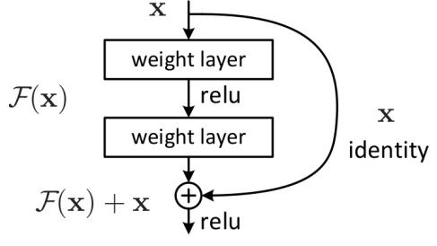
Prob
Softmax
mat
table
bed
desk
chair
Linear
xN
Add & Norm
Feed-Forward layer
Uses residual connections (He et al. 2016) — “information highways” between layers. (we saw them in the earlier chapter)
concatenate
O O O
O O O
O O O
O O O
lookup embeddings
and
our
problems
turning
into
context words in window of size 4 target word
[Sun and Iyyer 2021]

Slide 50
Prob
Softmax
mat
table
bed
desk
chair
Linear
xN
Add & Norm
Feed-Forward layer
Uses layer normalization (Ba et al. 2016) which reduces variance across different data/batches and makes the optimization easier/faster.
concatenate
O O O
O O O
O O O
O O O
lookup embeddings
and
our
problems
turning
into
context words in window of size 4 target word
[Sun and Iyyer 2021]

Slide 51
Prob
Softmax
mat
table
bed
desk
chair
Linear
xN
Use “dropout” to avoid overfitting.
Add & Norm
Feed-Forward layer
concatenate
Use ADAM optimizer (Kingma & Ba, 2017), a variant of Stochastic Gradient Descent.
O O O
O O O
O O O
O O O
lookup embeddings
and
our
problems
turning
into
context words in window of size 4 target word
[Sun and Iyyer 2021]

Slide 52
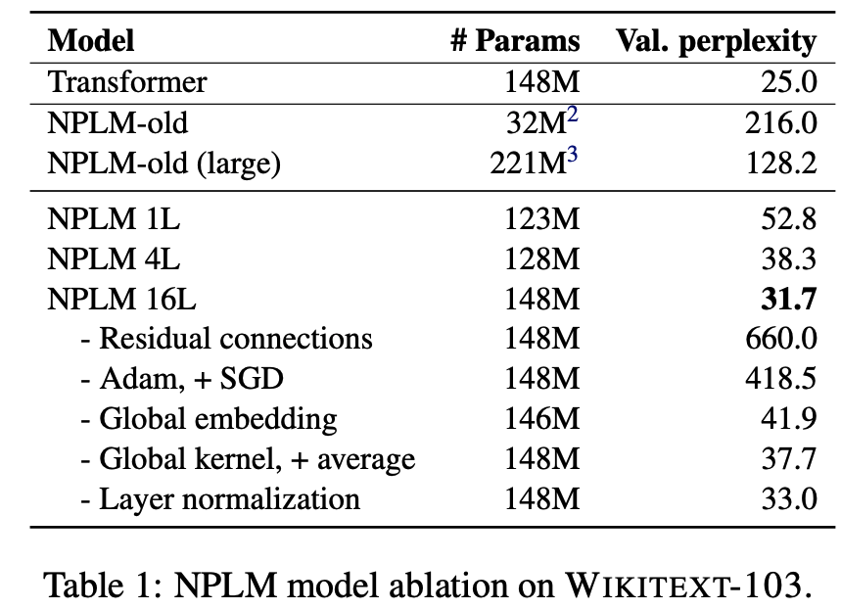
Prob
Softmax
mat
table
bed
desk
chair
Linear
xN
Add & Norm
Feed-Forward layer
concatenate
O O O
O O O
O O O
O O O
Takeaways:
Depth helps
Residual connections are important
Adam works (here) better than SGD
lookup embeddings
and
our
problems
turning
into
context words in window of size 4 target word
[Sun and Iyyer 2021]

Slide 53
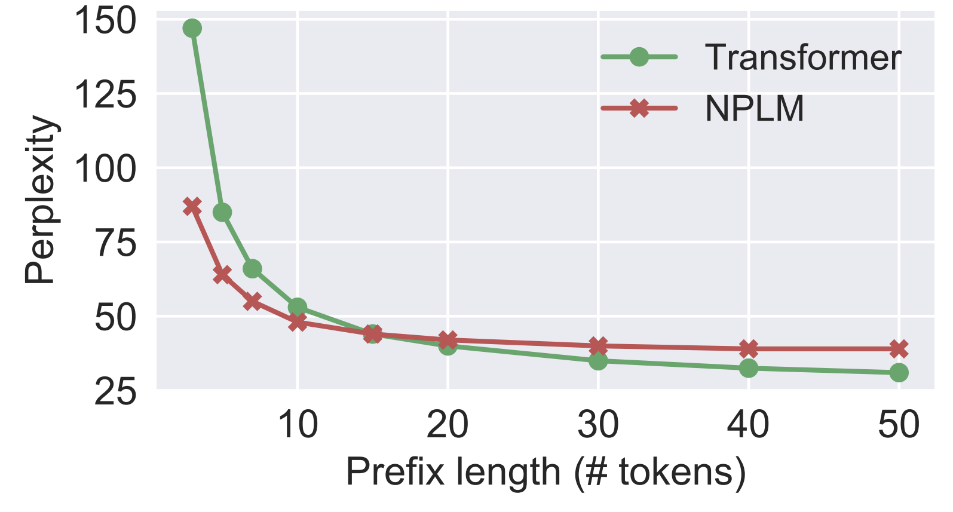
Effect of window size:
Fixed-WindowLM (NPLM) is better than the Transformer (will see them in 2 weeks!) with short prefixes but worse on longer ones.
Prob
Softmax
mat
table
bed
desk
chair
Linear
xN
Add & Norm
Feed-Forward layer
concatenate
O O O
O O O
O O O
O O O
lookup embeddings
and
our
problems
turning
into
context words in window of size 4 target word
[Sun and Iyyer 2021]

Slide 54
Fixed-Window LM in Practice
Fixed-Window LM trained on Wikipedia:
TBD

Slide 55
Flashback to Word2Vec
Word2Vec objective is similar to the language modeling objective.
Word2Vec representations are fixed
e.g., “play” has one vector regardless of the context.
In contrast, the meaning representation extracted from more advanced architectures (e.g, FFN-LM) is contextual.
…
problems
turning
into
banking
crises
as
…
outside context words center word outside context words in window of size 2 at position t in window of size 2

Slide 56
Using Self-Supervised Representations to Solve Tasks
Let’s say I want to train a model for sentiment analysis
In the past, I would simply train a supervised model on Word2Vec representation of review sentences (e.g., HW2).
A self-supervised model
A self-supervised model
step 1:
self-supervised pretraining
step 2:
supervised fine-tuning
A ton of unlabeled text
A ton of unlabeled text

Slide 57
Contextual representation of LMs is much stronger than word-level ones.
Now that we have Fixed-Window LM, we can use it to build better classifiers!
A self-supervised model
A self-supervised model
step 1:
self-supervised pretraining
step 2:
supervised fine-tuning
A ton of unlabeled text
A ton of unlabeled text

Slide 58
positive or negative
We can use the parameters this pre-trained model as initialization for a classifier.
For example, a classifier for mapping movie reviews to their sentiments.
Challenge: how to handle long sentences?
Repeated use of this classifier on moving window
More principled approaches later
Softmax
Linear
xN
Add & Norm
Feed-Forward layer
concatenate
O O O
O O O
O O O
O O O
lookup embeddings
and
our
problems
turning
movie reviews

Slide 59
Summary
Language Modeling (LM), a useful predictive objective for language
Perplexity, a measure of an LM’s predictive ability
N-gram models (~1980 to early 2000’s),
Early instances of LMs
Difficult to scale to large window sizes
FFN-LMs (early and mid-2000’s ),
Effective predictive models based on feed-forward networks
Difficulty in long-range dependencies

Slide 60
What Changed from N-Gram LMs to Neural LMs?
What is the source of Neural LM’s strength?
Why sparsity is less of an issue for Neural LMs?
Answer: In n-grams, we treat all prefixes independently of each other! (even those that are semantically similar)
students opened their ___
pupils opened their ___
scholars opened their ___
undergraduates opened their ___
students turned the pages of their ___ students attentively perused their ___
...
Neural LMs are able to share information across these semantically-similar prefixes and overcome the sparsity issue.

Slide 61
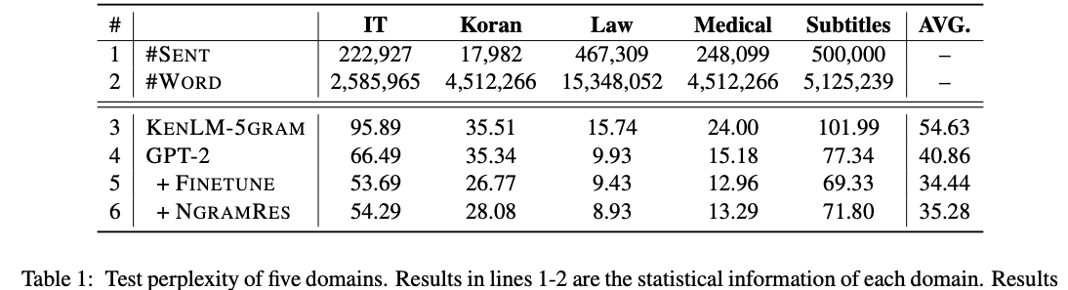
Best of both worlds
n-grams are easy to compute for small ”n”.
Why waste energy to make neural-LMs [re]learn these statistics?
Li et al. 2022 propose learning neural LMs to fits the residual between an n-gram LM and real-data distribution.
Allows the neural part to focus on the deeper understanding of language.
[N-gram Is Back: Residual Learning of Neural Text Generation with n-gram Language Model, Li et al. 2022]

Slide 62
Summary Thus Far
Language Models (LM): distributions over language
N-gram: language modeling via counting
Neural Language Models: neural networks trained with LM objective
Fixed-window Neural LM: first of many LMs we will see in this class
Key question: how to better capture long-range dependencies?

