Slide 1
Self-Supervised Learning w/ Recurrent Neural Nets
CSCI 601 471/671
NLP: Self-Supervised Models
https://self-supervised.cs.jhu.edu/sp2023/
[Slide credit: Chris Tanner, Mohit Iyyer, Chris Manning and many others ]

Slide 2
Recap
Prob
Softmax
mat
table
bed
desk
chair
Neural Language Models: neural networks trained with LM objective.
Fixed-window Neural LM: first of many neural LMs we will see in this class.
Linear
xN
Add & Norm
Feed-Forward layer
concatenate
O O O
O O O
O O O
O O O
lookup embeddings
and
our
problems
turning
into
context words in window of size 4 target word

Slide 3
What Changed from N-Gram LMs to Neural LMs?
What is the source of Neural LM’s strength?
Why sparsity is less of an issue for Neural LMs?
Answer: In n-grams, we treat all prefixes independently of each other! (even those that are semantically similar)
students opened their ___
pupils opened their ___
scholars opened their ___
undergraduates opened their ___
students turned the pages of their ___ students attentively perused their ___
...
Neural LMs are able to share information across these semantically-similar prefixes and overcome the sparsity issue.

Slide 4
Aside: Sampling From LMs

Slide 5
How do we generate language from LMs?
Given:
next word
context
P($X_{t}$| $X_{1}$, $…$, $X_{t−1}$)
Prob
mat
table
bed
desk
chair
Some model
“The cat sat on the [MASK]”

Slide 6
Approach 1: Greedy (Argmax)
Challenge:
Generates boring results — not creative.
May repeat itself .
“I went to the place that the place that the place that the place ...”
next word
context
$x_{t}$ =argmax P($X_{t}$| $X_{1}$, $…$, $X_{t−1}$)
Prob
mat
table
bed
desk
chair
Some model
“The cat sat on the [MASK]”
[The Curious Case of Neural Text Degeneration, Holtzman et al., 2020]

Slide 7
Approach 2: Sampling from the whole distribution
Challenge: Likely to result in lots of nonsensical generations.
Reason: LMs distribution is more meaningful about high-prob items, but as we get further away from high-prob items, the probs are less meaningful.
next word
context
$x_{t}$ ~ P($X_{t}$| $X_{1}$, $…$, $X_{t−1}$)
Prob
mat
table
bed
desk
chair
Some model
“The cat sat on the [MASK]”
[The Curious Case of Neural Text Degeneration, Holtzman et al., 2020]

Slide 8
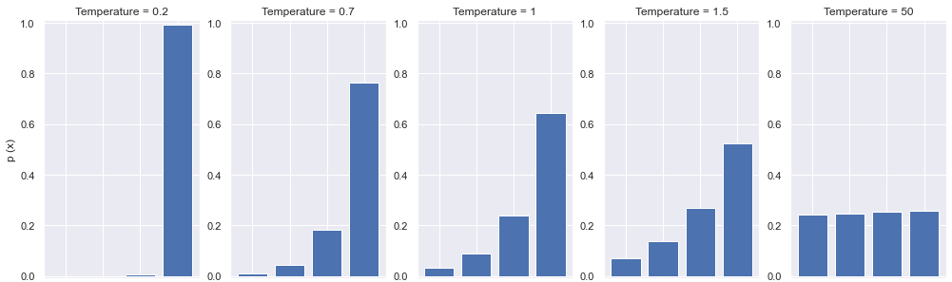
Approach 3: Sampling + Temperature
Small-ish T would assign more prob to the top of the distribution, while not losing diversity.
Prob
mat
table
bed
desk
chair
Some model
“The cat sat on the [MASK]”
[The Curious Case of Neural Text Degeneration, Holtzman et al., 2020]

Slide 9
Approach 4: Top-p Sampling (Nucleus sampling)
On each step, randomly sample from the distribution, but restricted to just the top-p most probable words
Like pure sampling, but truncate the distribution to high-prob content
p=1 is basically sampling from the whole distribution
Prob
mat
table
bed
desk
chair
Some model
“The cat sat on the [MASK]”
[The Curious Case of Neural Text Degeneration, Holtzman et al., 2020]

Slide 10
Local Incoherence
[The Curious Case of Neural Text Degeneration, Holtzman et al., 2020]

Slide 11
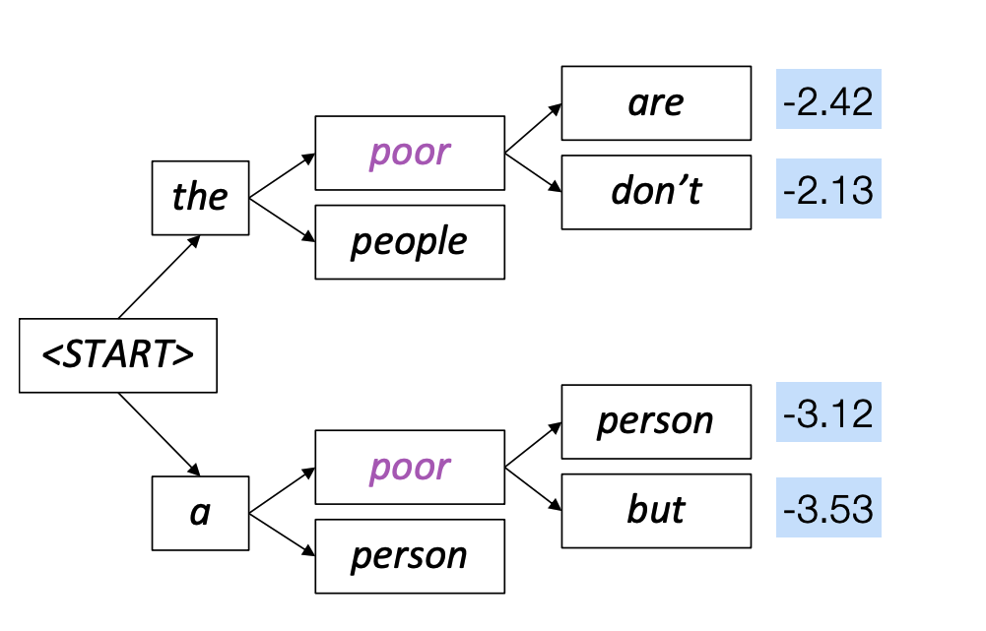
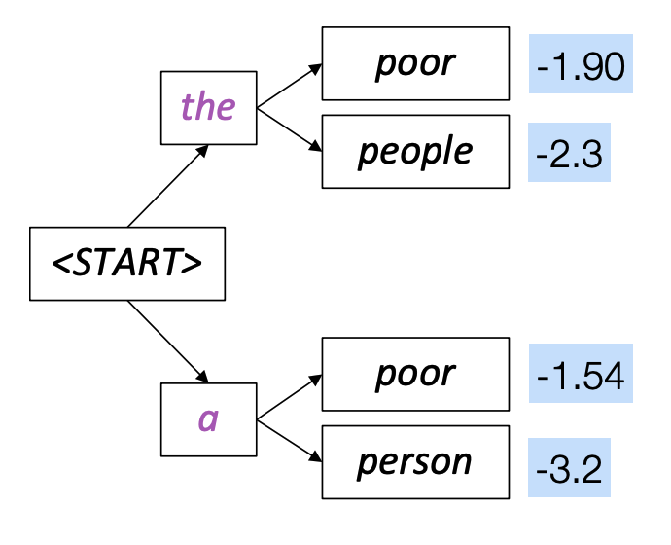
Fancier Approaches: Beam Search
A heuristic search that allows maximizing words probabilities for a window of words
Out of scope for us. Feel free to check it in your own time.

Slide 12
Summary on Sampling Algorithms
Greedy decoding: a simple method; gives low quality output
Sampling methods are a way to get more diversity and randomness
Good for open-ended / creative generation (poetry, stories)
Top-p sampling allows you to control diversity
Others: Beam search searches for high-probability output

Slide 13
Aside END!

Slide 14
Moving Beyond Feedforward Neural LMs
Prob
Softmax
mat
table
bed
desk
chair
Are competitive at language modeling task
However, they
have difficulty in remembering long range dependencies
have a fixed window size
Key question: how to better capture long-range dependencies?
Alternative here: a new family of neural networks: recurrent nets
Linear
xN
Add & Norm
Feed-Forward layer
concatenate
O O O
O O O
O O O
O O O
lookup embeddings
and
our
problems
turning
into
context words in window of size 4 target word

Slide 15
Recurrent LMs: Chapter Plan
A new faculty of neural networks: recurrent neural networks
A new family of language models: recurrent neural language models
Doing things with recurrent LMs
Issues with RNNs and fancier variants

Slide 16
Infinite Use of Finite Model
Main question: how can a finite model a long (infinite) context?
Solution: recursion! (recursive use of a model)
RNNs are a family of neural networks introduced to learn sequential data via recursive dynamics.
Inspired by the temporality of human thoughts
[Jeff Elman, “Finding structure in time,” 1990]

Slide 17
Recurrent Neural Networks (RNNs)
$h_{t}=f(h_{t−1}, x_{t})$
In the diagram, $f(.)$ looks at some input $x_{t}$ and its previous hidden state $h_{t−1}$ and outputs a revised state $h_{t}$.
A loop allows information to be passed from one step of the network to the next.
new state
old state
Input vector at t
[Jeff Elman, “Finding structure in time,” 1990]

Slide 18
Unrolling RNN
The diagram above shows what happens if we unroll the loop.
A recurrent neural network can be thought of as multiple copies of the same network, each passing a message to a successor.
time
[Jeff Elman, “Finding structure in time,” 1990]

Slide 19
LMs w/ Recurrent Neural Nets
P($X_{t}$| $X_{1}$, $…$, $X_{t−1}$)
next word
context
We feed the words one at a time to the RNN.
A predictive head uses the latest embedding vector to produce a probability over the vocabulary.

Slide 20
RNN: Forward Propagation
$$CE\left(y^{i},{\hat{y}}^{i}\right)=−\sum_{w∈V}{y_{w}^{i}\text{log}({\hat{y}}_{w}^{i})}$$
Error
$$CE\left(y^{1},{\hat{y}}^{1}\right)$$
$${\hat{y}}_{1}$$
Output layer
$$U$$
Hidden layer
$$W$$
Input layer
$$x_{1}$$
She

Slide 21
RNN: Forward Propagation
$$CE\left(y^{i},{\hat{y}}^{i}\right)=−\sum_{w∈V}{y_{w}^{i}\text{log}({\hat{y}}_{w}^{i})}$$
Error
$$CE\left(y^{1},{\hat{y}}^{1}\right)$$
$$CE\left(y^{2},{\hat{y}}^{2}\right)$$
$${\hat{y}}_{1}$$
$${\hat{y}}_{2}$$
Output layer
$$U$$
$$U$$
$$V$$
Hidden layer
$$W$$
$$W$$
Input layer
$$x_{1}$$
$$x_{2}$$
She
went

Slide 22
RNN: Forward Propagation
$$CE\left(y^{i},{\hat{y}}^{i}\right)=−\sum_{w∈V}{y_{w}^{i}\text{log}({\hat{y}}_{w}^{i})}$$
Error
$$CE\left(y^{1},{\hat{y}}^{1}\right)$$
$$CE\left(y^{2},{\hat{y}}^{2}\right)$$
$$CE\left(y^{3},{\hat{y}}^{3}\right)$$
$${\hat{y}}_{1}$$
$${\hat{y}}_{2}$$
$${\hat{y}}_{3}$$
Output layer
$$U$$
$$U$$
$$U$$
$$V$$
$$V$$
Hidden layer
$$W$$
$$W$$
$$W$$
Input layer
$$x_{1}$$
$$x_{2}$$
$$x_{3}$$
She
went
to

Slide 23
RNN: Forward Propagation
$$CE\left(y^{i},{\hat{y}}^{i}\right)=−\sum_{w∈V}{y_{w}^{i}\text{log}({\hat{y}}_{w}^{i})}$$
Error
$$CE\left(y^{1},{\hat{y}}^{1}\right)$$
$$CE\left(y^{2},{\hat{y}}^{2}\right)$$
$$CE\left(y^{3},{\hat{y}}^{3}\right)$$
$$CE\left(y^{4},{\hat{y}}^{4}\right)$$
$${\hat{y}}_{1}$$
$${\hat{y}}_{2}$$
$${\hat{y}}_{3}$$
$${\hat{y}}_{4}$$
Output layer
$$U$$
$$U$$
$$U$$
$$U$$
$$V$$
$$V$$
$$V$$
Hidden layer
$$W$$
$$W$$
$$W$$
$$W$$
Input layer
$$x_{1}$$
$$x_{2}$$
$$x_{3}$$
$$x_{4}$$
She
went
to
class

Slide 24
RNN: Forward Propagation
$$CE\left(y^{i},{\hat{y}}^{i}\right)=−\sum_{w∈V}{y_{w}^{i}\text{log}({\hat{y}}_{w}^{i})}$$
Error
$$CE\left(y^{1},{\hat{y}}^{1}\right)$$
$$CE\left(y^{2},{\hat{y}}^{2}\right)$$
$$CE\left(y^{3},{\hat{y}}^{3}\right)$$
$$CE\left(y^{4},{\hat{y}}^{4}\right)$$
During training, regardless of our output predictions, we feed in the correct inputs
$${\hat{y}}_{1}$$
$${\hat{y}}_{2}$$
$${\hat{y}}_{3}$$
$${\hat{y}}_{4}$$
Output layer
$$U$$
$$U$$
$$U$$
$$U$$
$$V$$
$$V$$
$$V$$
Hidden layer
$$W$$
$$W$$
$$W$$
$$W$$
Input layer
$$x_{1}$$
$$x_{2}$$
$$x_{3}$$
$$x_{4}$$
She
went
to
class

Slide 25
RNN: Forward Propagation
$$CE\left(y^{i},{\hat{y}}^{i}\right)=−\sum_{w∈V}{y_{w}^{i}\text{log}({\hat{y}}_{w}^{i})}$$
Error
$$CE\left(y^{1},{\hat{y}}^{1}\right)$$
$$CE\left(y^{2},{\hat{y}}^{2}\right)$$
$$CE\left(y^{3},{\hat{y}}^{3}\right)$$
$$CE\left(y^{4},{\hat{y}}^{4}\right)$$
went?
over?
class?
after?
Output layer
$$\hat{y}$$
$$U$$
$$U$$
$$U$$
$$U$$
$$V$$
$$V$$
$$V$$
Hidden layer
$$W$$
$$W$$
$$W$$
$$W$$
Input layer
She
went
to
class

Slide 26
RNN: Forward Propagation
$$CE\left(y^{i},{\hat{y}}^{i}\right)=−\sum_{w∈V}{y_{w}^{i}\text{log}({\hat{y}}_{w}^{i})}$$
Error
$$CE\left(y^{1},{\hat{y}}^{1}\right)$$
$$CE\left(y^{2},{\hat{y}}^{2}\right)$$
$$CE\left(y^{3},{\hat{y}}^{3}\right)$$
$$CE\left(y^{4},{\hat{y}}^{4}\right)$$
went?
over?
class?
after?
Output layer
$$\hat{y}$$
$$U$$
$$U$$
$$U$$
$$U$$
$$V$$
$$V$$
$$V$$
Hidden layer
Our total loss is simply the average loss across all $T$ time steps
$$W$$
$$W$$
$$W$$
$$W$$
Input layer
She
went
to
class

Slide 27
Backward Step
To update our weights (e.g.$Θ$), we calculate the gradient of our loss w.r.t. the repeated weight matrix (e.g., $\frac{∂L}{∂Θ} ).$
$$CE\left(y^{4},{\hat{y}}^{4}\right)$$
went?
over?
class?
after?
Using the chain rule, we trace the derivative all the way back to the beginning, while summing the results.
Output layer
$$\hat{y}$$
$$U$$
$$U$$
$$U$$
$$U$$
$$V$$
$$V$$
$$V$$
Hidden layer
$$W$$
$$W$$
$$W$$
$$W$$
Input layer
She
went
to
class

Slide 28
Backward Step
$\frac{∂L}{∂V}$
To update our weights (e.g.$Θ$), we calculate the gradient of our loss w.r.t. the repeated weight matrix (e.g., $\frac{∂L}{∂Θ} ).$
$$CE\left(y^{4},{\hat{y}}^{4}\right)$$
went?
over?
class?
Using the chain rule, we trace the derivative all the way back to the beginning, while summing the results.
Output layer
$$\hat{y}$$
$$U$$
$$U$$
$$U$$
$$U$$
$$V$$
$$V$$
$$V^{3}$$
Hidden layer
$$W$$
$$W$$
$$W$$
$$W$$
Input layer
She
went
to
class

Slide 29
Backward Step
$\frac{∂L}{∂V}$
To update our weights (e.g.$Θ$), we calculate the gradient of our loss w.r.t. the repeated weight matrix (e.g., $\frac{∂L}{∂Θ} ).$
$$CE\left(y^{4},{\hat{y}}^{4}\right)$$
went?
over?
class?
Using the chain rule, we trace the derivative all the way back to the beginning, while summing the results.
Output layer
$$\hat{y}$$
$$U$$
$$U$$
$$U$$
$$U$$
$$V$$
$$V^{2}$$
$$V^{3}$$
Hidden layer
$$W$$
$$W$$
$$W$$
$$W$$
Input layer
She
went
to
class

Slide 30
Backward Step
$\frac{∂L}{∂V}$
To update our weights (e.g.$Θ$), we calculate the gradient of our loss w.r.t. the repeated weight matrix (e.g., $\frac{∂L}{∂Θ} ).$
$$CE\left(y^{4},{\hat{y}}^{4}\right)$$
went?
over?
class?
Using the chain rule, we trace the derivative all the way back to the beginning, while summing the results.
Output layer
$$\hat{y}$$
$$U$$
$$U$$
$$U$$
$$U$$
$$V^{1}$$
$$V^{2}$$
$$V^{3}$$
Hidden layer
$$W$$
$$W$$
$$W$$
$$W$$
Input layer
She
went
to
class

Slide 31
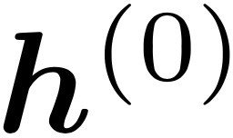
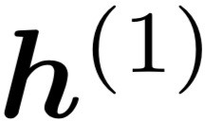
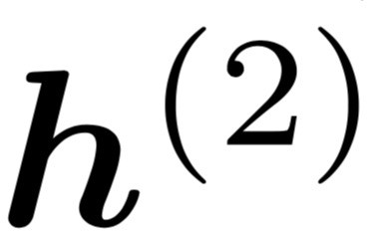
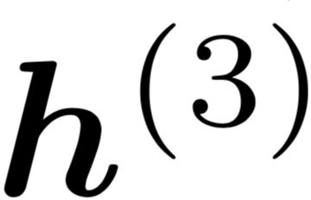
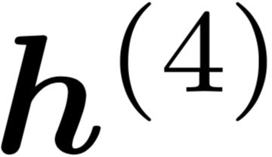
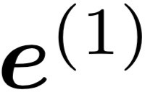
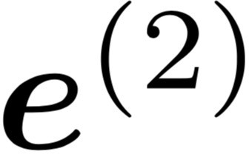
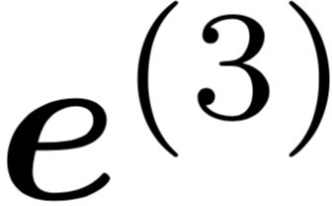
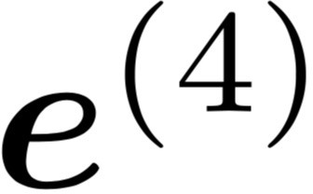
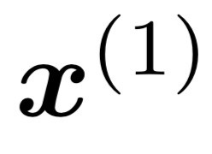
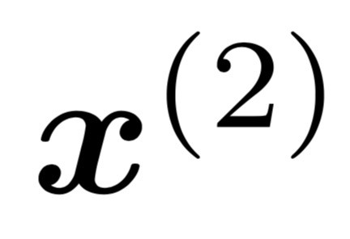
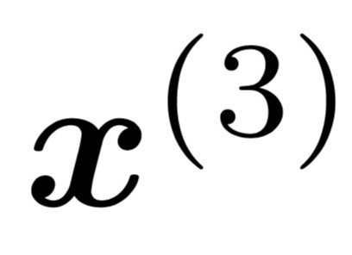
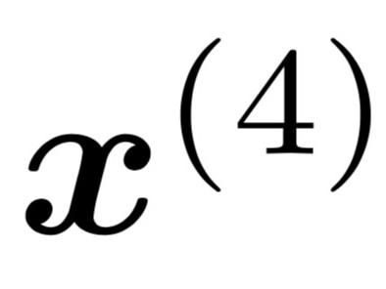
LMs w/ Recurrent Neural Nets
[adopted from Chris Manning]
books
laptops
Core idea: apply a model repeatedly
outputs
output distribution
is the initial hidden state
hidden states
word embeddings
Input
embedding
words / one-hot vectors
the
cat
sat
on
this input sequence could be much longer

Slide 32
Training RNNs: Summary
backpropagated feedback
$$ℒ$$
books
laptops
RNNs can be trained using “backpropagation through time.”
Can be viewed as applying normal backprop to the unrolled network.
Model’s learnable parameters $Θ$
Compute $ℒ(Θ)$ for a batch of sentences
Compute gradients $∇_{Θ}ℒ(Θ)$
Update the weights and then repeat
the
cat
sat
on

Slide 33
RNN: Generation
We can generate the most likely next event (e.g., word) by sampling from $\hat{y}$
Continue until we generate <EOS> symbol.

Slide 34
RNN: Generation
We can generate the most likely next event (e.g., word) by sampling from $\hat{y}$
Continue until we generate <EOS> symbol.
“Sorry”
Output layer
$$U$$
Hidden layer
$$W$$
Input layer
$$x_{1}$$
<START>

Slide 35
RNN: Generation
We can generate the most likely next event (e.g., word) by sampling from $\hat{y}$
Continue until we generate <EOS> symbol.
“Sorry”
Harry
Output layer
$$U$$
$$U$$
$$V$$
Hidden layer
$$W$$
$$W$$
Input layer
$$x_{1}$$
$$x_{2}$$
<START>
“Sorry”

Slide 36
RNN: Generation
We can generate the most likely next event (e.g., word) by sampling from $\hat{y}$
Continue until we generate <EOS> symbol.
“Sorry”
Harry
shouted,
Output layer
$$U$$
$$U$$
$$U$$
$$V$$
$$V$$
Hidden layer
$$W$$
$$W$$
$$W$$
Input layer
$$x_{1}$$
$$x_{2}$$
$$x_{3}$$
<START>
“Sorry”
Harry

Slide 37
RNN: Generation
We can generate the most likely next event (e.g., word) by sampling from $\hat{y}$
Continue until we generate <EOS> symbol.
“Sorry”
Harry
shouted,
panicking
Output layer
$$U$$
$$U$$
$$U$$
$$U$$
$$V$$
$$V$$
$$V$$
Hidden layer
$$W$$
$$W$$
$$W$$
$$W$$
Input layer
$$x_{1}$$
$$x_{2}$$
$$x_{3}$$
$$x_{4}$$
<START>
“Sorry”
Harry
shouted,

Slide 38
RNN: Generation
NOTE: we are transmitting contextual information over time.
“Sorry”
Harry
shouted,
panicking
Output layer
$$U$$
$$U$$
$$U$$
$$U$$
$$V$$
$$V$$
$$V$$
Hidden layer
$$W$$
$$W$$
$$W$$
$$W$$
Input layer
$$x_{1}$$
$$x_{2}$$
$$x_{3}$$
$$x_{4}$$
<START>
“Sorry”
Harry
shouted,

Slide 39
RNN: Generation
When trained on Harry Potter text, it generates:
Source: https://medium.com/deep-writing/harry-potter-written-by-artificial-intelligence-8a9431803da6

Slide 40
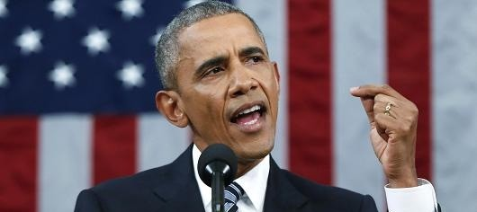
RNNs: Generation
RNN-LM trained on Obama speeches:
The United States will step up to the cost of a new challenges of the American people that will share the fact that we created the problem. They were attacked and so that they have to say that all the task of the final days of war that I will not be able to get this done.
https://medium.com/@samim/obama-rnn-machine-generated-political-speeches-c8abd18a2ea0

Slide 41
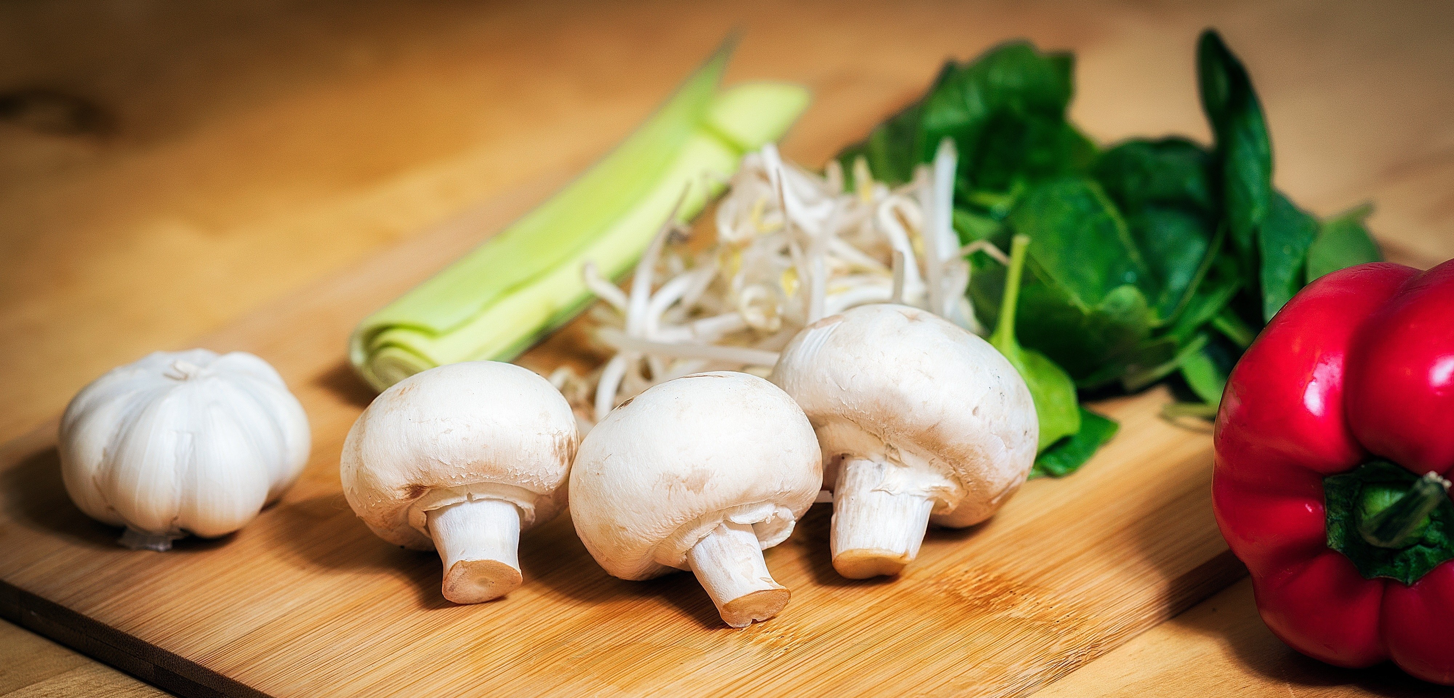
RNNs in Practice
RNN-LM trained on food recipes:
Title: CHOCOLATE RANCH BARBECUE
Categories: Game, Casseroles, Cookies, Cookies
Yield: 6 Servings
2 tb Parmesan cheese -- chopped
1 c Coconut milk
3 Eggs, beaten
Place each pasta over layers of lumps. Shape mixture into the moderate oven and simmer until firm. Serve hot in bodied fresh, mustard, orange and cheese. Combine the cheese and salt together the dough in a large skillet; add the ingredients and stir in the chocolate and pepper.
https://gist.github.com/nylki/1efbaa36635956d35bcc

Slide 42
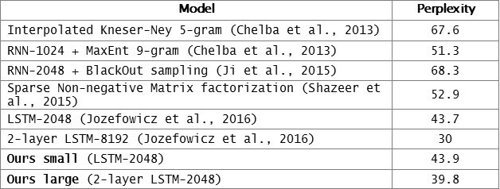
Evaluation LMs with Perplexity (2016)
n-gram model →
Increasingly complex RNNs
Source: https://engineering.fb.com/2016/10/25/ml-applications/building-an-efficient-neural-language-model-over-a-billion-words/

Slide 43
RNNs: Pros and Cons
books
laptops
Advantages:
Model size doesn’t increase for longer inputs — reusing a compact set of model parameters.
Computation for step t can (in theory) use information from many steps back
Disadvantages:
Recurrent computation is slow and difficult to parallelize.
Next week: self-attention mechanism, better at representing long sequences and also parallelizable.
While RNNs in theory can represent long sequences, they quickly forget portions of the input.
Vanishing/exploding gradients.
a
zoo
the students
opened
their

Slide 44
Vanishing/Exploding Gradient Problem
backpropagated feedback
$$ℒ$$
books
laptops
Backpropagated errors multiply at each layer, resulting in exponential decay (if derivative is small) or growth (if derivative is large).
Makes it very difficult train deep networks, or simple recurrent networks over many time steps.
$$∇_{ℒ}\left(W_{h}\right)={\left(J_{ℒ}\left(W_{L−1}\right)\right)}^{T}=\sum_{t=0}{{\left(J_{ℒ}\left(h^{(t)}\right){ J}_{h^{(t)}}\left(W_{h}\right)\right)}^{T}}$$
$$J_{ℒ}\left(h^{(0)}\right)=J_{h^{(1)}}\left(h^{(0)}\right)J_{h^{(2)}}\left(h^{(1)}\right) × … ×{ J}_{h^{(4)}}\left(h^{(3)}\right){ J}_{ℒ}\left(h^{(4)}\right)$$
chain rule
the
cat
sat
on
observed inputs

Slide 45
Vanishing/Exploding Gradient Problem
backpropagated feedback
$$ℒ$$
books
laptops
Gradient signal from far away is lost. So, model weights are updated only with respect to near effects, not long-term effects.
Note: instability of matrix powers can be determined from their eigenvalues.
$$J_{ℒ}\left(h^{(0)}\right)=J_{h^{(1)}}\left(h^{(0)}\right)J_{h^{(2)}}\left(h^{(1)}\right) × … ×{ J}_{h^{(4)}}\left(h^{(3)}\right){ J}_{ℒ}\left(h^{(4)}\right)$$
chain rule
the
cat
sat
on
observed inputs

Slide 46
RNNs: Difficulty in Learning Long-Range Dependencies
While RNNs in theory can represent long sequences, in practice teaching them about long-range dependencies is non-trivial.
Gradient clipping:
If the norm of the gradient is greater than some threshold, scale it down before applying SGD update.
Intuition: take a step in the same direction, but a smaller step
[“On the difficulty of training recurrent neural networks”, Pascanu et al, 2013]
Notes:
These models don’t guarantee that there is no vanishing/exploding gradient, but it does provide an easier way for the model to learn long-distance dependencies

Slide 47
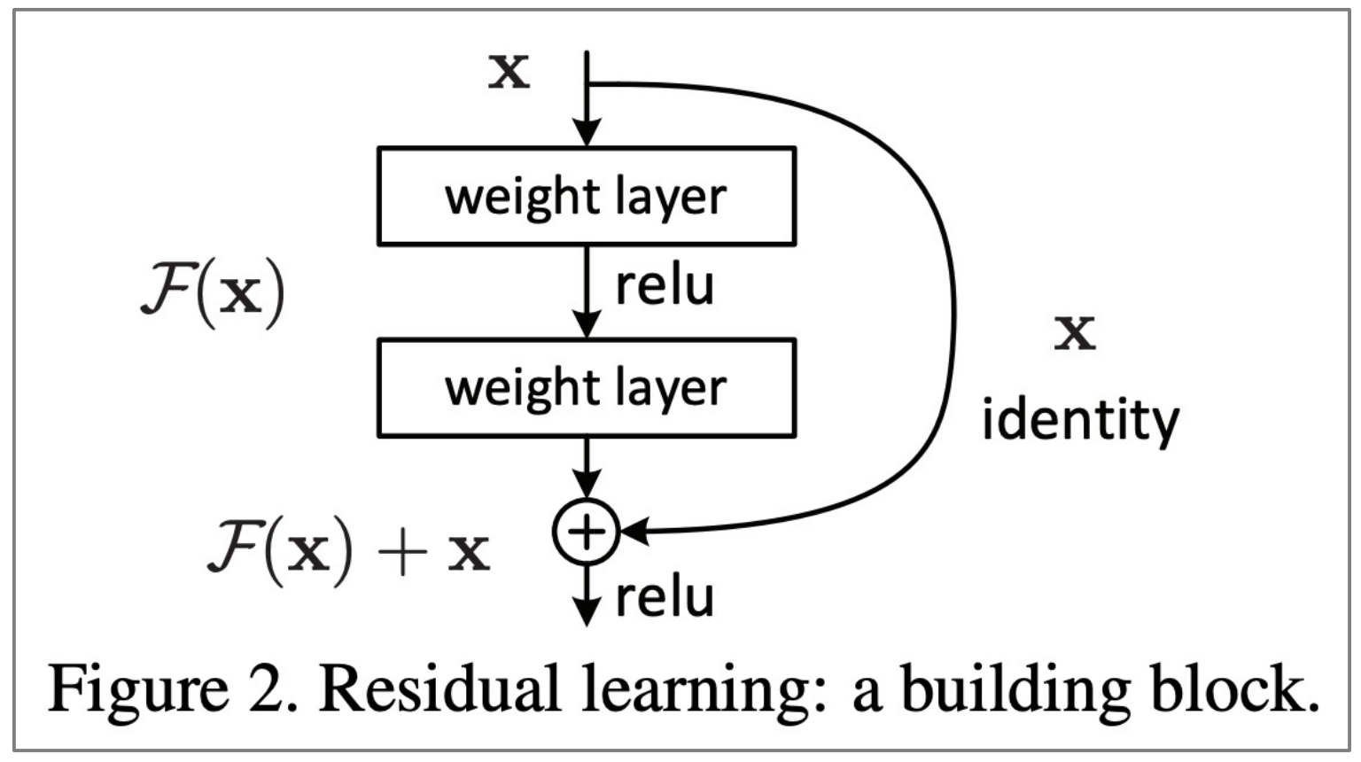
RNNs: Difficulty in Learning Long-Range Dependencies (2)
While RNNs in theory can represent long sequences, in practice teaching them about long-range dependencies is non-trivial.
Using residual layers:
lots of new deep architectures (RNN or otherwise) add direct connections, thus allowing the gradient to flow)
"Deep Residual Learning for Image Recognition", He et al, 2015. https://arxiv.org/pdf/1512.03385.pdf
Notes:
These models don’t guarantee that there is no vanishing/exploding gradient, but it does provide an easier way for the model to learn long-distance dependencies

Slide 48
RNNs: Difficulty in Learning Long-Range Dependencies (3)
While RNNs in theory can represent long sequences, in practice teaching them about long-range dependencies is non-trivial.
Changes to the architecture makes it easier for the RNN to preserve information over many timesteps
Long Short-Term Memory (LSTM) [Hochreiter and Schmidhuber 1997, Gers+ 2000]
Gated Recurrent Units (GRU) [Cho+ 2014]
Notes:
These models don’t guarantee that there is no vanishing/exploding gradient, but it does provide an easier way for the model to learn long-distance dependencies

Slide 49
RNNs: Difficulty in Learning Long-Range Dependencies (3)
While RNNs in theory can represent long sequences, in practice teaching them about long-range dependencies is non-trivial.
Changes to the architecture makes it easier for the RNN to preserve information over many timesteps
Long Short-Term Memory (LSTM) [Hochreiter and Schmidhuber 1997, Gers+ 2000]
Gated Recurrent Units (GRU) [Cho+ 2014]
Many of these variants were the dominant architecture of In 2013–2015.
We will not cover these alternative architecture in favor or spending more time on more modern developments.
Notes:
These models don’t guarantee that there is no vanishing/exploding gradient, but it does provide an easier way for the model to learn long-distance dependencies

Slide 50
Adapting RNNs to Application
Text Classification
Language Modeling
POS Tags

Slide 51
Encoder-Decoder Architectures
It is useful to think of generative models as two sub-models.
Some model
“The cat sat on the [MASK]”

Slide 52
Encoder-Decoder Architectures
It is useful to think of generative models as two sub-models.
Representation (compression) of the context
Encoder
Decoder
“The cat sat on the [MASK]”
Processes the context and compiles it into a vector.
Produces the output sequence item by item using the representation of the context.

Slide 53
Encoder-Decoder Architectures
https://jalammar.github.io/visualizing-neural-machine-translation-mechanics-of-seq2seq-models-with-attention/

Slide 54
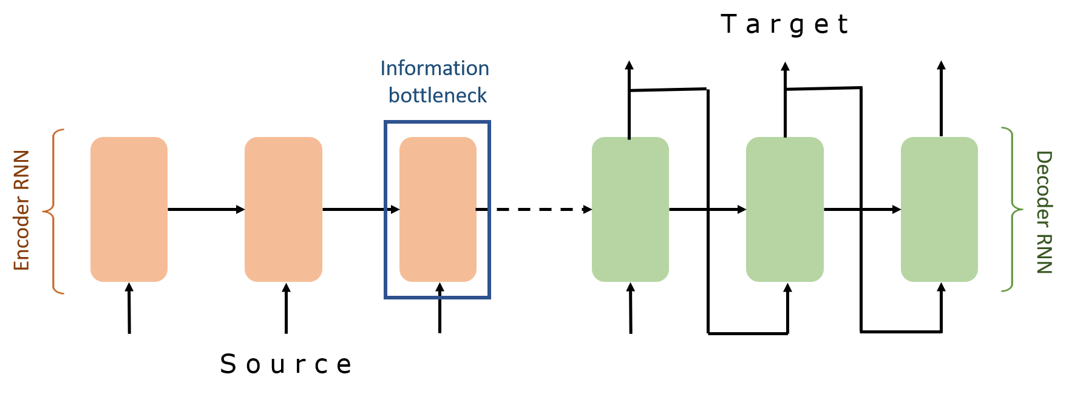
Encoder-Decoder Architectures

Slide 55
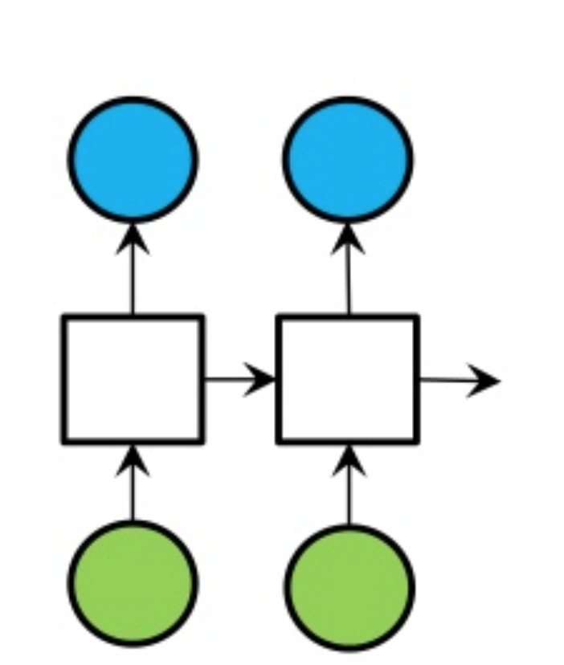
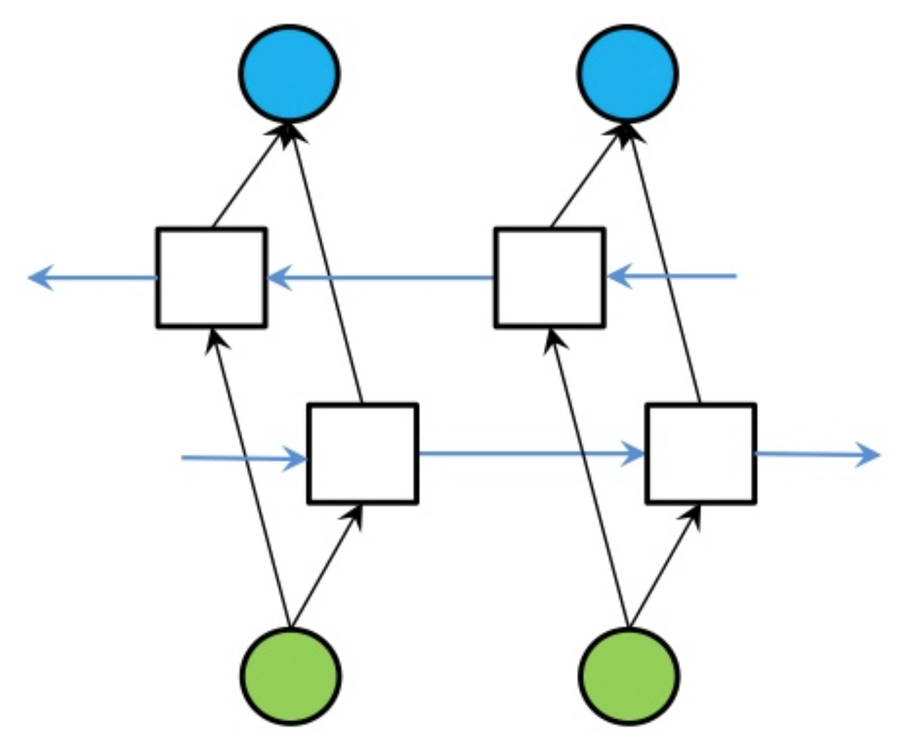
Extending RNNs to Both Directions
An RNN limitation: Hidden variables capture only one side of the context.
Solution: Bi-Directional RNNs
RNN
Bi-directional RNN

