Slide 1
Self-Supervised Learning w/ Recurrent Neural Nets
CSCI 601 471/671
NLP: Self-Supervised Models
https://self-supervised.cs.jhu.edu/sp2023/
[Slide credit: Chris Tanner, Mohit Iyyer, Chris Manning and many others ]

Slide 2
Logistics Update
HW3 grading is done.
HW5 is released.
Please be careful about the academic honesty code of the class.
We will taper off HWs as we get closer to the end of the semester.
We will have less HW than we expected (probably 8 HW).
This should give you time to focus on your final projects — Project details coming soon!

Slide 3
Recap: Recurrent Neural Networks
Repeated use of a finite model
“Sorry”
Harry
shouted,
panicking
Output layer
$$U$$
$$U$$
$$U$$
$$U$$
$$V$$
$$V$$
$$V$$
Hidden layer
$$W$$
$$W$$
$$W$$
$$W$$
Input layer
$$x_{1}$$
$$x_{2}$$
$$x_{3}$$
$$x_{4}$$
<START>
“Sorry”
Harry
shouted,

Slide 4
Recap: Encoder-Decoder Architectures
It is useful to think of generative models as two sub-models.
Some model
“The cat sat on the [MASK]”

Slide 5
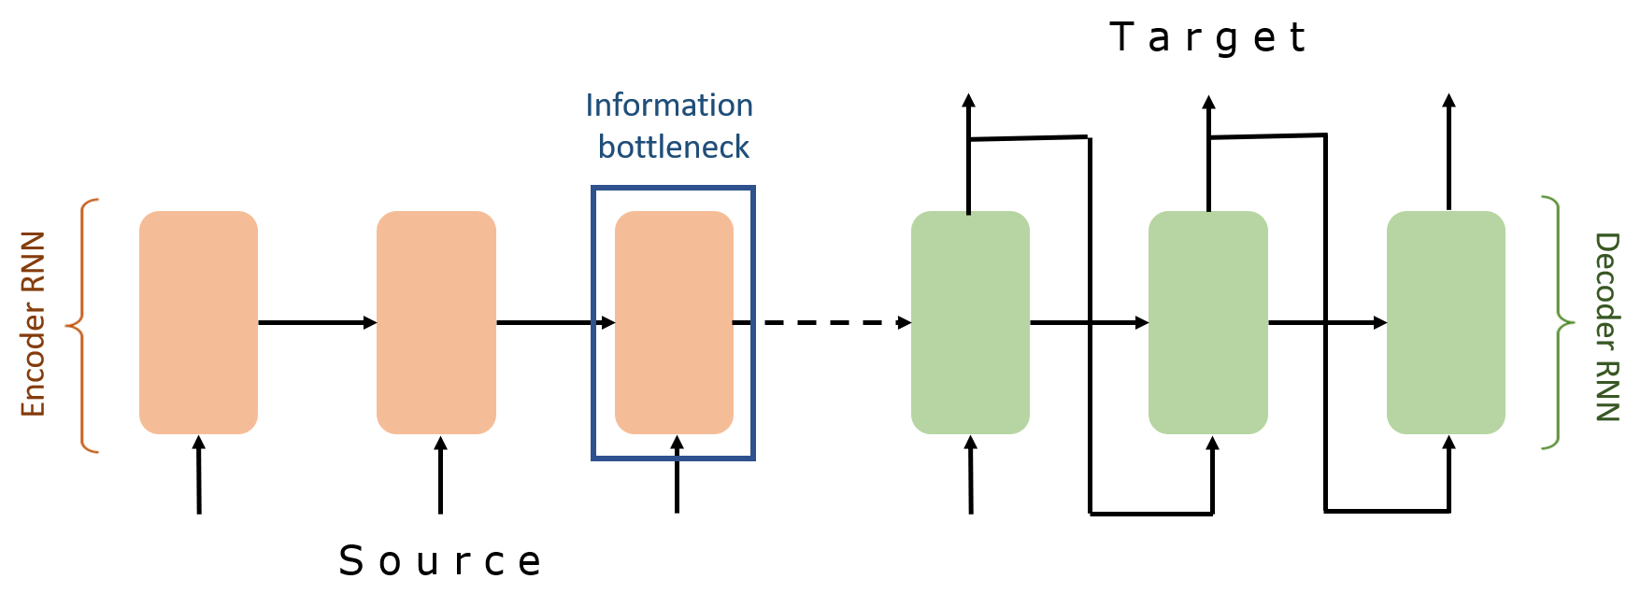
Recap: Encoder-Decoder Architectures

Slide 6
Sequence-to-Sequence (seq2seq)
_{ℎ}𝐸
_{ℎ}𝐸
_{ℎ}𝐸
_{ℎ}𝐸
1
2
3
4
Hidden layer
Input layer
The brown
dog
ran
ENCODER RNN

Slide 7
Sequence-to-Sequence (seq2seq)
The final hidden state of the encoder RNN is the initial state of the decoder RNN
_{ℎ}𝐸
_{ℎ}𝐸
_{ℎ}𝐸
_{ℎ}𝐸
1
2
3
4
Hidden layer
Input layer
The brown
dog
ran
ENCODER RNN

Slide 8
Sequence-to-Sequence (seq2seq)
The final hidden state of the encoder RNN is the initial state of the decoder RNN
_{ℎ}𝐸
_{ℎ}𝐸
_{ℎ}𝐸
_{ℎ}𝐸
_{ℎ}𝐷
1
2
3
4
1
Hidden layer
Input layer
The brown
dog
ran
<s>
ENCODER RNN
DECODER RNN

Slide 9
Sequence-to-Sequence (seq2seq)
The final hidden state of the encoder RNN is the initial state of the decoder RNN
Le
_{ℎ}𝐸
_{ℎ}𝐸
_{ℎ}𝐸 _{ℎ}𝐸
3 4
_{ℎ}𝐷
1
2
1
Hidden layer
Input layer
The brown
dog
ran
<s>
ENCODER RNN
DECODER RNN

Slide 10
Sequence-to-Sequence (seq2seq)
The final hidden state of the encoder RNN is the initial state of the decoder RNN
Le
_{ℎ}𝐸
_{ℎ}𝐸
_{ℎ}𝐸 _{ℎ}𝐸
3 4
_{ℎ}𝐷 _{ℎ}𝐷
1 2
1
2
Hidden layer
Input layer
The brown
dog
ran
<s>
Le
ENCODER RNN
DECODER RNN

Slide 11
Sequence-to-Sequence (seq2seq)
The final hidden state of the encoder RNN is the initial state of the decoder RNN
Le chien
_{ℎ}𝐸
_{ℎ}𝐸
_{ℎ}𝐸 _{ℎ}𝐸
3 4
_{ℎ}𝐷 _{ℎ}𝐷
1 2
1
2
Hidden layer
Input layer
The brown
dog
ran
<s>
Le
ENCODER RNN
DECODER RNN

Slide 12
Sequence-to-Sequence (seq2seq)
The final hidden state of the encoder RNN is the initial state of the decoder RNN
Le chien
_{ℎ}𝐸
_{ℎ}𝐸
_{ℎ}𝐸 _{ℎ}𝐸
3 4
_{ℎ}𝐷 _{ℎ}𝐷
1 2
_{ℎ}𝐷
1
2
3
Hidden layer
Input layer
The brown
dog
ran
<s>
Le
chien
ENCODER RNN
DECODER RNN

Slide 13
Sequence-to-Sequence (seq2seq)
The final hidden state of the encoder RNN is the initial state of the decoder RNN
Le chien
brun
_{ℎ}𝐸
_{ℎ}𝐸
_{ℎ}𝐸 _{ℎ}𝐸
3 4
_{ℎ}𝐷 _{ℎ}𝐷
1 2
_{ℎ}𝐷
1
2
3
Hidden layer
Input layer
The brown
dog
ran
<s>
Le
chien
ENCODER RNN
DECODER RNN

Slide 14
Sequence-to-Sequence (seq2seq)
The final hidden state of the encoder RNN is the initial state of the decoder RNN
Le chien
brun
_{ℎ}𝐸
_{ℎ}𝐸
_{ℎ}𝐸 _{ℎ}𝐸
3 4
_{ℎ}𝐷 _{ℎ}𝐷
1 2
_{ℎ}𝐷
_{ℎ}𝐷
1
2
3
4
Hidden layer
Input layer
The brown
dog
ran
<s>
Le
chien
brun
ENCODER RNN
DECODER RNN

Slide 15
Sequence-to-Sequence (seq2seq)
The final hidden state of the encoder RNN is the initial state of the decoder RNN
Le chien
brun a
couru <s>
_{ℎ}𝐸
_{ℎ}𝐸
_{ℎ}𝐸 _{ℎ}𝐸
3 4
_{ℎ}𝐷 _{ℎ}𝐷
1 2
_{ℎ}𝐷
_{ℎ}𝐷
_{ℎ}𝐷 _{ℎ}𝐷
5 6
1
2
3
4
Hidden layer
Input layer
The brown
dog
ran
<s>
Le
chien
brun
a couru
ENCODER RNN
DECODER RNN

Slide 16
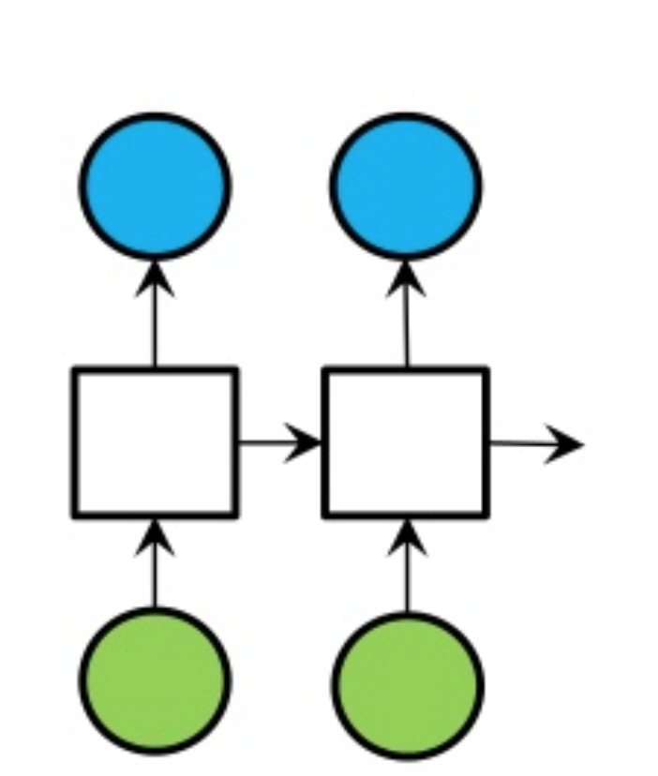
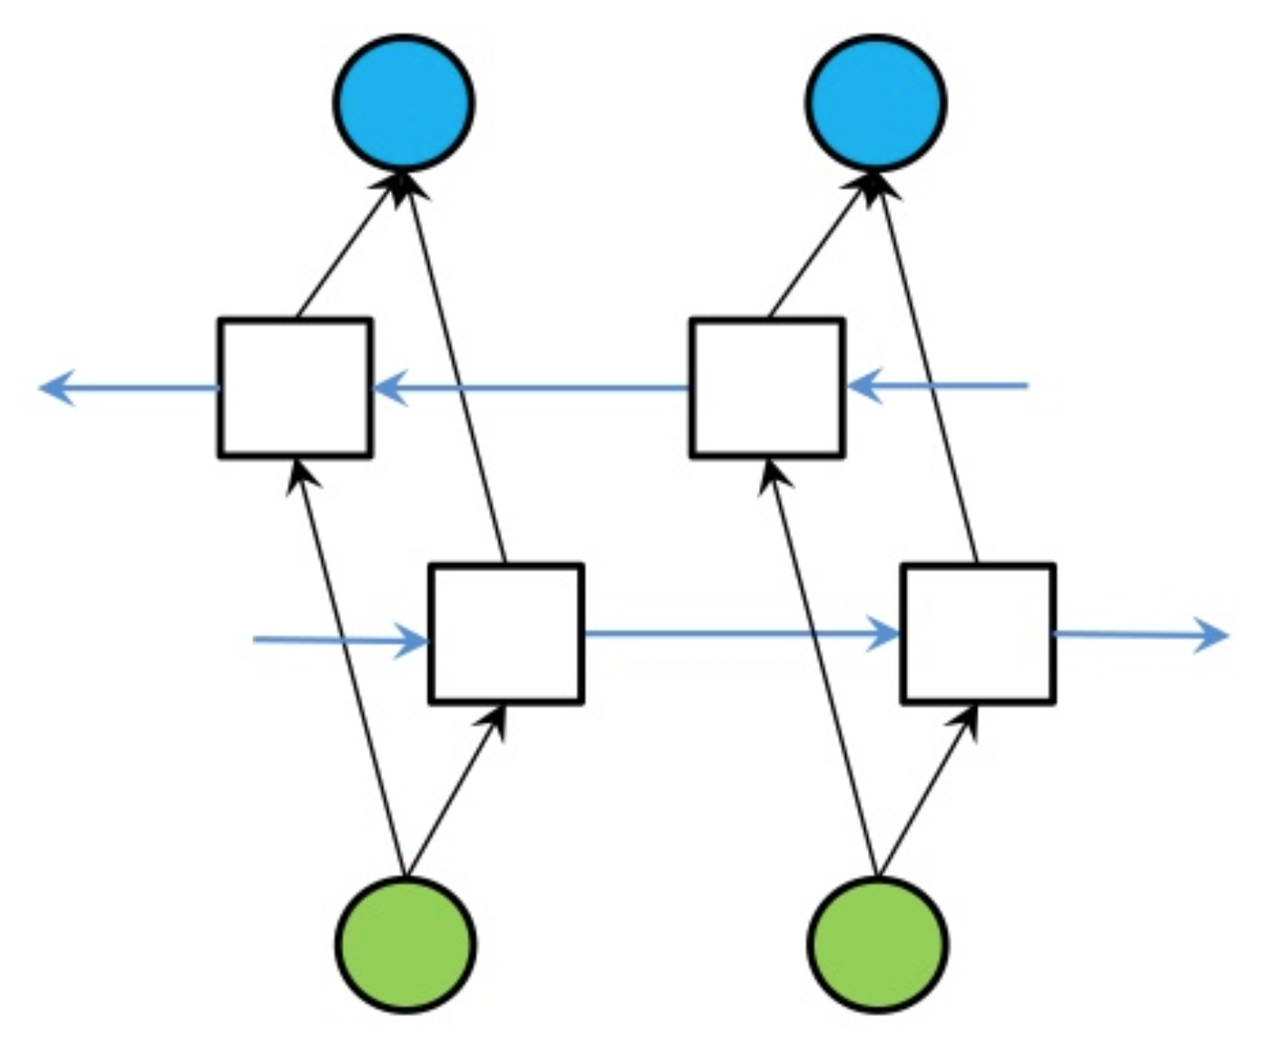
Recap: Extending RNNs to Both Directions
An RNN limitation: Hidden variables capture only one side of the context.
Solution: Bi-Directional RNNs
RNN
Bi-directional RNN

Slide 17
Self-Supervised Learning w/ RNNs

Slide 18
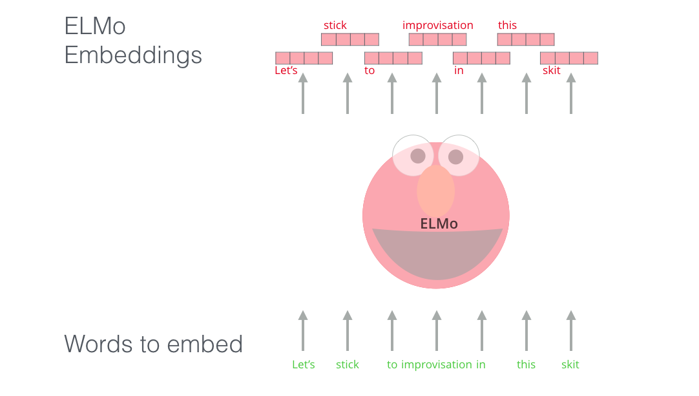
ELMo: First Major Self-Supervised LM
General idea: Goal is to get highly rich, contextualized embeddings (word tokens)
Contextual representations, i.e., depend on the entire sentence in which a word is used.
[Deep contextualized word representations, Peters et al. 2018]

Slide 19
ELMo: First Major Self-Supervised LM
Use both directions of context (bi-directional), with increasing abstractions (stacked)
Two LSTMs in different directions — capture both directions
[Deep contextualized word representations, Peters et al. 2018]

Slide 20
ELMo: First Major Self-Supervised LM
Linearly combine all abstract representations (hidden layers) and optimize w.r.t. a particular task (e.g., sentiment classification)
[Deep contextualized word representations, Peters et al. 2018]

Slide 21
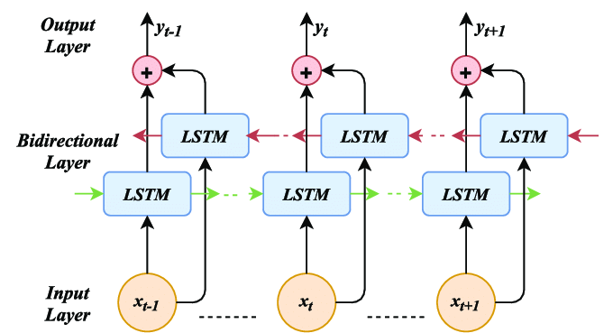
ELMo: Objective
[Deep contextualized word representations, Peters et al. 2018]

Slide 22
ELMo: Some Details
Train a forward LM and backward LMs
Use 4096 dim hidden states
Residual connections from the first to second layer
Trained 10 epochs on 1B Word Benchmark
Perplexity ~39
[Deep contextualized word representations, Peters et al. 2018]

Slide 23
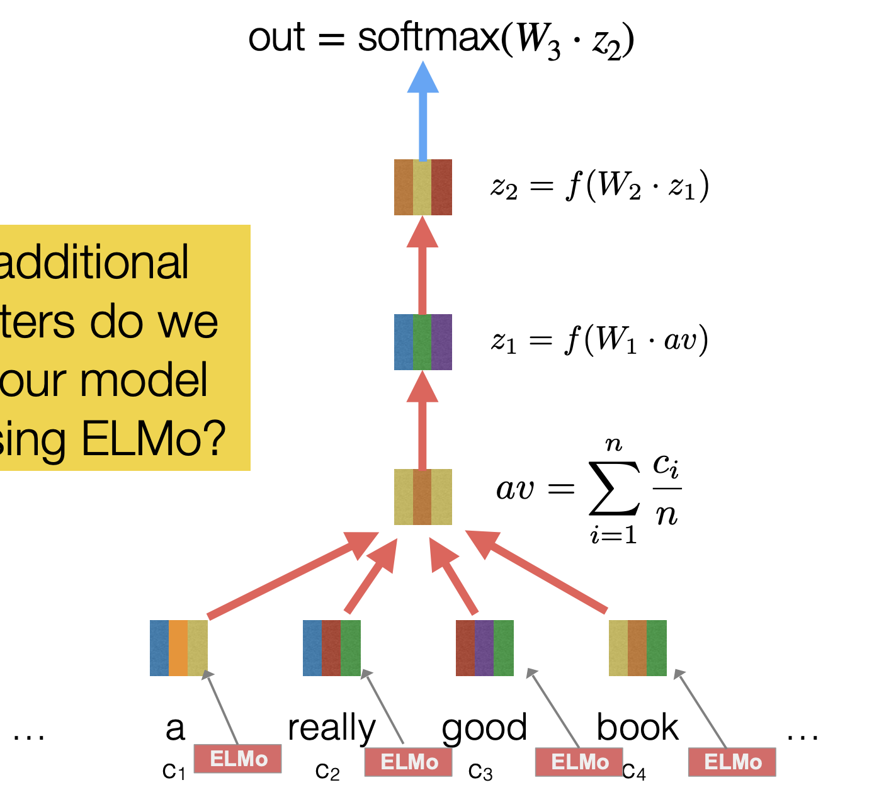
ELMo Representations for Tasks
Fine-tune classifiers using contextualized word representations extracted from ELMo.
[Deep contextualized word representations, Peters et al. 2018]

Slide 24
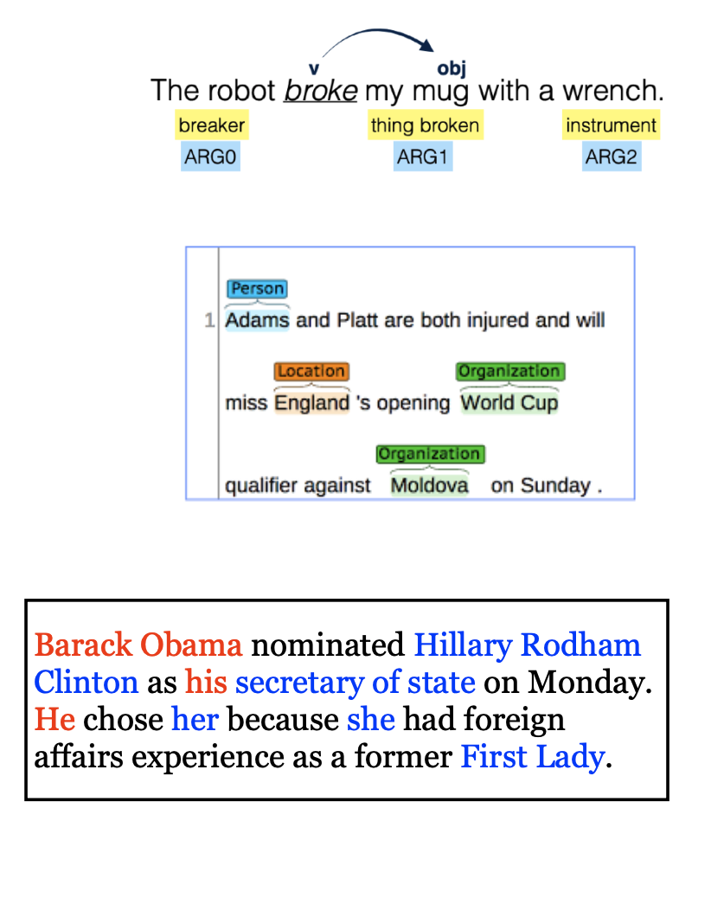
ELMo: Evaluation
SQuAD: question answering
SNLI: textual entailment
SRL: semantic role labeling
Coref: coreference resolution
NER: named entity recognition
SST-5: sentiment analysis
[Deep contextualized word representations, Peters et al. 2018]

Slide 25
Experimental Results
[Deep contextualized word representations, Peters et al. 2018]

Slide 26
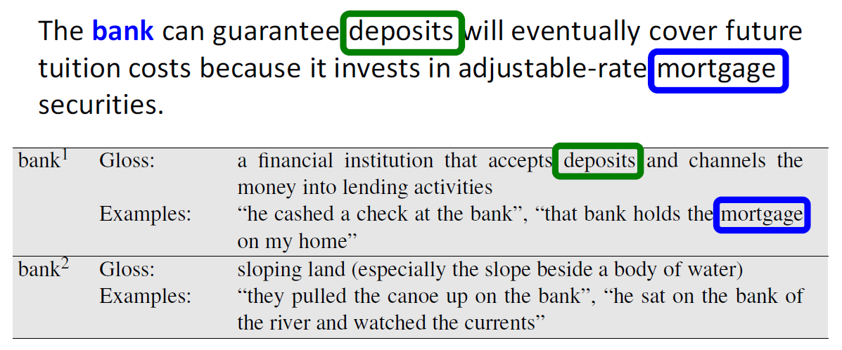
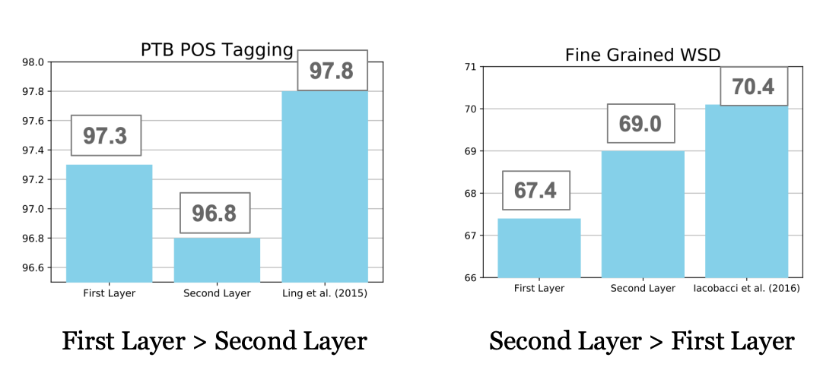
Syntactic information is better represented at lower layers while semantic information is captured a higher layers
[Deep contextualized word representations, Peters et al. 2018]

Slide 27
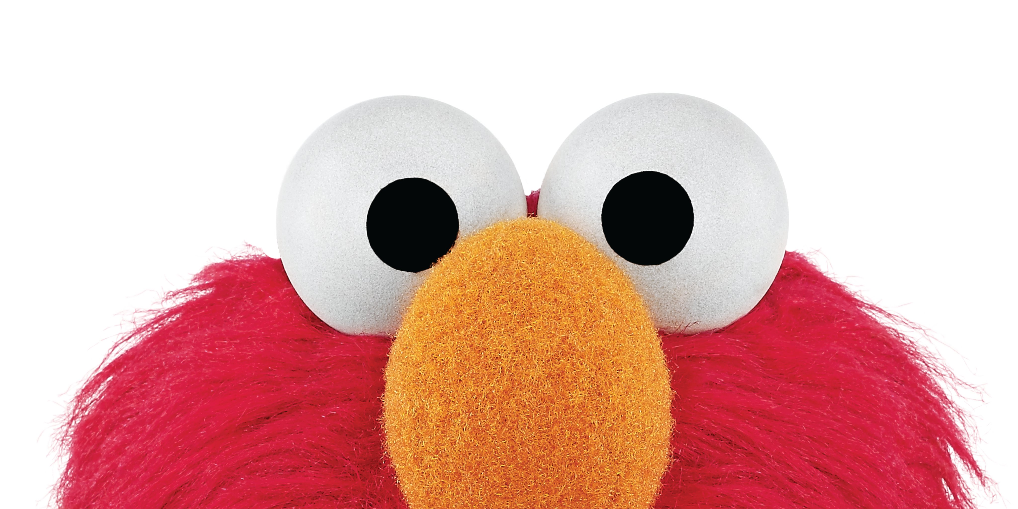
Summary
ELMo: Stacked Bi-directional LSTMs
ELMo yielded incredibly good contextualized embeddings, which yielded SOTA results when applied to many NLP tasks.
Main ELMo takeaway: given enough [unlabeled] training data, having tons of explicit connections between your vectors is useful — the system can determine how to best use context.
[Deep contextualized word representations, Peters et al. 2018]

Slide 28
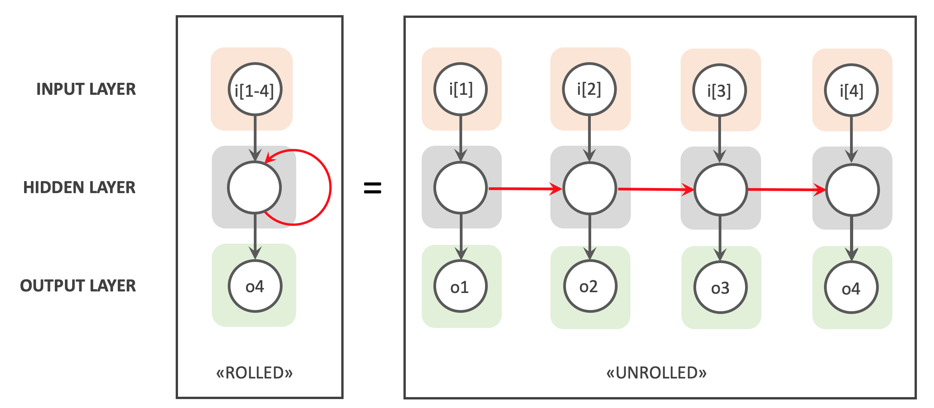
Summary
Recurrent Neural Networks
A family of neural networks that allow architecture for inputs of variable length
RNN-LM: LM based on RNNs
A notable example: ELMo
Cons:
Sequential processing
While in theory it maintain infinite history, in practice it suffers from long-range dependencies.

Slide 29
Atomic Units of Language

Slide 30
The cat sat on the mat.
Notes:
The …

Slide 31
The cat sat on the mat.
words split based on white space?
BOS, The, cat, sat, on, the, mat, ., EOS
characters?
BOS, T, h, e, SPACE, c, a, t, SPACE, s, …
bytes??!
011000010111000001110000011011000110010101100001
1110000011100000110110001100101011000010111000 …
Notes:
The …

Slide 32
The cat sat on the mat.
words split based on white space?
BOS, The, cat, sat, on, the, mat, ., EOS
characters?
BOS, T, h, e, SPACE, c, a, t, SPACE, s, …
bytes??!
011000010111000001110000011011000110010101100001
1110000011100000110110001100101011000010111000 …
Which one should we use as the atomic building blocks for modeling language? 🤔
Notes:
The …

Slide 33
Cost of Using Word Units
What happens when we encounter a word at test time that we’ve never seen in our training data?
Loquacious:
Omnishambles:
COVID-19: was unseen until 2020!
Aquire: incorrect spelling of “acquire”
Acknowleadgement: incorrect spelling of “acknowledgement”
What about relevant words?: “dog” vs “dogs”; ”run” vs “running”
With word level tokenization, we have no way of understanding an unseen word!
Also, not all languages have spaces between words like English!
Tending to talk a great deal; talkative.
A situation that has been mismanaged, due to blunders and miscalculations.

Slide 34
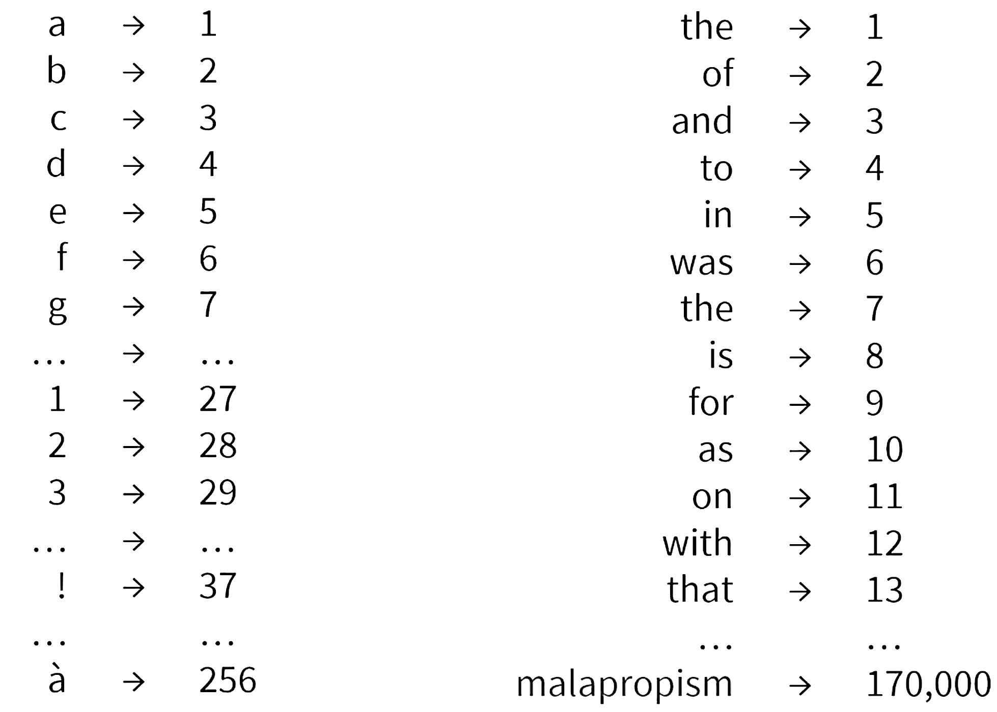
Cost of Using Character Units
What if we use characters?
Pro: (1) small vocabulary, just the number of unique characters in the training data. (2) fewer out-of-vocabulary tokens
Cost: much longer input sequences As we discussed, modeling long-range dependences is challenging.

Slide 35
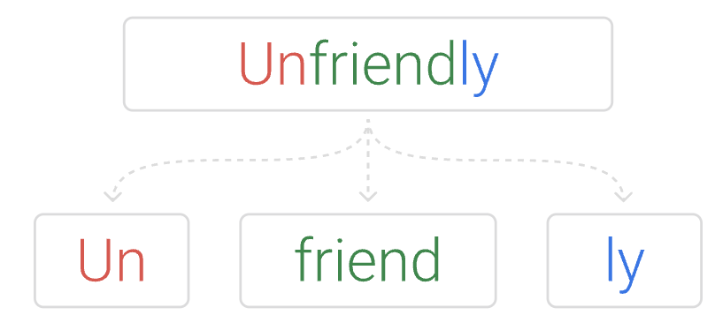
Subword Tokenization
Breaks words into smaller units that are indicative of their morphological construction.
Developed for machine translation (Sennrich et al. 2016)
Dominantly used in modern language models (BERT, T5, GPT, …)
Relies on a simple algorithm called byte pair encoding (Gage, 1994)
[Improving Neural Machine Translation Models with Monolingual Data, Sennrich et al. 2016]
[A new algorithm for data compression, Gage 1994]

Slide 36
from transformers import AutoTokenizer
tokenizer = AutoTokenizer.from_pretrained("bert-base-cased")
sequence = "Using a Transformer network is simple"
print(tokenizer.tokenize(sequence))
['Using', 'a', ‘Transform', '##er', 'network', 'is', 'simple’]
print(tokenizer.convert_tokens_to_ids(tokens))
[7993, 170, 13809, 23763, 2443, 1110, 3014]
tokenizer = AutoTokenizer.from_pretrained("albert-base-v1")
sequence = "Using a Transformer network is simple"
print(tokenizer.tokenize(sequence))
[‘_using', ‘_a', ‘_transform', 'er', ‘_network', ‘_is', ‘_simple’]

Slide 37
The Tokenization Pipeline
Normalization
Tokenization
Pos-processing
Pre-tokenization
Strip extra spaces
Unicode normalization, …

Slide 38
The Tokenization Pipeline
Normalization
Tokenization
Pos-processing
Pre-tokenization
White spaces between words and sentences
Punctuations
…

Slide 39
The Tokenization Pipeline
Normalization
Tokenization
Pos-processing
Pre-tokenization
BPE, …. (will discuss this in a second)

Slide 40
The Tokenization Pipeline
Normalization
Tokenization
Pos-processing
Pre-tokenization
Add special tokens: for example [CLS], [SEP] for BERT
Truncate to match the maximum length of the model
Pad all sentences in a batch to the same length

Slide 41
Byte-pair Encoding (BPE)
An algorithm for forming subword tokens based on a collection of raw text.
and there are no re ##fueling stations anywhere
One of the city’s more un ##princi ##pled real state agents
[Improving Neural Machine Translation Models with Monolingual Data, Sennrich et al. 2016]
[A new algorithm for data compression, Gage 1994]

Slide 42
Byte-pair Encoding (BPE)
Idea: Repeatedly merge the most frequent adjacent tokens
Doing 30k merges => vocabulary of around 30k subwords. Includes many whole words.
[Improving Neural Machine Translation Models with Monolingual Data, Sennrich et al. 2016]
[A new algorithm for data compression, Gage 1994]

Slide 43
Byte-pair Encoding (BPE): Example
Form base vocabulary of all characters that occur in the training set.
Example:
Our (very fascinating🙄) training data: “jhu jhu jhu hopkins hop hops hops”
Base vocab: h, i, j, k, n, o, p, s, u
Tokenized data: j h u j h u j h u h o p k i n s h o p h o p s h o p s
Does not show the word separator for simplicity.
[Improving Neural Machine Translation Models with Monolingual Data, Sennrich et al. 2016]
[A new algorithm for data compression, Gage 1994]

Slide 44
Byte-pair Encoding: Example (2)
Count the frequency of each token pair in the data
Example:
Our (very fascinating🙄) training data: “jhu jhu jhu hopkins hop hops hops”
Base vocab: h, i, j, k, n, o, p, s, u
Tokenized data: j h u j h u j h u h o p k i n s h o p h o p s h o p s
Token pair frequencies:
j + h -> 3
h + u -> 3
h + o -> 4
o + p -> 4
p + k -> 1
k + i -> 1
….
[Improving Neural Machine Translation Models with Monolingual Data, Sennrich et al. 2016]
[A new algorithm for data compression, Gage 1994]

Slide 45
Byte-pair Encoding: Example (3)
Choose the pair that occurs more, merge them and add to vocab.
Example:
Our (very fascinating🙄) training data: “jhu jhu jhu hopkins hop hops hops”
Base vocab: h, i, j, k, n, o, p, s, u
Tokenized data: j h u j h u j h u h o p k i n s h o p h o p s h o p s
Token pair frequencies:
j + h -> 3
h + u -> 3
h + o -> 4
o + p -> 4
p + k -> 1
k + i -> 1
….
[Improving Neural Machine Translation Models with Monolingual Data, Sennrich et al. 2016]
[A new algorithm for data compression, Gage 1994]

Slide 46
Byte-pair Encoding: Example (4)
Choose the pair that occurs more, merge them and add to vocab.
Example:
Our (very fascinating🙄) training data: “jhu jhu jhu hopkins hop hops hops”
Base vocab: h, i, j, k, n, o, p, s, u, ho
Tokenized data: j h u j h u j h u h o p k i n s h o p h o p s h o p s
Token pair frequencies:
j + h -> 3
h + u -> 3
h + o -> 4
o + p -> 4
p + k -> 1
k + i -> 1
….
[Improving Neural Machine Translation Models with Monolingual Data, Sennrich et al. 2016]
[A new algorithm for data compression, Gage 1994]

Slide 47
Byte-pair Encoding: Example (5)
Retokenize the data
Example:
Our (very fascinating🙄) training data: “jhu jhu jhu hopkins hop hops hops”
Base vocab: h, i, j, k, n, o, p, s, u, ho
Tokenized data: j h u j h u j h u ho p k i n s ho p ho p s ho p s
Token pair frequencies:
[Improving Neural Machine Translation Models with Monolingual Data, Sennrich et al. 2016]
[A new algorithm for data compression, Gage 1994]

Slide 48
Byte-pair Encoding: Example (6)
Count the token pairs and merge the most frequent one
Example:
Our (very fascinating🙄) training data: “jhu jhu jhu hopkins hop hops hops”
Base vocab: h, i, j, k, n, o, p, s, u, ho
Tokenized data: j h u j h u j h u ho p k i n s ho p ho p s ho p s
Token pair frequencies:
j + h -> 3
h + u -> 3
ho + p -> 4
p + k -> 1
k + i -> 1
i + n -> 1
….
[Improving Neural Machine Translation Models with Monolingual Data, Sennrich et al. 2016]
[A new algorithm for data compression, Gage 1994]

Slide 49
Byte-pair Encoding: Example (7)
Count the token pairs and merge the most frequent one
Example:
Our (very fascinating🙄) training data: “jhu jhu jhu hopkins hop hops hops”
Base vocab: h, i, j, k, n, o, p, s, u, ho
Tokenized data: j h u j h u j h u ho p k i n s ho p ho p s ho p s
Token pair frequencies:
j + h -> 3
h + u -> 3
ho + p -> 4
p + k -> 1
k + i -> 1
i + n -> 1
….
[Improving Neural Machine Translation Models with Monolingual Data, Sennrich et al. 2016]
[A new algorithm for data compression, Gage 1994]

Slide 50
Byte-pair Encoding: Example (7)
Count the token pairs and merge the most frequent one
Example:
Our (very fascinating🙄) training data: “jhu jhu jhu hopkins hop hops hops”
Base vocab: h, i, j, k, n, o, p, s, u, ho, hop
Tokenized data: j h u j h u j h u ho p k i n s ho p ho p s ho p s
Token pair frequencies:
j + h -> 3
h + u -> 3
ho + p -> 4
p + k -> 1
k + i -> 1
i + n -> 1
….
[Improving Neural Machine Translation Models with Monolingual Data, Sennrich et al. 2016]
[A new algorithm for data compression, Gage 1994]

Slide 51
Byte-pair Encoding: Example (7)
Count the token pairs and merge the most frequent one
Example:
Our (very fascinating🙄) training data: “jhu jhu jhu hopkins hop hops hops”
Base vocab: h, i, j, k, n, o, p, s, u, ho, hop
Tokenized data: j h u j h u j h u hop k i n s hop hop s hop s
Token pair frequencies:
j + h -> 3
h + u -> 3
ho + p -> 4
p + k -> 1
k + i -> 1
i + n -> 1
….
[Improving Neural Machine Translation Models with Monolingual Data, Sennrich et al. 2016]
[A new algorithm for data compression, Gage 1994]

Slide 52
Byte-pair Encoding: Example (8)
Count the token pairs and merge the most frequent one
Example:
Our (very fascinating🙄) training data: “jhu jhu jhu hopkins hop hops hops”
Base vocab: h, i, j, k, n, o, p, s, u, ho, hop
Tokenized data: j h u j h u j h u hop k i n s hop hop s hop s
Token pair frequencies:
j + h -> 3
h + u -> 3
hop + k -> 1
hop + s -> 2
k + i -> 1
i + n -> 1
n + s -> 1
….
[Improving Neural Machine Translation Models with Monolingual Data, Sennrich et al. 2016]
[A new algorithm for data compression, Gage 1994]

Slide 53
Byte-pair Encoding: Example (8)
Count the token pairs and merge the most frequent one
Example:
Our (very fascinating🙄) training data: “jhu jhu jhu hopkins hop hops hops”
Base vocab: h, i, j, k, n, o, p, s, u, ho, hop, jh
Tokenized data: j h u j h u j h u hop k i n s hop hop s hop s
Token pair frequencies:
j + h -> 3
h + u -> 3
hop + k -> 1
hop + s -> 2
k + i -> 1
i + n -> 1
n + s -> 1
….
[Improving Neural Machine Translation Models with Monolingual Data, Sennrich et al. 2016]
[A new algorithm for data compression, Gage 1994]

Slide 54
Byte-pair Encoding: Example (8)
Count the token pairs and merge the most frequent one
Example:
Our (very fascinating🙄) training data: “jhu jhu jhu hopkins hop hops hops”
Base vocab: h, i, j, k, n, o, p, s, u, ho, hop, jh
Tokenized data: jh u jh u jh u hop k i n s hop hop s hop s
Token pair frequencies:
j + h -> 3
h + u -> 3
hop + k -> 1
hop + s -> 2
k + i -> 1
i + n -> 1
n + s -> 1
….
[Improving Neural Machine Translation Models with Monolingual Data, Sennrich et al. 2016]
[A new algorithm for data compression, Gage 1994]

Slide 55
Byte-pair Encoding: Example (8)
Count the token pairs and merge the most frequent one
Example:
Our (very fascinating🙄) training data: “jhu jhu jhu hopkins hop hops hops”
Base vocab: h, i, j, k, n, o, p, s, u, ho, hop, jh
Tokenized data: jh u jh u jh u hop k i n s hop hop s hop s
Token pair frequencies:
j h+u -> 3
hop + k -> 1
hop + s -> 2
k + i -> 1
i + n -> 1
n + s -> 1
….
[Improving Neural Machine Translation Models with Monolingual Data, Sennrich et al. 2016]
[A new algorithm for data compression, Gage 1994]

Slide 56
Byte-pair Encoding: Example (8)
Count the token pairs and merge the most frequent one
Example:
Our (very fascinating🙄) training data: “jhu jhu jhu hopkins hop hops hops”
Base vocab: h, i, j, k, n, o, p, s, u, ho, hop, jh, jhu
Tokenized data: jh u jh u jh u hop k i n s hop hop s hop s
Token pair frequencies:
j h+u -> 3
hop + k -> 1
hop + s -> 2
k + i -> 1
i + n -> 1
n + s -> 1
….
[Improving Neural Machine Translation Models with Monolingual Data, Sennrich et al. 2016]
[A new algorithm for data compression, Gage 1994]

Slide 57
Byte-pair Encoding: Example (8)
Count the token pairs and merge the most frequent one
Example:
Our (very fascinating🙄) training data: “jhu jhu jhu hopkins hop hops hops”
Base vocab: h, i, j, k, n, o, p, s, u, ho, hop, jh, jhu
Tokenized data: jhu jhu jhu hop k i n s hop hop s hop s
Token pair frequencies:
j h+u -> 3
hop + k -> 1
hop + s -> 2
k + i -> 1
i + n -> 1
n + s -> 1
….
[Improving Neural Machine Translation Models with Monolingual Data, Sennrich et al. 2016]
[A new algorithm for data compression, Gage 1994]

Slide 58
Byte-pair Encoding
This can be a lot if including all unicode characters (there are ~138K unicode symbols)!
GPT-2 uses bytes as the base vocabulary (size 256) and then applies BPE on top of this sequence (with some rules to prevent certain types of merges).
Commonly have vocabulary sizes of 32K to 64K

Slide 59
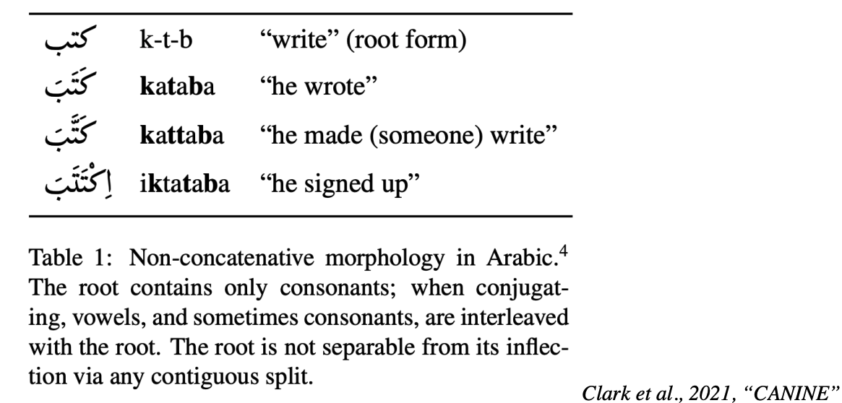
Limitations of Subwords
Hard to apply to languages with agglutinative (e.g., Turkish) or non-concatenative (e.g., Arabic) morphology

Slide 60
Other Subword Encodings
WordPiece (Schuster & Nakajima, ICASSP 2012): merge by likelihood as measured by language model, not by frequency
While voc size < target:
Build a language model over your corpus
Merge tokens that lead to highest improvement in LM perplexity
Issues: What LM to use? How to make it tractable?
[ Shuster & Nakajima 2012; Wu et al. 2016]

Slide 61
Other Subword Encodings (2)
SentencePiece (Kudo et al., 2018):
A more advanced tokenized extending BPE
Good for languages that don’t always separate words w/ spaces.
https://github.com/google/sentencepiece
[SentencePiece, Kudo & Richardson 2018]

Slide 62
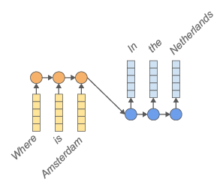
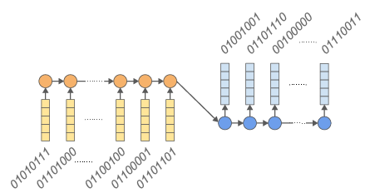
Other Subword Encodings (3)
Use byte representation of words
E.g., H -> 01010111
Vocabulary size: 2^8=256
Limitation: sequence length
[Byte-level machine reading across morphologically varied languages, Kenter et al. 2018; ByT5: Towards a Token-Free Future with Pre-trained Byte-to-Byte Models, Xue at al. 2021, and several others]

Slide 63
Summary
Fundamental question: what should be the atomic unit of representation?
Words: too coarse
Characters: too small
Subwords:
A useful representational choice for language.
Capture language morphology

