Slide 1
Large Language Models
CSCI 601 471/671
NLP: Self-Supervised Models
https://self-supervised.cs.jhu.edu/sp2023/
[Slide credit: Chris Tanner, Jacob Devlin and many others ]

Slide 2
Logistics Update
The midterm:
will be on March 7 during class time.
I will not be here; Adam (TA) will run the show.
it will be on paper
It will be based on the ideas you have seen in homework and lectures. If you understand them, you’re set!
Scope HW 1-5 and lectures until last Thursday (Feb 23)

Slide 3
Recap: Self-Attention
$b^{i}$ is obtained based on the whole input sequence.
can be parallelly computed.
$$b^{1}$$
$$b^{2}$$
$$b^{3}$$
$$b^{4}$$
$$b^{1}$$
$$b^{2}$$
$$b^{3}$$
$$b^{4}$$
RNN
Self-Attention Layer
$$x^{1}$$
$$x^{2}$$
$$x^{3}$$
$$x^{4}$$
$$x^{1}$$
$$x^{2}$$
$$x^{3}$$
$$x^{4}$$
Idea: replace any thing done by RNN with self-attention.
“Neural machine translation by jointly learning to align and translate” Bahdanau etl. 2014; “Attention is All You Need” Vaswani et al. 2017
[adopted from Hung-yi Lee]

Slide 4
Recap: RNN vs Transformer

Slide 5
Recap: Attention Block
Given input $x$:
$$Q=W^{q}x$$
$$K=W^{k}x$$
$$V=W^{v}x$$
$$Attention(x)=softmax\left(\frac{{QK}^{T}}{√h}\right)V$$
[Attention Is All You Need, Vaswani et al. 2017]

Slide 6
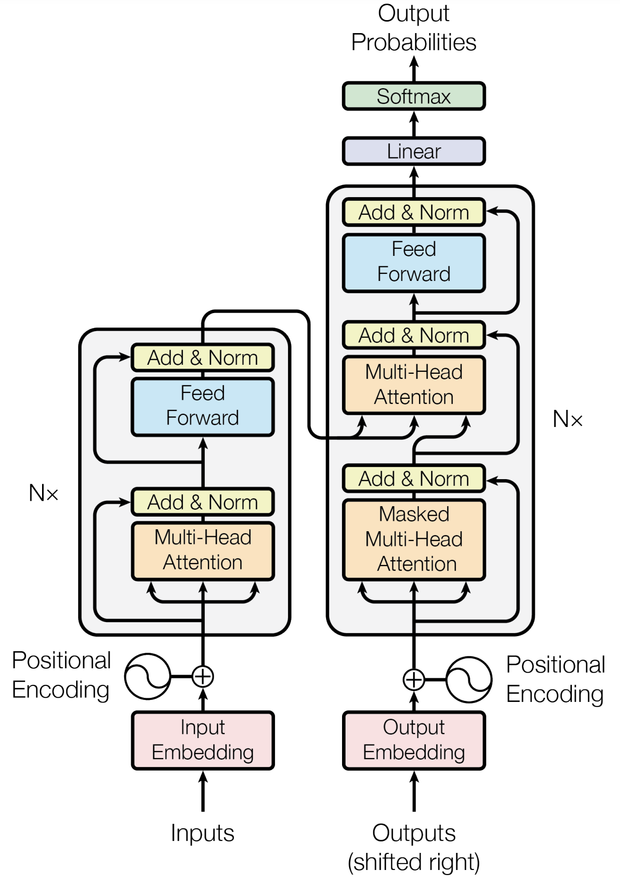
Recap: Transformer [Vaswani et al. 2017]
An encoder-decoder architecture
3 forms of attention
[Attention Is All You Need, Vaswani et al. 2017]

Slide 7
Llamma model:
https://github.com/facebookresearch/llama/blob/main/llama/model.py#L178-L195

Slide 8
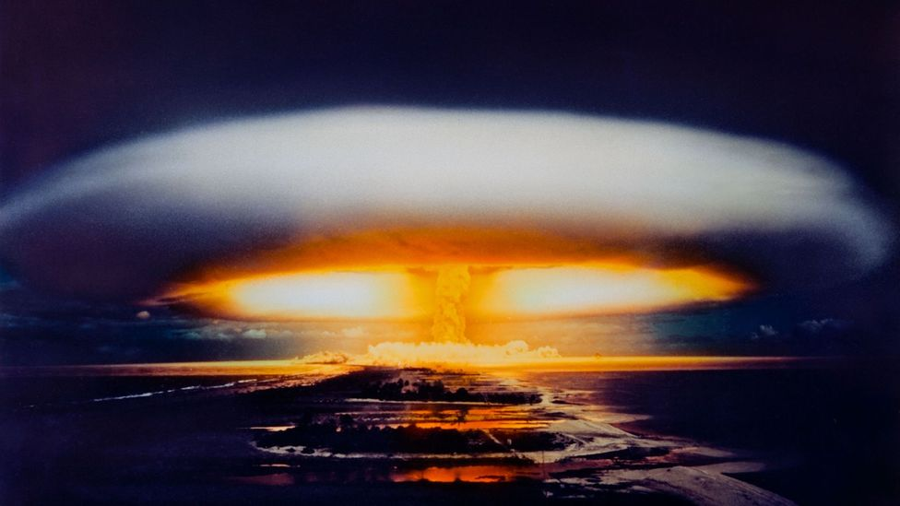
After Transformer …

Slide 9
Notes:
https://arxiv.org/pdf/2106.04554.pdf

Slide 10
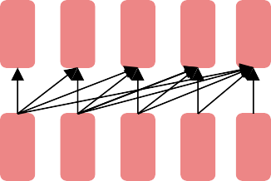
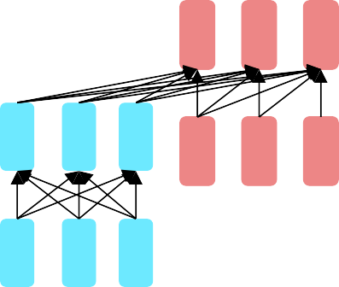
Impact of Transformers
A building block for a variety of LMs
Examples: BERT, RoBERTa, SciBERT.
Captures bidirectional context. Wait, how do we pretrain them?
Encoders
Examples: GPT-2, GPT-3, LaMDA
Other name: causal or auto-regressive language model
Nice to generate from; can’t condition on future words
Decoders
Encoder-
Decoders
Examples: Transformer, T5, Meena
What’s the best way to pretrain them?

Slide 11
BERT
Encoders

Slide 12
BERT
Bidirectional Encoder Representations from Transformers

Slide 13
BERT
Bidirectional
Encoder Representations from Transformers
Like Bidirectional LSTMs (ELMo), let’s look in both directions

Slide 14
BERT
Bidirectional
Encoder
Representations from
Transformers
Let’s only use Transformer Encoders, no Decoders

Slide 15
BERT
Bidirectional Encoder
Representations
from Transformers
It’s a language model that builds rich representations
via self-supervised learning (pre-training)

Slide 16
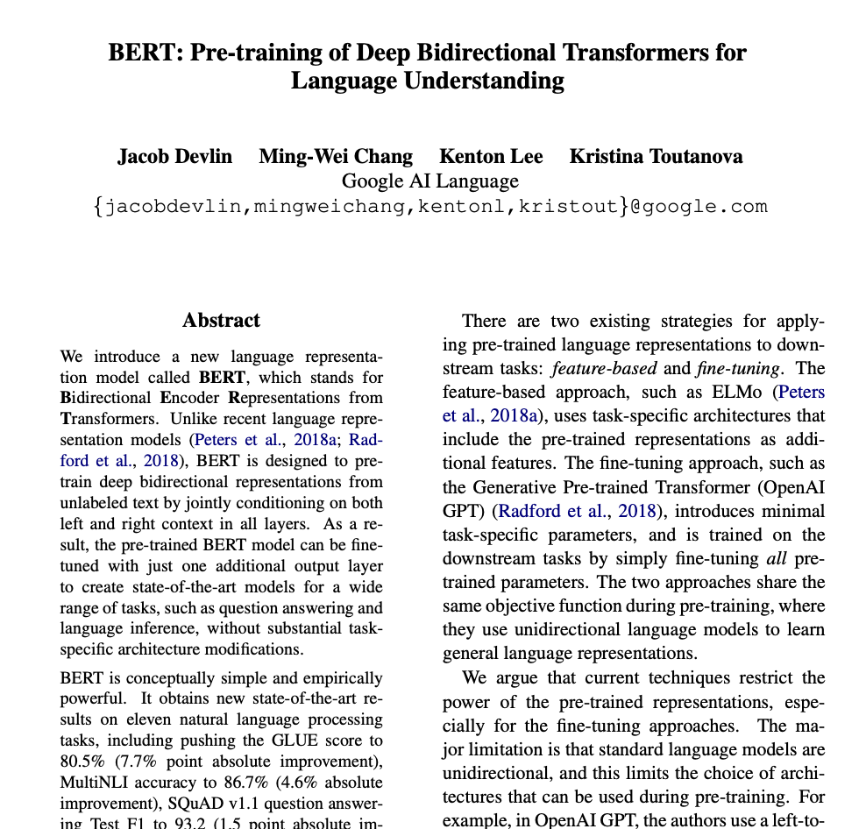
BERT (2018)
Transformer based network to learn representations of language
Improvements
Bi-directional LSTM -> Self-attention
Massive data
Masked-LM objective

Slide 17
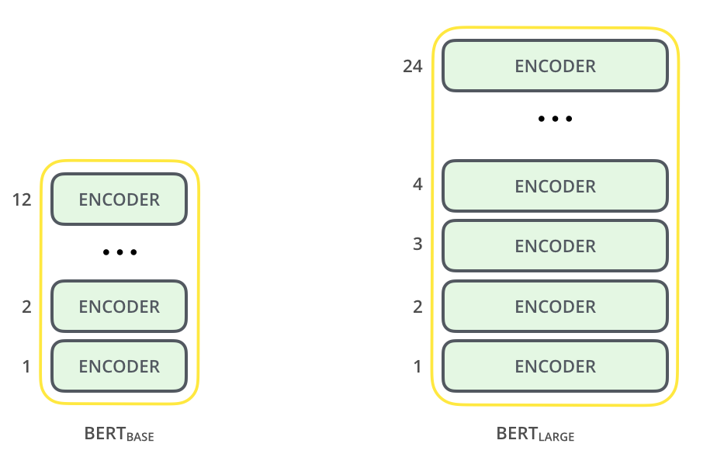
BERT: Architecture
Stacks of Transformer encoders”
[BERT: Pre-training of Deep Bidirectional Transformers for Language Understanding, Devlin et al. 2018]

Slide 18
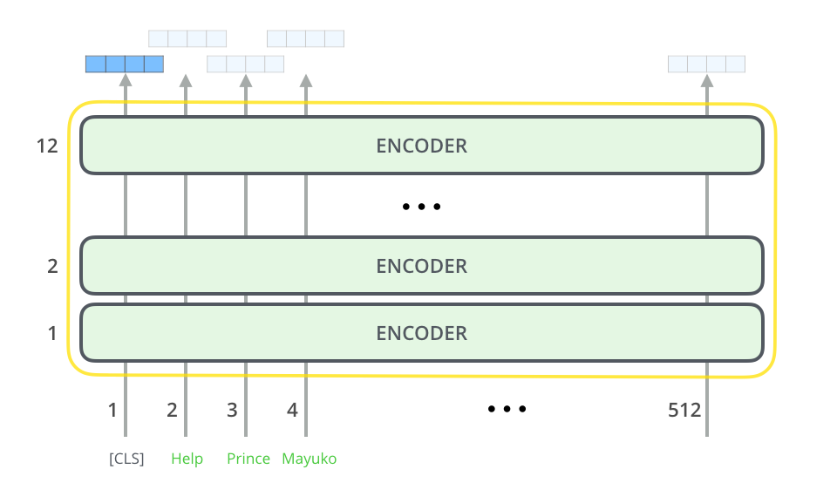
BERT: Architecture
Model output dimension: 512
[BERT: Pre-training of Deep Bidirectional Transformers for Language Understanding, Devlin et al. 2018]

Slide 19
brown 0.92
lazy 0.05
playful 0.03
BERT
BERT is trained to uncover masked tokens.
Encoder #12
Encoder #2
Encoder #1
<CLS>
x₁
The
x₂
brown dog
x₃ x₄
38

Slide 20
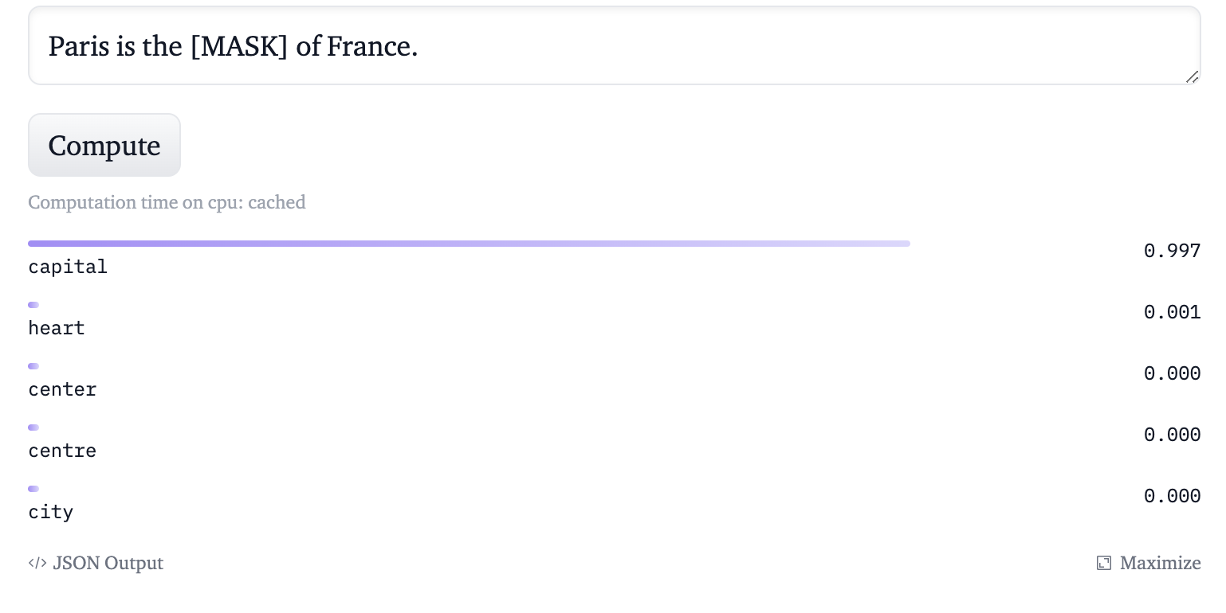
Probing BERT Masked LM
Making words forces BERT to use context in both directions to predict the masked word.
https://huggingface.co/bert-base-uncased

Slide 21
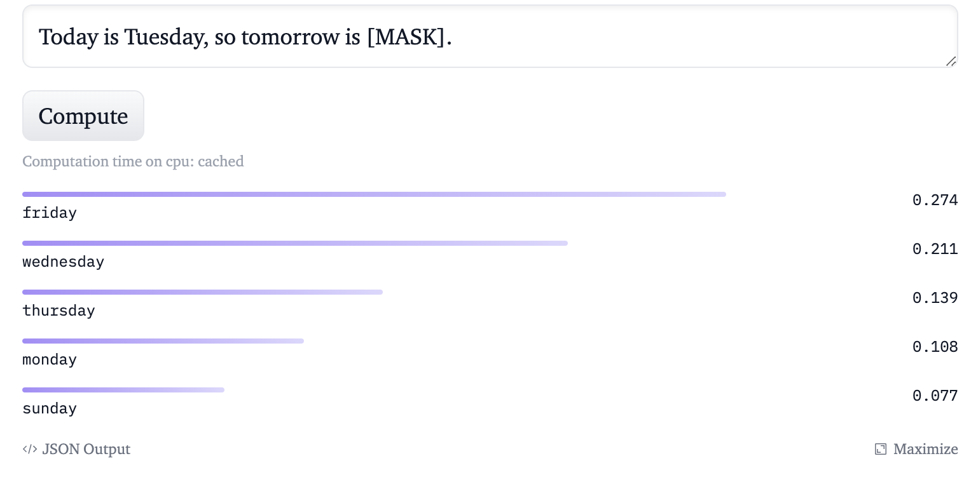
Probing BERT Masked LM
Making words forces BERT to use context in both directions to predict the masked word.
https://huggingface.co/bert-base-uncased

Slide 22
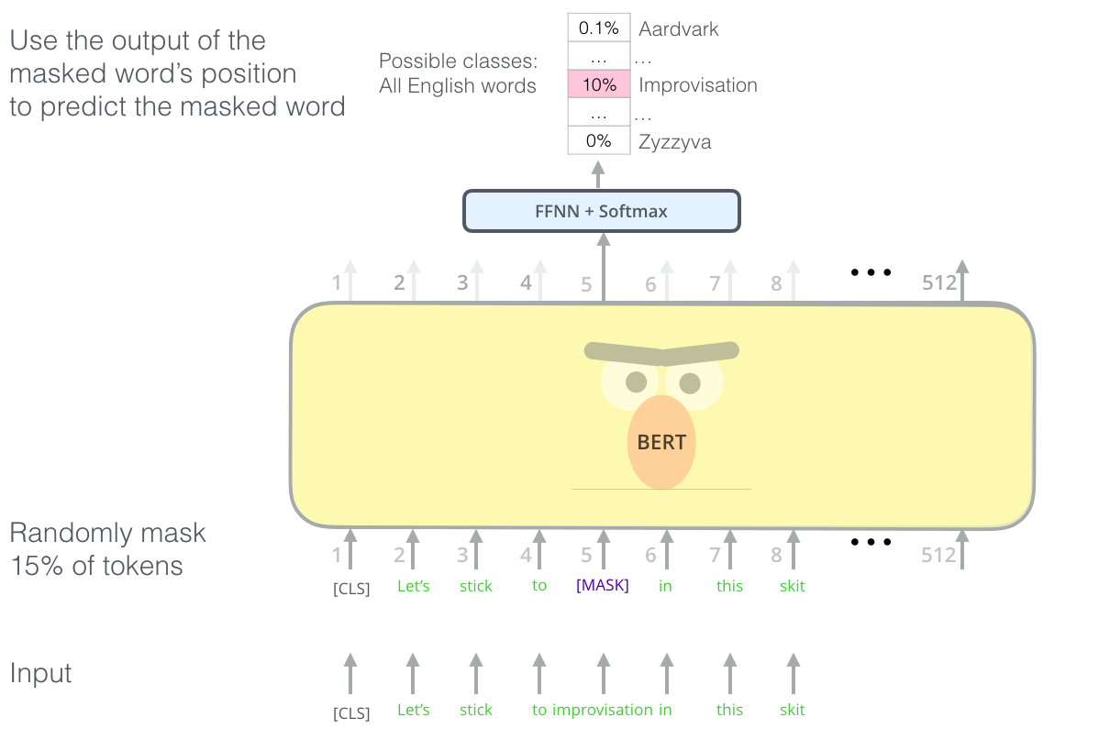
BERT: Pre-training Objective (1): Masked Tokens
Randomly mask 15% of the tokens and train the model to predict them.
[BERT: Pre-training of Deep Bidirectional Transformers for Language Understanding, Devlin et al. 2018]

Slide 23
BERT: Pre-training Objective (1): Masked Tokens
the man went to the [MASK] to buy a [MASK] of milk
Too little masking: Too expensive to train
Too much masking: Underdefined (not enough context)
store
Galon
[BERT: Pre-training of Deep Bidirectional Transformers for Language Understanding, Devlin et al. 2018]

Slide 24
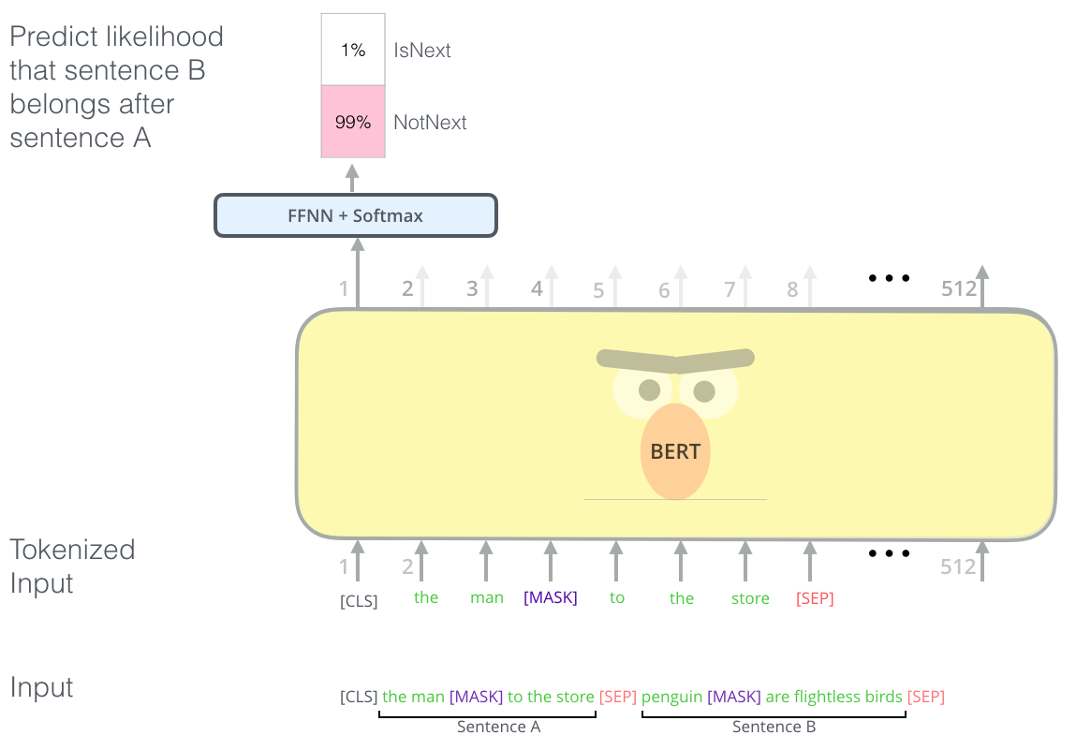
BERT: Pre-training Objective (2): Sentence Ordering
Predict sentence ordering
50% correct ordering, and 50% random incorrect ones
[BERT: Pre-training of Deep Bidirectional Transformers for Language Understanding, Devlin et al. 2018]

Slide 25
BERT: Pre-training Objective (2): Sentence Ordering
Learn relationships between sentences, predict whether Sentence B is actual sentence that proceeds Sentence A, or a random sentence
[BERT: Pre-training of Deep Bidirectional Transformers for Language Understanding, Devlin et al. 2018]

Slide 26
BERT
brown 0.92
lazy 0.05
playful 0.03
BERT has 2 training objectives:
BERT
1.
Predict the Masked word (a la CBOW)
Encoder #6
15% of all input words are randomly masked.
80% become [MASK]
10% become revert back
10% become are deliberately corrupted as wrong words
Encoder #2
Encoder #1
<CLS>
x₁
The
x₂
brown dog
x₃ x₄
39

Slide 27
BERT
BERT has 2 training objectives:
isNext _{0.98}
notNext _{0.02}
2.
Two sentences are fed in
BERT
at a time. Predict the if the
Encoder #6
second sentence of input truly follows the first one or not.
Encoder #2
Encoder #1
<CLS>
x₁
The
x₂
brown
x₃
dog
x₄
ran […] [SEP] Fido came home [SEP]
40

Slide 28
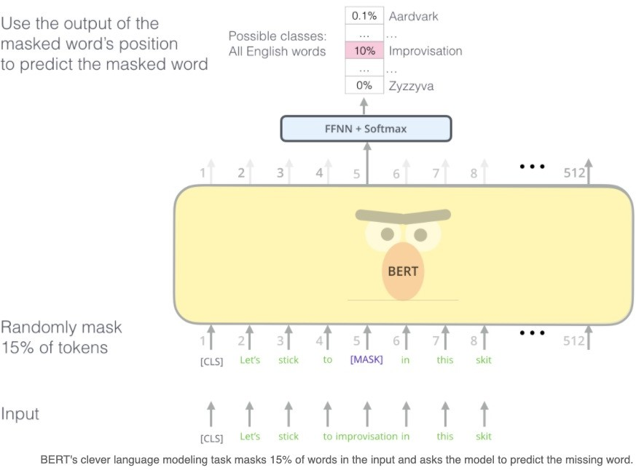
BERT (alternate view)
https://jalammar.github.io/illustrated-bert/

Slide 29
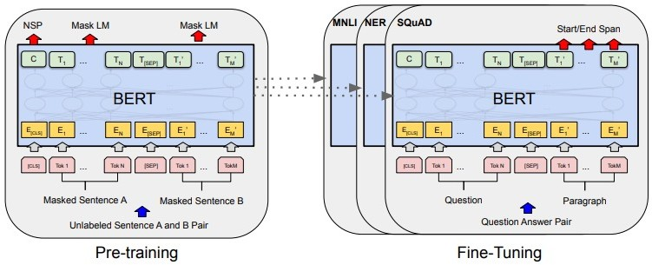
BERT
The two sentences are separated by a <SEP> token.
50% of the time, the 2nd sentence is a randomly selected sentence from the corpus.
50% of the time, it truly follows the first sentence in the corpus.
Source: original BERT paper: https://arxiv.org/pdf/1810.04805.pdf

Slide 30
BERT
NOTE: BERT also embeds the inputs
by their
WordPiece
embeddings.
WordPiece is a sub-word tokenization learns to merge and use characters based on which pairs maximize the likelihood of the training data if added to the vocab.
Source: original BERT paper: https://arxiv.org/pdf/1810.04805.pdf

Slide 31
BERT: Input Representation
Use 30,000 WordPiece vocabulary on input.
Each token is sum of three embeddings
Addition to transformer encoder: sentence embedding
[BERT: Pre-training of Deep Bidirectional Transformers for Language Understanding, Devlin et al. 2018]

Slide 32
Training
Trains model on unlabeled data over different pre-training tasks (self-supervised learning)
Data: Wikipedia (2.5B words) + BookCorpus (800M words)
Training Time: 1M steps (~40 epochs)
Optimizer: AdamW, 1e-4 learning rate, linear decay
BERT-Base: 12-layer, 768-hidden, 12-head
BERT-Large: 24-layer, 1024-hidden, 16-head
Trained on 4x4 or 8x8 TPUs for 4 days
[BERT: Pre-training of Deep Bidirectional Transformers for Language Understanding, Devlin et al. 2018]

Slide 33
BERT in Practice

Slide 34
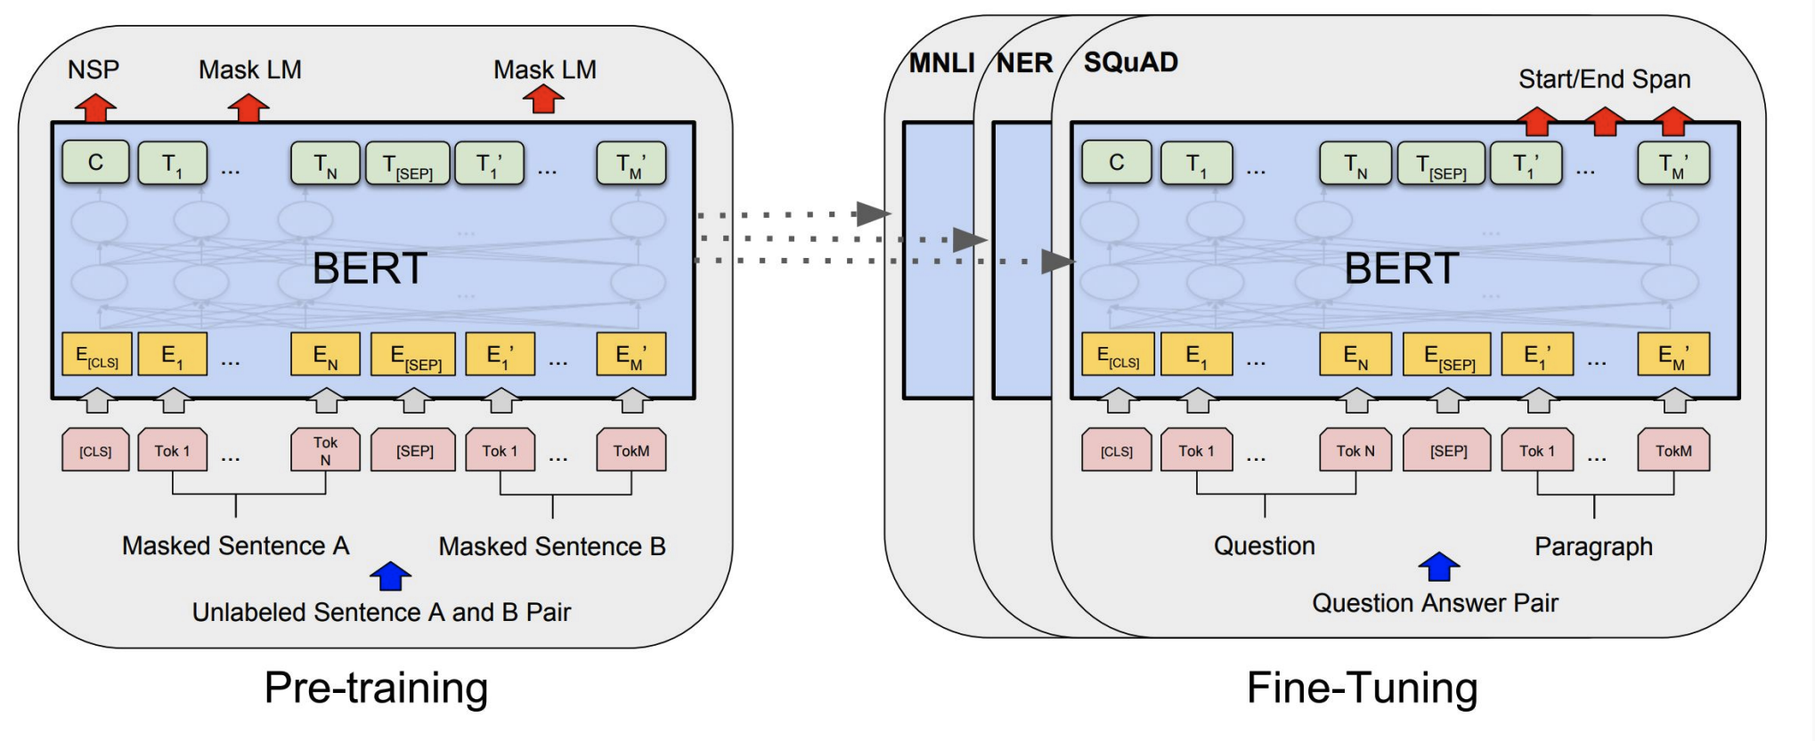
Fine-tuning BERT
“Pretrain once, finetune many times.”
Idea: Make pre-trained model usable in downstream tasks
Initialized with pre-trained model parameters
Fine-tune model parameters using labeled data from downstream tasks
[BERT: Pre-training of Deep Bidirectional Transformers for Language Understanding, Devlin et al. 2018]

Slide 35
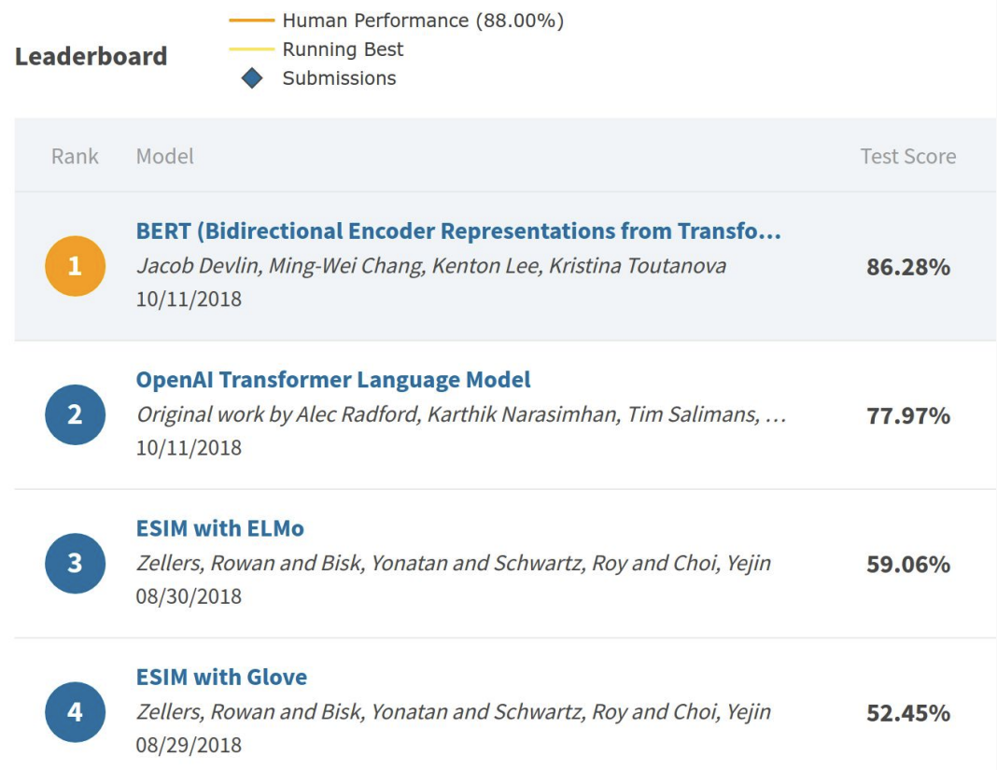
An Example Result: SWAG
Run each Premise + Ending through BERT.
Produce logit for each pair on token 0 ([CLS])
[BERT: Pre-training of Deep Bidirectional Transformers for Language Understanding, Devlin et al. 2018]

Slide 36
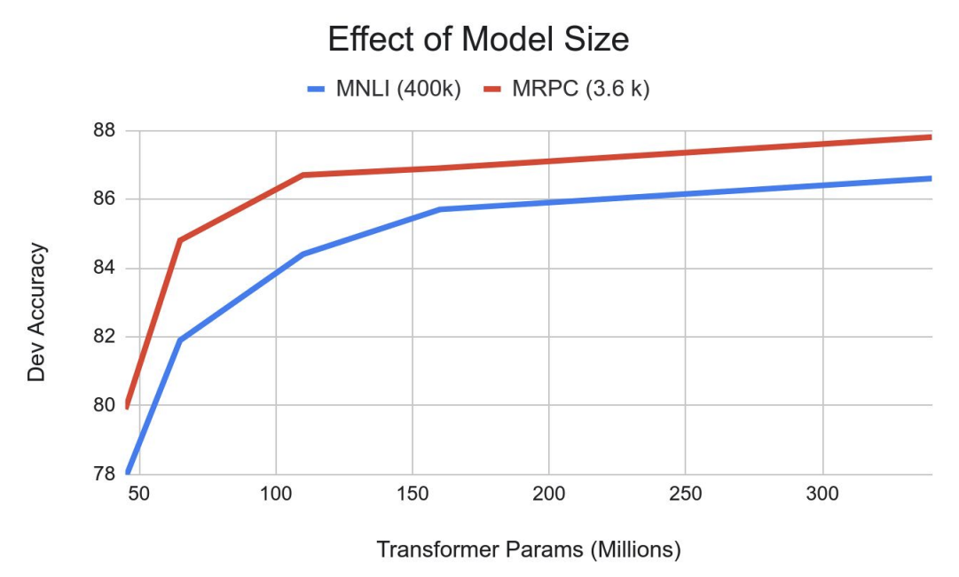
Effect of Model Size
Big models help a lot
Going from 110M -> 340M params helps even on datasets with 3,600 labeled examples
Improvements have not asymptoted
[BERT: Pre-training of Deep Bidirectional Transformers for Language Understanding, Devlin et al. 2018]

Slide 37
Why did no one think of this before?
Concretely, why wasn’t contextual pre-training popular before 2018 with ELMo?
Good results on pre-training is >1,000x to 100,000 more expensive than supervised training.

Slide 38
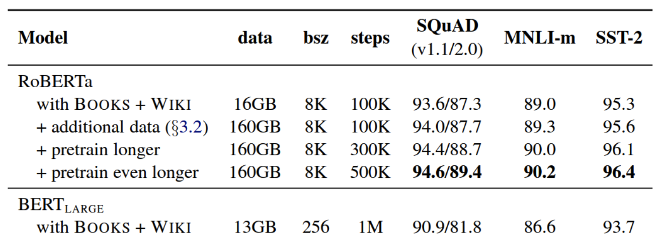
What Happened After BERT?
RoBERTa (Liu et al., 2019)
Drops the next sentence prediction loss!
Trained on 10x data (the original BERT was actually under-trained)
Much stronger performance than BERT (e.g., 94.6 vs 90.9 on SQuAD)
Still one of the most popular models to date

Slide 39
What Happened After BERT?
RoBERTa (Liu et al., 2019)
Drops the next sentence prediction loss!
Trained on 10x data (the original BERT was actually under-trained)
Much stronger performance than BERT (e.g., 94.6 vs 90.9 on SQuAD)
Still one of the most popular models to date
ALBERT (Lan et al., 2020)
Increasing model sizes by sharing model parameters across layers
Less storage, much stronger performance but runs slower..
ELECTRA (Clark et al., 2020)
Two models generator and discriminator
It provides a more efficient training method

Slide 40
What Happened After BERT?
Models that handle long contexts ( 512 tokens)
Longformer, Big Bird, …
Multilingual BERT
Trained single model on 104 languages from Wikipedia. Shared 110k WordPiece vocabulary
BERT extended to different domains
SciBERT, BioBERT, FinBERT, ClinicalBERT, …
Making BERT smaller to use
DistillBERT, TinyBERT, …

Slide 41
Text generation using BERT

Slide 42
Summary Thus Far
BERT and the family
An encoder; Transformer-based networks trained on massive piles of data.
Incredible for learning contextualized embeddings of words
It’s very useful to pre-train a large unsupervised/self-supervised LM then fine-tune on your particular task (replace the top layer, so that it can work)
However, they were not designed to generate text.

