Slide 1
In-context Learning
CSCI 601 471/671
NLP: Self-Supervised Models
https://self-supervised.cs.jhu.edu/sp2023/
[Slide credit: Iz Beltagy, Arman Cohan, Robert Logan IV, Sewon Min, Sameer Singh, and many others ]

Slide 2
Logistics
HW6: The Struggles … ☹
HW7 will be the last homework! ☺
Projects
Do you have an idea yet?
Do you have teammate(s) already?
Have you looked at the deck of ideas I shared yet?
Project proposal deadline: Thu Mar 16
Should we push it back? Alternative: Tue Mar 28

Slide 3
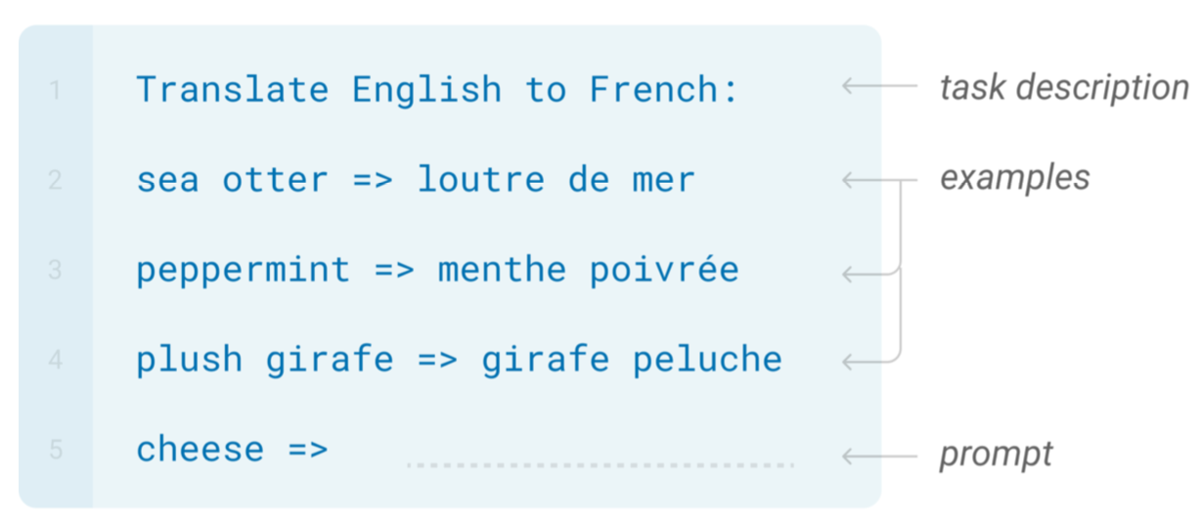
In-Context Learning

Slide 4
In-Context Learning
Learns to do a downstream task by conditioning on input-output examples!
No weight update — our model is not explicitly pre-trained to learn from examples
The underlying models are quite general
Today’s focus:
How to use effectively in practice?
Fundamentally, why does it work?

Slide 5
Why Do We Care About Few-Shot Learning?
Practically Useful
Intellectually Intriguing
[ACL 2022 Tutorial Beltagy, Cohan, Logan IV, Min and Singh]

Slide 6
Practically Useful
Labeling data is costly
May require domain expertise
Medical, legal, ﬁnancial
Inputs may be long/complex
Grammaticality
Outputs may be complex
Semantic parsing
[ACL 2022 Tutorial Beltagy, Cohan, Logan IV, Min and Singh; quote credit: Colin Raffel]

Slide 7
Practically Useful
Labeling data is costly
You want to do best with what you have
You don’t want to get more data
Emergent, time-sensitive scenarios
Something new happened
Need to react quickly!
[ACL 2022 Tutorial Beltagy, Cohan, Logan IV, Min and Singh]

Slide 8
Practically Useful
Labeling data is costly
You want to do best with what you have
Training is sensitive to hyperparams
Not enough validation data
We don’t quite understand how finetuning works
Finetuning can unstable
[ACL 2022 Tutorial Beltagy, Cohan, Logan IV, Min and Singh]

Slide 9
Practically Useful
Labeling data is costly
You want to do best with what you have Finetuning can be unstable
Finetuning large LMs is expensive
Expensive to train, time and memory
[ACL 2022 Tutorial Beltagy, Cohan, Logan IV, Min and Singh]

Slide 10
Intellectually Intriguing
Potential test for “Intelligent Behavior”
Generalization from few examples
Fundamental piece of intelligence
Often used in psychology
Quickly adjust to environment
[ACL 2022 Tutorial Beltagy, Cohan, Logan IV, Min and Singh]

Slide 11
Intellectually Intriguing
Potential test for “Intelligent Behavior”
“But… Deep learning is data hungry!”
Long-standing criticism of DL
Understand why it doesn’t work here
Or does it?
What are the new limitations of DL?
[ACL 2022 Tutorial Beltagy, Cohan, Logan IV, Min and Singh]

Slide 12
Intellectually Intriguing
Potential test for “Intelligent Behavior”
“But… Deep learning is data hungry!”
What does an LLM “know”?
What are the biases/limitations of LLMs?
…
Insights into Language Modeling
[ACL 2022 Tutorial Beltagy, Cohan, Logan IV, Min and Singh]

Slide 13
Intellectually Intriguing
Potential test for “Intelligent Behavior”
“But… Deep learning is data hungry!” Insights into Language Modeling
Training/inference/access is tough
What else can we do? ;)
Because LARGE language models
[ACL 2022 Tutorial Beltagy, Cohan, Logan IV, Min and Singh]

Slide 14
The Broader Context: Supervised Learning
[ACL 2022 Tutorial Beltagy, Cohan, Logan IV, Min and Singh]

Slide 15
The Broader Context: Semi-Supervised Learning
[ACL 2022 Tutorial Beltagy, Cohan, Logan IV, Min and Singh]

Slide 16
The Broader Context: [Traditional] Few-shot Learning
[ACL 2022 Tutorial Beltagy, Cohan, Logan IV, Min and Singh]

Slide 17
The Broader Context: [Modern] Few-shot Learning
[ACL 2022 Tutorial Beltagy, Cohan, Logan IV, Min and Singh]

Slide 18
In-Context Prompting
Movie review dataset
Input: An effortlessly accomplished and richly resonant work.
Label: positive
Input: A mostly tired retread of several other mob tales.
Label: negative
An effortlessly accomplished and richly resonant work. It was great! A mostly tired retread of several other mob tales. It was terrible!
A three-hour cinema master class. It was
Language Model
p1 = P(It was great! | 1st train input+output \n 2nd train input+output \n A three-hour cinema master class.)
p2 = P(It was terrible! | 1st train input+output \n 2nd train input+output \n A three-hour cinema master class.)
p1>p2
p1<p2
“positive” “negative”
[ACL 2022 Tutorial Beltagy, Cohan, Logan IV, Min and Singh]

Slide 19
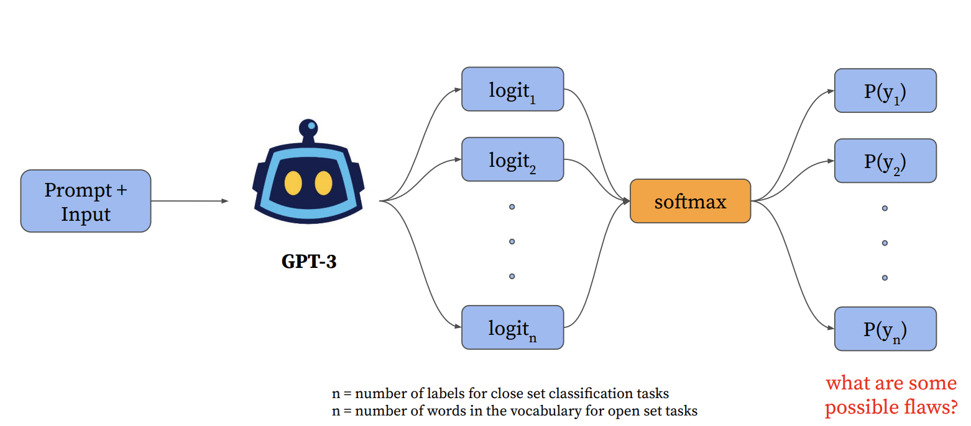
LM Prompting
[Slide credit: Howard Yen, Vishvak Murahari]

Slide 20
LM Prompting: Choices of Encoding
[Slide credit: Eric Wallace]

Slide 21
LM Prompting: Choices of Encoding
[Slide credit: Eric Wallace]

Slide 22
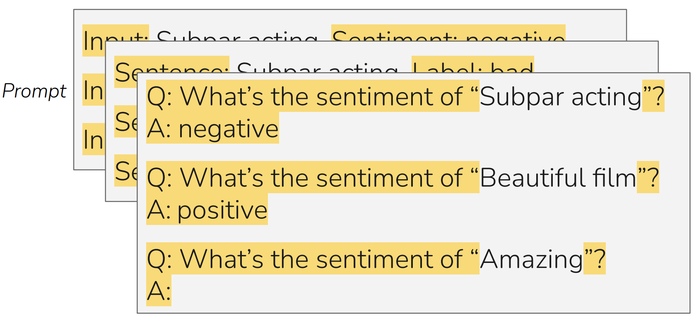
LM Prompting: Choices of Encoding
[Slide credit: Eric Wallace]

Slide 23
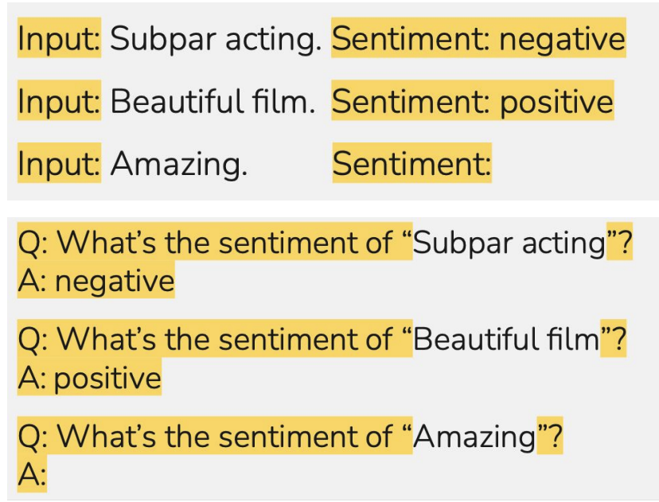
LM Prompting: Choices of Encoding
Pattern: A function that encodes the inputs.
Verbalizer: A function that encodes the output.
Pattern: f(<x>) = “Input: <x>"
Verbalizer: v(<x>)) = “Label: <x>)”
Pattern: f(<x>) = “Q: What is the sentiment of <x>”
Verbalizer: v(<x>) = “A: <x>”
[Slide credit: Eric Wallace]

Slide 24
In-Context Learning: Sensitivity to Encoding
[Slide credit: Eric Wallace]
In-context learning is highly sensitive to prompt format (training sets and patterns/verbalizers)
[“Calibrate Before Use: Improving Few-Shot Performance of Language Models.” Zhao et al. 2021]

Slide 25
In-Context Learning: Sensitivity to Demo. Permutations
[Slide credit: Eric Wallace]
Training Set #1

Slide 26
In-Context Learning: Sensitivity to Demo. Permutations
[Slide credit: Eric Wallace]
Example #1
Example #2
Example #3
Example #4
Training Set #1

Slide 27
In-Context Learning: Sensitivity to Demo. Permutations
[Slide credit: Eric Wallace]
Example #1
Example #2
Example #3
Example #4
Example #2
Example #1
Example #3
Example #4
Example #4
Example #3
Example #2
Example #1
...
Prompt #1
Prompt #2
Prompt #24
All 24 Permutations
Example #1
Example #2
Example #3
Example #4
Training Set #1

Slide 28
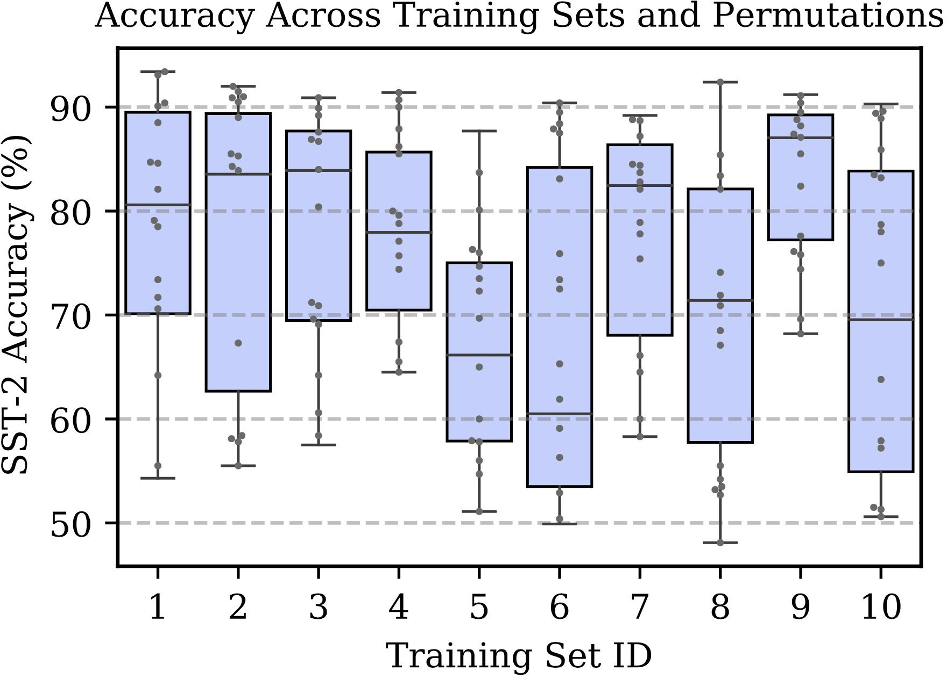
In-Context Learning: Sensitivity to Demo. Permutations
[Slide credit: Eric Wallace]
Example #1
Example #2
Example #3
Example #4
Example #2
Example #1
Example #3
Example #4
Example #4
Example #3
Example #2
Example #1
...
Prompt #1
Prompt #2
Prompt #24
All 24 Permutations
Example #1
Example #2
Example #3
Example #4
In-context learning is highly sensitive to prompt format (training sets and patterns/verbalizers)
Training Set #1
[“Calibrate Before Use: Improving Few-Shot Performance of Language Models.” Zhao et al. 2021]

Slide 29
In-Context Learning: Sensitivity to Demo. Permutations
[Slide credit: Eric Wallace]
Example #1
Example #2
Example #3
Example #4
Example #2
Example #1
Example #3
Example #4
Example #4
Example #3
Example #2
Example #1
...
Prompt #1
Prompt #2
Prompt #24
All 24 Permutations
Example #1
Example #2
Example #3
Example #4
Training Set #1
Training Set #2
[“Calibrate Before Use: Improving Few-Shot Performance of Language Models.” Zhao et al. 2021]

Slide 30
In-Context Learning: Sensitivity to Demo. Permutations
[Slide credit: Eric Wallace]
Example #1
Example #2
Example #3
Example #4
Example #2
Example #1
Example #3
Example #4
Example #4
Example #3
Example #2
Example #1
...
Prompt #1
Prompt #2
Prompt #24
All 24 Permutations
Example #1
Example #2
Example #3
Example #4
The choice of demonstrations and their order is quite important.
Training Set #1
Training Set #2
...
Training Set #10
[“Calibrate Before Use: Improving Few-Shot Performance of Language Models.” Zhao et al. 2021]

Slide 31
Sensitivity to Wording (Framing) of Prompts
Framing of prompts matters a lot.
Craft a question that requires commonsense to be answered. Based on the given context, craft a common-sense question, especially those that are LONG, INTERESTING, and COMPLEX. The goal is to write questions that are easy for humans and hard for AI machines! To create such questions, here are some suggestions: A. What may (or may not) be the plausible reason for an event? B. What may (or may not) happen before (or after, or during) an event? ...
Generate questions such that you use - ‘what may happen’, - ‘will ...?’, - ‘why might’, - ‘what may have caused’, - ‘what may be true about’,
- ‘what is probably true about’, - ‘what must’ and similar phrases in your question based on the input context.
[“Reframing Instructional Prompts to GPTk's Language.” Mishra et al. 2021.]

Slide 32
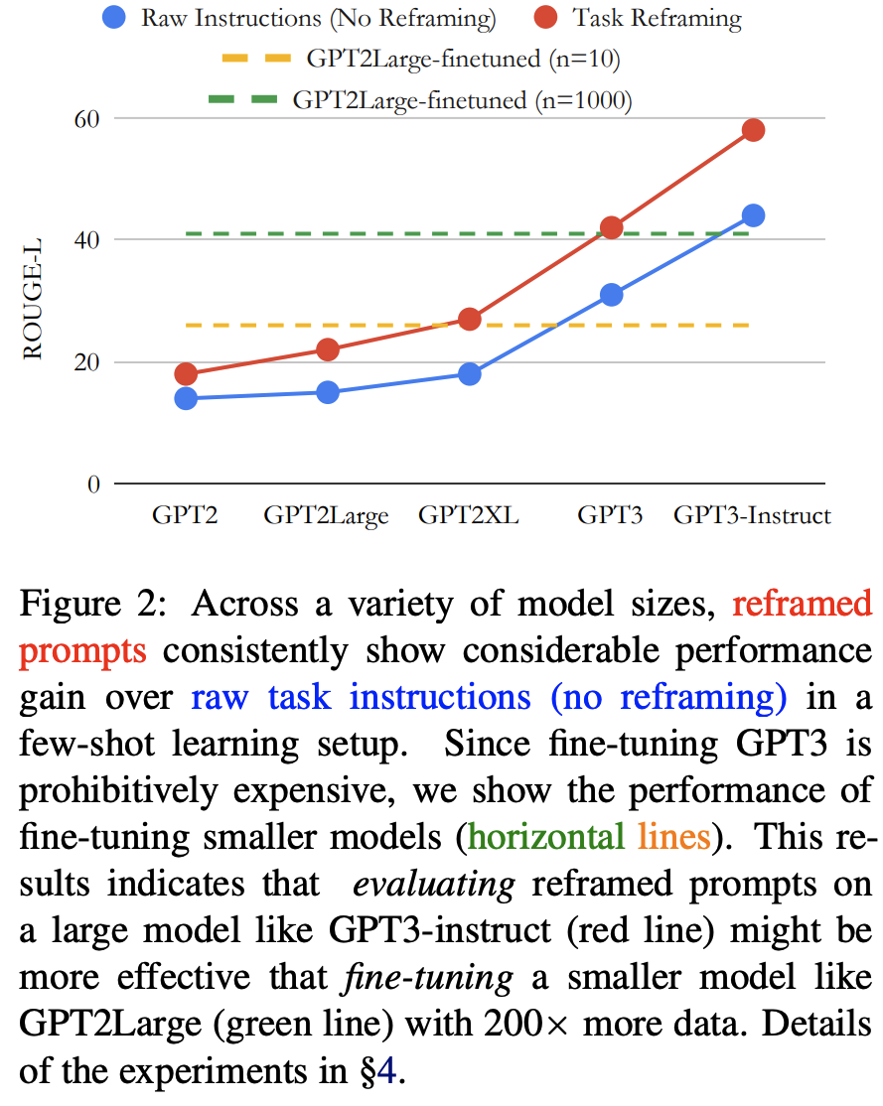
Sensitivity to Wording (Framing) of Prompts
Prompts can often be phrased in a language that are easier to be understood by language models.
Generally, it is easier for LMs to follow shorter, crisp, itemized prompts.
[“Reframing Instructional Prompts to GPTk's Language.” Mishra et al. 2021.]

Slide 33
Summary Thus Far
There are many possible ways to encode in-context examples of a fixed task
Many possible patterns/verbalizers
The choice of demonstrations
Ordering of the examples
….
It turns out there is a huge variance in performance depending on the encoding.
You can treat them as hyper-parameters
You should not choose these encodings based on the test data.
Generally, it is better to use encoding that makes the sequence closer to language modeling — closer to what is observed during pretraining.

Slide 34
What Causes These Variances?
Here we will provide several justifications …

Slide 35
Majority Label Bias

Slide 36
Majority Label Bias
Frequency of Positive Predictions
4/4
Positive
3/4
Positive
2/4
Positive
1/4
Positive
0/4
Positive
[“Calibrate Before Use: Improving Few-Shot Performance of Language Models.” Zhao et al. 2021]

Slide 37
Majority Label Bias
Frequency of Positive Predictions
100
56
37
20
0
4/4
Positive
3/4
Positive
2/4
Positive
1/4
Positive
0/4
Positive
[“Calibrate Before Use: Improving Few-Shot Performance of Language Models.” Zhao et al. 2021]

Slide 38
Majority Label Bias
Frequency of Positive Predictions
100
56
37
20
0
4/4
Positive
3/4
Positive
2/4
Positive
1/4
Positive
0/4
Positive
Majority label bias: frequent training answers dominate predictions
Explain some of the variances across example selections

Slide 39
Recency Bias

Slide 40
Recency Bias
Frequency of Positive Predictions
NPPP
PNPP
PPNP
PPPN

Slide 41
Recency Bias
Frequency of Positive Predictions
90
62
60
12
NPPP
PNPP
PPNP
PPPN
[“Calibrate Before Use: Improving Few-Shot Performance of Language Models.” Zhao et al. 2021]

Slide 42
Recency Bias
Frequency of Positive Predictions
90
62
60
12
NPPP
PNPP
PPNP
PPPN
Recency bias: examples near end of prompt dominate predictions
Explains variance across example permutations

Slide 43
Common Token Bias

Slide 44
Common Token Bias
Language Model
What topic is the following text about?
The Model T was released by Ford in 1908. Answer:
Prompt

Slide 45
Common Token Bias
Token
Prob
Language Model
book | 0.35
transportation | 0.23
school | 0.11
village | 0.03
company | 0.02
What topic is the following text about?
The Model T was released by Ford in 1908. Answer:
Prompt
Model is biased towards predicting the incorrect frequent token "book" even when both "book" and "transportation" are equally likely labels in the dataset
Common token bias: common n-grams dominate predictions
helps explain variance across prompt formats

Slide 46
Calibrating LM Probabilities
[Slide credit: Howard Yen, Vishvak Murahari]

Slide 47
Calibrating LM Probabilities
Step 1: Estimate the bias

Slide 48
Calibrating LM Probabilities
Step 1: Estimate the bias
Insert “content-free” test input into prompt
Input: Subpar acting. Sentiment: negative Input: Beautiful ﬁlm. Sentiment: positive Input: Sentiment:
N/A

Slide 49
Calibrating LM Probabilities
Step 1: Estimate the bias
Insert “content-free” test input into prompt
Input: Subpar acting. Sentiment: negative Input: Beautiful ﬁlm. Sentiment: positive Input: Sentiment:
N/A
Get model’s prediction
positive | 0.65
negative | 0.35

Slide 50
Calibrating LM Probabilities
Step 1: Estimate the bias Step 2: Counter the bias
Insert “content-free” test input into prompt
Input: Subpar acting. Sentiment: negative Input: Beautiful ﬁlm. Sentiment: positive Input: Sentiment:
N/A
Get model’s prediction
positive | 0.65
negative | 0.35

Slide 51
Calibrating LM Probabilities
Step 1: Estimate the bias Step 2: Counter the bias
(“Platt Scaling”)
Insert “content-free” test input into prompt
“Calibrate” predictions with afﬁne transformation
Input: Subpar acting. Sentiment: negative Input: Beautiful ﬁlm. Sentiment: positive Input: Sentiment:
N/A
Get model’s prediction
positive | 0.65
negative | 0.35
[“Calibrate Before Use: Improving Few-Shot Performance of Language Models.” Zhao et al. 2021]

Slide 52
Calibrating LM Probabilities
Step 1: Estimate the bias Step 2: Counter the bias
(“Platt Scaling”)
Insert “content-free” test input into prompt
“Calibrate” predictions with afﬁne transformation
Input: Subpar acting. Sentiment: negative Input: Beautiful ﬁlm. Sentiment: positive Input: Sentiment:
N/A
Calibrated probs
Original probs
Get model’s prediction
positive | 0.65
negative | 0.35
[“Calibrate Before Use: Improving Few-Shot Performance of Language Models.” Zhao et al. 2021]

Slide 53
Calibrating LM Probabilities
Step 1: Estimate the bias Step 2: Counter the bias
(“Platt Scaling”)
Insert “content-free” test input into prompt
“Calibrate” predictions with afﬁne transformation
Input: Subpar acting. Sentiment: negative Input: Beautiful ﬁlm. Sentiment: positive Input: Sentiment:
N/A
Calibrated probs
Original probs
Fit and to so that outputs for the content-free input are uniform
Get model’s prediction
positive | 0.65
negative | 0.35
[“Calibrate Before Use: Improving Few-Shot Performance of Language Models.” Zhao et al. 2021]

Slide 54
Calibrating LM Probabilities
Step 1: Estimate the bias Step 2: Counter the bias
(“Platt Scaling”)
Note, this calibration does not require any labeled data.
Classification tasks: normalized scores of labels
Generation tasks: probabilities of the first token of the generation over the entire vocabulary
Insert “content-free” test input into prompt
“Calibrate” predictions with afﬁne transformation
Input: Subpar acting. Sentiment: negative Input: Beautiful ﬁlm. Sentiment: positive Input: Sentiment:
N/A
Calibrated probs
Original probs
Fit and to so that outputs for the content-free input are uniform
Get model’s prediction
positive | 0.65
negative | 0.35
[“Calibrate Before Use: Improving Few-Shot Performance of Language Models.” Zhao et al. 2021]

Slide 55
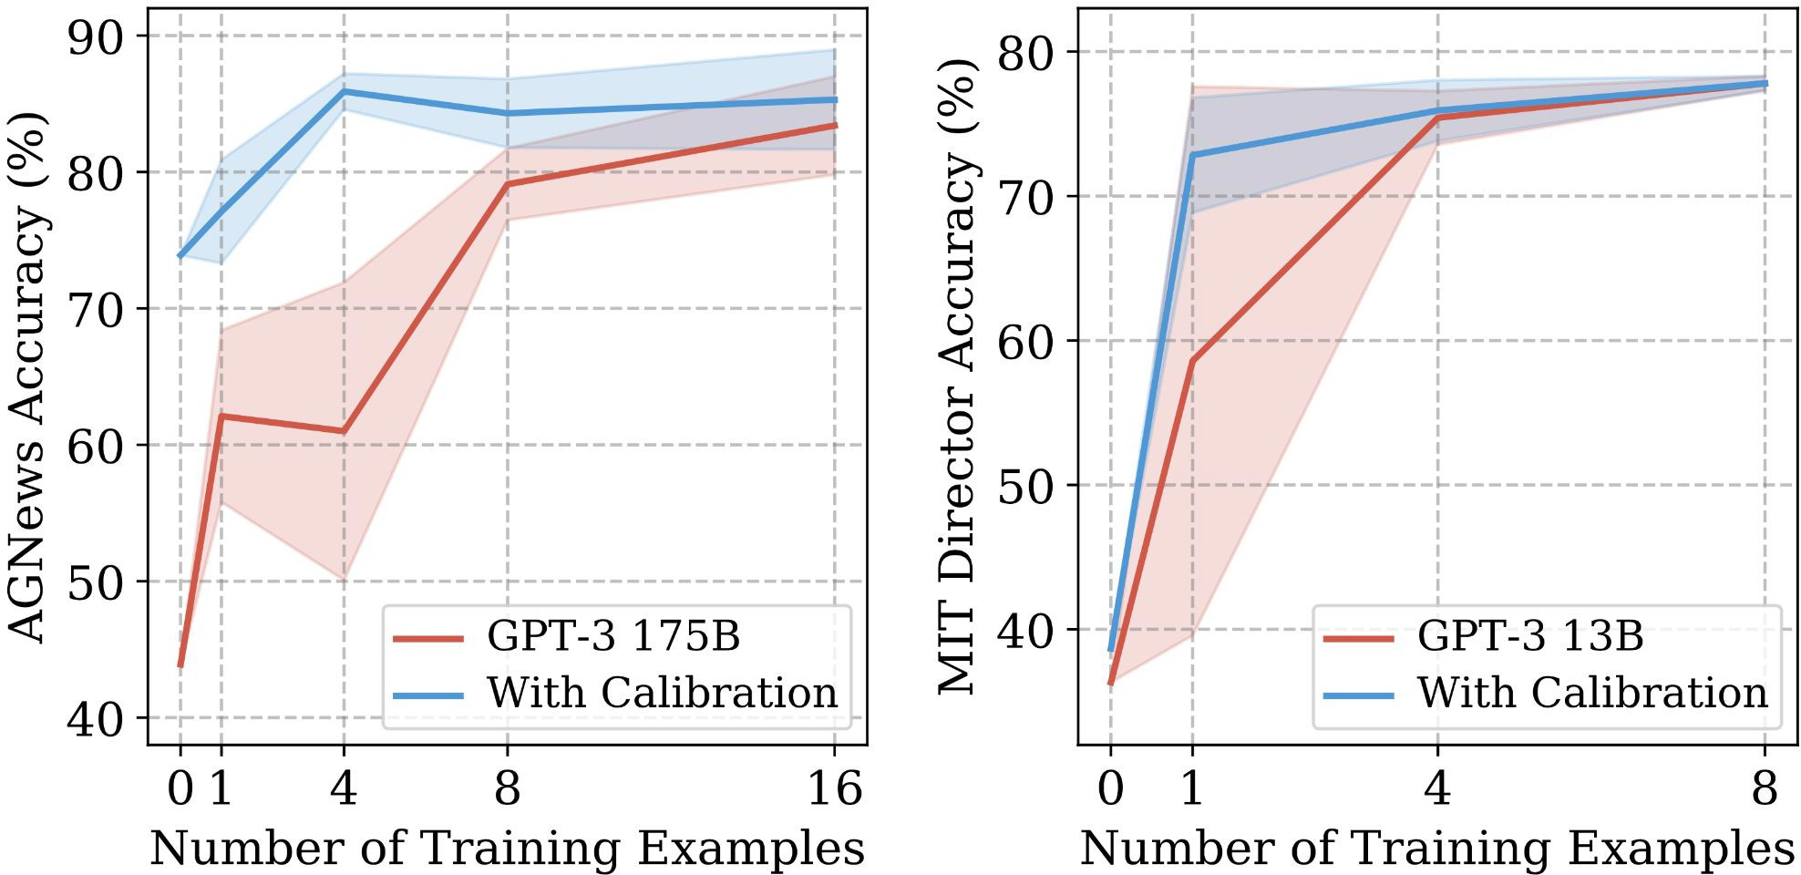
Effect of Calibration
Improves mean and worst-case accuracy
Reduces variance across training sets and permutations

Slide 56
Surface Form Competition
Surface forms are competing for probability mass — skew the probabilities.
There are some ideas on how to calibrate for these issues (see Holtzman et al 2021).
[Slide credit: Howard Yen, Vishvak Murahari]

Slide 57
Summary Thus Far
61
LM prompting & In-context learning show promising results, but their performance is highly unstable/brittle.
Better scoring: Calibration
Other factors:
Better formation of demonstrations
Better choice of demonstrative examples
Better ordering of demonstrative examples
[ACL 2022 Tutorial Beltagy, Cohan, Logan IV, Min and Singh]

Slide 58
How/Why does In-context Learning Work?
63
Any arbitrary task
Language Model
A few-shot learner
[ACL 2022 Tutorial Beltagy, Cohan, Logan IV, Min and Singh]

Slide 59
How/Why does In-context Learning Work?
64
Any arbitrary task
Language Model
A few-shot learner
[ACL 2022 Tutorial Beltagy, Cohan, Logan IV, Min and Singh]

Slide 60
Impact of Pretraining Term Frequencies
67
For each task, identify relevant terms from each instance—numbers and units
Count co-occurrences of these terms in the pretraining data (term pairs or triples within a ﬁxed window)
["Impact of Pretraining Term Frequencies on Few-Shot Reasoning" Razeghi et al. 2022.]

Slide 61
Impact of Pretraining Term Frequencies
This may also indicate that, demonstrations do not teach a new task; instead, it is about locating an already-learned task during pretraining (Reynolds & McDonell, 2021)
But that brings up the question of how much LMs actually reason when solving these tasks.🤔 Overlooking the impact of pretraining data can be misleading in evaluation!
In-context learning performance is highly correlated with
term frequencies during pretraining
["Impact of Pretraining Term Frequencies on Few-Shot Reasoning" Razeghi et al. 2022.]

Slide 62
Impact of Input-Output Mapping
Study the effect of randomizing labels in demonstrations.
Randomly sample a label from the correct label space
["Rethinking the Role of Demonstrations: What Makes In-Context Learning Work?" Min et al. 2022.]

Slide 63
Impact of Input-Output Mapping
Models see a small performance drop (0–5% absolute) with random labels
Takeaway: ground truth input-label mapping in the prompt is not as important as we thought
["Rethinking the Role of Demonstrations: What Makes In-Context Learning Work?" Min et al. 2022.]

Slide 64
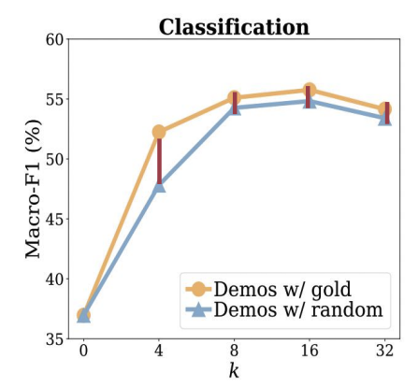
Impact of Input-Output Mapping
Vary number of demonstrations
Takeaway:
Performance drop from using gold labels to using random labels is consistently small across varying k, ranging from 0.8–1.6%
Using small number of examples with random labels is better than no examples
["Rethinking the Role of Demonstrations: What Makes In-Context Learning Work?" Min et al. 2022.]

Slide 65
Impact of Input-Output Mapping
Vary the size of the noisy demonstrations
Takeaway: Using all incorrect labels preserves 97% of improvements from using all correct labels
["Rethinking the Role of Demonstrations: What Makes In-Context Learning Work?" Min et al. 2022.]

