Slide 1
In-context Learning
CSCI 601 471/671
NLP: Self-Supervised Models
https://self-supervised.cs.jhu.edu/sp2023/
[Slide credit: Iz Beltagy, Arman Cohan, Robert Logan IV, Sewon Min, Sameer Singh, and many others ]

Slide 2
Logistics
HW7 is up! Due Thu March 30.
Projects: Please continue to brainstorm!
Project proposal deadline: Thu March 30.
Midterms grades?

Slide 4
HW 1-5

Slide 5
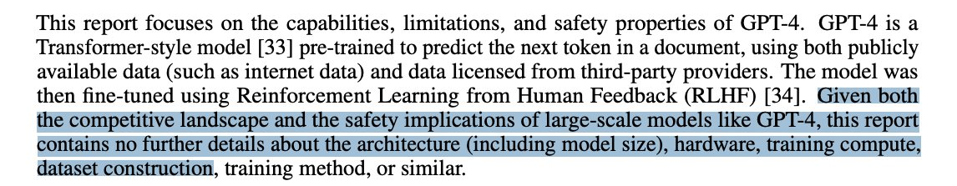
News: GPT-4 was released!!
“Transformer-style model pretrained to predict next token”
We don’t know the size ☹
We don’t know the amount of supervision ☹
From a company name “Open”AI — the irony

Slide 6
News: GPT-4 was released!!
It is trained with human feedback (RLHF) — we will discuss it in a few weeks.
It is trained on multi-modal signals — we will discuss it in a few weeks.
More results in the technical report: https://cdn.openai.com/papers/gpt-4.pdf

Slide 7
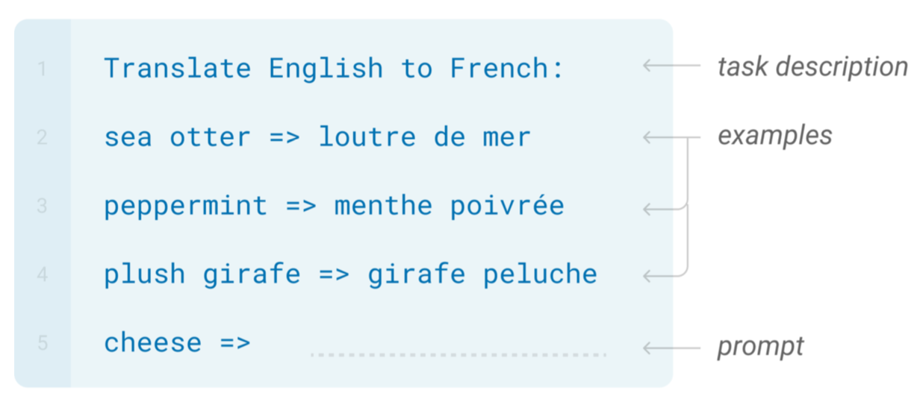
In-Context Learning
Learns to do a downstream task by conditioning on input-output examples!
No weight update — our model is not explicitly pre-trained to learn from examples
The underlying models are quite general
Today’s focus:
How to use effectively in practice?
Fundamentally, why does it work?

Slide 8
How/Why does In-context Learning Work?
64
Any arbitrary task
Language Model
A few-shot learner
[ACL 2022 Tutorial Beltagy, Cohan, Logan IV, Min and Singh]

Slide 9
In-context Learning as Bayesian Inference
(Xie et al., 2022) try to explain ICL as an implicit Bayesian inference.
Idea:
(Pre-trained LM learn to represent “concepts”, i.e. the ideas described by words.
ICL enables LMs to “locate” the learned concepts.
Can formulate this intuition as a Bayesian inference
Prior over latent “concepts”
Likelihood describes connection between text and concepts
Given an incomplete doc, use Bayes formula to infer what concept is likely it is generated from and then complete the document.
Does not explain everything.
GPT-3 can handle “unseen” concepts
$c_{1}$ $c_{2}$
latent concepts
observed documents
(e.g., demonstrations)
$d_{1}$ $d_{2}$ $d_{3}$

Slide 10
In-context Learning as Gradience Descent
65
ICL is implicitly equivalent to SGD on in-context demonstrations
[von Oswald et al. 2022; Akyurek et al. 2022; Dai et al. 2022, …]

Slide 11
Summary & Open questions
75
In-context learning has been a promising few-shot learning approach
No need for gradient updates → Much easier to use large models!
Better calibration, better scoring of model outputs, and better formation of demonstrations lead to great improvements
How to make it less sensitive?
How to scale it (longer context, more training examples, wider range of tasks)?
Still in progress …
Understanding how/why it works,
Disentangling looking up task location vs learning a new task
Can we predict whether in-context learning would work on a given task or not?

Slide 12
Prompting for Multi-Step Reasoning

Slide 13
Some Problems Involve Reasoning
Q: If there are 3 cars in the parking lot and 2 more cars arrive, how many cars are in the parking lot?
Q: Take the last letters of the words in "Elon Musk" and concatenate them
Q: What home entertainment equipment requires cable?
Answer Choices: (a) radio shack
(b) substation (c) television (d) cabinet
A: The answer is nk.
A: The answer is 5
A: The answer is (c).
Arithmetic Reasoning (AR)
(+ − ×÷…)
Symbolic Reasoning (SR)
Commonsense Reasoning (CR)

Slide 14
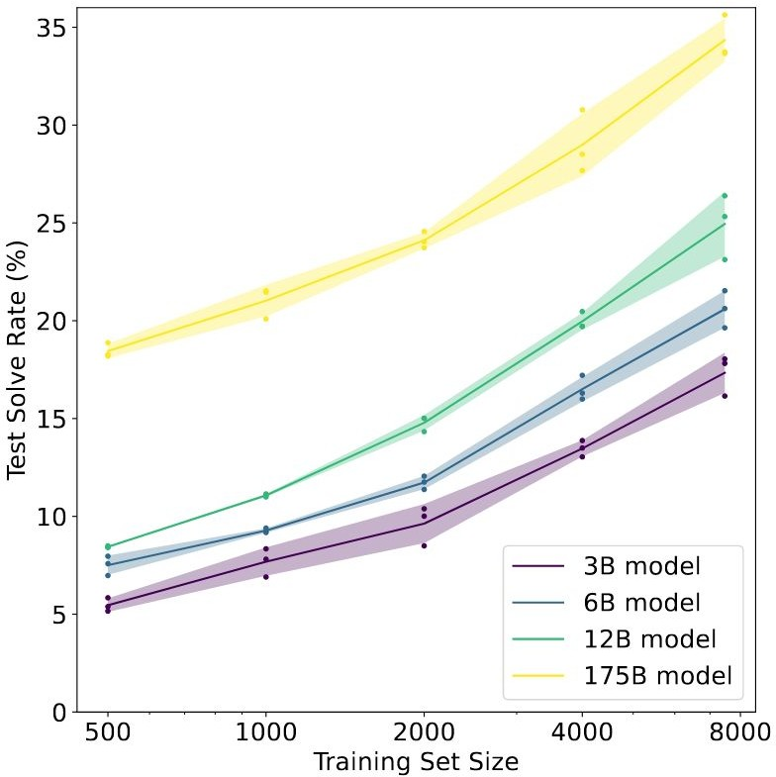
Reasoning Problems
(Cobbe et al. 2021)
Fine-tune LMs on GSM8K (arithmetic reasoning)
One may conjecture that, to achieve >80%, one needs 100x more training data for 175B model
Another option is to increase model sizes, which is expensive.
Other than these, how else can we improve the model performance on tasks that require multi-step reasoning?

Slide 15
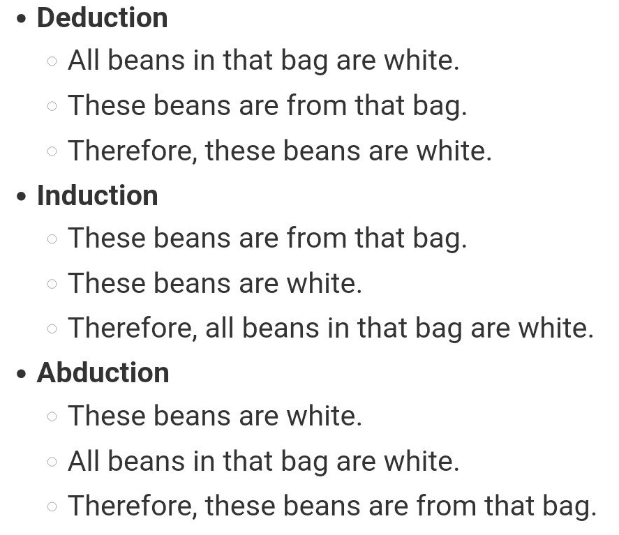
Reasoning Problems via Multi-Step Prompting
Basic idea: Rather than showing input-output pairs, prompting the model such that it shows its proof steps.
Note: ideas around models that are capable of multi-step reasoning go way back.
Aristotle (deduction),
Hume (induction),
Peirce (abduction)
Lots of other works in pre-LM era
Namely, my Ph.D. thesis ☺ on multi-step reasoning in semantic representations of language
[Reasoning-Driven Question-Answering for Natural Language Understanding]

Slide 16
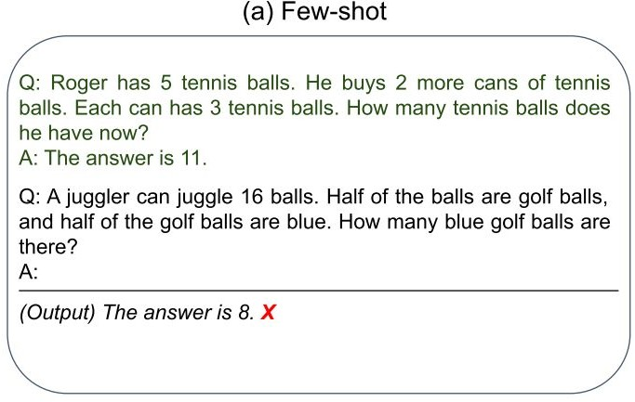
Reasoning Problems via Multi-Step Prompting

Slide 17
Reasoning Problems via Multi-Step Prompting
（Wei et al., 2022）
Step-by-step demonstration
Step-by-step Answer

Slide 18
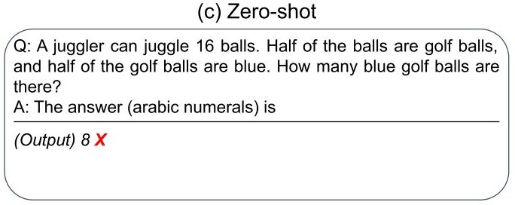
Reasoning Problems via Multi-Step Prompting
（Wei et al., 2022）
Step-by-step demonstration
Step-by-step Answer

Slide 19
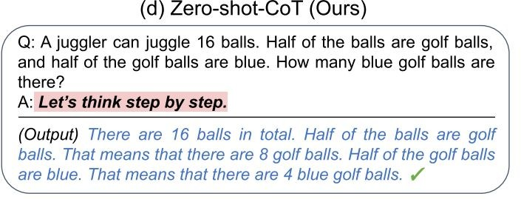
Reasoning Problems via Multi-Step Prompting
（Wei et al., 2022）
Step-by-step demonstration
Step-by-step Answer
（KoJima et al., 2022）
Two-stage Prompting Step-by-step Answer

Slide 20
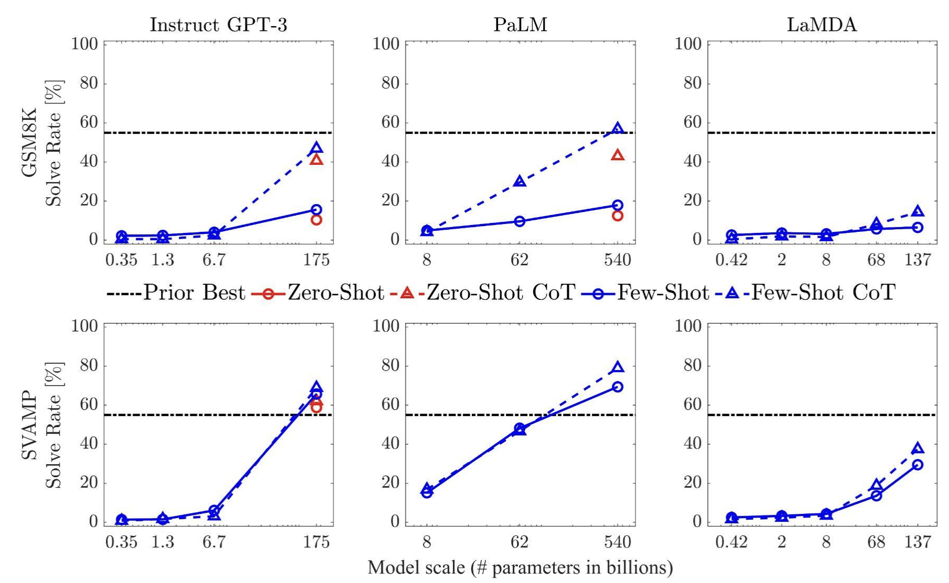
Multi-Step Prompting: Empirical Results
Setup: show demonstrations that contain the decompositions
The gains of multi-step prompting increases with scale.
Prompting achieves better perf than [smaller] models that are fine-tuned on a lot more data.
[“Chain of thought prompting elicits reasoning in large language models”, Wei et al. 2022]

Slide 21
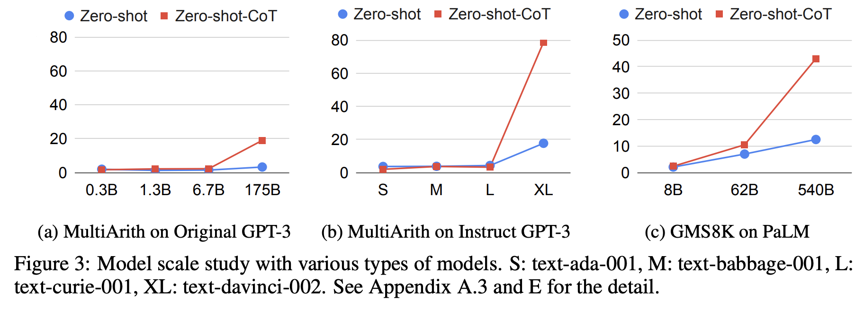
Multi-Step Prompting: Empirical Results
Setup: show demonstrations that contain the decompositions
The gains of multi-step prompting increases with scale.
Prompting achieves better perf than [smaller] models that are fine-tuned on a lot more data.
[“Large Language Models are Zero-Shot Reasoners”, Kojima et al. 2022]

Slide 22
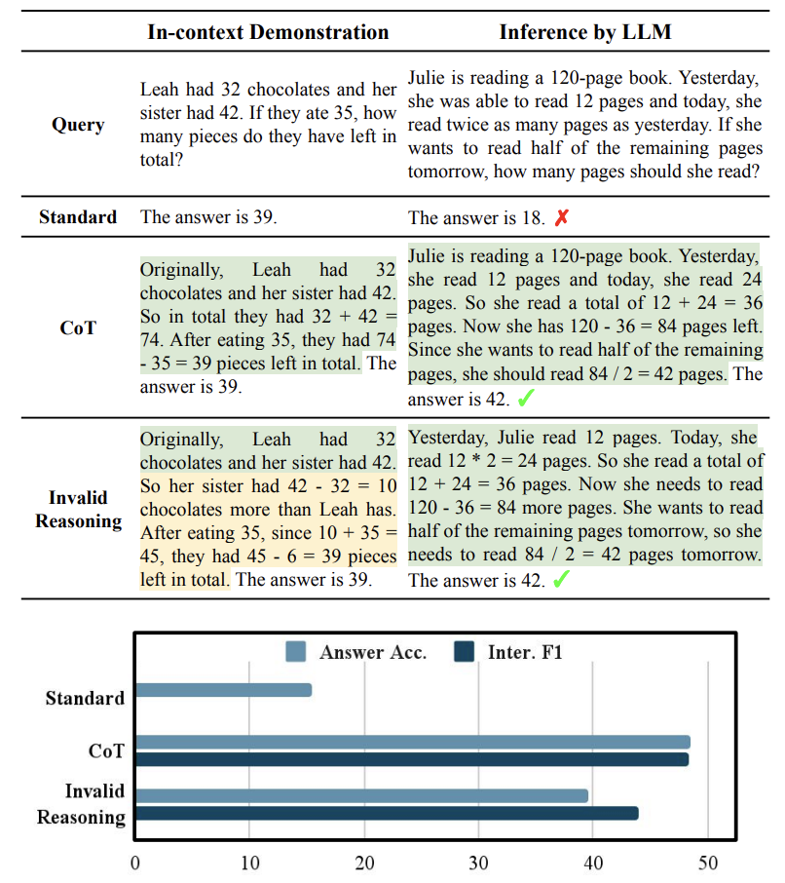
Multi-Step Prompting: Steps Don’t Have to Be Correct!
It is possible even with invalid demonstrations
Prompting with invalid reasoning steps can achieve over 80-90% of the performance with correct reasoning steps.
[“Towards Understanding Chain-of-Thought Prompting”, Wang et al. 2022]

Slide 23
ROSCOE: A Suite of Metrics for Scoring Step-by-Step Reasoning https://twitter.com/srush_nlp/status/1629229927898677252

Slide 24
Multi-Step Prompting: Parting Comments
Prompting LMs to explain their reasoning improves their performance.
However, their steps aren’t always correct.
A useful repository of annotation: https://github.com/OpenBioLink/ThoughtSource
There is much to research on here:
When do LMs over-reason or under-reason?
How do adjust the granularity of step?
How to use use given references in the proofs?
How do use external “tools” (e.g., logic, calculator, Python) in forming proofs?

Slide 25
Summary
Prompting language models is a powerful way to adapt them to our desired tasks.
They also serve as a gateway to understand the underlying dynamics inside models.
Lots of activity in this area and room for a lot of research progress.

Slide 26
Parameter-Efficient Tuning of LMs
CSCI 601 471/671
NLP: Self-Supervised Models
https://self-supervised.cs.jhu.edu/sp2023/
[Slide credit: Iz Beltagy, Arman Cohan, Robert Logan IV, Sewon Min, Sameer Singh, Danqi Chen and many others ]

Slide 27
Fine-tuning Pre-trained Models
81
A general recipe:
Pre-train a language model
Fine-tune a classification head on top of the LMs representations
Classiﬁcation
Head
Positive
Negative
Language
Model
Embeddings
Input
[CLS] A three-hour cinema master class.
[ACL 2022 Tutorial Beltagy, Cohan, Logan IV, Min and Singh]

Slide 28
Fine-tuning Pre-trained Models
82
Classiﬁcation
Head
Default ﬁnetuning recommendations are unstable in few-shot settings.
Positive
Negative
Stability can be improved by:
Using smaller learning rates
Training for more iterations
…
Language
Model
However ﬁnetuning still underperforms other methods.
Embeddings
Input
[CLS] A three-hour cinema master class.
["Fine-Tuning Pretrained Language Models: Weight Initializations, Data Orders, and Early Stopping" Dodge et al., 2020]
["On the Stability of Fine-tuning BERT: Misconceptions, Explanations, and Strong Baselines” Mosbach et al., 2020.]
[“Revisiting Few-sample BERT Fine-tuning” Zhang et al., 2020]
[ACL 2022 Tutorial Beltagy, Cohan, Logan IV, Min and Singh]

Slide 29
Prompt Tuning
113
Learn embeddings for placeholder tokens in the pattern.
Variants:
WARP [Hambardzumyan et al., 2021]
OptiPrompt [Zhong et al., 2021]
Prompt Tuning [Lester et al., 2021]
P-Tuning* [Li et al., 2021]
LM Head
Great
Terrible
Language
Model
Embeddings
Input
A three-hour cinema master
[ACL 2022 Tutorial Beltagy, Cohan, Logan IV, Min and Singh]

Slide 30
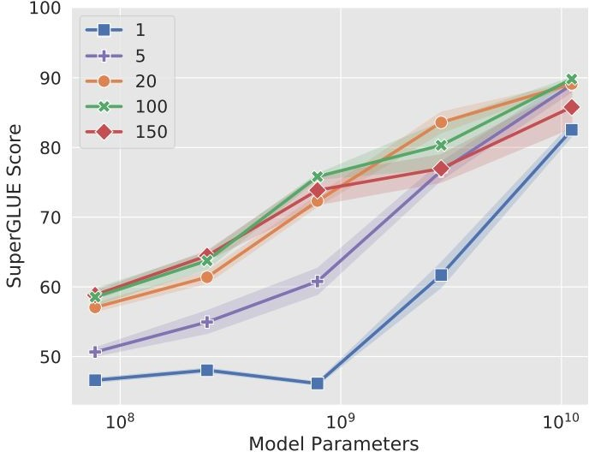
Prompt Tuning: Effect of Prompt Length
The shorter the prompt, the fewer new parameters must be tuned
Increasing prompt length is critical to achieving good performance
The largest model still gives strong results with a single-token prompt
Increasing beyond 20 tokens only yields marginal gains
[The Power of Scale for Parameter-Efficient Prompt Tuning. Lester et al. 2021]

Slide 31
BitFit
120
BitFit adds bias terms in self-attention and MLP layers and tunes those.
[ “BitFit: Simple Parameter-eﬃcient Fine-tuning for Transformer-based Masked Language-models” Ben Zaken et al., 2021.]

Slide 32
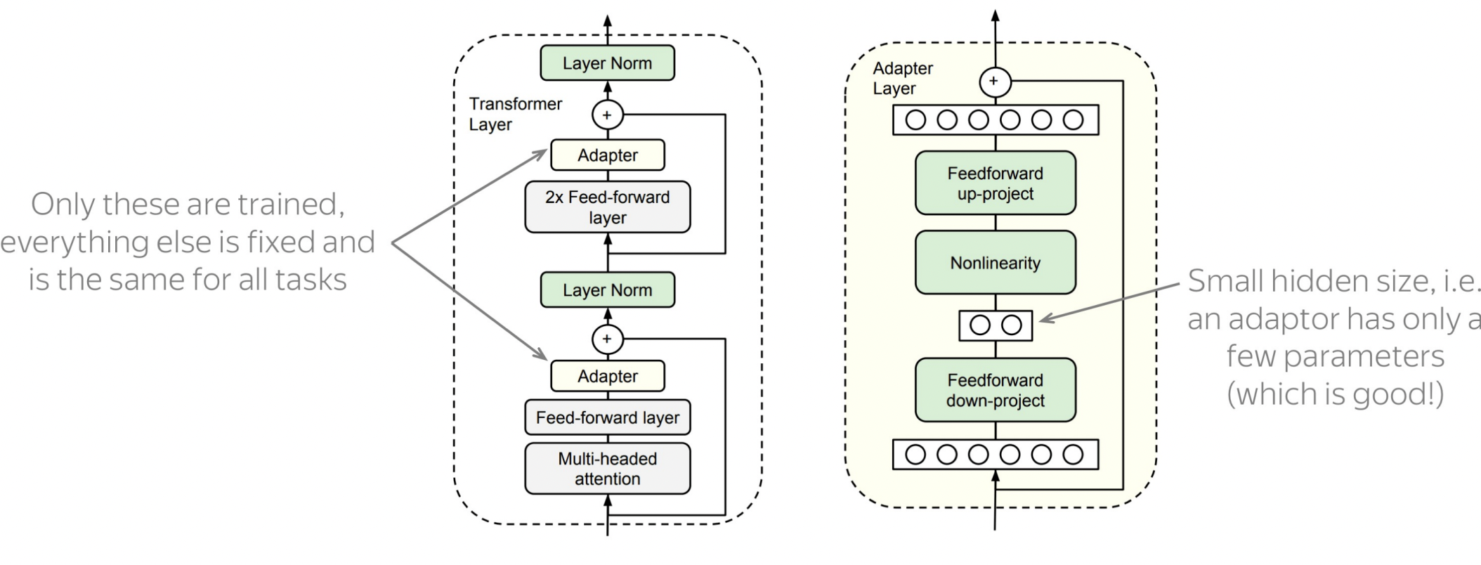
Adapters
Core idea: train small sub-networks and only tune those.
No need to store a full model for each task, only the adapter params.
[“Parameter-Eﬃcient Transfer Learning for NLP” Houlsby et al., 2019.]

Slide 33
Compacter
123
Compacter layers modify Adapter layers to use low-rank parameterized hypercomplex multiplication (i.e., parameter eﬃcient W’s).
Mahabadi et al., 2021. "COMPACTER: Eﬃcient Low-Rank Hypercomplex Adapter Layers"
[ACL 2022 Tutorial Beltagy, Cohan, Logan IV, Min and Singh]

Slide 34
Compacter
124
Compacter layers modify Adapter layers to use low-rank parameterized hypercomplex multiplication (i.e., parameter eﬃcient W’s).
Mahabadi et al., 2021. "COMPACTER: Eﬃcient Low-Rank Hypercomplex Adapter Layers"
[ACL 2022 Tutorial Beltagy, Cohan, Logan IV, Min and Singh]

Slide 35
LoRa
125
Low rank additive updates to model weights.
W = W₀ + AB
Where the rank of A and B << min(d,h)
[“LoRA: Low-Rank Adaptation of Large Language Models” Hu et al., 2021.]

Slide 36
Towards a Uniﬁed View of Parameter-Eﬃcient Transfer Learning
Approaches are more similar than at ﬁrst glance.
He et al., 2022. "Towards a Uniﬁed View of Parameter-Eﬃcient Transfer Learning"
[ACL 2022 Tutorial Beltagy, Cohan, Logan IV, Min and Singh]

Slide 37
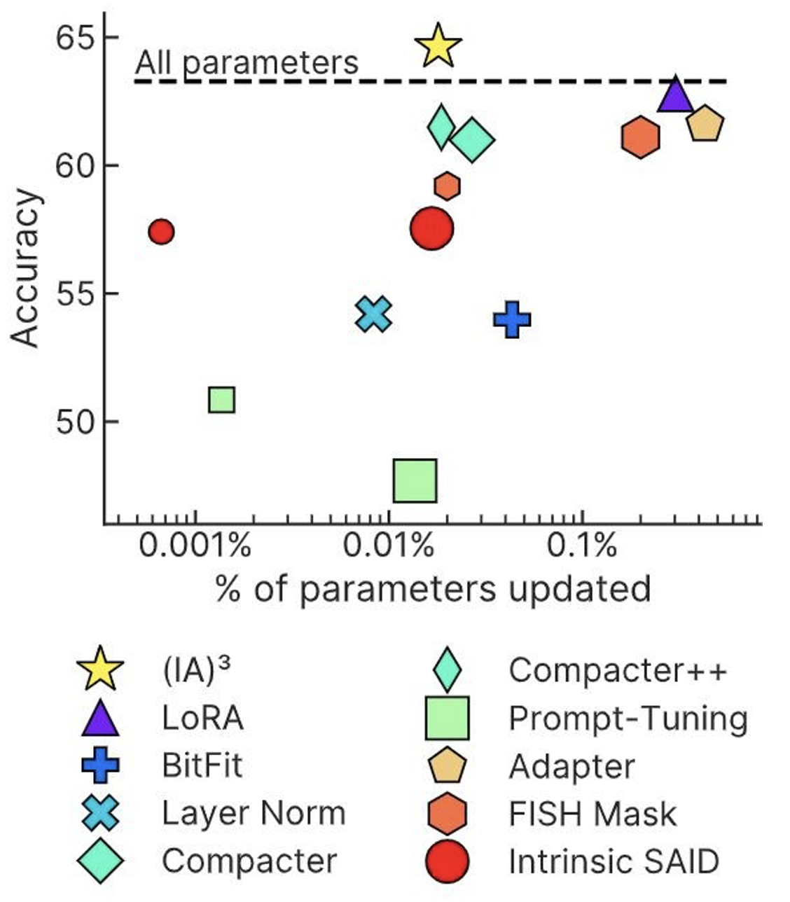
(IA)³ : Infused Adapter by Inhibiting and Amplifying Inner Activations
Element-wise rescaling of model activations with a learned vector:
keys and values in self-attention
feed-forward networks
["Few-Shot Parameter-Eﬃcient Fine-Tuning is Better and Cheaper than In-Context Learning" Liu et al., 2022.]

Slide 38
Prompt Tuning: Interpretability
Opposite goal: how unfaithful can their interpretation be of what they do?
Are continuous prompts interpretable?
Something related to sentiment analysis? 🤔
$p^{∗}$: optimized for the task
LM
Sentence: That was a great fantasy movie.
positive
["Prompt Waywardness: The Curious Case of Discretized Interpretation of Continuous Prompts" Khashabi et al., 2022.]

Slide 39
nearest-neighbor mapping of continuous prompt onto the word embeddings
definition of another task:
Write down the conclusion you can reach by combining the given Fact 1 and Fact 2.
$\tilde{p}$: optimized for the task + project to a given text
random sentence from web:
int clamp(int val, int min_val) { return std::max(min_val, val);
}
$p^{∗}$: optimized for the task
LM
Sentence: That was a great fantasy movie.
positive
["Prompt Waywardness: The Curious Case of Discretized Interpretation of Continuous Prompts" Khashabi et al., 2022.]
Notes:
Or a variety of random sentences we sampled from the web.
….
What do I mean by “projection”?
In our experiments we use nearest-neighbor projection of continuous prompt onto the word embeddings via dot product.
which is a commonly used in the field, for example, it is used in generative language models.

Slide 40
continuous prompts that
project to any given text
with tiny drop in task accuracy!
$\tilde{p}$: optimized for the task + project to a given text
$$\tilde{p}$$
91.8
$$Δ\sim 0.6\%$$
$p^{∗}$: optimized for the task
$p^{∗}$
92.4
accuracy
≈
40 60 80 100
accuracy
LM
Sentence: That was a great fantasy movie.
positive
["Prompt Waywardness: The Curious Case of Discretized Interpretation of Continuous Prompts" Khashabi et al., 2022.]
Notes:
In practice what we observe that, it is possible to find continuous prompts that project to a given text (≥ 94% token overlap with the given text) with tiny drop in task accuracy.

Slide 41
discrete (text) prompts: easy to interpret, but not easy to optimize
What is the sentiment of the following review? (positive or negative)
LM
Sentence: That was a great fantasy movie.
positive
continuous prompts:
unclear how to interpret, but easy to optimize
0.9 | 0.1 | -2.1 | 0.0
LM
Sentence: That was a great fantasy movie.
positive
["Prompt Waywardness: The Curious Case of Discretized Interpretation of Continuous Prompts" Khashabi et al., 2022.]
Notes:
... continuous prompts
Typically defined as a vector of real numbers prepended to the embedding of an input text to make the model generate a desired outcome.
For example, a continuous prompts that effectively solves the sentiment classification task.
Turns out that continuous prompts are complementary to their discrete counterparts:
We have algorithms for effectively optimizing them.
However, meaningful interpretation of continuous prompts as natural language is an open question problem.
(click) --- maybe this particular continuous prompt has something to do with sentiment analysis?? Unclear.
Motivated by this, we are interested in the research question of …
Motivated by the discrepancies between discrete and continuous prompts, we study focus continuous prompts and their interpretability.

Slide 42
Lots of good content here: https://docs.google.com/presentation/d/1seHOJ7B0bQEPJ3LBW5VmruMCILiVRoPb8nmU2OS-Eqc/edit#slide=id.p

Slide 43
Open questions & future work
Parameter efficient optimization — optimize fewer parameters than the whole model.
Space efficiency — fewer parameters to store
Computation efficiency? A bit unclear
Their interpretability is not quite clear.
Open research question: How to bridge the gap between continuous prompts vs discrete prompts?

