Slide 1
Logistics update
HW7 is due this week Thursday.
It is also the last homework … yay!
Q4 is now an extra credit.
Project proposals are due this week.
Please continue to discuss the project ideas with each other and the course staff.
Common question: What is the expected amount of effort for the project?
Imagine how much effort you put toward finishing the weekly homework assignments. Now you’d put that toward the final project.
final project = ~[4-6] x homework assignment

Slide 2
On Project Proposals
Make sure that you follow the expected protocol for the proposal.
If you’re missing these details, we will not receive the “proposal” credits and we will ask you to redo it.

Slide 3
On Project Proposals: Examples of Wordings
“we will first collect an extensive dataset from various sources such as Google News articles, Reddit discussions, and Twitter conversations.”
What data? What annotations?
“the model will be trained to produce a sentiment indicator that ranges from -10 to 10 …”
What model?
Where did we get these labels?
You want to be as clear and as specific as possible.

Slide 4
Scaling LMs 📈

Slide 5
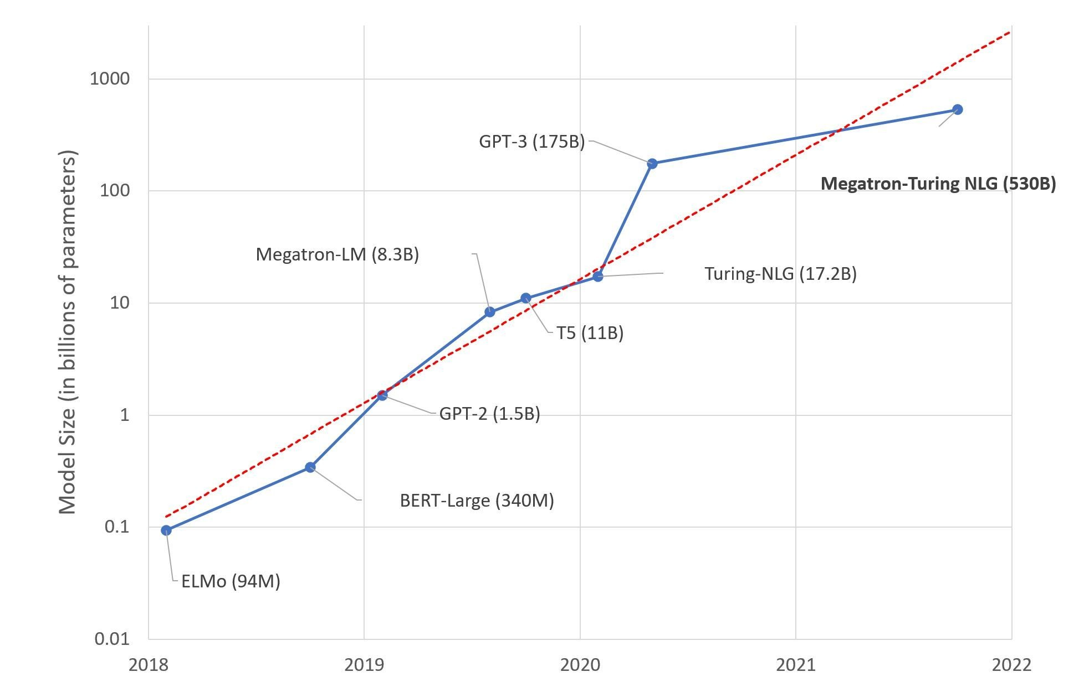
Scaling
257
LM are getting larger and more expensive
Photo credit: Microsoft Research Blog, Alvi et. al., 2021

Slide 6
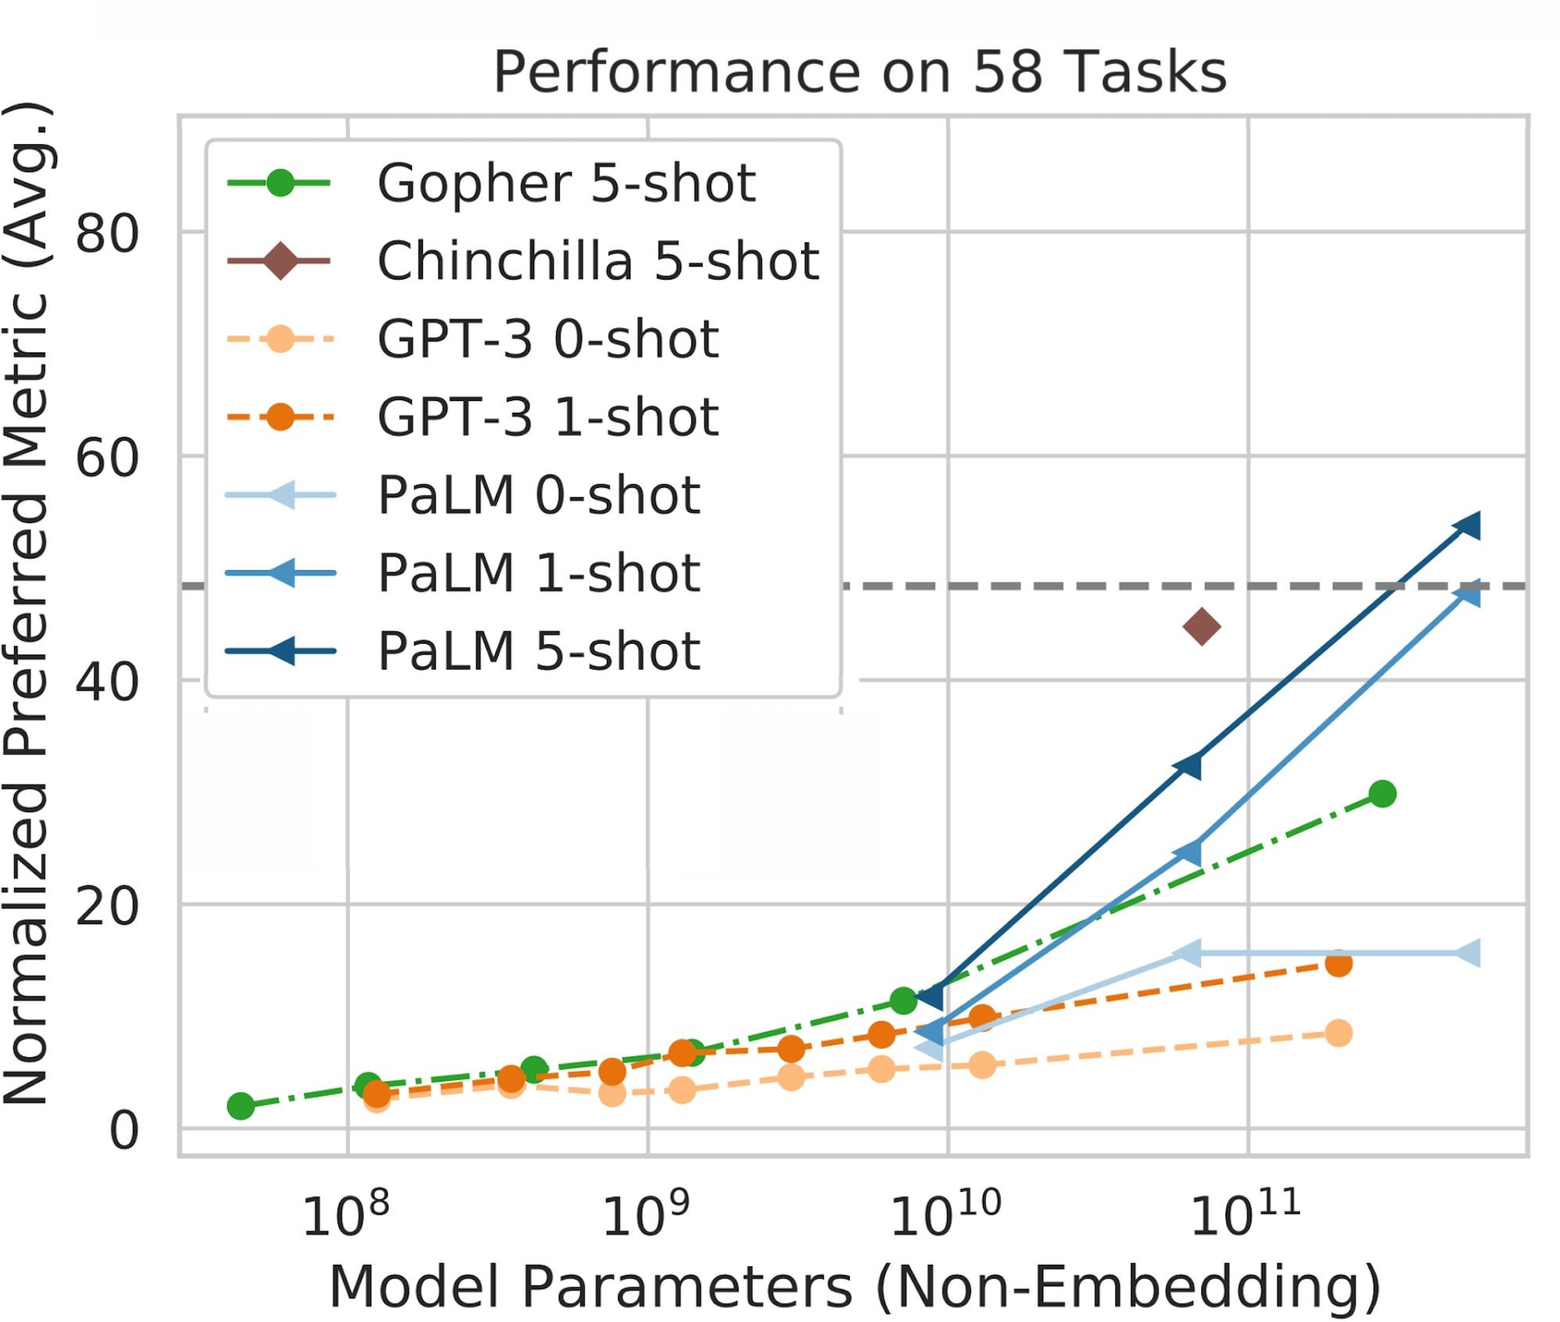
Scaling
Photo credit: PaLM, Chowdhery et. al., 2022
Larger LMs ⇒ better zero/few-shot performance

Slide 7
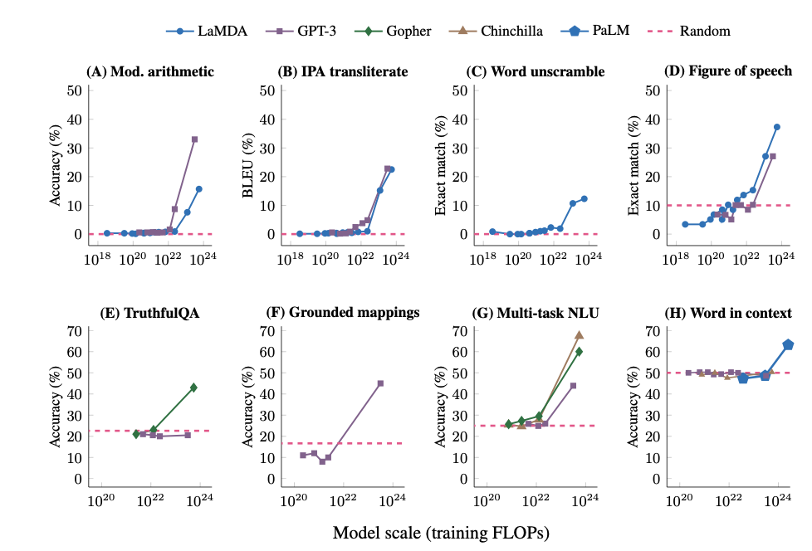
Large language models exhibit emergent abilities
With scaling models their ICL perf consistency improves.
Emergence —qualitative changes in behavior with some scaling parameter

Slide 8
What is “Scaling”?
259
“scaling means larger model size”
But model parameters may be under-utilized.
“scaling means more compute”
But computation may be unnecessarily wasted.
“scaling means more data”
But more data might not necessarily contain more information (e.g., duplications)
Scale means all the above: effective compression of information
Requires model capacity
Requires compute
Requires large, rich data

Slide 9
Scaling Laws
Hypothesis: there are fundamental principles that govern effective scaling
Importance: understanding these “laws” would allow us to find optimal models for a given data/compute budget.
Think of Newton’s laws
Provide the basis for understanding and analyzing the motion of objects in the physical world
Can be used to calculate the trajectory of a rocket, the speed of a car, or the motion of a planet.

Slide 10
Scaling - Optimal Model Size
262
Large model reaches lower loss
Small model plateaus early
Smaller models don’t have enough capacity to utilize the extra compute. They plateau early.
Larger models are initially slower to train, but with more compute they reach lower losses.
Given a compute budget, what is the optimal model size to use?
Optimal model size for compute
Photo credit: GPT3, Brown et. al., 2020
[ACL 2022 Tutorial Beltagy, Cohan, Logan IV, Min and Singh]

Slide 11
Scaling - Optimal Model Size
263
Large model reaches lower loss
Small model plateaus early
The idea of “optimal model size for given compute” was introduced by Kaplan et. al.
In ideal world, we are given lots of compute to train many models to find the optimality.
Alas not feasible when you have budget to train a single model.
If we have the equations (“laws”) describing the behavior, we can compute it analytically.
Optimal model size for compute
Photo credit: GPT3, Brown et. al., 2020
[ACL 2022 Tutorial Beltagy, Cohan, Logan IV, Min and Singh]

Slide 12
Scaling Laws of Kaplan et. al., 2020
265
Constants
Model size
Number of steps
[ACL 2022 Tutorial Beltagy, Cohan, Logan IV, Min and Singh]

Slide 13
Scaling Laws of Kaplan et. al., 2020
Predicted (dotted) accurately matches empirical learning curves (solid).
Do these generalize to models?
Fit constants using small models then predict learning curves of larger models.
[ACL 2022 Tutorial Beltagy, Cohan, Logan IV, Min and Singh]

Slide 14
Scaling Laws of Kaplan et. al., 2020
Also, ﬁt a power-law function to predict the “compute eﬃcient” frontier:
Use it to predict the optimal model size and optimal number of tokens, for a given amount of compute
Photo credit: GPT3, Brown et. al., 2020
[ACL 2022 Tutorial Beltagy, Cohan, Logan IV, Min and Singh]

Slide 15
Scaling - Kaplan et. al., 2020
268
Notations:
C = 6 N B S = 6 N D
C: compute N: model size B: batch size
S: number of steps
D: number of tokens (a single epoch, no repeated tokens)
[ACL 2022 Tutorial Beltagy, Cohan, Logan IV, Min and Singh]

Slide 16
Scaling - Kaplan et. al., 2020
269
With more compute, should you increase model size or number of tokens?
C = 6 N D
C: compute N: model size D: number of tokens
[ACL 2022 Tutorial Beltagy, Cohan, Logan IV, Min and Singh]

Slide 17
Scaling Laws: Kaplan et al.
N: number of model parameters
C: compute
D: dataset size
Optimal model size and optimal number of tokens, for a given compute budget
N_{opt} exponent >> D_{opt} exponent
Takeaway: grow the model size faster than growing the number of tokens.
Example: Given 10x compute, increase N by 5.5x, and D by 1.8x
GPT3 (and many other followed this recipe) training a 175B model on 300B tokens
Kaplan et. al. 2020 | ^{N}opt | ∝ | _{C}0.73 | ^{D}opt | ∝ | _{C}0.27
[ACL 2022 Tutorial Beltagy, Cohan, Logan IV, Min and Singh]

Slide 18
Scaling Laws: Hoﬀmann et al.
N: number of model parameters
C: compute
D: dataset size
Optimal model size and optimal number of tokens, for a given compute budget
N_{opt} exponent ≅ D_{opt} exponent
Compute and tokens should increase at the same rate.
Example: Given 10x compute, grow N by 3.2x and D by 3.2x
Hoﬀmann et. al., followed this recipe:
Trained a 70B model on 1.4T tokens (Chinchilla) outperforming their previous 280B model trained on 300B tokens (Gopher)
Kaplan et. al. 2020 | ^{N}opt | ∝ | _{C}0.73 | ^{D}opt | ∝ | _{C}0.27
Hoﬀmann et. al., 2021 | ^{N}opt | ∝ | _{C}0.50 | ^{D}opt | ∝ | _{C}0.50
[ACL 2022 Tutorial Beltagy, Cohan, Logan IV, Min and Singh]

Slide 19
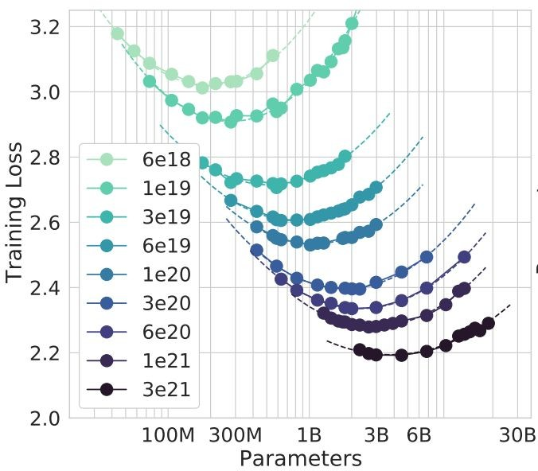
Scaling - Kaplan et. al., 2020 vs. Hoﬀmann et. al., 2022
The main diﬀerence is the learning rate schedule!!!
Kaplan et. al.: all experiments same LR schedule
Hoﬀmann et. al. experiment while changing diﬀerent LR schedule
Their LR reaches zero at the end of the training
[ACL 2022 Tutorial Beltagy, Cohan, Logan IV, Min and Singh]
From Hoffmann et al., 2022

Slide 20
Scaling Laws of Hoﬀmann et al.: Implications
273
We trained many “oversized” and “under-trained” models
On the positive side, we already ﬁgured out the engineering for scaling to sizes much larger than needed
For example, optimality of 175B model (GPT3-size) at 3.7T tokens (12x more compute than GPT3)
We should also focus on increasing compute budget and data size not model size
[ACL 2022 Tutorial Beltagy, Cohan, Logan IV, Min and Singh]

Slide 21
Why didn’t we scale earlier??

Slide 22
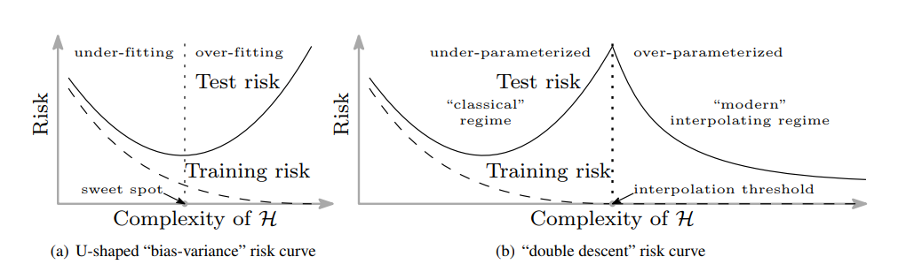
ML Theory Told Us Otherwise
Learning theory made us allergic to over-parametrized models.
[Reconciling modern machine learning practice and the bias-variance trade-off, Belkin et al. 2019]

Slide 23
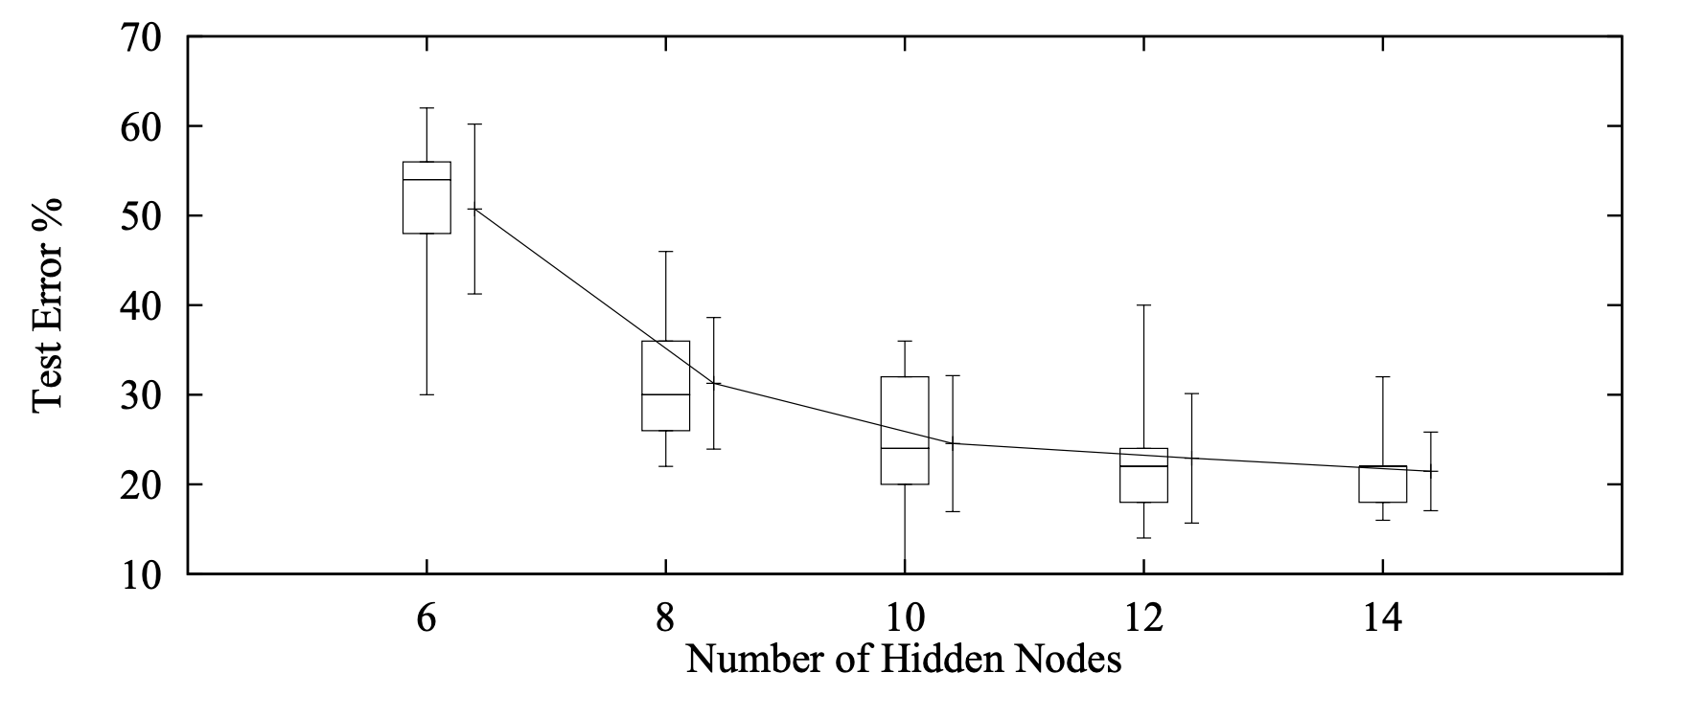
There Were Empirical Evidence
Even in mid-90’s there were evidence supporting the benefit of larger models
Although they were ignored ….
“ …. larger networks may generalize well and better generalization is possible from larger networks if they can be trained more successfully than the smaller networks” -- Lawrence, Giles, and Tsoi in 1997
[Lawrence, Giles, and Tsoi 1997]

Slide 24
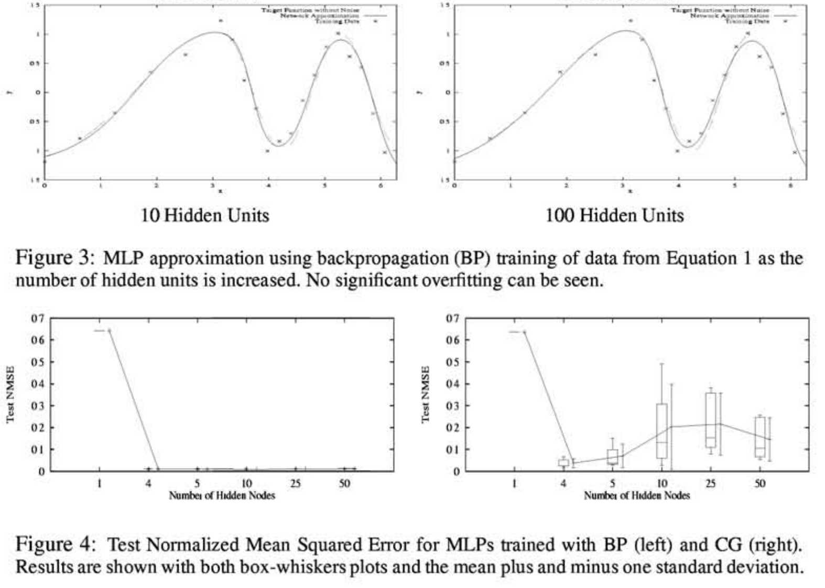
There Were Empirical Evidence
Even in mid-90’s there were evidence supporting the benefit of larger models
Although they were ignored ….
“ …. "Nets of all sizes overfit some problems. But generalization is surprisingly insensitive to excess capacity if the net is trained with backprop.”
-- Caruana, Lawrence, and Giles (2000)
[Caruana, Lawrence, and Giles 2000]

Slide 25
Retrieval-Augmented LMs

Slide 26
What is Missing from LMs?
LMs automatically acquire knowledge from the web, but…
… a lot of it is noisy or incorrect: misinformation, rumors, opinions.
… we cannot trace the model's knowledge back to an attributable source.
We can edit individual facts inside a Transformer's memory, but…
… it doesn't work reliably yet.
… current approaches break down after multiple edits.
We can store knowledge inside feedforward layers, but…
… current memory capacity is too small, and scaling up is expensive!
[Slides: Kelvin Guu]

Slide 27
What is a Memory-Augmented Model?
A memory could be:
Documents on the web
Record in a database
Images of the world
…
what do you call a group of dolphins
Neural
network
a pod
Memory retriever
This model can have desirable attributes:
Separates world knowledge from LM parameters
Less opaque; more interpretable
Editable knowledge
Attribution
More efficient scaling
…
A group of dolphins is called a "school" or a "pod"...
[Slides: Kelvin Guu]

Slide 28
What are the Key Design Questions?
What are your memories?
Documents, database records, training examples, etc.
How to retrieve memories?
Use an off-the-shelf search engine (e.g. Google, StackOverflow).
How to train your own memory retriever.
How to use retrieved memories?
"Text fusion", "label smearing".
Common failure modes:
Underutilization: model ignores retrieved memories.
Overreliance: model depends too much on memories!
[Slides: Kelvin Guu]

Slide 29
Anatomy of a Neural Retriever
Score the input against each key.
Return the value for the highest scoring key.
key
value
1.2
key
value
0.3
input
6.8
key
value
7.1
key
value
[Slides: Kelvin Guu]

Slide 30
Anatomy of a Neural Retriever
Score the input against each key.
Return the value for the highest scoring key.
Example:
Input = “An essay on Eiffel Tower”
Key = <doc title>
Value =<doc content>
key
value
1.2
key
value
0.3
input
6.8
key
value
7.1
key
value
[Slides: Kelvin Guu]

Slide 31
Anatomy of a Neural Retriever
Score the input against each key.
Return the value for the highest scoring key.
key
value
1.2
key
value
0.3
input
6.8
key
value
7.1
key
value
A retriever is just a function: f(input, key) → score
[Slides: Kelvin Guu]

Slide 32
Anatomy of a Neural Retriever: Simplified
Score the input against each memory.
Return the highest scoring memory.
memory
1.2
memory
0.3
input
6.8
memory
7.1
memory
A retriever is just a function: f(input, memory) → score
[Slides: Kelvin Guu]

Slide 33
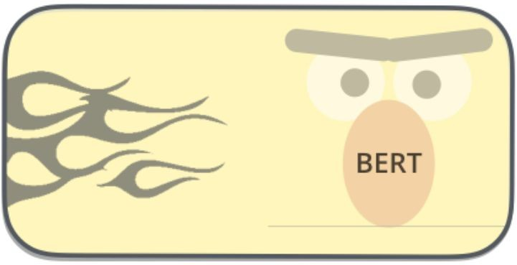
Retrieval Scoring Function
f(input, memory) → score
score
Advantages:
Using a powerful Transformer model to compare the input against each memory.
Differentiable -- can optimize with gradient descent.
Disadvantages:
For each new input, you have to do this comparison against EVERY memory.
Too slow if you have millions of memories.
regression
input
memory
[Slides: Kelvin Guu]

Slide 34
Retrieval Scoring Function
f(input, memory) → score
Advantages:
Can precompute all memory vectors.
Only have to do this once, NOT for every input.
Computing a simple dot product is fast.
Differentiable -- can optimize with gradient descent.
Disadvantages:
Dot product is not very expressive.
dot product
input vector
mem vector
input
memory
[Slides: Kelvin Guu]

Slide 35
End-to-end Training
There are various ideas in the literature for how to train these models efficiently and in an end-to-end fashion.

Slide 36
Retrieval-Augmented Language Models
RAG (Lewis, et al. 2020)
REALM (Guu et al. 2020)
SPALM (Yogatama et al. 2021)
RETRO (Borgeaud, et al. 2022)
RePlug (Shi et al. 2022)
RA-CM3 (Yasunaga et al. 2022)
BlenderBot 2.0 (Komeili et al. 2021)

Slide 37
Highlighting Some Results

Slide 38
End-to-end learning
memory
A good memory will result in a good answer.
1.2
memory
A bad memory will result in a bad answer.
0.3
input
6.8
memory
7.1
Can we use this as a training signal?
memory
Reader
answer
[Slides: Kelvin Guu]

Slide 39
End-to-end learning
memory
Who is īhe bad guy in lord of īhe rings?
1.2
memory
0.3
input
6.8
memory
7.1
memory
The main anīagonisī is Sauron…
Sauron
Reader
answer
[Slides: Kelvin Guu]

Slide 40
End-to-end learning
memory
Who is īhe bad guy in lord of īhe rings?
1.2
memory
0.3
input
6.8
memory
7.1
memory
Lord of īhe Rings received a bad review from IMDB…
IMDB
Reader
answer
[Slides: Kelvin Guu]

Slide 41
Intuitive idea (trial and error)
Exploration
Use our (imperfect) retriever to select a memory.
Try feeding that memory to the Reader.
Learn from success / failure
If the memory helps the Reader generate the right answer
→ increase its retrieval score.
If the memory does not help the Reader generate the right answer
→ decrease its retrieval score.
Over time, helpful memories get the highest scores.
[Slides: Kelvin Guu]

Slide 42
Formal idea (ORQA: Lee et al, 2019)
Exploration
A retriever is just a scoring function, f(input, memory) → score.
Take softmax over all memory scores:
Randomly sample a memory from this distribution.
[Slides: Kelvin Guu]

Slide 43
Formal idea
Learn from success / failure
Once we pick a memory, see if it helps.
Reader's probability of generating right answer:
If high → increase retrieval score of this memory.
If low → decrease retrieval score of this memory.
[Slides: Kelvin Guu]

Slide 44
Formal idea
If we randomly sample a memory and then generate an answer… what is the probability that we get the answer right?
Retriever:
propose memory
Reader:
succeed or fail
Each term in this summation is a "trial" of a different memory.
Some memories will succeed, others won't.
ORQA: Use gradient descent to maximize this quantity (more precisely, the log of this)
p(memory | input) will naturally place its mass on good memories.
[Slides: Kelvin Guu]

Slide 45
Main takeaways
How do we enable LMs to utilize external knowledge?
Retrieval-augmented language models
A retriever is a function, f(input, memory) → score
What we did not discuss:
Tracing decisions to the source knowledge
How to modify the knowledge
Conflicting knowledge
....

Slide 46
Transformers on Long Sequences

Slide 47
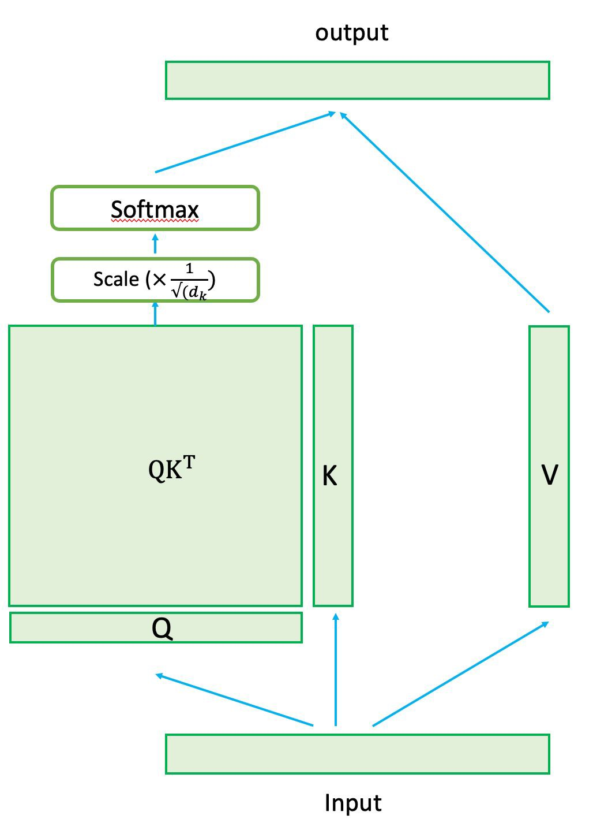
Self-Attention

Slide 48
Transformer Encoder-Decoder
Encoder-Decoder Machine translation
h = Encoder(English)
French = Decoder(h)
N = Enc. sequence length
M = Dec. sequence length
Enc. Attention = O(N²)
Dec. Attention = O(N*M + M²)
Note, similar space complexity that are limited by GPU memory.
Fig source: https://ai.googleblog.com/2017/08/transformer-novel-neural-network.html

Slide 49
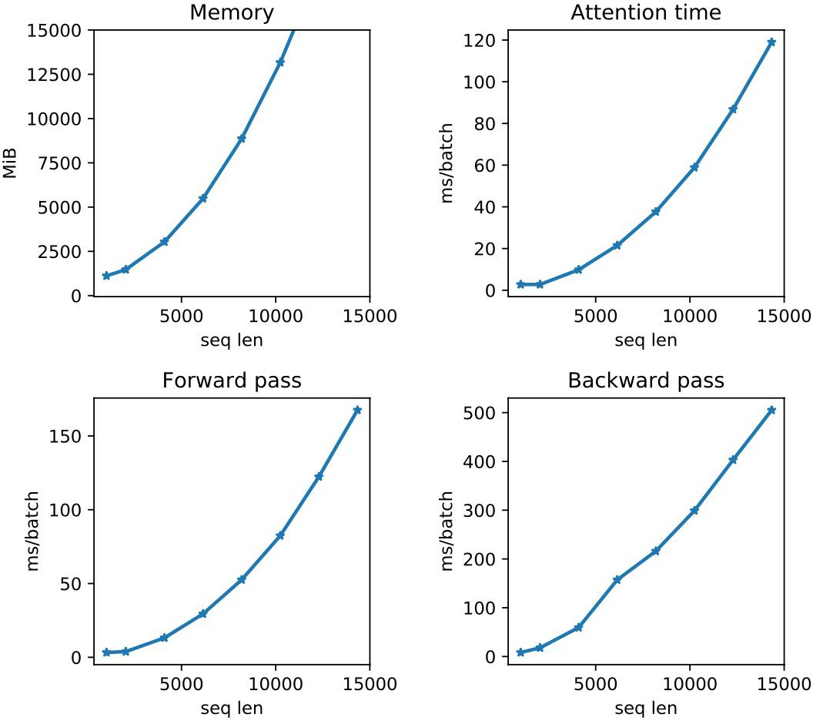
Transformer on Long Input
Longer inputs quickly become a bottleneck for Transformers
Single-head single-layer transformer Titan RTX8000 GPU
[NAACL 2021 Tutorial Beltagy, Cohan, Hajishirzi, Min, and Peters]

Slide 50
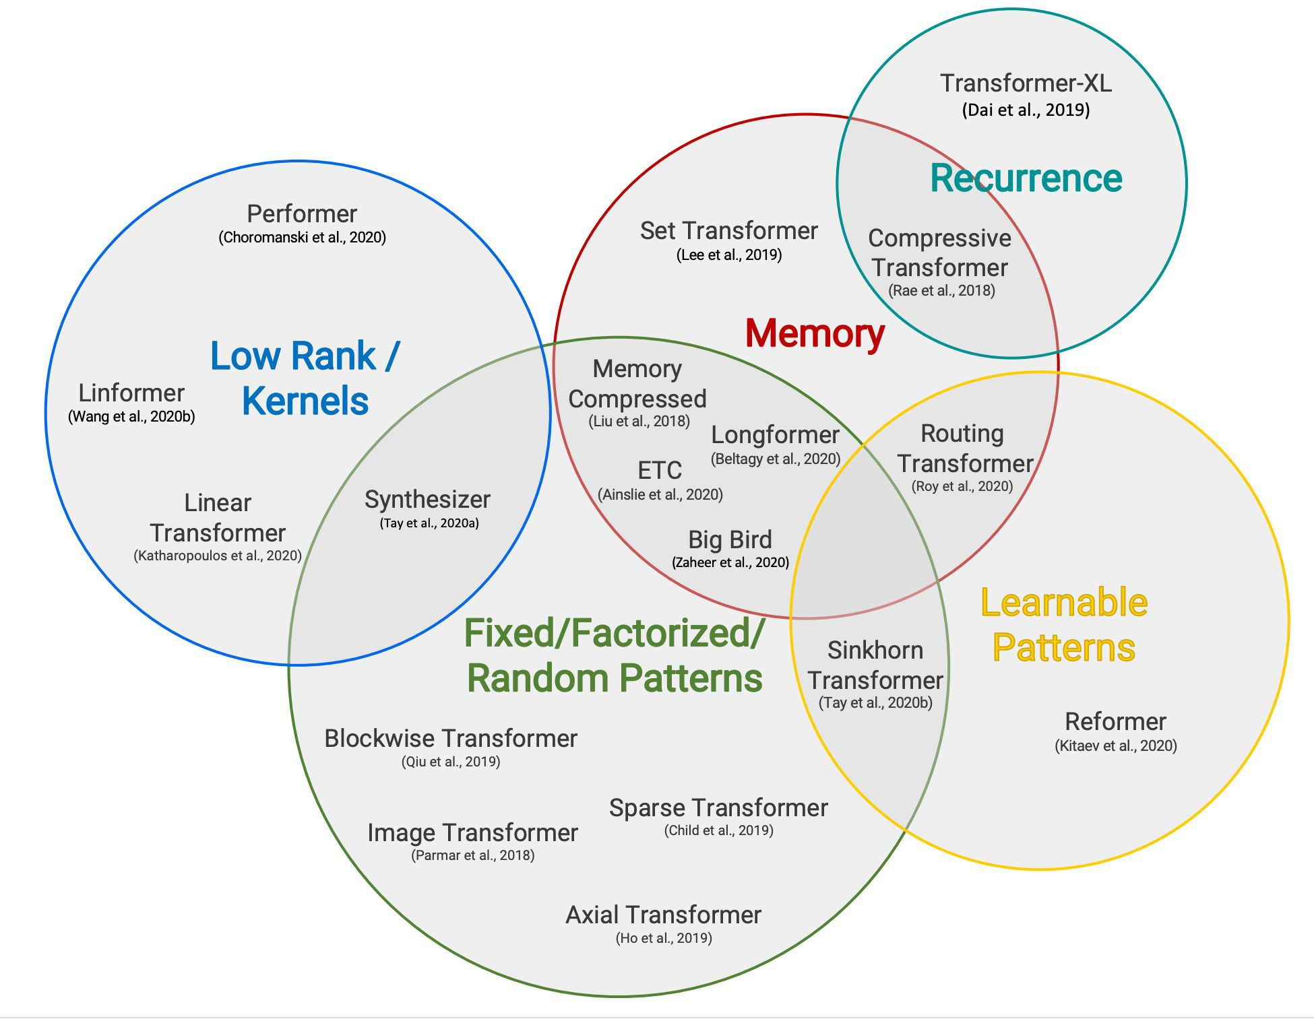
Extending Transformers to Longer Inputs
A wide variety of recently proposed method to make Transformers efﬁcient for large sequences
We will cover few important works
Fig reference: Tay et al., 2020
[NAACL 2021 Tutorial Beltagy, Cohan, Hajishirzi, Min, and Peters]

Slide 51
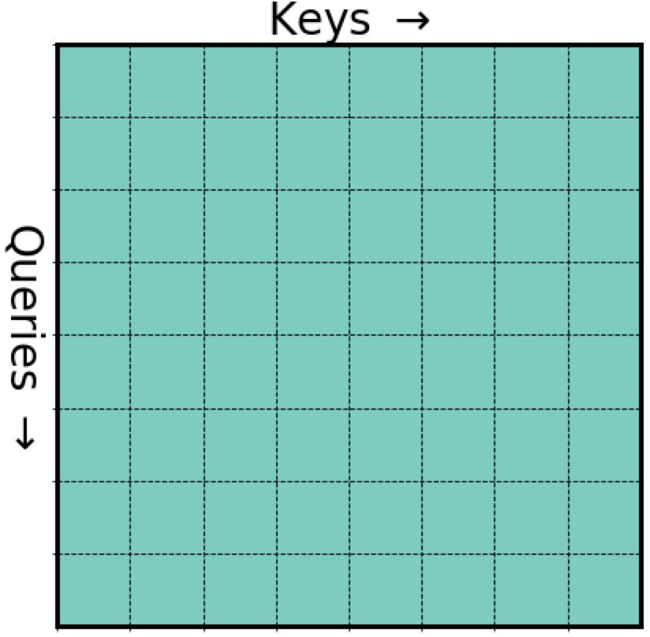
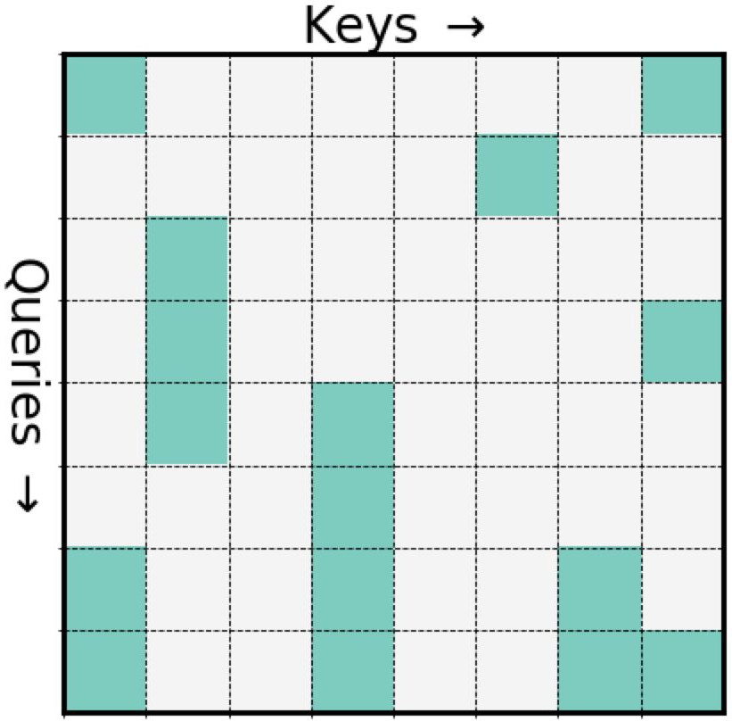
Sparse Attention Patterns
The idea is to make the attention operation sparse
[NAACL 2021 Tutorial Beltagy, Cohan, Hajishirzi, Min, and Peters]

Slide 52
Sparse Patterns
How to sparsify?
Content-based
Routing Transformers (Roy et al., 2019)
Sinkhorn (Tay et al., 2020)
Reformer (Kitaev et al., 2020)
Pre-speciﬁed patterns
Sparse Transformer (Child et al,. 2019)
Longformer (Beltagy, et al., 2020)
ETC (Ainslie et al., 2020)
BigBird (Zaheer et al., 2020)
[NAACL 2021 Tutorial Beltagy, Cohan, Hajishirzi, Min, and Peters]

Slide 53
Content based patterns
Reformer (Kitaev et al., 2020)
Using Locality Sensitive Hashing (LSH)
Efﬁcient & approximate way of nearest neighbors search in high dimensional datasets
Select hash functions such that if x is close to y then with high enough probability we have hash(x) == hash(y)
Find LSH hashes of Q and K matrices.
Compute attention only for the k and q vectors within the same hash buckets.
[NAACL 2021 Tutorial Beltagy, Cohan, Hajishirzi, Min, and Peters]

Slide 54
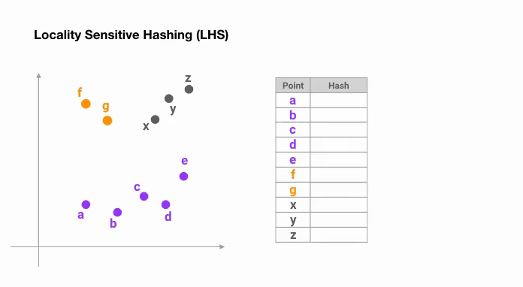
Notes:
https://towardsdatascience.com/illustrating-the-reformer-393575ac6ba0

Slide 55
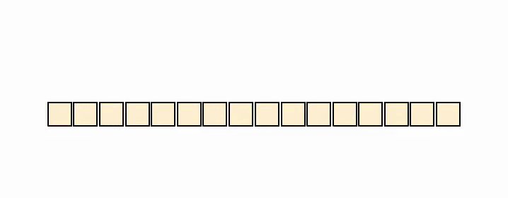
Content based patterns- Reformer (Kitaev et al., 2020)
LSH attention
Figure from illustrating reformer blog
[NAACL 2021 Tutorial Beltagy, Cohan, Hajishirzi, Min, and Peters]

Slide 56
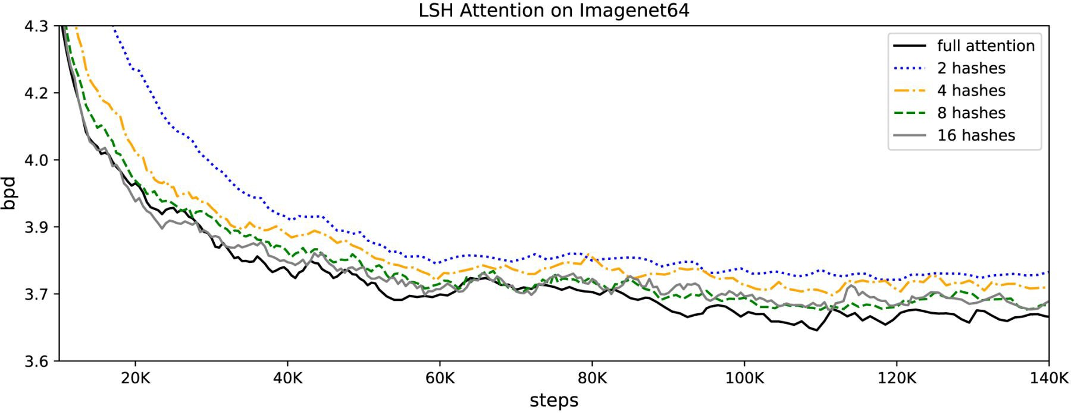
Content based patterns - Reformer (Kitaev et al., 2020)
Model quality
[NAACL 2021 Tutorial Beltagy, Cohan, Hajishirzi, Min, and Peters]

Slide 57
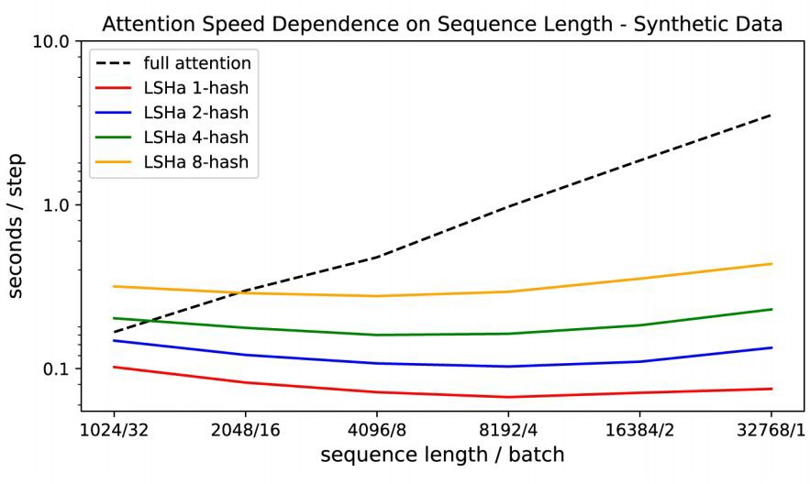
Content based patterns - Reformer (Kitaev et al., 2020)
Performance speed
[NAACL 2021 Tutorial Beltagy, Cohan, Hajishirzi, Min, and Peters]

Slide 58
Content based patterns - Reformer (Kitaev et al., 2020)
Additional contribution: Using Reversible Resnets (Gomez et al., 2017)
Allow the activations at any given layer to be recovered from the activations at the following layer, using only the model parameters.
Normal residual connection
Reversible: works on a pairs of inputs/outputs
A layer can be reversed by subtracting (rather than adding) the residuals
[NAACL 2021 Tutorial Beltagy, Cohan, Hajishirzi, Min, and Peters]

Slide 59
Content based patterns - Reformer (Kitaev et al., 2020)
Reversible layers
F: Attention, G: Feed Forward
[NAACL 2021 Tutorial Beltagy, Cohan, Hajishirzi, Min, and Peters]

Slide 60
Content based patterns - Reformer (Kitaev et al., 2020)
Not storing activations doesn't hurt performance at all.
[NAACL 2021 Tutorial Beltagy, Cohan, Hajishirzi, Min, and Peters]

Slide 61
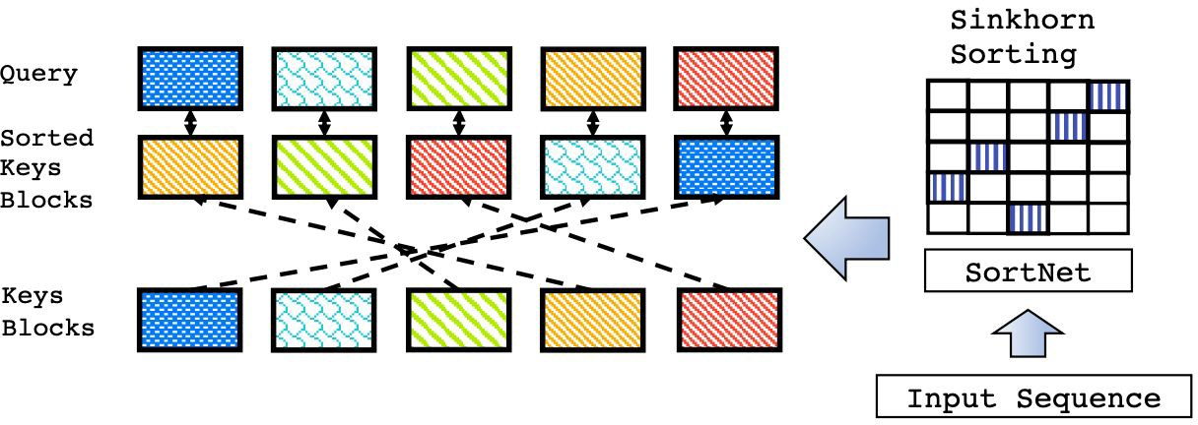
Content based patterns
Sparse Sinkhorn Attention (Tay et al., 2020)
Key idea: Use block-wise local attention but sort the key blocks
Differentiable sorting of internal representations within self-attention
Using a differentiable Sinkhorn balancing mechanism
After sorting, attention computation is efﬁcient even in local neighborhood
[NAACL 2021 Tutorial Beltagy, Cohan, Hajishirzi, Min, and Peters]

Slide 62
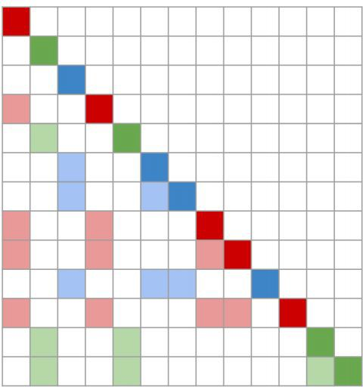
Content-Based Patterns
Routing Transformer (Roy et al., 2020)
Clustering-based attention mechanism that learns the attention sparsity in a data driven fashion.
Project Q and K into routing matrix R
The R matrix undergoes k-means clustering
After clustering, each token only attends to tokens from the same cluster
Auto-regressive attention, each color shows cluster membership
[NAACL 2021 Tutorial Beltagy, Cohan, Hajishirzi, Min, and Peters]

Slide 63
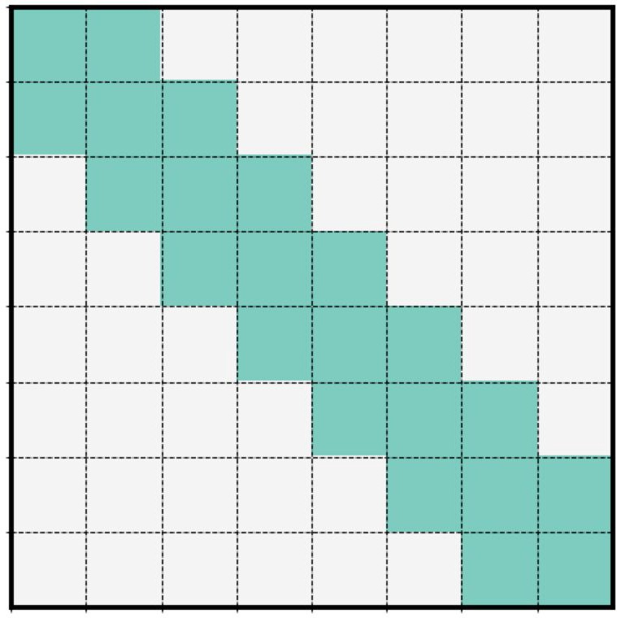
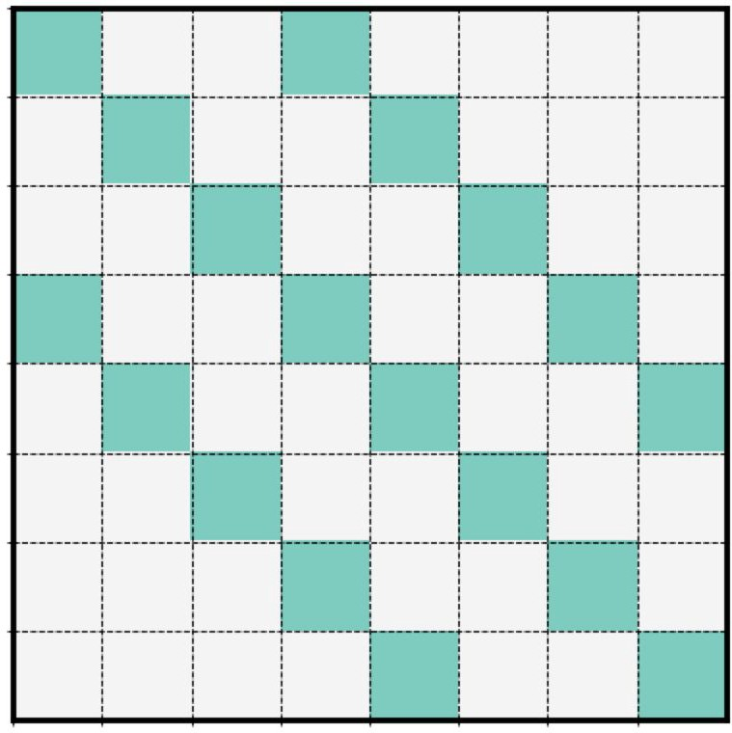
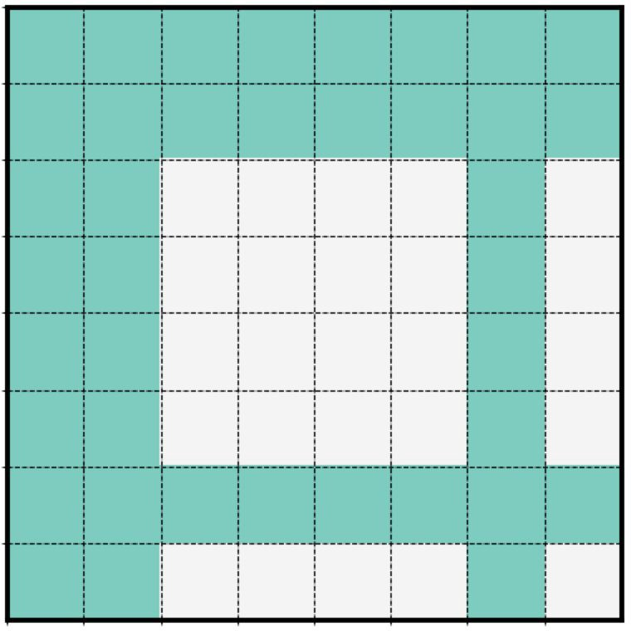
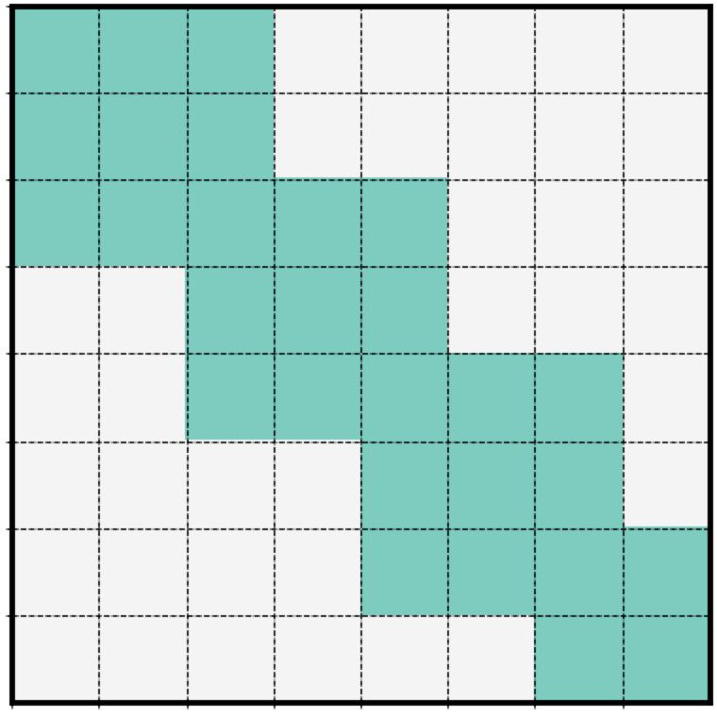
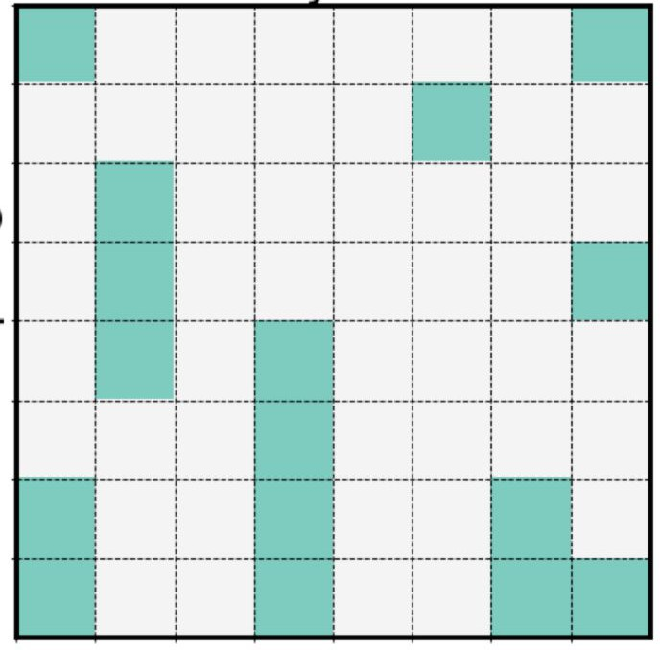
Pre-speciﬁed Sparsity Patterns
A variety of patterns has been explored in the past work
Longformer (Beltagy et al., 2020), Sparse Transformer (Child et al., 2019), …
Sliding window
Dilated
Global
Blocked
Random
Sparse Transformer Longformer
Longformer
Big Bird
Big Bird Sinkhorn
Big Bird
[NAACL 2021 Tutorial Beltagy, Cohan, Hajishirzi, Min, and Peters]

Slide 64
Pre-speciﬁed Sparsity Patterns
What patterns to use? Big Bird (Zaheer et al., 2020) and ETC (Ainslie et al., 2020)

Slide 65
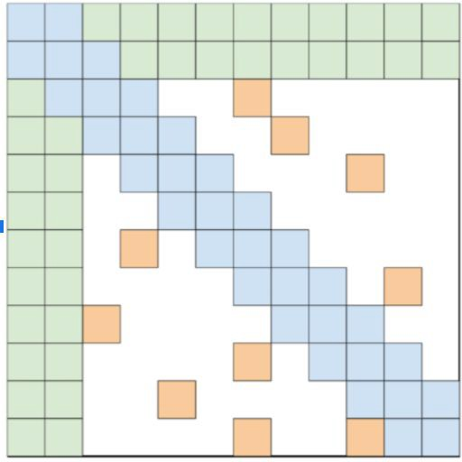
Pre-speciﬁed Sparsity Patterns
Special "global" tokens are used in the beginning of the sequence
Global attention is used on these tokens
Serving as "global memory"
Big Bird (Zaheer et al., 2020) and ETC (Ainslie et al., 2020), GMAT (Gupta et al., 2020)

Slide 66
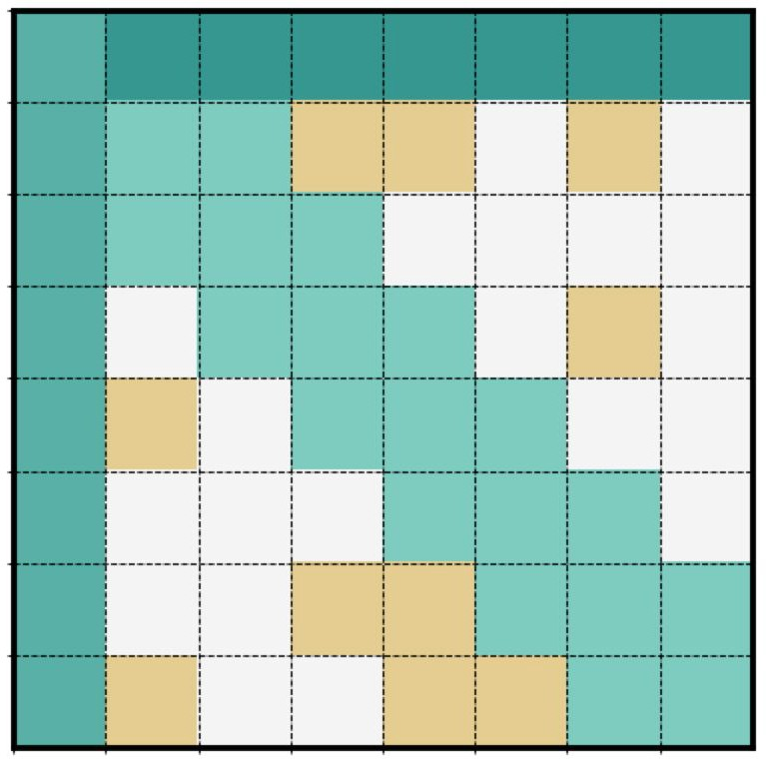
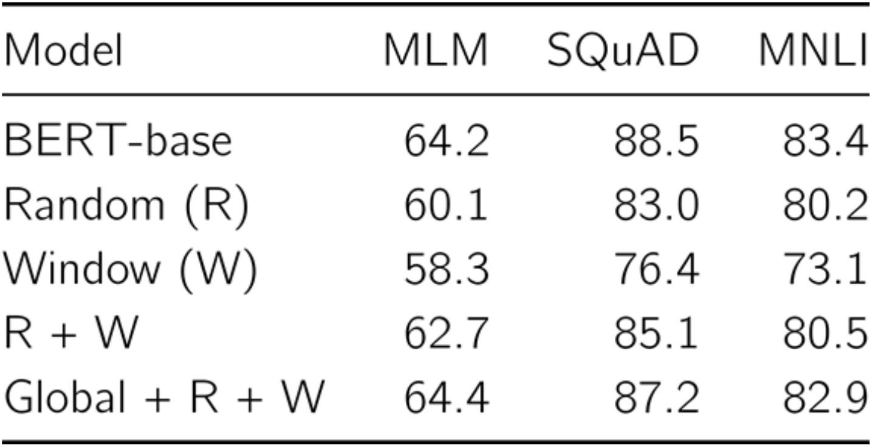
Pre-speciﬁed Sparsity Patterns
Big Bird (Zaheer et al., 2020)
Local and Random sparse attention is not enough to match the performance of full attention
[NAACL 2021 Tutorial Beltagy, Cohan, Hajishirzi, Min, and Peters]

Slide 67
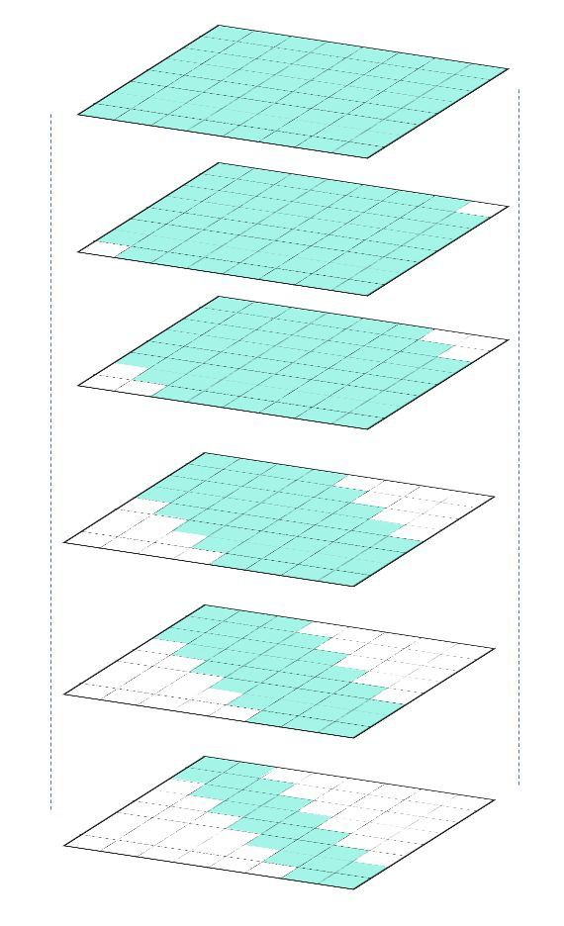
Pre-speciﬁed Sparsity Patterns
Different layers and attention heads can follow different patterns
A common setup is to have earlier layers with sparser attention pattern.
Longformer (Beltagy et al., 2020)

Slide 68
A Notable Adoption: GPT-3
Sparse patterns also used in GPT-3 (Brown et al., 2020)

Slide 69
Pre-speciﬁed Sparsity Patterns: Computations
Ok sparsity is great, but how to efﬁciently implement this?
Challenge: Arbitrary sparse matrix multiplication is not supported in DL libraries
A solution: Perform computations in blocks
[NAACL 2021 Tutorial Beltagy, Cohan, Hajishirzi, Min, and Peters]

Slide 70
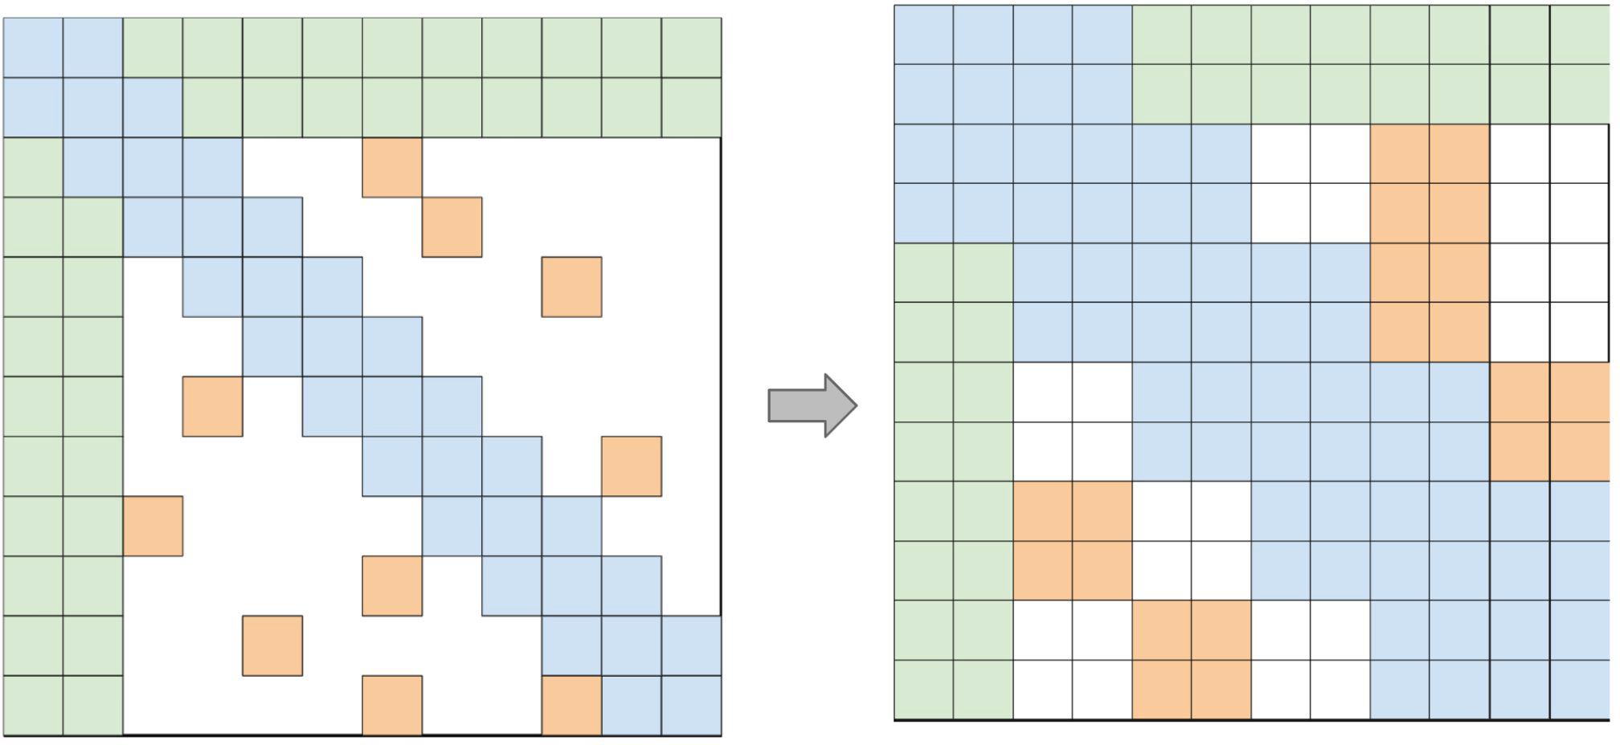
Pre-speciﬁed Sparsity Patterns: Computations
Efﬁcient blockiﬁed implementation
There are libraries for implementing blockified sparse matrix multiplication.
Can be hardware speciﬁc
Block Sparse (Gray et al., 2017)
TVM toolkit (Chen et al., 2018)
cuSPARSE
[Big Bird (Zaheer et al., 2020)]

Slide 71
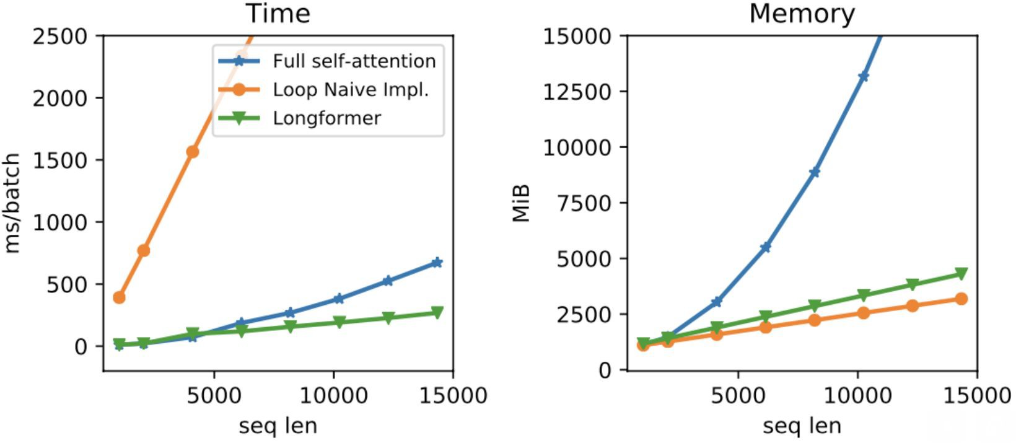
Pre-speciﬁed Sparsity Patterns: Computations
[Longformer (Beltagy et al., 2020)]

Slide 72
Summary
How well do Transformers work on long sequences? Not so well.
How can we make them more efficient? Induce sparsity.
Many open questions we did not get into:
Limitations of sportifying Transformers
Alternatives to Transformers (e.g., state-space models)
…

Slide 73
Approximating attention and kernel methods
[NAACL 2021 Tutorial Beltagy, Cohan, Hajishirzi, Min, and Peters]

Slide 74
Kernels and approximating self-attention
Intuition from Linear Transformer (Katharopoulos et al. 2020)
Recall self-attention formula Could rewrite as following:
Instead of dot product for similarity, use a kernel function:
[NAACL 2021 Tutorial Beltagy, Cohan, Hajishirzi, Min, and Peters]

Slide 75
Kernels and approximating self-attention
Instead of dot product for similarity, use a kernel function:
Associative property of matrix multiplication
The cost becomes linear as can be computed once and reused
Feature map based on the exponential linear unit activation (elu)
[NAACL 2021 Tutorial Beltagy, Cohan, Hajishirzi, Min, and Peters]

Slide 76
Kernels and approximating self-attention
Linear Transformer (Katharopoulos et al. 2020)
How can this be extended to autoregressive transformers?
Causal masking
* Some of the linear Transformer slides are from original author slides
[NAACL 2021 Tutorial Beltagy, Cohan, Hajishirzi, Min, and Peters]

Slide 77
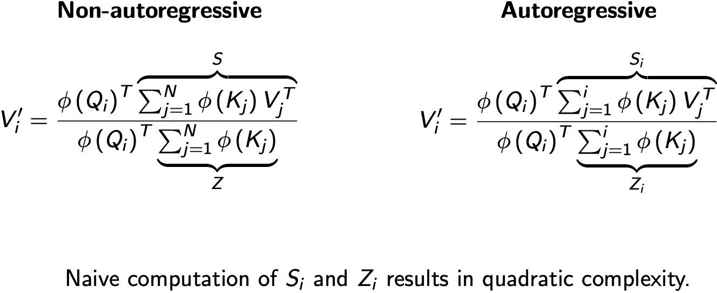
Kernels and approximating self-attention
Linear Transformer (Katharopoulos et al. 2020)
However, both S_{i} and Z_{i} can be computed as cumulative sums (constant time) given the previous values Allows recovering linear complexity
[NAACL 2021 Tutorial Beltagy, Cohan, Hajishirzi, Min, and Peters]

Slide 78
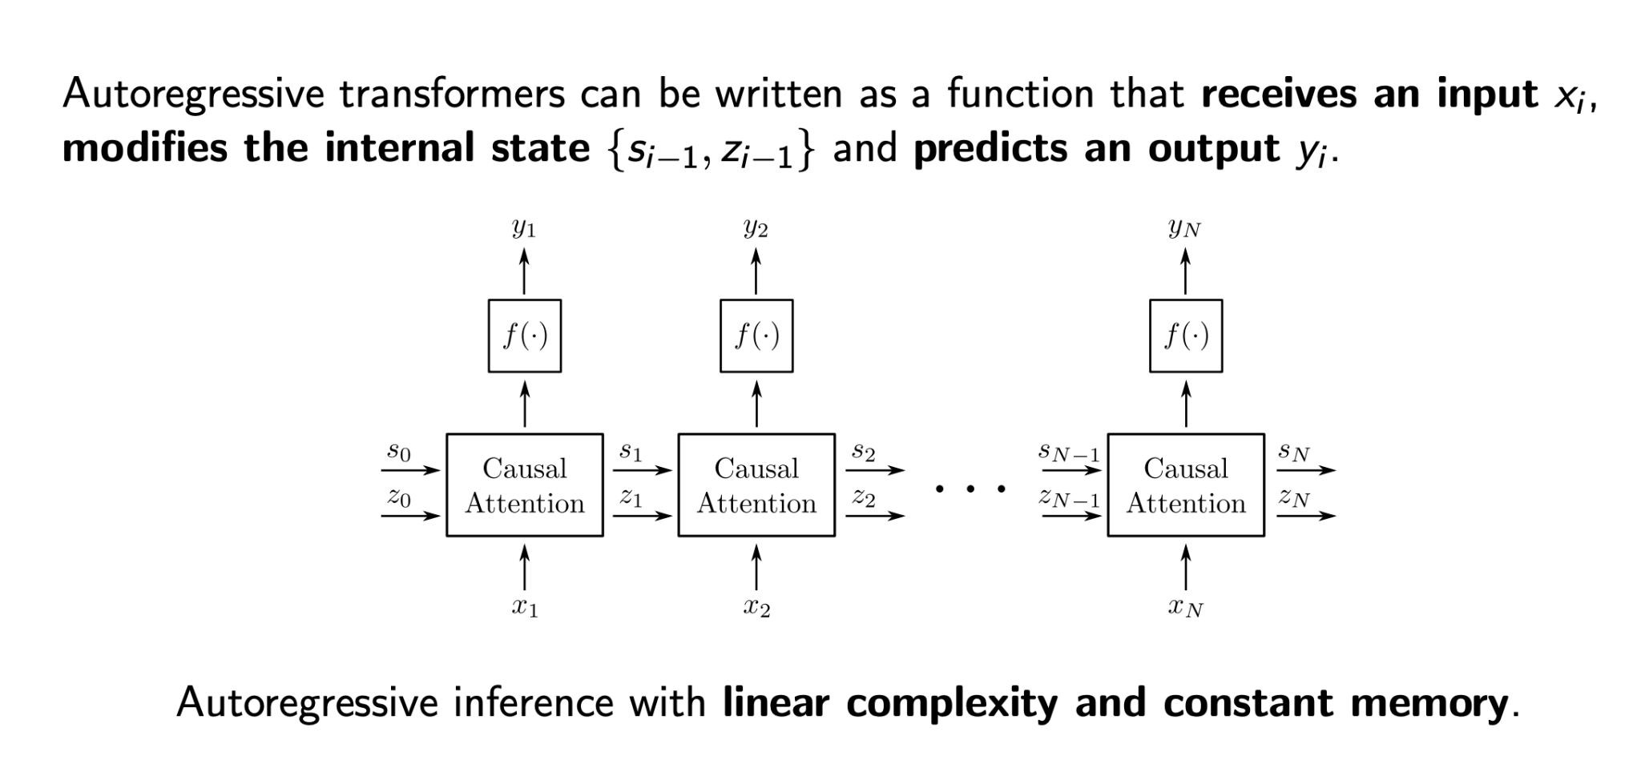
Kernels and approximating self-attention
Linear Transformer (Katharopoulos et al. 2020)
[NAACL 2021 Tutorial Beltagy, Cohan, Hajishirzi, Min, and Peters]

Slide 79
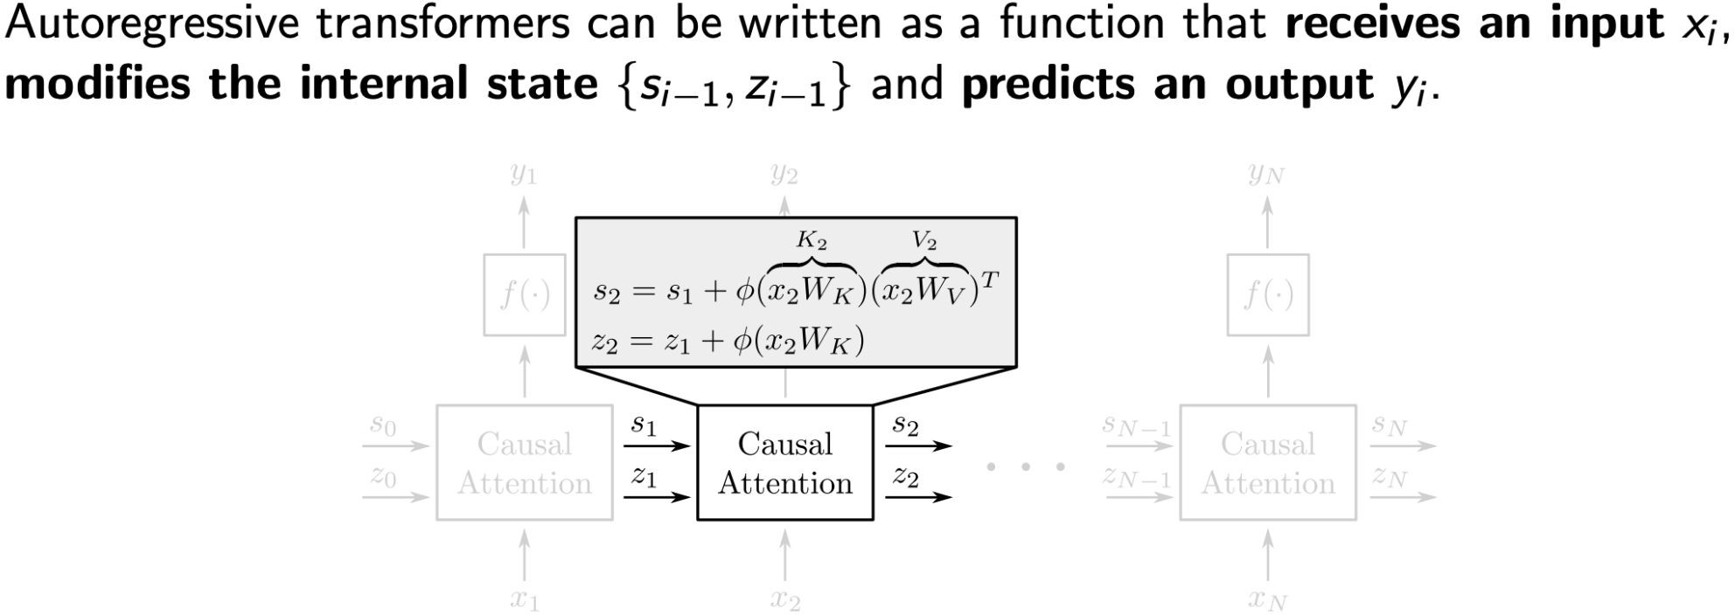
Kernels and approximating self-attention
Linear Transformer (Katharopoulos et al. 2020)
[NAACL 2021 Tutorial Beltagy, Cohan, Hajishirzi, Min, and Peters]

Slide 80
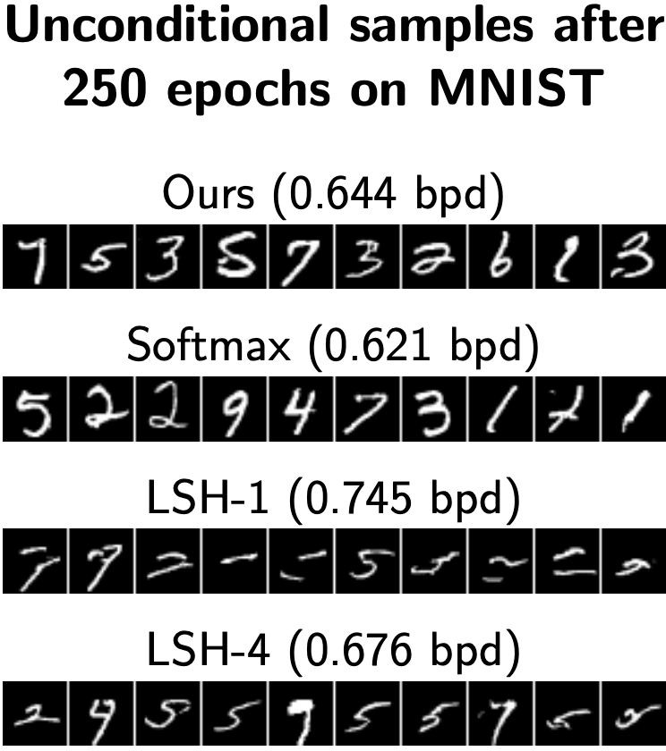
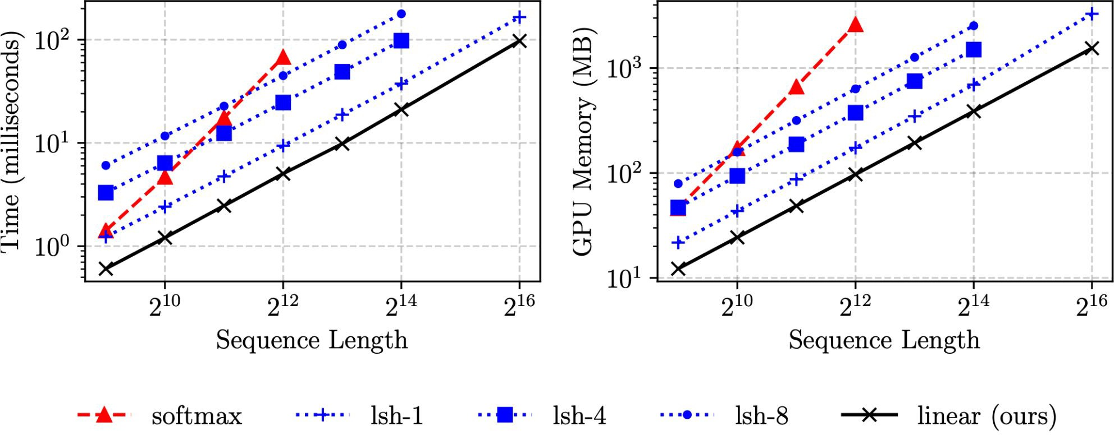
Kernels and approximating self-attention
Linear Transformer (Katharopoulos et al. 2020)
[NAACL 2021 Tutorial Beltagy, Cohan, Hajishirzi, Min, and Peters]

Slide 81
Kernels and approximating self-attention
Performer (Choromanski et al., 2020)
Generalized attention mechanizm and random kernels
[NAACL 2021 Tutorial Beltagy, Cohan, Hajishirzi, Min, and Peters]
* Some of Performer related slides are taken from the original slides by the authors

Slide 82
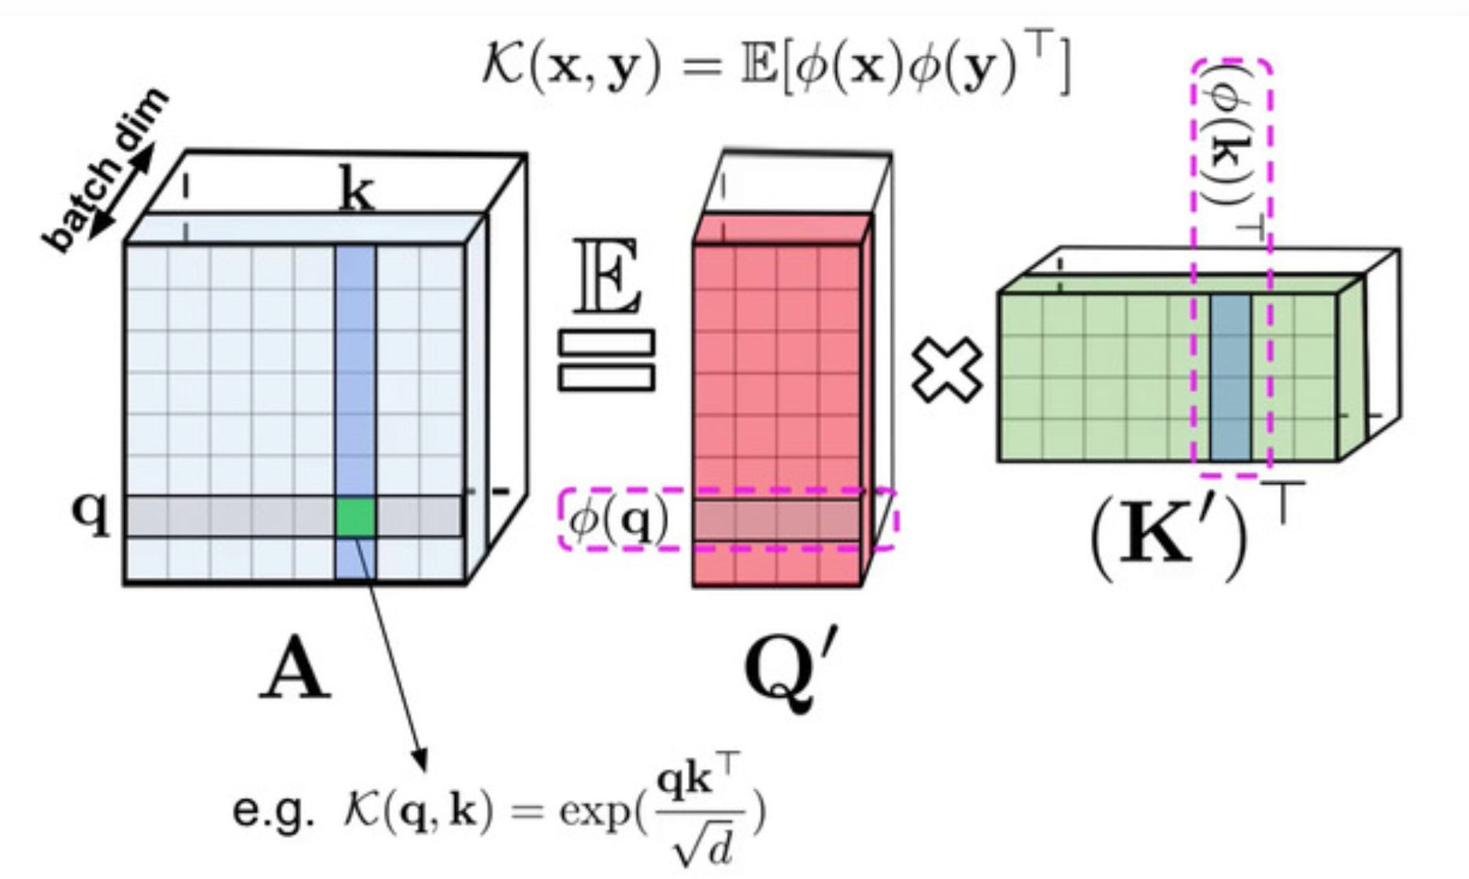
Estimating full self-attention
Performer (Choromanski et al., 2020)
Attention is Kernelizable
[NAACL 2021 Tutorial Beltagy, Cohan, Hajishirzi, Min, and Peters]

Slide 83
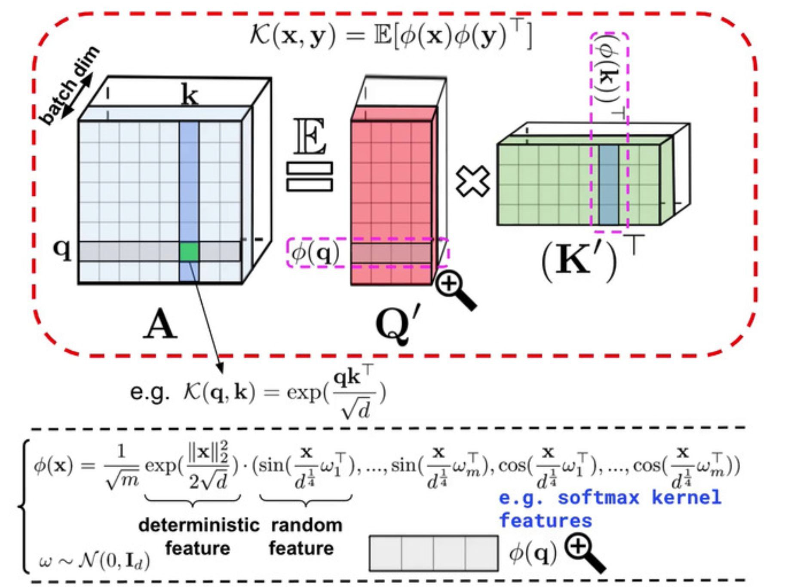
Kernels and approximating self-attention
Performer (Choromanski et al., 2020)
Random Fourier features
FAVOR+ algorithm
[NAACL 2021 Tutorial Beltagy, Cohan, Hajishirzi, Min, and Peters]

Slide 84
Kernels and approximating self-attention
Performer (Choromanski et al., 2020)
In practice the number of features is much lower than the sequence length
[NAACL 2021 Tutorial Beltagy, Cohan, Hajishirzi, Min, and Peters]

Slide 85
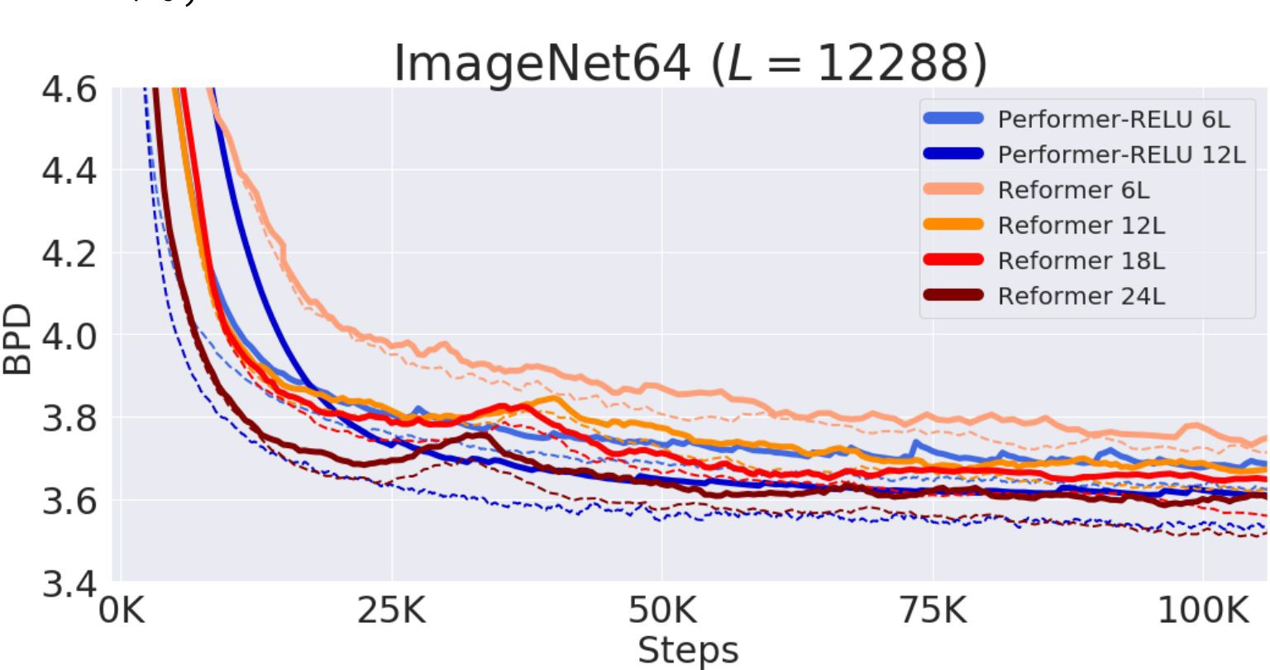
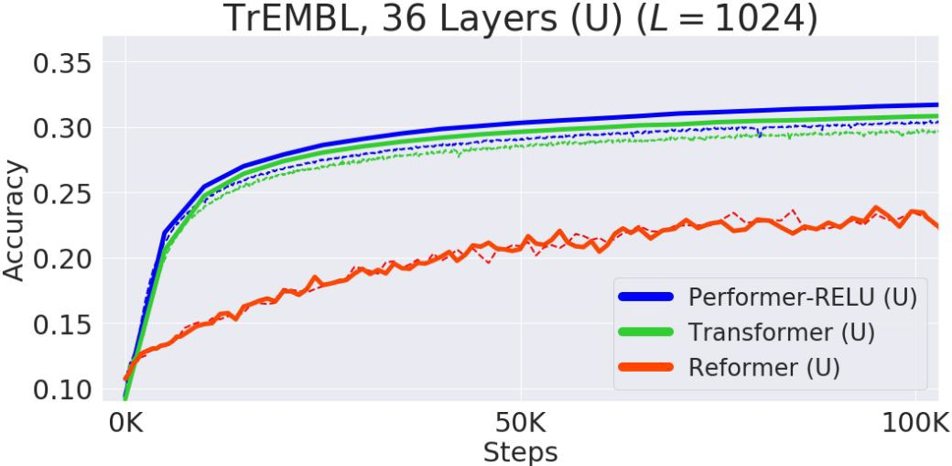
Kernels and approximating self-attention
Performer (Choromanski et al., 2020)
Modeling protein sequence
Generating images
[NAACL 2021 Tutorial Beltagy, Cohan, Hajishirzi, Min, and Peters]

Slide 86
Kernels and approximating self-attention
Random Feature Attention (Peng et al., 2021)
Kernelizing attention similar to Linear Transformer
Instead of exponential linear unit feature map, uses random features
- D dimensional random vectors w_i are sampled from
[NAACL 2021 Tutorial Beltagy, Cohan, Hajishirzi, Min, and Peters]

Slide 87
Kernels and approximating self-attention
Random Feature Attention (Peng et al., 2021)
Concurrent work with Performer
Performer uses positive random features to approximate softmax, aiming for a lower variance in critical regions.
RFA instead normalizes the queries and keys before random projection to reduce variance
[NAACL 2021 Tutorial Beltagy, Cohan, Hajishirzi, Min, and Peters]

Slide 88
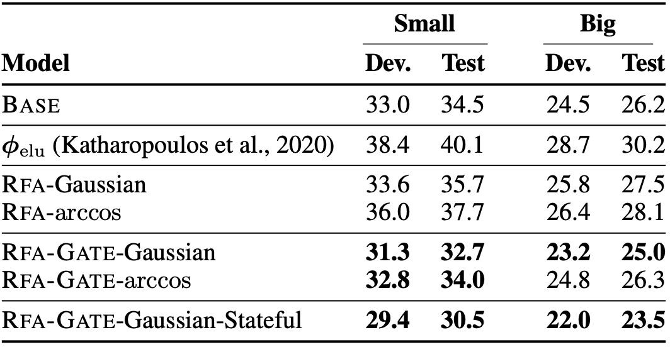
Kernels and approximating self-attention
Random Feature Attention (Peng et al., 2021)
LM Preplexity on Wikitext 103
[NAACL 2021 Tutorial Beltagy, Cohan, Hajishirzi, Min, and Peters]

Slide 89
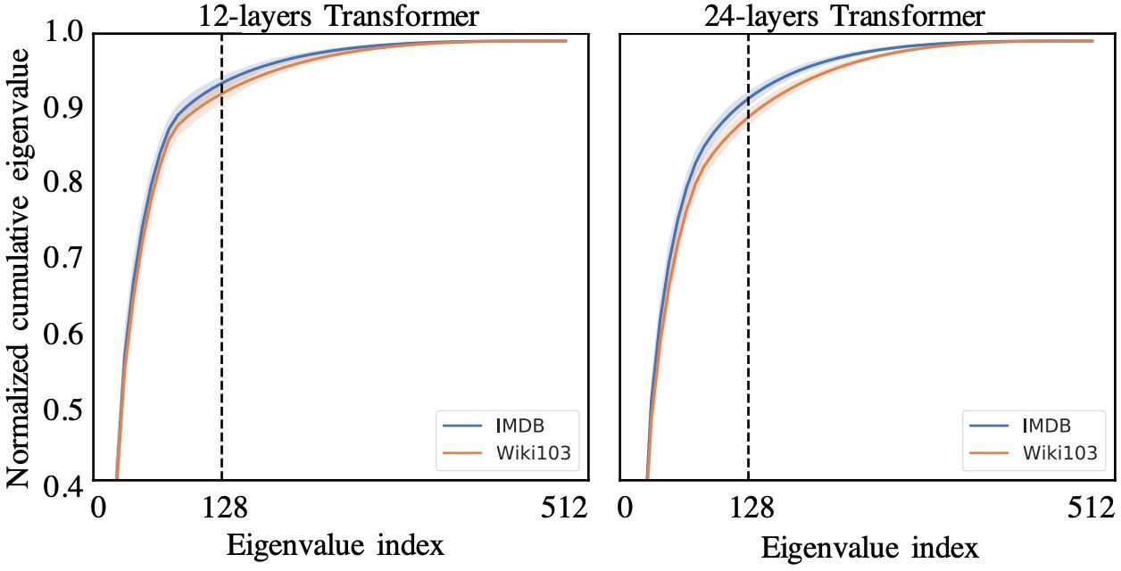
Kernels and approximating self-attention
Linformer (Wang et al 2020)
Self-attention matrix is low-rank
Apply SVD on matrix P (self-attention)
Most of the information of matrix P can be recovered from the first few largest singular values
[NAACL 2021 Tutorial Beltagy, Cohan, Hajishirzi, Min, and Peters]

Slide 90
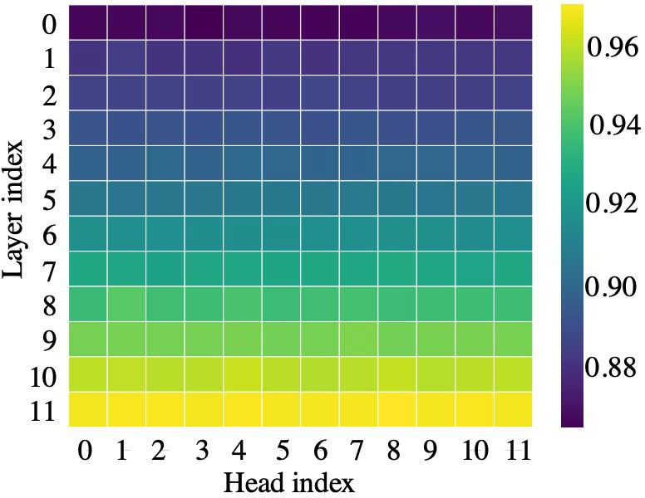
Kernels and approximating self-attention
Linformer (Wang et al 2020)
Rank in higher layers is even lower
heatmap of the normalized cumulative singular value at the 128-th largest singular value
[NAACL 2021 Tutorial Beltagy, Cohan, Hajishirzi, Min, and Peters]

Slide 91
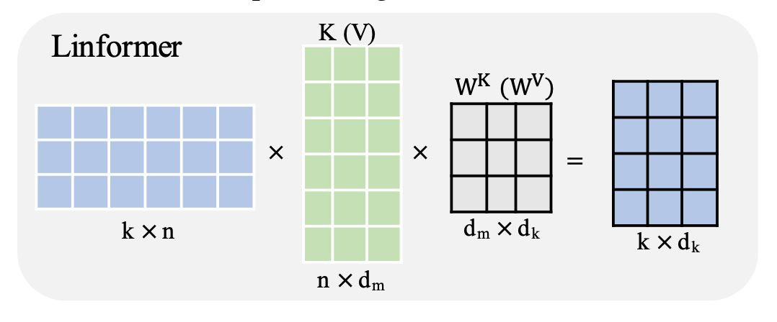
Kernels and approximating self-attention
Linformer (Wang et al 2020)
Low-rank approximations of the self-attention matrix
Projects the length dimension of keys and values to a lower-dimensional representation (N → k) [N: seq len]
Reduce O(N^2) to O(Nk)
[NAACL 2021 Tutorial Beltagy, Cohan, Hajishirzi, Min, and Peters]

Slide 92
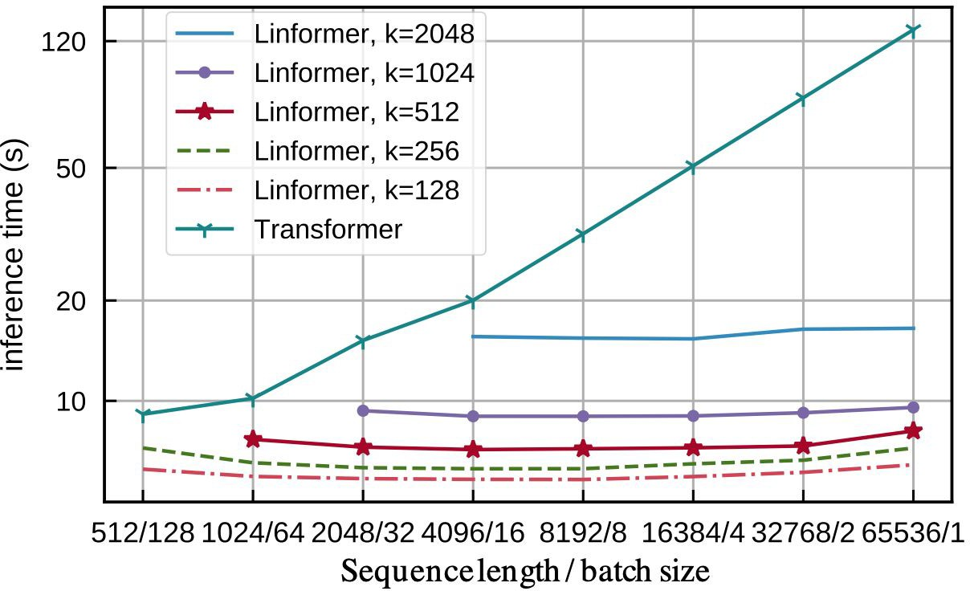
Kernels and approximating self-attention
Linformer (Wang et al 2020)
[NAACL 2021 Tutorial Beltagy, Cohan, Hajishirzi, Min, and Peters]

Slide 93
Kernels and approximating self-attention
Linformer (Wang et al 2020)
When pre-trained, competitive performance with full self-attention
[NAACL 2021 Tutorial Beltagy, Cohan, Hajishirzi, Min, and Peters]

Slide 94
Benchmarking Transformers
[NAACL 2021 Tutorial Beltagy, Cohan, Hajishirzi, Min, and Peters]

Slide 95
Benchmarking Transformers
Long Range Arena (Tay et al., 2020)
A suite of 6 tasks to evaluate transformers, without the need for pre-training
Long list ops
Byte-level text classiﬁcation
Byte-level document retrieval
Image classiﬁcation on sequence of pixels
[NAACL 2021 Tutorial Beltagy, Cohan, Hajishirzi, Min, and Peters]

Slide 96
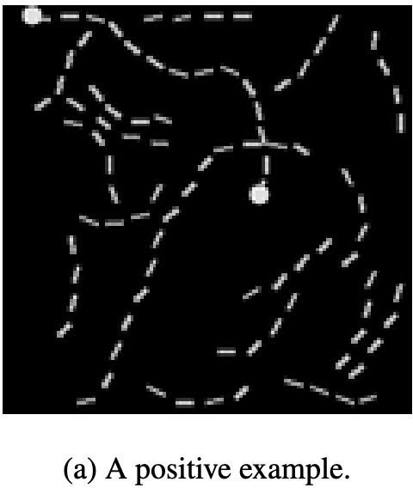
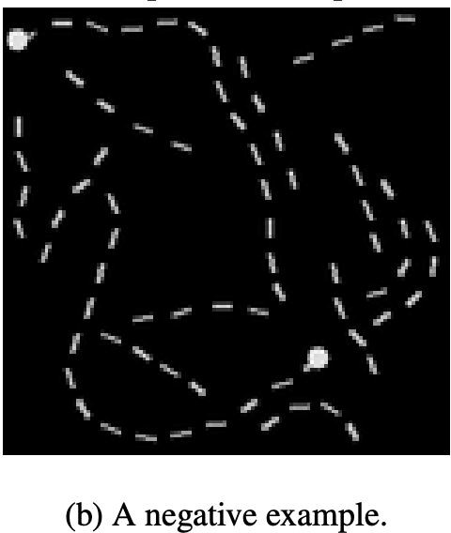
Benchmarking Transformers
Long Range Arena (Tay et al., 2020)
A suite of 6 tasks to evaluate transformers, without the need for pre-training
Pathﬁnder: binary classiﬁcation whether two points represented are connected by a path consisting of dashes
32x32 images (1024 max seq len)
Pathﬁnder-X
128x128 images (16K seq len)
[NAACL 2021 Tutorial Beltagy, Cohan, Hajishirzi, Min, and Peters]

Slide 97
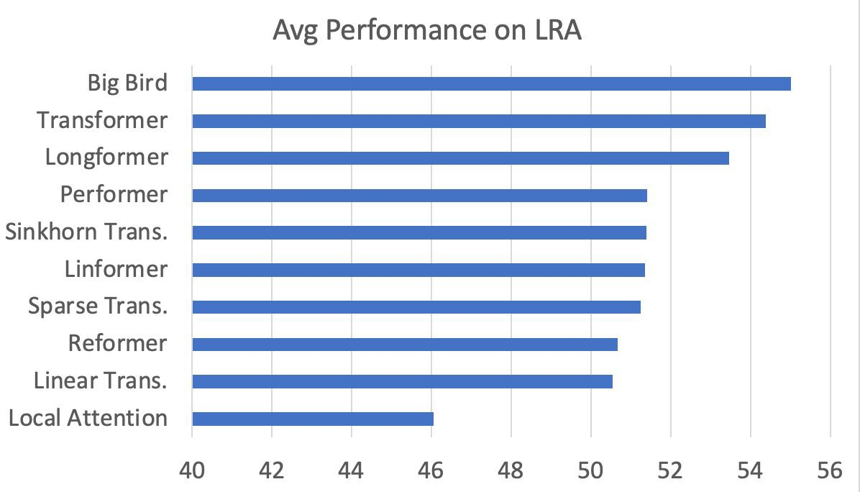
Benchmarking Transformers
[NAACL 2021 Tutorial Beltagy, Cohan, Hajishirzi, Min, and Peters]

Slide 98
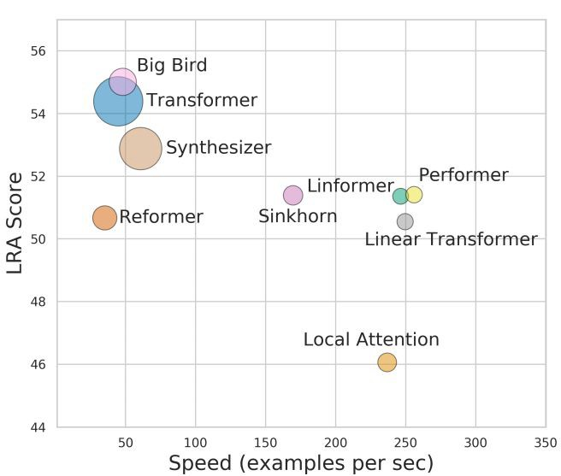
Benchmarking Transformers
Note: these results might be sensitive to implementation details, hardware and hyper-parameters.
[NAACL 2021 Tutorial Beltagy, Cohan, Hajishirzi, Min, and Peters]

Slide 99
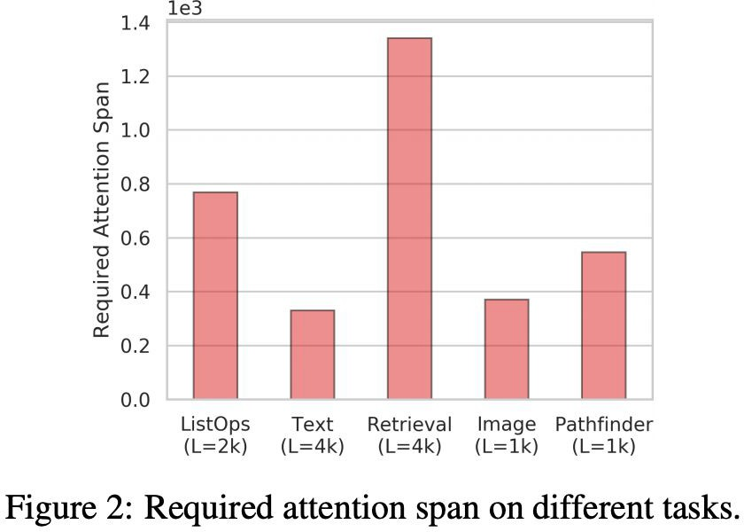
Benchmarking Transformers
Long Range Arena (Tay et al., 2020)
A nice benchmark for probing and analyses of Transformer models
Eliminates the need for expensive pre-training
Most tasks are synthetic, might not reﬂect behavior on real downstream tasks
[NAACL 2021 Tutorial Beltagy, Cohan, Hajishirzi, Min, and Peters]

Slide 100
Summary Thus far
Many approaches for making transformers efﬁcient for long sequences
Sparse Patterns
Kernels and approximations
Most of these methods can provide attention computation in linear time without notable performance loss, allowing scaling to long sequences
Many of these approaches are complementary to each other and can be
combined for more efﬁcient models
While many works have been introduced, few of them conduct extensive analyses on downstream NLP tasks (next section provides more details).
[NAACL 2021 Tutorial Beltagy, Cohan, Hajishirzi, Min, and Peters]

