Slide 1
Self-Supervised Models of Vision + Language
CSCI 601 471/671
NLP: Self-Supervised Models
https://self-supervised.cs.jhu.edu/sp2023/

Slide 2
Logistics update
We recommended few projects for revision. Due on Monday noon.
Please talk to us if you need more brainstorming to scope your proposal better.
Each team is assigned to a mentor (we will email you about the assignment).
Each team is responsible to schedule meeting time with their mentor.
Our suggestion: meet with them at least once every 10 days.
Starting next week: no TA/CA office hours.
We will have external speakers next week!

Slide 3
Attention Is All You Need
Transformers are eating the world
SOTA performance across a range of NLP tasks
...QA
...summarization
… paraphrasing
Is Attention all you need?
Everything thus far has been text
What about other modalities, e.g., images?
What about multi-modal settings, e.g., captioned images?

Slide 4
Today's Talk
Resources, datasets, & problems of interest
Models & architectures
Challenges & envisioned future

Slide 5
COCO, VQA, CLEVR, oh my
Common Objects In Context (2014)
Object detection, segmentation, key-point detection, and captioning
~330K Images
[Microsoft COCO: Common Objects in Context, 2014]

Slide 6
COCO, VQA, CLEVR, oh my
Visual Question Answering (2017)
Open-ended questions about images
~265K Images, at least 3 questions per image, "gold" answers
[VQA: Visual Question Answering, 2015]

Slide 7
COCO, VQA, CLEVR, oh my
CLEVER (2017)
"strong biases that models can exploit to correctly answer questions without reasoning"
~100K Images
~865K Questions
Answers to all train/val questions
[CLEVR: A Diagnostic Dataset for Compositional Language and Elementary Visual Reasoning, 2016]

Slide 8
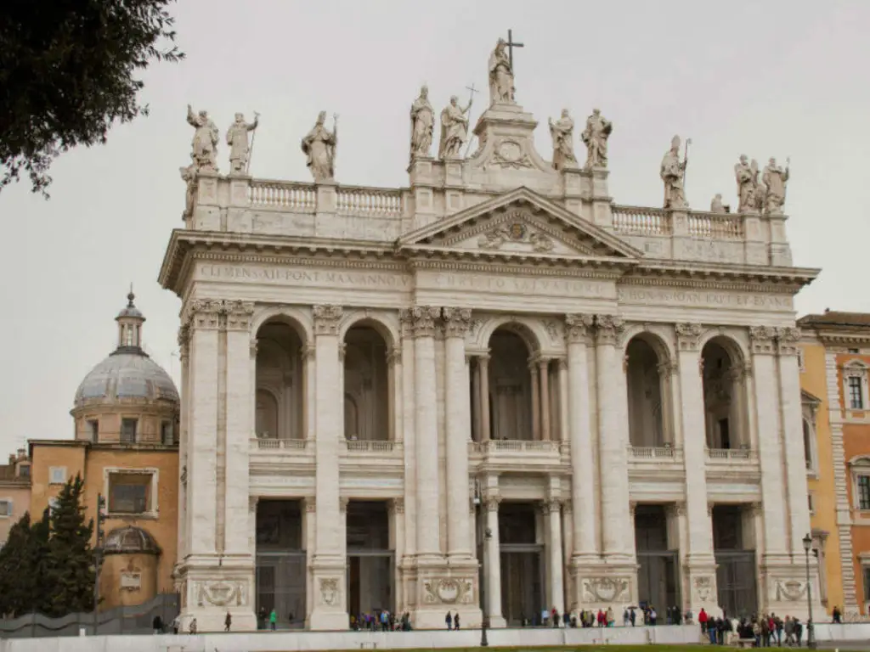
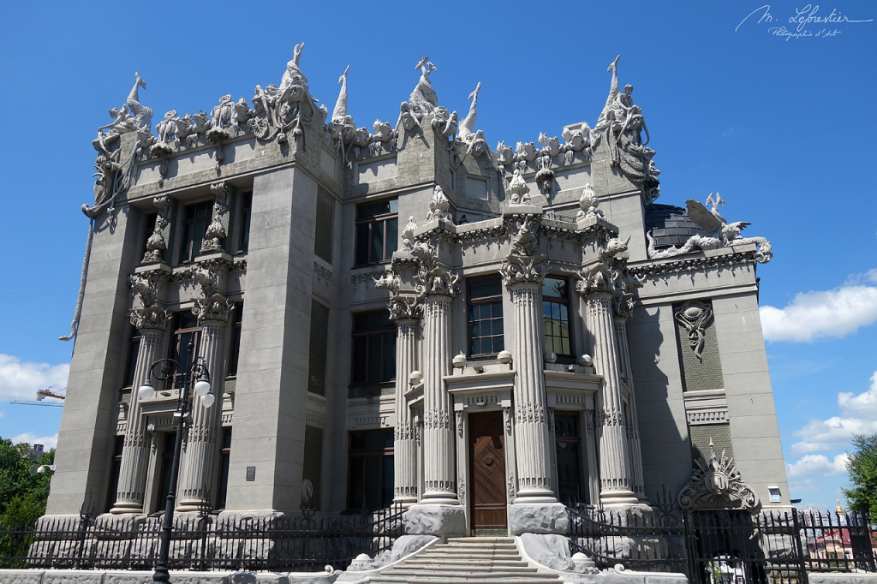
Let's Consider Images – How to Encode?

Slide 9
Let's Consider Images - Vision Transformer

Slide 10
Let's Consider Images - Vision Transformer

Slide 11
Let's Consider Images - Vision Transformer
[An Image is Worth 16x16 Words: Transformers for Image Recognition at Scale, 2020]

Slide 12
What about paired image-text – How to Encode?
Basilica of St. John Lateran
House with Chimeras – Kiev

Slide 13
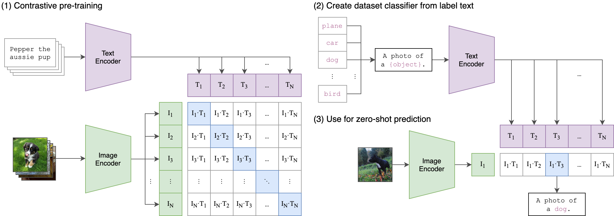
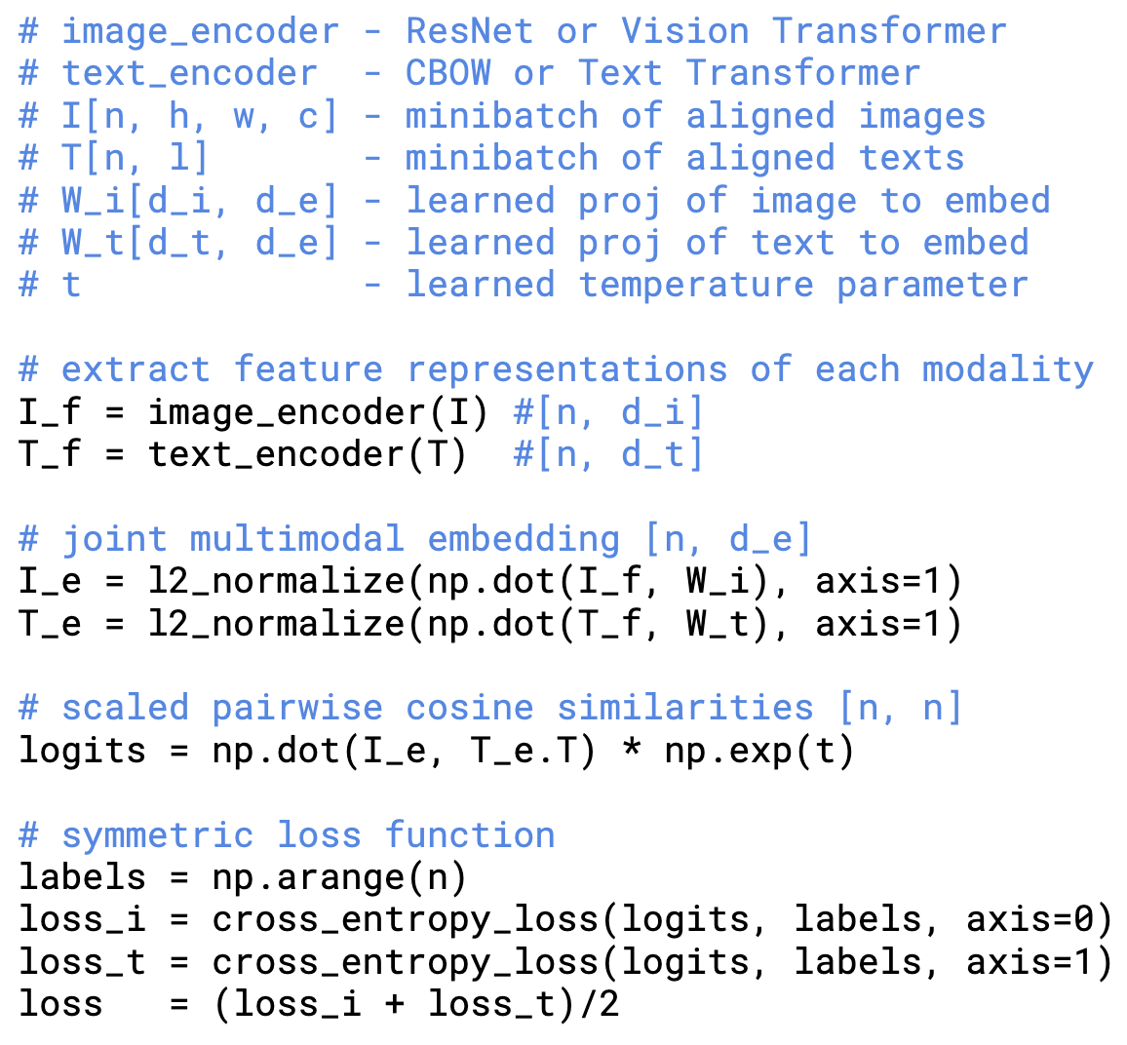
Contrastive Language–Image Pre-training (CLIP)
Given a batch of N (image, text) pairs, predict which of the N × N possible (image, text) pairings across a batch occurred
[Learning Transferable Visual Models From Natural Language Supervision, 2021]

Slide 14
Contrastive Language–Image Pre-training (CLIP)
Consider classifying photos of dogs vs cats - for each image, check if CLIP predicts text description “a photo of a dog” or “a photo of a cat” is more likely to be paired with it
[Learning Transferable Visual Models From Natural Language Supervision, 2021]

Slide 15
What can CLIP do?
CLIP evaluates associations between image-text pairs:
Image Classification
Image Searching
Controllable Caption Generation

Slide 16
What can't CLIP do?
No generation capabilities
Prompting / In-Context Learning
Few-shot captioning

Slide 17
Text-to-Image

Slide 18
DALL-E
First, a text prompt is input into a text encoder that is trained to map the prompt to a representation space.
[Zero-Shot Text-to-Image Generation, 2021]

Slide 19
DALL-E
First, a text prompt is input into a text encoder that is trained to map the prompt to a representation space.
Next, a prior maps the text encoding to a corresponding image encoding that captures the semantic information of the prompt contained in the text encoding.
[Zero-Shot Text-to-Image Generation, 2021]

Slide 20
DALL-E
First, a text prompt is input into a text encoder that is trained to map the prompt to a representation space.
Next, a prior maps the text encoding to a corresponding image encoding that captures the semantic information of the prompt contained in the text encoding.
Finally, an image decoder stochastically generates an image which is a visual manifestation of this semantic information.
[Zero-Shot Text-to-Image Generation, 2021]

Slide 21
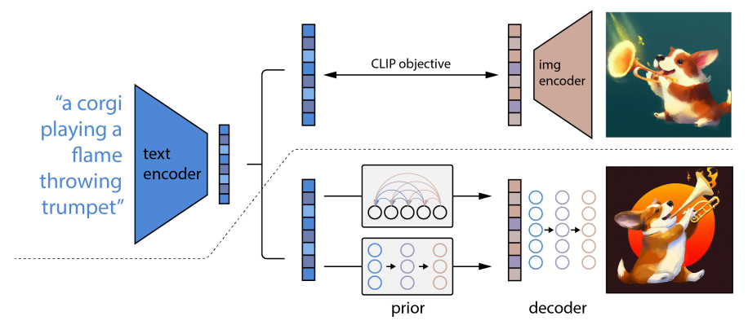
DALL-E
[Zero-Shot Text-to-Image Generation, 2021]

Slide 22
Multimodal Prompting
CLIP addresses ImageNet, but what if we introduce novel images / text / classes?
DALL-E addresses controllable image generation, but still no ICL
LLMs are transferrable to new tasks via prompting with examples
Can we do the same thing in a multimodal setting, e.g. vision + language?

Slide 23
Multimodal Few-Shot Learning with Frozen Language Models
First, consider a pretrained LLM
GPT-2-esque (7B)
Pretrained on C4
Next, consider a vision encoder
Input images (e.g. WxHxC)
Output N tokens
[Multimodal Few-Shot Learning with Frozen Language Models, 2021]

Slide 24
Multimodal Few-Shot Learning with Frozen Language Models
[Multimodal Few-Shot Learning with Frozen Language Models, 2021]

Slide 25
GPT-4

Slide 28
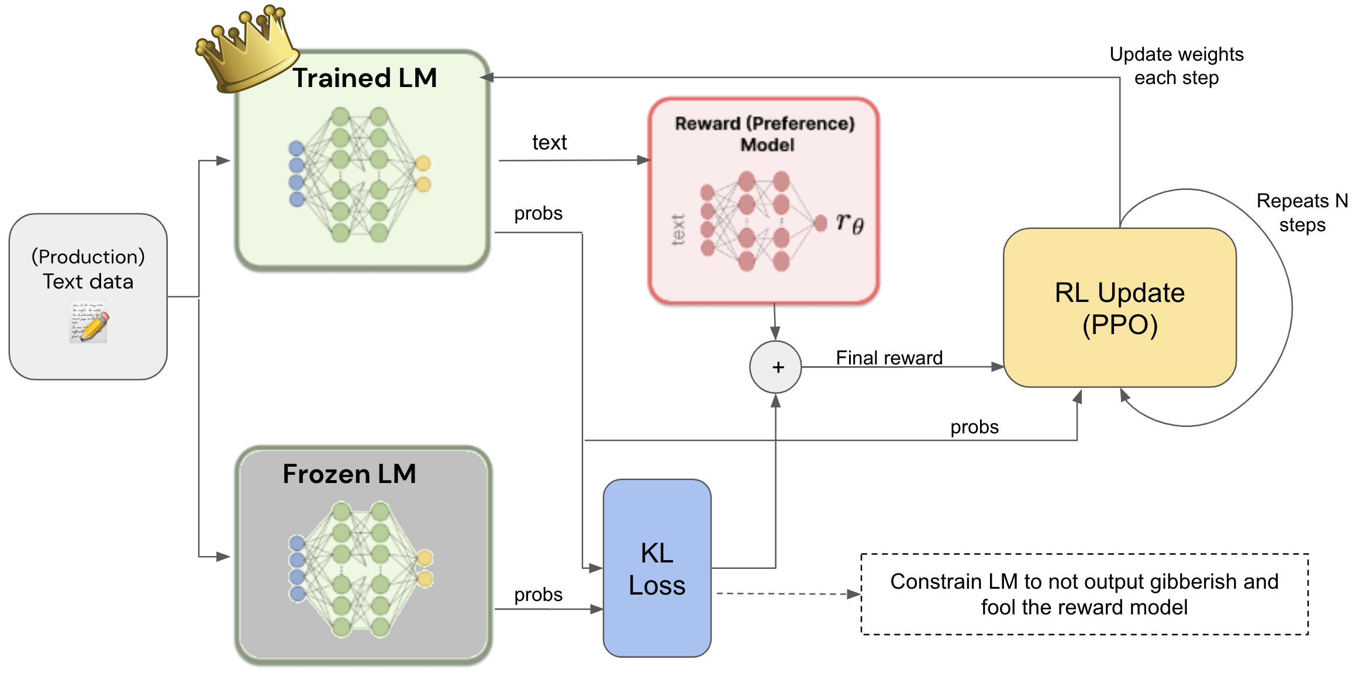
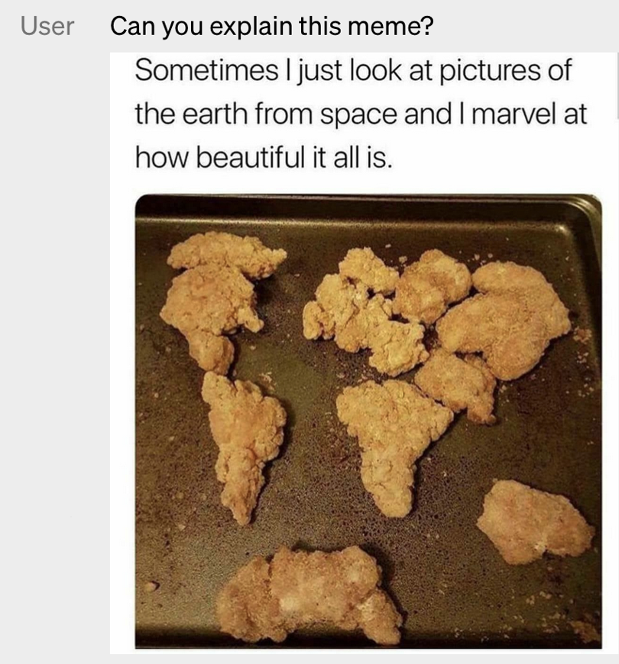
Multimodal - RLHF
The input could be any modality!
[Improving Multimodal Interactive Agents with Reinforcement Learning from Human Feedback, 2022]

Slide 29
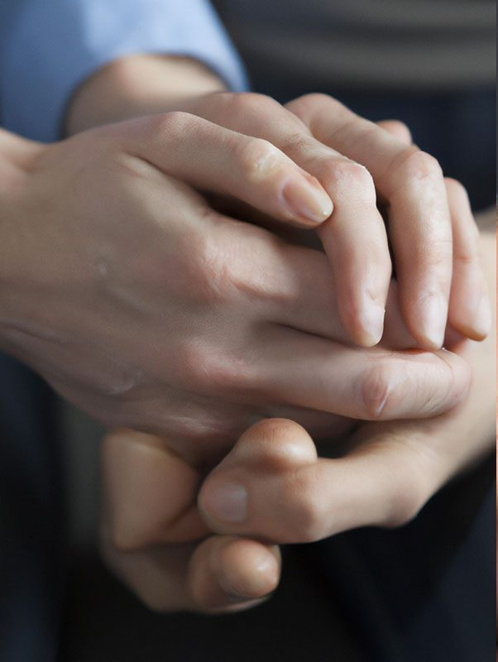
Challenges we still face Models’ quality depend on frequency of patterns

Slide 30
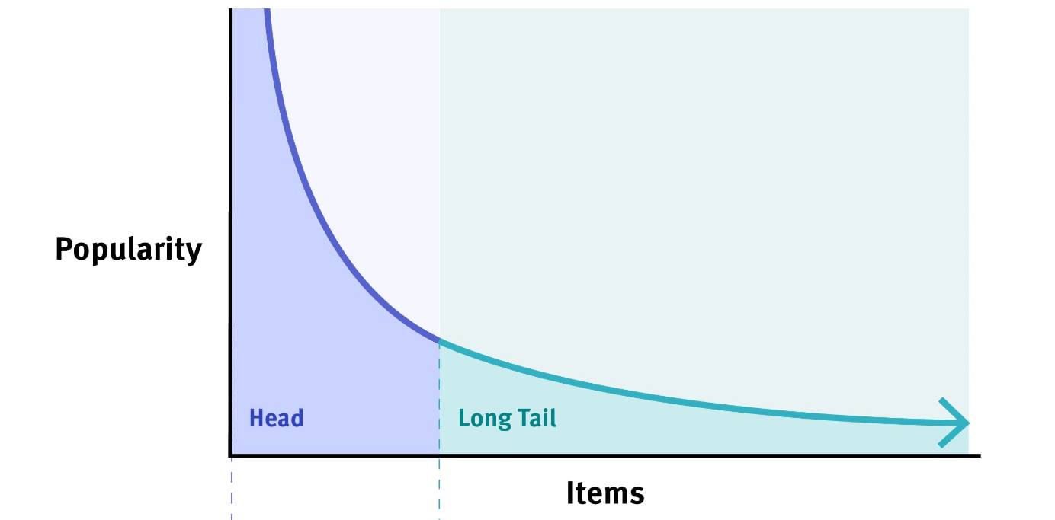
Challenges we still face - The long tail Most things are infrequent

Slide 31
Envisioning the future
More modalities — combinations of video (2D, 3D), text, code, etc.
Large models and more efficient scaling
More breath — more data and more types of data
Interaction with physical world — models with hands and actuators
Better personalization — these agents should serve your 🫵 needs
Better human-machine teaming
CoPilot for coding
CoPilot for writing
….
CoPilot for life!!!

Slide 32
https://nips.cc/media/neurips-2021/Slides/21895.pdf https://vlp-tutorial-acl2022.github.io/ https://vlp-tutorial.github.io/

