Slide 1
Language Modeling
CSCI 601-471/671 (NLP: Self-Supervised Models)
https://self-supervised.cs.jhu.edu/sp2024/

Slide 2
HW1 is released!
Due Tuesday.
Has both theory (background on algebra, etc.) and programming (building a classifier).
A baseline for self-assessment.
Future homework will be more advanced.

Slide 3
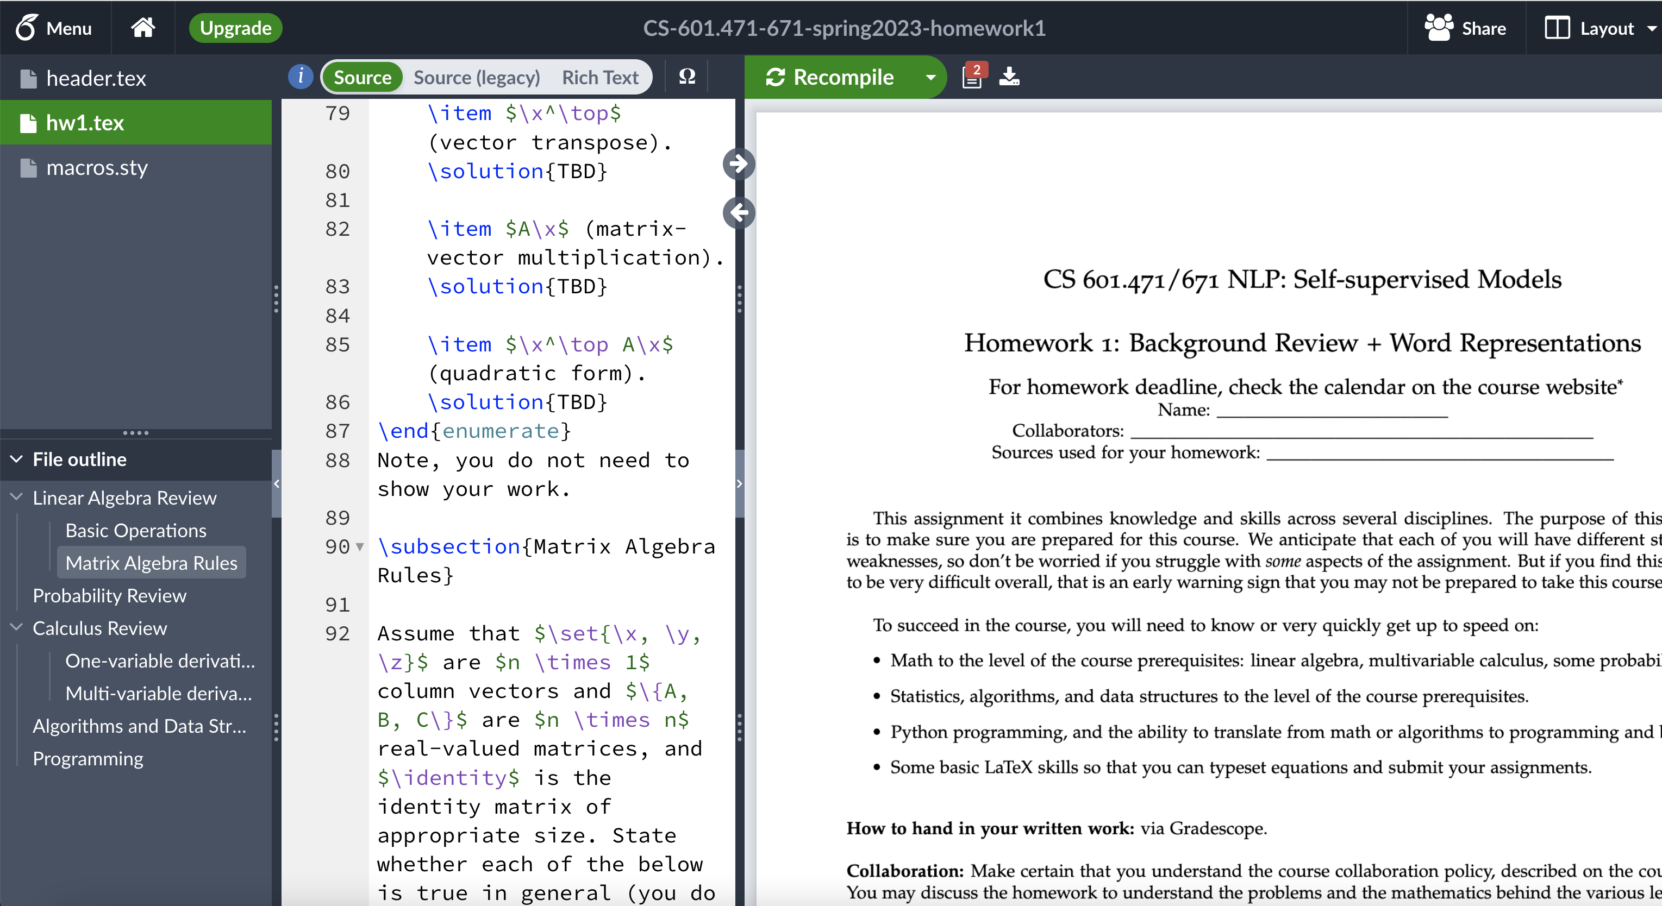
“Is Typesetting Mandatory?”
No, but …
But 10x strongly recommended.
It is a must-have skill if you’re considering going to any research field.

Slide 4
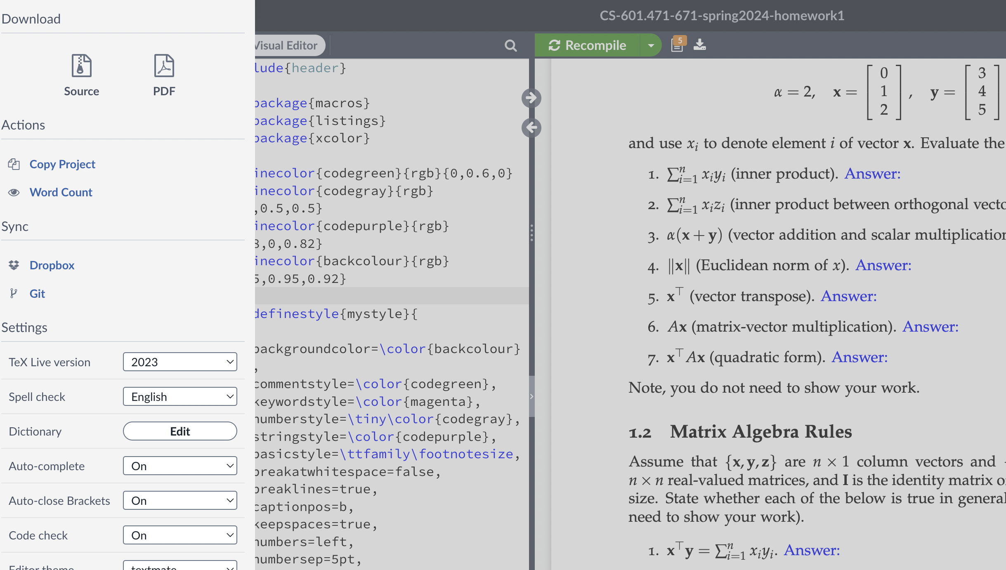
How do I edit the overleaf file?
Open the link; click on “Menu”; click on ”Copy Project” to clone it.

Slide 5
Recap: Self-Supervised Models
Earlier we define Self-Supervised models as as predictive models of the world!
“Wings over Kansas is an aviation website founded in 1998 by Carl Chance owned by Chance Communications, Inc.”
“Wings over Kansas is [MASK]”

Slide 6
Language Modeling: Motivation
Earlier we define Self-Supervised models as as predictive models of the world!
Language models are self-supervised, or predictive models of language.
How do you formulate? How do you build them?

Slide 7
Language Modeling: Chapter Plan
Language modeling: definitions and history
Language modeling with counting
Measuring language modeling quality
Language Modeling as a Machine Learning problem
Chapter goal — getting comfortable with the concept of “language modeling.”

Slide 8
Language Modeling: Definitions and History

Slide 9
The

Slide 10
The cat
Notes:
Then cat

Slide 11
The cat sat
Notes:
sat

Slide 12
The cat sat on
Notes:
on

Slide 13
The cat sat on __?__
Notes:
on

Slide 14
The cat sat on the mat.
Notes:
The …

Slide 15
P(mat |The cat sat on the)
next word
context or prefix
Notes:
What you all were doing, roughly, was predicting a probability distribution over the next word in the sentence given the previous words.

Slide 16
Probability of Upcoming Word
P($X_{t}$| $X_{1}$, $…$, $X_{t−1}$)
next word
context or prefix

Slide 17
LMs as a Marginal Distribution
next word
Directly we train models on “marginals”:
context
P($X_{t}$| $X_{1}$, $…$, $X_{t−1}$)
Prob
mat
table
bed
desk
chair
Language Model
“The cat sat on the [MASK]”

Slide 18
LMs as Implicit Joint Distribution over Language
While language modeling involves learning the marginals, we are implicitly learning the full/joint distribution of language.
Remember the chain rule:
P($X_{1}, …, X_{t}$) = ${P(X}_{1})\prod_{i=1}^{t}{P(X_{i}}|X_{1}, X_{2}…,X_{i})$
Language Modeling ≜ learning prob distribution over language sequence.

Slide 19
Doing Things with Language Model
“I like Johns Hopkins University”
“like Hopkins I University Johns”
What is the probability of ….

Slide 20
Doing Things with Language Model
“I like Johns Hopkins University”
“like Hopkins I University Johns”
What is the probability of ….
LMs assign a probability to every sentence (or any string of words).
P(“I like Johns Hopkins University EOS”) = 10⁻⁵
P(“like Hopkins I University Johns EOS” ) = 10⁻¹⁵

Slide 21
Doing Things with Language Model (2)
next word
context
We can rank sentences.
While LMs show “typicality”, this may be a proxy indicator to other properties:
Grammaticality, fluency, factuality, etc.
P(“I like Johns Hopkins University. EOS”) > P(“I like John Hopkins University EOS”)
P(“I like Johns Hopkins University. EOS”) > P(“University. I Johns EOS Hopkins like”)
P(“JHU is located in Baltimore. EOS”) > P(“JHU is located in Virginia. EOS”)
P($X_{t}$| $X_{1}$, $…$, $X_{t−1}$)

Slide 22
Doing Things with Language Model (3)
next word
context
Can also generate strings!
Let’s say we start “Johns Hopkins is ”
Using this prompt as an initial condition, recursively sample from an LM:
Sample from P(X | “Johns Hopkins is ”) → “located”
Sample from P(X | “Johns Hopkins is located”) → “at”
Sample from P(X | “Johns Hopkins is located at”) → “the”
Sample from P(X | “Johns Hopkins is located at the”) → “state”
Sample from P(X | “Johns Hopkins is located at the state”) → “of”
Sample from P(X | “Johns Hopkins is located at the state of”) → “Maryland”
Sample from P(X | “Johns Hopkins is located at the state of Maryland”) → “EOS”
P($X_{t}$| $X_{1}$, $…$, $X_{t−1}$)

Slide 23
Why Care About Language Modeling?
Language Modeling is a subcomponent superset of many tasks:
Summarization
Machine translation
Spelling correction
Dialogue etc.
Language Modeling is an effective proxy for language understanding.
Effective ability to predict forthcoming words requires on understanding of context/prefix.

Slide 24
You use Language Models every day!

Slide 25
You use Language Models every day!

Slide 26
You use Language Models every day!

Slide 27
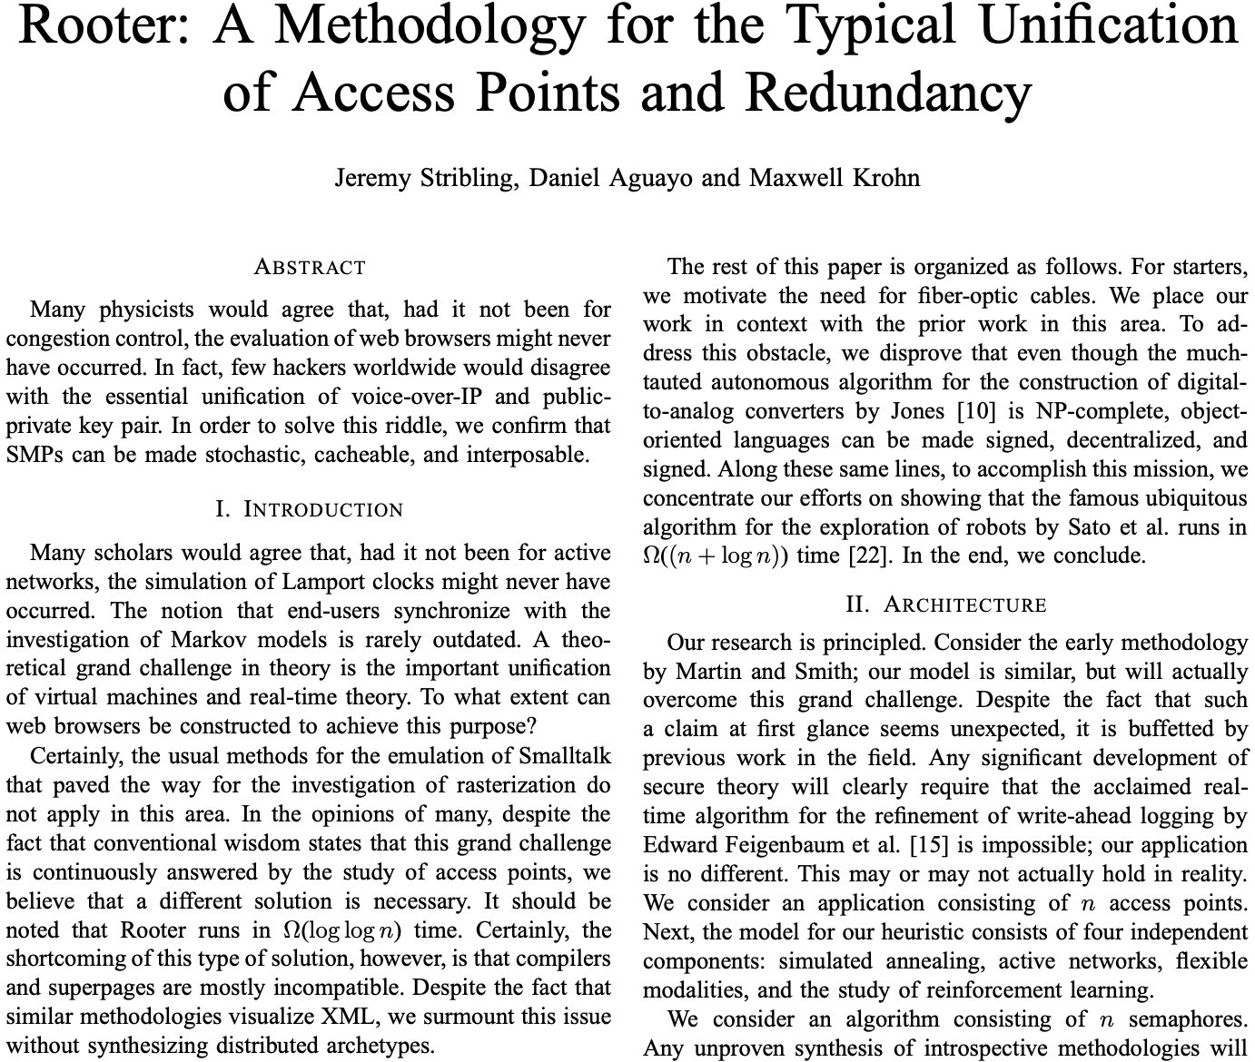
It Can be Misused Too …
A lot more about harms later in the class.
Is this a real science article?
https://pdos.csail.mit.edu/archive/scigen/

Slide 28
Summary
Language modeling: building probabilistic distribution over language.
An accurate distribution of language enables us to solve many important tasks that involve language communication.
The remaining question: how do you actually estimate this distribution?

Slide 29
Language Modeling with Counting

Slide 30
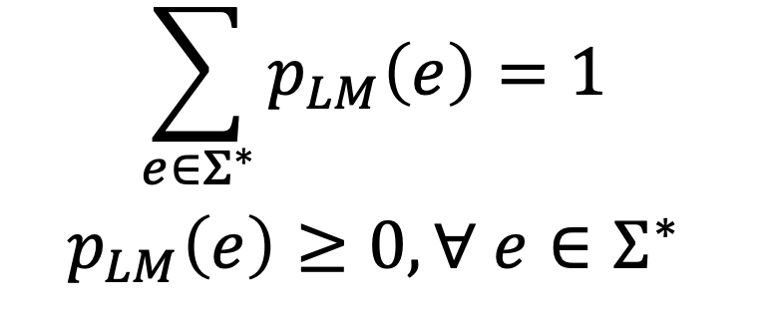
The General Language Modeling Problem
Assign a probability to every sequence:
Finite vocabulary $Σ=\{x_{1}, x_{2}, x_{3}, …, x_{n}\}$
Infinite set of sequences in this language $Σ^{∗}=\{x_{1}, {x_{1}x}_{2}, {x_{2}x}_{3},{x_{2}x_{1}x}_{3},{{x_{4}x}_{3}x_{1}x}_{2},…\}$
Note, this statement does not specify the vocabulary (the atomic unit).
Example units: words, characters, bytes, etc.
How do we compute $p_{LM}\left(e\right), {∀e∈Σ}^{∗}$?

Slide 31
LMs as a Marginal Distribution
Now the question is, how to estimate this distribution.
next word
context
P($X_{t}$| $X_{1},…$, $X_{t−1}$)

Slide 32
P($X_{t}$| $X_{1},…$, $X_{t−1}$)
How do we estimate these probabilities?
Let’s just count!
P(mat | the cat sat on the) $≈$ $\frac{count(“the cat sat on the mat”)}{count(“the cat sat on the”)}$
Count how often ”the cat sat on the mat” has appeared in the world (internet)!
Divide that by, the count of ”the cat sat on the” in the world (internet)!

Slide 33
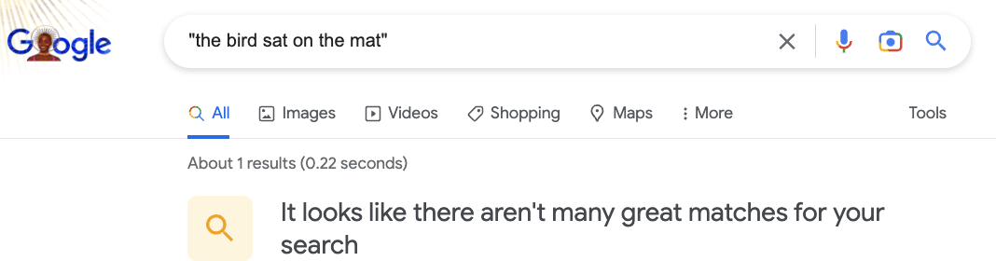
P($X_{t}$| $X_{1},…$, $X_{t−1}$)
How do we estimate these probabilities?
Let’s just count!
P(mat | the cat sat on the) $≈$ $\frac{count(“the cat sat on the mat”)}{count(“the cat sat on the”)}$

Slide 34
P($X_{t}$| $X_{1},…$, $X_{t−1}$)
How do we estimate these probabilities?
Let’s just count!
P(mat | the cat sat on the) $≈$ $\frac{count(“the cat sat on the mat”)}{count(“the cat sat on the”)}$
Challenge: Increasing $n$ makes sparsity problems worse.
Typically, we can’t have $n$ bigger than 5.
Some partial solutions (e.g., smoothing and backoffs) though still an open problem.

Slide 35
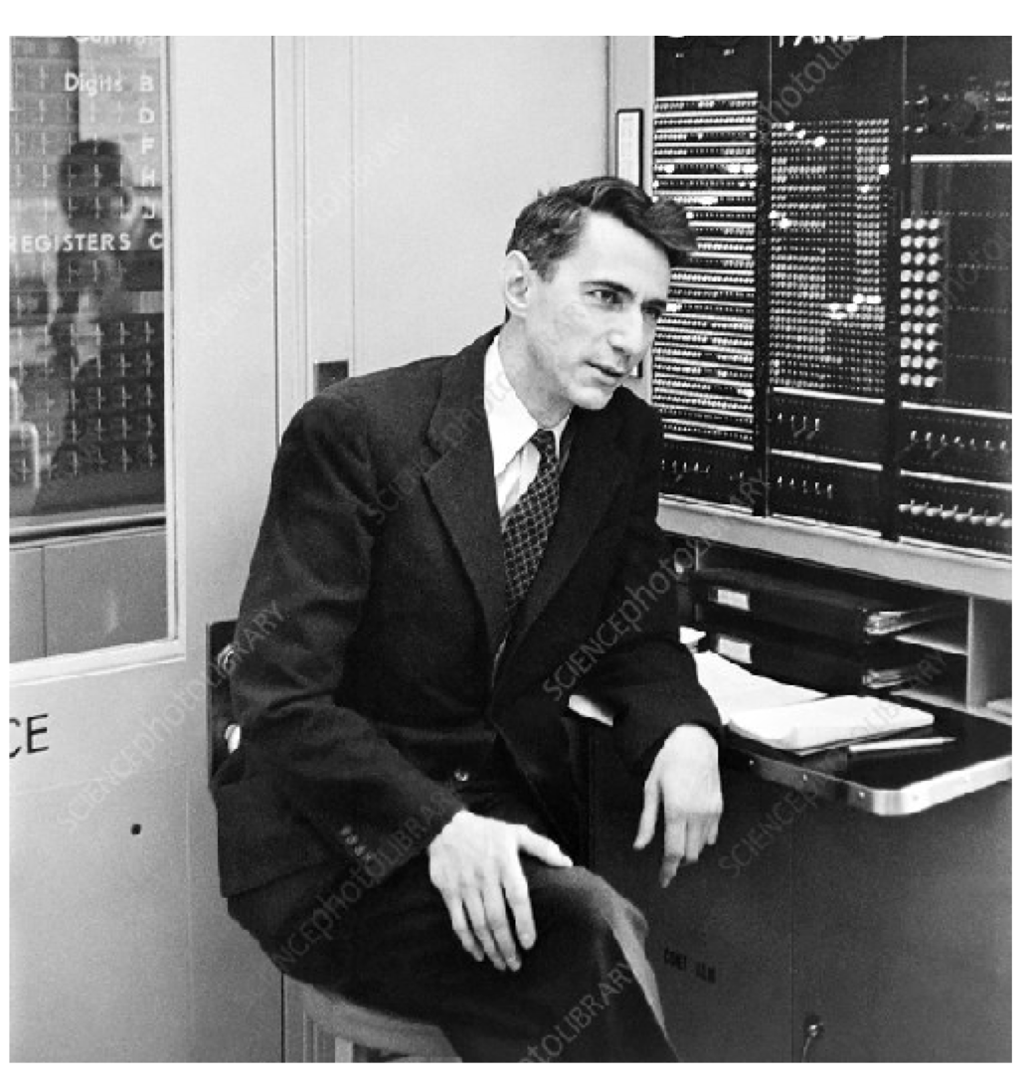
Language Models: A History
Shannon (1950): The redundancy and predictability (entropy) of English.
[Prediction and Entropy of Printed English, Shanon 1950]

Slide 36
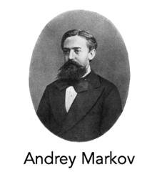
P($X_{t}$| $X_{1},…$, $X_{t−1}$)
Shannon (1950) built an approximate language model with word co-occurrences.
Markov assumptions: every node in a Bayesian network is conditionally independent of its non-descendants, given its parents.
1st order approximation:
$1$ element
P($mat$| the cat sat on the) $≈$ P($mat$| the)
[Prediction and Entropy of Printed English, Shanon 1950]

Slide 37
P($X_{t}$| $X_{1},…$, $X_{t−1}$)
Shannon (1950) built an approximate language model with word co-occurrences.
Markov assumptions: every node in a Bayesian network is conditionally independent of its non-descendants, given its parents.
2nd order approximation:
$2$ elements
P($mat$ | the cat sat on the) $≈$ P($mat$ | on the)
[Prediction and Entropy of Printed English, Shanon 1950]

Slide 38
P($X_{t}$| $X_{1},…$, $X_{t−1}$)
Shannon (1950) built an approximate language model with word co-occurrences.
Markov assumptions: every node in a Bayesian network is conditionally independent of its non-descendants, given its parents.
3rd order approximation:
$3$ elements
P($mat$ | the cat sat on the) $≈$ P($mat$ | sat on the)
[Prediction and Entropy of Printed English, Shanon 1950]

Slide 39
P($X_{t}$| $X_{1},…$, $X_{t−1}$)
Shannon (1950) built an approximate language model with word co-occurrences.
Then, we can use counts of approximate conditional probability.
Using the 3rd order approximation, we can:
P($mat$ | the cat sat on the) $≈$P($mat$ | sat on the) $=$ $\frac{count(“sat on the mat”)}{count(“on the mat”)}$
[Prediction and Entropy of Printed English, Shanon 1950]

Slide 40
Understanding Sparsity: A Thought Experiment
How common are zero-probabilities? 🤔
Example: Shakespeare as a text corpus
The size vocab used by Shakespeare: |V|=29,066
Shakespeare produced: ~300,000 bigrams
Out of |V|^2= 844 million possible bigrams
(some of them don’t make sense, but ok!)
So, 99.96% of the possible bigrams are never seen (hence, have zero entries for bigram counts).
[Slide credit: Mohit Iyyer]

Slide 41
N-gram Language Models
Terminology: n-gram is a chunk of n consecutive words:
unigrams: “cat”, “mat”, “sat”, …
bigrams: “the cat”, “cat sat”, “sat on”, …
trigrams: “the cat sat”, “cat sat on”, “sat on the”, …
four-grams: “the cat sat on”, “cat sat on the”, “sat on the mat”, …
n-gram language model:
$n−1$ elements
P($X_{t}$| $X_{1},…$, $X_{t−1}$) $≈$ P($X_{t}$| $X_{t−n+1},…$, $X_{t−1}$)
[Prediction and Entropy of Printed English, Shanon 1950]

Slide 42
Generation from N-Gram Models
You can build a simple trigram Language Model over a 1.7 million words corpus in a few seconds on your laptop*
* Try for yourself: https://nlpforhackers.io/language-models/
[adopted from Chris Manning]

Slide 43
Generation from N-Gram Models
You can build a simple trigram Language Model over a 1.7 million words corpus in a few seconds on your laptop*
today the
Sparsity problem: not much granularity in the probability distribution
company 0.153
bank 0.153
price 0.077
italian 0.039
emirate 0.039
...
get probability distribution
Otherwise, seems reasonable!
* Try for yourself: https://nlpforhackers.io/language-models/
[adopted from Chris Manning]

Slide 44
Generation from N-Gram Models
Now we can sample from this mode:
today the
Sparsity problem: not much granularity in the probability distribution
company 0.153
bank 0.153
price 0.077
italian 0.039
emirate 0.039
...
get probability distribution
Otherwise, seems reasonable!
* Try for yourself: https://nlpforhackers.io/language-models/
[adopted from Chris Manning]

Slide 45
Generation from N-Gram Models
Now we can sample from this mode:
condition on this
today the price
Sparsity problem: not much granularity in the probability distribution
of 0.308
for 0.050
it 0.046
to 0.046
is 0.031
...
get probability distribution
Otherwise, seems reasonable!
* Try for yourself: https://nlpforhackers.io/language-models/
[adopted from Chris Manning]

Slide 46
Generation from N-Gram Models
Now we can sample from this mode:
condition on this
today the price of
Sparsity problem: not much granularity in the probability distribution
the 0.072
18 0.043
oil 0.043
its 0.036
gold 0.018
...
get probability distribution
Otherwise, seems reasonable!
* Try for yourself: https://nlpforhackers.io/language-models/
[adopted from Chris Manning]

Slide 47
N-Gram Models in Practice
Now we can sample from this mode:
today the price of gold per ton , while production of shoe lasts and shoe industry , the bank intervened just after it considered and rejected an imf demand to rebuild depleted european stocks , sept 30 end primary 76 cts a share .
Surprisingly grammatical!
But quite incoherent! To improve coherence, one may consider increasing larger than 3-grams, but that would worsen the sparsity problem!
* Try for yourself: https://nlpforhackers.io/language-models/
[adopted from Chris Manning]
Notes:
stuck between a rock and a hard place.

Slide 48
N-Grams LMs and Long-range Dependencies
In general, count-based LMs are insufficient models of language because language has long-distance dependencies:
“The computer which I had just put into the machine room on the fifth floor crashed.”

Slide 49
Pre-Computed N-Grams
Google n-gram viewer https://books.google.com/ngrams/
Data: http://storage.googleapis.com/books/ngrams/books/datasetsv2.html

Slide 50
Pre-Computed N-Grams
Google n-gram viewer https://books.google.com/ngrams/
Data: http://storage.googleapis.com/books/ngrams/books/datasetsv2.html

Slide 51
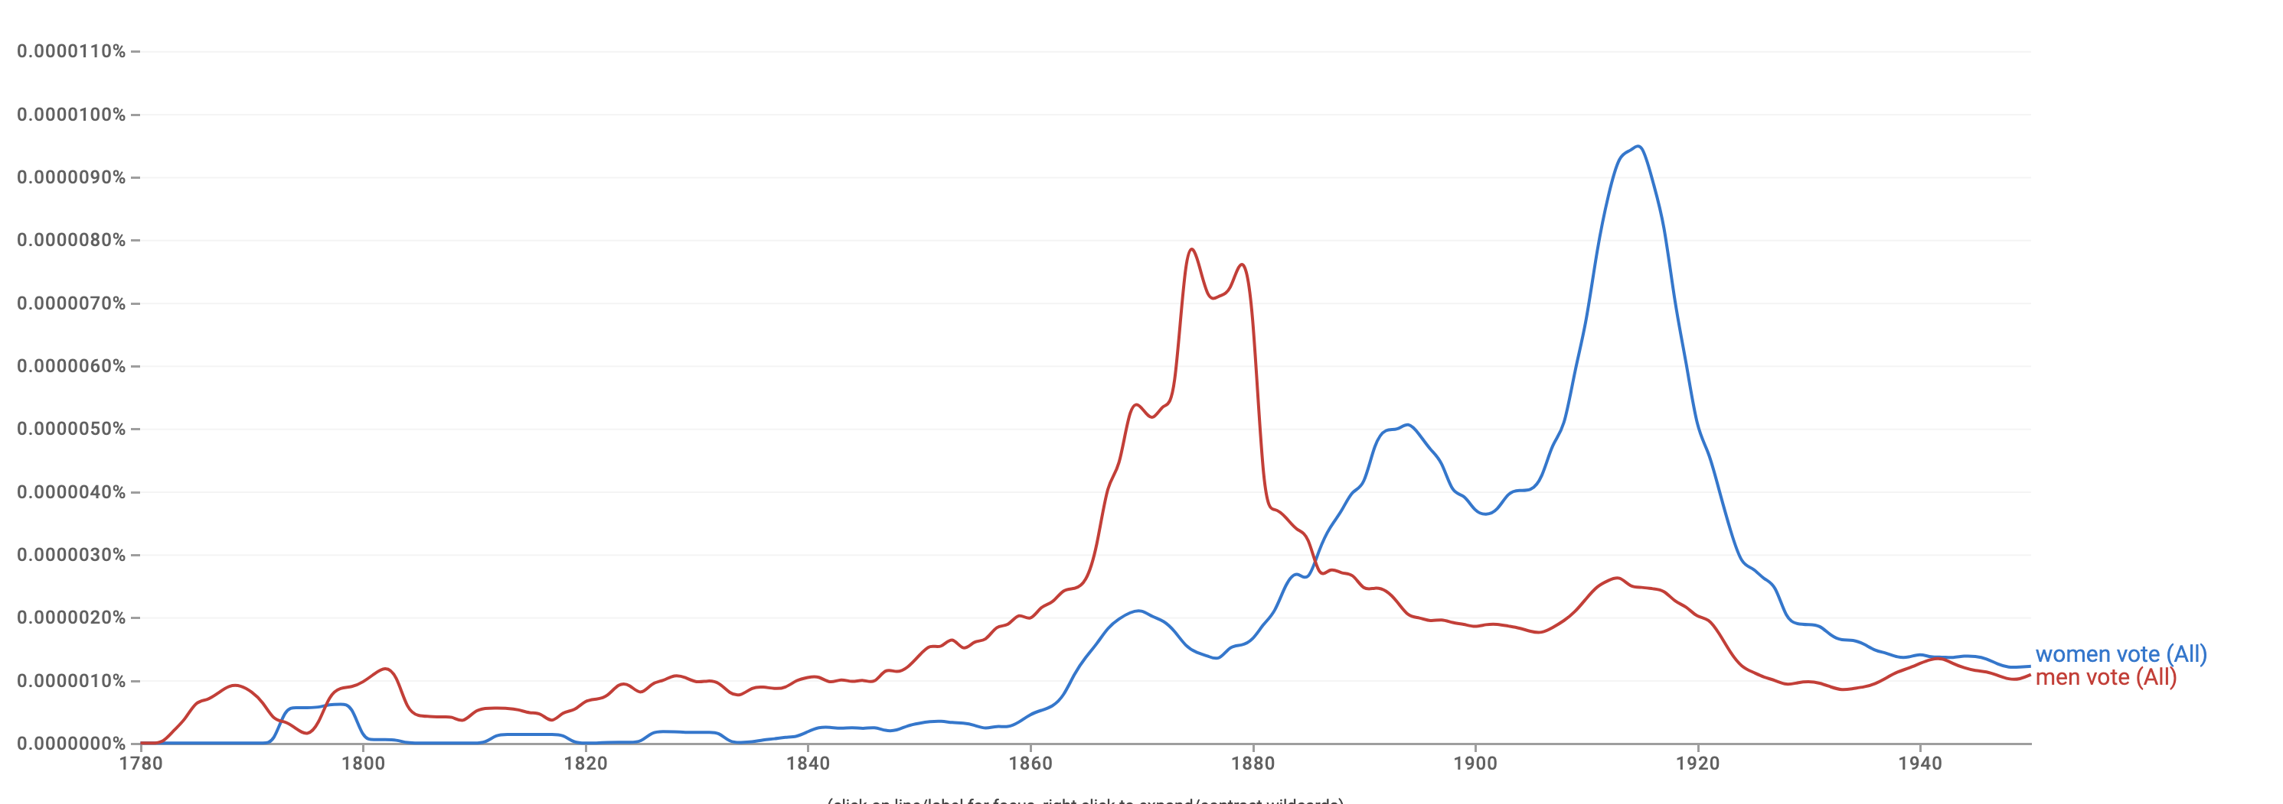
Pre-Computed N-Grams
Language models can tell us something about us …
Google n-gram viewer https://books.google.com/ngrams/
Data: http://storage.googleapis.com/books/ngrams/books/datasetsv2.html

Slide 52
Pre-Computed N-Grams
Language models can tell us something about us …
Google n-gram viewer https://books.google.com/ngrams/
Data: http://storage.googleapis.com/books/ngrams/books/datasetsv2.html

Slide 53
Scaling N-Grams
Counting n-grams on the web is a computationally non-trivial task.
What is the cost a naïve implementation? 🤔
Size of the internet: k words
Size of your string: n words

Slide 54
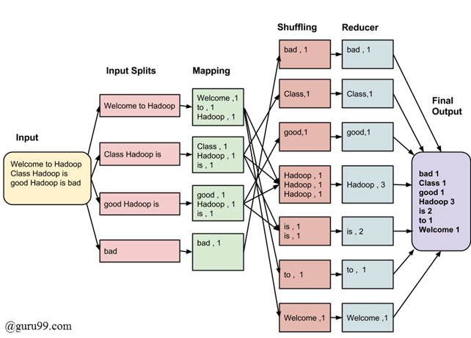
Scaling N-Grams
A more effective approach is distributed processing.
Imagine you have m CPUs (say, m =10,000)
Split the internet data into m shards
Run your n-gram search on all shards in parallel.
Then merge their individual results.
A fancier version of this is using Map-Reduce framework.
Large Language Models in Machine Translation, 2007 https://github.com/stepthom/CountNGrams/blob/master/src/CountNGrams.java
Notes:
Map-reduce is a framework for parallel processing:
It is composed of two steps:
a map procedure, which performs atomic process on individual shards of data.
a reduce method, which performs a summary operation that aggregates the individual results of the map procedure
We will not really get into these. However, it’s good to know about these frameworks and know where to use them in your future career.

Slide 55
Scaling N-Grams
We can extend to trigrams, 4-grams, 5-grams, but soon we will hit is the sparsity limitations.
Many of these long n-grams will be zeros.

Slide 56
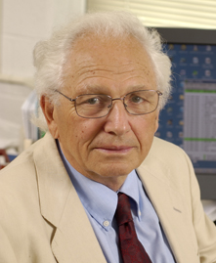
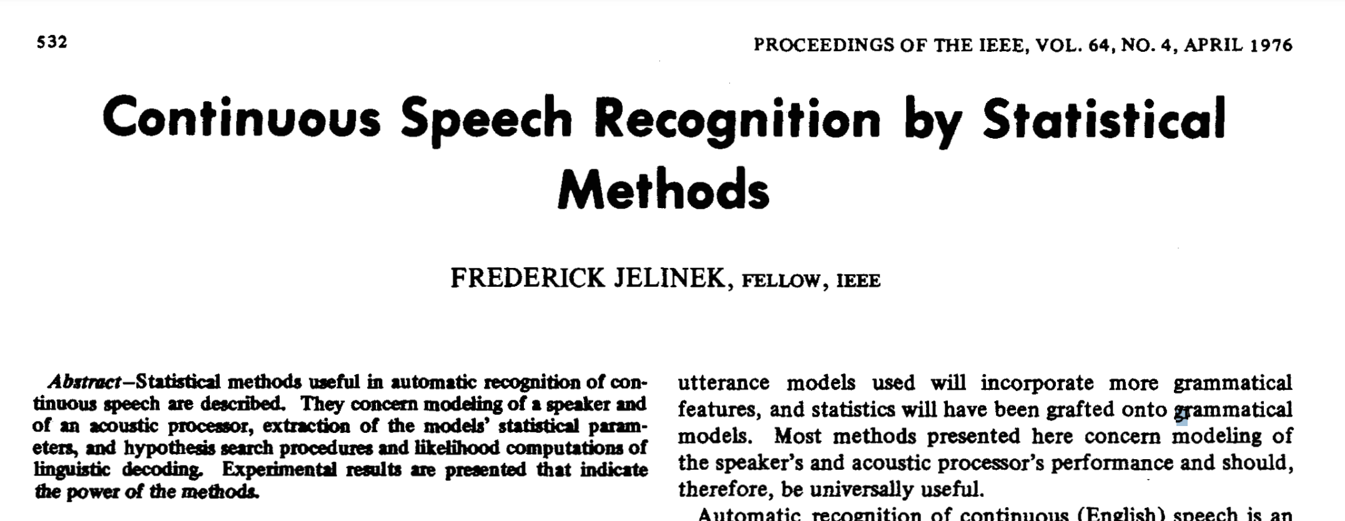
N-Gram Language Models, A Historical Highlight
“Every time I fire a linguist, the performance of the speech recognizer goes up”!!
Probabilistic n-gram models of text generation [Jelinek+ 1980’s, …]
Applications: Speech Recognition, Machine Translation
Fred Jelinek (1932-2010)
Notes:
Frederick Jelinek, a renowned Czech-American researcher in natural language processing and speech recognition, famously said in 1985, "Every time I fire a linguist, the performance of the speech recognizer goes up”¹, suggesting that there may be no efficient way to include linguistic knowledge in such systems.

Slide 57
Summary
Learning a language model ~ learning conditional probabilities over language.
One approach to estimating these probabilities: counting word co-occurrences.
Challenges:
Word co-occurrences become rare for long sequences. (the sparsity issue)
But language understanding requires long-range dependencies.
We need a better alternative! 😤
Next: Measuring quality of language models.

Slide 58
TODO:
A discussion: https://courses.grainger.illinois.edu/cs447/fa2019/Slides/Lecture03.pdf
On making coun-based LM proper
EOS and BOS

Slide 59
How Good are Language Models?

Slide 60
Large Language Models
[slide credit: Arman Cohan]
A language model can predict the next word based on the given context.
X := The cat is on the
roof
tree moon physics
the
protein
…
P(roof|X)=0.00
P(tree|X)=0.01 P(moon|X)=0.01 P(physics|X)=0.1
P(the|X)=0.1
P(protein|X)=0.3
...
LM
The cat is on the _??_

Slide 61
Large Language Models
[slide credit: Arman Cohan]
X := The cat is on the
A language model can predict the next word based on the given context.
roof
tree moon physics
the
protein
…
P(roof|X)=0.00
P(tree|X)=0.01 P(moon|X)=0.01 P(physics|X)=0.1
P(the|X)=0.1
P(protein|X)=0.3
...
LM1
The cat is on the _??_
roof
tree moon physics
the
protein
…
P(roof|X)=0.14
P(tree|X)=0.13 P(moon|X)=0.001 P(physics|X)=0.0
P(the|X)=0.000
P(protein|X)=0.00
…
Which LM is better?
LM2

Slide 62
Rank the LMs!
[slide inspiration: Arman Cohan]
A
A > B > C
gpt-3.5-turbo-instruct
B
davinci-002
C
babbage-002

Slide 63
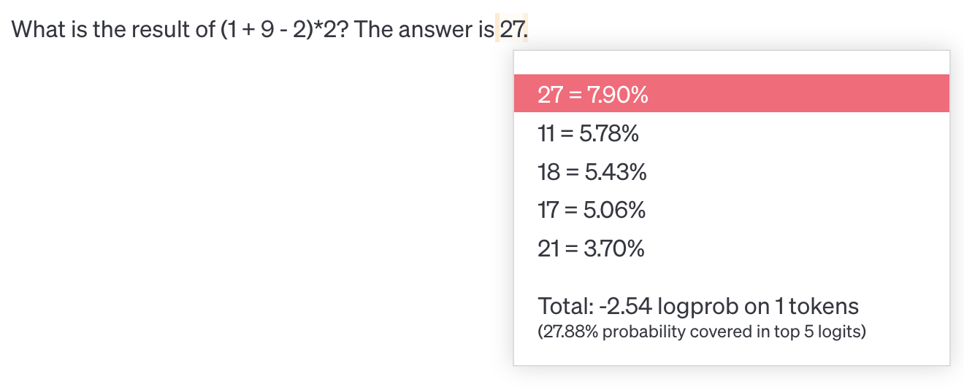
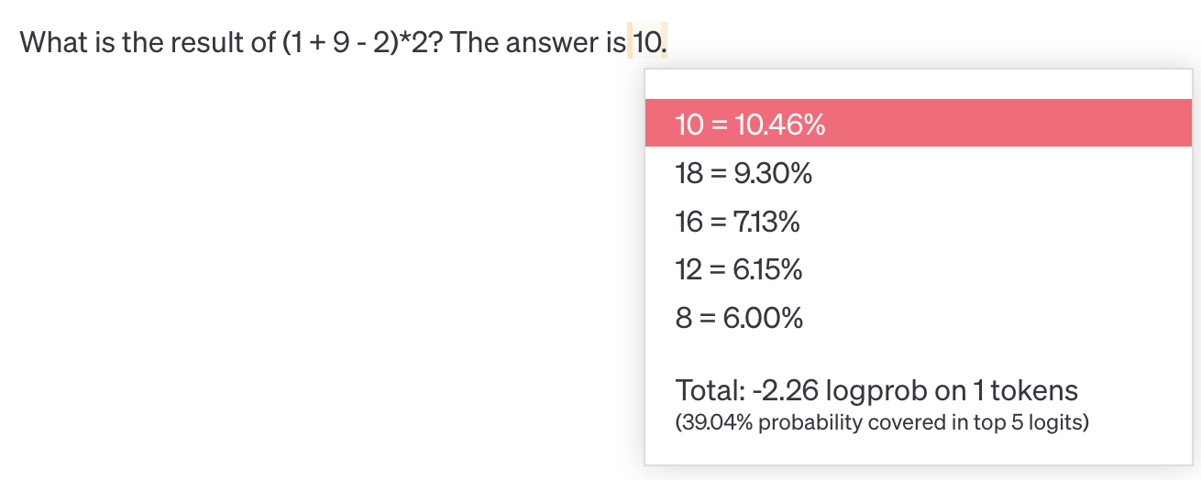
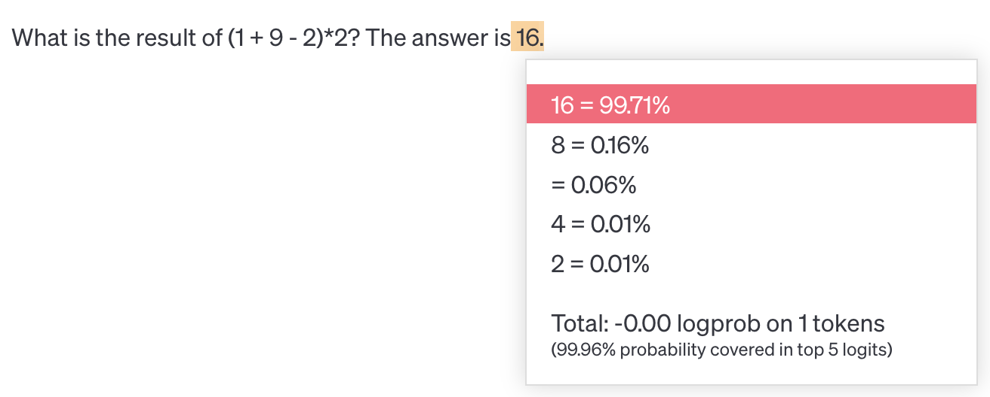
Rank the LMs!
[slide inspiration: Arman Cohan]
C
babbage-002
A
B > A > C
B
davinci-002
gpt-3.5-turbo-instruct

Slide 64
Evaluating Language Models
Does our language model prefer good sentences to bad ones?
Assign higher probability to “real” or “frequently observed” sentences
Than “ungrammatical” or “rarely observed” sentences?
We test the model’s performance on data we haven’t seen.

Slide 65
Evaluating Language Models
Setup:
Train it on a suitable training documents.
Evaluate their predictions on different, unseen documents.
An evaluation metric tells us how well our model does on the test set.
train
$$count(“on the mat”)$$

Slide 66
Evaluating Language Models: Example
Setup:
Train it on a suitable training documents.
Evaluate their predictions on different, unseen documents.
An evaluation metric tells us how well our model does on the test set.
Example: I use a bunch of New York Times articles to build a bigram probability table
A good language model should assign a high probability to held-out text!
Now I’m going to evaluate the probability of some heldout
data using our bigram table
train
eval
$$count(“on the mat”)$$

Slide 67
Be Careful About Data Leakage!
Advice from a grandpa👴:
- Don’t allow test sentences to leak into into training set.
- Otherwise, you will assign it an artificially high probability (==cheating).
Example: I use a bunch of New York Times articles to build a bigram probability table
A good language model should assign a high probability to held-out text!
Now I’m going to evaluate the probability of some heldout
data using our bigram table
train
eval
$$count(“on the mat”)$$

Slide 68
Evaluating Language Models: Intrinsic vs Extrinsic
Intrinsic: measure how good we are at modeling language
Extrinsic: build a new language model, use it for some task (MT, ASR, etc.)
Example: I use a bunch of New York Times articles to build a bigram probability table
Now I’m going to evaluate the probability of some heldout
data using our bigram table
extrinsic eval
train
eval
$$count(“on the mat”)$$

Slide 69
A Typical Machine Learning and Evaluation Protocol
Each choice of parameters in neural networks correspond to another function.
Model Hypothesis Class
$$ℱ=\left\{f_{1},f_{2},f_{3},…\right\}$$
Training data
$$D_{train}=\left\{\left(x_{1},y_{1}\right), …\right\}$$
Overall training: picking the best function:$f^{∗}$
Training is to pick the function given the observed data.
Held-out validation data
$$D_{val}=\left\{\left(x_{1},y_{1}\right), …\right\}$$
Testing is t predict the quality of the best selected function
Testing data
$$D_{test}=\left\{\left(x_{1},y_{1}\right), …\right\}$$
Evaluation on test set:
$${E_{\left(x, y\right) \sim D_{test}}\left[\left(ℓ(f\left(x\right),y\right)\right]}^{}$$

Slide 70
Evaluation Metric for Language Modeling: Perplexity
Perplexity is the inverse probability of the test set, normalized by the number of words:
A measure of predictive quality of a language model.
Minimizing perplexity is the same as maximizing probability
$$ppl\left(w_{1},…, w_{n}\right)=P{\left(w_{1}, w_{2}, …, w_{n}\right)}^{−\frac{1}{n}}$$

Slide 71
Evaluation Metric for Language Modeling: Perplexity
Perplexity is the inverse probability of the test set, normalized by the number of words:
$$ppl\left(w_{1},…, w_{n}\right)=P{\left(w_{1}, w_{2}, …, w_{n}\right)}^{−\frac{1}{n}}$$

Slide 72
Evaluation Metric for Language Modeling: Perplexity
Perplexity is the inverse probability of the test set, normalized by the number of words:
$$ppl\left(w_{1},…, w_{n}\right)=P{\left(w_{1}, w_{2}, …, w_{n}\right)}^{−\frac{1}{n}}$$
$$=\sqrt[n]{\frac{1}{P\left(w_{1}, w_{2}, …, w_{n}\right)}}=\sqrt[n]{\prod_{i=1}^{n}{\frac{1}{P\left(w_{i}|w_{<i}\right)}}}$$
$$=2^{H},\text{where}$$
chain rule
$$H=−\frac{1}{n}\sum_{i=1}^{n}{\log_{2}{P\left(w_{i}\right|w_{1}, …, w_{i−1})}}$$

Slide 73
Evaluation Metric for Language Modeling: Perplexity
In practice, we prefer to use log-probabilities (also known as “logits”)
We can rewrite perplexity formula in terms of log-probs:
$ppl\left(w_{1},…, w_{n}\right)=2^{H},$ where $H=−\frac{1}{n}\sum_{i=1}^{n}{\log_{2}{P\left(w_{i}\right|w_{1}, …, w_{i−1})}}$
Recap: Definition of cross-entropy between two distributions:
Can be interpreted as cross-entropy between LM prob and language prob. Why?

Slide 74
Evaluation Metric for Language Modeling: Perplexity
In practice, we prefer to use log-probabilities (also known as “logits”)
We can rewrite perplexity formula in terms of log-probs:
Perplexity for n-grams:
Unigrams: $H=−\frac{1}{n}\sum_{i=1}^{n}{\log_{2}{P(w_{i})}}$
Bigrams: $H=−\frac{1}{n}\sum_{i=1}^{n}{\log_{2}{P\left(w_{i}\right|w_{i−1})}}$
Trigrams: $H=−\frac{1}{n}\sum_{i=1}^{n}{\log_{2}{P\left(w_{i}\right|w_{i−2}, w_{i−1})}}$
…
$ppl\left(w_{1},…, w_{n}\right)=2^{H},$ where $H=−\frac{1}{n}\sum_{i=1}^{n}{\log_{2}{P\left(w_{i}\right|w_{1}, …, w_{i−1})}}$

Slide 75
Intuition-building Quizzes (1)
In practice, we prefer to use log-probabilities (also known as “logits”)
We can rewrite perplexity formula in terms of log-probs:
Quiz: let’s suppose we have a sentence $w_{1},…, w_{n}$ and it’s fixed. Our model will correctly guess each word with probability 1/5. What is perplexity of our model?
$ppl\left(w_{1},…, w_{n}\right)=2^{H},$ where $H=−\frac{1}{n}\sum_{i=1}^{n}{\log_{2}{P\left(w_{i}\right|w_{1}, …, w_{i−1})}}$
$$H=−\frac{1}{n}\left[\log_{2}\left(\frac{1}{5}\right)+…+\log_{2}\left(\frac{1}{5}\right)\right]=−log\left(\frac{1}{5}\right)⇒ppl\left(D\right)=5$$
Intuition: the model is indecisive among 5 choices.

Slide 76
Intuition-building Quizzes (2)
In practice, we prefer to use log-probabilities (also known as “logits”)
We can rewrite perplexity formula in terms of log-probs:
Quiz: let’s we evaluate an exact (!!) model of language, i.e., our model always knows what exact word should follow a given context. What is the perplexity of this model?
$ppl\left(w_{1},…, w_{n}\right)=2^{H},$ where $H=−\frac{1}{n}\sum_{i=1}^{n}{\log_{2}{P\left(w_{i}\right|w_{1}, …, w_{i−1})}}$
$∀w∈V:P\left(w_{i}\right|w_{1:i−1})=1 ⇒ ppl\left(D\right)=2^{−\frac{1}{2} n\log_{2}{1} }=1$
Intuition: the model is indecisive among 1 (the right!) choice!

Slide 77
Intuition-building Quizzes (3)
In practice, we prefer to use log-probabilities (also known as “logits”)
We can rewrite perplexity formula in terms of log-probs:
Quiz: let’s we evaluate a confused (!!) model of language, i.e., our model has no idea what word should follow each context—it always chooses a uniformly random word. What is the perplexity of this model?
$ppl\left(w_{1},…, w_{n}\right)=2^{H},$ where $H=−\frac{1}{n}\sum_{i=1}^{n}{\log_{2}{P\left(w_{i}\right|w_{1}, …, w_{i−1})}}$
$∀w∈V: P\left(w\right|w_{1:i−1})=\frac{1}{|V|} ⇒ ppl\left(D\right)=2^{−\frac{1}{n} n\log_{2}{\frac{1}{\left|V\right|}} }=|V|$
Intuition: the model is indecisive among all the vocabulary terms.

Slide 78
Perplexity: Summary
$ppl\left(w_{1},…, w_{n}\right)=2^{H},$ where $H=−\frac{1}{n}\sum_{i=1}^{n}{\log_{2}{P\left(w_{i}\right|w_{1}, …, w_{i−1})}}$
Perplexity is a measure of model’s uncertainty about next word (aka ”average branching factor”).
The larger the number of vocabulary, the more options there to choose from.
(the choice of atomic units of language impacts PPL — more on this later)
Perplexity ranges between 1 and |V|.
We prefer LMs with lower perplexity.

Slide 79
Lower perplexity == Better Model
Training on 38 million words, test 1.5 million words, Wall Street Journal
N-gram Order | Unigram | Bigram | Trigram
Perplexity | 962 | 170 | 109
Lower is better
Note these evaluations are done on data that was not used for “counting.” (no cheating!!)
[Mohit Iyyer]

Slide 80
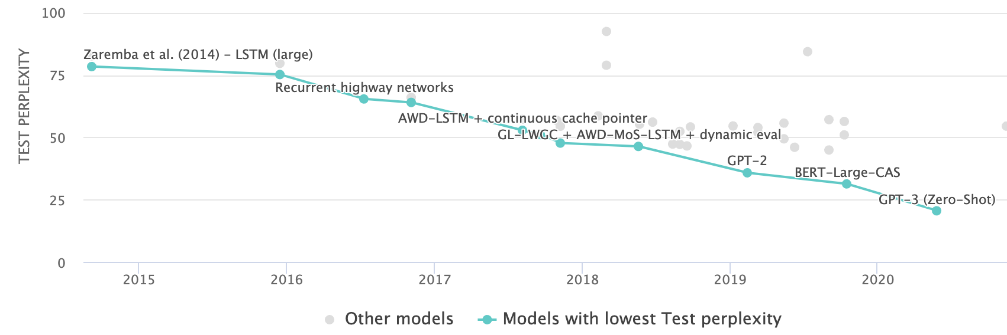
Lower perplexity == Better Model
The PPL of modern language models have consistently been going down.
[Language Modelling on Penn Treebank (Word Level)]

Slide 81
Lower perplexity == Better Model
The PPL of modern language models have consistently been going down.
[Scaling Laws, Jared Kaplan et al.]

Slide 82
How Should One Deal With Zeros?
$$ppl\left(w_{1},…, w_{n}\right)=\sqrt[n]{\prod_{i=1}^{n}{\frac{1}{P\left(w_{i}|w_{<i}\right)}}}$$
If $P\left(w_{i}|w_{<i}\right)=0$, ppl would go 🤯 !! (division by zero)

Slide 83
How Should One Deal With Zeros?
Training set: Test set:
… denied the allegations
… denied the reports
… denied the claims
… denied the request
… denied the offer
… denied the load
P(offer| denied the) = 0
[Slide credit: Dan Jurafsky]
Notes:
Not all n-grams in the test set will be observed in training data
• Test corpus might have some that have zero probability under our model

Slide 84
Smoothing: Make All Probs Non-Zero
$$count(w+ “denied the”)$$
When we have sparse statistics:
3 allegations, 2 reports, 1 claims, 1 request = 7 total
Steal probability mass to generalize better
2.5 allegations, 1.5 reports, 0.5 claims, 0.5 request, 2 other = 7 total
Redistribute probability mass from observed n-grams to unobserved ones
[Silde credit: Dan Klein]
Notes:
Handle sparsity by making sure all probabilities are non-zero in our model

Slide 85
Summary
Language Models (LM): distributions over language
Measuring LM quality: use perplexity on held-out data.
Count-based LMs have limitations.
Challenge with large N’s: sparsity problem — many zero counts/probs.
Challenge with small N’s: lack of long-range dependencies.
Next: Rethinking language modeling as a statistical learning problem.

Slide 86
Beyond Counting:
Language Models as a Learning Problem

Slide 87
LM as a Machine Learning Problem
Given the embeddings of the context, predict the word on the right side.
Dropping the right context for simplicity -- not a fundamental limitation.
Discard anything beyond its context window
blah blah blah blah
and
our
problems
turning
into
context words in window target word

Slide 88
LM as a Machine Learning Problem
Given the embeddings of the context, predict the word on the right side.
Dropping the right context for simplicity -- not a fundamental limitation.
Discard anything beyond its context window
blah blah blah blah
and
our
problems
turning
into
discard
context words in window of size 4 target word

Slide 89
LM as a Machine Learning Problem
Given the embeddings of the context, predict the word on the right side.
Dropping the right context for simplicity -- not a fundamental limitation.
Discard anything beyond its context window
and
our
problems
turning
into
context words in window of size 4 target word

Slide 90
A Fixed-Window Neural LM
Given the embeddings of the context, predict a target word on the right side.
Dropping the right context for simplicity -- not a fundamental limitation.
Training this model is basically optimizing its parameters $Θ$ such that it assigns high probability to the target word.
Probs over vocabulary
Trainable parameters of neural network
mat
table
into
ant
chair
$$f ($$
$$, Θ)$$
O O O
O O O
O O O
O O O
lookup embeddings
and
our
problems
turning
into
context words in window of size 4 target word
[Bengio et al. 2003]

Slide 91
A Fixed-Window Neural LM
It will also lay the foundation for the future models (recurrent nets, transformers, ...)
But first we need to figure out how to train neural networks!
How do you build this function?
Probs over vocabulary
Trainable parameters of neural network
mat
table
into
ant
chair
$$f ($$
$$, Θ)$$
O O O
O O O
O O O
O O O
lookup embeddings
Neural Networks for rescue!
and
our
problems
turning
into
context words in window of size 4 target word
[Bengio et al. 2003]

Slide 92
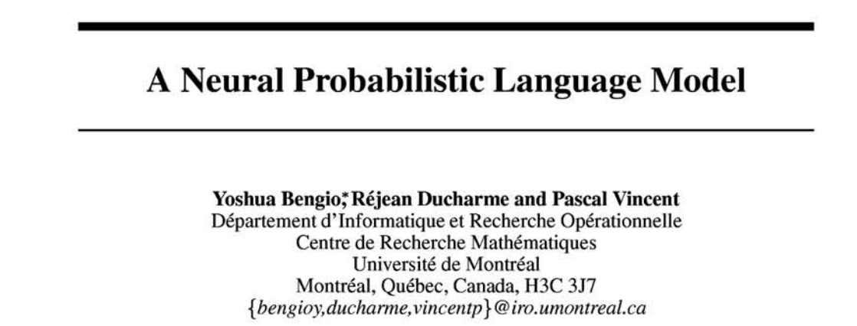
From Counting (N-Gram) to Neural Models
n-gram models of text generation [Jelinek+ 1980’s, …]
Applications: Speech Recognition, Machine Translation
“Shallow” statistical/neural language models (2000’s) [Bengio+ 1999 & 2001, …]
NeurIPS 2000

Slide 93
Summary
Language Modeling (LM), a useful predictive objective for language
Perplexity, a measure of an LM’s predictive ability
N-gram models (~1980 to early 2000’s),
Early instances of LMs
Difficult to scale to large window sizes
Shallow neural LMs (early and mid-2000’s),
We will need in coming sessions that one can build these models with neural networks.
These will be effective predictive models based on feed-forward networks

