Slide 1
Neural Networks
CSCI 601-471/671 (NLP: Self-Supervised Models)
https://self-supervised.cs.jhu.edu/sp2024/

Slide 2
How was HW1
Select that best applies:
  It was smooth sailing through things I knew; my hamster nearly finished it.
  it was familiar stuff but I had to learn or refresh a few things.
  It was like shoveling snow in the middle of a blizzard, it just kept getting worse
  It was so challenging, it felt like climbing Mount Everest with slippers on.

Slide 3
HW2 is released
Did you see it?
Due Tuesday noon.
  Feels like a long time away? it’s due in 120 hours!

Slide 4
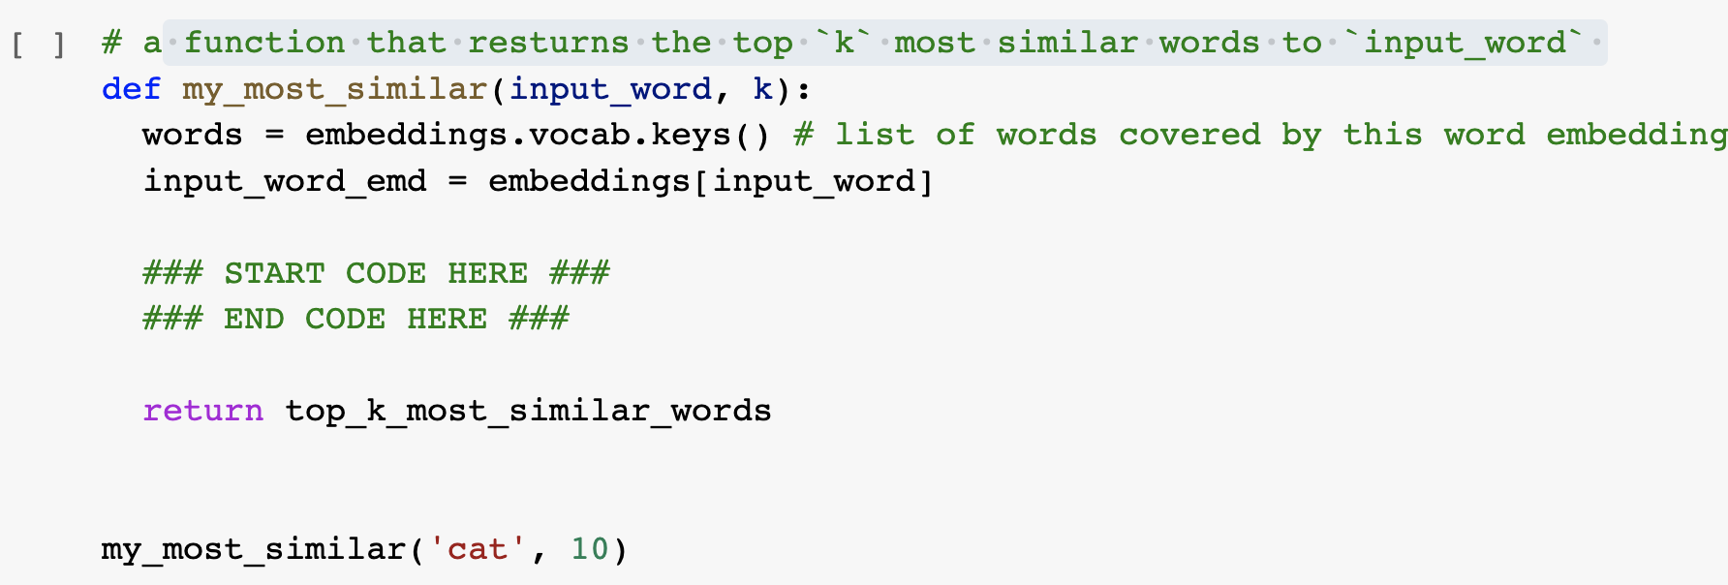
“Can I use external libraries?” No, unless specified!
Use the basic Python functions (no external libraries), unless explicitly specified.
In almost all places, you’re not expected to write more than 3-4 lines of code.

Slide 5
“I can’t install ….”
Current code is based on 3.6.0.
If you use other version, you might need to make minor changes to Gensim functions. Feel free to consult with Gensim documentation.
  This is part of any programming experience.
  It's part of the job! Don't hate it, embrace it! 🤗

Slide 6
Recap: Language Modeling
Language Modeling: estimating distributions over language.
One approach we previously saw: counting word co-occurrences.
  Pro: easy — just count!
  Con: difficult to scale to longer context due to the sparsity challenge.
Another approach:
  Using a learnable function that can estimate word transition probabilities.
    Now: What are these learnable functions and how can we train them.

Slide 7
Neural Networks: Chapter Plan
Defining neural networks (feedforward nets)
Neural nets: brief history
Algebra background for training neural nets
Training neural networks: analytical backpropagation
Backprop in practice
Chapter goal: Get comfortable with thinking, designing and building neural networks — very powerful modeling tools.

Slide 8
Feedforward
Neural Nets

Slide 9
Neural Networks
What are neural networks?
  Functions that take an input and produce an output.
What is inside this box?
NN
NN
Video
Caption
Text
Image
NN
Game
state
Action

Slide 10

Notes:
Saul Goodman

Slide 11
Feedforward networks
This is a particular class called “feedforward” networks.
  Cascade neurons together
[Slides: HKUST]

Slide 12
Feedforward networks
Inputs multiplied by initial set of weights
[Slide: HKUST]

Slide 13
Feedforward networks
Intermediate “predictions” computed at first hidden layer
[Slide: HKUST]

Slide 14
Feedforward networks
Intermediate predictions multiplied by second layer of weights
Predictions are fed forward through the network
[Slide: HKUST]

Slide 15
Feedforward networks
Compute second set of intermediate predictions
[Slide: HKUST]

Slide 16
Feedforward networks
Multiply by final set of weights
[Slide: HKUST]

Slide 17
Feedforward networks
Aggregate all the computations in the output
  e.g. probability of a particular class
[Slide: HKUST]

Slide 18
Feedforward networks
All the intermediate parameters are ought to be learned.
Weights to learn!
Weights to learn!
Weights to learn!
[Slide: HKUST]

Slide 19
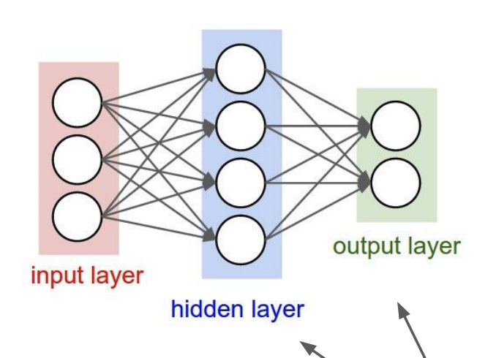
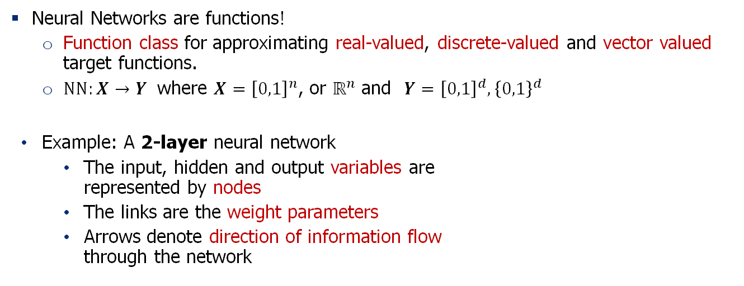
Feedforward Neural Network
Neural Networks are functions!
  Function class for approximating real-valued, discrete-valued and vector valued target functions.
  $NN:X→Y$ where $X={\left[0,1\right]}^{n}$, or $ℝ^{n}$ and $Y={\left[0,1\right]}^{d}, {\left\{0,1\right\}}^{d}$
Example: A 2-layer neural network
  The input, hidden and output variables are
  represented by nodes
  The links are the weight parameters
  Arrows denote direction of information flow
  through the network

Slide 20
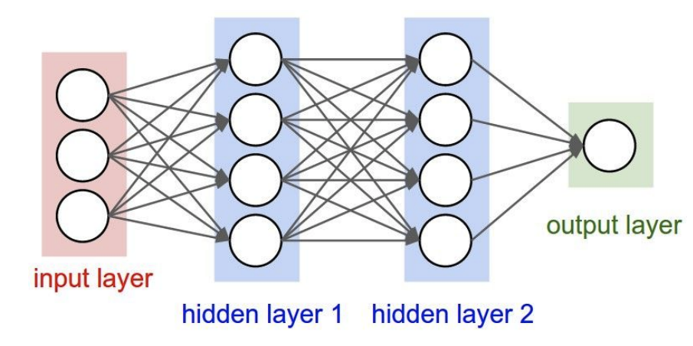
Neural Network: Making it bigger
Add more layers, or wider layers!
A 2-layer neural network A 3-layer neural network

Slide 21
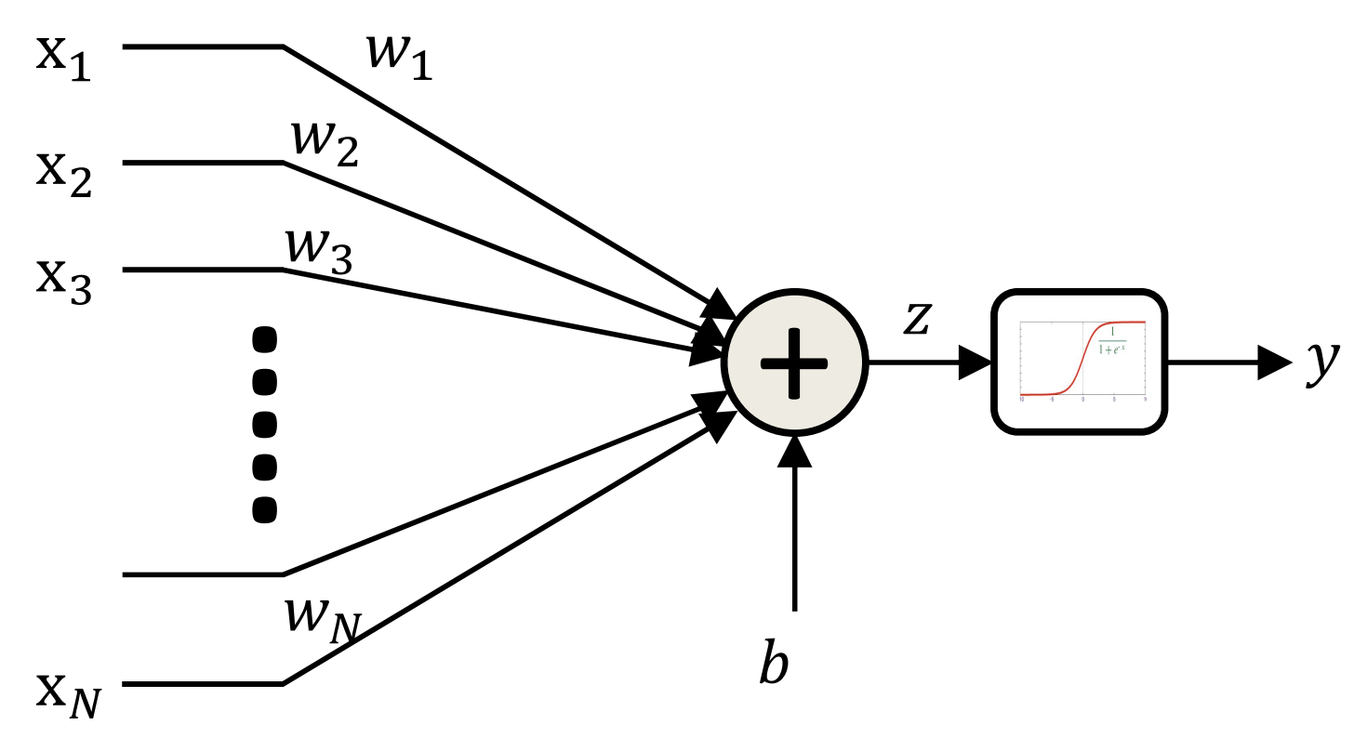
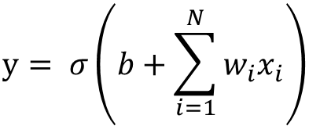

Feedforward Neural Network: The Neurons
A mathematical model of neuron is “perceptron”.
It consists of a non-linear function that “fires” if
the affine (linear) function of inputs is above a threshold.
The bias is the negative of the threshold T in the previous slide
$$y= σ\left(b+\sum_{i=1}^{N}{w_{i}x_{i}}\right)$$
$σ\left(z\right)=\frac{1}{1+e^{−x}}$ (sigmoid function)

Slide 22
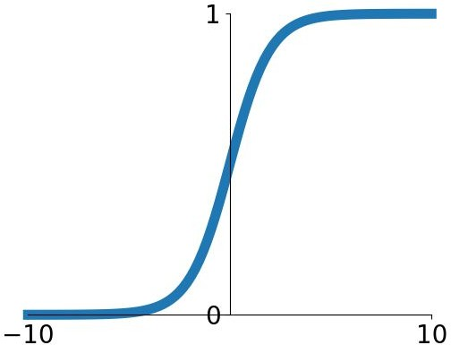
Feedforward Neural Network: The Neurons
Sigmoid is a “squashing” function.
  It maps small inputs to zero.
  It maps large inputs to one.
The bias is the negative of the threshold T in the previous slide
$$y= σ\left(b+\sum_{i=1}^{N}{w_{i}x_{i}}\right)$$
$σ\left(z\right)=\frac{1}{1+e^{−x}}$ (sigmoid function)

Slide 23
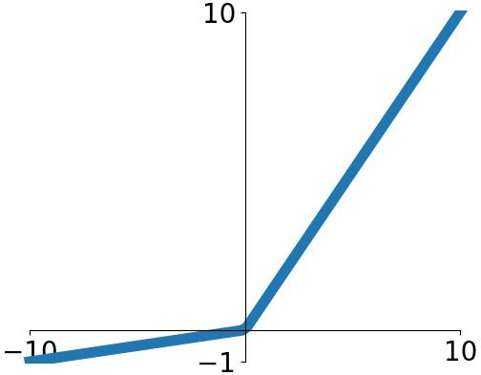


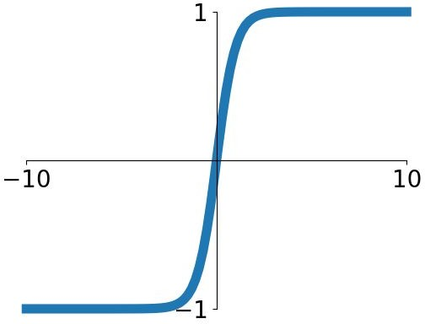


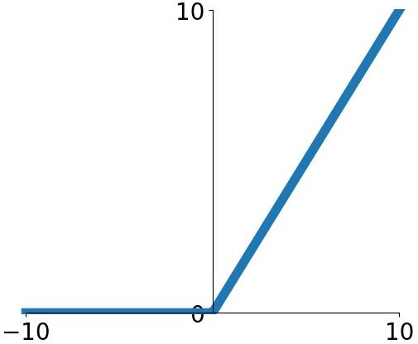
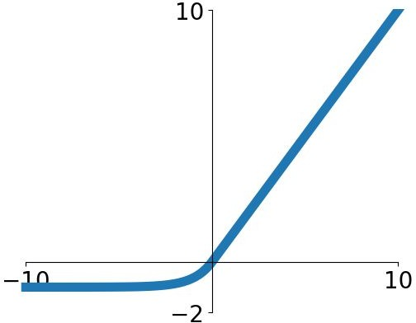

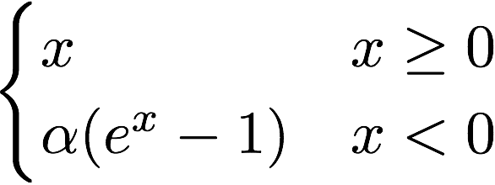
Other Activation Functions
Does not always have to be a squashing function
Sigmoid
tanh
Leaky ReLU
Maxout
ReLU
ELU
Fei-Fei Li & Justin Johnson & Serena Yeung Lecture 6 - April 19, 2018
We will talk about their pro/cons later!

Slide 24
Terminology: Multi-Layer Perceptron (MLP)
Multi-layer Perceptron (MLP):
  A feedforward network with
  perceptrons as its nodes.
A feedforward network does not
have to be an MLP.
  But people sometimes use the names
  interchangeably! 🤷
The original MLP [McCulloch–Pitts] was based
on “threshold” activation.

Slide 25
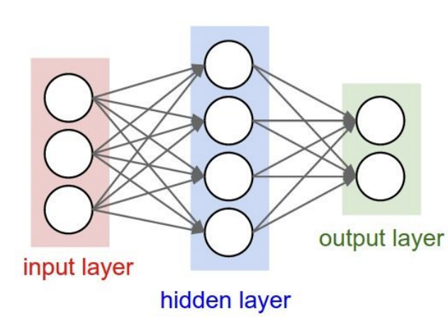


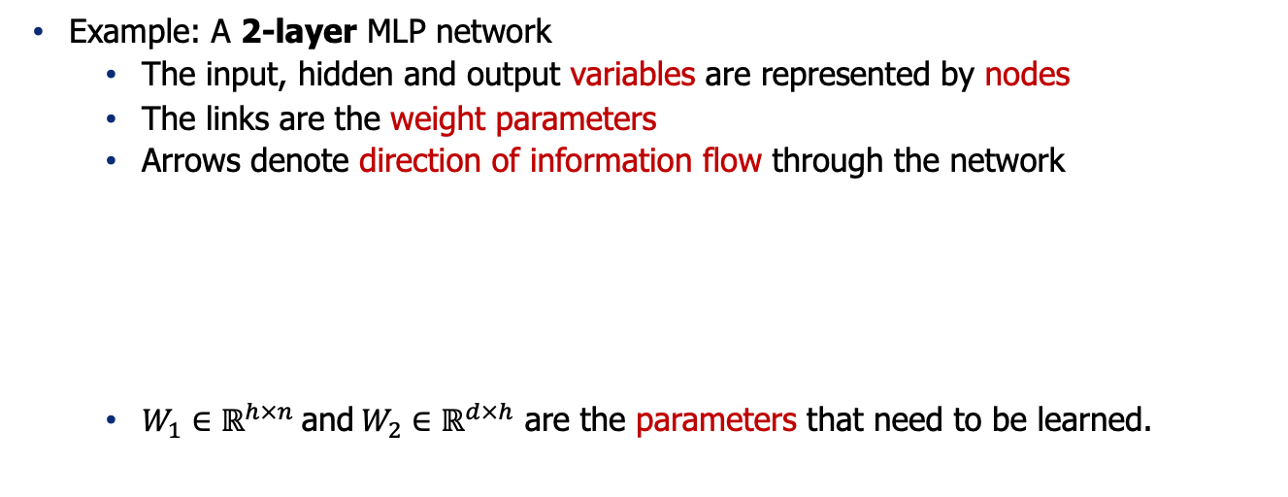


Formally Defining an MLP
Example: A 2-layer MLP network
  The input, hidden and output variables are represented by nodes
  The links are the weight parameters
  Arrows denote direction of information flow through the network
  $W_{1}∈ℝ^{h×n} \text{and} W_{2}∈ℝ^{d×h}$ are the parameters that need to be learned.
$$f\left(x\right)=W_{2} g(W_{1}x)$$
$x∈ℝ^{n}$, $y∈ℝ^{d}$
$g\left(z\right)=\left[σ\left(z_{1}\right), …, σ\left(z_{h}\right)\right]$ (nonlinearity)
$σ\left(z_{i}\right)=\frac{1}{1+e^{−x}}$ (sigmoid function)

Slide 26
Quiz Time (1)
What is needed to fully specify a neural network?
  Architecture (which input goes through what function etc.)
  Parameters of the function (the weights)
  Both

Slide 27
Quiz Time (2)
Which of the followings has more parameters?

Slide 28
Quiz Time (3)
Given an input to these models, which of them take longer to compute an output?

Slide 29
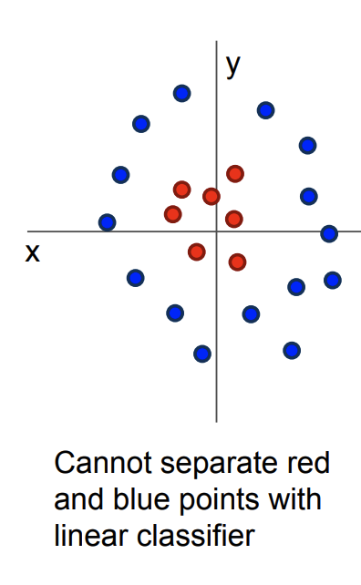



Why Add Non-linearity?
Without non-linearity, the overall model amounts to a linear model.
A linear function cannot approximate complex tasks.
Non-linearity adds capacity to the model to approximate
any continuous function to arbitrary accuracy
given sufficiently many hidden units.
  See “universal approximation theorem”
$$f\left(x\right)=W_{2} g(W_{1}x)$$
$\tilde{f}\left(x\right)=W_{2}W_{1}x=W_{3}x$ (a linear function)
drop $g$

Slide 30
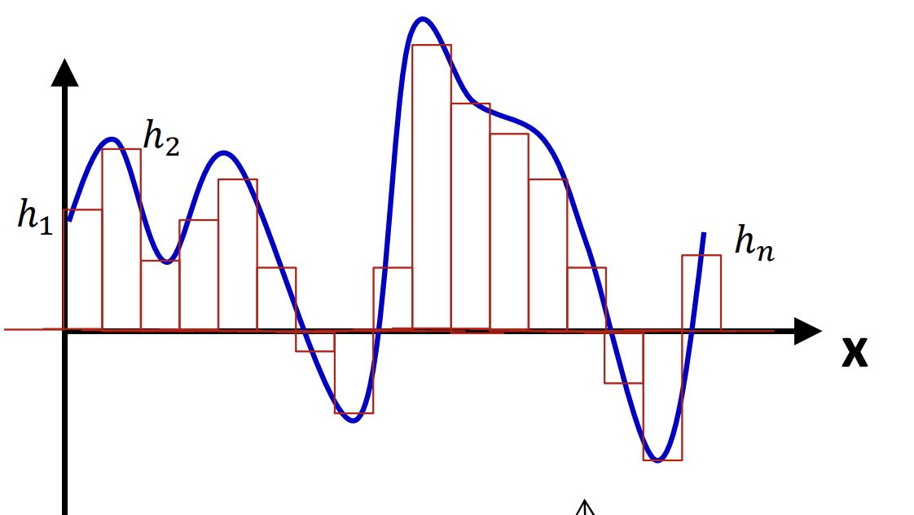
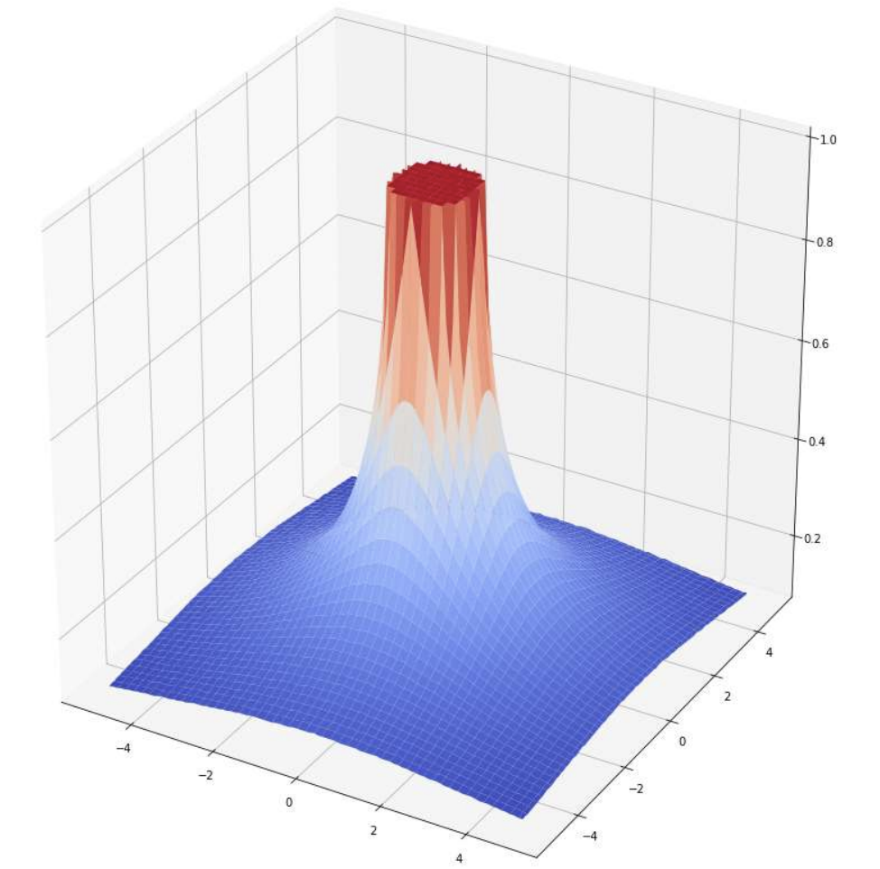
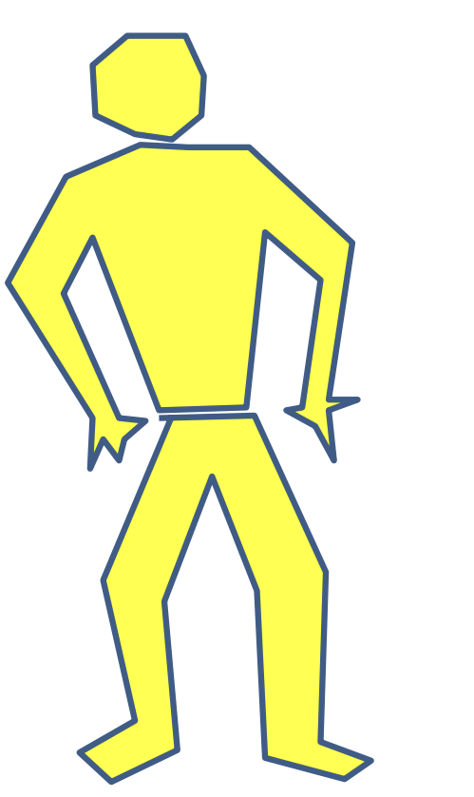
Universal Approximation
An MLP can represent any function, with enough expressivity.
Maiorov & Pinkus. Lower bounds for approximation by MLP neural networks, 1999.

Slide 31
Quiz Time
What makes neural networks expressive functions?
  Activations (non-linearities)
  Depth (number of hidden layers)
  Width (number of variables in each hidden layer)
  All the above

Slide 32
Demo time!
Link: https://playground.tensorflow.org/

Slide 33
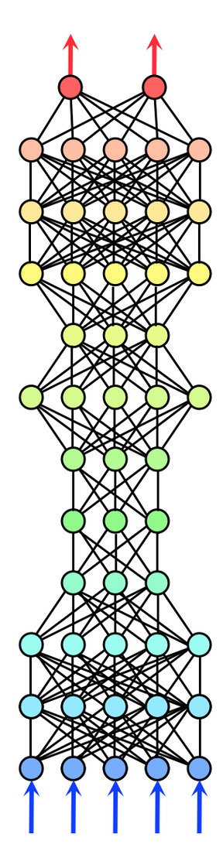
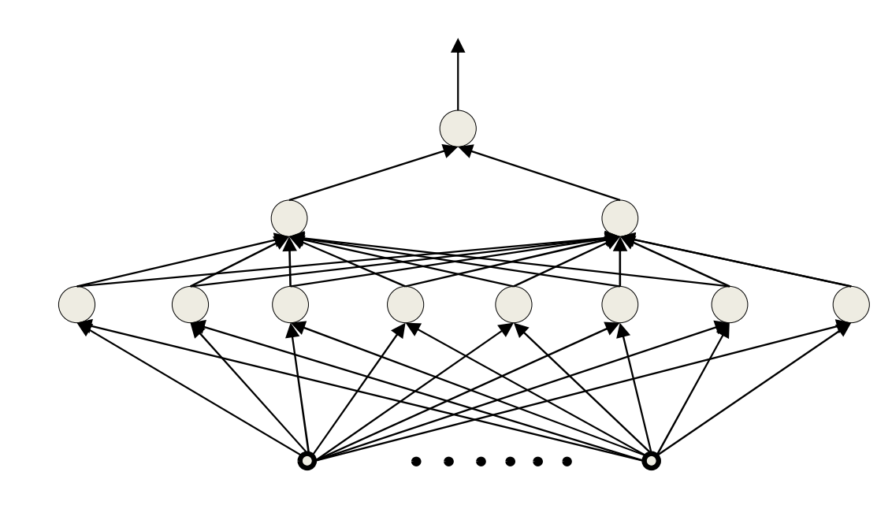
What is a good architecture? Depth vs. Width
Architectural parameters of a neural network
affect its capacity to learn.
  Deep vs. wide

Slide 34
Depth vs Width on Boolean functions
An MLP is a universal Boolean function.
A shallow (single hidden layer) is a universal Boolean machine
  But it may require an exponentially large number of units.
Deeper networks may require far fewer neurons than shallower
networks to express the same function
Notes:
Analysis on ”circuits” provide intuitions about the power of depth vs. width in neural networks.
Circuit: functions constructed with logical gates (AND, OR, XOR, …).

Slide 35

Depth vs Width on Boolean functions
Theorem: There are certain class of functions with $n$ inputs that can be represented with deep neural network with $O(n)$ units, whereas it would require $O(2^{√n})$units for a shallow network.
Hastad, Almost optimal lower bounds for small depth circuits, 1986.
Delalleau & Bengio. Shallow vs. deep sum-product networks, 2011.

Slide 36
Summary
An MLP is a universal function
But can represent a given function only if
  It is sufficiently wide
  It is sufficiently deep
  Depth can be traded off for (sometimes) exponential growth of the width of the network
Optimal width and depth depend on the complexity of the problem.
Next: A bit of history.

Slide 37
Neural Nets:
Origin and History

Slide 38
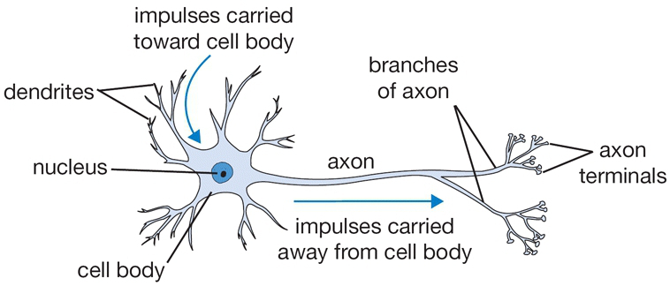
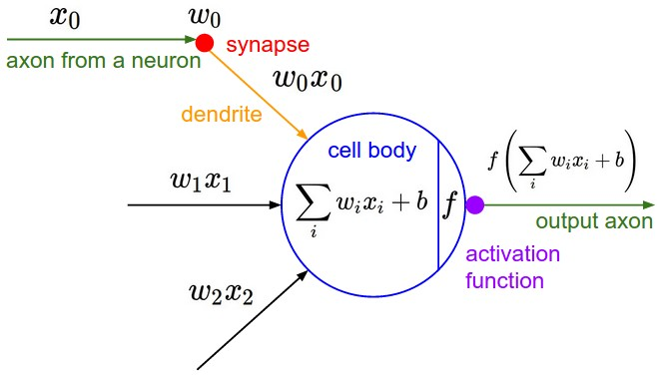
Artificial Neurons: An Inspiration from Nature
A single node in your neural network
  Accept information from multiple inputs
  Transmit information to other neurons
A neuron’s function is inspired by its biological counterpart:
  Apply some function on inputs signals
  If output of function over threshold, neuron “fires”
Notes:
From Wikipedia: At the majority of synapses, signals are sent from the axon of one neuron to a dendrite of another... All neurons are electrically excitable, maintaining voltage gradients across their membranes… If the voltage changes by a large enough amount, an all-or-none electrochemical pulse called an action potential is generated, which travels rapidly along the cell's axon, and activates synaptic connections with other cells when it arrives.
The dendrite of the neuron receives signals (information) from other neurons. The body of the neuron processes this information and if the accumulated signal is strong enough (exceeds a certain threshold), it sends it further through a long 'cable' called an axon. The axon terminus connects with the dendrites of other neurons through synapses. The strength of the connections between the neurons, i.e., the synapses, change as we learn - this process is known as synaptic plasticity.
The strength of the connections between the artificial neurons, similar to synapses in biological neurons, is represented by weights, which are adjusted during the training process, mirroring the process of synaptic plasticity in the human brain.
So in the analogy, dendrites are like the input values in an artificial neuron, the neuron body is like the processing stage (sum and non-linear function) in the artificial neuron, the axon is like the output of the artificial neuron, and synapses are analogous to the weights assigned to the inputs in artificial neural networks.

Slide 39
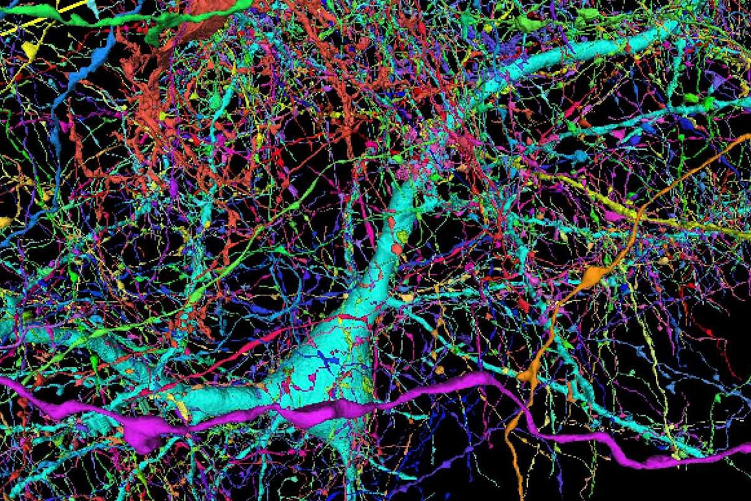
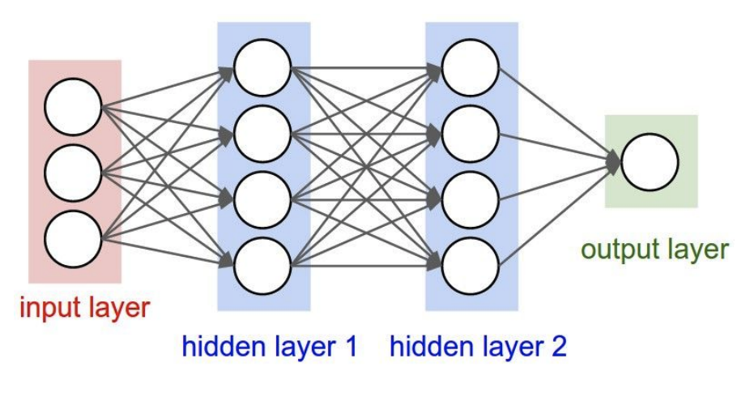
Artificial Neurons: Not Quite Analogous to Nature
Neurons in an artificial neural network:
organized based on a highly regular structure for computational efficiency
Biological neurons:
complex connectivity
Source: Google Brain Map
Notes:
Be careful with analogies:
Many different types
Dendrites can perform complex non-linear computations
Synapses are not a single weight but a complex nonlinear dynamical system
Abstracting a neuron by “firing rate” isn’t enough; temporal sequences of activations matter too (spiking neural networks)

Slide 40
Very Brief History of Neural Networks
Single-layer neural networks (1943-1969)
Symbolic AI & knowledge engineering (1970-1985)
Multi-layer NNs and symbolic learning (1985-1995)
Shallow statistical learning/probabilistic models (1995-2010)
Deep networks and self-supervised learning (2010-?)

Slide 41
Very Brief History of Neural Networks
Single-layer neural networks (1943-1969)
Symbolic AI & knowledge engineering (1970-1985)
Multi-layer NNs and symbolic learning (1985-1995)
Shallow statistical learning/probabilistic models (1995-2010)
Deep networks and self-supervised learning (2010-?)

Slide 42
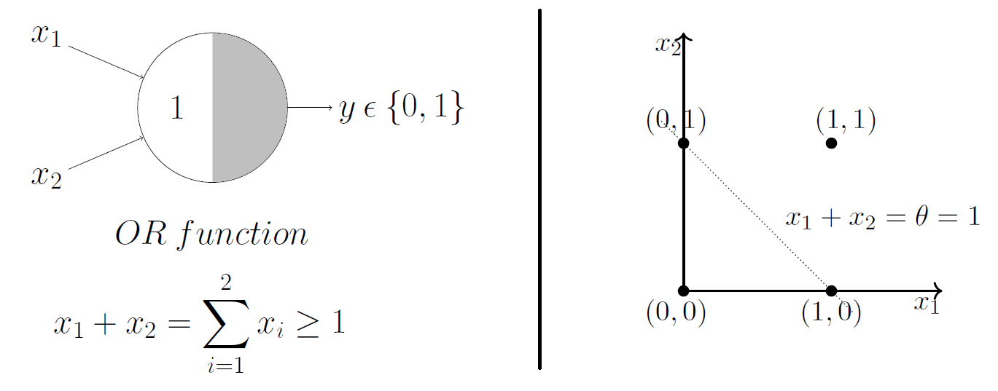
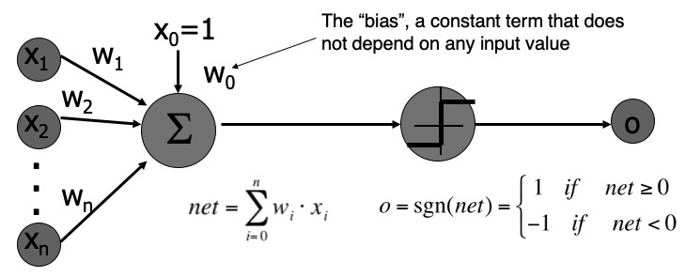
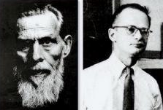
A Neuron as a Mathematical Model of Computation
McCulloch and Pitts (1943) showed how linear threshold units can be used to compute logical functions
An alternative model of computation (comparable to “Turing Machine”)
Notice the step function (threshold)!
Early models didn’t need to be differentiable.
[A Logical Calculus of Ideas Immanent in Nervous Activity, McCulloch and Pitts 1943]
Notes:
Walter Pitts”

Slide 43
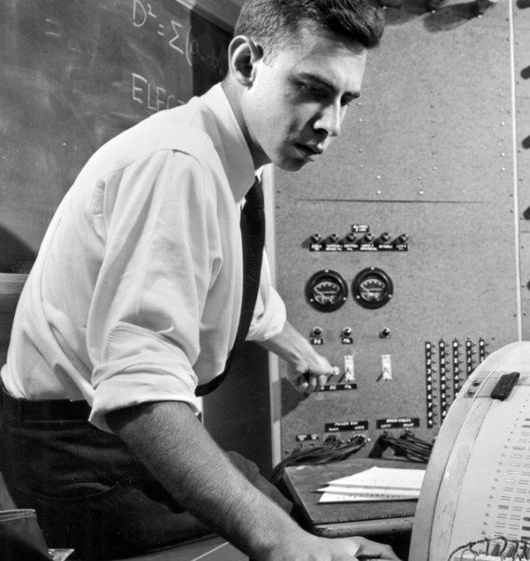
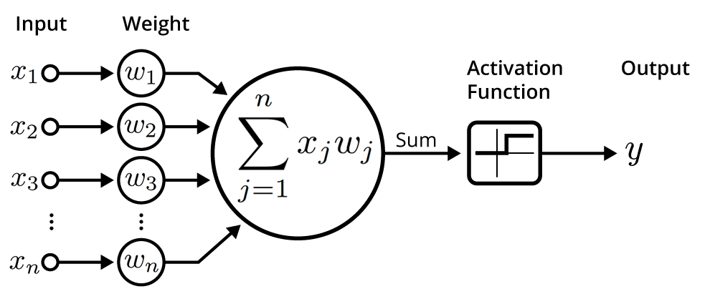

Perceptron Learning Rule — Imitating Nature’s Learning Process
Rosenblatt (1959) developed the Perceptron algorithm —
  An iterative algorithm for learning the weights of a linear threshold unit.
A single neuron with a fixed input, it can incrementally change weights and learn to produce a fixed output using the Perceptron learning rule.
Update each weights by:
$$o$$
t: the target value
[The perceptron: a probabilistic model for information storage and organization in the brain, Rosenblatt 1959]

Slide 44


Quiz (1): Understanding Perceptron Update Rule
Suppose the inputs $x_{i}∈\left\{0, 1\right\}$ and $η=1$. If LTU’s output $o$ exactly matches the target value $t$, How would the update rule change the weights?
  Would increase them
  Would decrease them
  Would not change them
$$o$$

Slide 45
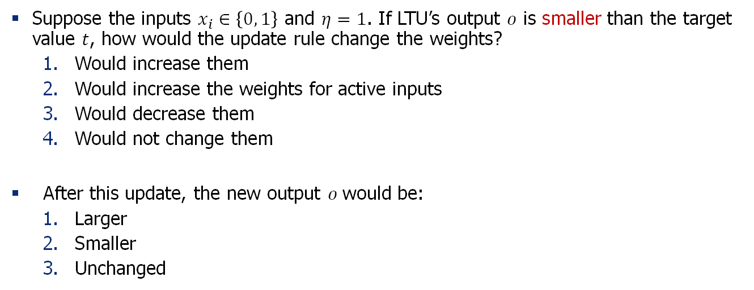
Quiz (2): Understanding Perceptron Update Rule
Suppose the inputs $x_{i}∈\left\{0, 1\right\}$ and $η=1$. If LTU’s output $o$ is smaller than the target value $t$, how would the update rule change the weights?
  Would increase them
  Would increase the weights for active inputs
  Would decrease them
  Would not change them
After this update, the new output $o$would be:
  Larger
  Smaller
  Unchanged
$$o$$

Slide 46
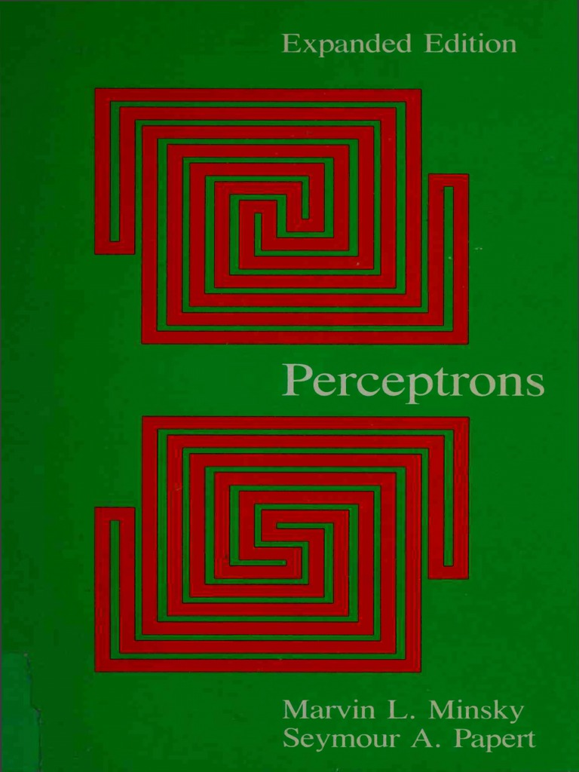
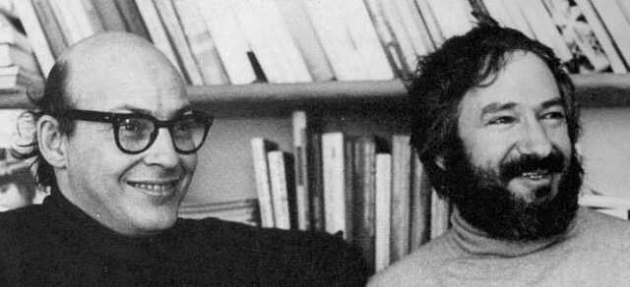
Perceptron: Demise
“Perceptrons” (1969) by Minsky and Papert illuminated
few limitations of the perceptron.
It showed that:
  Shallow (2-layer) networks are unable to learn or
  represent many classification functions (e.g. XOR)
  Only the linearly separable functions are learnable.
Also, there was an understanding that deeper networks
were infeasible to train.
Result: research on NNs dissipated during the 70’s and early 80’s!
[slide: Ray Mooney]

Slide 47
Very Brief History of Neural Networks
Single-layer neural networks (1943-1969)
Symbolic AI & knowledge engineering (1970-1985)
Multi-layer NNs and symbolic learning (1985-1995)
Shallow statistical learning/probabilistic models (1995-2010)
Deep networks and self-supervised learning (2010-?)

Slide 48
Very Brief History of Neural Networks
Single-layer neural networks (1943-1969)
Symbolic AI & knowledge engineering (1970-1985)
Multi-layer NNs and symbolic learning (1985-1995)
Shallow statistical learning/probabilistic models (1995-2010)
Deep networks and self-supervised learning (2010-?)

Slide 49
Neural Networks Resurgence (1986)
Interest in NNs revived in the mid 1980’s due to the rise of “connectionism.”
Backpropagation algorithm was [re-]introduced for training three-layer NN’s.
  Generalized the iterative “hill climbing” method to approximate networks with multiple layers, but no convergence guarantees.
what was possible
to train in 1970’s
what became possible
to train via BP in 1980’s
[Learning representations by back-propagating errors, Rumelhart, Hinton & Williams 1986;
for a broader context, see: http://people.idsia.ch/~juergen/who-invented-backpropagation.html]

Slide 50
Second NN Demise (1995-2010)
Generic backpropagation did not generalize that well to training deeper networks.
  Overfitting / underfitting remained an issue.
  Computers were still quite slow
Little theoretical justification for underlying methods.
Machine learning research moved to graphical/probabilistic models and kernel methods.
[slide: Ray Mooney]

Slide 51
Very Brief History of Neural Networks
Single-layer neural networks (1943-1969)
Symbolic AI & knowledge engineering (1970-1985)
Multi-layer NNs and symbolic learning (1985-1995)
Shallow statistical learning/probabilistic models (1995-2010)
Deep networks and self-supervised learning (2010-?)

Slide 52
Very Brief History of Neural Networks
Single-layer neural networks (1943-1969)
Symbolic AI & knowledge engineering (1970-1985)
Multi-layer NNs and symbolic learning (1985-1995)
Shallow statistical learning/probabilistic models (1995-2010)
Deep networks and self-supervised learning (2010-?)

Slide 53
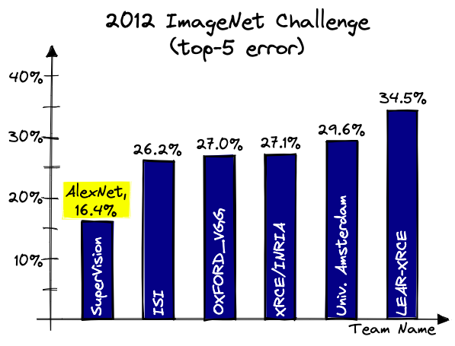

Deep Learning Revolution (2010…)
Various successes with training deep neural works.
  Convolutional neural nets (CNNs) for vision — 2012 AlexNet showed 16% error
  reduction on ImageNet benchmark.
  Rise of deep reinforcement learning for games—AlphaGo beat human players.

Slide 54
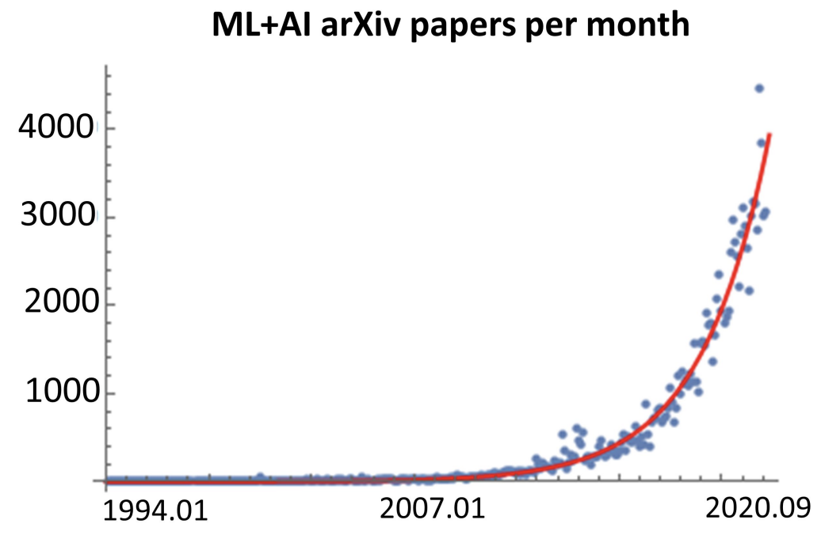
Deep Learning Revolution (2010…)
Various successes with training deep neural works.
  Convolutional neural nets (CNNs) for vision — 2012 AlexNet showed 16% error
  reduction on ImageNet benchmark.
  Rise of deep reinforcement learning for games—AlphaGo beat human players.
arXiv
papers
per month
Figure credit:
https://twitter.com/MarioKrenn6240/status/1314622995139264517

Slide 55
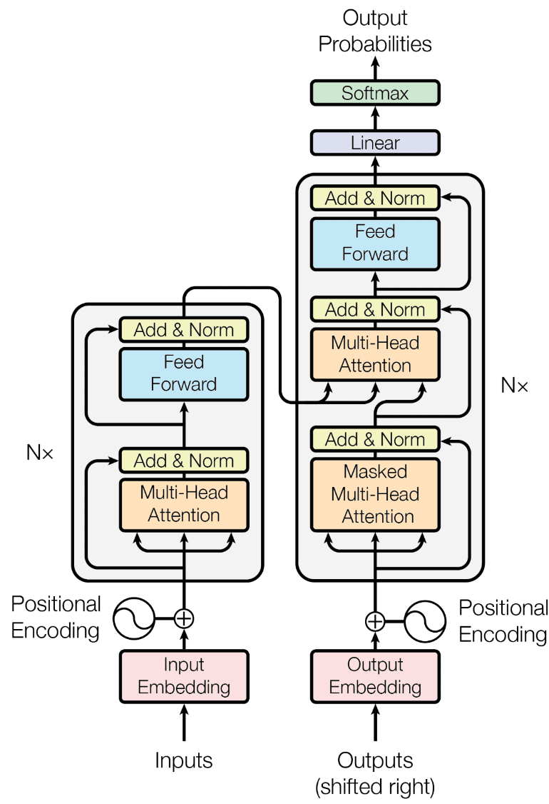
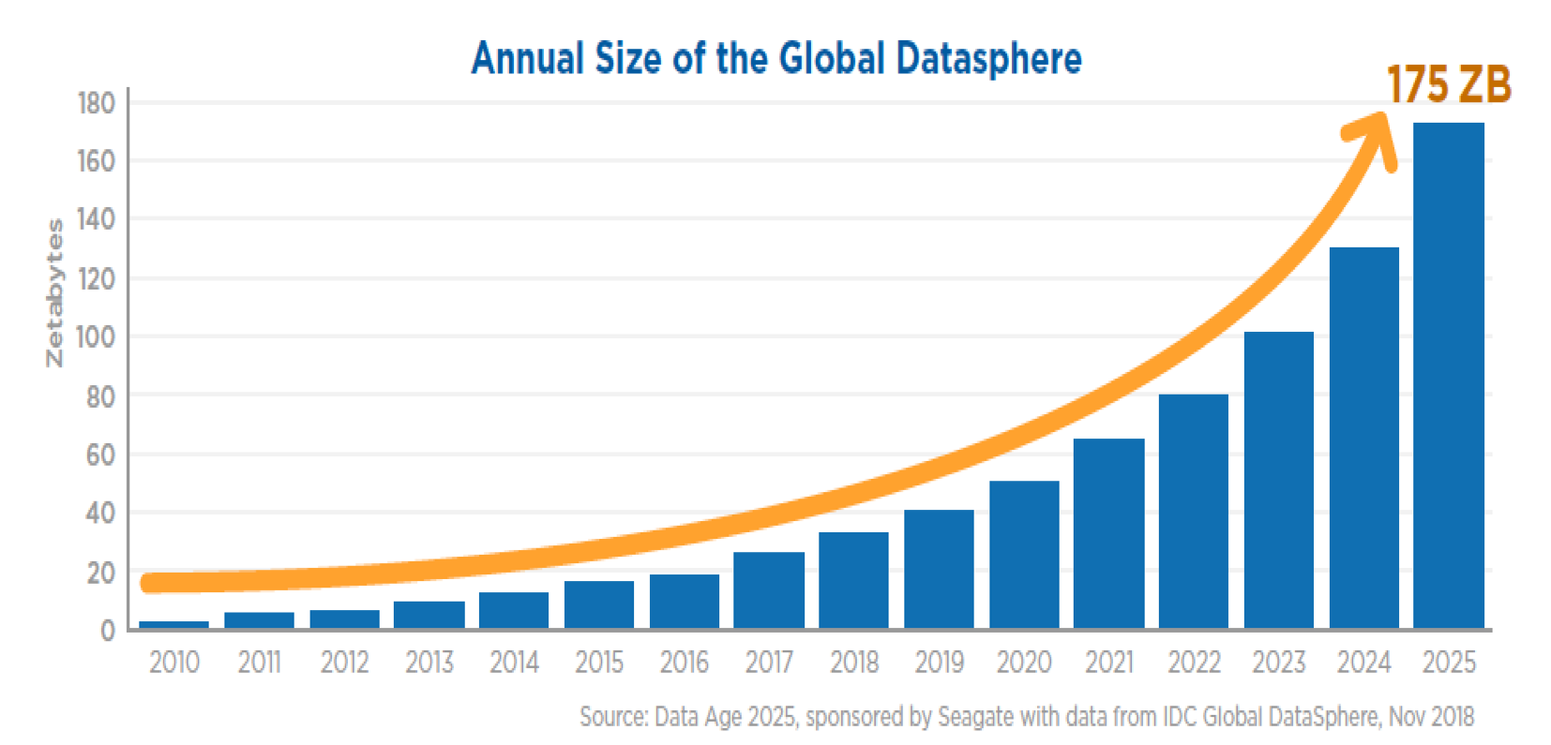
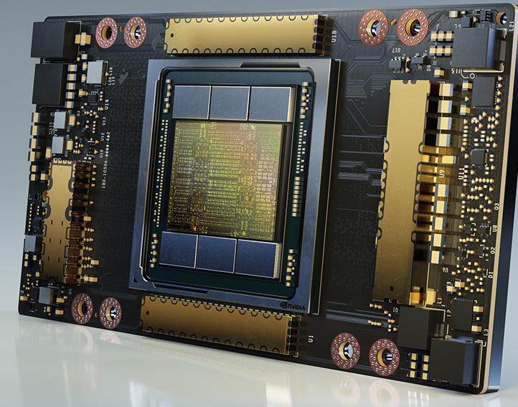
Deep Learning Revolution (2010…)
The success continued enabled by 3 forces:
  Availability of massive [unlabeled] data — the data on Internet.
  Faster computing technologies — specialized hardware (e.g., GPUs)
  Algorithmic innovations — architectures, optimization, etc.

Slide 56
Very Brief History of Neural Networks
Single-layer neural networks (1943-1969)
Symbolic AI & knowledge engineering (1970-1985)
Multi-layer NNs and symbolic learning (1985-1995)
Shallow statistical learning/probabilistic models (1995-2010)
Deep networks and self-supervised learning (2010-?)

Slide 57
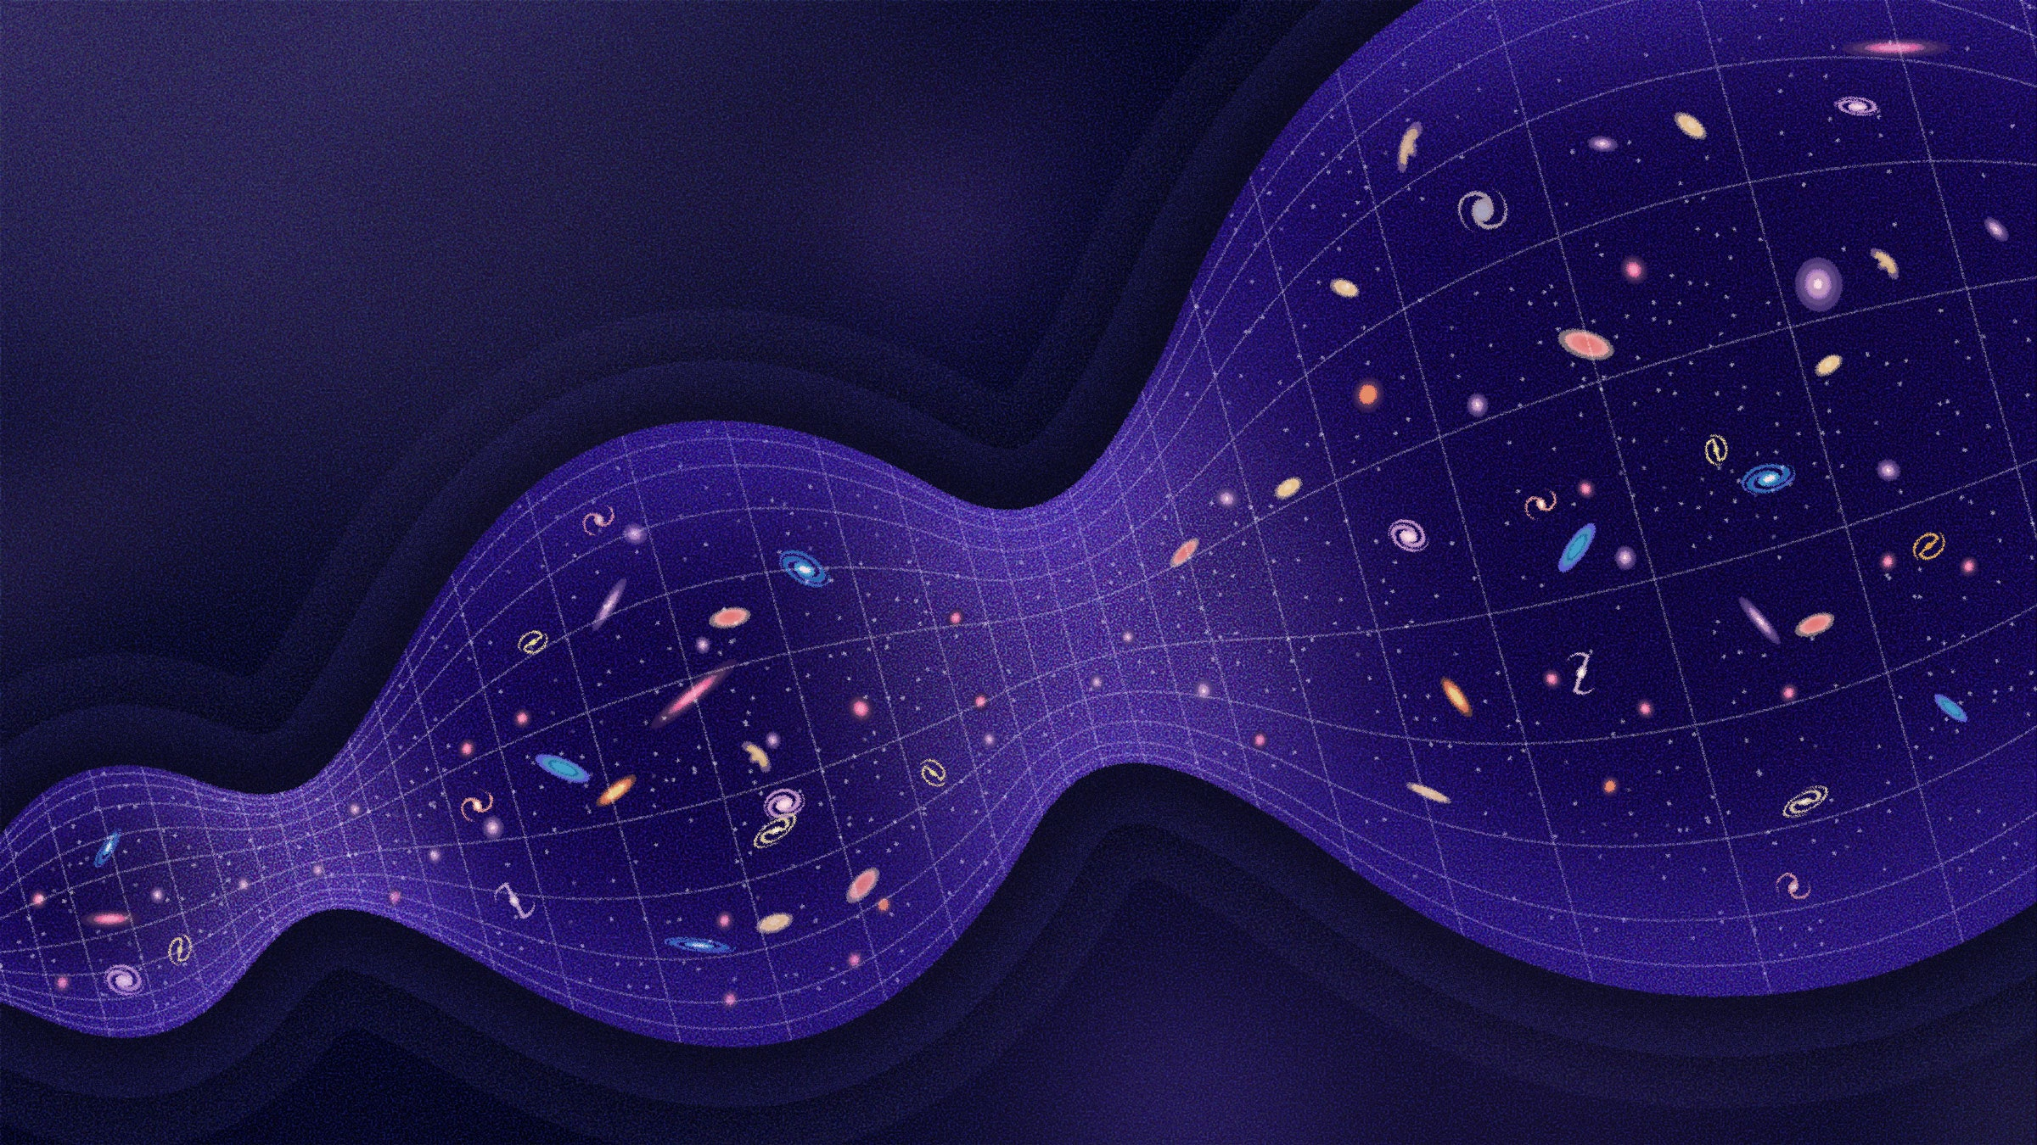
https://en.wikipedia.org/wiki/Big_Bounce
Notes:
The history of AI very much resembles a model of universe in cosmology, in which it goes through periods of expansion and contraction
The first one ….
The second one …
Now it seems like we are at a major expansion
If history is any guide, we will inevitably go though another round of contraction in future, but the technology will come out stronger and better at the end of it.

Slide 58
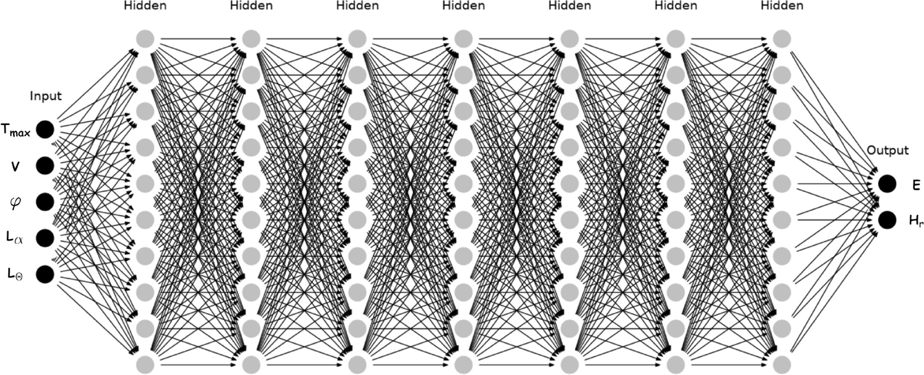
How it started How it’s going
[slide: Ray Mooney]

Slide 59
Summary
Neural networks have been long in the making since 1950s.
It’s a remarkable journey of science with many ups and downs.
Next: How do you train NNs? We will start with some algebra refreshers.

Slide 60
Background for Training NNs
The Refreshers🍹

Slide 61
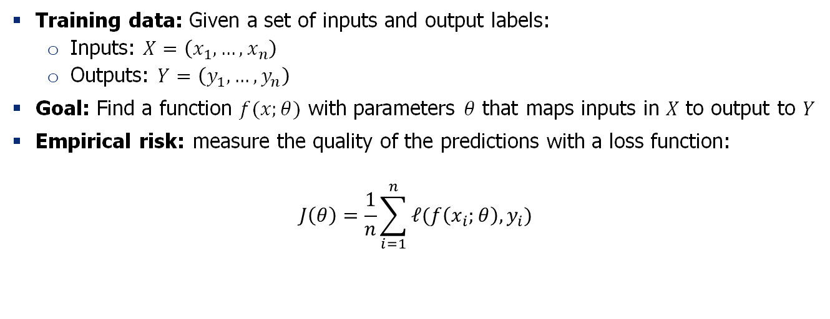
Machine Learning Problems
Training data: Given a set of inputs and output labels:
  Inputs: $X=\left(x_{1},…,x_{n}\right)$
  Outputs: $Y=\left(y_{1},…,y_{n}\right)$
Goal: Find a function $f(x;θ)$ with parameters $θ$ that maps inputs in $X$ to output to $Y$
Empirical risk: measure the quality of the predictions with a loss function:
$$J\left(θ\right)=\frac{1}{n}\sum_{i=1}^{n}{ℓ(f\left(x_{i};θ\right), y_{i})}$$

Slide 62
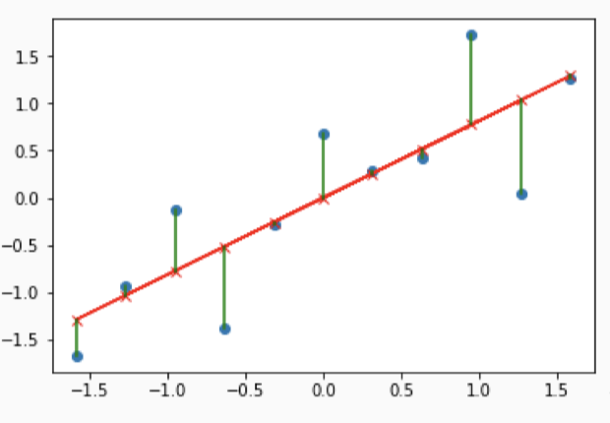
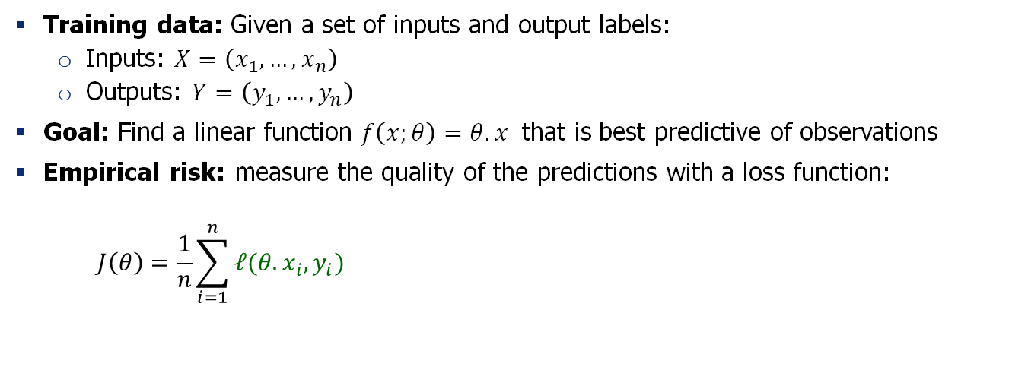
A Special Case: Linear Regression
Training data: Given a set of inputs and output labels:
  Inputs: $X=\left(x_{1},…,x_{n}\right)$
  Outputs: $Y=\left(y_{1},…,y_{n}\right)$
Goal: Find a linear function $f\left(x;θ\right)=θ.x$ that is best predictive of observations
Empirical risk: measure the quality of the predictions with a loss function:
$$J\left(θ\right)=\frac{1}{n}\sum_{i=1}^{n}{ℓ(θ.x_{i}, y_{i})}$$
What are good choices for loss function?

Slide 63
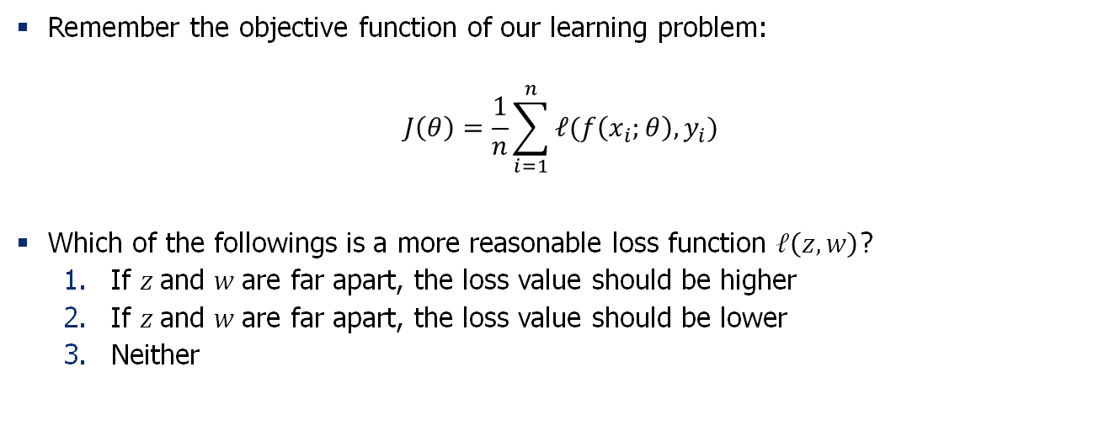
Quiz: Loss functions
Remember the objective function of our learning problem:
$$J\left(θ\right)=\frac{1}{n}\sum_{i=1}^{n}{ℓ(f\left(x_{i};θ\right), y_{i})}$$
Which of the followings is a more reasonable loss function $ℓ\left(z, w\right)$?
  If $z$and $w$are far apart, the loss value should be higher
  If $z$and $w$are far apart, the loss value should be lower
  Neither

Slide 64
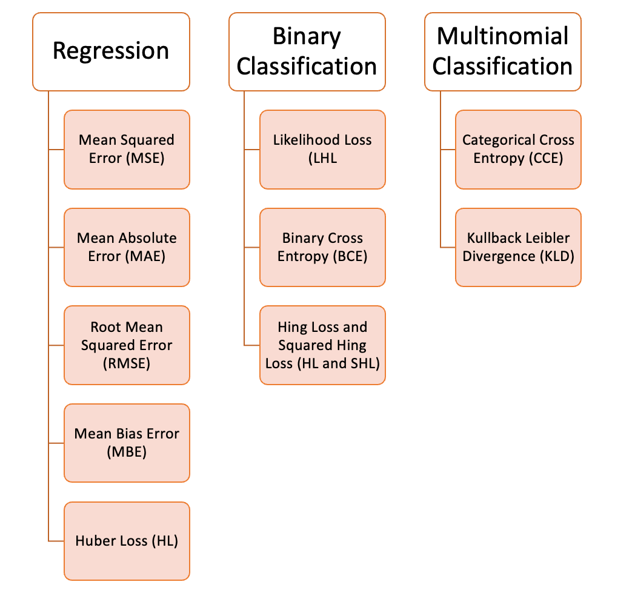


Loss Functions
The choice of loss function depends
on the problem
$$ℓ\left(y, \hat{y}\right)={\left(y−\hat{y}\right)}^{2}$$
$$ℓ\left(y, \hat{y}\right)=|y−\hat{y}|$$

Slide 65
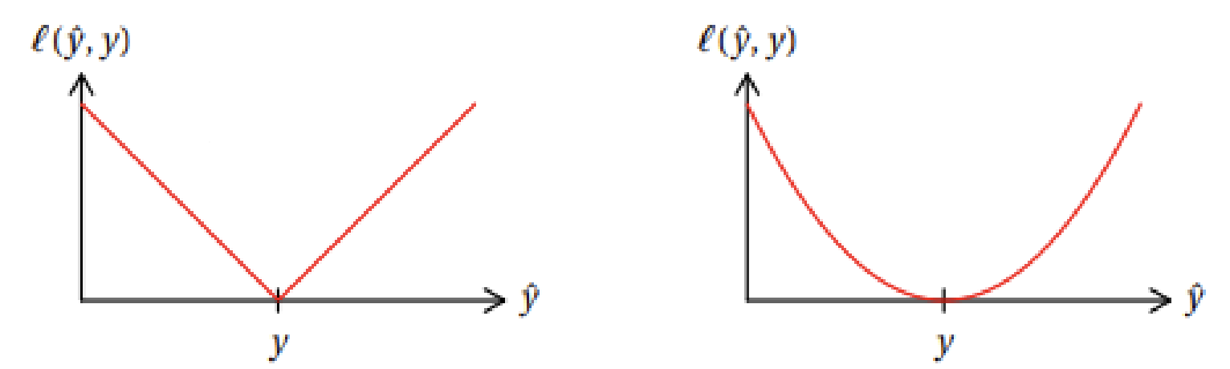


Quiz: MSE vs. MAE loss
MSE: $ℓ\left(y, \hat{y}\right)={\left(y−\hat{y}\right)}^{2}$
Remember MSE and MAE loss:
  Which visualization corresponds to which loss?
  Which loss is more sensitive to outlier data (noisy outputs)?
  Which loss is more difficult to compute gradients for?
MAE: $ℓ\left(y, \hat{y}\right)=|y−\hat{y}|$

Slide 66
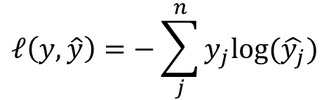
Loss Functions
The choice of loss function depends
on the problem
$$ℓ\left(y, \hat{y}\right)={\left(y−\hat{y}\right)}^{2}$$
$$ℓ\left(y, \hat{y}\right)=|y−\hat{y}|$$
$$ℓ\left(y, \hat{y}\right)=−\sum_{j}^{n}{y_{j}log⁡(\hat{y_{j}})}$$

Slide 67
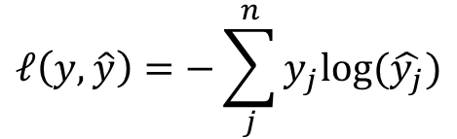
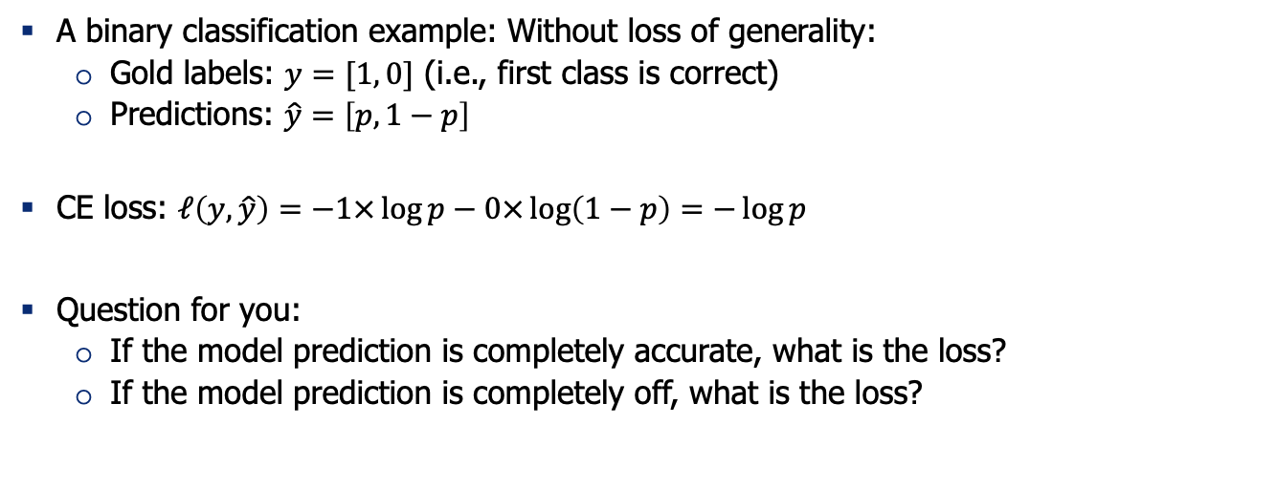
Loss Functions: Cross-Entropy
$$ℓ\left(y, \hat{y}\right)=−\sum_{j}^{n}{y_{j}log⁡(\hat{y_{j}})}$$
A binary classification example: Without loss of generality:
  Gold labels: $y=[1, 0]$ (i.e., first class is correct)
  Predictions: $\hat{y}=\left[p, 1−p\right]$
CE loss: $ℓ\left(y, \hat{y}\right)=−1×\log{p}−0×\log\left(1−p\right)=−\log{p}$
Question for you:
  If the model prediction is completely accurate, what is the loss?
  If the model prediction is completely off, what is the loss?
Summation over the dimensions of y

Slide 68

Machine Learning Problems
Training data: Given a set of inputs and output labels:
  Inputs: $X=\left(x_{1},…,x_{n}\right)$
  Outputs: $Y=\left(y_{1},…,y_{n}\right)$
Goal: Find a function $f(x;θ)$ with parameters $θ$ that maps inputs in $X$ to output to $Y$
Empirical risk: measure the quality of the predictions with a loss function:
$$J\left(θ\right)=\frac{1}{n}\sum_{i=1}^{n}{ℓ(f\left(x_{i};θ\right), y_{i})}$$
Machine learning as optimization:
$\underset{θ}{argmin}{J\left(θ\right)}$
How do you solve this optimization?

Slide 69


Gradient Descent
We have a cost function $J\left(θ\right)$we want to minimize
  We can use Gradient Descent algorithm!
Idea: for current value of $θ$, calculate gradient of $J\left(θ\right)$, then take small step in direction of negative gradient. Repeat.
Note: Our objectives may not be
convex like this. But life turns out to be okay!

Slide 70


Gradient Descent (1): Intuition
Imagine you’re blindfolded
Need to walk down a hill
You can use your hands
to find the directions
that may be downhill
[slide: Andrej Karpathy]

Slide 71



Gradient Descent (2): Intuition
$$\frac{∂L}{∂θ_{j}}=\lim_{h→0}{\frac{L\left(θ_{j}+h\right)−L(θ_{j})}{h}}$$
In 1-dimension, the derivative of a function:
Why step in direction of negative gradient?
  Gradient quantifies how rapidly the
  function $L(θ)$ varies when we change
  the argument $θ_{j}$ by a tiny amount.

Slide 72




Gradient Descent (3)
𝛼 = step size or learning rate
Update equation (in matrix notation):
Update equation (for single parameter):
Algorithm:
Iteratively subtract the gradient with respect to the model parameters ($θ$)
i.e., we’re moving in a direction opposite to the gradient of the loss $L(θ)$
I.e., we’re moving towards smaller loss $L(θ)$

Slide 73

Gradient Descent (4)
Update equation (in matrix notation):
[demo credit: ICMS YouTube channel]

Slide 74


Gradient Descent: Setting the Step Size
What is a good value for step size $α$?
  If $α=$ too small, it may be too slow
  If $α=$ too large, it may oscillate
It may take trial-and-errors to find the sweet spot.
Another trick is to define a “schedule” for gradually reducing the learning rate starting from a large number.
[figure from: https://www.jeremyjordan.me/nn-learning-rate/]

Slide 75






A Typical Machine Learning and Evaluation Protocol
Each choice of parameters in neural networks correspond to another function.
Model Hypothesis Class
$$ℱ=\left\{f_{1},f_{2},f_{3},…\right\}$$
Training data
$$D_{train}=\left\{\left(x_{1},y_{1}\right), …\right\}$$
Overall training: picking the best function:$f^{∗}$
Training is to pick the function given the observed data.
Held-out validation data
$$D_{val}=\left\{\left(x_{1},y_{1}\right), …\right\}$$
Testing is t predict the quality of the best selected function
Testing data
$$D_{test}=\left\{\left(x_{1},y_{1}\right), …\right\}$$
Evaluation on test set:
$${E_{\left(x, y\right) \sim D_{test}}\left[\left(ℓ(f\left(x\right),y\right)\right]}^{}$$

Slide 76
Summary Thus Far
A statistical learning problem can be formulated as an optimization problem.
The objective of this optimization consists of:
  Learning data (input/outputs)
  Predictive model architecture (encoding how an input gets mapped to an output)
  Loss function (quantifying quality of predictions)
Soon, we will use see how to use Neural Nets as the predictive model.

Slide 77
Algebra Refresher

Slide 78




Derivatives
First let’s get the notation right:
The arrow shows functional dependence of $z$on $y$,
i.e. given $y$, we can calculate$z$.
  For example:$z(y) = 2y^{2}$
The derivative of $z$, with respect to $y$: $\frac{∂z}{∂y}$
$$z$$
$$\frac{∂z}{∂y}$$
$$y$$

Slide 79



Quiz time!
If $z(x, y)={y^{4}x}^{5}$what is the following derivative $\frac{∂z}{∂y}$ ?
  $\frac{∂z}{∂y}=4y^{3}x^{5}$
  $\frac{∂z}{∂y}={5y}^{4}x^{4}$
  $\frac{∂z}{∂y}={20y}^{3}x^{4}$
  None of the above
$$z$$
$$y x$$

Slide 80






Gradient
$$f$$
Given a function with 1 output and $n$ inputs
Its gradient is a vector of partial derivatives with respect to each input
$$x_{1} x_{2} … x_{n}$$
$$f\left(x\right)=f\left(x_{1},x_{2}, …,x_{n}\right)∈ℝ$$
$∇f\left(x\right)=\left[\begin{aligned}\frac{∂f}{∂x_{1}} \\ \frac{∂f}{∂x_{2}} \\ ⋮ \\ \frac{∂f}{∂x_{n}}\end{aligned}\right]$ $∈ℝ^{n}$
(always assume vectors are
column vectors, i.e., they’re in $ℝ^{n×1}$)

Slide 81

Quiz time!
If $z(x,y)={y^{4}x}^{5}$what is the following gradient $∇z$?
  $∇z(x,y)=4y^{3}x^{5}$
  $∇z(x,y)=({5y}^{4}x^{4},{20y}^{3}x^{4}$)
  $∇z(x,y)=({5y}^{4}x^{4},{4y}^{3}x^{5}\text{)}$
  None of the above
$$z$$
$$y x$$

Slide 82




Jacobian Matrix: Generalization of the Gradient
$$f_{1} {… f}_{m}$$
Given a function with m outputs and n inputs
It’s Jacobian is an m x n matrix of partial derivatives: ${\left(J_{f}\left(x\right)\right)}_{ij}=\frac{∂f_{i}}{∂x_{j}}$
$$x_{1} x_{2} … x_{n}$$
$$f\left(x\right)=\left[f_{1}\left(x_{1},x_{2}, …,x_{n}\right), …,f_{m}\left(x_{1},x_{2}, …,x_{n}\right)\right]∈ℝ^{m}$$
$$J_{f}\left(x\right)=\left[\begin{matrix}\frac{∂f_{1}}{∂x_{1}} & ⋯ & \frac{∂f_{1}}{∂x_{n}} \\ ⋮ & ⋱ & ⋮ \\ \frac{∂f_{m}}{∂x_{1}} & ⋯ & \frac{∂f_{m}}{∂x_{n}}\end{matrix}\right]∈ℝ^{m×n}$$

Slide 83


Quiz: Jacobian’s special case (1)
Remember Jacobians:
When m=1 (scalar-valued function), Jacobian reduces to …?
$$f\left(x\right)=\left[f_{1}\left(x_{1},x_{2}, …,x_{n}\right), …,f_{m}\left(x_{1},x_{2}, …,x_{n}\right)\right]∈ℝ^{m}$$
$J_{f}\left(x\right)=\left[\begin{matrix}\frac{∂f_{1}}{∂x_{1}} & ⋯ & \frac{∂f_{1}}{∂x_{n}} \\ ⋮ & ⋱ & ⋮ \\ \frac{∂f_{m}}{∂x_{1}} & ⋯ & \frac{∂f_{m}}{∂x_{n}}\end{matrix}\right]∈ℝ^{m×n}$ or ${\left(J_{f}\left(x\right)\right)}_{ij}=\frac{∂f_{i}}{∂x_{j}}$
$∇^{T}f\left(x\right)$ (gradient transpose)

Slide 84

Quiz: Jacobian’s special case (2)
Remember Jacobians:
When m=n=1 (single-variable function), Jacobian reduces to …?
$$f\left(x\right)=\left[f_{1}\left(x_{1},x_{2}, …,x_{n}\right), …,f_{m}\left(x_{1},x_{2}, …,x_{n}\right)\right]∈ℝ^{m}$$
$J_{f}\left(x\right)=\left[\begin{matrix}\frac{∂f_{1}}{∂x_{1}} & ⋯ & \frac{∂f_{1}}{∂x_{n}} \\ ⋮ & ⋱ & ⋮ \\ \frac{∂f_{m}}{∂x_{1}} & ⋯ & \frac{∂f_{m}}{∂x_{n}}\end{matrix}\right]∈ℝ^{m×n}$ or ${\left(J_{f}\left(x\right)\right)}_{ij}=\frac{∂f_{i}}{∂x_{j}}$
the derivative of $f$

Slide 85


Jacobian for Matrix Inputs
Given a function with $m$ outputs and $n×p$ inputs
Jacobian is a $m×n×p$ tensor (i.e., matrix of matrices) of partial derivatives:
$${\left(J_{f}\left(X\right)\right)}_{ijk}=\frac{∂f_{i}}{∂x_{jk}}$$
The Jacobian math holds if you keep adding more dimensions to the input or output.
$f\left(X\right)=\left[f_{1}\left(X\right), …,f_{m}\left(X\right)\right]∈ℝ^{m}$, where $X=\left[\begin{matrix}x_{11} & ⋯ & x_{1p} \\ ⋮ & ⋱ & ⋮ \\ x_{n1} & ⋯ & x_{np}\end{matrix}\right]∈ℝ^{n×p}$

Slide 86


Why Use Matrix/Tensor Form?
In essence, matrix form (multi-variate calculus) is just an extension of single-variable calculus.
Two reasons:
Compact derivations: with matrix form calculations we can compute a concise statements.
Implementing algorithms in matrix form is much faster.
  GPUs are optimized for VERY FAST matrix/tensor operations.

Slide 87







Chain Rule
$$z$$
$$y$$
Function composition:
$$z∘y\left(x\right)=z\left(y\left(x\right)\right)= z\left(x\right)$$
Then:
$$x$$
If $z$ is a function of $y$, and
$y$ is a function of $x$, then
$z$ is a function of $x$, as well.
$$\frac{∂z}{∂x}$$
$=\frac{∂z}{∂y}$ $\frac{∂y}{∂x}$

Slide 88






Chain Rule for Multivariable Functions
$$f$$
Let $x∈ℝ^{d}$, $g: ℝ^{d}→ℝ^{n}\text{, }f: ℝ^{n}→ℝ^{m}$
Composing them: $f∘g\left(x\right)=f\left(g\left(x\right)\right):ℝ^{d}→ℝ^{m}$
The result looks similar to the single-variable setup:
Note, the above statement is a matrix multiplication!
Function $f∘g$ has m outputs and d inputs → Jacobian’s dims:
$$g$$
$$x$$
$$J_{f}\left(g(x)\right){ J}_{g}\left(x\right)$$
$$J_{f∘g}\left(x\right)=$$
m by d

Slide 89






Quiz Time!
$$z$$
$$y_{2}$$
$$y_{1}$$
$$…$$
$$y_{n}$$
Let $x∈ℝ$, $y:ℝ→ℝ^{n}\text{, }z: ℝ^{n}→ℝ$
What is the Jacobean of $z∘y\left(x\right)=z(y_{1}\left(x\right),…, y_{n}\left(x\right))$?
1. $J_{z∘y}\left(x\right)=J_{z}\left(y(x)\right){ J}_{y}\left(x\right)$
2. $J_{z∘y}\left(x\right)=\left[\frac{∂z}{∂y_{1} }, …,\frac{∂z}{∂y_{n} }\right]{\left[\frac{∂y_{1}}{∂x }, …,\frac{∂y_{n}}{∂x }\right]}^{T}$
3. $J_{z∘y}\left(x\right)=\sum_{i=1}^{n}{\frac{∂z}{∂y_{i} } \frac{∂y_{i}}{∂x }}$
4. All the above!
$$x$$

Slide 90
Summary
We reviewed lots of background about neural networks!
  Linear algebra foundation
  Gradient descent
  Extending gradients to tensor form: Jacobians
Next: training a neural net!

Slide 91
Training Neural Networks:
Analytical Backprop

Slide 92
Recap: Multi-Layer Perceptron
[Slide: HKUST]

Slide 93
Recap: Multi-Layer Perceptron
Weights to learn!
Weights to learn!
Weights to learn!
[Slide: HKUST]

Slide 94







Training Neural Networks: Setup
We are given an architecture though its weights $W$.
We are given a training data $D=\{(x_{i}, y_{i}^{∗})\}$
We are given a loss function $ℓ:ℝ×ℝ→(0, 1)$
  $ℓ\left(y^{∗}, y\right)$quantifies distance between an answer $y^{∗}$and prediction $y=NN\left(x;W\right)$ — lower is better.
Overall objective to optimize: $ℒ\left(D;W\right)=\sum_{\left(x_{i}, y_{i}^{∗}\right)∈D}{ℓ(NN\left(x_{i};W\right){, y}_{i}^{∗})}$
$$x_{1}$$
$$x_{2}$$
$$x=\left(x_{1},x_{2},x_{3},x_{4}\right)∈ℝ^{4}$$
Weights to learn!
Weights to learn!
Weights to learn!
$$y∈ℝ$$
$$x_{3}$$
$$x_{4}$$

Slide 95






Training Neural Networks ~ Optimizing Parameters
$$ℒ\left(D;W\right)$$
We can use gradient descent to
minimizes the loss.
At each step, the weight vector is modified
in the direction that produces the steepest
descent along the error surface.
$$W$$
$$W_{}^{(3)}$$
$$W_{}^{(2)}$$
$$W_{}^{(1)}$$
$$W_{}^{(0)}$$
$$x_{1}$$
$$x_{2}$$
$$x=\left(x_{1},x_{2},x_{3},x_{4}\right)∈ℝ^{4}$$
Weights to learn!
Weights to learn!
Weights to learn!
$$y∈ℝ$$
$$x_{3}$$
$$x_{4}$$

Slide 96



Training Neural Networks ~ Optimizing Parameters
For each sub-parameter $W_{i}∈W$:
$$W_{i}^{(t+1)}=W_{i}^{(t)}−α\frac{∂ℒ}{∂W_{i}}$$
$$ℒ\left(D;W\right)$$
It all comes down to effectively computing $\frac{∂ℒ}{∂W_{i}}$
$$W$$
$W_{}^{(3)}$ $W_{}^{(2)}$ $W_{}^{(1)}$ $W_{}^{(0)}$
$$x_{1}$$
$$x_{2}$$
$$x=\left(x_{1},x_{2},x_{3},x_{4}\right)∈ℝ^{4}$$
Weights to learn!
Weights to learn!
Weights to learn!
$$y∈ℝ$$
$$x_{3}$$
$$x_{4}$$

Slide 97

Training Neural Networks ~ Computing the Gradients
How do you efficiently compute $\frac{∂ℒ}{∂W_{i}}$ for all parameters?
It’s easy to learn the final layer – it’s just a linear unit.
How about the weights in the earlier layers (i.e., before the final layer)?
$$x_{1}$$
$$x_{2}$$
$$x=\left(x_{1},x_{2},x_{3},x_{4}\right)∈ℝ^{4}$$
Weights to learn!
Weights to learn!
Weights to learn!
$$y∈ℝ$$
$$x_{3}$$
$$x_{4}$$

Slide 98


Necessity of a Principled Algorithm for Gradient Computation
Depth gives more representational capacity
to neural networks.
However, computing gradients for deeper
layers is not trivial and tedious.
Even if we have analytical formula for gradient,
if they’re architecture-specific, they must be
repeated for each new architecture.
The solution is “Backpropagation” algorithm!
Architecture of the BERT model with over 24 layers and millions of parameters — we will study get to this model in a few weeks!

Slide 99




BP: Required Intuitions
$$ℒ\left(D;W\right)$$
Gradient Descent
  Change the weights $W$in the direction of gradient to minimize the error function.
Chain Rule
  Use the chain rule to calculate the weights of the intermediate weights
Dynamic Programming (Memoization)
  Memoize the weight updates to make the updates faster.
$$W$$
$W_{}^{(3)}$ $W_{}^{(2)}$ $W_{}^{(1)}$ $W_{}^{(0)}$
$$x_{1}$$
$$x_{2}$$
$$x_{3}$$
$$x_{4}$$

Slide 100











A Generic Multi-Layer Perceptron
$$y$$
$$u^{T}h_{L}$$
+
$$f_{L−1}$$
Given the following definition:
Trainable parameters: $W=\left\{W_{0},W_{1}, …,W_{L}, u\right\}$
$x=h_{0}∈ℝ^{d_{0}}$ (input)
$h_{i+1}=f_{i}(W_{i}h_{i})∈ℝ^{d_{i}}$ (hidden layer $i$ , $0≤i≤L−1$)
$y=u^{T}h_{L}∈ℝ$ (output)
$ℒ=ℓ(y,y^{∗})∈ℝ$ (loss)
$$W_{L−1}h_{L−1}$$
$⋮ ⋮$ $⋮$
$$W_{1}h_{1}$$
$$f_{0}$$
$$W_{0}x$$
$$x$$

Slide 101


A Generic Neural Network: Forward Step
$$y$$
$$u^{T}h_{L}$$
+
Given some [initial] values for the parameters, we
can compute the forward pass, layer by layer.
Forward pass is basically $L$ matrix multiplications, each followed by an activation function.
Matrix multiplication can be done efficiently with GPUs.
  Therefore, forward pass is somewhat fast.
Complexity of forward pass is ….
$$f_{L−1}$$
$$W_{L−1}h_{L−1}$$
$⋮ ⋮$ $⋮$
$$W_{1}h_{1}$$
$$f_{0}$$
linear of depth $O\left(L\right)$.
$$W_{0}x$$
$$x$$

Slide 102




A Generic Neural Network: Direct Gradients
$$y$$
$$u^{T}h_{L}$$
+
$x=h_{0}∈ℝ^{d_{0}}$ (input)
$h_{i+1}=f_{i}(W_{i}h_{i})∈ℝ^{d_{i}}$
($0≤i≤L−1$)
$y=u^{T}h_{L}∈ℝ$ (output)
$ℒ=ℓ(y,y^{∗})∈ℝ$ (loss)
$$W=\left\{W_{0},W_{1}, …,W_{L}, u\right\}$$
$$f_{L−1}$$
$$W_{L−1}h_{L−1}$$
We want the gradients of $ℒ$ with respect to model parameters.
Use the chain rule to simplify the following term:
$$∇_{ℒ}\left(W_{L−1}\right)={\left(J_{ℒ}\left(W_{L−1}\right)\right)}^{T}=$$
$⋮ ⋮$ $⋮$
$${\left(J_{ℒ}\left(y\right){ J}_{y}\left(h_{L}\right){ J}_{h_{L}}\left(W_{L−1}\right)\right)}^{T}$$
$$x$$

Slide 103


A Generic Neural Network: Direct Gradients
$$y$$
$$u^{T}h_{L}$$
+
$x=h_{0}∈ℝ^{d_{0}}$ (input)
$h_{i+1}=f_{i}(W_{i}h_{i})∈ℝ^{d_{i}}$
($0≤i≤L−1$)
$y=u^{T}h_{L}∈ℝ$ (output)
$ℒ=ℓ(y,y^{∗})∈ℝ$ (loss)
$$W=\left\{W_{0},W_{1}, …,W_{L}, u\right\}$$
$$f_{L−1}$$
$$W_{L−1}h_{L−1}$$
We want the gradients of $ℒ$ with respect to model parameters.
Use the chain rule to simplify the following term:
$$∇_{ℒ}\left(W_{L−2}\right)={\left(J_{ℒ}\left(W_{L−2}\right)\right)}^{T}=$$
$⋮ ⋮$ $⋮$
$${\left(J_{ℒ}\left(y\right){ J}_{y}\left(h_{L}\right){ J}_{h_{L}}\left(h_{L−1}\right){ J}_{h_{L−1}}\left(W_{L−2}\right)\right)}^{T}$$
$$x$$

Slide 104


A Generic Neural Network: Direct Gradients
$$y$$
$$u^{T}h_{L}$$
+
$x=h_{0}∈ℝ^{d_{0}}$ (input)
$h_{i+1}=f_{i}(W_{i}h_{i})∈ℝ^{d_{i}}$
($0≤i≤L−1$)
$y=u^{T}h_{L}∈ℝ$ (output)
$ℒ=ℓ(y,y^{∗})∈ℝ$ (loss)
$$W=\left\{W_{0},W_{1}, …,W_{L}, u\right\}$$
$$f_{L−1}$$
$$W_{L−1}h_{L−1}$$
We want the gradients of $ℒ$ with respect to model parameters.
Use the chain rule to simplify the following term:
$$∇_{ℒ}\left(W_{L−i}\right)={\left(J_{ℒ}\left(W_{L−i}\right)\right)}^{T}=$$
$⋮ ⋮$ $⋮$
$${\left(J_{ℒ}\left(y\right){ J}_{y}\left(h_{L}\right){ J}_{h_{L}}\left(h_{L−1}\right)…{ J}_{h_{L−i}+1}\left(W_{L−i}\right)\right)}^{T}$$
$$x$$

Slide 105


A Generic Neural Network: Direct Gradients
$$y$$
$$u^{T}h_{L}$$
+
$x=h_{0}∈ℝ^{d_{0}}$ (input)
$h_{i+1}=f_{i}(W_{i}h_{i})∈ℝ^{d_{i}}$
($0≤i≤L−1$)
$y=u^{T}h_{L}∈ℝ$ (output)
$ℒ=ℓ(y,y^{∗})∈ℝ$ (loss)
$$W=\left\{W_{0},W_{1}, …,W_{L}, u\right\}$$
$$f_{L−1}$$
$$W_{L−1}h_{L−1}$$
We want the gradients of $ℒ$ with respect to model parameters.
$∇_{ℒ}\left(W_{L−1}\right)={\left(J_{ℒ}\left(W_{L−1}\right)\right)}^{T}={\left(J_{ℒ}\left(y\right){ J}_{y}\left(h_{L}\right){ J}_{h_{L}}\left(W_{L−1}\right)\right)}^{T}$
$∇_{ℒ}\left(W_{L−2}\right)={\left(J_{ℒ}\left(W_{L−2}\right)\right)}^{T}={\left(J_{ℒ}\left(y\right){ J}_{y}\left(h_{L}\right){ J}_{h_{L}}\left(h_{L−1}\right){ J}_{h_{L−1}}\left(W_{L−2}\right)\right)}^{T}$
…
$∇_{ℒ}\left(W_{0}\right)={\left(J_{ℒ}\left(W_{L−3}\right)\right)}^{T}={\left(J_{ℒ}\left(y\right){ J}_{y}\left(h_{L}\right){ J}_{h_{L}}\left(h_{L−1}\right)…J_{h_{1}}\left(W_{0}\right)\right)}^{T}$
In total, how many matrix multiplications are done here?
(A) $O\left(L\right)$ (B) $O\left(L^{2}\right)$ (C) $O\left(L^{3}\right)$ (C) $O\left(exp(L)\right)$
$⋮ ⋮$ $⋮$
3 matrix
multiplications
4 matrix
multiplications
$L+2$ matrix
multiplications
Can we do better
than this? 🤔
$$x$$

Slide 106

Caching Gradients: The Main Idea
$$y$$
$$u^{T}h_{L}$$
+
$$f_{L−1}$$
Suppose we’re computing.
$$∇_{ℒ}\left(W_{L−1}\right)={\left(J_{ℒ}\left(y\right){ J}_{y}\left(h_{L}\right){ J}_{h_{L}}\left(W_{L−1}\right)\right)}^{T}$$
What can we cache to speed up the gradient computations
of the earlier layer?
$$∇_{ℒ}\left(W_{L−2}\right)={\left(J_{ℒ}\left(y\right){ J}_{y}\left(h_{L}\right){ J}_{h_{L}}\left(h_{L−1}\right){ J}_{h_{L−1}}\left(W_{L−2}\right)\right)}^{T}$$
$$W_{L−1}h_{L−1}$$
$⋮ ⋮$ $⋮$
$$x$$

Slide 107





A Generic Neural Network: Gradients with Caching/Memoization
$$y$$
$$u^{T}h_{L}$$
+
$$∇_{ℒ}\left(W_{L−1}\right)={\left(J_{ℒ}\left(y\right){ J}_{y}\left(h_{L}\right){ J}_{h_{L}}\left(W_{L−1}\right)\right)}^{T}$$
  $$∇_{ℒ}\left(W_{L−2}\right)={\left(J_{ℒ}\left(y\right){ J}_{y}\left(h_{L}\right){ J}_{h_{L}}\left(h_{L−1}\right){ J}_{h_{L−1}}\left(W_{L−2}\right)\right)}^{T}$$
  …
  $$∇_{ℒ}\left(W_{0}\right)={\left(J_{ℒ}\left(y\right){ J}_{y}\left(h_{L}\right){ J}_{h_{L}}\left(h_{L−1}\right)…J_{h_{1}}\left(W_{0}\right)\right)}^{T}$$
$$={\left(δ_{L}{ J}_{h_{L}}\left(W_{L−1}\right)\right)}^{T}$$
$$f_{L−1}$$
$$={\left(δ_{L−1}{ J}_{h_{L−1}}\left(W_{L−2}\right)\right)}^{T}$$
$$W_{L−1}h_{L−1}$$
$$={\left(δ_{1}{ J}_{h_{1}}\left(W_{0}\right)\right)}^{T}$$
$⋮ ⋮$ $⋮$
Parameter gradients depend on the gradients of the earlier layers!
So, when computing gradients at each layer, we don’t need to start from scratch!
I can reuse gradients computed for higher layers for lower layers (i.e., memoization).
In total, how many matrix multiplications are done here when using caching/memoization?
(A) $O\left(L\right)$ (B) $O\left(L^{2}\right)$ (C) $O\left(L^{3}\right)$ (C) $O\left(exp(L)\right)$
Let $δ_{i}$ denote Jacobian at the output of layer $i$:
First layer: $δ_{L}=J_{ℒ}\left(y\right){ J}_{y}\left(h_{L}\right)$
Subsequent layers: $δ_{i}=$ $δ_{i+1}$ ${ J}_{h_{i}}\left(h_{i−1}\right), ∀i$: $0≤i≤L−1$
$$x$$

Slide 108


Gradient: Local Grad + Upstream Grad
$$y$$
$$u^{T}h_{L}$$
+
$$f_{L−1}$$
Gradients at each layer computed by
$$W_{L−1}h_{L−1}$$
  $$∇_{ℒ}\left(W_{L−i}\right)={\left(δ_{L−i+1}{ J}_{h_{L−i+1}}\left(W_{L−i}\right)\right)}^{T}$$
$⋮ ⋮$ $⋮$
Upstream gradient ~ We lookup from the layer above.
Local
Gradient
Let $δ_{i}$ denote Jacobian at the output of layer $i$:
$$δ_{i}=J_{ℒ}\left(y\right){ J}_{y}\left(h_{L}\right){ J}_{h_{L}}\left(h_{L−1}\right)…{ J}_{h_{i}}\left(h_{i−1}\right)$$
$δ_{i}=$ $δ_{i+1}$ ${ J}_{h_{i}}\left(h_{i−1}\right)$
$$x$$

Slide 109

A Generic Neural Network: Backward Step
$$y$$
$$u^{T}h_{L}$$
+
Backward step computes the gradients starting from the end to the beginning, layer by layer.
Start by computing local gradients: ${ J}_{h_{L−i+1}}\left(W_{L−i}\right)$
Use then to compute upstream gradients $δ_{L}$, then $δ_{L−1}$, then $δ_{L−2}$, ….
Use these to compute global gradients:$∇_{ℒ}\left(W_{i}\right)$
Computational cost as a function of depth:
  With memoization, gradient computation is a linear function of depth $L$
    (same cost as the forward process!!)
  Without memorization, gradients computation would grow quadratic with $L$
$$f_{L−1}$$
$$W_{L−1}h_{L−1}$$
$⋮ ⋮$ $⋮$
$$W_{1}h_{1}$$
$$f_{0}$$
$$W_{0}x$$
$$x$$

Slide 110

A Generic Neural Network: Back Propagation
$$y$$
$$u^{T}h_{L}$$
+
Initialize network parameters with random values
Loop until convergence
  Loop over training instances
    Forward step:
    Start from the input and compute all the layers till the end (loss $ℒ$)
    Backward step:
    Compute local gradients, starting from the last layer
    Compute upstream gradients $δ_{i}$ values, starting from the last layer
    Use $δ_{i}$ values to compute global gradients $∇_{ℒ}\left(W_{i}\right)$ at each layer
    Gradient update:
    Update each parameter: $W_{i}^{(t+1)}←W_{i}^{(t)}−α$ $∇_{ℒ}\left(W_{i}\right)$
$$f_{L−1}$$
In practice, this step is done over batches of instances!
$$W_{L−1}h_{L−1}$$
$⋮ ⋮$ $⋮$
$$W_{1}h_{1}$$
$$f_{0}$$
$$W_{0}x$$
$$x$$

Slide 111
Summary
Backpropagation: an algorithm for training neural networks.
Using Dynamic Programming for efficient computation of gradients.
Next: Backprop in real practice.

Slide 112
Backprop via
Computation Graph

Slide 113

Computation Graph: Example
In reality, neural networks are not as regular as the previous example …

Slide 114







Backprop in General Computation Graph
Single scalar output
What if the network does not have a regular structure? Same idea!
Sort the nodes in topological order (what depends on what)
  Cost: Linear in the number of nodes/edges.
…
…
Inputs

Slide 115
Backprop in General Computation Graph
Single scalar output
What if the network does not have a regular structure? Same idea!
Sort the nodes in topological order (what depends on what)
Forward-Propagation:
  Visit nodes in topological sort order and
  compute value of node given predecessors
  Cost: Linear in the number of node/edges
…
…
Inputs

Slide 116
Backprop in General Computation Graph
Single scalar output
What if the network does not have a regular structure? Same idea!
Sort the nodes in topological order (what depends on what)
Forward-Propagation:
  Visit nodes in topological sort order and
  compute value of node given predecessors
Backward-Propagation:
  Compute local gradients
  Visit nodes in reverse order and
  compute global gradients using gradients of successors
  Cost: Linear in the number of nodes/edges.
…
…
Inputs

Slide 117
A Generic Example

Slide 118


f
Figure from Andrej Karpathy

Slide 119


“local gradient”
f
Figure from Andrej Karpathy

Slide 120

“local gradient”
f
Upstream
gradient
Figure from Andrej Karpathy

Slide 121

“local gradient”
Global or
downstream
gradients
f
Upstream
gradient
Figure from Andrej Karpathy

Slide 122

“local gradient”
Global or
downstream
gradients
f
Upstream
gradient
Figure from Andrej Karpathy

Slide 123
“local gradient”
Global or
downstream
gradients
f
Upstream
gradient
Figure from Andrej Karpathy

Slide 124


Computation Graph: An Example
Evaluated at: x = -2, y = 5, z = -4
Start with local gradients!
[Slide: Stanford CS231N]

Slide 125




Computation Graph: An Example
Evaluated at: x = -2, y = 5, z = -4
Start with local gradients!
[Slide: Stanford CS231N]

Slide 126

Computation Graph: An Example
Evaluated at: x = -2, y = 5, z = -4
Start with local gradients!
[Slide: Stanford CS231N]

Slide 127
Computation Graph: An Example
Evaluated at: x = -2, y = 5, z = -4
Start with local gradients!
[Slide: Stanford CS231N]

Slide 128

Computation Graph: An Example
Evaluated at: x = -2, y = 5, z = -4
Start with local gradients!
[Slide: Stanford CS231N]

Slide 129
Computation Graph: An Example
Evaluated at: x = -2, y = 5, z = -4
Start with local gradients!
[Slide: Stanford CS231N]

Slide 130

Computation Graph: An Example
Evaluated at: x = -2, y = 5, z = -4
Start with local gradients!
[Slide: Stanford CS231N]

Slide 131


Computation Graph: An Example
Evaluated at: x = -2, y = 5, z = -4
Start with local gradients!
Chain rule:
Upstream gradient
Local gradient
[Slide: Stanford CS231N]

Slide 132
Computation Graph: An Example
Evaluated at: x = -2, y = 5, z = -4
Start with local gradients!
Chain rule:
Upstream gradient
Local gradient
[Slide: Stanford CS231N]

Slide 133

Computation Graph: An Example
Evaluated at: x = -2, y = 5, z = -4
Start with local gradients!
[Slide: Stanford CS231N]

Slide 134
Computation Graph: An Example
Evaluated at: x = -2, y = 5, z = -4
Start with local gradients!
Chain rule:
Upstream gradient
Local gradient
[Slide: Stanford CS231N]

Slide 135
Computation Graph: An Example
Evaluated at: x = -2, y = 5, z = -4
Start with local gradients!
Chain rule:
Upstream gradient
Local gradient
[Slide: Stanford CS231N]

Slide 136



Computation Graph: An Example
$$f\left(x_{1}, x_{2},x_{3},x_{4},x_{5}\right)=\left(x_{1}+x_{2}\right)x_{3}−x_{4}$$
Evaluated at: $\left(x_{1}, x_{2},x_{3},x_{4}\right)=(5, 4, 3, 2)$
Want: $\frac{∂f}{∂x_{1}}, \frac{∂f}{∂x_{2}},$ $\frac{∂f}{∂x_{3}},$ $\frac{∂f}{∂x_{4}}$
In what order should we process the forward step?

Slide 137








Computation Graph: An Example
$$f\left(x_{1}, x_{2},x_{3},x_{4},x_{5}\right)=\left(x_{1}+x_{2}\right)x_{3}−x_{4}$$
Evaluated at: $\left(x_{1}, x_{2},x_{3},x_{4}\right)=(5, 4, 3, 2)$
$$5$$
$$9$$
$$4$$
$$27$$
In what order should we process the forward step?
$$3$$
$$25$$
$$2$$

Slide 138

Computation Graph: An Example
$$f\left(x_{1}, x_{2},x_{3},x_{4},x_{5}\right)=\left(x_{1}+x_{2}\right)x_{3}−x_{4}$$
Evaluated at: $\left(x_{1}, x_{2},x_{3},x_{4}\right)=(5, 4, 3, 2)$
$$5$$
Want: $\frac{∂f}{∂x_{1}}, \frac{∂f}{∂x_{2}},$ $\frac{∂f}{∂x_{3}},$ $\frac{∂f}{∂x_{4}}$
$$9$$
$$4$$
$$27$$
In what order should we process the backward step?
$$3$$
$$25$$
$$2$$

Slide 139
Computation Graph: An Example
$$f\left(x_{1}, x_{2},x_{3},x_{4},x_{5}\right)=\left(x_{1}+x_{2}\right)x_{3}−x_{4}$$
Evaluated at: $\left(x_{1}, x_{2},x_{3},x_{4}\right)=(5, 4, 3, 2)$
$$5$$
$$9$$
$$4$$
$$27$$
In what order should we process the backward step?
$$3$$
$$25$$
$$2$$

Slide 140


Computation Graph: An Example
$$f\left(x_{1}, x_{2},x_{3},x_{4},x_{5}\right)=\left(x_{1}+x_{2}\right)x_{3}−x_{4}$$
Evaluated at: $\left(x_{1}, x_{2},x_{3},x_{4}\right)=(5, 4, 3, 2)$
$$5$$
$$a=9$$
$$4$$
$$b=27$$
$$25$$
Introduce intermediate variable names
$$3$$
$$2$$

Slide 141





Computation Graph: An Example
U: Upstream grad
L: Local grad
$$f\left(x_{1}, x_{2},x_{3},x_{4},x_{5}\right)=\left(x_{1}+x_{2}\right)x_{3}−x_{4}$$
Evaluated at: $\left(x_{1}, x_{2},x_{3},x_{4}\right)=(5, 4, 3, 2)$
$$f=b{−x}_{4}$$
$$5$$
$$a=9$$
L
U
$$4$$
$\frac{∂f}{∂x_{4}}=\frac{∂f}{∂x_{4}}×$ $\frac{∂f}{∂f}$
$$=\left(−1\right)×1=−1$$
$$b=27$$
$$3$$
$$25$$
$$1$$
$$2$$
$$−1$$

Slide 142




Computation Graph: An Example
U: Upstream grad
L: Local grad
$$f\left(x_{1}, x_{2},x_{3},x_{4},x_{5}\right)=\left(x_{1}+x_{2}\right)x_{3}−x_{4}$$
Evaluated at: $\left(x_{1}, x_{2},x_{3},x_{4}\right)=(5, 4, 3, 2)$
$$f=b{−x}_{4}$$
$$5$$
$$a=9$$
L
U
$$4$$
$\frac{∂f}{∂x_{4}}=\frac{∂f}{∂x_{4}}×$ $\frac{∂f}{∂f}=\left(−1\right)×1=−1$
$$b=27$$
$$1$$
$$25$$
L
U
$$3$$
$\frac{∂f}{∂b}=\frac{∂f}{∂b}×$ $\frac{∂f}{∂f}$
$$=1×1=1$$
$$1$$
$$2$$
$$−1$$

Slide 143




Computation Graph: An Example
U: Upstream grad
L: Local grad
$$f\left(x_{1}, x_{2},x_{3},x_{4},x_{5}\right)=\left(x_{1}+x_{2}\right)x_{3}−x_{4}$$
Evaluated at: $\left(x_{1}, x_{2},x_{3},x_{4}\right)=(5, 4, 3, 2)$
$$b=a×{ x}_{3}$$
$$5$$
$$a=9$$
L
U
$$4$$
$\frac{∂f}{∂x_{3}}=\frac{∂b}{∂x_{3}}×$ $\frac{∂f}{∂b}=$
$$a×1=9$$
$$b=27$$
$$1$$
$$3$$
$$25$$
$$9$$
$$1$$
$$2$$
$$−1$$

Slide 144



Computation Graph: An Example
U: Upstream grad
L: Local grad
$$f\left(x_{1}, x_{2},x_{3},x_{4},x_{5}\right)=\left(x_{1}+x_{2}\right)x_{3}−x_{4}$$
Evaluated at: $\left(x_{1}, x_{2},x_{3},x_{4}\right)=(5, 4, 3, 2)$
$$b=a×{ x}_{3}$$
$$5$$
$$a=9$$
L
U
$$3$$
$\frac{∂f}{∂x_{3}}=\frac{∂b}{∂x_{3}}×$ $\frac{∂f}{∂b}=$
$$4$$
$$a×1=9$$
$$b=27$$
$$1$$
$$25$$
L
U
$$3$$
$\frac{∂f}{∂a}=\frac{∂b}{∂a}×$ $\frac{∂f}{∂b}$
$$9$$
$$=x_{3}×1=3$$
$$1$$
$$2$$
$$−1$$

Slide 145




Computation Graph: An Example
U: Upstream grad
L: Local grad
$$f\left(x_{1}, x_{2},x_{3},x_{4},x_{5}\right)=\left(x_{1}+x_{2}\right)x_{3}−x_{4}$$
Evaluated at: $\left(x_{1}, x_{2},x_{3},x_{4}\right)=(5, 4, 3, 2)$
$$a=x_{1}+{ x}_{2}$$
$$5$$
$$a=9$$
L
U
$$3$$
$\frac{∂f}{∂x_{2}}=\frac{∂a}{∂x_{2}}×$ $\frac{∂f}{∂a}=$
$$4$$
$$1×3=3$$
$$b=27$$
$$3$$
$$1$$
$$3$$
$$25$$
$$9$$
$$1$$
$$2$$
$$−1$$

Slide 146





Computation Graph: An Example
U: Upstream grad
L: Local grad
$$f\left(x_{1}, x_{2},x_{3},x_{4},x_{5}\right)=\left(x_{1}+x_{2}\right)x_{3}−x_{4}$$
Evaluated at: $\left(x_{1}, x_{2},x_{3},x_{4}\right)=(5, 4, 3, 2)$
$$a=x_{1}×{ x}_{2}$$
$$5$$
$$3$$
$$a=9$$
L
U
$$3$$
$\frac{∂f}{∂x_{2}}=\frac{∂a}{∂x_{2}}×$ $\frac{∂f}{∂a}=$
$$4$$
$$1×3=3$$
$$b=27$$
$$3$$
$$1$$
$$25$$
L
U
$$3$$
$\frac{∂f}{∂x_{1}}=\frac{∂a}{∂x_{1}}×$ $\frac{∂f}{∂a}=$
$$9$$
$$1×3=3$$
$$1$$
$$2$$
$$−1$$

Slide 147
Backprop via Computation Graph
Single scalar output
What if the network does not have a regular structure? Same idea!
Sort the nodes in topological order (what depends on what)
Forward-Propagation:
  Visit nodes in topological sort order and
  compute value of node given predecessors
Backward-Propagation:
  Compute local gradients
  Visit nodes in reverse order and
  compute global gradients using gradients of successors
…
…
Inputs

Slide 148

Demo Time!
https://teachablemachine.withgoogle.com/

Slide 149

Summary
Computation graphs: directed graph where the nodes correspond to mathematical operations.
  A way of expressing mathematical operations.
This allows general-purpose implementation of Backprop to any form of networks (not just multilayer perceptron).
  This is why n practice you don’t need to worry about implementing Backprop!!
Next: Implementing Backprop yourself + industrial software libraries.

Slide 150
Backprop via
Automatic Differentiation

Slide 151
Backward propagation
The computation graph makes it easy to backpropagate all the way
Let’s think about how this is implemented!

Slide 152


[Slide credit: Arman Cohan]

Slide 153

[Slide credit: Arman Cohan]

Slide 154


[Slide credit: Arman Cohan]

Slide 155

The computational graph should be directed and acyclic.
We start calling backward in order
[Slide credit: Arman Cohan]

Slide 156
Auto-diff in PyTorch

Slide 157

PyTorch’s Implementation: Forward/Backward API
PyTorch has implementation of forward/backward operations for various operators.
Example: multiplication operator

Slide 158


PyTorch Operators
PyTorch’s lower-level functions translate activities to graphics processor via libraries like OpenGL

Slide 159


Example Activation Functions

Slide 160

Check out PyTorch Documentations
This is the main library the vast majority of the community uses.
It contains hundreds of mathematical operations with “backward()” function to allow automatic gradient computation on computation graph.
See: https://pytorch.org/docs/stable/index.html

Slide 161

Backprop in PyTorch
Want:
x = torch.tensor(-2.0, requires_grad=True)
y = torch.tensor(5.0, requires_grad=True)
z = torch.tensor(-4.0, requires_grad=True)
f = (x+y)*z # Define the computation graph
f.backward() # PyTorch’s internal backward gradient computation
print('Gradients after backpropagation:', x.grad, y.grad, z.grad)

Slide 162
Why Learn All These Details About Backprop?
Modern deep learning frameworks compute gradients for you!
But why take a class on compilers or systems when they are implemented for you?
  Understanding what is going on under the hood is useful!
Backpropagation doesn’t always work perfectly out of the box
  Understanding why is crucial for debugging and improving models

Slide 163
Summary
Modern deep learning libraries such as PyTorch implement a vast library of operations to allow automatic and efficient Backprop.
We will make extensive use of PyTorch in this class (yay!)
Next: We will discuss a few practical considerations regarding training NNs.

Slide 164
Practical considerations
for training neural nets

Slide 165

Batching
GPUs are fast with
Tensor operations
Rather than visiting
instances in sequentially ,
batch them together
for faster training and
inference.

Slide 166






Batches of Data: Example
The case of natural language:
  Each word is mapped to a vector $ℝ^{d}$
  Then, each sentence of length is mapped to
  A batch of sentences (size $b)$ is mapped to
  a matrix $ℝ^{ℓ×d}$
  a tensor $ℝ^{ℓ×d×b}$

Slide 167

Batches of Data, In Practice
PyTorch makes it easy to batch data.
  All its functionalities are designed around batched process.
  For example, you can create any tensor of any dimension.
https://pytorch.org/docs/stable/generated/torch.rand.html

Slide 168
Batches of Data, In Practice
Avoid loops, use tensors.
import torch
def matmul(A, B):
C = torch.zeros_like(A)
for i in range(A.size(0)):
for j in range(B.size(1)):
for k in range(A.size(1)):
C[i, j] += A[i, k] * B[k, j]
return C
# Example usage:
A = torch.randn(10, 10)
B = torch.randn(10, 10)
C = matmul(A, B)
import torch
# Example usage:
A = torch.randn(10, 10)
B = torch.randn(10, 10)
C = torch.matmul(A, B)

Slide 169

Normalize Your Data!
We do not like very large numbers.
  Large numbers lead to numerical problems (e.g., overflow) and lead to NaNs 😭
We prefer if our data is distributed around zero.

Slide 170

Normalize Your Data!
We do not like very large numbers.
  Large numbers lead to numerical problems (e.g., overflow) and lead to NaNs 😭
We prefer if our data is distributed around zero.
https://developers.google.com/machine-learning/clustering/prepare-data

Slide 171




Non-Zero-Centered Data
$$f=w^{⊤}x+b$$
$⇒\frac{∂ℒ}{∂w_{i}}=\frac{∂ℒ}{∂f}$ $\frac{∂f}{∂w_{i}}=upstream × x_{i}$
If data is always positive (i.e., $∀i: x_{i}>0$), all the dimensions of $∇_{w}ℒ$ would have the same sign (all positive or all negative, same sign as upstream).
A hypothetical training trajectory
feasible direction
for gradients
Impossible directions
for gradients
The weight vector needs more updates to be trained.
start
Solution:
(i) Inter-leave normalization operators to normalize data around zero.
(ii) Choose activation functions that that are centered around zero.
goal

Slide 172


Normalization: Layer, Batch, …
Normalization of values standardizes the ranges of values
Prevents value disparities
Stabilizes and speeds up training
See PyTorch documentations: https://pytorch.org/docs/stable/nn.html#normalization-layers
[Ba et al. “Layer Normalization”]

Slide 173

Activation Functions
How do you choose what activation function to use?
In general, it is problem-specific and might require trial-and-error.
Here are some tips about popular action functions.

Slide 174






Activation Functions : Sigmoid
Squashes numbers to range [0,1]
Historically popular, interpretation as
“firing rate” of a neuron
Key limitation: Saturated neurons “kill” the gradients
Whenever |x| > 5, the gradients are basically zero.
If all the gradients flowing back will be zero and weights will never change.
x
sigmoid
gate
[dance figure: https://www.imaginary.org/gallery/maths-dance-moves]

Slide 175

Activation Functions : Tanh
Symmetric around [-1, 1]
Still saturates |x| > 3 and “kill” the gradients
Zero-centered — faster optimization (why?)
[LeCun et al., 1991]
[dance figure: https://www.imaginary.org/gallery/maths-dance-moves]

Slide 176

Activation Functions : ReLU
Computationally efficient
In practice, converges faster than
sigmoid/tanh in practice
Does not saturate (in +region) — will die less!
ReLU
(Rectified Linear Unit)
[Krizhevsky et al., 2012]
[dance figure: https://www.imaginary.org/gallery/maths-dance-moves]

Slide 177



Activation Functions : Leaky ReLU
Does not saturate — will not die.
Computationally efficient
In practice it converges faster than
sigmoid/tanh in practice
Other parametrized variants:
  Parametric Rectifier (PReLU):
  Maxout:
Provide more flexibility, though at the cost of more learnable parameters.
  For example, Maxout doubles the number of parameters.
[He et al., 2015]
[Goodfellow et al., 2013]
[dance figure: https://www.imaginary.org/gallery/maths-dance-moves]

Slide 178
Choose Activations: In Practice
In general, it is problem-specific and might require trial-and-error.
A useful recipe:
  Generally, ReLU is a good activation to start with.
  Time/compute permitting, you can try other activations to squeeze out more performance.

Slide 179

Exploding/Vanishing Gradients
If many numbers |x| > 1 get multiplied, the result will become too big.
NaN gradients --> no learning!
If many numbers |x| < 1 get multiplied, the result will become too small.
Zero gradients -> no learning!

Slide 180

Exploding/Vanishing Gradients
$$y$$
$$u^{T}h_{L}$$
+
$$f_{L−1}$$
Remember gradient computation at layer $L−k$:
This matrix multiplication could quickly approach
  $∞,$if the matrix elements are a large — exploding gradients.
  $0$, if the matrix elements are small — vanishing gradients.
  $∞/0$ gradients would kill learning (no flow of information).
For those interested, convergences of matrix powers is determined
by its largest eigenvalue (HW, extra credit).
$$∇_{ℒ}\left(W_{L−k}\right)={\left(J_{ℓ}\left(y\right){ J}_{y}\left(h_{L}\right){ J}_{h_{L}}\left(h_{L−1}\right){ J}_{h_{L−1}}\left(W_{L−2}\right)…{ J}_{h_{L−k+1}}\left(W_{L−k}\right)\right)}^{T}$$
$$W_{L−1}h_{L−1}$$
O(k)-many matrix multiplication
$⋮ ⋮$ $⋮$
$$W_{1}h_{1}$$
$$f_{0}$$
$$W_{0}x$$
$$x$$

Slide 181


Residual Connections/Blocks
Create direct “information highways” between layers.
Shown to diminish vanishing/exploding gradients
Early in the training, there are fewer layers to propagate through.
  The network would restore the skipped layers, as it learns richer features.
  It is also shown to make the
  optimization objective smoother.
  [Fun fact: the paper (He et al. 2015)
  introducing residual layers is the most
  cited paper of century!!]
[Li et al. “Visualizing the Loss Landscape of Neural Nets”]

Slide 182
Weight Initialization
Initializing all weights with a fixed constant (e.g., 0’s) is a very bad idea! (why?)
If the neurons start with the same weights, then all the neurons will follow the same gradient, and will always end up doing the same thing as one another.
Effective initialization is one that breaks such ”symmetries” in the weight space.

Slide 183
Weight Initialization
Better idea: initialize weights with random Gaussian noise.
There are fancier initializations (Xavier, Kaiming, etc.) that we won’t get into.
x = torch.tensor.empty(3, 5)
nn.init.normal_(w)
[read more here: https://pytorch.org/docs/stable/nn.init.html]

Slide 184

Over-training Prevention
Running too many epochs and/or a NN with many hidden layers may lead to an overfit network
Keep a held-out validation set and evaluate accuracy after every epoch
Early stopping: maintain weights for best performing network on the validation set and return it when performance decreases significantly beyond that.

Slide 185


Dropout Training
In each forward pass, randomly set some neurons to zero
Probability of dropping is a hyperparameter; 0.5 is common
Dropout is implicitly an ensemble (average) of model that share parameters.
  Each binary mask is one model
  For example, a layer with 4096 units
  has 2⁴⁰⁹⁶ ~ 10¹²³³ possible masks!
  Only ~ 10⁸² atoms in the universe ...
[Hinton et al, 2012; Srivastava et al, “Dropout: A simple way to prevent neural networks from overfitting”, JMLR 2014]

Slide 186
Dropout During Test Time
The issue for the test time:
  Dropout adds randomization. ☹
  Each dropout mask would lead to a slightly different outcome.
In ideal world, we would like to “average out” the outcome across all the possible random masks:
  Not feasible.
  Remember the example: a layer with 4096 units has 2⁴⁰⁹⁶ ~ 10¹²³³ possible masks!
  Only ~ 10⁸² atoms in the universe ...

Slide 187



Dropout During Test Time (2)
The alternative is to not apply dropout.
Without dropout, the input values to each neuron would be higher than what was seen during the training (mismatch between train/test).
Example: imagine we apply dropout (p=0.5) to the following model:
  Training time: $E\left[a\right]=\frac{1}{4}\left(w_{1}x_{1}+w_{2}x_{2}\right)+\frac{1}{4}\left(0+0\right)$
  + $\frac{1}{4}\left(0+w_{2}x_{2}\right)$ + $\frac{1}{4}\left(w_{1}x_{1}+0\right)=\frac{1}{2}\left(w_{1}x_{1}+w_{2}x_{2}\right)$
  Test time: $E\left[a\right]=w_{1}x_{1}+w_{2}x_{2}$
Solution: scale the values proportional to dropout probability.
  Can be applied in either testing (scaling down) or training (scaling up).
  A very common interview question! ☺
a
w₁
w₂
x
y

Slide 188
Dropout in Practice
dropout = nn.Dropout(p=0.2)
x = torch.randn(20, 16)
y = dropout(x)
Just call the PyTorch function!
It automatically
activates the dropout for training.
deactivatives it during evaluations and
scales the values according to its parameter.
# training step
...
model.train()
...
# evaluate model:
...
model.eval()
  ...
See PyTorch documentations https://pytorch.org/docs/stable/generated/torch.nn.Dropout.html

Slide 189
The Only Time You Want to Overfit: The First Tryout
A model with buggy implementation (e.g., incorrect gradient calculations or updates) cannot learn anything.
Therefore, a good and easy sanity check is to see if you can overfit few examples.
  This is really the first test you should do, before any hyperparameter tuning.
Try to train to 100% training accuracy/performance on a small sample (<30) of training data and monitor the training loss trends.
  Does it down? If not, something must be wrong.
  Try checking the learning rate or modifying the initialization.
  If those don’t help, check the gradients.
    If they’re NaN or Inf, might indicate exploding gradients.
    If they’re zeros, might indicate vanishing gradients.

Slide 190
Additional Comments on Training
No guarantee of convergence; neural networks form non-convex functions with multiple local minima
In practice, many large networks can be trained on large data.
Many steps (tens of thousands) may be needed for adequate training.
May be tricky to set learning rate or number of hidden units/layers.
To avoid local minima: several trials with different random initial weights with majority or voting techniques

Slide 191

Intuition about Neural Net Representations

Slide 192

Intuition about Neural Net Representations
[Zeiler & Fergus 2013; Yosinski et al. 2015]

Slide 193
Summary
Feed-forward network architecture
  But many of the concepts here hold for any architecture.
We learned Backprop, a general-purpose algorithm for efficient training of NNs.
  Recursively (and hence efficiently) apply the chain-rule along computation graph.
  The most important algorithm in neural networks! 🎉
Lots of empirical tricks for training neural networks:
  Things to be careful about: over-fitting, activations, exploding/vanishing gradients, …

