Slide 1
Recurrent Neural Language Models
CSCI 601-471/671 (NLP: Self-Supervised Models)
https://self-supervised.cs.jhu.edu/sp2024/

Slide 2
Logistics review
How was the quiz 1?
Sweeter than a piece of cake.
Good, but somewhat challenging. About what I expected.
Feels like walking through the jungle barefoot... while juggling chainsaws.
Next few homework assignments:
Will likely involve GPUs
Will likely be in groups
Think about who you may want to be teammates with.

Slide 3
Recap
Prob
Softmax
mat
table
bed
desk
chair
Linear
Neural Language Models: neural networks trained with LM objective.
Fixed-window Neural LM: first of many neural LMs we will see in this class.
xN
Add & Norm
Feed-Forward layer
concatenate
O O O
O O O
O O O
O O O
lookup embeddings
and
our
problems
turning
into
context words in window of size 4 target word

Slide 4
What Changed from N-Gram LMs to Neural LMs?
What is the source of Neural LM’s strength?
Why sparsity is less of an issue for Neural LMs?
Answer: In n-grams, we treat all prefixes independently of each other! (even those that are semantically similar)
students opened their ___
pupils opened their ___
scholars opened their ___
undergraduates opened their ___
students turned the pages of their ___ students attentively perused their ___
...
Neural LMs are able to share information across these semantically-similar prefixes and overcome the sparsity issue.

Slide 5
Moving Beyond Feedforward Neural LMs
Prob
mat
table
bed
desk
chair
Softmax
Are competitive at language modeling task
However, they
have difficulty in remembering long range dependencies
have a fixed window size
Key question: how to better capture long-range dependencies?
Alternative here: a new family of neural networks: recurrent nets
Linear
xN
Add & Norm
Feed-Forward layer
concatenate
O O O
O O O
O O O
O O O
lookup embeddings
and
our
problems
turning
into
context words in window of size 4 target word

Slide 6
Chapter Goals
Introducing Recurrent Neural Networks (RNNs)
Training RNNs
RNNs for natural language, particularly for language modeling
RNNs: Pros and Cons
Algorithms for sampling from LMs
Use [Pre-trained] LMs for downstream tasks
Chapter goals — Getting comfortable with RNNs for language modeling and the use of LMs for solving down-stream tasks.

Slide 7
Recurrent
Neural Nets

Slide 8
Infinite Use of Finite Model
Main question: how can a finite model a long (infinite) context?
Solution: recursion! (recursive use of a model)
RNNs are a family of neural networks introduced to learn sequential data via recursive dynamics.
Inspired by the temporality of human thoughts
[Jeff Elman, “Finding structure in time,” 1990]

Slide 9
Recurrent Neural Networks (RNNs)
new state
old state
Input vector at t
$h_{t}=f(h_{t−1}, x_{t})$
In the diagram, $f(.)$ looks at some input $x_{t}$ and its previous hidden state $h_{t−1}$ and outputs a revised state $h_{t}$.
A loop allows information to be passed from one step of the network to the next.
[Jeff Elman, “Finding structure in time,” 1990]

Slide 10
Unrolling RNN
The diagram above shows what happens if we unroll the loop.
A recurrent neural network can be thought of as multiple copies of the same network, each passing a message to a successor.
time
[Jeff Elman, “Finding structure in time,” 1990]

Slide 11
RNN: Forward Propagation
$$CE\left(y^{i},{\hat{y}}^{i}\right)=−\sum_{w∈V}{y_{w}^{i}\text{log}({\hat{y}}_{w}^{i})}$$
Error
$$CE\left(y^{1},{\hat{y}}^{1}\right)$$
$${\hat{y}}_{1}$$
Output layer
$$U$$
Hidden layer
$$W$$
Input layer
$$x_{1}$$
She
[Slide credit: Chris Tanner]

Slide 12
RNN: Forward Propagation
$$CE\left(y^{i},{\hat{y}}^{i}\right)=−\sum_{w∈V}{y_{w}^{i}\text{log}({\hat{y}}_{w}^{i})}$$
Error
$$CE\left(y^{1},{\hat{y}}^{1}\right)$$
$$CE\left(y^{2},{\hat{y}}^{2}\right)$$
$${\hat{y}}_{1}$$
$${\hat{y}}_{2}$$
Output layer
$$U$$
$$U$$
$$V$$
Hidden layer
$$W$$
$$W$$
Input layer
$$x_{1}$$
$$x_{2}$$
She
went
[Slide credit: Chris Tanner]

Slide 13
RNN: Forward Propagation
$$CE\left(y^{i},{\hat{y}}^{i}\right)=−\sum_{w∈V}{y_{w}^{i}\text{log}({\hat{y}}_{w}^{i})}$$
Error
$$CE\left(y^{1},{\hat{y}}^{1}\right)$$
$$CE\left(y^{2},{\hat{y}}^{2}\right)$$
$$CE\left(y^{3},{\hat{y}}^{3}\right)$$
$${\hat{y}}_{1}$$
$${\hat{y}}_{2}$$
$${\hat{y}}_{3}$$
Output layer
$$U$$
$$U$$
$$U$$
$$V$$
$$V$$
Hidden layer
$$W$$
$$W$$
$$W$$
Input layer
$$x_{1}$$
$$x_{2}$$
$$x_{3}$$
She
went
to
[Slide credit: Chris Tanner]

Slide 14
RNN: Forward Propagation
$$CE\left(y^{i},{\hat{y}}^{i}\right)=−\sum_{w∈V}{y_{w}^{i}\text{log}({\hat{y}}_{w}^{i})}$$
Error
$$CE\left(y^{1},{\hat{y}}^{1}\right)$$
$$CE\left(y^{2},{\hat{y}}^{2}\right)$$
$$CE\left(y^{3},{\hat{y}}^{3}\right)$$
$$CE\left(y^{4},{\hat{y}}^{4}\right)$$
$${\hat{y}}_{1}$$
$${\hat{y}}_{2}$$
$${\hat{y}}_{3}$$
$${\hat{y}}_{4}$$
Output layer
$$U$$
$$U$$
$$U$$
$$U$$
$$V$$
$$V$$
$$V$$
Hidden layer
$$W$$
$$W$$
$$W$$
$$W$$
Input layer
$$x_{1}$$
$$x_{2}$$
$$x_{3}$$
$$x_{4}$$
She
went
to
class
[Slide credit: Chris Tanner]

Slide 15
Summary
Main idea behind RNNs: Infinite use of finite structure.
Inference is a repeated use of a same model over time.
Next: how do you train RNNs?

Slide 16
Recurrent Neural Networks and Natural Language

Slide 17
LMs w/ Recurrent Neural Nets
We feed the words one at a time to the RNN.
A predictive head uses the latest embedding vector to produce a probability over the vocabulary.
P($X_{t}$| $X_{1}$, $…$, $X_{t−1}$)
next word
context

Slide 18
RNN to Map Sequence to Another Sequence (aka Seq2Seq)
_{ℎ}𝐸
_{ℎ}𝐸
_{ℎ}𝐸
_{ℎ}𝐸
1
2
3
4
Hidden layer
Input layer
The brown
dog
ran
ENCODER RNN

Slide 19
RNN to Map Sequence to Another Sequence (aka Seq2Seq)
The final hidden state of the encoder RNN is the initial state of the decoder RNN
_{ℎ}𝐸
_{ℎ}𝐸
_{ℎ}𝐸
_{ℎ}𝐸
1
2
3
4
Hidden layer
Input layer
The brown
dog
ran
ENCODER RNN

Slide 20
RNN to Map Sequence to Another Sequence (aka Seq2Seq)
The final hidden state of the encoder RNN is the initial state of the decoder RNN
_{ℎ}𝐸
_{ℎ}𝐸
_{ℎ}𝐸
_{ℎ}𝐸
_{ℎ}𝐷
1
2
3
4
1
Hidden layer
Input layer
The brown
dog
ran
<s>
ENCODER RNN
DECODER RNN

Slide 21
RNN to Map Sequence to Another Sequence (aka Seq2Seq)
The final hidden state of the encoder RNN is the initial state of the decoder RNN
Le
_{ℎ}𝐸
_{ℎ}𝐸
_{ℎ}𝐸 _{ℎ}𝐸
3 4
_{ℎ}𝐷
1
2
1
Hidden layer
Input layer
The brown
dog
ran
<s>
ENCODER RNN
DECODER RNN

Slide 22
RNN to Map Sequence to Another Sequence (aka Seq2Seq)
The final hidden state of the encoder RNN is the initial state of the decoder RNN
Le
_{ℎ}𝐸
_{ℎ}𝐸
_{ℎ}𝐸 _{ℎ}𝐸
3 4
_{ℎ}𝐷 _{ℎ}𝐷
1 2
1
2
Hidden layer
Input layer
The brown
dog
ran
<s>
Le
ENCODER RNN
DECODER RNN

Slide 23
RNN to Map Sequence to Another Sequence (aka Seq2Seq)
The final hidden state of the encoder RNN is the initial state of the decoder RNN
Le chien
_{ℎ}𝐸
_{ℎ}𝐸
_{ℎ}𝐸 _{ℎ}𝐸
3 4
_{ℎ}𝐷 _{ℎ}𝐷
1 2
1
2
Hidden layer
Input layer
The brown
dog
ran
<s>
Le
ENCODER RNN
DECODER RNN

Slide 24
RNN to Map Sequence to Another Sequence (aka Seq2Seq)
The final hidden state of the encoder RNN is the initial state of the decoder RNN
Le chien
_{ℎ}𝐸
_{ℎ}𝐸
_{ℎ}𝐸 _{ℎ}𝐸
3 4
_{ℎ}𝐷 _{ℎ}𝐷
1 2
_{ℎ}𝐷
1
2
3
Hidden layer
Input layer
The brown
dog
ran
<s>
Le
chien
ENCODER RNN
DECODER RNN

Slide 25
RNN to Map Sequence to Another Sequence (aka Seq2Seq)
The final hidden state of the encoder RNN is the initial state of the decoder RNN
Le chien
brun
_{ℎ}𝐸
_{ℎ}𝐸
_{ℎ}𝐸 _{ℎ}𝐸
3 4
_{ℎ}𝐷 _{ℎ}𝐷
1 2
_{ℎ}𝐷
1
2
3
Hidden layer
Input layer
The brown
dog
ran
<s>
Le
chien
ENCODER RNN
DECODER RNN

Slide 26
RNN to Map Sequence to Another Sequence (aka Seq2Seq)
The final hidden state of the encoder RNN is the initial state of the decoder RNN
Le chien
brun
_{ℎ}𝐸
_{ℎ}𝐸
_{ℎ}𝐸 _{ℎ}𝐸
3 4
_{ℎ}𝐷 _{ℎ}𝐷
1 2
_{ℎ}𝐷
_{ℎ}𝐷
1
2
3
4
Hidden layer
Input layer
The brown
dog
ran
<s>
Le
chien
brun
ENCODER RNN
DECODER RNN

Slide 27
RNN to Map Sequence to Another Sequence (aka Seq2Seq)
The final hidden state of the encoder RNN is the initial state of the decoder RNN
Le chien
brun a
couru <s>
_{ℎ}𝐸
_{ℎ}𝐸
_{ℎ}𝐸 _{ℎ}𝐸
3 4
_{ℎ}𝐷 _{ℎ}𝐷
1 2
_{ℎ}𝐷
_{ℎ}𝐷
_{ℎ}𝐷 _{ℎ}𝐷
5 6
1
2
3
4
Hidden layer
Input layer
The brown
dog
ran
<s>
Le
chien
brun
a couru
ENCODER RNN
DECODER RNN

Slide 28
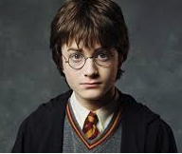
RNN: Generation
When trained on Harry Potter text, it generates:
Source: https://medium.com/deep-writing/harry-potter-written-by-artificial-intelligence-8a9431803da6

Slide 29
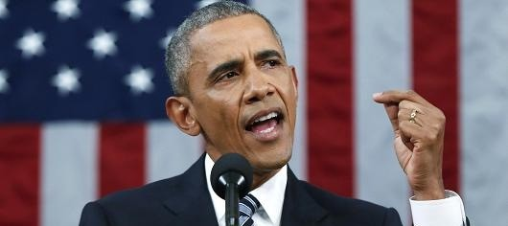
RNNs: Generation
RNN-LM trained on Obama speeches:
The United States will step up to the cost of a new challenges of the American people that will share the fact that we created the problem. They were attacked and so that they have to say that all the task of the final days of war that I will not be able to get this done.
https://medium.com/@samim/obama-rnn-machine-generated-political-speeches-c8abd18a2ea0

Slide 30
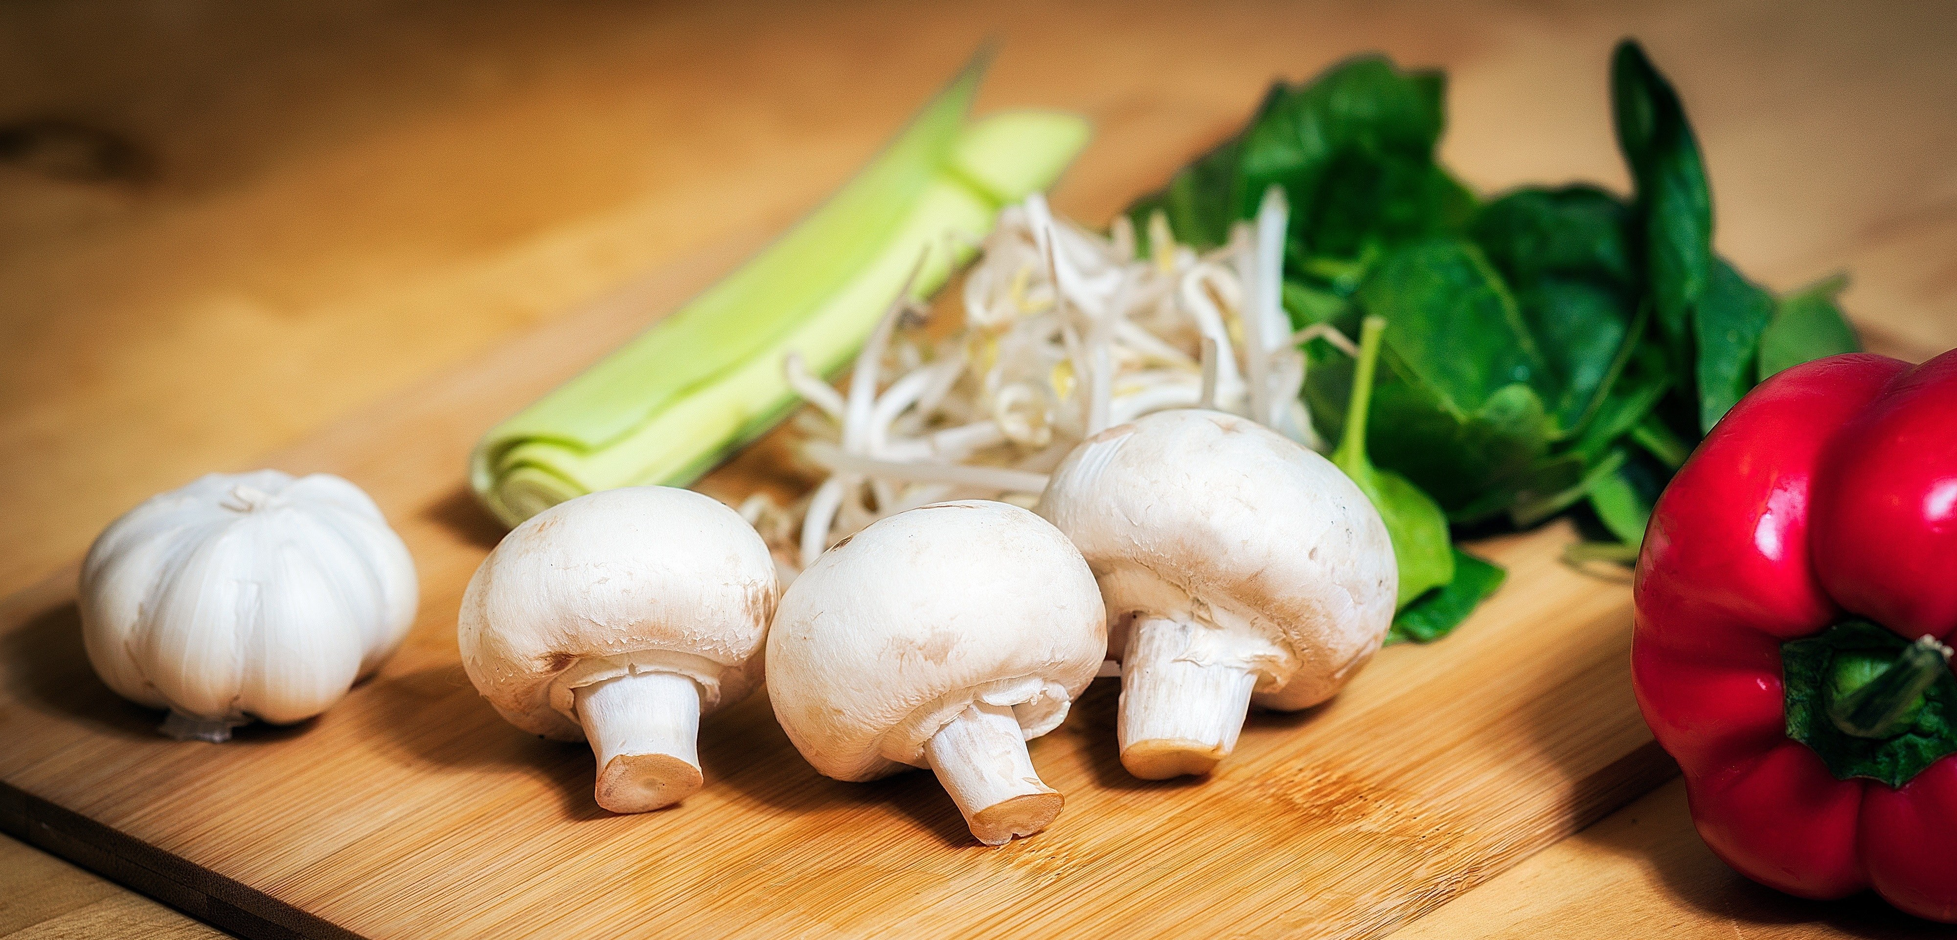
RNNs in Practice
RNN-LM trained on food recipes:
Title: CHOCOLATE RANCH BARBECUE
Categories: Game, Casseroles, Cookies, Cookies
Yield: 6 Servings
2 tb Parmesan cheese -- chopped
1 c Coconut milk
3 Eggs, beaten
Place each pasta over layers of lumps. Shape mixture into the moderate oven and simmer until firm. Serve hot in bodied fresh, mustard, orange and cheese. Combine the cheese and salt together the dough in a large skillet; add the ingredients and stir in the chocolate and pepper.
https://gist.github.com/nylki/1efbaa36635956d35bcc

Slide 31
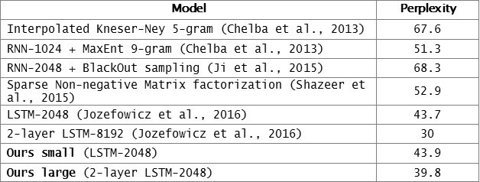
Evaluation LMs with Perplexity (2016)
n-gram model →
Increasingly complex RNNs
Source: https://engineering.fb.com/2016/10/25/ml-applications/building-an-efficient-neural-language-model-over-a-billion-words/

Slide 32
Summary
RNNs: Repeated use of finite structure.
A natural fit for language modeling.
Next: how to train then.

Slide 33
Training RNNs

Slide 34
RNN: Forward Propagation
$$CE\left(y^{i},{\hat{y}}^{i}\right)=−\sum_{w∈V}{y_{w}^{i}\text{log}({\hat{y}}_{w}^{i})}$$
Error
$$CE\left(y^{1},{\hat{y}}^{1}\right)$$
$${\hat{y}}_{1}$$
Output layer
$$U$$
Hidden layer
$$W$$
Input layer
$$x_{1}$$
She
[Slide credit: Chris Tanner]

Slide 35
RNN: Forward Propagation
$$CE\left(y^{i},{\hat{y}}^{i}\right)=−\sum_{w∈V}{y_{w}^{i}\text{log}({\hat{y}}_{w}^{i})}$$
Error
$$CE\left(y^{1},{\hat{y}}^{1}\right)$$
$$CE\left(y^{2},{\hat{y}}^{2}\right)$$
$${\hat{y}}_{1}$$
$${\hat{y}}_{2}$$
Output layer
$$U$$
$$U$$
$$V$$
Hidden layer
$$W$$
$$W$$
Input layer
$$x_{1}$$
$$x_{2}$$
She
went
[Slide credit: Chris Tanner]

Slide 36
RNN: Forward Propagation
$$CE\left(y^{i},{\hat{y}}^{i}\right)=−\sum_{w∈V}{y_{w}^{i}\text{log}({\hat{y}}_{w}^{i})}$$
Error
$$CE\left(y^{1},{\hat{y}}^{1}\right)$$
$$CE\left(y^{2},{\hat{y}}^{2}\right)$$
$$CE\left(y^{3},{\hat{y}}^{3}\right)$$
$${\hat{y}}_{1}$$
$${\hat{y}}_{2}$$
$${\hat{y}}_{3}$$
Output layer
$$U$$
$$U$$
$$U$$
$$V$$
$$V$$
Hidden layer
$$W$$
$$W$$
$$W$$
Input layer
$$x_{1}$$
$$x_{2}$$
$$x_{3}$$
She
went
to
[Slide credit: Chris Tanner]

Slide 37
RNN: Forward Propagation
$$CE\left(y^{i},{\hat{y}}^{i}\right)=−\sum_{w∈V}{y_{w}^{i}\text{log}({\hat{y}}_{w}^{i})}$$
Error
$$CE\left(y^{1},{\hat{y}}^{1}\right)$$
$$CE\left(y^{2},{\hat{y}}^{2}\right)$$
$$CE\left(y^{3},{\hat{y}}^{3}\right)$$
$$CE\left(y^{4},{\hat{y}}^{4}\right)$$
$${\hat{y}}_{1}$$
$${\hat{y}}_{2}$$
$${\hat{y}}_{3}$$
$${\hat{y}}_{4}$$
Output layer
$$U$$
$$U$$
$$U$$
$$U$$
$$V$$
$$V$$
$$V$$
Hidden layer
$$W$$
$$W$$
$$W$$
$$W$$
Input layer
$$x_{1}$$
$$x_{2}$$
$$x_{3}$$
$$x_{4}$$
She
went
to
class
[Slide credit: Chris Tanner]

Slide 38
RNN: Forward Propagation
$$CE\left(y^{i},{\hat{y}}^{i}\right)=−\sum_{w∈V}{y_{w}^{i}\text{log}({\hat{y}}_{w}^{i})}$$
Error
$$CE\left(y^{1},{\hat{y}}^{1}\right)$$
$$CE\left(y^{2},{\hat{y}}^{2}\right)$$
$$CE\left(y^{3},{\hat{y}}^{3}\right)$$
$$CE\left(y^{4},{\hat{y}}^{4}\right)$$
During training, regardless of our output predictions, we feed in the correct inputs
$${\hat{y}}_{1}$$
$${\hat{y}}_{2}$$
$${\hat{y}}_{3}$$
$${\hat{y}}_{4}$$
Output layer
$$U$$
$$U$$
$$U$$
$$U$$
$$V$$
$$V$$
$$V$$
Hidden layer
$$W$$
$$W$$
$$W$$
$$W$$
Input layer
$$x_{1}$$
$$x_{2}$$
$$x_{3}$$
$$x_{4}$$
She
went
to
class
[Slide credit: Chris Tanner]

Slide 39
RNN: Forward Propagation
$$CE\left(y^{i},{\hat{y}}^{i}\right)=−\sum_{w∈V}{y_{w}^{i}\text{log}({\hat{y}}_{w}^{i})}$$
Error
$$CE\left(y^{1},{\hat{y}}^{1}\right)$$
$$CE\left(y^{2},{\hat{y}}^{2}\right)$$
$$CE\left(y^{3},{\hat{y}}^{3}\right)$$
$$CE\left(y^{4},{\hat{y}}^{4}\right)$$
went?
over?
class?
after?
Output layer
$$\hat{y}$$
$$U$$
$$U$$
$$U$$
$$U$$
$$V$$
$$V$$
$$V$$
Hidden layer
$$W$$
$$W$$
$$W$$
$$W$$
Input layer
She
went
to
class
[Slide credit: Chris Tanner]

Slide 40
RNN: Forward Propagation
$$CE\left(y^{i},{\hat{y}}^{i}\right)=−\sum_{w∈V}{y_{w}^{i}\text{log}({\hat{y}}_{w}^{i})}$$
Error
$$CE\left(y^{1},{\hat{y}}^{1}\right)$$
$$CE\left(y^{2},{\hat{y}}^{2}\right)$$
$$CE\left(y^{3},{\hat{y}}^{3}\right)$$
$$CE\left(y^{4},{\hat{y}}^{4}\right)$$
went?
over?
class?
after?
Output layer
$$\hat{y}$$
$$U$$
$$U$$
$$U$$
$$U$$
$$V$$
$$V$$
$$V$$
Hidden layer
Our total loss is simply the average loss across all $T$ time steps
$$W$$
$$W$$
$$W$$
$$W$$
Input layer
She
went
to
class
[Slide credit: Chris Tanner]

Slide 41
Backward Step
$$CE\left(y^{i},{\hat{y}}^{i}\right)=−\sum_{w∈V}{y_{w}^{i}\text{log}({\hat{y}}_{w}^{i})}$$
To update our weights (e.g.$Θ$), we calculate the gradient of our loss w.r.t. the repeated weight matrix (e.g., $\frac{∂L}{∂Θ} ).$
$$CE\left(y^{4},{\hat{y}}^{4}\right)$$
went?
over?
class?
after?
Using the chain rule, we trace the derivative all the way back to the beginning, while summing the results.
Output layer
$$\hat{y}$$
$$U$$
$$U$$
$$U$$
$$U$$
$$V$$
$$V$$
$$V$$
Hidden layer
$$W$$
$$W$$
$$W$$
$$W$$
Input layer
She
went
to
class
[Slide credit: Chris Tanner]

Slide 42
Backward Step
$\frac{∂L}{∂V}$
To update our weights (e.g.$Θ$), we calculate the gradient of our loss w.r.t. the repeated weight matrix (e.g., $\frac{∂L}{∂Θ} ).$
$$CE\left(y^{4},{\hat{y}}^{4}\right)$$
went?
over?
class?
Using the chain rule, we trace the derivative all the way back to the beginning, while summing the results.
Output layer
$$\hat{y}$$
$$U$$
$$U$$
$$U$$
$$U$$
$$V$$
$$V$$
$$V^{3}$$
Hidden layer
$$W$$
$$W$$
$$W$$
$$W$$
Input layer
She
went
to
class
[Slide credit: Chris Tanner]

Slide 43
Backward Step
$\frac{∂L}{∂V}$
To update our weights (e.g.$Θ$), we calculate the gradient of our loss w.r.t. the repeated weight matrix (e.g., $\frac{∂L}{∂Θ} ).$
$$CE\left(y^{4},{\hat{y}}^{4}\right)$$
went?
over?
class?
Using the chain rule, we trace the derivative all the way back to the beginning, while summing the results.
Output layer
$$\hat{y}$$
$$U$$
$$U$$
$$U$$
$$U$$
$$V$$
$$V^{2}$$
$$V^{3}$$
Hidden layer
$$W$$
$$W$$
$$W$$
$$W$$
Input layer
She
went
to
class
[Slide credit: Chris Tanner]

Slide 44
Backward Step
$\frac{∂L}{∂V}$
To update our weights (e.g.$Θ$), we calculate the gradient of our loss w.r.t. the repeated weight matrix (e.g., $\frac{∂L}{∂Θ} ).$
$$CE\left(y^{4},{\hat{y}}^{4}\right)$$
went?
over?
class?
Using the chain rule, we trace the derivative all the way back to the beginning, while summing the results.
Output layer
$$\hat{y}$$
$$U$$
$$U$$
$$U$$
$$U$$
$$V^{1}$$
$$V^{2}$$
$$V^{3}$$
Hidden layer
$$W$$
$$W$$
$$W$$
$$W$$
Input layer
She
went
to
class
[Slide credit: Chris Tanner]

Slide 45
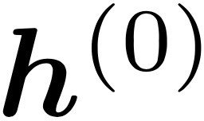
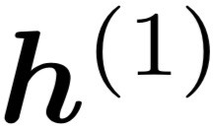
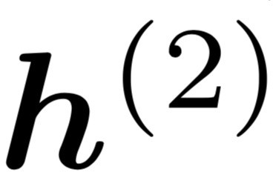
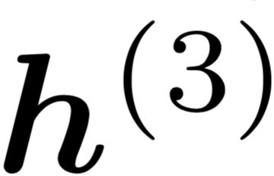
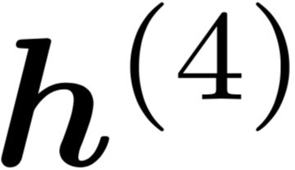
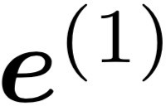
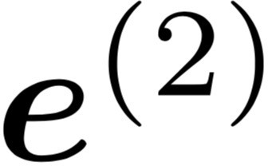
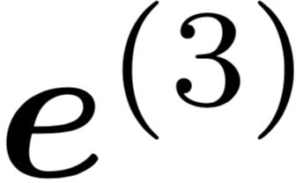
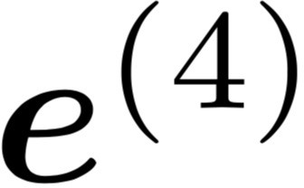
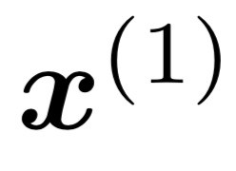
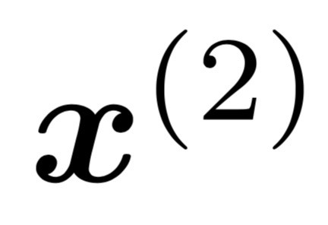
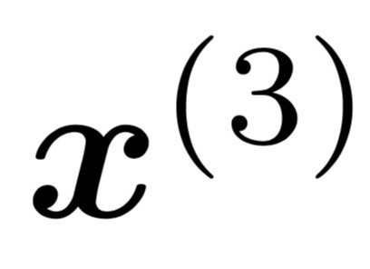
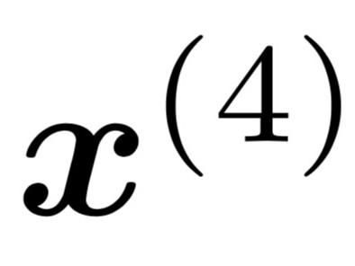
LMs w/ Recurrent Neural Nets
[adopted from Chris Manning]
books
laptops
Core idea: apply a model repeatedly
outputs
output distribution
is the initial hidden state
hidden states
word embeddings
Input
embedding
words / one-hot vectors
the
cat
sat
on
this input sequence could be much longer

Slide 46
Training RNNs: Summary
backpropagated feedback
$$ℒ$$
books
laptops
RNNs can be trained using “backpropagation through time.”
Can be viewed as applying normal backprop to the unrolled network.
Model’s learnable parameters $Θ$
Compute $ℒ(Θ)$ for a batch of sentences
Compute gradients $∇_{Θ}ℒ(Θ)$
Update the weights and then repeat
the
cat
sat
on

Slide 47
RNN-LMs:
Pros and Cons

Slide 48
RNNs: Advantages
books
laptops
Model size doesn’t increase for longer inputs — reusing a compact set of model parameters.
Computation for step t can (in theory) use information from many steps back
a
zoo
the students
opened
their

Slide 49
RNNs: Weaknesses
books
laptops
Recurrent computation is slow and difficult to parallelize.
Next week: self-attention mechanism, better at representing long sequences and also parallelizable.
While RNNs in theory can represent long sequences, they quickly forget portions of the input.
Vanishing/exploding gradients.
a
zoo
the students
opened
their

Slide 50
Vanishing/Exploding Gradient Problem: Intuition
Backpropagated errors multiply at each layer, resulting in
Figure from Graham Neubig

Slide 51
Vanishing/Exploding Gradient Problem
backpropagated feedback
$$ℒ$$
books
laptops
Backpropagated errors multiply at each layer, resulting in exponential decay (if derivative is small) or growth (if derivative is large).
Makes it very difficult train deep networks, or simple recurrent networks over many time steps.
$$∇_{ℒ}\left(W_{h}\right)={\left(J_{ℒ}\left(W_{L−1}\right)\right)}^{T}=\sum_{t=0}{{\left(J_{ℒ}\left(h^{(t)}\right){ J}_{h^{(t)}}\left(W_{h}\right)\right)}^{T}}$$
$$J_{ℒ}\left(h^{(0)}\right)=J_{h^{(1)}}\left(h^{(0)}\right)J_{h^{(2)}}\left(h^{(1)}\right) × … ×{ J}_{h^{(4)}}\left(h^{(3)}\right){ J}_{ℒ}\left(h^{(4)}\right)$$
chain rule
the
cat
sat
on
observed inputs

Slide 52
Vanishing/Exploding Gradient Problem
backpropagated feedback
$$ℒ$$
books
laptops
Note: instability of matrix powers can be determined from their eigenvalues.
Gradient signal from far away is lost. So, model weights are updated only with respect to near effects, not long-term effects.
$$J_{ℒ}\left(h^{(0)}\right)=J_{h^{(1)}}\left(h^{(0)}\right)J_{h^{(2)}}\left(h^{(1)}\right) × … ×{ J}_{h^{(4)}}\left(h^{(3)}\right){ J}_{ℒ}\left(h^{(4)}\right)$$
chain rule
the
cat
sat
on
observed inputs

Slide 53
RNNs: Difficulty in Learning Long-Range Dependencies
While RNNs in theory can represent long sequences, in practice teaching them about long-range dependencies is non-trivial.
Gradient clipping:
If the norm of the gradient is greater than some threshold, scale it down before applying SGD update.
Intuition: take a step in the same direction, but a smaller step
[“On the difficulty of training recurrent neural networks”, Pascanu et al, 2013]
Notes:
These models don’t guarantee that there is no vanishing/exploding gradient, but it does provide an easier way for the model to learn long-distance dependencies

Slide 54
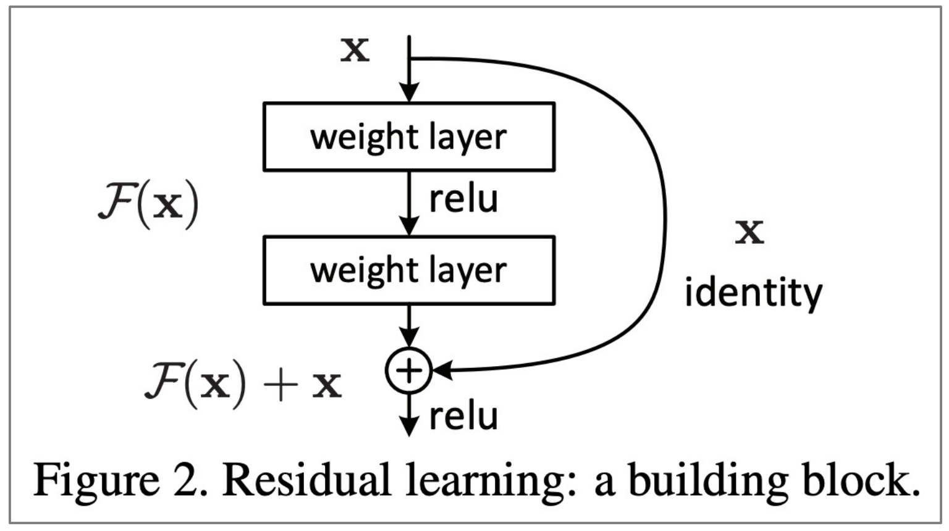
RNNs: Difficulty in Learning Long-Range Dependencies (2)
While RNNs in theory can represent long sequences, in practice teaching them about long-range dependencies is non-trivial.
Using residual layers:
lots of new deep architectures (RNN or otherwise) add direct connections, thus allowing the gradient to flow)
"Deep Residual Learning for Image Recognition", He et al, 2015. https://arxiv.org/pdf/1512.03385.pdf
Notes:
These models don’t guarantee that there is no vanishing/exploding gradient, but it does provide an easier way for the model to learn long-distance dependencies

Slide 55
RNNs: Difficulty in Learning Long-Range Dependencies (3)
While RNNs in theory can represent long sequences, in practice teaching them about long-range dependencies is non-trivial.
Changes to the architecture makes it easier for the RNN to preserve information over many timesteps
Long Short-Term Memory (LSTM) [Hochreiter and Schmidhuber 1997, Gers+ 2000]
Gated Recurrent Units (GRU) [Cho+ 2014]
Notes:
These models don’t guarantee that there is no vanishing/exploding gradient, but it does provide an easier way for the model to learn long-distance dependencies

Slide 56
RNNs: Difficulty in Learning Long-Range Dependencies (3)
While RNNs in theory can represent long sequences, in practice teaching them about long-range dependencies is non-trivial.
Changes to the architecture makes it easier for the RNN to preserve information over many timesteps
Long Short-Term Memory (LSTM) [Hochreiter and Schmidhuber 1997, Gers+ 2000]
Gated Recurrent Units (GRU) [Cho+ 2014]
Many of these variants were the dominant architecture of In 2013–2015.
We will not cover these alternative architecture in favor or spending more time on more modern developments.
Notes:
These models don’t guarantee that there is no vanishing/exploding gradient, but it does provide an easier way for the model to learn long-distance dependencies

Slide 57
Adapting RNNs to Application
Text Classification
Language Modeling
POS Tags

Slide 58
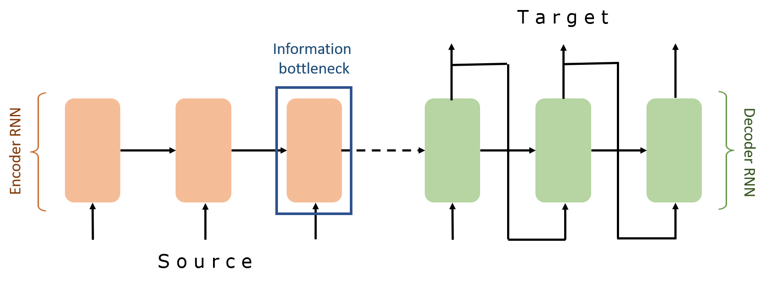
Encoder-Decoder Architectures

Slide 59
Encoder-Decoder Architectures
It is useful to think of generative models as two sub-models.
Some model
“The cat sat on the [MASK]”

Slide 60
Encoder-Decoder Architectures
It is useful to think of generative models as two sub-models.
Representation (compression) of the context
Encoder
Decoder
“The cat sat on the [MASK]”
Processes the context and compiles it into a vector.
Produces the output sequence item by item using the representation of the context.

Slide 61
Encoder-Decoder Architectures
https://jalammar.github.io/visualizing-neural-machine-translation-mechanics-of-seq2seq-models-with-attention/

Slide 62
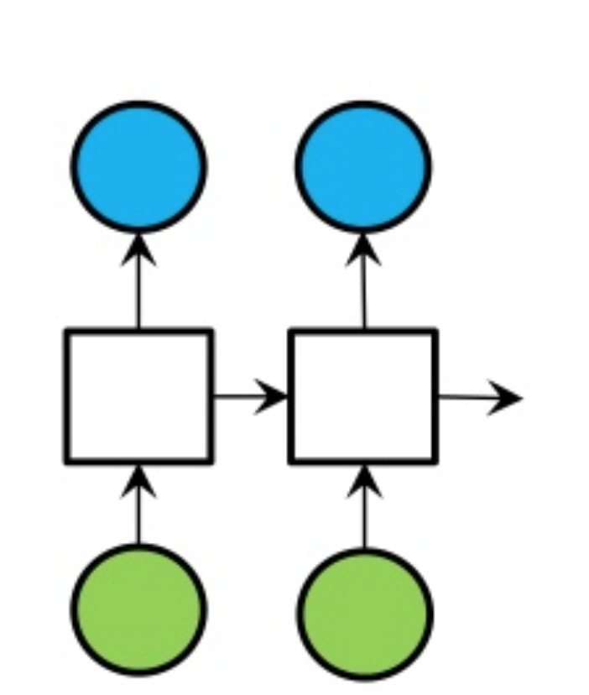
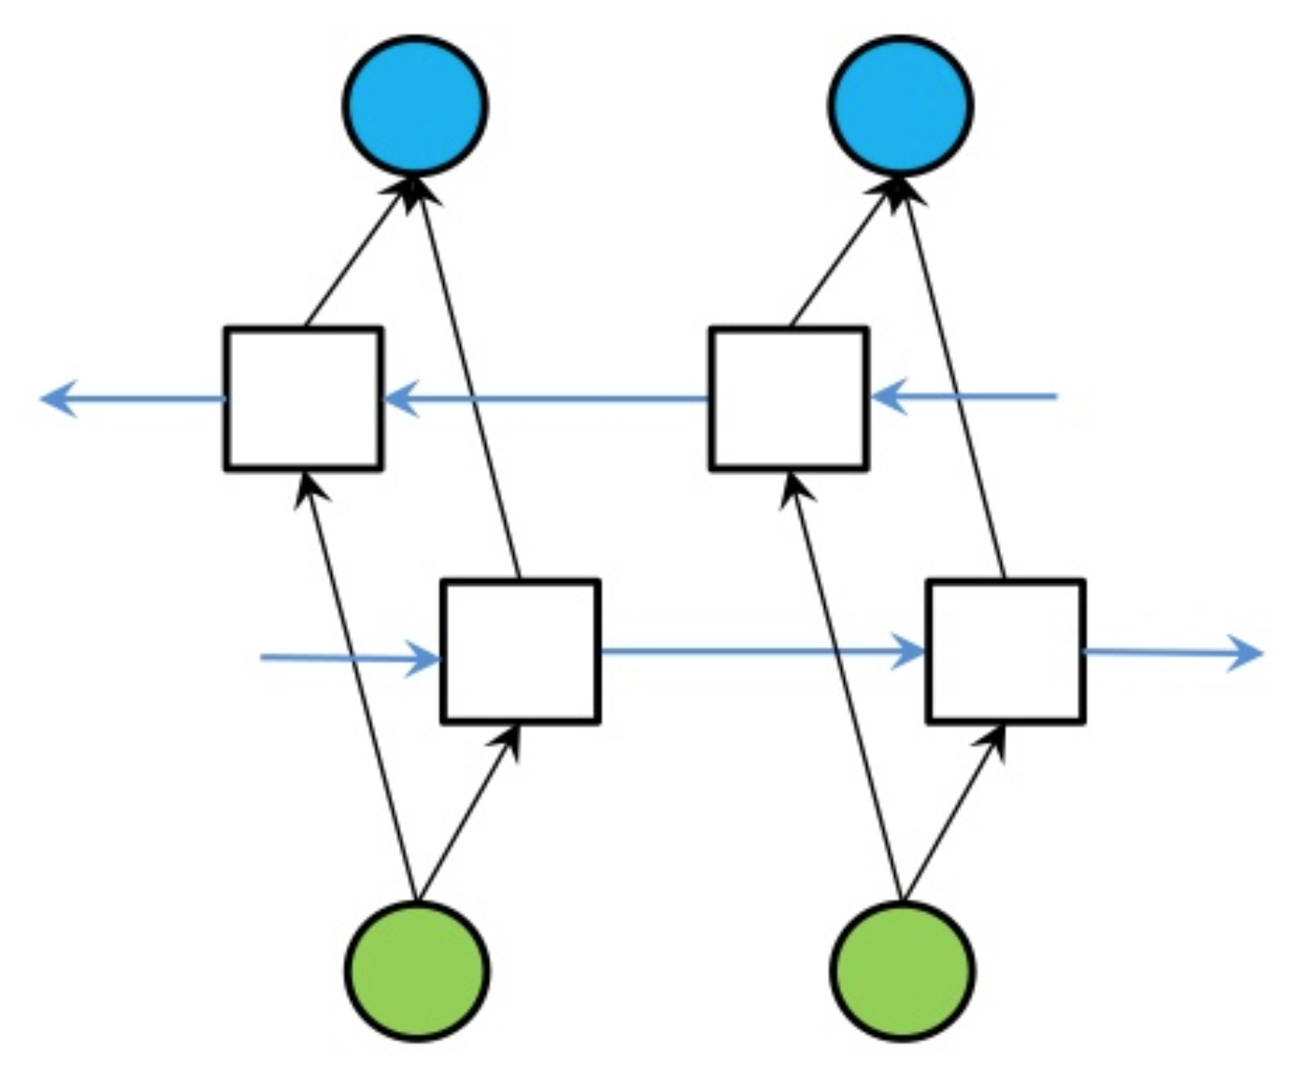
Extending RNNs to Both Directions
An RNN limitation: Hidden variables capture only one side of the context.
Solution: Bi-Directional RNNs
RNN
Bi-directional RNN

Slide 63
Summary
RNNs provide a compact model, regardless of sequence size. In theory, this is great!
In practice, however:
They still struggle with remembering long-range dependencies.
Training them is not difficult because of vanishing/exploding gradients.
Despite these limits, RNNs provided improvements at the time that they were introduced and laid the foundation for the future progress.
Next: Pre-training RNNs

Slide 64
Bonus: Pre-training Representations of RNNs

Slide 65
Recap: Recurrent Neural Networks
Repeated use of a finite model
“Sorry”
Harry
shouted,
panicking
Output layer
$$U$$
$$U$$
$$U$$
$$U$$
$$V$$
$$V$$
$$V$$
Hidden layer
$$W$$
$$W$$
$$W$$
$$W$$
Input layer
$$x_{1}$$
$$x_{2}$$
$$x_{3}$$
$$x_{4}$$
<START>
“Sorry”
Harry
shouted,

Slide 66
Recap: Encoder-Decoder Architectures
It is useful to think of generative models as two sub-models.
Some model
“The cat sat on the [MASK]”

Slide 67
Recap: Encoder-Decoder Architectures

Slide 68
Contextual Meaning of Words
Earlier word embedding methods (e.g., Word2Vec, GloVe) learn a single “static” vector for each word.
Static embeddings are not flexible and expressive enough.
The children love to play outside in the park.
She went to see a play at the local theater.
They play the piano beautifully.
Information from context is necessary to capture the correct meaning of the word.
[Deep contextualized word representations, Peters et al. 2018]

Slide 69
ELMo: First Major Self-Supervised LM
Goal: get highly rich, contextualized embeddings (word tokens) that depend on the entire sentence in which a word is used.
The children love to play outside in the park.
She went to see a play at the local theater.
They play the piano beautifully.
[-0.37, 0.17, -0.36, 0.12, 0.18]
[0.45, -0.26, 0.49, 2.37, -1.2]
[2.05, -1.57, 1.07, 1.37, 0.32]
[Deep contextualized word representations, Peters et al. 2018]

Slide 70
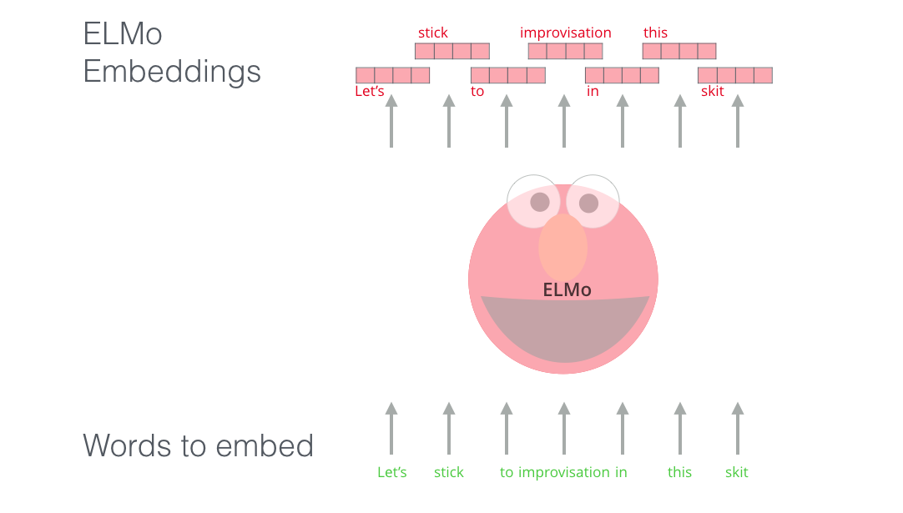
ELMo: First Major Self-Supervised LM
Goal: get highly rich, contextualized embeddings (word tokens) that depend on the entire sentence in which a word is used.
[Deep contextualized word representations, Peters et al. 2018]

Slide 71
ELMo: First Major Self-Supervised LM
Use both directions of context (bi-directional), with increasing abstractions (stacked)
Two LSTMs in different directions — capture both directions
[Deep contextualized word representations, Peters et al. 2018]

Slide 72
ELMo: First Major Self-Supervised LM
Linearly combine all abstract representations (hidden layers) and optimize w.r.t. a particular task (e.g., sentiment classification)
[Deep contextualized word representations, Peters et al. 2018]

Slide 73
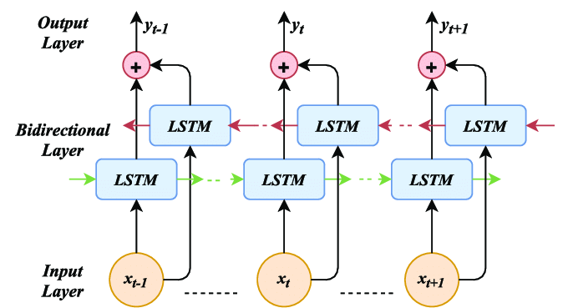
ELMo: Some Details
Train a forward language model by modeling prob of each word, given its left context.
Similarly, train a backward language model, conditioned on the right context.
Some training details:
Use 4096 dim hidden states
Residual connections from the first to second layer
Trained 10 epochs on 1B Word Benchmark
Results in perplexity of ~39
[Deep contextualized word representations, Peters et al. 2018]

Slide 74
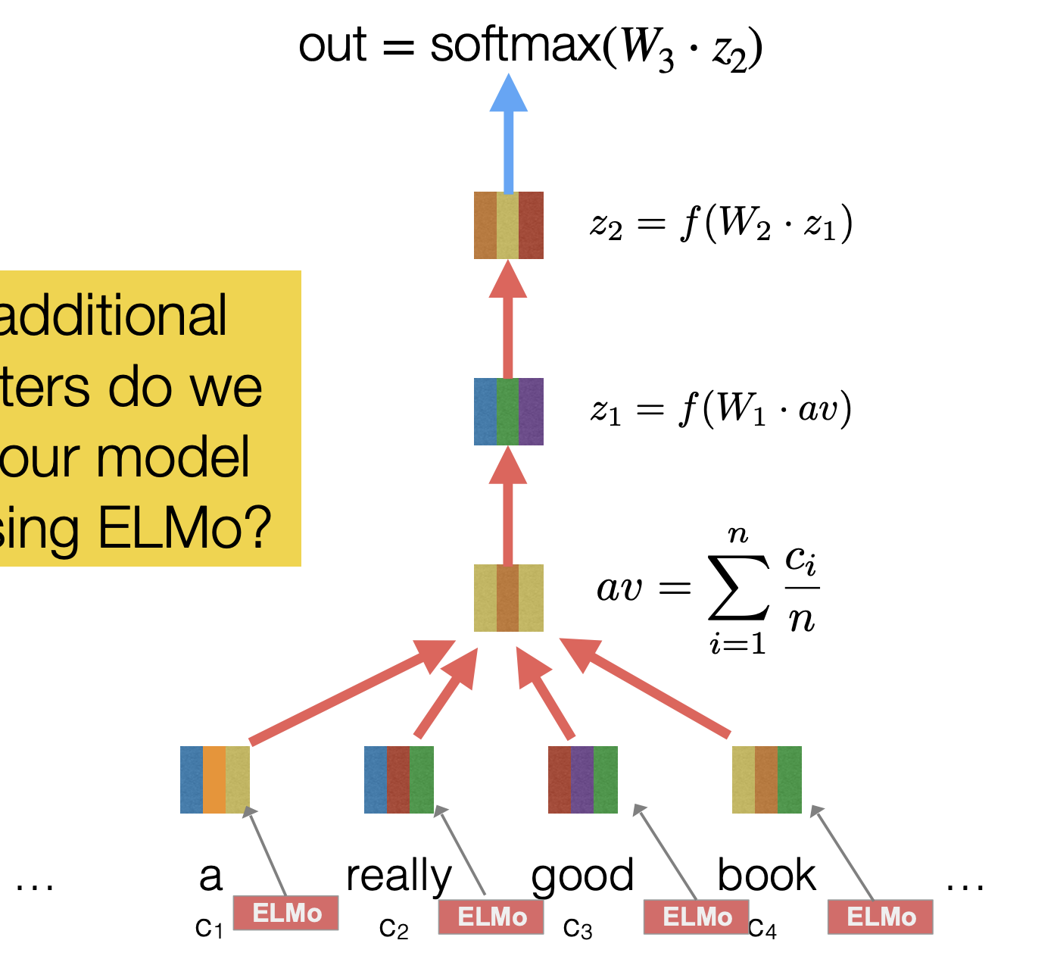
Adapting ELMo Representations for Tasks
Fine-tune classifiers using contextualized word representations extracted from ELMo.
[Deep contextualized word representations, Peters et al. 2018]

Slide 75
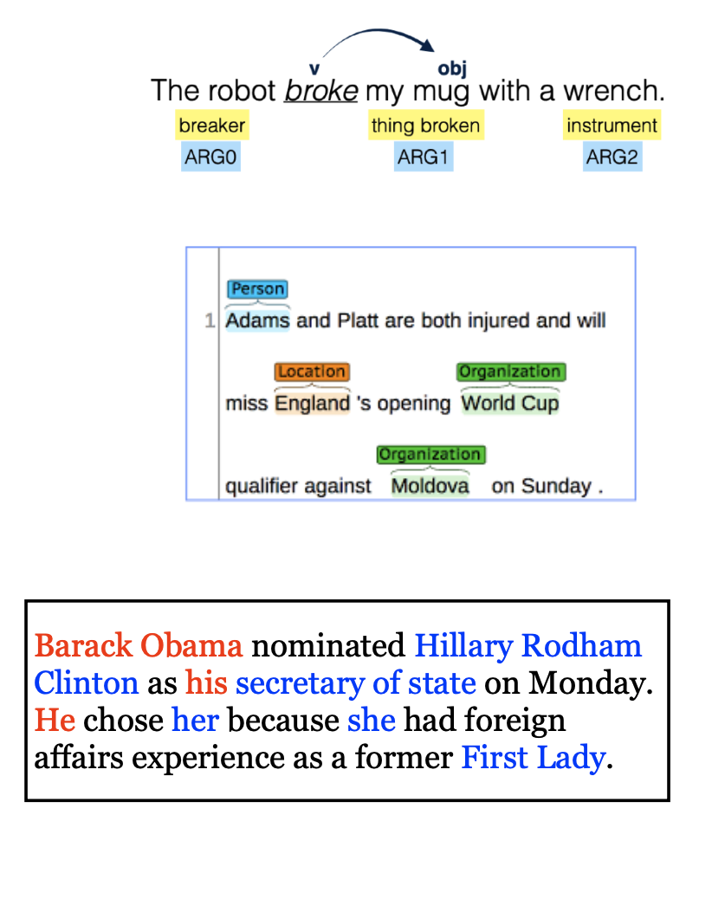
ELMo: Evaluation
SQuAD: question answering
SNLI: textual entailment
SRL: semantic role labeling
Coref: coreference resolution
NER: named entity recognition
SST-5: sentiment analysis
[Deep contextualized word representations, Peters et al. 2018]

Slide 76
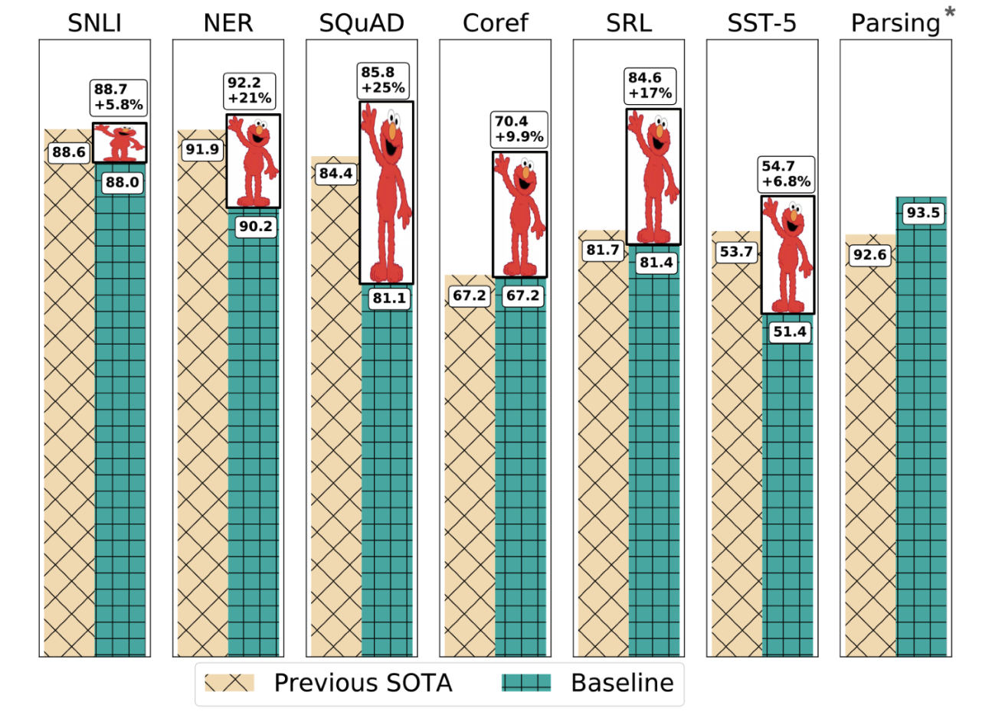
Experimental Results
[Deep contextualized word representations, Peters et al. 2018]

Slide 77
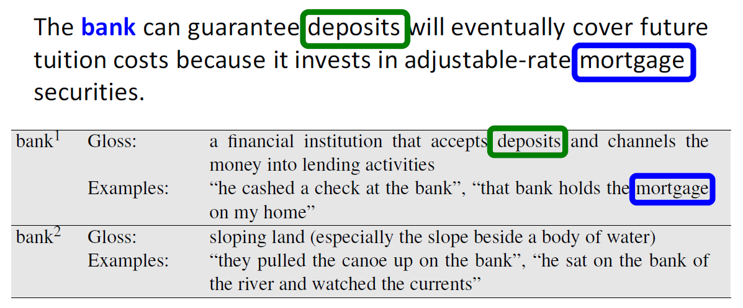
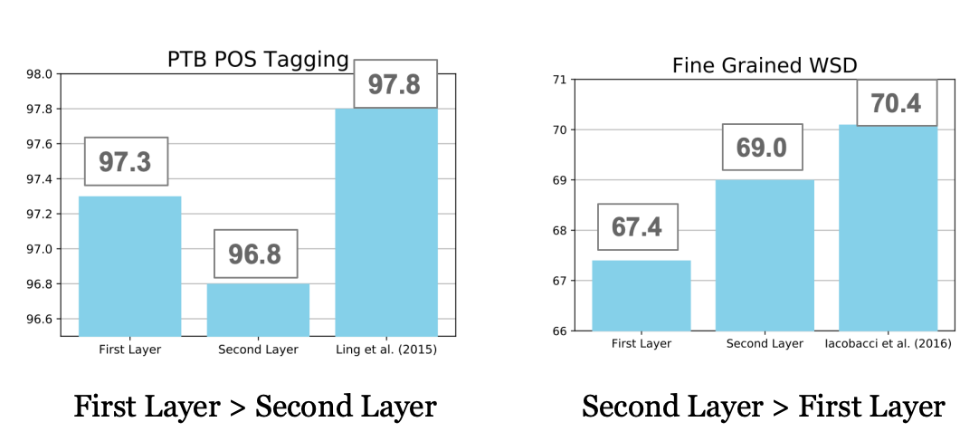
POS tagging
Word-Sense Disambiguation
Syntactic information is better represented at lower layers while semantic information is captured a higher layers
[Deep contextualized word representations, Peters et al. 2018]

Slide 78
A broader lesson: Pre-training + Fine-tuning
Let’s say I want to train a model for sentiment analysis
In the past, I would simply train a supervised model on Word2Vec representation of review sentences (e.g., HW2).
A self-supervised model
A self-supervised model
step 1:
self-supervised pretraining
step 2:
supervised fine-tuning
A ton of unlabeled text
A ton of unlabeled text

Slide 79
A broader lesson: Pre-training + Fine-tuning
Contextual representation of LMs is much stronger than word-level ones.
Now that we have Fixed-Window LM, we can use it to build better classifiers!
A self-supervised model
A self-supervised model
step 1:
self-supervised pretraining
step 2:
supervised fine-tuning
A ton of unlabeled text
A ton of unlabeled text

Slide 80
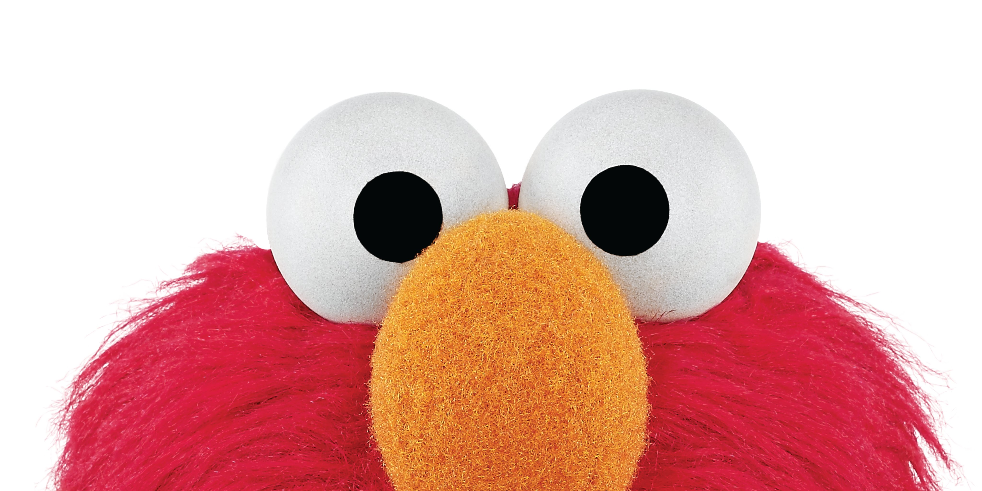
Summary
ELMo: Stacked Bi-directional LSTMs
ELMo yielded incredibly good contextualized embeddings, which yielded SOTA results when applied to many NLP tasks.
Main ELMo takeaway: given enough [unlabeled] training data, having tons of parameters model is useful — the system can determine how to best use context.
[Deep contextualized word representations, Peters et al. 2018]

Slide 81
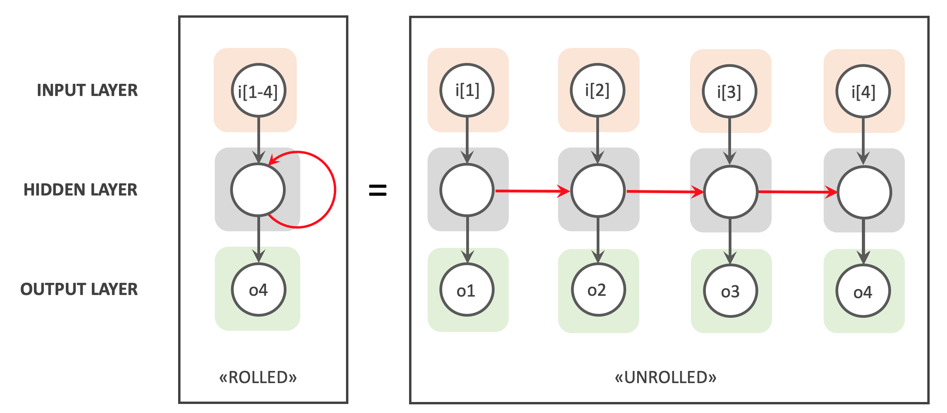
Summary
Recurrent Neural Networks
A family of neural networks that allow architecture for inputs of variable length
RNN-LM: LM based on RNNs
A notable example: ELMo
Cons:
Sequential processing
While in theory it maintain infinite history, in practice it suffers from long-range dependencies.

Slide 82
Algorithms for Sampling from Language Models
CSCI 601-471/671 (NLP: Self-Supervised Models)
https://self-supervised.cs.jhu.edu/sp2024/

Slide 83
The Sampling Question
How do we generate language from LMs?
Given:
next word
context
P($X_{t}$| $X_{1}$, $…$, $X_{t−1}$)
Prob
mat
table
bed
desk
chair
Some model
“The cat sat on the [MASK]”

Slide 84
Approach 1: Greedy (Argmax)
Challenge:
Generates boring results — not creative.
May repeat itself .
“I went to the place that the place that the place that the place ...”
next word
context
$x_{t}$ =argmax P($X_{t}$| $X_{1}$, $…$, $X_{t−1}$)
Prob
mat
table
bed
desk
chair
Some model
“The cat sat on the [MASK]”
[The Curious Case of Neural Text Degeneration, Holtzman et al., 2020]

Slide 85
Approach 2: Sampling from the whole distribution
Challenge: Likely to result in lots of nonsensical generations.
Reason: LMs distribution is more meaningful about high-prob items, but as we get further away from high-prob items, the probs are less meaningful.
next word
context
$x_{t}$ ~ P($X_{t}$| $X_{1}$, $…$, $X_{t−1}$)
Prob
mat
table
bed
desk
chair
Some model
“The cat sat on the [MASK]”
[The Curious Case of Neural Text Degeneration, Holtzman et al., 2020]

Slide 86
Quiz: Softmax Temperature Parameter
Let’s add parameter T to our Softmax definition:
Suppose if T=1, the output of Softmax looks like this:
How will increasing T it change this distribution?

Slide 87
Approach 3: Sampling + Temperature
Small-ish T would assign more prob to the top of the distribution, while not losing diversity.
Prob
mat
table
bed
desk
chair
Some model
“The cat sat on the [MASK]”
[The Curious Case of Neural Text Degeneration, Holtzman et al., 2020]

Slide 88
Approach 4: Top-p Sampling (Nucleus sampling)
On each step, randomly sample from the distribution, but restricted to just the top-p most probable words
Like pure sampling, but truncate the distribution to high-prob content
p=1 is basically sampling from the whole distribution
Prob
mat
table
bed
desk
chair
Some model
“The cat sat on the [MASK]”
[The Curious Case of Neural Text Degeneration, Holtzman et al., 2020]

Slide 89
Local Incoherence
[The Curious Case of Neural Text Degeneration, Holtzman et al., 2020]

Slide 90
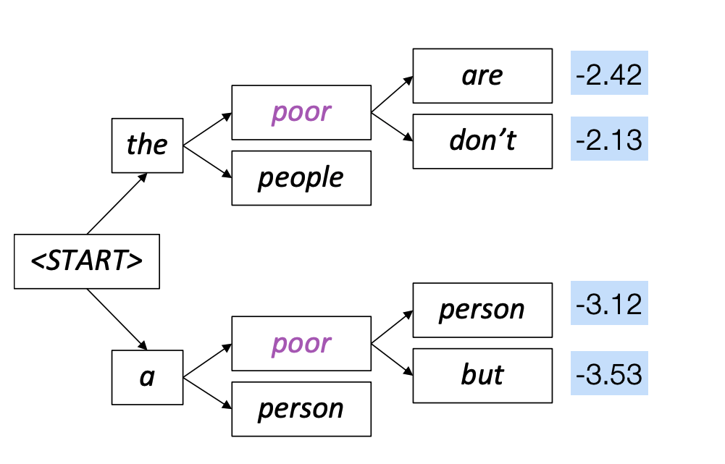
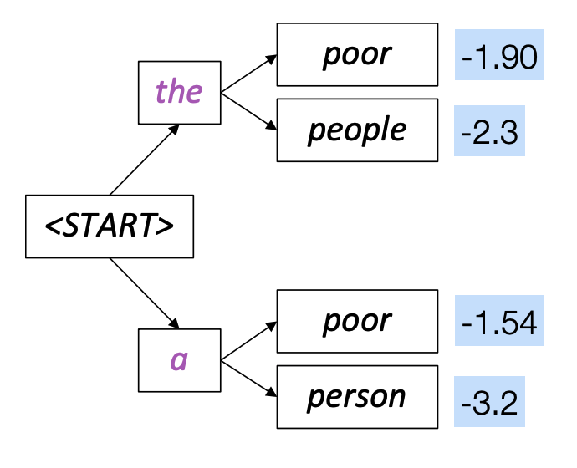
Fancier Approaches: Beam Search
A heuristic search that allows maximizing words probabilities for a window of words
Out of scope for us. Feel free to check it in your own time.

Slide 91
Many others that we do not cover …
There are many other algorithms for sampling sentences from LMs that we will not see in this course.

Slide 92
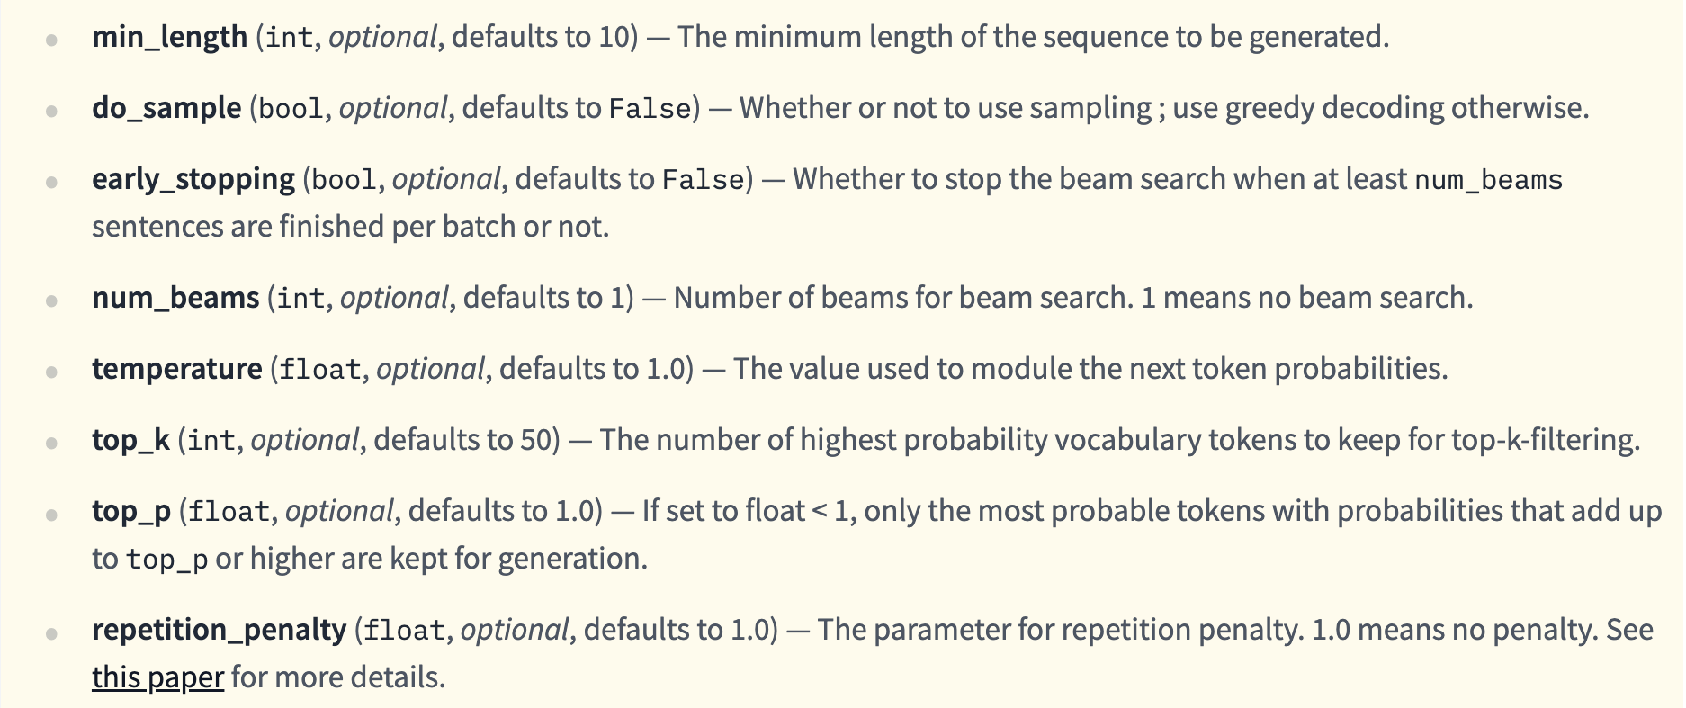
HuggingFace🤗 Generation Function
https://huggingface.co/docs/transformers/main/en/main_classes/text_generation#transformers.GenerationMixin.generate

Slide 93
Summary on Sampling Algorithms
Greedy decoding: a simple method; gives low quality output
Sampling methods are a way to get more diversity and randomness
Good for open-ended / creative generation (poetry, stories)
Top-p sampling allows you to control diversity
Others: Beam search searches for high-probability output

