Slide 1
Adapting Language Models
[Slide credit: Iz Beltagy, Arman Cohan, Robert Logan IV, Sewon Min, Sameer Singh, and many others ]
CSCI 601-471/671 (NLP: Self-Supervised Models)
https://self-supervised.cs.jhu.edu/sp2024/

Slide 2
Language Models are not trained to do what you want
There is a mismatch between LLM pre-training and user intents.

Slide 3
Adapting Language Models: Chapter Plan
You have a pre-trained language model that is pre-trained on massive amounts of data.
They do not necessarily do useful things—they only complete sentences.
Now how to you ”adapt” them for your use-case?
Prompting: adapting model inputs (language statements)
Tuning: adapting (modifying) model parameters

Slide 4
Adapting Language Models: Chapter Plan
Adaptation via Fine-tuning
Parameter-efficient fine-tuning
Adaptation via In-Context Learning
In-context learning of multi-step problems.
Chapter goal: Get comfortable with various forms of adapting LMs for solving your tasks!

Slide 5
Adaptation via Fine-Tuning

Slide 6
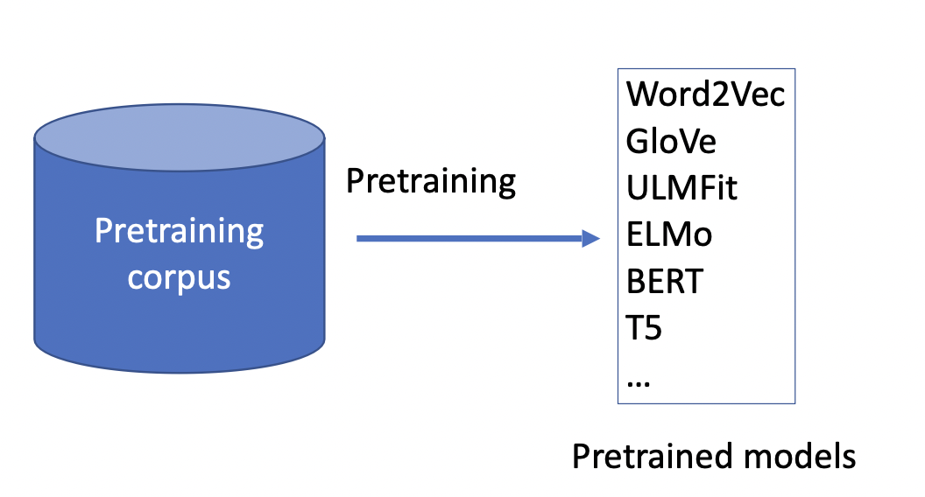

Slide 7
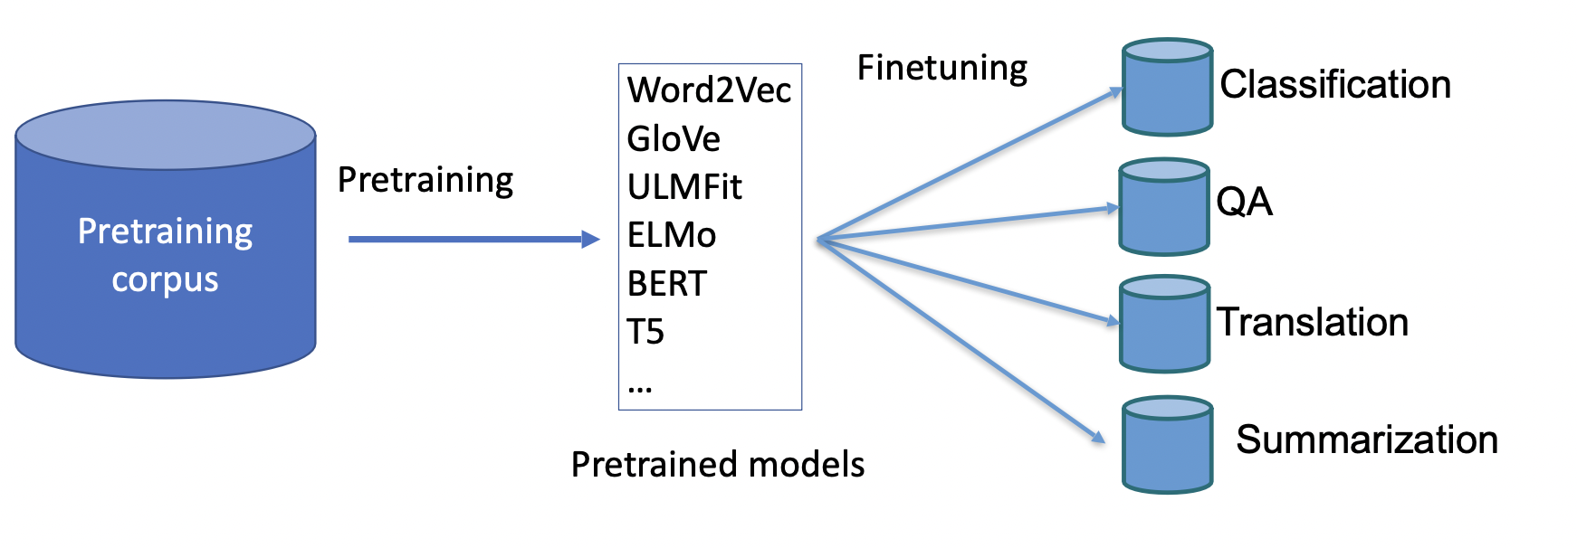
Fine-Tuning for Tasks

Slide 8
Fine-Tuning for Tasks
o gato é fofo
DET N VB ADJ
positive
The cat is
cute
layer2
layer2
layer2
layer2
layer1
layer1
layer1
layer1
The cat is cute
The cat is cute
[CLS] The cat is cute
<s> The cat is cute
Translation
POS Tagging
Text classification
Language modeling

Slide 9
Fine-tuning Pre-trained Models
81
Classiﬁcation
Head
Whole model tuning:
Run an optimization defined on your task data that updates all model parameters
Head-tuning:
Run an optimization defined on your task data that updates the parameters of the model “head”
Positive
Negative
Language
Model
Embeddings
Input
[CLS] A three-hour cinema master class.
[ACL 2022 Tutorial Beltagy, Cohan, Logan IV, Min and Singh]

Slide 10
Parameter-efficient Fine-tuning
In fine-tuning we need to updating and storing all the parameters of the LM
We would need to store a copy of the LM for each task
With large models, storage management becomes difficult
E.g., A model of size 170B parameters requires ~340Gb of storage
If you fine-tune a separate model for 100 tasks:
340 * 100 = 34 TB of storage!

Slide 11
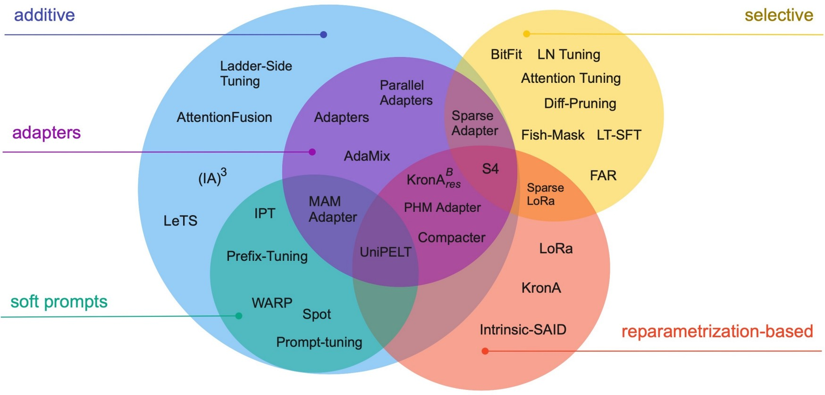
Parameter-efficient Fine-tuning
fig source https://arxiv.org/pdf/2303.15647.pdf

Slide 12
Parameter-efficient Fine-tuning: Adding Models
Augmenting the existing pre-trained model with extra parameters or layers and training only the new parameters
Two commonly used methods:
Soft prompts
Adapters

Slide 13
Soft Prompts
output
the
mat was soft <s> <p>
LM
continue the sentence
the
cat
sat
on
the
mat
prompt
input
[Slide: Arman Cohan]

Slide 14
Soft Prompts
output
the
mat was soft <s> <p>
LM
continue the sentence
the
cat
sat
on
the
mat
prompt
input
• Designing good prompts might be difficult for each task
• Maybe we can “learn” the prompts?
[Slide: Arman Cohan]

Slide 15
Soft Prompts
output
the
mat was soft <s> <p>
LM
x1
x2
x3
x4
x5
the
cat
sat
on
the
mat
soft (trainable) prompts
input
• Designing good prompts might be difficult for each task
• Maybe we can “learn” the prompts?
[Slide: Arman Cohan]

Slide 16
Soft Prompts
output
the
mat was soft <s> <p>
FROZEN
not trained
only the model’s input embeddings is fine-tuned via gradient descent.
LM
x1
x2
x3
x4
x5
the
cat
sat
on
the
mat
soft (trainable) prompts
input
It is better to initialize soft prompts from existing vocab than randomly. [Lester et al., 2021]

Slide 17
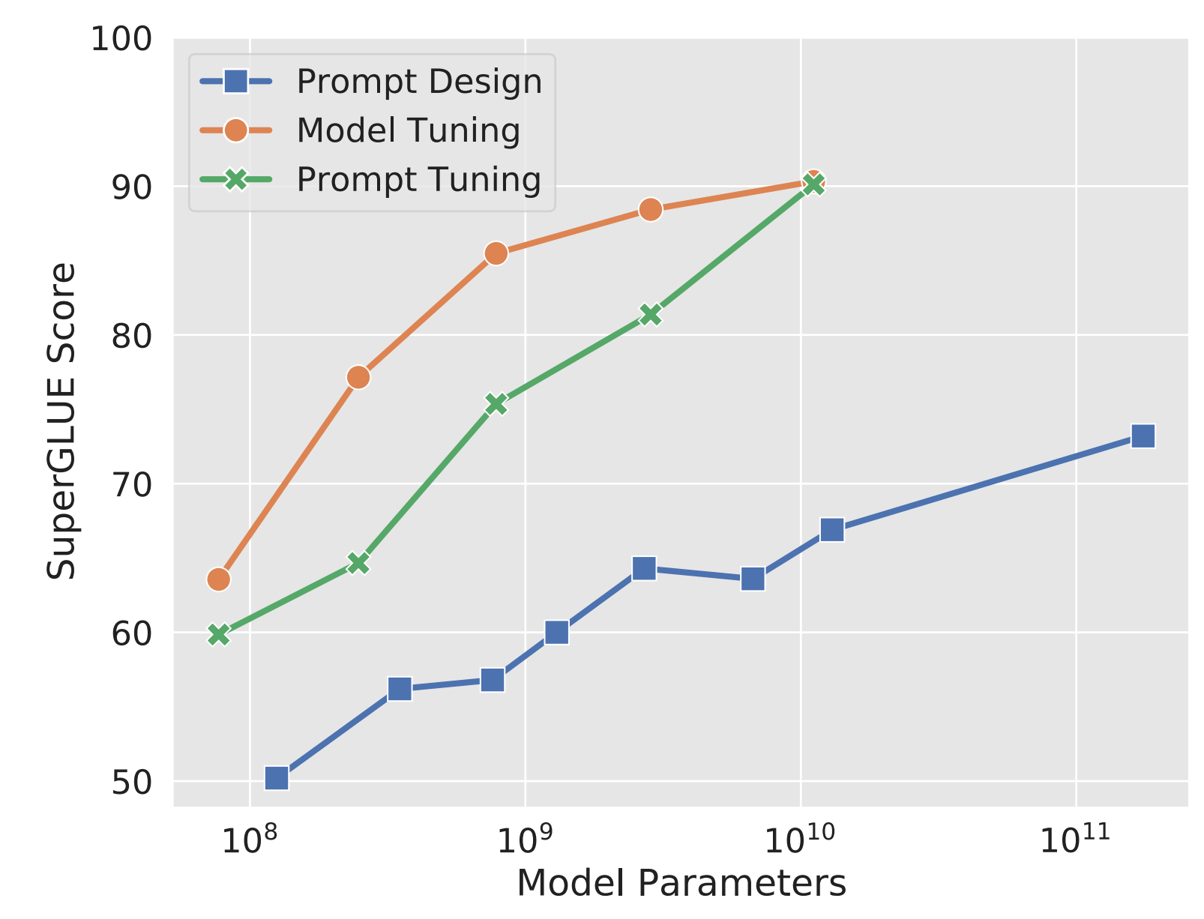
Prompt Tuning: Effect of Prompt Length
Prompt tuning only matches fine-tuning at the largest model size
Prompt tuning performs poorly at smaller model sizes and on harder tasks.
[The Power of Scale for Parameter-Efficient Prompt Tuning. Lester et al. 2021]

Slide 18
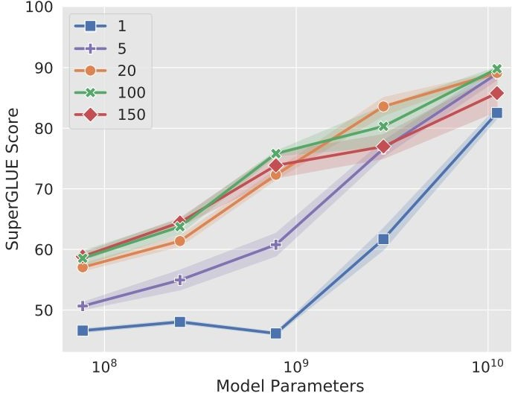
Prompt Tuning: Effect of Prompt Length
The shorter the prompt, the fewer new parameters must be tuned
Increasing prompt length is critical to achieving good performance
The largest model still gives strong results with a single-token prompt
Increasing beyond 20 tokens only yields marginal gains
[The Power of Scale for Parameter-Efficient Prompt Tuning. Lester et al. 2021]

Slide 19
Are continuous prompts as interpretable as Discrete (Language) prompts?

Slide 20
[Continuous] Prompt Waywardness
Prompt waywardness hypothesis, states that:
There are infinite-many continuous prompts that can solve a given task.
LM
Sentence: That was a great fantasy movie.
positive
["Prompt Waywardness: The Curious Case of Discretized Interpretation of Continuous Prompts" Khashabi et al., 2022.]

Slide 21
[Continuous] Prompt Waywardness
Prompt waywardness hypothesis, states that:
There are infinite-many continuous prompts that can solve a given task.
There exist continuous prompts that ”project” to the description of irrelevant or contradictory tasks.
Project := nearest-neighbor mapping of continuous prompt onto the word embeddings
definition of another task:
Write down the conclusion you can reach by combining the given Fact 1 and Fact 2.
random sentence from web:
int clamp(int val, int min_val) { return std::max(min_val, val); }
LM
Sentence: That was a great fantasy movie.
positive
["Prompt Waywardness: The Curious Case of Discretized Interpretation of Continuous Prompts" Khashabi et al., 2022.]

Slide 22
discrete (text) prompts: easy to interpret, but not easy to optimize
What is the sentiment of the following review? (positive or negative)
LM
Sentence: That was a great fantasy movie.
positive
continuous prompts:
unclear how to interpret, but easy to optimize
0.9 | 0.1 | -2.1 | 0.0
LM
Sentence: That was a great fantasy movie.
positive
["Prompt Waywardness: The Curious Case of Discretized Interpretation of Continuous Prompts" Khashabi et al., 2022.]
Notes:
... continuous prompts
Typically defined as a vector of real numbers prepended to the embedding of an input text to make the model generate a desired outcome.
For example, a continuous prompts that effectively solves the sentiment classification task.
Turns out that continuous prompts are complementary to their discrete counterparts:
We have algorithms for effectively optimizing them.
However, meaningful interpretation of continuous prompts as natural language is an open question problem.
(click) --- maybe this particular continuous prompt has something to do with sentiment analysis?? Unclear.
Motivated by this, we are interested in the research question of …
Motivated by the discrepancies between discrete and continuous prompts, we study focus continuous prompts and their interpretability.

Slide 23
Parameter-efficient Fine-tuning: Adding Models
Augmenting the existing pre-trained model with extra parameters or layers and training only the new parameters
Two commonly used methods:
Soft prompts
Adapters

Slide 24
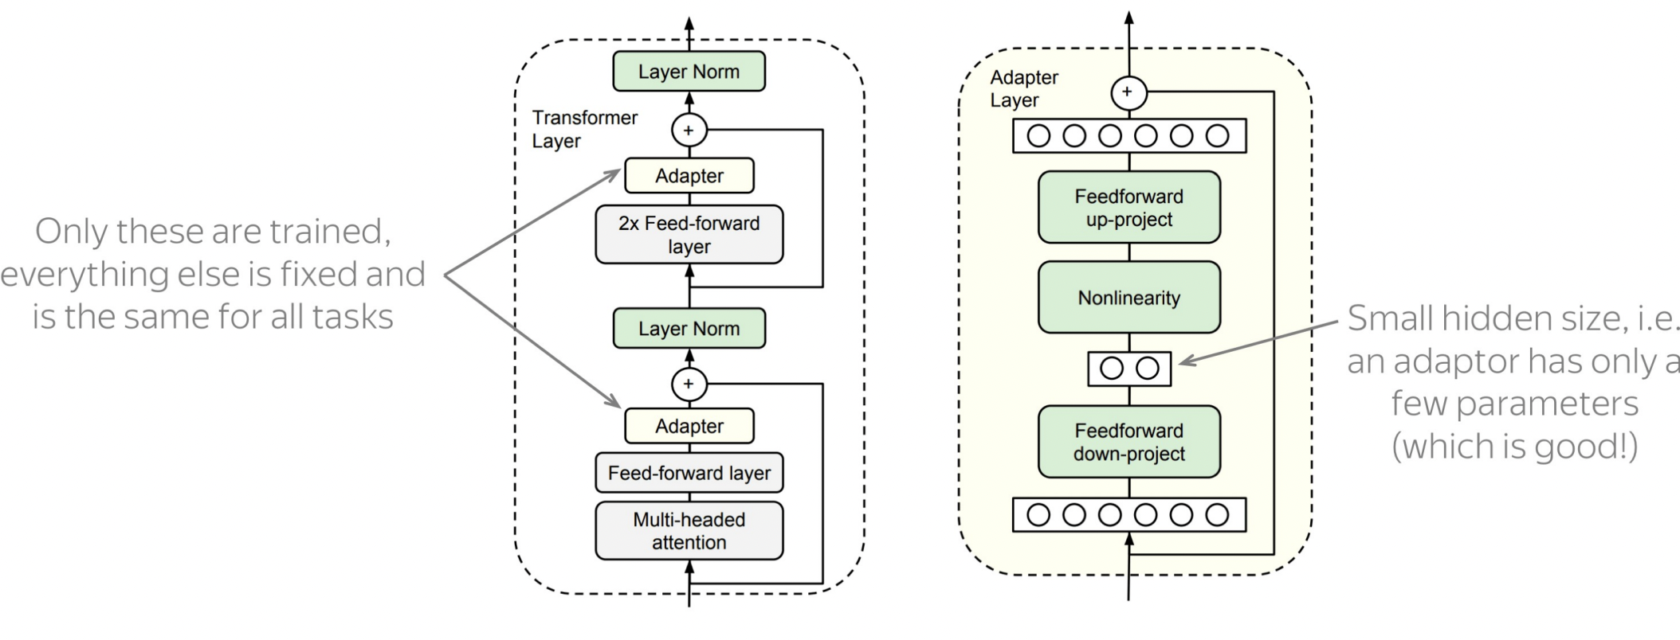
Adapters
Idea: train small sub-networks and only tune those.
FF projects to a low dimensional space to reduce parameters.
No need to store a full model for each task, only the adapter params.
[“Parameter-Eﬃcient Transfer Learning for NLP”, Houlsby et al., 2019.]

Slide 25
Question
Is parameter-efficient tuning more (1) computationally efficient; (2) memory-efficient than whole-model tuning?
It is not faster! You still need to do the entire forward and backward pass.
It is more memory efficient.
You only need to keep the optimizer state for parameters that you are fine-tuning and not all the parameters.

Slide 26
Selective methods
Selective methods fine-tune a subset of the existing parameters of the model.
It could be a layer depth-based selection, layer type-based selection, or even individual parameter selection.
Ben Zaken et al., 2021. “BitFit: Simple Parameter-eﬃcient Fine-tuning for Transformer-based Masked Language-models”

Slide 27
BitFit
120
BitFit adds bias terms in self-attention and MLP layers and tunes those.
BitFit only updates about 0.05% of the model parameters.
Ben Zaken et al., 2021. “BitFit: Simple Parameter-eﬃcient Fine-tuning for Transformer-based Masked Language-models”

Slide 28
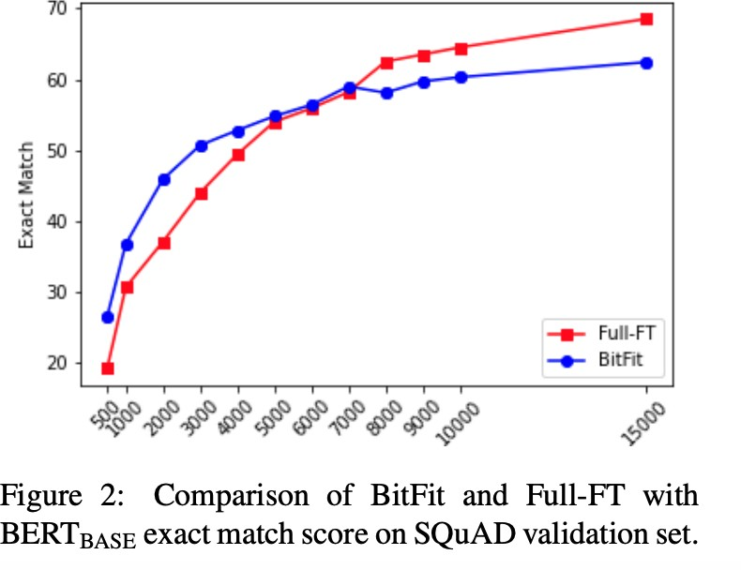
BitFit
Ben Zaken et al., 2021. “BitFit: Simple Parameter-eﬃcient Fine-tuning for Transformer-based Masked Language-models”

Slide 29
Reparametrization based methods
Reparametrize the weights of the network using a low-rank transformation. This decreases the trainable parameter count while still allowing the method to work with high-dimensional matrices
71

Slide 30
LoRA
125
Hypothesis: the intrinsic rank of the weight matrices in a large language model is low
Parameter update for a weight matrix is decomposed into a product of two low-rank matrices
A is initialized with random Gaussian Initialization, B is initialized to zero
[“LoRA: Low-Rank Adaptation of Large Language Models” Hu et al., 2021.]

Slide 31
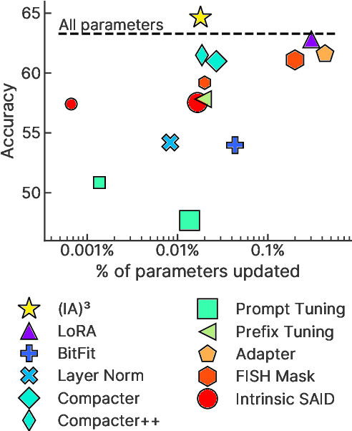
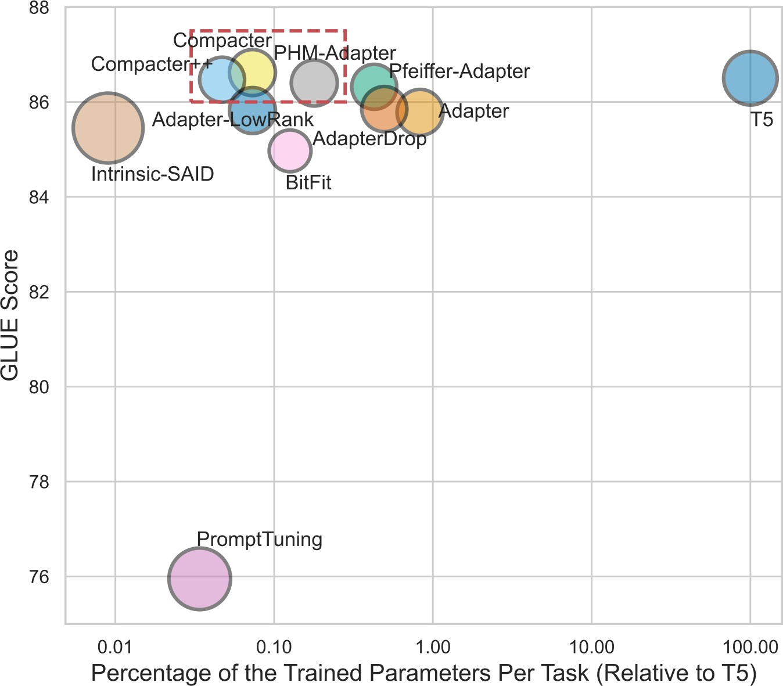
Performance/compactness comparison

Slide 32
Summary
Parameter efficient optimization — optimize fewer parameters than the whole model.
Space efficiency — fewer parameters to store
Computation efficiency? A bit unclear
Their interpretability is not quite clear.

Slide 33
Logistics Update
Quiz 2: Next week Thursday.
Question distribution: similar to Quiz 1.
Content: everything covered by the end of this week.
Based on the content discussed in the class and homework assignments.
You’re not expected to read any of the papers cited on the slides.

Slide 34
Prompting and In-Context Learning

Slide 35
Limitations of Pre-training, then Fine-tuning
Often you need a large labeled data
Though more pre-training can reduce the need for labeled data

Slide 36
“I have an extremely large collection of clean labeled data”
-- No one
[Colin Raffel]

Slide 37
Limitations of Pre-training, then Fine-tuning
Often you need a large labeled data
Though more pre-training can reduce the need for labeled data
End up with many copies (or sub-copies) of the same [sub]model

Slide 38
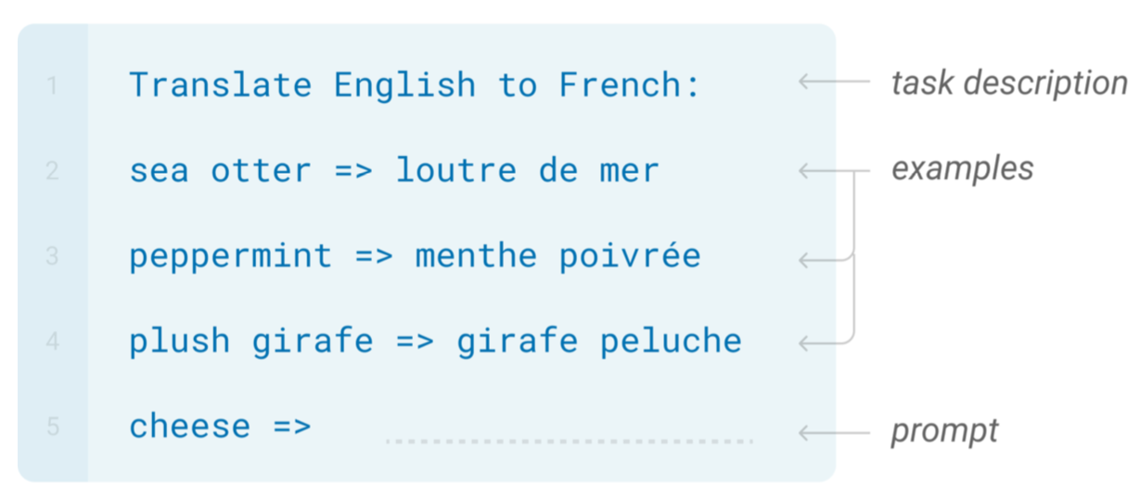
In-Context Learning

Slide 39
In-Context Learning
Learns to do a downstream task by conditioning on input-output examples!
No weight update — our model is not explicitly pre-trained to learn from examples
The underlying models are quite general
Today’s focus:
How to use effectively in practice?
Fundamentally, why does it work?

Slide 40
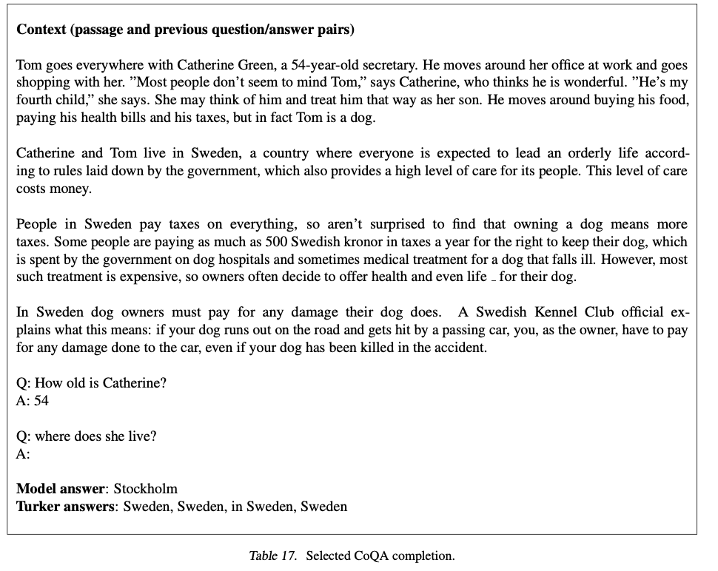
In-Context Learning
https://gpt3experiments.substack.com/p/is-gpt-3-really-doing-few-shot-learning

Slide 41
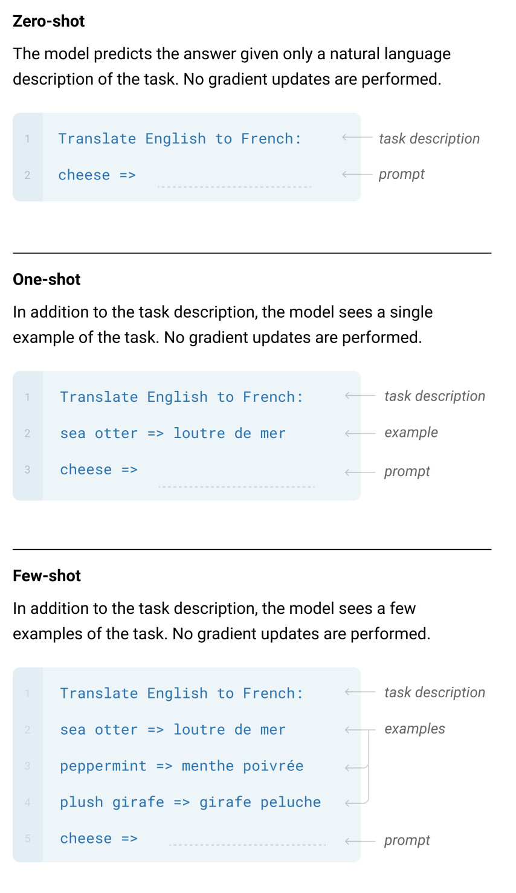
GPT-3: Language Models are Few-Shot Learners

Slide 42
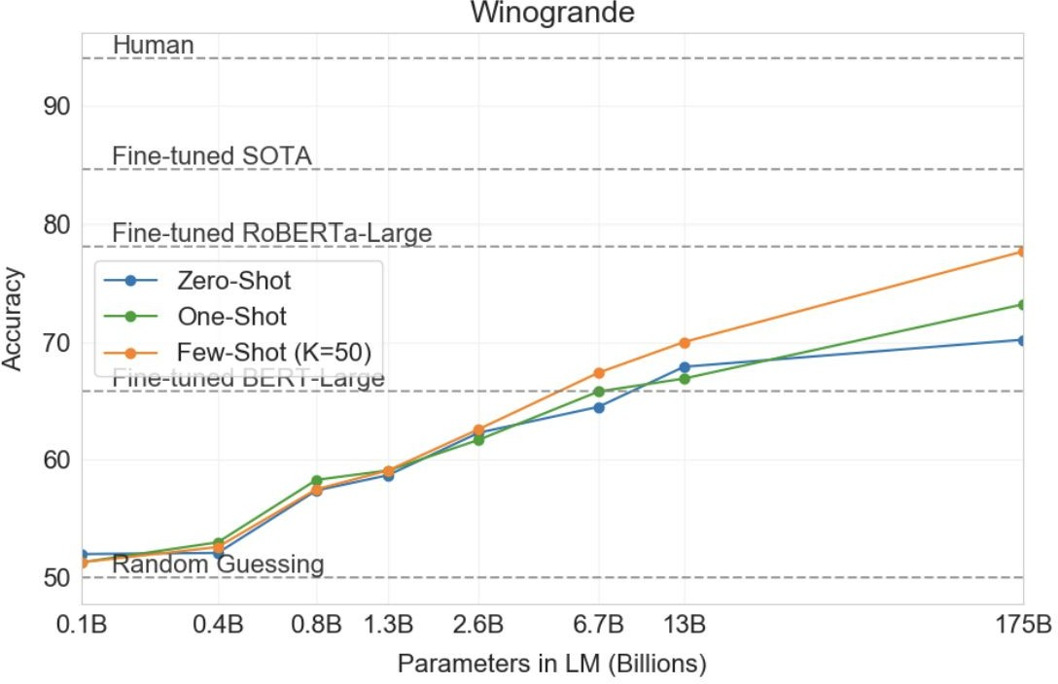
In-context learning results
Brown et al. 2020. “Language Models are Few-Shot Learners”

Slide 43
In-Context Prompting: Implementation
Movie review dataset
Input: An effortlessly accomplished and richly resonant work.
Label: positive
Input: A mostly tired retread of several other mob tales.
Label: negative
An effortlessly accomplished and richly resonant work. It was great! A mostly tired retread of several other mob tales. It was terrible!
A three-hour cinema master class. It was
Language Model
p1 = P(It was great! | 1st train input+output \n 2nd train input+output \n A three-hour cinema master class.)
p2 = P(It was terrible! | 1st train input+output \n 2nd train input+output \n A three-hour cinema master class.)
p1 > p2 →
p1 < p2 →
“positive” “negative”
[ACL 2022 Tutorial Beltagy, Cohan, Logan IV, Min and Singh]

Slide 44
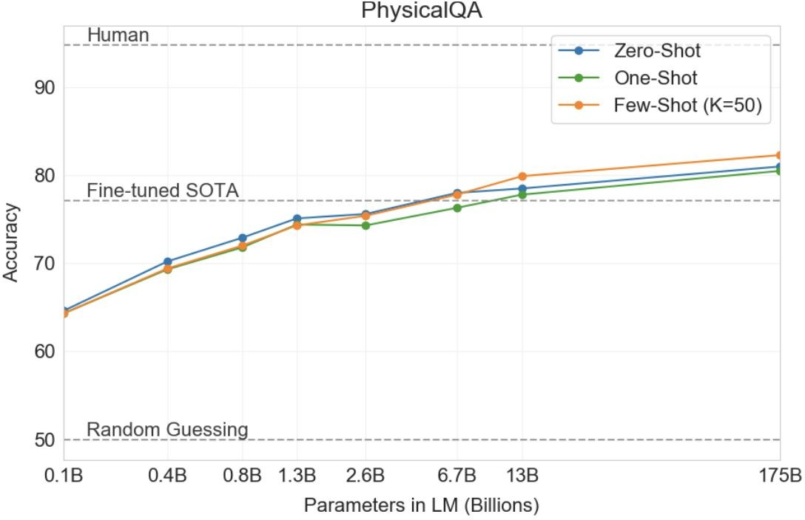
In-Context learning Results
Brown et al. 2020. “Language Models are Few-Shot Learners”

Slide 45
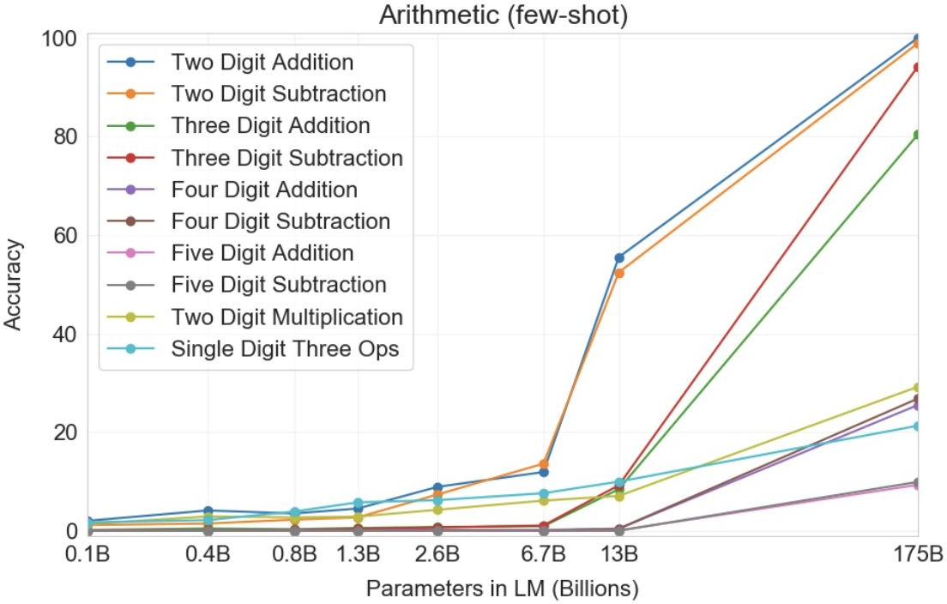
In-Context learning Results
Example:
Q: What is 48 plus 76?
A: 124
Observations:
Scale is important
Number of digits correlate with their difficulty.
Multiplication is harder than summation!
Brown et al. 2020. “Language Models are Few-Shot Learners”

Slide 46
Why Do We Care About In-Context Learning?
Practically Useful
Intellectually Intriguing
[ACL 2022 Tutorial Beltagy, Cohan, Logan IV, Min and Singh]

Slide 47
In-Context Learning: Practically Useful
May require domain expertise
Medical, legal, ﬁnancial
You don’t want to get more data
Emergent, time-sensitive scenarios
Something new happened—need to react quickly!
Labeling data is costly
Finetuning can tricky
Training is sensitive to hyperparams
Not enough validation data
We don’t quite understand how finetuning works
Expensive to train, time and memory
[ACL 2022 Tutorial Beltagy, Cohan, Logan IV, Min and Singh; quote credit: Colin Raffel]

Slide 48
In-Context Learning: Intellectually Intriguing
Potential test for “Intelligent Behavior”
Insights into Language Modeling
Generalization from few examples
Fundamental piece of intelligence
Often used in psychology
Quickly adjust to environment
What does an LLM “know”?
What are the biases/limitations of LLMs?
…
[ACL 2022 Tutorial Beltagy, Cohan, Logan IV, Min and Singh]

Slide 49
The Broader Context: Supervised Learning
[ACL 2022 Tutorial Beltagy, Cohan, Logan IV, Min and Singh]

Slide 50
The Broader Context: [Modern] Few-shot Learning
[ACL 2022 Tutorial Beltagy, Cohan, Logan IV, Min and Singh]

Slide 51
ICL as a General-Purpose Few-Show Learning Mechanism
Any arbitrary task
Language Model
A few-shot learner
[ACL 2022 Tutorial Beltagy, Cohan, Logan IV, Min and Singh]

Slide 52
Summary
ICL is a surprising phenomenon that came out of large-scale pre-training LMs.
It allows test-time adaptation via examples.
Few examples are often enough—data efficient!
No parameter updates—no model replicas!
When does it work? What are its strength or weaknesses? 🤔

Slide 53
ICL’s Sensitivity

Slide 54
LM Prompting: Choices of Encoding
[Slide credit: Eric Wallace]

Slide 55
LM Prompting: Choices of Encoding
[Slide credit: Eric Wallace]

Slide 56
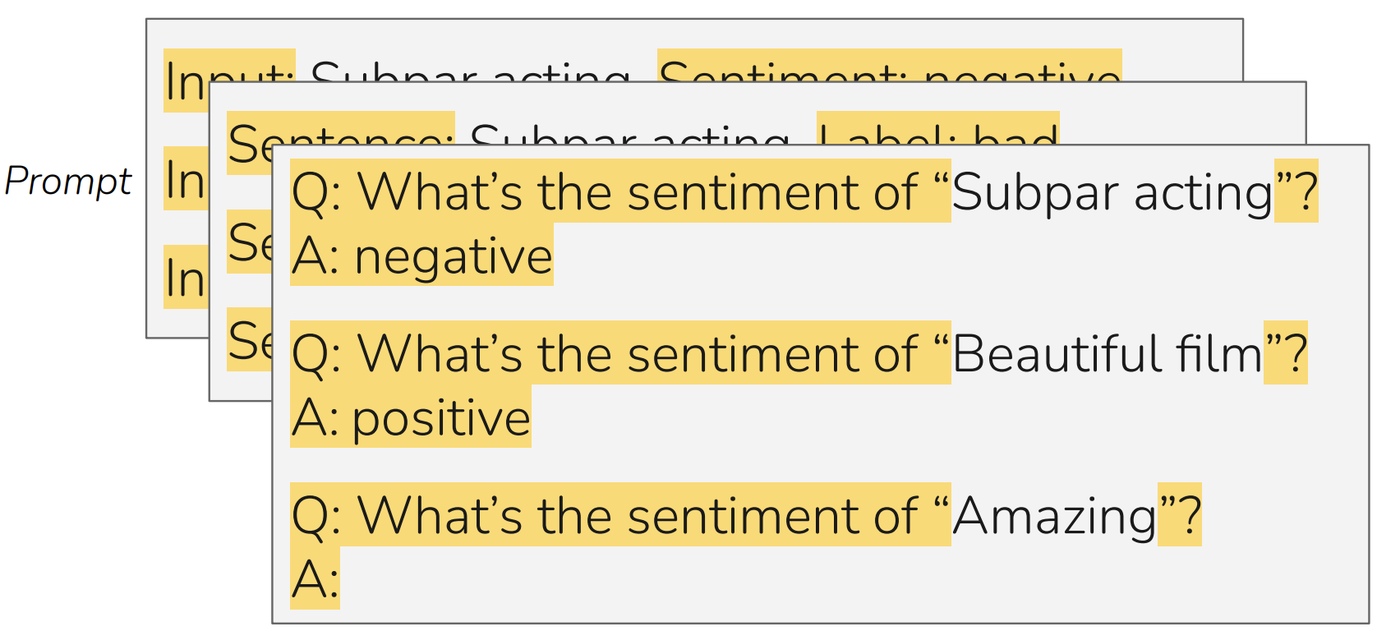
LM Prompting: Choices of Encoding
[Slide credit: Eric Wallace]

Slide 57
In-Context Learning: Sensitivity to Encoding
[Slide credit: Eric Wallace]
In-context learning is highly sensitive to prompt format (training sets and patterns/verbalizers)
[“Calibrate Before Use: Improving Few-Shot Performance of Language Models.” Zhao et al. 2021]

Slide 58
In-Context Learning: Sensitivity to Demo. Permutations
[Slide credit: Eric Wallace]
Training Set #1

Slide 59
In-Context Learning: Sensitivity to Demo. Permutations
[Slide credit: Eric Wallace]
Example #1
Example #2
Example #3
Example #4
Training Set #1

Slide 60
In-Context Learning: Sensitivity to Demo. Permutations
[Slide credit: Eric Wallace]
Example #1
Example #2
Example #3
Example #4
Example #2
Example #1
Example #3
Example #4
Example #4
Example #3
Example #2
Example #1
...
Prompt #1
Prompt #2
Prompt #24
All 24 Permutations
Example #1
Example #2
Example #3
Example #4
Training Set #1

Slide 61
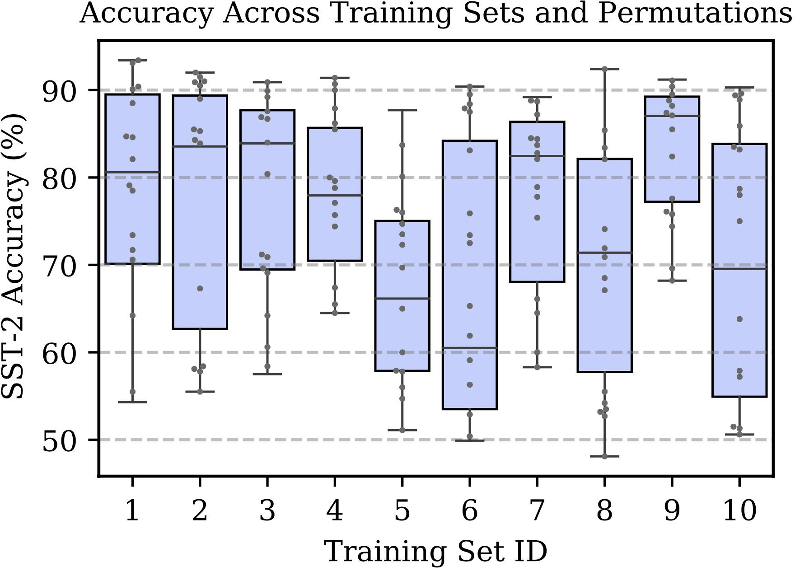
In-Context Learning: Sensitivity to Demo. Permutations
[Slide credit: Eric Wallace]
Example #1
Example #2
Example #3
Example #4
Example #2
Example #1
Example #3
Example #4
Example #4
Example #3
Example #2
Example #1
...
Prompt #1
Prompt #2
Prompt #24
All 24 Permutations
Example #1
Example #2
Example #3
Example #4
In-context learning is highly sensitive to prompt format (training sets and patterns/verbalizers)
Training Set #1
[“Calibrate Before Use: Improving Few-Shot Performance of Language Models.” Zhao et al. 2021]

Slide 62
In-Context Learning: Sensitivity to Demo. Permutations
[Slide credit: Eric Wallace]
Example #1
Example #2
Example #3
Example #4
Example #2
Example #1
Example #3
Example #4
Example #4
Example #3
Example #2
Example #1
...
Prompt #1
Prompt #2
Prompt #24
All 24 Permutations
Example #1
Example #2
Example #3
Example #4
Training Set #1
Training Set #2
[“Calibrate Before Use: Improving Few-Shot Performance of Language Models.” Zhao et al. 2021]

Slide 63
In-Context Learning: Sensitivity to Demo. Permutations
[Slide credit: Eric Wallace]
Example #1
Example #2
Example #3
Example #4
Example #2
Example #1
Example #3
Example #4
Example #4
Example #3
Example #2
Example #1
...
Prompt #1
Prompt #2
Prompt #24
All 24 Permutations
Example #1
Example #2
Example #3
Example #4
The choice of demonstrations and their order is quite important.
Training Set #1
Training Set #2
...
Training Set #10
[“Calibrate Before Use: Improving Few-Shot Performance of Language Models.” Zhao et al. 2021]

Slide 64
Sensitivity to Wording (Framing) of Prompts
Framing of prompts matters a lot.
Craft a question that requires commonsense to be answered. Based on the given context, craft a common-sense question, especially those that are LONG, INTERESTING, and COMPLEX. The goal is to write questions that are easy for humans and hard for AI machines! To create such questions, here are some suggestions: A. What may (or may not) be the plausible reason for an event? B. What may (or may not) happen before (or after, or during) an event? ...
Generate questions such that you use - ‘what may happen’, - ‘will ...?’, - ‘why might’, - ‘what may have caused’, - ‘what may be true about’,
- ‘what is probably true about’, - ‘what must’ and similar phrases in your question based on the input context.
[“Reframing Instructional Prompts to GPTk's Language.” Mishra et al. 2021.]

Slide 65
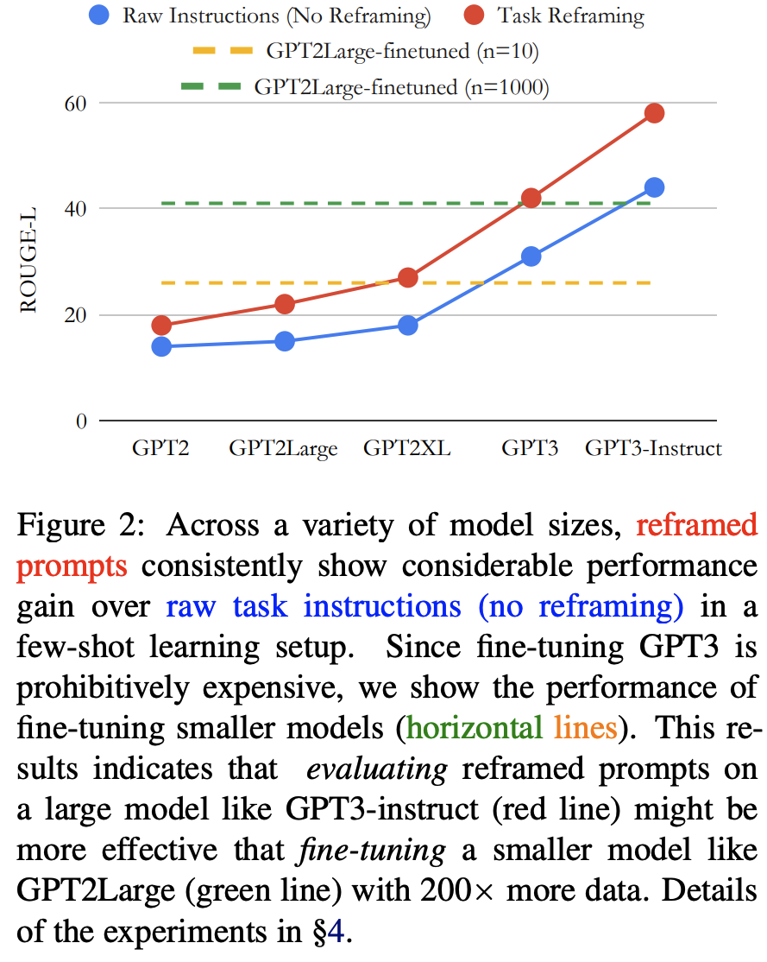
Sensitivity to Wording (Framing) of Prompts
Prompts can often be phrased in a language that are easier to be understood by language models.
Generally, it is easier for LMs to follow shorter, crisp, itemized prompts.
[“Reframing Instructional Prompts to GPTk's Language.” Mishra et al. 2021.]

Slide 66
Summary Thus Far
In-context learning:
Pre-trained LMs imitated examples provided in their context. (why??)
It turns out there is a huge variance in performance depending on the encoding.
The choice of demonstrations, their order, wording, etc.
You can treat them as hyper-parameters
You should not choose these encodings based on the test data.
Generally, you want to an encoding that makes your task similar to language modeling — closer to what is observed during pretraining.

Slide 67
What Causes These Variances?
Here we will provide several justifications …

Slide 68
Majority Label Bias
Among 4 demonstrations, count how many are “positive”.
Then check if the model output correlates with the number of “positive” demos.

Slide 69
Majority Label Bias
Among 4 demonstrations, count how many are “positive”.
Then check if the model output correlates with the number of “positive” demos.
100
Majority label bias: frequent training answers dominate predictions.
Frequency of Positive Predictions
56
37
20
0
4/4
Positive
3/4
Positive
2/4
Positive
1/4
Positive
0/4
Positive
[“Calibrate Before Use: Improving Few-Shot Performance of Language Models.” Zhao et al. 2021]

Slide 70
Recency Bias
Check if the label of the most-recent demo biases the model output.

Slide 71
Recency Bias
Check if the label of the most-recent demo biases the model output.
90
Recency bias: examples near end of prompt dominate predictions — Explains variance across example permutations!
62
60
Frequency of Positive Predictions
12
NPPP
PNPP
PPNP
PPPN
[“Calibrate Before Use: Improving Few-Shot Performance of Language Models.” Zhao et al. 2021]

Slide 72
Surface Form Competition
Surface forms are competing for probability mass (Holtzman et al 2021).
[Slide credit: Howard Yen, Vishvak Murahari]

Slide 73
Common Token Bias
Is a bias toward words that are more frequently observed in pre-training data?

Slide 74
Common Token Bias
Language Model
What topic is the following text about?
The Model T was released by Ford in 1908. Answer:
Prompt

Slide 75
Common Token Bias
Token
Prob
Language Model
book | 0.35
transportation | 0.23
school | 0.11
village | 0.03
company | 0.02
What topic is the following text about?
The Model T was released by Ford in 1908. Answer:
Prompt
Model is biased towards predicting the incorrect frequent token "book" even when both "book" and "transportation" are equally likely labels in the dataset
Common token bias: common n-grams dominate predictions
helps explain variance across prompt formats

Slide 76
Impact of Pretraining Term Frequencies
For each task, identify relevant terms from each instance—numbers and units
Count co-occurrences of these terms in the pretraining data (term pairs or triples within a ﬁxed window)
["Impact of Pretraining Term Frequencies on Few-Shot Reasoning" Razeghi et al. 2022.]

Slide 77
Impact of Pretraining Term Frequencies
accuracy
frequency
frequency
In-context learning performance is highly correlated with
term frequencies during pretraining
["Impact of Pretraining Term Frequencies on Few-Shot Reasoning" Razeghi et al. 2022.]

Slide 78
Impact of Pretraining Term Frequencies
This may also indicate that, demonstrations do not teach a new task; instead, it is about locating an already-learned task during pretraining (Reynolds & McDonell, 2021)
But that brings up the question of how much LMs actually reason when solving these tasks.🤔 Overlooking the impact of pretraining data can be misleading in evaluation!
In-context learning performance is highly correlated with
term frequencies during pretraining
["Impact of Pretraining Term Frequencies on Few-Shot Reasoning" Razeghi et al. 2022.]

Slide 79
Impact of Input-Output Mapping
Study the effect of randomizing labels in demonstrations.
Randomly sample a label from the correct label space
["Rethinking the Role of Demonstrations: What Makes In-Context Learning Work?" Min et al. 2022.]

Slide 80
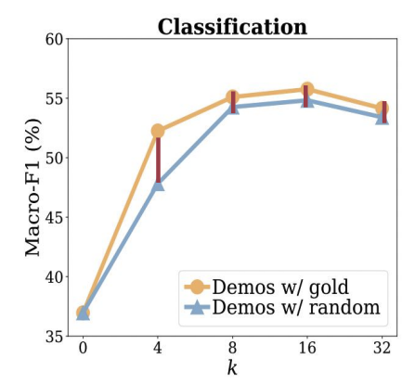
Impact of Input-Output Mapping
Vary number of demonstrations.
Models see a small performance drop (0–5%) with random labels
Takeaway:
Ground truth input-label mapping in the prompt is not as important as we thought!
["Rethinking the Role of Demonstrations: What Makes In-Context Learning Work?" Min et al. 2022.]

Slide 81
Summary Thus Far
In-context learning, while being fascinating, is highly unstable/brittle.
Next: why does ICL emerge?
[ACL 2022 Tutorial Beltagy, Cohan, Logan IV, Min and Singh]

Slide 82
Why Does ICL Emerge?

Slide 83
Why Does ICL Emerge?
We don’t know!
We have partial empirical explanations.
And some theoretical analogies.
But none of them fully explain ICL.

Slide 84
ICL Emerges Due to Parallel Structures in Pre-training
Natural text is abundant with “parallel structure”.
Various forms of coreference
Tables
Lists
…
Hypothesis: Such parallel structure is essential for the emergence of ICL.
Parallel Structures in Pre-training Data Yield In-Context Learning, 2024

Slide 85
In-context Learning as Bayesian Inference
(Xie et al., 2022) try to explain ICL as an implicit Bayesian inference.
Idea:
(Pre-trained LM learn to represent “concepts”, i.e. the ideas described by words.
ICL enables LMs to “locate” the learned concepts.
Can formulate this intuition as a Bayesian inference
Prior over latent “concepts”
Likelihood describes connection between text and concepts
Given an incomplete doc, use Bayes formula to infer what concept is likely it is generated from and then complete the document.
Does not explain everything.
GPT-3 can handle “unseen” concepts
$c_{1}$ $c_{2}$
latent concepts
observed documents
(e.g., demonstrations)
$d_{1}$ $d_{2}$ $d_{3}$

Slide 86
In-context Learning as Gradient Descent?
[von Oswald et al. 2022; Akyurek et al. 2022; Dai et al. 2022, …]
Hypothesis: ICL is implicitly equivalent to SGD on in-context demonstrations
However, unclear whether these formalisms hold in reality.
[Do Pre-trained Transformers Really Learn In-context by Gradient Descent?, 2024]

Slide 87
Summary
In-context learning has been a promising few-shot learning approach
No gradient updates → Much easier to use large models!
Many open questions …
Understanding how/why it works,
Can we predict whether in-context learning would work on a given task or not?

Slide 88
Prompting to Solve Multi-step Problems

Slide 89
Some Problems Involve Reasoning
Q: If there are 3 cars in the parking lot and 2 more cars arrive, how many cars are in the parking lot?
Q: Take the last letters of the words in "Elon Musk" and concatenate them
Q: What home entertainment equipment requires cable?
Answer Choices: (a) radio shack
(b) substation (c) television (d) cabinet
A: The answer is nk.
A: The answer is 5
A: The answer is (c).
Arithmetic Reasoning (AR)
(+ − ×÷…)
Symbolic Reasoning (SR)
Commonsense Reasoning (CR)

Slide 90
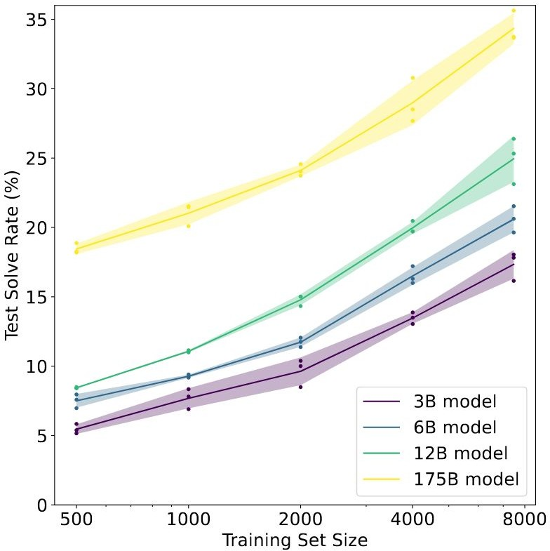
Fine-tuning on Reasoning Problems
(Cobbe et al. 2021)
Fine-tune LMs on GSM8K (arithmetic reasoning)
One may conjecture that, to achieve >80%, one needs 100x more training data for 175B model
Another option is to increase model sizes, which is expensive.
Other than these, how else can we improve the model performance on tasks that require multi-step reasoning?

Slide 91
Vanilla ICL on Reasoning Problems
Q: “Elon Musk” A: “nk”
Q: “Bill Gates” A: “ls”
Q: “Barack Obama” A:
LM
Input

Slide 92
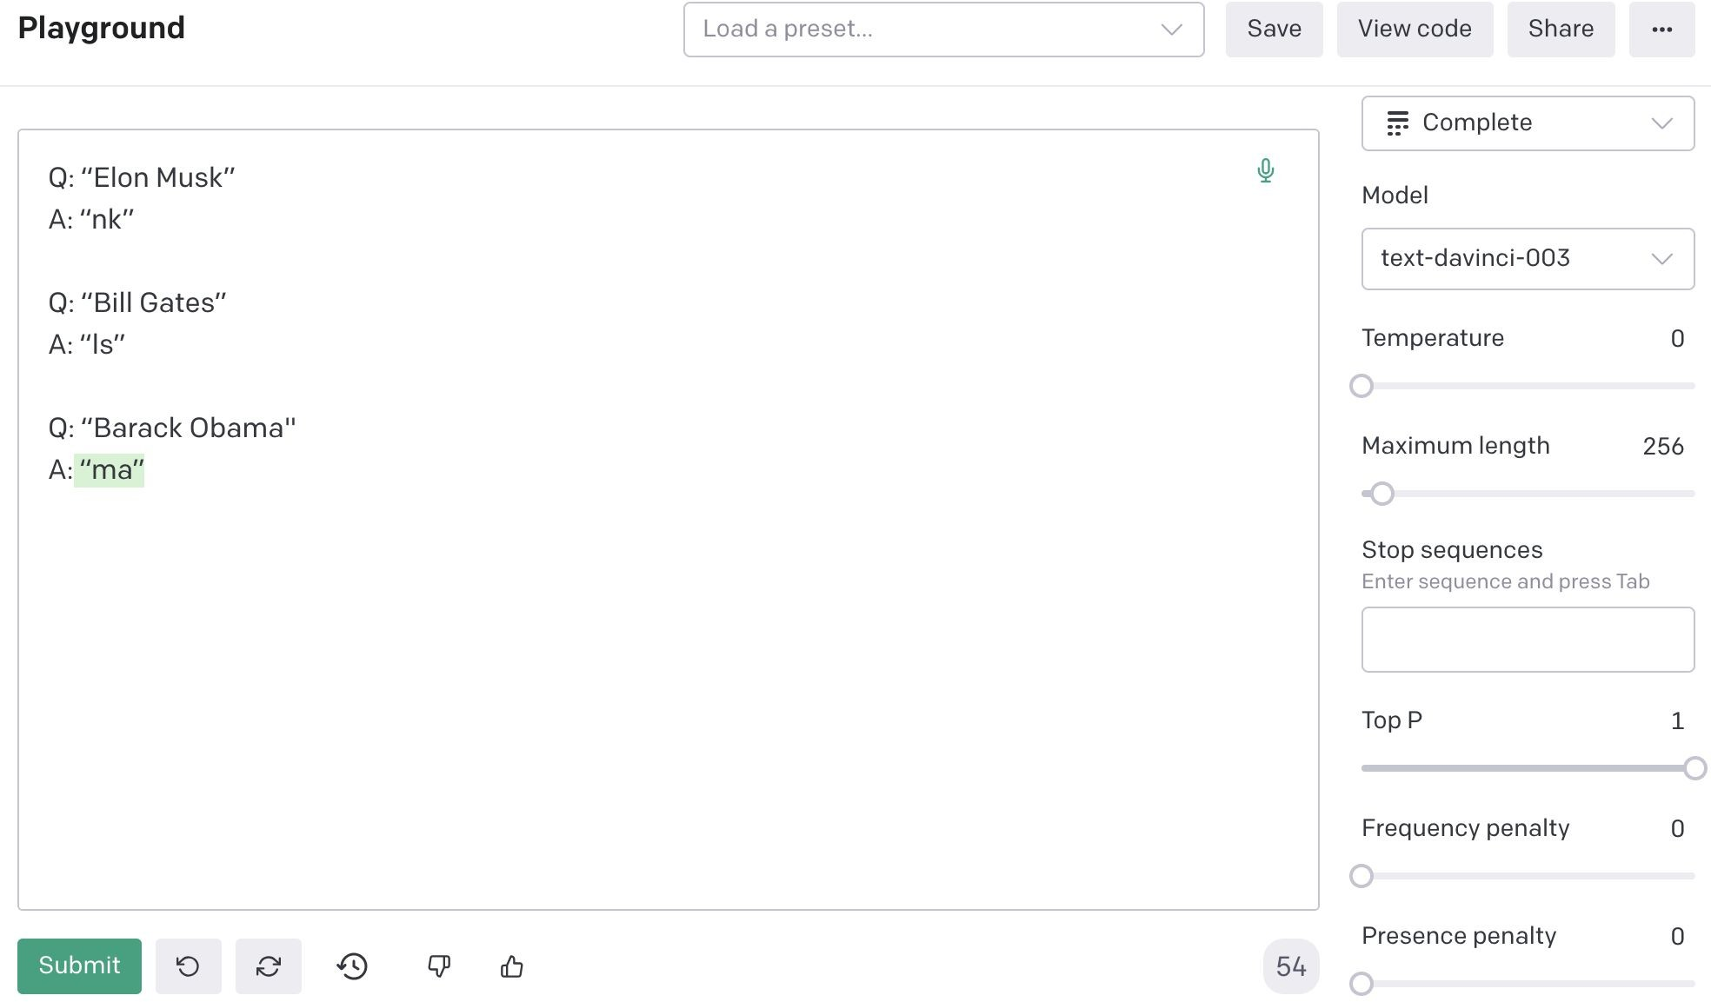
[Denny Zhou]

Slide 93
How about adding more examples?
[Denny Zhou]

Slide 94
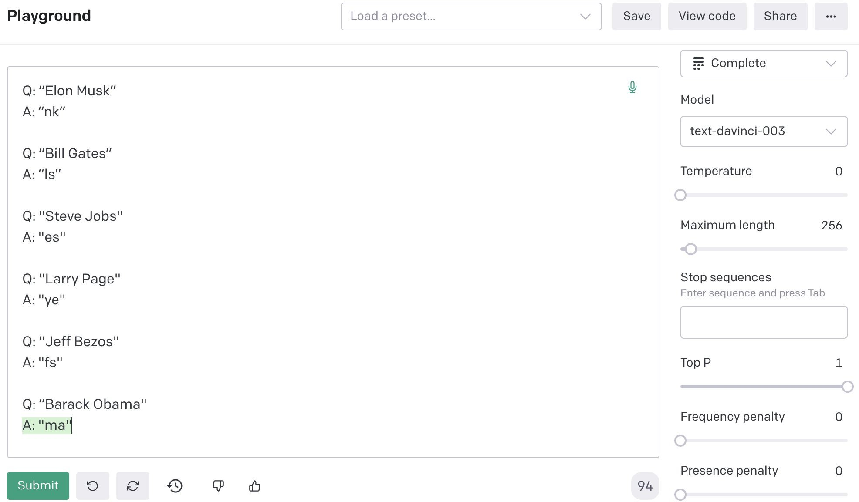
[Denny Zhou]

Slide 95
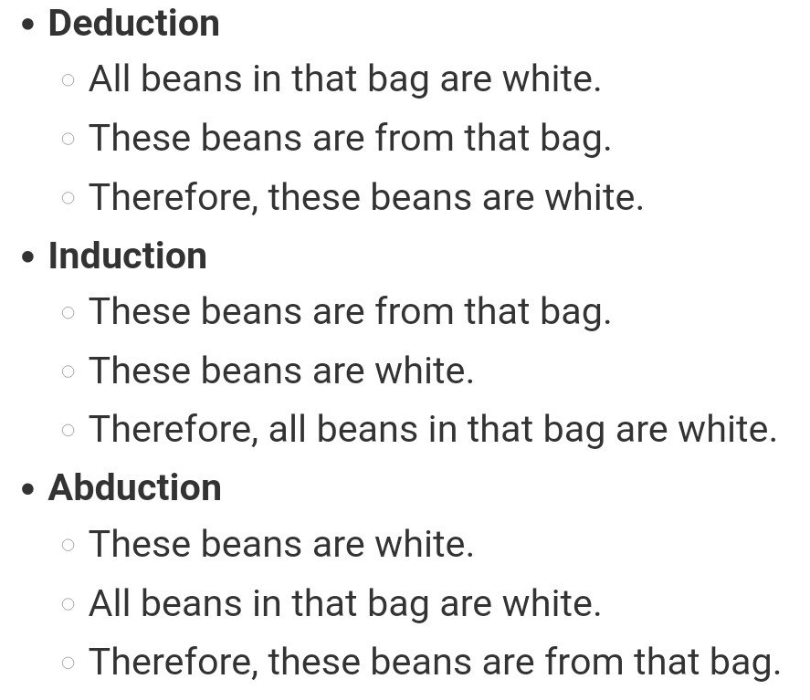
Reasoning Problems via Multi-Step Prompting
Basic idea: Rather than showing input-output pairs, prompting the model such that it shows its proof steps.
Note: ideas around models that are capable of multi-step reasoning go way back.
Aristotle (deduction),
Hume (induction),
Peirce (abduction)
Lots of other works in pre-LM era
Namely, my Ph.D. thesis ☺ on multi-step reasoning in semantic representations of language!
[Reasoning-Driven Question-Answering for Natural Language Understanding]

Slide 96
CoT: Adding “thought” before “answer”
Q: “Elon Musk”
A: the last letter of "Elon" is "n". the last letter of "Musk" is "k". Concatenating "n", "k" leads to "nk". so the output is "nk". _{thought}
Q: “Bill Gates”
A: the last letter of "Bill" is "l". the last letter of "Gates" is "s". Concatenating "l", "s" leads to "ls". so the output is "ls".
Q: “Barack Obama" A:
[Denny Zhou]

Slide 97
CoT: Adding “thought” before “answer”
Q: “Elon Musk”
A: the last letter of "Elon" is "n". the last letter of "Musk" is "k". Concatenating "n", "k"
leads to "nk".
so the output is "nk".
thought
Q: “Bill Gates”
A: the last letter of "Bill" is "l". the last letter of "Gates" is "s". Concatenating "l", "s" leads to "ls". so the output is "ls".
Q: “Barack Obama"
A:
the last letter of "Barack" is "k". the last letter of "Obama" is "a". Concatenating "k", "a"
leads to "ka". so the output is "ka".
[Denny Zhou]

Slide 98
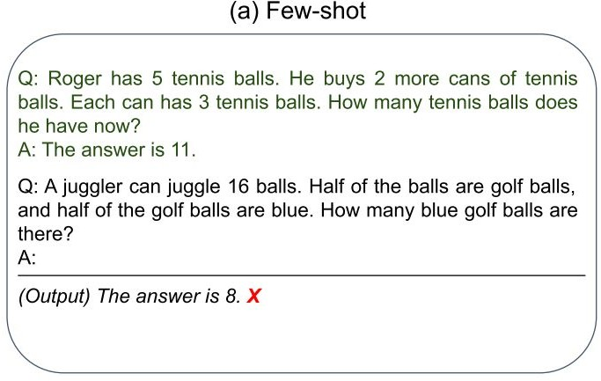
CoT: Adding “thought” before “answer”

Slide 99
CoT: Adding “thought” before “answer”
（Wei et al., 2022）
Step-by-step demonstration
Step-by-step Answer
The use of natural language to describe rationales is critical for the success of CoT.

Slide 100
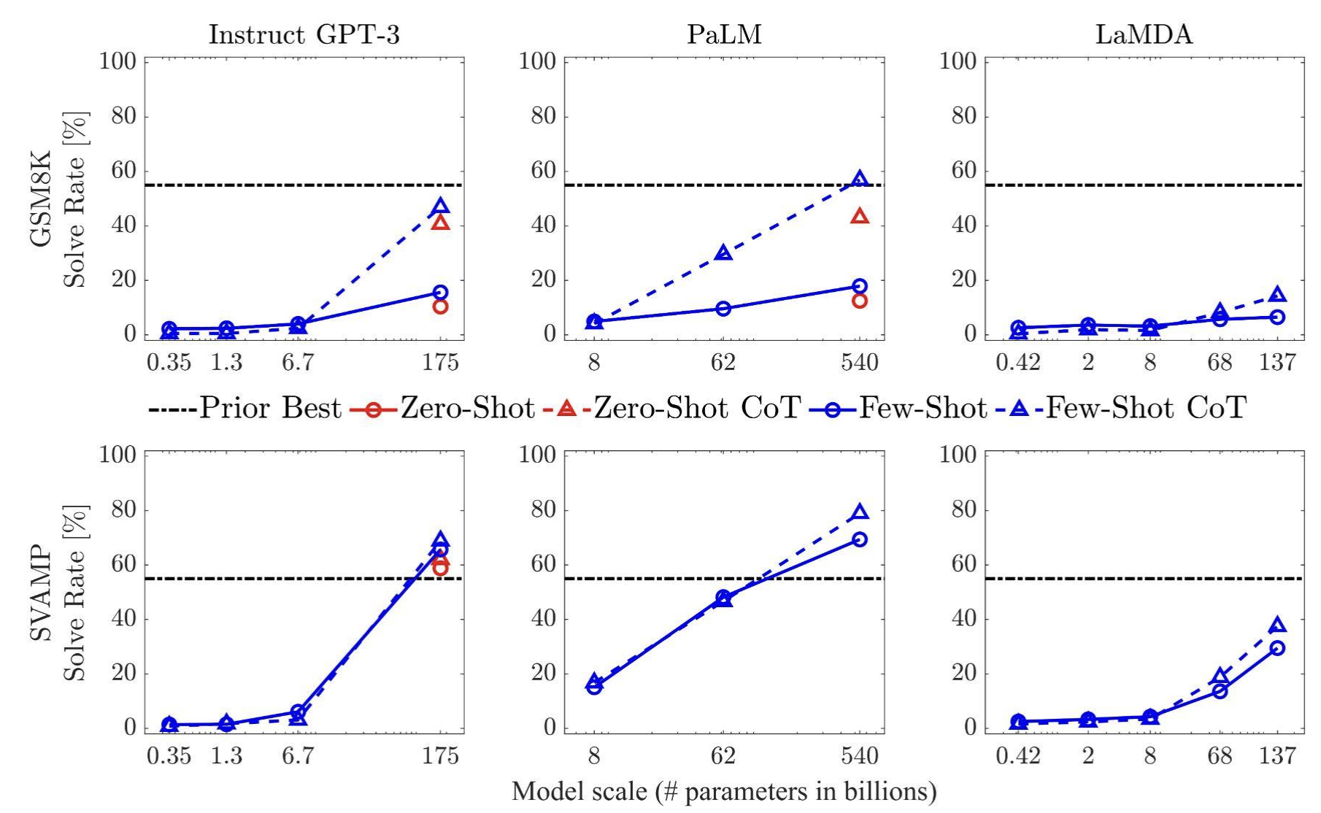
CoT Prompting: Empirical Results
Setup: show demonstrations that contain the decompositions
The gains of multi-step prompting increases with scale.
Prompting achieves better perf than [smaller] models that are fine-tuned on a lot more data.
[“Chain of thought prompting elicits reasoning in large language models”, Wei et al. 2022]

Slide 101
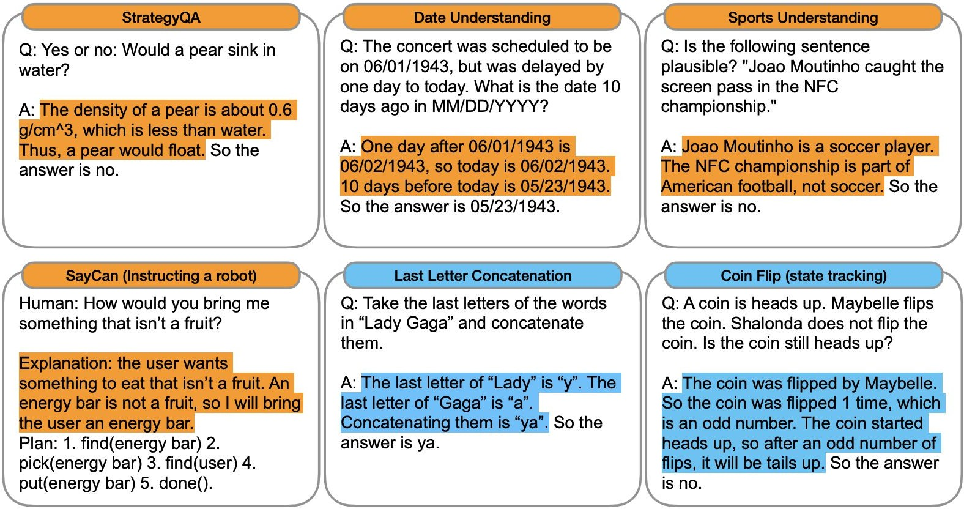
Apply CoT to Any Task
Though each task’s demonstrations need to be “engineered” manually! ☹

Slide 102
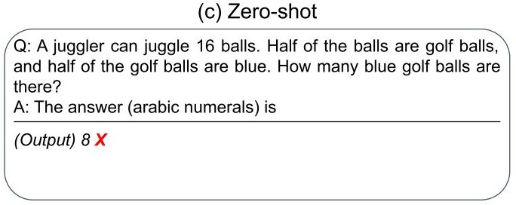
Zero-Shot CoT
（Wei et al., 2022）
Step-by-step demonstration
Step-by-step Answer

Slide 103
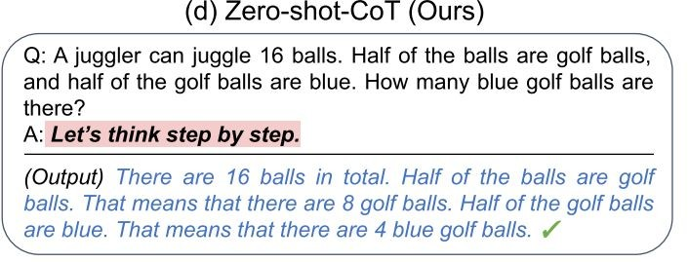
Zero-Shot CoT
（Wei et al., 2022）
Step-by-step demonstration
Step-by-step Answer
（KoJima et al., 2022）
Two-stage Prompting Step-by-step Answer

Slide 104
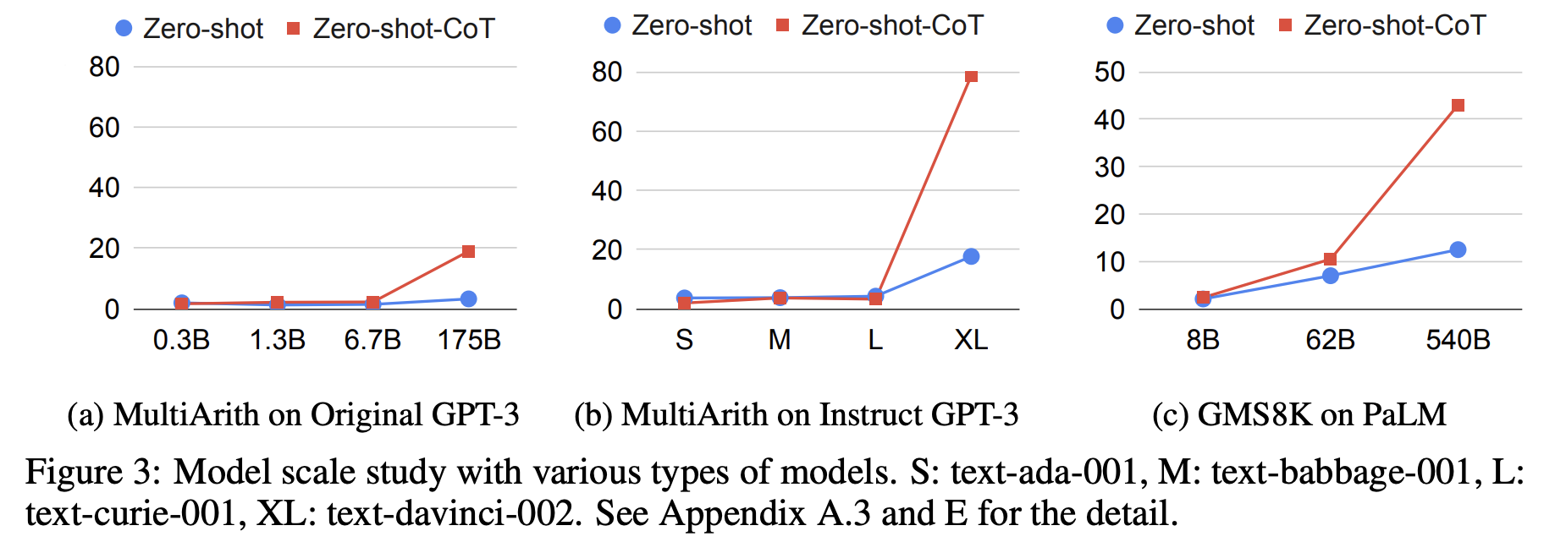
Multi-Step Prompting: Empirical Results
Setup: show demonstrations that contain the decompositions
The gains of multi-step prompting increases with scale.
Prompting achieves better perf than [smaller] models that are fine-tuned on a lot more data.
[“Large Language Models are Zero-Shot Reasoners”, Kojima et al. 2022]

Slide 105
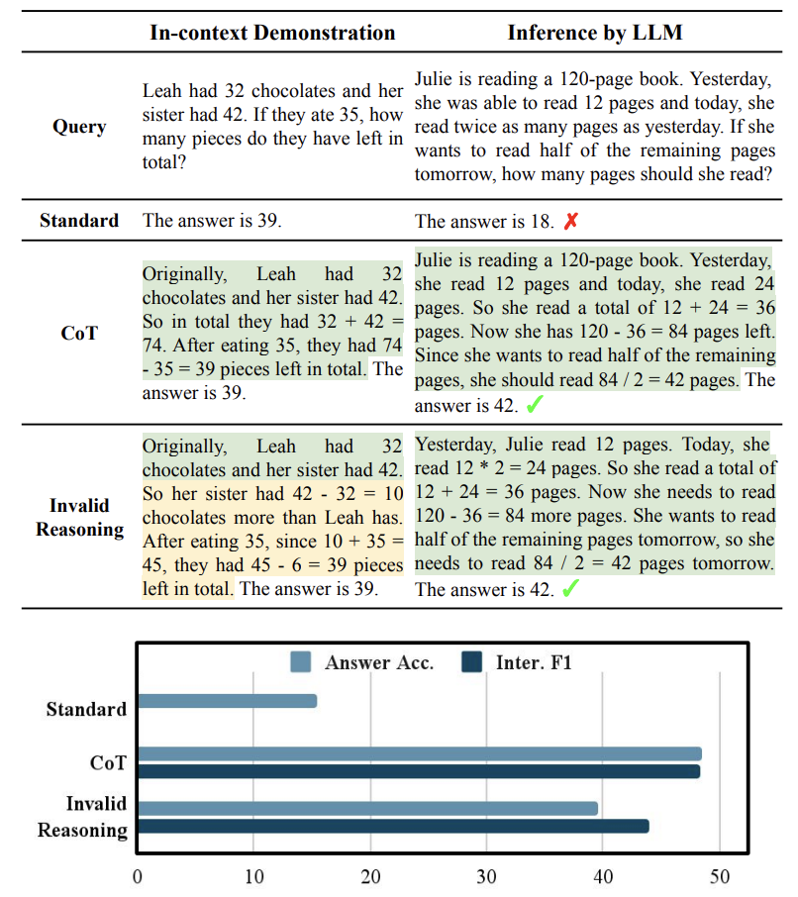
Multi-Step Prompting: Steps Don’t Have to Be Correct!
It is possible even with invalid demonstrations
Prompting with invalid reasoning steps can achieve over 80-90% of the performance with correct reasoning steps.
[“Towards Understanding Chain-of-Thought Prompting”, Wang et al. 2022]

Slide 107
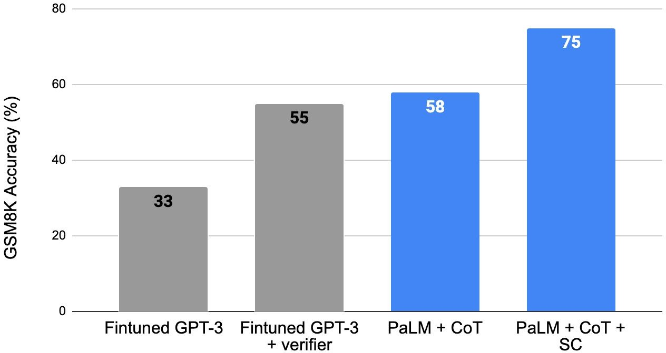
Self-Consistency Leads to Improved Results

Slide 108
Multi-Step Prompting: Parting Comments
Prompting LMs to explain their reasoning improves their performance.
However, their steps aren’t always correct.
A useful repository of annotation: https://github.com/OpenBioLink/ThoughtSource
There is much to research on here:
When do LMs over-reason or under-reason?
How do adjust the granularity of step?
How to use use given references in the proofs?
How do use external “tools” (e.g., logic, calculator, Python) in forming proofs?

Slide 109
Summary
Prompting language models is a powerful way to adapt them to our desired tasks.
We saw prompting via in-context demonstrations
We also saw various variants and extensions
They also serve as a gateway to understand the underlying dynamics inside models.
Lots of activity in this area and room for a lot of research progress.

Slide 110
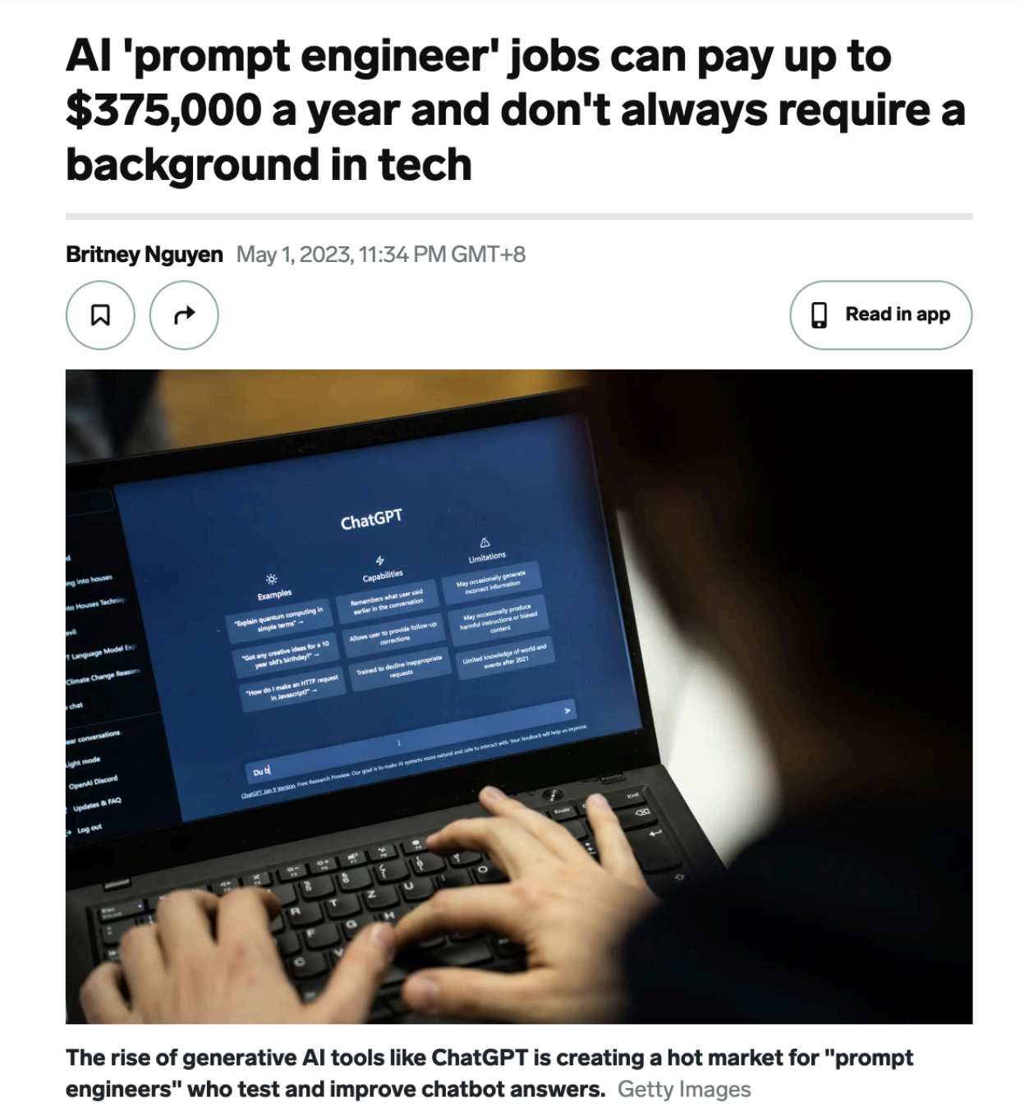
Prompt Engineering
Reformulating tasks to a language that is easier to for the models.
Show demonstrations
Decompose your problem
Ask for rationales (a la CoT)
Check for consistency
…
Question for you: will ”prompt engineering” be relevant topic in the coming years?
Notes:
Prompt engineering

Slide 111
The Phases of Our Understanding
“Language modeling is a useful subtask for many NLP tasks” – everyone, pre-2018
“Language modeling is a useful supertask for many NLP tasks” – everyone, post-2018

