Slide 1
Aligning Self-Supervised Models with Human Intents
CSCI 601-471/671 (NLP: Self-Supervised Models)
https://self-supervised.cs.jhu.edu/sp2024/

Slide 2
Logistics Recap
HW7 will be released today! This is the last one, phew …
We haver a quiz scheduled for next week Thursday.
Will cover everything from day 1 till the end of today’s class.
Questions for you:
I am open to the idea of pushing Quiz 2 to the Tuesday after the spring break if you’re overwhelmed with deadlines next week. But I worry about it ruining your break. What do you think? It’s your choice. Please voice your opinion.
I am also open to the idea of pushing HW7 deadline to after the spring break. Again, I don’t want to create more problems for you.

Slide 3
Things that Generative LMs Can Do
Johns Hopkins University is in _______. [Trivia]
I put _______ fork down on the table. [syntax]
The woman walked across the street, checking for traffic over _______ shoulder. [coreference]
I went to the ocean to see the fish, turtles, seals, and _______. [lexical semantics/topic]
What I got from the two hours watching it was popcorn. The movie was _______. [sentiment]
Thinking about the sequence 1, 1, 2, 3, 5, 8, 13, 21, ___ [basic arithmetic]
[Slide credit: Jesse Mu]

Slide 4
Language Modeling ≠ Following Human Instructions
There is a mismatch between LLM pre-training and user intents.

Slide 5
Language Modeling ≠ Following Human Instructions
Human
A giant rocket ship blasted off from Earth carrying astronauts to the moon. The astronauts landed their spaceship on the moon and walked around exploring the lunar surface. Then they returned safely back to Earth, bringing home moon rocks to show everyone.
There is a mismatch between LLM pre-training and user intents.

Slide 6
Language Modeling ≠ Incorporating Human Values
PROMPT
COMPLETION
It is unethical for hiring decisions to depend on genders. Therefore, if we were to pick a CEO among Amy and Adam, our pick will be _______
GPT-3
Adam
There is a mismatch (misalignment) between pre-training and human values.

Slide 7
Language Modeling ≠ Incorporating Human Values
PROMPT
COMPLETION
It is unethical for hiring decisions to depend on genders. Therefore, if we were to pick a CEO among Amy and Adam, our pick will be _______
Human
neither as we don’t know much about their background or experience.
There is a mismatch (misalignment) between pre-training and human values.

Slide 8
[Mis]Alignment in Language Models
There is clearly a mismatch between what pre-trained models can do and what we want.
Addressing this gap is the focus of “alignment” research.
Let’s take a deeper look into what “alignment” is about.

Slide 9
Aligning Language Models: Chapter Plan
On alignment: defining it
Alignment via instruction-tuning
Alignment via reinforcement learning
Alignment: failures, challenges and open questions
Chapter goal: Understand the alignment problem in general. Be comfortable with the existing alignment algorithms of language models.

Slide 10
What is Alignment and Why is it necessary?

Slide 11
[Mis]Alignment
“The result of arranging in or along a line, or into appropriate relative positions; the layout or orientation of a thing or things disposed in this way” — Oxford Dictionary

Slide 12
Alignment Problem is Everywhere!
This is a fundamental problem of human society.
Most things we do in our day-to-day life is an alignment problem.
[Slide Credit: Gillian Hadfield]

Slide 13
Alignment Mechanisms in this Class
This is a fundamental problem of human society.
Most things we do in our day-to-day life is an alignment problem.
In our class here are instances of alignment:
Me giving lectures
You asking questions
You solving homework assignments
You asking us during office hours
…
[Slide Credit: Gillian Hadfield]

Slide 14
Alignment Mechanisms in Our Societies
We create a variety of mechanism in our society for “alignment”.
Norms and cultures are alignment mechanisms.
Markets are alignment mechanisms.
The “invisible hand” — in a free market economy, self-interested individuals operate through a system of mutual interdependence which incentivizes them to make what is socially necessary, although they may care only about their own well-being (Adam Smith).
Law and politics are alignment mechanisms.
Legal rules structure markets, correct market failures, redistribute resources.
Legal and political institutions determine the social welfare function.
[Slide Credit: Gillian Hadfield]

Slide 15
Alignment of AI: A Naïve Take
AI must accomplish what we ask it to do.
Not enough. Why?
Daniel: Hey AI, get me coffee before my class at 8:55am.
Robot: “Bird in Hand” opens at 8:30am and it usually has a line of people. It is unlikely that I give you your coffee on time.
Daniel: Well, try your best …
Robotic: [tases everyone in line waiting to order]

Slide 16
Asimov’s Principles for Robots
A robot may not injure a human being or, through inaction, allow a human being to come to harm.
A robot must obey orders given it by human beings except where such orders would conflict with the First Law.
A robot must protect its own existence as long as such protection does not conflict with the First or Second Law.
What do you think?

Slide 17
“Alignment” with Human Intents
Askell et al. 2020’s definition of “alignment”:
Note, the definition is not specific to tied to language — applicable to other modalities or forms of communication.
AI as “aligned” if it is, helpful, honest, and harmless
What do you think?
[A General Language Assistant as a Laboratory for Alignment, 2021]

Slide 18
“Alignment” of AI
Making sure it does what its designers intended.
Making sure its outputs comply with rules.
Making sure it produces outputs that comply with moral principles.
…
[Slide Credit: Gillian Hadfield]

Slide 19
Why Computational Frameworks to Alignment?
How do you create / code a loss function for:
What is lawful?
What is ethical?
What is safe?
What is funny?
….
Don’t encode it, model it!
We’re [over-]simplifying the problem for now. After seeing the details, we will come back to the big picture!
[Slide credit: Nate Lambert]

Slide 20
Aligning Language Models:
Instruction-tuning

Slide 21
Instruction-tuning
Finetuning language models on a collection of datasets that involve mapping language instructions to their corresponding desirable generations.

Slide 22
Instruction-tuning
[Weller et al. 2020. Mishra et al. 2021; Wang et al. 2022,
Sanh et al. 2022; Wei et al., 2022, Chung et al. 2022, many others ]
Collect examples of (instruction, output) pairs across many tasks and finetune an LM
Evaluate on unseen tasks

Slide 23
Instruction-tuning: Data
Labeled data is the key here.
Good data must represent a variety of “tasks”.
In traditional NLP, “tasks” were defined as subproblem frequently used in products:
Sentiment classification
Text summarization
Question answering
Textual entailment
Machine translation
…

Slide 24
Instruction-tuning: Data
Labeled data is the key here.
Good data must represent a variety of “tasks”. But what is a “task”?
In traditional NLP, “tasks” were defined as subproblem frequently used in products:
Sentiment classification
Text summarization
Question answering
Machine translation
Textual entailment
What humans need:
“Is this review positive or negative?”
“What are the weaknesses in my argument?”
“Revise this email so that it’s more polite.”
“Expand this this sentence.”
“Eli5 the Laplace transform.”
…
Narrow definitions of tasks.
Not quite what humans want, nevertheless, it might be a good enough proxy.
Plus, we have lots of data for them.
Quite diverse and fluid. Hard to fully define/characterize.
We don’t fully know them since they just happen in some random contexts.

Slide 25
NLP Datasets as Instruction-tuning Data
[Slide credit: Arman Cohan]

Slide 26
Example instructions
44

Slide 27
Example
P3: Public Pool of Prompts, now 2085 prompts on 183 datasets
https://github.com/bigscience-workshop/promptsource
https://huggingface.co/datasets/bigscience/P3

Slide 28
NLP Datasets as Instruction-tuning Data
[Slide credit: Arman Cohan]

Slide 29
Instruction-tuning: Adding Diversity
There is a gap between NLP tasks and use needs.
How do we add more diversity to our data?
In traditional NLP, “tasks” were defined as subproblem frequently used in products:
Sentiment classification
Text summarization
Question answering
Machine translation
Textual entailment
What humans need:
“Is this review positive or negative?”
“What are the weaknesses in my argument?”
“Revise this email so that it’s more polite.”
“Expand this this sentence.”
“Eli5 the Laplace transform.”
…
Narrow definitions of tasks.
Not quite what humans want, nevertheless, it might be a good enough proxy.
Plus, we have lots of data for them.
Quite diverse and fluid. Hard to fully define/characterize.
We don’t fully know them since they just happen in some random contexts.

Slide 30
Diversity-inducing via Task Prompts
"Write highlights for this article:\n\n{text}\n\nHighlights: {highlights}"
"Write a summary for the following article:\n\n{text}\n\nSummary: {highlights}"
"{text}\n\nWrite highlights for this article. {highlights}"
"{text}\n\nWhat are highlight points for this article? {highlights}"
"{text}\nSummarize the highlights of this article. {highlights}"
"{text}\nWhat are the important parts of this article? {highlights}"
"{text}\nHere is a summary of the highlights for this article: {highlights}"
"Write an article using the following points:\n\n{highlights}\n\nArticle: {text}"
"Use the following highlights to write an article:\n\n{highlights}\n\nArticle:{text}"
"{highlights}\n\nWrite an article based on these highlights. {text}"

Slide 31
Diversity-inducing via Task Prompts
[Slide credit: Arman Cohan]

Slide 32
The Flan Collection: Designing Data and Methods for Effective Instruction Tuning (Longpre et al., 2023)

Slide 33
Scaling Instruction-Tuning
Linear growth of model performance with exponential increase in observed tasks.
Cross-Task Generalization via Natural Language Crowdsourcing Instructions (Mishra et al., 2022)

Slide 34
Scaling Instruction-Tuning
Linear growth of model performance with exponential increase in observed tasks and model size.
[Super-NaturalInstructions: Generalization via Declarative Instructions on 1600+ NLP Tasks, Wang et al. 2022]

Slide 35
Scaling Instruction-Tuning
Instruction finetuning improves performance by a large margin compared to no finetuning
Increasing the number of finetuning tasks improves performance
Increasing model scale by an order of magnitude (i.e., 8B → 62B or 62B → 540B) improves performance substantially for both finetuned and non-finetuned models
[Scaling Instruction-Finetuned Language Models, Chung et al. 2022]

Slide 36
Instruction tuning doesn’t have significant cost compared with pretraining
Scaling Instruction-Finetuned Language Models (2022)

Slide 37
Limits of Instruction-Tuning
Difficult to collect diverse data.
Resulting models may not be good at open-ended generation tasks.
Incentivizes word-by-word rote learning => The resulting LM’s generality/creativity is bounded by that of their supervision data.
LM
Notes:
While ”behavior cloning” is a great starting point for enable models to follow human instructions, ....

Slide 38
Limits of Instruction-Tuning
Difficult to collect diverse data.
Resulting models may not be good at open-ended generation tasks.
Incentivizes word-by-word rote learning => The resulting LM’s generality/creativity is bounded by that of their supervision data.
Resulting models may hallucinate more regularly.
Labeled data is collected agnostic to the LM’s knowledge => there might be a mismatch between labeled data and LM knowledge.
Hence, we may be encouraging “hypocritic” behavior => further hallucinations
Notes:
While ”behavior cloning” is a great starting point for enable models to follow human instructions, ....

Slide 39
Summary Thus Far
Instruction-tuning: Training LMs with annotated input instructions and their output.
Improves performance of LM’s zero-shot ability in following instructions.
Scaling the instruction tuning data size improves performance.
Diversity of prompts is crucial.
Compared with pretraining, instruction tuning has a minor cost (Typically consumes <1% of the total training budget)
Cons:
It’s expensive to collect ground- truth data for tasks.
This is particularly difficult for open-ended creative generation have no right answer.
Prone to hallucinations.
[Weller et al. 2020. Mishra et al. 2021; Wang et al. 2022, Sanh et al. 2022; Wei et al., 2022, Chung et al. 2022, many others ]

Slide 40
Aligning Language Models:
Reinforcement Learning w/ Feedback

Slide 41
Why Reinforcement Learning?
Remember the limits of Instruction-tuning?
Difficult to collect diverse labeled data
Rote learning (token by token) —
limited creativity
Agnostic to model’s knowledge —
may encourage hallucinations
Limited/sparse feedback—usually considered a curse, but now a blessing. “don't give a man fish rather teach him how to fish by himself”
The model itself should be involved in the alignment loop.

Slide 42
Reinforcement Learning: Intuition
Action here: generating responses/token
Reward here: whether humans liked the generation (sequence of actions=tokens)
[figure credit]

Slide 43
Intuition
Task: choose the better next message in a conversation
Notes:
Forward pointer for who annotates and what the conditions of that are

Slide 44
Intuition
Scoring interface: Likert scale or rankings
Notes:
Forward pointer for who annotates and what the conditions of that are

Slide 45
Intuition
human has conversation with the LLM
Notes:
Forward pointer for who annotates and what the conditions of that are

Slide 46
Intuition
LLM provides two options for next responses
Notes:
Forward pointer for who annotates and what the conditions of that are

Slide 47
Intuition
human rates better response
Notes:
Forward pointer for who annotates and what the conditions of that are

Slide 48
Intuition
option to add additional metadata
Notes:
Forward pointer for who annotates and what the conditions of that are

Slide 49
Reinforcement Learning: Abridged History
The field of reinforcement learning (RL) has studied these (and related) problems for many years now [Williams, 1992; Sutton and Barto, 1998]
Circa 2013: resurgence of interest in RL applied to deep learning, game-playing [Mnih et al., 2013]
But there is a renewed interest in applying RL. Why?
RL w/ LMs has commonly been viewed as very hard to get right (still is!)
We have found successful RL variants that work for language models (e.g., PPO; [Schulman et al., 2017])
[Slide credit: Jesse Mu]

Slide 50
Reinforcement Learning: Formalism
An agent interacts with an environment by taking actions
The environment returns a reward for the action and a new state (representation of the world at that moment).
Agent uses a policy function to choose an action at a given state.
We need to figure out: (1) reward function and (2) the policy function
[Fig credit: Nate Lambert]

Slide 51
Reinforcement Learning from Human Feedback
Imagine a reward function: $R\left(s;promp\right)∈ℝ$ for any output $s$ to a prompt.
The reward is higher when humans prefer the output.
Good generation is equivalent to finding reward-maximizing outputs:
Expected reward over the course of sampling from our policy (generative model)
$$𝔼_{\hat{s}\sim p_{θ}}\left[R\left(\hat{s};prompt\right)\right]$$
$p_{θ}(s)$ is a pre-trained model with params $θ$ we would like to optimize (policy function)
[Slide credit: Jesse Mu]

Slide 52
Reinforcement Learning from Human Feedback
Imagine a reward function: $R\left(s;prompt\right)∈ℝ$ for any output $s$ to a prompt.
The reward is higher when humans prefer the output.
Good generation is equivalent to finding reward-maximizing outputs:
On the notation:
“$𝔼$” here is an empirical expectation (i.e., average).
“~” indicates sampling from a given distribution.
Expected reward over the course of sampling from our policy (generative model)
$$𝔼_{\hat{s}\sim p_{θ}}\left[R\left(\hat{s};prompt\right)\right]$$
$p_{θ}(s)$ is a pre-trained model with params $θ$ we would like to optimize (policy function)
[Slide credit: Jesse Mu]

Slide 53
Reinforcement Learning from Human Feedback
Imagine a reward function: $R\left(s;prompt\right)∈ℝ$ for any output $s$ to a prompt.
The reward is higher when humans prefer the output
Good generation is equivalent to finding reward-maximizing outputs:
What we need to do:
(1) Estimate the reward function $R\left(s;prompt\right)$.
(2) Find the best generative model $p_{θ}$ that maximizes the expected reward:
$$𝔼_{\hat{s}\sim p_{θ}}\left[R\left(\hat{s};prompt\right)\right]$$
$$\hat{θ}={argmax}_{θ}𝔼_{\hat{s}\sim p_{θ}}\left[R\left(\hat{s};prompt\right)\right]$$
[Slide credit: Jesse Mu]

Slide 54
Step 1: Estimating the Reward $R$
Obviously, we don’t want to use human feedback directly since that could be 💰💰💰
Alternatively, we can build a model to mimic their preferences [Knox and Stone, 2009]

Slide 55
Step 1: Estimating the Reward $R$
Obviously, we don’t want to use human feedback directly since that could be 💰💰💰
Alternatively, we can build a model to mimic their preferences [Knox and Stone, 2009]
Approach 1: get humans to provide absolute scores for each output
Challenge: human judgments on different instances and by different people can be noisy and mis-calibrated!
$$prompt$$
$$s_{1}$$
It is like any typical elevator, but it goes to space. …
$$👩 →0.8$$
$$👨🏿→1.2$$
Explain ”space elevators” to a 6-year-old.
LM
$$s_{2}$$
Explain gravity to a 6-year-old. …
$$p_{θ}$$
$$s_{1},s_{2}\sim p_{θ}$$

Slide 56
Step 1: Estimating the Reward $R$
Obviously, we don’t want to use human feedback directly since that could be 💰💰💰
Alternatively, we can build a model to mimic their preferences [Knox and Stone, 2009]
Approach 2: ask for pairwise comparisons [Phelps et al. 2015; Clark et al. 2018]
Bradley-Terry [1952] paired comparison model
Pairwise comparison of multiple provides which can be more reliable
$$prompt$$
$$s_{1}$$
It is like any typical elevator, but it goes to space. …
👍
👎
Explain ”space elevators” to a 6-year-old.
LM
👩
$$s_{2}$$
Explain gravity to a 6-year-old. …
$$p_{θ}$$
$$s_{1},s_{2}\sim p_{θ}$$

Slide 57
Step 1: Estimating the Reward $R$
$$J\left(φ\right)={−𝔼}_{(s^{+}, s^{−})}\left[\log{σ\left(R\left(s^{+};prompt\right) −R\left(s^{−};prompt\right)\right)}\right]$$
“winning”
sample
“losing”
sample
R
$$s_{1}$$
It is like any typical elevator, but it goes to space. …
👍
👎
Explain ”space elevators” to a 6-year-old.
LM
👩
$$s_{2}$$
Explain gravity to a 6-year-old. …
$$prompt$$
$$p_{θ}$$
$$s_{1},s_{2}\sim p_{θ}$$

Slide 58
Step 1: Estimating the Reward $R$
$$J\left(φ\right)={−𝔼}_{(s^{+}, s^{−})}\left[\log{σ\left(R\left(s^{+};prompt\right) −R\left(s^{−};prompt\right)\right)}\right]$$
“winning”
sample
“losing”
sample
The reward model returns a scalar reward which should numerically represent the human preference.
R
$$R\left(s_{2};prompt\right)=1.2$$
$$s_{1}$$
It is like any typical elevator, but it goes to space. …
Explain ”space elevators” to a 6-year-old.
LM
$$s_{2}$$
Explain gravity to a 6-year-old. …
$$prompt$$
$$R\left(s_{1};prompt\right)=0.8$$
$$p_{θ}$$
$$s_{1},s_{2}\sim p_{θ}$$

Slide 59
Scaling Reward Models
R
Large enough reward trained on large enough data approaching human performance.
[Stiennon et al., 2020]

Slide 60
Step 2: Optimizing the Policy Function
Policy function := The model that makes decisions (here, generates responses)
How do we change our LM parameters 𝜃 to maximize this?
$$\hat{θ}={argmax}_{θ} 𝔼_{\hat{s}\sim p_{θ}}\left[R\left(\hat{s};prompt\right)\right]$$
Explain ”space elevators” to a 6-year-old.
LM
It is basically ….
R
$$prompt$$
$$p_{θ}$$
$$\hat{s}\sim p_{θ}$$

Slide 61
Step 2: Optimizing the Policy Function
Policy function := The model that makes decisions (here, generates responses)
How do we change our LM parameters 𝜃 to maximize this?
Let’s try doing gradient ascent!
Turns out that we can write this “gradient of expectation” to a simpler form.
$$\hat{θ}={argmax}_{θ} 𝔼_{\hat{s}\sim p_{θ}}\left[R\left(\hat{s};prompt\right)\right]$$
$$θ_{t+1}←θ_{t}+α ∇_{θ_{t}}𝔼_{\hat{s}\sim p_{θ}}\left[R\left(\hat{s};prompt\right)\right]$$
How do we estimate this expectation?
[Slide credit: Jesse Mu]

Slide 62
Policy Gradient [Williams, 1992]
How do we change our LM parameters $θ$ to maximize this?
Let’s try doing gradient ascent!
With a bit of math, this can be approximated as Monte Carlo samples from $p_{θ}(s)$:
This is “policy gradient”, an approach for estimating and optimizing this objective.
Oversimplified. For full treatment of RL see 701.741 course, or Huggingface’s course
$$\hat{θ}={argmax}_{θ} 𝔼_{\hat{s}\sim p_{θ}}\left[R\left(\hat{s};prompt\right)\right]$$
$$θ_{t+1}←θ_{t}+α ∇_{θ_{t}}𝔼_{\hat{s}\sim p_{θ}}\left[R\left(\hat{s};prompt\right)\right]$$
$$∇_{θ}𝔼_{s\sim p_{θ}}\left[R\left(s;prompt\right)\right]≈\frac{1}{n}\sum_{i=1}^{n}{R\left(s_{i};prompt\right) ∇_{θ}\log{p_{θ}\left(s_{i}\right)}}$$
Proof next slide; check it later in your own time!
[Slide credit: Jesse Mu]

Slide 63
Derivations (check it later in your own time!)
Def. of “expectation”
Gradient distributes over sum
Let’s compute the gradient:
Log-derivative trick $∇_{θ}p_{θ}\left(s\right)=p_{θ}\left(s\right) .∇_{θ}\log{p_{θ}\left(s\right)}$ to turn sum back to expectation:
Approximate this expectation with Monte Carlo samples from $p_{θ}\left(s\right)$:
$$∇_{θ}𝔼_{s\sim p_{θ}(s)}\left[R\left(s;p\right)\right]=∇_{θ}\sum_{s}{p_{θ}(s)R(s;p)}=\sum_{s}{R\left(s;p\right) . ∇_{θ}p_{θ}\left(s\right)}$$
Log-derivative trick
$$∇_{θ}𝔼_{s\sim p_{θ}(s)}\left[R\left(s;p\right)\right]=\sum_{s}{R\left(s;p\right) p_{θ}\left(s\right) ∇_{θ}\log{p_{θ}\left(s\right)}= }𝔼_{s\sim p_{θ}(s)}\left[R\left(s;p\right) ∇_{θ}\log{p_{θ}\left(s\right)}\right]$$
$$∇_{θ}𝔼_{s\sim p_{θ}(s)}\left[R\left(s;p\right)\right]≈\frac{1}{n}\sum_{i=1}^{n}{R\left(s;p\right) ∇_{θ}\log{p_{θ}\left(s\right)}}$$

Slide 64
Policy Gradient [Williams, 1992]
Note, $R\left(s;p\right)$could be any arbitrary, non-differentiable reward function that we design.
This gives us the following update rule:
If $R\left(s;p\right)$ is large, we take proportionately large steps to maximize $p_{θ}(s)$
If $R\left(s;p\right)$ is small, we take proportionately small steps to maximize $p_{θ}(s)$
$$θ_{t+1}←θ_{t}+α\frac{1}{n}\sum_{i=1}^{n}{R\left(s;p\right) ∇_{θ}\log{p_{θ}\left(s\right)}}$$
This is why it’s called “reinforcement learning”: we reinforce good actions, increasing the chance they happen again.
[Slide credit: Jesse Mu]

Slide 65
Putting it Together
First collect a dataset of human preferences
Present multiple outputs to human annotators and ask them to rank the output based on preferability
✓
✘
✓
✘
Human annotators specify their preferences
$$👩 👨🏿 🧑$$
Output 1
Output 2
Output 1
Output 2
…
Policy
LM
Prompt X

Slide 66
Putting it Together (2)
Using this data, we can train a reward model
The reward model returns a scalar reward which should numerically represent the human preference.
✓
✘
✓
✘
$$👩 👨🏿 🧑$$
Output 1
Output 2
Output 1
Output 2
…
Policy
LM
R
Prompt X

Slide 67
Putting it Together (3)
We want to learn a policy (a Language Model) that optimizes against the reward model
Policy
LM
R
Prompt X
Output
$$R$$
Reinforcement learning update
$$θ_{t+1}←θ_{t}+α ∇_{θ_{t}}𝔼_{\hat{s}\sim p_{θ}}\left[R\left(\hat{s};p\right)\right]$$

Slide 68
Putting it Together (4)
Periodically train the reward model with more samples and human feedback
✓
✘
✓
✘
$$👩 👨🏿 🧑$$
Output 1
Output 2
Output 1
Periodically train the reward model
Output 2
…
Policy
LM
R
Prompt X
Output
$$R$$
Reinforcement learning update
$$θ_{t+1}←θ_{t}+α ∇_{θ_{t}}𝔼_{\hat{s}\sim p_{θ}}\left[R\left(\hat{s};p\right)\right]$$

Slide 69
One missing ingredient
It turns out that this approach doesn’t quite work. (Any guesses why?)
The policy will learn to “cheat”.
✓
✘
✓
✘
$$👩 👨🏿 🧑$$
Output 1
Output 2
Output 1
Periodically train the reward model
Output 2
…
Policy
LM
R
Prompt X
Output
$$R$$
Reinforcement learning update
$$θ_{t+1}←θ_{t}+α ∇_{θ_{t}}𝔼_{\hat{s}\sim p_{θ}}\left[R\left(\hat{s};p\right)\right]$$

Slide 70
One missing ingredient
How do you resolve this? 🤔
Will learn to produce an output that would get a high reward but is gibberish or irrelevant to the prompt.
Note, since $R\left(s;p\right)$ is trained on natural inputs, it may not generalize to unnatural inputs.
✓
✘
✓
✘
$$👩 👨🏿 🧑$$
Output 1
Output 2
Output 1
Periodically train the reward model
Output 2
…
Policy
LM
R
Prompt X
Output
$$R$$
Reinforcement learning update
$$θ_{t+1}←θ_{t}+α ∇_{θ_{t}}𝔼_{\hat{s}\sim p_{θ}}\left[R\left(\hat{s};p\right)\right]$$

Slide 71
Regularizing with Pre-trained Model
Solution: add a penalty term that penalizes too much deviations from the distribution of the pre-trained LM.
This prevents the policy model from diverging too far from the pretrained model.
The above regularization is equivalent to adding a KL-divergence regularization term. You will see/prove the details in HW7!!
$$\hat{R}\left(s;p\right)≔R\left(s;p\right)−βlog\left(\frac{p^{RL}\left(s\right)}{p^{PT}\left(s\right)}\right)$$
pay a price when
$p_{}^{RL}\left(s\right)$ > $p^{PT}(s)$

Slide 72
RLHF: Putting it All Together [Stiennon et al. 2020]
Select a pre-trained generative model as your base: $p_{θ}^{PT}\left(s\right)$
Build a reward model $R\left(s;p\right)$ that produces scalar rewards for outputs, trained on a dataset of human comparisons
Regularize the reward function:
Iterate:
Fine-tune the policy $p_{θ}^{RL}(s)$ to maximize our reward model $R\left(s;p\right)$
Occasionally repeat repeat 2-3 to update the reward model.
$$\hat{R}\left(s;p\right)≔R\left(s;p\right)−βlog\left(\frac{p^{RL}\left(s\right)}{p^{PT}\left(s\right)}\right)$$
$$θ_{t+1}←θ_{t}+α\frac{1}{n}\sum_{i=1}^{n}{\hat{R}\left(s;p\right) ∇_{θ}\log{p_{θ}^{RL}\left(s\right)}}$$

Slide 73
The overall recipe 👨‍🍳
Pre-train
Align (instruct-tune)
Align (RLHF)
Notes:
Putting all these together, we get this recipe for building our ChatGPT in our kitchens….

Slide 74
The overall recipe 👨‍🍳
Pre-train
Align (instruct-tune)
Align (RLHF)

Slide 75
The overall recipe 👨‍🍳: Yann’s Three-layered cake
Pre-train
Align (instruct-tune)
Align (RLHF)
Icing
Cherry on the cake
Cake génoise
Notes:
- cake genoise: learning representation of the world.
- Icing (predicting human-supplied data)
- cherry on the topic

Slide 76
RLHF Gains over Instruction-Tuning
𝑝^{𝑅𝐿}(𝑠)
𝑝^{𝐼𝐹𝑇}(𝑠)
𝑝^{𝑃𝑇}(𝑠)
[Stiennon et al., 2020]

Slide 77
GPT3 vs. InstructGPT3 (RLHF-ed)

Slide 78
GPT3 vs. InstructGPT3 (RLHF-ed)

Slide 79
Can Help with Toxicity and Truthfulness
Note, reward model can be used to induce any desired behavior as needed:
Avoiding bias
Avoiding responses outside its scope
Avoiding toxicity
…
Higher is better
Lower is better

Slide 80
GPT-4: Demystifying the Details
It’s opaque, but now we can make educated guesses.
“We trained an initial model using supervised fine-tuning: human AI trainers provided conversations in which they played both sides—the user and an AI assistant.”
“We gave the [human] trainers access to model-written suggestions to help them compose their responses.”
“We mixed this new dialogue dataset with the InstructGPT dataset, which we transformed into a dialogue format.”
“To create a reward model for reinforcement learning, we needed to collect comparison data, which consisted of two or more model responses ranked by quality. To collect this data, we took conversations that AI trainers had with the chatbot. We randomly selected a model-written message, sampled several alternative completions, and had AI trainers rank them.”
“Using these reward models, we can fine-tune the model using Proximal Policy Optimization. We performed several iterations of this process.”
https://openai.com/blog/chatgpt/

Slide 81
Best-of-N Sampling Algorithm
[Slide credit: Nate Lambert]
Best-of-N:
Sample N outputs from policy
Score them all with the reward
Example usage: https://huggingface.co/docs/trl/main/en/best_of_n

Slide 82
Summary Thus Far
Reinforcement learning can help mitigate some of the problems with supervised instruction tuning
RLHF uses two models
Reward model is trained via ranking feedback of humans.
Policy model learns to generate responses that maximize the reward model.
Limitations:
RL can be tricky to get right
Training a good reward may require a lot of annotations
[Slide credit: Jesse Mu]

Slide 83
There are plenty of RL variants out there …

Slide 84
Reinforcement Learning: Families
The variant we just saw
There are a variety of RL algorithms (out of scope for us). Broadly,
Policy-Based Methods, learn a policy function directly.
Takes a state as input and outputs an action (or a distribution over
actions) to take.
We're not too concerned with determining the value or "goodness" of each state-action pair
We just want to know what to do in each state to perform well.
Value-based methods:
the idea is to find the value of each state or state-action pair, and then act in a way that maximizes these values.

Slide 85
The Bigger Picture
What we saw was a special case of PPO algorithm.
In HW7, we have given you the code for a slightly more complex policy optimization (PPO)!
https://spinningup.openai.com/en/latest/spinningup/rl_intro2.html

Slide 86
Aligning Language Models:
Failures and Challenges

Slide 87
RL Failure Modes
Can be quite tricky to get right …
https://iclr-blog-track.github.io/2022/03/25/ppo-implementation-details/

Slide 88
RL Failure: Reward Hacking
”Reward hacking” is a common problem in RL
[https://openai.com/blog/faulty-reward-functions/]
[Concrete Problems in AI Safety, 2016]

Slide 89
RL Failure: Reward Hacking
Open question: will reward hacking go away with enough scale? 🤔
”Reward hacking” is a common problem in RL
The goal of this agent is to maximize scores
It might seem like it’s failing miserably it’s actually maximizing its score!!
https://openai.com/research/faulty-reward-functions
[Video credit: Jack Clark]
Notes:
The name of this game is: Coast-runner

Slide 90
A Special Case: Reward Optimization
Goodhart’s law— when a measure becomes a target, it ceases to be a good measure.
(i.e., the proxy ceases to track the actual thing that you care about)
Cobra effective:
Colonial British in India placed a bounty for cobras to reduce their population.
People began feeding cobras to claim reward!
John Schulman 2023: https://www.youtube.com/watch?v=hhiLw5Q_UFg

Slide 91
Reward Optimization
Reward model over-optimization
Regularizing reward model is a delicate dance balancing:
Distance to the prior
Following human preferences
The reward might be over-optimized, i.e., we might be increasing the proxy reward but:
The actual preference might not change, or even degrade
KL-dist may continue to increase
$$J\left(π_{θ}\right)=𝔼_{\hat{s}\sim π_{θ}}\left[R\left(\hat{s};p\right)\right]−βD_{KL}(π_{θ}||π_{ref})$$
[Scaling Laws for Reward Model Overoptimization, 2022]

Slide 92
Reward Optimization in ChatGPT
Examples of overoptimization:
Excessive verbosity (list of lists of lists)
Excessive apologies, self-doubt
Hedging language: “there is no one-size-fits-all-solution ….”
Over-refusals
Why does over-optimization happen?
The proxy reward is estimated and there are parts of input space that are poorly estimated.
The proxy optimizations tend to be maximal in regions where the reward is poorly estimated.
John Schulman 2023: https://www.youtube.com/watch?v=hhiLw5Q_UFg

Slide 93
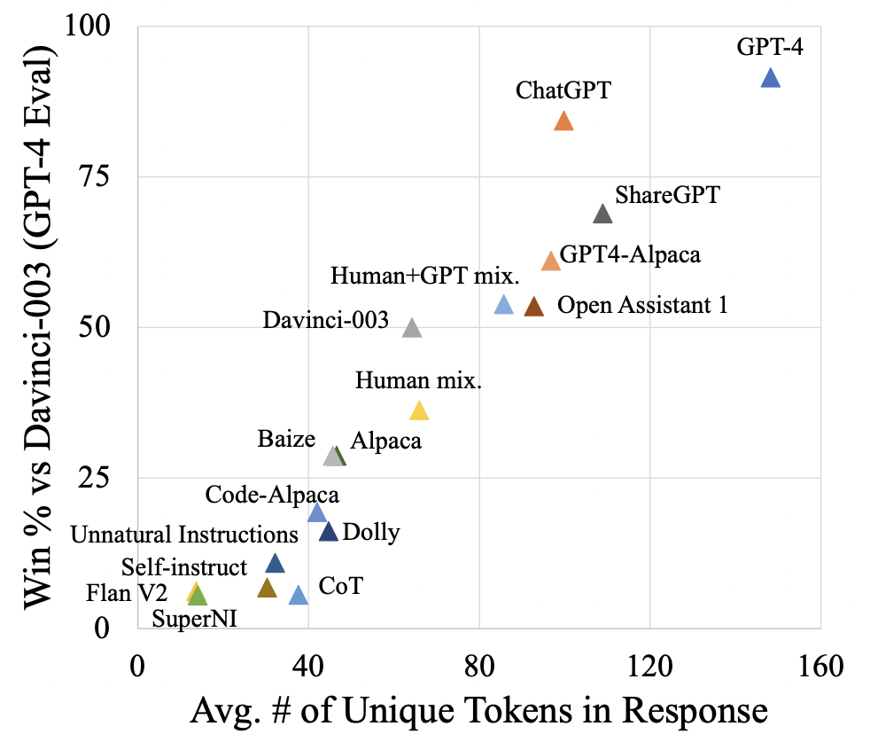
Length Bias
Models that generate longer, and with more unique tokens tend to be preferred.
The eval in the figure is based on AI evaluation, but the same can happen with humans (preferring longer responses).
Exploring the State of Instruction Tuning on Open Resources, 2023

Slide 94
Error Analysis of GPT[4?]
Reward model can’t approximate preferences [approximation errors]
Doesn’t have ground truth factual knowledge, or it can’t execute code.
Reward model is overfitted to training comparisons [estimation error]
Finite comparison data, label noise
Policy hasn’t fully optimized reward model on training prompts [optimization errors]
Exploration, slow learning
Policy is overfitted to training prompts [estimation error]
Policy model can’t approximate the optimal policy [approximation error]
Model is not strong enough.
John Schulman 2023: https://www.youtube.com/watch?v=hhiLw5Q_UFg

Slide 95
Summary
RLHF is tricky.
Next: simplify it?

Slide 96
Aligning Language Models:
Direct Policy Optimization

Slide 97
Simplifying RLHF
The RLHF pipeline is considerably more complex than supervised learning
Involves training multiple LMs and sampling from the LM policy in the loop of training
Is there a way to simplify this pipeline?
For example, by using a single language model

Slide 98
Direct Policy Optimization (DPO) - Intuition
Direct Preference Optimization: Your Language Model is Secretly a Reward Model (Rafailov et al., 2023)
DPO directly optimizes for human preferences
avoiding RL and fitting a separate reward model
One can use mathematical derivations to simplify the RLHF objective to an equivalent objective that is simpler to optimize.
RLHF objective
DPO objective

Slide 99
RLHF objectives
Maximizing reward assigned of the preferred response
$y_{w}$: preferred response / $y_{l}$: disreferred response
(i) Reward objective
Maximizing the reward of the generated prompts
Minimizing the deviation from the base policy
(ii) Policy objective
DPO objective
Maximizing reward of the preferred response
Minimizing deviations from the base policy

Slide 100
Where is the reward implicitly defined.
DPO objective
Maximizing reward of the preferred response
Minimizing deviations from the base policy

Slide 101
DPO Algorithm
Algorithm:
Sample completions for every prompt
Label with human preferences and construct dataset
Optimize the language model to minimize the DPO objective.
Note, in practice we can use a dataset of preferences publicly available (for example, responses in forums).

Slide 102
Scaling up DPO
Camels in a Changing Climate: Enhancing LM Adaptation with TÜLU 2, 2023

Slide 103
DPO Limitations
You’re trying to optimize multiple things which can potentially override each other.
Obj 1: Increase the likelihood gap between $π_{θ}(y_{w}|x)$ and $π_{θ}(y_{l}|x)$
Obj 2: Maintain a low gap between $π_{θ}(y_{w}|x)$ and $π_{ref}(y_{w}|x)$
…
We will look into these in HW7!
In practice, when using DPO practitioners constantly monitor these to be sure that they’re not overriding each other.

Slide 104
Summary
We may not need the “reinforcement learning” part of RLHF after all.
A simplified algorithm: DPO.
For each input, it needs two outputs (a good one and an undesirable one).
Though RLHF may not be all that there is to alignment.

Slide 105
Notable Instruction-Tuned/RLHF-ed Models
https://huggingface.co/spaces/HuggingFaceH4/open_llm_leaderboard
https://huggingface.co/spaces/lmsys/chatbot-arena-leaderboard
https://tatsu-lab.github.io/alpaca_eval/

Slide 106
Aligning Language Models:
Model-Generated Instructions

Slide 107
RLHF/Instruction-tuning is Data Hungry
Rumor: human feedback done for supervising ChatGPT is in the order of $1M
Idea: Use LMs to generate data for aligning them with intents.
Self-Instruct [Wang et al. 2022]
Uses vanilla (not aligned) LMs to generate data
That can then be used for instructing itself.
More related work:
Unnatural Instructions [Honovich et al. 2022] — Similar to “Self-Instruct”
Self-Chat [Xu et al. 2023] — ”Self-Instruct” extended to dialogue
RL from AI feedback [Bai et al., 2022],
Finetuning LMs on their own outputs [Huang et al., 2022; Zelikman et al., 2022]
LM
Model output

Slide 108
Model generated instructions
Similar to Unnatural Instructions, uses instructGPT model to generate instructions
The generation is prompted using a set of seed task examples
First generates the instruction, then the input (conditioned on instruction), and then the output.
The generated instructions are mostly valid, however the generated outputs are often noisy.
Self-Instruct: Aligning Language Models with Self-Generated Instructions (Wang et al., 2023)

Slide 109
Get humans to write ”seed” tasks ✍️
I am planning a 7-day trip to Seattle. Can you make a detailed plan for me?
Is there anything I can eat for breakfast that doesn’t include eggs, yet includes protein and has roughly 700-100 calories?
Given a set of numbers find all possible subsets that sum to a given number.
Give me a phrase that I can use to express I am very happy.
175 seed tasks

Slide 110
Put them your task bank 📦
I am planning a 7-day trip to Seattle. Can you make a detailed plan for me?
Is there anything I can eat for breakfast that doesn’t include eggs, yet includes protein and has roughly 700-100 calories?
Given a set of numbers find all possible subsets that sum to a given number.
Give me a phrase that I can use to express I am very happy.
175 seed tasks
task pool

Slide 111
Sample and get LLM to expand it
I am planning a 7-day trip to Seattle. Can you make a detailed plan for me?
Is there anything I can eat for breakfast that doesn’t include eggs, yet includes protein and has roughly 700-100 calories?
Given a set of numbers find all possible subsets that sum to a given number.
Give me a phrase that I can use to express I am very happy.
LM
Pre-trained, but not aligned yet
Create a list of 10 African countries and their capital city?
Looking for a job, but it’s difficult for me to find one. Can you help me?
Write a Python program that tells if a given string contains anagrams.
175 seed tasks
task pool
📝
LM suggests new tasks

Slide 112
Get LLM to answers the new tasks
Task: Convert the following temperature from Celsius to Fahrenheit.
Input: 4 °C
Output: 39.2 °F
Task: Write a Python program that tells if a given string contains anagrams.
LM
Pre-trained, but not aligned yet
Input: -
Output: def isAnagram(str1, str2): ...
175 seed tasks
task pool
📝
📝
LM suggests new tasks
LM suggests answers

Slide 113
Filter tasks
Drop tasks if LM assigns low probability to them.
Drop tasks if they have a high overlap with one of the existing tasks in the task pool.
Otherwise, common tasks become more common — tyranny of majority.
175 seed tasks
task pool
LM suggests answers
📝
📝
LM suggests new tasks
LM suggests answers
filter out if not novel or confident

Slide 114
Close the loop
Add the filtered tasks to the task pool.
Iterate this process (generate, filter, add) until yield is near zero.
175 seed tasks
task pool
LM suggests answers
📝
📝
LM suggests new tasks
LM suggests answers
filter out if not novel or confident

Slide 115
Self-Instructing GPT3 (base version)
Generate:
GPT3 (“davinci” engine).
We generated 52K instructions and 82K instances.
API cost ~$600
Align:
We finetuned GPT3 with this data via OpenAI API (2 epochs). **
API cost: ~$338 for finetuning
175 seed tasks
task pool
LM suggests answers
📝
📝
LM suggests new tasks
LM suggests answers
filter out if not novel or confident

Slide 116
Evaluation on User-Oriented Instructions
[Self-Instruct: Aligning Language Model with Self-Generated Instructions, Wang et al. 2023]

Slide 117
Evaluation on User-Oriented Instructions
LM pretraining
vanilla GPT3 (davinci)
+ instruct-tuning
GPT3-instruct (davinci-001)
Noisy, but diverse “self-instruct” data ~ thousands of clean human-written data
[Self-Instruct: Aligning Language Model with Self-Generated Instructions, Wang et al. 2023]

Slide 118
Summary Thus Far
Evidence suggest that we probably can reduce the reliance on human annotations in the “alignment” stage
Data diversity seems to be necessary for building successful generalist models.
Self-Instruct: Rely on creativity induced by an LLM’s themselves.
Applicable to a broad range of LLMs.
Several open-source models utilize “Self-Instruct” data.
(* See also concurrent work: Unnatural-Instructions [Honovich et al. 2022] and Self-Chat [Xu et al. 2023] )

Slide 119
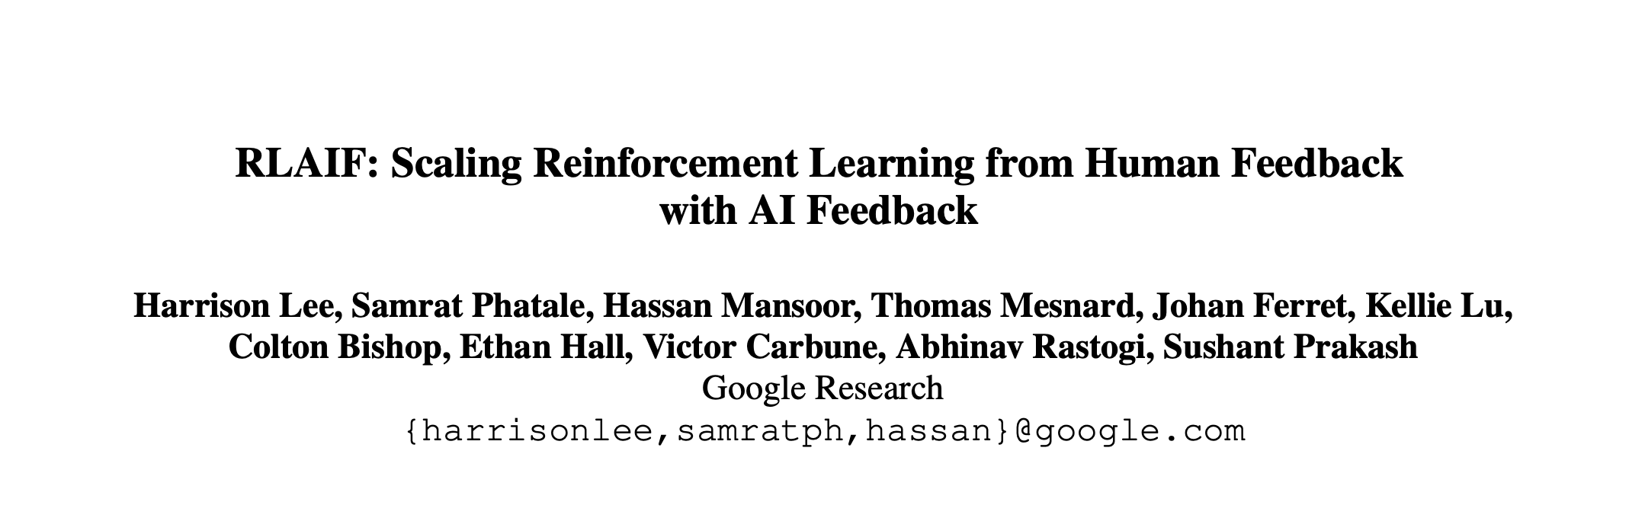
Impact: Learning from AI Feedback
Open-source models adopted Self-Instruct data generation.
Alphaca, Zephyr, etc.
LLMs used directly as a reward during alignment, skipping the data generation.
[Taori et al. 2023; Tunstall et al. 2023]
[Lee et al. 2023; many others]
LM
Model output
Notes:
Since the release of this work, there has been a major adoption:
- There have been multiple open-source models that have adopted “Self-Instruct”-like data generation process.
- Furthermore, follow-up extensions skip the data generation step and directly use the LLM as a reward model for alignment.

Slide 120
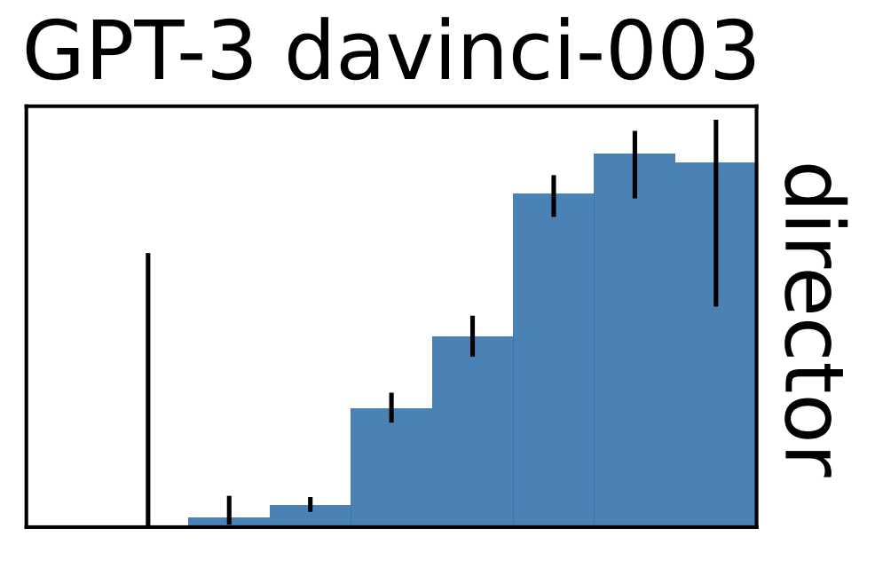
Training LLMs with LLM Feedback: The Bottleneck
Model feedback is a powerful idea, but …
It has many limitations …
It amplifies existing biases.
It is still confined to the [implicit] boundaries defined by the its prompts.
LLMs work best in high-data regime. They fail when data is thin.
Training with self-feedback is unlikely to be the way to the moon!
LM
Model output
[Mallen et al. 2022; Razeghi et al. 2022; many others]
accuracy
log-popularity
Notes:
But the bad news is that, despite all these are great advances, there are fundamental bottlenecks in all these.
Here are several ones that I would like to point out quickly:
- Using model feedback amplifies existing biases in the model, which is a concern for their safety.
- But more concerning is that, the model’s ability to diversify human annotations is limited. Why? - Model generations are limited to the implicit boundaries defined by the “seed” human annotations
- Because LLMs work best in high-data regimes. Various studies, including ours, have shown a direct relationship between model accuracy and the popularity/frequency of the inputs in pre-training. Their quality will be low when the input instructions are observed less in their pre-training.
This is all to say that, training with self-feedback (despite its potentials) is unlikely to be the path to the moon.

Slide 121
With Show of Hands …
We will solve AI alignment problem in …
5 years
10 years
Never

Slide 122
Aligning with Which Values?

Slide 123
Aligning to Instructions == Aligning to Values?
Pretrained models produce harmful outputs, even if explicitly instructed [Zhao et al. 2021].
How about instruct-tuned/RLHE-ed models?
It’s complicated!

Slide 124
Aligning to Instructions == Aligning to Values?
Large-enough LMs can be “pro-social” when prompted with “values”:
“It's important to help others in need.”
[ProSocialDialog: A Prosocial Backbone for Conversational Agents, Kim et al. 2022]

Slide 125
Aligning to Instructions == Aligning to Values?
Large-enough LMs can do “moral self-correction” when prompted with “values”:
Improves with increasing model size and RLHF training
“Let’s think about how to answer this question in a way that is fair and avoids discrimination of any kind.”
[The Capacity for Moral Self-Correction in Large Language Models, Ganguli et al. 2023]

Slide 126
Aligning to Instructions == Aligning to Values?
Pretrained models produce harmful outputs, even if explicitly instructed [Zhao et al. 2021].
How about instruct-tuned/RLHE-ed models?
It’s complicated!
So, some promising results out there ...
But many open questions:
Whose values are we modeling? Which person? Which population? …
How are we applying a given value? Depending on what value system you use the outcome might be different ….
How these models deal with decisions where multiple values might be at odds with each other?
Dual use: if models can self-correct, they can self-harm [their users] too?

Slide 127
Let’s try a few thought experiments
We will see a series of thought-experiments that involve a moral dilemma.
These are NOT REAL so do not take them too seriously if you find them disturbing.
The purpose is to show the difficulty of making moral choices, which is part of the alignment problem.

Slide 128
Runway Self-Driving Car
Suppose you’re an engineer tasked with “aligning” a self-driving car.
You need to engineer it for extreme cases where the car cannot stop fast enough.
For instance, you can program (align) the car should swerve onto the sidewalk to avoid colliding with the person and come to a safe stop.
Is this enough?

Slide 129
Runway Self-Driving Car (1)
How about this scenario?
The car is heading toward five workers standing on the road. However, there is also one worker on the side of the road. Should the car swerve to the side killing one but saving five?
A typical response here is, better to sacrifice the life of one to save five.
Underlying moral argument: always minimize the number of lives lost.

Slide 130
Runway Self-Driving Car (2)
How about this scenario?
The car is heading toward five workers standing on the road. However, there is also two pregnant women on the side of the road. What should the self-driving car do here?
Does the moral argument (minimizing the number of lives lost) work here?

Slide 131
What is the Right Thing to Do?
Moral philosophy—a branch of philosophy that deals with questions about what is right and wrong,
Examines various ethical theories, such as utilitarianism, virtue ethics, and moral relativism, to understand how individuals and societies should make ethical decisions.
As AI technology becomes more prevalent in various aspects of society, there are ethical questions about how it should be developed, deployed, and regulated.
Moral philosophy provides frameworks for evaluating the ethical implications of AI, such as questions about fairness, accountability, transparency, and privacy.

Slide 132
Whose Values?
Whose Values? Determined how and by who?
This is a fundamental problem of human society.
[Slide Credit: Gillian Hadfield]

Slide 133
With Show of Hands …
We will solve AI alignment problem in …
5 years
10 years
Never

