Slide 1
Connecting Language to the World
CSCI 601-471/671 (NLP: Self-Supervised Models)
https://self-supervised.cs.jhu.edu/sp2024/

Slide 2
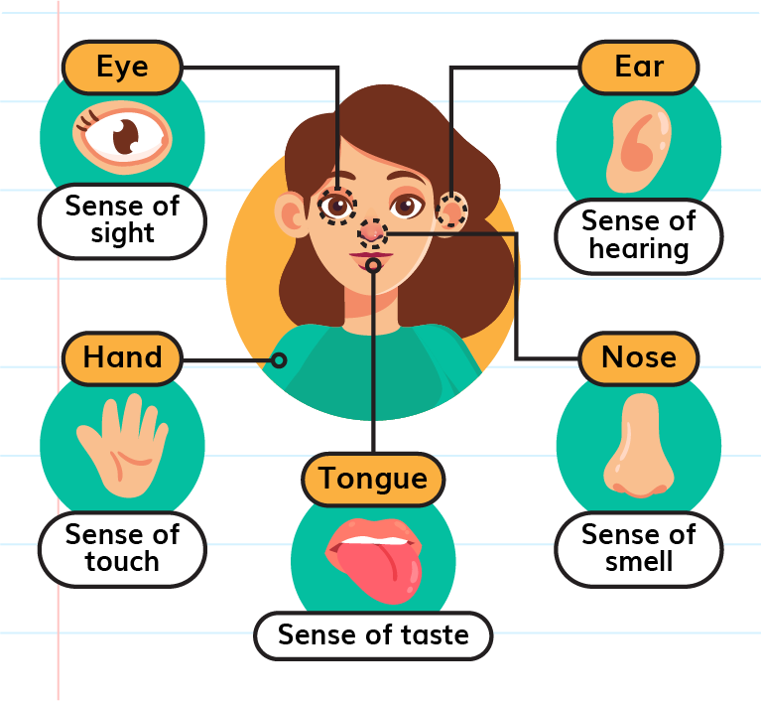
Connecting Language to the World
So far, we have focused on only “language” as our primary focus.
But there is there are other modalities in which humans communicate with the world.

Slide 3
Connecting LMs to the World: Chapter Plan
Connecting vision and language
Generative vision-language models
Other modalities [speech, audio, …]
From language to code
From language to action
Chapter goal: Getting comfortable with thinking about extending LLMs to other modalities of the world and their limits.

Slide 4
Connecting
vision and language

Slide 5
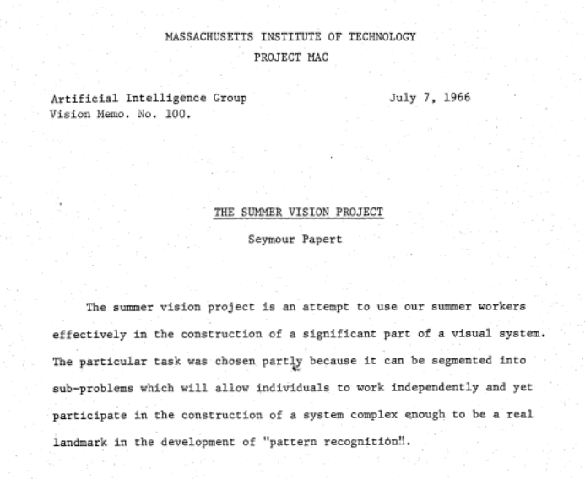
Computer Vision Abridged History
1960s - First computer vision projects (MIT summer project)

Slide 6
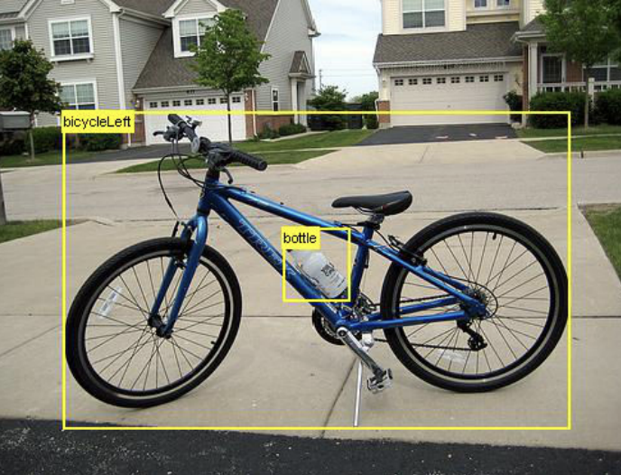
Computer Vision Abridged History
1960s - First computer vision projects (MIT summer project)
2000s - Emergence of “tasks” and benchmarking in computer vision
Caltech-101 (2003)
Caltech-256 (2007)
PASCAL Visual Object Classes (2005-2012)
ImageNet (2009)
ImageNet (2009)
https://en.wikipedia.org/wiki/List_of_datasets_in_computer_vision_and_image_processing

Slide 7
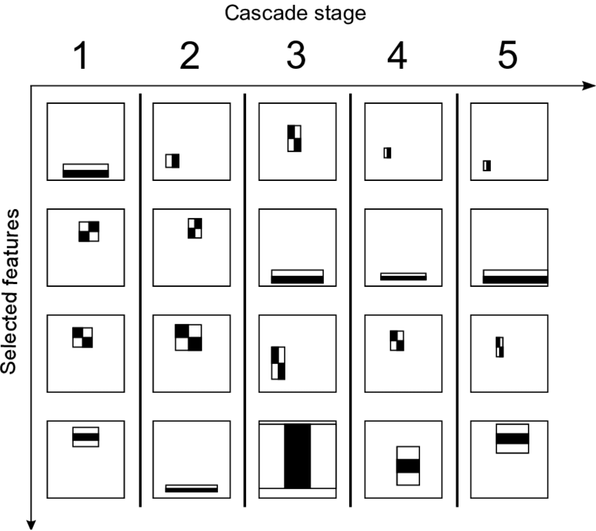
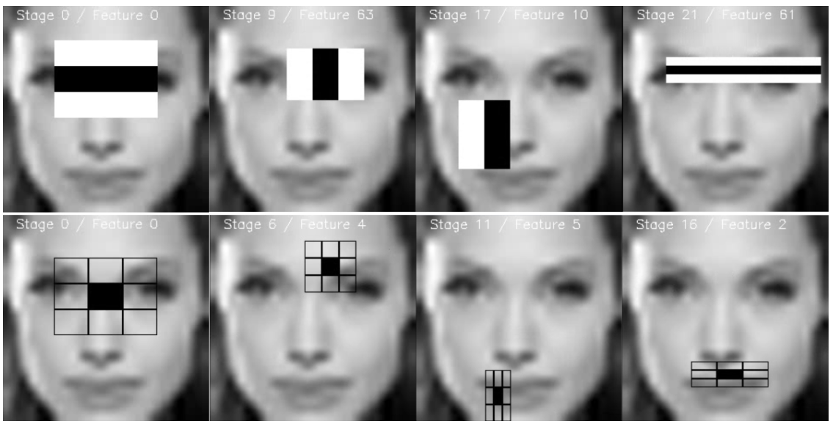
Computer Vision Abridged History
1960s - First computer vision projects (MIT summer project)
2000s - Emergence of “tasks” and benchmarking in computer vision
2000s - Shallow classifiers and feature engineering (e.g., Viola & Jones algorithm)

Slide 8
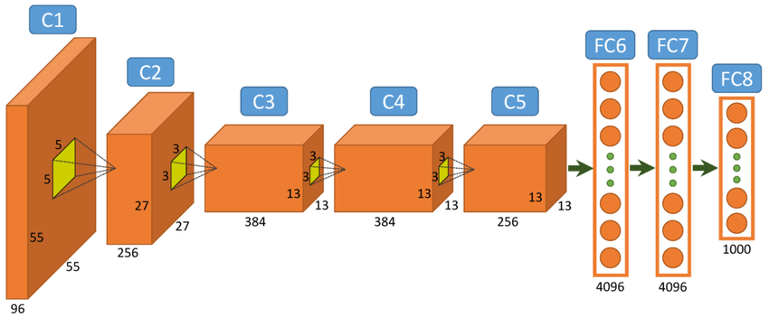
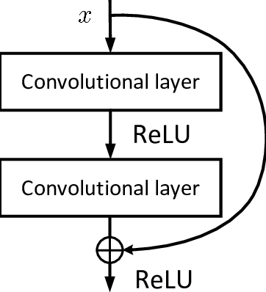
Computer Vision Abridged History
1960s - First computer vision projects (MIT summer project)
2000s - Emergence of “tasks” and benchmarking in computer vision
2000s - Shallow classifiers and feature engineering
2012 - Deep Learning revolution:
Success of Convolutional neural nets in ImageNet
ImageNet Classification with Deep Convolutional Neural Networks, 2012
Deep Residual Learning for Image Recognition, 2015

Slide 9
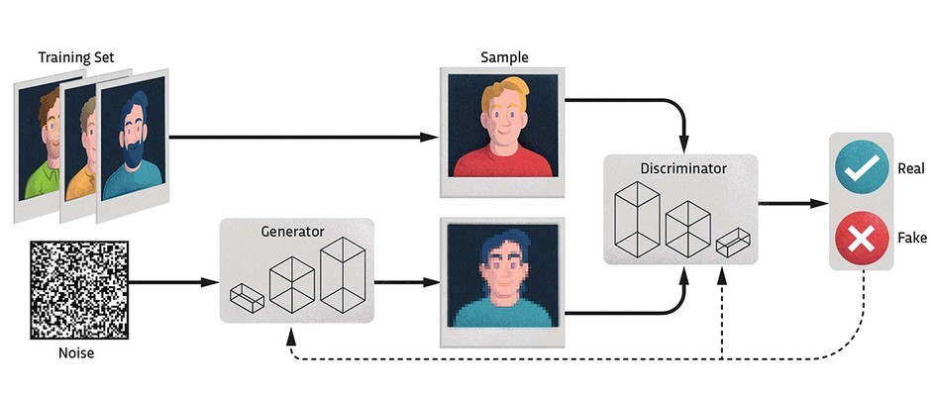
Computer Vision Abridged History
1960s - First computer vision projects (MIT summer project)
2000s - Emergence of “tasks” and benchmarking in computer vision
2000s - Shallow classifiers and feature engineering
2012 - Deep Learning revolution:
Success of Convolutional neural nets in ImageNet
Unification of architectures
Rise of image generation (VAEs, GANs, etc.)
Kingma et al. Auto-Encoding Variational Bayes, 2013
Goodfellow et al. Generative Adversarial Networks, 2014

Slide 10
Computer Vision Abridged History
1960s - First computer vision projects (MIT summer project)
2000s - Emergence of “tasks” and benchmarking in computer vision
2000s - Shallow classifiers and feature engineering
2012 - Deep Learning revolution:
Success of Convolutional neural nets in ImageNet
Unification of architectures
Rise of image generation (VAEs, GANs, etc.)
2020s - Era of Vision Transformer
Stronger connection to language
Better generative models
Further unification of models and tasks
This is where we begin!

Slide 11
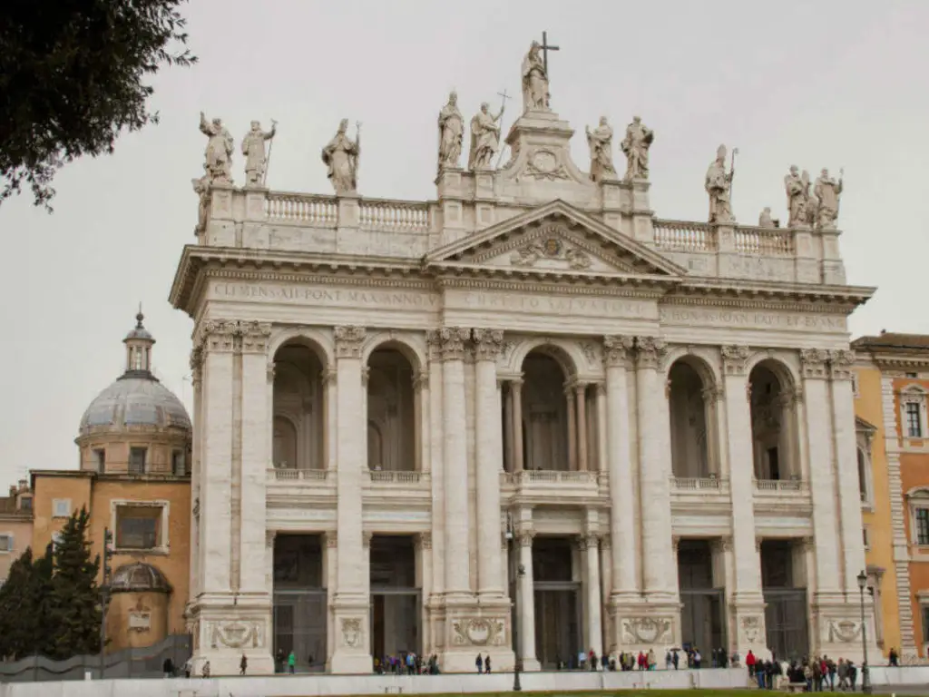
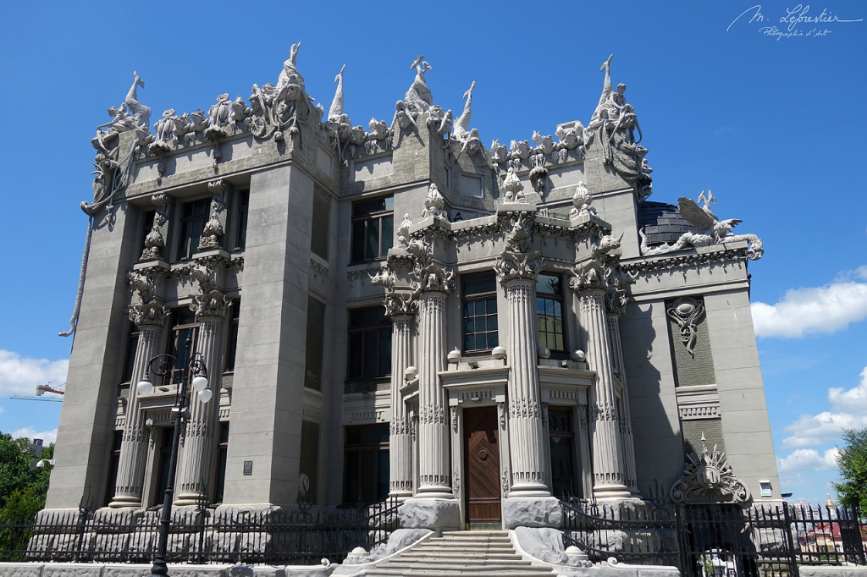
Let's Consider Images – How to Encode?

Slide 12
Vision Transformers
tokenize" the image by cutting it into patches of 16px², and treating each patch as a token, e.g. embedding it into input space

Slide 13
Vision Transformers

Slide 14
Vision Transformers
[An Image is Worth 16x16 Words: Transformers for Image Recognition at Scale, 2020]

Slide 15
TODO: how to train it

Slide 16
What about paired image-text – How to Encode?
Basilica of St. John Lateran
House with Chimeras – Kiev

Slide 17
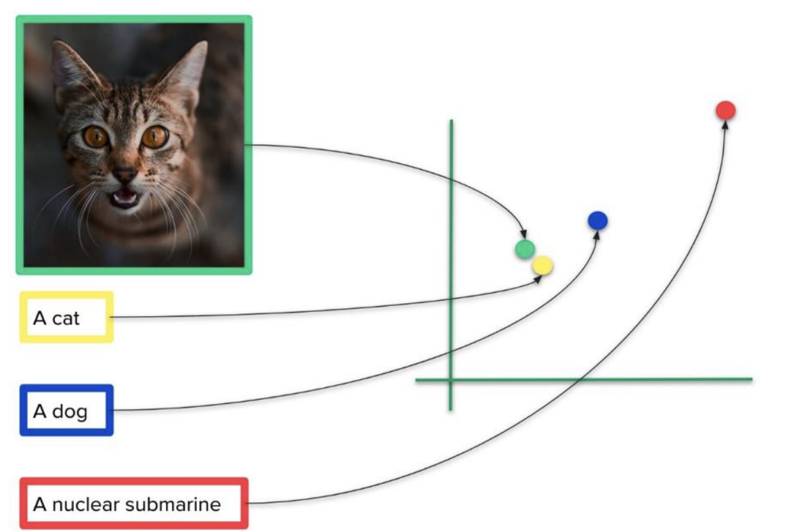
What about paired image-text – How to Encode?
The idea is to create a space to represent both semantics of language and image.
Then, create a model that can align semantically-equivalent text and images nearby.

Slide 18
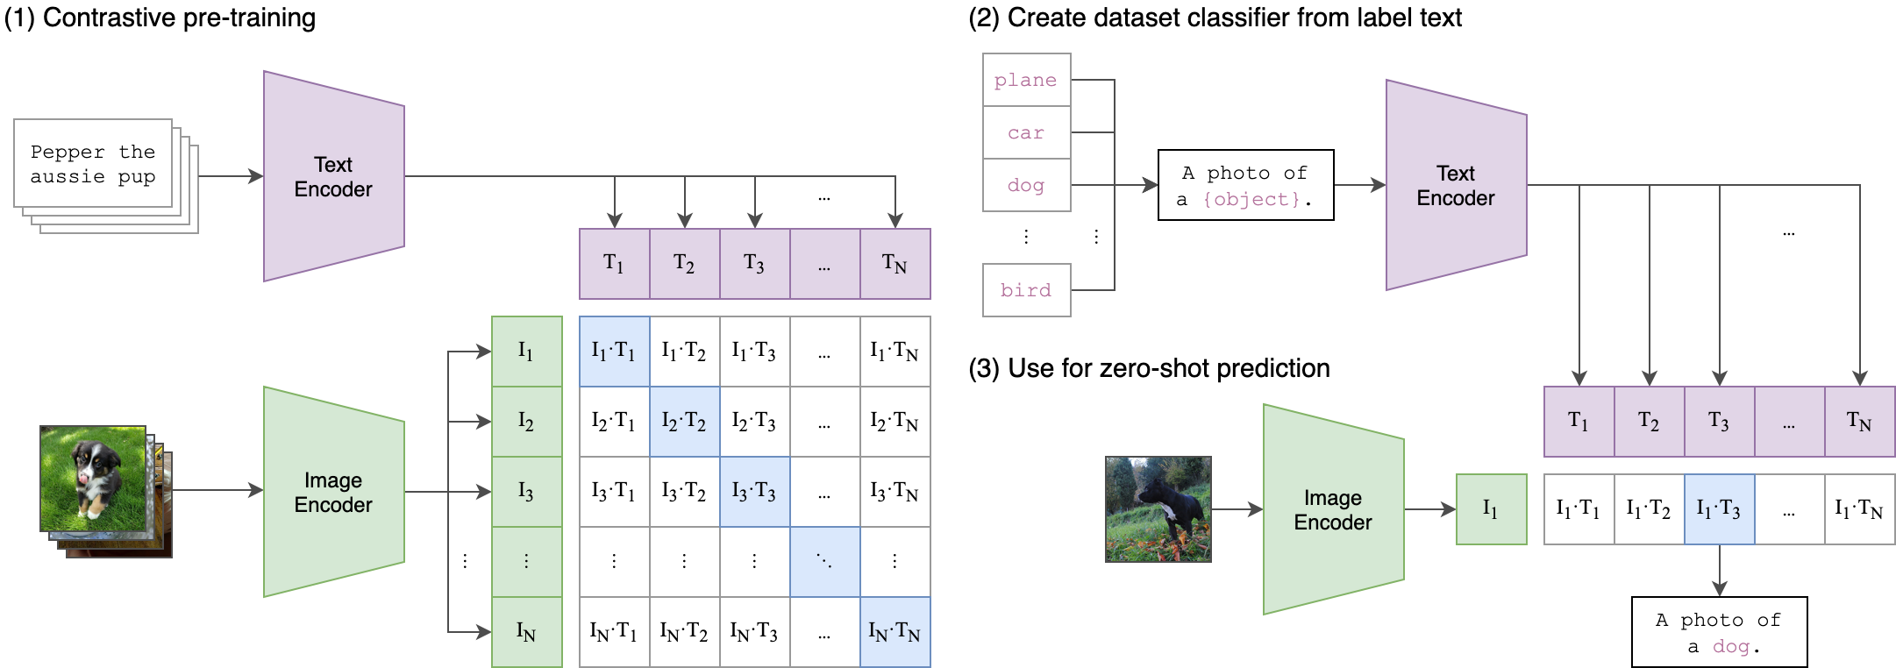
Contrastive Language–Image Pre-training (CLIP)
Training: simple contrastive loss between image-text pairs
Learning image representations from web-scale noisy text supervision
Notes:
Image-caption pairs sampled from large datasets
Model optimizes a contrastive loss between image-caption pairs that encourages representations that lead to more consistent/aligned representations between text/images that correspond to one another.

Slide 19
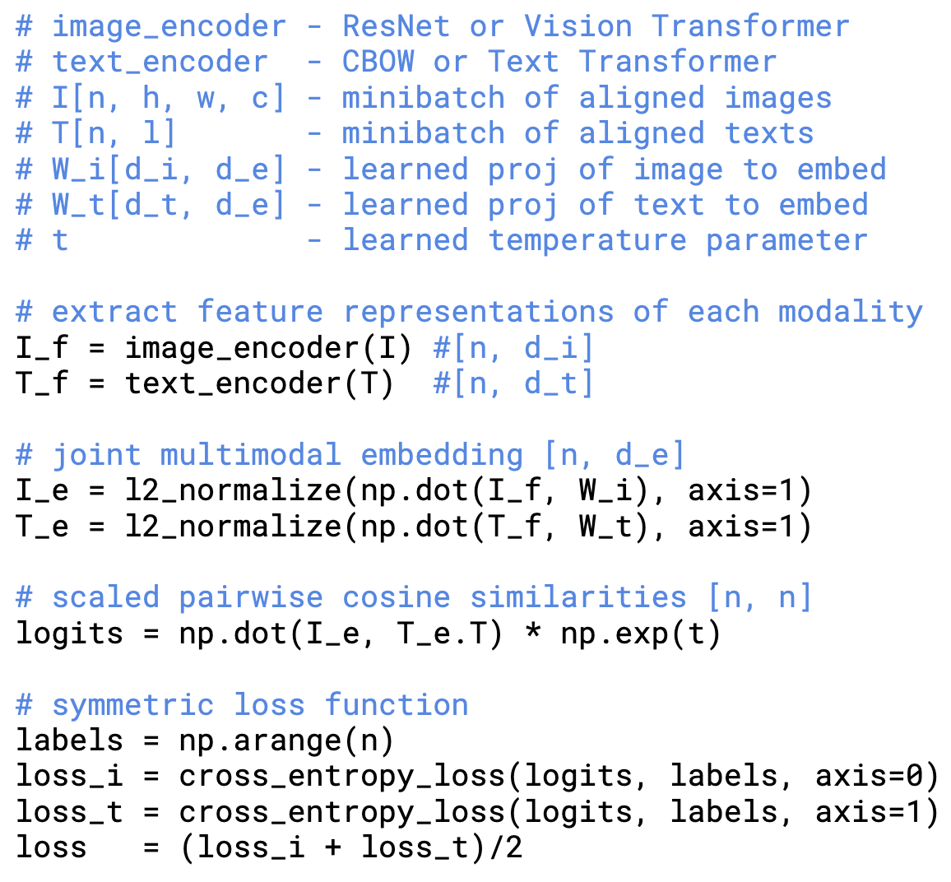
Contrastive Language–Image Pre-training (CLIP)
Given a batch of N (image, text) pairs, predict which of the N × N possible (image, text) pairings across a batch occurred.
[Learning Transferable Visual Models From Natural Language Supervision, 2021]

Slide 20
What can CLIP do?
Downstream: zero-shot image classification and image-text retrieval
Image classification can be reformatted as a retrieval task via considering the semantics behind label name.
[Learning Transferable Visual Models From Natural Language Supervision, 2021]

Slide 21
What can CLIP do?
Consider classifying photos of “dogs” vs “cats”—for each image, check if CLIP predicts text description “a photo of a dog” or “a photo of a cat” is more likely to be paired with it.
[Learning Transferable Visual Models From Natural Language Supervision, 2021]

Slide 22
What can CLIP do?
CLIP evaluates associations between image-text pairs:
Image Classification
Image Searching
…

Slide 23
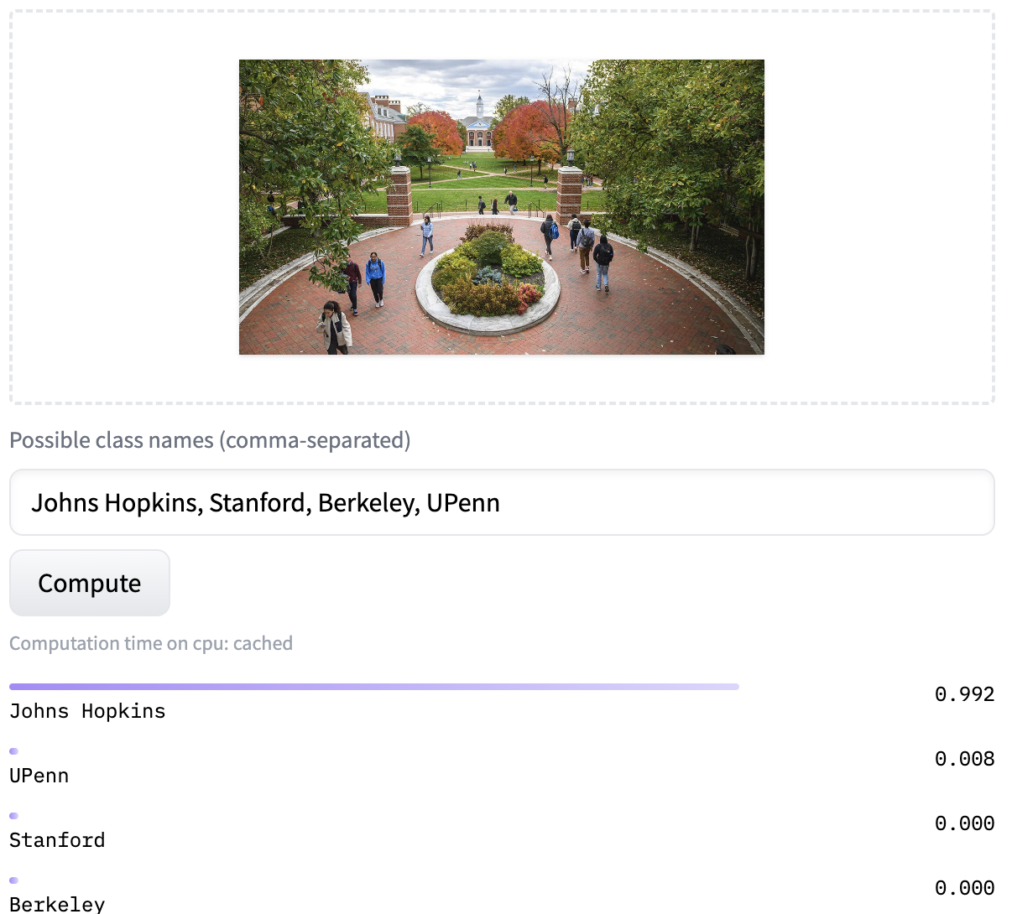
What can CLIP do?
https://huggingface.co/openai/clip-vit-large-patch14
CLIP evaluates associations between image-text pairs:
Image Classification
Image Searching
…

Slide 24
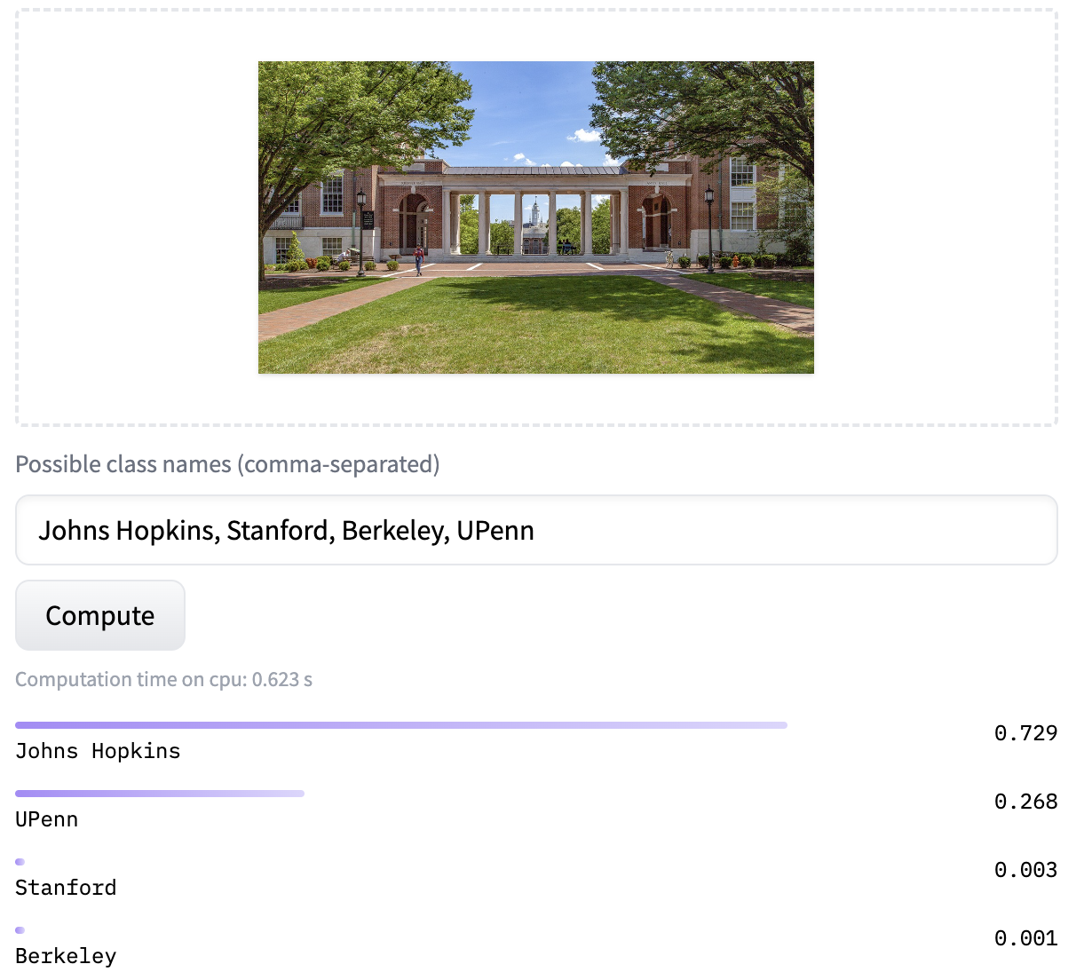
What can CLIP do?
https://huggingface.co/openai/clip-vit-large-patch14
CLIP evaluates associations between image-text pairs:
Image Classification
Image Searching
…

Slide 25
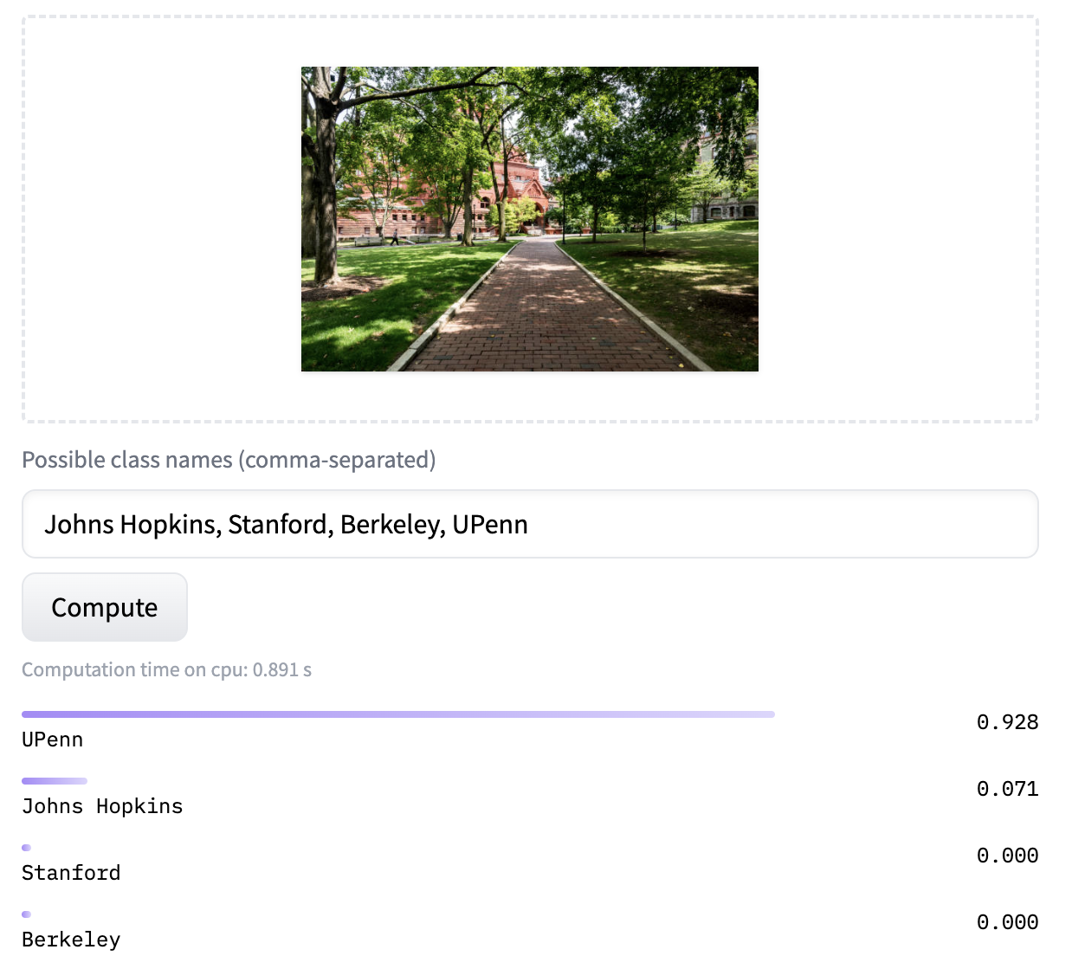
What can CLIP do?
https://huggingface.co/openai/clip-vit-large-patch14
CLIP evaluates associations between image-text pairs:
Image Classification
Image Searching
…

Slide 26
What can't CLIP do?
No generation capabilities
Prompting / In-Context Learning
Few-shot captioning

Slide 27
What can't CLIP do?
No generation capabilities
Prompting / In-Context Learning
Few-shot captioning
CLIP is not perfect.

Slide 28
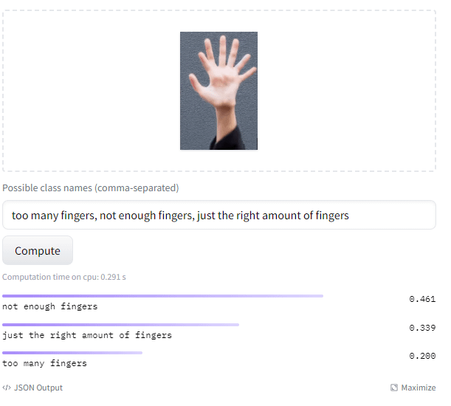
What can't CLIP do?
https://huggingface.co/openai/clip-vit-large-patch14
No generation capabilities
Prompting / In-Context Learning
Few-shot captioning
CLIP is not perfect.

Slide 29
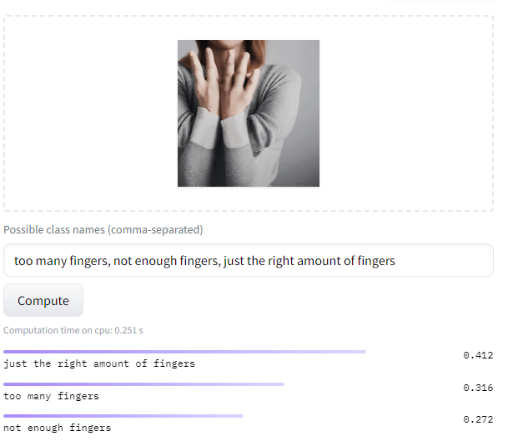
What can't CLIP do?
https://huggingface.co/openai/clip-vit-large-patch14
No generation capabilities
Prompting / In-Context Learning
Few-shot captioning
CLIP is not perfect.

Slide 30
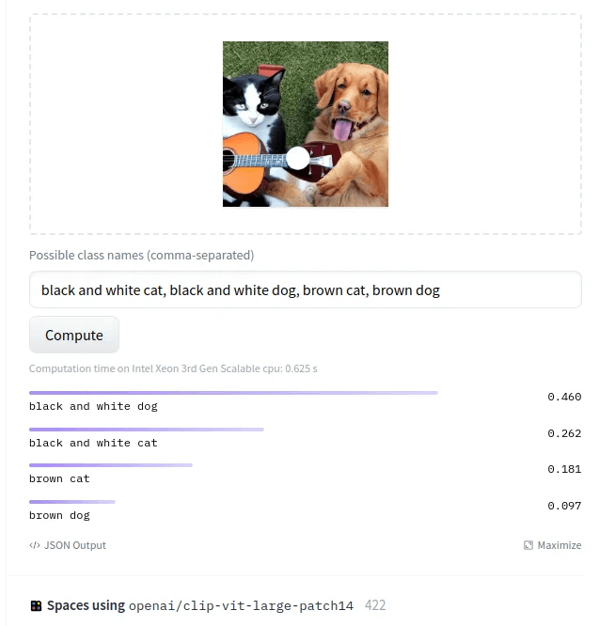
What can't CLIP do?
https://huggingface.co/openai/clip-vit-large-patch14
No generation capabilities
Prompting / In-Context Learning
Few-shot captioning
CLIP is not perfect.

Slide 31
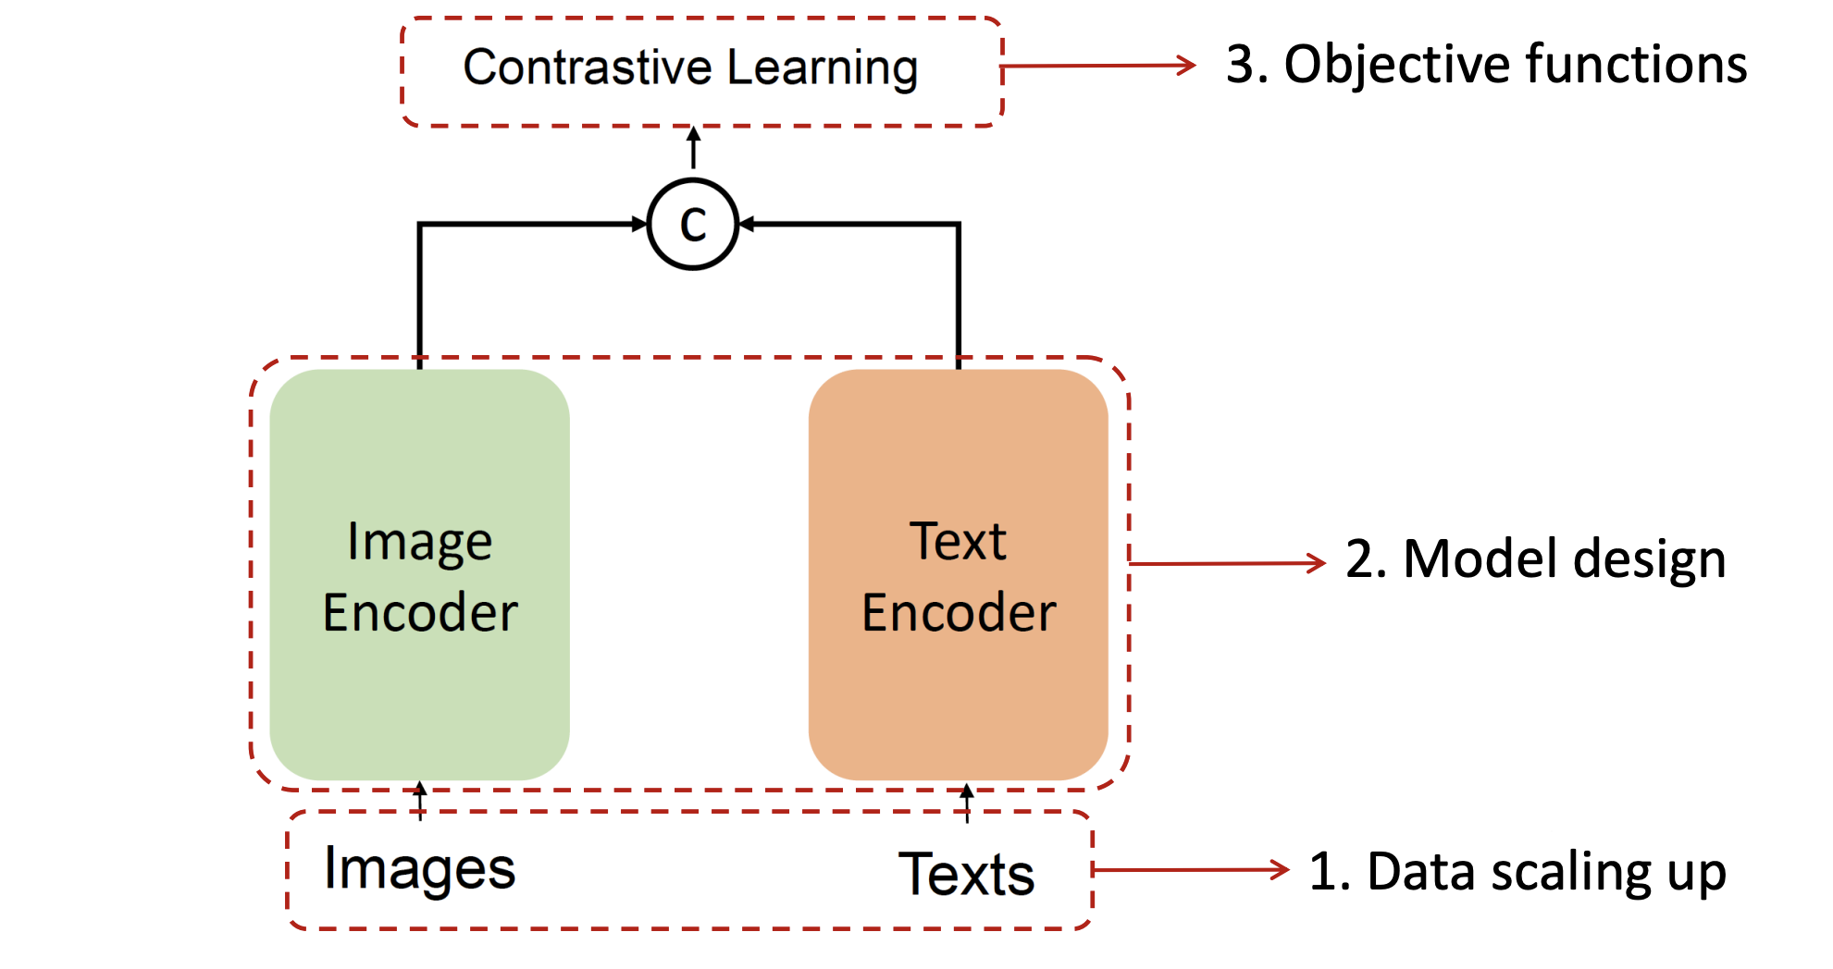
What happened after CLIP?
Ton of follow-up work on improve its design:

Slide 32
What happened after CLIP?
Open-source reproduction and scaling up
Open-source model: OpenCLIP
Pre-training on LAION-5B dataset
Ilharco et al., OpenCLIP, 2021
https://github.com/mlfoundations/open_clip

Slide 33
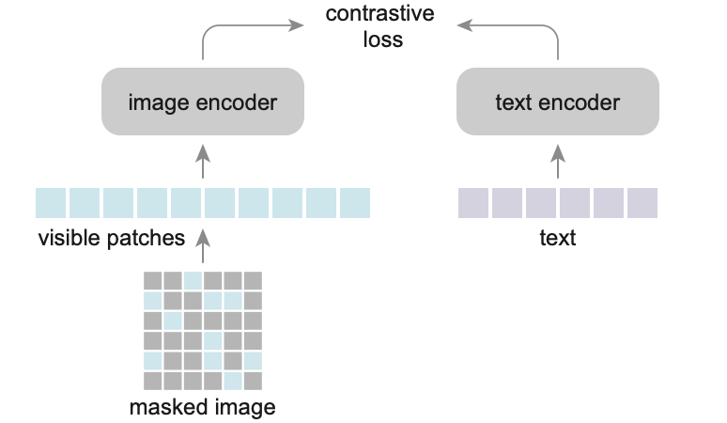
What happened after CLIP?
Open-source reproduction and scaling up
Modifying the training process
A notable example is FLIP
Randomly masking out image patches
Does not hurt the performance, yet it improves the training efficiency
Scaling Language-Image Pre-training via Masking, 2022

Slide 34
What happened after CLIP?
Open-source reproduction and scaling up
Modifying the training process
Adding more modalities:
ImageBind: linking 7 modalities
https://facebookresearch.github.io/ImageBind
ImageBind: One Embedding Space To Bind Them All, 2023

Slide 35
What happened after CLIP?
Open-source reproduction and scaling up
Modifying the training process
Adding more modalities:
Generative models:
Text → Image
Image, Text → Image
Image, Image → Text
…
Forthcoming

Slide 36
Summary
The same computational architecture (e.g., Transformer) can represent different modalities.
One can build models that embed different modalities in the same space.
Next: generative vision-language models.

Slide 37
Generative Vision-Language Models

Slide 38
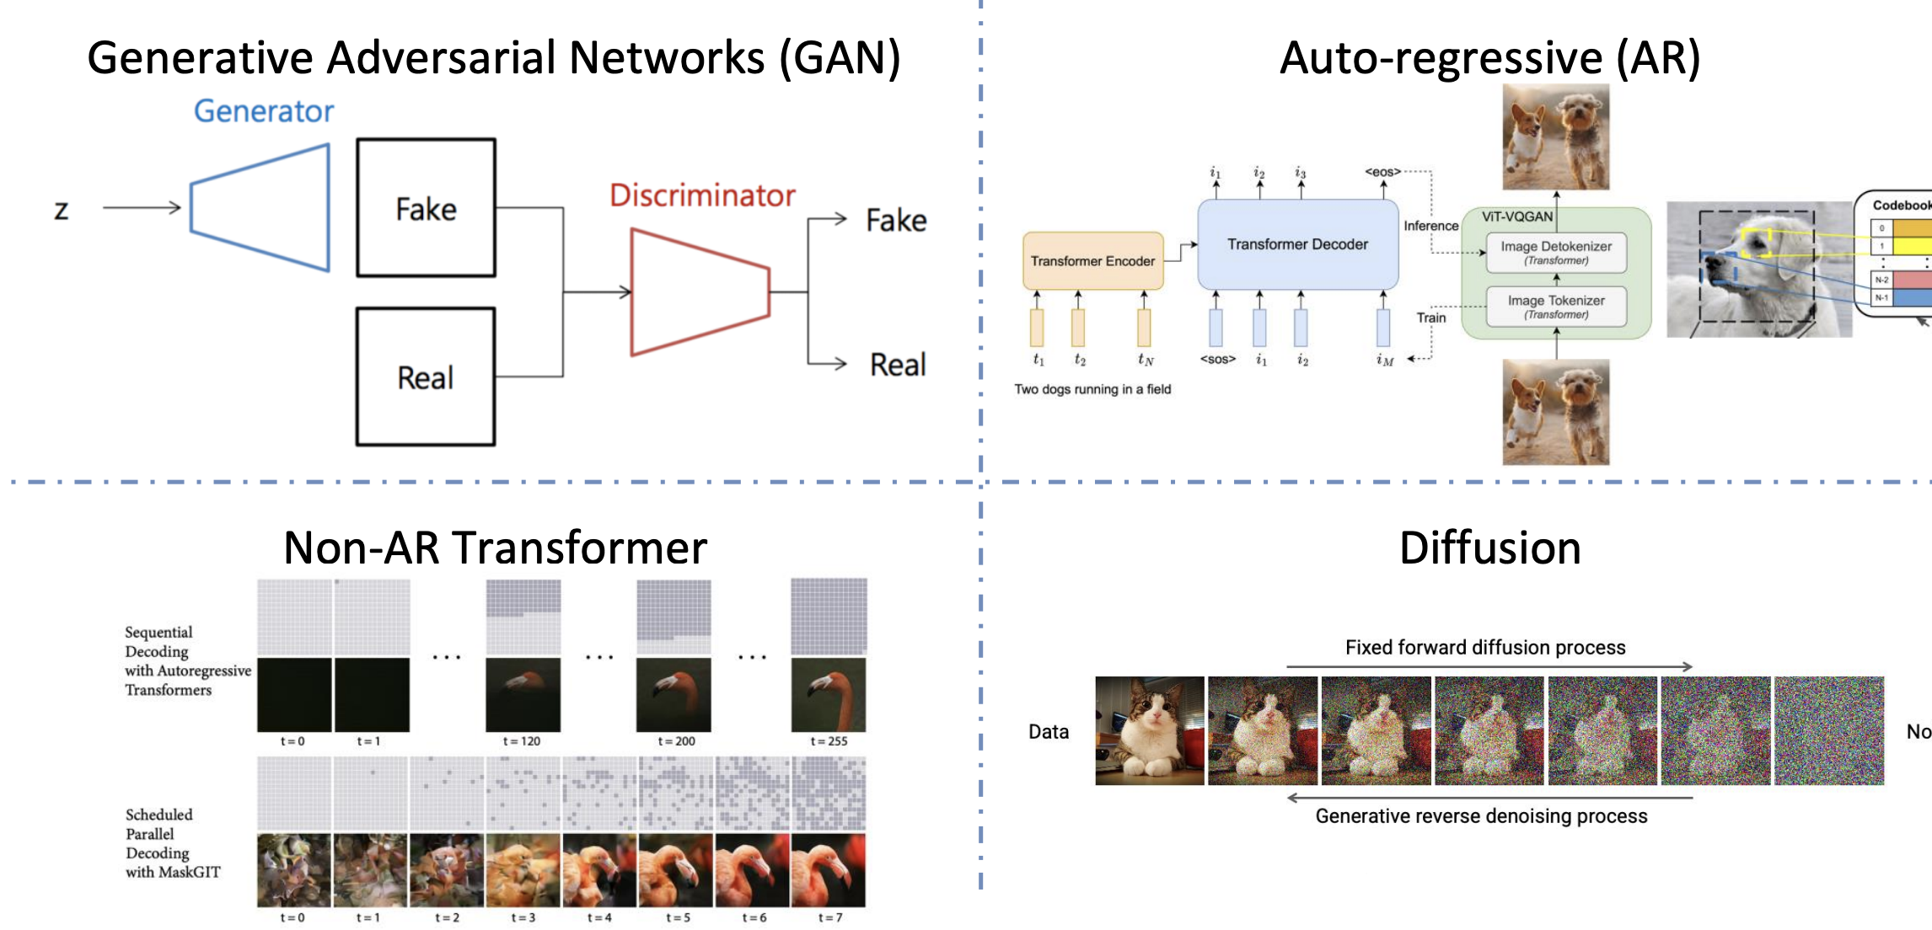
Image Generation Toolkit

Slide 39
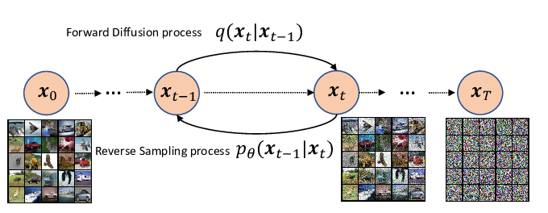
Image Generation Toolkit: Diffusions
Image generation is out of scope for us. You can learn more by taking a computer vision class or watching the online tutorials. For example:
https://cvpr2022-tutorial-diffusion-models.github.io/
Notes:
Well-motivated formalism rooted in Stochastic Differential Equations.
We effectively train models in discrete time.

Slide 40
Text to Image Generation
Notes:
Now goal here is not just mapping a bunch of random vectors into images.
But more specifically, mapping vectors that result from encoding an input prompt.
Essentially, we need to build an architecture that would understand the vector representation of sentences and map it to its corresponding image.
This is almost like the reverse process of what CLIP does (given image-text pair, tell us whether they correspond to each other or not).

Slide 41
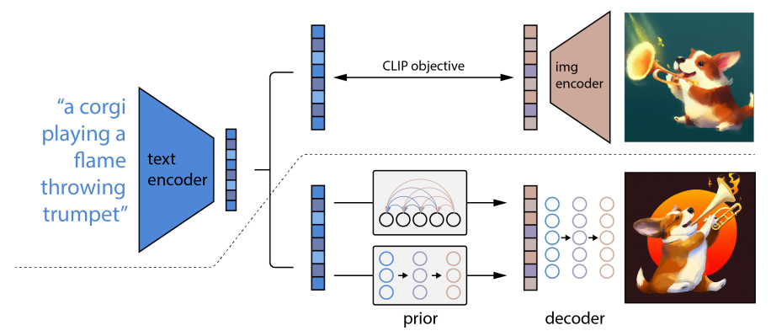
DALL-E
Zero-Shot Text-to-Image Generation, 2021
Hierarchical Text-Conditional Image Generation with CLIP Latents. 2022

Slide 42
DALL-E
DALL-E is built on top of a pre-trained CLIP model.
This frozen model provides the representations of text and images.
Zero-Shot Text-to-Image Generation, 2021
Hierarchical Text-Conditional Image Generation with CLIP Latents. 2022
Notes:
It is built on top of a pre-trained CLIP model.
Given this pre-trained CLIP model, from this model we can extract the embeddings of images and captions

Slide 43
DALL-E
First, a text prompt is input into a text encoder that is trained to map the prompt to a representation space.
Zero-Shot Text-to-Image Generation, 2021
Hierarchical Text-Conditional Image Generation with CLIP Latents. 2022
Notes:
The generation process itself has two components.
The first one is a prior module that produces image embeddings, given caption embeddings.

Slide 44
DALL-E
A prior maps the text encoding to a corresponding image encoding that captures the semantic information of the prompt contained in the text encoding.
Zero-Shot Text-to-Image Generation, 2021
Hierarchical Text-Conditional Image Generation with CLIP Latents. 2022
Notes:
The generation process itself has two components.
The first one is a prior module that produces image embeddings, given caption embeddings.

Slide 45
DALL-E
Finally, an image decoder stochastically generates an image which is a visual manifestation of this semantic information.
Zero-Shot Text-to-Image Generation, 2021
Hierarchical Text-Conditional Image Generation with CLIP Latents. 2022
Notes:
The 2nd module maps the image embeddings into actual images.

Slide 46
DALL-E
[Ignoring some details] Both modules are implemented using “diffusion models”.
Zero-Shot Text-to-Image Generation, 2021
Hierarchical Text-Conditional Image Generation with CLIP Latents. 2022

Slide 47
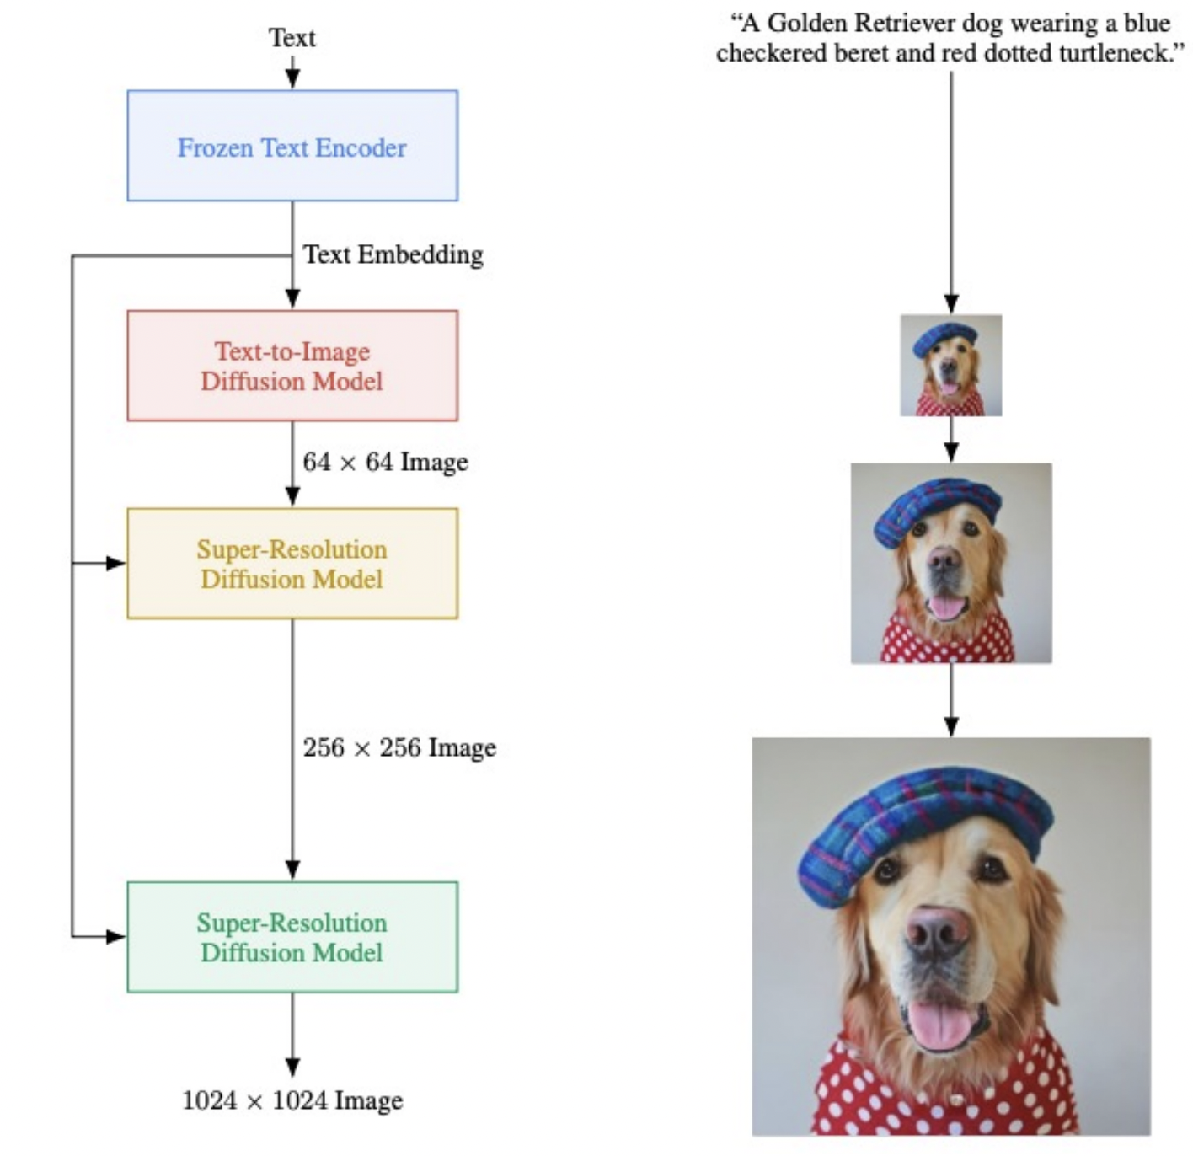
Imagen
Simpler than DALL-E
Key components:
Frozen language model providing text embeddings to all diffusion models.
Human raters prefer T5-XXL as the text encoder over CLIP encoder.
Cascaded diffusion models providing effective way to generate high-quality images.
Photorealistic Text-to-Image Diffusion Models with Deep Language Understanding, 2022

Slide 48
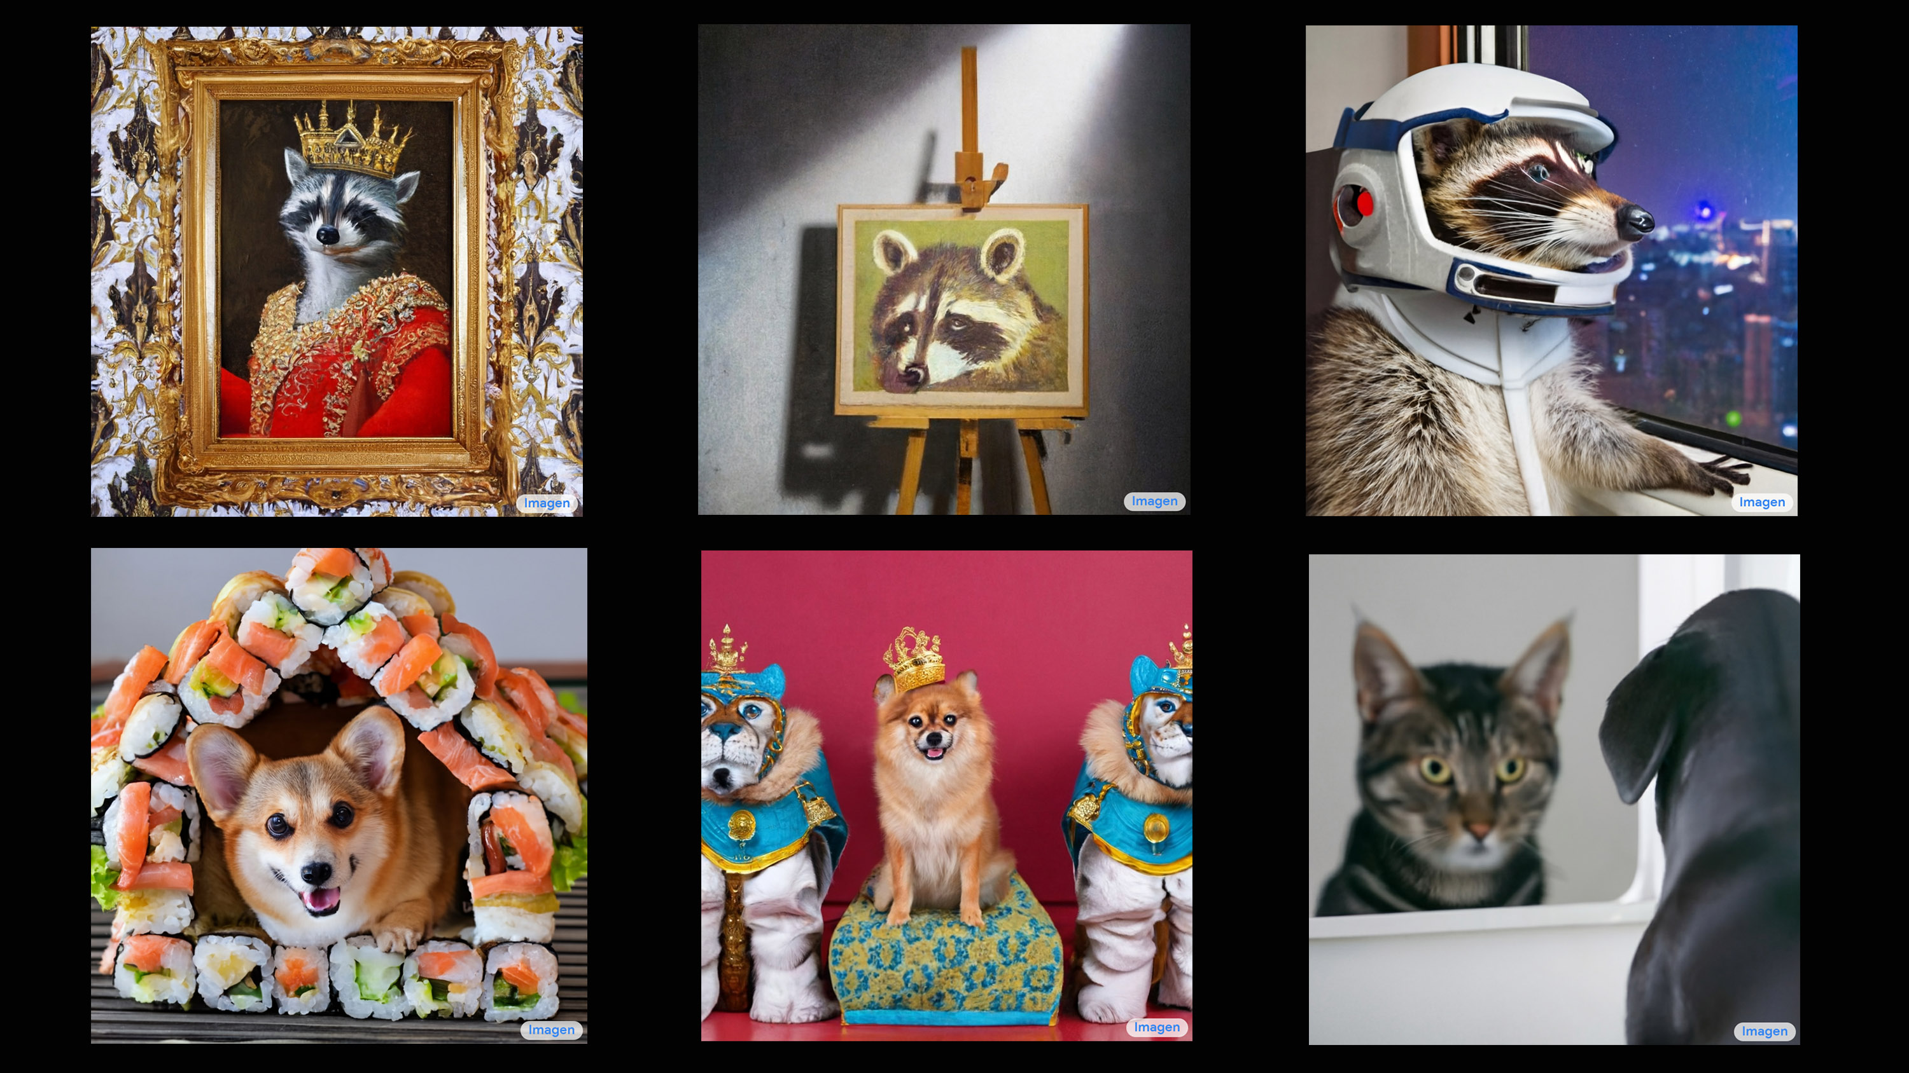
Imagen
Photorealistic Text-to-Image Diffusion Models with Deep Language Understanding, 2022

Slide 49
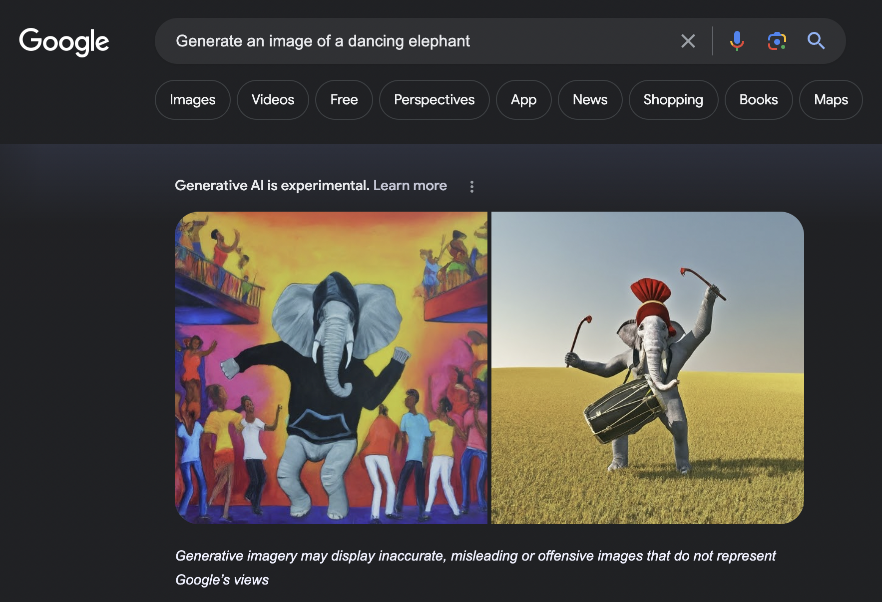
Notes:
A more advanced version of imagen is actually accessible via Google search now.
You should give it a try if you haven’t yet.

Slide 50
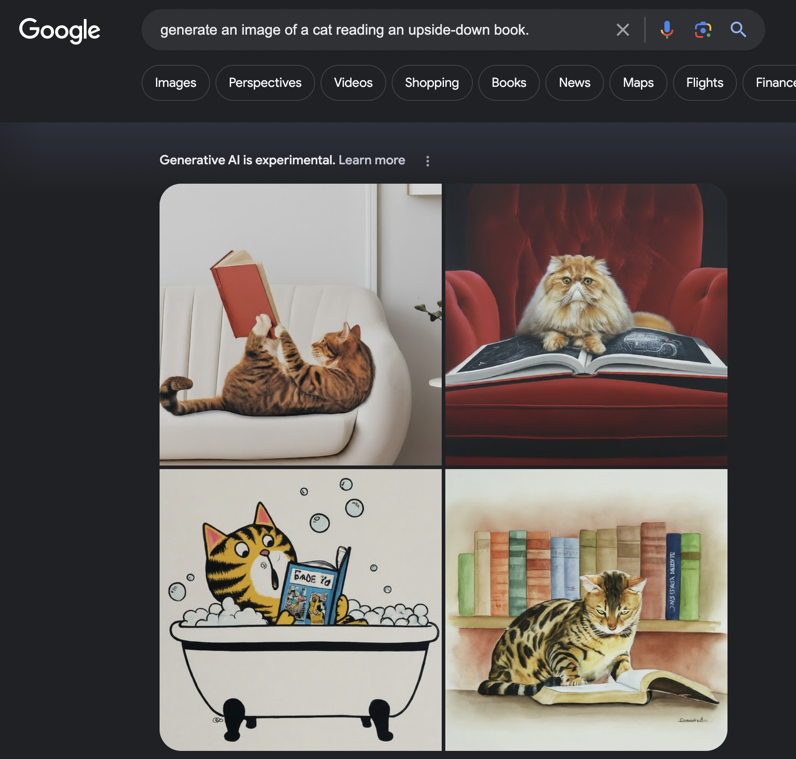

Slide 51
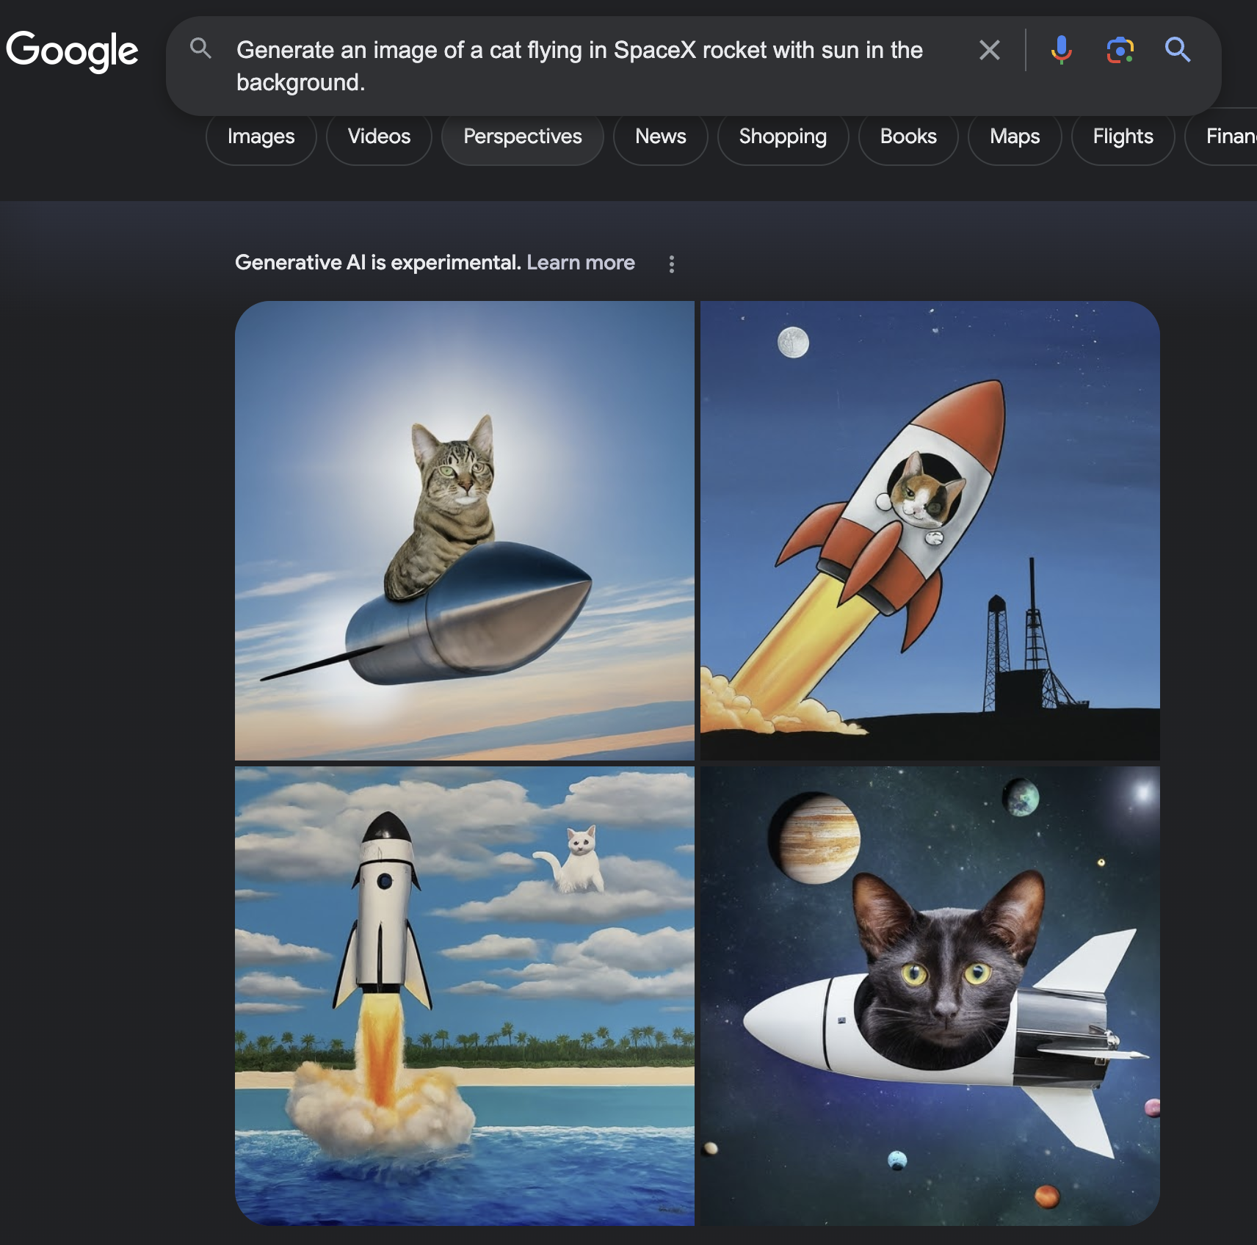

Slide 52
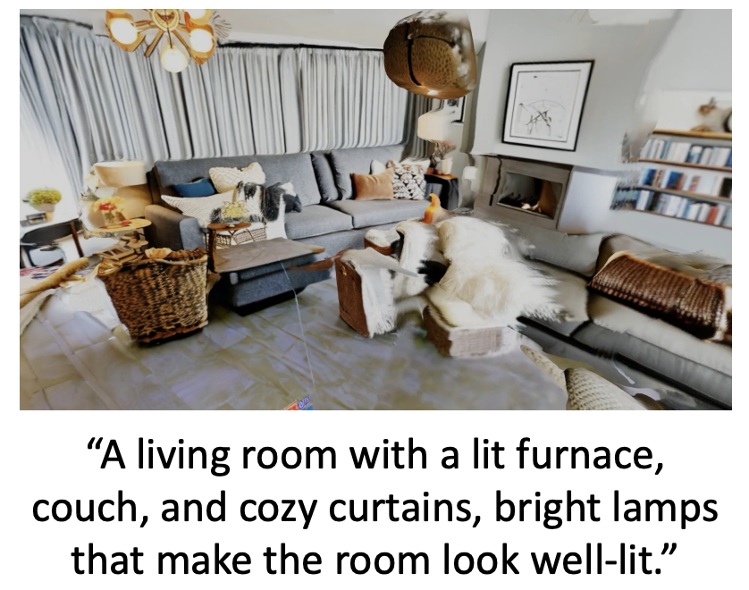
A ton of work on T → V
Text to video
Text to 3D shapes
Text to motions/navigation
Notes:
Ton of work in these areas
An evolving landscape that is changing by the week.
If you’re interested in getting into computer vision research, this is a very active area.

Slide 53
What about models that generate text?

Slide 54
Multi-modal GPT4
Model: unknown
Strong zero-shot visual understanding & reasoning capability
How do we build opensource models that are as good as GPT4?

Slide 55
Image-to-Text Generative Models
Model architectures:
Pre-trained image encoders
Pre-trained language models
Modules (to be trained) to connect the two modalities

Slide 56
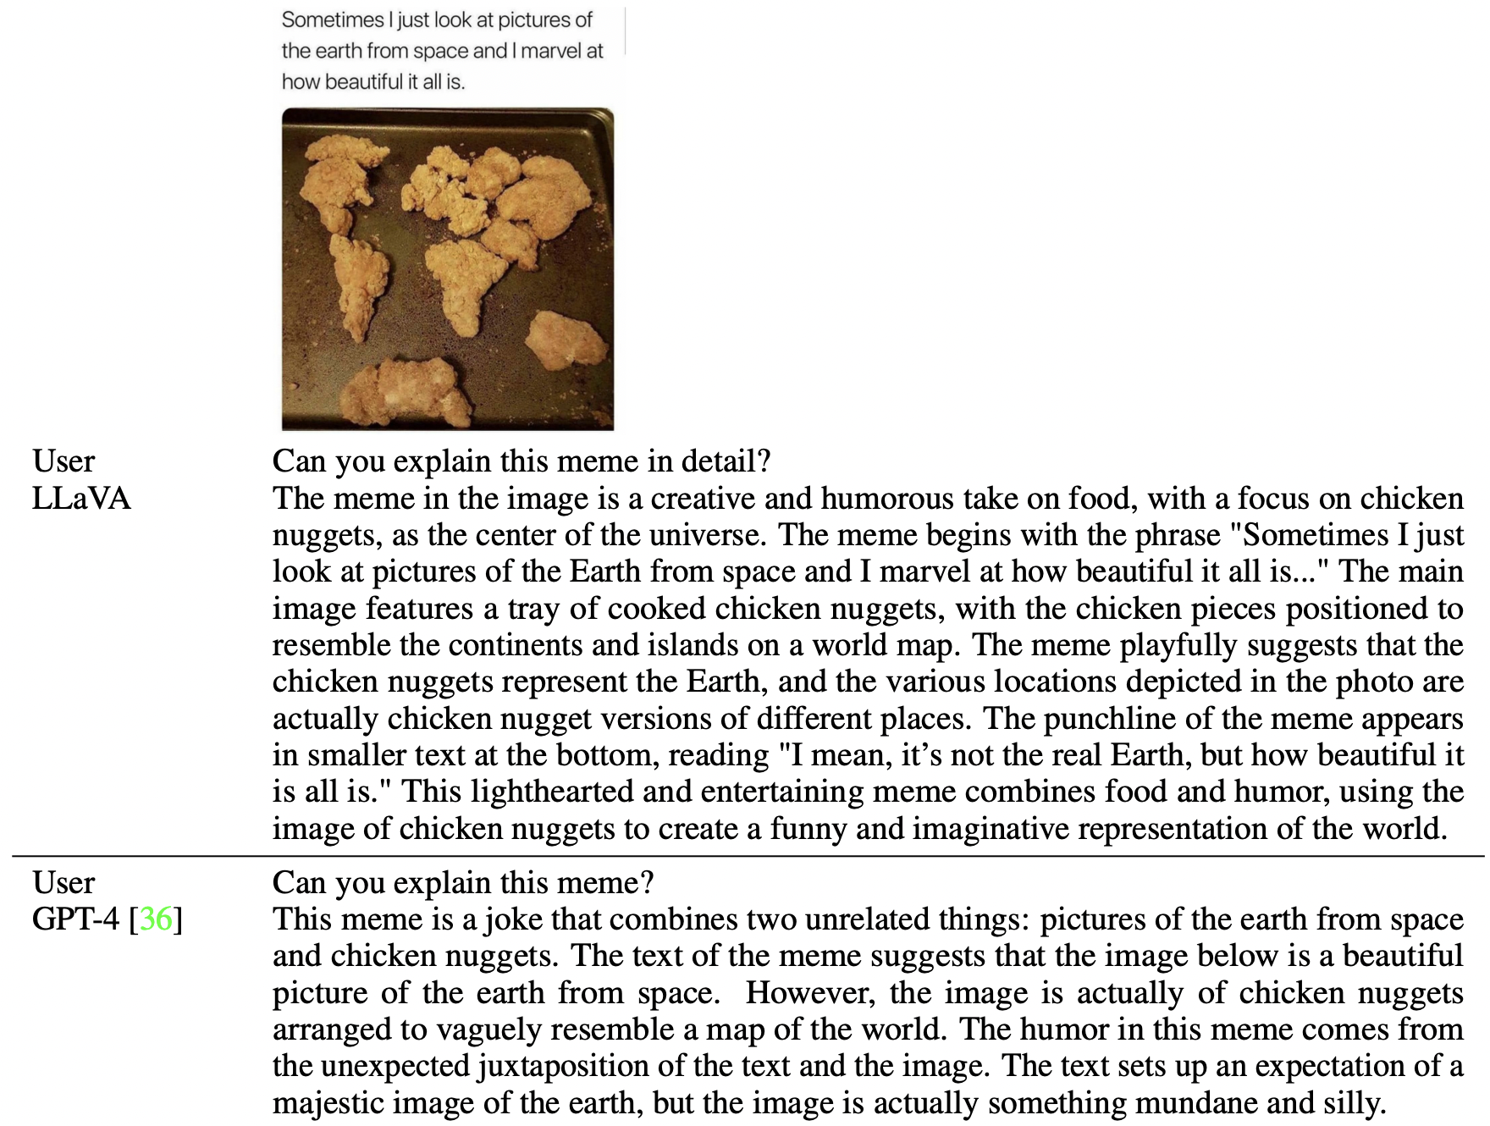
LLaVA Model
Give it a try! https://llava-vl.github.io/
https://arxiv.org/pdf/2304.08485.pdf
Visual Instruction Tuning, 2023

Slide 57
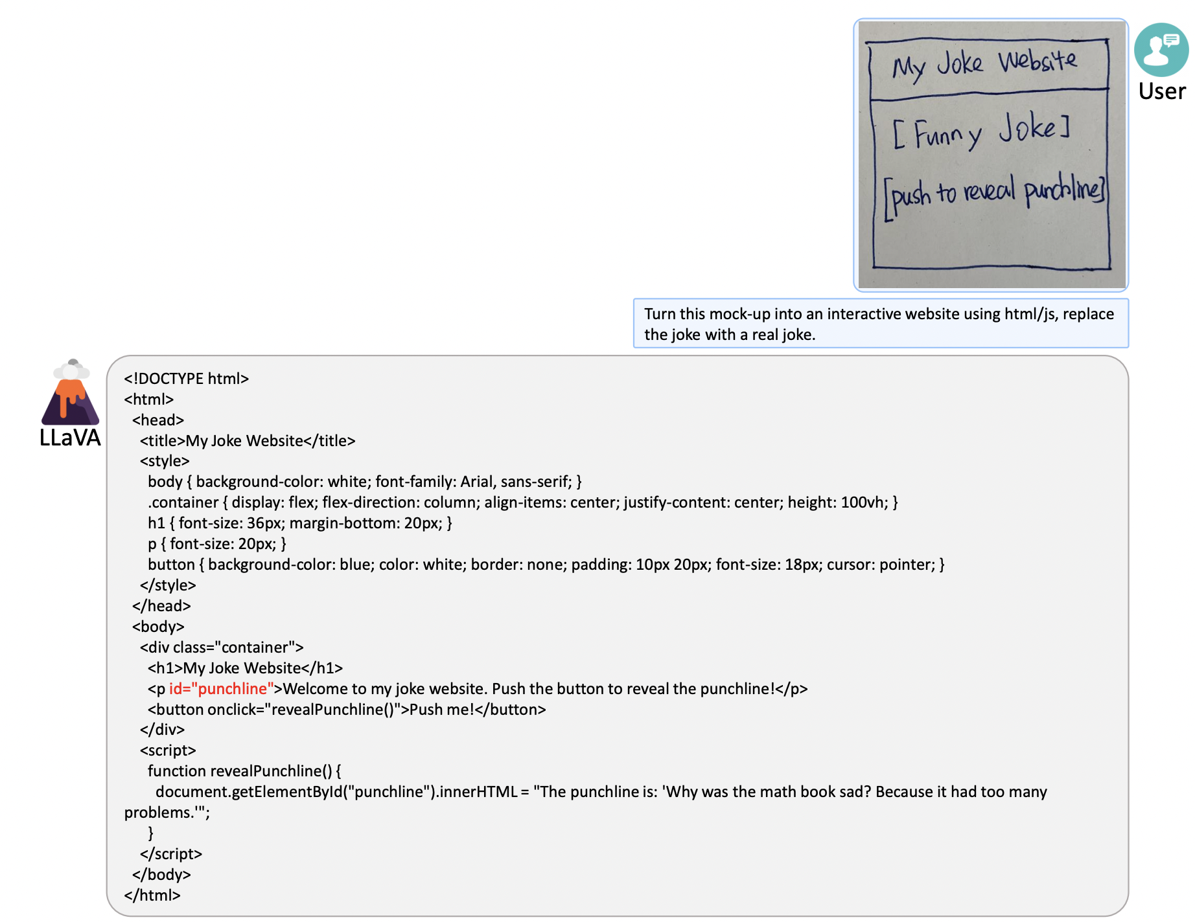
LLaVA Model
Give it a try! https://llava-vl.github.io/
https://arxiv.org/pdf/2304.08485.pdf
Visual Instruction Tuning, 2023

Slide 58
LLaVA Architecture
This projection matrix maps the embedded image to the same dimension as the LLM input (word embeddings).
CLIP image encoder
Language instructions
https://arxiv.org/pdf/2304.08485.pdf
Visual Instruction Tuning, 2023
Notes:
For an input image we consider the pre-trained CLIP visual encoder which provides the visual featur.
We consider a simple linear layer to connect image features into the word embedding space.
Specifically, we apply a trainable projection matrix W to convert Zv into language embedding tokens Hv, which have the same dimensionality as the word embedding space in the language model.
Thus, we have a sequence of visual tokens

Slide 59
LLaVA: GPT4-assisted data generation
The raw data: image captioning datasets
Consists of images, captions and bounding boxes of objects
Augmentation: it uses GPT4 to augment these with detailed captions.

Slide 60
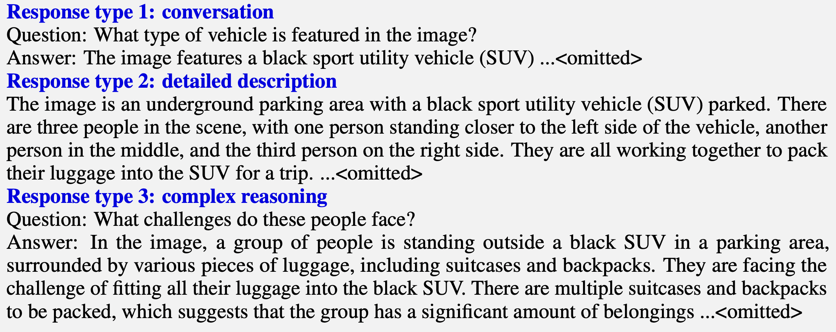
GPT4
Notes:
Three different types of instructions

Slide 61
LLaVA Architecture: Training
Step 1: Feature alignment — aligning the representation of Vision Encoder and LLM
Both Vision Encoder and LLM are kept frozen.
The only training parameter is W (the projection matrix)
Step 2: End-to-end fine-tuning
Vision Encoder is kept frozen. The training params are W and LLM.
Trainable parameters
Trainable parameters
https://arxiv.org/pdf/2304.08485.pdf
Visual Instruction Tuning, 2023
Notes:
Step 1: mainly to align the representation of the concepts
Step 2 is the step that incentivizes your model to be chatty and generate elaborate responses.
keep both the visual encoder and LLM weights frozen, and maximize the likelihood over output captions.
trainable parameters are the W matrix (the projection matrix) only.
In this way, the image features can be aligned with the pre-trained LLM word embedding, effectively turning into word tokens.

Slide 62
Many open-source models …
BLIP/BLIP2 [Li et al. 2023]
Instruct-BLIP [Dai et al. 2023]
MiniGPT4 [Zhu et al. 2023]
CoCa [Yu et al. 2022]
Shikra [Chen et al. 2023]
LLaVA 1.5 [Liu et al. 2023]
…

Slide 63
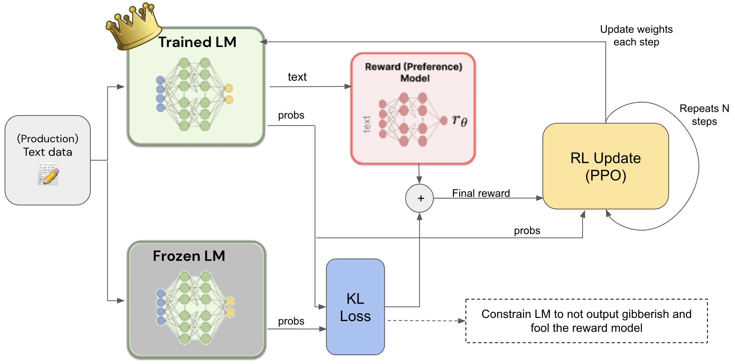
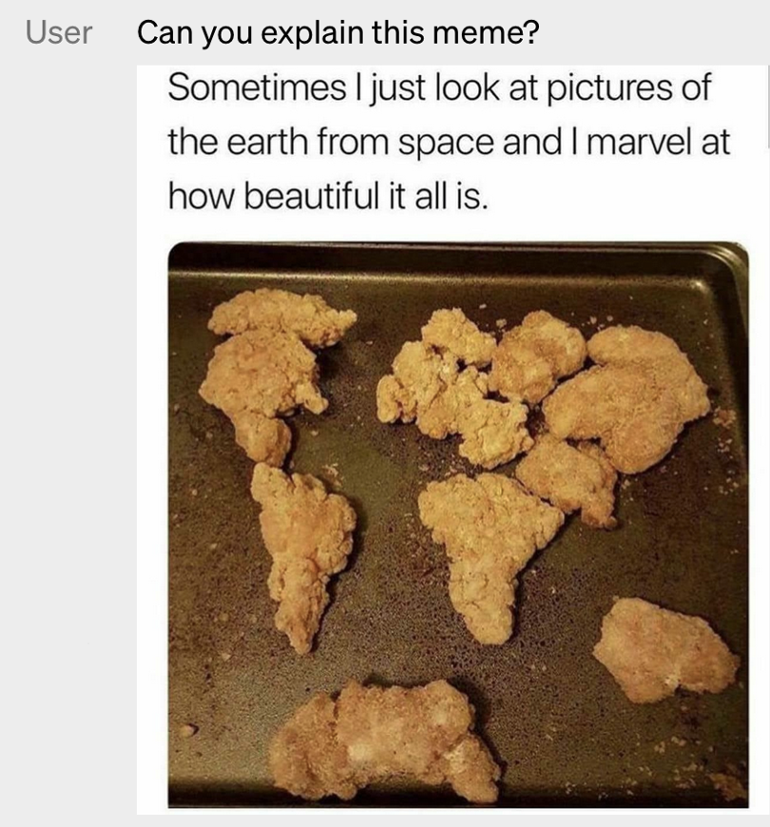
Note: You Can Also do Multimodal RLHF

Slide 64
Summary
There are massive amounts of unimodal data in the world.
We can build strong unimodal self-supervised models.
Multi-modal models: the key challenge is aligning the representations.
Many recent successes but a lot of challenges remain.
Making the models efficient.
Further scaling up — data scaling and model scaling
Better alignment of the representations — more natural/richer signals for alignment.

Slide 65
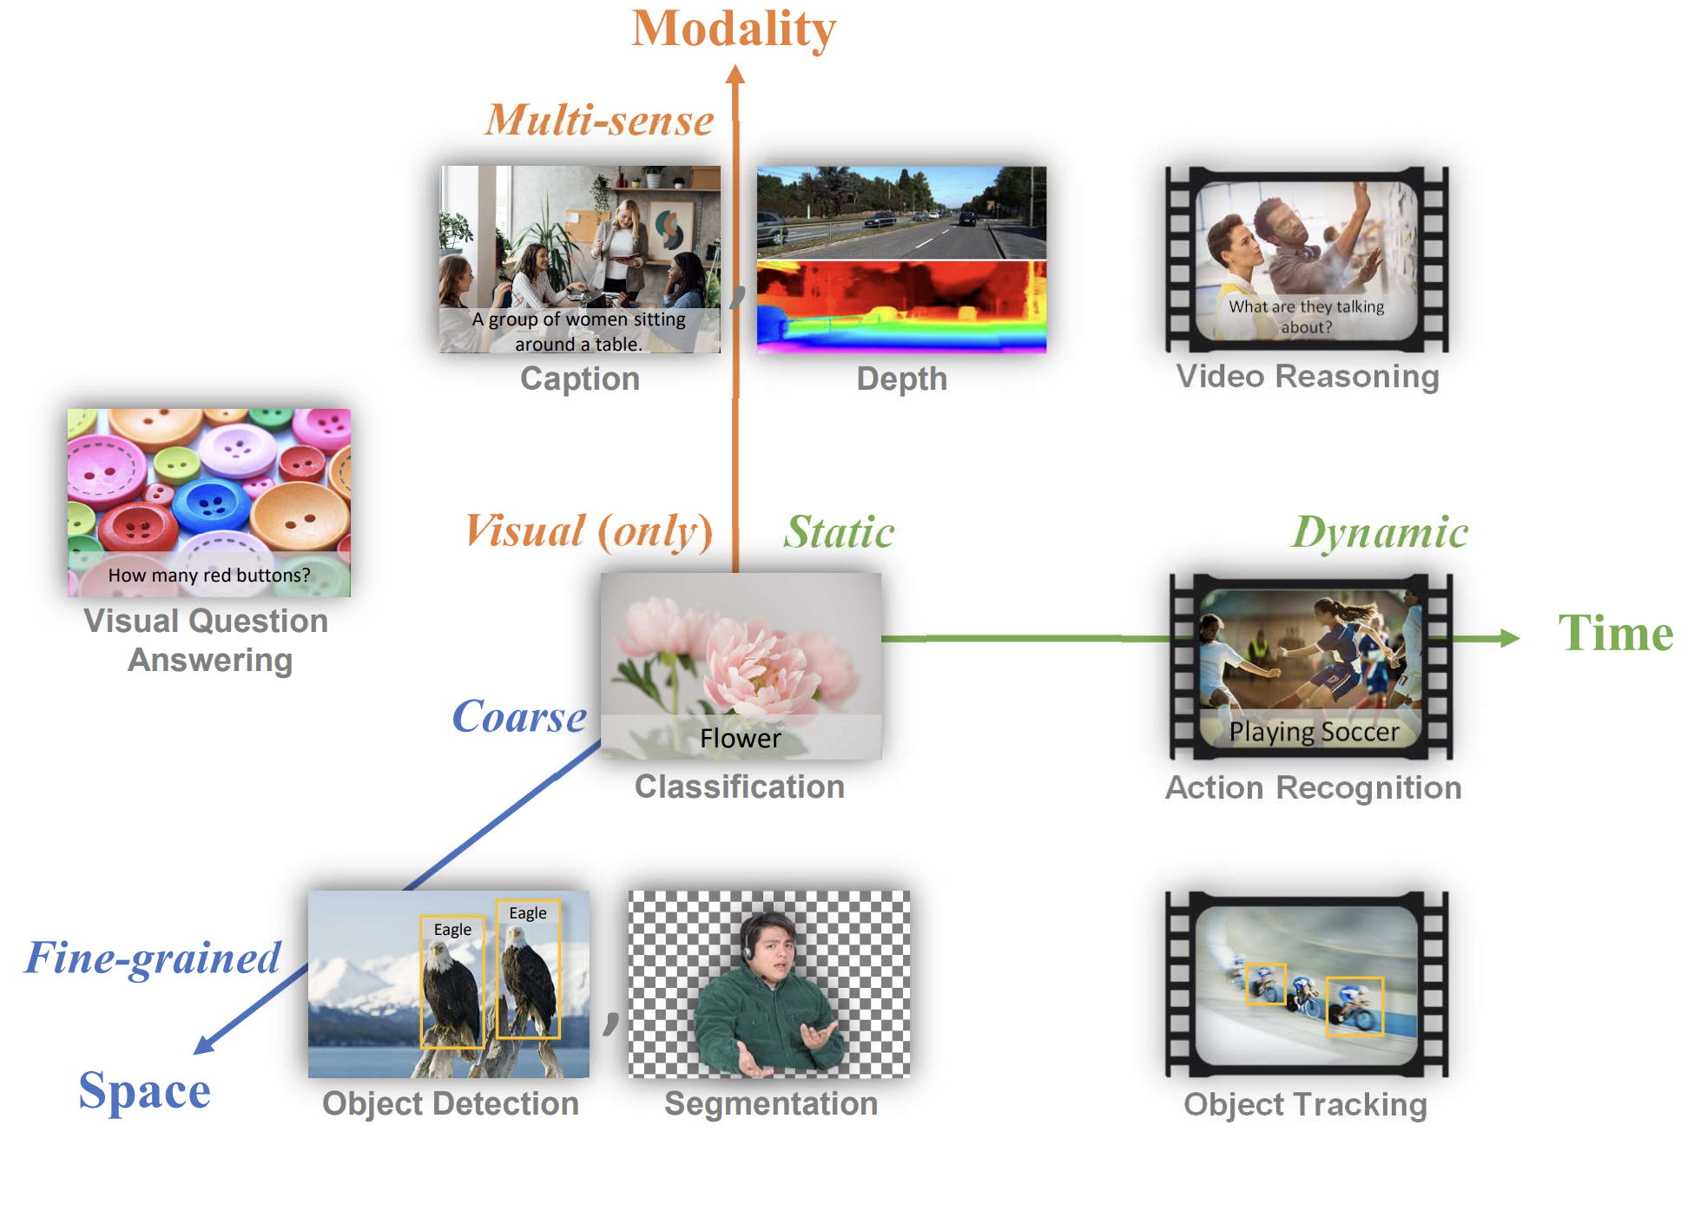
Challenges for Future Multi-Modal Models
Different modalities of information: Images, regions, pixels, ….
Different tasks: Classification, captioning, detection, grounding, segmentation, depth, …
Different types of inputs
Temporality: static images, short videos, very long videos, …
Figure: https://arxiv.org/pdf/2111.11432.pdf

Slide 66
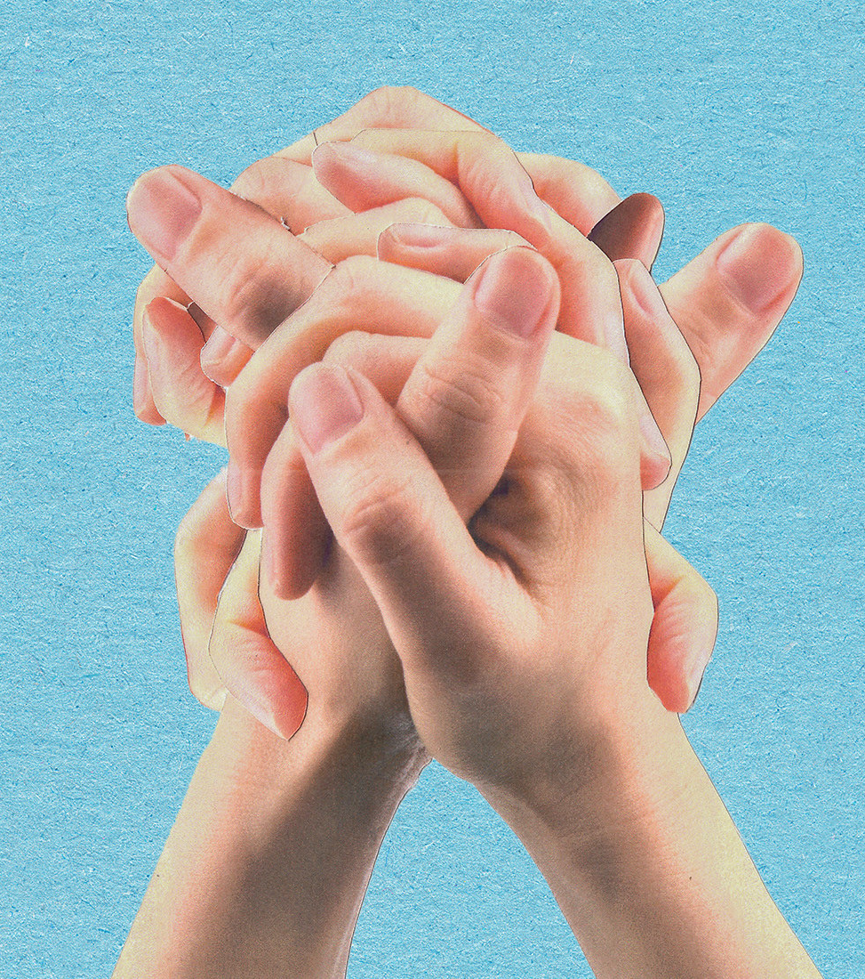
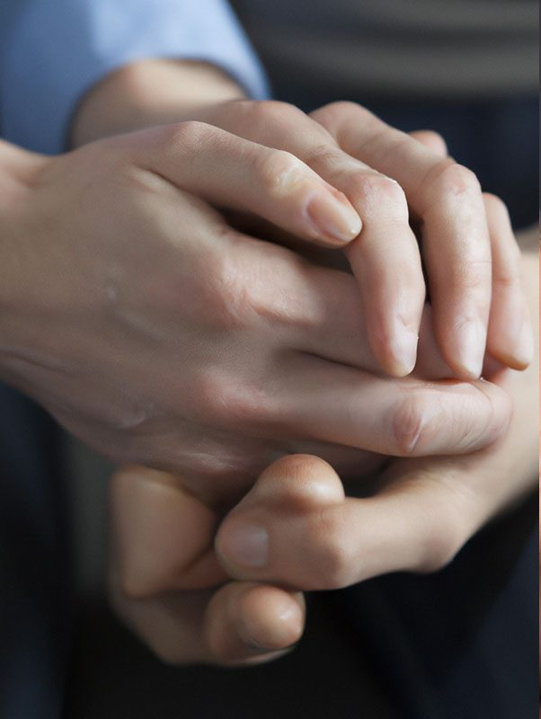
Challenges for Future Multi-Modal Models

Slide 67
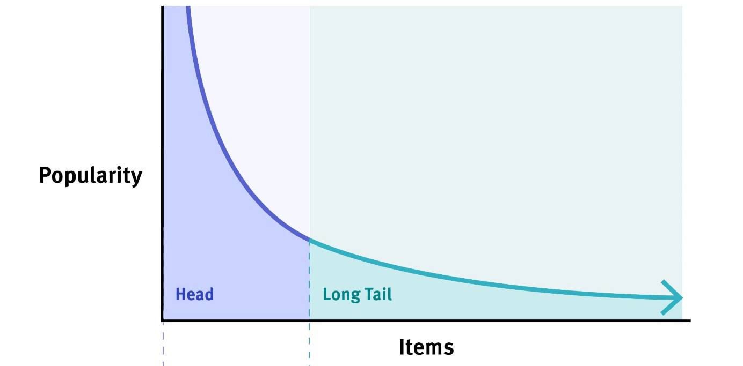
The long tail: Most things are infrequent

