Slide 1
Final Projects
https://self-supervised.cs.jhu.edu/sp2024/

Slide 2
Logistics update
Quiz 2 is this Thursday.
Will cover everything until the end of last week’s class.
Distribution:
40%: multiple choice
40% short-answer
20% analytical questions

Slide 3
Overview
30% of your overall grade (proposal, midway presentation, final report and poster)
The objective of the final project is to
make use of what you have learned during this course
to solve a hard problem.
What is “a hard problem”?
Go beyond what has been done.
Identify their weaknesses or make them better. Or make something completely new! (more in a bit.)
What is the expected amount of effort for the project?
Final project effort = ~[4-6] x homework assignment effort

Slide 4
Overview: Topic
The topic of this project is open-ended.
This project, for example, can focus on
demonstrating systemic limitations of prior work or
suggesting improvements on methods
…
Really, anything!
Must substantively involve human language!
We also have a set of default project ideas. Will be released this week.

Slide 5
Overview: Honor Code
Group work: Students can work in groups (team sizes 1-3 people).
Being in a team is encouraged.
A larger team project or a project used for multiple classes should be broader and involves exploring more models/tasks/analysis.
If multi-person: Include a brief statement on the work of each teammate
In almost all cases, each team member gets the same score, but we reserve the right to differentiate in egregious cases.
It’s okay (and encouraged) to use existing code/resources
Don't re-invent the wheel.
You must document it and give them credit .
You will be graded on your value-add.
Use any language/framework for your project. Though we expect most will use PyTorch.

Slide 6
Overview: Mentorship
You have access to the mentorship of the course staff throughout!
You will be aligned with at least one (possibly two) course staff.
I would love to talk to each team, alas there is only one of me …
You must meet them at least once every 2 weeks to discuss your progress or hurdles.
It’s your 🫵 job to reach out to them to coordinate times, in case office hours do not fit your schedule.

Slide 7
Project Timeline
Proposal deadline: March 28, via Gradescope
Midway report: April 16, via Gradescope
Midway presentation: April 16-25, in class
Final project posters: May 13 (6-9pm).
Final project report: EOD, via Gradescope

Slide 8
Project Proposals
All groups will be required to submit a project proposal.
via Gradescope.
The project proposal is a 2-page description of what you intend to do
motivation,
hypothesis,
experiments,
datasets,
methods,
expected outcome,
etc.

Slide 9
Project Proposals
How to think critically (about an existing paper, application, etc.)
What were the main novel contributions or points?
Is what makes it work something general and reusable or a special case?
Are there flaws or neat details in what they did?
You need to have an overall sensible idea:
Do you have appropriate data or a realistic plant to be able to collect it in a short period of time.
Do you have a realistic way to evaluate your work.
Do you have appropriate baselines or proposed ablation studies for comparisons.
Ask for help if needed
I encourage you to talk to all course staff about your project ideas.
If I had ∞ time, I would talk to all of you. Sadly, that won’t happen.

Slide 10
Project Proposals
Make sure that you follow the expected protocol for the proposal.
If you’re missing these details, we will not receive the “proposal” credits and we will ask you to redo it.

Slide 11
Proposals: Be as Precise as You Can
“we will first collect an extensive dataset from various sources such as Google News articles, Reddit discussions, and Twitter conversations.”
What data? What annotations?
“the model will be trained to produce a sentiment indicator that ranges from -10 to 10 …”
What model?
Where did we get these labels?
You want to be as clear and as specific as possible.

Slide 12
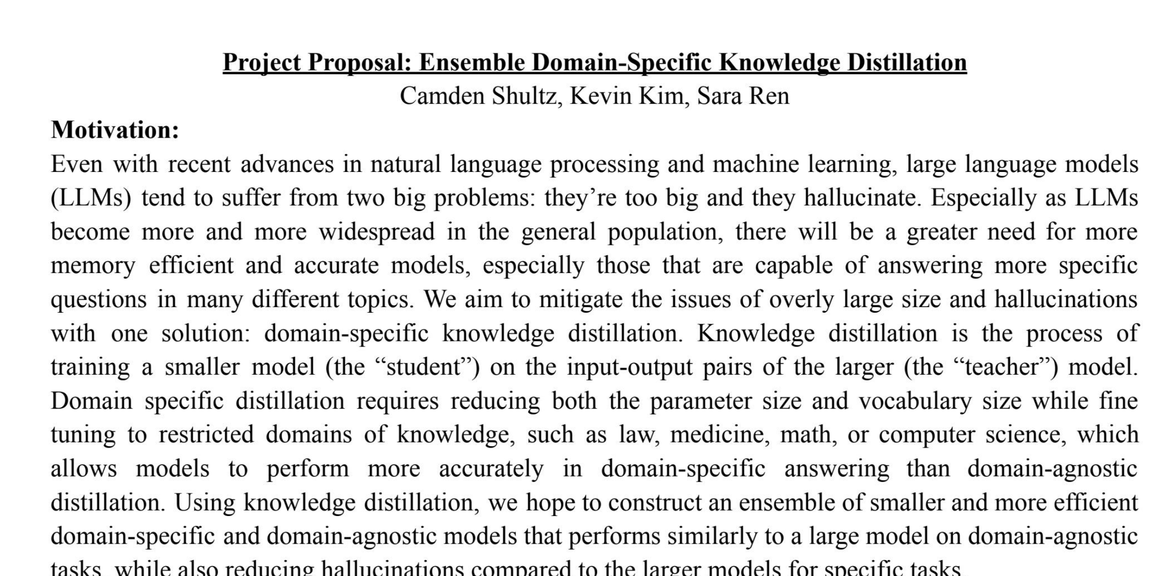
Proposal: An Example
https://self-supervised.cs.jhu.edu/sp2024/files/proposal-2_seek-extracted_171762894.pdf

Slide 13
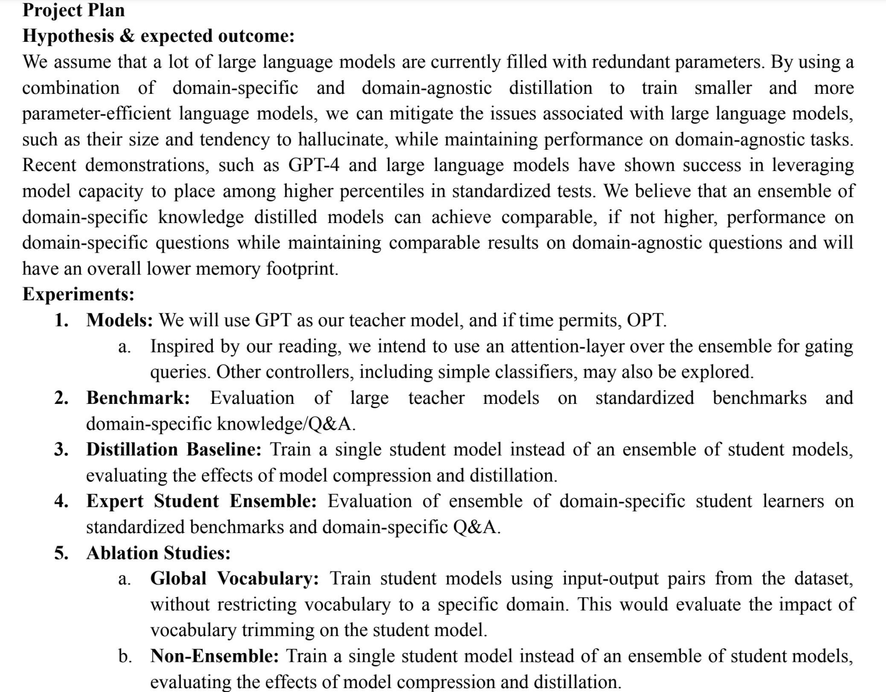
Proposal: An Example

Slide 14
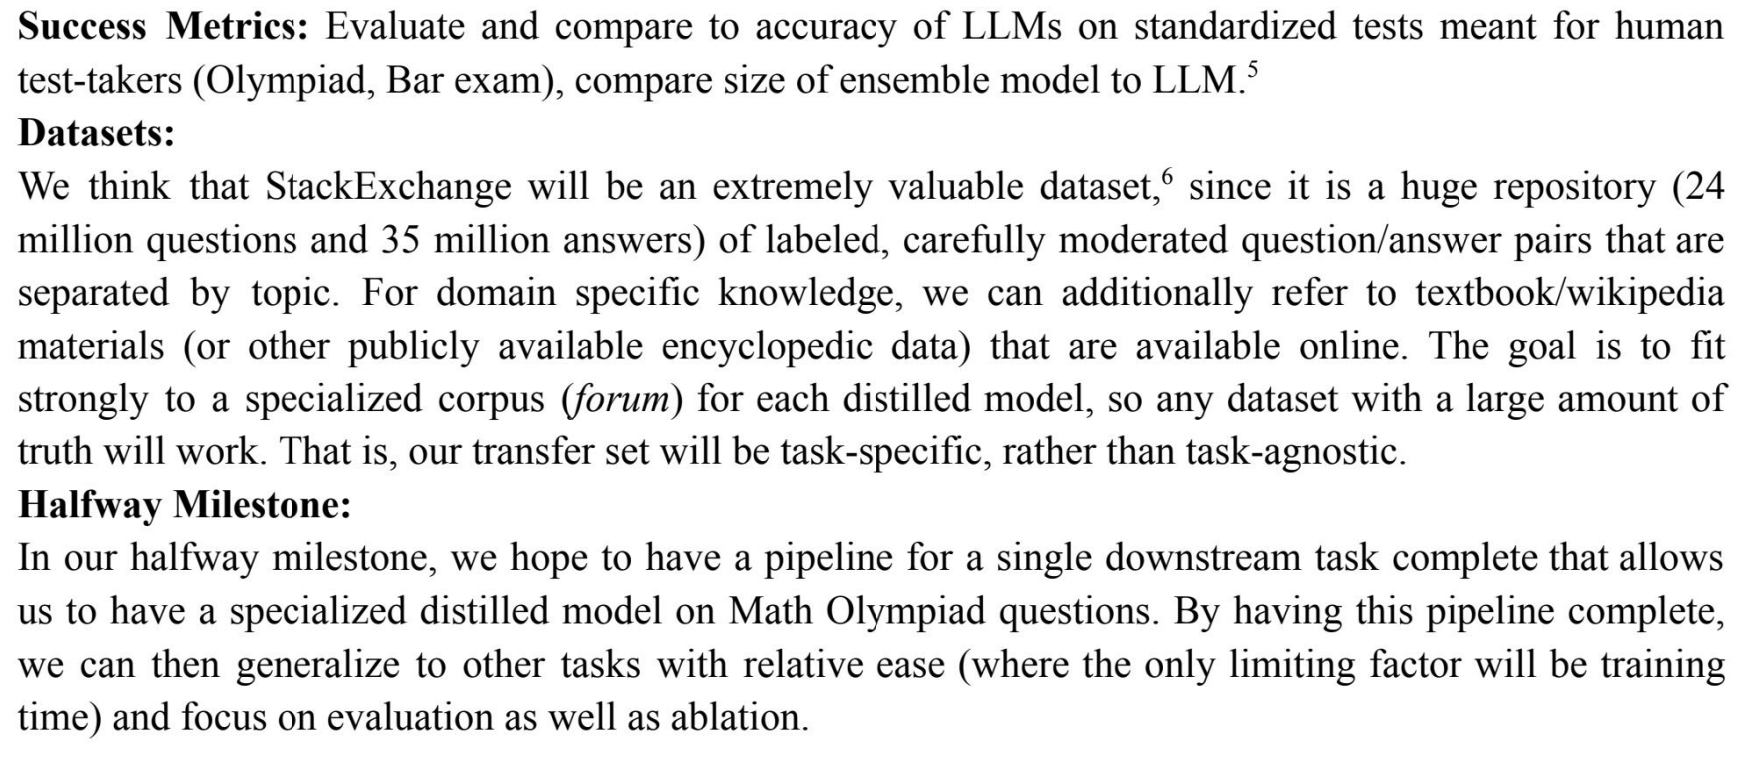
Proposal: An Example

Slide 15
Timeline: Midway Report
This is a progress report — Max 5 pages, via Gradescope.
Should be more than halfway done!
Describe the progress made
Experiments you have run
Preliminary results you have obtained
how you plan to spend the rest of your time.
….
You’re expected to have implemented some system, and to have some experimental results to show by this date.

Slide 16
Final Report
You will write up the results in a report.
Should be max 8 pages, on Gradescope.
The final report should summarize your findings and answer the following questions:
Motivation: What approach did you take to address this problem, and why?
Related work: How did you explore the space of solutions?
Approach: How did you pick your solution?
Evaluation: How did you evaluate the performance of the approach(es) you investigated?
Findings: What worked, what did not work, and why?
Conclusion and future work
Writeup quality is very important for your grade!
See course page for an example of a strong report.

Slide 17
Final Poster
All students will present their findings at a poster presentation during the final exam period.
Then we will celebrate! 🎉
Best Project Awards !
Selected by course staff
Popular vote by the class
Awards details are TBD

Slide 18
Back to finding project ideas

Slide 19
Suggesting a small extension to a paper
Choose a paper, propose a small improvement or extension to the paper.
The paper should be high-quality
Ideally discuss your plan with TAs early on selecting the paper In your proposal justify why you chose this paper

Slide 20
Finding Good Papers
Check out papers from recent conferences:
ICLR 2024 submissions (will be available on OpenReview end of September)
NeurIPS 2023: https://openreview.net/group?id=NeurIPS.cc/2023/Conference
ICML 2023: https://icml.cc/virtual/2023/papers.html?filter=titles
ACL 2023: https://aclanthology.org/events/acl-2023/#2023acl-long
ArXiv and Twitter (be aware of noise and low-quality papers)

Slide 21
Behavior analysis of models
Analyze the behavior of a model to provide some new insights.
Examples:
Investigate hypotheses like “LLMs are more likely to hallucinate content if they are presented with unfamiliar examples”.
Investigations into the data. How training data can impact some behavior of LLMs.
Investigating the bias and trustworthiness of LLMs

Slide 22
Theoretical Analysis
Theoretical analysis: Show some interesting and new theoretical analysis/results of an existing approach.
This type of project is only recommended for folks who have a strong theoretical background E.g., prove that sparse attention models are universal function approximators.

Slide 23
Think Broadly
Take into account the topics that we will discuss in coming weeks: RLHF, text2code, tool-use, LLMs for grounded reasoning, vision-language models, efficient computational frameworks, bias and fairness, legal issues regarding LLMs.
Look at an interesting interdisciplinary problem,
This is a perfect project for those who have other backgrounds in addition to CS
E.g., LLMs for scientific discovery
E.g., Applications to education
E.g., LLMs for Robotics

Slide 24
Applications
Good project for those who are excited about building applications.
Here are a few examples:

Slide 25
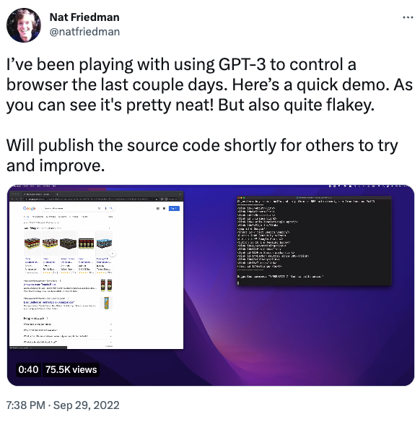
https://twitter.com/natfriedman/status/1575631194032549888

Slide 26
You're in charge ….
Lastly, this is your chance to get your hands dirty and work on a problem that you care about.
Think broadly!

