Slide 1
Feeding Lots Data to Language Models
CSCI 601-471/671 (NLP: Self-Supervised Models)
https://self-supervised.cs.jhu.edu/sp2024/

Slide 2
Logistics update
By popular demand, project proposal deadline is pushed to Monday, Apr 1.
Addressing a question:
John Doe: “I want to do X”
Me: What data are you going to use?
John Doe: hmm??
Me: 😭😭
John Doe: “I want to build an application X via prompt-engineering”
Depending on what you mean by “Prompt-engineering” it can be something that high-school kids can do as well.
So, you need to argue either of these: (1) this is a non-trivial ”engineering”; or (2) it’s a compelling application.
Clarification on “default” ideas:
There are ways to go about these without massive compute.
For example, for the ideas involving positional encodings we have provided links to prior implementations that you can use.
If they seem complex or unclear, feel free to ask me or TA.

Slide 3
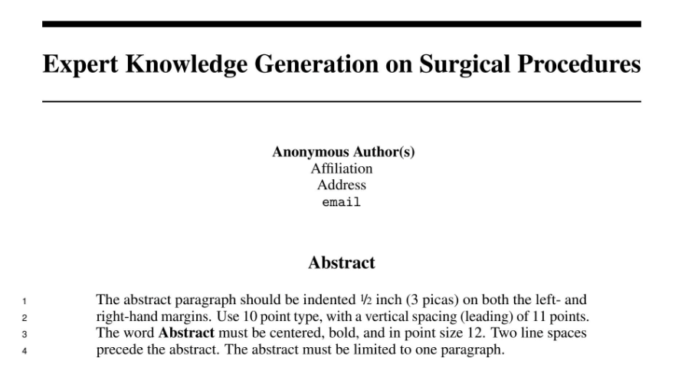
More on Proposals
Anonymous? :)
No abstract? :)

Slide 4
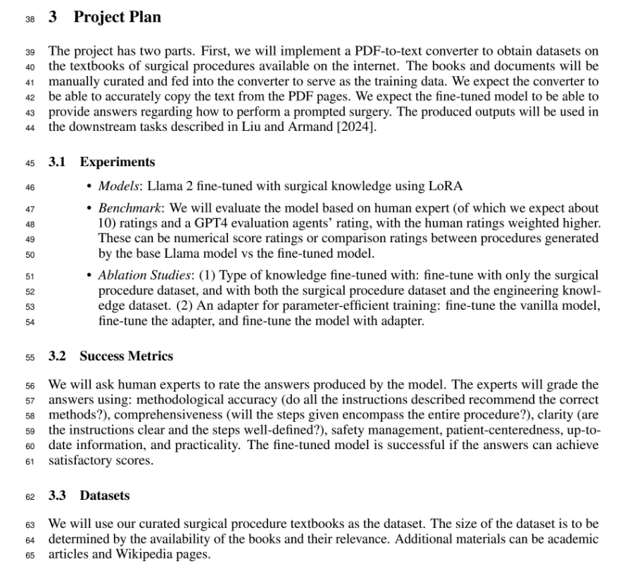
More on Proposals
What is the input to your system?
“our curated surgical procedures”: → show an example
Dataset: have you thought about using existing datasets?

Slide 5
This is NOT Just an Academic Exercise
Imagine you’re in a tech company.
You need to write memos, reports and proposals for before or after any project.
Jeff Bezos: “There is no way to write a six-page narratively structured memo and not have clear thinking.”
https://medium.com/@nathan.baugh/welcome-to-the-jungle-38fdde285b6f
https://writingcooperative.com/the-anatomy-of-an-amazon-6-pager-fc79f31a41c9

Slide 6
Back to our topic

Slide 7
Feeding Lots of Things to LM
Books, scientific articles, government reports, videos, your daily experience, etc. they all are much longer than 2k tokens!!
How do you enable language models process massive amounts of data?
One approach: just scale up your model—train it on a much longer context window size.
The bottleneck, memory usage and number of operations in Self-Attention increases quadratically.

Slide 8
Plan: Feeding Lots of Things to LM
Understanding Positional encodings
Length generalization of Transformer LMs
Retrieval-augmented generation
Chapter goal: Get familiar with techniques that are related and important for length generalization of LMs.

Slide 9
Revisiting Encoding Positional Information

Slide 10
Recap: Self-Attention
Given input $x$:
$$Q=W^{q}x$$
$$K=W^{k}x$$
$$V=W^{v}x$$
$$Attention(x)=softmax\left(\frac{{QK}^{T}}{α}\right)V$$
Remember that, without positional encoding the input is just bag of words for self-attention.

Slide 11
$$b^{1}=\sum_{i}{{\hat{α}}_{1,i}v^{i} }$$
O O
One issue: the model doesn’t know word positions/ordering.
$${\hat{α}}_{1,1}$$
$${\hat{α}}_{1,2}$$
$${\hat{α}}_{1,3}$$
$${\hat{α}}_{1,4}$$
Softmax
$$α_{1,1}$$
$$α_{1,2}$$
$$α_{1,3}$$
$$α_{1,4}$$
$$q_{1}$$
$$k_{1}$$
$$v_{1}$$
$$q_{2}$$
$$k_{2}$$
$$v_{2}$$
$$q_{3}$$
$$k_{3}$$
$$v_{3}$$
$$q_{4}$$
$$k_{4}$$
$$v_{4}$$
O O
O O
O O
O O
O O
O O
O O
O O
O O
O O
O O
O O
Allows model to learn relative positioning
$p_{i}$ are positional embeddings
O O O O O
O O O O O
O O O O O
O O O O O
$$p_{1}$$
$$p_{2}$$
$$p_{3}$$
$$p_{4}$$
O O O O O
O O O O O
O O O O O
O O O O O
$$x_{1}$$
$$x_{2}$$
$$x_{3}$$
$$x_{4}$$

Slide 12
Positional Embeddings: The Flavors
There are many different choices of positional encodings:
Some are learned (BERT, Devlin et al. 2018) and some are fixed.
Learn the position-specific embeddings through Backprop.
Some encode absolute position. Will see more on this.
Some encode relative position. Will see more on this.
O O
O O
O O
O O
O O
O O
O O
O O
O O
O O
O O
O O
Allows model to learn relative positioning
$p_{i}$ are positional embeddings
O O O O O
O O O O O
O O O O O
O O O O O
$$p_{1}$$
$$p_{2}$$
$$p_{3}$$
$$p_{4}$$
O O O O O
O O O O O
O O O O O
O O O O O
$$x_{1}$$
$$x_{2}$$
$$x_{3}$$
$$x_{4}$$

Slide 13
Positional Embeddings: The Flavors
Why “add”? Why not, say, “concatenate and then project”?
“concatenate and then project” would be a more general approach with more trainable parameters.
In practice, “sum” works fine that
The intuition here is that “summing” forms point clouds of word embedding information around position embeddings unique to each position.
O O
O O
O O
O O
O O
O O
O O
O O
O O
O O
O O
O O
Allows model to learn relative positioning
$p_{i}$ are positional embeddings
O O O O O
O O O O O
O O O O O
O O O O O
$$p_{1}$$
$$p_{2}$$
$$p_{3}$$
$$p_{4}$$
O O O O O
O O O O O
O O O O O
O O O O O
$$x_{1}$$
$$x_{2}$$
$$x_{3}$$
$$x_{4}$$

Slide 14
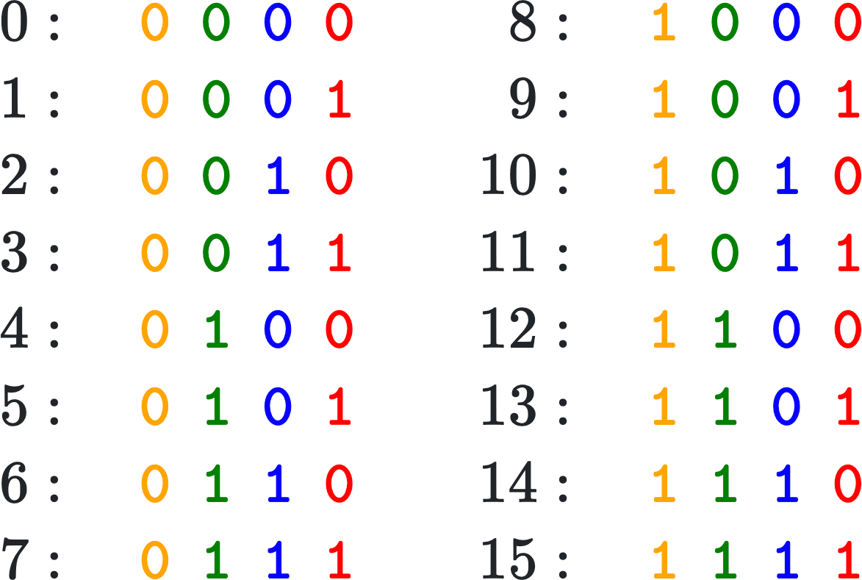
Absolute Positional Embeddings
The idea is to create vectors that uniquely encoder each position.
For example, consider vectors of binary values.
Example below shows 4-dimensional position encodings for 16 positions.
The issue with binary encoding is that the positional information is localized around a few bits.
https://kazemnejad.com/blog/transformer_architecture_positional_encoding/

Slide 15
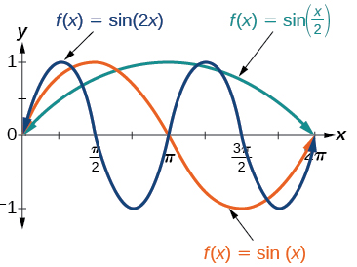
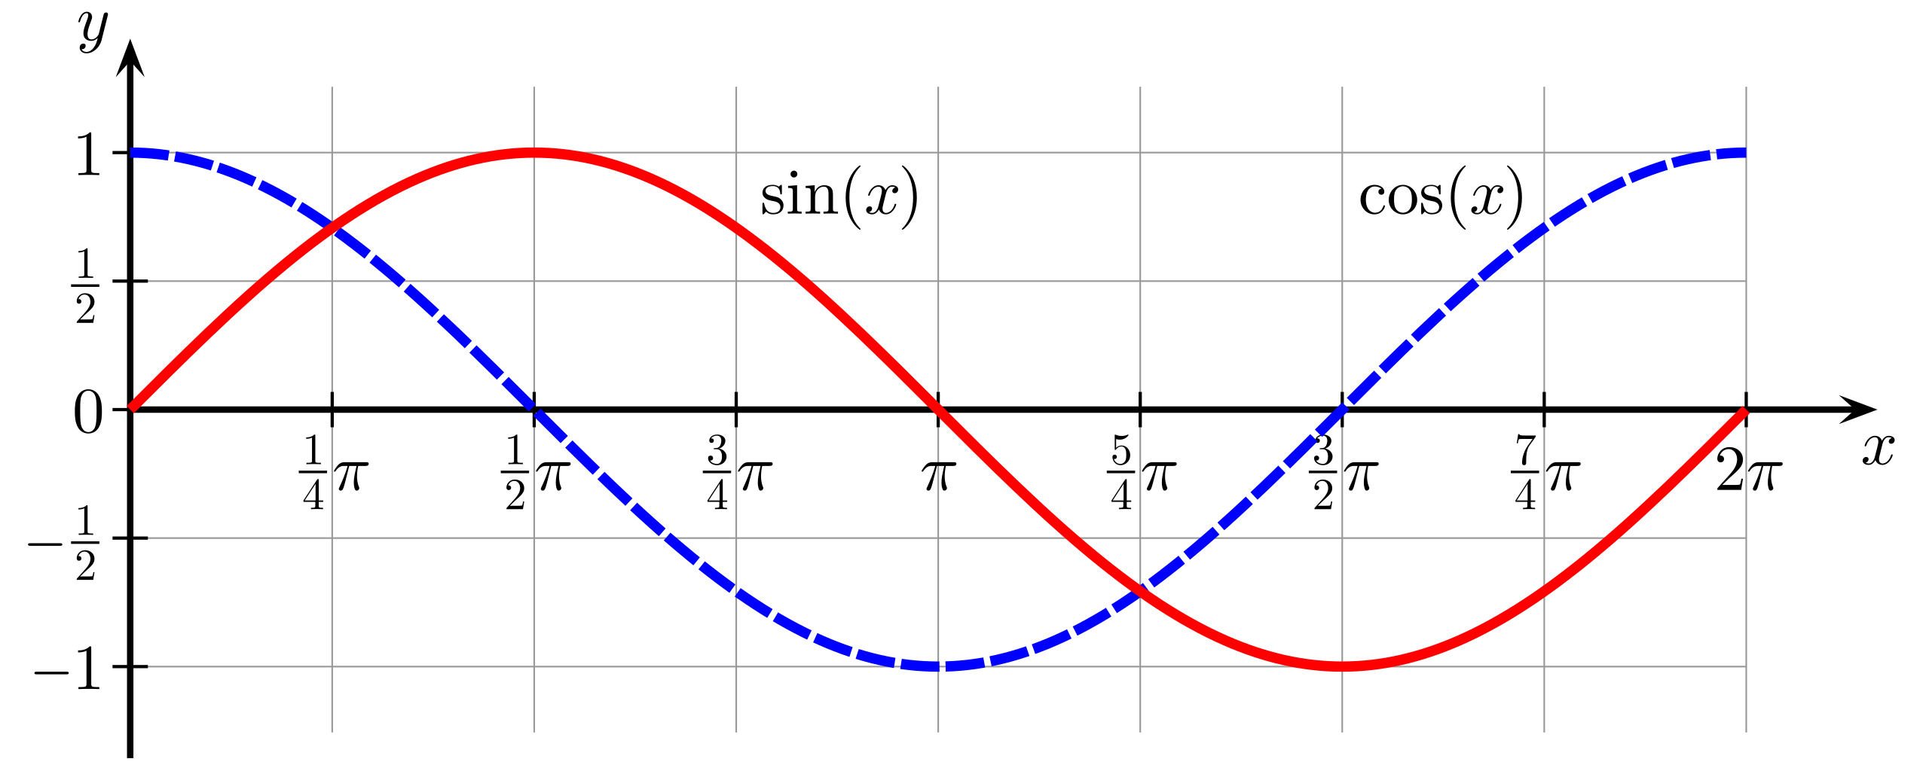
Math Recap: Sine and Cosine Functions

Slide 16
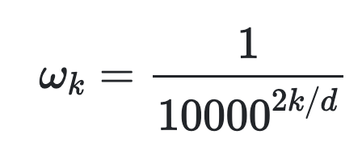
Absolute Positional Embeddings
Let t be a desired position. Then the i-th element of the positional vector is:
Here d is the maximum dimension.
This provides unique vectors for each position.
https://kazemnejad.com/blog/transformer_architecture_positional_encoding/

Slide 17
Quiz
Let t be a desired position:
Q: Are the frequencies increasing with dimension i ?
Answer: The frequencies are decreasing along the vector dimension.
https://kazemnejad.com/blog/transformer_architecture_positional_encoding/

Slide 18
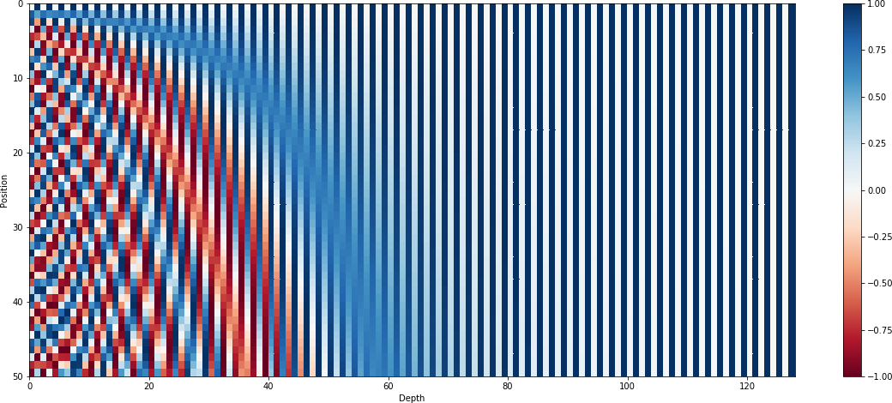
Visualizing Absolute Positional Embeddings
Here positions range from 0-50, for an embedding dimension of 130.

Slide 19
Limits of Absolute Positional Encoding
We can have fixed positional embeddings for each index training position (e.g., 1, 2, 3, … 1000).
What happens if we get a sequence with 5000 words at test time?
We want something that can generalize to arbitrary sequence lengths.
Approach: encoding the relative positions, for example based on the distance of the tokens in a local window to the current token.

Slide 20
A Unified Perspective on Positional Encoding
We are input sequence $x_{0},x_{1},…$ and
Then the unnormalized attention value between position $i,$ and $j$ is:
$${QK_{ij}=\left(W_{q}x_{i}\right)}^{T}\left(W_{k}x_{j}\right)=x_{i}^{T}W_{q}^{T}W_{k}x_{j}$$
Now also assume that positional embeddings are added to $x_{i}$, i.e., they’re $x_{i}+p_{i}$
${QK_{ij}=\left(W_{q}{[x}_{i}+p_{i}]\right)}^{T}\left(W_{k}{[x}_{j}+p_{j}]\right)=x_{i}^{T}{W_{q}}^{T}W_{k}x_{j}+x_{i}^{T}{W_{q}}^{T}W_{k}p_{j}$+$p_{i}^{T}{W_{q}}^{T}W_{k}x_{j}$+ $p_{i}^{T}{W_{q}}^{T}W_{k}p_{j}$
The original attention term: how much attention should we pay to word $x_{j}$ given word $x_{i}$
How much attention should we pay to word $x$ given the position $p$
How much attention should position $p_{i}$ should attend to position $p_{j}$

Slide 21
A Unified Perspective on Positional Encoding
You can rewrite the statement from the previous slide in the following form:
$$QK_{ij}={\left(W_{q}{[x}_{i}+p_{i}]\right)}^{T}\left(W_{k}{[x}_{j}+p_{j}]\right)=x_{i}^{T}{W_{q}}^{T}W_{k}x_{j}+P_{ij}$$

Slide 22
Relative Positional Encoding
You can rewrite the statement from the previous slide in the following form:
$$QK_{ij}={\left(W_{q}{[x}_{i}+p_{i}]\right)}^{T}\left(W_{k}{[x}_{j}+p_{j}]\right)=x_{i}^{T}{W_{q}}^{T}W_{k}x_{j}+P_{ij}$$
Note, the values of $P_{ij}$encode the relative of $i$ and $j$.
How should we construct $P_{ij}$?
How much attention should position $i$ should attend to position $j$

Slide 23
Relative Positional Encoding
There have been various choices:
T5 models simplify this into learnable relative embeddings $P_{ij}$ such that:
$$QK_{ij}=x_{i}^{T}{W_{q}}^{T}W_{k}x_{j}+P_{ij}$$
DeBERTa learns relative positional embeddings ${ \tilde{p}}_{i−j}$ such that:
$$QK_{ij} =x_{i}^{T}{W_{q}}^{T}W_{k}x_{j}+x_{i}^{T}{W_{q}}^{T}W_{k}{ \tilde{p}}_{i−j}\text{+}{\tilde{p}}_{i−j}^{T}{W_{q}}^{T}W_{k}x_{j}$$
Tranformer-XL learns relative positional embeddings ${ \tilde{p}}_{i−j}$ and trainable vectors $u$, $v$ s.t.:
$QK_{ij} =x_{i}^{T}{W_{q}}^{T}W_{k}x_{j}+x_{i}^{T}{W_{q}}^{T}W_{k}{ \tilde{p}}_{i−j}$+$u^{T}{W_{q}}^{T}W_{k}x_{j}$+$v^{T}{W_{q}}^{T}W_{k}{ \tilde{p}}_{i−j}$
ALiBi learns learns a scalar $m$such that:
$$QK_{ij}=x_{i}^{T}{W_{q}}^{T}W_{k}x_{j}−m |i−j|$$
Exploring the Limits of Transfer Learning with a Unified Text-to-Text Transformer, 2020

Slide 24
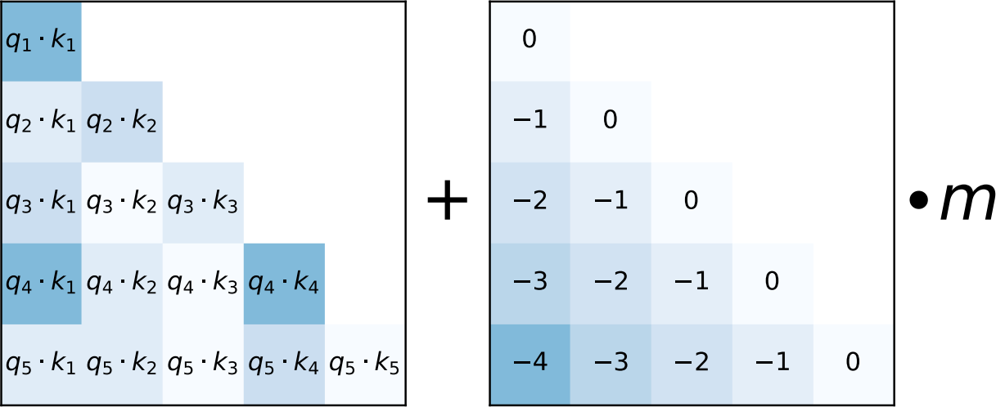
Attention with Linear Biases (ALiBi)
Add a constant value to the attention logits
Apply a head specific scalar m
Train Short, Test Long: Attention with Linear Bia4s2es Enables Input Length Extrapolation (2022)
41

Slide 25
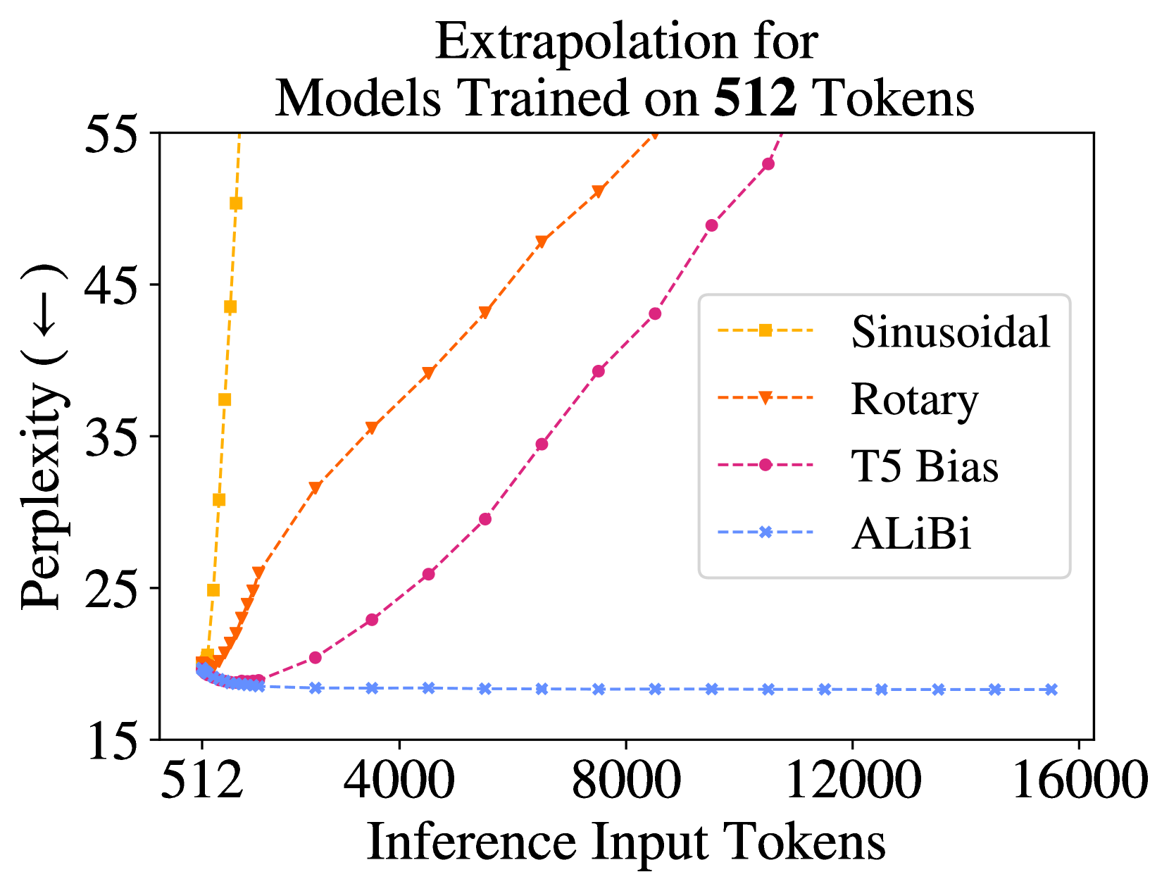
Length Extrapolation
Note there are two interpretations of “length extrapolation”:
Modest interpretation: LM should not crash when given long context, i.e., PPL should not get worse with more context.
Strict interpretation: LM should exploit the added information, i.e., PPL should get smaller with more context.
This result shows that ALiBi is length generalizable according to the modest definition. It does not tell us whether it is length generalization according to the strict interpretation.
fig from Ofir Press (2023)

Slide 26
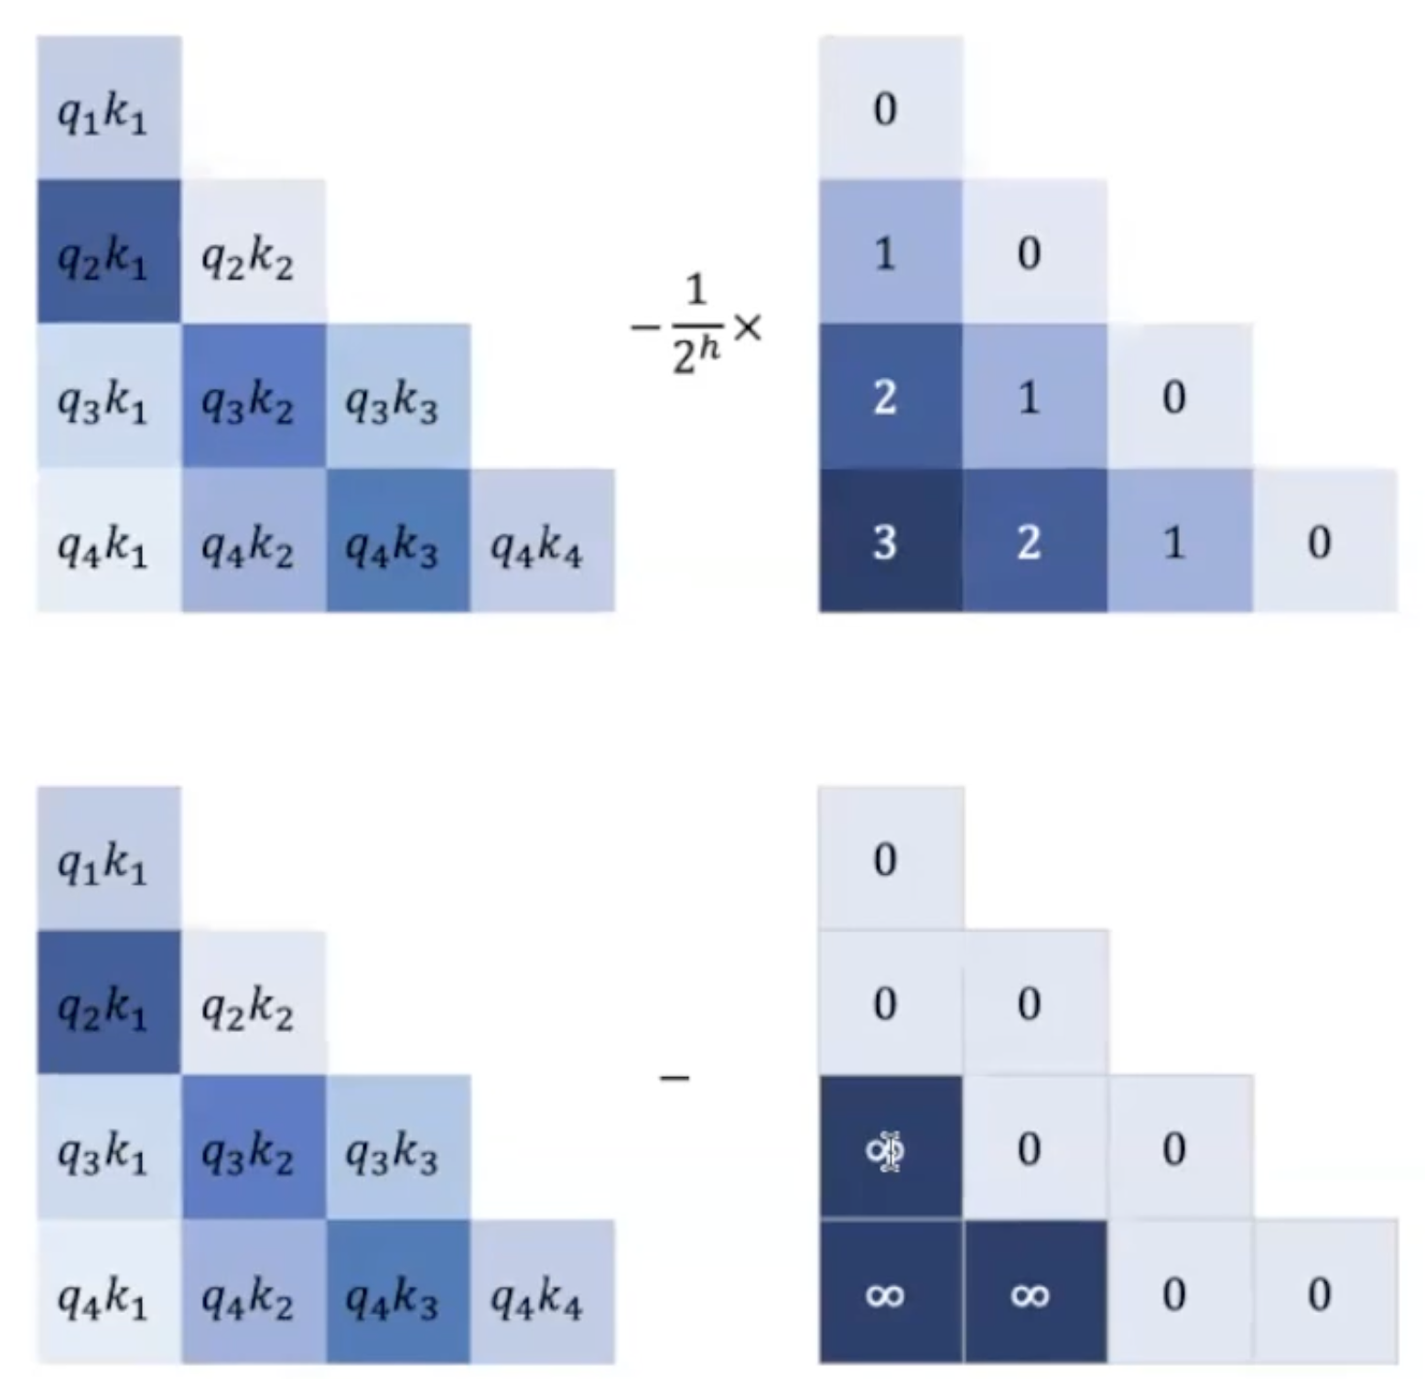
ALiBi vs. Fixed Window
Hypothesis: ALiBi might be acting like a fixed-window.
ALiBi scales the attention values based on their distance, effectively ignoring long-range context and acting like a moving window.
This sounds like a bad idea, since the we want language models to attend to long-range dependencies.
But the good news is that, stacking self-attention layers mitigates such narrow attention window.
fig from Ta-Chung Chi (2023)

Slide 27
Fixed Window Attending to Long-Context
Imagine you have a Self-Attention limited to a window of size 4.
Transformer-XL: Attentive Language Models Beyond a Fixed-Length Context, 2020

Slide 28
Fixed Window Attending to Long-Context
Imagine you have a Self-Attention limited to a window of size 4.
Transformer-XL: Attentive Language Models Beyond a Fixed-Length Context, 2020

Slide 29
Fixed Window Attending to Long-Context
Imagine you have a Self-Attention limited to a window of size 4.
Transformer-XL: Attentive Language Models Beyond a Fixed-Length Context, 2020

Slide 30
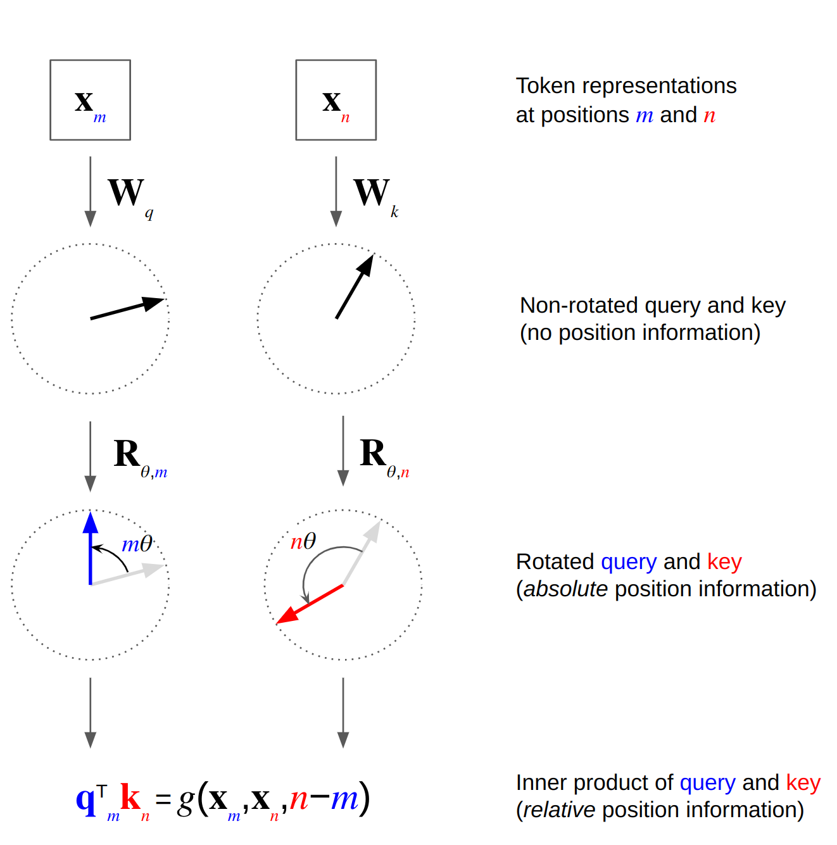
Rotary Positional Encoding (RoPE)
Drop the additive positional encoding and make it multiplicative.
$$qk_{mn}={\left(R_{θ, m}W_{q}x_{m}\right)}^{T}\left(R_{θ, n}W_{k}x_{n}\right)$$
$=x_{m}^{T}W_{q}^{T}R_{θ, m}^{T}R_{θ, n}W_{k}x_{j}$
$θ$: the size of rotation
$R_{θ, m}$: rotation matrix, rotates a vector it gets multiplied to proportional to $θ$and the position index $m$.
Intuition: nearby words have smaller relative rotation.
RoFormer: Enhanced Transformer with Rotary Position Embedding (2022)
Figure source

Slide 31
Thinking About Rotation Matrix
In 2D, a rotation matrix can be defined in the following form:
$R_{θ, m}=\left(\begin{matrix}\cos{mθ} & −\sin{mθ} \\ \sin{mθ} & \cos{mθ}\end{matrix}\right)$
The rotation increases with increasing $θ$ and $m$.
$x′$ $=\left[\begin{matrix}a′ \\ b′\end{matrix}\right]$
$$x^{′}= R_{θ, m}x$$
$$mθ$$
$$x=\left[\begin{matrix}a \\ b\end{matrix}\right]$$

Slide 32
Thinking About Rotation Matrix
In practice, we are rotating $d$ dimensional embedding matrices.
Idea: rotate different dimensions with different angles:
$Θ=\{θ_{0}, θ_{1},θ_{2},θ_{3},…, θ_{d/2}\}$

Slide 33
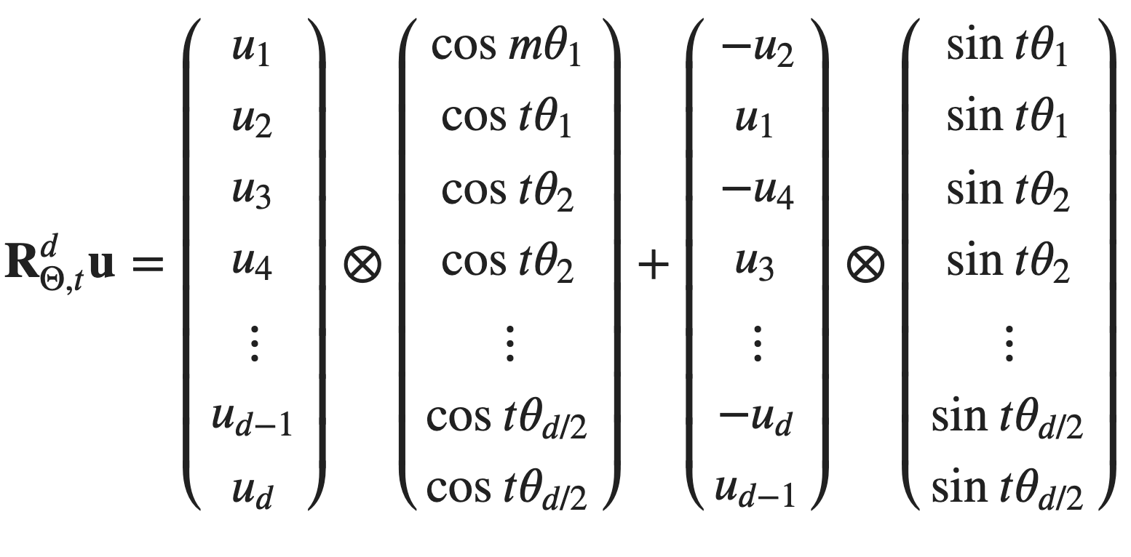
RoPE in its General Form
$$qk_{mn} ={\left(R_{Θ, m}^{d}W_{q}x_{m}\right)}^{T}\left(R_{Θ, m}^{d}W_{k}x_{n}\right),$$
where $R_{Θ, m}^{d}$ is a $d$-dimensional rotation matrix.
Since $R_{Θ, m}^{d}$ is a sparce matrix, its multiplication is implemented via dense operations:

Slide 34
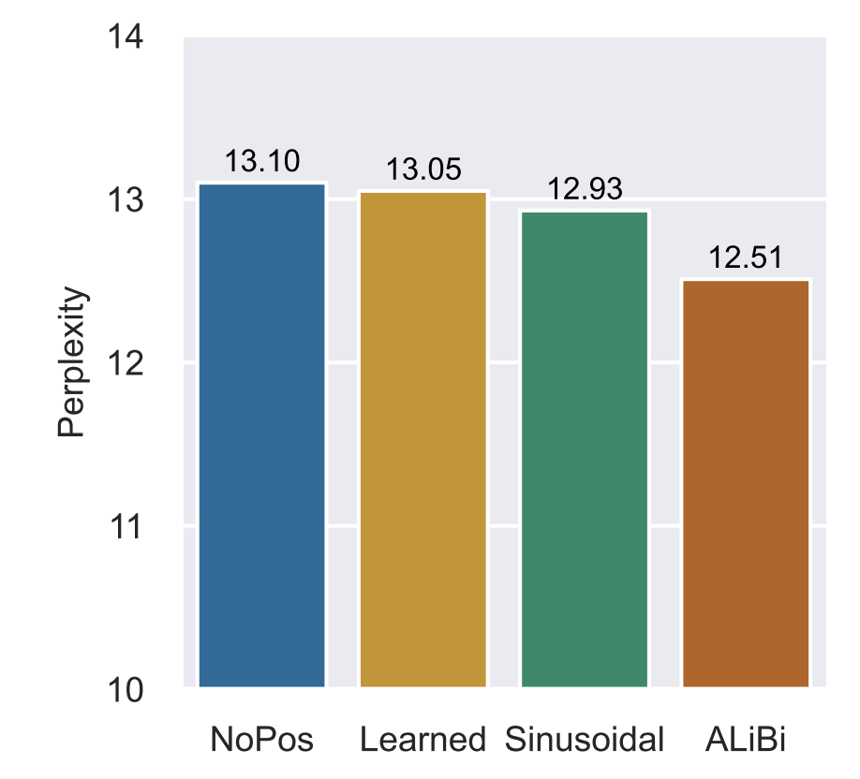
Positional Encodings May Not be Necessary!!
Some result suggest that, you might be able to build low-ppl LMs even if you drop the positional embeddings.
Notice that these results are for causal (decoder) Transformer architectures.
Now the questions are:
How can Transformers do language modeling without positional embeddings?
Does low PPL for language modeling entail being good for any language ability? (e.g., ICL)
Transformer Language Models without Positional Encodings Still Learn Positional Information, 2022

Slide 35
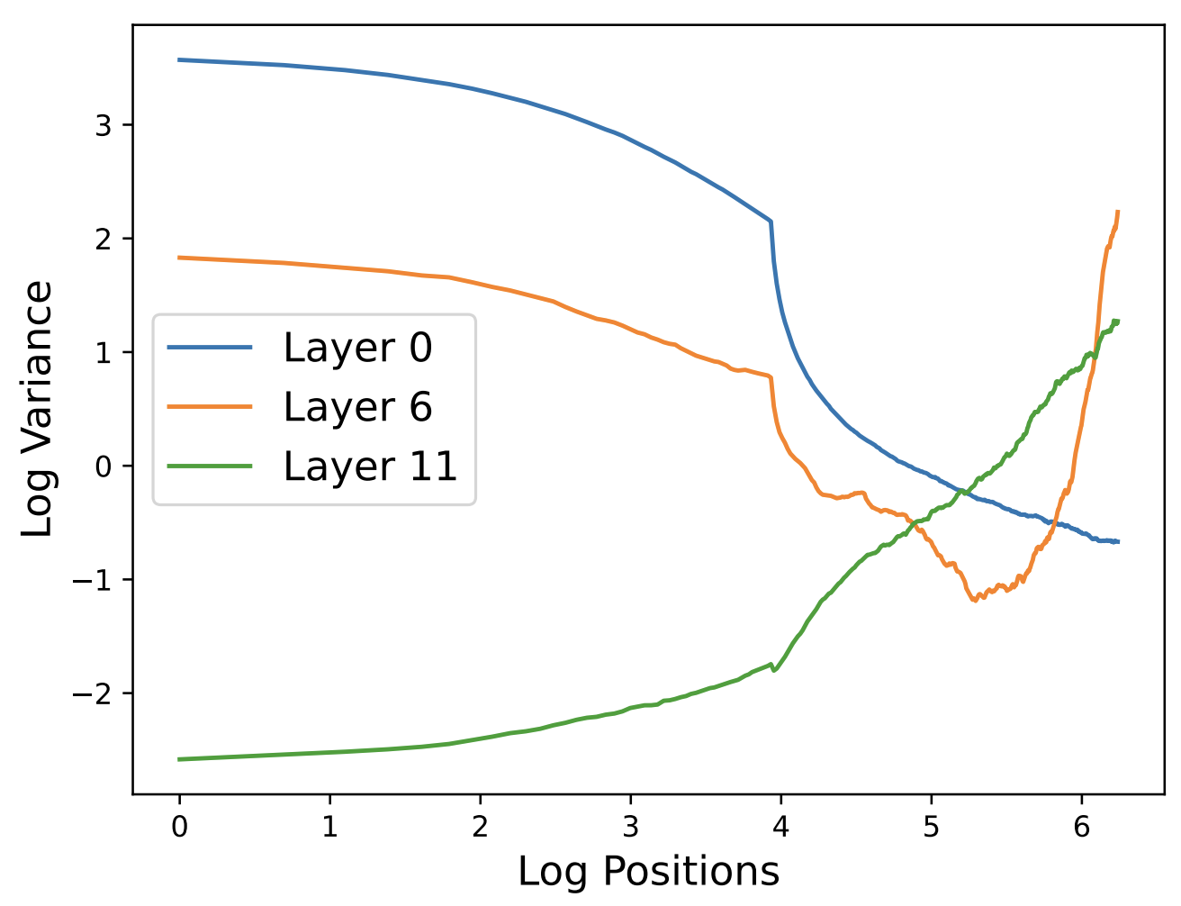
Encoding Positions without Encoding it
One explanation is that decoder Transformers implicitly encoder positional information in variances of attention values.
Attention values of position m result from combining the information of m positions. If the input values are samples from Gaussian distribution, the variance of output values scale with 1/m.
In practice, the earlier layers follow this pattern. But still variance encodes positions.
Latent Positional Information is in the Self-Attention Variance of Transformer Language Models Without Positional Embeddings, 2023

Slide 36
Summary
Encoding positional information in language models is a non-trivial problem.
We discussed various proposal: learned, absolute, relative encoding, NoPos, etc.
This is an important literature related to the length generalization of Transformers.
This is an active research area and likely to change in the coming years.

Slide 37
Long Context: Efficiency and Generalization

Slide 38
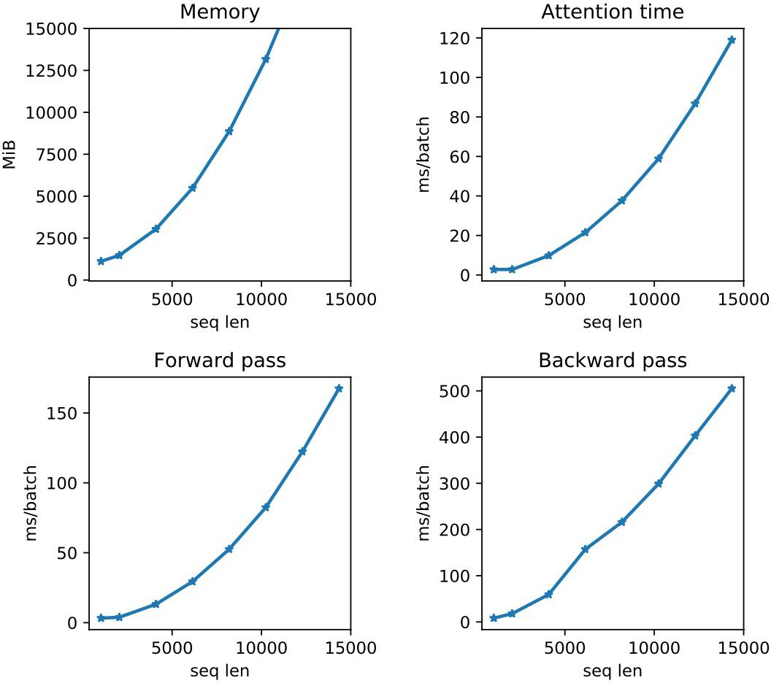
Transformer LMs and Long Inputs
Length generalization: Do Transformers work accurately on long inputs?
Efficiency considerations: How efficient are LMs are long inputs?

Slide 39
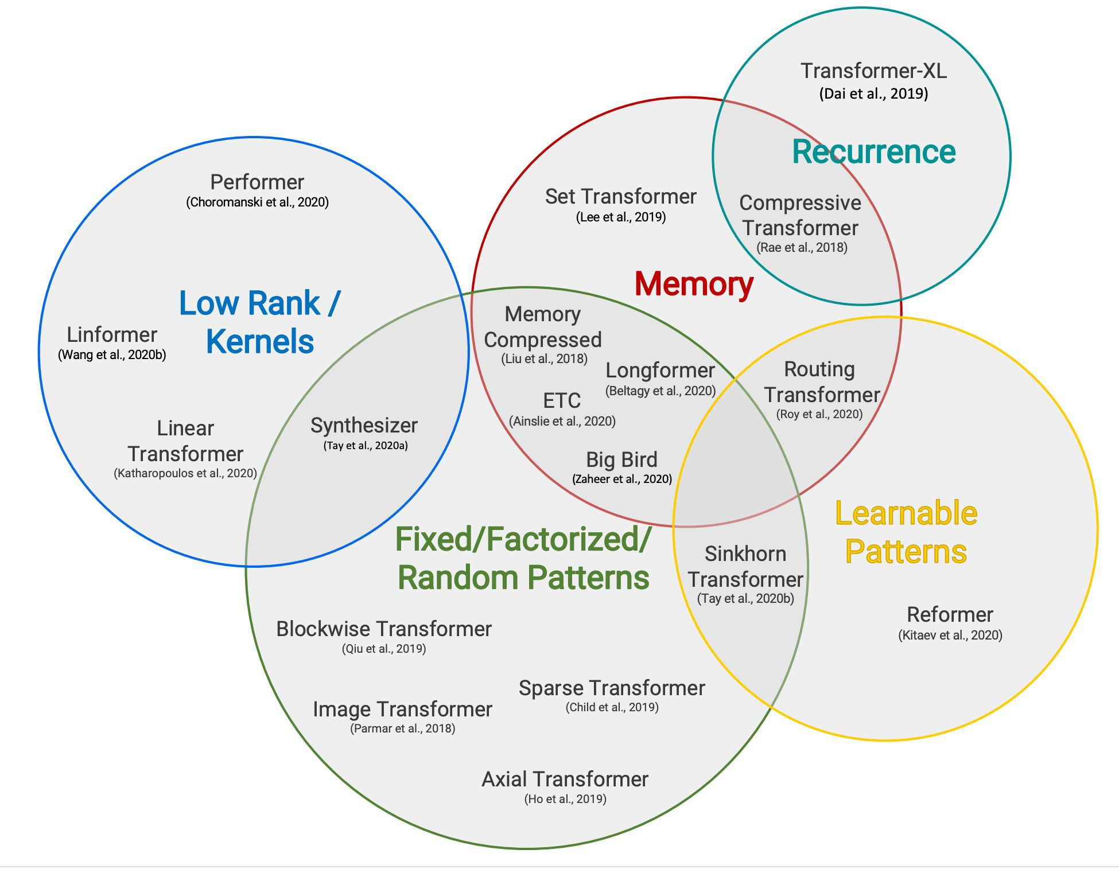
Transformer LMs and Long Inputs
A wide variety of topics.
We will cover few only.
Fig reference: Tay et al., 2020

Slide 40
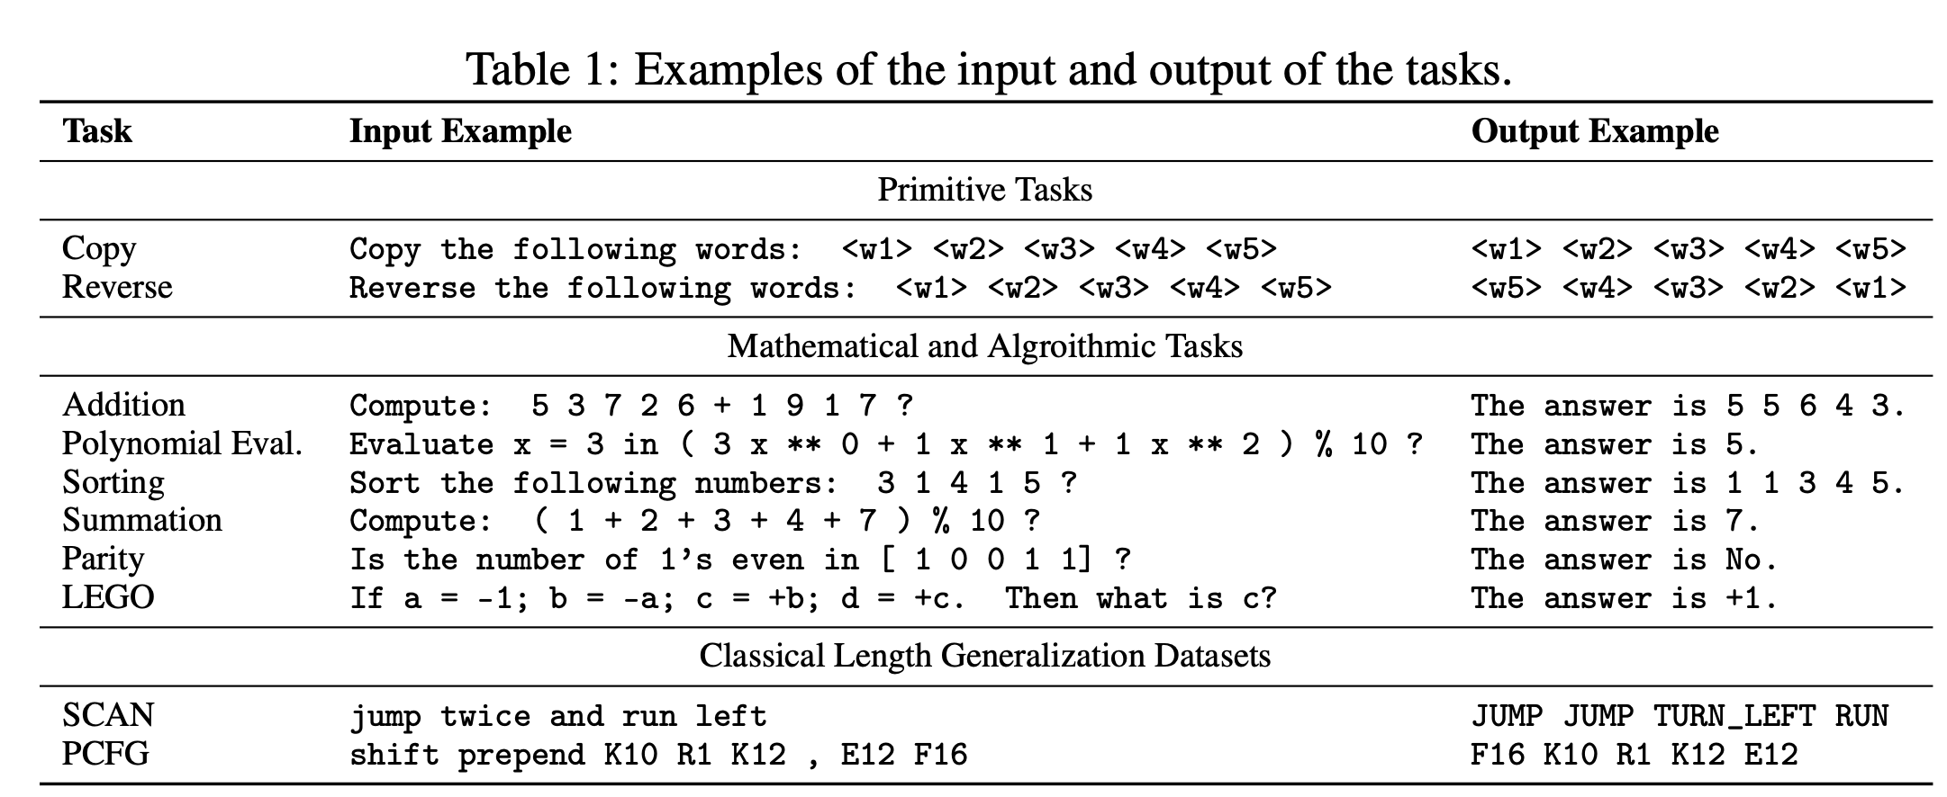
Length Generalization
The Impact of Positional Encoding on Length Generalization in Transformers, 2023

Slide 41
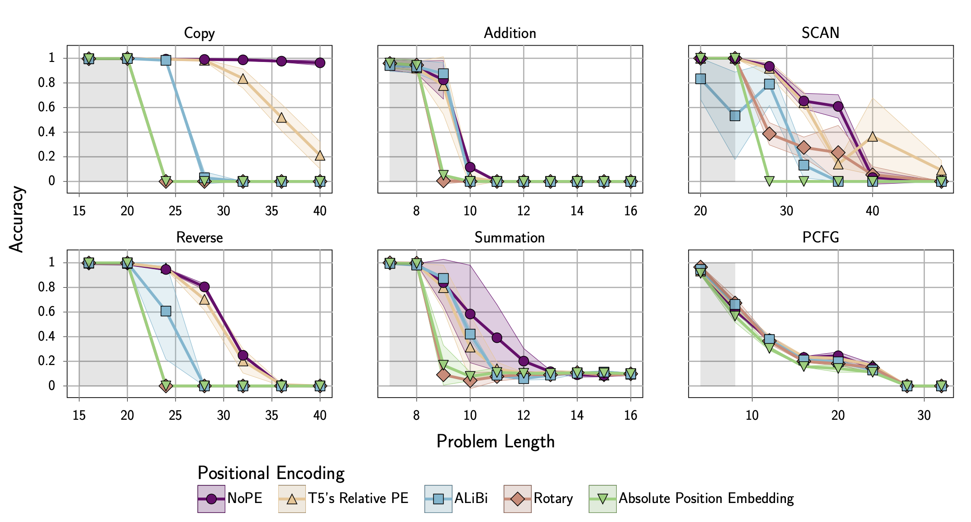
Length Generalization
The Impact of Positional Encoding on Length Generalization in Transformers, 2023

Slide 42
Efficiency considerations

Slide 43
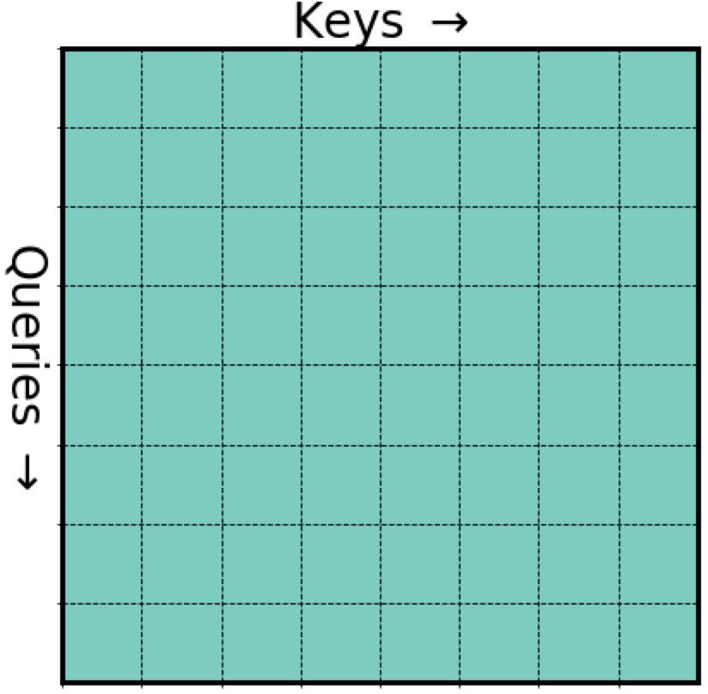
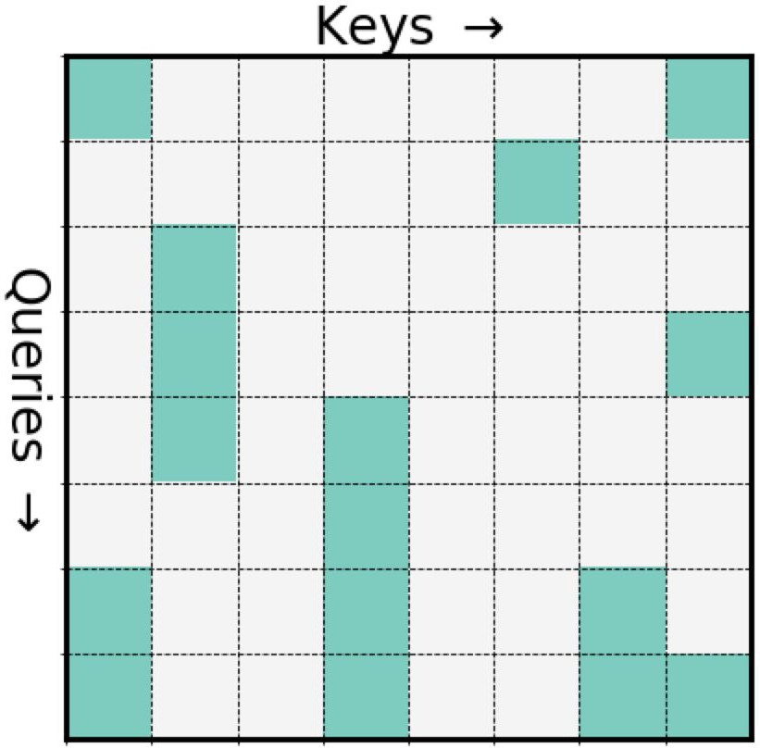
Sparse Attention Patterns
The idea is to make the attention operation sparse
[NAACL 2021 Tutorial Beltagy, Cohan, Hajishirzi, Min, and Peters]

Slide 44
Sparse Attention Patterns: Challenge
Ok sparsity is great, but how to efﬁciently implement this?
Challenge: Arbitrary sparse matrix multiplication is not supported in DL libraries
A solution: Perform computations in blocks
[NAACL 2021 Tutorial Beltagy, Cohan, Hajishirzi, Min, and Peters]

Slide 45
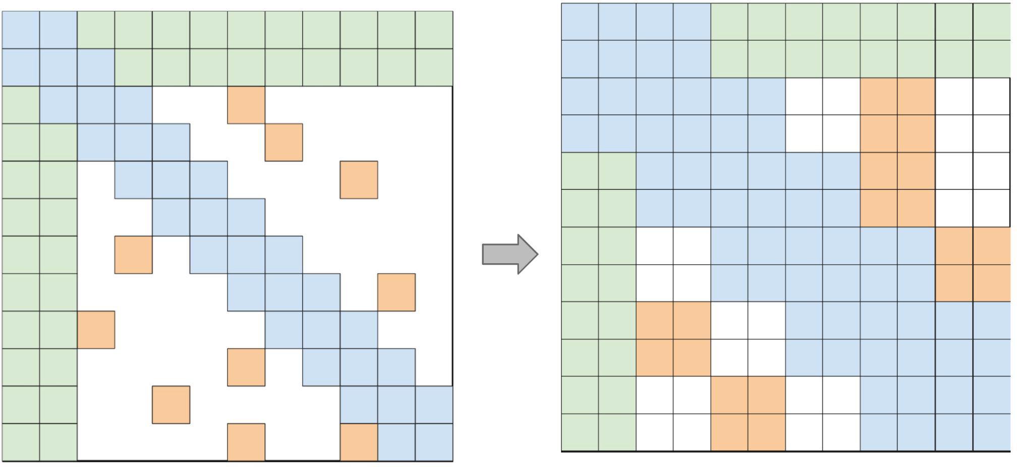
Pre-speciﬁed Sparsity Patterns: Computations
Efﬁcient blockiﬁed implementation
There are libraries for implementing blockified sparse matrix multiplication.
Can be hardware speciﬁc
Block Sparse (Gray et al., 2017)
TVM toolkit (Chen et al., 2018)
cuSPARSE
[Big Bird (Zaheer et al., 2020)]

Slide 46
Sparse Patterns
How to sparsify?
Content-based
Routing Transformers (Roy et al., 2019)
Sinkhorn (Tay et al., 2020)
Reformer (Kitaev et al., 2020)
Pre-speciﬁed patterns
Sparse Transformer (Child et al,. 2019)
Longformer (Beltagy, et al., 2020)
ETC (Ainslie et al., 2020)
BigBird (Zaheer et al., 2020)
[NAACL 2021 Tutorial Beltagy, Cohan, Hajishirzi, Min, and Peters]

Slide 47
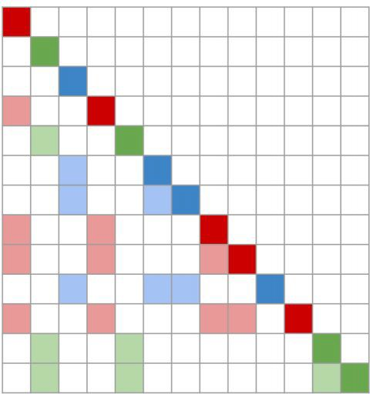
Content-Based Patterns
Routing Transformer (Roy et al., 2020)
Clustering-based attention mechanism that learns the attention sparsity in a data driven fashion.
Project Q and K into routing matrix R
The R matrix undergoes k-means clustering
After clustering, each token only attends to tokens from the same cluster
Auto-regressive attention, each color shows cluster membership
[NAACL 2021 Tutorial Beltagy, Cohan, Hajishirzi, Min, and Peters]

Slide 48
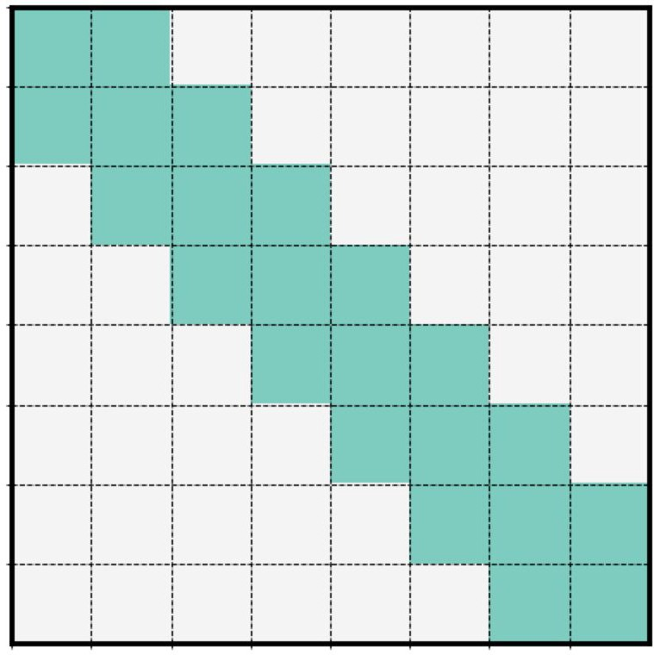
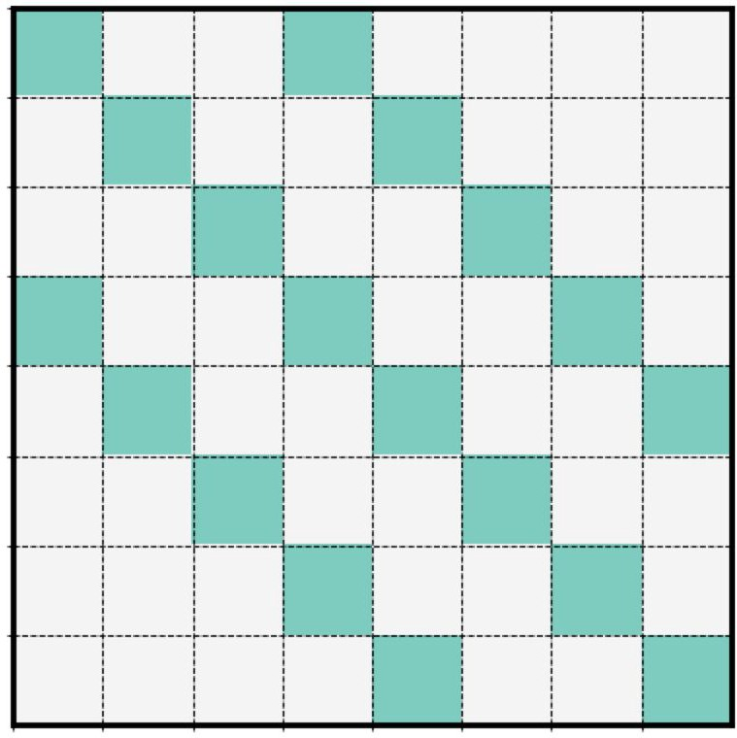
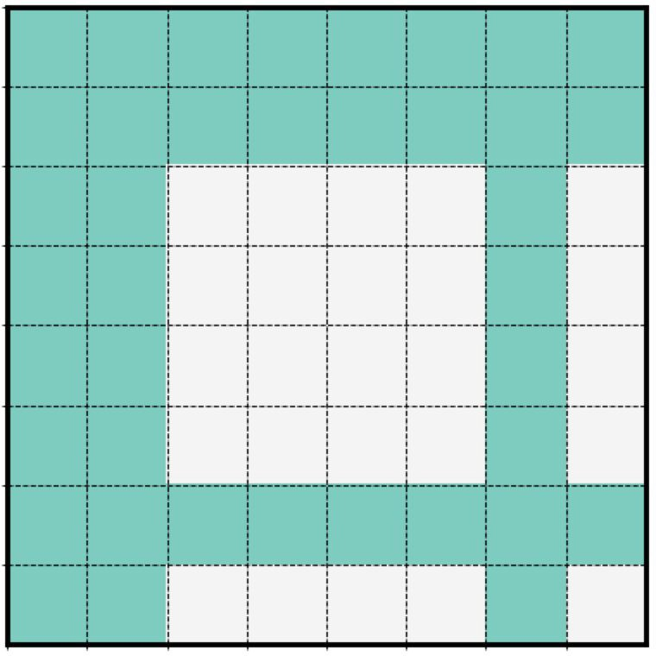
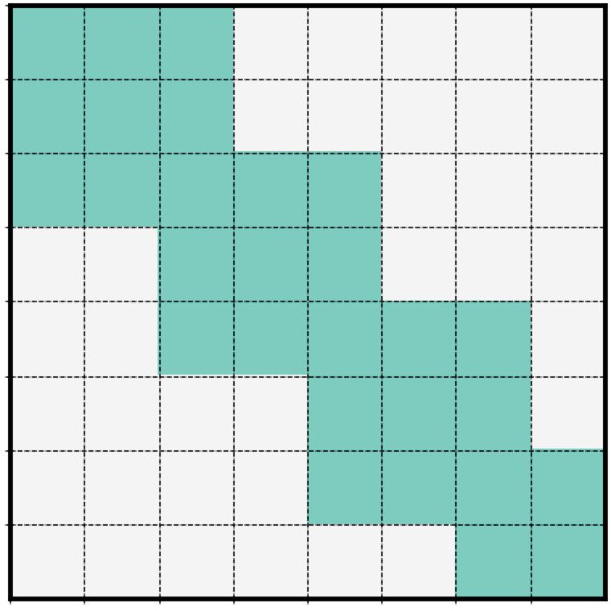
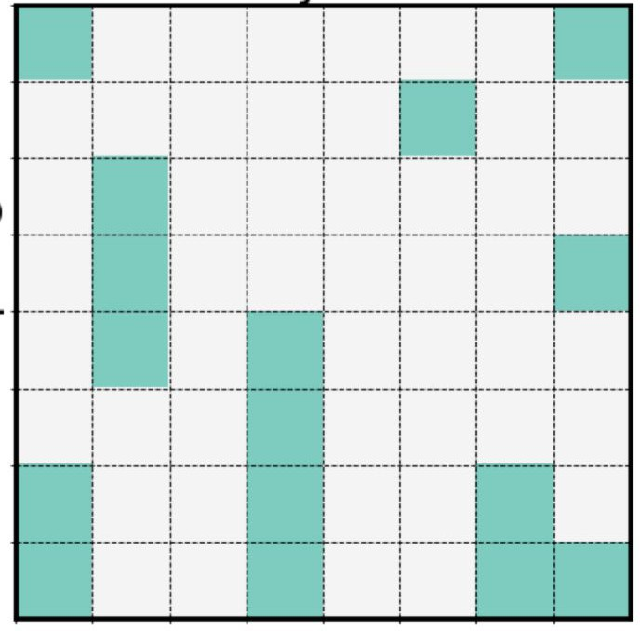
Pre-speciﬁed Sparsity Patterns
A variety of patterns has been explored in the past work
Longformer (Beltagy et al., 2020), Sparse Transformer (Child et al., 2019), …
Sliding window
Dilated
Global
Blocked
Random
Sparse Transformer Longformer
Longformer
Big Bird
Big Bird Sinkhorn
Big Bird
[NAACL 2021 Tutorial Beltagy, Cohan, Hajishirzi, Min, and Peters]

Slide 49
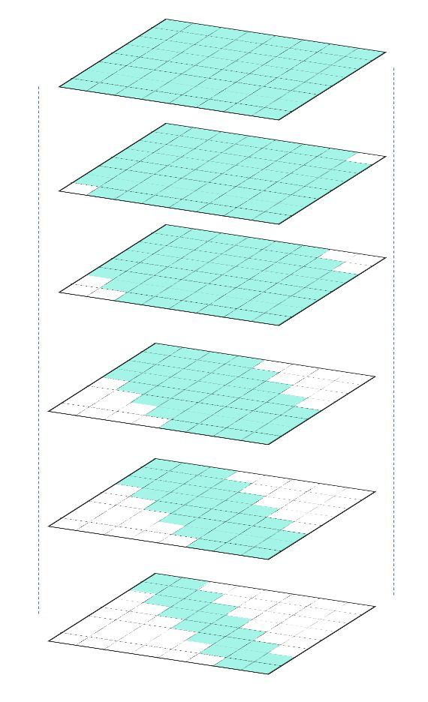
Pre-speciﬁed Sparsity Patterns
Different layers and attention heads can follow different patterns
A common setup is to have earlier layers with sparser attention pattern.
Longformer (Beltagy et al., 2020)

Slide 50
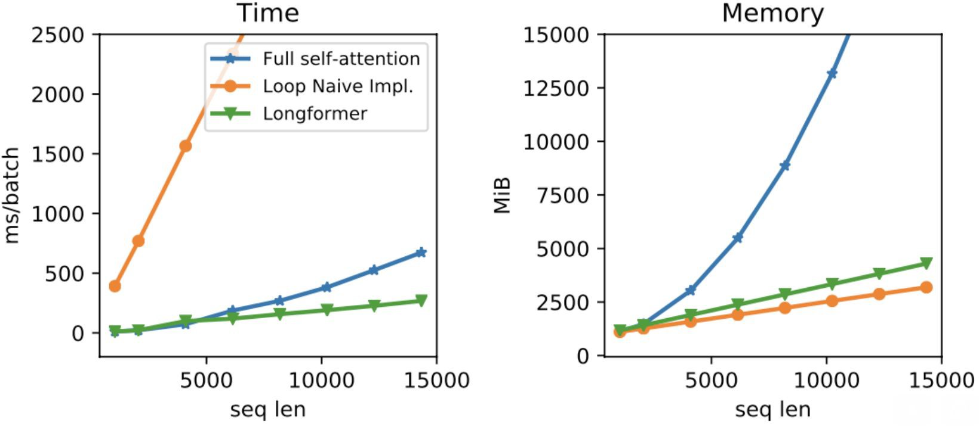
Pre-speciﬁed Sparsity Patterns: Computations
[Longformer (Beltagy et al., 2020)]

Slide 51
A Notable Adoption: GPT-3
Sparse patterns also used in GPT-3 (Brown et al., 2020)

Slide 52
Summary
How well do Transformers work on long sequences? Not so well.
How can we make them more efficient? Induce sparsity.
Many open questions we did not get into:
Limitations of sportifying Transformers
Alternatives to Transformers (e.g., state-space models)
…

Slide 53
Retrieval-Augmented LMs

Slide 54
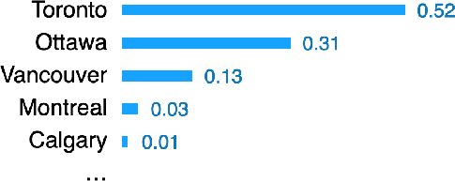
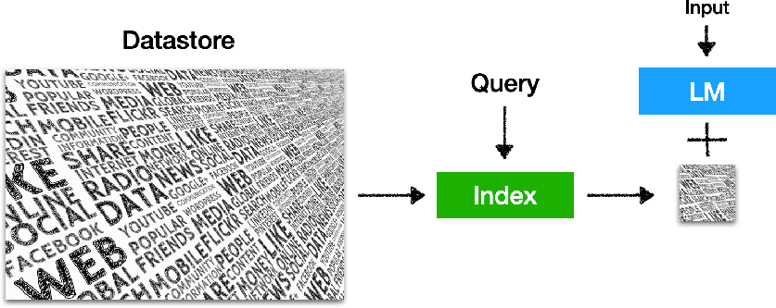
Retrieval-based Language Models
It is a language model
P(x_{n} | x₁, x₂, ⋯, x_{n−1})
The capital city of Ontario is
(can be broadly extended to masked language models or encoder-decoder models)
It retrieves from an external datastore (at least during inference time)
(Also referred to semiparametric and non-parametric models)
[Slides: Akari Asai, Sewon Min, Zexuan Zhong, Danqi Chen]

Slide 55
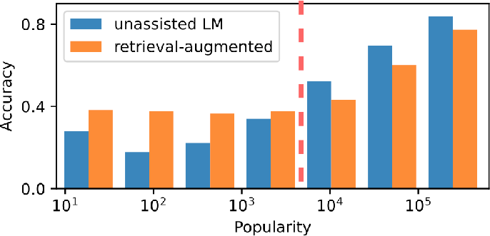
Why retrieval-based LMs?
LLMs can’t memorize all (long-tail) knowledge in their parameters
List 5 important papers authored by Geoffrey Hinton
What is Kathy Saltzman’s occupation?
Geoffrey Hinton is a renowned computer scientist … Here are five important papers authored by him:
"Learning Internal Representations by Error Propagation" (with D. E. Rumelhart and R. J. Williams) - This paper, published in 1986, ..
"Deep Boltzmann Machines" (with R.
Salakhutdinov) - Published in 2009, ..
…
"Deep Learning" (with Y. Bengio and A. Courville) - Published as a book in 2016,…
"Attention Is All You Need" (with V. Vaswani, N. Shazeer, et al.) - Published in 2017, this paper introduced the Transformer model,…
(Mallen et al., 2023)
GPT-3 davinci-003: 20%-30% accuracy
[Slides: Akari Asai, Sewon Min, Zexuan Zhong, Danqi Chen]

Slide 56
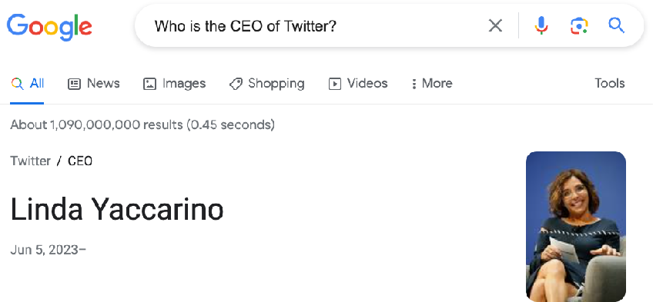
Why retrieval-based LMs?
LLMs’ knowledge is easily outdated and hard to update
Who is the CEO of Twitter?
As of my knowledge cutoff in September 2021, the CEO of Twitter is Jack Dorsey….
Existing knowledge editing methods are still NOT scalable (active research!)
The datastore can be easily updated and
expanded - even without retraining!
New!
[Slides: Akari Asai, Sewon Min, Zexuan Zhong, Danqi Chen]

Slide 57
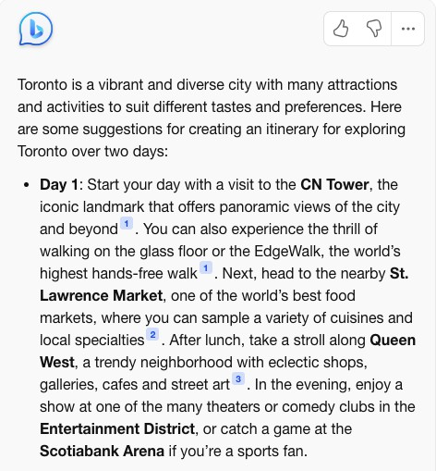
Why retrieval-based LMs?
LLMs’ output is challenging to interpret and verify
[Slides: Akari Asai, Sewon Min, Zexuan Zhong, Danqi Chen]

Slide 58
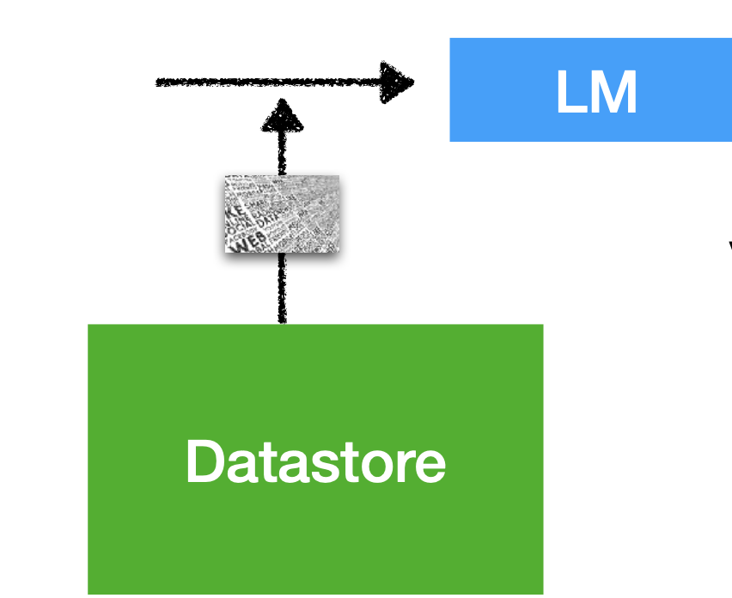
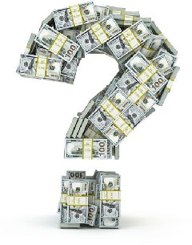
Why retrieval-based LMs?
LLMs are *large* and expensive to train and run
LM
vs.
Long-term goal: can we possibly reduce the training and
inference costs, and scale down the size of LLMs?
e.g., RETRO (Borgeaud et al., 2021): “obtains comparable performance to GPT-3 on the Pile, despite using 25x fewer parameters”
[Slides: Akari Asai, Sewon Min, Zexuan Zhong, Danqi Chen]

Slide 59
What are the Key Design Questions?
What are your memories?
Documents, database records, training examples, etc.
How to retrieve memories?
Use an off-the-shelf search engine (e.g. Google, StackOverflow).
How to train your own memory retriever.
How to use retrieved memories?
"Text fusion"
Common failure modes:
Underutilization: model ignores retrieved memories.
Overreliance: model depends too much on memories!
[Slides: Kelvin Guu]

Slide 60
Anatomy of a Neural Retriever
Score the input against each key.
Return the value for the highest scoring key.
key
value
1.2
key
value
0.3
input
6.8
key
value
7.1
key
value
[Slides: Kelvin Guu]

Slide 61
Anatomy of a Neural Retriever
Score the input against each key.
Return the value for the highest scoring key.
key
value
1.2
key
value
0.3
input
6.8
key
value
7.1
key
value
A similarity function: sim(input, key) → score
[Slides: Kelvin Guu]

Slide 62
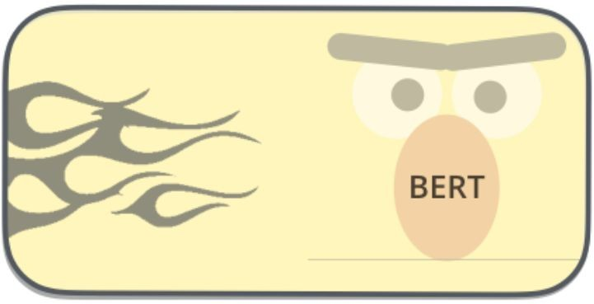
Defining Similarity Metrics
sim(I,M)= Encoder(I) x Encoder(M)
Advantages:
Differentiable -- can optimize with gradient descent.
Disadvantages:
Works well for data on which your LM is pre-trained on.
dot product
input vector
mem vector
input
memory
[Slides: Kelvin Guu]

Slide 63
Defining Similarity Metrics: Approach 2
sim(I,M)= tf(I, M) x log N/d_I
Advantages:
Differentiable -- can optimize with gradient descent.
Disadvantages:
Works well for data on which your LM is pre-trained on.
tf(I, M): # of occurrences of I in M.
N: # of documents
d_I: # of documents that contain I.
[Slides: Kelvin Guu]

Slide 64
Finding Nearest Neighbors

Slide 65
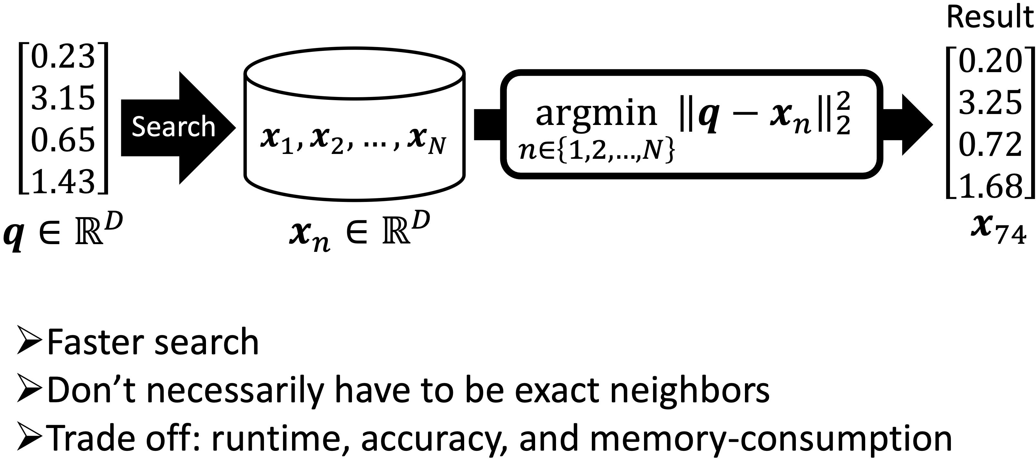
Approximate Finding Nearest Neighbors

Slide 66
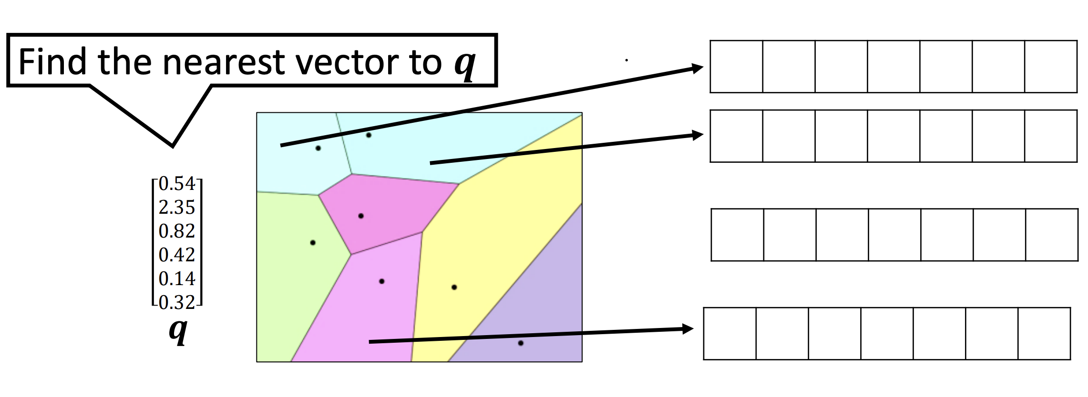
Approximate NNs: Algorithms, Libraries, Services
Space partitioning + data compression
More information: https://github.com/facebookresearch/faiss/wiki
[Slides: Martin Aumüller]

Slide 67
Approximate NNs: Algorithms, Libraries, Services
Algorithm
Scientific paper
Math
Often, by researchers
Library
Implementations of algorithms
Usually, a search function only
By researchers, developers, etc
faiss
NMSLIB
hnswlib
ScaNN
Service (e.g., vector DB)
Library + (handling metadata,
serving, scaling, IO, CRUD, etc)
Usually, by companies
Product Quantization + Inverted Index (PQ, IVFPQ) [Jégou+, TPAMI 2011]
Pinecone
Qdrant
Hierarchical Navigable Small World (HNSW) [Malkov+, TPAMI 2019]
Milvus
jina
Vald
Vertex AI Matching Engine
ScaNN (4-bit PQ)
[Guo+, ICML 2020]
Weaviate
29
[Slides: Yusuke Matsui]

Slide 68
Three levels of technology
Algorithm Library Service (e.g., vector DB)
➢ Scientific paper ➢ Implementations of algorithms ➢ Library + (handling metadata,
➢ Math ➢ Usually, a search function only serving, scaling, IO, CRUD, etc)
➢ Often, by researchers ➢ By researchers, developers, etc ➢ Usually, by companies
Pinecone
Qdrant
Milvus
NMSLIB jina
^{Vald} Vertex AI
_{ScaNN (4-bit PQ)} ^{hnswlib} Matching Engine
[Guo+, ICML 2020]
ScaNN Weaviate
30
Product Quantization + Inverted Index (PQ, IVFPQ) [Jégou+, TPAMI 2011]
faiss
Hierarchical Navigable Small World (HNSW) [Malkov+, TPAMI 2019]
One library may implement
multiple algorithms
☹ “I benchmarked faiss”
☺ “I benchmarked PQ in faiss”
[Slides: Yusuke Matsui]

Slide 69
One algorithm may be
Three levels of technology
Algorithm Library Service (e.g., vector DB)
➢ Scientific paper ➢ Implementations of algorithms ➢ Library + (handling metadata,
➢ Math ➢ Usually, a search function only serving, scaling, IO, CRUD, etc)
➢ Often, by researchers ➢ By researchers, developers, etc ➢ Usually, by companies
Product Quantization + _{Pinecone}
Inverted Index (PQ, IVFPQ)
[Jégou+, TPAMI 2011]
Qdrant
Milvus
jina
^{Vald} Vertex AI
_{ScaNN (4-bit PQ)} Matching Engine
[Guo+, ICML 2020]
ScaNN Weaviate
31
implemented in multiple libraries
faiss
Hierarchical Navigable Small World (HNSW) [Malkov+, TPAMI 2019]
NMSLIB
hnswlib
[Slides: Yusuke Matsui]

Slide 70
One service may use some libraries
Three levels of technology
Algorithm Library Service (e.g., vector DB)
➢ Scientific paper ➢ Implementations of algorithms ➢ Library + (handling metadata,
➢ Math ➢ Usually, a search function only serving, scaling, IO, CRUD, etc)
➢ Often, by researchers ➢ By researchers, developers, etc ➢ Usually, by companies
Product Quantization + _{Pinecone}
Inverted Index (PQ, IVFPQ)
[Jégou+, TPAMI 2011]
Qdrant
NMSLIB jina
^{Vald} Vertex AI
_{ScaNN (4-bit PQ)} Matching Engine
[Guo+, ICML 2020]
ScaNN
33
faiss
Hierarchical Navigable Small World (HNSW) [Malkov+, TPAMI 2019]
Milvus
hnswlib
… or re-implement algorithms from scratch (e.g., by Go)
Weaviate
[Slides: Yusuke Matsui]

Slide 71
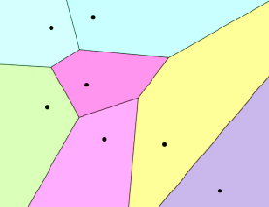
𝑁
Inverted index + data compression
Space partition Data compression
k-means
PQ/OPQ
Graph traversal
etc…
Raw data
Scalar quantization
PQ/OPQ
etc…
billion-scale
10⁹
…
For raw data: Acc. ☺, Memory: ☹
For compressed data: Acc. ☹, Memory: ☺
Look-up-based
million-scale
Locality Sensitive Hashing (LSH)
0.34
0.22
0.68
0.71
ID: 2
Linear-scan by
Asymmetric Distance
ID: 123
10⁶
Tree / Space Partitioning
Hamming-based
0.34
0.22
0.68
0.71
0
1
0
0
Linear-scan by
Hamming distance
Graph traversal
[Slides: Yusuke Matsui]

Slide 72
Let’s assume that we have our retrieval engine and data ready

Slide 73
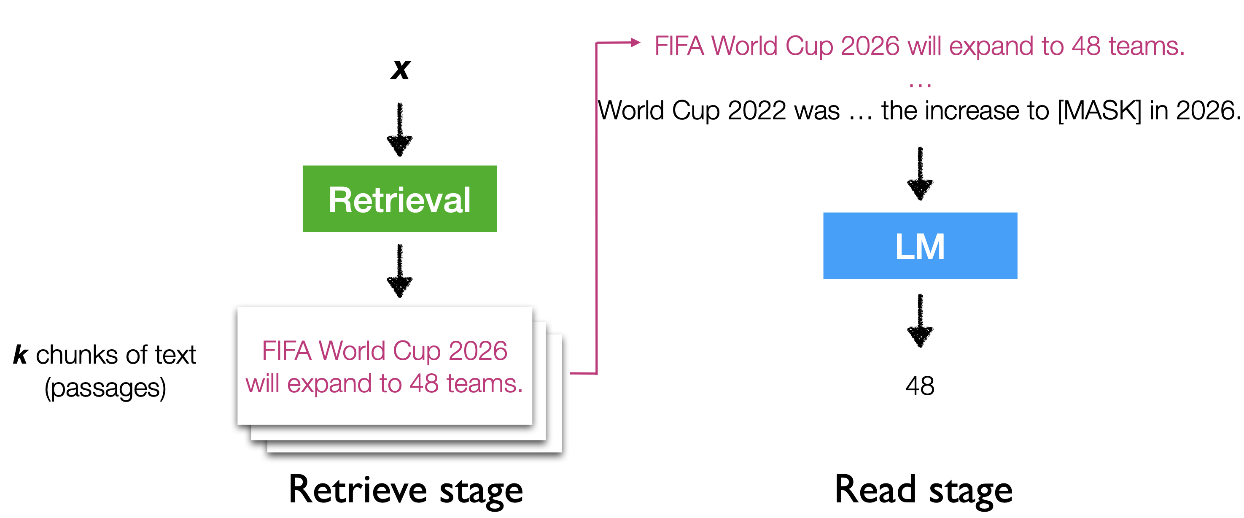
Retrieval-Augmented LM
x = World Cup 2022 was the last before the increase to [MASK] in the 2026 tournament.
[Slides: Akari Asai, Sewon Min, Zexuan Zhong, Danqi Chen]

Slide 74
Retrieval-Augmented LM
FIFA World Cup 2026 will expand to 48 teams.
Encoder
In 2022, the 32 national teams involved in the tournament.
Encoder
Team USA celebrated after winning its match against Iran …
z = Encoder(z)
Encoder
Wikipedia
13M chunks (passages)
(called documents in the paper)
[Slides: Akari Asai, Sewon Min, Zexuan Zhong, Danqi Chen]
7

Slide 75
Retrieval-Augmented LM
x = World Cup 2022 was … the increase to [MASK] in 2026.
FIFA World Cup 2026 will expand to 48 teams.
Encoder
In 2022, the 32 national teams involved in the tournament.
Encoder
Team USA celebrated after winning its match against Iran …
z = Encoder(z)
Encoder
Wikipedia
13M chunks (passages)
(called documents in the paper)
[Slides: Akari Asai, Sewon Min, Zexuan Zhong, Danqi Chen]
7

Slide 76
Retrieval-Augmented LM
x = World Cup 2022 was … the increase to [MASK] in 2026.
Encoder
FIFA World Cup 2026 will expand to 48 teams.
Encoder
In 2022, the 32 national teams involved in the tournament.
Encoder
z = Encoder(z)
x = Encoder(x)
Team USA celebrated after winning its match against Iran …
Encoder
Wikipedia
13M chunks (passages)
(called documents in the paper)
[Slides: Akari Asai, Sewon Min, Zexuan Zhong, Danqi Chen]
7

Slide 77
Retrieval-Augmented LM
x = World Cup 2022 was … the increase to [MASK] in 2026.
Encoder
FIFA World Cup 2026 will expand to 48 teams.
Fast nearest neighbor search
Encoder
In 2022, the 32 national teams involved in the tournament.
Encoder
z = Encoder(z)
x = Encoder(x)
Team USA celebrated after winning its match against Iran …
Encoder
Wikipedia
13M chunks (passages)
(called documents in the paper)
[Slides: Akari Asai, Sewon Min, Zexuan Zhong, Danqi Chen]
7

Slide 78
Retrieval-Augmented LM
x = World Cup 2022 was … the increase to [MASK] in 2026.
Encoder
FIFA World Cup 2026 will expand to 48 teams.
Fast nearest neighbor search
Encoder
In 2022, the 32 national teams involved in the tournament.
Encoder
z = Encoder(z)
x = Encoder(x)
z₁, . . . , z_{k} = argTop-k (x ⋅ z)
Team USA celebrated after winning its match against Iran …
Encoder
Wikipedia
13M chunks (passages)
(called documents in the paper)
k retrieved chunks
[Slides: Akari Asai, Sewon Min, Zexuan Zhong, Danqi Chen]
7

Slide 79
Retrieval-Augmented LM
x + z₁
x + z₂
LM
P(y | x, z₁)
P(y | x, z₂)
LM
…
x + z_{k}
LM
P(y | x, z_{k})
[Slides: Akari Asai, Sewon Min, Zexuan Zhong, Danqi Chen]
8

Slide 80
Retrieval-Augmented LM: Variants
What to retrieve?
How to use retrieval?
When to retrieve?
Chunks
Tokens
Others
Input layer
Intermediate layers
Output layer
Once
Every n tokens (n>1)
Every token
[Slides: Akari Asai, Sewon Min, Zexuan Zhong, Danqi Chen]

Slide 81
Retrieval-Augmented LM: Common Variant
What to retrieve?
How to use retrieval?
When to retrieve?
Chunks
Tokens
Others
Input layer
Intermediate layers
Output layer
Once
Every n tokens (n>1)
Every token
[Slides: Akari Asai, Sewon Min, Zexuan Zhong, Danqi Chen]

Slide 82
IR in the Middle of LM
[Slides: Akari Asai, Sewon Min, Zexuan Zhong, Danqi Chen]
x = World Cup 2022 was the last with 32 teams, before the increase to
1 2 3
(k chunks of text per split)
Retrieval Encoder
Index
p¹ . . . p^{k}
1 1
1
2
3
p¹ . . . p^{k}
2 2
p¹ . . . p^{k}
3 3
Borgeaud et al. 2021. “Improving language models by retrieving from trillions of tokens”

Slide 83
IR in the Middle of LM
[Slides: Akari Asai, Sewon Min, Zexuan Zhong, Danqi Chen]
x = World Cup 2022 was the last with 32 teams, before the increase to
1 2 3
(k chunks of text per split)
Retrieval Encoder
Index
p¹ . . . p^{k}
1 1
LM
Encoder
1
2
3
p¹ . . . p^{k}
2 2
p¹ . . . p^{k}
3 3
Borgeaud et al. 2021. “Improving language models by retrieving from trillions of tokens”

Slide 84
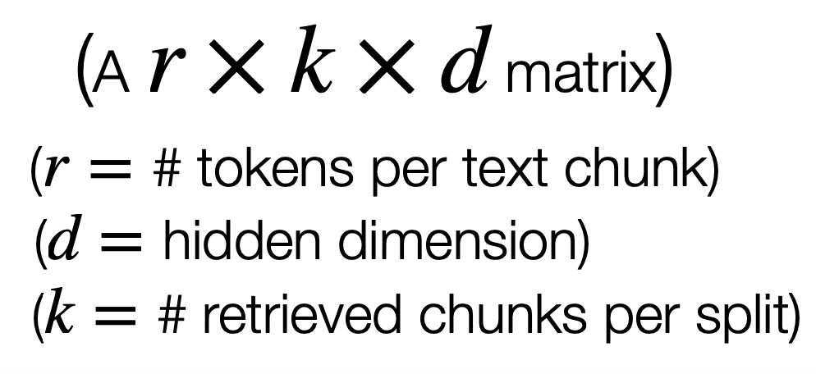
IR in the Middle of LM
[Slides: Akari Asai, Sewon Min, Zexuan Zhong, Danqi Chen]
x = World Cup 2022 was the last with 32 teams, before the increase to
1 2 3
(k chunks of text per split)
Retrieval Encoder
Index
p¹ . . . p^{k}
1 1
LM
Encoder
E
1
2
3
1
p¹ . . . p^{k}
2 2
E
2
p¹ . . . p^{k}
3 3
E₃
Borgeaud et al. 2021. “Improving language models by retrieving from trillions of tokens”

Slide 85
Regular Decoder
1
ATTN
FFN
2
EMB
HEAD
3
Transformers blocks (xL)

Slide 86
Regular Decoder with IR Embeddings
E₁ E₂ E₃
1
ATTN
CCA
FFN
2
EMB
EMB
HEAD
3
RETRO blocks (xL)
Chunked Cross Attention (CCA)

Slide 87
Results
Perplexity: The lower the better
Significant improvements by retrieving from 1.8 trillion tokens
42

Slide 88
Results
Perplexity: The lower the better
Significant improvements by retrieving from 1.8 trillion tokens
42

Slide 89
Retrieval-Augmented LM
What to retrieve?
How to use retrieval?
When to retrieve?
Chunks
Tokens
Others
Input layer
Intermediate layers
Output layer
Once
Every n tokens (n>1)
Every token
[Slides: Akari Asai, Sewon Min, Zexuan Zhong, Danqi Chen]

Slide 90
How do you train these models?

Slide 91
End-to-end Training
There are various ideas in the literature for how to train these models efficiently and in an end-to-end fashion.

Slide 92
Main takeaways
How do we enable LMs to utilize external knowledge?
Retrieval-augmented language models
A retriever is a function, f(input, memory) → score
What we did not discuss:
Attribution: Tracing decisions to the source knowledge
How to modify the knowledge
Conflicting knowledge
Editing knowledge
More efficient scaling
....

Slide 93
TODO
Worth adding a short chapter on: how models resolve conflicts between their parameters and context?
2310.15910.pdf (arxiv.org)
Orion has a paper
Eunsol has multiple papers too

