Slide 1
📈 Scaling Language Models
CSCI 601-471/671 (NLP: Self-Supervised Models)
https://self-supervised.cs.jhu.edu/sp2024/

Slide 2
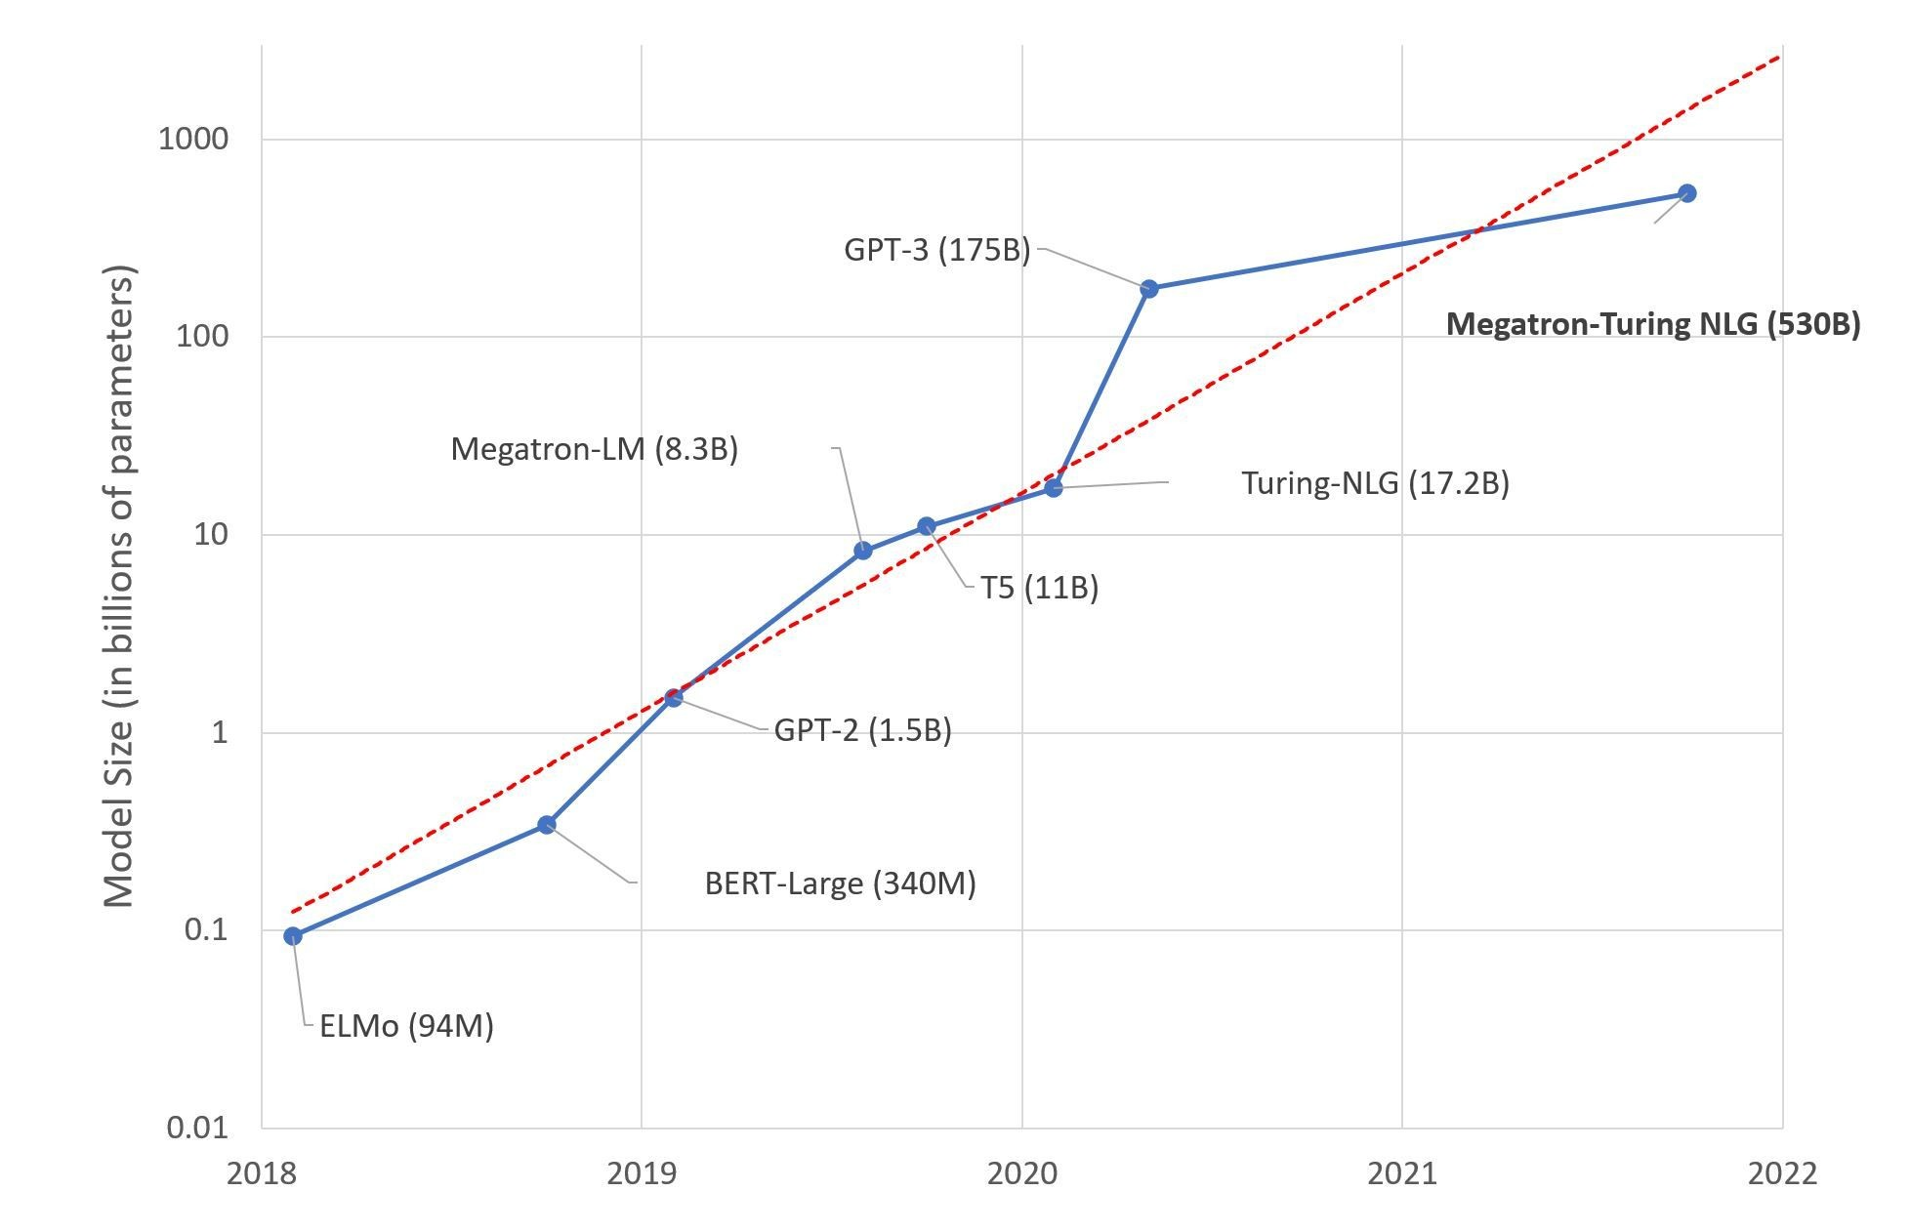
Scaling model size
LM are getting larger and more expensive
Photo credit: Microsoft Research Blog, Alvi et. al., 2021

Slide 3
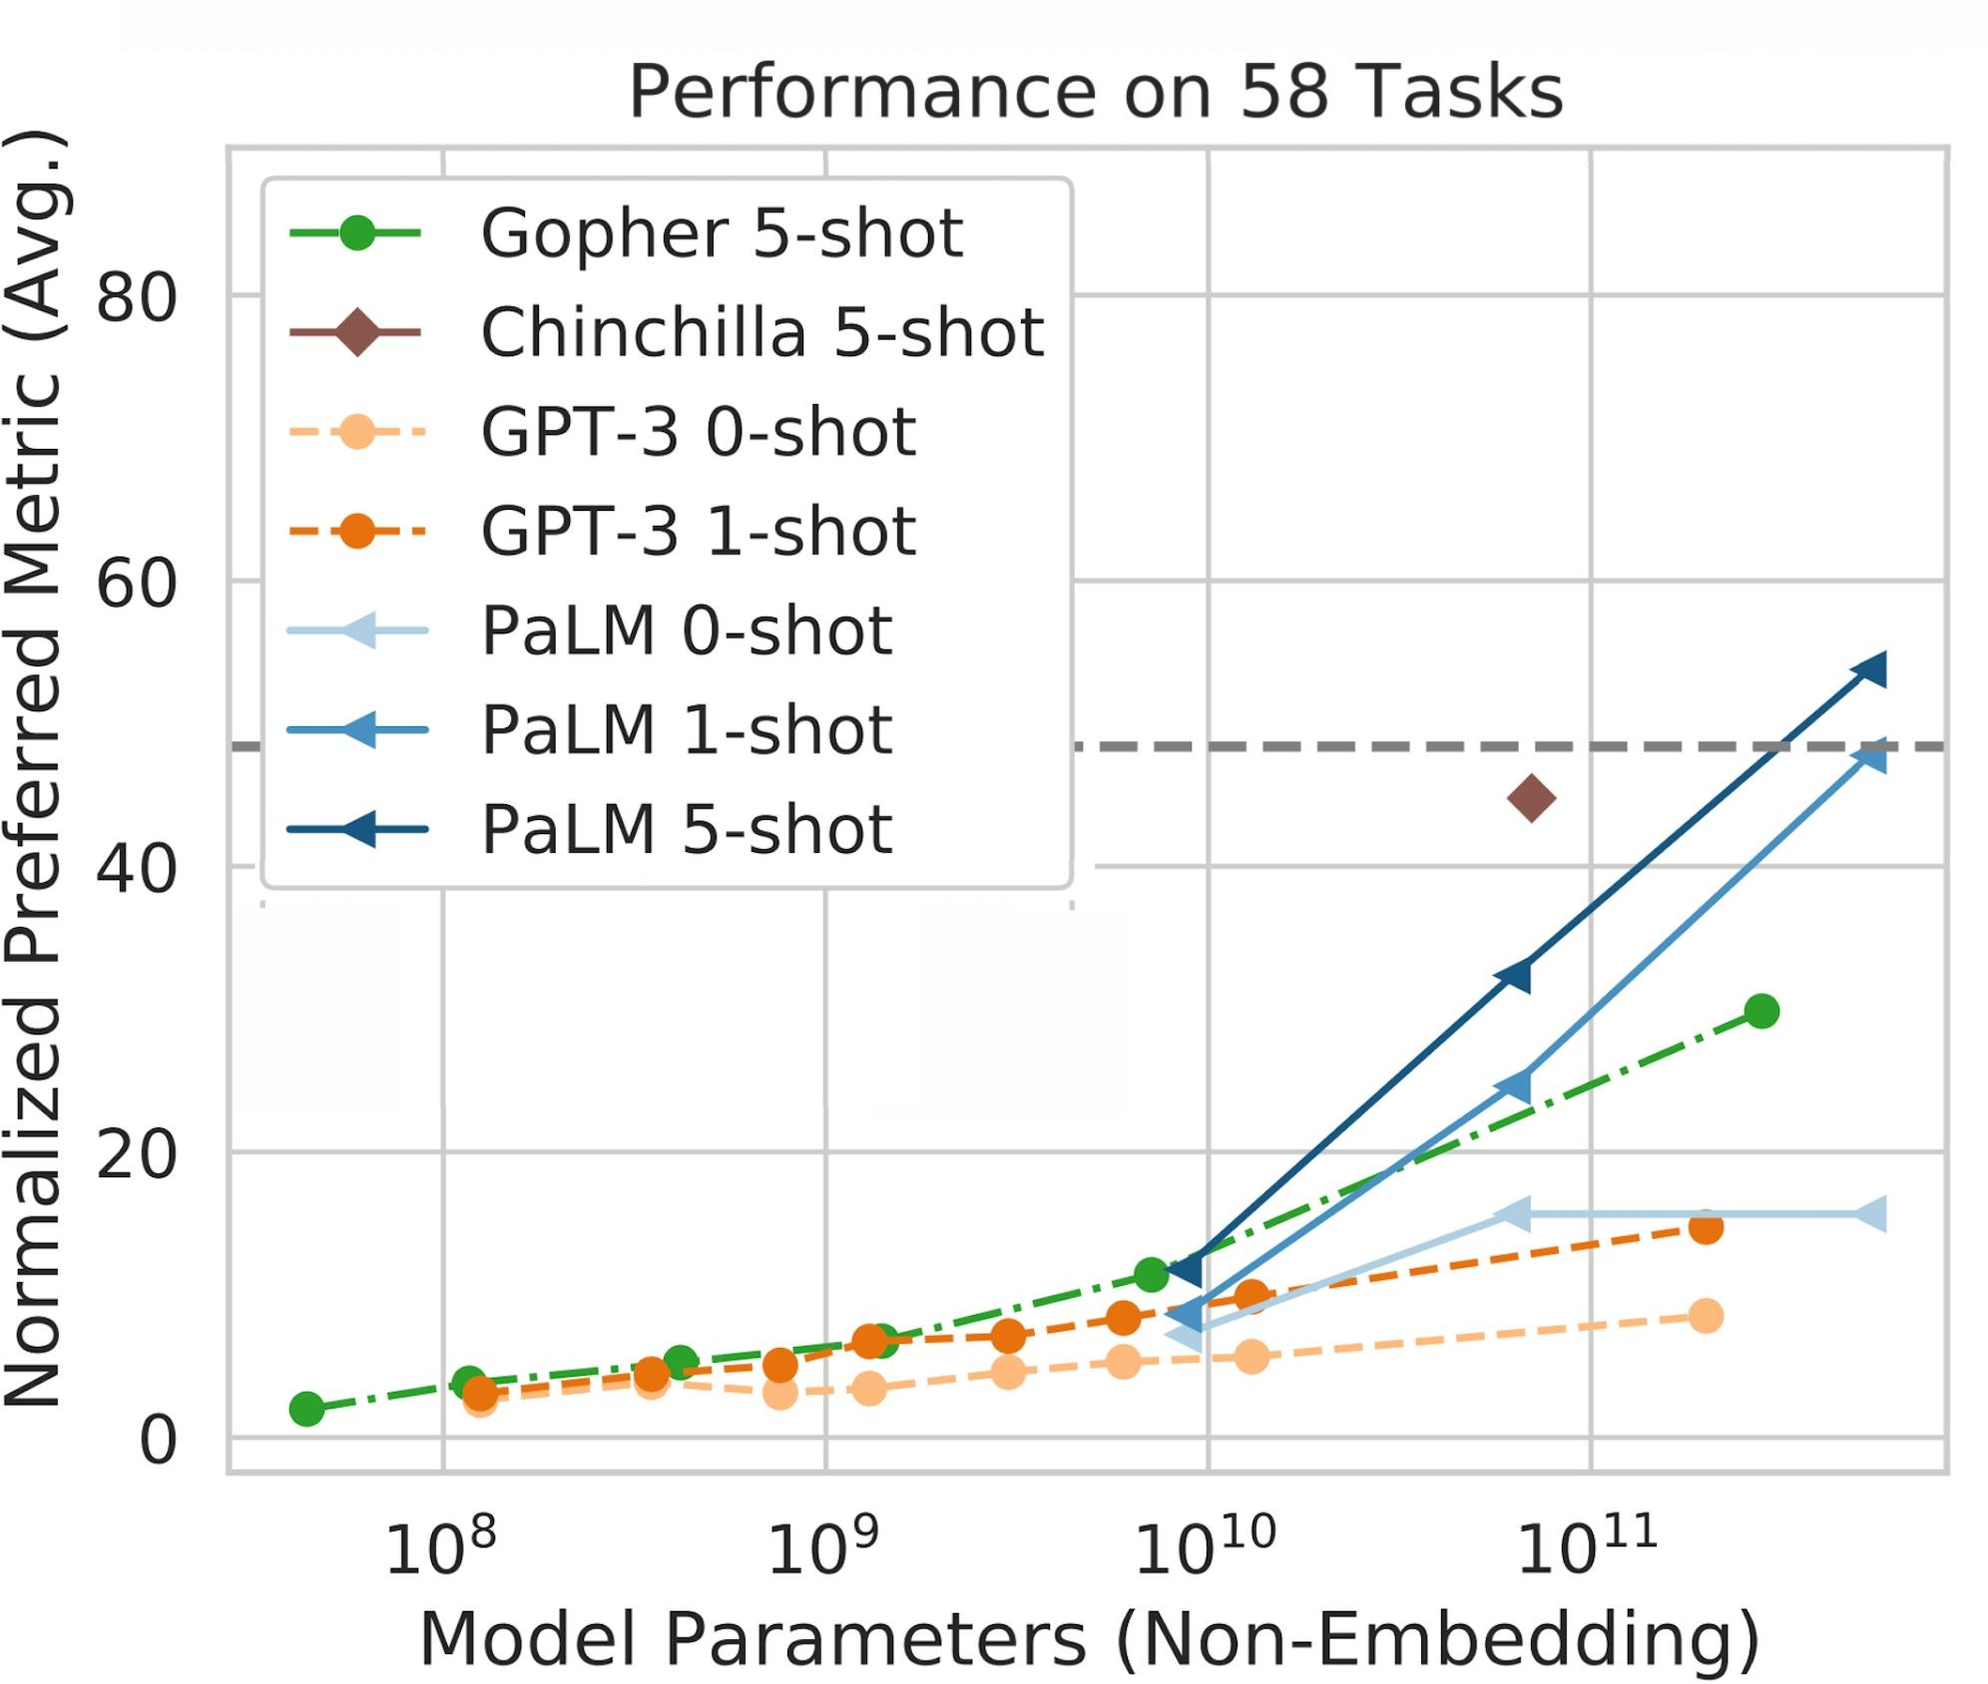
Model Size vs. Accuracy
Photo credit: PaLM, Chowdhery et. al., 2022
Larger LMs ⇒ better zero/few-shot performance

Slide 4
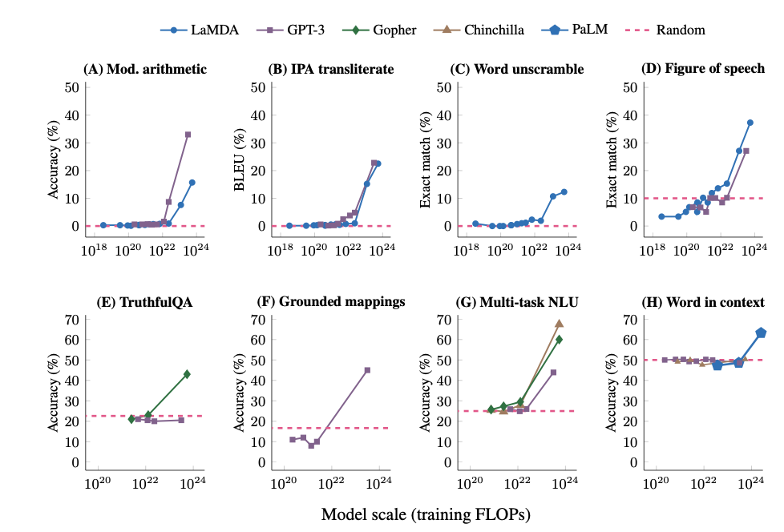
Large Language Models Exhibit “Emergent” Abilities
With scaling models their ICL perf consistency improves.
Emergence —qualitative changes in behavior with some “scaling” parameter

Slide 5
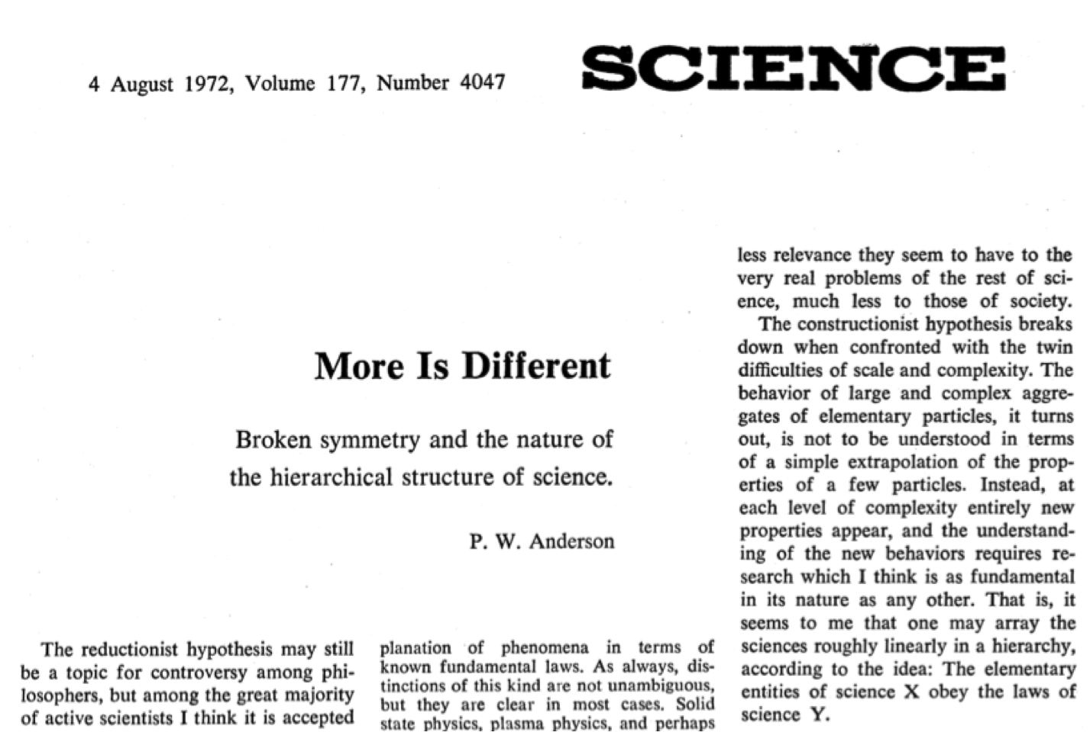
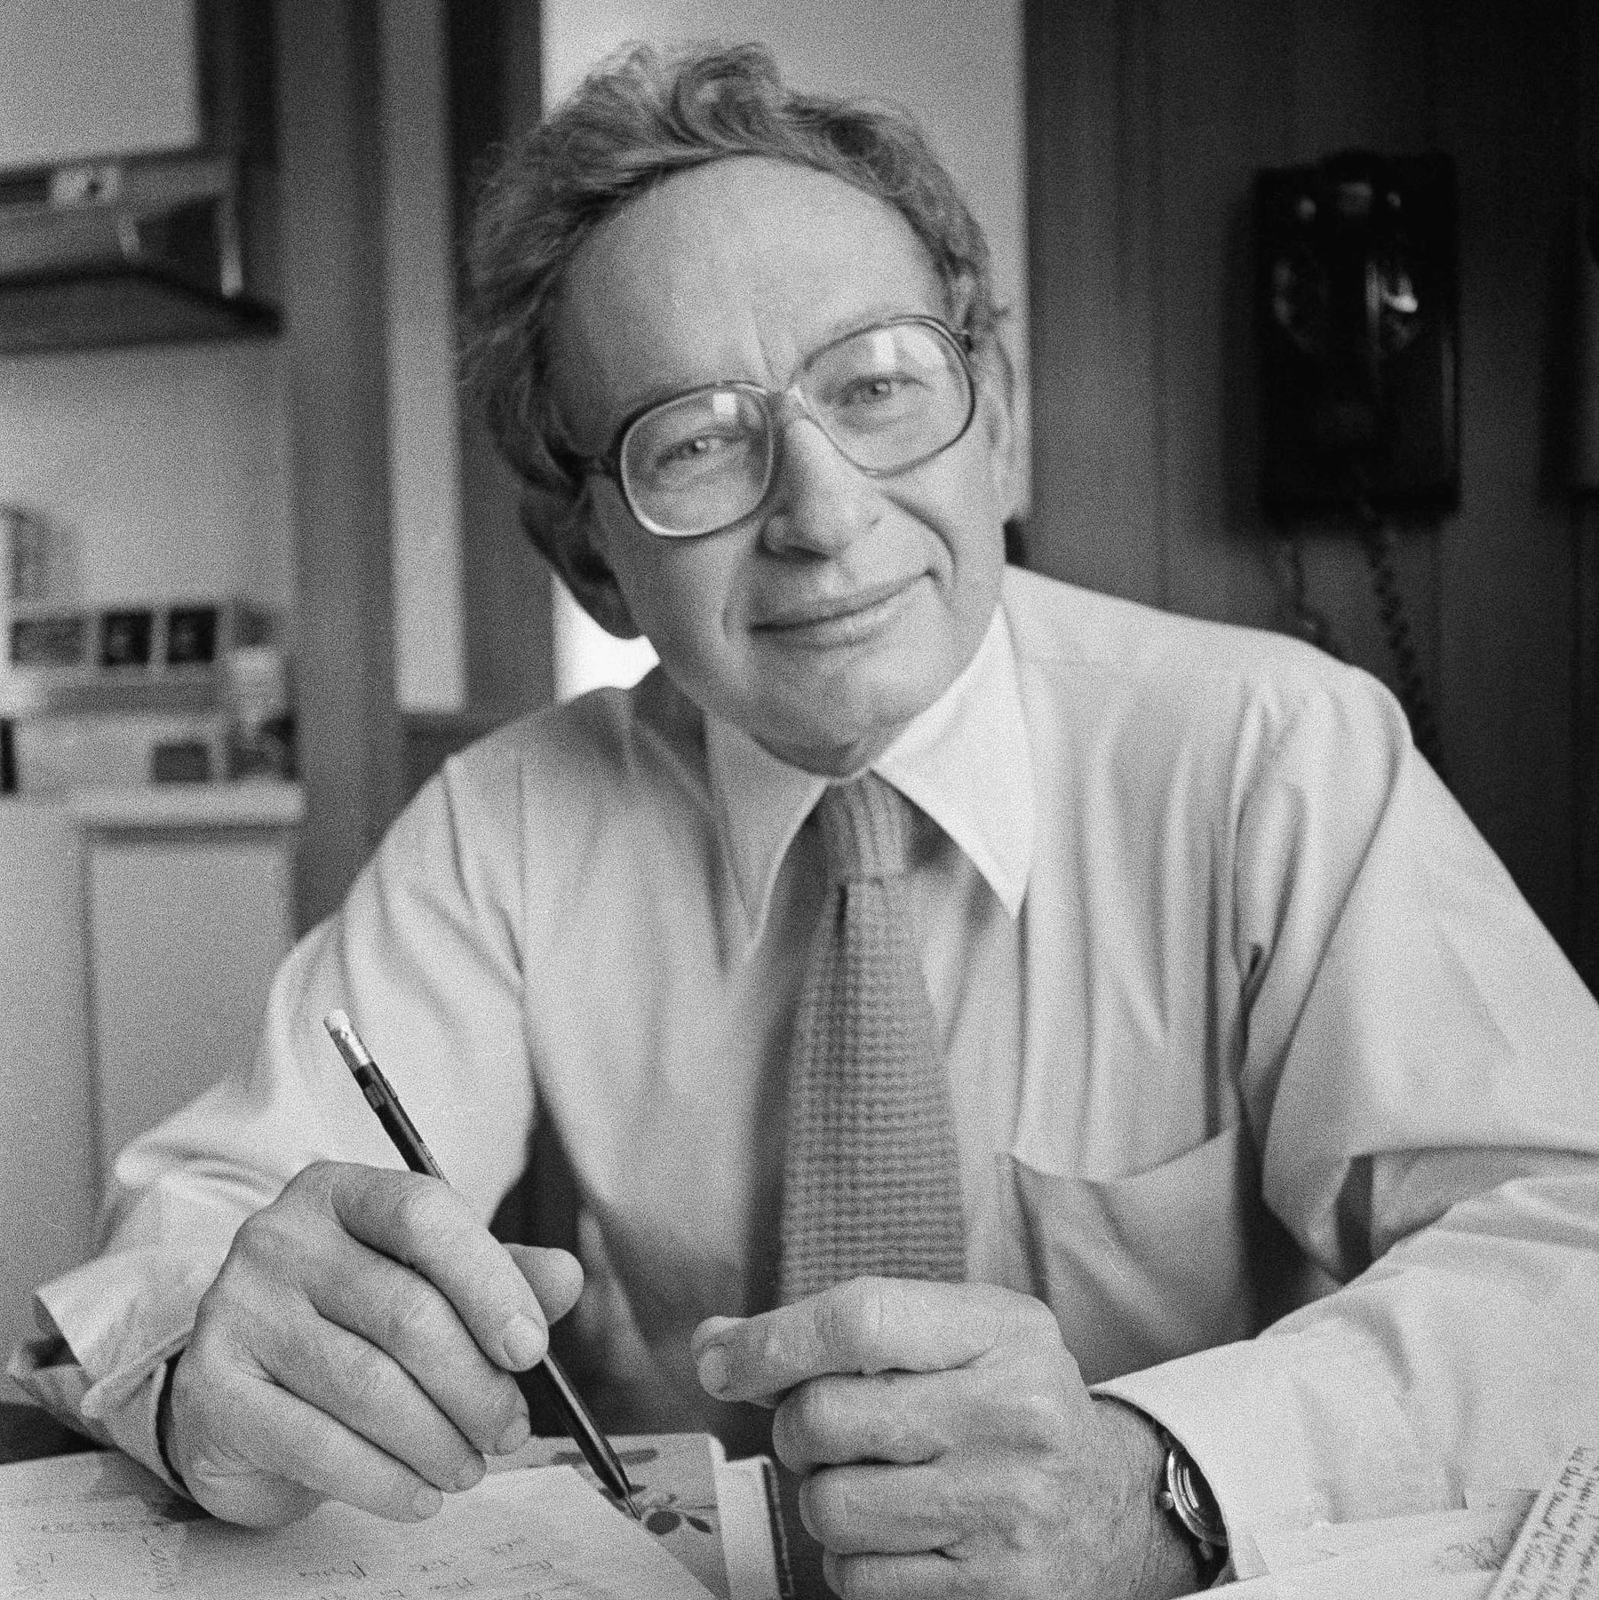
“More is Different”
The idea that complex physical systems can behave in ways that can't be understood by the laws that govern their microscopic parts.
Anderson also gives an example of "More is Different" at the molecular level.
He describes a peculiar broken symmetry that appears in larger-scale molecules, which seems to go against a law defined at the smaller scale.
This broken symmetry is a new effect that appears when the scale changes.
Anderson argues that new properties appear at each level of complexity.
For example, although chemistry is subject to the laws of physics, we can't infer chemistry from our knowledge of physics.

Slide 6
What is “Scaling”?
259
“scaling means larger model size”
But model parameters may be under-utilized.
“scaling means more compute”
But computation may be unnecessarily wasted.
“scaling means more data”
But more data might not necessarily contain more information (e.g., duplications)
Scale means all the above: effective compression of information
Requires model capacity
Requires compute
Requires large, rich data

Slide 7
Constraints of Real World
Even massive companies have their own constraints.
Examples of constraints:
The total amount of data
The total computing budget.
Time
….
Given a set of constraints, how do you choose which LM to train?
Note, trial and error is wasteful.

Slide 8
Scaling Laws
Hypothesis: there are fundamental principles that govern effective scaling
Importance: understanding these “laws” would allow us to find optimal models for a given data/compute budget.
Think of Newton’s laws
Provide the basis for understanding and analyzing the motion of objects in the physical world
Can be used to calculate the trajectory of a rocket, the speed of a car, or the motion of a planet.

Slide 9
Scaling Language Models: Chapter Plan
Scaling laws for computational cost of models
Optimal scaling of model size and pre-training data
Why didn’t we scale earlier?
Is scale all you need? A discussion.
Chapter goal: Getting familiar with various ideas related to “scaling”.

Slide 10
Computation Cost of Models

Slide 11
How do you compute computational cost of a single-layer NN with one matrix multiplication?

Slide 12
FLOPS
Floating point operations per second (FLOPS, flops or flop/s)
Each FLOP can represent an addition, subtraction, multiplication, or division of floating-point numbers,
The total FLOP of a model (e.g., Transformer) provides a basic approximation of computational costs associated with that model.

Slide 13
FLOPS: Matrix Multiplication
Matrix-vector multiplication are common in Self-Attention (e.g., QKV projection)
Requires $2mn$ (2 x matrix size) operations for multiplying $A∈ℝ^{m×n}$ and $b∈ℝ^{n}$
(2 because 1 for multiplication, 1 for addition)

Slide 14
FLOPS: Matrix Multiplication
Matrix-vector multiplication are common in Self-Attention (e.g., QKV projection)
Requires $2mn$ (2 x matrix size) operations for multiplying $A∈ℝ^{m×n}$ and $b∈ℝ^{n}$
(2 because 1 for multiplication, 1 for addition)
For multiplying $A∈ℝ^{m×n}$ and $B∈ℝ^{n×p}$, one needs $2mnp$ operations.
Again, 2 because of 1 for multiplication, 1 for addition
Now this is just forward propagation in Backprop. What about the backward step?

Slide 15
FLOPS: Matrix Multiplication: Backward
Backward pass needs to calculate the derivative of loss with respect to each hidden state and for each parameter
We also need $\frac{∂L}{∂X}$ to continue to pass gradient to the previous layers.
$$X$$
$$\frac{∂L}{∂W}$$
$$=\frac{∂L}{∂Y}\frac{∂Y}{∂W}$$
$$Y$$
$$×$$
One matrix multiplication for $\frac{∂L}{∂W}$
$$\frac{∂L}{∂Y}$$
Upstream gradient
$$W$$
$$=\frac{∂L}{∂Y}\frac{∂Y}{∂W}$$
$$\frac{∂L}{∂W}$$
FLOPs for backward pass is roughly twice of forward pass.

Slide 16
FLOPS: Matrix Multiplication: Backward
FLOPs for backward pass is roughly twice of forward pass.
Note that, this ratio depends on various parameters (architecture, batch size, et).
What’s the backward-forward FLOP ratio for Neural Networks? LessWrong, 2021
https://www.lesswrong.com/posts/fnjKpBoWJXcSDwhZk/what-s-the-backward-forward-flop-ratio-for-neural-networks

Slide 17
FLOPS: Matrix Multiplication: Altogether
Multiplying an input by a weight matrix requires 2x matrix size FLOPS.
FLOPs for backward pass is roughly twice of forward pass.
Training FLOPs for multiplying by a matrix W =
6 x (batch size) x (size of W)

Slide 18
Computing the computational cost of Transformer

Slide 19
Transformer FLOPs: The Quick Estimate
The Weight FLOPs Assumption
The FLOPs that matter the most are weight FLOPs, that is ones performed when intermediate states are multiplied by weight matrices.
The weight FLOPs are the majority of Transformer FLOPs
We can ignore FLOPs for
Bias vector addition
layer normalization
residual connections
non-linearities
Softmax
The FLOPs Calculus of Language Model Training, Dzmitry Bahdanau (2022)

Slide 20
Transformer FLOPs: The Quick Estimate
Let N be number of parameters (the sum of size of all matrices)
Let D be the number of tokens in pre-training dataset.
Forward pass:
FLOPs for forward pass on a single token is roughly 2N
FLOPs for forward pass for the entire dataset is roughly 2ND
Backward pass:
FLOPs for backward pass is roughly twice of forward pass
FLOPs for backward pass for the entire dataset is roughly 4ND
What is the total?

Slide 21
Transformer FLOPs: The Quick Estimate
Let N be number of parameters (the sum of size of all matrices)
Let D be the number of tokens in pre-training dataset.
The total cost of pre-training on this dataset is:
You can already see how this relates to our constraints:
If you have a fixed compute budget C, increasing D means decreasing N (and vice versa).
C ~ 6ND

Slide 22
TBD
What do you think about the FLOPS of the followings:
nn.Embedding
This is a dictionary lookup, so technically it has 0 FLOPS.

Slide 23
Transformer Parameter Count
One can show that:
Assuming:
the size of MLP hidden layer to be ${4.d}_{model}$
$n_{heads}.d_{hidden}=d_{model}$
You will prove this in homework assignment! 😊
Most Transformer LMs make these design assumptions.

Slide 24
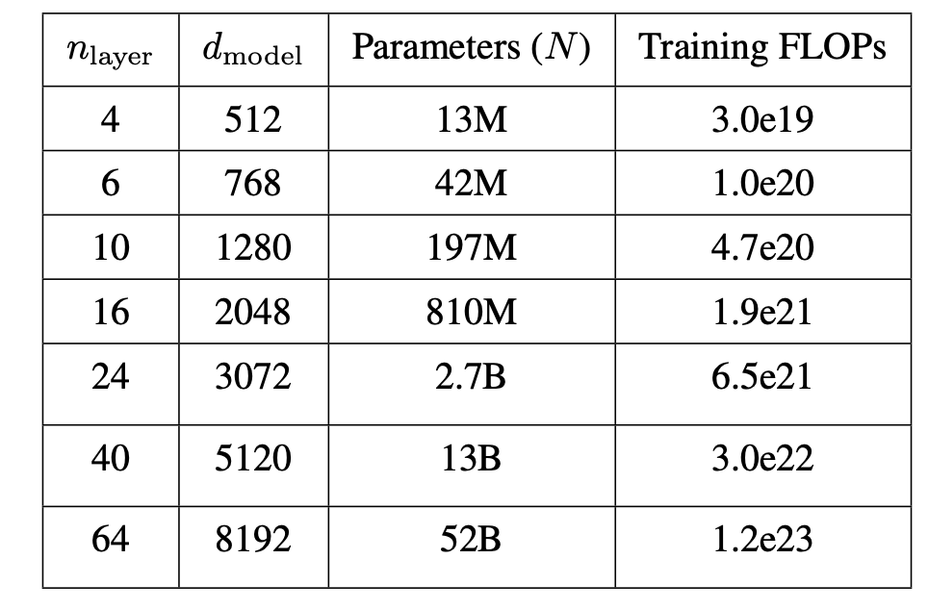
Transformer Parameter Count
One can show that:
For example, see the models in the following table:
$$N_{non−embedding}=12 × 64 × {8192}^{2}=51.5B$$
Vocab size = $65536$
Positional emb size = ?
$$N_{embedding}=\left(65536 + ?\right) × 8192=0.5B + ?$$
Table from: A General Language Assistant as a Laboratory for Alignment, 2021

Slide 25
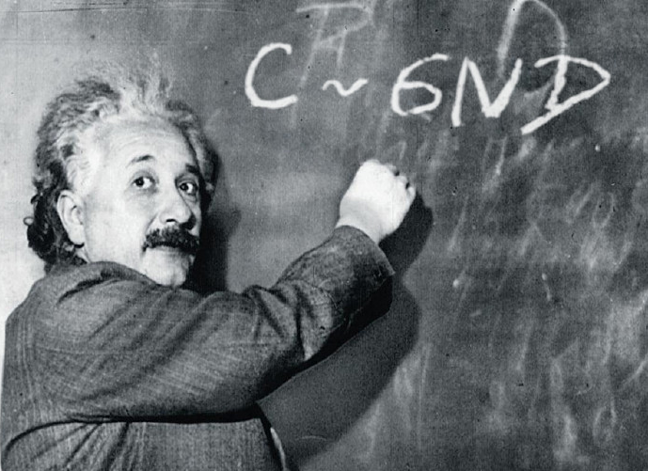
Transformer Parameter Count
Given the pre-training data with 400B tokens.
Training cost (FLOPs):
$$C≈ 6ND$$
$$= 6 ×\left(400 × {10}^{9}\right)×\left(52 ×{10}^{9}\right)$$
$$=1.24 ×{10}^{23}$$
Table from: A General Language Assistant as a Laboratory for Alignment, 2021

Slide 26
Estimating training time
This is a very practical question in real world.
We will use our formula earlier to estimate training time.
Consider HyperCLOVA, an 82B parameter model that was pre-trained on 150B tokens, using a cluster of 1024 A100 GPUs.
Intensive Study on HyperCLOVA: Billions-scale Korean Generative Pretrained Transformers, 2021 https://arxiv.org/pdf/2109.04650.pdf

Slide 27
Estimating training time
Consider HyperCLOVA, an 82B parameter model that was pre-trained on 150B tokens, using a cluster of 1024 A100 GPUs.
Training cost (FLOPs):
The peak throughput of A100 GPUs if 312 teraFLOPS or $3.12 ×{10}^{14}$.
How long would this take?
$$C≈ 6ND$$
$$= 6 ×\left(150 × {10}^{9}\right)×\left(82 ×{10}^{9}\right)=7.3 ×{10}^{22}$$
$Duration= \frac{model compute cost}{cluster throughput}=\frac{7.3 ×{10}^{22}}{3.12 ×{10}^{14}× 1024}=2.7 days$
Intensive Study on HyperCLOVA: Billions-scale Korean Generative Pretrained Transformers, 2021 https://arxiv.org/pdf/2109.04650.pdf

Slide 28
Estimating training time
How long would this take?
According to the white paper, training took 13.4 days. Our estimate is 5 times off (why?), but we did get the order of magnitude right! 🙌
$Duration= \frac{model compute cost}{cluster throughput}=\frac{7.3 ×{10}^{22}}{3.12 ×{10}^{14}× 1024}=2.7 days$
Intensive Study on HyperCLOVA: Billions-scale Korean Generative Pretrained Transformers, 2021 https://arxiv.org/pdf/2109.04650.pdf

Slide 29
Factors We Did Not Consider
Note that these estimates can be slightly off in practice
Theoretical peak throughput is not achievable with distributed training. (unless your model only does large matrix multiplications).
We ignored many additional operations like softmax, ReLU/GeLU activations, self-attention, Layer Norm etc.
Training divergence and restarting from earlier checkpoints are not uncommon.
There are various factors that contribute to computation latency
Communication latency, memory bandwidth, caching, etc.
See https://kipp.ly/transformer-inference-arithmetic/ for an excellent discussion.

Slide 30
Measuring FLOPS Empirically
There are libraries for computing FLOPS
Example: https://github.com/MrYxJ/calculate-flops.pytorch

Slide 31
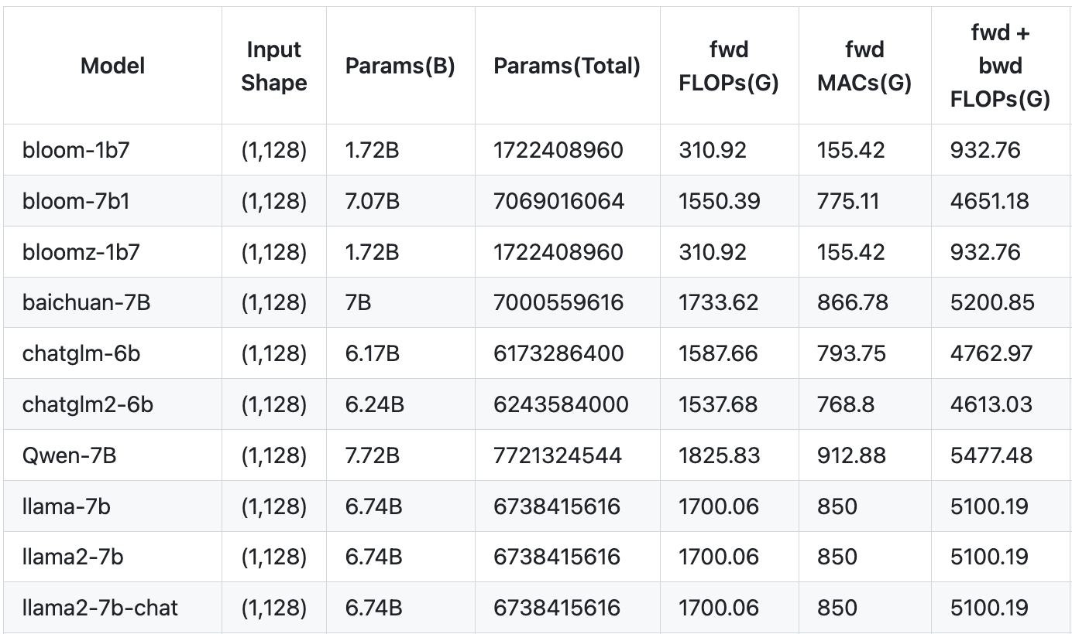
Measuring FLOPS Empirically
There are libraries for computing FLOPS
Example: https://github.com/MrYxJ/calculate-flops.pytorch

Slide 32
Summary
One can measure the computational cost of training neural networks in terms of FLOPS.
Such estimates allow you to estimate the training time of your model, given your GPU specs.
What else can we do?

Slide 33
Optimal Scaling

Slide 34
Optimal Scaling
A real problem: Your boss gives you a compute budget $$$. What is the best model you can build with this budget?
We know from the literature that larger models generally lead to better models.
Does that mean that you should aim to build the largest model possible?
Intuitively, if you choose a model that is too large for your budget, you need to cut your training cycles that may reduce its quality.
This chapter: principled approach to selecting optimal data/model scaling.

Slide 35
Scaling
Experimental Setup:
Pre-train various models of different sizes
Plot their validation loss throughout training
Optimal model size for compute
Photo credit: GPT3, Brown et. al., 2020

Slide 36
Scaling
Large model reaches lower loss
Small model plateaus early
Smaller models don’t have enough capacity to utilize the extra compute. They plateau early.
Larger models are initially slower to train, but with more compute they reach lower losses.
Photo credit: GPT3, Brown et. al., 2020

Slide 37
Scaling - Optimal Model Size
Optimal model
Let’s say our compute budget is ${C=10}^{−2}$ PetaFLOPs-days.
The optimal model is the one that plateaus at exactly $C$.
If we train a larger model than optimality point, we won’t reach the best performance.
If we train a smaller model the performance wouldn’t be optimal
Optimality
Photo credit: GPT3, Brown et. al., 2020

Slide 38
Scaling - Optimal Model Size
The idea of “optimal model size for given compute” was introduced by Kaplan et. al.
In ideal world, we are given lots of compute to train many models to find the optimality.
Alas not feasible when you have budget to train a single model.
If we have the equations (“laws”) describing the behavior, we can compute it analytically.
Photo credit: GPT3, Brown et. al., 2020

Slide 39
Scaling - Optimal Model Size
What is the function that describes this optimality line?
Photo credit: GPT3, Brown et. al., 2020

Slide 40
Scaling Laws of Kaplan et. al., 2020
265
Constants
Model size
Number of steps
[ACL 2022 Tutorial Beltagy, Cohan, Logan IV, Min and Singh]

Slide 41
Scaling Laws of Kaplan et. al., 2020
Predicted (dotted) accurately matches empirical learning curves (solid).
Do these generalize to models?
Fit constants using small models then predict learning curves of larger models.
[ACL 2022 Tutorial Beltagy, Cohan, Logan IV, Min and Singh]

Slide 42
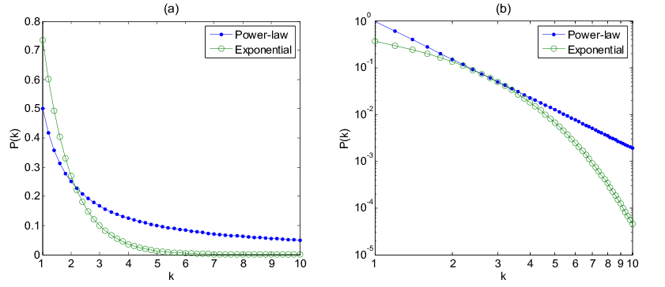
Terminology: Power law vs exponential
Power law trend looks linear, when the variable is shown in logarithmic scale.
Exponential goes to zero at a faster rate.
Power law $={variable}^{\left(constant\right)}$
Exponential $={\left(constant\right)}^{variable}$

Slide 43
Scaling Laws of Kaplan et. al., 2020
A power-law function predicts the “compute eﬃcient” frontier:
Using this (and some other analysis not shown here) we can analytically predict the optimal model and data size, for a given amount of compute.
$$L∝C^{−0.48}$$
Photo credit: GPT3, Brown et. al., 2020

Slide 44
Scaling Laws: Kaplan et al.
N: number of model parameters
C: compute
D: dataset size
Optimal model size and optimal number of tokens, for a given compute budget
$N_{opt}$ exponent >> $D_{opt}$ exponent
Takeaway: grow the model size faster than growing the number of tokens.
Example: Given 10x compute, increase N by 5.5x, and D by 1.8x
GPT3 (and many other followed this recipe) training a 175B model on 300B tokens
Kaplan et. al. 2020
$$N_{opt}∝C^{0.73}$$
$$D_{opt}∝C^{0.27}$$
[MASK]
[MASK]
[ACL 2022 Tutorial Beltagy, Cohan, Logan IV, Min and Singh]

Slide 45
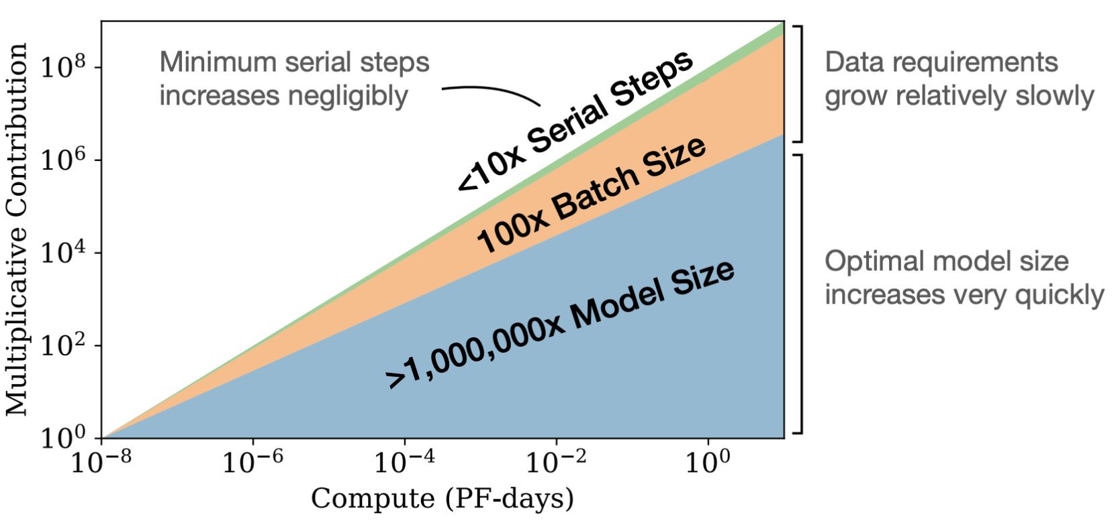
Recap: Scaling Laws (Kaplan et al.)
It appears that there are Precise scaling laws predicting the performance of AI models based on
Model size: Number of params
Dataset size
Total compute used for training
Scaling Laws: scale model size at a faster rate.
Given a 10x increase in compute budget,
increase the size of the model by 5.5x, and training data size by 1.8x.

Slide 46
Implications of Scaling Laws (Kaplan et al.)
Subsequent papers tried to engineer larger and larger models

Slide 47
However …
In 2022 a Hoffmann et al. from DeepMind showed a different set of scaling laws.

Slide 48
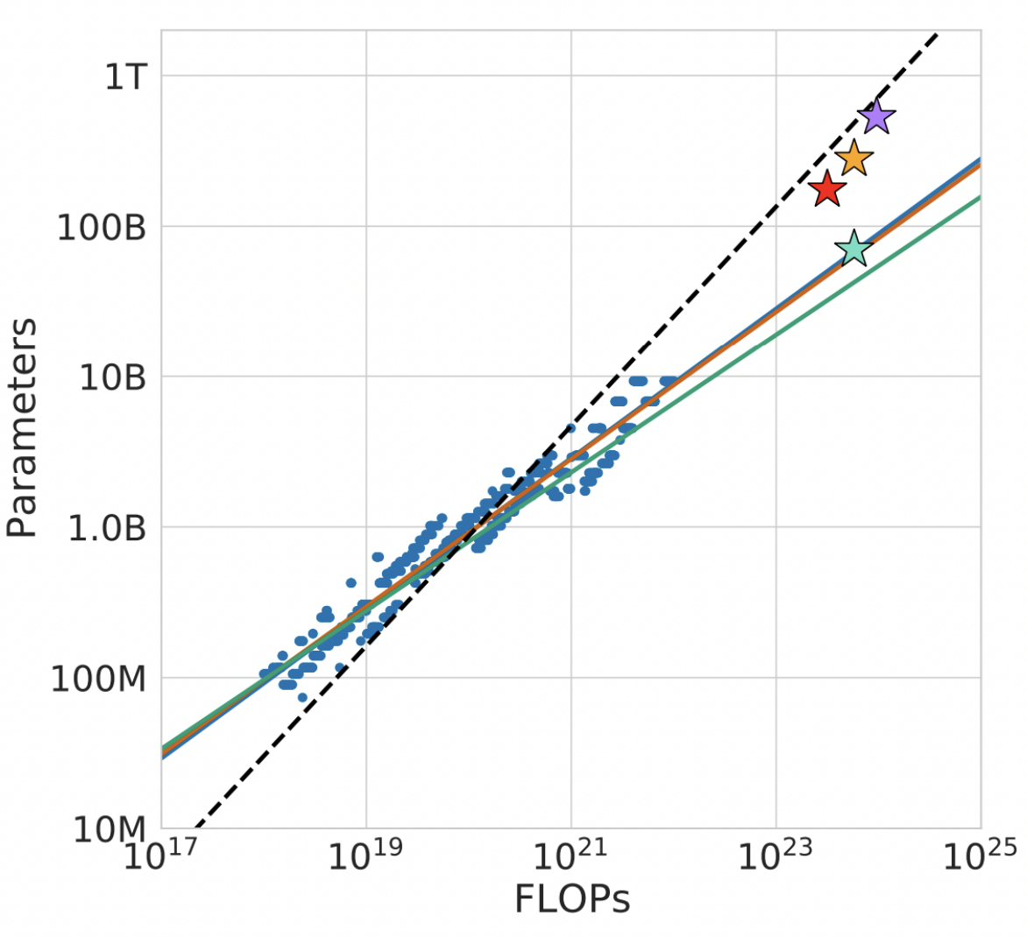
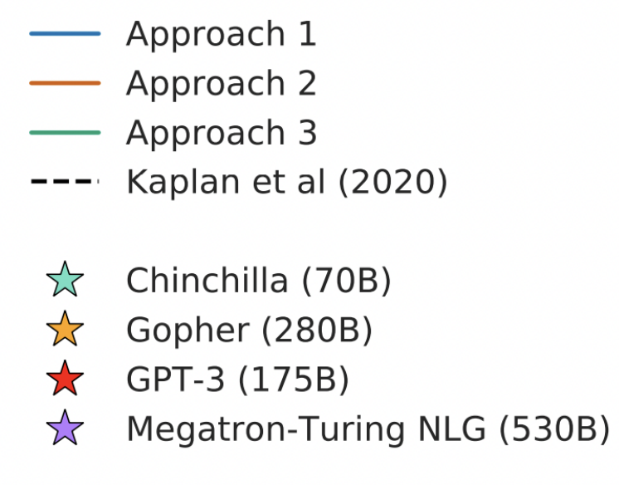
Scaling Laws: Hoﬀmann et al.
Training Compute-Optimal Large Language Models (2022) https://arxiv.org/pdf/2203.15556.pdf

Slide 49
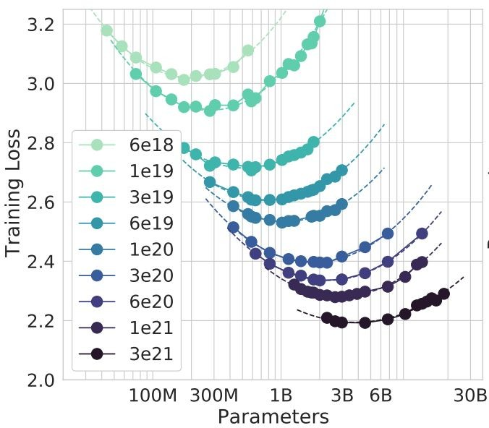
Scaling - Kaplan et al. vs. Hoﬀmann et al.
Experimental setup:
They chose different compute budgets.
For each compute budget, train different sized models (varying data or model size)
They find a clear valley like shape
For each compute budget there is an optimal model to train
Training Compute-Optimal Large Language Models (2022) https://arxiv.org/pdf/2203.15556.pdf

Slide 50
Scaling - Kaplan et al. vs. Hoﬀmann et al.
The main diﬀerence is the learning rate schedule!!!
Kaplan et. al.: all experiments same LR schedule
Hoﬀmann et. al. experiment while changing diﬀerent LR schedule
Their LR reaches zero at the end of the training
[ACL 2022 Tutorial Beltagy, Cohan, Logan IV, Min and Singh]
From Hoffmann et al., 2022

Slide 51
Scaling Laws: Hoﬀmann et al.
N: number of model parameters
C: compute
D: dataset size
Optimal model size and optimal number of tokens, for a given compute budget
$N_{opt}$ exponent ≅ $D_{opt}$ exponent
Compute and tokens should increase at the same rate.
Example 1: Given 10x compute, grow N by 3.2x and D by 3.2x
Example 2: Given 100x compute, grow N by 10x and D by 10x
Kaplan et. al. 2020
Hoﬀmann et. al., 2021
$$N_{opt}∝C^{0.73}$$
$$D_{opt}∝C^{0.27}$$
$$N_{opt}∝C^{0.5}$$
$$D_{opt}∝C^{0.5}$$
[MASK]
[MASK]
[ACL 2022 Tutorial Beltagy, Cohan, Logan IV, Min and Singh]

Slide 52
Recap
We used to train “oversized” and “under-trained” models.
You should scale your model at the same rate as your data.
For example, if you get a 100x increase in compute,
you should make your model 10x bigger and your data 10x bigger.

Slide 53
A Word of Caution
While we kept referring to these as “law”, one should take them with grain of salt.
There are various confounding factors here:
Different optimizer: AdamW vs. Adam vs. others
Different tokenizers
Different numerical representation (e.g., bfloat16 vs float32)
….

Slide 54
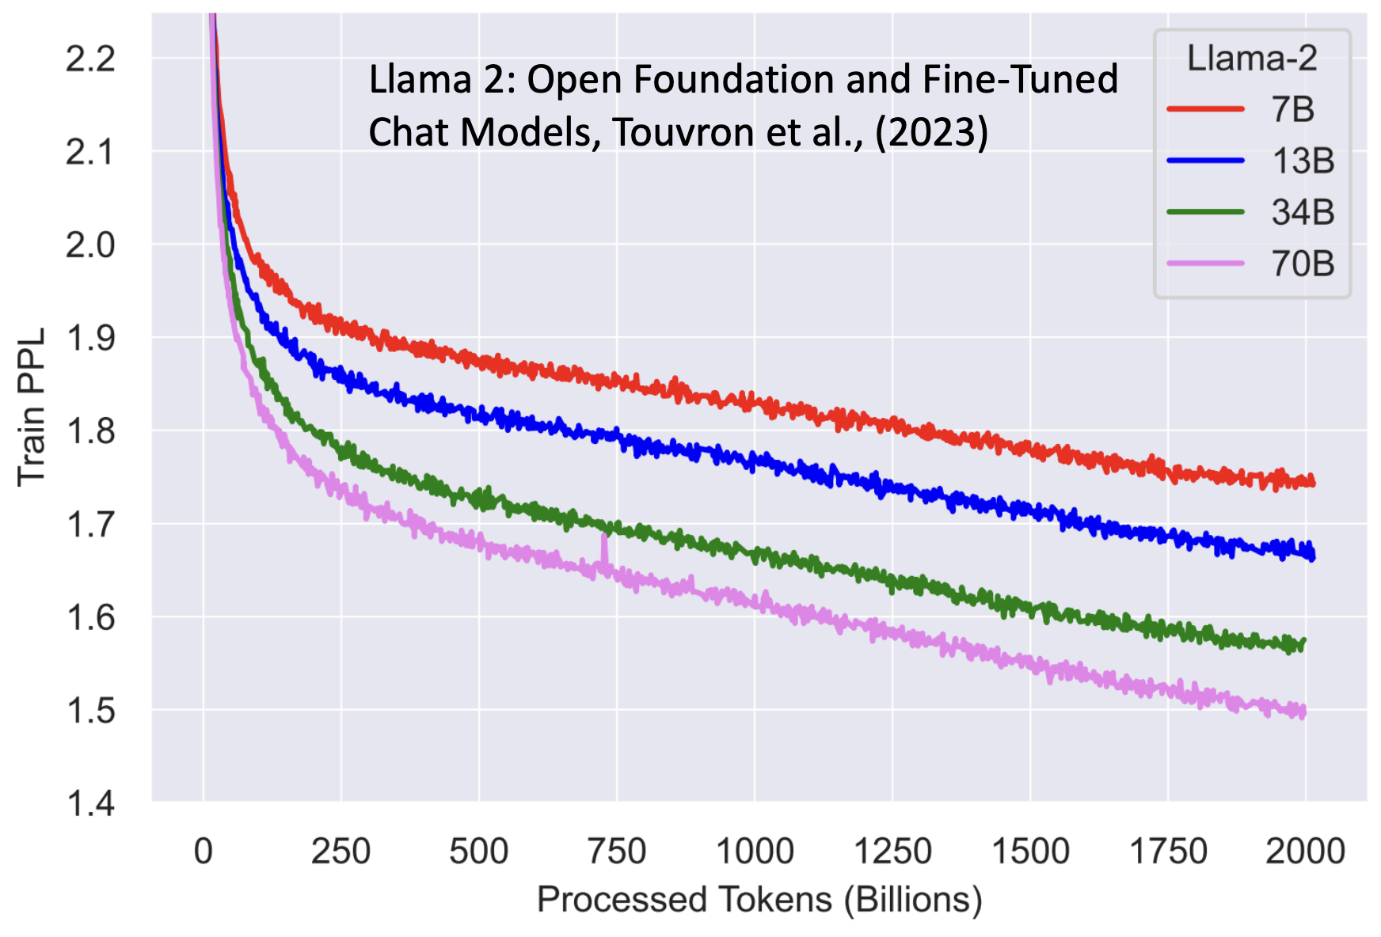
More Recently …
Training Loss for Llama 2 models.
After pretraining on 2T Tokens, the models still did not show any sign of saturation. Why? 🤔
The scaling laws are usually derived on much smaller scales. Behavior might be different at larger scales.

Slide 55
Data Quality Matters
There is increasing evidence that data more than just token count.
Previously we saw that data duplications and noise hurts LLM performance.
There is also evidence that’s one can be selective about data diversity.
These are topics of the ongoing research and there will be more discuss here in coming years.
Beyond neural scaling laws: beating power law scaling via data pruning (Sorscher et al., 2022)

Slide 56
Data-Constrained Scaling Laws
Here I can discuss Sasha Rush’s recent work.

Slide 57
Summary
Optimality conditions: given a limited budget (compute, data, size) what is the best model you can train.
For now: maintain similar ratio for model size and data size.
Next: why didn’t we scale earlier?

Slide 58
Why didn’t we scale earlier??

Slide 59
The Old Wisdom: Optimizing Model Capacity
[Figure credit: NeurIPS ‘23 Tutorial: Reconsidering Overfitting in the Age of Overparameterized Models]

Slide 60
The Old Wisdom: Optimizing Model Capacity
Small models cannot fit perfectly.
they cannot express complex functions → high statistical bias.
largely ignores noise → does not fluctuate a lot (small variance)
[Figure credit: NeurIPS ‘23 Tutorial: Reconsidering Overfitting in the Age of Overparameterized Models]

Slide 61
The Old Wisdom: Optimizing Model Capacity
Large models fit perfectly (overfit)
Can express function of interest → small statistical bias.
Fits too much of the noise (overfit) → fluctuates a lot (high variance)
[Figure credit: NeurIPS ‘23 Tutorial: Reconsidering Overfitting in the Age of Overparameterized Models]

Slide 62
The Old Wisdom: Optimizing Model Capacity
Classical generalization theory — one can get generalization by optimizing for capacity (expressivity) — equivalent to balancing the bias-variance trade-off.
[Figure credit: NeurIPS ‘23 Tutorial: Reconsidering Overfitting in the Age of Overparameterized Models]

Slide 63
The Old Wisdom: Optimizing Model Capacity
Classical generalization theory — one can get generalization by optimizing for capacity (expressivity) — equivalent to balancing the bias-variance trade-off.
[Reconciling modern machine learning practice and the bias-variance trade-off, Belkin et al. 2019]

Slide 64
Harmless Interpolation for Large Models
Learning theory made us allergic to over-parametrized models.
[Reconciling modern machine learning practice and the bias-variance trade-off, Belkin et al. 2019]

Slide 65
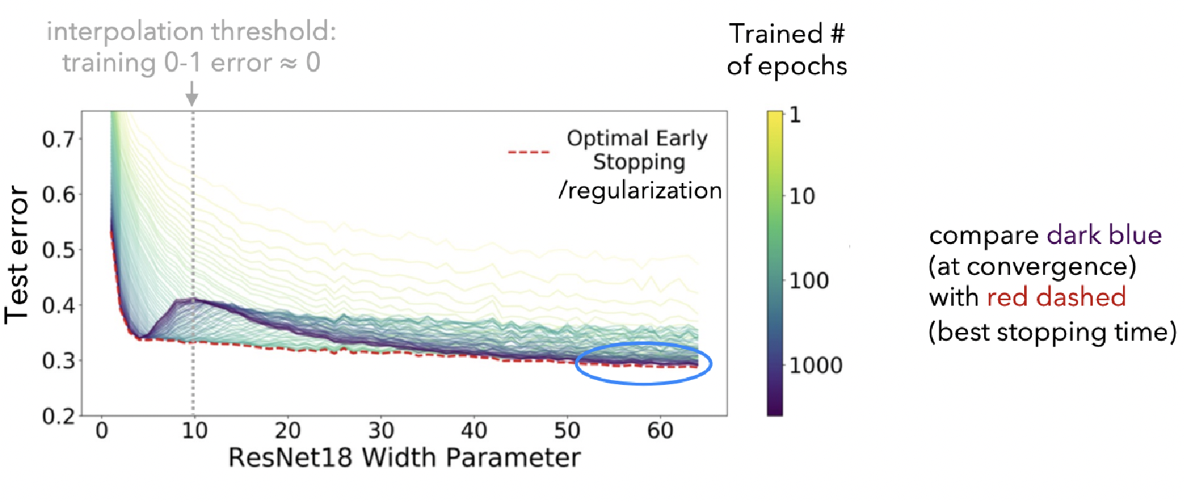
Harmless Interpolation for Large Models
[Nakkiran, Kaplun, Bansal, Yang, Barak, Sutskever ’20]

Slide 66
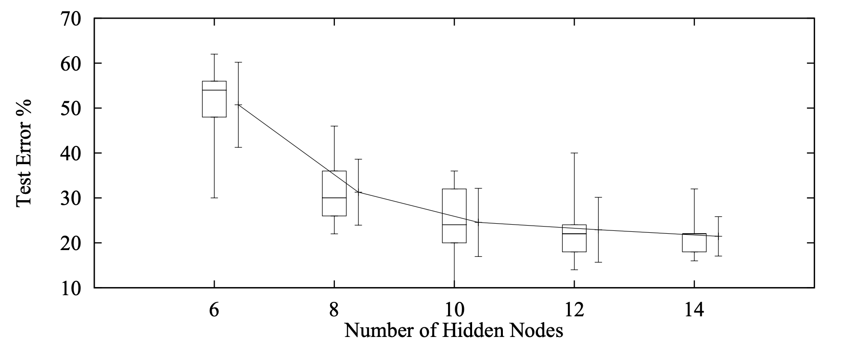
There Were Empirical Evidence
Even in mid-90’s there were evidence supporting the benefit of larger models
Although they were ignored ….
“ …. larger networks may generalize well and better generalization is possible from larger networks if they can be trained more successfully than the smaller networks” -- Lawrence, Giles, and Tsoi in 1997
[Lawrence, Giles, and Tsoi 1997]

Slide 67
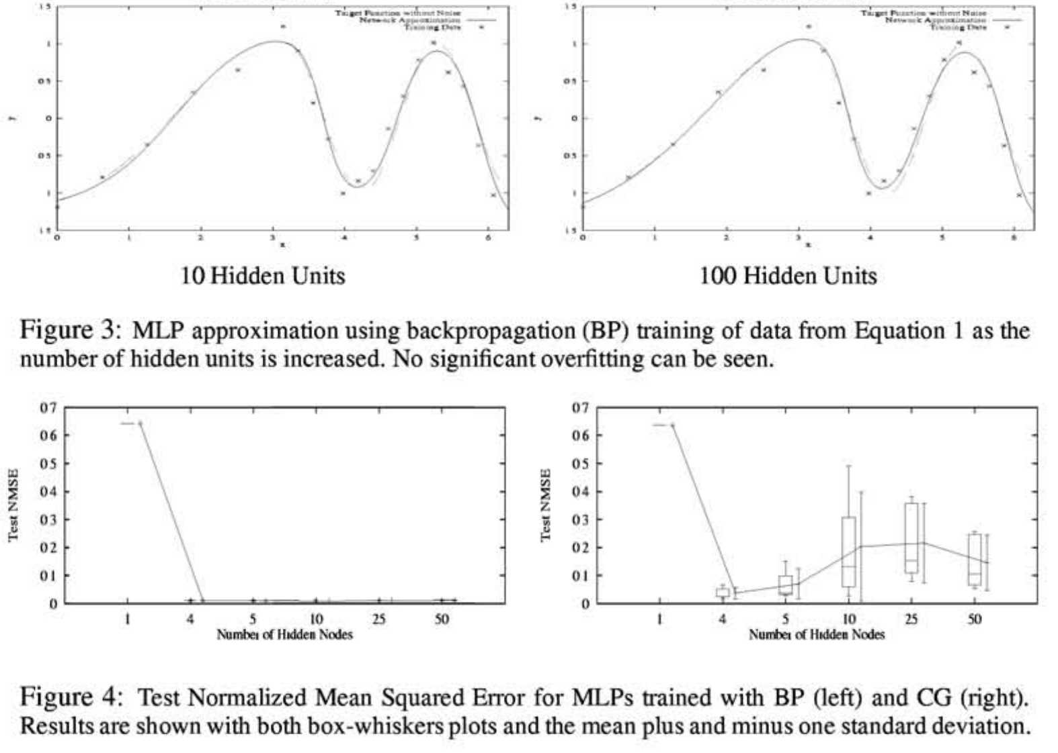
There Were Empirical Evidence
Even in mid-90’s there were evidence supporting the benefit of larger models
Although they were ignored ….
“ …. "Nets of all sizes overfit some problems. But generalization is surprisingly insensitive to excess capacity if the net is trained with backprop.”
-- Caruana, Lawrence, and Giles (2000)
[Caruana, Lawrence, and Giles 2000]

Slide 69
Summary
We some had evidence for impact of scaling.
Took us some time to trust them.

Slide 70
Is Scale All You Need?

Slide 71
Is Scale All We Need?
For what purpose?
For building useful applications (answering simple questions, translating simple sentences) we already have good models. Not our focus.
General intelligence: think of an assistant that is always with you, knows what you want, assists you with anything you need.

Slide 72
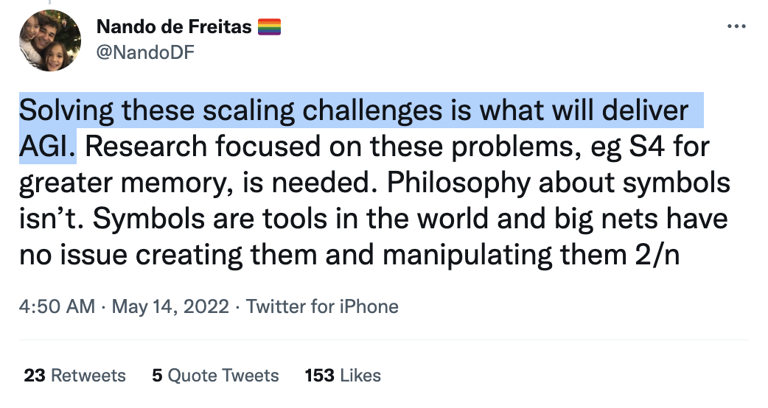
Is Scale All We Need?
For what purpose?
For building useful applications (answering simple questions, translating simple sentences) we already have good models. Not our focus.
General intelligence: think of an assistant that is always with you, knows what you want, assists you with anything you need.
Do you agree with Nando?

Slide 73
Is Scale All We Need?
Is scale the/a right “hill to climb”?
Even if it is a right “hill” is it feasible/practical to climb this hill? (there might be other “hills” too).

Slide 74
Argument: Not Enough Compute
Limitations regarding compute:
There is simply not enough compute available.
Models have been increasing 10x every year
Moore’s law: # of transistors on an IC doubles about every two years.
There are physical limits to how much faster computers can get.
Even if we have the compute, scaling the compute will be quite costly.
Scaling compute is simply infeasible. [QED]
Are you convinced?

Slide 75
Rebutting “Not Enough Compute”
On insufficiency of compute resource:
Hardware technologies continue to progress at a rapid pace.
Huang’s law: advancements in GPUs happen at much faster rate than what Moore predicted.
So much potentials in parallel computing.
On cost-[in]efficiency of scaling:
While models like GPT3 cost a lot (monetary or otherwise), their availability prevent training MANY smaller, mediocre models.
Therefore, it might be that the net cost of scaling large models is negative.
It is the case within Microsoft according to its CTO, Kevin Scott.

Slide 76
Argument: Not Enough Data
Hoffmann et al showed that, to be compute-optimal, model size and training data must be scaled equally.
It shows that existing LLMs are severely data-starved and under-trained.
Given the new scaling law, even if you pump a billions of params into a model, the gains will not compensate for more training tokens.
There is simply not enough [language] data. [QED]
Are you convinced?
[Training Compute-Optimal Large Language Models. Hoffmann+ NeurIPS, 2022]

Slide 77
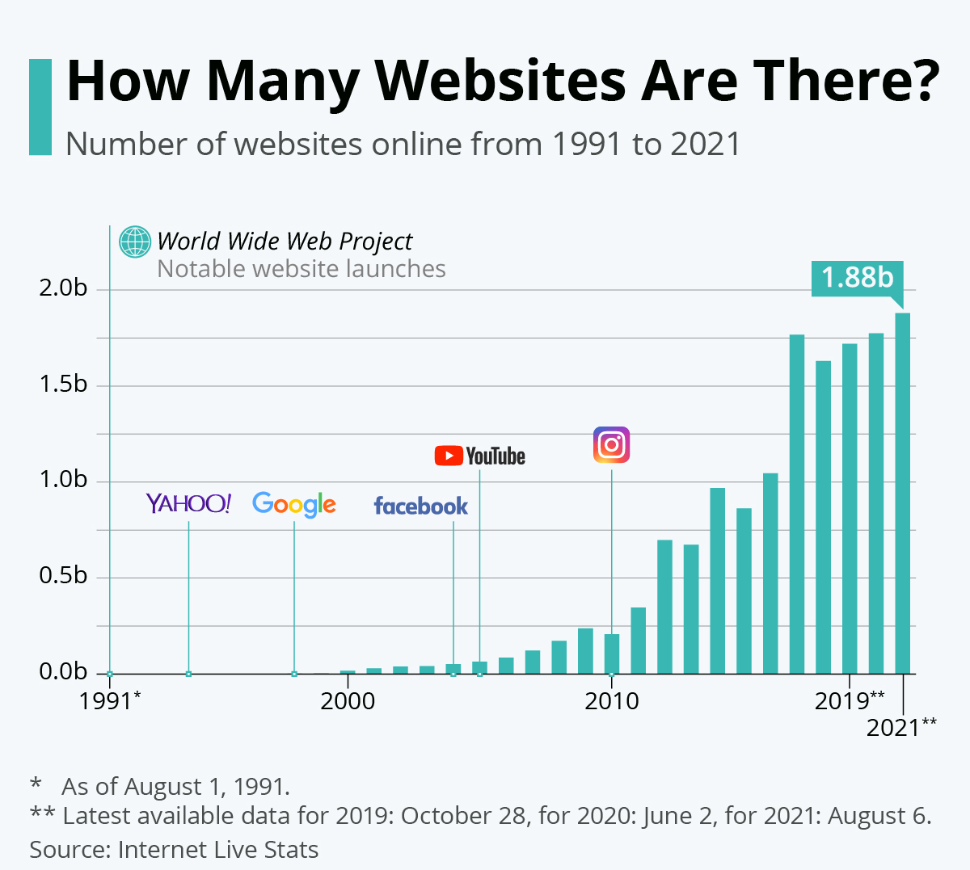
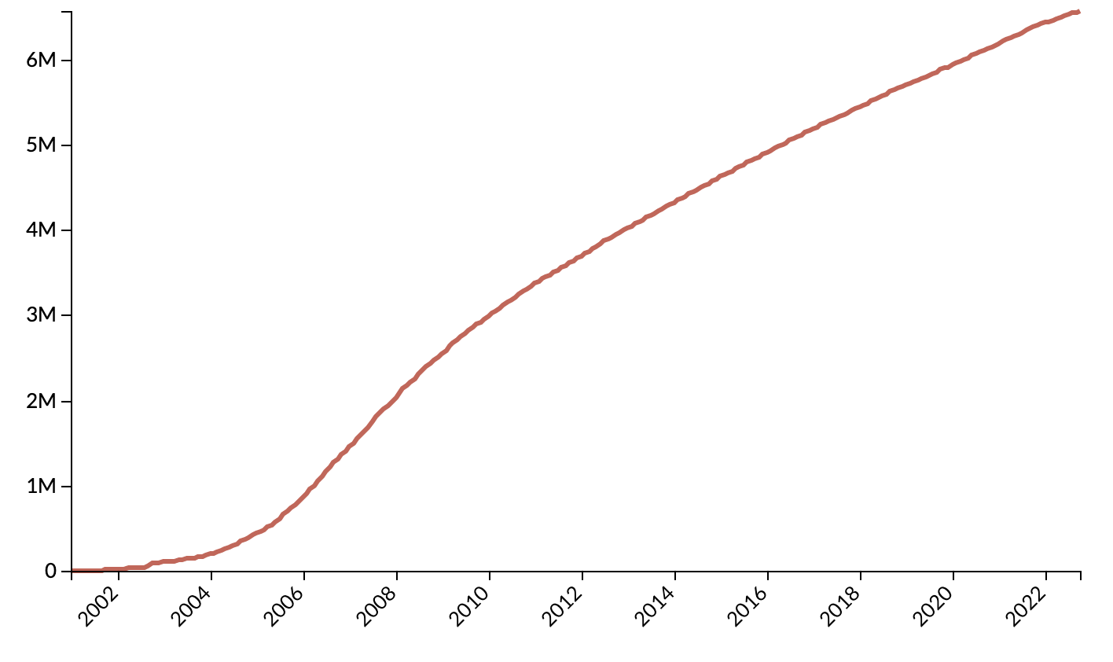
Rebutting “Not Enough Data”
Data is growing exponentially (?)
Wikipedia size

Slide 78
Rebutting “Not Enough Data” (2)
You can harness data from other modalities.
For example, to get more text data we can build a solid speech processor model that converts speech to text.
(aside: more than 80% if internet traffic is video)
(aside2: is that why OpenAI built Whisper?!)
["Robust speech recognition via large-scale weak supervision." Radford+ 2022]

Slide 79
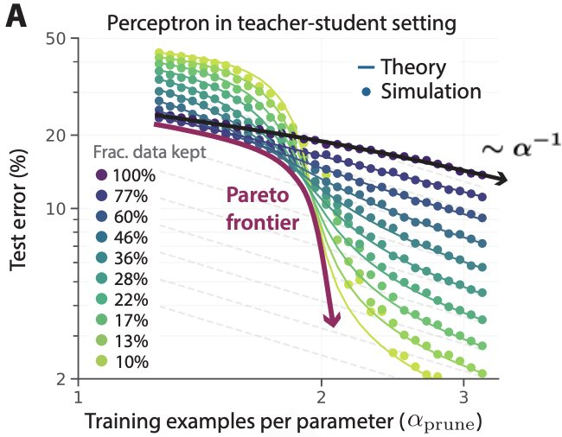
Rebutting “Not Enough Data” (3)
You can use data more effectively.
Sorscher et al. lays out recipes to achieve *exponential* scaling instead through statistical mechanics theory.
Carefully curating a small subset goes a long way!
[Beyond neural scaling laws: beating power law scaling via data pruning. Sorscher+ 2022]

Slide 80
Argument: Scale is Not all You Need Because of Tail Phenomena
Tail phenomena will never go away!
Head tasks:
Translating simple sentences
Generate rhyming sentence
Indicating spans of location
…
popularity
tasks

Slide 81
Argument: Scale is Not all You Need Because of Tail Phenomena
Tail phenomena will never go away!
Tail tasks:
Translation while while retaining rhyme scheme.
Extract all ACL conference chairs since 1990.
Do literature review summarizing human studies on corona viruses.
popularity
tasks

Slide 82
Argument: Scale is Not all You Need Because of Tail Phenomena
Tail phenomena will never go away!
Example: Google Translate
“The number of parallel sentences […] ranges from around tens of thousands to almost 2 billion.”
Massively multilingual neural machine translation in the wild: Findings and challenges. Arivazhagan+ 2019.

Slide 83
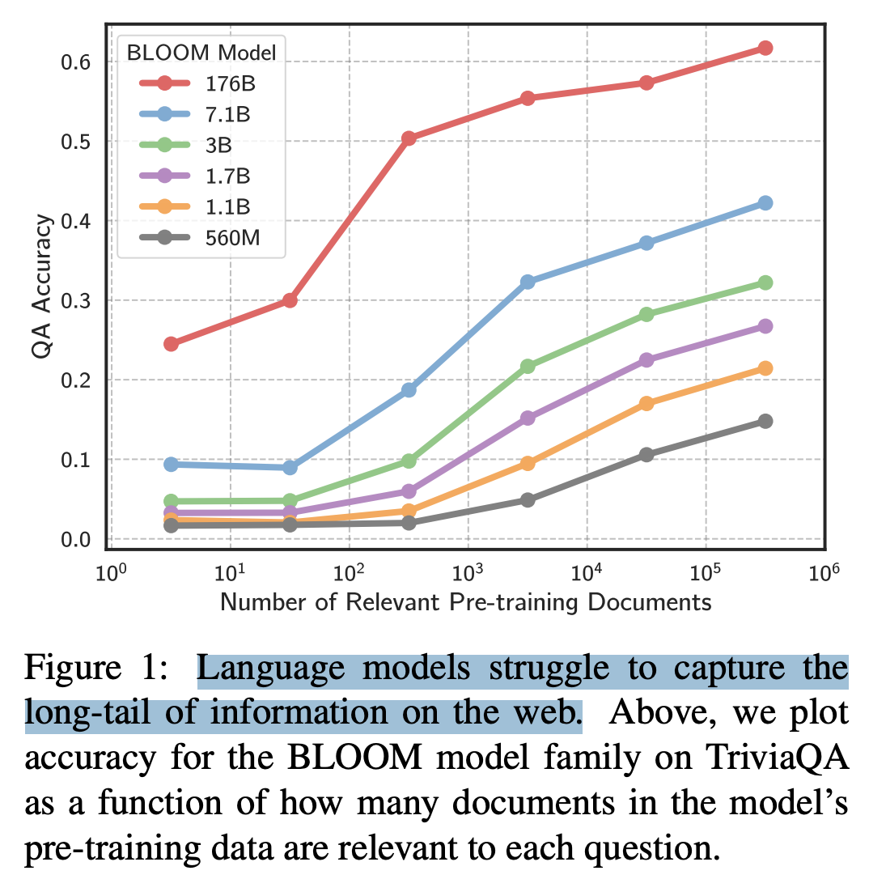
Argument: Scale is Not all You Need Because of Tail Phenomena
Impact of Pretraining Term Frequencies on Few-Shot Reasoning, Razeghi+ 2022
Large Language Models Struggle to Learn Long-Tail Knowledge, Kandpal+ 2022

Slide 84
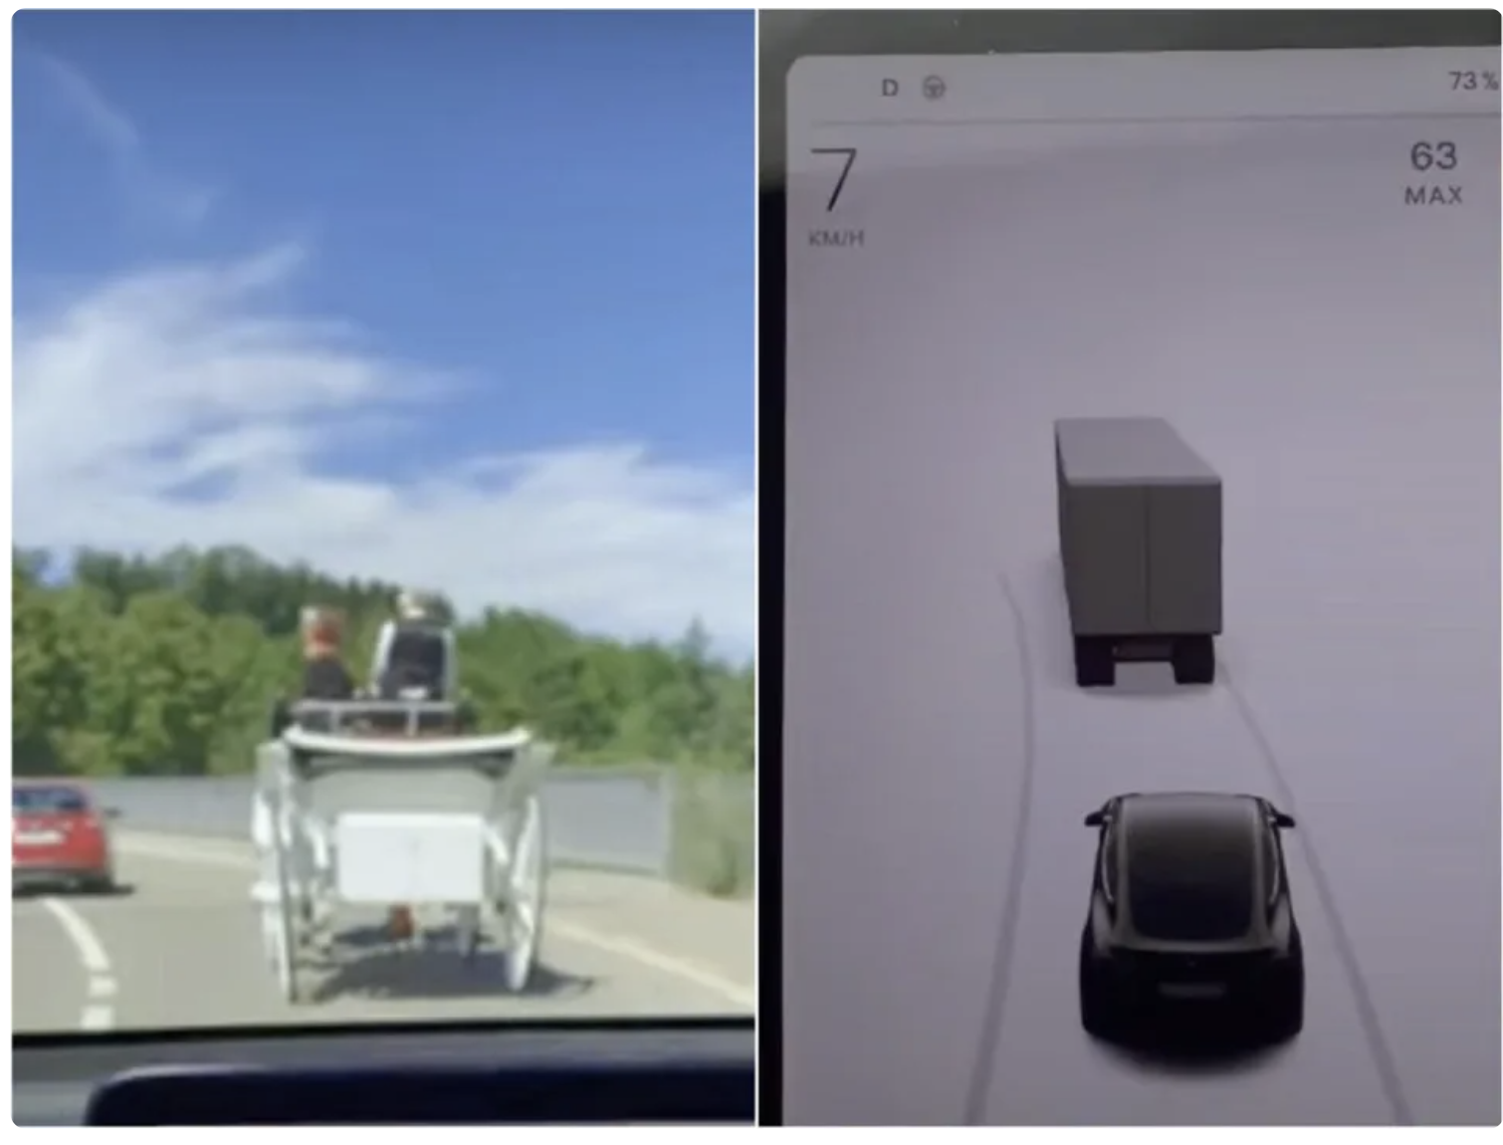
Argument: Scale is Not all You Need Because of Tail Phenomena
Tail phenomena will never go away!
Will result in brittleness to small changes
“Tesla's Autopilot system confusing horse-drawn carriage for truck”

Slide 86
Argument: Scale is Not all You Need Because of Tail Phenomena
Hence, scale won’t solve the tail phenomena. [QED]
Let’s do a poll!
Head tasks:
Translating simple sentences
Generate rhyming sentence
Indicating spans of location
…
popularity
tasks

Slide 87
Argument: Scale is Not all You Need Because of Tail Phenomena
How do you rebut this??

Slide 88
Fundamentally What does “Scale” Solve?
Maybe data or compute are the bottleneck.
If “Scale is All You Need”, is good predictive ability* all needed for “general intelligence”?
(is prediction all about “prediction”?)
* Self-supervised models == predictive models of the world.
What about causality, planning, coordination, … ?
What do you think?

Slide 89
Summary
“Scaling” is here is here to stay for now.
There is plenty of data out there that we haven’t been able to use.
There is no sign of development in hardware technology.
The long tail poses a serious challenge:
It’s possible that scaling will continue to yield gains in the long-tail, but unlike to solve it.
It is unclear if there are better ways of solving long tail phenomena.
Unclear “scale” can say about other aspect of intelligence
coordination, cooperation, communication, etc.

Slide 90
https://www.cs.princeton.edu/courses/archive/fall22/cos597G/lectures/lec12.pdf
https://arxiv.org/pdf/2109.05472.pdf
https://www.deep-kondah.com/scaling-large-language-models/
https://arxiv.org/pdf/1712.00409.pdf
https://www.cirm-math.fr/RepOrga/2551/Slides/Mensch.pdf
https://ai.google/static/documents/palm2techreport.pdf
https://arxiv.org/pdf/2205.05198.pdf
https://www.nextbigfuture.com/2023/05/more-ai-breakthroughs-and-reaching-agi.html
https://members.loria.fr/CGardent/publis/thesis-lescao-2023.pdf
https://arxiv.org/pdf/2309.08520.pdf
https://www.lesswrong.com/posts/fnjKpBoWJXcSDwhZk/what-s-the-backward-forward-flop-ratio-for-neural-networks

Slide 91
Scaling costs

Slide 92
When Scaling Does NOT Help
https://arxiv.org/pdf/2306.09479.pdf

