Slide 1
Language Modeling
CSCI 601-471/671 (NLP: Self-Supervised Models)
https://self-supervised.cs.jhu.edu/sp2025/

Slide 2
Recap: Self-Supervised Models
Earlier we define Self-Supervised models as as predictive models of the world!
“Wings over Kansas is an aviation website founded in 1998 by Carl Chance owned by Chance Communications, Inc.”
“Wings over Kansas is [MASK]”
Notes:
In this chapter, we'll make progress by connecting our discussion on self-supervised models to ….

Slide 3
Language Modeling: Motivation
Earlier we define Self-Supervised models as as predictive models of the world!
Language models are self-supervised, or predictive models of language.
How do you formulate? How do you build them?
Notes:
to natural language which are the manifestation of self-supervision in the context of natural language, in the sense that predictive models of the world.
Our goal is to explore how to formulate and build them.

Slide 4
Language Modeling: Chapter Plan
Language modeling: definitions and history
Language modeling with counting
Measuring language modeling quality
Language Modeling as a Machine Learning problem
Chapter goal — getting comfortable with the concept of “language modeling.”
Notes:
This is the chapter plan. We'll define language models, discuss their history, model them, build a simple version based on counting word co-occurrences, measure their quality, and then move beyond simplistic models to cast language modeling as a machine learning problem. These are our goals: to get comfortable with the concept of language modeling as a broad concept.

Slide 5
Language Modeling: Definitions and History
Notes:
Let's start with definitions and some history.

Slide 6
The
Notes:
Here's a simple example:

Slide 7
The cat
Notes:
Then cat

Slide 8
The cat sat
Notes:
sat

Slide 9
The cat sat on

Slide 10
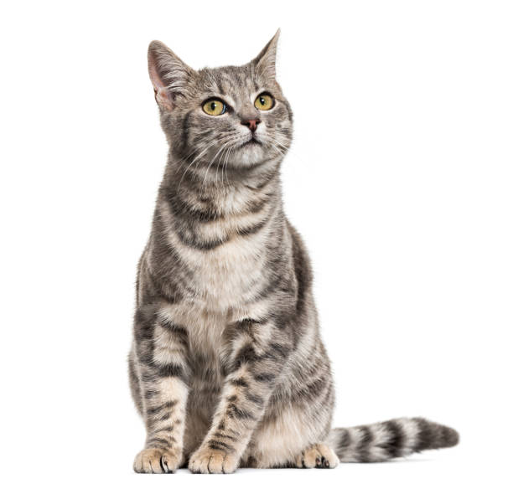
The cat sat on __?__
Notes:
if I give you the sequence "The cat sat on the," what do you think should come next?

Slide 11
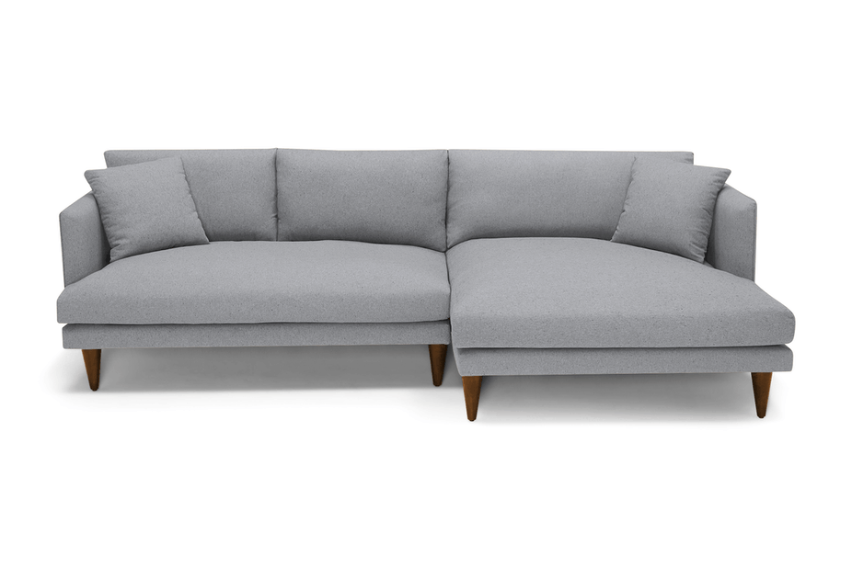
The cat sat on __?__
Notes:
I asked this in the class, someone suggested "sofa" and many people liked it

Slide 12
The cat sat on __?__
Notes:
someone else suggested "mat" and again, many people agree with this.

Slide 13
The cat sat on __?__
Notes:
But when I asked ”atom" as continuation, almost no one liked.

Slide 14
P(mat |The cat sat on the)
next word
context or prefix
Notes:
The point here is that natural language can be viewed as a probability distribution.
We’re predicting a probability distribution over the next word in the sentence given the previous words.
Why is this a valid thing to do? When you want to continue a sequence, you're relying on your world model of what's possible and likely, shared among independent humans. More people favored "sofa" and "mat," while fewer favored "atom." This doesn't mean "atom" is impossible, it's just less likely and surprising. Language modeling involves understanding the world and turning it into a probability distribution for decision-making in natural language. It involves building a probability distribution over sequences of tokens or words.

Slide 15
Probability of Upcoming Word
P($X_{t}$| $X_{1}$, $…$, $X_{t−1}$)
next word
context or prefix
Notes:
Let's formalize this idea. You have random variables X1 to Xt-1, which are your observations. You want to compute the distribution over what's next. This is the abstract version of the problem..

Slide 16
LMs as a Marginal Distribution
next word
Directly we train models on “marginals”:
context
P($X_{t}$| $X_{1}$, $…$, $X_{t−1}$)
Prob
mat
table
bed
desk
chair
Language Model
“The cat sat on the [MASK]”
…
Notes:
We want to build a box called a language model. Given a prefix, it should produce a probability distribution over possible continuations. This is a long probability distribution over everything in your dictionary. The likely continuations might be "mat," "table," "bed," and "wall." Symbolically, we represent it like this. The question is, how do we estimate this probability distribution?

Slide 17
LMs as Implicit Joint Distribution over Language
While language modeling involves learning the marginals, we are implicitly learning the full/joint distribution of language.
Remember the chain rule:
P($X_{1}, …, X_{t}$) = ${P(X}_{1})\prod_{i=1}^{t}{P(X_{i}}|X_{1}, X_{2}…,X_{i})$
Language Modeling ≜ learning prob distribution over language sequence.
Notes:
Before discussing estimation, an important statement: even though this might seem like a marginal distribution, language modeling implicitly involves learning a joint distribution over all sequences in natural language. This is because, through the chain rule, a joint probability distribution can be decomposed into conditionals. So, by predicting conditionals, you're implicitly learning a joint distribution. Language modeling is about learning a probability distribution over language sequences. That's the most general definition you'll see in this class.

Slide 18
The Language Modeling Problem, Formally
Learning to assign a probability to every sequence:
Finite vocabulary $Σ=\{x_{1}, x_{2}, x_{3}, …, x_{n}\}$
Infinite set of sequences in this language $Σ^{∗}=\{x_{1}, {x_{1}x}_{2}, {x_{2}x}_{3},{x_{2}x_{1}x}_{3},{{x_{4}x}_{3}x_{1}x}_{2},…\}$
$$\sum_{e∈Σ^{∗}}{p_{LM}\left(e\right)}=1,$$
$$p_{LM}\left(e\right)≥0, ∀e∈Σ^{∗}$$
Note, this statement does not specify the vocabulary (the atomic unit).
Example units: words, characters, bytes, etc.
Note that this is a (joint) distribution over sequences; different from (but related to) the conditional.
Notes:
For those who are mathematically minded, here is the formal definition of a language model:
Suppose we have a finite vocabulary.
Language model, is a distribution over all sequences that may exist in the language.
Note that for this to be a valid probability distribution, it needs to satisfy a few properties:
The probability of all sequences needs to sum to one.
And the probability assigned to each sequence needs to be non-negative.
Another note that in this definition, we don’t specify the atomic units of language. They may be words, characters, bytes, or something else!

Slide 19
Suppose we have a language model now. What can we do with it? (how is it useful?)
Notes:
Let's move on. Assuming we have a conditional and can turn it into a joint distribution, how can we use it?

Slide 20
Doing Things with Language Model
“I like Johns Hopkins University”
“like Hopkins I University Johns”
What is the probability of ….
Notes:
One use is assigning probability to sequences. Given two sequences, "I like Johns Hopkins University" and "Hopkins I University John," which has a higher probability.

Slide 21
Doing Things with Language Model
“I like Johns Hopkins University”
“like Hopkins I University Johns”
What is the probability of ….
LMs assign a probability to every sentence (or any string of words).
P(“I like Johns Hopkins University”) = 10⁻⁵
P(“like Hopkins I University Johns” ) = 10⁻¹⁵
Notes:
And intuitively, the first one has a higher probability.
Notice that both probabilities are small because our model has to account for a massive space of inputs.
Nevertheless, the first sentence has much much higher probability than the second one.

Slide 22
Doing Things with Language Model (2)
next word
context
We can rank sentences.
While LMs show “typicality”, this may be a proxy indicator to other properties:
Grammaticality, fluency, factuality, etc.
P(“I like Johns Hopkins University.”) > P(“I like John Hopkins University”)
P(“I like Johns Hopkins University.”) > P(“University. I Johns EOS Hopkins like”)
P(“JHU is located in Baltimore.”) > P(“JHU is located in Virginia.”)
P($X_{t}$| $X_{1}$, $…$, $X_{t−1}$)
Notes:
You can also compare probabilities, preferring one sequence over another based on grammaticality or factuality. Language modeling captures various aspects of natural language.

Slide 23
Doing Things with Language Model (3)
next word
context
Can also generate strings!
Let’s say we start “Johns Hopkins is ”
Using this prompt as an initial condition, recursively sample from an LM:
Sample from P(X | “Johns Hopkins is ”) → “located”
Sample from P(X | “Johns Hopkins is located”) → “at”
Sample from P(X | “Johns Hopkins is located at”) → “the”
Sample from P(X | “Johns Hopkins is located at the”) → “state”
Sample from P(X | “Johns Hopkins is located at the state”) → “of”
Sample from P(X | “Johns Hopkins is located at the state of”) → “Maryland”
Sample from P(X | “Johns Hopkins is located at the state of Maryland”) → “EOS”
P($X_{t}$| $X_{1}$, $…$, $X_{t−1}$)
Notice this special word to indicate end of sentences
Notes:
You can also generate strings. Given a prompt, like in ChatGPT, you can use the probability distribution to generate a sequence. You sample words based on their probabilities until you reach the end of the sentence.
….
Notice the "EOS" at the end, indicating the end of a sequence. It's not just practical but also theoretically important for ensuring a proper probability distribution.

Slide 24
Why Care About Language Modeling?
Language Modeling is a subcomponent superset of many tasks:
Summarization
Machine translation
Spelling correction
Dialogue etc.
Language Modeling is an effective proxy for language understanding.
Effective ability to predict forthcoming words requires on understanding of context/prefix.
Notes:
Why do we care about language modeling? It used to be a component in NLP tasks, but now it's a superset, subsuming many tasks.
Language modeling has become a powerful tool for solving various language problems.

Slide 25
You use Language Models every day!
Notes:
And you can obviously find its usecases almost everywhere: on your phone for auto-complete systems …

Slide 26
You use Language Models every day!
Notes:
Chatgpt, of course, …

Slide 27
Summary
Language modeling: building probabilistic distribution over language.
An accurate distribution of language enables us to solve many important tasks that involve language communication.
Next question: how do you actually estimate this distribution?
Notes:
To recap, we defined language modeling as building a probability distribution over sequences of words.
The quality of estimation matters. The next question is how to estimate this distribution. That's our next topic.

Slide 28
Language Modeling with Counting
Notes:
language modeling with counting.

Slide 29
LMs as a Marginal Distribution
Now the question is, how to estimate this distribution.
next word
context
P($X_{t}$| $X_{1},…$, $X_{t−1}$)
Notes:
We want to build a conditional probability distribution. How do we estimate it?

Slide 30
P($X_{t}$| $X_{1},…$, $X_{t−1}$)
How do we estimate these probabilities?
Let’s just count!
P(“mat” | “the cat sat on the”) $≈$ $\frac{count(“the cat sat on the mat”)}{count(“the cat sat on the”)}$
Count how often ”the cat sat on the mat” has appeared in the world (internet)!
Divide that by, the count of ”the cat sat on the” in the world (internet)!
Notes:
A simple proposal is counting.
For example, to compute the probability of "mat" given "the cat sat on the," count how often "the cat sat on the mat" appears on the internet and divide it by the count of "the cat sat on the."
You may want to pause the video at this point and think about the feasiblity of this approach.

Slide 31
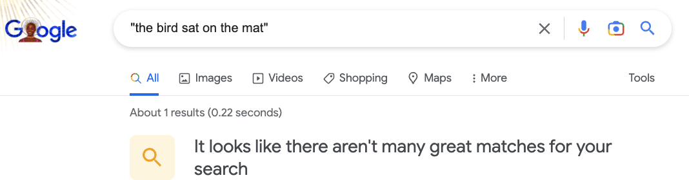
P($X_{t}$| $X_{1},…$, $X_{t−1}$)
How do we estimate these probabilities?
Let’s just count!
P(“mat” | “the cat sat on the”) $≈$ $\frac{count(“the cat sat on the mat”)}{count(“the cat sat on the”)}$
Notes:
You might have guesed it that, a key issue is that many phrases, especially the long ones may not appear enought or at all on the internet. And that does not mean that they're impossible, it's just no one has bothered to write them down.

Slide 32
P($X_{t}$| $X_{1},…$, $X_{t−1}$)
How do we estimate these probabilities?
Let’s just count!
P(“mat” | “the cat sat on the”) $≈$ $\frac{count(“the cat sat on the mat”)}{count(“the cat sat on the”)}$
Challenge: Increasing $n$ makes sparsity problems worse.
Typically, we can’t have $n$ bigger than 5.
Some partial solutions (e.g., smoothing and backoffs) though still an open problem.
Notes:
This is the sparsity problem: longer sequences are less frequent.

Slide 33
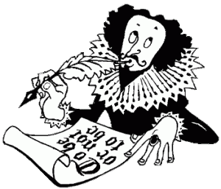
Understanding Sparsity: A Thought Experiment
Consider Shakespeare’s writing.
Say, we want the count of any word-pair that Shakespeare knows
The size vocab used by Shakespeare: |V|=29,066
The number of potential word-pairs 29,066 x 29,066 ~ 844 million
(some of them don’t make sense, but ok!)
Of this, Shakespeare has used ~300K word-pair combinations in his writings!
So, 99.96% of the possible bigrams are never seen (hence, have zero entries for bigram counts).
Notes:
Let me show the sparsity problem with a short example:
….
… the number of possible bigrams far exceeds the actual bigrams produced. This highlights the difficulty of counting long sequences.

Slide 34
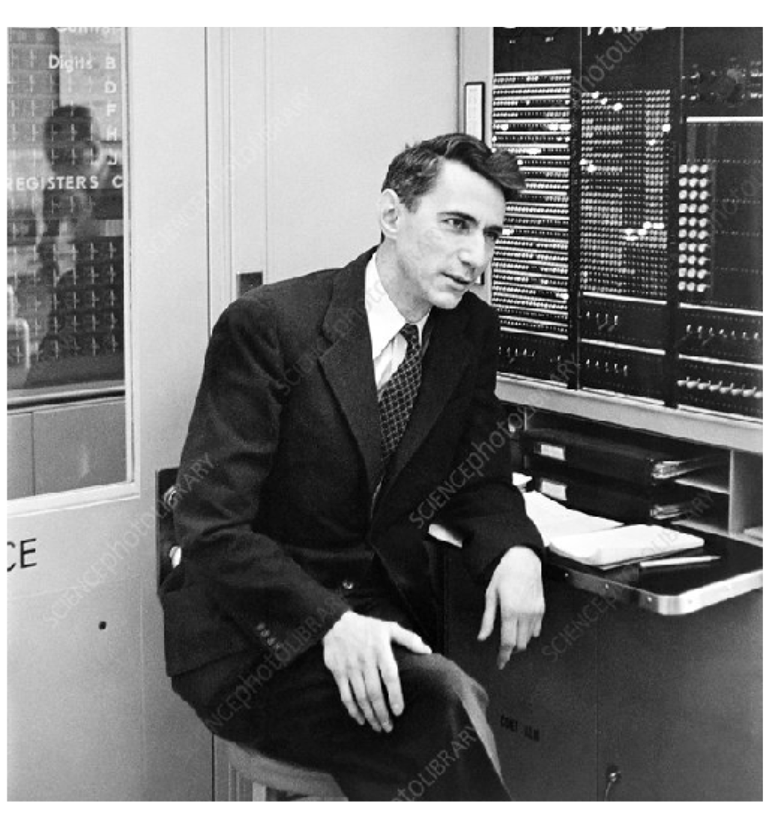
Language Models: A History
Shannon (1950): The redundancy and predictability (entropy) of English.
[Prediction and Entropy of Printed English, Shanon 1950]
Notes:
Claude Shannon, the father of information theory, was interested in the entropy of natural language for efficient communication. .
. …

Slide 35
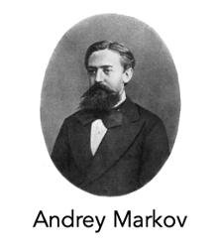
P($X_{t}$| $X_{1},…$, $X_{t−1}$)
Shannon (1950) built an approximate language model with word co-occurrences.
Markov assumptions: every node in a Bayesian network is conditionally independent of its non-descendants, given its parents.
$1$ element
1st order approximation:
P($mat$ | the cat sat on the) $≈$ P($mat$ | the)
[Prediction and Entropy of Printed English, Shanon 1950]
Notes:
We observed the sparsity problem and relied on Markov's principle of independence, simplifying the problem by considering only the nearest neighbor words. This leads to n-gram language models, which approximate conditionals with shorter contexts.

Slide 36
P($X_{t}$| $X_{1},…$, $X_{t−1}$)
2nd order approximation:
$2$ elements
P($mat$ | the cat sat on the) $≈$ P($mat$ | on the)
$1$ element
1st order approximation:
P($mat$ | the cat sat on the) $≈$ P($mat$ | the)
[Prediction and Entropy of Printed English, Shanon 1950]

Slide 37
P($X_{t}$| $X_{1},…$, $X_{t−1}$)
3rd order approximation:
$3$ elements
P($mat$ | the cat sat on the) $≈$ P($mat$ | sat on the)
2nd order approximation:
$2$ elements
P($mat$ | the cat sat on the) $≈$ P($mat$ | on the)
$1$ element
1st order approximation:
P($mat$ | the cat sat on the) $≈$ P($mat$ | the)
[Prediction and Entropy of Printed English, Shanon 1950]

Slide 38
P($X_{t}$| $X_{1},…$, $X_{t−1}$)
3rd order approximation:
Then, we can use counts of approximate conditional probability.
Using the 3rd order approximation, we can:
$3$ elements
P($mat$ | the cat sat on the) $≈$ P($mat$ | sat on the)
P($mat$ | the cat sat on the) $≈$P($mat$ | sat on the) $=$ $\frac{count(“sat on the mat”)}{count(“on the mat”)}$
[Prediction and Entropy of Printed English, Shanon 1950]

Slide 39
N-gram Language Models
Terminology: n-gram is a chunk of n consecutive words:
unigrams: “cat”, “mat”, “sat”, …
bigrams: “the cat”, “cat sat”, “sat on”, …
trigrams: “the cat sat”, “cat sat on”, “sat on the”, …
four-grams: “the cat sat on”, “cat sat on the”, “sat on the mat”, …
n-gram language model:
$n−1$ elements
P($X_{t}$| $X_{1},…$, $X_{t−1}$) $≈$ P($X_{t}$| $X_{t−n+1},…$, $X_{t−1}$) = $\frac{count(X_{t−n+1},…\text{,} X_{t−1},{ X}_{t})}{count(X_{t−n+1},…\text{,} X_{t−1})}$
[Prediction and Entropy of Printed English, Shanon 1950]
Notes:
N-grams are sequences of words: unigrams, bigrams, trigrams, etc.
N-gram language models truncate the context to n-1 elements, simplifying counting.

Slide 40
How easy is it to build an n-gram language model?

Slide 41
Generation from N-Gram Models
You can build a simple trigram Language Model over a 1.7 million words corpus in a few seconds on your laptop*
* Try for yourself: https://nlpforhackers.io/language-models/
[adopted from Chris Manning]
Notes:
You can easily build a trigram language model on your computer.

Slide 42
Generation from N-Gram Models
You can build a simple trigram Language Model over a 1.7 million words corpus in a few seconds on your laptop*
today the
Sparsity problem: not much granularity in the probability distribution
company 0.153
bank 0.153
price 0.077
italian 0.039
emirate 0.039
...
get probability distribution
Otherwise, seems reasonable!
* Try for yourself: https://nlpforhackers.io/language-models/
[adopted from Chris Manning]
Notes:
Here's a real generation based on a trigram model. The prefix is "Today the," and the model generates a sequence. Locally, it makes sense, but globally, it lacks coherence. The model reflects the data it's trained on, like news articles.

Slide 43
Generation from N-Gram Models
Now we can sample from this mode:
today the
Sparsity problem: not much granularity in the probability distribution
company 0.153
bank 0.153
price 0.077
italian 0.039
emirate 0.039
...
get probability distribution
Otherwise, seems reasonable!
* Try for yourself: https://nlpforhackers.io/language-models/
[adopted from Chris Manning]

Slide 44
Generation from N-Gram Models
Now we can sample from this mode:
condition on this
today the price
Sparsity problem: not much granularity in the probability distribution
of 0.308
for 0.050
it 0.046
to 0.046
is 0.031
...
get probability distribution
Otherwise, seems reasonable!
* Try for yourself: https://nlpforhackers.io/language-models/
[adopted from Chris Manning]

Slide 45
Generation from N-Gram Models
Now we can sample from this mode:
condition on this
today the price of
Sparsity problem: not much granularity in the probability distribution
the 0.072
18 0.043
oil 0.043
its 0.036
gold 0.018
...
get probability distribution
Otherwise, seems reasonable!
* Try for yourself: https://nlpforhackers.io/language-models/
[adopted from Chris Manning]

Slide 46
N-Gram Models in Practice
Now we can sample from this mode:
today the price of gold per ton , while production of shoe lasts and shoe industry , the bank intervened just after it considered and rejected an imf demand to rebuild depleted european stocks , sept 30 end primary 76 cts a share .
Surprisingly grammatical!
But quite incoherent! To improve coherence, one may consider increasing larger than 3-grams, but that would worsen the sparsity problem!
* Try for yourself: https://nlpforhackers.io/language-models/
[adopted from Chris Manning]
Notes:
stuck between a rock and a hard place.

Slide 47
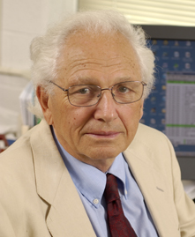
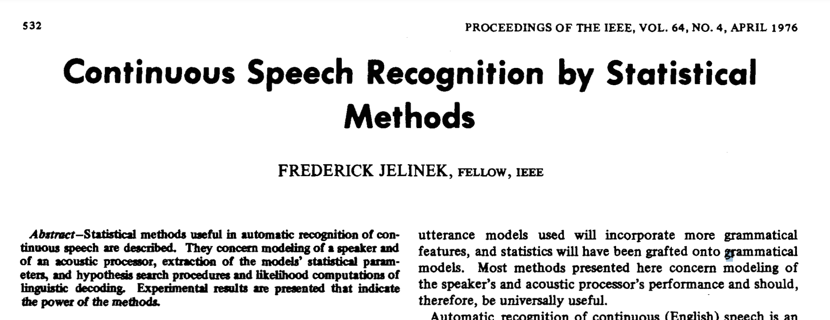
N-Gram Language Models, A Historical Highlight
“Every time I fire a linguist, the performance of the speech recognizer goes up”!!
Probabilistic n-gram models of text generation [Jelinek+ 1980’s, …]
Applications: Speech Recognition, Machine Translation
Fred Jelinek (1932-2010)
Notes:
Frederick Jelinek, a renowned Czech-American researcher in natural language processing and speech recognition, famously said in 1985, "Every time I fire a linguist, the performance of the speech recognizer goes up”¹, suggesting that there statistical learning may be a more effective way to teach models about language.

Slide 48
n-gram language models are enough to give us many interesting insights!
Notes:
N-grams, despite their simplicity, capture interesting patterns in data.

Slide 49
Pre-Computed N-Grams
Google n-gram viewer https://books.google.com/ngrams/
Data: http://storage.googleapis.com/books/ngrams/books/datasetsv2.html
Notes:
Google's n-gram visualizer shows probabilities over time, reflecting historical discourse.
For example, "depression" peaks during the Great Depression, and "terrorism" peaks after 9/11. N-grams encode our collective discourse.

Slide 50
Pre-Computed N-Grams
Language models can tell us something about us …
Google n-gram viewer https://books.google.com/ngrams/
Data: http://storage.googleapis.com/books/ngrams/books/datasetsv2.html

Slide 51
Pre-Computed N-Grams
Google n-gram viewer https://books.google.com/ngrams/
Data: http://storage.googleapis.com/books/ngrams/books/datasetsv2.html

Slide 52
Limits of N-Grams LMs: Long-range Dependencies
In general, count-based LMs are insufficient models of language because language has long-distance dependencies:
“The computer which I had just put into the machine room on the fifth floor crashed.”
Notes:
However, n-grams have limitations. They struggle with long-range dependencies, which are prevalent in natural language. We need better models.

Slide 53
Summary
Learning a language model ~ learning conditional probabilities over language.
One approach to estimating these probabilities: counting word co-occurrences.
Challenges:
Word co-occurrences become rare for long sequences. (the sparsity issue)
But language understanding requires long-range dependencies.
We need a better alternative! 😤
Next: Measuring quality of language models.
Notes:
To summarize, we introduced n-gram language models, which are easy to estimate but struggle with long contexts. We need better alternatives. Before that, we'll discuss evaluating language models, focusing on intrinsic evaluation and perplexity.

Slide 54
How Good are Language Models?
Notes:
Let's continue with evaluating language models.

Slide 55
Large Language Models
[slide credit: Arman Cohan]
A language model can predict the next word based on the given context.
X := The cat is on the
roof
tree moon physics
the
protein
…
P(roof|X)=0.00
P(tree|X)=0.01 P(moon|X)=0.01 P(physics|X)=0.1
P(the|X)=0.1
P(protein|X)=0.3
...
LM
The cat is on the _??_

Slide 56
Large Language Models
[slide credit: Arman Cohan]
X := The cat is on the
A language model can predict the next word based on the given context.
roof
tree moon physics
the
protein
…
P(roof|X)=0.00
P(tree|X)=0.01 P(moon|X)=0.01 P(physics|X)=0.1
P(the|X)=0.1
P(protein|X)=0.3
...
LM1
The cat is on the _??_
roof
tree moon physics
the
protein
…
P(roof|X)=0.14
P(tree|X)=0.13 P(moon|X)=0.001 P(physics|X)=0.0
P(the|X)=0.000
P(protein|X)=0.00
…
Which LM is better?
LM2

Slide 57
Evaluating Language Models
Does our language model prefer good sentences to bad ones?
Assign higher probability to “real” or “frequently observed” sentences
Than “ungrammatical” or “rarely observed” sentences?
We test the model’s performance on data we haven’t seen.

Slide 58
Evaluating Language Models
Setup:
Train it on a suitable training documents.
Evaluate their predictions on different, unseen documents.
An evaluation metric tells us how well our model does on the test set.
Notes:
We want to assign a number to their quality, guiding our design and progress. The setup involves training data, evaluation data, and possibly held-out data for hyperparameter tuning. Hyperparameters are settings in your training algorithm, like learning rates. It's important to evaluate on data different from your training data to avoid overfitting.

Slide 59
Evaluating Language Models: Example
Setup:
Train it on a suitable training documents.
Evaluate their predictions on different, unseen documents.
An evaluation metric tells us how well our model does on the test set.
Example: I use a bunch of New York Times articles to build a bigram probability table
A good language model should assign a high probability to held-out text!
Now I’m going to evaluate the probability of some heldout
data using our bigram table
train
eval
$$count(“on the mat”)$$

Slide 60
Be Careful About Data Leakage!
Advice from a grandpa👴:
- Don’t allow test sentences to leak into into training set.
- Otherwise, you will assign it an artificially high probability (==cheating).
Example: I use a bunch of New York Times articles to build a bigram probability table
A good language model should assign a high probability to held-out text!
Now I’m going to evaluate the probability of some heldout
data using our bigram table
train
eval
$$count(“on the mat”)$$

Slide 61
Quiz: Building Intuition
Sample a sentence $\left(w_{1}, w_{2}, …, w_{n}\right)=(cat, sat, on, the,mat)$ from our natural data.
We can show the probability that our language model assigns to this sentence with:
$$P{\left(w_{1}, w_{2}, …, w_{n}\right)}^{}$$
A strong language model would assign a __ probability to this sentence. (high or low?)
A weak language model would assign a __ probability to this sentence. (high or low?)
Next, we will define “perplexity”, a metric that quantifies LM’s uncertainty with respect to a corpus of natural sentences.

Slide 62
Evaluation Metric for Language Modeling: Perplexity
Sample a sentence $\left(w_{1}, w_{2}, …, w_{n}\right)$ from our natural data.
Perplexity is the inverse probability of the test set, normalized by the number of words:
A measure of predictive quality of a language model.
A LM with lower perplexity is better because it assigns a higher probability to the unseen test corpus.
$$ppl\left(w_{1},…, w_{n}\right)=P{\left(w_{1}, w_{2}, …, w_{n}\right)}^{−\frac{1}{n}}$$
The negative power ${(.)}^{−}$ inverses the score. So, a small probability become a larger score – working with small numbers is tedious.
$\frac{1}{n}$ normalizes the probability as a function of length so that longer sequences are not assigned lower scores.
Notes:
To measure perplexity, you sample sentences from the natural world, like from Wikipedia. You sample a document because it's written by humans. If it's a good sentence, you'd expect your language model to assign a high probability to it. That's the idea behind perplexity.
Perplexity is defined as the probability assigned to a given sentence, raised to the power of one over n, where n is the length of your sentence. In an alternative world, I could have defined my measure of quality as just this probability. But probabilities are very small, and they're tedious to work with. It's easier if I inverse this ratio and look at one minus probability, which makes it easier to study. That's why you have this to the power of a negative value.
Why do you have one over n here? Because statistically, longer sentences will have more words. If you're just looking at one word, it's to the power of one because every word occurs once in its space in a document. But with two words, each word occurs twice in the sample, which means the sample itself continues to grow with an increasing number of n. Larger numbers would statistically lower each particular set combination of words. To normalize between one word and, say, six words, we use negative one. If you don't have this dependence on n, the quality might vary with sentence length. Short sentences might have a high probability because many sentences start with common words like "Hello." The probability of short sentences is higher than long ones, so you want to normalize for length. That's why you raise this probability to the power of one over n.

Slide 63
Evaluation Metric for Language Modeling: Perplexity
Sample a sentence $\left(w_{1}, w_{2}, …, w_{n}\right)$ from our natural data.
Perplexity is the inverse probability of the test set, normalized by the number of words:
$$ppl\left(w_{1},…, w_{n}\right)=P{\left(w_{1}, w_{2}, …, w_{n}\right)}^{−\frac{1}{n}}$$
But wait, we usually have conditionals not the joint distribution! 🤔
Notes:
These two reasons explain why we have one negative to the power of negative one over n. But using this definition was difficult because, when we built our language model, we didn't have the joint distribution; we had the conditionals. We need to transform this into a format with a conditional distribution, meaning the probability of the next word given a context.

Slide 64
Evaluation Metric for Language Modeling: Perplexity
Sample a sentence $\left(w_{1}, w_{2}, …, w_{n}\right)$ from our natural data.
Perplexity is the inverse probability of the test set, normalized by the number of words:
$$ppl\left(w_{1},…, w_{n}\right)=P{\left(w_{1}, w_{2}, …, w_{n}\right)}^{−\frac{1}{n}}$$
$$=\sqrt[n]{\frac{1}{P\left(w_{1}, w_{2}, …, w_{n}\right)}}=\sqrt[n]{\prod_{i=1}^{n}{\frac{1}{P\left(w_{i}|w_{<i}\right)}}}$$
$=2^{H},\text{where}$
chain rule
$$H=−\frac{1}{n}\sum_{i=1}^{n}{\log_{2}{P\left(w_{i}\right|w_{1}, …, w_{i−1})}}$$
Notes:
We can rewrite it as 2 to the power of H, where H is the summation of log probabilities. Special cases help with interpretation. For a unigram model, we estimate unigram probabilities; for bigrams, bigram probabilities; and for trigrams, trigram probabilities.
Again, you sampled a sentence from the natural world, like from Wikipedia. You're computing the probability assigned to partial sequences of the sentence you sampled using your language model. You're trying to see if your model assigns a high probability to the sentence you sampled from the internet.

Slide 65
Putting Things Together: Perplexity Definition
For a given a sampled sentence $\left(w_{1}, w_{2}, …, w_{n}\right)$ from our natural data:
Notice that this consists of probability assigned to all the partial sentences (i.e., next word probabilities).
In practice, we prefer to use log-probabilities (also known as “logits”) since probabilities are too small and hard to understand (e.g., 10^-18 vs -18).
$ppl\left(w_{1},…, w_{n}\right)=2^{H},$ where $H=−\frac{1}{n}\sum_{i=1}^{n}{\log_{2}{P\left(w_{i}\right|w_{1}, …, w_{i−1})}}$

Slide 66
Intuition-building Quizzes (1)
Quiz: let’s we evaluate a confused (!!) model of language, i.e., our model has no idea what word should follow each context—it always chooses a uniformly random word. What is the perplexity of this model?
Answer: $\left|V\right|$ (size of the vocabulary) – why?
Notes:
You have a language model that's perpetually confused and doesn't know the right configuration. What's the perplexity of this language model?
The answer is the the size of the vocabulary. This not very obvious to see. Let’s unpack it a bit.

Slide 67
Intuition-building Quizzes (1)
Quiz: let’s we evaluate a confused (!!) model of language, i.e., our model has no idea what word should follow each context—it always chooses a uniformly random word. What is the perplexity of this model?
Sample a sentence from corpus: X=“The cat is on the mat.”
roof
tree moon physics
…
P(roof|X)=1/|V|
P(tree|X)=1/|V| P(moon|X)=1/|V| P(physics|X)=1/|V|
…
For any partial sub-sentence: X=The cat is on the _??_
LM
$∀w∈V: P\left(w\right|w_{1:i−1})=\frac{1}{|V|} ⇒ ppl\left(D\right)=2^{−\frac{1}{n} n\log_{2}{\frac{1}{\left|V\right|}} }=|V|$
Notes:
For each conditional probability, the probability would be uniformly distributed. Exactly. Let's stop there for a second. Andy is saying that you sampled your sentence from the internet. The first step is to find all the partial sentences so you can compute the next word probability for all of them. Then you compute the probability of the next word. Each conditional probability would be uniformly distributed because your model is confused about which word should be next. You plug this probability into your formula, and you can derive the perplexity, showing it's the size of your vocabulary. This gave us the intuition that perplexity quantifies the branching factor. If your language model is confused about the next options, the perplexity will be high.

Slide 68
Intuition-building Quizzes (2)
Quiz: let’s suppose we have a sentence $w_{1},…, w_{n}$ and it’s fixed. Our language is model is mildly confused because it narrows down the plausible continuations to 5 words, but it is confused among them. So it it assigns probability 1/5 to the correct next word. What is perplexity of our model?
P(roof|X)=1/5
P(tree|X)=1/5 P(table|X)=1/5 P(mat|X)=1/5
P(wall|X)=1/5
P(physics|X)=0
P(tesla|X)=0
…
A partial sentence: X=The cat is on the _??_
LM
Our LM has narrowed down the right continuation to one of these five words.
$$H=−\frac{1}{n}\left[\log_{2}\left(\frac{1}{5}\right)+…+\log_{2}\left(\frac{1}{5}\right)\right]=−log\left(\frac{1}{5}\right)⇒ppl\left(D\right)=5$$
Intuition: the model is indecisive among 5 choices.
Notes:
We also thought about a mildly confused language model, where it narrowed down the choices to the top five words. It made progress because many probabilities are zero, and only five are not. In this case, we showed that perplexity is five. Tom's intuition was right that the branching factor is five.
Let's solve a thought experiment. If a language model guesses each word with probability 1/5, the perplexity is 5. This means the model is confused between five choices. Perplexity measures branching factor: how many options the model is confused between.

Slide 69
Intuition-building Quizzes (2)
Quiz: let’s we evaluate an exact (!!) model of language, i.e., our model always knows what exact word should follow a given context. What is the perplexity of this model?
P(mat|X)=1
P(physics|X)=0
P(tesla|X)=0
…
🪄
A partial sentence: X=The cat is on the _??_
LM
$∀w∈V:P\left(w_{i}\right|w_{1:i−1})=1 ⇒ ppl\left(D\right)=2^{−\frac{1}{n} n\log_{2}{1} }=1$
Intuition: the model is indecisive among 1 (the right!) choice!
Notes:
We also discussed an unrealistic scenario where you have an exact language model that knows the exact right word to come next. It's unrealistic but a thought experiment. The language model's perplexity would be one. So, what's the summary of perplexity? How would you explain this?
For an exact model, perplexity is 1, as it knows the exact word. For a confused model, perplexity is the vocabulary size, as it's confused between all words.

Slide 70
Perplexity: Summary
$ppl\left(w_{1},…, w_{n}\right)=2^{H},$ where $H=−\frac{1}{n}\sum_{i=1}^{n}{\log_{2}{P\left(w_{i}\right|w_{1}, …, w_{i−1})}}$
Perplexity is a measure of model’s uncertainty about next word (aka ”average branching factor”).
The larger the number of vocabulary, the more options there to choose from.
(the choice of atomic units of language impacts PPL — more on this later)
Perplexity ranges between 1 and |V|.
We prefer LMs with lower perplexity.
Notes:
Perplexity is a measure of branching factor. A lower perplexity indicates a better model.
Because we have a branching factor explanation of perplexity, we see that any model is between two extremes: either it's very sure about the next word, with a perplexity of one, or it's uniformly confused, with a high perplexity. Any model should be between these two extremes. A lower perplexity intuitively means a lower branching factor, meaning the model is more certain about the next word.

Slide 71
Quiz: Perplexity for N-Grams
Remember the ppl definition:
Which expression corresponds to PPL of (1) unigram, (2) bigram and (3) trigram LM.
$ppl\left(w_{1},…, w_{n}\right)=2^{H},$ where $H=−\frac{1}{n}\sum_{i=1}^{n}{\log_{2}{P\left(w_{i}\right|w_{1}, …, w_{i−1})}}$
$$H=−\frac{1}{n}\sum_{i=1}^{n}{\log_{2}{P\left(w_{i}\right|w_{i−1})}} H=−\frac{1}{n}\sum_{i=1}^{n}{\log_{2}{P\left(w_{i}\right)}} H=−\frac{1}{n}\sum_{i=1}^{n}{\log_{2}{P\left(w_{i}\right|w_{i−2}, w_{i−1})}}$$

Slide 72
Lower perplexity == Better Model
Training on 38 million words, test 1.5 million words, Wall Street Journal
N-gram Order | Unigram | Bigram | Trigram
Perplexity | 962 | 170 | 109
Lower is better
Note these evaluations are done on data that was not used for “counting.” (no cheating!!)
[Mohit Iyyer]

Slide 73
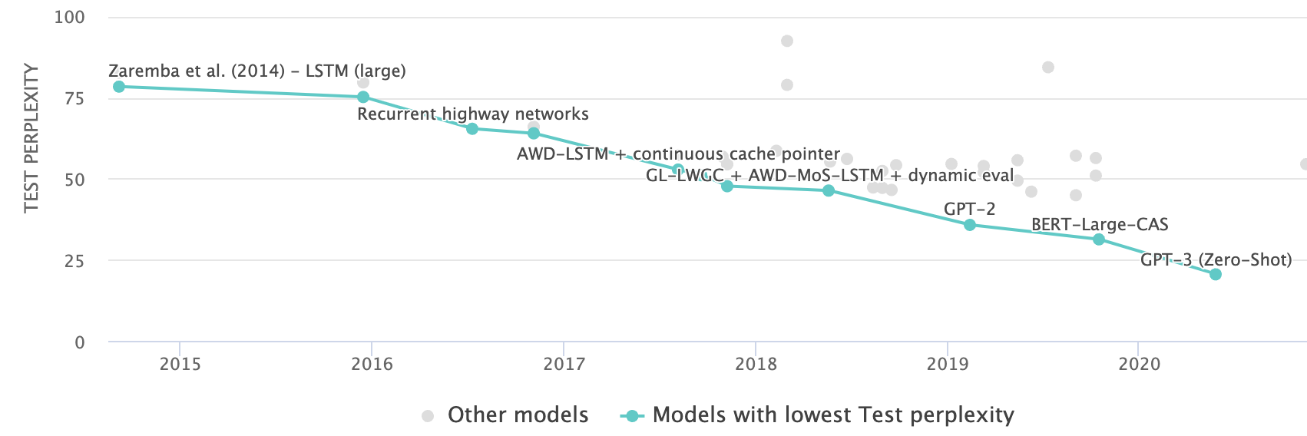
Lower perplexity == Better Model
The PPL of modern language models have consistently been going down.
[Language Modelling on Penn Treebank (Word Level)]
Notes:
Historically, perplexity has decreased, reflecting progress in AI. Recent models achieve perplexity under 10, narrowing down possible continuations significantly.

Slide 74
Lower perplexity == Better Model
The PPL of modern language models have consistently been going down.
[Scaling Laws, Jared Kaplan et al.]

Slide 75
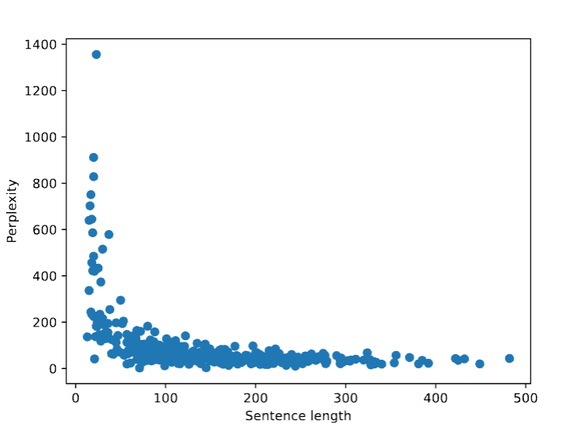
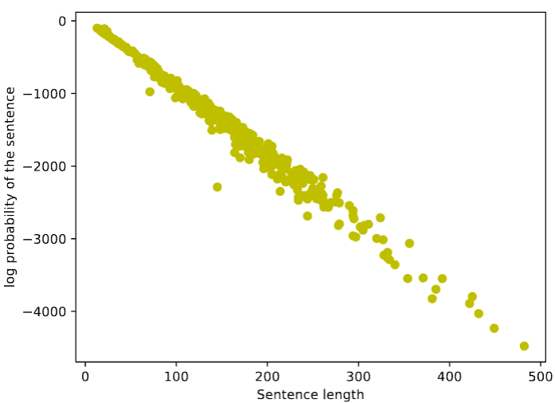
Quiz: Thinking About Sentence Lengths
Would you expect higher PPL for longer sentences?
Would you expect a higher probability for longer sentences?
$$ppl\left(w_{1},…, w_{n}\right)=2^{−\frac{1}{n}\sum_{i=1}^{n}{\log_{2}{P\left(w_{i}\right|w_{1}, …, w_{i−1})}}}$$
$$P(w_{1}, …, w_{n})=\prod_{i=1}^{n}{P\left(w_{i}\right|w_{1}, …, w_{i−1})}$$
In the beginning, LM has no clue when you are generating the first token.
Mostly uniform

Slide 76
Perplexity as An Implicit Cross-Entropy
Compare the definition of PPL and cross-entropy:
$ppl\left(w_{1},…, w_{n}\right)=2^{H},$ where $H=−\frac{1}{n}\sum_{i=1}^{n}{\log_{2}{P\left(w_{i}\right|w_{1}, …, w_{i−1})}}$
Cross-entropy between two distributions $q, p$:
$$CE(q, p)=−\sum_{x∈𝒳}{q\left(x\right)\log{p(x)}}$$
The H term in PPL can be interpreted as cross-entropy between LM distribution and the latent (unobserved) distribution of language. Why? Hint: Monte Carlo Approximation + Law of Large Numbers.
Notes:
One might say you can view perplexity as an implicit cross-entropy. Remember the definition of cross-entropy from basic probability or information theory courses: the cross-entropy between two distributions, P and Q, is defined as the summation over the space of inputs, with P multiplied by the log of Q. This is the cross-entropy of the two distributions.
When we talk about entropy, we're averaging over all sequences. So, the P of X we're missing here is the language prior, which is how sequences are distributed naturally in the world.
The claim is that perplexity is a cross-entropy between the probability produced by your language model and the true probability of sentences produced by nature. Let's say nature has a distribution for how language should look. Humans learn about that true distribution and write sentences according to it. Every time we sample sentences from the internet, these are implicit samples from that distribution. We don't write that probability because we don't know the true distribution. We're averaging over samples of that distribution, so the weighting is implicit. We just don't write it there because we sample from that distribution directly.
Hint:
A Monte Carlo estimate of expectation with respect to a distribution is essentially an summation based on samples of from that distribution.
By the Law of Large Numbers, this empirical average converges to the true expectation as the number of samples go to infinity.

Slide 77
Summary
Language Models (LM): distributions over language
Measuring LM quality: use perplexity on held-out data.
Count-based LMs have limitations.
Challenge with large N’s: sparsity problem — many zero counts/probs.
Challenge with small N’s: lack of long-range dependencies.
Next: Rethinking language modeling as a statistical learning problem.
Notes:
To summarize, we defined language models as probability distributions over word sequences. We introduced perplexity as a measure of quality, with lower perplexity indicating better models. We discussed n-gram models and their limitations, motivating the need for better models.

Slide 78
Evaluating Language Models: Intrinsic vs Extrinsic
Intrinsic: measure how good we are at modeling language
Extrinsic: build a new language model, use it for some task (MT, ASR, etc.)
Example: I use a bunch of New York Times articles to build a bigram probability table
Now I’m going to evaluate the probability of some heldout
data using our bigram table
extrinsic eval
train
eval
LM
Notes:
There are two broad categories of metrics: intrinsic evaluation, focusing on next-token prediction, and extrinsic evaluation, measuring user-relevant outcomes. We'll focus on intrinsic evaluation, specifically perplexity.

Slide 79
Beyond Counting:
Language Models as a Learning Problem

Slide 80
LM as a Machine Learning Problem
Given the embeddings of the context, predict the word on the right side.
Dropping the right context for simplicity -- not a fundamental limitation.
Discard anything beyond its context window
blah blah blah blah
and
our
problems
turning
into
context words in window target word
Notes:
The setup looks like this: given a context with potentially many words, I want to learn a function that maps this context to a probability distribution for my next word. But because I don't know how to formulate an arbitrary long context window, I'm going to simplify by using a fixed context window. We'll get back to this, but for now, let's ignore it.

Slide 81
LM as a Machine Learning Problem
Given the embeddings of the context, predict the word on the right side.
Dropping the right context for simplicity -- not a fundamental limitation.
Discard anything beyond its context window
blah blah blah blah
and
our
problems
turning
into
discard
context words in window of size 4 target word

Slide 82
LM as a Machine Learning Problem
Given the embeddings of the context, predict the word on the right side.
Dropping the right context for simplicity -- not a fundamental limitation.
Discard anything beyond its context window
and
our
problems
turning
into
context words in window of size 4 target word

Slide 83
A Fixed-Window Neural LM
Given the embeddings of the context, predict a target word on the right side.
Dropping the right context for simplicity -- not a fundamental limitation.
Training this model is basically optimizing its parameters $Θ$ such that it assigns high probability to the target word.
Probs over vocabulary
Trainable parameters of neural network
mat
table
into
ant
chair
$$f ($$
$$, Θ)$$
O O O
O O O
O O O
O O O
lookup embeddings
and
our
problems
turning
into
…
context words in window of size 4 target word
[Bengio et al. 2003]

Slide 84
A Fixed-Window Neural LM
It will also lay the foundation for the future models (recurrent nets, transformers, ...)
But first we need to figure out how to train neural networks!
How do you build this function?
Probs over vocabulary
Trainable parameters of neural network
mat
table
into
ant
chair
$$f ($$
$$, Θ)$$
O O O
O O O
O O O
O O O
lookup embeddings
Neural Networks for rescue!
and
our
problems
turning
into
…
context words in window of size 4 target word
[Bengio et al. 2003]
Notes:
I'm going to have a fixed context window and try to find a function, let's call it f, that takes in all my words in my context. It builds a representation for all these words.
We'll identify what those representations are, but let's say I can map every word to a unique representation. It will take the representation and give us a distribution over all the valid next word probabilities. This function is parameterized with parameters, let's call them Thetas. We don't know what they are yet. The question is, what is this function class? If you define what those function classes are, how do you train them? For us, the answer is neural networks. We are going to build and use neural networks to learn these function classes for learning this mapping.
That's going to motivate the next chapter, which will be all about building neural networks and training them. But before we dive into neural networks, let me give you a sneak peek of what happened after n-gram language models.

Slide 85
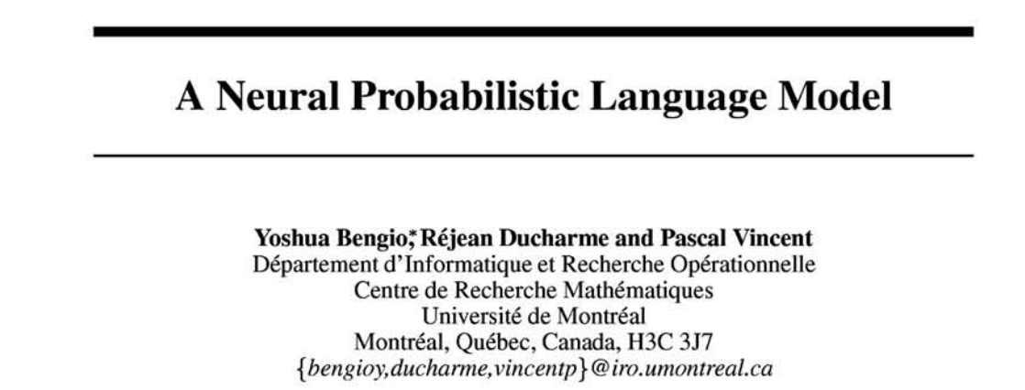
From Counting (N-Gram) to Neural Models
n-gram models of text generation [Jelinek+ 1980’s, …]
Applications: Speech Recognition, Machine Translation
“Shallow” statistical/neural language models (2000’s) [Bengio+ 1999 & 2001, …]
NeurIPS 2000
Notes:
N-gram language models were popular until the mid-90s and were well-used in industry. One of the pioneers of n-gram language models in the industry was Fred Jelinek, who was a faculty member here and probably sat in one of these chairs. Then came shallow statistical neural networks, where people started using neural networks to approximate n-gram language models and use them on a larger scale. This was in the early 2000s. That's the history there.

Slide 86
Summary
Language Modeling (LM), a useful predictive objective for language
Perplexity, a measure of an LM’s predictive ability
N-gram models (~1980 to early 2000’s),
Early instances of LMs
Difficult to scale to large window sizes
Shallow neural LMs (early and mid-2000’s),
We will learn about build neural networks in the next chapter.
These will be effective predictive models based on feed-forward networks
Notes:
After n-gram language models, shallow neural networks became popular. Then, lots of other cool things happened, which I'll get to in the next few sessions. To summarize, we talked about language modeling, defined perplexity, and defined n-gram models. I briefly mentioned that after n-gram language models came shallow neural networks in the early 2000s. We are not going to talk about these immediately. Next, we are going to discuss neural networks and how to define and train them. After that, we'll return to this topic and see how to use a neural network to build a shallow neural language model.
With that, that's the end of the chapter. I'm going to switch my slides to the discussion of neural networks.

