Slide 1
Recurrent Neural Language Models
CSCI 601-471/671 (NLP: Self-Supervised Models)
https://self-supervised.cs.jhu.edu/sp2025/

Slide 2
Recap
Prob
Softmax
mat
table
bed
desk
chair
Linear
Neural Language Models: neural networks trained with LM objective.
Fixed-window Neural LM: first of many neural LMs we will see in this class.
xN
Add & Norm
Feed-Forward layer
concatenate
O O O
O O O
O O O
O O O
lookup embeddings
and
our
problems
turning
into
context words in window of size 4 target word

Slide 3
What Changed from N-Gram LMs to Neural LMs?
What is the source of Neural LM’s strength?
Why sparsity is less of an issue for Neural LMs?
Answer: In n-grams, we treat all prefixes independently of each other! (even those that are semantically similar)
students opened their ___
pupils opened their ___
scholars opened their ___
undergraduates opened their ___
students turned the pages of their ___ students attentively perused their ___
...
Neural LMs are able to share information across these semantically-similar prefixes and overcome the sparsity issue.

Slide 4
Moving Beyond Feedforward Neural LMs
Prob
mat
table
bed
desk
chair
Softmax
Are competitive at language modeling task
However, they
have difficulty in remembering long range dependencies
have a fixed window size
Key question: how to better capture long-range dependencies?
Alternative here: a new family of neural networks: recurrent nets
Linear
xN
Add & Norm
Feed-Forward layer
concatenate
O O O
O O O
O O O
O O O
lookup embeddings
and
our
problems
turning
into
context words in window of size 4 target word

Slide 5
Chapter Goals
Introducing Recurrent Neural Language Models
RNNs: Pros and Cons
Algorithms for sampling from LMs
Bonus: Pre-trained RNN language models
Chapter goals — Getting comfortable with RNNs for language modeling and the use of LMs for solving down-stream tasks.

Slide 6
Recurrent
Neural Nets

Slide 7
Infinite Use of Finite Model
Main question: how can a finite model a long (infinite) context?
Solution: recursion! (recursive use of a model)
RNNs are a family of neural networks introduced to learn sequential data via recursive dynamics.
Inspired by the temporality of human thoughts.
[Jeff Elman, “Finding structure in time,” 1990]

Slide 8
Recurrent Neural Networks (RNNs)
new state
old state
Input vector at t
$h_{t}=f(h_{t−1}, x_{t})$
In the diagram, $f(.)$ looks at some input $x_{t}$ and its previous hidden state $h_{t−1}$ and outputs a revised state $h_{t}$.
A loop allows information to be passed from one step of the network to the next.
[Jeff Elman, “Finding structure in time,” 1990]

Slide 9
Unrolling RNN
The diagram above shows what happens if we unroll the loop.
A recurrent neural network can be thought of as multiple copies of the same network, each passing a message to a successor.
time
[Jeff Elman, “Finding structure in time,” 1990]

Slide 10
LMs w/ Recurrent Neural Nets
We feed the words one at a time to the RNN.
A predictive head uses the latest embedding vector to produce a probability over the vocabulary.
P($X_{t}$| $X_{1}$, $…$, $X_{t−1}$)
next word
context

Slide 11
Example Inference (Generation) with RNN
_{ℎ}𝐸
_{ℎ}𝐸
_{ℎ}𝐸
_{ℎ}𝐸
1
2
3
4
Hidden layer
Input layer
The brown
dog
ran

Slide 12
Example Inference (Generation) with RNN
_{ℎ}𝐸
_{ℎ}𝐸
_{ℎ}𝐸
_{ℎ}𝐸
1
2
3
4
Hidden layer
Input layer
The brown
dog
ran

Slide 13
Example Inference (Generation) with RNN
_{ℎ}𝐸
_{ℎ}𝐸
_{ℎ}𝐸
_{ℎ}𝐸
_{ℎ}𝐷
1
2
3
4
1
Hidden layer
Input layer
The brown
dog
ran
<s>

Slide 14
Example Inference (Generation) with RNN
out
_{ℎ}𝐸
_{ℎ}𝐸
_{ℎ}𝐸 _{ℎ}𝐸
3 4
_{ℎ}𝐷
1
2
1
Hidden layer
Input layer
The brown
dog
ran
<s>

Slide 15
Example Inference (Generation) with RNN
out
_{ℎ}𝐸
_{ℎ}𝐸
_{ℎ}𝐸 _{ℎ}𝐸
3 4
_{ℎ}𝐷 _{ℎ}𝐷
1 2
1
2
Hidden layer
Input layer
The brown
dog
ran
<s>
out

Slide 16
Example Inference (Generation) with RNN
out
the
_{ℎ}𝐸
_{ℎ}𝐸
_{ℎ}𝐸 _{ℎ}𝐸
3 4
_{ℎ}𝐷 _{ℎ}𝐷
1 2
1
2
Hidden layer
Input layer
The brown
dog
ran
<s>
out

Slide 17
Example Inference (Generation) with RNN
out
the
_{ℎ}𝐸
_{ℎ}𝐸
_{ℎ}𝐸 _{ℎ}𝐸
3 4
_{ℎ}𝐷 _{ℎ}𝐷
1 2
_{ℎ}𝐷
1
2
3
Hidden layer
Input layer
The brown
dog
ran
<s>
out
the

Slide 18
Example Inference (Generation) with RNN
out
the
door
_{ℎ}𝐸
_{ℎ}𝐸
_{ℎ}𝐸 _{ℎ}𝐸
3 4
_{ℎ}𝐷 _{ℎ}𝐷
1 2
_{ℎ}𝐷
1
2
3
Hidden layer
Input layer
The brown
dog
ran
<s>
out
the

Slide 19
Example Inference (Generation) with RNN
out
the
door
_{ℎ}𝐸
_{ℎ}𝐸
_{ℎ}𝐸 _{ℎ}𝐸
3 4
_{ℎ}𝐷 _{ℎ}𝐷
1 2
_{ℎ}𝐷
_{ℎ}𝐷
1
2
3
4
Hidden layer
Input layer
The brown
dog
ran
<s>
out
the
door

Slide 20
Example Inference (Generation) with RNN
out
the
door while
barking <s>
_{ℎ}𝐸
_{ℎ}𝐸
_{ℎ}𝐸 _{ℎ}𝐸
3 4
_{ℎ}𝐷 _{ℎ}𝐷
1 2
_{ℎ}𝐷
_{ℎ}𝐷
_{ℎ}𝐷 _{ℎ}𝐷
5 6
1
2
3
4
Hidden layer
Input layer
The brown
dog
ran
<s>
out
the
door
while barking

Slide 21
Training RNNs

Slide 22
RNN: Forward Propagation
$$CE\left(y^{i},{\hat{y}}^{i}\right)=−\sum_{w∈V}{y_{w}^{i}\text{log}({\hat{y}}_{w}^{i})}$$
Error
$$CE\left(y^{1},{\hat{y}}^{1}\right)$$
$${\hat{y}}_{1}$$
Output layer
$$U$$
Hidden layer
$$W$$
Input layer
$$x_{1}$$
She
[Slide credit: Chris Tanner]

Slide 23
RNN: Forward Propagation
$$CE\left(y^{i},{\hat{y}}^{i}\right)=−\sum_{w∈V}{y_{w}^{i}\text{log}({\hat{y}}_{w}^{i})}$$
Error
$$CE\left(y^{1},{\hat{y}}^{1}\right)$$
$$CE\left(y^{2},{\hat{y}}^{2}\right)$$
$${\hat{y}}_{1}$$
$${\hat{y}}_{2}$$
Output layer
$$U$$
$$U$$
$$V$$
Hidden layer
$$W$$
$$W$$
Input layer
$$x_{1}$$
$$x_{2}$$
She
went
[Slide credit: Chris Tanner]

Slide 24
RNN: Forward Propagation
$$CE\left(y^{i},{\hat{y}}^{i}\right)=−\sum_{w∈V}{y_{w}^{i}\text{log}({\hat{y}}_{w}^{i})}$$
Error
$$CE\left(y^{1},{\hat{y}}^{1}\right)$$
$$CE\left(y^{2},{\hat{y}}^{2}\right)$$
$$CE\left(y^{3},{\hat{y}}^{3}\right)$$
$${\hat{y}}_{1}$$
$${\hat{y}}_{2}$$
$${\hat{y}}_{3}$$
Output layer
$$U$$
$$U$$
$$U$$
$$V$$
$$V$$
Hidden layer
$$W$$
$$W$$
$$W$$
Input layer
$$x_{1}$$
$$x_{2}$$
$$x_{3}$$
She
went
to
[Slide credit: Chris Tanner]

Slide 25
RNN: Forward Propagation
$$CE\left(y^{i},{\hat{y}}^{i}\right)=−\sum_{w∈V}{y_{w}^{i}\text{log}({\hat{y}}_{w}^{i})}$$
Error
$$CE\left(y^{1},{\hat{y}}^{1}\right)$$
$$CE\left(y^{2},{\hat{y}}^{2}\right)$$
$$CE\left(y^{3},{\hat{y}}^{3}\right)$$
$$CE\left(y^{4},{\hat{y}}^{4}\right)$$
$${\hat{y}}_{1}$$
$${\hat{y}}_{2}$$
$${\hat{y}}_{3}$$
$${\hat{y}}_{4}$$
Output layer
$$U$$
$$U$$
$$U$$
$$U$$
$$V$$
$$V$$
$$V$$
Hidden layer
$$W$$
$$W$$
$$W$$
$$W$$
Input layer
$$x_{1}$$
$$x_{2}$$
$$x_{3}$$
$$x_{4}$$
She
went
to
class
[Slide credit: Chris Tanner]

Slide 26
RNN: Forward Propagation
$$CE\left(y^{i},{\hat{y}}^{i}\right)=−\sum_{w∈V}{y_{w}^{i}\text{log}({\hat{y}}_{w}^{i})}$$
Error
$$CE\left(y^{1},{\hat{y}}^{1}\right)$$
$$CE\left(y^{2},{\hat{y}}^{2}\right)$$
$$CE\left(y^{3},{\hat{y}}^{3}\right)$$
$$CE\left(y^{4},{\hat{y}}^{4}\right)$$
During training, regardless of our output predictions, we feed in the correct inputs
$${\hat{y}}_{1}$$
$${\hat{y}}_{2}$$
$${\hat{y}}_{3}$$
$${\hat{y}}_{4}$$
Output layer
$$U$$
$$U$$
$$U$$
$$U$$
$$V$$
$$V$$
$$V$$
Hidden layer
$$W$$
$$W$$
$$W$$
$$W$$
Input layer
$$x_{1}$$
$$x_{2}$$
$$x_{3}$$
$$x_{4}$$
She
went
to
class
[Slide credit: Chris Tanner]

Slide 27
RNN: Forward Propagation
$$CE\left(y^{i},{\hat{y}}^{i}\right)=−\sum_{w∈V}{y_{w}^{i}\text{log}({\hat{y}}_{w}^{i})}$$
Error
$$CE\left(y^{1},{\hat{y}}^{1}\right)$$
$$CE\left(y^{2},{\hat{y}}^{2}\right)$$
$$CE\left(y^{3},{\hat{y}}^{3}\right)$$
$$CE\left(y^{4},{\hat{y}}^{4}\right)$$
went?
over?
class?
after?
Output layer
$$\hat{y}$$
$$U$$
$$U$$
$$U$$
$$U$$
$$V$$
$$V$$
$$V$$
Hidden layer
$$W$$
$$W$$
$$W$$
$$W$$
Input layer
She
went
to
class
[Slide credit: Chris Tanner]

Slide 28
RNN: Forward Propagation
$$CE\left(y^{i},{\hat{y}}^{i}\right)=−\sum_{w∈V}{y_{w}^{i}\text{log}({\hat{y}}_{w}^{i})}$$
Error
$$CE\left(y^{1},{\hat{y}}^{1}\right)$$
$$CE\left(y^{2},{\hat{y}}^{2}\right)$$
$$CE\left(y^{3},{\hat{y}}^{3}\right)$$
$$CE\left(y^{4},{\hat{y}}^{4}\right)$$
went?
over?
class?
after?
Output layer
$$\hat{y}$$
$$U$$
$$U$$
$$U$$
$$U$$
$$V$$
$$V$$
$$V$$
Hidden layer
Our total loss is simply the average loss across all $T$ time steps
$$W$$
$$W$$
$$W$$
$$W$$
Input layer
She
went
to
class
[Slide credit: Chris Tanner]

Slide 29
Backward Step
$$CE\left(y^{i},{\hat{y}}^{i}\right)=−\sum_{w∈V}{y_{w}^{i}\text{log}({\hat{y}}_{w}^{i})}$$
To update our weights (e.g.$Θ$), we calculate the gradient of our loss w.r.t. the repeated weight matrix (e.g., $\frac{∂L}{∂Θ} ).$
$$CE\left(y^{4},{\hat{y}}^{4}\right)$$
went?
over?
class?
after?
Using the chain rule, we trace the derivative all the way back to the beginning, while summing the results.
Output layer
$$\hat{y}$$
$$U$$
$$U$$
$$U$$
$$U$$
$$V$$
$$V$$
$$V$$
Hidden layer
$$W$$
$$W$$
$$W$$
$$W$$
Input layer
She
went
to
class
[Slide credit: Chris Tanner]

Slide 30
Backward Step
$\frac{∂L}{∂V}$
To update our weights (e.g.$Θ$), we calculate the gradient of our loss w.r.t. the repeated weight matrix (e.g., $\frac{∂L}{∂Θ} ).$
$$CE\left(y^{4},{\hat{y}}^{4}\right)$$
went?
over?
class?
Using the chain rule, we trace the derivative all the way back to the beginning, while summing the results.
Output layer
$$\hat{y}$$
$$U$$
$$U$$
$$U$$
$$U$$
$$V$$
$$V$$
$$V^{3}$$
Hidden layer
$$W$$
$$W$$
$$W$$
$$W$$
Input layer
She
went
to
class
[Slide credit: Chris Tanner]

Slide 31
Backward Step
$\frac{∂L}{∂V}$
To update our weights (e.g.$Θ$), we calculate the gradient of our loss w.r.t. the repeated weight matrix (e.g., $\frac{∂L}{∂Θ} ).$
$$CE\left(y^{4},{\hat{y}}^{4}\right)$$
went?
over?
class?
Using the chain rule, we trace the derivative all the way back to the beginning, while summing the results.
Output layer
$$\hat{y}$$
$$U$$
$$U$$
$$U$$
$$U$$
$$V$$
$$V^{2}$$
$$V^{3}$$
Hidden layer
$$W$$
$$W$$
$$W$$
$$W$$
Input layer
She
went
to
class
[Slide credit: Chris Tanner]

Slide 32
Backward Step
$\frac{∂L}{∂V}$
To update our weights (e.g.$Θ$), we calculate the gradient of our loss w.r.t. the repeated weight matrix (e.g., $\frac{∂L}{∂Θ} ).$
$$CE\left(y^{4},{\hat{y}}^{4}\right)$$
went?
over?
class?
Using the chain rule, we trace the derivative all the way back to the beginning, while summing the results.
Output layer
$$\hat{y}$$
$$U$$
$$U$$
$$U$$
$$U$$
$$V^{1}$$
$$V^{2}$$
$$V^{3}$$
Hidden layer
$$W$$
$$W$$
$$W$$
$$W$$
Input layer
She
went
to
class
[Slide credit: Chris Tanner]

Slide 33
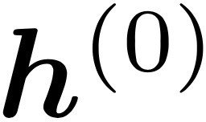
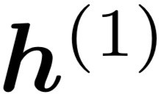
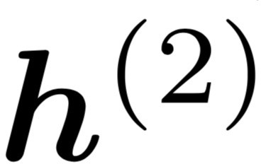
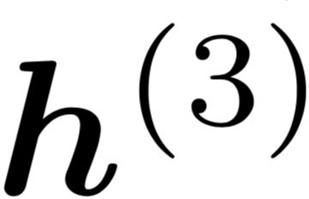
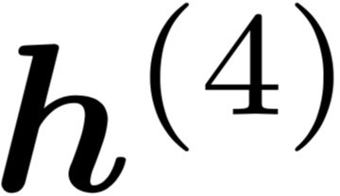
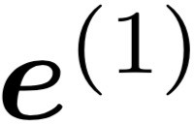
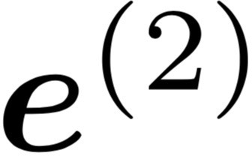
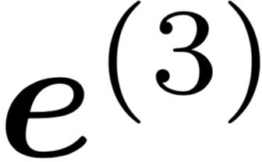
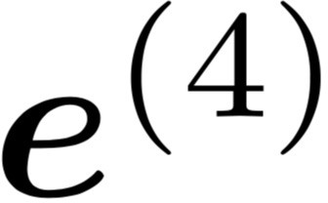
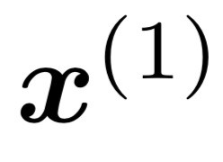
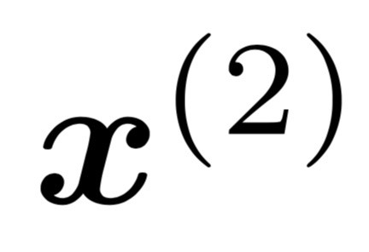
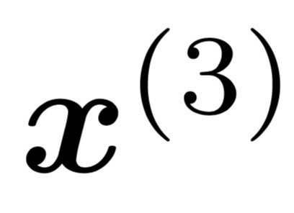
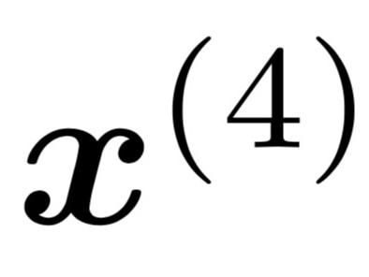
Training RNNs: Summary
backpropagated feedback
$$ℒ$$
books
laptops
RNNs can be trained using “backpropagation through time.”
Can be viewed as applying normal backprop to the unrolled network.
Model’s learnable parameters $Θ$
Compute $ℒ(Θ)$ for a batch of sentences
Compute gradients $∇_{Θ}ℒ(Θ)$
Update the weights and then repeat
the
cat
sat
on

Slide 34
Examples

Slide 35
RNN: Generation
When trained on Harry Potter text, it generates:
Source: https://medium.com/deep-writing/harry-potter-written-by-artificial-intelligence-8a9431803da6

Slide 36
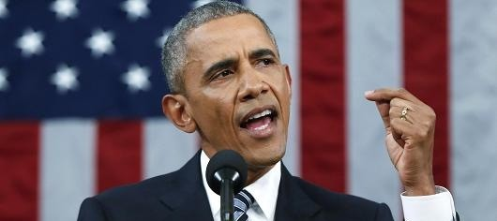
RNNs: Generation
RNN-LM trained on Obama speeches:
The United States will step up to the cost of a new challenges of the American people that will share the fact that we created the problem. They were attacked and so that they have to say that all the task of the final days of war that I will not be able to get this done.
https://medium.com/@samim/obama-rnn-machine-generated-political-speeches-c8abd18a2ea0

Slide 37
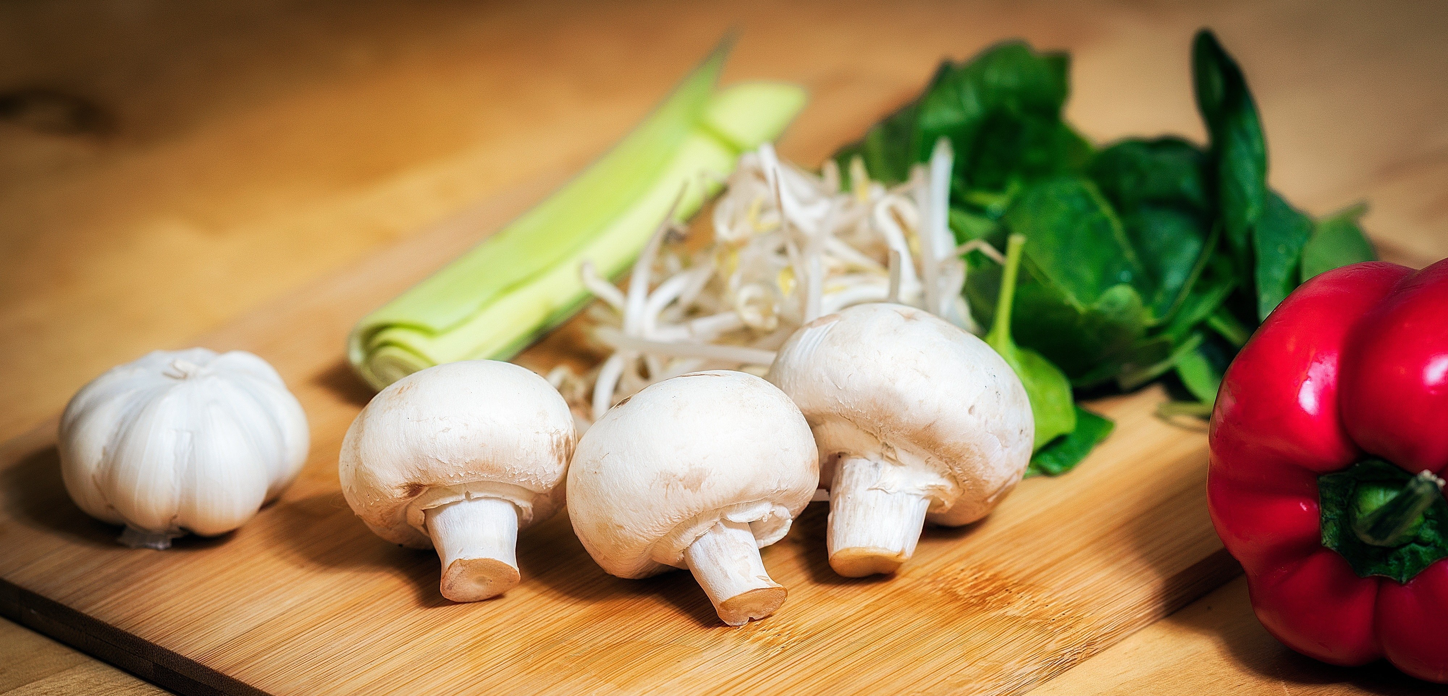
RNNs in Practice
RNN-LM trained on food recipes:
Title: CHOCOLATE RANCH BARBECUE
Categories: Game, Casseroles, Cookies, Cookies
Yield: 6 Servings
2 tb Parmesan cheese -- chopped
1 c Coconut milk
3 Eggs, beaten
Place each pasta over layers of lumps. Shape mixture into the moderate oven and simmer until firm. Serve hot in bodied fresh, mustard, orange and cheese. Combine the cheese and salt together the dough in a large skillet; add the ingredients and stir in the chocolate and pepper.
https://gist.github.com/nylki/1efbaa36635956d35bcc

Slide 38
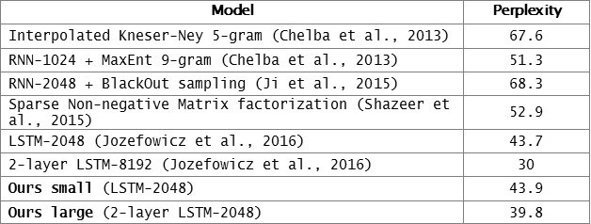
Evaluation LMs with Perplexity (2016)
n-gram model →
Increasingly complex RNNs
Source: https://engineering.fb.com/2016/10/25/ml-applications/building-an-efficient-neural-language-model-over-a-billion-words/

Slide 39
Summary
RNNs: Repeated use of finite structure.
A natural fit for language modeling.
Next: let’s summarize the pros and cons.

Slide 40
RNN-LMs:
Pros and Cons

Slide 41
RNNs: Advantages
books
laptops
Model size doesn’t increase for longer inputs — reusing a compact set of model parameters.
Computation for step t can (in theory) use information from many steps back
a
zoo
the students
opened
their

Slide 42
RNNs: Weaknesses
books
laptops
Recurrent computation is slow and difficult to parallelize.
Next week: self-attention mechanism, better at representing long sequences and also parallelizable.
While RNNs in theory can represent long sequences, they quickly forget portions of the input.
Vanishing/exploding gradients.
a
zoo
the students
opened
their

Slide 43
Vanishing/Exploding Gradient Problem: Intuition
Backpropagated errors multiply at each layer, resulting in
Figure from Graham Neubig

Slide 44
Vanishing/Exploding Gradient Problem
backpropagated feedback
$$ℒ$$
books
laptops
Backpropagated errors multiply at each layer, resulting in exponential decay (if derivative is small) or growth (if derivative is large).
Makes it very difficult train deep networks, or simple recurrent networks over many time steps.
$$∇_{ℒ}\left(W_{h}\right)={\left(J_{ℒ}\left(W_{L−1}\right)\right)}^{T}=\sum_{t=0}{{\left(J_{ℒ}\left(h^{(t)}\right){ J}_{h^{(t)}}\left(W_{h}\right)\right)}^{T}}$$
$$J_{ℒ}\left(h^{(0)}\right)=J_{h^{(1)}}\left(h^{(0)}\right)J_{h^{(2)}}\left(h^{(1)}\right) × … ×{ J}_{h^{(4)}}\left(h^{(3)}\right){ J}_{ℒ}\left(h^{(4)}\right)$$
chain rule
the
cat
sat
on
observed inputs

Slide 45
Vanishing/Exploding Gradient Problem
backpropagated feedback
$$ℒ$$
books
laptops
Note: instability of matrix powers can be determined from their eigenvalues.
Gradient signal from far away is lost. So, model weights are updated only with respect to near effects, not long-term effects.
$$J_{ℒ}\left(h^{(0)}\right)=J_{h^{(1)}}\left(h^{(0)}\right)J_{h^{(2)}}\left(h^{(1)}\right) × … ×{ J}_{h^{(4)}}\left(h^{(3)}\right){ J}_{ℒ}\left(h^{(4)}\right)$$
chain rule
the
cat
sat
on
observed inputs

Slide 46
Coping with Exploding Gradients
Gradient clipping:
If the norm of the gradient is greater than some threshold, scale it down before applying SGD update.
Intuition: take a step in the same direction, but a smaller step
[“On the difficulty of training recurrent neural networks”, Pascanu et al, 2013]
Notes:
These models don’t guarantee that there is no vanishing/exploding gradient, but it does provide an easier way for the model to learn long-distance dependencies

Slide 47
Coping with Vanishing Gradients
Using residual connections:
lots of new deep architectures (RNN or otherwise) add direct connections, thus allowing the gradient to flow)
Notes:
These models don’t guarantee that there is no vanishing/exploding gradient, but it does provide an easier way for the model to learn long-distance dependencies

Slide 48
RNNs: Difficulty in Learning Long-Range Dependencies (3)
While RNNs in theory can represent long sequences, in practice teaching them about long-range dependencies is non-trivial.
Changes to the architecture makes it easier for the RNN to preserve information over many timesteps
Long Short-Term Memory (LSTM) [Hochreiter and Schmidhuber 1997, Gers+ 2000]
Gated Recurrent Units (GRU) [Cho+ 2014]
Notes:
These models don’t guarantee that there is no vanishing/exploding gradient, but it does provide an easier way for the model to learn long-distance dependencies

Slide 49
RNNs: Difficulty in Learning Long-Range Dependencies (3)
While RNNs in theory can represent long sequences, in practice teaching them about long-range dependencies is non-trivial.
Changes to the architecture makes it easier for the RNN to preserve information over many timesteps
Long Short-Term Memory (LSTM) [Hochreiter and Schmidhuber 1997, Gers+ 2000]
Gated Recurrent Units (GRU) [Cho+ 2014]
Many of these variants were the dominant architecture of In 2013–2015.
We will not cover these alternative architecture in favor or spending more time on more modern developments.
Notes:
These models don’t guarantee that there is no vanishing/exploding gradient, but it does provide an easier way for the model to learn long-distance dependencies

Slide 50
Summary
RNNs provide a compact model, regardless of sequence size. In theory, this is great!
In practice, however:
They still struggle with remembering long-range dependencies.
Training them is not difficult because of vanishing/exploding gradients.
Despite these limits, RNNs provided improvements at the time that they were introduced and laid the foundation for the future progress.

Slide 51
Bonus: Pre-training RNN
Language Models

Slide 52
Recap: Recurrent Neural Networks
Repeated use of a finite model
“Sorry”
Harry
shouted,
panicking
Output layer
$$U$$
$$U$$
$$U$$
$$U$$
$$V$$
$$V$$
$$V$$
Hidden layer
$$W$$
$$W$$
$$W$$
$$W$$
Input layer
$$x_{1}$$
$$x_{2}$$
$$x_{3}$$
$$x_{4}$$
<START>
“Sorry”
Harry
shouted,

Slide 53
Recap: Encoder-Decoder Architectures
It is useful to think of generative models as two sub-models.
Some model
“The cat sat on the [MASK]”

Slide 54
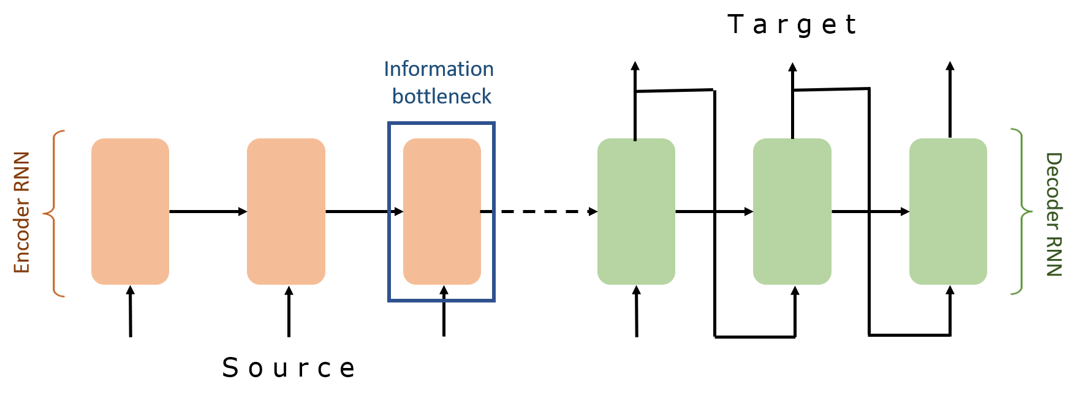
Recap: Encoder-Decoder Architectures

Slide 55
Contextual Meaning of Words
Earlier word embedding methods (e.g., Word2Vec, GloVe) learn a single “static” vector for each word.
Static embeddings are not flexible and expressive enough.
The children love to play outside in the park.
She went to see a play at the local theater.
They play the piano beautifully.
Information from context is necessary to capture the correct meaning of the word.
[Deep contextualized word representations, Peters et al. 2018]

Slide 56
ELMo: First Major Self-Supervised LM
Goal: get highly rich, contextualized embeddings (word tokens) that depend on the entire sentence in which a word is used.
The children love to play outside in the park.
She went to see a play at the local theater.
They play the piano beautifully.
[-0.37, 0.17, -0.36, 0.12, 0.18]
[0.45, -0.26, 0.49, 2.37, -1.2]
[2.05, -1.57, 1.07, 1.37, 0.32]
[Deep contextualized word representations, Peters et al. 2018]

Slide 57
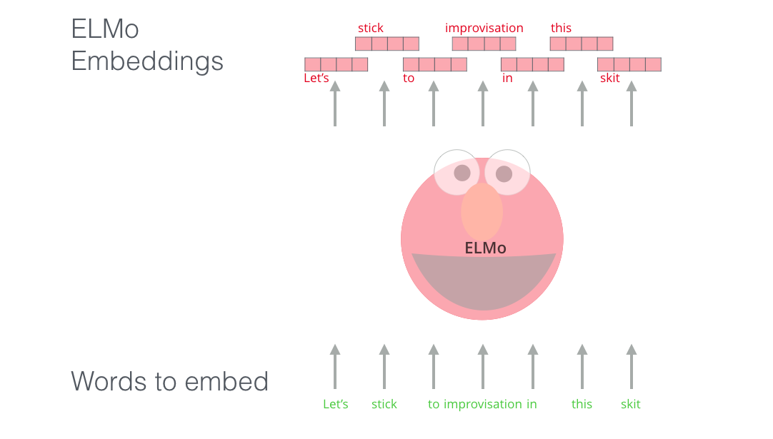
ELMo: First Major Self-Supervised LM
Goal: get highly rich, contextualized embeddings (word tokens) that depend on the entire sentence in which a word is used.
[Deep contextualized word representations, Peters et al. 2018]

Slide 58
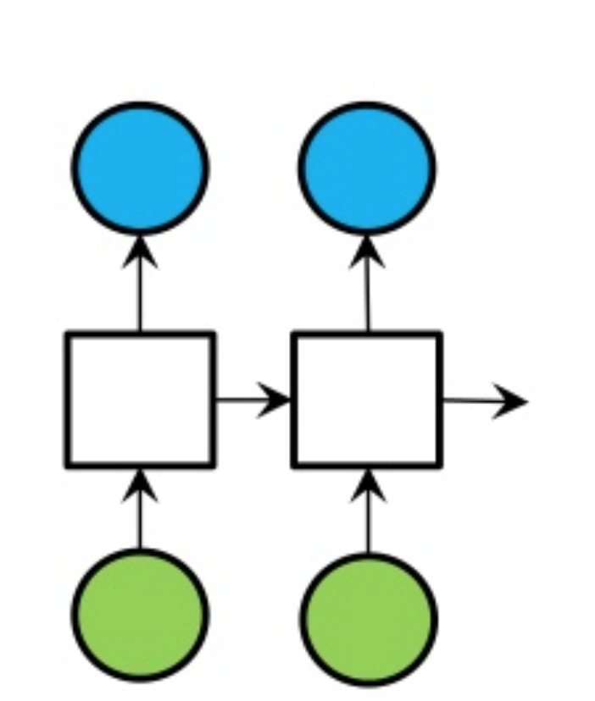
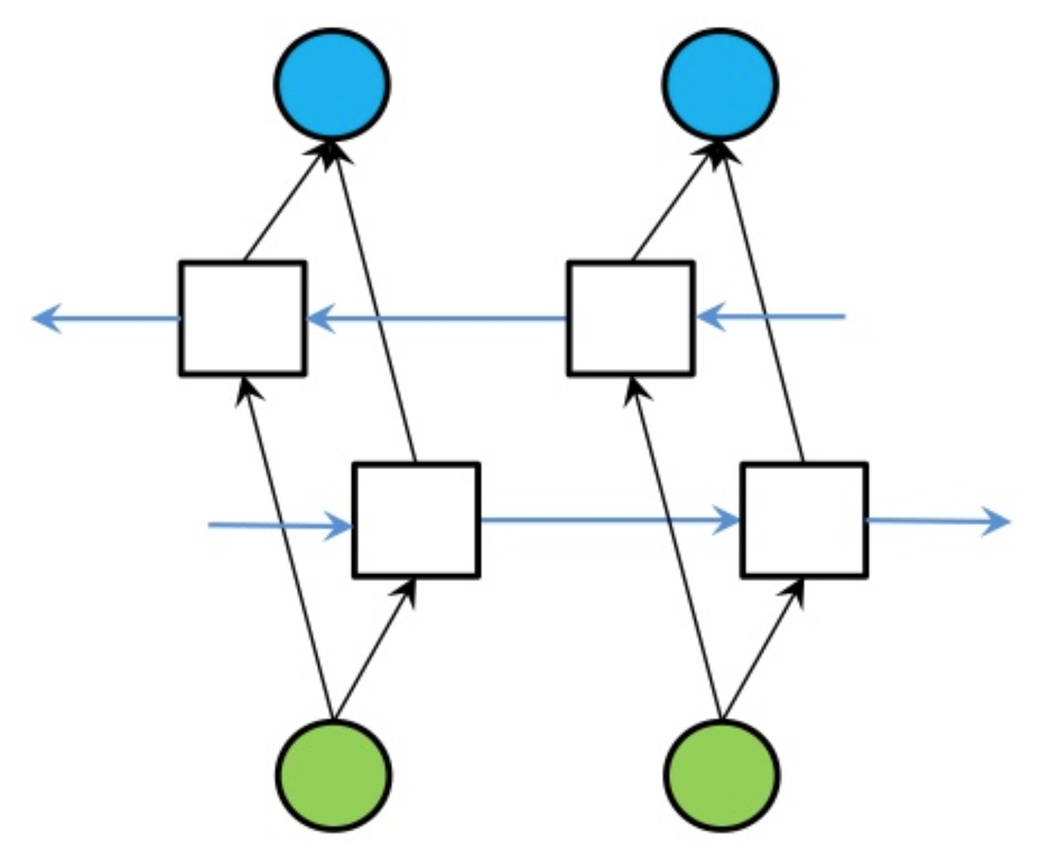
Extending RNNs to Both Directions
An RNN limitation: Hidden variables capture only one side of the context.
Solution: Bi-Directional RNNs
RNN
Bi-directional RNN

Slide 59
ELMo: First Major Self-Supervised LM
Use both directions of context (bi-directional), with increasing abstractions (stacked)
Two LSTMs in different directions — capture both directions
[Deep contextualized word representations, Peters et al. 2018]

Slide 60
ELMo: First Major Self-Supervised LM
Linearly combine all abstract representations (hidden layers) and optimize w.r.t. a particular task (e.g., sentiment classification)
[Deep contextualized word representations, Peters et al. 2018]

Slide 61
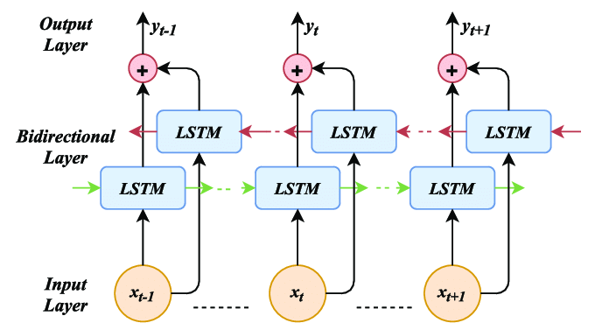
ELMo: Some Details
Train a forward language model by modeling prob of each word, given its left context.
Similarly, train a backward language model, conditioned on the right context.
Some training details:
Use 4096 dim hidden states
Residual connections from the first to second layer
Trained 10 epochs on 1B Word Benchmark
Results in perplexity of ~39
[Deep contextualized word representations, Peters et al. 2018]

Slide 62
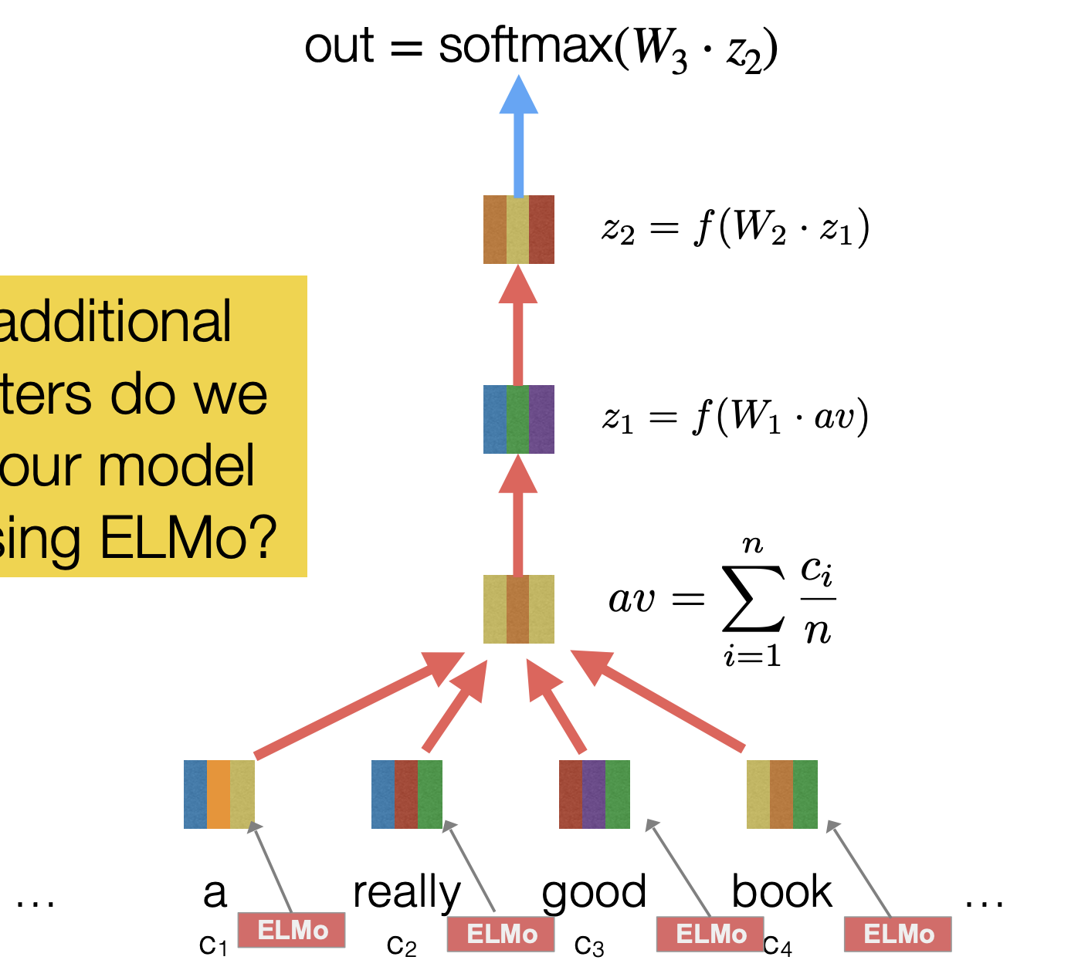
Adapting ELMo Representations for Tasks
Fine-tune classifiers using contextualized word representations extracted from ELMo.
[Deep contextualized word representations, Peters et al. 2018]

Slide 63
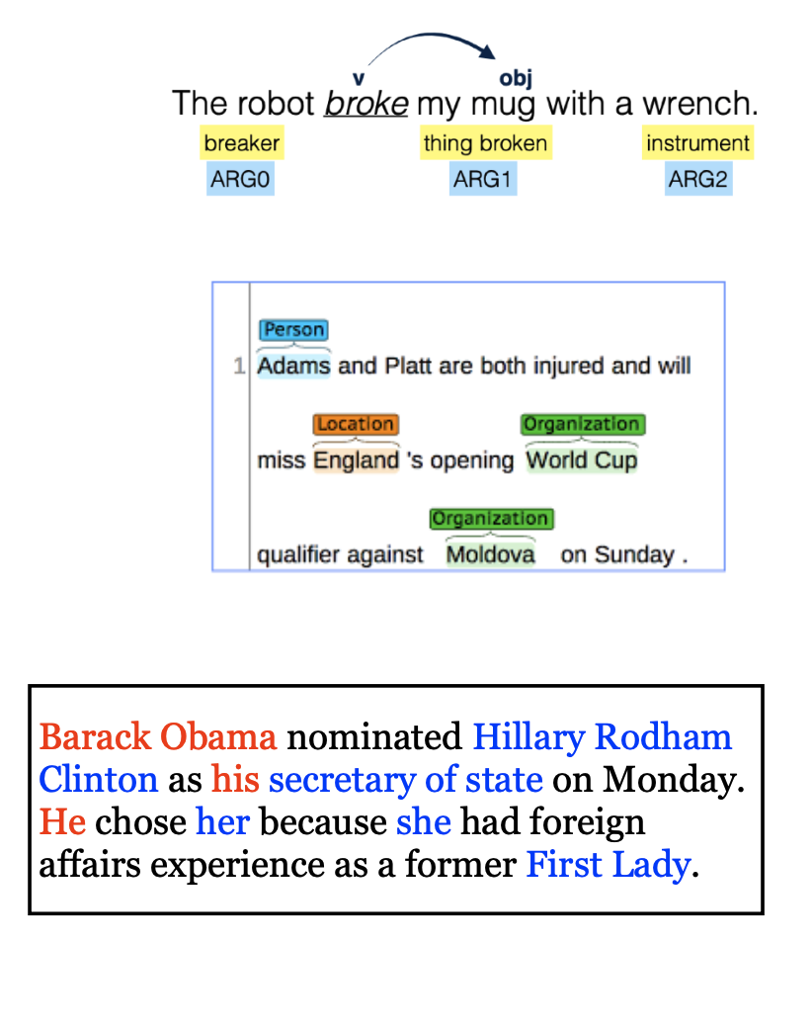
ELMo: Evaluation
SQuAD: question answering
SNLI: textual entailment
SRL: semantic role labeling
Coref: coreference resolution
NER: named entity recognition
SST-5: sentiment analysis
[Deep contextualized word representations, Peters et al. 2018]

Slide 64
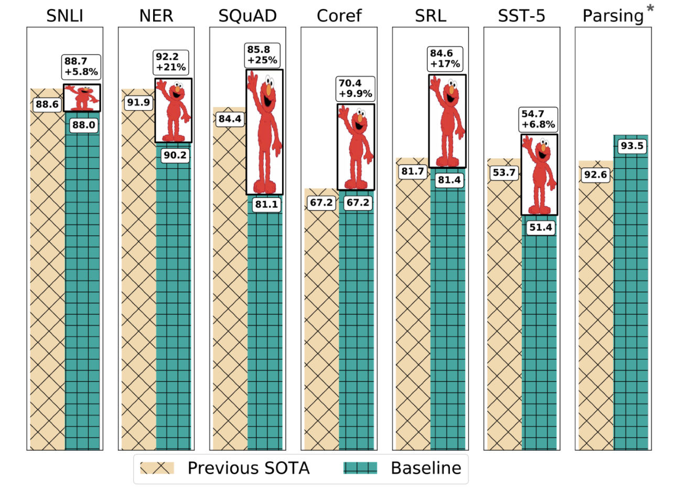
Experimental Results
[Deep contextualized word representations, Peters et al. 2018]

Slide 65
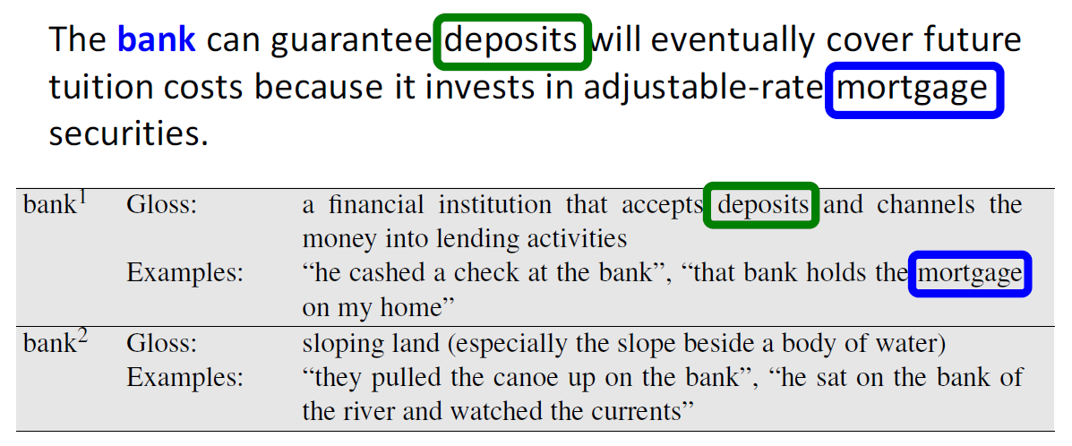
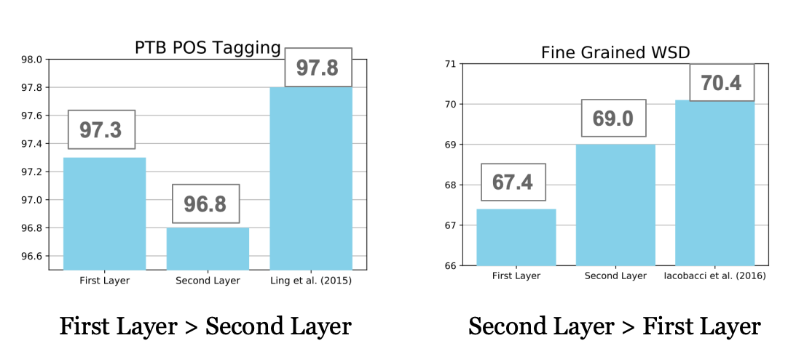
POS tagging
Word-Sense Disambiguation
Syntactic information is better represented at lower layers while semantic information is captured a higher layers
[Deep contextualized word representations, Peters et al. 2018]

Slide 66
A broader lesson: Pre-training + Fine-tuning
Let’s say I want to train a model for sentiment analysis
In the past, I would simply train a supervised model on Word2Vec representation of review sentences (e.g., HW2).
A self-supervised model
A self-supervised model
step 1:
self-supervised pretraining
step 2:
supervised fine-tuning
A ton of unlabeled text
A ton of unlabeled text

Slide 67
A broader lesson: Pre-training + Fine-tuning
Contextual representation of LMs is much stronger than word-level ones.
Now that we have Fixed-Window LM, we can use it to build better classifiers!
A self-supervised model
A self-supervised model
step 1:
self-supervised pretraining
step 2:
supervised fine-tuning
A ton of unlabeled text
A ton of unlabeled text

Slide 68
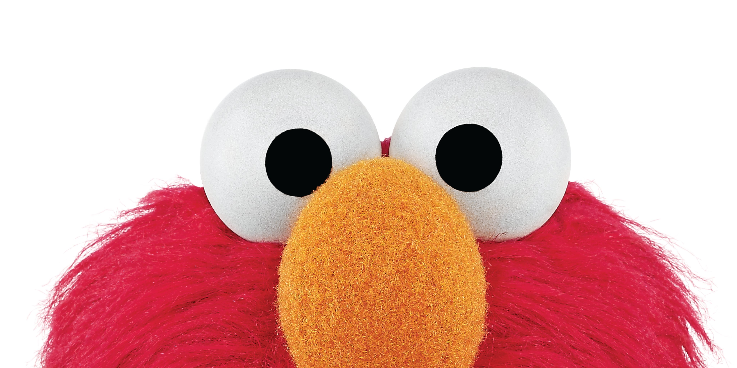
Summary
ELMo: Stacked Bi-directional LSTMs
ELMo yielded incredibly good contextualized embeddings, which yielded SOTA results when applied to many NLP tasks.
Main ELMo takeaway: given enough [unlabeled] training data, having tons of parameters model is useful — the system can determine how to best use context.
[Deep contextualized word representations, Peters et al. 2018]

Slide 69
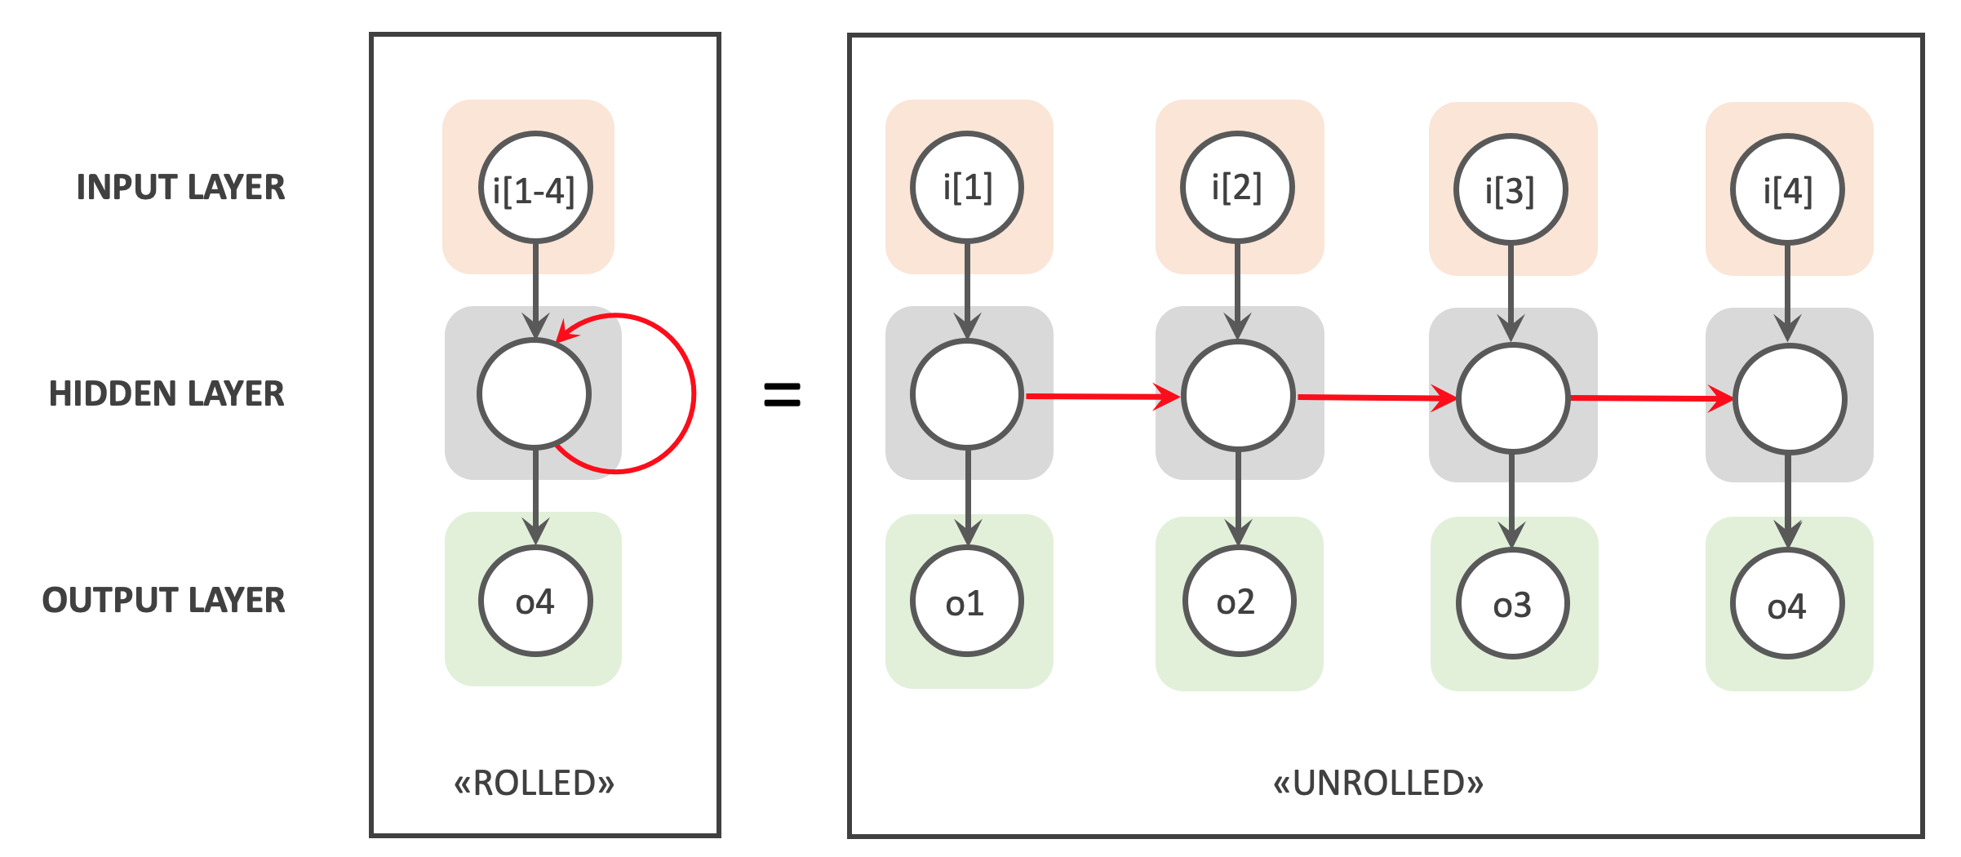
Summary
Recurrent Neural Networks
A family of neural networks that allow architecture for inputs of variable length
RNN-LM: LM based on RNNs
A notable example: ELMo
Cons:
Sequential processing
While in theory it maintain infinite history, in practice it suffers from long-range dependencies.

