Slide 1
Algorithms for Sampling from Language Models
CSCI 601-471/671 (NLP: Self-Supervised Models)
https://self-supervised.cs.jhu.edu/sp2024/

Slide 2
The Sampling Question
How do we generate language from LMs?
Given:
next word
context
P($X$| $x_{<t}$) = P($X$| $x_{1}$, $…$, $x_{t−1}$)
Prob
mat
table
bed
desk
chair
Some model
“The cat sat on the [MASK]”

Slide 3
Greedy Sampling
Greedy: Deterministically choose most probable token according P($X$| $x_{<t}$)
Challenge:
May repeat itself.
Generates boring results — not creative.
“I went to the place that the place
that the place that the place ...”
$x$ =${\text{argmax}}_{x∈V}$ P($X=x$|$x_{<t}$)
Prob
mat
table
bed
desk
chair
Some model
“The cat sat on the [MASK]”
[The Curious Case of Neural Text Degeneration, Holtzman et al., 2020]
Notes:
- Generating boring results: Even with a perfect fluency model, generating high-quality text depends on balancing randomness (diversity) and determinism (consistency). Simply maximizing fluency could lead to generic or repetitive outputs.

Slide 4
Sampling from the whole distribution
Sample according to multinomial distribution given by P($X$| $x_{<t}$)
$x \text{\sim }$ P($X=x$|$x_{<t}$)
Prob
mat
table
bed
desk
chair
Some model
“The cat sat on the [MASK]”
[The Curious Case of Neural Text Degeneration, Holtzman et al., 2020]

Slide 5
Quiz: Softmax Temperature Parameter
$$\frac{exp⁡(z_{i}/T)}{\sum_{j}{exp⁡(z_{j}/T)}}$$
Let’s add parameter T to our Softmax definition:
Suppose if T=1 (i.e., no Softmax) the dist looks like this:
Question: How will increasing T it change this distribution?

Slide 6
Quiz: Guess the Temperature
T=0.2
T=0.7
T=1
T=1.5
T=50

Slide 7
Temperature Sampling
Sample according to multinomial distribution given by Softmax [ P($X$ | $x_{<t}$); $T$ ]
When $T→0$, this is similar to greedy (argmax) decoding.
When $T=1$, this is to sampling from LM distribution.
When $T>10$, this is to sampling from near uninformative dist.
$$T→0$$
$$T=1$$
$$T=10$$
Temperature
$x \text{\sim }$ Softmax [ P($X=x$|$x_{<t}$); $T$ ]
Prob
mat
table
bed
desk
chair
Some model
“The cat sat on the [MASK]”
[The Curious Case of Neural Text Degeneration, Holtzman et al., 2020]

Slide 8
Consequences of Temperature Sampling
One day a cat decided to climb a tree but was
caught by a dog. The cat was taken to the vet
and the vet said the cat had a broken leg. The
cat was then taken to the vet and the vet said
the cat had a broken leg and was in a lot of
pain. The cat was then .....
One day a cat decided to climb a tree but did
not properly rock climb, Zoo workers put her
(feet down), disastrously Raphael
Staonymusensht October 28, 2014 at 12:38
PM Hot Cat written by .....
Peaky distributions lead to repetitive text
Flat distributions lead to
incoherent text
[Slide: Tutorial on “Generating Text from Language Models”]

Slide 9
Top-k Sampling
Simply truncate the tail by selecting the $k$ tokens with the largest probability.
Sample according to the truncated score function $s(x,x_{<t})$ (not a proper probability!)
$$s(x,x_{<t}) \text{=}\left\{\begin{matrix}\text{P}\text{(}X=x\text{|}x_{<t}\text{)} & if x is top\text{−}k \\ 0 & otherwise\end{matrix}\right.$$
Top k=2 tokens
Prob
mat
table
bed
desk
chair
Some model
“The cat sat on the [MASK]”

Slide 10
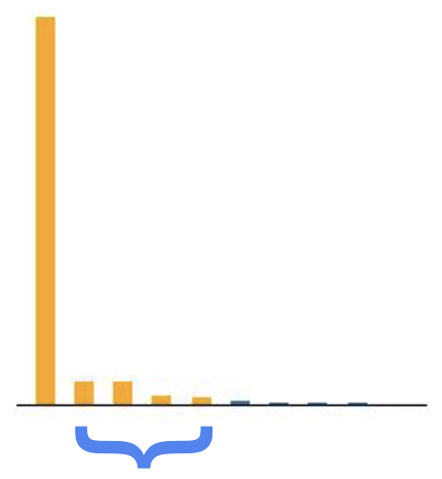
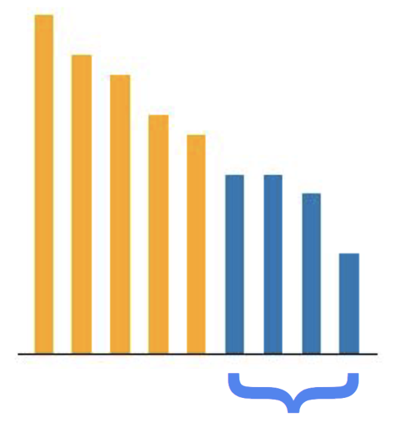
Failure of Top-k Sampling
The use of a fixed $k$ can become problematic across sentences with different entropies.
Suppose we fix $k=5.$
$$P\left( . \right| “Hopkins is located in”)$$
$$P\left( . \right| “I want to”)$$
If the entropy of the distribution is low, we unnecessarily select tokens from its tail
If the entropy of the
distribution is high,
we truncate tokens
that are not in the tail.
[Slide: Tutorial on “Generating Text from Language Models”]

Slide 11
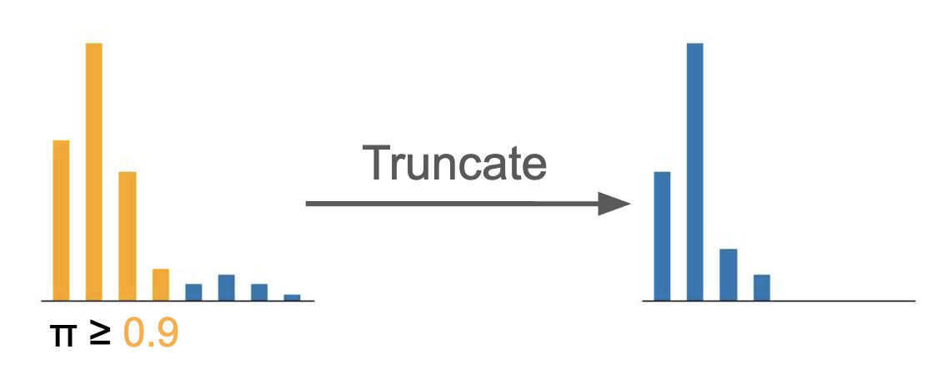
Top-p (Nucleus) Sampling
Select tail size dynamically by only considering the “nucleus” of the distribution
On each step, randomly sample from the distribution, but restricted to just the top-p most probable words
Top p tokens
Prob
mat
table
bed
desk
chair
Some model
“The cat sat on the [MASK]”
[The Curious Case of Neural Text Degeneration, Holtzman et al., 2020]

Slide 12
Top-p (Nucleus) Sampling
Select tail size dynamically by only considering the “nucleus” of the distribution
On each step, randomly sample from the distribution, but restricted to just the top-p most probable words
$$s(x,x_{<t}) \text{=}\left\{\begin{matrix}\text{P}\text{(}X=x\text{|}x_{<t}\text{)} & if x∈arg\min_{\tilde{V}⊂V} |\tilde{V}| \\ 0 & otherwise\end{matrix}\right.$$
$$s.t. \sum_{x∈\tilde{V}}{\text{P}\text{(}x\text{|}x_{<t}\text{)} ≥ p}$$
Top p tokens
Prob
mat
table
bed
desk
chair
Some model
“The cat sat on the [MASK]”
[The Curious Case of Neural Text Degeneration, Holtzman et al., 2020]

Slide 13
Top-p (Nucleus) Sampling: Quiz
Select tail size dynamically by only considering the “nucleus” of the distribution
On each step, randomly sample from the distribution, but restricted to just the top-p most probable words.
Question 1: If $p=1$, top-$p$ sampling reduces to what algorithm?
Question 2: How about $p→0$?
Top p tokens
Prob
mat
table
bed
desk
chair
Some model
“The cat sat on the [MASK]”

Slide 14
Local Incoherence
[The Curious Case of Neural Text Degeneration, Holtzman et al., 2020]

Slide 15
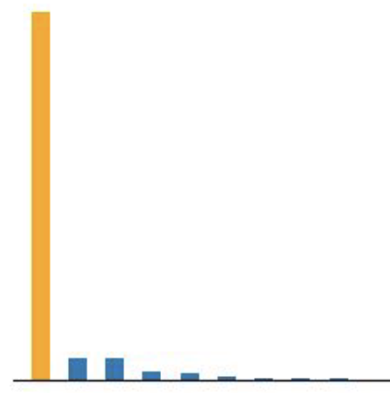
Failure Mode of Top-p Sampling
Suppose we fix $p=0.8$. In certain cases, one of the failure modes of top-$k$ sampling can also appear with top-$p$ sampling:
$$P\left( . \right| “Donald”)$$
We forgot the 🦆!
If the distribution is overly peaky, the nucleus may exclude perfectly valid continuations.
[Slide: Tutorial on “Generating Text from Language Models”]

Slide 16
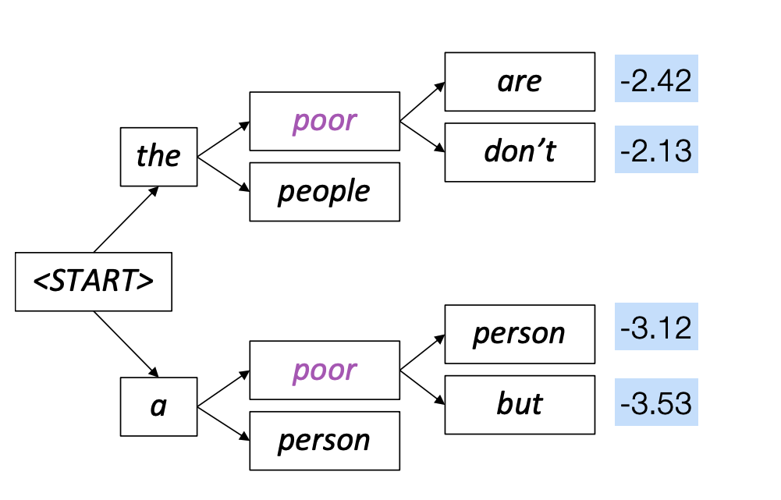
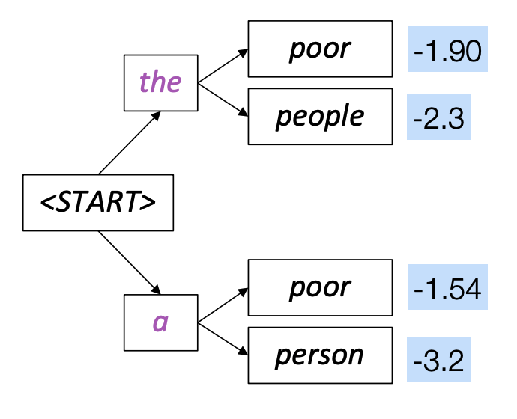
Fancier Approaches: Beam Search
A heuristic search that allows maximizing words probabilities for a window of words
Take top $k$ continuations, then only keep the $k$ best from the $k^{2}$, ….
Details out of scope for us. Feel free to check it in your own time (or take the NLP course!).
$X$ =${\text{argmax}}_{\tilde{Y}⊂B, \left|\tilde{Y}\right|=k}$ P($\tilde{Y}$| $x_{<t}$)

Slide 17
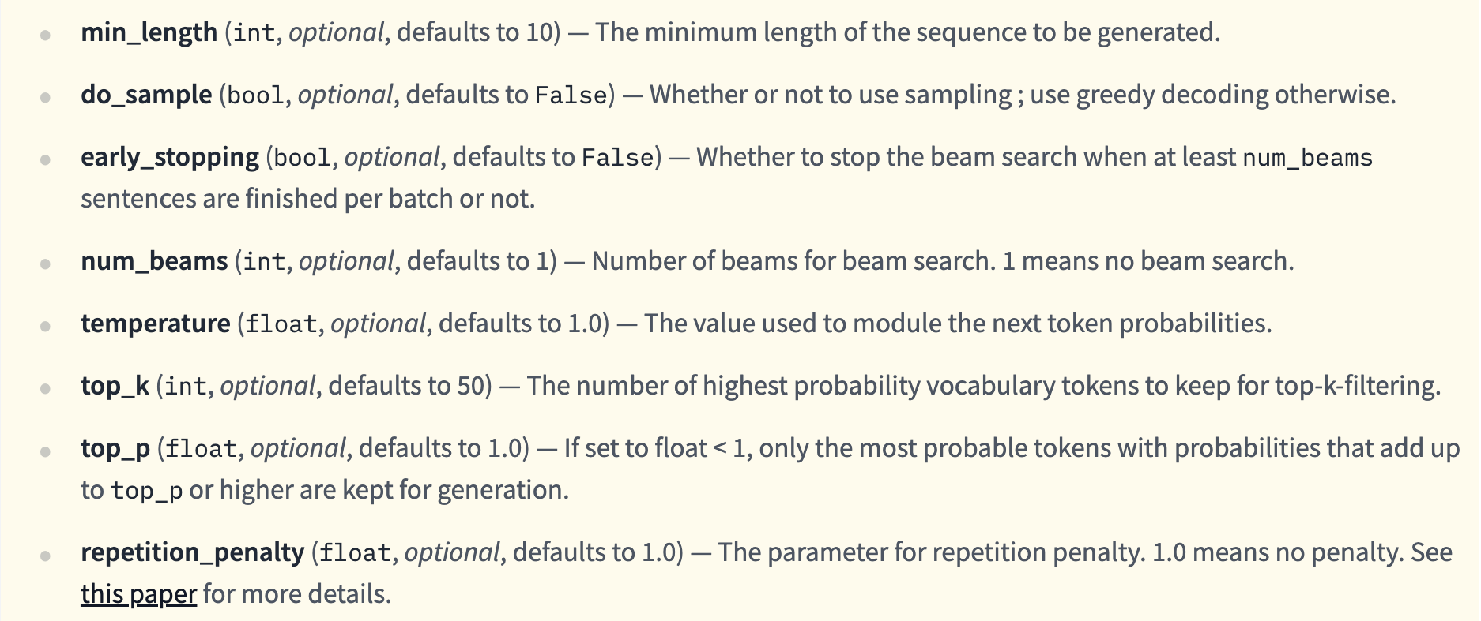
HuggingFace🤗 Generation Function
https://huggingface.co/docs/transformers/main/en/main_classes/text_generation#transformers.GenerationMixin.generate

Slide 18
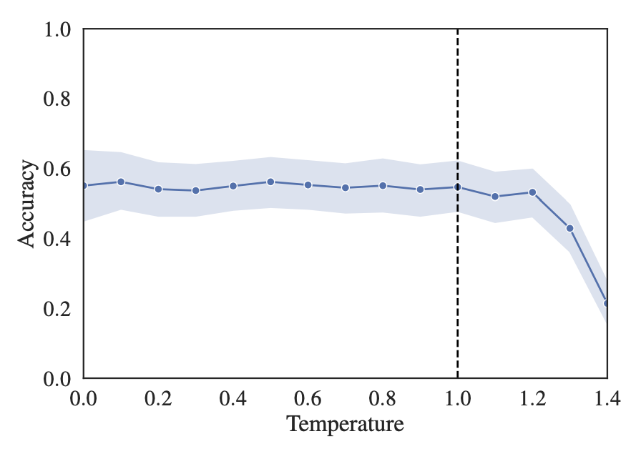
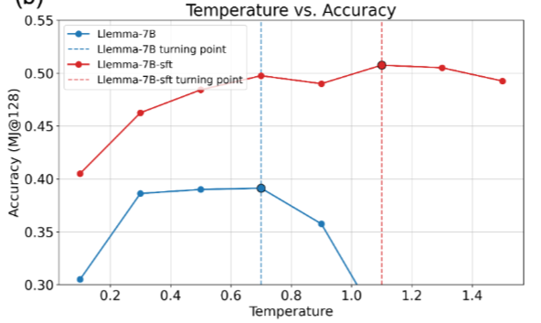
Evaluation accuracy vs temperature
Does higher temperature entail lower accuracy? Not necessarily. But it depends on tasks.
Figure left: GPT-3.5 results on a multiple-choice questions w/ CoT prompting (coming up).
Figure right: Llemma-7B on math problems.
The Effect of Sampling Temperature on Problem Solving in Large Language Models, 2024
Optimizing Temperature for Language Models with Multi-Sample Inference, 2025

Slide 19
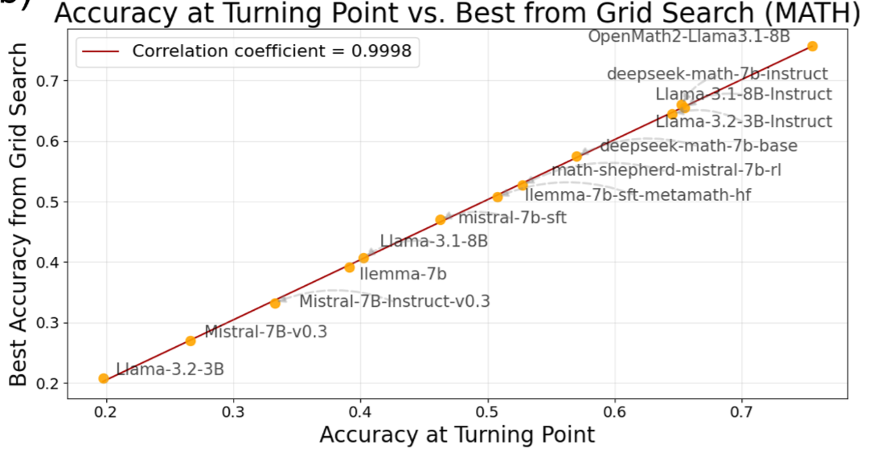
Evaluation accuracy vs temperature
Does higher temperature entail lower accuracy? It also depends on models.
Figure: temperature that leads to the highest accuracy with different models.
Optimizing Temperature for Language Models with Multi-Sample Inference, 2025

Slide 20
Summary on Sampling Algorithms
Greedy decoding: a simple method; gives low-surprising output
Sampling methods are a way to balance diversity vs quality
Temperature is a way of balancing for distribution peakiness
Top-k and top-p sampling allows you to control diversity

Slide 21
Many others that we do not cover …
There are many other algorithms for sampling sentences from LMs that we will not see in this course.
Mirostat: https://arxiv.org/abs/2007.14966
Eta-sampling and Epsilon-sampling: https://aclanthology.org/2022.findings-emnlp.249/
…

Slide 22
Bonus Content:
More Sampling Algorithms

Slide 23
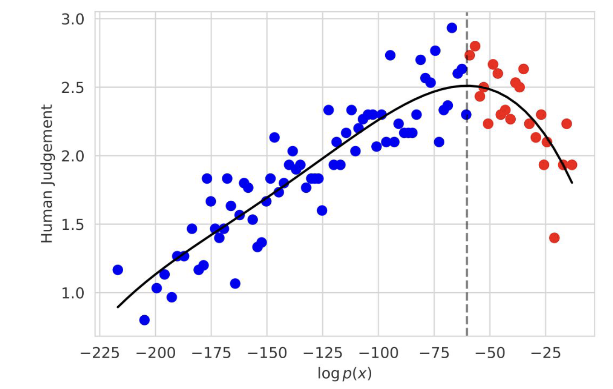
Perplexity and Generation Quality
Surprisal: $−log{P\left(x | x_{<t}\right)}$
High-quality text (human judgement) has been shown to exhibit surprisal values that fall within a narrow range
This motivates decoding algorithms that maintain a target “surprisal” during generation.
Trading Off Diversity and Quality in Natural Language Generation, 2021
[Slide: Tutorial on “Generating Text from Language Models”]

Slide 24
Mirostat
Idea: Perform top-$k$ sampling; Tune 𝑘 so that the surprisal of the generated text is close to a target value $τ.$
At each generation step:
Choose the top-k set to sample a token with a desirable surprisal:
$$k=|x∈V:−\log{P\left(x | x_{<t}\right)≤2τ}|$$
Update using the surprisal of the sampled token $x^{∗}$
$$τ=τ −η(−\log{P\left(x^{∗} | x_{<t}\right)}−τ)$$
The dynamic value of $k$ helps avoiding repetitions and incoherent text.
Typical of small $k$
Typical of large $k$
Mirostat: A Neural Text Decoding Algorithm that Directly Controls Perplexity, 2021
[Slide: Tutorial on “Generating Text from Language Models”]

Slide 25
Typical Sets
In information theory, is a set of sequences whose prob is close to a “typical” value.
where:
Taking the log of all sides:

Slide 26
Typical Decoding
Select the set of tokens that are locally “typical”.
Based on the assumption that natural language has an information content close to the expected information content given prior context.
Locally typical sampling does not necessarily select high-probability tokens, avoiding repeated or dull text and promoting lexical diversity.
$$s(x,x_{<t}) \text{=}\left\{\begin{matrix}\text{P}\text{(}X=x\text{|}x_{<t}\text{)} & if x∈arg\min_{\tilde{V}⊂V} |H\left(P\left(. | x_{<t}\right)\right)+\log{\text{P}\text{(}x\text{|}x_{<t}\text{)}}| \\ \begin{aligned} \\ \\ 0\end{aligned} & \begin{aligned} \\ \\ otherwise\end{aligned}\end{matrix}\right.$$
$$s.t. \sum_{x∈\tilde{V}}{\text{P}\text{(}x\text{|}x_{<t}\text{)} ≥ p}$$
Locally Typical Sampling, 2023
[Slide: Tutorial on “Generating Text from Language Models”]

Slide 27
$η$-Sampling
Enforces the concurrent application of two principles:
Absolute probability principle: The scoring function shouldn’t truncate high-probability tokens above a small threshold.
Relative probability principle: The scoring function should only truncate low-probability words if they are low relative to the rest of the distribution.
$$s(x,x_{<t}) \text{=}\left\{\begin{matrix}\text{P}\text{(}X=x\text{|}x_{<t}\text{)} & if x∈\left\{y∈V\right| \text{P}\text{(}x\text{|}x_{<t}\text{)}\text{ > }η \} \\ \begin{aligned} \\ \\ 0\end{aligned} & \begin{aligned} \\ \\ otherwise\end{aligned}\end{matrix}\right.$$
$$s.t. η=\min{(ε, \sqrt{ε} exp (−H(.|x_{<t})) )}$$
Truncation Sampling as Language Model Desmoothing, 2022
[Slide: Tutorial on “Generating Text from Language Models”]

