Slide 1
Inference Scaling
CSCI 601-471/671 (NLP: Self-Supervised Models)
https://self-supervised.cs.jhu.edu/sp2025/

Slide 2
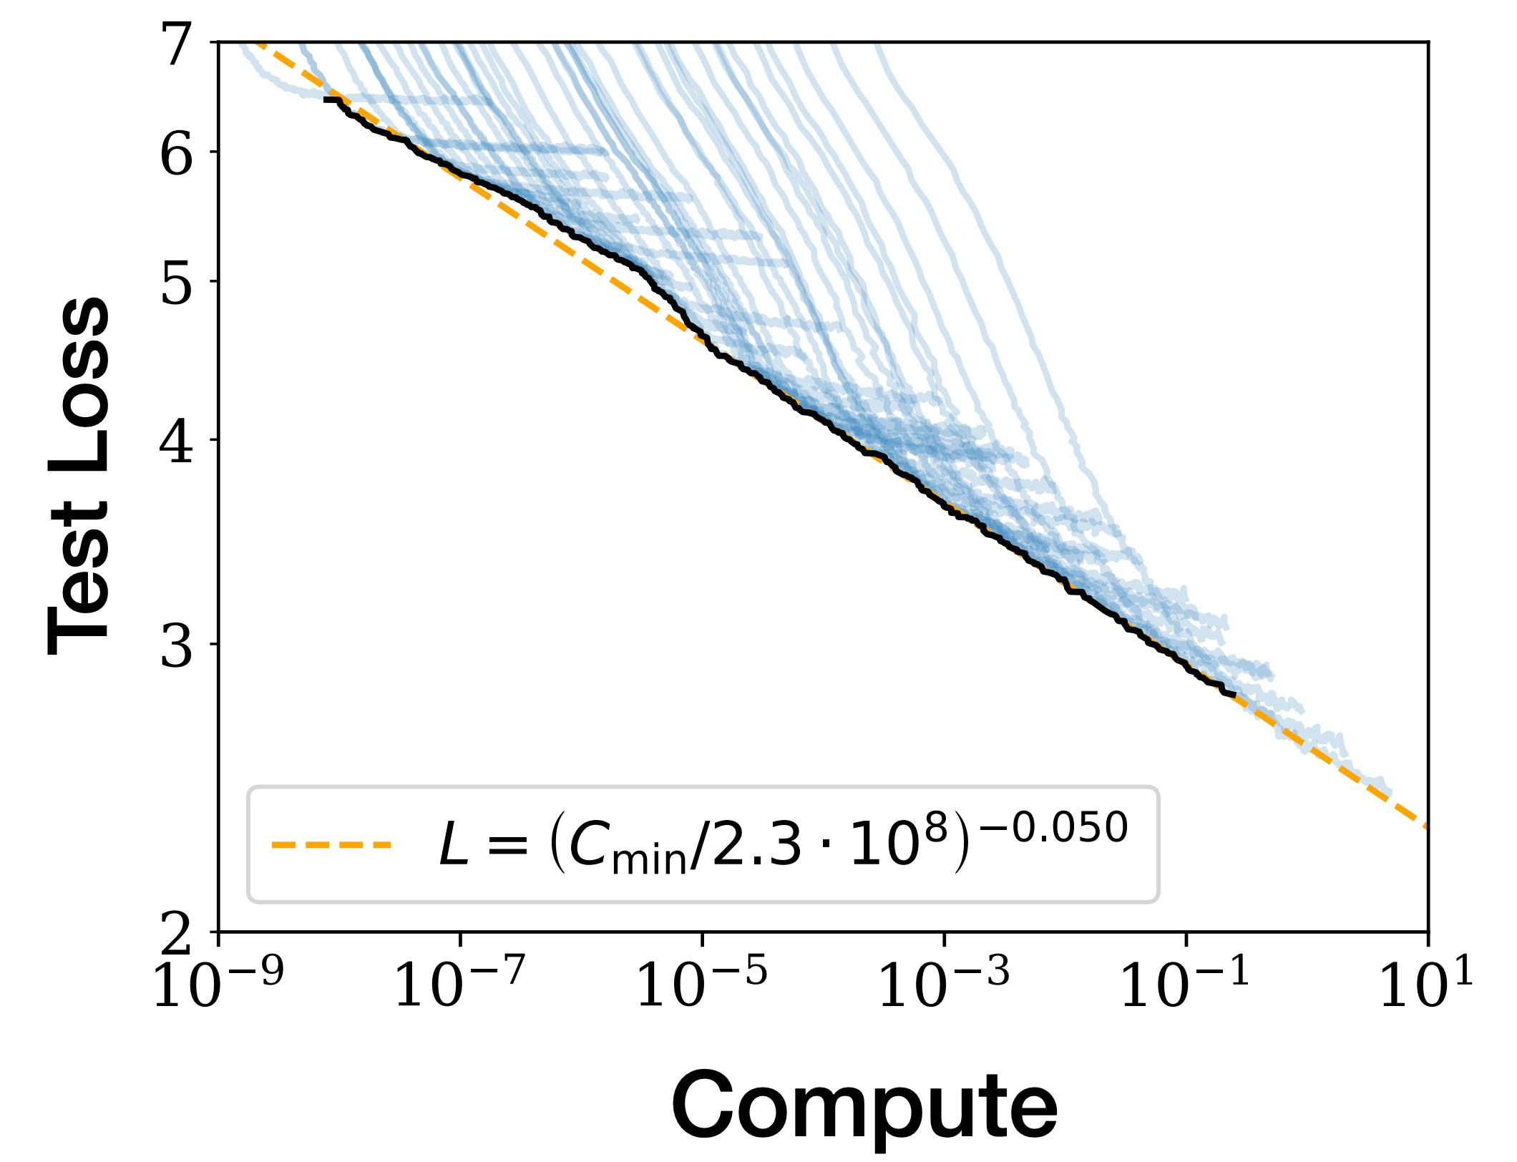
Scaling pre-training
The dominant focus of past few years has been on scaling training.
Involves multiple axes: model params, pre-training data and computing resources
test loss predictably improves with increased pretraining compute
[Kaplan et al 2020]

Slide 3
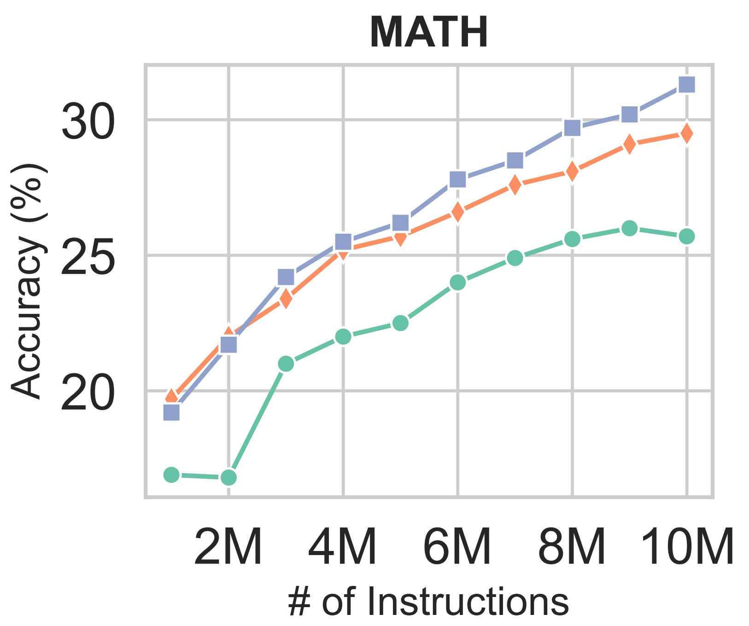
Scaling fine-tuning
We have also seen the benefits of scaling fine-tuning/alignment on diverse range of data.
MAmmoTH2: Scaling Instructions from the Web, 2024
Super-NaturalInstructions: Generalization via Declarative Instructions on 1600+ NLP Tasks, Wang et al. 2022

Slide 4
Inference-time scaling: example (1)
Inference-time scaling: allowing models to continue reasoning at inference time to get better results, at the cost of inference compute.
An earlier example: Letting models produce “thought” tokens improves its accuracy.
[Slide credit: Sean Welleck]

Slide 5
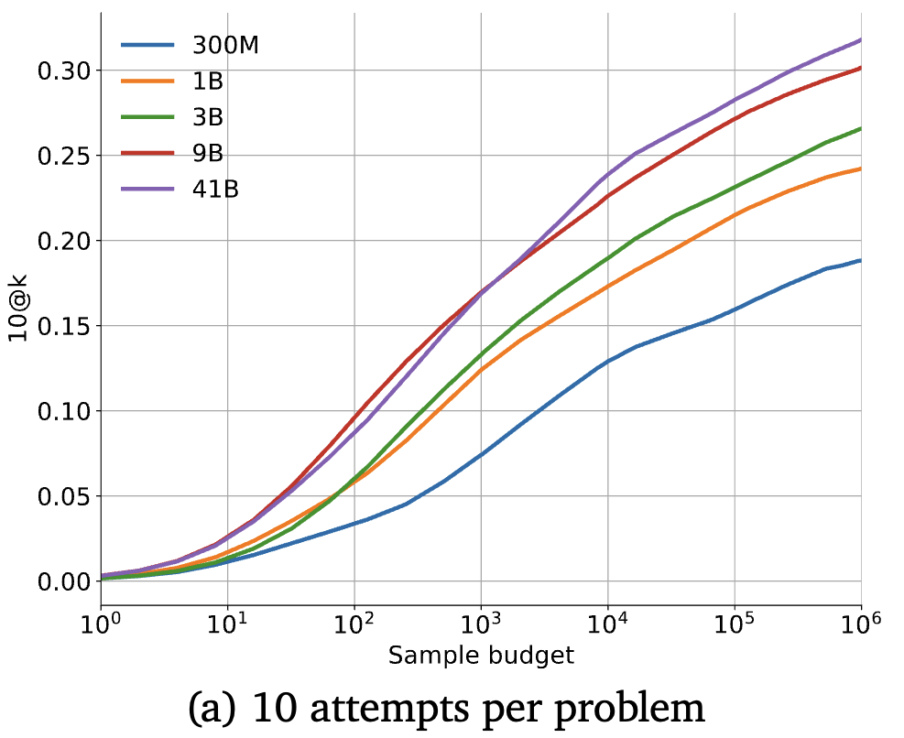
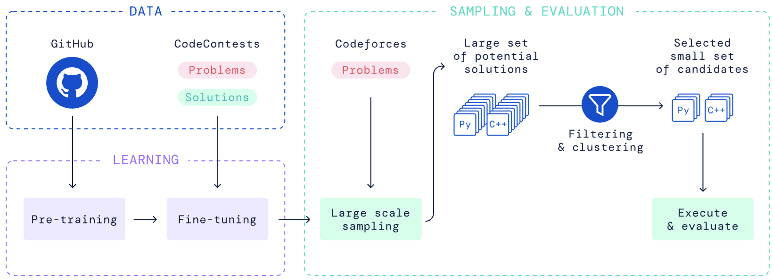
Inference-time scaling: example (2)
Inference-time scaling: allowing models to continue reasoning at inference time to get better results, at the cost of inference compute.
Example: Solving math problems—Generating multiple responses and pick the best.
[Slide credit: Sean Welleck]
Competition-Level Code Generation with AlphaCode, 2022

Slide 6
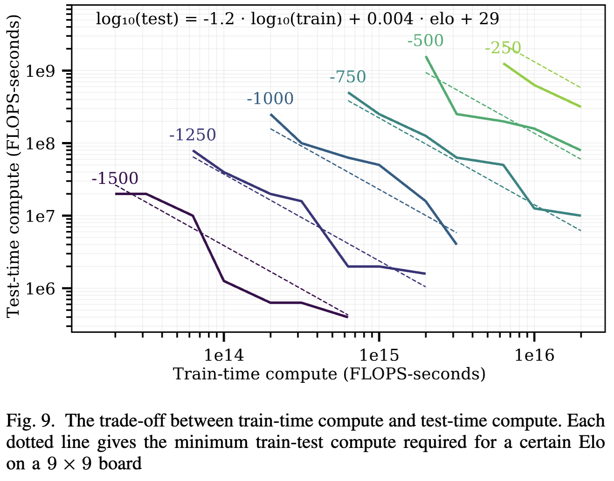
Inference-time scaling: example (3)
Inference-time scaling: allowing models to continue reasoning at inference time to get better results, at the cost of inference compute.
Example from different domain: Training vs inference scaling laws in board games.
Notice that one can make up for less training with more inference-time scaling.
[Scaling Scaling Laws with Board Games, 2021]

Slide 7
Inference scaling: problem setup
Input problem is given: $x$
Intermediate thoughts: $z_{1:T}^{}$
The “thoughts” are characterized by a policy model (the “thinker”): $p_{θ}(.|x)$.
The “thoughts” may also depend on a reward: $r_{φ}(.|x)$.
(Other names for “reward”: verifier, teacher, feedback.)
Note: these may accept partial thoughts: $r_{φ}\left(z_{t+1}^{} | x,z_{1:t}^{}\right)$ to score thought continuation.
Ultimate answer: $y^{}\sim p(.|x,z_{1:T}^{})$
Answer given question and thoughts.
Sampled from the policy model.
[Figure: Sasha Rush]

Slide 8
Inference-time scaling: dimensions
Here are the key issues we need to figure out:
How should we think about the reward function $r_{φ}(.)$?
What we do during inference, given $r_{φ}(.)$ and $p_{θ}(.)$ that are fixed?
How we train the policy $p_{θ}(.)$ and reward model $r_{φ}(.)$?

Slide 9
Inference-time scaling: dimensions
Here are the key issues we need to figure out:
How should we think about the reward function $r_{φ}(.)$?
What we do during inference, given $r_{φ}(.)$ and $p_{θ}(.)$ that are fixed?
How we train the policy $p_{θ}(.)$ and reward model $r_{φ}(.)$?

Slide 10
The Reward Function

Slide 11
Reward mechanisms
A reward function $r_{φ}(.)$ tells you whether the response is going in the “right” direction.
The reward can be a neural network or a non-statistical model.
Non-statistical examples:
Python Linter check (was there a syntax errors?)
SQL execution response (did the query find the right columns?)
Regular expression (did the math equations adhere to proper syntax?)
Chess engine (did the policy model win the game against the opponent?)
Statistical examples:
A classifier trained to predict how likely the current thoughts lead to an answer.
An LM prompted with certain goal (“LLM-as-a-judge”, e.g., "Constitutional AI")

Slide 12
Reward mechanisms: flavors
The reward may be binary $r_{φ}\left(.\right)∈\{0, 1\}$ or continuous $r_{φ}\left(.\right)∈(0, 1)$.
Some rewards may need full thoughts, but some may work for partial thoughts.
Outcome or process? → Learned or not learned? ↓ | Outcome reward (ORM) | Process Reward (PRM)
Learned typically, $r_{φ}\left(.\right)∈(0, 1)$ | Can be trained. | One can train it, but generally expensive.
Not learned typically, $r_{φ}\left(.\right)∈\{0, 1\}$ | Can be found in-the-world for specific problems (e.g., chess). | Rare; if you have a reliable one, it’d trivialize your problem.
[Uesato et al., 2022, Lightman et al., 2023]

Slide 13
Inference-time scaling: dimensions
Here are the key issues we need to figure out:
How should we think about the reward function $r_{φ}(.)$?
What we do during inference, given $r_{φ}(.)$ and $p_{θ}(.)$ that are fixed?
How we train the policy $p_{θ}(.)$ and reward model $r_{φ}(.)$?

Slide 14
Inference Algorithms

Slide 15
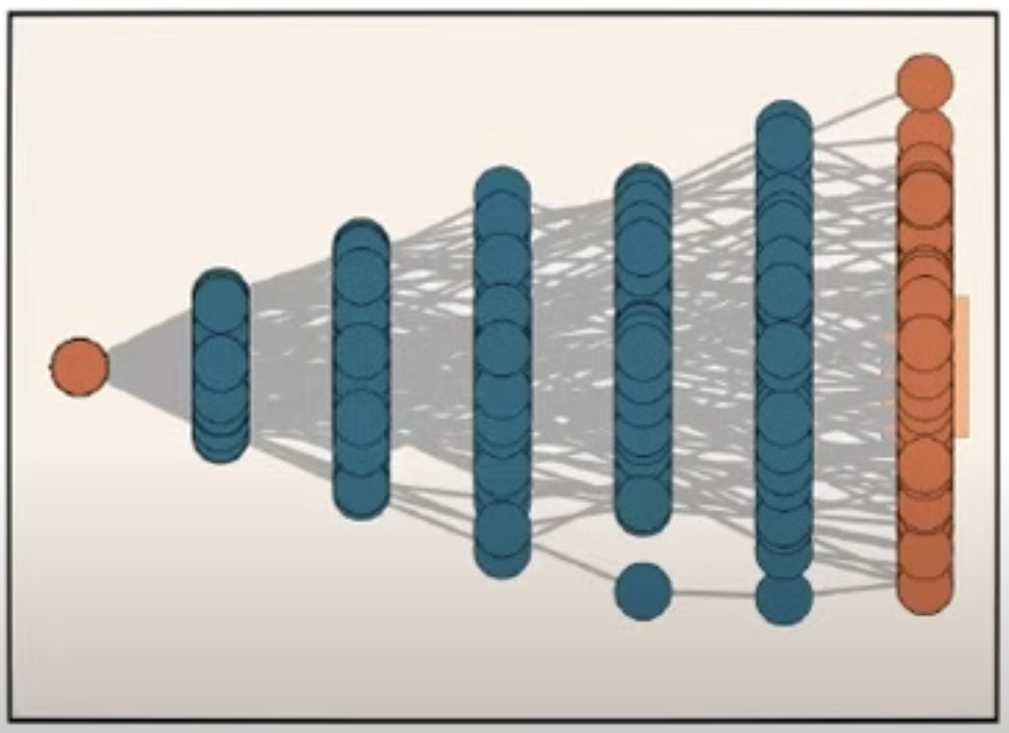
Inference scaling: inference objective
Thoughts as latent variables — Suppose $r_{φ}(.)$ and $p_{θ}(.)$ are fixed.
We care about $p\left(y | x\right)$, but that depends on intermediate thoughts.
Think about a marginalization over all possible thoughts $z_{1:T}$:
In other words, if we were to magically explore the whole space of “thoughts” what is the best solution?
But the space of thoughts is combinatorially large! 🙅
So, we need to think of a cost-efficient way to explore the the space of “thoughts”.
$$\max_{y}{p\left(y | x\right)}=\max_{y}{𝔼_{z\sim p_{θ}(.|x)}\left[p\left(y | z_{1:T}, x\right)\right]}$$
[figure credit: Sasha Rush]

Slide 16
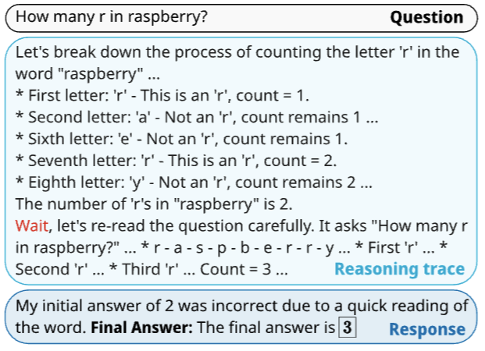
Inference-time scaling: Just let your LLM speak/think
Get your LLMs spell out its thoughts.
Challenge: LLMs tend to stop early if they believe they’ve already answered.
How can you force models to keep thinking?
A simple heuristic is to keep “nudging” the model to continue generating responses; if it stops, append "wait" or "wait, are you sure?" to encourage further output.
s1: Simple test-time scaling, 2025

Slide 17
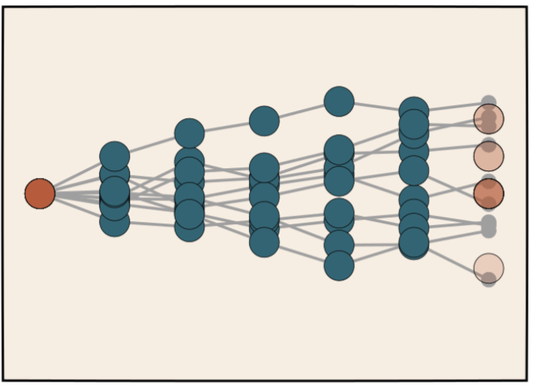
Inference-time scaling: self-consistency
Self-Consistency or Majority voting — Generate collections of isolated “thoughts” (parallel) and then aggregate them.
For $N$ samples:
Sample thoughts: $z_{1:T}^{n}\sim p(.|x)$
Sample answers: $y^{n}\sim p(.|x,z_{1:T}^{n})$
Pick majority vote: $y\sim p(.|x, {\left\{z_{1:T}^{n}, y^{n}\right\}}_{n=1}^{N})$
[Slide credit: Sasha Rush]

Slide 18
Inference-time scaling: best-of-N
Rejection Sampling (best of N) — Generate collections of isolated “thoughts” (parallel) and their corresponding answer. Then pick one/best.
For $N$ samples:
Sample thoughts: $z_{1:T}^{n}\sim p(.|x)$
Sample answers: $y^{n}\sim p(.|x,z_{1:T}^{n})$
Pick the best — few choices:
Based on the reward: $\max_{n} r(y^{n}|x,z_{1:T}^{n})$
Based on the policy + reward: $\max_{n} \left[p\left(y^{n} | x,z_{1:T}^{n}\right)r_{φ}\left(y^{n} | x,z_{1:T}^{n}\right)\right]$
[Slide credit: Sasha Rush]

Slide 19
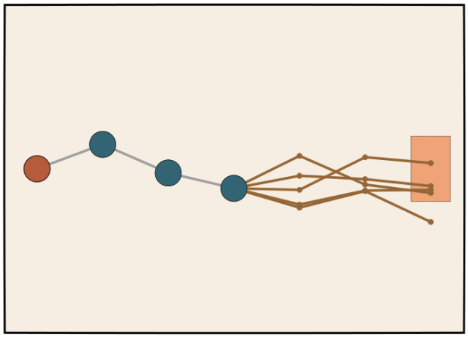
Inference-time scaling: search
Bonus
Search algorithm— Using the intermediate scores at each step, i.e., reward $r_{φ}(.)$ and policy $p_{θ}(.)$, progressively guide the generation of thoughts using A*, Beam Search, Monte Carlo Tree Search (MCTS), etc.
Think of Beam search which is a heuristic search algorithm.
For $T$ steps:
Maintain a beam of size $B$, # of candidate sequences at each step.
Given a partial “thought” $z_{1:t}^{}\sim p(x)$, expand each sequence in the beam by considering the top $k$ probable next steps based on $p\left(.\right)$.
Score each sequence (based on reward or policy).
Prune out the search space by keeping the top $B$ sequences.
[figure credit: Sasha Rush]
[Slide credit: Sasha Rush]

Slide 20
Inference-time scaling: dimensions
Here are the key issues we need to figure out:
How should we think about the reward function $r_{φ}(.)$?
What we do during inference, given $r_{φ}(.)$ and $p_{θ}(.)$ that are fixed?
How we train the policy $p_{θ}(.)$ and reward model $r_{φ}(.)$?

Slide 21
Training a good inference-scaler

Slide 22
Thinking about the inference objective
Thoughts as latent variables — Suppose $r_{φ}(.)$ and $p_{θ}(.)$ are fixed.
We care about $p\left(y | x\right)$, but that depends on intermediate thoughts.
Think about a marginalization over all possible thoughts $z_{1:T}$:
In other words, if we were to magically explore the whole space of “thoughts” what is the best solution?
But the space of thoughts is combinatorially large! 🙅
So, we need to think of a cost-efficient way to explore the the space of “thoughts”.
Can be replaced with $r_{φ}(.)$
$$\max_{y}{p\left(y | x\right)}=\max_{y}{𝔼_{z\sim p_{θ}(.|x)}\left[p\left(y | z_{1:T}, x\right)\right]}$$
[figure credit: Sasha Rush]

Slide 23
Training for scale inference
The central question here is how do you train the “policy” (the “thinker”) to be more conducive to inference-scaling?
Why is this non-trivial? Remember the inference goal:
$$p_{θ}\left(y | x\right)=𝔼_{z\sim p_{θ}(.|x)}\left[p\left(y | z_{1:T}, x\right)\right]$$
Even if I give you training data $(x, y)$ (or equivalently, a perfect verifier of final answers), you still can’t train it since you don’t know what thoughts lead to a given correct answers)

Slide 24
Approach 1: Guess and Check
Guess and Check:
Sample $N$ chain of thoughts
Check if successful with ORM
Train on the good ones
[Slide credit: Sasha Rush]

Slide 25
Guess and Check, formalized
There is a principled way to describe “Guess and Guess” via Expectation Maximization (EM).
The training goal: $\max_{θ} \left\{𝔼_{z\sim p_{θ}(.|x)}\left[p_{θ}\left(y, z_{1:T} | x\right)\right] \right\}$
E-Step: Explore in the space of likely thoughts
For $N$ samples:
Sample thoughts: $z_{1:T}^{n}\sim p(.|x)$
Sample answers: $y^{n}\sim p(.|x,z_{1:T}^{n})$
Using ORM (gold label or verifier), keep the “good” thoughts: $Z_{good}$.
M-Step: Update parameters to maximize our objective.
$θ^{′}←\max_{θ}\sum_{Z_{good}}{p_{θ}\left(y, z | x\right)}$
[Slide credit: Sasha Rush]

Slide 26
Guess and Check as EM: Few Examples
Different people refer to this approach under different names:
Self-Training [Yarowsky, 1995]
Best-of-N Training [Cobbe et al., 2021]
STaR [Zelikman et al., 2022]
ReST [Gulcehre et al., 2023]
ReST-EM [Singh et al., 2023]
Filtered Rejection Sampling [Nakano et al., 2021]
[Slide credit: Sasha Rush]

Slide 27
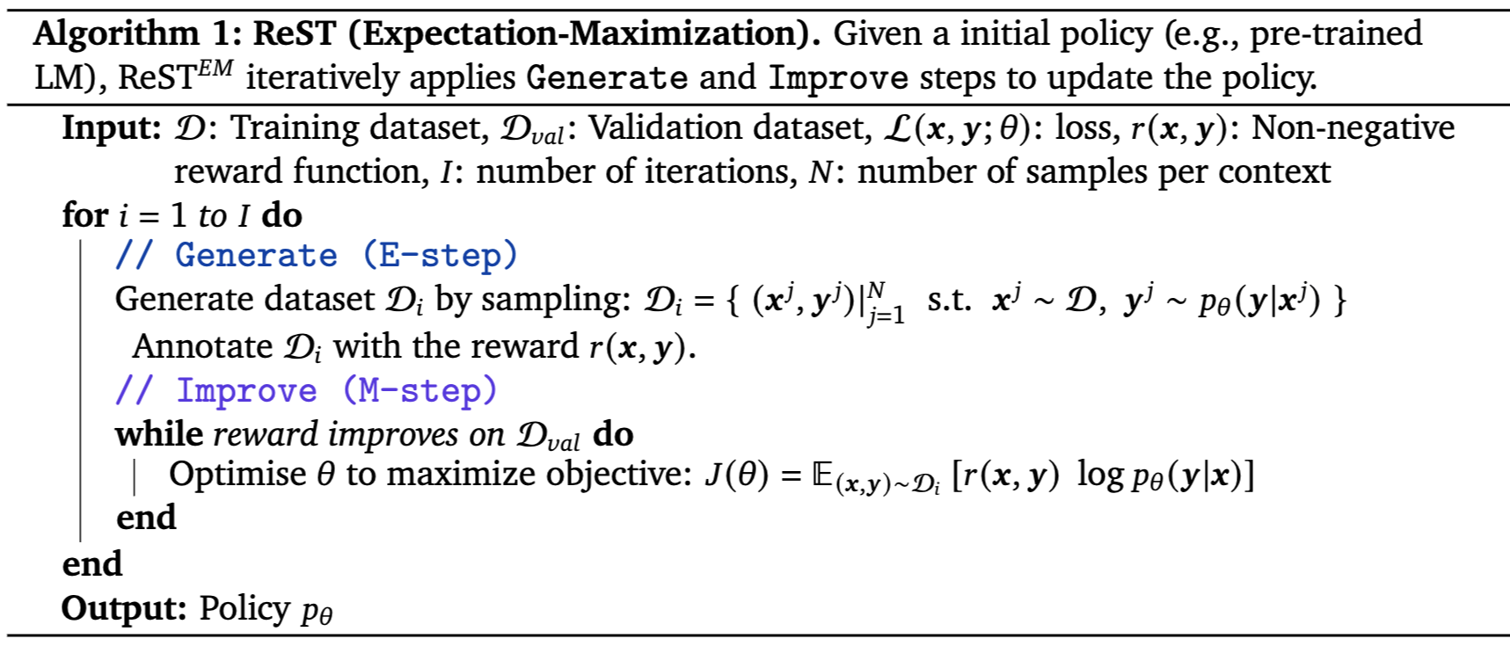
ReST-EM
[Beyond Human Data: Scaling Self-Training for Problem-Solving with Language Models, 2023]

Slide 28
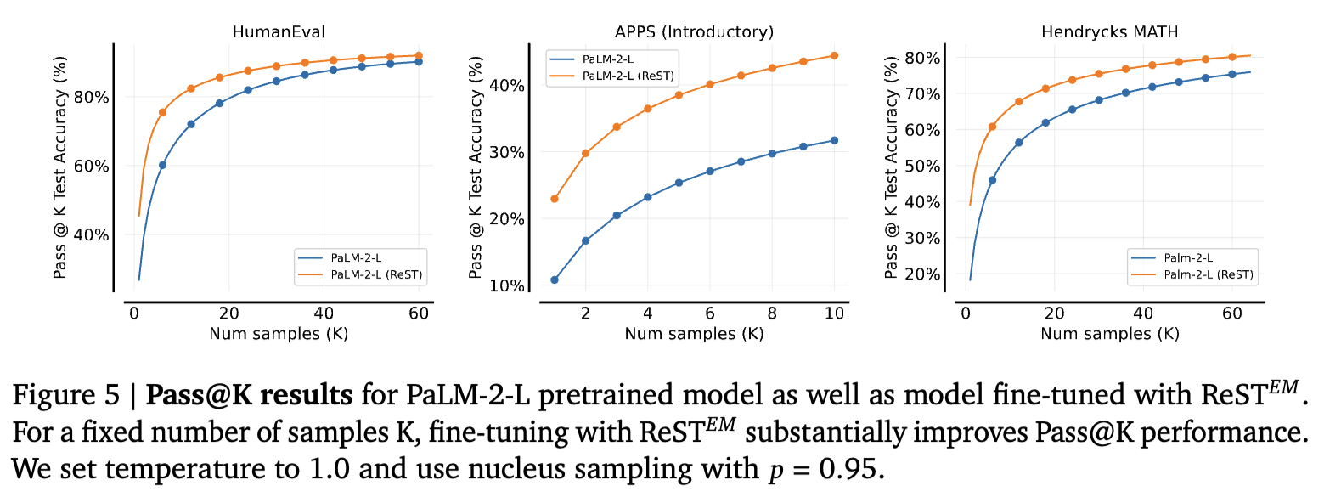
ReST-EM
[Beyond Human Data: Scaling Self-Training for Problem-Solving with Language Models, 2023]

Slide 29
Guess and Check: challenges
Collapse: ”Good” and “bad” thoughts may share most of the path. Often, one or few small mistakes may lead to a bad outcome. If the training data is not able to distinguish such nuances then the model may not learn anything useful.
Cost efficiency: Will sampling around give us reasonable thoughts? If the problem is complex this may take forever!

Slide 30
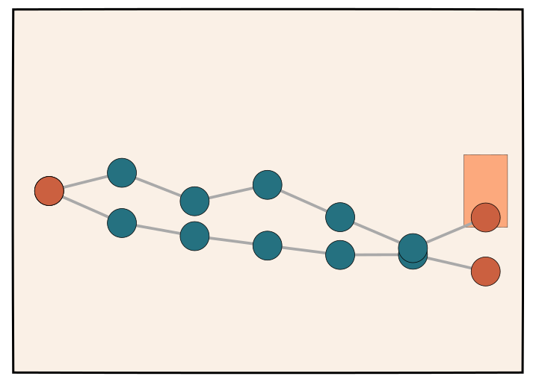
Approach 2: Roll-out and Re-organize
Bonus
Like “guess and check”, but carefully organize the roll-outs:
Guess and re-organize:
Sample $N$ chain of thoughts and label the good and bad ones with ORM.
Re-organize the roll-outs:
Identify the [likely] good portions of bad roll-outs
Construct “thoughts” that contain transitions from “bad” to “good”.
Train on the re-organized roll-outs.

Slide 31
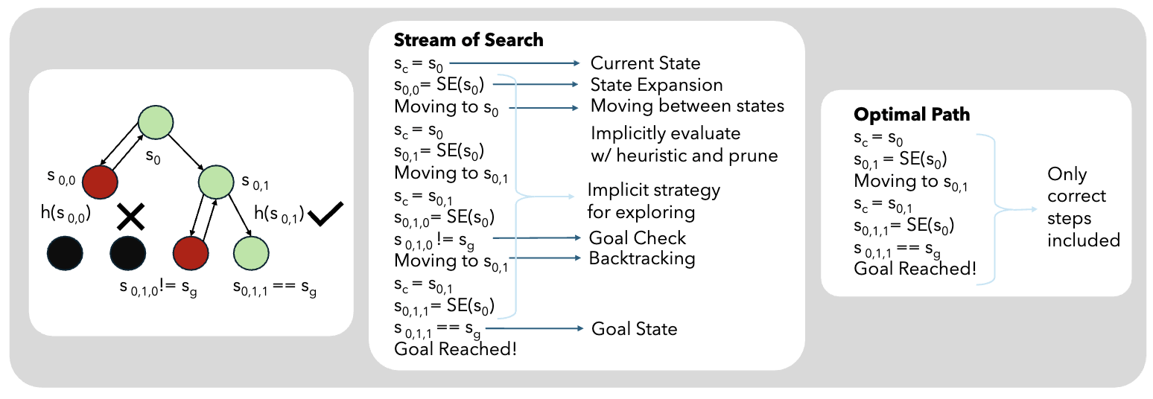
Example: Stream of Search
Bonus
Through a careful search, find a “good” path (thought).
Say, this gives us $z_{1:T}^{∗}$ path (the shortest path from start to end)
To find this path we had to go through several rabitholes and backtrack since the search found out that these were not good.
The idea is to linearize this logic and train on it.
Stream of Search (SoS): Learning to Search in Language, 2024

Slide 32
Example: Stream of Search
Bonus
Through a careful search, find a “good” path (thought).
Say, this gives us $z_{1:T}^{∗}$ path (the shortest path from start to end)
To find this path we had to go through several rabitholes and backtrack since the search found out that these were not good.
The idea is to linearize this logic and train on it.
Specifically, find an alternative path ${\hat{z}}_{1:T^{′}}^{}$ ($T^{′}>T$) which encodes the whole search (including its “bad” segments). Basically, the chain includes transitions from “bad” segments to the “good” ones.
We can find ${\hat{z}}_{1:T^{′}}^{}$ through linearizing tree process.
Upon finding ${\hat{z}}_{1:T^{′}}^{}$ , we train an autoregressive model on it.
Inference time is just linear generation (no fancy search).
Intuitively, this model learns to pivot, if it goes through “bad” direction. (learning to recover)
Stream of Search (SoS): Learning to Search in Language, 2024

Slide 33
Example: learning to “self-correct”
Bonus
Learning to Self-Correct:
Given an input $x,$sample $N$ chain of thoughts and score them with ORM.
Pair of “thoughts” $z$ and $z^{′}$ such that:
They’re similar (lots of overlap)
One is improving upon the other, i.e., ORM($z$) > ORM($z^{′}$)
Train a “corrector” model to produce $z$, given input $x$ and $z^{′}$.
Applying it at the inference time:
Given input $x$, generate an initial solution $z$
Iteratively apply the corrector to $z$ to improve/correct it.
Generating Sequences by Learning to Self-Correct, 2022

Slide 34
Example:
https://arxiv.org/pdf/2402.06457

Slide 35
Approach 3: Training process rewards with search mechanisms
Bonus
If you can train a process reward (PRM) $r_{φ}\left(.\right)$ that approximately tell us whether the partial thought is going in the right direction, that will be a strong signal during inference. But how do you train it?
It’s going to be difficult to annotate data for training a PRM. It’s a massive space!*
It may be more feasible to infer labels for PRM, using an ORM!
Consider MCTS but can be done with any search algorithm.
At each step, we have a partial rollout: $z_{1:t}^{}$ up to $t$.
Over-sample rollouts from $t$ onward, score them with ORM, and score the chances that $z_{1:t}^{}$ would lead to a good outcome.
Train PRM with such estimates.
[figure credit: Sasha Rush]
* Still some folks chose to do human annotations! [Uesato et al., 2022, Lightman et al., 2023]

Slide 36
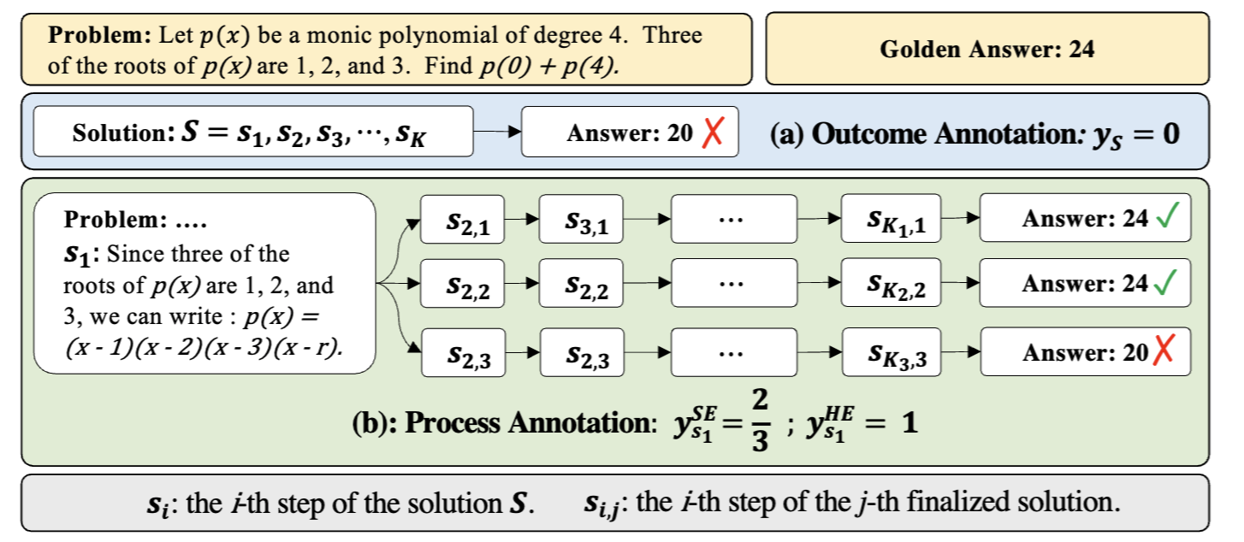
Process Reward via MCTS: example
Bonus
Math-Shepherd: Verify and Reinforce LLMs Step-by-step without Human Annotations, 2023

Slide 37
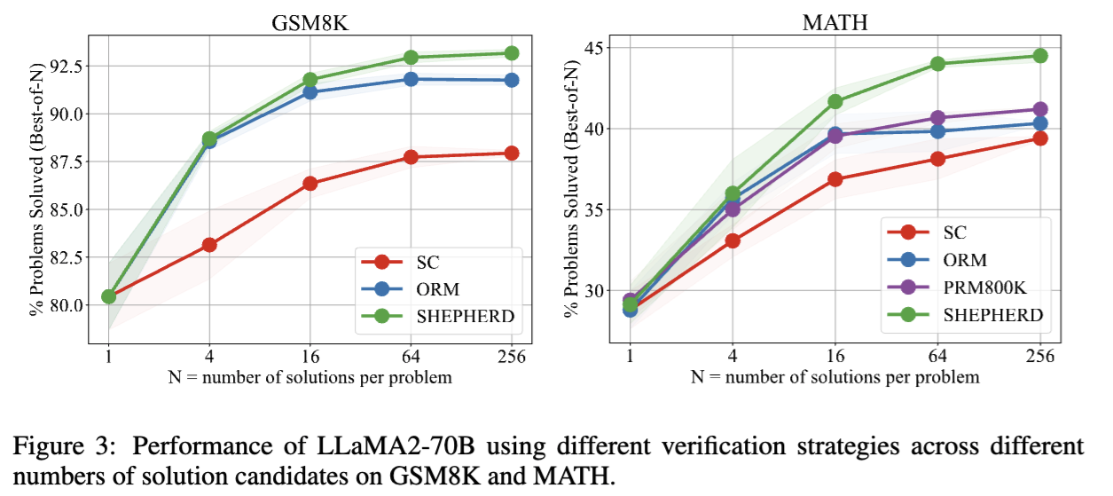
Process reward via MCTS: example
Bonus
Math-Shepherd: Verify and Reinforce LLMs Step-by-step without Human Annotations, 2023

Slide 38
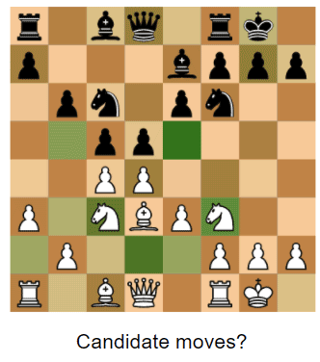
Example: AlphaZero
Bonus
Goal is to train:
a policy (the decision maker)
a value function (estimates the expected outcome of the game from that state)
Self-play using guided-search with exploration
The exploration is through MCTS.
The search explores moves based on visit counts and value estimates.
The final move is selected based on these MCTS evaluations.
Label final outcomes of self-play games
Train the policy and the value function
Figure source
Mastering Chess and Shogi by Self-Play with a General Reinforcement Learning Algorithm, 2017

Slide 39
Approach 4: Learning to think with RL
Bonus
Assuming that we have an ORM (gold outcome labels or verifier), we can train our policy model so they’re incentivized to follow up with alternative “thoughts” (rather than repeating their prior “thoughts”).
TODO
https://arxiv.org/pdf/2410.01679

Slide 40
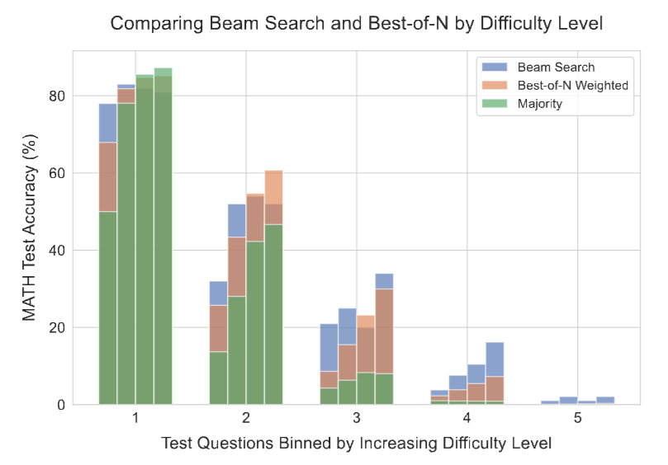
Which approach is better? Depends
Bonus
The effectiveness of different approaches to scaling test-time compute critically varies depending on the difficulty of the prompt/task.
Figure: Comparing beam search and best-of-N binned by difficulty level.
The four bars correspond to increasing test-time compute budgets (4, 16, 64, and 256 generations).
On the easier problems (bins 1 and 2), beam search shows signs of over-optimization with higher budgets, whereas best-of-N does not.
On the medium difficulty problems (bins 3 and 4), we see beam search demonstrating consistent improvements over best-of-N.
Scaling LLM Test-Time Compute Optimally can be More Effective than Scaling Model Parameters, 2024

Slide 41
What is OpenAI doing?

Slide 42
Do we know what OpenAI is doing?
We don’t know the details.
But from their blog post, we can guess:
Uses RL during training; therefore, there is explicit training to incentivize better inference-scaling.
CoT: At the test time, it articulates long sequence of “thoughts”. Hence, no explicit search algorithm at inference.
Data efficient: ?
Let’s look at a few examples!
https://openai.com/index/learning-to-reason-with-llms/
[Slide credit: Sasha Rush]

Slide 43
Do we know what OpenAI is doing?
A key design consideration is how to train a model for this:
Would you get humans to annotate follow up thoughts (off-policy data) or let the model annotate candidate answers and labels good/bad ones (on-policy data).
Seems like OpenAI went for the latter.
“When training a model for reasoning, one thing that immediately jumps to mind is to have humans write out their thought process and train on that. When we saw that if you train the model using RL to generate and hone its own chain of thoughts it can do even better than having humans write chains of thought for it. That was the “Aha!” moment that you could really scale this.”
https://www.youtube.com/watch?v=tEzs3VHyBDM
[Slide credit: Sasha Rush]

Slide 44
Thinking about cost and ...
Obviously, long inputs/outputs cost money.
Generally output tokens cost a bit more than input tokens.
Output tokens are generated one token at a time (one forward pass per token)
Input tokens are parallel, but require parallel processing
How about latency?

Slide 45
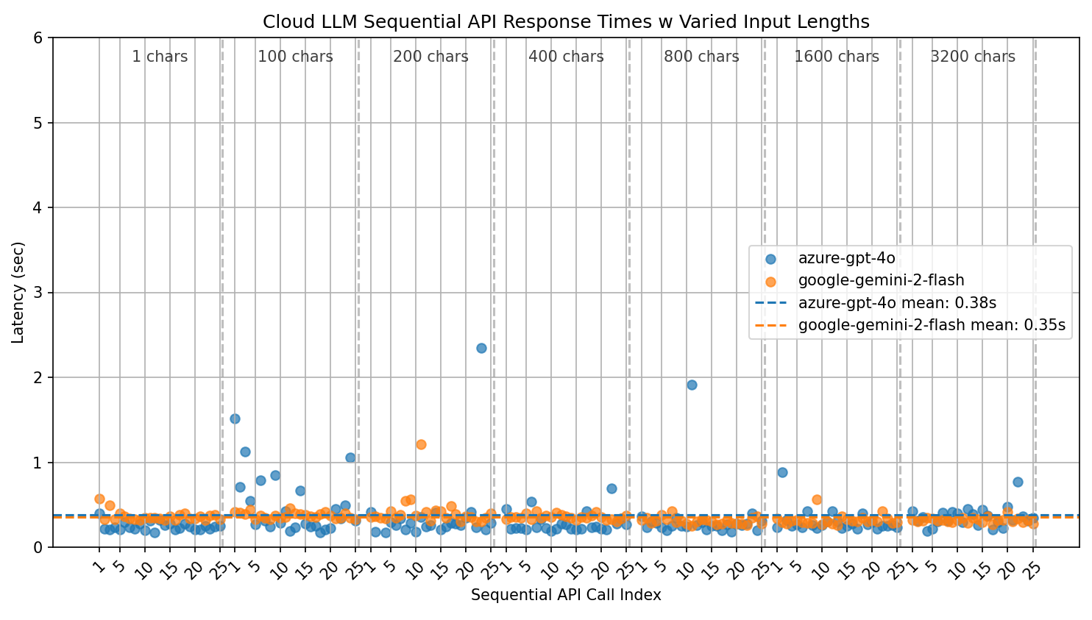
Thinking about cost and latency
Two cloud-based models: (1) Azure GPT4 on Azure; (2) Gemini2-flash on GCP.
Reading long sequences is quite fast, across different input lengths (~0.5 sec)
[Results credit: Owen Bianchi]

Slide 46
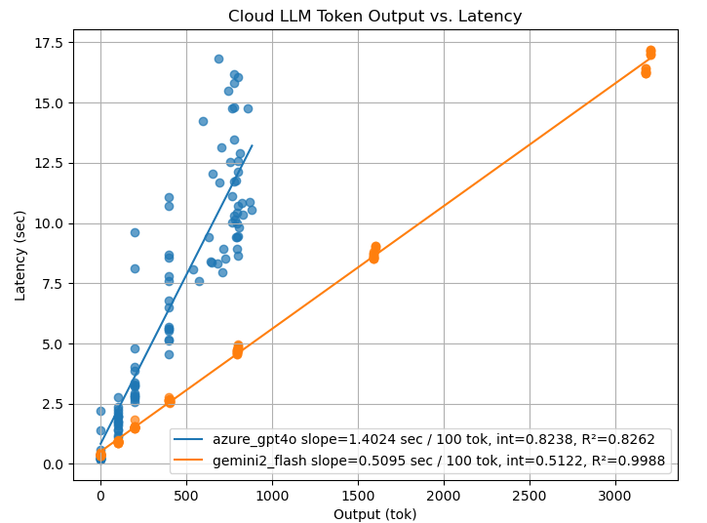
Thinking about cost and latency
Generating long sequences can be slow. Latency cost grows linearly in length.
Azure GPT4: 1.4 sec / token
Gemini2-flash: 0.5 sec / token
[Results credit: Owen Bianchi]

Slide 47
To incorporate: https://arxiv.org/pdf/2406.16838
https://arxiv.org/pdf/2408.15240
https://github.com/srush/LLM-Talk/blob/main/Tutorial.pdf

Slide 48
Borrow some visualizations here:
https://arxiv.org/pdf/2408.03314

