Slide 1
Model Efficiency
CSCI 601-471/671 (NLP: Self-Supervised Models)
https://self-supervised.cs.jhu.edu/sp2025/

Slide 2
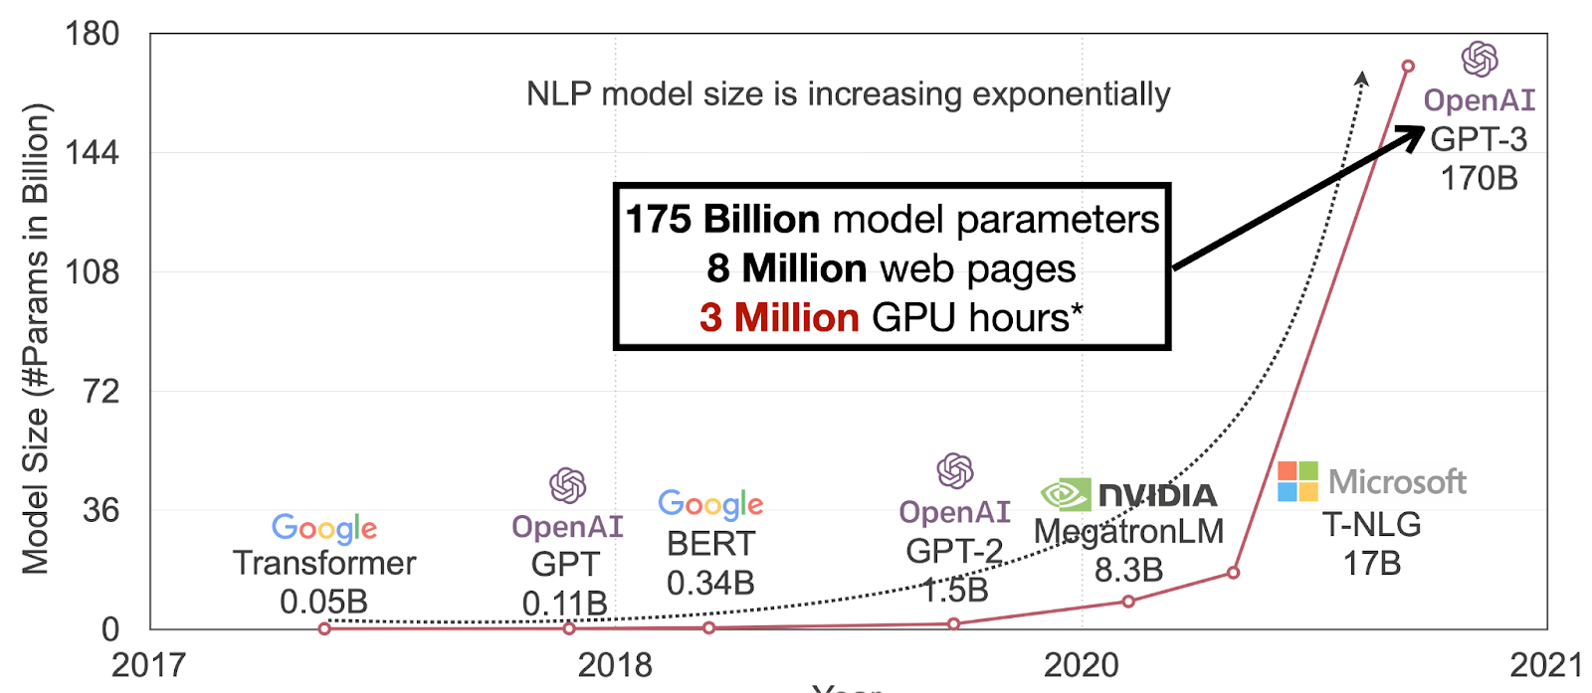
Our models are getting larger!
TBD
Figure Credit: Song Han (MIT)

Slide 3
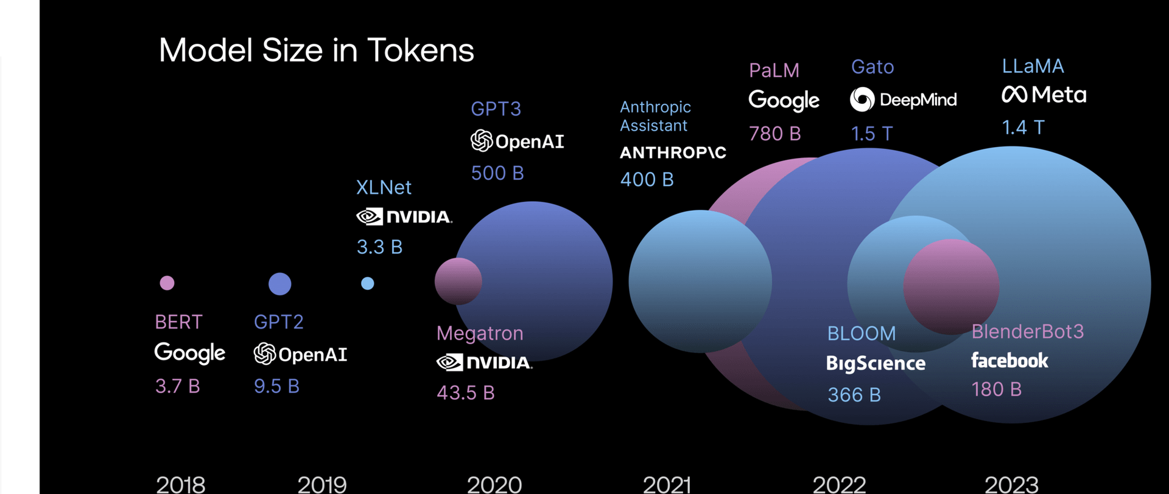
And consumes a lot of data!

Slide 4
Motivation
How much GPU memory (at least) do we need to perform inference/training?
(batch size=1, ignoring the KV cache)
Model Size (Llama 3 Arch) | Inference Memory (~2x model size) | Training Memory (~7x model size)
8B | 16GB | 60GB
70B | 140GB | 500GB
405B | 810GB | 3.25TB
Source: https://huggingface.co/blog/llama31#inference-memory-requirements

Slide 5
Where did all the memory go?
Longer sequences require much more memory in training!
Training Sequence Length (Number of Tokens)
Source: https://nanotron-ultrascale-playbook.static.hf.space/dist/index.html

Slide 6
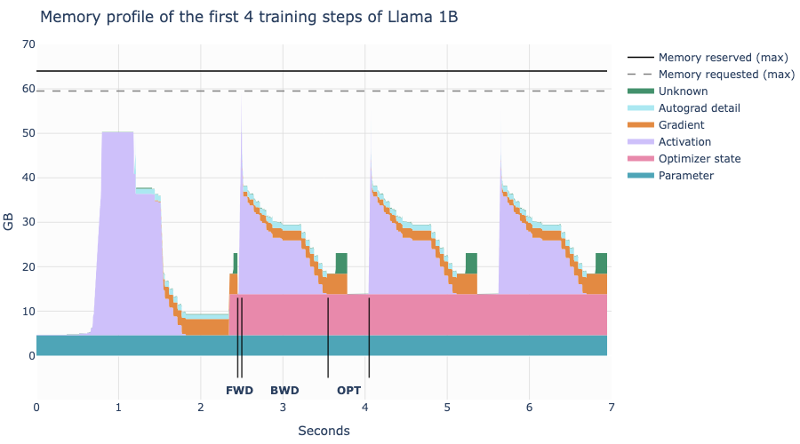
Memory consumption is not static
During backward, activation memory gets freed, gradients gets more memory
During the forward step, the activations occupy most of the memory
Source: https://nanotron-ultrascale-playbook.static.hf.space/dist/index.html

Slide 7
Model Efficiency: Topics
Distributed Training
Quantization (Post Training Quantization)
Distillation
Chapter goal: Getting comfortable with various mathematical and systems foundations for efficient deployment of LLMs.

Slide 8
Distributed Training

Slide 9
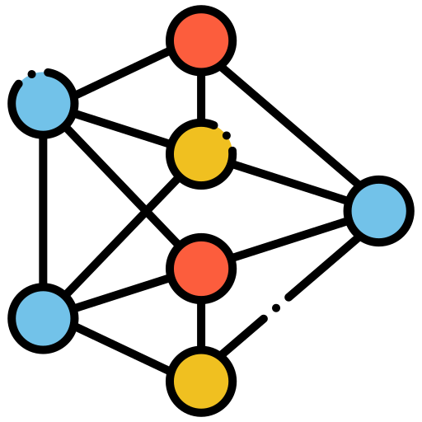
Distributed Training
Naïve Data Parallelism
Sharding Optimizer States (ZeRO, FSDP)
Model Parallelism (Tensor Parallelism, Pipeline Parallelism)
GPU 0
Model Copy
GPU 2
Model Copy
GPU 3
Model Copy

Slide 10
Naïve Data Parallelism
Dataset
GPU 0
Model Copy
GPU 1
Model Copy
GPU 2
Model Copy
First, we want to shard the dataset and feed them into different GPUs
How do we update the parameters?

Slide 11
Naïve Data Parallelism
Each GPU compute gradient with a single shard of data
Gradient 1
Gradient 2
Gradient 3
GPU 1
Model Copy
GPU 2
Model Copy
GPU 3
Model Copy

Slide 12
Naïve Data Parallelism
Gradient 3
One GPU accumulates the gradients
(reduce in torch.distributed)
Gradient 2
Gradient 1
GPU 1
Model Copy
GPU 2
Model Copy
GPU 3
Model Copy

Slide 13
NCCL Operations: Reduce
Nvidia Collective Communications Library (NCCL) - A library developed to provide inter-GPU communications primitives (operations)
Reduce: *Sums* over all *tensors* and stores it in a root GPU

Slide 14
Naïve Data Parallelism
Gradient 3
One GPU accumulates the gradients
(reduce in torch.distributed)
Gradient 2
Gradient 1
GPU 1
Model Copy
GPU 2
Model Copy
GPU 3
Model Copy

Slide 15
Naïve Data Parallelism
And send the accumulated gradient to all other GPUs (broadcast in torch.distributed)
Gradient 3
Gradient 3
Gradient 3
Gradient 2
Gradient 2
Gradient 2
Gradient 1
Gradient 1
Gradient 1
GPU 1
Model Copy
GPU 2
Model Copy
GPU 3
Model Copy

Slide 16
NCCL Operations: Broadcast
Broadcast: Duplicates one tensor to all GPUs

Slide 17
Naïve Data Parallelism
Accumulate gradients across all GPUs and perform gradient updates
（all_reduce in torch.distributed）
Gradient 3
Gradient 3
Gradient 3
Gradient 2
Gradient 2
Gradient 2
Gradient 1
Gradient 1
Gradient 1
GPU 1
Model Copy
GPU 2
Model Copy
GPU 3
Model Copy

Slide 18
NCCL Operations: All Reduce
All Reduce = Reduce + Broadcast
= Sum over input tensors, then duplicate it to all GPUs

Slide 19
Naïve Data Parallelism
Accumulate gradients across all GPUs and perform gradient updates
（all_reduce in torch.distributed）
Gradient 3
Gradient 3
Gradient 3
Gradient 2
Gradient 2
Gradient 2
Gradient 1
Gradient 1
Gradient 1
GPU 1
Model Copy
GPU 2
Model Copy
GPU 3
Model Copy

Slide 20
What is wrong with Naïve DP
GPU 1
Model Copy
Consumes too much memory in each GPU!
2 bytes for FP/BF16 model params
2 bytes for FP/BF16 gradients
4 bytes for FP32 master weights
(the thing you accumulate into in SGD, used in mixed precision training)
4 bytes for FP32 Adam first order estimates
4 bytes for FP32 Adam second order estimates
We need to store 5 copies of weights,
which occupies 16 bytes per param
Slide Credit: Tatsunori Hashimoto (Stanford)

Slide 21
What is wrong with Naïve DP

Slide 22
Naïve DP – Requires too much memory!
Memory/GPU for a 7.5B model:
7.5B * 16 bytes = 120 GB!
ZeRO: Memory Optimizations Toward Training Trillion Parameter Models (Rajbhandari et al., 2019)

Slide 23
ZeRO Stage 1: Sharding Optimizer States
Memory/GPU for a 7.5B model:
7.5B * (2+2+4) bytes = 60 GB!
ZeRO: Memory Optimizations Toward Training Trillion Parameter Models (Rajbhandari et al., 2019)

Slide 24
ZeRO Stage 1: How it works
Update Parameters
Each GPU compute gradient with a single shard of data
(The same as naïve DP)
Gradient 1
Gradient 2
Gradient 3
GPU 1
Model Copy
GPU 2
Model Copy
GPU 3
Model Copy
ZeRO: Memory Optimizations Toward Training Trillion Parameter Models (Rajbhandari et al., 2019)

Slide 25
ZeRO Stage 1: How it works
Assuming that
GPU1 stores parameter states for parameters A,
GPU2 stores states for params B,
GPU3 stores states for params C
Gradient 1
Gradient 2
Gradient 3
A
B
C
GPU 1
Model Copy
GPU 2
Model Copy
GPU 3
Model Copy
ZeRO: Memory Optimizations Toward Training Trillion Parameter Models (Rajbhandari et al., 2019)

Slide 26
ZeRO Stage 1: How it works
Split / shard the gradients into 3 parts!
A
B
C
A
B
C
A
B
C
Gradient 1
Gradient 2
Gradient 3
A
B
C
GPU 1
Model Copy
GPU 2
Model Copy
GPU 3
Model Copy
ZeRO: Memory Optimizations Toward Training Trillion Parameter Models (Rajbhandari et al., 2019)

Slide 27
ZeRO Stage 1: How it works
Each GPU accumulates gradients of the params whose optimizer states the GPU is storing (reduce_scatter in torch.distributed)
A
B
C
A
B
C
A
B
C
Gradient 1
Gradient 2
Gradient 3
A
B
C
GPU 1
Model Copy
GPU 2
Model Copy
GPU 3
Model Copy
ZeRO: Memory Optimizations Toward Training Trillion Parameter Models (Rajbhandari et al., 2019)

Slide 28
NCCL Operations: Reduce Scatter
reduce_scatter: each GPU stores the sum of a shard of the input.
all_reduce: one GPU stores the sum over all the input.

Slide 29
ZeRO Stage 1: How it works
Each GPU accumulates gradients of the params whose optimizer states the GPU is storing (reduce_scatter in torch.distributed)
A
B
C
A
B
C
A
B
C
Gradient 1
Gradient 2
Gradient 3
A
B
C
GPU 1
Model Copy
GPU 2
Model Copy
GPU 3
Model Copy
ZeRO: Memory Optimizations Toward Training Trillion Parameter Models (Rajbhandari et al., 2019)

Slide 30
ZeRO Stage 1: How it works
GPU1 : update params A; GPU2: Updates Params B; GPU3: updates params C. GPU1 can only update params A since it only stores optimizer states of params A.
Updated A
Updated B
Updated C
Gradient 1
Gradient 2
Gradient 3
A
B
C
GPU 1
Model Copy
GPU 2
Model Copy
GPU 3
Model Copy
ZeRO: Memory Optimizations Toward Training Trillion Parameter Models (Rajbhandari et al., 2019)

Slide 31
ZeRO Stage 1: How it works
Each GPU sends updated params to every other GPU. Finishing optimizer.step(). (all_gather in torch.distributed)
Updated A
Updated A
Updated A
Updated B
Updated B
Updated B
Updated C
Updated C
Updated C
Gradient 1
Gradient 2
Gradient 3
GPU 1
Model Copy
GPU 2
Model Copy
GPU 3
Model Copy
ZeRO: Memory Optimizations Toward Training Trillion Parameter Models (Rajbhandari et al., 2019)

Slide 32
Quiz: NCCL Operations: All Gather
all_gather: every GPU performs a ___?___ operation in parallel.
A.Reduce B. Broadcast C. Reduce_scatter

Slide 33
NCCL Operations: All Gather
all_gather: every GPU performs a ___broadcast___ operation in parallel.
A.Reduce B. Broadcast C. Reduce_scatter

Slide 34
ZeRO Stage 1: How it works
Before all_gather
Updated A
Updated B
Updated C
Gradient 1
Gradient 2
Gradient 3
A
B
C
GPU 1
Model Copy
GPU 2
Model Copy
GPU 3
Model Copy
ZeRO: Memory Optimizations Toward Training Trillion Parameter Models (Rajbhandari et al., 2019)

Slide 35
ZeRO Stage 1: How it works
After all_gather, every GPU has a updated copy of the model
Updated A
Updated A
Updated A
Updated B
Updated B
Updated B
Updated C
Updated C
Updated C
Gradient 1
Gradient 2
Gradient 3
GPU 1
Model Copy
GPU 2
Model Copy
GPU 3
Model Copy
ZeRO: Memory Optimizations Toward Training Trillion Parameter Models (Rajbhandari et al., 2019)

Slide 36
Summary: ZeRO 1
reduce_scatter on the gradients: splitting the gradients into different GPUs
Each GPU individually perform gradient updates
all_gather on updated parameters
Basically free! (Compared to Naïve Data Parallelism)

Slide 37
ZeRO Stage 1: How it works
Notice: Aside from the forward pass, GPU 1 only needs gradients A, but in fact it stores A and B and C
A
You only need these
A
A
Gradient 1
Hey GPU1, you don't need this (can be large)
GPU 1
Model Copy
GPU 2
Model Copy
GPU 3
Model Copy
ZeRO: Memory Optimizations Toward Training Trillion Parameter Models (Rajbhandari et al., 2019)

Slide 38
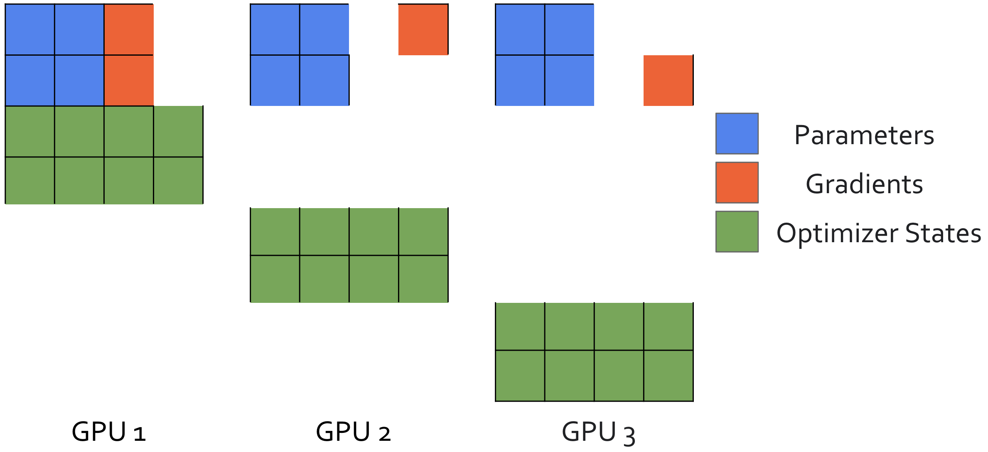
ZeRO Stage 2: Sharding Gradients
Memory/GPU for a 7.5B model:
7.5B * (2+2/3+4) bytes = 50 GB!
ZeRO: Memory Optimizations Toward Training Trillion Parameter Models (Rajbhandari et al., 2019)

Slide 39
ZeRO Stage 2: How it works
Splitting the gradient of a single layer during backprop, then immediately shard it!
A
B
C
A
B
C
A
B
C
A
B
C
Gradient of layer X
Gradient of layer X
Gradient of layer X
GPU 1
Model Copy
GPU 2
Model Copy
GPU 3
Model Copy
ZeRO: Memory Optimizations Toward Training Trillion Parameter Models (Rajbhandari et al., 2019)

Slide 40
ZeRO Stage 2: How it works
Params A
Params A
Params A
All-gather
Params B
Params B
Params B
Params C
Params C
Params C
A
B
C
A
B
C
A
B
C
Gradient 1
Gradient 2
Gradient 3
GPU 1
Model Copy
GPU 2
Model Copy
GPU 3
Model Copy
ZeRO: Memory Optimizations Toward Training Trillion Parameter Models (Rajbhandari et al., 2019)

Slide 41
Summary: ZeRO 12
reduce_scatter on the gradients: splitting the gradients into different GPUs
Calculate gradients layer by layer and perform reduce_scatter, once layer is done, free the gradient
Each GPU individually perform gradient updates
all_gather on updated parameters
Almost free!

Slide 42
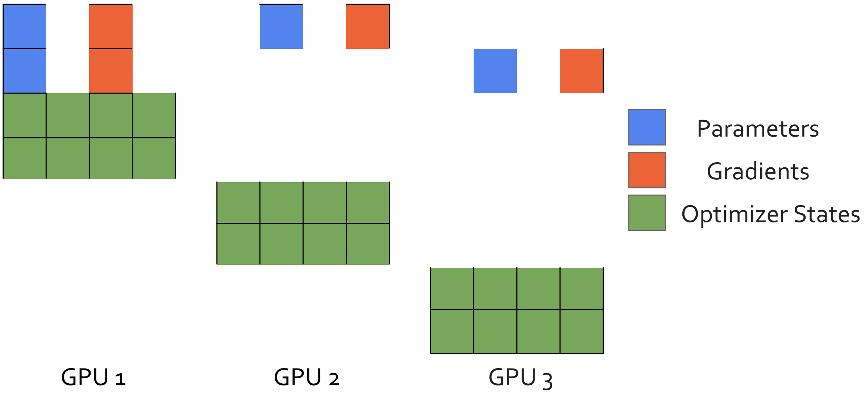
ZeRO-3 (aka FSDP): Shard Everything!
Memory/GPU for a 7.5B model:
7.5B * (2/3+2/3+4) bytes = 40 GB!
ZeRO: Memory Optimizations Toward Training Trillion Parameter Models (Rajbhandari et al., 2019)

Slide 43
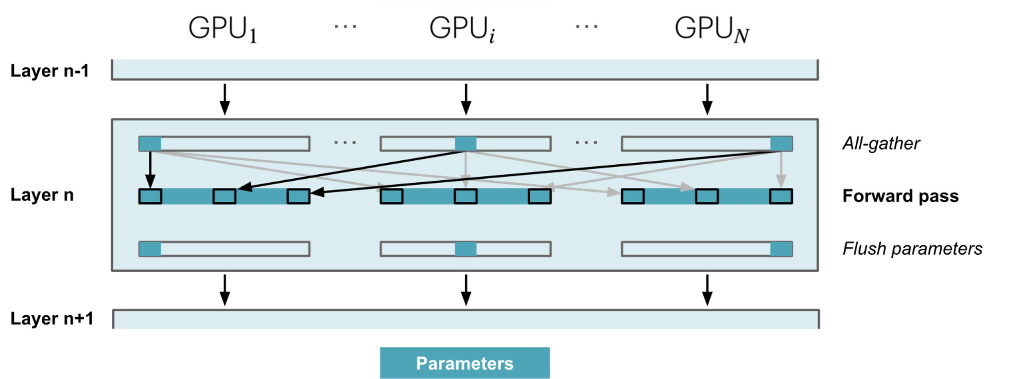
ZeRO Stage 3: How it works (simplified)
During forward pass, the parameters are gathered on-demand

Slide 44
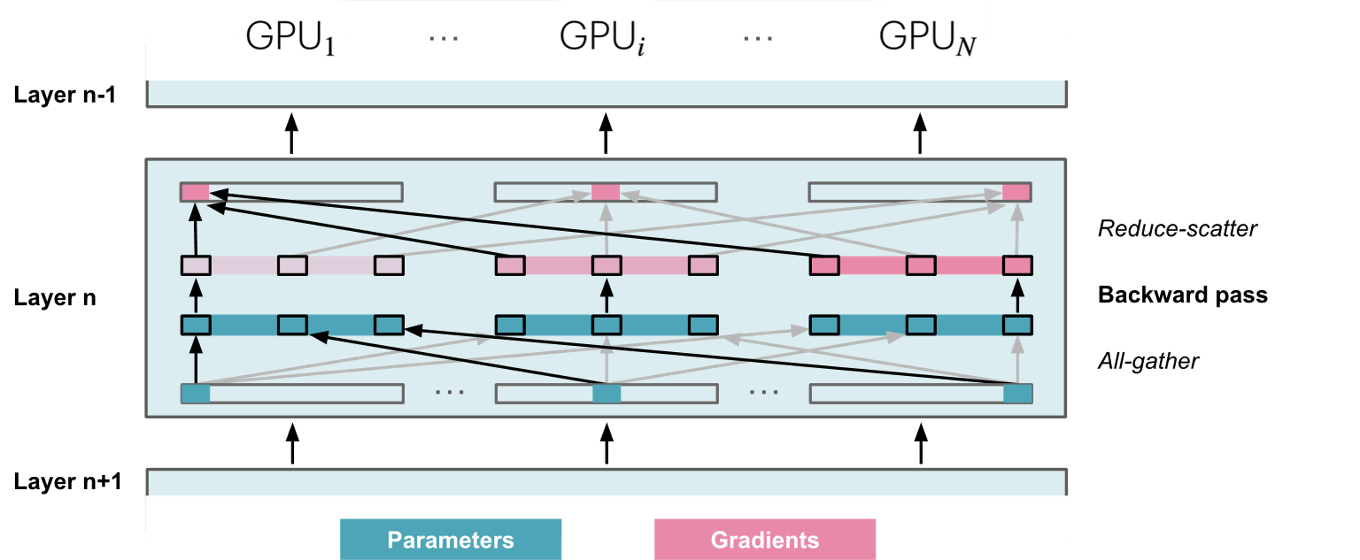
ZeRO Stage 3: How it works (simplified)
During backward pass, the gradients are scattered (Reduce_Scatter)

Slide 45
Communication Costs
Naïve Data Parallel: 2x parameter (all_reduce)
ZeRO-1: 2x parameter (reduce_scatter + all_gather) - this is free! Might as well always use it.
ZeRO-2: 2x parameter (reduce_scatter + all_gather + overhead) - this is (almost) free!
ZeRO-3: 3x parameter – which can be quite slow.

Slide 46
Where did all the memory go?
So far, we dealt with the optimizer states
but what about the activations?
Training Sequence Length (Number of Tokens)
Source: https://nanotron-ultrascale-playbook.static.hf.space/dist/index.html

Slide 47
Prefix Caching
but what about the activations?
<System> You are a helpful assistant … <System>
<User> I want to know how can I use the coffee machine <User>
<System> You are a helpful assistant … <System>
<User> Write the code for training my language model. <User>
<System> You are a helpful assistant … <System>
<User> Help me revise my email ... <User>

Slide 48
Prefix Caching
Storing the activations in CPU and retrieve it when needed.
<System> You are a helpful assistant … <System>
KV Cache
CPU
But, can we slice the activations to fit them in different GPUs?
- Yes, by Tensor Parallelism

Slide 49
Tensor Parallelism
We can either cut the weights W into two columns (Column Parallelism)
or into two rows (Row Parallelism)

Slide 50
Column-wise Tensor Parallelism
Cuts the weight matrix W into 2
columns
Source: https://nanotron-ultrascale-playbook.static.hf.space/dist/index.html

Slide 51
Row-wise Tensor Parallelism
Cuts the weight matrix W into 2
rows
Source: https://nanotron-ultrascale-playbook.static.hf.space/dist/index.html

Slide 52
Tensor Parallelism
Computing matrix multiplications without storing internal activations (e.g. xW1)
In Feed-Forward Networks,
The dimension of
W1 is usually 4x the hidden dimension.
W1
W2
X
Y

Slide 53
Tensor Parallelism: Llama Feed-Forward
activations are element-wise operations, can be parallelized
Source: https://github.com/meta-llama/llama/blob/main/llama/model.py

Slide 54
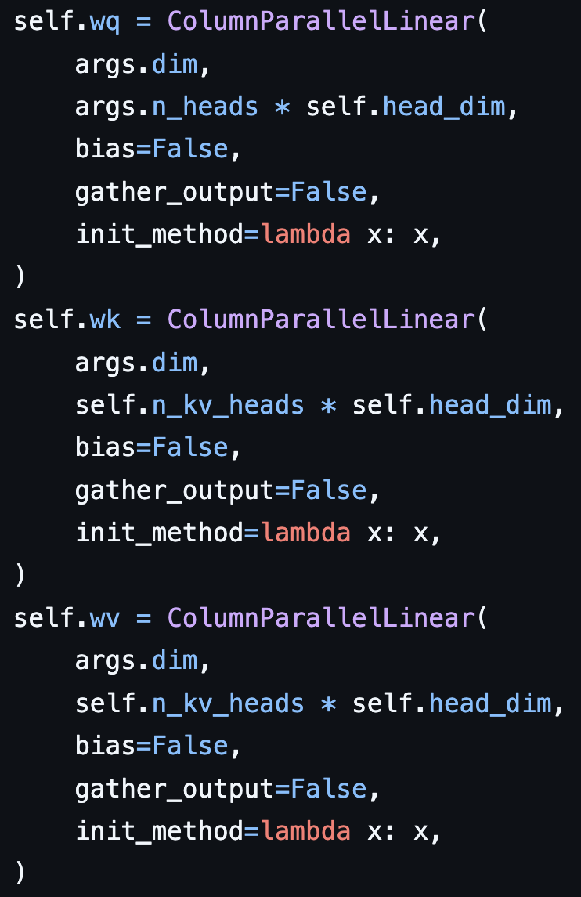
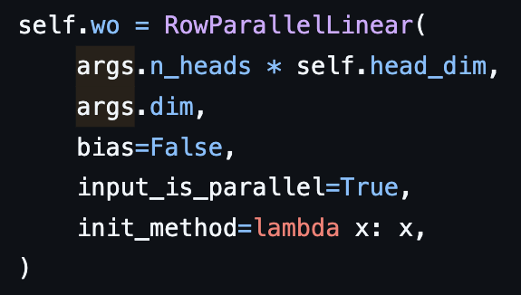
Tensor Parallelism: Llama Attention
Column Parallel for Query, Key and Vector
and Row Parallel for attention output
Source: https://github.com/meta-llama/llama/blob/main/llama/model.py

Slide 55
Summary so far
Data Parallelism
Naïve Data Parallelism
NCCL Operations
(reduce, all_reduce, reduce_scatter, broadcast, all_gather)
ZeRO-1, ZeRO-2, ZeRO-3
Prefix Caching
Tensor Parallelism
Row-wise Tensor Parallelism
Column-wise Tensor Parallelism

Slide 56
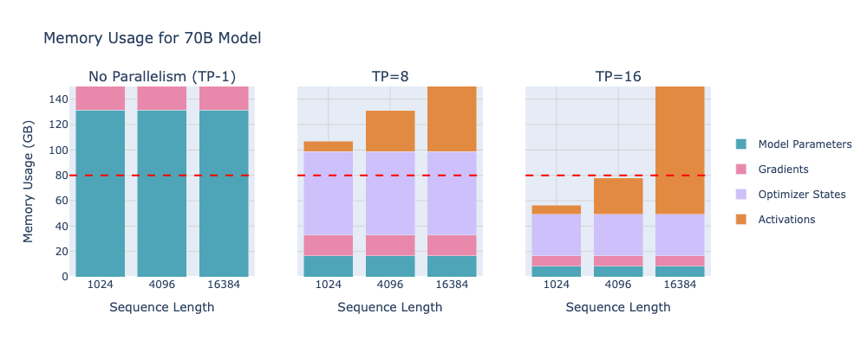
Tensor Parallelism
Source: https://github.com/meta-llama/llama/blob/main/llama/model.py

Slide 57
Throughput Scaling of Tensor Parallelism
A large drop in throughput when scaling beyond 8 GPUs (one node)
Source: https://nanotron-ultrascale-playbook.static.hf.space/dist/index.html

Slide 58
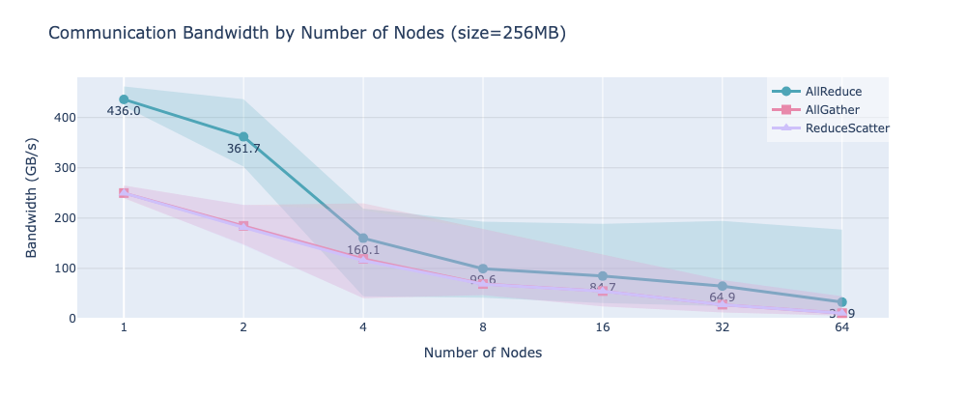
Throughput Scaling of Tensor Parallelism
Throughput drops significantly once we go beyond one node!
Source: https://nanotron-ultrascale-playbook.static.hf.space/dist/index.html

Slide 59
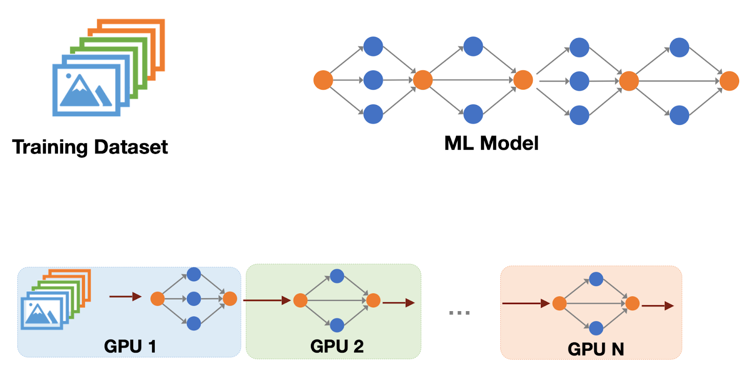
Pipeline Parallelism
Shard each layer of the model into individual GPUs:
Prevents the cost of syncing params
Credit: Song Han (MIT)

Slide 60
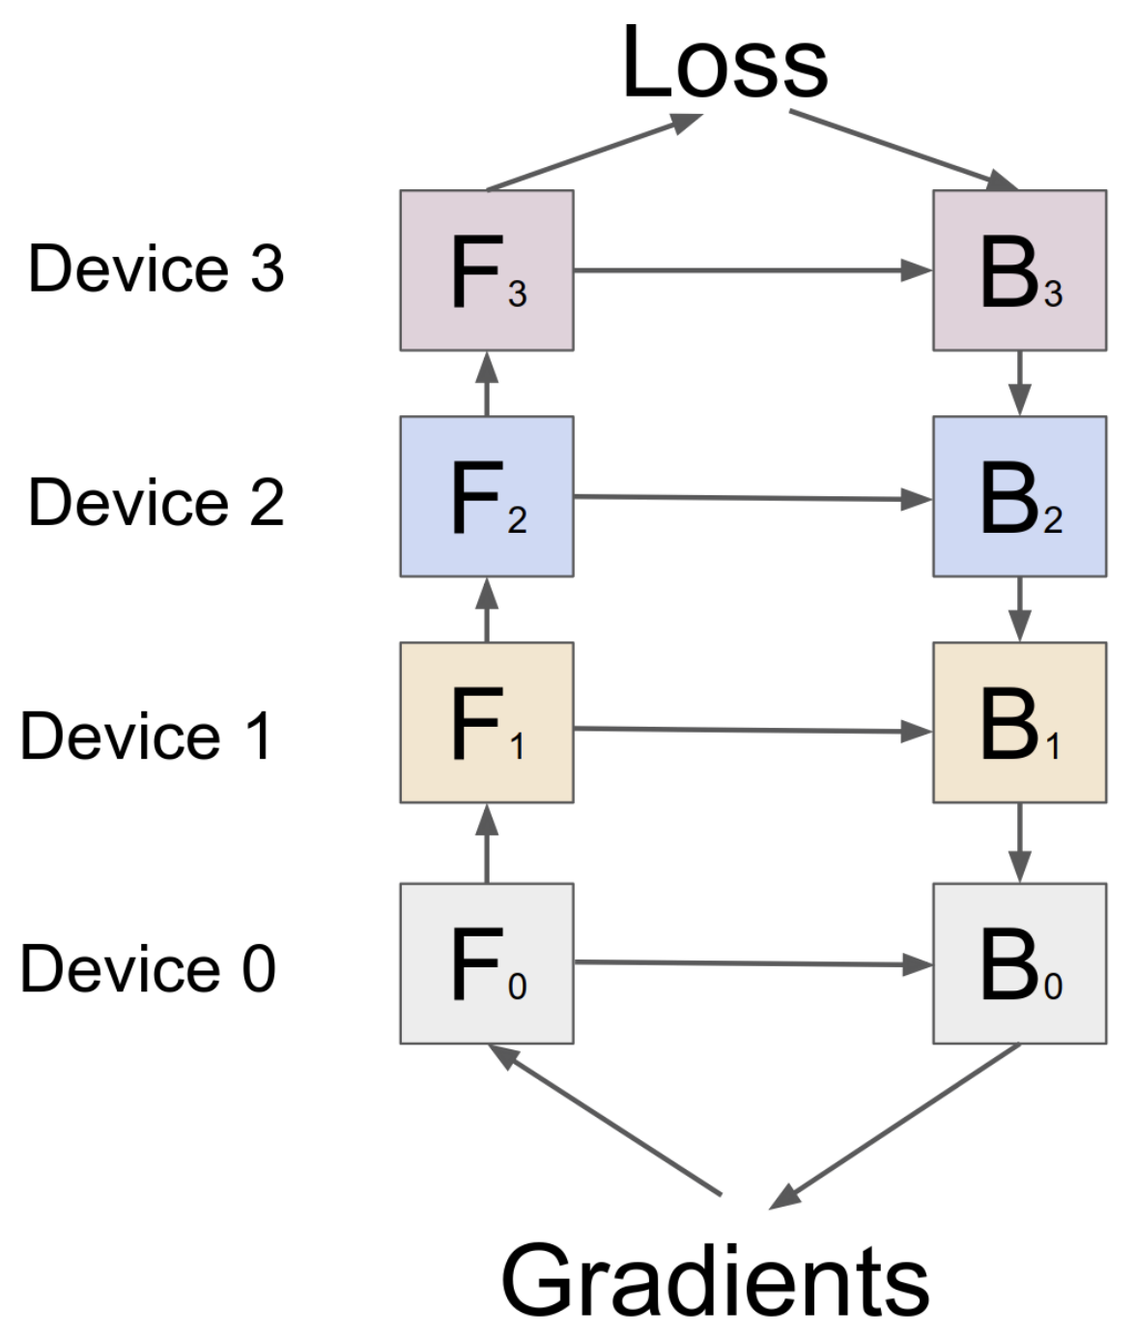
Pipeline Parallelism
Each GPU is only working for 1/PP = ¼ of the time!
Idle/Work ratio = pp – 1 = 3
GPipe: Easy Scaling with Micro-Batch Pipeline Parallelism (Huang et al., NeurIPS 2019)

Slide 61
Pipeline Parallelism: Improvement
Solution: Splitting the data into mini-batches! (AFAB)
Idle / Work Ratio = PP-1 / M= 3 / 4
GPipe: Easy Scaling with Micro-Batch Pipeline Parallelism (Huang et al., NeurIPS 2019)

Slide 62
Pipeline Parallelism
A cleverer version of AFAB: 1 Forward 1 Backward (1F1B)
Idea: Do backward as early as possible, releasing activations on the fly
Roughly the same Idle/Work Ratio but less memory
(as you only need to store p=4 activations rather than m=8)
GPipe: Easy Scaling with Micro-Batch Pipeline Parallelism (Huang et al., NeurIPS 2019)

Slide 63
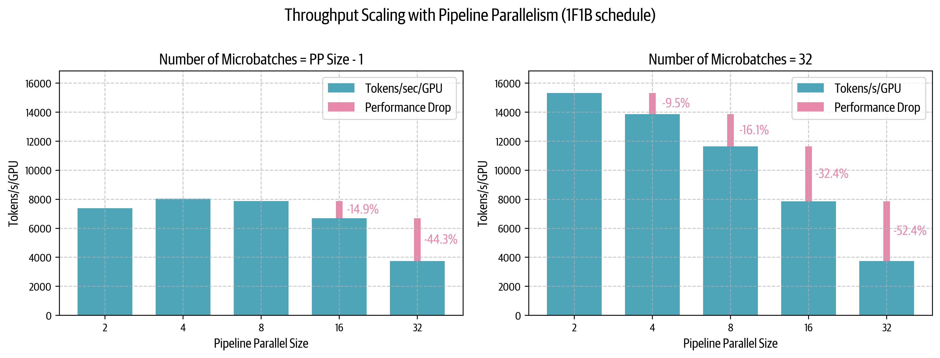
Pipeline Parallelism Throughput
A small drop in throughput when scaling beyond 8 GPUs (one node)
but a large drop as we increase the microbatch number

Slide 64
Interleaving Pipeline Parallelism (LLama3)

Slide 65
Interleaved Pipeline Parallelism (DeepSeek)
backprop for weights (blue) can be computed at any time!
We fill in the bubble with weight back propagation.

Slide 66
What about (super) long sequences?
Suppose we want to split the sequence into different GPUs
This is a super long sequence of text.
This is
a super long
sequence of text
GPU 1
Model Copy
GPU 2
Model Copy
GPU 3
Model Copy

Slide 67
What about (super) long sequences?
Feed Forward Network / LayerNorm is not affected by splitting the sequence, each token is processed individually
But what about attention? Each token needs to compute dot product with every other token.

Slide 68
Context Parallelism (Ring Attention)
Just pass the Key, Value pairs around!
However, attention mask is usually causal – Q1 does not need K2, V2, ...
Source: Ring Attention with Blockwise Transformers For Near-Infinite Context (Liu et al., 2023)

Slide 69
Context Parallelism (Ring Attention)
GPU 1 computes the pre-softmax-ed scores for
Q1, Q2, Q3, Q4.. then becomes idle.
Source: Ring Attention with Blockwise Transformers For Near-Infinite Context (Liu et al., 2023)

Slide 70
Context Parallelism (Ring Attention)
Balancing the workload for each individual GPUs.
Source: Striped Attention: Faster Ring Attention for Causal Transformers (Brandon et al., 2023)

Slide 71
Context Parallelism (Ring Attention)
Source: https://nanotron-ultrascale-playbook.static.hf.space/dist/index.html

Slide 72
Summarizing
Source: Tatsunori Hashimoto (Stanford)

Slide 73
Solutions
DeepSeek V3: DP=1, PP=16, EP (Expert Parallelism) = 8
Llama 3: Staged Training

Slide 74
Quantization

Slide 75
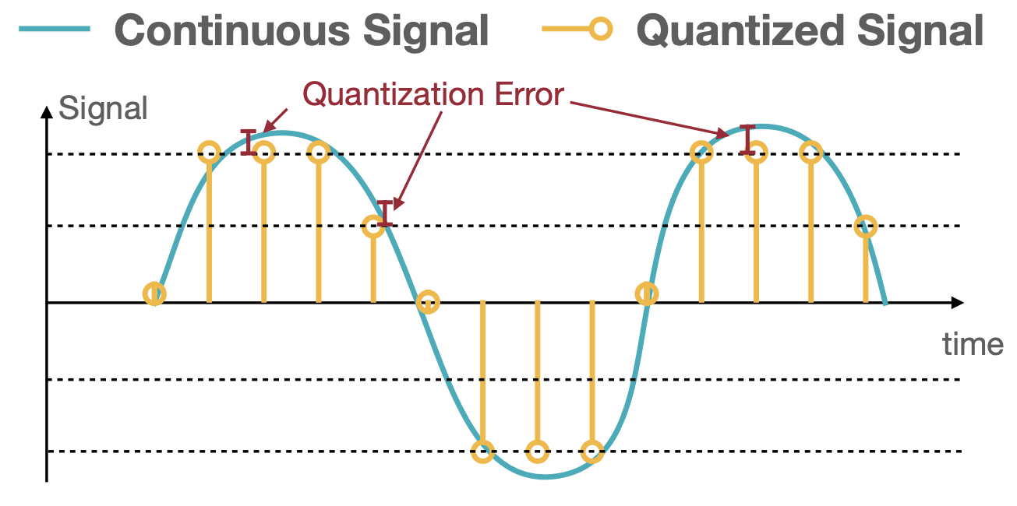
Quantization: Mapping from high to low precision

Slide 76
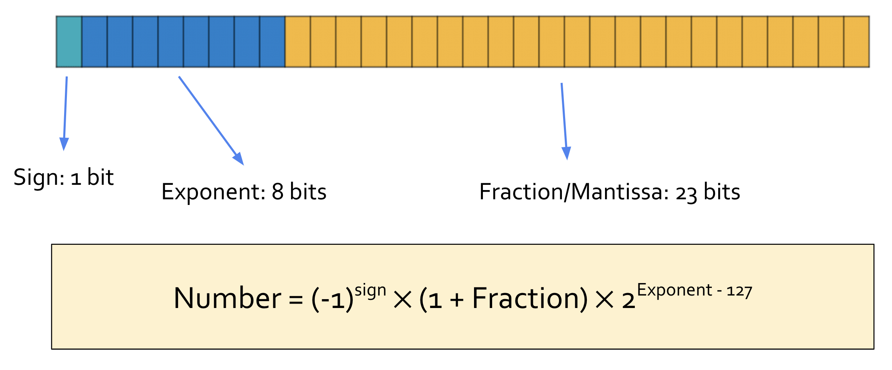
Numeric Data Types
Example: 32-bit floating point number in IEEE 754 (FP32)

Slide 77
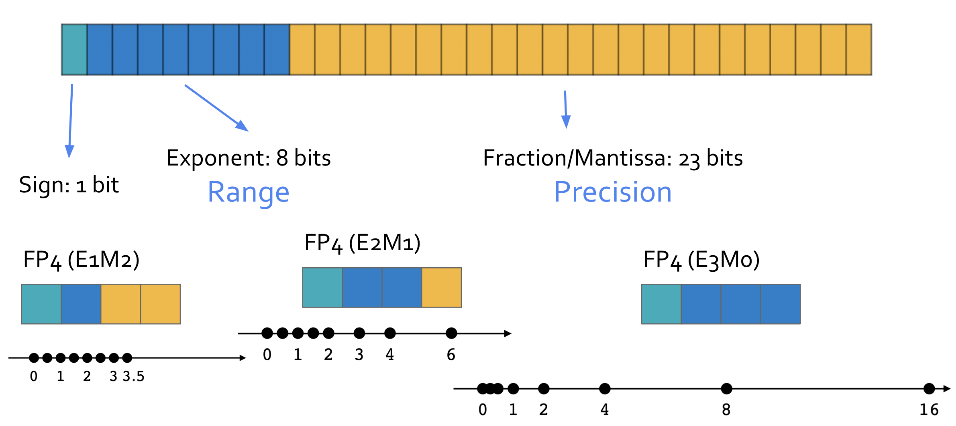
Floating Point Numbers

Slide 78
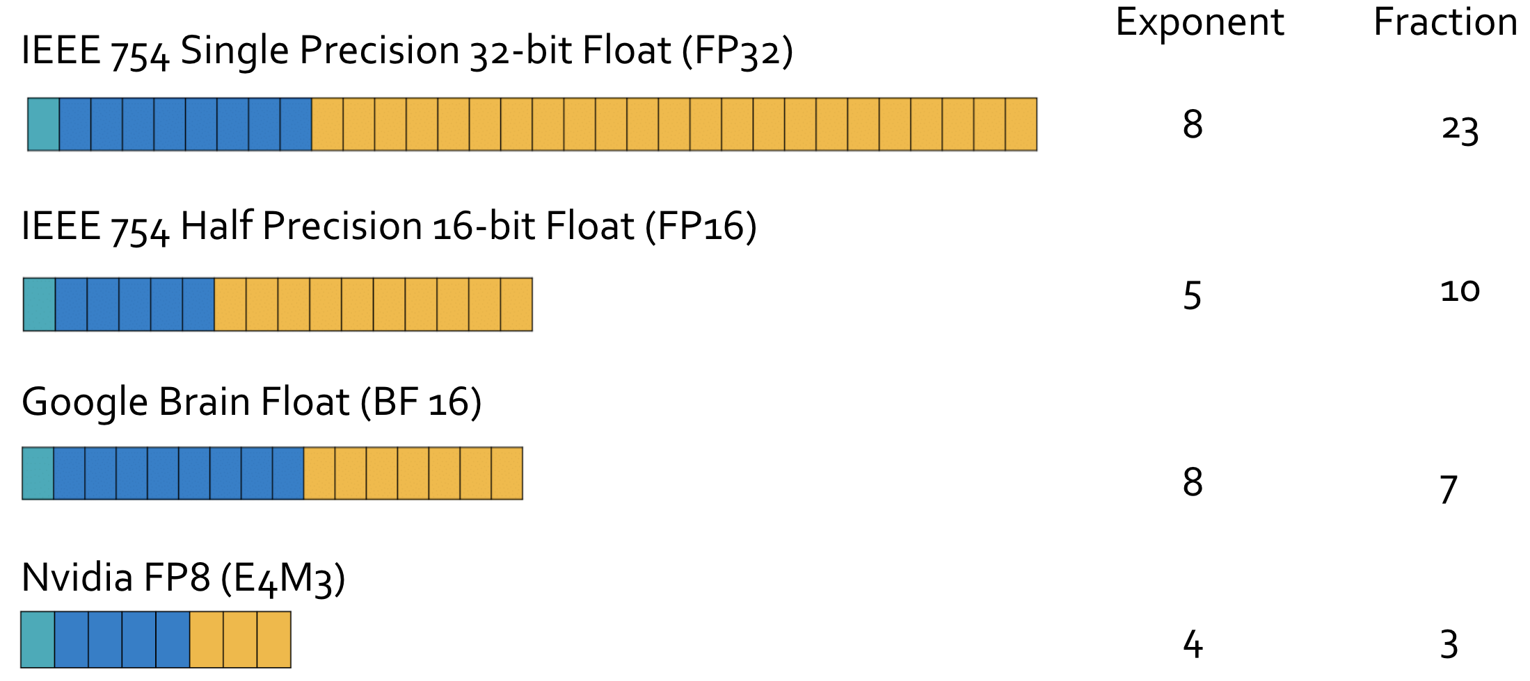
Floating Point Numbers
More range, less precision

Slide 79
Linear Quantization
How to find these numbers?​

Slide 80
Linear Quantization

Slide 81
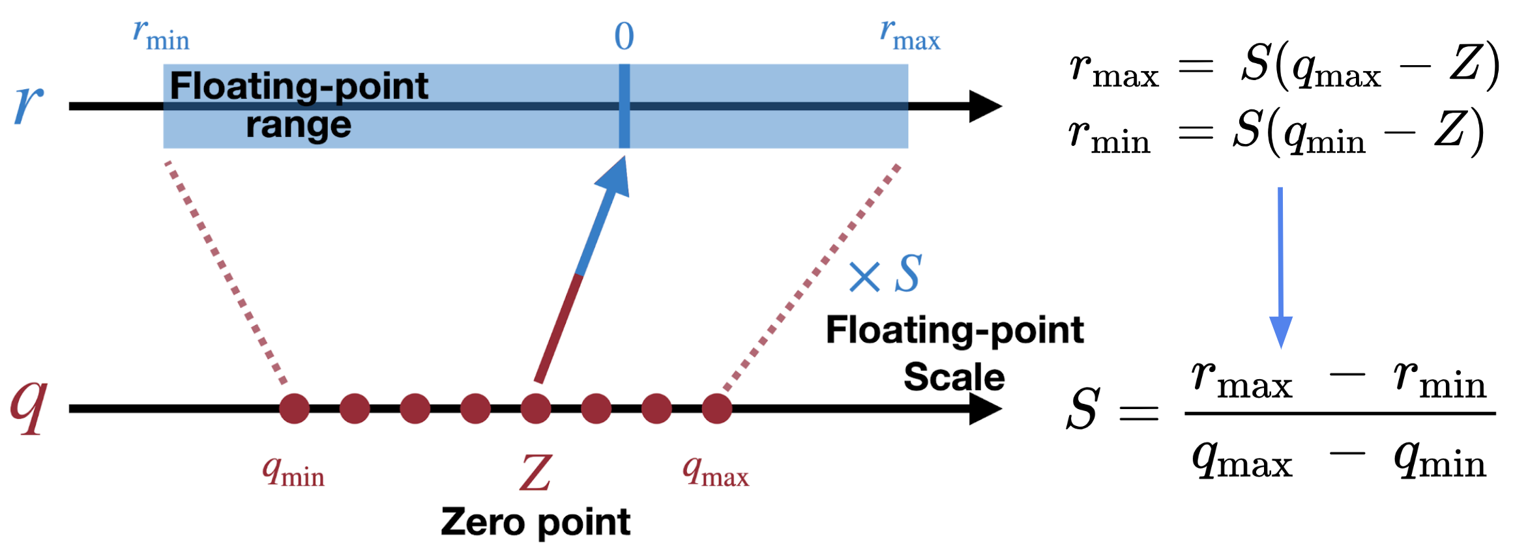
Linear Quantization: Scale
Quantization and Training of Neural Networks for Efficient Integer-Arithmetic-Only Inference (Jacob et al., CVPR 2018)

Slide 82
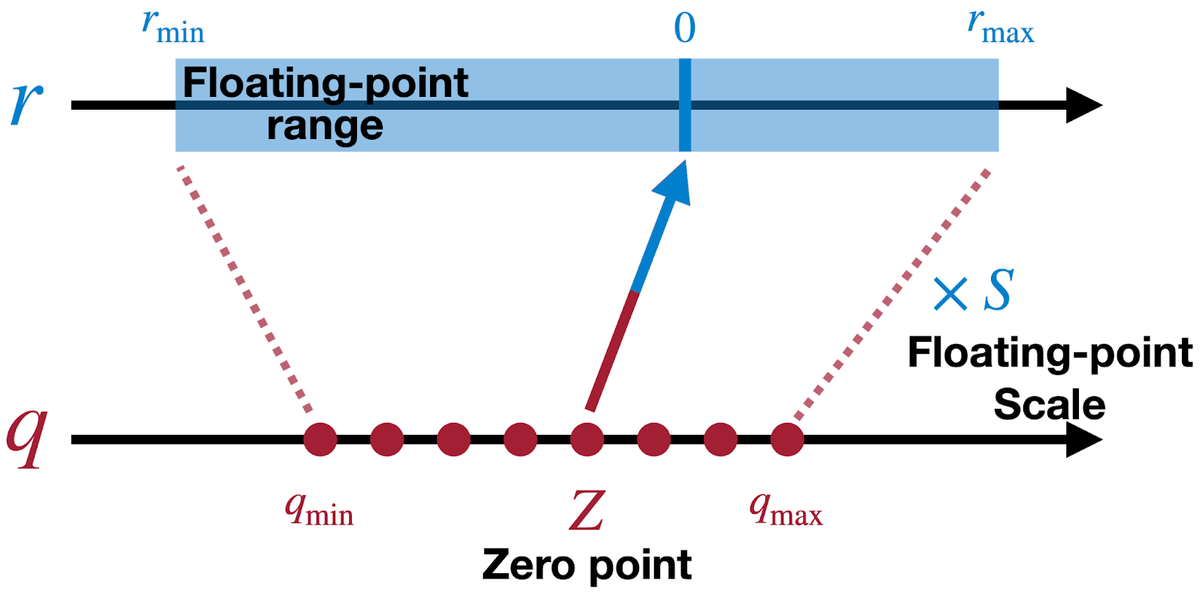
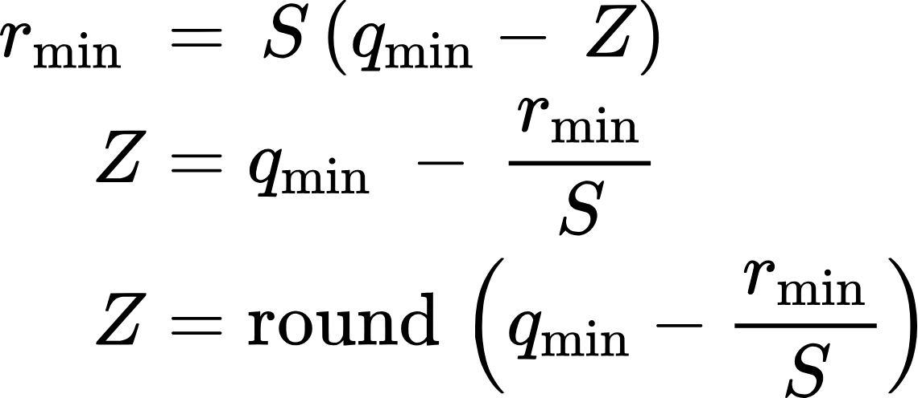
Linear Quantization: Zero Point
Quantization and Training of Neural Networks for Efficient Integer-Arithmetic-Only Inference (Jacob et al., CVPR 2018)

Slide 83
Linear Quantization: Zero Point
Quantization and Training of Neural Networks for Efficient Integer-Arithmetic-Only Inference (Jacob et al., CVPR 2018)

Slide 84
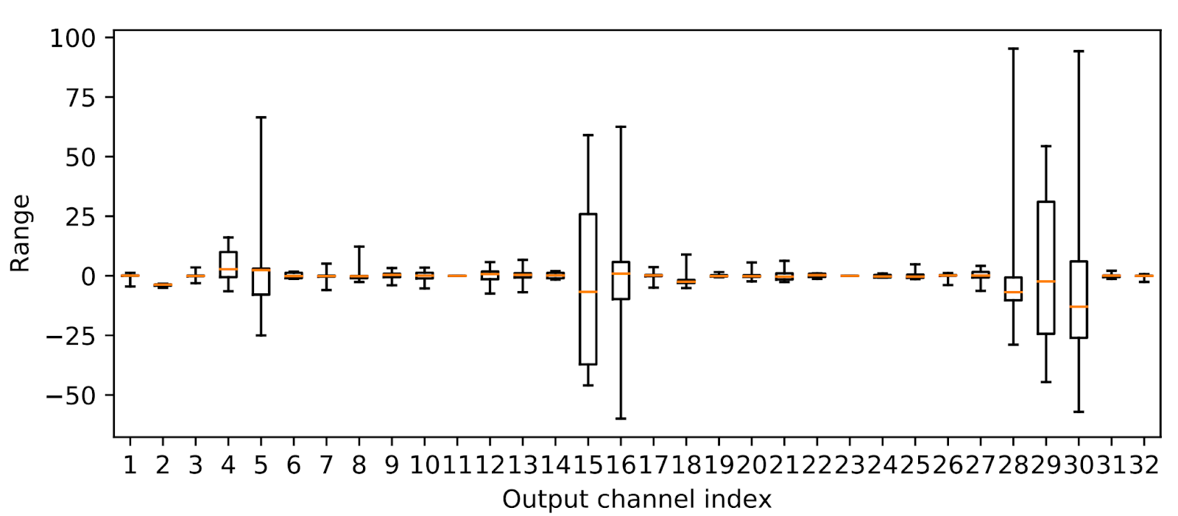
Quantization of Language Models
There exists many outliers in activations (activations of the first layer MobileNetV2):
Data-Free Quantization Through Weight Equalization and Bias Correction (Kagel et al., ICCV 2019)

Slide 85
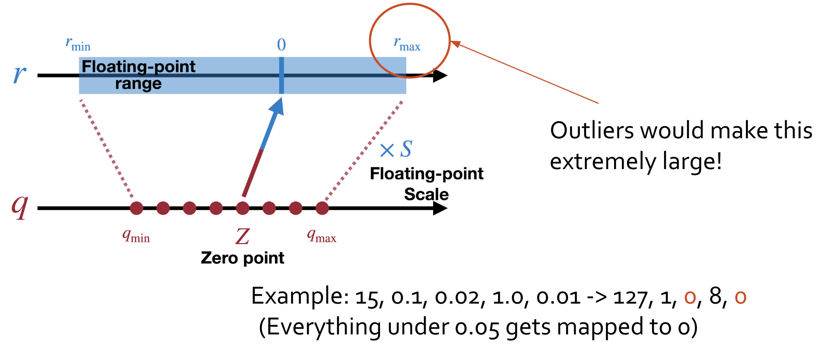
Quantization of Language Models
Data-Free Quantization Through Weight Equalization and Bias Correction (Kagel et al., ICCV 2019)

Slide 86
Quantization of Language Models
Quantize each channel individually, each channel gets its own scale and Zero-point!
Data-Free Quantization Through Weight Equalization and Bias Correction (Kagel et al., ICCV 2019)

Slide 87
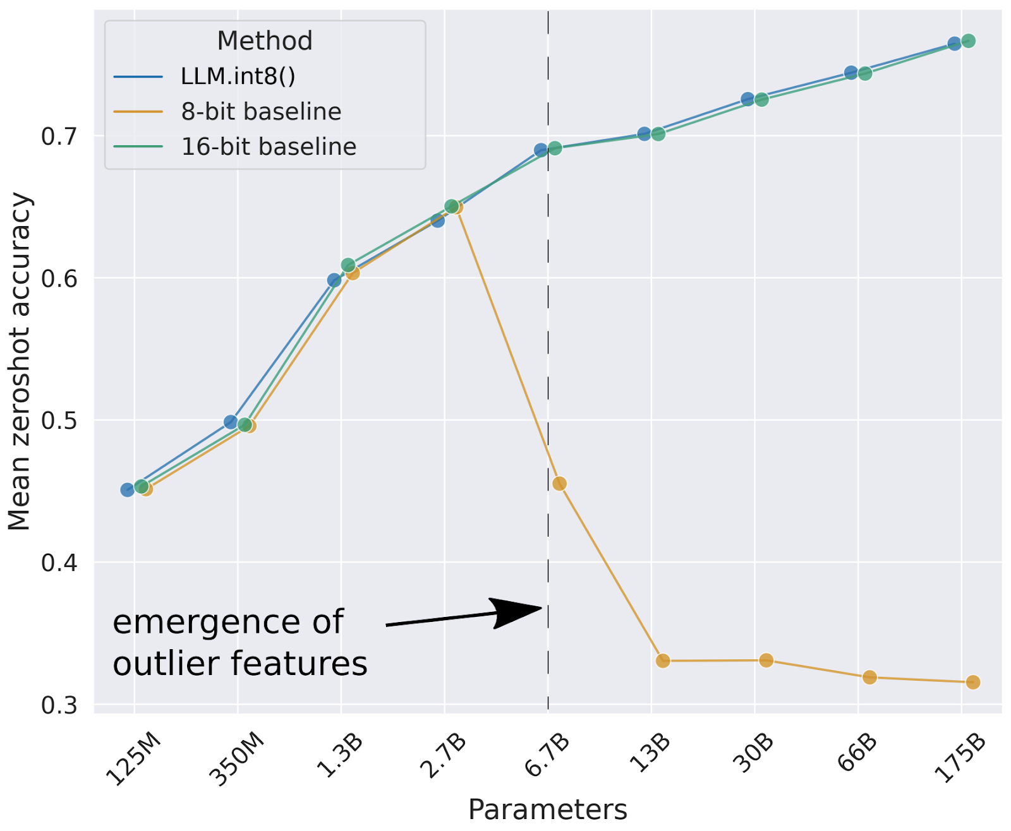
Quantization of Language Models
Outlier features significantly harms performance after quantization in LMs.
LLM.int8(): 8-bit Matrix Multiplication for Transformers at Scale (Dettmers et al., NeurIPS 2022)

Slide 88
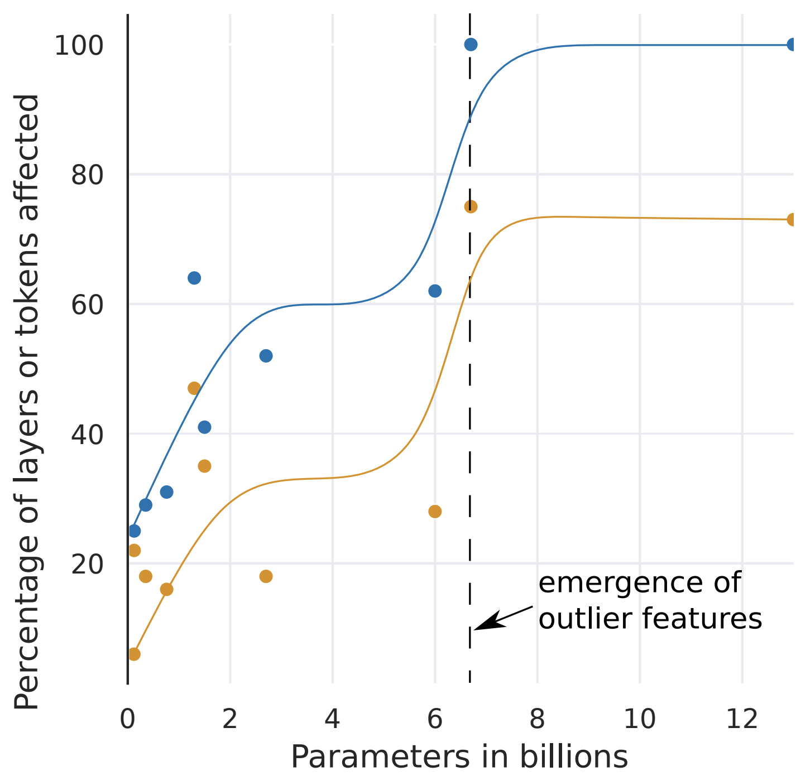
Quantization of Language Models
Outlier features significantly harms performance after quantization in LMs.
LLM.int8(): 8-bit Matrix Multiplication for Transformers at Scale (Dettmers et al., NeurIPS 2022)

Slide 89
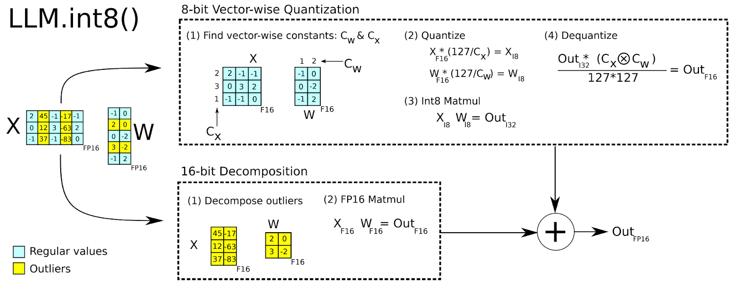
Quantization of Language Models
Keep outlier channels / features in 16-bit, quantize the rest.
LLM.int8(): 8-bit Matrix Multiplication for Transformers at Scale (Dettmers et al., NeurIPS 2022)

Slide 90
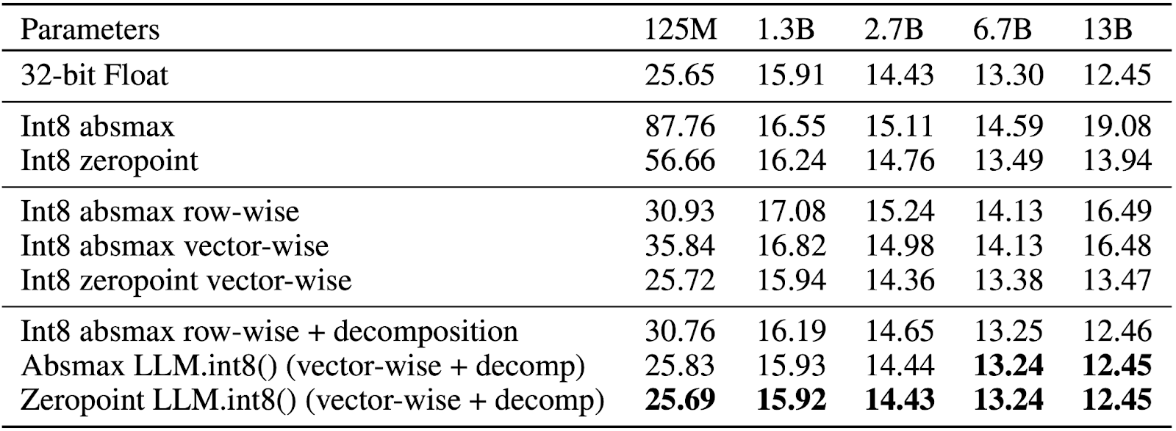
Quantization of Language Models
Zeropoint > absmax because outliers non-symmetric (either very large or very small, but not both)
LLM.int8(): 8-bit Matrix Multiplication for Transformers at Scale (Dettmers et al., NeurIPS 2022)

Slide 91
Quantization of Language Models
Maps floating point numbers (fp32, fp16, bf16) to low precision numbers (fp8, int8) to save memory.
Is effective in reducing the memory required for both training / inference.
8-bit quantization loses minimal performance, while 4-bit quantization is hard, can be harmful to model performance.

Slide 92
Distilling the knowledge of larger models

Slide 93
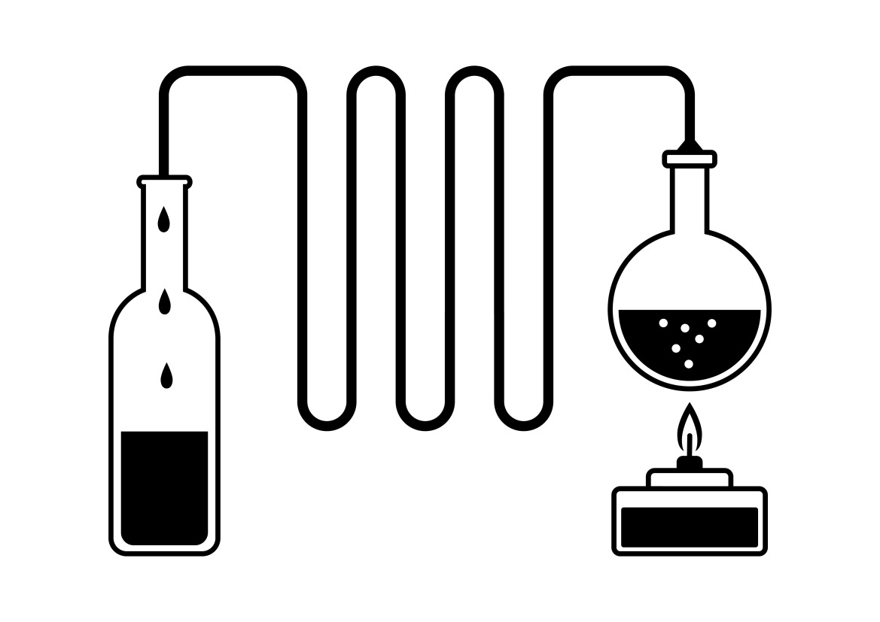
Distillation
Knowledge and/or capabilities of a larger model
small model

Slide 94
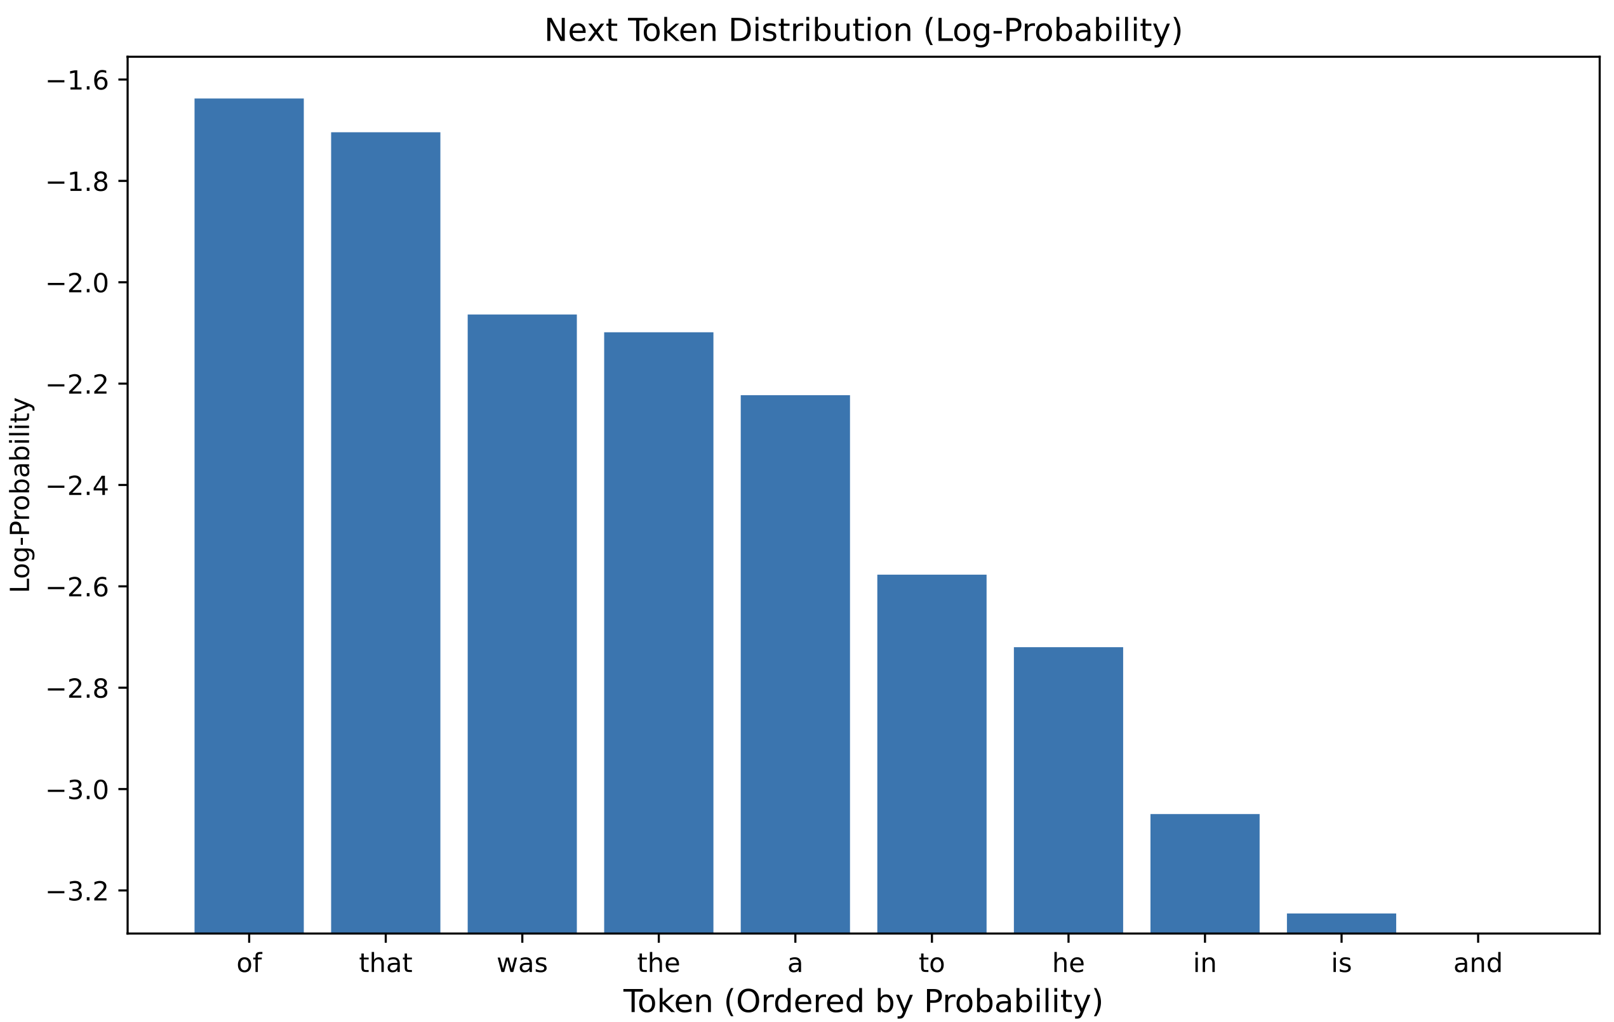
Revisit: Standard Training (NLLloss)
prefix: The strange case ___
groundtruth: of
Loss = -log p(of)
= Cross Entropy(y_pred, groundtruth)

Slide 95
Revisit: Standard Training (NLLloss)
prefix: The strange case ___
groundtruth: of
loss = -log p(of)

Slide 96
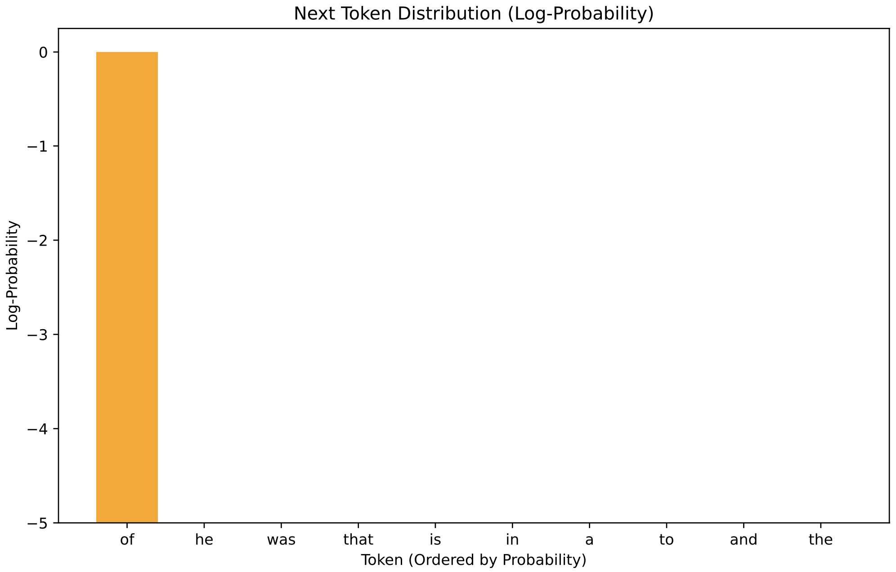
Revisit: Standard Training (NLLloss)
loss = -log p(of) = Cross Entropy(groundtruth, y_pred)
Groundtruth
(one-hot)
y_pred

Slide 97
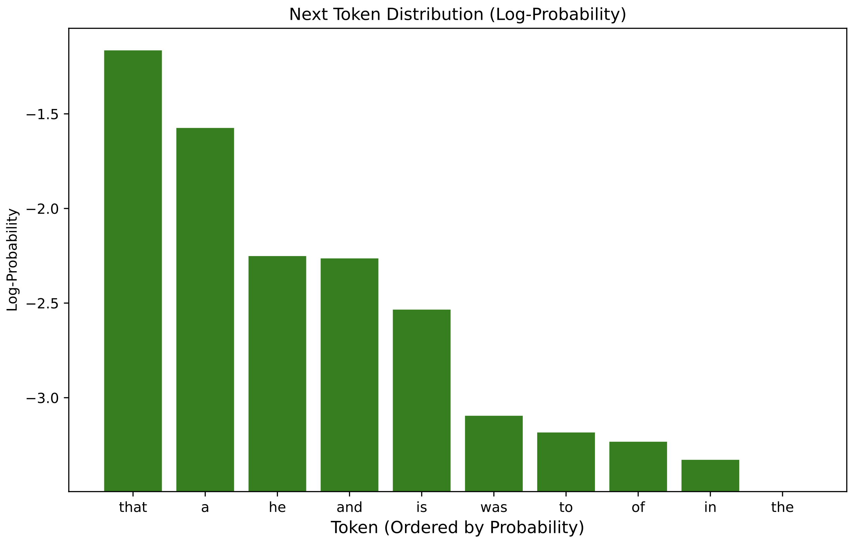
Knowledge Distillation
KD loss = Cross Entropy(y_large, y_pred)
Large model next token probs (y_large)
small model next token probs
(y_pred)

Slide 98
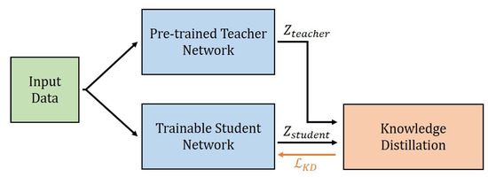
Knowledge Distillation
Step 1: Initialize teacher model with a large and capable model
Step 2: Feed input data to both student and teacher (freezed)
Step 3: Use teacher outputs to train student (Cross Entropy)

Slide 99
What if the teacher is Proprietary (GPT)?
Step 1: Initialize teacher model with a large and capable model
Step 2: Feed input data to both student and teacher (freezed)
Step 3: Use teacher generations (instead of outputs) to train student!

Slide 100
Revisit: Standard Training (NLLloss)
loss = -log p(of) = Cross Entropy(sampled text, y_pred)
Sampled output
(one-hot)
y_pred

Slide 101
What works better (a study in 2016)
Use teacher log-probs
Use teacher generations
Sequence-Level Knowledge Distillation (Kim & Rush, EMNLP 2016)

Slide 102
Knowledge Distillation
Train student (usually smaller model) on the output of a teacher (usually a larger model)
The output can be log-probabilities or sampled outputs
Effective in "distilling" the knowledge of large models to smaller ones.

